Slide 1
The Instructional Practice Suite for ELA/Literacy
The webinar will begin shortly. You may wish to download the handouts (check the tab on your webinar control panel) while you wait.
Core Advocate Webinar
November 17, 2015
7:00 – 8:00 EST

Slide 2
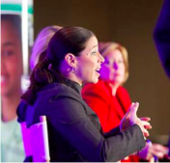
Introductions
Sandra Alberti, Field Impact Team
Rachel Etienne, Literacy Team

Slide 3
Introductions
Sandra Alberti, Field Impact Team
Rachel Etienne, Literacy Team
Core Advocates are educators who:
Believe in the potential of the CCSS to prepare all students for college and careers;
Are eager to support their colleagues and communities in understanding and advocating for the CCSS and CCSS-aligned instruction;
Understand and embrace the shifts in instruction and assessment required by the CCSS

Slide 4
To learn more about Core Advocates…
Contact Max Wagner (wagnerm@studentsachieve.net ) or Joanie Funderburk (jfunderburk@studentsachieve.net)
Complete this survey to join our database (and mailing lists): http://www.tfaforms.com/362186
Visit our website: www.achievethecore.org

Slide 5
For Tweeters…
Please feel free to tweet during and after the webinar using #coreadvocates
@achievethecore,
@salberti

Slide 6
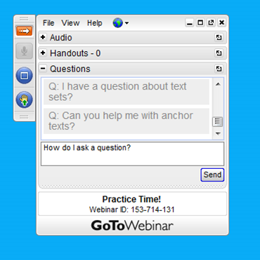
Webinar protocols
During the webinar
– Accessing Documents
– Questions option
– Polling
After the webinar
– Survey
– Access to recorded webinar

Slide 7
Goals of the webinar
Gain a basic understanding of the design and functionality of the tools in the Instructional Practice Suite for ELA/Literacy
Consider how the Instructional Practice Suite of tools work together in a teaching-learning cycle for teachers
Be familiar with Teaching the Core as a resource for full length classroom videos annotated to the Instructional Practice Guide: Coaching tool

Slide 8
What tools are in the Instructional Practice Suite for ELA/Literacy?

Slide 9
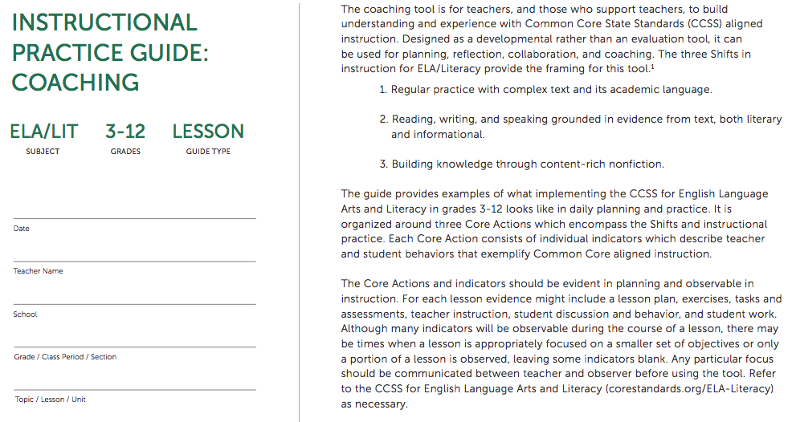
Instructional Practice Guide: Coaching Tool

Slide 10
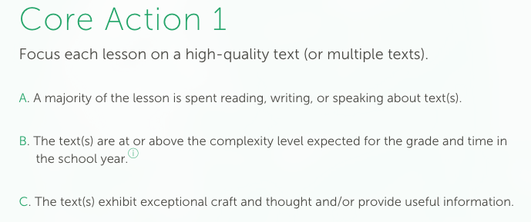
Instructional Practice Guide: Coaching Tool

Slide 11
Instructional Practice Guide: Coaching Tool

Slide 12
Instructional Practice Guide: Coaching Tool

Slide 13
Instructional Practice Guide: Coaching Tool
Helpful uses...
lesson planning
PLC/teacher team meetings
Discussing instructional strategies
select a focus area for improvement
peer observation
coach observation
reviewing classroom video
Unhelpful... (don’t do this!)
evaluate teachers
serve as a checklist of what every teacher should do every day
rate a teacher’s effectiveness
mandate instructional practices
rank how well a teacher is performing

Slide 14
Poll: Which of these uses of the IPG is most relevant for you?

Slide 15
Instructional Practice Guide: Beyond the Lesson
Content

Slide 16
Instructional Practice Guide: Beyond the Lesson
Provides context for the lesson - all things considered
Capture the ideas and moves you can’t see/hear in one lesson
Spark conversation about classroom activities that happen over time
building knowledge
student progress towards independence
range and volume of texts and tasks

Slide 17
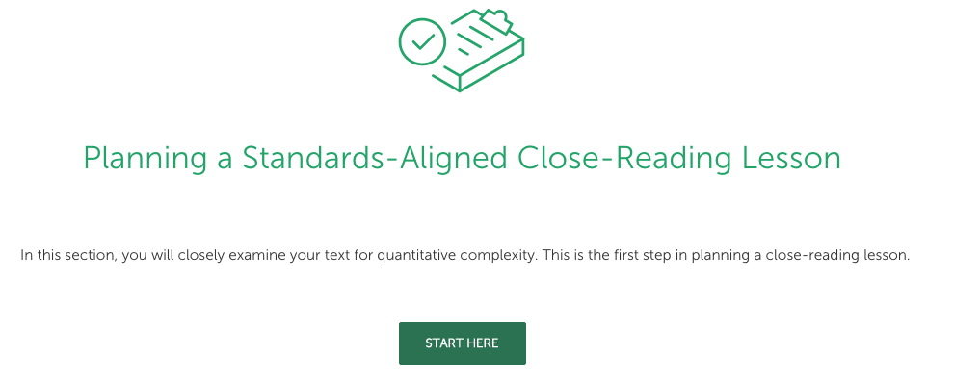
Instructional Practice Guide: Lesson Planning Tool

Slide 18
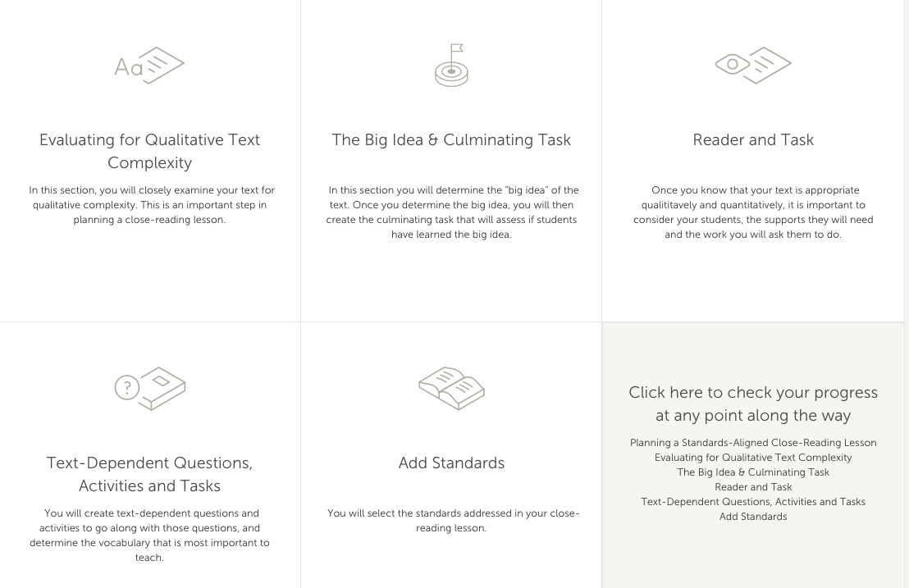
Instructional Practice Guide: Lesson Planning Tool

Slide 19
Instructional Practice Guide: Lesson Planning Tool
Close reading takes more that just one lesson period; time invested in planning is work worth doing!
Addresses all aspects of planning for close reading - consider text complexity, text-dependent questions and tasks, vocabulary, and supporting all students
Supports your individual planning process - start/stop in any place and continue at any time

Slide 20
Question: In what ways have you used these tools? If you haven’t, what are you most looking forward to utilizing?
Use the “Question” tab on your control panel to submit your response.

Slide 21
How do the tools in the Instructional Practice Suite work together?

Slide 22
Teaching – Learning Cycle*
*Graphic courtesy of Cherry Creek Schools
Centennial, CO

Slide 23
Teaching – Learning Cycle*
Lesson Planning Tool
Coaching Tool
*Graphic courtesy of Cherry Creek Schools
Centennial, CO

Slide 24
Teaching – Learning Cycle*
Coaching Tool
*Graphic courtesy of Cherry Creek Schools
Centennial, CO

Slide 25
Teaching – Learning Cycle*
Coaching Tool & conversations
Beyond the Lesson
*Graphic courtesy of Cherry Creek Schools
Centennial, CO

Slide 26
Teaching – Learning Cycle*
Coaching Conversations &
Reflection
Lesson Planning Tool
*Graphic courtesy of Cherry Creek Schools
Centennial, CO

Slide 27
Question: How might the Suite of Instructional Tools enhance your current planning-teaching processes?
Use the “Question” tab on your control panel to submit your response.

Slide 28
How do the videos on Teaching the Core support the Instructional Practice Suite?

Slide 29
Teaching the Core

Slide 30
Poll: Have you seen or used the videos on Teaching the Core?

Slide 31
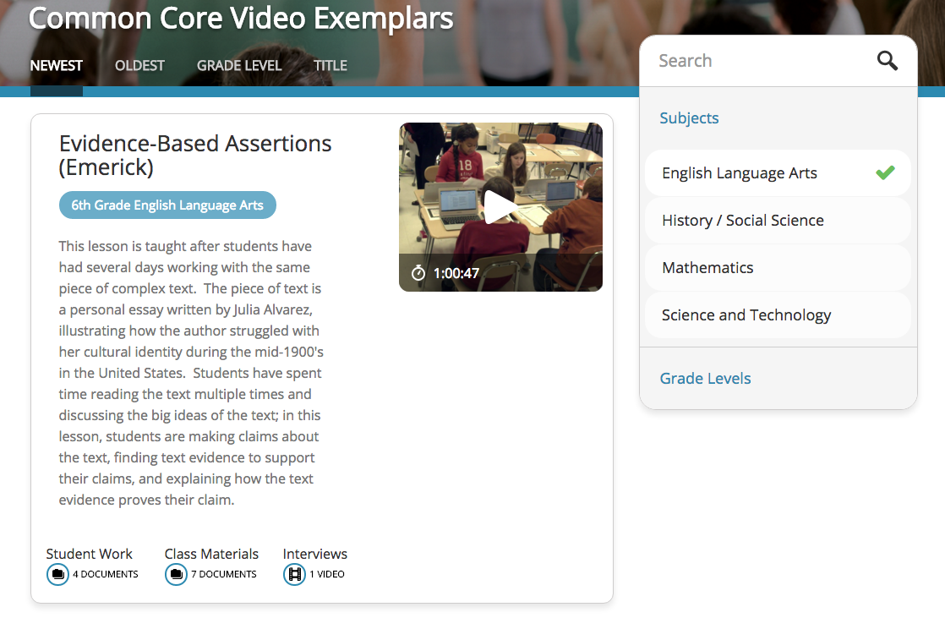
Teaching the Core

Slide 32
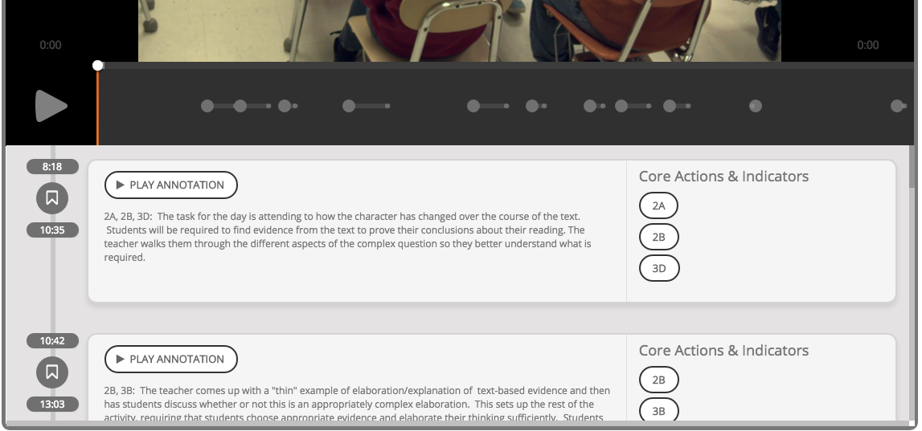
Teaching the Core

Slide 33
Your questions? Use the “Question” tab on your control panel to submit your questions.

Slide 34
Follow Up
Watch a Teaching the Core video yourself or with colleagues with the IPG in hand and have a conversation about what you see.
Utilize any of the tools in the Instructional Practice Suite and tell us how they helped you do your job better.
Share information about these tools with your colleagues!
Submit comments and reflections here.

Slide 35
Upcoming Webinars
“Ask the Experts: Office Hours”
Tuesday, December 15, 2015
7:00 – 8:00 pm EST
Submit your questions for the experts here
Register here

Slide 36
Thank You!

Slide 37
Resources
www.Achievethecore.org
Submit your action steps here http://bit.ly/1EYfuMQ

