Slide 1
The Matthew Effect: A Different Look at the Causes of the Achievement Gap
The webinar will begin shortly. You may wish to download the handouts (check the tab on your webinar control panel) while you wait.
Core Advocate Webinar
August 18, 2015
7:00 – 8:00 EDT

Slide 2
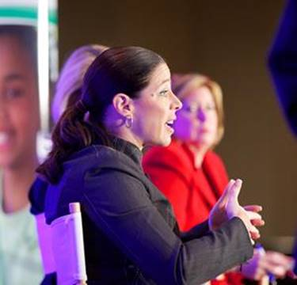
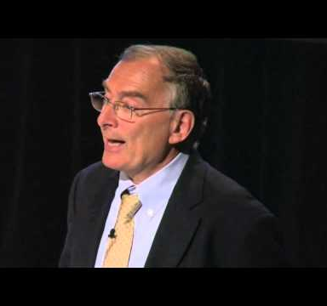
Introductions
Sandra Alberti
Field Impact Team
David Liben Literacy Team

Slide 3
Core Advocates
Core Advocates are educators who:
Believe in the potential of the CCSS to prepare all students for college and careers;
Are eager to support their colleagues and communities in understanding and advocating for the CCSS and CCSS-aligned instruction;
Understand and embrace the shifts in instruction and assessment required by the CCSS

Slide 4
To learn more about Core Advocates…
Contact Max Wagner (wagnerm@studentsachieve.net ) or Joanie Funderburk (jfunderburk@studentsachieve.net)
Complete this survey to join our database (and mailing lists): http://www.tfaforms.com/362186
Visit our website: www.achievethecore.org

Slide 5
Goals of the webinar
Participants will have an understanding of the research regarding factors that contribute to an achievement gap between affluent students and their less affluent peers.
Participants will consider ways in which changes to the curriculum can help close the achievement gap.
Participants will have resources for making changes that will reduce the gap.

Slide 6
Overview of the webinar
Content
What does the research say about causes of and cures for low student achievement?
What are instructional and curricular components for supporting students who are behind?
What can teachers do to build students’ knowledge and vocabulary?
Q & A
Next Steps and Closing

Slide 7
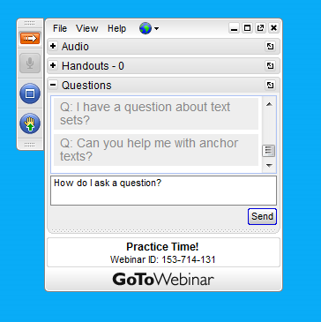
Webinar protocols
During the webinar
Accessing Documents
Questions option
Polling
After the webinar
Survey
Access to recorded webinar

Slide 8
For Tweeters…
Please feel free to tweet during and after the webinar using #coreadvocates
@salberti and @achievethecore

Slide 9
What does the research say?

Slide 10
Five Essential Studies
Hernandez 2011 – Students who are not proficient in 3rd grade 4 times less likely to graduate on time.
Lesnick et al 2010 – 3rd grade scores predictive of 8th grade scores, high school, & college enrollment.
Fletcher and Lyon 1998 – 74% of 3rd graders who read poorly will still be struggling in 9th grade
Snow et al 1998 – “A person who is not at least a modestly skilled reader by the end of third grade is quite unlikely to graduate from high school.”
Juel 1988 – 1st grade reading scores are a “reliable predictor of later reading scores.”

Slide 11
Poll: What factors do you think help explain these data?

Slide 12
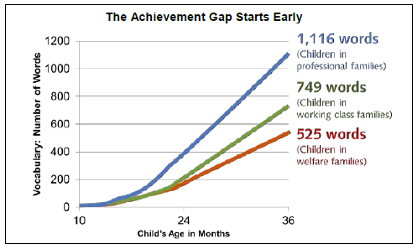
The Matthew Effect
Proficient readers start at a higher point than non-proficient readers
Proficient readers grow faster each year relative to non-proficient readers
Hart & Risley (1995) “The 30 Million Word Gap”

Slide 13
Systems that contribute to the problem
Leveled reading
Less time spent on social studies and science
Failure of foundational skills reading programs to meet the needs of all students

Slide 14
They need more
Basically, giving students who are behind LESS..
Vocabulary
Knowledge
Practice with complex text
Support for foundational skills
Support for fluency
… Instead of what they need to catch up: MORE

Slide 15
Students who are behind need support with:
Vocabulary
Knowledge
Fluency
Syntax
Foundational skills

Slide 16
Pause and Reflect
How have you seen the achievement gap in your setting?
Can you think of a time where lack of knowledge or vocabulary (or both) inhibited your or your students’ ability to comprehend a text, especially a complex text?
Use the question box on your control panel to submit your response.

Slide 17
What can teachers do to support students who are behind?

Slide 18
Increase knowledge
Knowledge of content has a higher impact on comprehension than reading ability.
If students don’t have at least a minimum level of knowledge about content of a text, they will have trouble comprehending a text – even if they can decode all the words.

Slide 19
For example
“This brain scan is fuzzy, so the patient must have been wearing make-up.”
How does the conclusion “the patient must have been wearing make-up” follow from the statement “this brain scan is fuzzy?”
Respond using the question box on your control panel.

Slide 20
Fuzzy brain scan
Idea 1: The brain scan is fuzzy.
+
Brain scans use magnets, and metal makes images fuzzy
+
Make-up contains trace amounts of metal
=
Idea 2: the patient wore make-up

Slide 21
So which content knowledge should I build?
It’s not about the content, it’s about content!
Use this fact to your advantage in instruction:
Content that will provide more opportunity for science and social studies learning
Content that is interesting to students
Content that is generally useful information

Slide 22
Build vocabulary
Vocabulary is highly correlated to comprehension.
Not knowing words on the page is frustrating and debilitating.
The more words you know, the better you are at figuring out words in context.

Slide 23
The achievement gap at work
Below Level: Shelter, splattered, fixed, rescue
On Level: Journal, tremors, traction, interval, volunteered, retrieve
Above level: Generation, abandoned, languished, terrified, warble, galvanized, debris, hoisted, shuddered

Slide 24
Vocabulary statistics
Students on track for college and career are learning approximately 3,000 new vocabulary words each year (Nagy & Anderson, 984); it is impossible to learn this many words through vocabulary exercises.
Children’s vocabulary size approximately doubles between grades 3 and 7.
High school seniors near the top of their class knew about four times as many words as their lower performing classmates. (Smith, 1941)

Slide 25
So how do I accelerate vocabulary learning?
The most efficient and effective way to learn vocabulary is by reading, not by any vocabulary exercise.
The organization of reading selections should keep the building of knowledge and vocabulary in mind.

Slide 26
BIG IDEA: The most efficient way to build knowledge and vocabulary is to engage students with text sets.

Slide 27
What is a text set?
A text set is a collection of related texts organized around a single topic and contains a variety of resources.
Purposely orders resources to support students in building vocabulary and knowledge.
Includes suggested activities to be completed after each resource to demonstrate comprehension and students’ building knowledge and/or vocabulary.
Is designed to be completed with increasing independence by students.

Slide 28
Poll: What is the difference between a topic and a theme?

Slide 29
Text Sets or “Expert Packs”
Collection of resources organized for students to build knowledge about a specific topic
Glossary of terms to help students access challenging vocabulary
Suggested activities to help students capture and express their learning

Slide 30
1. Resources
Variety of resources
Sequenced to create a coherent and gradual learning process
Generally beginning with lower reading levels (quantitative and qualitative measures) and moving to more complex levels
Support students’ ability to read the next selection (mostly) independently
Students become ‘experts’ on the topic

Slide 31
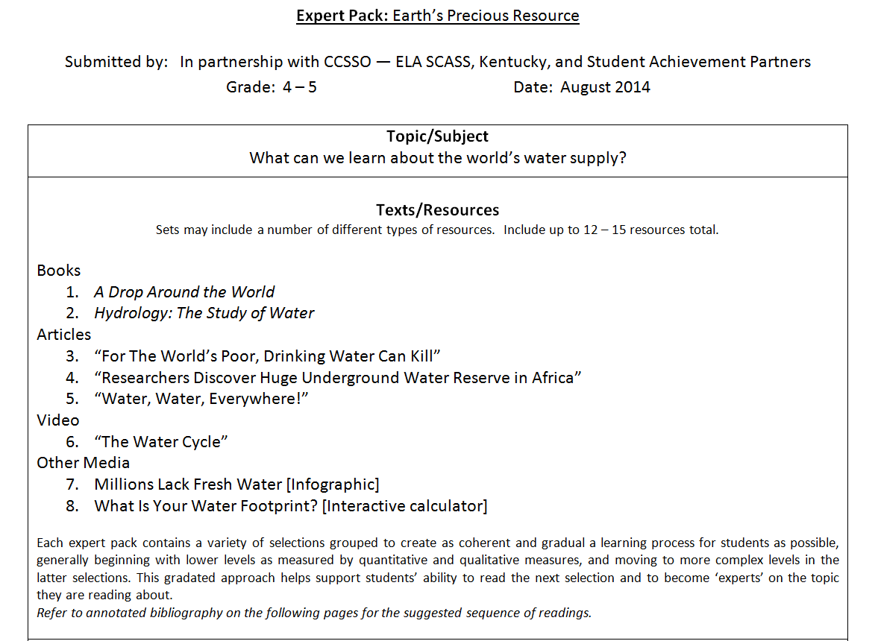
Example – “Earth’s Precious Resource”
Suggested Sequence
“For the World’s Poor, Drinking Water Can Kill”
“Millions Lack Safe Water”
“The Water Cycle”
“Water, Water, Everywhere!”
Hydrology: The Study of Water
A Drop Around the World
“Researchers Discover Huge Underground Water Reserve in Africa”
“What is Your Water Footprint?”

Slide 32
2. Glossary of Terms
Help students access challenging vocabulary
Which words?
Tier 2 (academic vocabulary)
Essential to text
Likely to appear in future texts
Tier 3 (domain-specific)
Key terms essential to understanding the text
May also be defined in the text (footnote, text box, etc.)

Slide 33
Example – “Earth’s Precious Resource”

Slide 34
3. Suggested Activities
Learning Worth Remembering
Student accountability – Is this work worth doing?
“Light-touch approach” for teachers and students. Can this be done with ease and (mostly) independence?

Slide 35
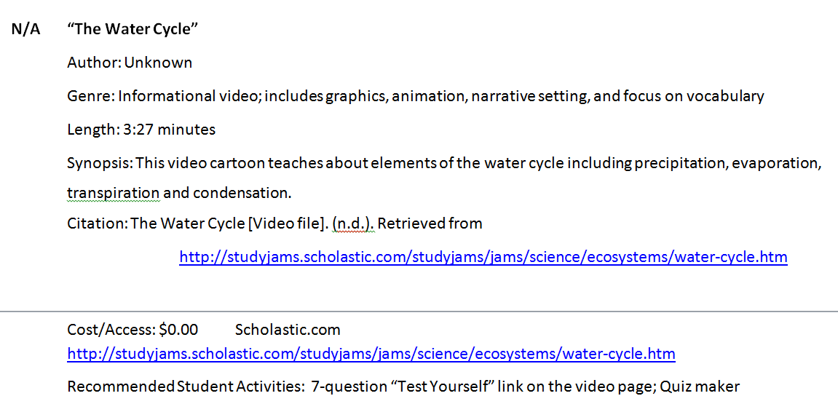
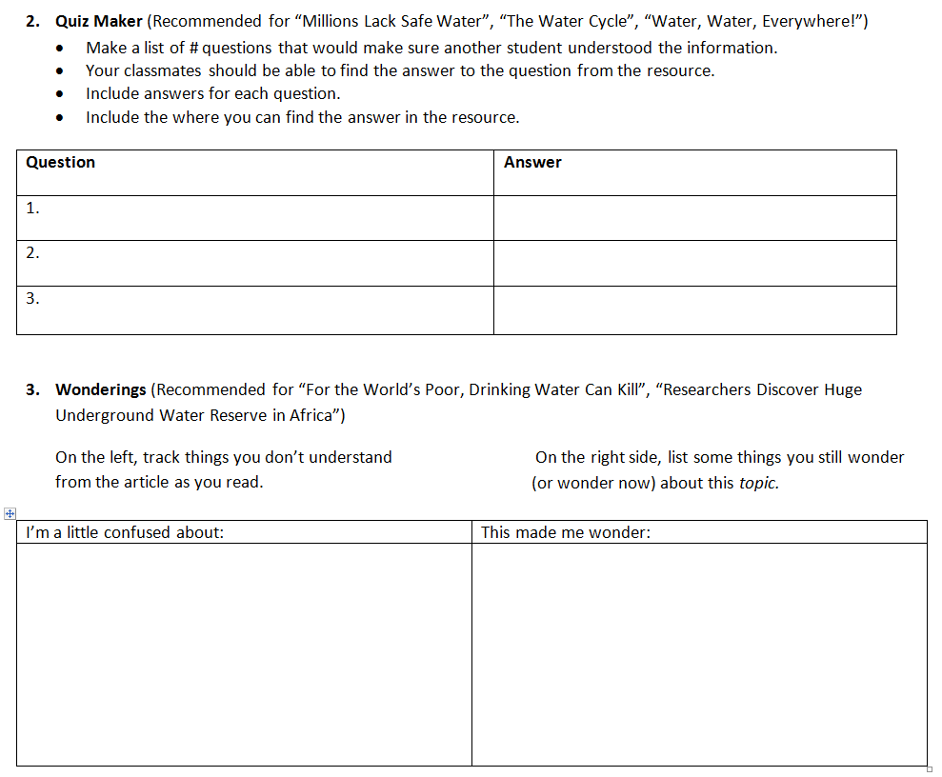
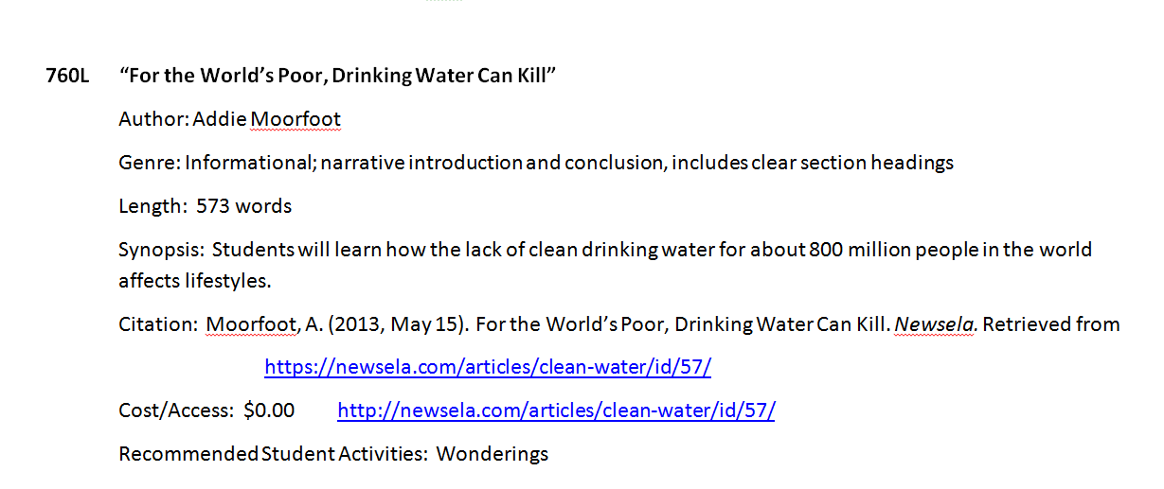
Example – “Earth’s Precious Resource”

Slide 36
Why use text sets?
Building knowledge and vocabulary can help level the playing field between affluent students and their less affluent peers.
Students acquire vocabulary up to four times faster when they read a series of related texts.

Slide 37
Questions for Discussion
What ways do you think you can begin to implement read aloud as discussed here in K-2? What obstacles do you see?
What ways do you think you can begin to implement texts sets as discussed here in 3-8? What obstacles do you see?
Use the Question button on your control panel.

Slide 38
Next Steps
A call to action!
Try using a text set! Tweet your topic! #coreadvocates
Tell us about your experience here.
Office Hours with David Liben
Follow up on tonight’s webinar
Sep 1 7:00 – 8:00 pm EDT
Submit questions here.
Share these ideas with your colleagues.
Complete the Core Advocates survey to join our network: http://www.tfaforms.com/362186

Slide 39
Next in our webinar series
Next month’s webinar:
The Knowledge and Practice Survey: Supporting Teachers’ Learning
September 15, 2015 7:00 – 8:00 pm EDT
Register now using this link.

Slide 40
Don’t forget to check out all the great resources on AchievetheCore.org

Slide 41
Thank You!

Slide 42
Resources
Learn more about the research shared
Submit your action steps here
Access completed text sets via Edmodo
Join Edmodo (free) if you haven’t already
Log in and join the Text Set Project Group (code sma265)
Click on the “Text Set Project” tab on the left side of the screen
Choose “Folders” from the top of the next screen and click on the folder that says “Completed expert packs)

