Slide 1
Teachers’ New (School) Year’s Resolution
Core Advocates Monthly Webinar
July 19, 2016
The webinar will begin shortly. You may wish to download the handouts (check the tab on your webinar control panel) while you wait.

Slide 2
Introductions
Sandra Alberti, Janelle Fann, Jennie Beltramini, & Joanie Funderburk: Field Impact Team
Core Advocate Guests: Ben Dickson, Ryan Redd, Joanna Schimizzi
Core Advocates are educators who:
Believe in the potential of the CCSS to prepare all students for college and careers;
Are eager to support their colleagues and communities in understanding and advocating for the CCSS and CCSS-aligned instruction;
Understand and embrace the shifts in instruction and assessment required by the CCSS

Slide 3
To learn more about Core Advocates…
Contact Jennie Beltramini (jbeltramini@studentsachieve.net ) or Joanie Funderburk (jfunderburk@studentsachieve.net)
Complete this survey to join our database (and mailing lists): http://bitly.com/joincoreadvocates
Visit our website: www.achievethecore.org

Slide 4
For Tweeters…
Please feel free to tweet during and after the webinar using #coreadvocates
@achievethecore
@JoanieFun, @salberti, @JennieBeltro, @BDicksonNV, @aredd21, @Mrs_Schimizzi

Slide 5
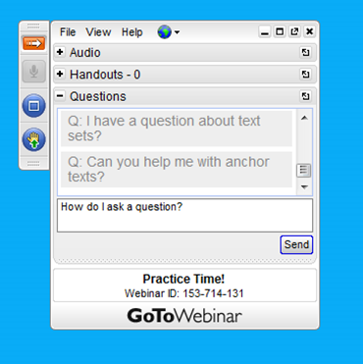
Webinar protocols
During the webinar
– Accessing Documents
– Questions option
– Polling
After the webinar
– Survey
– Access to recorded webinar

Slide 6
Celebrating our Webiversary!

Slide 7
Goals of the webinar
Learn about the Instructional Practice Guide: Coaching Tool and how educators in various roles are using it
Use the IPG to reflect on your practice and set a goal for becoming even better at what you do in the next school year
Learn about resources that align with the Core Actions of the IPG and how they can support you in reaching your goal for the new school year

Slide 8
New Year’s Resolutions
Res
A firm decision to do or not to do something
The action of solving a problem, dispute, or contentious matter
“A New Year’s resolution is a tradition… in which a person makes a promise to do an act of self-improvement …beginning from New Year’s Day.”

Slide 9
New School Year’s Resolutions
What’s the thing you’ve been wanting to change in your classroom or practice?
Self-reflection Compare current situation
to desired situation

Slide 10
What is the Instructional Practice Guide and how is it used?

Slide 11
Instructional Practice Guide: Coaching
Tool to help teachers and those who support them in recognizing Shifts-aligned instruction in the classroom
2 versions for math: K-8 and HS
2 versions for ELA: K-2 and 3-12
Beyond the Lesson Guide

Slide 12
Instructional Practice Guide: Coaching
Math IPG – Core Actions
ELA IPG – Core Actions
Ensure the work of the lesson reflects the Shifts required by the CCSS for Mathematics.
Employ instructional practices that allow all students to master the content of the lesson.
Provide all students with opportunities to exhibit mathematical practices in connection with the content of the lesson.
Focus each lesson on a high-quality text (or multiple texts).
Employ questions and tasks, both oral and written, that are text specific and reflect the standards.
Provide all students with opportunities to engage in the work of the lesson.

Slide 13
Where are the Shifts?
Core Actions of the IPG
The Shifts for Math
Core Action 1: Ensure the work of the lesson reflects the Shifts required by the CCSS for Mathematics.
Core Action 2: Employ instructional practices that allow all students to master the content of the lesson.
Core Action 3: Provide all students with opportunities to exhibit mathematical practices in connection with the content of the lesson.
Focus: Focus strongly where the standards focus.
Coherence: Think across grades, and link to major topics within grades.
Rigor: In major topics pursue conceptual understanding, procedural skill and fluency, and application with equal intensity.

Slide 14
Where are the Shifts?
Core Actions of the IPG
The Shifts for ELA/Literacy
Core Action 1: Focus each lesson on a high-quality text.
Core Action 2: Employ questions and tasks, both oral and written, that are text specific and reflect the standards.
Core Action 3: Provide all students with opportunities to engage in the work of the lesson
Regular practice with complex text and its academic language.
Reading, writing, and speaking grounded in evidence from text, both literary and informational.
Building knowledge through content-rich nonfiction.

Slide 15
Question: What is the relationship between the Shifts and the Core Actions? Please use the Questions tab on your control panel to respond.

Slide 16
Using the IPG: A teacher’s perspective
Ryan Redd: 8th Grade Math Teacher, New Hanover County Schools
I use the IPG to:
ensure my practice is grounded in the Shifts
plan how I will create a classroom culture (at the beginning of the year) that elicits the use of the MPs
design and intellectually prepare for my lessons

Slide 17
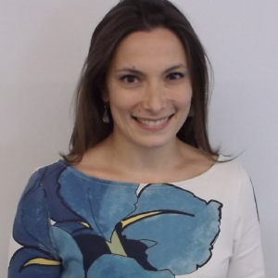
Using the IPG: A PD provider’s perspective
Joanna Schimizzi, North Carolina Virtual Public Schools; North Carolina Core Advocates Captain
I use the IPG to:
Help teachers see that the Shifts are about students doing the work
Support conversation about video (using Teaching the Core)
Help teachers choose a focus for improving their practice

Slide 18
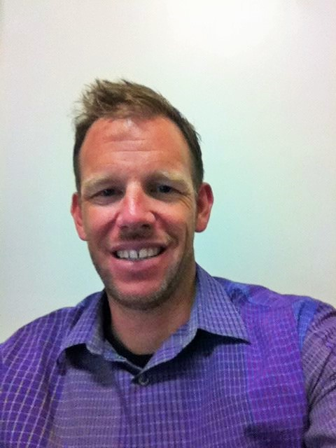
Using the IPG: An administrator’s perspective
Ben Dickson, Assistant Principal, Washoe County School District
I use the IPG to:
Support PLC conversations
Keep conversations with teachers focused on instruction
Help teachers gather evidence to support their teacher evaluation rubric
Beyond the Lesson guides to help administrators/coaches talk with teachers

Slide 19
Poll: How have you used the Instructional Practice Guide?

Slide 20
How can I use the IPG to reflect on my practice and set a goal for the upcoming school year?

Slide 21
Continuous Improvement
“We must do a better job of putting ourselves on our ‘to do’ list.” - Michelle Obama
Kaizen

Slide 22
Current Situation vs Desired Situation
Reflect with student achievement in mind
What’s going well?
Complex text
Using Evidence
Building Knowledge
Focus
Coherence
Rigor
What could be going better?

Slide 23
Reflect: Identify your strengths
Review the IPG for your content area
Select one or two Indicators that are strengths for you
Note your rationale for identifying those strengths

Slide 24
Reflect: Identify your growth areas
Select one or two Indicators that are areas where you could improve and grow
Note your rationale for identifying those growth areas

Slide 25
Goal-setting
Assess your current situation – what does your classroom look like and sound like now, in contrast?
Picture your desired situation – what will your classroom will look and sound like when you have improved in this area?
Identify one or two ways to move from your current situation toward your desired situation.
Make these steps clear, specific and actionable
Determine a time frame for taking these steps
How will you measure your progress?

Slide 26
Example - ELA
Current situation: Students need frequent reminding to use textual evidence in their responses, and will answer specific questions, but often miss the big idea of a text
Desired situation: Students use evidence from the text consistently in their oral and written responses to questions and tasks, and they get to the important knowledge of the text by engaging with it

Slide 27
Example - ELA
Strengths:
Indicator 1C: I use texts worth reading
Indicator 2A: Questions and tasks address the text
Areas of growth:
Indicator 2D: questions are not always sequenced to guide students to the big idea
Indicator 3B: I don’t always probe students for precision and evidence when they respond

Slide 28
Example - ELA
My goal: I will intentionally sequence questions to build knowledge by guiding students to delve deeper into the text and graphics (2D), and I will be consistent in expecting them to provide evidence in their responses (3B).
Break down into steps that are clear, specific and actionable
Determine a time frame for taking these steps
How will you measure your progress?

Slide 29
Example - Math
My current situation: Student give up when they don’t immediately know what to do with a math problem. They are focused on getting the right answers.
My desired situation: Students persevere when faced with difficult problems, and have a growth mindset about struggling with math.

Slide 30
Example - Math
Strengths:
Indicator 2B: students work with grade level problems
Indicator 3C: students explain their thinking
Areas of Growth:
Indicator 3B: students don’t persevere
Indicator 2C: I don’t use varied student approaches to strengthen all students’ understanding

Slide 31
Example - Math
My Goal: I will strengthen all students’ understanding of the content by sharing a variety of students’ representations and solution methods (2C). I will use incomplete and incorrect work to value the process of getting to a correct solution.
Break down into steps that are clear, specific and actionable.
Determine a time frame for taking these steps.
How will you measure your progress?

Slide 32
Examples from our Guest Core Advocates

Slide 33
Poll: Which Core Action are you attending to with your goal?

Slide 34
What resources are available to support me in reaching my goal?

Slide 35
ELA Resources
Core Action 1: ELA Lessons; Academic Word Finder , Analysis of Text Complexity
Core Action 2: Guide to Creating Text Dependent Questions, February 2016 Webinar
Core Action 3: ELA Lessons; Academic Word Finder , Analysis of Text Complexity; Student Writing Samples, Mini-Assessments, Fluency Resources

Slide 36
Math Resources
Core Action 1: Focus Documents, Coherence Map, Lessons, Tasks
Core Action 2: Coherence Map, Progressions Documents, Mini-Assessments
Core Action 3: Lessons, Tasks, Mini-Assessments

Slide 37
General Resources for ALL Goals
Instructional Practice Guides
Beyond the Lesson Guides
Teaching the Core Videos

Slide 38
Question: Which resources will you use to reach your goal? Do you have additional resources to recommend? Please use the Questions tab on your control panel to respond.

Slide 39
Tell us about your goal: http://bit.ly/29LAfNS

Slide 40
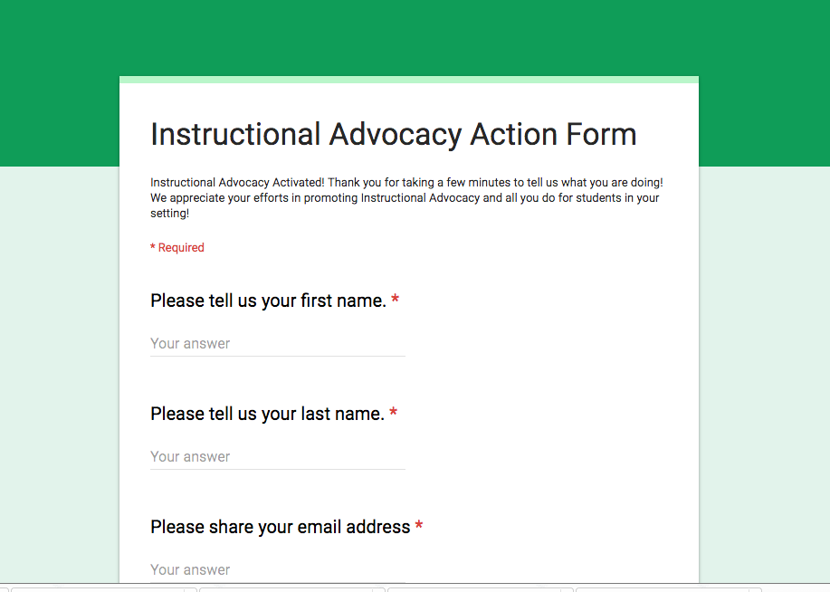
Tell us about your successes

Slide 41
Your Questions

Slide 42
Please join us again next month!
August Core Advocate Webinar: “Understanding and Using Imperfect Curricular Resources”
Tuesday, August 16 7:00 – 8:00 pm EDT
Register Here: https://attendee.gotowebinar.com/register/667454510604815362

Slide 43
Thank You!

