Slide 1
Building a Deeper Understanding of the ELA Shifts and Standards in PLCs
Core Advocates Monthly Webinar
October 5, 2016
The webinar will begin shortly. You may wish to download the handouts (check the tab on your webinar control panel) while you wait.

Slide 2
Introductions
Your hosts from the Field Impact Team
Sandra Alberti, Director
Janelle Fann, Project Manager
Jennie Beltramini, Teacher Engagement Manager
Joanie Funderburk, Manager of Professional Learning
Lynda Nguyen, Coordinator
This Month’s Guests
Cathy Schmidt, SAP ELA team
Kate Crist, NV Core Advocate
Aaron Grossman, NV Core Advocate

Slide 3
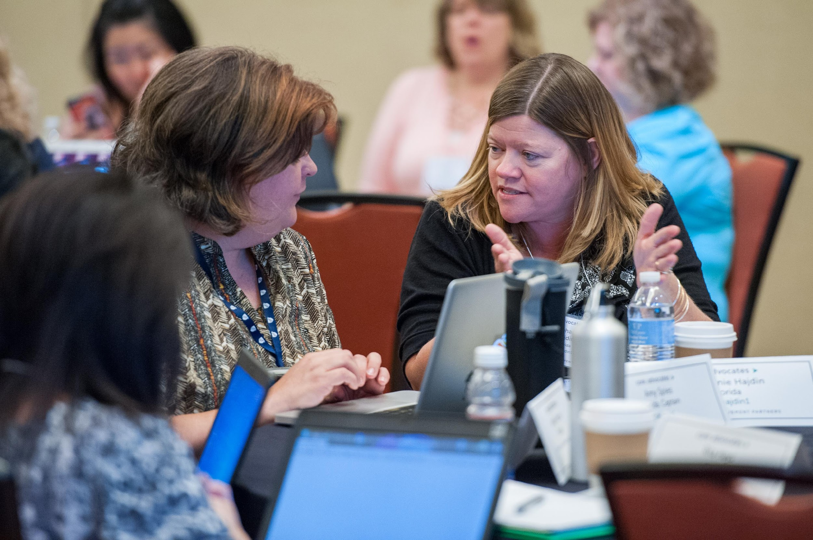
Who are Core Advocates?
Core Advocates are educators who:
Believe in the potential of the CCSS to prepare all students for college and careers;
Are eager to support their colleagues and communities in understanding and advocating for the CCSS and CCSS-aligned instruction;
Understand and embrace the shifts in instruction and assessment required by the CCSS

Slide 4
To learn more about Core Advocates…
Contact Jennie Beltramini (jbeltramini@studentsachieve.net ) or Joanie Funderburk (jfunderburk@studentsachieve.net)
Complete this survey to join our database (and mailing lists): http://bitly.com/joincoreadvocates
Visit our website: www.achievethecore.org

Slide 5
For Tweeters…
Please feel free to tweet during and after the webinar using #coreadvocates
@achievethecore
@JoanieFun, @salberti, @JennieBeltro
@cathsch256, @coretaskproject,
@sfkato

Slide 6
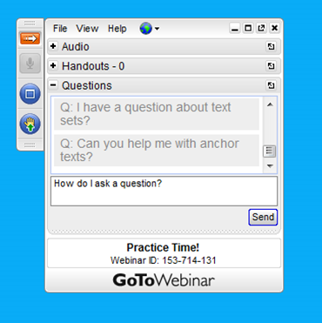
Webinar protocols
During the webinar
– Accessing Documents
– Questions option
– Polling
After the webinar
– Survey
– Access to recorded webinar

Slide 7
Instructional Advocacy – A Definition
Grounded in a firm understanding of the Shifts, educators owning, supporting, and promoting the resources, tools, and practices that create learning environments in which students develop college- and career- readiness.

Slide 8
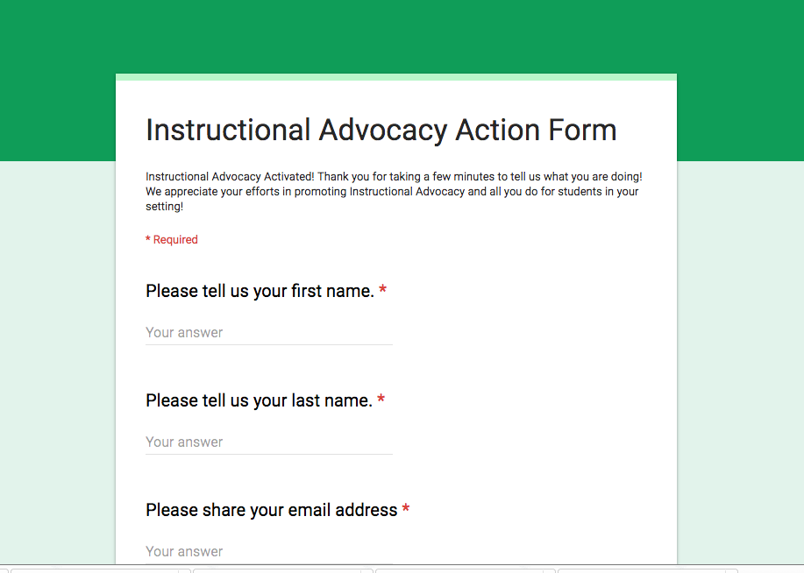
Tell us about your successes

Slide 9
Goals of the webinar
Goal 1 Engage with a dynamic PLC structure that supports teachers in improving student learning
Goal 2 Explore tools & resources grounded in the Standards and ELA Shifts that support PLCs
Goal 3 Learn about guidelines to follow when analyzing and reflecting on student learning

Slide 10
Question:
What do PLCs look like in your setting?
What structures exist for teachers to work together on building their knowledge of the Standards and the Shifts? Please use the Questions tab on your control panel to respond.

Slide 11
A dynamic structure for PLCs: The Plan - Do - Study - Act Cycle

Slide 12
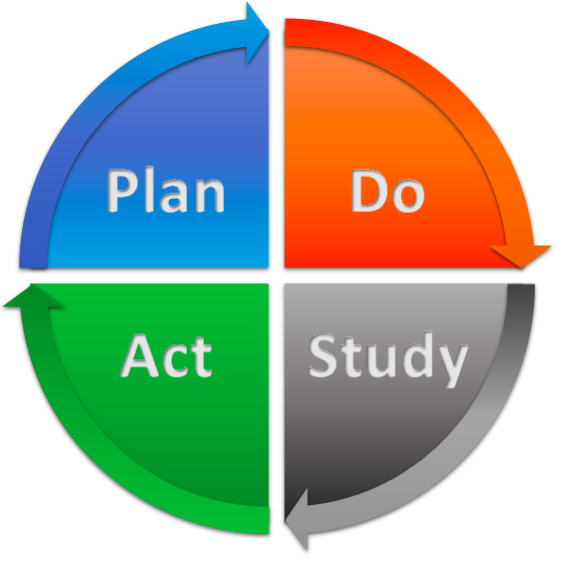
Cycle of continuous improvement

Slide 13
Three Shifts Demanded by the CCSS for ELA
Complexity: Regular practice with complex text and its academic language
Evidence: Reading, writing, and speaking grounded in evidence from text, both literary and informational
Knowledge: Building knowledge through content-rich nonfiction

Slide 14
PLC planning with the Shifts in mind
Lessons are focused on a high-quality text(s)
What high-quality text is at the center of the lesson?
Is the text at or above the complexity level expected for the grade and time in the school year?
Does the text exhibit exceptional craft and thought and/or provide useful information?
Standard 10: Read and comprehend complex literary and informational texts independently and proficiently.

Slide 15
PLC Planning with the Shifts in mind
Questions and tasks are text-specific and reflect the standards
Do the questions and tasks address the text by attending to its structure, concepts, ideas and details?
What questions require students to use evidence both written and oral as they are led to understanding the central ideas of the text?
How do questions and tasks attend to the academic language within the text?
Standard 1: Read closely to determine what the text says explicitly and to make logical inferences from it; cite specific evidence when writing or speaking to support conclusions drawn from the text.

Slide 16
PLC planning with the Shifts in mind
How will all students be provided opportunities to engage in the work of the lesson?

Slide 17
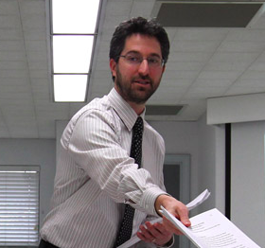
Guest Core Advocate
Aaron Grossman
5th Grade Teacher
Roy Gomm Elementary
Classroom page www.Room360.org Twitter: @classroomd4

Slide 18
Plan
Questions we ask:
How will our instruction reflect the Shifts?
Based on assessment data, what standards will be emphasized?
What vetted resources will we use?
Achieve the Core
EngageNY
www.63000resources
www.projecttahoe.org
What formative data will we collect?

Slide 19
Do
This lesson addresses the Core Actions by
Utilizing a series of text-dependent questions.
All students participate in a Structured Academic Controversy.
The culminating activity requires students to use key academic vocabulary and support a claim with evidence and reasoning.

Slide 20
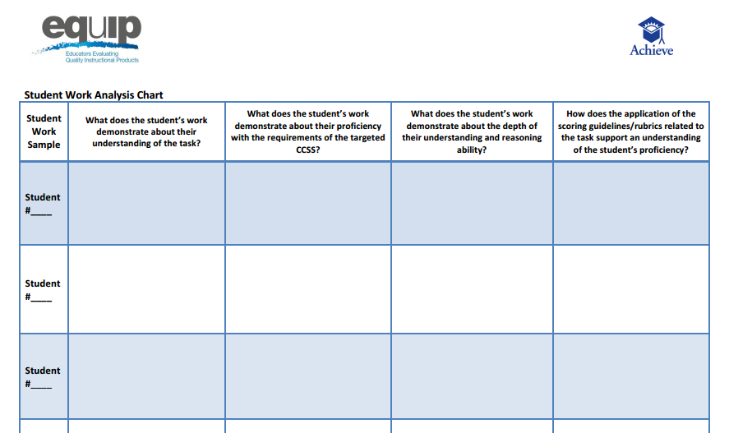
Study
Analysis of culminating writing with questions from Student Work Analysis
Written reflections
Formative data

Slide 21
Act
What learning did students secure?
What needs to revisited?
What needs to be practiced?

Slide 22
Question: Why is it important to anchor PLC planning conversations in the ELA shifts? Please use the Questions tab on your control panel to respond.

Slide 23
What resources are available to support PLCs in the Plan-Do-Study-Act cycle?

Slide 24
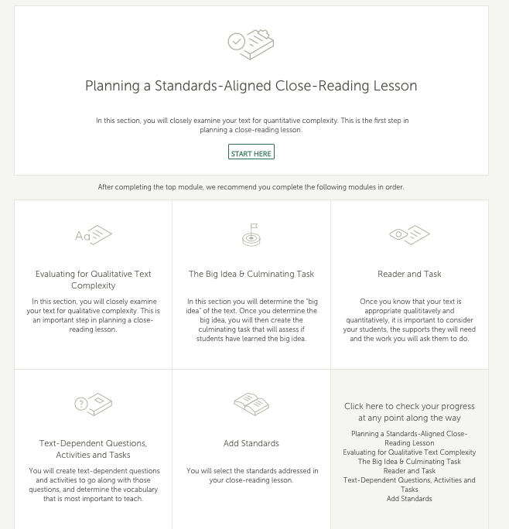
Lesson Planning Tool achievethecore.org

Slide 25
Aligned Lesson Resources
Close reading exemplars
Basal Alignment Project lessons
K-2: Read Aloud Project Lessons
Materials Adaptation Project: Journeys 2014

Slide 26
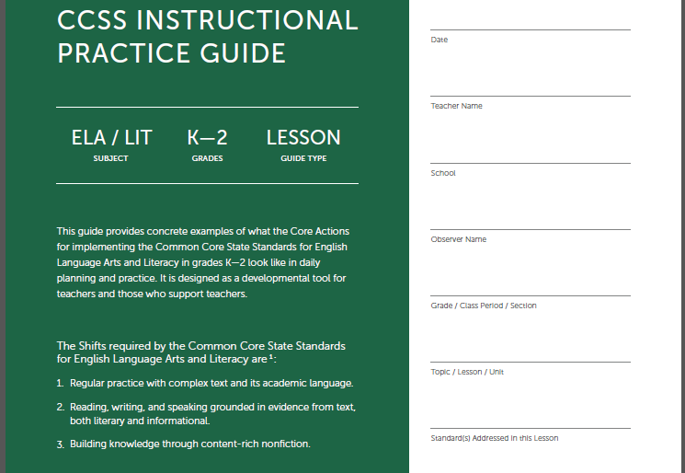
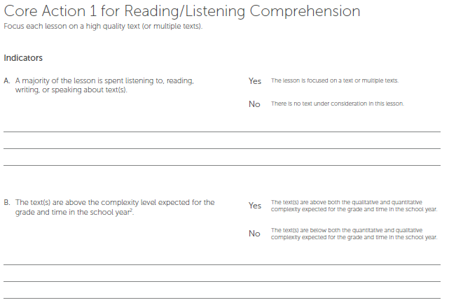
CCSS Instructional Practice Coaching Tool
Instructional Practice Guides
Daily Lessons for
Grades K – 2 and 3 – 12
Core Actions
Key Practices
(numbered sections)
Indicators
Observable
(lettered details under each Core Action)
Support ideas with evidence

Slide 27
Core Action 3: Productive Engagement
Peer observations
Coaching
Common language around practice based on finding evidence of what the teacher and students are doing

Slide 28
Guest Core Advocates
Kate Crist
Implementation Specialist
education4500.com Twitter @sfkato

Slide 29
Instructional Practice Guides to Support PLCs
Plan & Do
Professional Learning focused on Core Actions 1, 2, and 3
Peer Observations using IPGs
Study
Gather observation evidence
Empty areas on the IPGs becomes an area of focus for professional learning
Act
Intentional use of resources and instructional moves to support what is missing
Continued peer observations using IPGs

Slide 30
Instructional Shifts to Support PLCs
Plan & Do
Professional Development focused on Complexity, Evidence, Knowledge
Curriculum Maps aligned to Shifts and Standards - Texts Worth Reading!
Study
Using student work to determine next steps
Coaching and Professional Learning on complexity and evidence
Act
Based on evidence from student work, teachers & instructional coaches act to focus instructional moves

Slide 31
Poll: Your PLC engages in which of the following regularly?

Slide 32
Study & Act: Reflecting on the lesson

Slide 33
Analyzing Student Work
How does the task attend to the structure, concepts, ideas, events, and details of the text? Does the task attend to the words, phrases, and sentences within the text or understanding the central ideas or development of the text?
How does the task require students to use evidence from text(s) to demonstrate understanding and to support ideas about the text?
Do the directions, prompts, and/or scoring guidelines for the task adequately provide or indicate opportunities for students to demonstrate the requirements of the targeted standard(s) for the task?

Slide 34
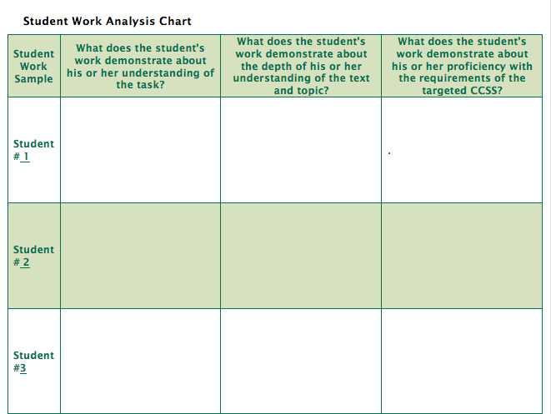
Student Work Analysis Chart

Slide 35
PLC Discussion: What action is necessary?
On what aspects of the task did students generally perform well?
What are the most frequent and fundamental problems students appear to be having? Are there common errors made across the collection of student work samples?
What are the planned next steps to provide students with feedback or reinforce the learning?
Teachers: Is there something more we need to learn?

Slide 36
Try it in your setting!

Slide 37
A few other resources to consider
Beyond the Lesson Discussion Guide - questions put the lesson in the broader instructional plan for the year
Mini-assessments - formative grade-level assessments including text passages, text-dependent questions and writing prompts, and rubrics

Slide 38
Question: Which tool, resource, or practice can you take back to improve your PLC’s effectiveness right away? Please use the Questions tab on your control panel to respond.

Slide 39
Your Questions

Slide 40
Instructional Advocacy – A Definition
Grounded in a firm understanding of the Shifts, educators owning, supporting, and promoting the resources, tools, and practices that create learning environments in which students develop college- and career- readiness.

Slide 41
Tell us about your successes

Slide 42
Please join us again next month!
Next month’s webinar:
Connecting the Criteria for High-Quality Assessments to Standards- and Shifts- Aligned Instruction
Wednesday, November 2, 7:00 - 8:00 EDT
Register Here: http://bit.ly/29V1E2A

Slide 43
Thank You!

