Slide 1
What I Use in My Classroom
Core Advocates Monthly Webinar
July 5, 2017
The webinar will begin shortly. You may wish to download the handouts (check the tab on your webinar control panel) while you wait.

Slide 2
Introductions
Your hosts from the Field Impact Team
Sandra Alberti, Director
Jennie Beltramini, Teacher Engagement Manager
Janelle Fann, Project Manager
Joanie Funderburk, Manager of Professional Learning
Lynda Nguyen, Team Coordinator
This Month’s Guests - Kentucky Core Advocates
Tiffany Gruen - 2nd grade teacher
Stephanie Barnett - 8th grade math teacher
Angie Gunter - Literacy Specialist

Slide 3
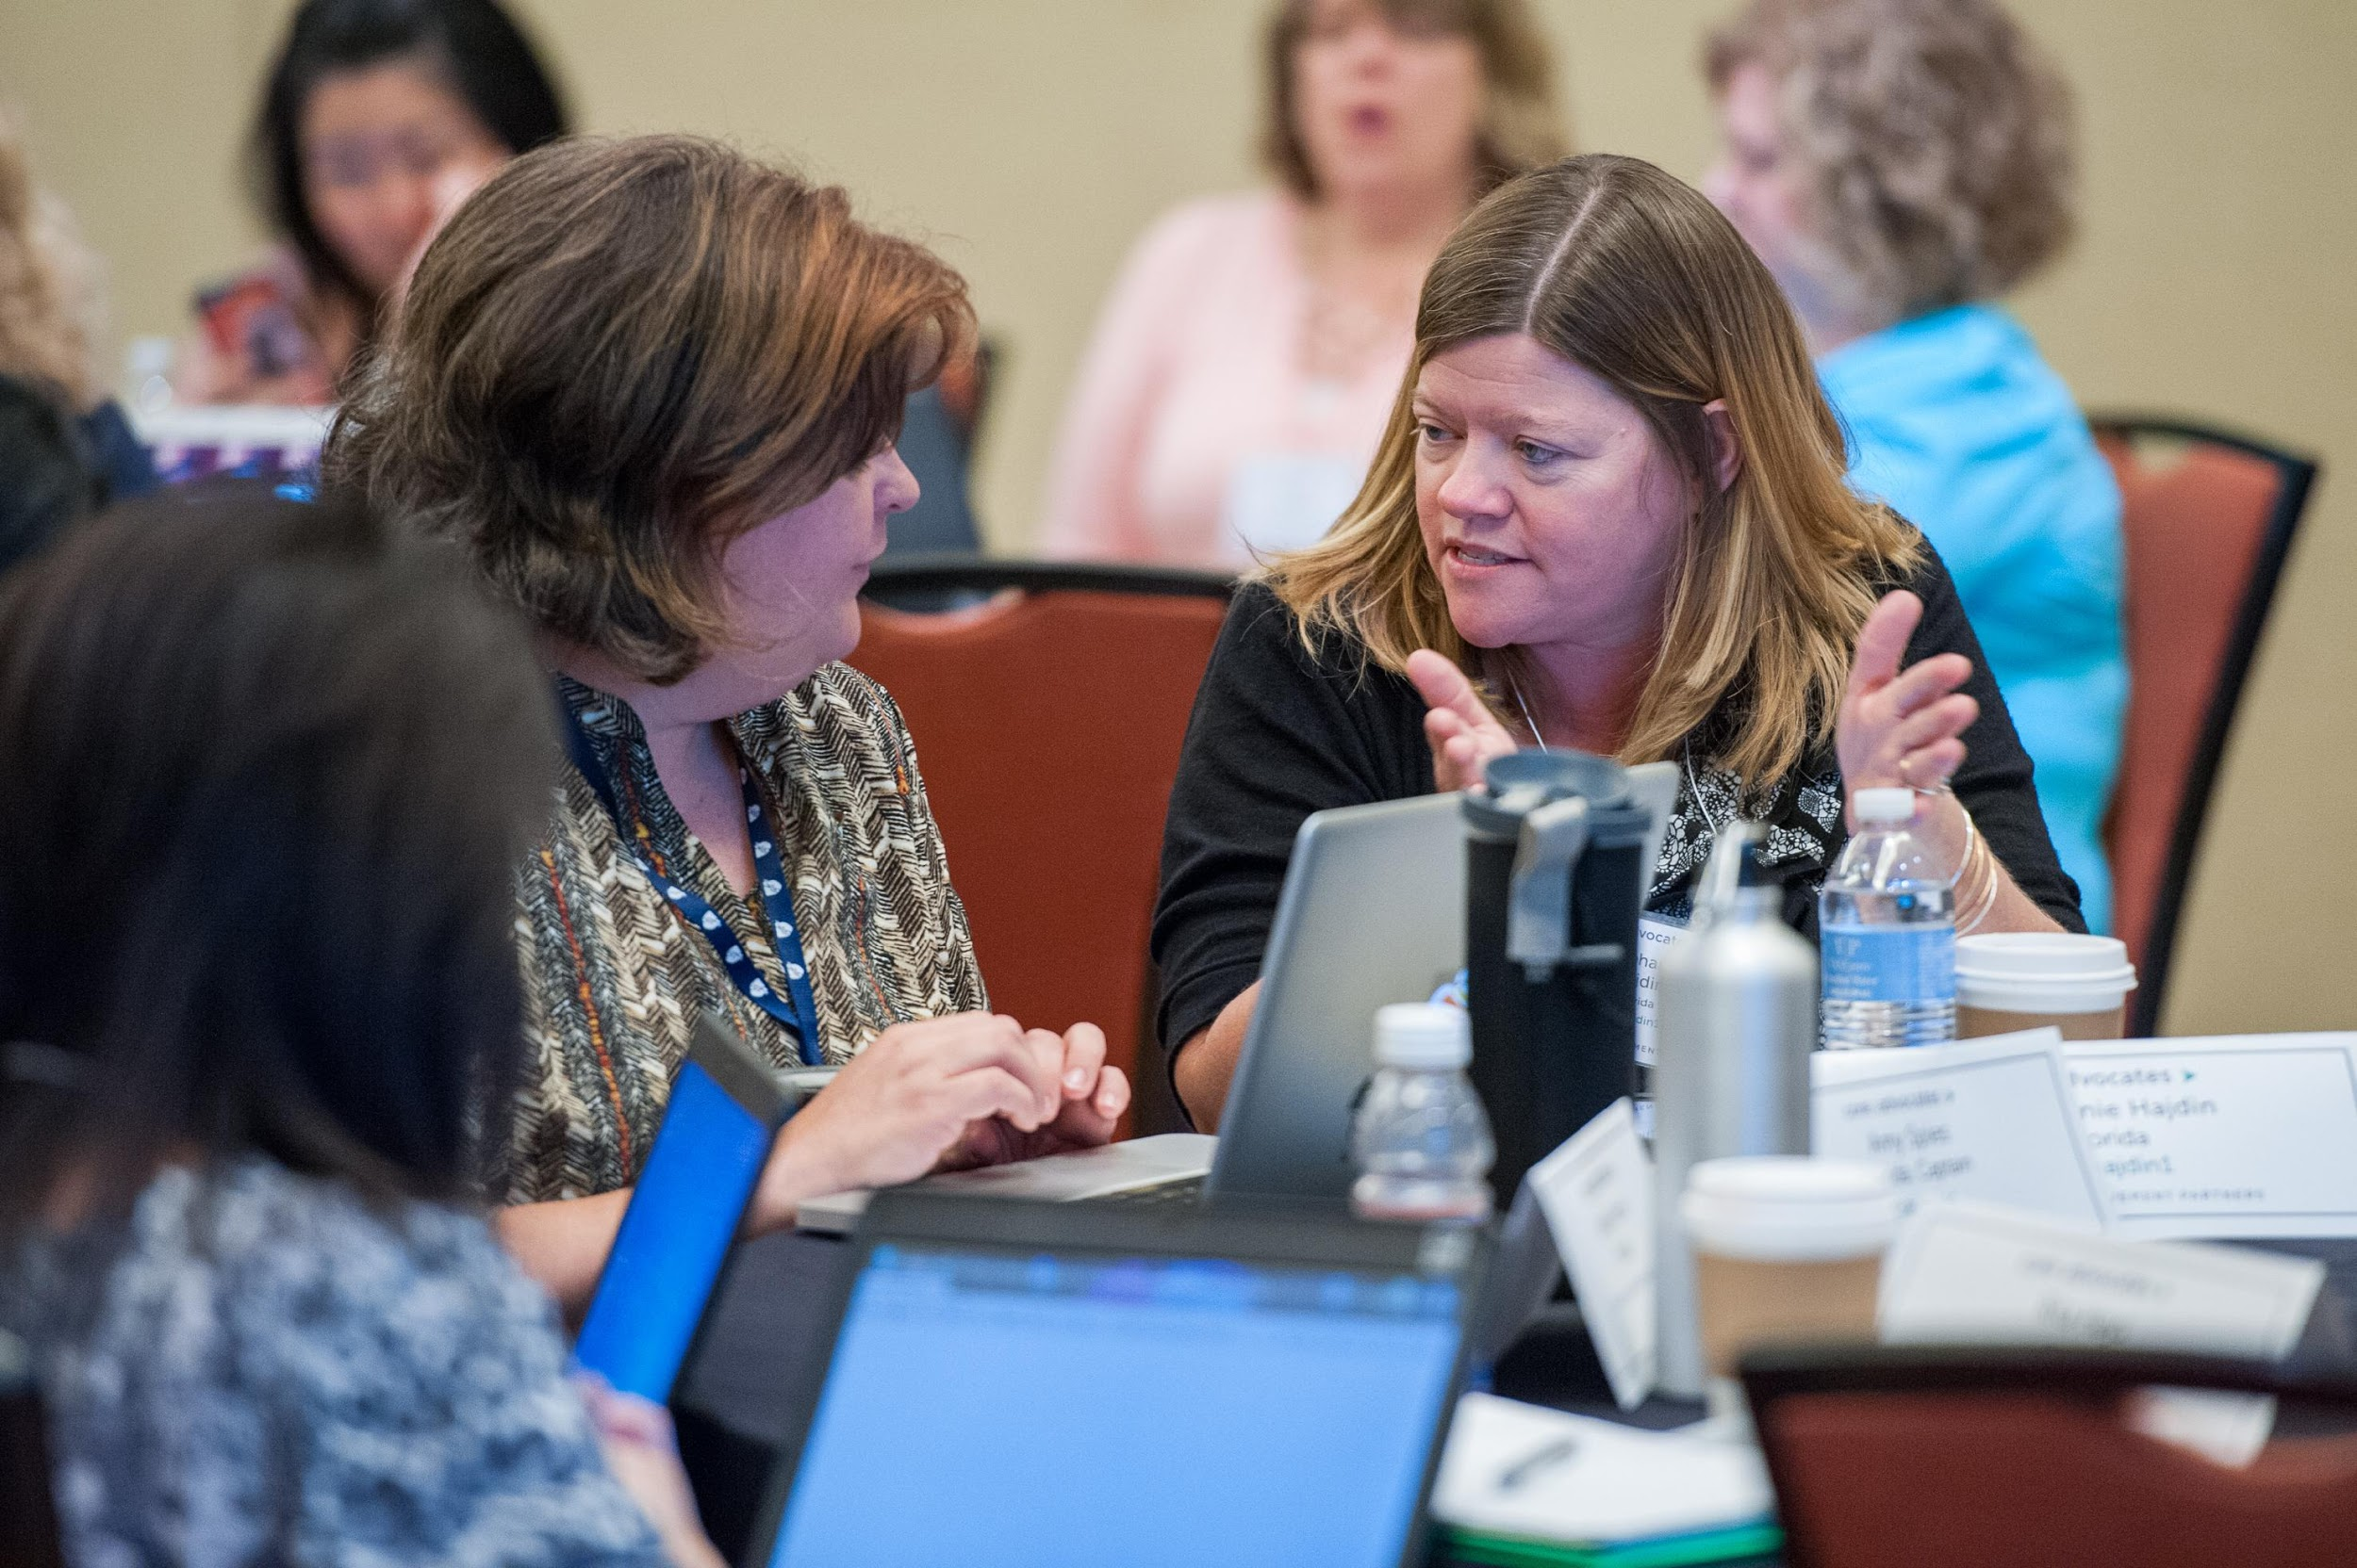
Who are Core Advocates?
Core Advocates are educators who:
Believe in the potential of the CCSS to prepare all students for college and careers;
Are eager to support their colleagues and communities in understanding and advocating for the CCSS and CCSS-aligned instruction;
Understand and embrace the shifts in instruction and assessment required by the CCSS

Slide 4
To learn more about Core Advocates…
Contact Jennie Beltramini (jbeltramini@studentsachieve.net ) or Joanie Funderburk (jfunderburk@studentsachieve.net)
Complete this survey to join our database (and mailing lists): http://bitly.com/joincoreadvocates
Visit our website: www.achievethecore.org

Slide 5
For Tweeters…
Please feel free to tweet during and after the webinar using #coreadvocates
@achievethecore
@JoanieFun, @salberti, @JennieBeltro, @angiegunter, @BarnettPCMSmath

Slide 6
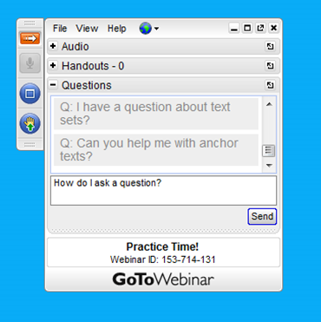
Webinar protocols
During the webinar
– Accessing Documents
– Questions option
– Polling
After the webinar
– Survey
– Access to recorded webinar

Slide 7
Instructional Advocacy – A Definition
Grounded in a firm understanding of the Shifts, educators owning, supporting, and promoting the resources, tools, and practices that create learning environments in which students develop college- and career- readiness.

Slide 8
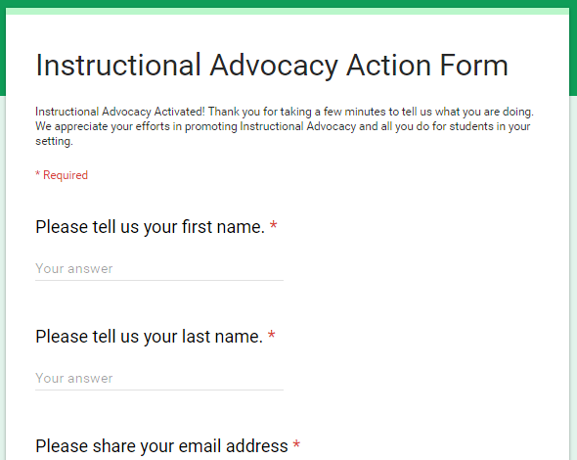
Tell us about your efforts
www.achievethecore.org/educators-taking-action

Slide 9
Goals of the webinar
Goal 1: Learn about great resources available for free online
Goal 2: Learn about how Core Advocates are using these resources in their own classrooms
Goal 3: Share YOUR great classroom tips and tricks and get some new ideas from others

Slide 10
Question: What tips do you have for managing grading and/or giving feedback to students on their homework? Please use the Questions tab on your control panel to respond.

Slide 11
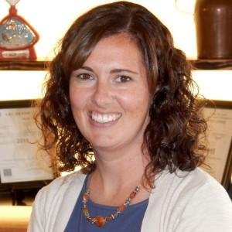
Core Advocate Guest
Tiffany Gruen
2nd grade teacher
please upload a headshot here

Slide 12
Tiffany’s favorite resources

Slide 13
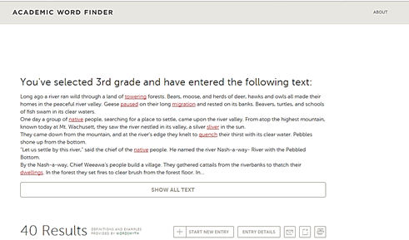
Academic Word Finder
Determines tier 2 words in a complex text
Identifies words as above, below or at grade level
Provides various definitions for contextual application

Slide 14
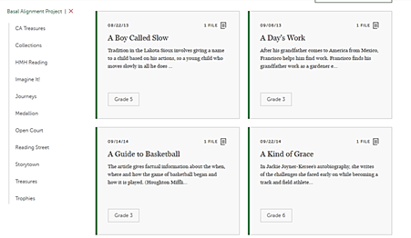
Basal Alignment Project
Teacher-created, standards-aligned lessons developed around existing basal texts
Can search by basal (13 basals included in the project)
Professional learning toolkit to aid in collaboratively designing lessons within a school

Slide 15
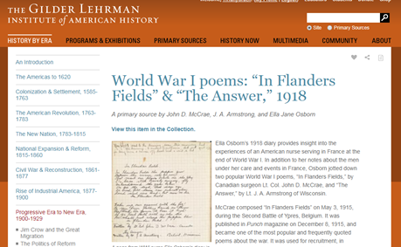
The Gilder Lehrman Institute of American History: Primary Sources
Digital access to primary sources spanning every era in American history
“Questions for Discussion”- utilizing text-dependency and historical context

Slide 16
Question: What structures do you use for effective parent communication?
Please use the Questions tab on your control panel to respond.

Slide 17
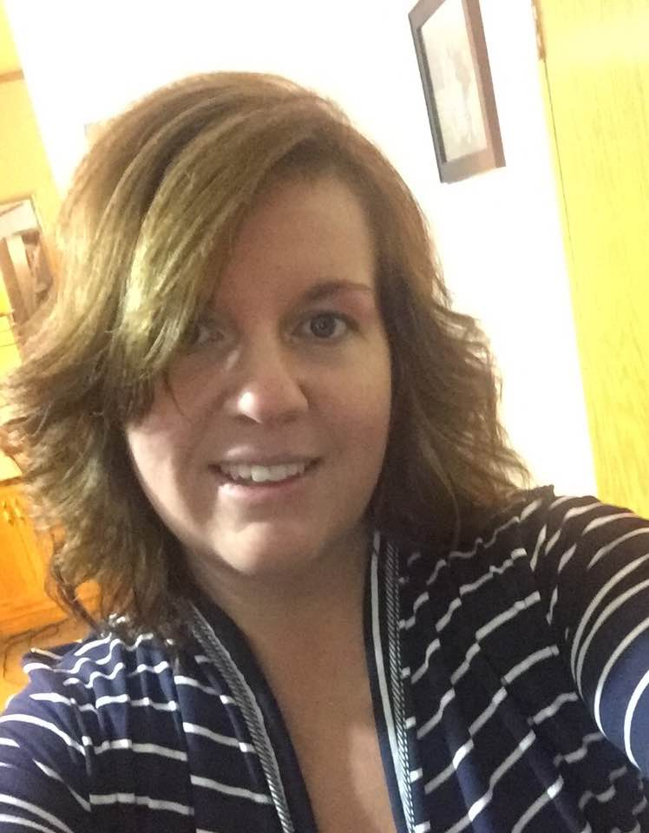
Core Advocate Guest
Stephanie Barnett
8th grade math teacher

Slide 18
Stephanie’s favorite resources

Slide 19
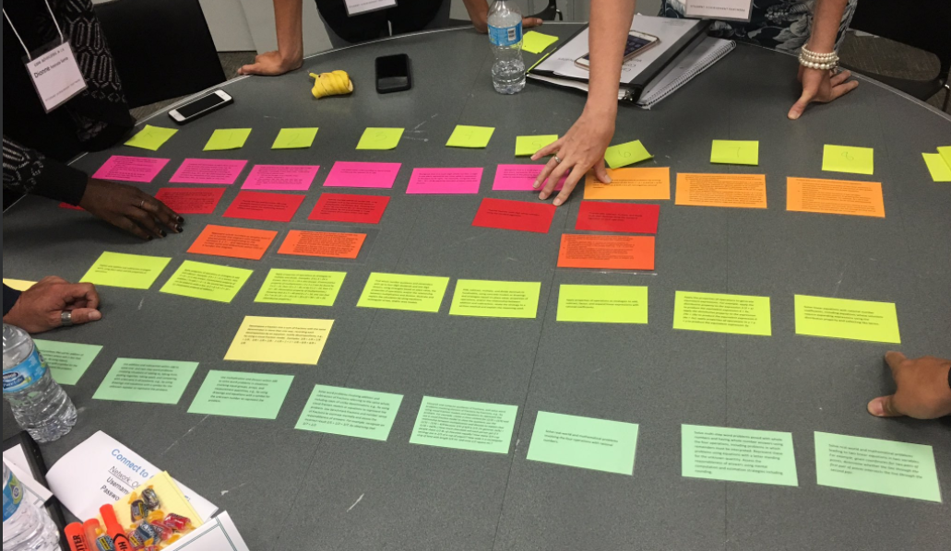
Coherence Map/Card Sort
Identifies the connections through the CCSS for K-8 mathematics/links major topics of grade
Engage educators in uncovering the Math Progressions woven into the Standards
Resource activity to share in district or school PLC or professional development

Slide 20
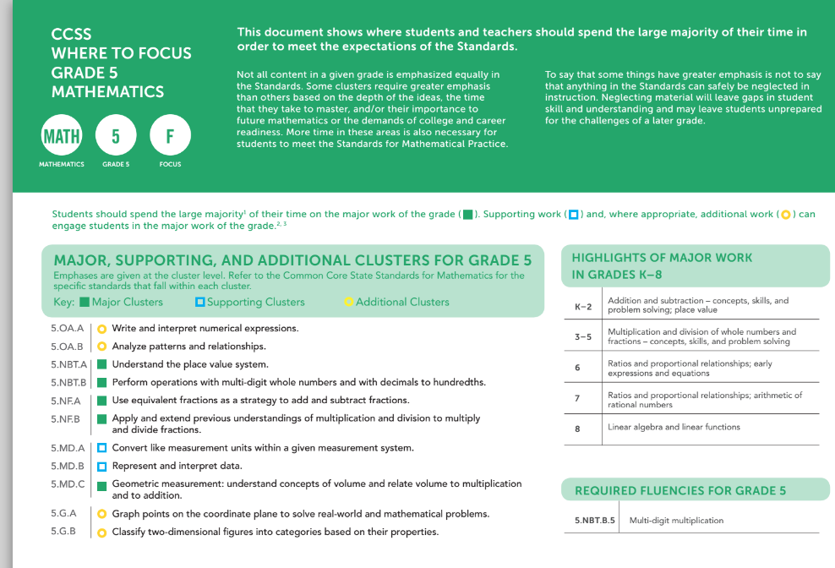
Focus by Grade Level
Identifies the major topics of grade level K-8 mathematics
Provides Supporting and Additional work clusters for each grade
Identifies the major work that teachers should spend 65-85% of time teaching in order for students to meet the expectations of the standards

Slide 21
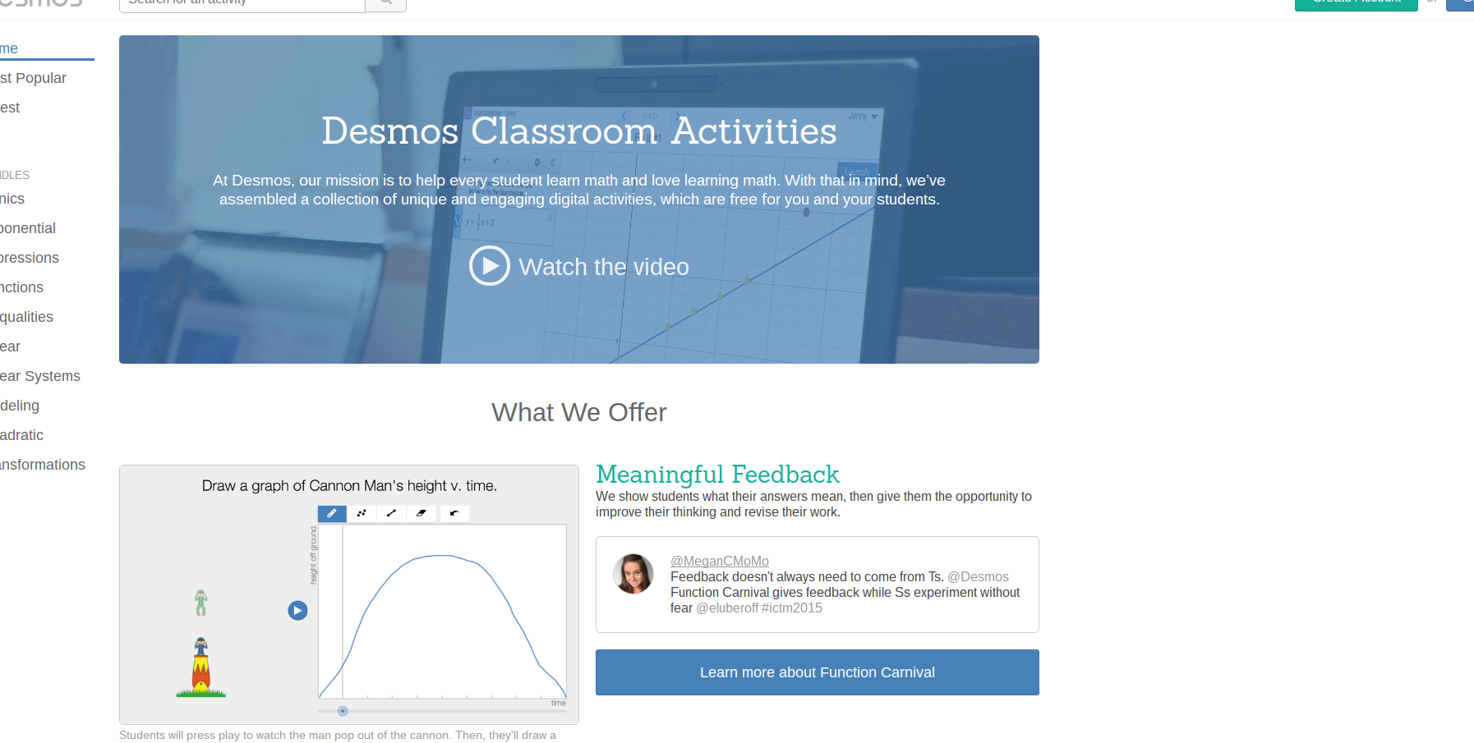
Teacher DESMOS
Access to interactive, digital activities created by DESMOS faculty and teachers that align to CCSS for mathematics
Searchable games/activities to promote problem solving and communication skills
Useful in individual or whole-class instruction, differentiation, or stations

Slide 22
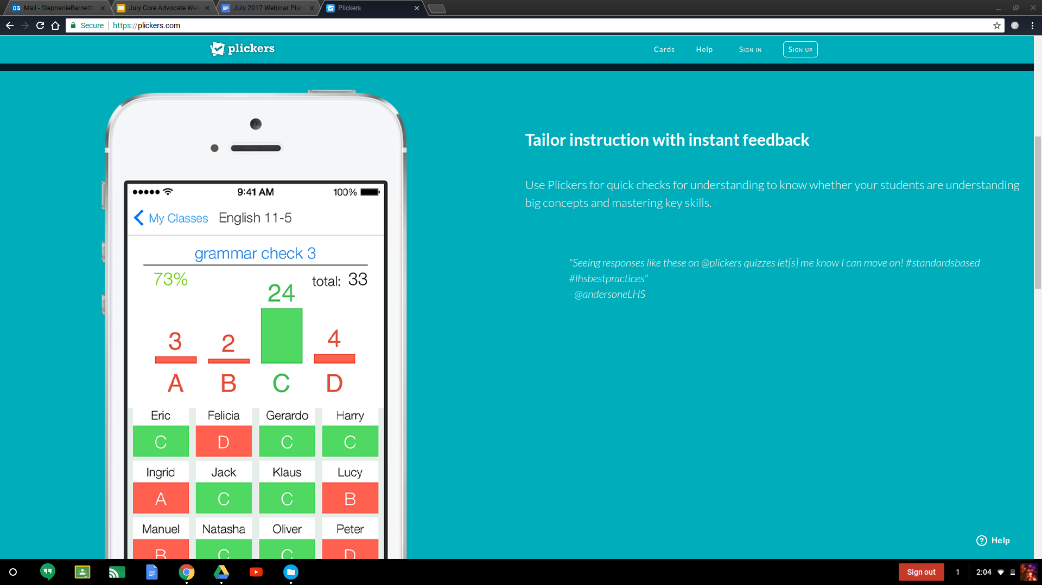
Plickers
Collects real-time feedback on formative assessment data without student devices
A quick check for student understanding on major topics or skills
Provides ALL students an opportunity to think and respond without feeling self-conscious

Slide 23
Question: How do you manage flexible grouping of your students? Please use the Questions tab on your control panel to respond.

Slide 24
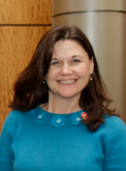
Core Advocate Guest
Angie Gunter
Literacy Specialist

Slide 25
Angie’s favorite resources

Slide 26
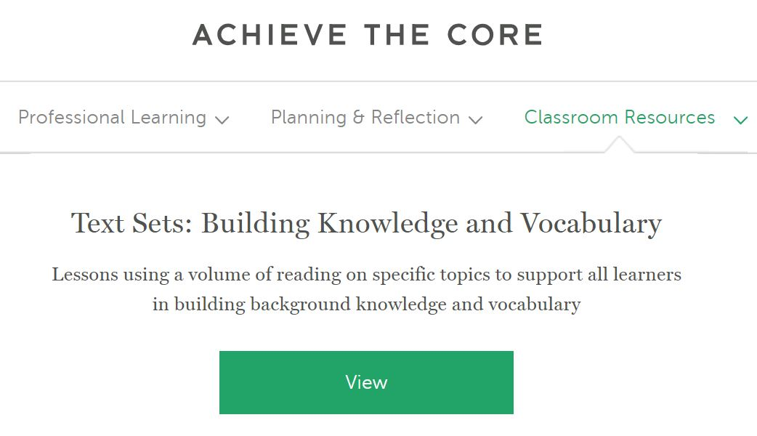
Achieve the Core
Text Sets: Building Knowledge and Vocabulary
Collection of standards-aligned text sets
Various grade levels and topics
Resources to share for professional learning/training

Slide 27
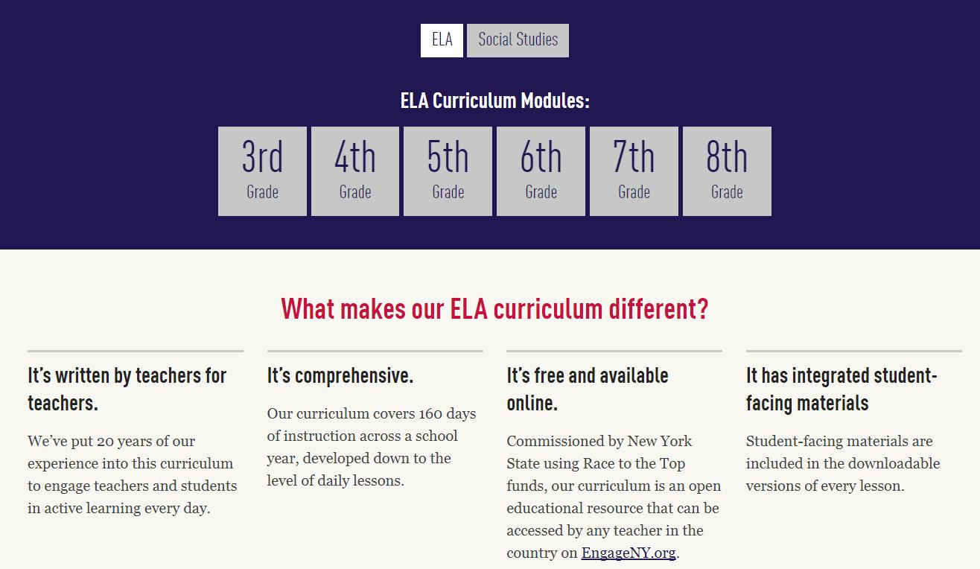
Expeditionary Learning
Complete year-long standards-aligned curriculum
ELA grades 3-8 with models of exemplary student work
Social studies for grades 6 and 9
ELA grades K-5 coming this summer
Videos and resources for professional learning/training

Slide 28
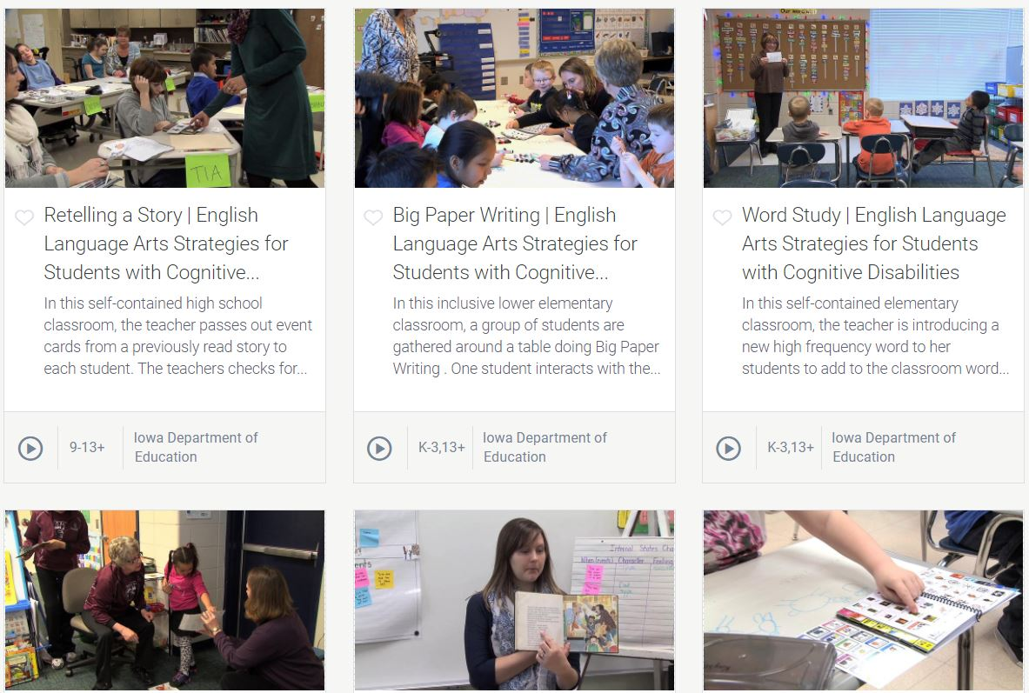
PBS Learning Media
Access to more than 100,000 videos, images, and articles
Searchable by grade level, content topic, and standards
Useful for station learning, flipped classroom model, individualized or whole group instruction

Slide 29
Poll:
What is your favorite Achieve the Core resource?

Slide 30
Questions for our Guests?

Slide 31
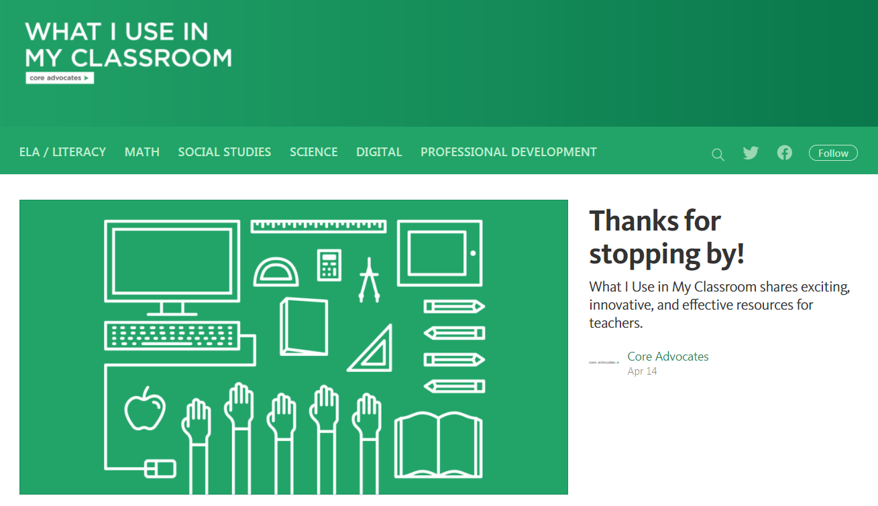
Check out the What I Use in My Classroom website!
https://whatiuseinmyclassroom.org/

Slide 32
Poll:
Which resource shared tonight do you want to use first?

Slide 33
Tell us about your efforts
www.achievethecore.org/educators-taking-action

Slide 34
Please join us again next month!
Next month’s webinar: Impact through Instructional Advocacy
Wednesday, August 2 7:00 - 8:00 pm EDT
Register Here: https://attendee.gotowebinar.com/register/3548001260767819521

Slide 35
Thank You!

Slide 36
Resources
http://achievethecore.org/academic-word-finder/
http://achievethecore.org/category/411/ela-literacy-lessons?filter_cat=696
https://www.gilderlehrman.org/collections
http://achievethecore.org/coherence-map/
http://achievethecore.org/page/400/deep-dive-into-the-math-shifts
http://achievethecore.org/category/774/mathematics-focus-by-grade-level
https://teacher.desmos.com/
https://plickers.com/
http://achievethecore.org/category/411/ela-literacy-lessons?filter_cat=1112
https://eleducation.org/
https://www.pbslearningmedia.org/

