Slide 1
Reviewing Using the Instructional Materials Evaluation Tool: Mathematics
Module 103: Standards for Mathematical Practice and Access for All Students (AC 2 and 3)
www.achievethecore.org

Slide 2
Essential Questions
How does the Instructional Materials Evaluation Tool (IMET) reflect the major features of the Standards and the Shifts?
What understandings support high-quality, accurate application of the IMET metrics?
Notes:
Big Idea: Share essential questions and frame the session.
Depending on how the modules are delivered, this slide may be used to have participants reflect on what they have learned so far, or just reviewed quickly to remind participants of the purpose of the work.
Talking Points:
These questions will be guiding our thinking as we work through all of the modules. We will come back to reflect on them at the end of each module.
In the modules, we are digging into what the Standards and Shifts look like in instructional materials – the IMET is the tool to help us to do it.
To use the tool accurately, we need to bring our knowledge and understanding of CCSS, and think about how our own understandings get applied through a new lens.
It is important to set aside personal style or preference when teaching the materials. The goal of the IMET is not to find your perfect match in terms of your own teaching style; it is a fairly legalistic and bureaucratic task on whether or not the materials reflect these high level shifts.

Slide 3
Goals
Understand how aligned materials embody the shifts inherent in the Common Core State Standards
Understand the precise meaning of each metric of the IMET
Recognize examples and non-examples related to each metric of Alignment Criteria 2 and 3
Notes:
Big Idea: Share goals of the session.
Talking Points:
The goals outline what participants will know and be able to do at the end of this module.
As the goals imply, engaging in this process is a constant cycle of learning. What we know about the CCSS informs how we look at the IMET; what we learn about the IMET deepens our understanding of CCSS.

Slide 4
Alignment Criterion 2:
Standards for Mathematical Practice

Slide 5
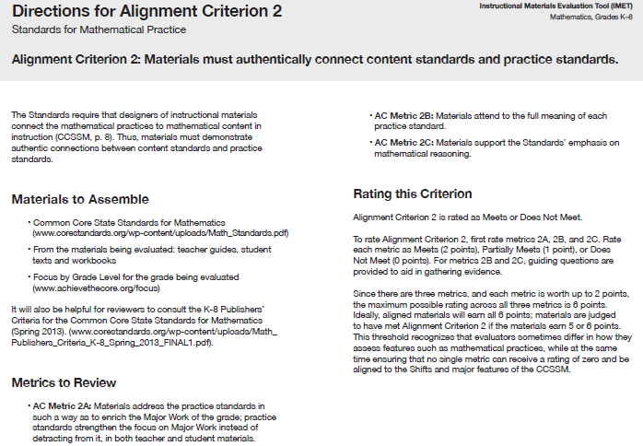
Standards for Mathematical Practice
Alignment Criterion 2: Materials must demonstrate authentic connections between content standards and practice standards.
IMET p. 25
Notes:
Big Idea: Introduce Alignment Criterion 2 and the associated metrics.
Talking Points:
We are starting out by looking at the second Alignment Criterion – Standards for Mathematical Practice.
This metric addresses a major feature of the Standards and it is an alignment criterion because the metrics have more room for interpretation by reviewers.
This criterion has three metrics, and some of the metrics have associated questions to help reviewers collect evidence and make a decision about the rating, just as in Alignment Criterion 1.

Slide 6
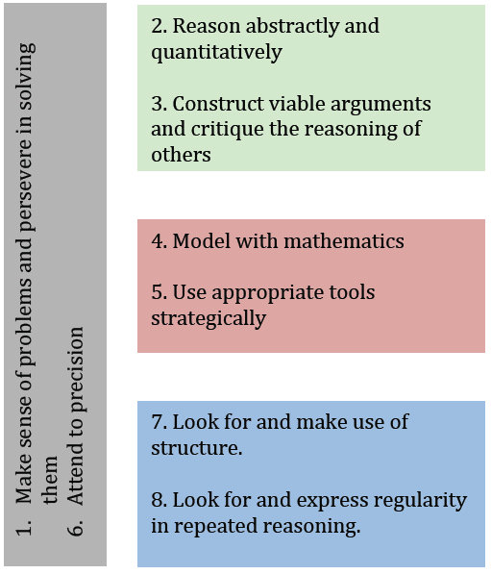
Not uniformly applied over all the work that students do
Not intended as free-floating proficiencies
Handout p. 2
Notes:
Big Idea: Review the Standards for Mathematical Practice and see how they can be grouped to better understand connections among them.
Talking Points:
In the Standards document, the Standards for Mathematical Practices (SMP) are defined as “describe[ing] varieties of expertise that mathematics educators at all levels should seek to develop in their students.”
One big misconception that teachers have about the SMPs is that students should be engaging in all of the SMPs at all times in a math classroom. Although there is not always one specific MP aligned to a specific problem or activity, materials should be utilizing the SMPs strategically in the design of lessons and problems. (It is a red flag if you see most MPs in every lesson or one lesson aligned to each MP is any given unit.)
A related caveat from Standards author Bill McCallum: “If you think about it long enough you can associate just about any practice standard with any content standard, but this sort of matrix thinking can lead to a dilution of the force of the practice standards—if you try to do everything all the time, you end up doing nothing.”
This graphic, created by McCallum, provides a helpful way of thinking about how the SMPs pair together.
Both MP.1 and 6 are overarching habits that need to be infused in many lessons throughout the year.
The other pairs show SMPs that support each other and will often make sense to connect with the same content.
None of the SMP are intended to be free-floating proficiencies; they should always be tied to content standards.
Graphic and commentary available here: http://commoncoretools.me/2011/03/10/structuring-the-mathematical-practices/

Slide 7
Standards for Mathematical Practice
  In K-8, practice standards are embedded within the content standards, in addition to being a separate list of expectations
    4.NBT.A.1 Recognize that in a multi-digit whole number, a digit in one place represents ten times what it represents in the place to its right. For example, recognize that 700 ÷ 70 = 10 by applying concepts of place value and division.
  Intentional connections between practice and content standards
  Content standards increase in complexity over the course of the grades, so should the MPs
Notes:
Big Idea: The Standards for Mathematical Practice are deeply connected with the Standards for practice.
Talking Points:
Although the Standards document includes the Standards for Mathematical Practice (SMPs) as a separate list, they are also baked into the content standards. In any grade K-8, if instructional materials meet the full intent of all the content standards, students would have necessarily engaged and developed their proficiency with each of the SMPs.
This does not mean that instructional materials should not explicitly attend to the SMPs; however, it does mean that the SMPs should always be present as designed within the Standards – as a way to deepen student understanding and engagement with the content.
To see what this means, let’s look at an example of a grade 4 standard.
<Give participants time to read the standard and discuss which SMPs may be required to reach the full depth of this standard.> <2 minutes>
This content standard has MP.7 -- Look for and make use of structure – embedded within it.
4.NBT.A.1 requires students to think about the structure of the place value system and use that structure to do calculations with multiples of tens.
Participants may come up with connections to other SMPs. Be sure they are providing specific evidence to how those SMPs are required for students to understand the content required in this Standard.
The SMPs are the same every year from K-12. Because of that, each year of instruction provides an opportunity for teachers to help students further develop their ability to use the SMPs. Just as the content standards grow in complexity, so do the SMPs, which means that we should see this reflected in instructional materials.

Slide 8
Standards for Mathematical Practice
AC Metric 2B: Materials attend to the full meaning of each practice standard.
IMET p. 27
Notes:
Big Idea: Introduce AC Metric 2B.
Talking Points:
We are starting out by looking at the second metric under Alignment Criterion 2.
Reviewers find it is easier to start with metric 2B because it allows for the opportunity to really dig deeply into how instructional materials are dealing with the SMPs. So, we’re going to be looking at the metrics for Alignment Criterion 2 slightly out of order.
Just like the metrics in Alignment Criterion 1, this metric has three questions to help reviewers gather evidence that will lead to the overall rating of the metric.

Slide 9
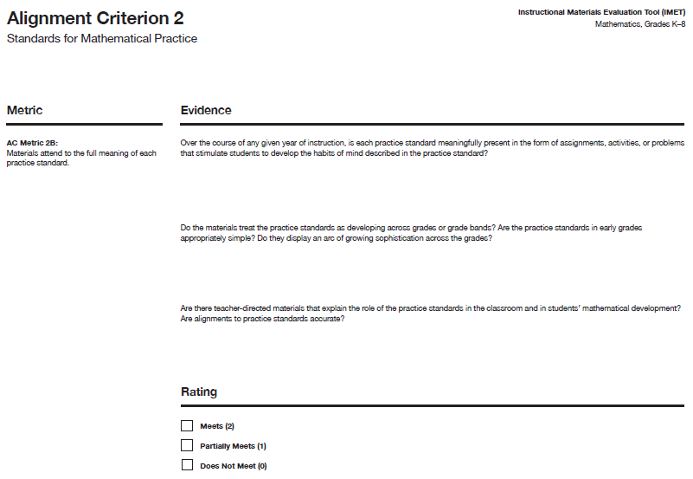
IMET p. 28
Notes:
Big Idea: Show AC Metric 2B with the associated questions.
Talking Points:
In the IMET, you have space to write evidence for each of the questions related to AC Metric 2B. <Read questions.>

Slide 10
2B: Materials attend to the full meaning of each practice Standard.
MP.1 does not say, “Solve problems.”
  or “Make sense of problems.”
  or “Make sense of problems and solve them.”
It says “Make sense of problems and persevere in solving them.”
Notes:
Big Idea: Define what it means to attend to the full meaning of SMPs.
Talking Points:
The SMPs are important to developing the mathematical habits of mind that students need to be powerful mathematical thinkers. To do this, materials need to attend to the full meaning of the SMPs over the course of the year.
For example, MP.1 – Make sense of problems and persevere in solving them doesn’t mean do problems or just solve problems, but for students to have opportunities to solve grade-level-appropriate problems that they need to make sense of and that requires them to persevere to a solution beyond the point when they would like to give up. Materials need to give students opportunities to engage in the full meaning of the practice standards. It is important to note that meeting the full meaning of MP.1 doesn’t mean that every problem students encounter needs to require perseverance. When looking at a whole year worth of materials, reviewers should make sure there are repeated meaningful opportunities to engage in problems that require perseverance throughout the materials.
Similarly, MP. 5: Use appropriate tools strategically doesn’t mean simply “use a calculator,” nor does it mean that students are given manipulatives to solve a problem.

Slide 11
What Is the Full Meaning of Each Practice Standard?
Jigsaw: Elaborations for Standards for Mathematical Practice
Do a close reading of your pair of MPs. Underline important words in the text.
At your table, discuss the big ideas of the pair of MPs.
Create a group with one person from each table and share the important ideas of each MP.
Notes:
Big Idea: Use the Illustrative Mathematics’ Elaborations to understand the full depth of the SMPs.
See Facilitator’s Guide for more information on how to set up this activity.
Talking Points:
Illustrative Math has published elaborations on the SMPs for each grade band K-5 and 6-8. We are going to do a jigsaw to learn more about each of the SMPs which will help as you evaluate the metrics of Alignment Criteria 2. Be sure to take notes on each SMP so that you can refer back to them as you are reviewing instructional materials.
<Have participants engage in a jigsaw activity that allows them to discuss a pair of SMPs in-depth and then share them with others.> <15 minutes>
K-5 Elaboration: http://commoncoretools.me/wp-content/uploads/2014/02/Elaborations.pdf
6-8 Elaboration: http://commoncoretools.me/wp-content/uploads/2014/05/2014-05-06-Elaborations-6-8.pdf

Slide 12
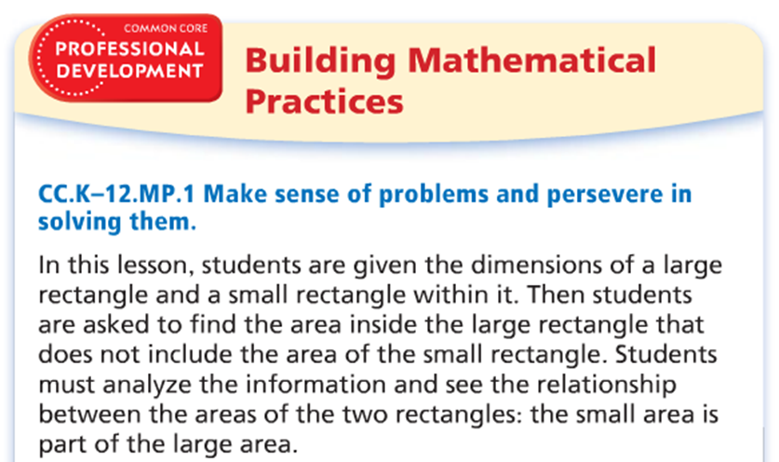
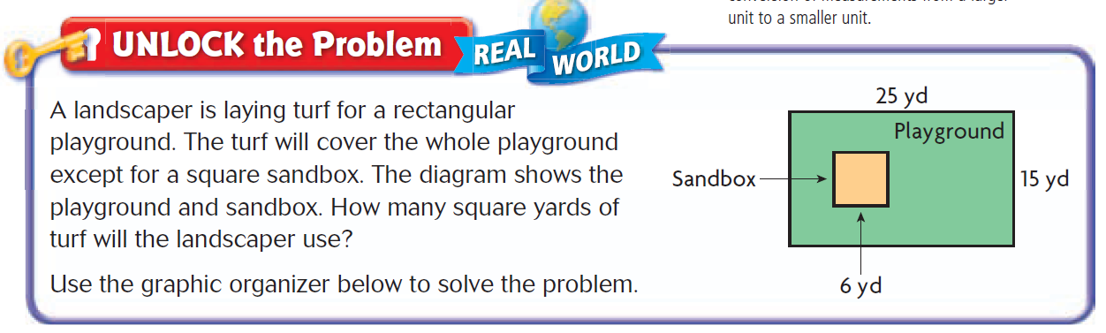
  AC 2B: Over the course of any given year of instruction, is each mathematical practice standard meaningfully present in the form of assignments, activities, or problems that stimulate students to develop the habits of mind described in the practice standard?
IMET p. 28
Handout p. 3
Notes:
Big Idea: Some materials will describe how students should be engaging in the MPs accurately, but that doesn’t always translate to what students are actually doing.
Talking Points:
We are going to start looking at some examples through the lens of the questions associated with AC Metric 2B. The first question used to gather evidence is: “Over the course of any given year of instruction, is each mathematical practice standard meaningfully present in the form of assignments, activities, or problems that stimulate students to develop the habits of mind described in the practice standard?”
This is an example of a description from a grade 4 book of how students will engage in MP.1 and the problem that follows.
<Give participants a chance to read the description and review the problem and discuss whether the materials are meeting the full meaning of MP.1.> <5 minutes>
Based on the description, it seems like the problem described may allow students to engage with MP.1.
However, when you look at the actual student work, the question is so scaffolded that it is hard to imagine a student having to persevere to solve the problem (unless we consider having to fill in all those blanks to get to an answer persevering).
While the problem on its own could be a good one for allowing students to make sense and persevere in solving it, the amount of scaffolding provided takes that away from students.
This doesn’t mean that students should never have scaffolding in problems they are working on. However, if the materials are intending for students to engage in MP.1, they cannot have this kind of scaffolding. For instance, if students were just provided with the guiding questions in bold (What do I need to find?/What information do I need to use?, etc.) without the fill-in-the-blank sentences, they would have support in developing the habit of mind required by MP.1.
Note: Just like with all of our examples, one question like this in materials doesn’t mean that these materials would not meet the metric. Reviewers need to look at how the SMPS are developed across many lessons and student materials to gather evidence that will allow them to make a holistic decision about the materials for each metric.

Slide 13
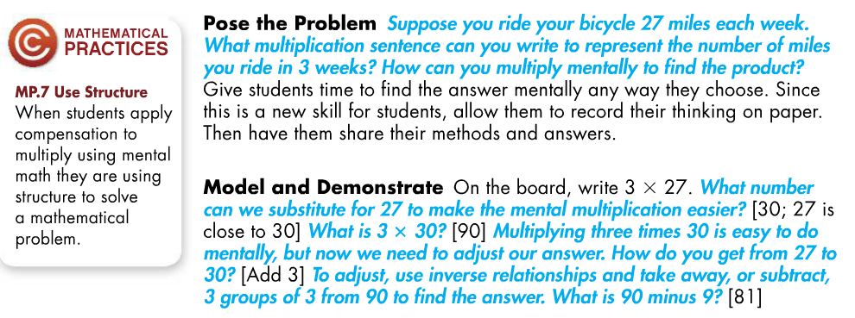
  AC 2B: Are there teacher directed materials that explain the role of the practice standards in the classroom and in students’ mathematical development? Are alignments to practice standards accurate?
IMET p. 28
Handout p. 4
Notes:
Big Idea: Show an example of embedded support for teachers that will aid them to enact SMPs in the classroom.
Talking Points:
The second question used to gather evidence is: “Are there teacher directed materials that explain the role of the practice standards in the classroom and in students’ mathematical development? Are alignments to practice standards accurate?”
This is an excerpt from a lesson in a grade 4 book focusing on multi-digit multiplication.
<Give participants an opportunity to read the excerpt and discuss whether it provides support for teachers to understand the role of the practice standards in the classroom and in students’ mathematical development. Participants may want to refer to the Elaboration document.> <4 minutes>
Although this is just a brief excerpt, they have provided an explanation of how the targeted SMP allows students to engage with the mathematical content of the lesson. Participants may note that this excerpt aligns better to MP.8, which makes sense because MP.7 and MP.8 are so closely related.
The questions provided in the lesson allow teachers to probe students on the structure and how it can support their content work. However, they may not be explicit enough for teachers to understand what the practice should look like in the classroom.
To really evaluate the metric, we would want to see whether there was other information provided to teachers on the role of each practice in the classroom.
Note: Just like with all of our examples, one part of a lesson like this in materials doesn’t mean that these materials would meet the metric. Reviewers need to look at how the SMPS are supported across the teacher materials to gather evidence that will allow them to make a holistic decision about the materials for each metric.

Slide 14
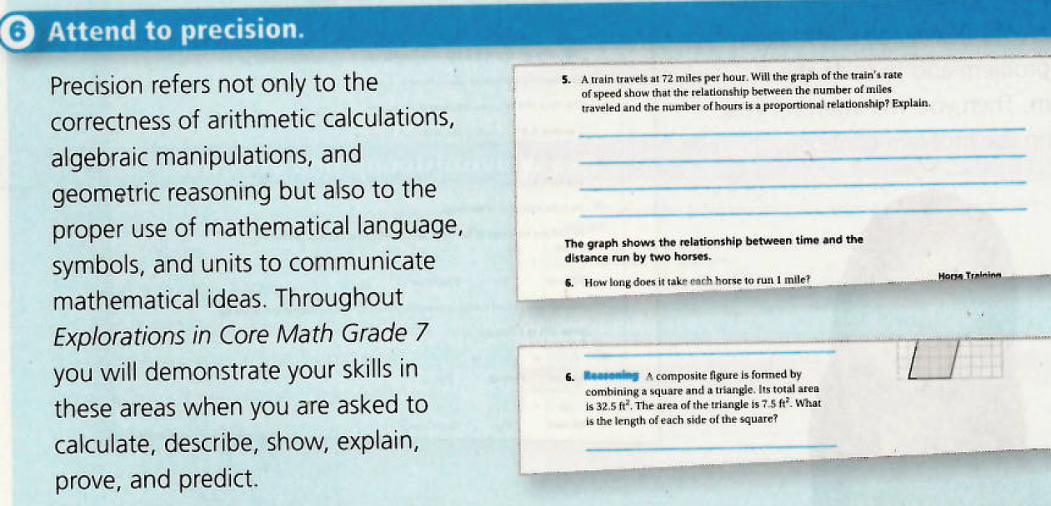
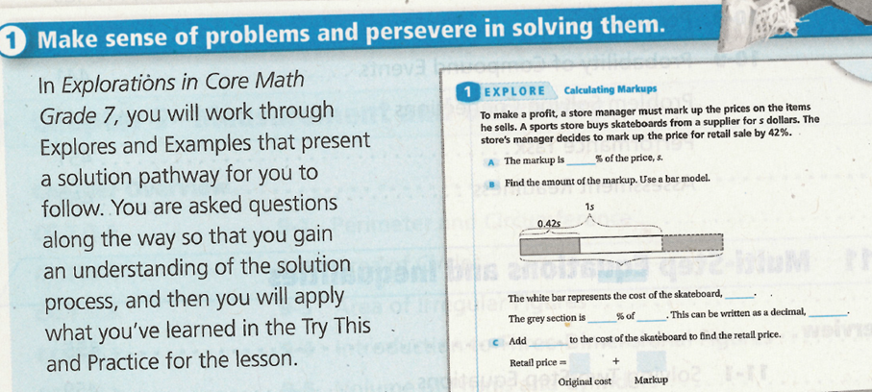
AC 2B: Are there teacher directed materials that explain the role of the practice standards in the classroom and in students’ mathematical development? Are alignments to practice standards accurate?
IMET p. 28
Handout p. 5
Notes:
Big Idea: Contrast two examples of alignment to MPs – one that is accurate and one that is not.
Talking Points:
For this example, we are going to zoom in on the second part of this question: “Are alignments to practice standards accurate?”
Although these excerpts are student-facing, they still provide explanation to teachers about what the MP should look like. There is one alignment that is accurate and one that is not.
<Give participants an opportunity to read the excerpts and discuss which one accurately describes the practices. Participants may want to refer to the Elaboration document.> <3 minutes>
This explanation of MP.6 is a good starting point to describing the multiple ways that students need to be precise in their mathematical work. (Some instructional materials tend to only define MP.6 as being about students getting the right answers.)
The explanation of MP.1 doesn’t seem to be accurately describing what students should be doing for MP.1. The process being described is very scaffolded, with students being expected to copy a method that is shown to them rather than having the opportunity to authentically solve problems. If it comes up, this excerpt is from a grade 7 book.
Many times when we are reviewing, we will find examples and non-examples in the same set of reviewers. This means we need to keep digging into the materials to be able to rate it holistically. In this case, we would want to look at some of the lessons and activities identified with each of the MPs to see whether there is support provided for the teacher to understand the role of the practice standards in the classroom.
Note: Just like with all of our examples, seeing this in materials doesn’t mean that these materials would meet the metric. Reviewers need to look at how the SMPs are identified throughout the teacher materials to gather evidence that will allow them to make a holistic decision about the materials for each metric.

Slide 15
  AC 2B: Do the materials treat practice standards as developing across grades or grade bands? Are the practice standards in early grades appropriately simple? Do they display an arc of growing sophistication across the grades?
Read and solve the 4 problems provided.
Match each problem to one of the standards listed at the top of the page.
Discuss with your group:
  What kind of modeling is required for each problem?
  How does modeling grow in sophistication from K-4?
Handout p. 6
Notes:
Big Idea: Look at how the expectation for MP.4 develops across grades.
Talking Points:
The last set of questions used to gather evidence for AC Metric 2B is: “Do the materials treat practice standards as developing across grades or grade bands? Are the practice standards in early grades appropriately simple? Do they display an arc of growing sophistication across the grades?”
In this activity, you will get an opportunity to see how a specific Mathematical Practice – MP.4 – grows in complexity across grades. Solve the problems and then match them with the corresponding standard to sequence them across grades. Once you’ve done that, talk with your group about the discussion questions that are posted.
<Give participants a chance to solve the problems, sequence them, and discuss how the complexity of modeling grows across grades.> <12 minutes>
Problems are not intended to show “this is the grade where this kind of modeling first appears” but rather to represent the kinds of problems that students should gradually see more of in later grades and fewer of in earlier grades
Going clockwise from the upper left, the problems represent 3.OA.A.3, 1.OA.A.2, K.OA.A.1 and 4.OA.A.3.
The problems show a growing sophistication in how students use equations to represent increasingly complex problems from K-4, incorporating their understanding of the relationships between operations and the meaning of operations to see that there are sometimes multiple equations that could be used to represent the same situation in the grade 4 example.

Slide 16
Standards for Mathematical Practice
AC Metric 2A: Materials address the practice standards in such a way as to enrich the Major Work of the grade; practice standards strengthen the focus on Major Work instead of detracting from it, in both teacher and student materials
IMET p. 26
Notes:
Big Idea: Introduce AC Metric 2A and describe how SMPs connect to the shift of Focus.
Talking Points:
We are going to jump back to the first metric under Alignment Criterion 2.
This is the only metric in this criterion that does not have related questions.
This metric ensures that instructional materials are not looking at Focus and the SMPs as completely separate ideas. They work together. By focusing on the Major Work of the grade, we are able to go deeper into the content and, as students are engaging deeply in the content of the grade level, they should also be engaging in the SMPs.

Slide 17
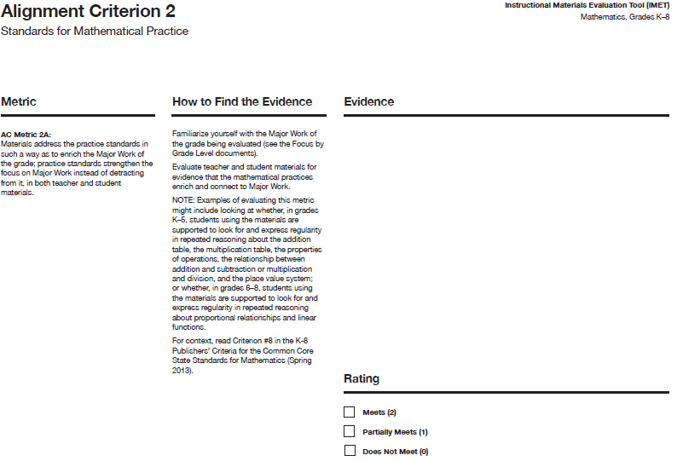
IMET p. 26
Notes:
Big Idea: Show AC Metric 2A.
Talking Points:
AC Metric 2A is the only metric in this criterion without associated questions.

Slide 18
2A: Connecting Content and Practice
  “Designers of curricula, assessments, and professional development should all attend to the need to connect the mathematical practices to mathematical content in mathematics instruction.” (CCSSM, p. 8)
Notes:
Big Idea: Reinforce the idea that the point of the SMPs is to enhance student understanding of the content – no practices for practice’s sake!
Talking Points:
Although we have two distinct lists of standards (Standards for Mathematical Content and Standards for Mathematical Practice), they can’t be addressed separately. The Standards issue a call to connect these two lists on page 8.
<Ask participants why the word “connect” is in red in the quote.>
Instructional materials should not have lessons on content and separate lessons on SMPs. They need to be interwoven throughout the materials.
A good example of this is MP.3: Construct viable arguments and critique the reasoning of others. We would not want to see a series of lessons that focuses on having students explain and justify repeating patterns in early elementary grades because this is content that is not part of the Standards.
Materials can't do what was traditionally done in the past and teach a bunch of procedures, then throw in a couple of problems at the end that require sense making and perseverance. Content and practices must be interwoven.

Slide 19
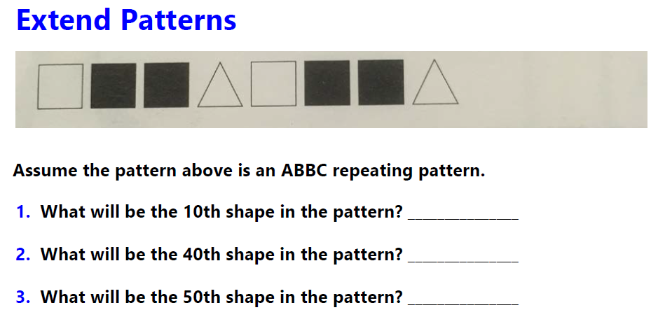
AC 2A: Materials address the practice standards in such a way as to enrich the Major Work of the grade; practice standards strengthen the focus on Major Work instead of detracting from it, in both teacher and student materials
IMET p. 26
Handout p. 7
Notes:
Big Idea: Show an example of materials that use the MPs to strengthen the focus on Major Work of the grade.
This example should also illustrate that reviewers need to look closely to understand the intent of the book before making judgements.
Talking Points:
Let’s take a look at an excerpt from a grade 4 book.
<Give participants an opportunity to read the problem on the slide and discuss whether it enhances the focus on Major Work of the grade. Participants will most likely answer that it does not because it is working with repeating patterns. Have participants read the full excerpt of this lesson in the participant packet, and have them discuss whether this changes their opinion about how this example meets metric AC 2A.> <2 minutes to discuss the slide/5 minutes to look at full excerpt>
At first glance, this work does not seem as though it is deepening students’ understanding of the Major Work of the grade. However, in looking at the discussion questions provided for the teacher, you can see that students are engaging with interpreting remainders (4.OA.A.3) and looking for and using structure (MP.7).
Although this initially doesn’t seem to be meeting the metric, reading the teacher-facing materials closely allows us to see how MP.7 is being used to deepen students’ ability to interpret remainders. We need to be sure to thoroughly investigate materials before simply dismissing them as being unaligned.
Note: Just like with all of our examples, one part of a lesson like this in materials doesn’t mean that these materials would meet the metric. Reviewers need to look across the teacher materials to gather evidence that will allow them to make a holistic decision about the materials for each metric.

Slide 20
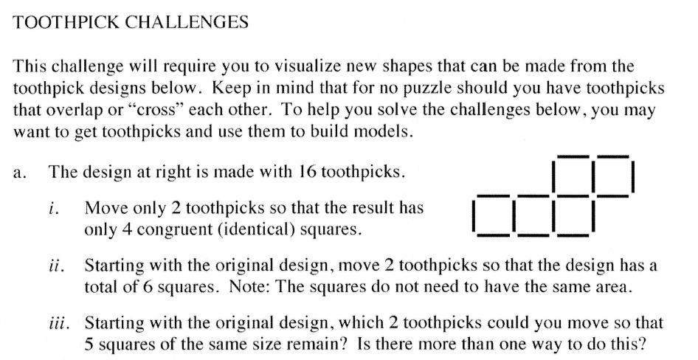
AC 2A: Materials address the practice standards in such a way as to enrich the Major Work of the grade; practice standards strengthen the focus on Major Work instead of detracting from it, in both teacher and student materials
IMET p. 26
Handout p. 8
Notes:
Big Idea: Show an example of materials that do not use the MPs to strengthen the focus on MajorWork of the grade.
Talking Points:
Let’s take a look at a problem that is not using the MPs to deepen understanding of grade-level content.
<Give participants an opportunity to read problem and discuss why it doesn’t meet the metric.> <3 minutes>
This is a really interesting problem and would probably be fun for kids to solve. Although it would require them to make sense and persevere through the problem, it is not related to the Major Work (or really any work) of grade 4.
If materials choose to include problems like this, they should be few and far between with the majority of work connecting MPs to content.
Note: Just like with all of our examples, one problem like this in materials doesn’t mean that these materials would not meet the metric. Reviewers need to look across the teacher materials to gather evidence that will allow them to make a holistic decision about the materials for each metric.

Slide 21
Standards for Mathematical Practice
AC Metric 2C: Materials support the Standards’ emphasis on mathematical reasoning.
IMET p. 29
Notes:
Big Idea: Introduce AC Metric 2C.
Talking Points:
The last metric for AC 2 deals with how reasoning is addressed in materials.
Just like metric 2B in this criterion, this metric has three associated questions to help reviewers gather evidence that will lead to the overall rating of the metric.

Slide 22
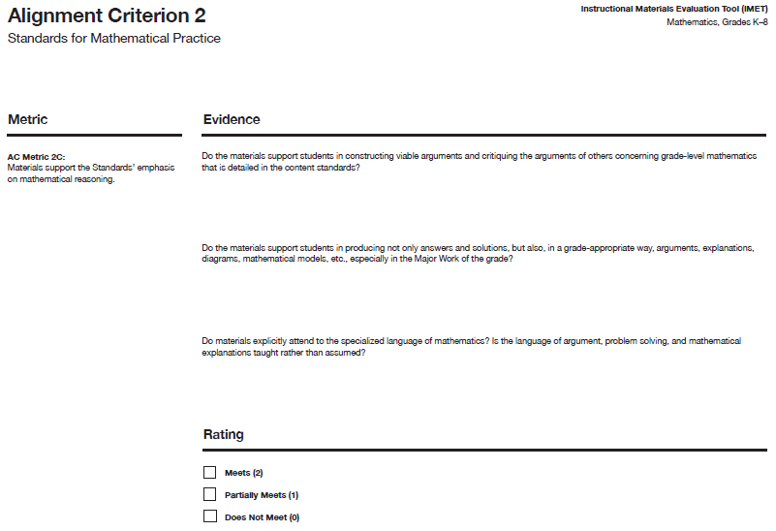
IMET p. 30
Notes:
Big Idea: Show AC Metric 2C with the associated questions.
Talking Points:
In the IMET, you have space to write evidence for each of the questions related to AC Metric 2C. <Read questions.>

Slide 23
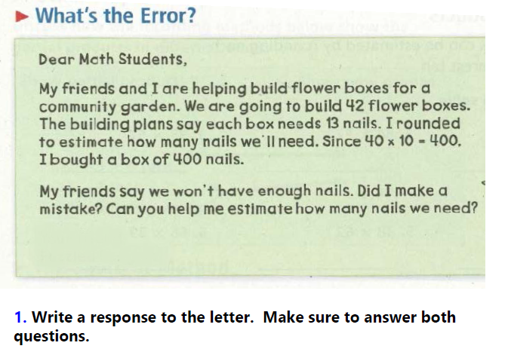
AC 2C: Do the materials support students in constructing viable arguments and critiquing the arguments of others concerning grade-level mathematics that is detailed in the content standards?
IMET p. 30
Handout p. 9
Notes:
Big Idea: Look at an example of a problem that ask students to construct and critique arguments in a grade appropriate way.
Talking Points:
We are going to start looking at some examples through the lens of the questions associated with AC Metric 2C. The first question used to gather evidence is: “Do the materials support students in constructing viable arguments and critiquing the arguments of others concerning grade-level mathematics that is detailed in the content standards?
We are going to look at an example from a grade 4 book that shows a strong example of meeting this question of the metric.
<Give participants a chance to read the question and discuss why it is an example of supporting students in constructing viable arguments and critiquing the arguments of others concerning grade-level mathematics.> <6 minutes>
This problem gives students an opportunity to critique the reasoning of others, although the other is not a classmate. Questions like these allow instructional materials to lay out specific arguments that students need to interpret and reason about.
Because it is easier for students to identify an error than to explain how to fix it, this level of critique is appropriate for grade 4.
This question aligns to grade-level math (4.OA.A.3)
Note: Just like with all of our examples, one problem like this in materials doesn’t mean that these materials would meet the metric. Reviewers need to look across the materials to gather evidence that will allow them to make a holistic decision about the materials for each metric.

Slide 24
Alignment Criterion 2: Optional Activity
Review the grade 4 lesson on pp. 10-14 of your handout.
Note evidence for each question associated with Alignment Criteria 2 on pp. 26, 28, & 30 of your IMET.
Discuss:
  Gut check: Would these materials meet, partially meet, or not meet AC 2? What is your evidence?
  What other things would you want to look at in these materials to determine your rating?
Notes:
Big Idea: Give participants an opportunity to review a full lesson against all 3 metrics of AC 2.
Taking points:
As we’ve talked about, it’s impossible to rate materials based on a single problem, lesson, or even unit. That being said, we want to give you an opportunity to look more holistically at materials against the rubric.
You are going to review a lesson and gather as much evidence as you can against the metrics, using the questions under each metric.
Although you won’t be able to give a rating, give a gut check about whether you think this series would receive 5 out of 6 points for this criterion, assuming that this lesson was typical of the materials’ approach to the SMPs.
Also note what else you would need to look at to determine your ratings or specific questions you have about these materials.
<Give participants time to review the lesson and discuss their gut check ratings and the evidence they found.><15 minutes>
Although the lesson only briefly refers to the SMPs (and not even by their label), there are lots of examples throughout the lesson of how teachers will support students to develop the SMPs and how this engagement will deepen students’ understanding of content.
The way the problems are structured, students will engage in looking for and using structure (MP.7) in order to understand the definition of prime and composite numbers.
In problem 1-65, students use an array to deepen their understanding of remainders, which is part of the Major Work of the grade (MP.5). Since students are not choosing tools in this lesson, a reviewer would want to look into whether choosing tools happens in other lessons over the course of the year.
Since the content of this lesson is not entirely focused on the Major Work of the grade, to determine a rating, a reviewer would need to look at lessons on Major Work to see whether SMPs were also being used to strengthen understanding of content in those lessons.

Slide 25
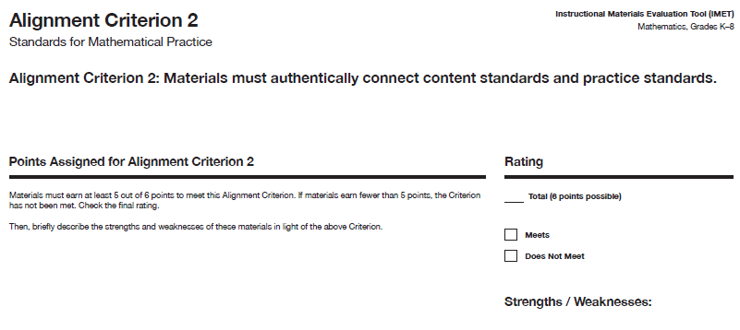
IMET p. 31
Notes:
Big Idea: Show summary page for AC 2.
Talking Points:
After completing your review of the metrics for AC 2, you will complete a summary page where you total the number of points earned for each metric. Because this is an Alignment Criterion, materials need to receive 5 of 6 points to be considered aligned. There is also space to note strengths and weaknesses of the materials as they relate to AC 2.

Slide 26
Alignment Criterion 3:
Access to the Standards for All Students

Slide 27
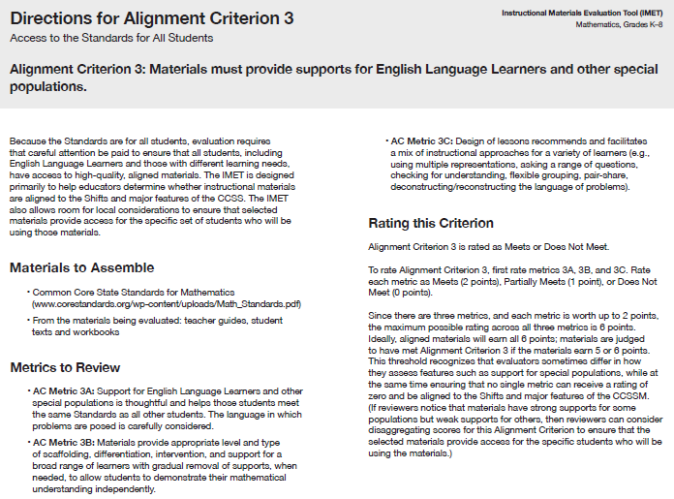
Access for All Students
Alignment Criterion 3: Materials must provide supports for English Language Learners and other special populations.
IMET p. 32
Notes:
Big Idea: Introduce Alignment Criterion 3 and the associated metrics.
Talking Points:
We’ve reached the last of our criteria in the IMET- Alignment Criterion 3 is about access to the Standards for all students.
Because the promise of the Standards is about equity, it is essential to ensure that instructional materials meet the needs of a variety of learners.
There are 3 metrics in this criterion and, unlike the rest of the Alignment Criteria, there are no questions associated with the metrics.

Slide 28
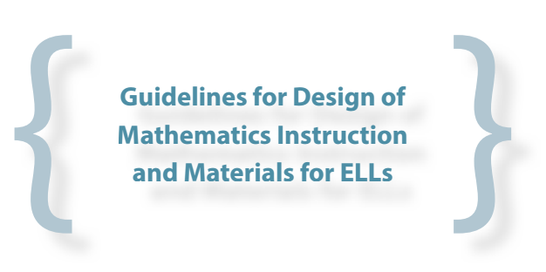

Guidance for Supporting Special Populations
http://ell.stanford.edu/
Handout p. 15
Notes:
Big Idea: Share best practices for supporting English Language Learners and see how many of these supports are embedded in the Standards, as written.
Talking Points:
In order to fulfill the promise of the Standards for college and career readiness for all students, instructional materials need to provide specific supports for special populations of students.
This is an excerpt from guidance from researchers at Stanford University about the kind of supports needed for students.
<Give participants time to read the excerpt, and discuss and summarize the recommendations provided.> <5 minutes>
Many of the ideas presented in this excerpt are features of instructional materials that we’ve looked at in previous metrics on the IMET. <Ask participants to name some of these>
Additional guidance reinforces the idea that students who are English Language Learners need to be encouraged to express mathematical ideas that they may not yet have the language to explain.
A big theme in supports that we will see throughout this criterion is that materials need to have supports that allow all learners to reach the full depth of the Standards.

Slide 29
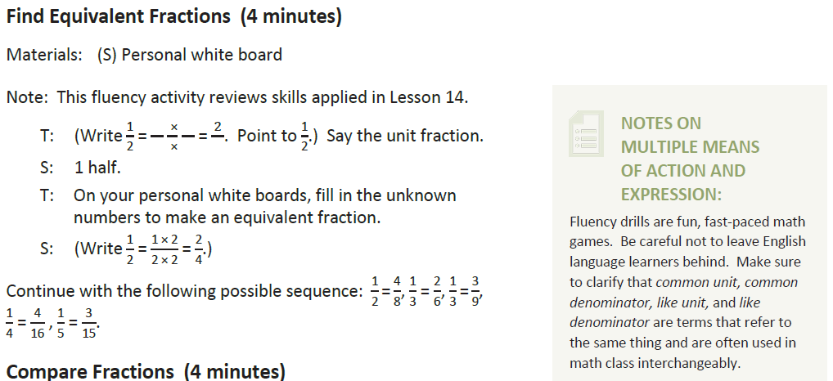
  AC 3A: Support for English Language Learners and other special populations is thoughtful and helps those students meet the same Standards as all other students. The language in which problems are posed is carefully considered.
IMET p. 33
Handout p. 16
Notes:
Big Idea: Give participants an opportunity to discuss what kind of supports will allow all students to meet the same standards.
Talking Points:
We’re going to look at a few examples of supports that materials provide to ensure all learners meet the Standards. Although the supports needed may vary based on the population of students that a district or school is serving, there are some standard supports that are necessary.
<Give participants an opportunity to read the lesson excerpt and discuss whether it provides supports that will help all students meet the standard.> <5 minutes>
In the text box, the materials are explicitly noting that the mathematical content needs to be accessible to all students.
The materials suggest the research-based strategy of previewing academic vocabulary and encouraging students to connect vocabulary.
Based on the small size of this excerpt, there could be other arguments made for ways to provide more supports to special populations. For example, teachers may need more guidance about how to introduce the vocabulary to students.
Note: Just like with all of our examples, one small excerpt like this in materials doesn’t mean that these materials would not meet the metric. Reviewers need to look across the materials to gather evidence that will allow them to make a holistic decision about the materials for each metric.

Slide 30
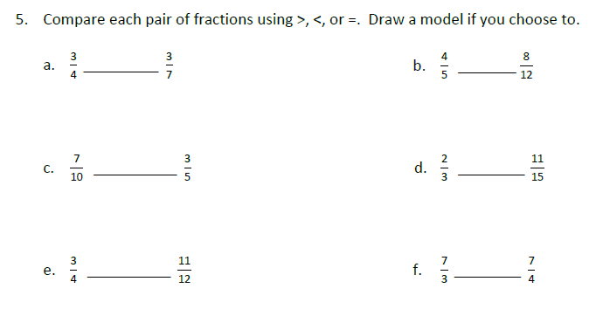
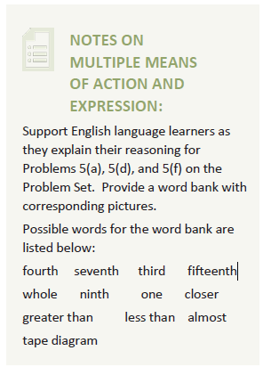
  AC 3B: Materials provide appropriate level and type of scaffolding, differentiation, intervention, and support for a broad range of learners with gradual removal of supports, when needed, to allow students to demonstrate their mathematical understanding independently.
IMET p. 34
Handout p. 17
Notes:
Big Idea: Give participants an opportunity to discuss what kind of supports will allow all students to meet the same standards.
Talking Points:
Here’s another brief example from a grade 4 book.
<Give participants an opportunity to read the lesson excerpt and discuss whether it provides gradual removal of supports.> <4 minutes>
The choice to only give supports on certain questions emphasizes the idea that students should not get blanket supports, but supports that will move them toward greater independence.
Note: Just like with all of our examples, one small excerpt like this in materials doesn’t mean that these materials would meet the metric. Reviewers need to look across the materials to gather evidence that will allow them to make a holistic decision about the materials for each metric.

Slide 31
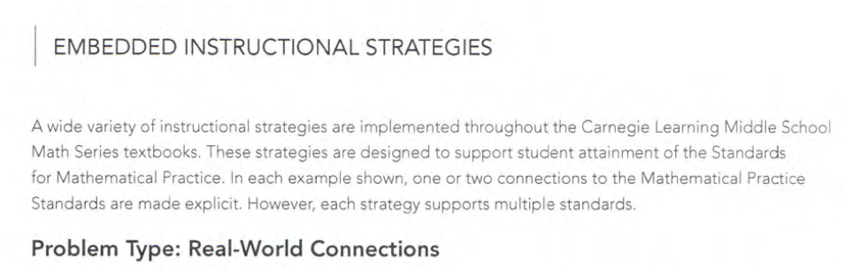
  AC 3C: Design of lessons recommends and facilitates a mix of instructional approaches for a variety of learners (e.g., using multiple representations, asking a range of questions, checking for understanding, flexible grouping, pair-share, deconstructing/ reconstructing the language of problems).
IMET p. 35
Handout pp. 18-19
Notes:
Big Idea: Give participants an opportunity to discuss what a mix of instructional approaches can look like.
Talking Points:
For the last metric, we need to consider the variety of instructional approaches provided in instructional materials.
To get a sense of this, you are going to look at some excerpts from the front matter of a series to read about how they describe their approach.
<Give participants an opportunity to read through the excerpt of the front matter and discuss whether it provides a mix of instructional strategies and how they may or may not be helpful to a range of learners.> <5 minutes>
As defined by the publisher, the materials seem to provide guidance on a variety of instructional strategies that would meet the needs of varied learners.
To further investigate these materials, reviewers may want to check to make sure there are more specifically teacher-led strategies to provide additional supports to all learners.
Note: Just like with all of our examples, just seeing this in the front matter doesn’t mean that these materials would meet the metric. Reviewers need to look across the materials to gather evidence that will allow them to make a holistic decision about the materials for each metric.

Slide 32
Alignment Criterion 3: Optional Activity
Review the grade 4 lesson on pp. 20-24 of your
handout.
Note evidence for each question associated with
Alignment Criteria 3 on pp. 33-35 of your
IMET.
Discuss:
  Gut check: Would these materials meet,
  partially meet or not meet AC 3? What is your
  evidence?
  What other things would you want to look at in
  these materials to determine your rating?
Notes:
Big Idea: Give participants an opportunity to review a full lesson against all 3 metrics of AC 3.
Talking points:
As we’ve talked about, it’s impossible to rate materials based on a single problem, lesson, or even unit. That being said, we want to give you an opportunity to look more holistically at materials against the rubric.
You are going to review a lesson and gather as much evidence as you can against the metrics, using the questions under each metric.
Although you won’t be able to give a rating, give a gut check about whether you think this series would receive 5 out of 6 points for this criterion, assuming that this lesson was typical of their approach to supports for learners.
Also note what else you would need to look at to determine your ratings or specific questions you have about these materials.
<Give participants time to review the lesson and discuss their gut check ratings and the evidence they found.><15 minutes>
There are places in the lesson that point out misconceptions that students may have, and provide supports for teachers. One example of this is in the discussion of “Different Fraction Divisions on the Number Line” at the top of page X. The materials point out a common confusion about labeling fractions on a number line and suggests instructional moves that will support all students with accessing the grade-level content.
The specific supports provided for ELLs next to this discussion may be helpful to that part of the lesson. However, in a full review of these materials, reviewers may look for more robust supports for special populations and ELLs.
The resources provided on pg. x for differentiated instruction ask students to engage in a similar activity to compare fractions with different sizes of numbers for the different levels of instruction. This shows an opportunity for all students to engage with the grade-level content. However, in a full review, reviewers would need to make sure that students who are below grade level are not always limited to working with fractions less than 1.
Based on the limited evidence provided in one lesson, it is reasonable for participants to give a gut check or either “meets” or “not meets.” Encourage participants to talk about what else they would be looking for if they were doing a full review of these materials.

Slide 33
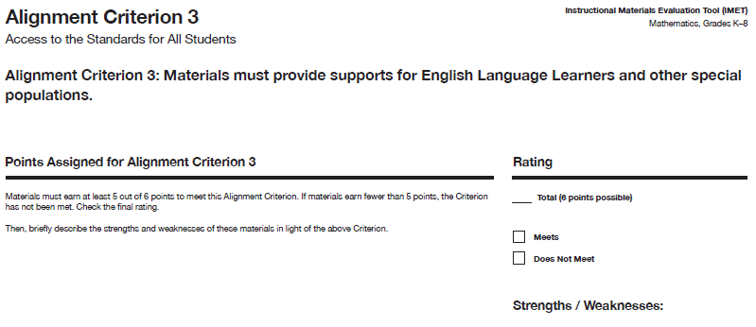
IMET p. 36
Notes:
Big Idea: Show summary page for AC 3.
Talking Points:
After completing your review of the metrics for AC 3, you will complete a summary page where you total the number of points earned for each metric. Because this is an Alignment Criterion, materials need to receive 5 of 6 points to be considered aligned. There is also space to note strengths and weaknesses of the materials as they relate to AC 3.

Slide 34
Wrapping Up

Slide 35
Alignment Criteria and Metrics
AC #2: Standards for Mathematical Practice
2A: Connecting SMPs to content
2B: Full meaning of each practice
2C: Emphasizing mathematical reasoning
AC #3: Access for All Students
3A: Access for all students to grade-level content
3B: Supporting the range of learners
3C: Variety of instructional approaches
Notes:
Big Idea: Give participants a big picture view of the metrics covered in this module.
Talking Points:
These are all the metrics you learned about today!
There is a short-hand name to describe each metric. Many reviewers feel that it is helpful to have this on hand as they begin the review process to help them remember the metrics and think about where evidence they are finding in books fit in.

Slide 36
Essential Questions -- Discuss
How does the Instructional Materials Evaluation Tool (IMET) reflect the major features of the Standards and the Shifts?
What understandings support high-quality, accurate application of the IMET metrics?
Notes:
Big Idea: Give participants an opportunity to reflect on the essential questions for the session.
Talking Points:
Either in pairs or in writing, have participants describe what they’ve learned in this session as it relates to the essential questions.

