Slide 1
Using Achieve the Core Tools to Tackle Common ELA Issues
Core Advocates Monthly Webinar
January 10, 2018
The webinar will begin shortly. You may wish to download the handouts (check the tab on your webinar control panel) while you wait.

Slide 2
Introductions
Your hosts from the Field Impact Team
Lynda Nguyen, Team Coordinator
Jennie Beltramini, Teacher Engagement Manager
Janelle Fann, Project Manager
Sandra Alberti, Director
Joanie Funderburk, Manager of Professional Learning
This Month’s Guests -
Lisa Goldschmidt - Director, Digital Team at SAP
LeAndrea Taylor, TN Core Advocate
Najla Staggers, CT Core Advocate

Slide 3
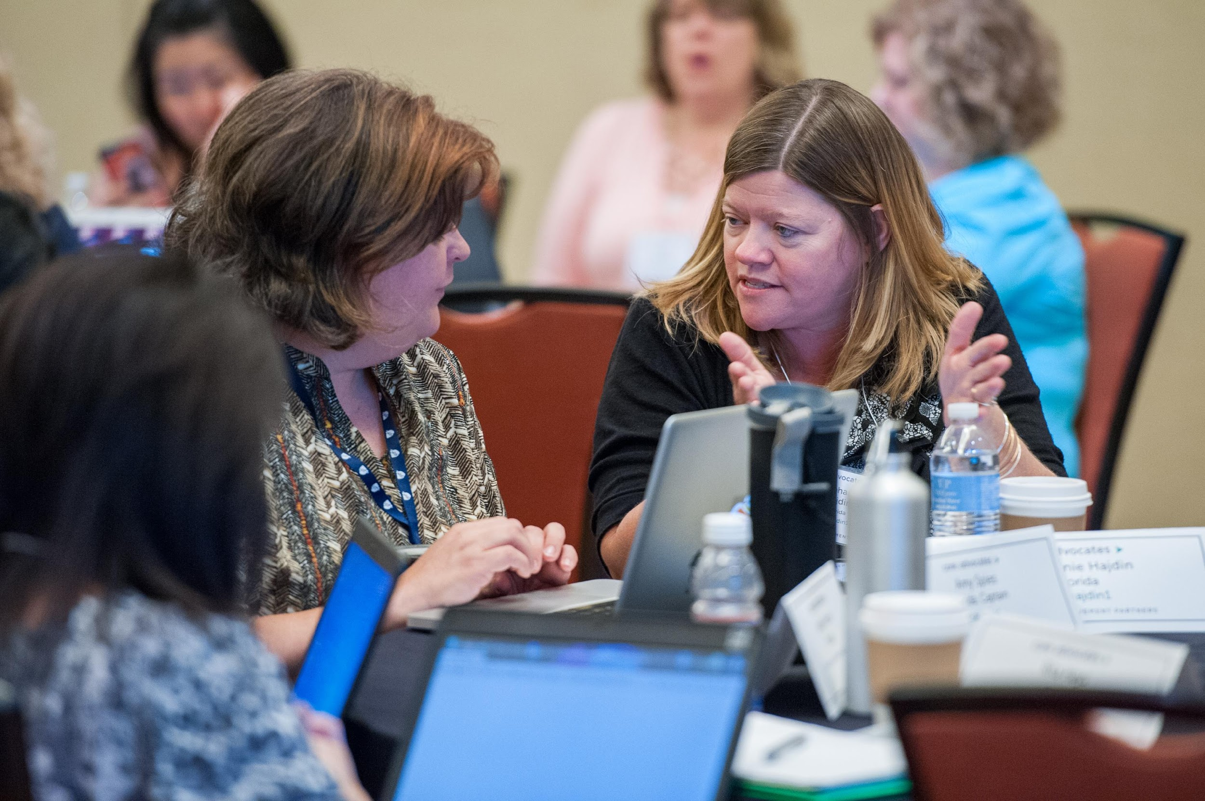
Who are Core Advocates?
Core Advocates are educators who:
Believe in the potential of high-quality standards to prepare all students for college and careers;
Are eager to support their colleagues and communities in understanding and advocating for the college- and career-ready standards, and standards-aligned instruction;
Understand and embrace the Shifts in instruction and assessment required by the college- and career-ready standards

Slide 4
Learn more about us!
Contact Jennie Beltramini (jbeltramini@studentsachieve.net ) or Joanie Funderburk (jfunderburk@studentsachieve.net)
Complete this survey to join our database (and mailing lists): www.achievethecore.org/ca-signup
Visit our website: www.achievethecore.org

Slide 5
Tweet with us!
Please feel free to tweet during and after the webinar using #coreadvocates
@achievethecore
@JoanieFun, @salberti, @JennieBeltro, @gravitygirl1111

Slide 6
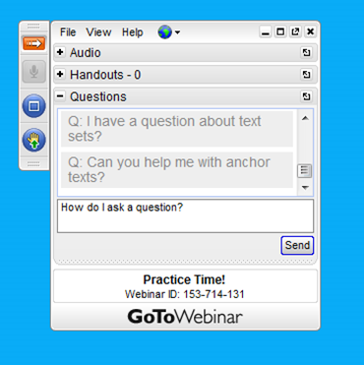
Engage with us!
During the webinar
– Accessing Documents
– Questions option
– Polling
After the webinar
– Survey
– Access to recorded webinar

Slide 7
Goals of the webinar
Understand how to find what you need on achievethecore.org (ATC)
Explore ATC resources you can use to build knowledge, share with groups, or use in your classroom
Hear from educators using ATC tools and resources to improve ELA/literacy instruction

Slide 8
Poll:
How frequently do you use Achievethecore.org?

Slide 9
Section 1: Tour de Core

Slide 10
Achieve the Core

Slide 11
Achieve the Core

Slide 12
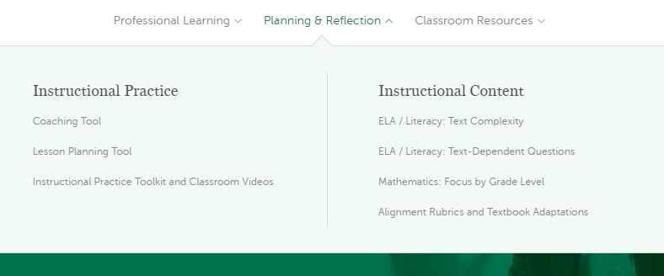
Achieve the Core

Slide 13
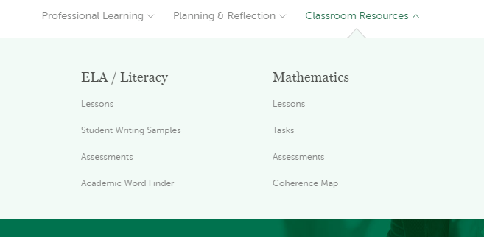
Achieve the Core

Slide 14
Achieve the Core

Slide 15
Achieve the Core

Slide 16
Common issues that ELA/literacy teachers face
Designing text-dependent questions
Building knowledge through reading
Identifying and scaffolding complex text
Working with imperfect materials
Integrating standards into PLC discussions

Slide 17
Question:
What challenges do you experience as an ELA/literacy teacher? Please use the Questions tab on your control panel to respond.

Slide 18
Section 2: Identifying and Scaffolding Complex Text

Slide 19
Setting the Scene...
K-5 school
4 teachers per grade
1 Literacy Specialist for grades 3-5
Literacy Specialist
Provides 1-on-1 coaching
Leads ELA/literacy discussion for grades 3-5 teachers; 45 minutes once every two weeks
School has integrated complex text into curriculum
Teachers are struggling with making complex text accessible for all students

Slide 20
Complex Text – Build Knowledge
Webinars
What is text complexity and why does it matter? (Feb 2016)
Supporting ALL Learners in Accessing Complex Text (Feb 2017)
Professional Learning<Professional Development
<Access Monthly Webinars

Slide 21
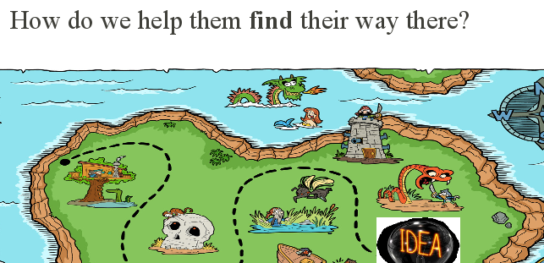
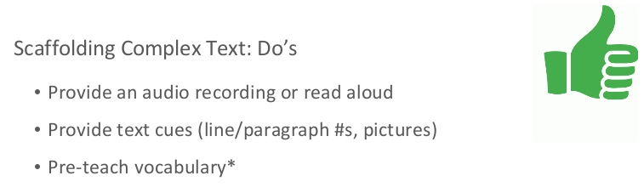
Complex Text – Build Knowledge
What is text complexity and why does it matter? (Feb 2016)
Supporting ALL Learners in Accessing Complex Text (Feb 2017)

Slide 22
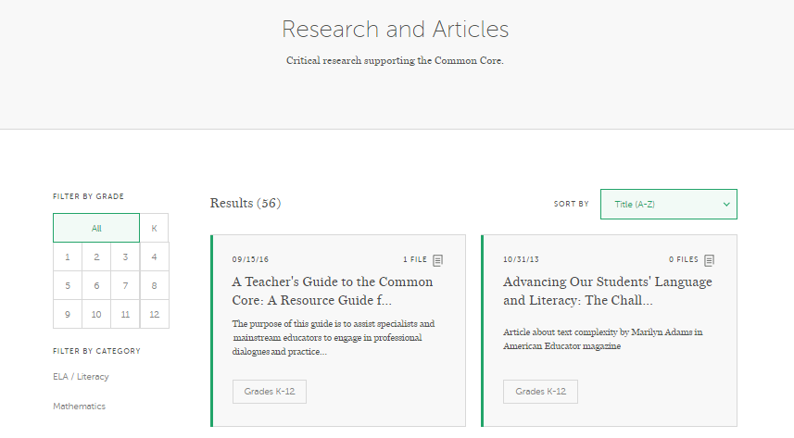
Complex Text – Build Knowledge
Research
Research Supporting Shift 1
Implementation - The Role of Close Reading
Professional Learning<Research and Articles

Slide 23
Complex Text – Build Knowledge
Aligned Blog
Supporting All Learners with Complex Texts: Strategies to scaffold instruction of Standards-aligned, complex texts
Top 5 Questions About ELA Scaffolding in High School
Top 5 Questions About ELA Scaffolding in Elementary School
Achievethecore.org/aligned

Slide 24
Poll:
What do you use most often to build your knowledge when you have questions about CCR standards?

Slide 25
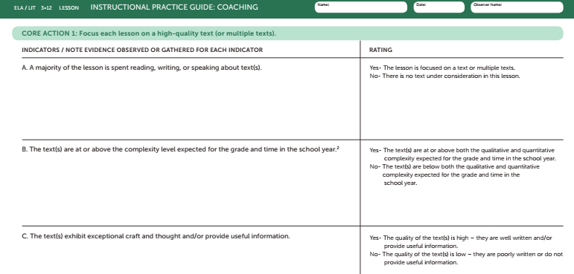
Complex Text – Share with Groups
Planning and Reflection > Instructional Practice Guide

Slide 26
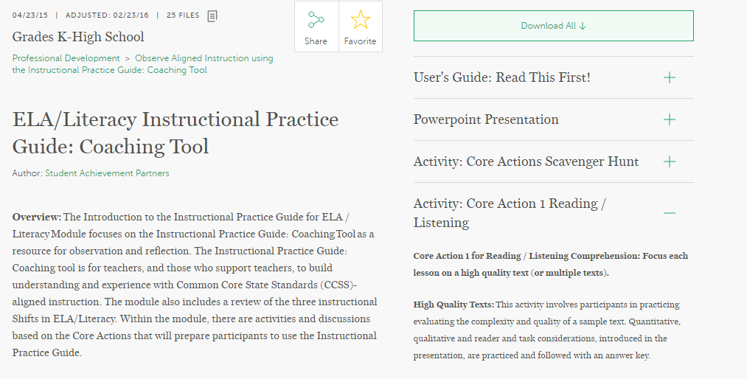
Complex Text – Share with Groups
Professional Learning<Professional Development
<Observe Aligned Instruction

Slide 27
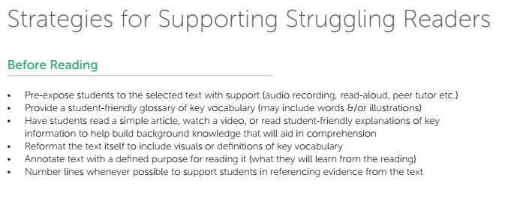
Complex Text – Share with Groups
Achievethecore.org/Aligned

Slide 28
Complex Text – Share with Groups
Planning and Reflection > Instructional Practice Toolkit and Classroom Videos > Supplemental Lesson Videos

Slide 29
Poll:
Who do you share resources and ideas with most often?

Slide 30
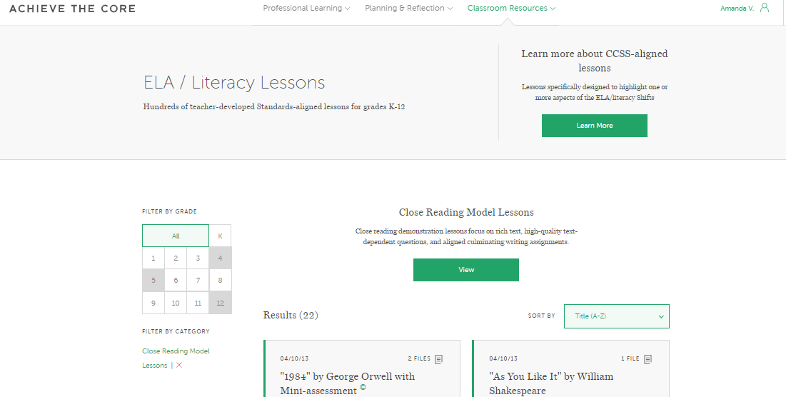
Complex Text – Use in the Classroom
Close Reading Model Lessons
Classroom Resources<Lessons<Close Reading Model Lessons

Slide 31
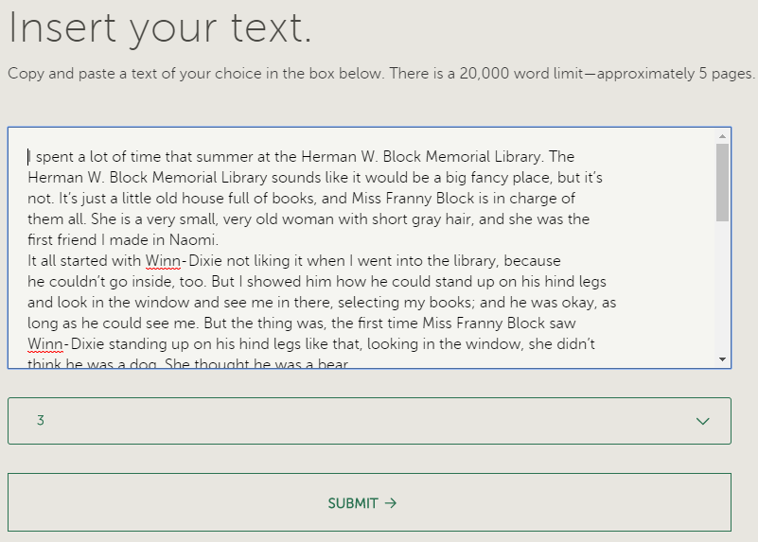
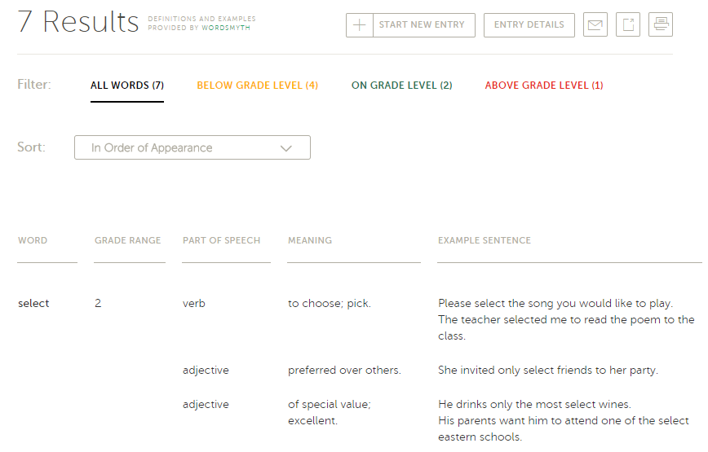
Complex Text – Use in the Classroom
Achievethecore.org/academic-word-finder

Slide 32
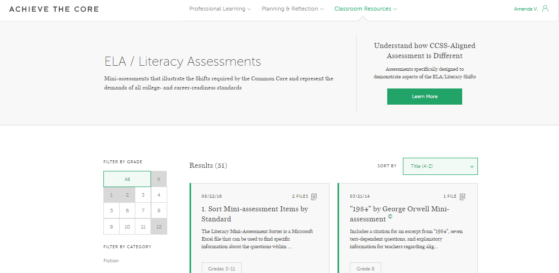
Complex Text – Use in the Classroom
Mini-Assessments
Classroom Resources<Assessments

Slide 33
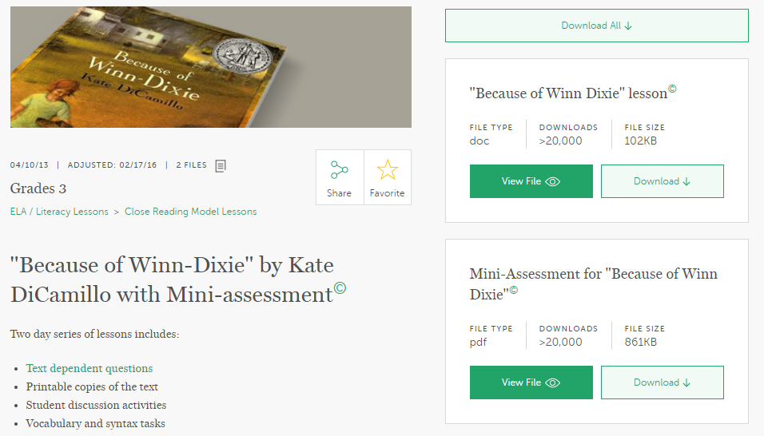
Complex Text – Use in the Classroom

Slide 34
Question:
How could one or more of the tools mentioned help you in your setting?
Please use the Questions tab on your control panel to respond.

Slide 35
Section 3: Core Advocates Tackling ELA/literacy Issues

Slide 36
LeAndrea Taylor
District Instructional Facilitator
Memphis, TN

Slide 37
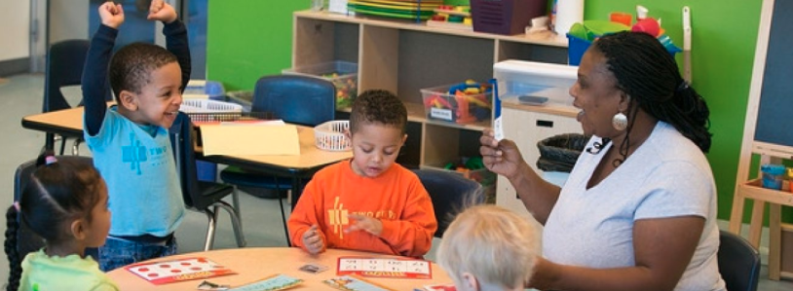
District-adopted Curricular Resources:
Expeditionary Learning
Teachers no longer spending hours searching for appropriate complex texts
Teachers still need instructional support

Slide 38
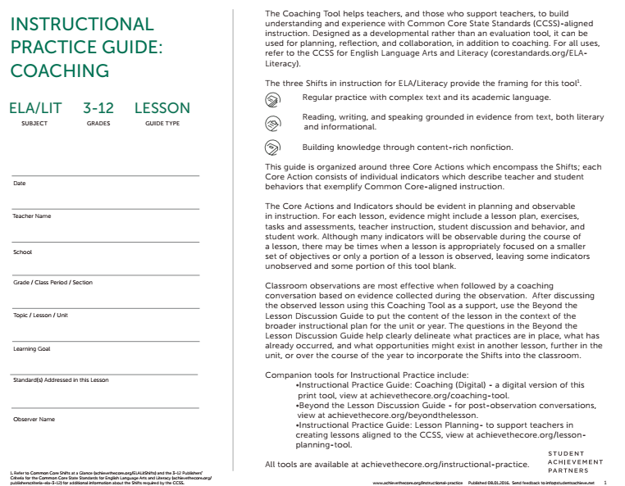
Gather data about strengths and needs in instruction

Slide 39
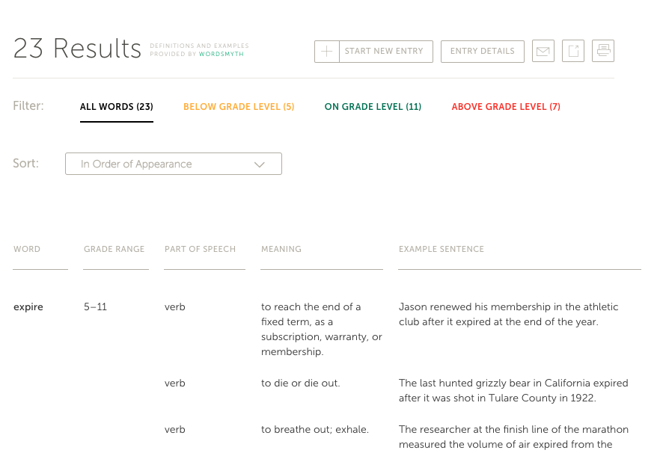
Supporting Teachers with Vocabulary Instruction

Slide 40
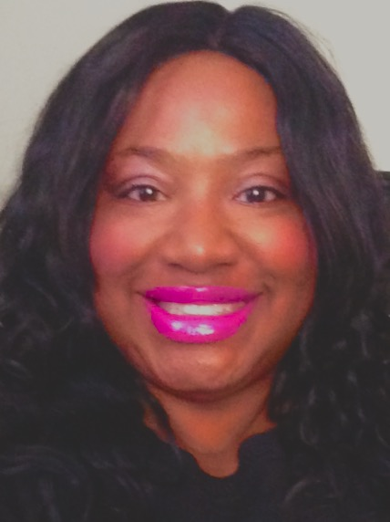
Najla Staggers
Literacy Education Specialist
Greater Hartford Region, CT

Slide 41
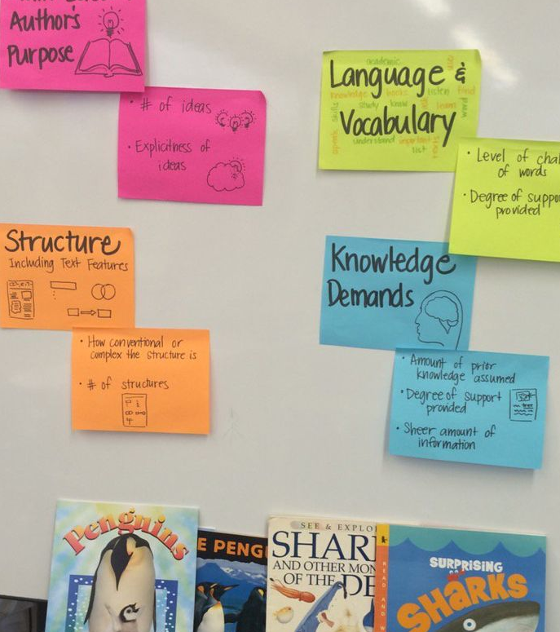
Problem of Practice: Independent Reading Within Bands of Text Complexity

Slide 42
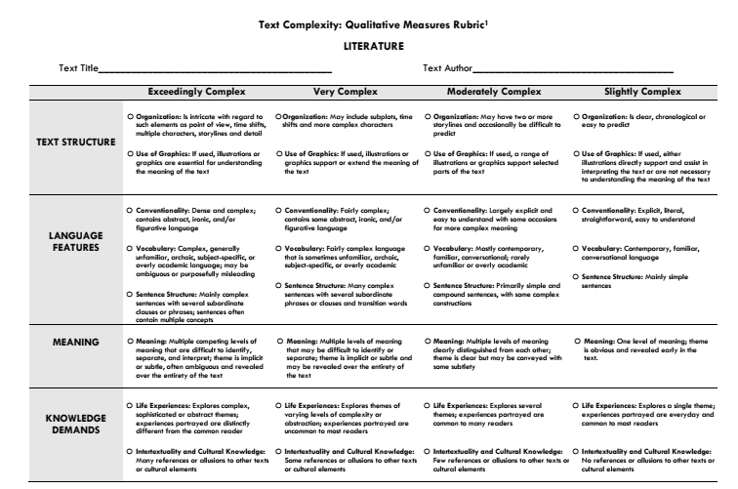
Problem of Practice: Independent Reading Within Bands of Text Complexity

Slide 43
Problem of Practice: Independent Reading Within Bands of Text Complexity
How does this change practice?
Students need access to complex text
Qualitative measures help teachers assess reader needs
Quickly moving students up reading levels “no more being on one level for the entire year”

Slide 44
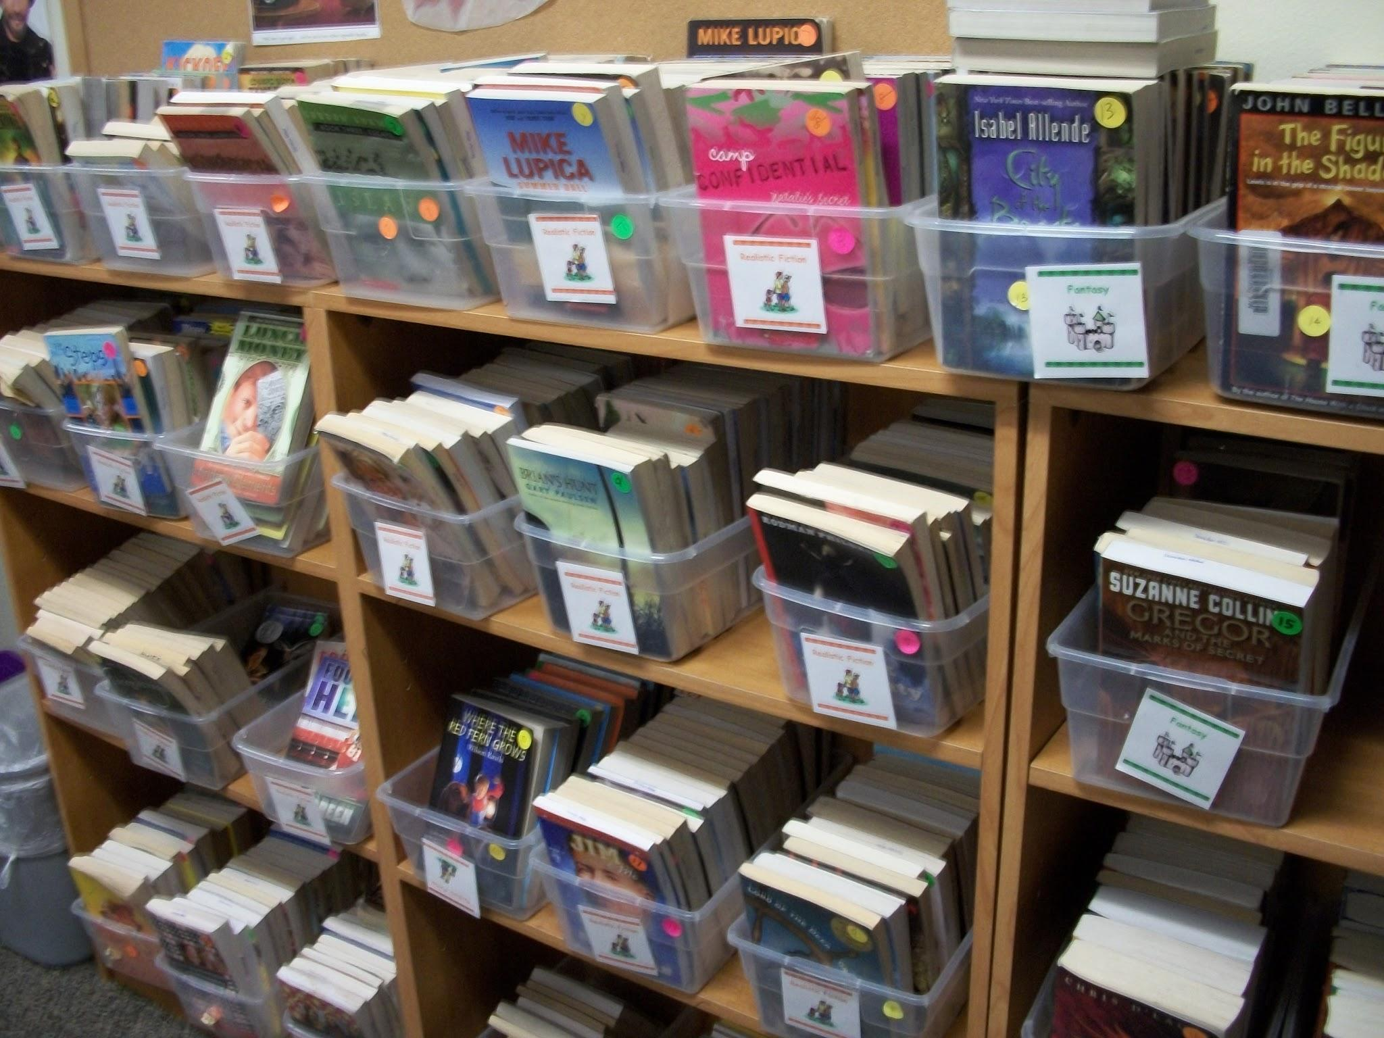
Problem of Practice: Independent Reading Within Bands of Text Complexity
Visible Change

Slide 45
Questions for our Guests?

Slide 46
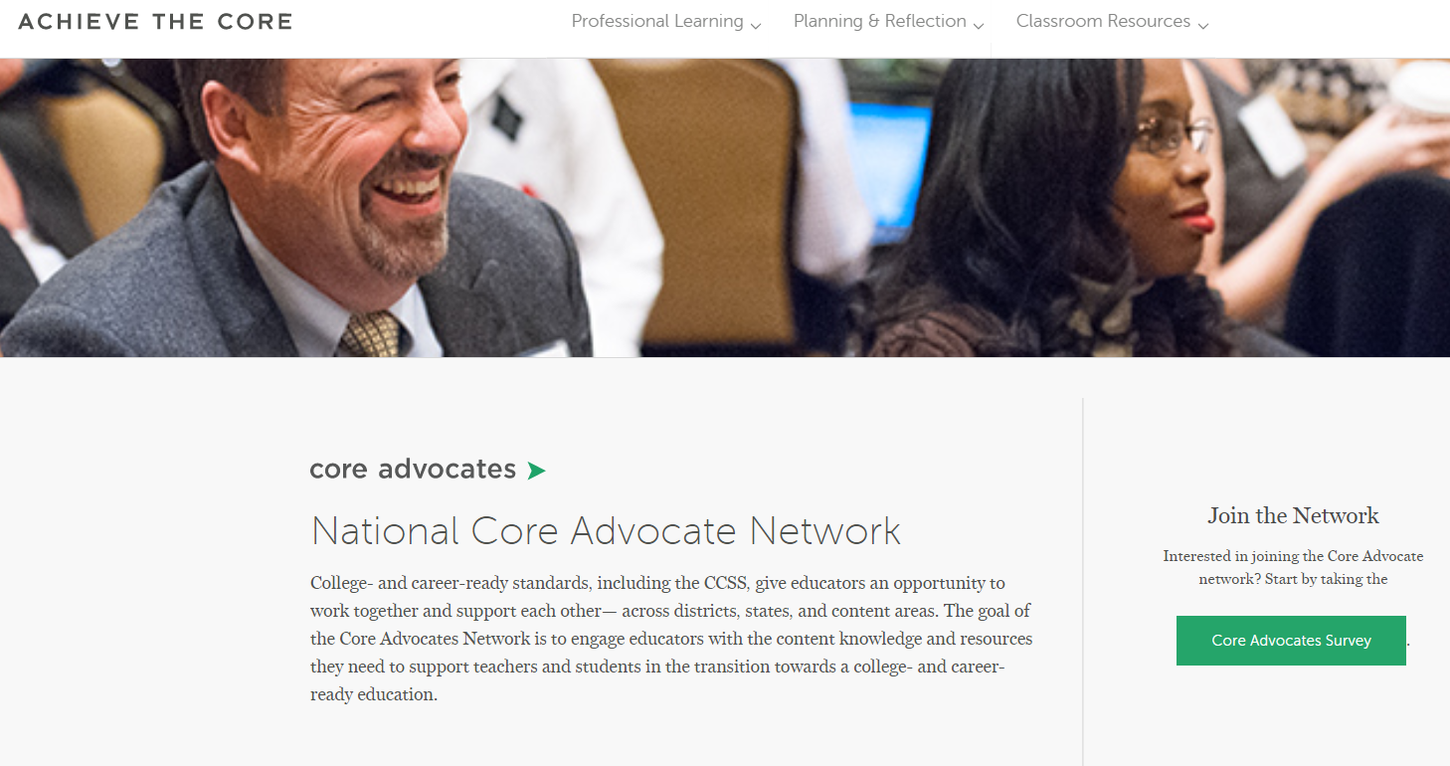
Join our network!
www.achievethecore.org/ca-signup

Slide 47
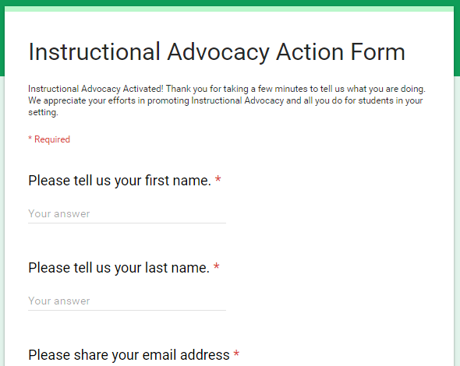
Tell us about your efforts
www.achievethecore.org/educators-taking-action

Slide 48
Please join us again next month!
Next month’s webinar: Math Modeling Myths
Wednesday, February 7, 7:00 - 8:00 p.m. ET
Register Here: https://attendee.gotowebinar.com/register/2536628688215854593

Slide 49
Thank You!

