Slide 1
Empowering Practitioners to Lead the Core
Sandra Alberti
@salberti
@achievethecore
#CCSS

Slide 2
Reframing the Work
Historical Perspective
Where are we now?
Why did we do this to begin with?
Rebranding of the Standards
Purpose
Opportunity
A bell that can’t be unrung

Slide 3
Standards-Based Instruction
Clear expectations
Clear connection of classroom activities to expectations
Clear information on student progress toward meeting expectations.
AKA assessment

Slide 4
Recognize the Politics
Not easy work
Support, not sympathy is necessary
Focus, not simplify
Standards ≠ Standardization

Slide 5
Conditions for Doing this Well
Learning Organization
What does this mean?
Not just about time
Who is responsible for culture?
Learning is not the same as training
Culture
Structure

Slide 6
Conditions for Doing this Well
Systems Approach
Make sense
Connect the dots
Don’t leave that to chance
PD
Observation/Evaluation
Assessment
Curriculum
PLCs

Slide 7
Conditions for Doing this Well
Know the Work

Slide 8
Conditions for Doing this Well
ELA/Literacy
Regular practice with complex text and its academic language
Reading, writing and speaking grounded in evidence from text, both literary and informational
Building knowledge through content-rich nonfiction
Mathematics
Focus strongly where the Standards focus
Coherence: Think across grades, and link to major topics within grades
Rigor: In major topics, pursue with equal intensity: conceptual understanding, procedural skill and fluency, and application

Slide 9
Conditions for Doing this Well
Know the Work
What does it look like?
How will we know?
Are our efforts getting us there?
Why are we doing this?

Slide 10
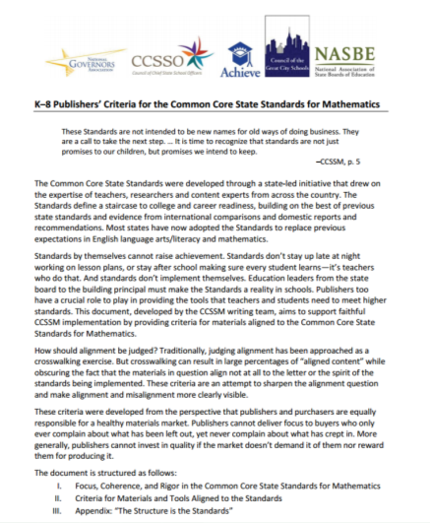
Implementation
Standards by themselves cannot raise achievement. Standards don’t stay up late at night working on lesson plans, or stay after school making sure every student learns – it’s teachers who do that. And standards don’t implement themselves. Education leaders from the state board to the building principal must make the Standards a reality in schools.

Slide 11
Teachers Must Own the Work
Unless teachers are the owners, these new standards will fail like all those before. But to make them owners, we must do more than invite a few token teachers to the next standards workshop. Teachers themselves must become the leaders when implementing the standards. Those who have mastered the ideas and the content must mentor their peers. Those who are challenged must work with their colleagues; those who are indifferent must become engaged; those who are cynical must be won over. Teachers must shape both the standards and assessments as educational tools rather than data-gathering instruments
– John Ewing, “Give the Standards Back to Teachers”

Slide 12
Teachers Must Own the Work
Core Advocates
Strong grounding in understanding the work
Enrolled, not Told
Teacher Voice – Closest to the work
Opportunities
Permission

Slide 13
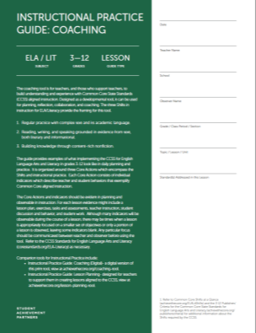
Update on Tools: Achieve The Core
What does it look like?
Instructional Practice Guide
Lesson Planning Tool
TeachingtheCore.org

Slide 14
Update on Tools: Achieve the Core
Materials Alignment
Instructional Materials Taskforce
Assessment Evaluation

Slide 15
Update on Tools: Achieve the Core
Academic Word Finder
Student Achievement Partners “Survey”
Self Assessment of Knowledge and Practice
Responsive professional learning plans

Slide 16
Thank You!
Sandra Alberti
salberti@studentsachieve.net
www.achievethecore.org
www.achievethecore.org/salberti
Twitter: @salberti @achievethecore

