Slide 1

Read Aloud Project
Insert Location
Insert Date
Notes:
This module was last updated on February 2016.

Slide 2
Purpose and Goals of the Read Aloud Project (RAP)
For us:
Learning together what work worth doing looks like for young children
Tapping into the power of collaboration to create more together than any of us can separately

Slide 3
Purpose and Goals of the Read Aloud Project (RAP)
For our children:
Creating deep readers while achieving the standards through listening to books read aloud.
Building knowledge of the world and the words that describe it from the very beginning days of school
Allow every child equal access to meaningful learning

Slide 4
Choosing the right book!
Should not be anything students can read on their own
Rule of thumb 2,3 years above grade level of class, in some cases can be even more
Worth reading multiple times!

Slide 5
Building Knowledge
From the standards, “…texts within and across grade levels need to be selected from topics and themes that systematically develop the knowledge base of students”
Also from the standards, “Within a grade lever there should be an adequate number of titles on a single topic that would allow students to study that topic for a sustained period”.
This does not mean the death of Goodnight Moon or Dr. Seuss

Slide 6
What about skills and strategies?
Focus on knowledge and vocabulary
Skills and strategies are embedded
Ok to go over them, at the end!

Slide 7
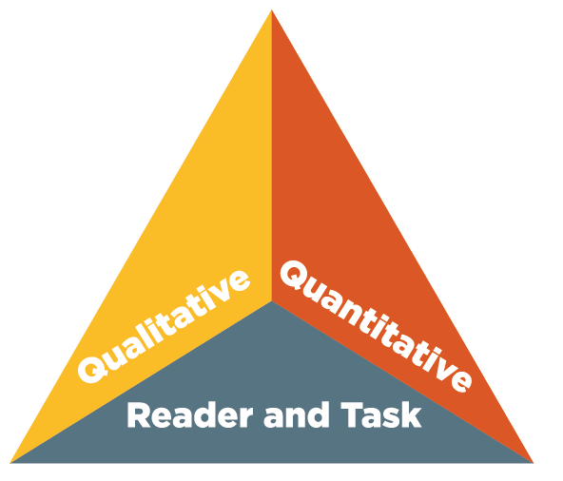
What Makes a Read-Aloud Complex?

Slide 8
What Makes a Read-Aloud Complex?
Layers of meaning
Structure
Text features
Knowledge
Background
Language
Vocabulary
Purpose
Concept complexity
Genre
Organization
Experiences
Sentence length and structure
Figurative language
Regional/historical usage (dialects)
Meaning

Slide 9
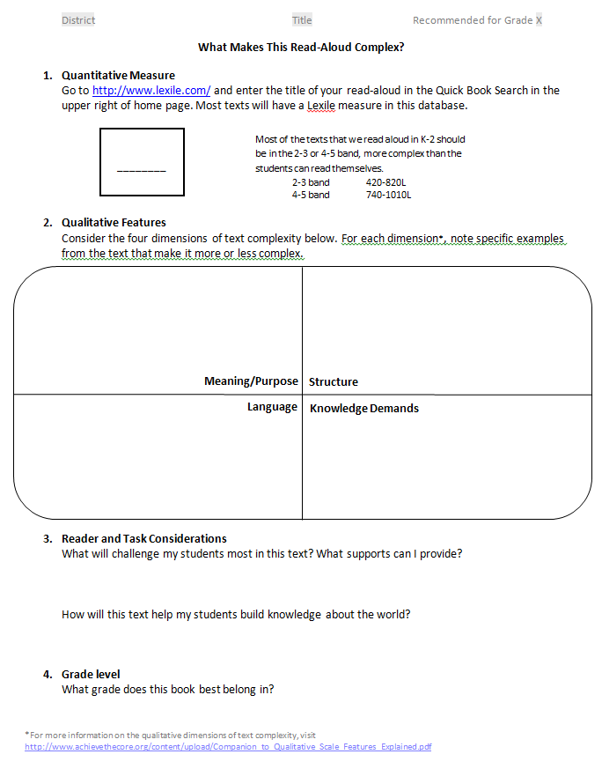
What does this look like in the template?
Notes:
Turn to the last page of your paper template. It sits last to not distract the teacher, but it should ALWAYS be done before anything else is thought about!

Slide 10
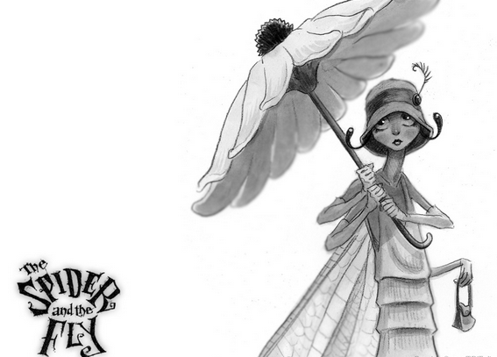
LISTEN: WHAT MAKES THIS READ ALOUD
COMPLEX?
The Spider and The Fly
A fable by Mary Howitt (1799-1888)
“Will you step into my parlor?” said the spider to the fly;
“’Tis the prettiest little parlor that ever you did spy.
The way into my parlor is up a winding stair,
And I have many curious things to show when you are there.”
Notes:
Read Aloud : Choose 2 people in advance to play Spider and Fly.
After reading, have audience briefly share what they noticed was complex, affirming their observations using the language on the wheel
(i.e. Observation: “Students may have trouble understanding that Spider and Fly are talking to each other in the poem.”
Response: “So, you noticed that the back and forth structure of the poem was complex.”).

Slide 11
Thinking about complexity in
The Spider and the Fly
Meaning
Structure
Knowledge
Language
“And take a lesson from this tale…”
“Will you walk into my parlor?” said the Spider to the Fly
“For who goes up your winding stair can ne’er go down again.”
“And if you like to rest awhile, I’ll snugly tuck you in”
Notes:
Here are some examples I noticed… Read each, explain why it is complex and how it relates to element in that quadrant.
Note: The purpose of introducing this wheel is to deepen understanding of the ways in which a text may be complex, and later, to show how specific observations on text complexity drive TDQ’s and activities. Emphasize that these four quadrants serve as different lenses for looking at a text or part of a text. This tool helps you notice things about the text that you may not have noticed at first and can guide you in identifying , more specifically, what makes the text challenging (Why will this section be difficult for my students?).

Slide 12
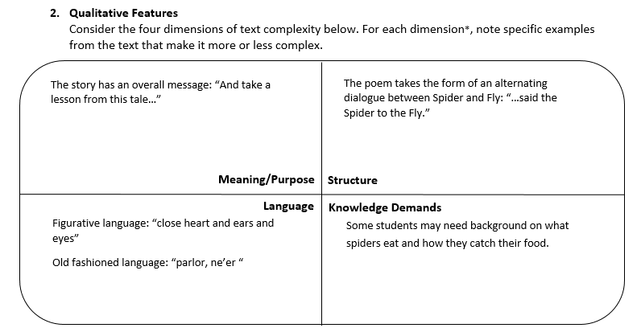
Example from The Spider and the Fly
LEXILE: Grade 4-5 Band
SCREEN SHOT OF DIANA’S COMPLETED WHAT MAKES THIS READ ALOUD COMPLEX PAGE
Notes:
Call attention to the place on the template where they will record their observations/analysis

Slide 13
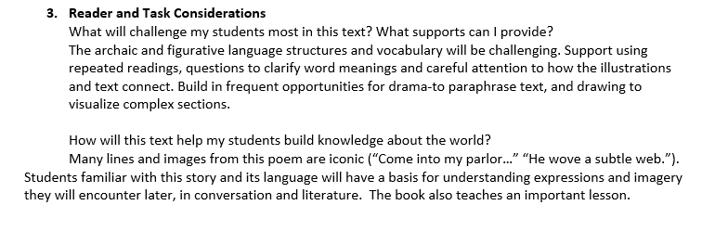
Other questions to consider…
Notes:
Emphasize that Reader and Task considerations result in instruction in areas students will find difficult, not in choosing a simpler text or task for students who are likely to struggle.

Slide 14
You try!
Work with all of the members of your writing team to:
Read your book out loud. Enjoy it!
Complete the “What Makes This Read-Aloud Complex” page in the template.
Refer to Step #1 and #2 on the Checklist
Notes:
Give directions, break into work time.

Slide 15

Begin with a complex text
and a “Big Idea”…
FOCUSING QUESTION:
What do I want my students to learn?
Notes:
Big Idea will drive many of the instructional choices you need to make.

Slide 16
What’s the Big Idea?
Reverse-engineered or backwards-designed
Crucial for creating sequenced set of questions, activities, and tasks – line of inquiry
Critical for creating an appropriate
culminating assignment
Notes:
Review each point.

Slide 17
Begin with a complex text and a “Big Idea”…
FOCUSING QUESTION:
How does the Spider trick the Fly into his web?
What is the lesson in this story?
Don’t be let yourself be tricked by sweet, flattering words.
Notes:
To notice:
Big Idea is about meaning drawn from text/not about standards or skills
Broader question “What is the lesson in the story?” is proceeded by a question that prompt the analysis they will need to do in order to answer that question.
Think, “What did I, as an adult reader, notice/synthesize in order to come to the Big Idea?” and craft a question that will help students to notice those things, too.

Slide 18
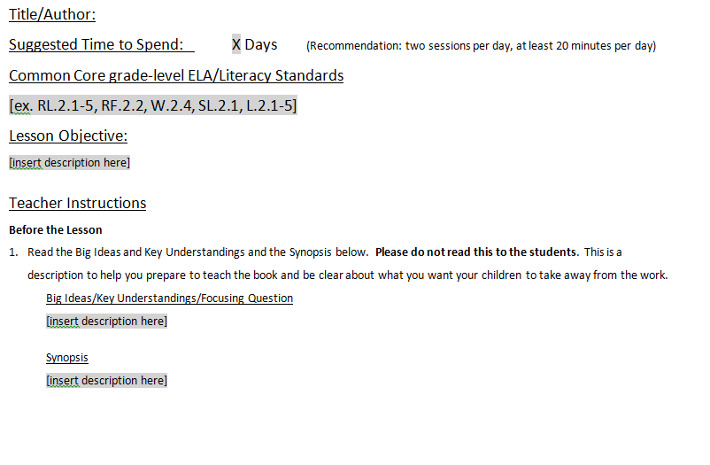
What does this look like in the template?
Notes:
Orient people to the place on the template where they will record their Big Idea/Focusing Question. Point out that this is often the hardest step!

Slide 19
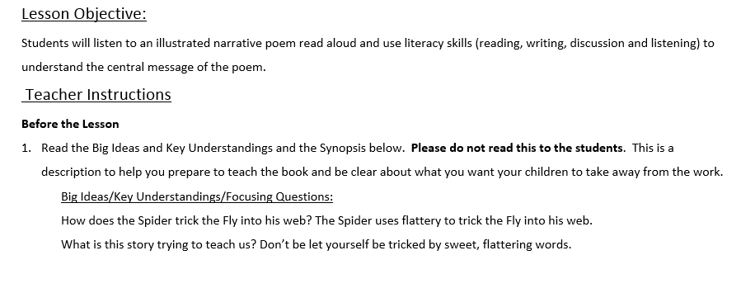
How does the Spider trick the Fly into his web?
What is this story trying to teach us?
Notes:
Explain Spider and Fly example

Slide 20
You try!
Work with all of the members of your writing team to:
Come to consensus about the “Big Idea” of your book.
Write the Big Idea and Synopsis in the template.
Refer to Step #3 on the Checklist

Slide 21
Types of Text-Dependent Questions
When you're writing a set of questions, consider the following categories:
Questions that support the understanding of meaning.
Questions that support the understanding of language.
Questions that support the understanding of structure.
Questions that build a knowledge base.
Notes:
Here’s how the text complexity circle ties into the Close Read you are going to design.

Slide 22
Text-Dependent Questions, Activities, and Tasks
Pull students back to the text.
Can be literal (checking for understanding) but must also involve analysis, synthesis, evaluation.
Focus on word, sentence, and paragraph, as well as larger ideas, themes, or events.
Focus on difficult portions of text in order to enhance reading proficiency.
Lead students to a larger understanding – often culminate in prompts for writing or discussion.

Slide 23
Emphasize Vocabulary
Role in complex text
One of two features of text most predictive of student difficulty (Chall 1996, Stanovich 1986, Nelson et al 2012, NAEP 2012)
Vocabulary Gap grows larger each year our students are in school (Biemiller 2010)
Vocabulary is difficult to catch up.
Academic vocabulary is key: “symbols, circles (verb), mixes, together, drifting, fact, doubt, huge, twirling, tossed, control, “break through”,

Slide 24
Emphasize Vocabulary
Which words should be taught?
  Essential to text
  Likely to appear in future texts students will choose or be asked to read
  Which words should get relatively more time and attention?
  Part of semantic word family
    (grow, grows, grown, growing, growth; mix, mixes, mixed)
  Relatively more abstract
    symbols, doubt, control
  Refer to an idea, concept, event likely less familiar to many students at that grade level
    symbol, “break through”, doubt

Slide 25
Emphasize Vocabulary
Which words get relatively less time and attention
  Concrete
    twirling, huge,
  Refer to an idea, concept, event likely more familiar or easy for most students to visualize
    circle (verb), tossed, huge, together
Words requiring less time are essential to teach

Slide 26
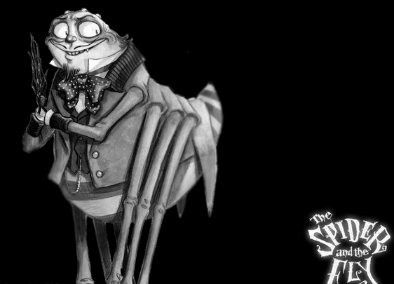
A reminder about where we’re headed…
FOCUSING QUESTION:
How does the Spider trick the Fly into his web?
Notes:
Just, read…

Slide 27
Where will my students need support?
Example from The Spider and The Fly
Meaning
Structure
Knowledge
Language
Layers of meaning:
The story has an
overall message:
“And take a
lesson from
this tale…”
Alternating dialogue between two
characters:
“…said the Spider
to the Fly”
Figurative language:
“close heart and
ears and eyes”
Old fashioned language: “parlor” and “ne’er”
Students may
need background
information on how spiders live and eat
Notes:
Remind people of the major areas of complexity we identified in Spider and the Fly earlier. Emphasize that our goal is to help all students deeply understand this complex text. To do that , we need to provide carefully planned instructional experiences that will help students navigate the complexity we identified. That is what Close Reading is!
We’ll be looking at one example from each quadrant to support understanding of each of the quadrants and provide an example of how to plan to address that type of complexity. In “real life” you won’t always find complexity in all four dimensions , nor will the four dimensions have equal weight in the lesson sequence.

Slide 28
How can I help students to understand the lesson in the story?
Meaning
Layers of meaning:
the lesson in
this tale
A Set of Repeating Text Dependent Questions:
How does the Spider try to trick the Fly?
What does the Fly do?
Notes:
I noticed that understanding the 2 layers of meaning in this text (a story about a spider/fly and a “cautionary tale”) would likely be a challenge for my students.
So, I crafted these specific text dependent questions to help students notice a pattern in the text. These questions will be repeatedly asked after each interaction between the Spider and the Fly.

Slide 29
And an activity to help them see a pattern in the answers…
How does the Spider try to trick the fly into his web? | What does the Fly say or do?
Invites her to see cool things in his parlor | O no, no
Says she can rest in a comfortable bed | O no, no
Offers her yummy things to eat | O no, no
Tells her to look in the mirror to see how pretty she is | I thank you, gentle sir
Tells her that her wings and body and eyes are beautiful | Comes nearer and nearer
Notes:
These questions are meant to uncover a pattern that will help students understand the Big Idea of the poem. This pattern will be more apparent if they can see it visually.
As a class we will record their observations and analyze them together (Where does the Fly’s response to Spider change? What do you think caused that change? What evidence in the text supports your assertion?) .

Slide 30
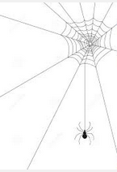
How does the Spider trick the Fly into his web?
How does the Spider try to trick the fly into his web? | What does the Fly say or do?
Notes:
Evidence for analysis can recorded on a simple full class chart. This chart functions as the students’ “notes”.

Slide 31


Notes can be taken
by individual students
or by the teacher
to record the thinking of the full class…
Notes:
At first, teacher will need to model by recording “Public Notes”.
Later students can take their own notes, or these two approaches can be combined (i.e. students choose from public notes to create an individual graphic organizer for writing or discussion).

Slide 32

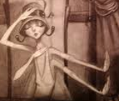

Notes can be taken using illustrations
How does the Spider try to trick the fly into his web? | What does the Fly say or do?
Or drawings…
Notes:
Taking notes needs to be thought of broadly as recording important information. Students/classes can take notes in any form that will later allow them to access the information. At the primary grades, this is often best done with visual cues like illustrations from the text, drawing, photos, or even objects.

Slide 33
Where will my students need support?
Structure
Alternating dialogue between two characters
Text Dependent Questions:
Who is talking here?
How do you know Spider is talking?
Notes:
I also noticed that understanding the structure of this text will likely be challenging for my students.
So, I crafted these specific text dependent questions to help students notice the alternating dialogue between the spider and the fly in the text. These questions will be repeatedly asked after each page.

Slide 34
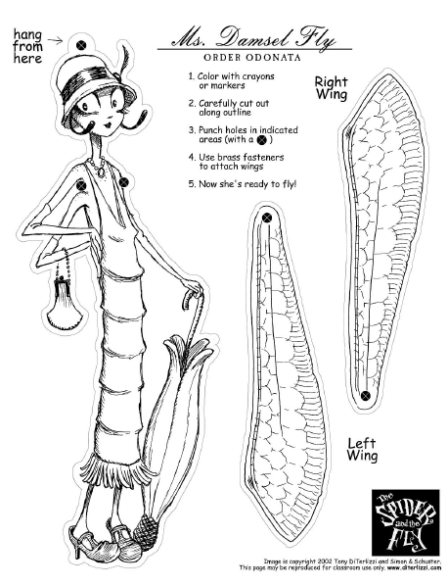
And an activity to help them “feel” the structure…
Hold up your puppet to show me who is talking.
http://diterlizzi.com/home/project/the-spider-and-the-fly/
Notes:
Along with the questions, students will do a moving/thinking activity that will help them “feel” this structure.
Demonstrate Activity by reading a short section of the dialogue and having the audience lift up a rolled left hand fist for spider and a spread right hand for the Spider.
Ask audience to reflect on how this activity affected the way they interacted with and understood the text (focused listening, noticed cues about who was speaking :“said the Spider to the Fly…”, alternating pattern hard to miss, etc.)

Slide 35
Where will my students need support?
Knowledge
Text Dependent Questions:
What is a spider’s “table”?
What does “set his table ready” mean?
Information about how spiders live and eat
Notes:
I also noticed that there is some context students will need outside of the text if they are to fully understand the text. For example, to fully appreciate the poem, students will need to know how spiders get their food. To answer the questions above students will likely need some information and help from the teacher, but notice how the questions are text based in order to highlight the connection between this outside knowledge and the text. After helping students understand that a Spider’s table is his web, students are asked to immediately apply this understanding to the text (What does “set his table ready” mean?).

Slide 36

Build a knowledge base
and add an activity to assess understanding:
Draw a picture of what Spider is doing.
Notes:
If a lot of knowledge needs to be built, consider using another text to build it. In this case, working with the nonfiction book Spiders (lesson in your handouts) before working with this poem would be a wonderful way to build a knowledge base about spiders. Again students are actively asked to engage with the text by drawing to show understanding.

Slide 37
Where will my students need support?
Language
Text Dependent Questions:
Ne’er is an old fashioned word. What word do you know that sounds like ne’er?
Why do you think the bugs “ne’er come down again”?
Old fashioned and figurative language
Notes:
The last area of complexity that I want to be sure to plan for is language. In addition to other vocabulary, I want to be sure to draw attention to the old fashioned and figurative language in the poem. Often archaic words (like ne’er) are the result of changes in spelling, grammar or usage over time. The first question encourages students to check for this type of connection when faced with an unknown word. The second question (like the one about the table) immediately asks students to apply their new understanding to the poem.

Slide 38
And add an activity to support basic comprehension
Act out the passages
to help students paraphrase the poem (repeat after each exchange between Spider and Fly):
Come into my living room, little fly. It’s right upstairs and there are lots of cool things to see there.
No way! When someone goes into your living room, they never come out again!
Notes:
Once again, we want to pair TDQ’s with active involvement. Acting out sections of the text (and adding their own version of the dialogue) is a great interactive way to practice paraphrasing and check understanding. Classmates in the audience can offer advice to the actors about appropriate gestures, expression and body language. This is especially effective if the teacher asks the students to explain, what, in the text, led to their suggestions and choices.

Slide 39
Putting it all together in the Template
FIRST READING:
Questions/Activities/Vocabulary/Tasks | Expected Outcome or Response (for each)
Pull the students together or use a document camera so that all can enjoy the illustrations. Read aloud the entire book with minimal interruption. Since the poem is written as a dialogue between the Spider and the Fly, consider pulling in a second reader and taking parts, or reading in two distinct voices. After the first reading, have each student create two stick puppets, one of Spider and one of Fly to use during subsequent readings. | The goal here is for students to enjoy the book- the words, the rhythm and the pictures, and to experience it as a whole. Don’t be concerned if students understand very little on this first reading. The idea is to give them some context and a sense of the characters and story before they dive into examining parts of the book more carefully. Puppets are downloadable from the author’s website http://diterlizzi.com/home/project/the-spider-and-the-fly/, or can be drawn by the students and attached to popsicle sticks.
Notes:
After you have done all of this good thinking about the text and about your students. It’s time to pull it altogether into a lesson plan.
Explain how this part of the template is set up (Questions/directions on left, explanation/sample responses on right) using this example.

Slide 40
SECOND READING:
Questions/Activities/Vocabulary/Tasks | Expected Outcome or Response (for each)
Use the Puppets and answer TDQ’s Reread page 1 Who is talking here? Show me by holding up a puppet. How do you know Spider is talking? A parlor is like a living room in a house. What might a spider’s “parlor” look like? Read page 4 Who is talking here? Show me by holding up a puppet. How do you know Fly is talking? Ne’er is an old fashioned word. What word do you know that sounds like ne’er? Why do you think the bugs “ne’er come down again”? | Students respond by holding up the appropriate stick puppet. Help students to notice cues that signal a character is speaking like the phrase ,”said the Spider to the Fly” and the quotation marks. Some students may make the connection that a spider’s parlor is his web, others may draw on the fanciful illustrations in the book to answer. These ideas will be confirmed or revised as you reread the rest of the story. Students respond by holding up the Fly stick puppet and noting the words, “said the little Fly”. Ne’er sounds like “never”. The bugs never come down again because the Spider eats (or captures) them.
Notes:
Notice how the text is “chunked” with questions/activities for each section.

Slide 41
SECOND READING cont.:
Questions/Activities/Vocabulary/Tasks | Expected Outcome or Response (for each)
Act out the passages: Establish the following pattern of activities to help students paraphrase the poem (repeat after each exchange between Spider and Fly): Reread the two stanzas fluently (Spider’s invitation and Fly’s response), clearly showing the change in speakers with your voice. Choose two students to act out these two stanzas by paraphrasing what the characters say, and showing actions and reactions with their bodies. Reread sections of the text as needed to ensure that the dramatic interpretation accurately reflects the words in the story. | Check to see that students are able to paraphrase the poem and add support as needed. Sample student dialogue: Spider: Come into my living room, little fly. It’s right upstairs and there are lots of cool things to see there. Fly: No way! I know that when someone goes into your living room, they never come out again! Help students to better understand the character’s actions and reactions by asking the class to notice, or give suggestions about, the actors’ body language and expressions.

Slide 42
SECOND READING cont.:
Questions/Activities/Vocabulary/Tasks | Expected Outcome or Response (for each)
Fill in the chart: Direct the rest of the class to watch the scene and then pose the following questions: How does the Spider try to trick the Fly into his web? What does the Fly say? Record a response to each question on a class chart using words, pictures from the text, quick sketches or some combination of the three. | See sample graphic organizer in Teacher Notes. Possible responses:
How does the Spider try to trick the fly into his web? | What does the Fly say or do?
Tells her there are cool things to see in his parlor. | Oh no, no!

Slide 43
More Reading…
Continue rereading, in short sessions, supporting comprehension using text dependent questions and activities.
Finish with a culminating task that addresses your “Big Idea” or focusing question.

Slide 44
Getting Ready for the Culminating Task…
The last page of the book tells us to “close heart and ear and eye” .
Show me how you might “close your ears”.
Show me how you might “close your eyes”.
Show me how you might “close your heart”. (Can you do this?!)
What do you think the author wants us to do when we meet someone like Spider?

Slide 45
Culminating Task
What is “the lesson of this tale”? What is this story trying to teach us?
Use pictures and words to show what the author wants us to learn from the story in this book.
Circulate as students work, encouraging them to tell you more about their drawings and writing. Share responses in small groups or display on a bulletin board.

Slide 46
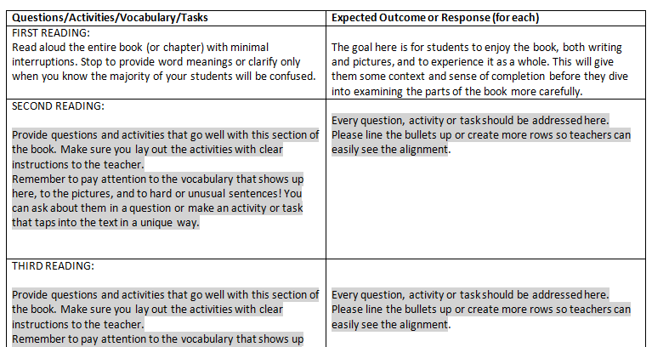
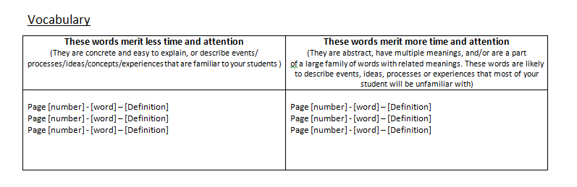
What does this look like in the template?

Slide 47
You try!
Work with all of the members of your writing team to:
Develop a series of text-specific questions, activities, tasks, and vocabulary.
This will take quite a bit of time…
Be sure to capture your ideas in the template.
Refer to Step #4a, 4b, and 4c on the Checklist

Slide 48
Finally, check the CCSS…
Once all questions, activities, tasks, and vocabulary have been outlined – align with the standards.
Make any adjustments as needed or plan ahead
Why wait to the end of the planning process?
Refer to Step #5 on the Checklist

Slide 49
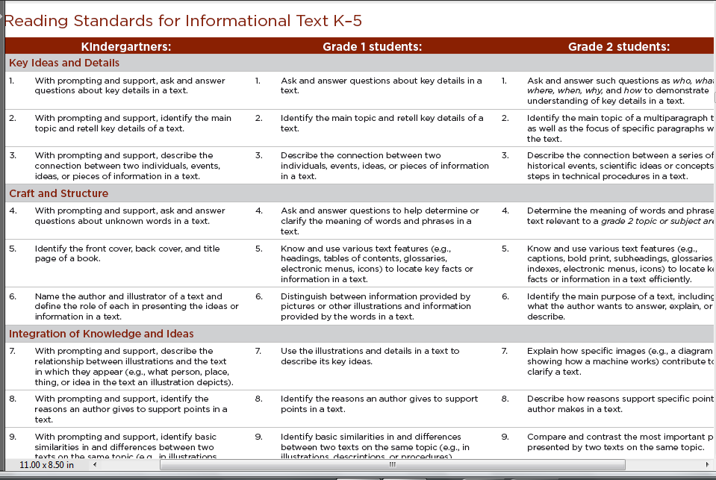
The CCSS

Slide 50
Bands
11-CCR
9-10
6-8
4-5
2-3
K-1
Standard One
Standard Ten
Bands
11-CCR
9-10
6-8
4-5
2-3
K-1
Increased Ability to Use Text Evidence
Increasing Range and Complexity
Standards Two through Nine

Slide 51
What about skills and strategies?
Ok to go over them, at the end!
What is the message or the moral of the story?
vs
How did the spider trick the fly? (then…….)
  What is the lesson we can learn?

Slide 52
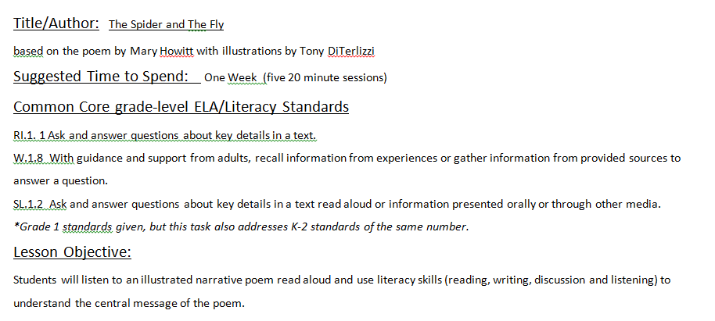
Example from The Spider and the Fly

Slide 53
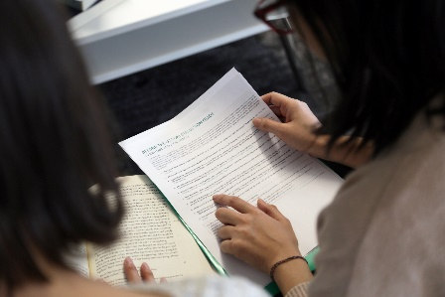
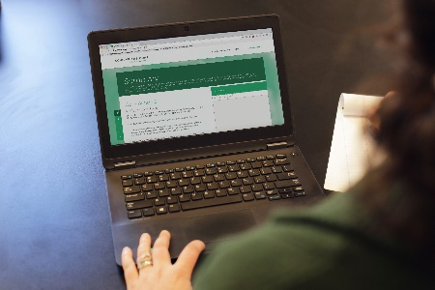

About Achieve the Core
Visit achievethecore.org to find:
Professional Learning Content
PD modules
Research
The Aligned Blog
Tools for Planning and Reflection
The Instructional Practice Toolkit
The Instructional Practice Guide
The Lesson Planning Tool
Focus Documents
Alignment rubrics and adaptation guidance
Classroom Resources
Math and ELA lessons
Mini-assessments
Writing resources
The Coherence Map
Academic Word Finder

Slide 54
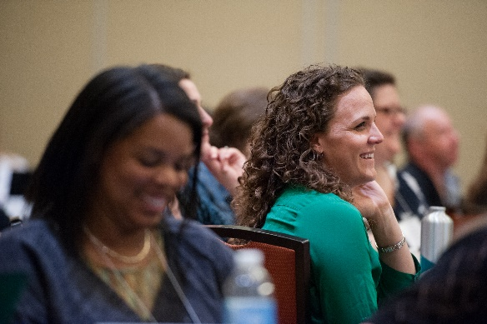
The Core Advocate Network
Who are the Core Advocates?
Core Advocates are educators who:
Believe in the potential of high-quality standards grounded in evidence to prepare all students for college and career.
Understand and embrace the Shifts in instruction and assessment required by college- and career-ready standards.
Are eager to support their colleagues and communities in understanding and translating the Shifts into instructional practice.
What do Core Advocates do?
As instructional advocates, Core Advocates lead other educators in their communities in understanding the Shifts, as well as sharing practices aligned to the Shifts and the standards. Among other actions, Core Advocates:
Lead professional development sessions and professional learning communities.
Create, refine, and share standards-aligned resources with the field.
Advocate for high-quality instruction, instructional resources, and professional learning.
Use and provide feedback on high-quality instructional tools and resources.
How can I get involved?
Join the Core Advocate Network by taking the Core Advocate survey at: www.achievethecore.org/ca-signup
Email coreadvocates@studentsachieve.net with any questions.

Slide 55




Stay Connected
Subscribe for email updates on achievethecore.org
Follow us on social media:
Facebook: facebook.com/achievethecore
Twitter: twitter.com/achievethecore
Pinterest: pinterest.com/achievethecore

