Slide 1
BASAL ALIGNMENT PROJECT
Council of the Great City Schools
and
Student Achievement Partners
Notes:
This module was last updated on February 2016.
QUESTIONS WELCOME THROUGHOUT----NOT HERE TO BADMOUTH BASALS– THIS GENERATION WAS DESIGNED FOR DIFFERENT STANDARDS
SOME OF WHAT WE GO OVER HERE IS IN WRITTEN INTRODUCTION---VAST MAJORITY OF LEARNING WILL COME FROM WORK IN GROUPS
GREAT LEVERAGE HERE CGCS/SAP/STATES/DISTRICTS! COMMON EFFORT FOR ALL OUR STUDENTS.

Slide 2
BASALS CURRENTLY NOT ALIGNED
Many questions not text-dependent
Virtually all culminating assignments not text dependent
Focus on comprehension strategies
Do not focus as strongly on academic (tier two) vocabulary
Notes:
THIS IS WHERE WE WILL PUT OUR WORK—LITTLE MATTERS IF THIS IS NOT CHANGED---WORD ON COMPREHENSION STRATEGIES. TEACHERS NEED ALIGNED MATERIAL IN THEIR HANDS, STUDENTS NEED ALIGNED MATERIAL TO WORK WITH.

Slide 3
BASALS CURRENTLY NOT ALIGNED
Do not, “within and across grade levels…systematically develop the knowledge base of students”
Some number of texts not aligned in terms of complexity
Narrative/Informational proportions at each grade level not aligned
Notes:
WE CANNOT ADDRESS THIS HERE, MAYBE ON A WEBINAR OR CHAT DURING THE WRITING PERIOD— READ ALOUDS IN BASALS– EMAIL US FOR OTHER IDEAS--WILL INSTEAD ADDRESS OTHER AREAS BEGINNING WITH TEXT DEPENDENT QUESTIONS---SPIKES OF COMPLEXITY

Slide 4
WHAT BAP DOES ADDRESS
Big Ideas/Key Understandings
Text-dependent questions
  Importance of rereading and returning to the text
Academic (Tier Two) vocabulary
Culminating tasks
Additional activities
Notes to the Teacher
Notes:
Need to say why in each case. Refer to overview intro that will accompany each set of revisions.

Slide 5
WHAT BAP DOES NOT ADDRESS
Will not alter sections on phonics, spelling, grammar, word study, science and social studies connections
Will not be supporting any supplemental texts such as leveled readers.
Notes:
Need to say why in each case. Refer to overview intro that will accompany each set of revisions.

Slide 6
ROLE OF PRE-READING
Multiple readings (required in BAP revisions) often make this unnecessary
Too often provides information students can glean from careful reading of the text–in many cases provide a complete summary
Almost impossible to wean students from this
Teachers feel helpful when they can “smooth the road” for their students–this is hurting them, not helping them
There is no research base for this
Notes:
NOTE SHANAHAN BLOG

Slide 7
Big Ideas, Key Understandings
Reverse-engineered or backwards-designed
Crucial for creating an overarching set of successful questions
Critical for creating an appropriate culminating assignment

Slide 8
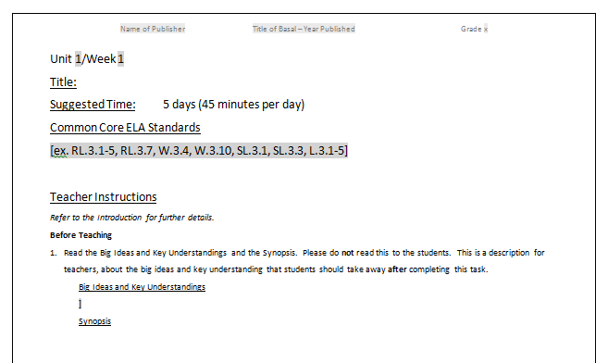
Big Ideas, Key Understandings
Found on the first page of every BAP revision.

Slide 9
WHAT ARE TEXT-DEPENDENT QUESTIONS?
Questions that can only be answered with evidence from the text
Can be literal but can also involve analysis, synthesis, evaluation
Focus on word, sentence and paragraph as well as larger ideas, themes or events
Focus on difficult portions of text in order to enhance reading proficiency
Much more in your guides
Notes:
LEARN ABOUT THIS BY DOING IT AND THIS IS A REAL DOING TWO DAYS

Slide 10
WHY TEXT-DEPENDENT QUESTIONS? or, WHY NOT GO OUTSIDE THE TEXT?
More time outside the text less inside
Going outside the text privileges those who have that experience
It is easier to talk about our experiences than to analyze the text
These are college and career standards
That being said….

Slide 11
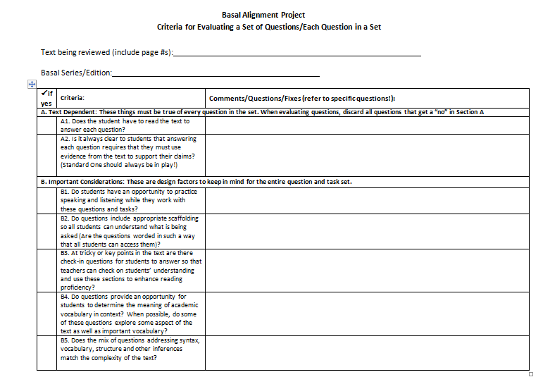
CREATING TEXT-DEPENDENT QUESTIONS: Review, Critique, and Revise
Refer to Training Materials folder on Edmodo for a copy of this.

Slide 12
CREATING TEXT-DEPENDENT QUESTIONS
Use the guides and support structures.
Consistency is vital!
Big ideas and key understandings
Culminating activity or activities
Refer to the standards as last step
Finding difficult sections of text
Expect thorough response
Notes:
FINDING DIFFICULT SECTIONS OF TEXT HELPS WITH COMPLEXITY---NOT A FORMULA– WILL NOT ALL BE THE SAME—HOW EXACTLY DOES QUESTION MATCH STANDARD KEEP IN MIND HERE THAT MATCHING UP MANY STANDARDS EACH WEEK—THOROUGH RESPONSE EXAMPLE OF JONATHAN IN EARTHQUAKE STORY WHY HE IS DRAGGING WORRIED ABOUT MOTHER/ISOLATED/CONCERNED ABOUT SISTER—HOW MANY QUESTIONS FOR EACH PASSAGE---QUESTIONS NO ONE CAN ANSWER

Slide 13
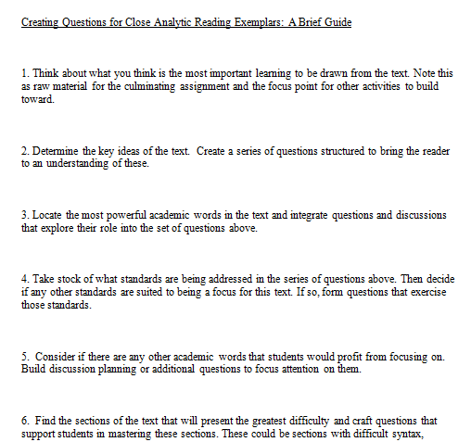
CREATING TEXT-DEPENDENT QUESTIONS
Refer to Training Materials folder on Edmodo for a copy of this.
Notes:
FINDING DIFFICULT SECTIONS OF TEXT HELPS WITH COMPLEXITY---NOT A FORMULA– WILL NOT ALL BE THE SAME—HOW EXACTLY DOES QUESTION MATCH STANDARD KEEP IN MIND HERE THAT MATCHING UP MANY STANDARDS EACH WEEK—THOROUGH RESPONSE EXAMPLE OF JONATHAN IN EARTHQUAKE STORY WHY HE IS DRAGGING WORRIED ABOUT MOTHER/ISOLATED/CONCERNED ABOUT SISTER—HOW MANY QUESTIONS FOR EACH PASSAGE---QUESTIONS NO ONE CAN ANSWER

Slide 14
VOCABULARY IS ESSENTIAL
Role in complex text
One of two features of text most predictive of student difficulty (Chall 1996, Stanovich 1986, Nelson et al 2012)
Many of the basal stories have a great deal of powerful academic vocabulary
From, “Officer Buckle” third grade (department, attention, speech, applauded, frowned, onstage, swivel, frowned, afterward, announced, discovered, grinned, roared, enormous, bowed)
Vocabulary is difficult to catch up

Slide 15
VOCABULARY
Which words should be taught?
  Essential to text
  Likely to appear in future text
  Which words should get more time and attention?
  More abstract words (persist vs. checkpoint noticed vs. accident)
      Words which are part of semantic word family (secure, securely, security, secured)

Slide 16
VOCABULARY
When should you provide the meaning; when should students determine from context?
  Addressed in the vocabulary chart of every revision
How should words be taught?
  Distributed practice
  Use the text
  Note differences (applaud vs. clap; isolated vs. alone)
Notes:
CAN’T GET INTO THIS HERE. WE CONCENTRATE STUDENT ATTENTION ON IT AS MUCH AS POSSIBLE.
DIFFICULT TO PROVIDE ALL THE ACTIVITIES TO DO THIS--

Slide 17
INTEGRATING VOCABULARY INTO TEXT DEPENDENT QUESTIONS
From “Hot and Cold Summer” Trophies 5th grade
“To avoid someone means to keep away from them so that you don’t have to see them and they don’t have to see you. How did the boys avoid meeting Bolivia at first? (pg. 23)”
Re-read the last two paragraphs on page 39. Rory had a “strong suspicion”. What is a suspicion? What details in the story made Rory suspicious of Bolivia?

Slide 18
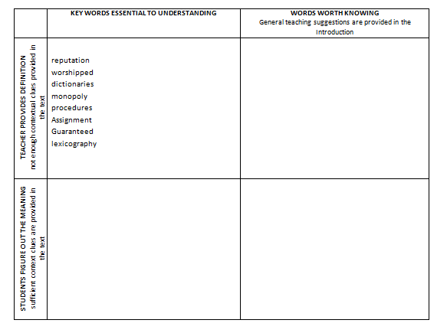
VOCABULARY
Refer to Training Materials folder on Edmodo for a copy of this.

Slide 19
SYNTAX
Just as important as vocabulary in predicting student performance
Use text dependent questions to address difficult syntax
Notes:
WE DID NOT MODEL THIS AS MUCH AS WE WOULD HAVE LIKED

Slide 20
FLUENCY
Some basals address it, some don’t. We must!
With the arrival of more complex text, more students will struggle to read fluently
Some revisions include fluency activities under additional activities.

Slide 21
CULMINATING TASK
Should relate to big ideas and key understandings
These types of culminating assignments will be a significant shift for students and teachers—take more time
Culminating task and sample student answer are included
at the end of every revision

Slide 22
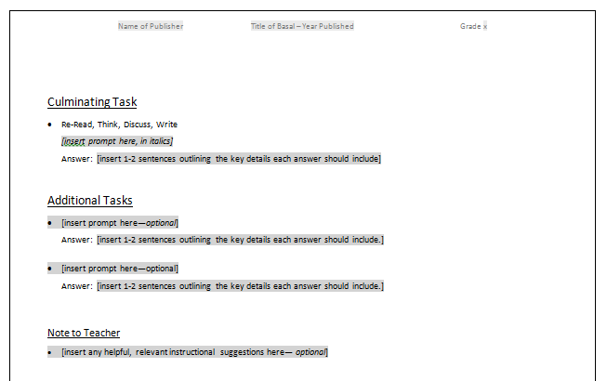
Tasks and Teacher Notes
Culminating task, additional activities, and notes to teacher
found at the end of every revision

