Slide 1
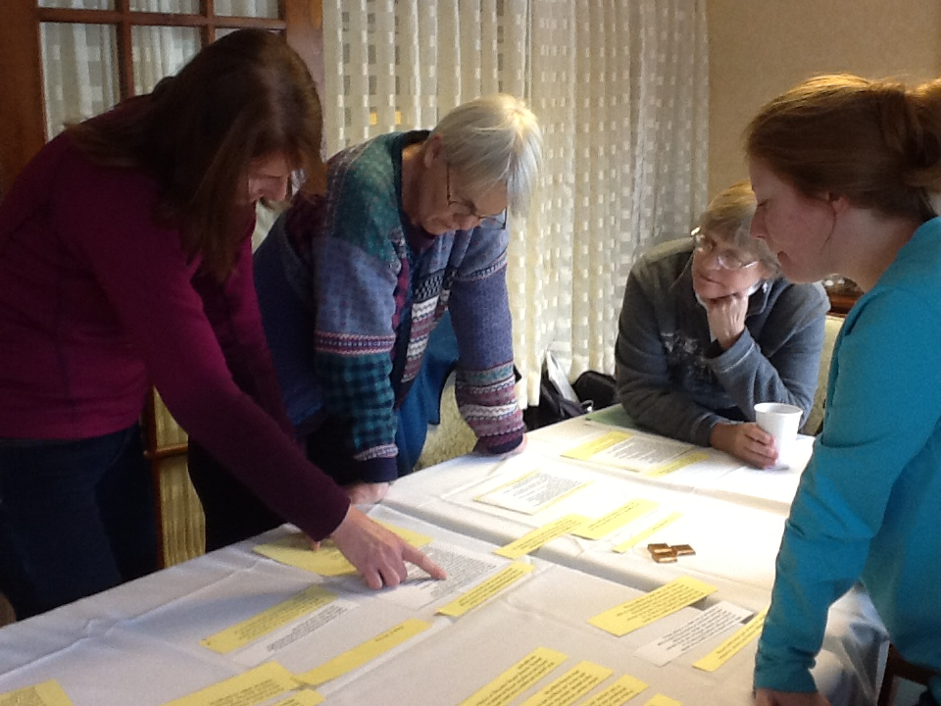
Common Ground
Protocols for Working with the K-12 Writing Samples in In Common
Student writing samples that can be used with these protocols can be found at www.achievethecore.org
Notes:
In order to help educators use In Common, the Vermont Writing Collaborative has developed several protocols that offer directions for preparing and using the student work in the collection for professional learning.

Slide 2

Common Ground Protocols
A set of activities designed to help educators and students understand the elements of an effective piece of writing as described by the Common Core Writing Standards.
Activities can be adapted to any writing type, grade level or cluster of grade levels.
Can be used with In Common or other sets of student samples .
Notes:
The Vermont writing Collaborative has created 4 different activities that can be used by teachers, administrators, and other literacy leaders to deepen understanding of what effective Common Core aligned writing might look like. Some of these activities can even be adapted to be used by students!
All of the protocols can be used at any grade level to analyze work in any of the three CCSS writing types. The Common Ground Protocols can be used with the student samples collected in In Common or with writing generated by your own students.

Slide 3
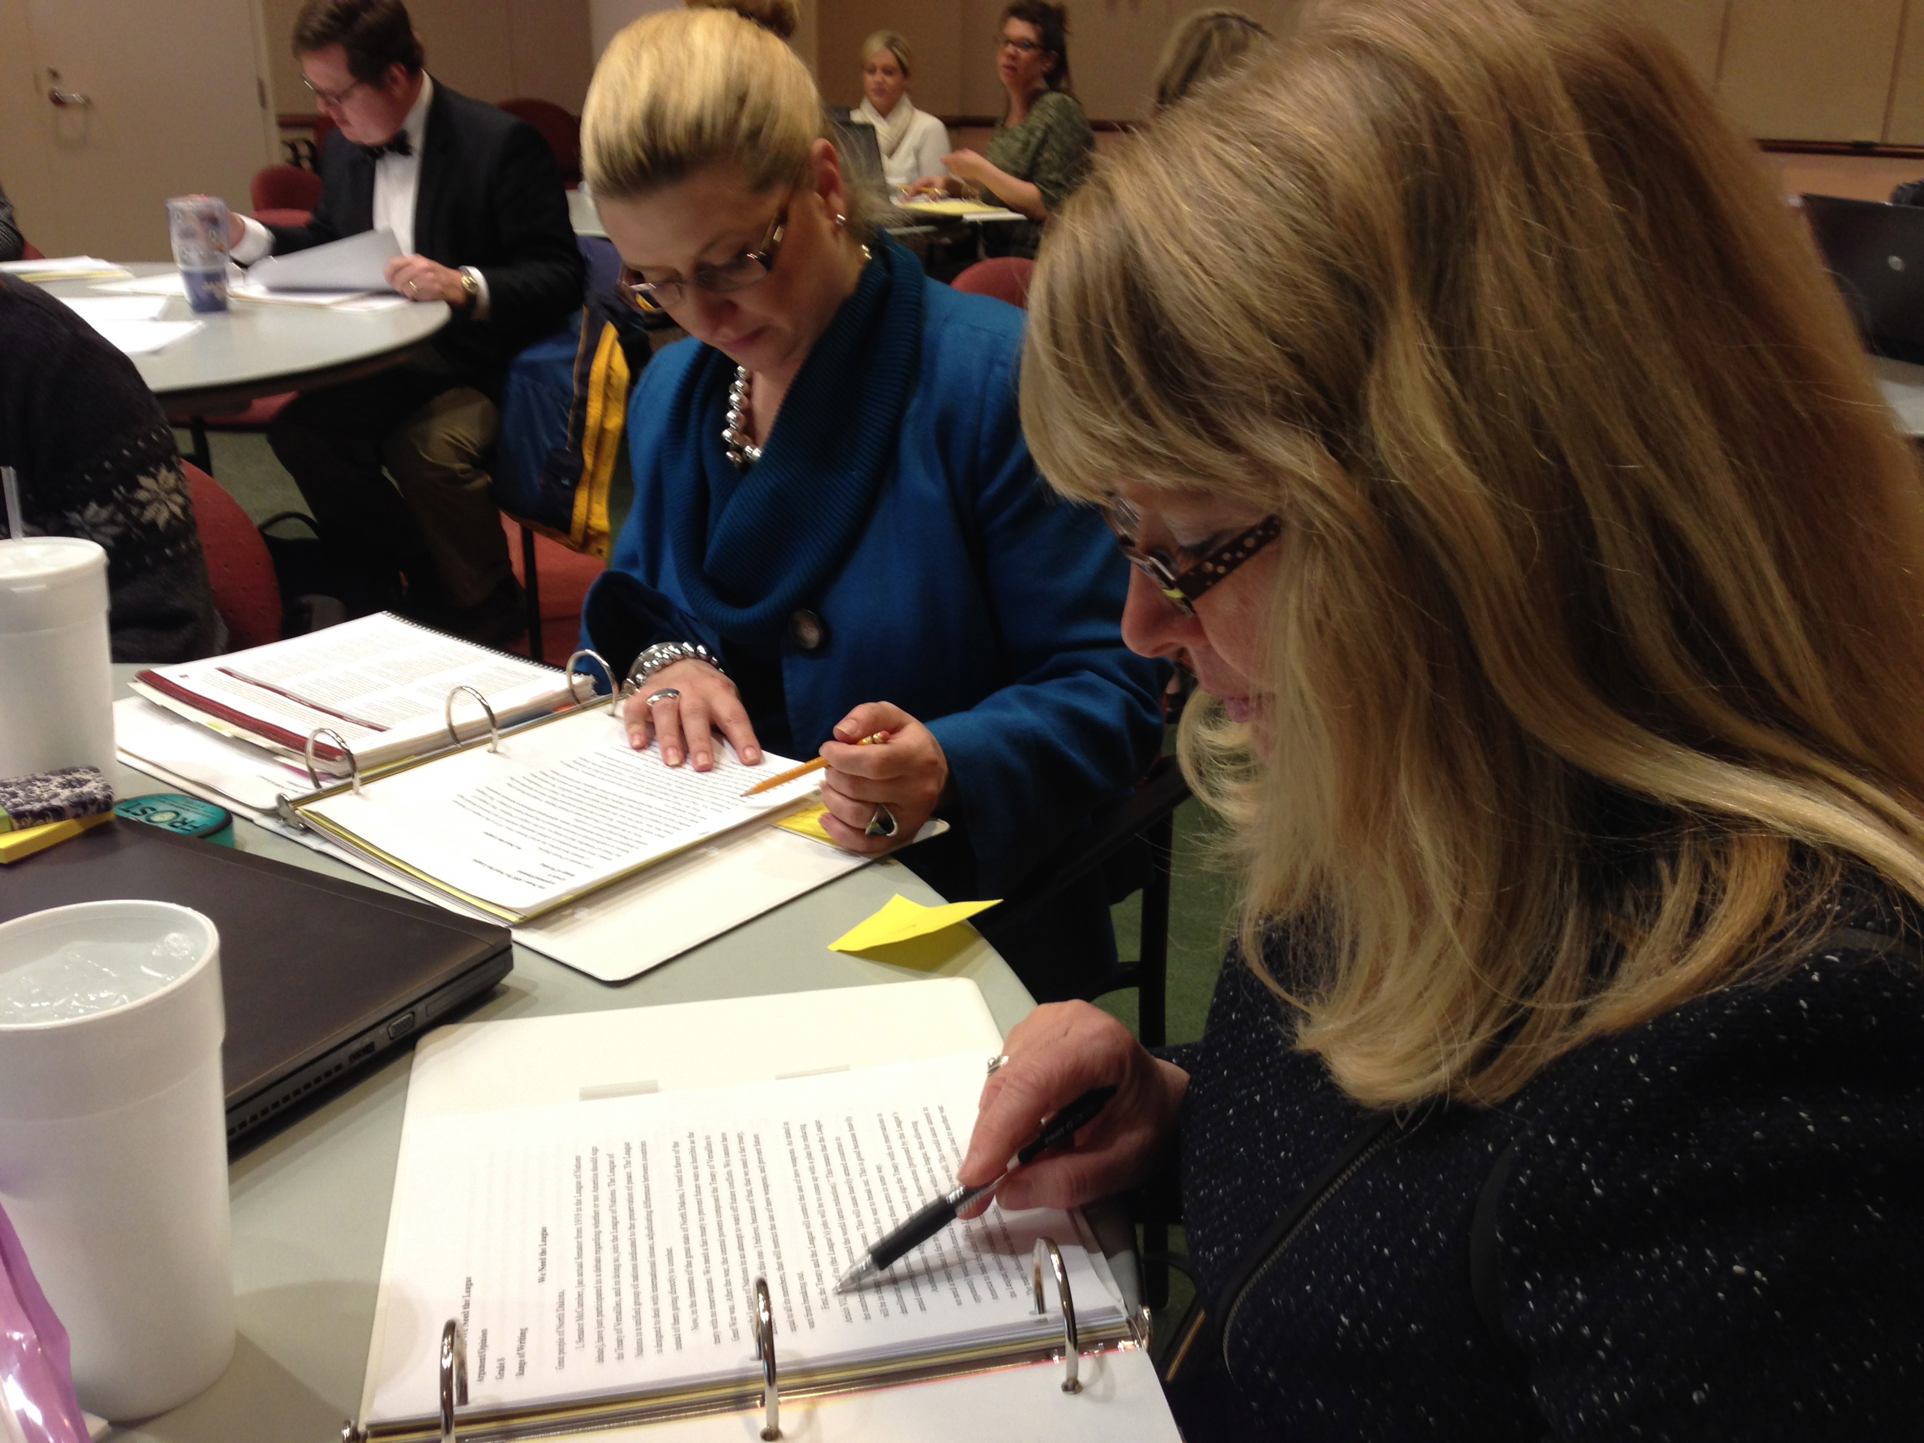
For each Common Ground Activity, you will find:
A Professional Development
Planning Page
A Protocol
A Recording Sheet
Notes:
The Protocols, available for free on achievethecore.org, each contain
a planning page, with instructions on preparing and leading the activity,
the protocol itself , which clarifies the purpose of the activity and gives directions to participants
and
some type of recording sheet for capturing learning and observations.

Slide 4
Four Protocols are available for guiding professional learning using In Common:
How Does Your Garden Grow?
Learning by Example
Colorful Language
What Can My Students Learn by Writing?
Protocols are available on achievethecore.org
Notes:
There are four protocols available, and each can be used flexibly.

Slide 5
Today we will deepen our understanding one of the Common Core writing types a Common Ground Activity:
Opinion/Argument
Colorful Language
NOTE: This protocol can be used with any writing type.

Slide 6

Colorful Language
PURPOSE:
To refine and deepen understanding of particular aspects of effective writing.
Notes:
This prototype is called Colorful Language. It is designed to help teachers or students refine their understanding of a specific writing type at a particular grade level.

Slide 7
Opinion/Argument
Writing
W.1 Write arguments to support claims in an analysis of substantive topics or texts, using valid reasoning and relevant and sufficient evidence.

Slide 8
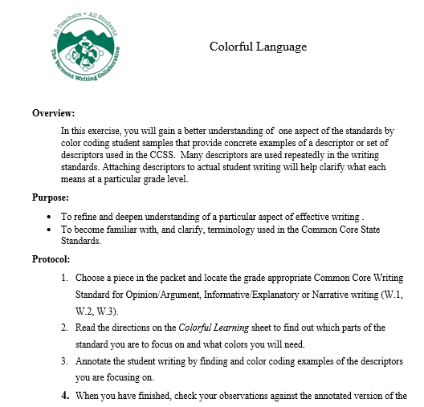
Notes:
There is a set of directions that includes an overview and purpose.

Slide 9
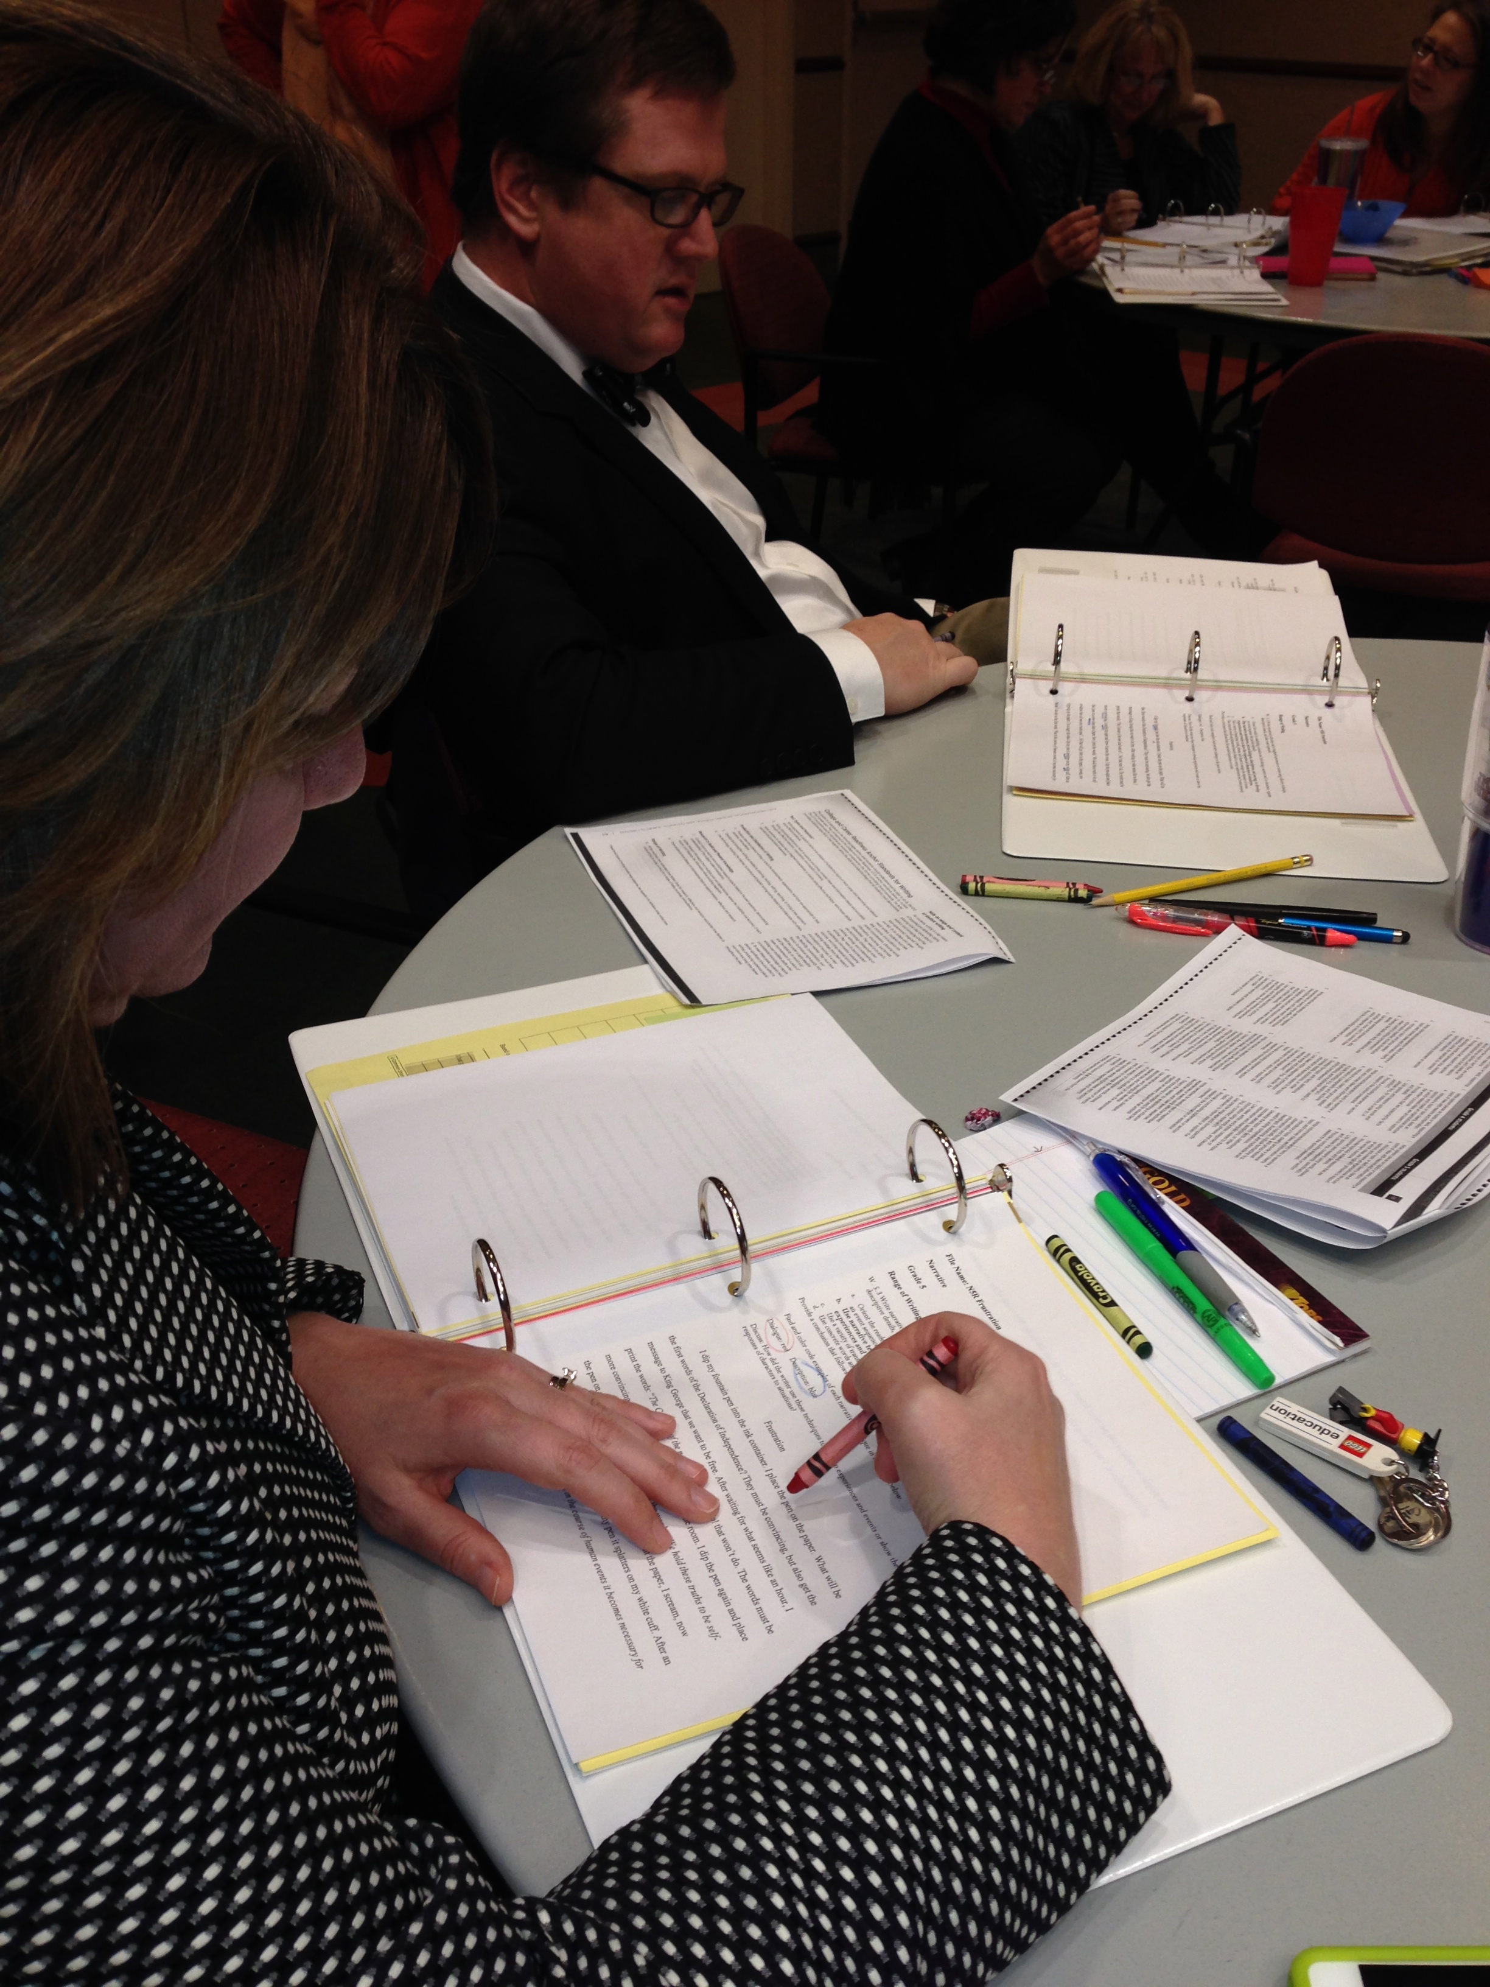
Analyzing Student Samples Using Color
Notes:
In this activity, participants use color to identify and reflect on specific descriptors in a Common Core standard.

Slide 10
An Example:
Color Code the pieces in your packet:
Find and color code examples to show each of the following:
Introduction: red
Opinion Statement: light green
Reason #1 and supporting facts and details: yellow
Reason #2 and supporting facts and details: blue
Concluding Section: darker green
Notes:
For example, to analyze an opinion piece, teachers might be asked to find the introduction and shade it red. To locate the stated opinion and color it green or to trace the reasoning in the piece using yellow and blue.

Slide 11
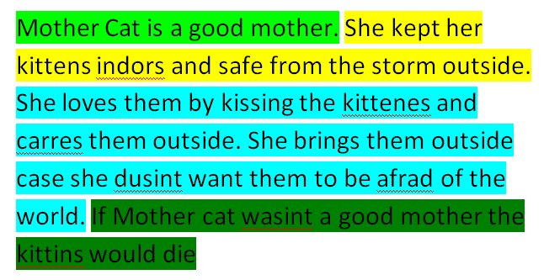
Introduction: red
Opinion Statement: light green
Reason #1 and supporting facts and details: yellow
Reason #2 and supporting facts and details: blue
Concluding Section: darker green
Colorful Language
Informational/Explanatory
Grade 1
Range of Writing
Notes:
The sometimes abstract language of the standard comes alive as teachers connect the words in each descriptor with the written words of an actual student. If this activity is done with multiple pieces, participants can develop an understanding of the standard which is nuanced, yet concrete.

Slide 12
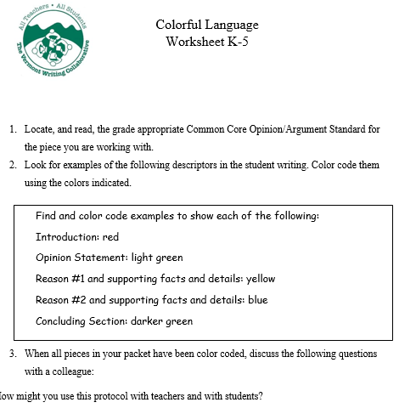
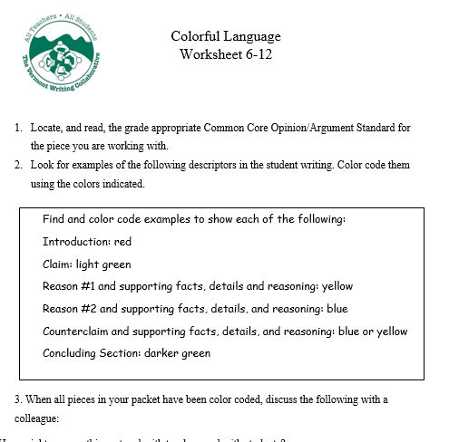
Two different sets of directions for color coding
K-5 OR 6-12
Follow the directions in the box for the grade cluster chosen.
Notes:
This slide can be modified to reflect your grade level focus.

Slide 13
Follow the directions in the box for the grade cluster chosen.

Slide 14
Follow the directions in the box for the grade cluster chosen.

Slide 15
REFLECT
Colorful Language
When all pieces in your packet have been color coded, discuss the following with a colleague:
How might you use this activity
with colleagues?
with students ?
Notes:
Again, reflection questions after the activity prompt synthesis and discussion.

