Slide 1
Common Ground
Protocols for Working with
the K-12
Writing Samples in In Common
Student writing samples that can be used with these protocols can be found at www.achievethecore.org
Notes:
In order to help educators use In Common, the Vermont Writing Collaborative has developed several protocols that offer directions for preparing and using the student work in the collection for professional learning.

Slide 2
Common Ground Protocols
A set of activities designed to help educators and students understand the elements of an effective piece of writing as described by the Common Core Writing Standards.
Activities can be adapted to any writing type, grade level or cluster of grade levels.
Can be used with In Common or other sets of student samples .
Notes:
The Vermont writing Collaborative has created 4 different activities that can be used by teachers, administrators, and other literacy leaders to deepen understanding of what effective Common Core aligned writing might look like. Some of these activities can even be adapted to be used by students!
All of the protocols can be used at any grade level to analyze work in any of the three CCSS writing types. The Common Ground Protocols can be used with the student samples collected in In Common or with writing generated by your own students.

Slide 3
For each Common Ground Activity, you will find:
A Professional Development
Planning Page
A Protocol
A Recording Sheet
Notes:
The Protocols, available for free on achievethecore.org, each contain
a planning page, with instructions on preparing and leading the activity,
the protocol itself , which clarifies the purpose of the activity and gives directions to participants
and
some type of recording sheet for capturing learning and observations.

Slide 4
Four Protocols are available for guiding professional learning using In Common:
How Does Your Garden Grow?
Learning by Example
Colorful Language
What Can My Students Learn by Writing?
Protocols are available on achievethecore.org
Notes:
There are four protocols available, this slide show will focus on “What Can My Students Learn by Writing?”.

Slide 5
Today we will deepen our understanding of content and text based writing using a Common Ground Activity:
What Can My Students Learn by Writing?

Slide 6
PURPOSE:
To demonstrate some ways that reading and writing can be used to build deep understanding in science, social studies, literature and other areas.
To explore the role of backward design in writing instruction.
What Can My Students Learn by Writing?
Notes:
This activity is called, “What Can my Students Learn by Writing?”. In this protocol, teachers examine content based writing and “work backward” to speculate about the instruction that took place before the piece was written.

Slide 7
Common Core Writing Standards
Some Key Differences
Writing from text
Closely integrated with content
All content areas
All writing types
Notes:
A key difference in the CCSS is that the standards emphasize writing based on information from text and writing in all content areas.

Slide 8
Notes:
Here’s the protocol, which is designed to be used with pieces from the In Common that show a depth of understanding about science, social studies or literature.

Slide 9
Exploring Backward Design
Notes:
After reading a student piece, teachers focus on specific aspects of the student work and speculate about what might have gone on in the classroom before the piece was written.

Slide 10
Notes:
Their analysis is guided by a question sheet that calls attention to evidence of solid backward design in what the student has written. For example, teachers look for a “Big Idea” in the writing and speculate on the question that focused the writing task. They look at the information used in the student piece and speculate on what texts may have been read before writing.

Slide 11
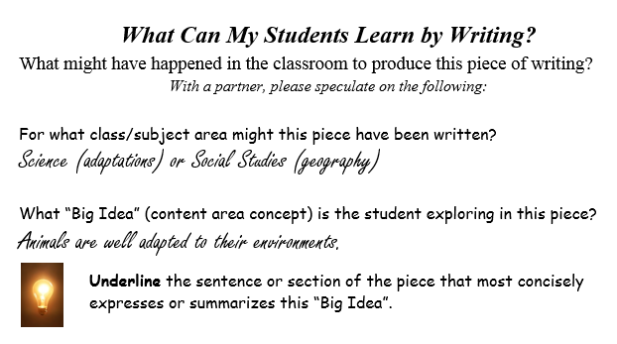
Australian Animal adaptations
In the hot desert of Australia there are many animals big and small. Some of those animals are the kangaroo, the dingo, and the blue-tongued skink. All of animals in the Australian desert must be well adapted to their hot and dangerous environment. The emu and the thorny devil are well adapted to the Australian desert.
The emu in Australian has predators like many other animals. The emus have long legs and can run 50 to 60 mph to get away from predators like the dingo. This is a good adaptation so
Notes:
Looking carefully at student writing that shows clear mastery of content or concepts can help teachers to begin to think about ways to use backward design in planning writing assignments that effectively integrate writing throughout the curriculum.

Slide 12
Protocol:
Begin by choosing a student piece that interests you. The pieces do not need to be read in order.
Read the piece, focusing on the content expressed as well as the way the piece was written.
With a partner, discuss each question on the What Can My Students Learn by Writing? Recording Sheet. Capture your thinking on the sheet as you work.
Jot any questions you have on the back of the sheet.
Repeat this process with another piece of your choice.
Be prepared to share your observations and questions with the larger group.
Notes:
Use the packet of pieces provided and the “What Can My students Learn by Writing?” Recording Sheet to complete this activity with a partner.

Slide 13
.
REFLECT
What Can My Students Learn by Writing?
How is this this writing similar to, different from the writing students have been doing?
What is needed, instructionally, for students to be able to write pieces like this?
How can writing be used as a tool for learning in the classroom?
Notes:
Reflecting as a team or a school on what it takes to support students in writing to show understanding of content or concepts learned in class can be particularly powerful- sparking discussion about both why and how curriculum and instruction may need to change.

