Slide 1
Introduction to the Instructional Materials Evaluation Tool (IMET): ELA
www.achievethecore.org
Notes:
This module was last updated on September 2016.
Estimated time for slides 1 - 10: 10 minutes
Big Idea: This is an introduction to the Instructional Materials Evaluation Tool for ELA, known as the IMET.
Details:
Presenters introduce themselves.
Who’s in the room? Teachers, coaches, others – vary the approach depending on the size and composition of the group.
Do a quick activity called “That’s Me.” Ask the following questions – participants stand when then the answer is “yes”.
How many of you are here to learn about reviewing instructional materials?
How many of you are looking for a way to deliver professional development around materials?
Identifying gaps in your current materials?
Evaluating materials you are building in-house?
All of the above?
Something else? Ask those standing to name their purpose for being there.

Slide 2
Essential Questions
What is the Instructional Materials Evaluation Tool (IMET)? How is it structured?
How does the IMET enable reviewers to evaluate whether instructional materials are aligned to the major features of the Standards and fulfill the Shifts they require?
How could the IMET be useful in a variety of settings to bring the CCSS and Shifts to life for students?
Notes:
Big Idea: Student Achievement Partners, a nonprofit organization comprised of a group of the authors of the Common Core State Standards, developed and offers a toolkit available to assist with evaluating materials for Common Core State Standards (CCSS) alignment.
Details:
Found on p. 1 in handout
The Instructional Materials Evaluation Tool, which we’ll be working with today, is just one of the tools available in the Instructional Materials Toolkit, which some of you may already know. These are our essential questions which will guide our learning today.
Have participants read over the questions.
We have a unique opportunity to press the reset button--to actually align materials, instruction, and assessment on a grand scale if we use the CCSS as a guide.
We will refer to the Instructional Materials Evaluation Tool as “the IMET” for the balance of the presentation today.

Slide 3
Goals
Understand that the IMET is a powerful tool that enables reviewers to evaluate whether instructional materials are aligned to the Common Core State Standards
Understand how the IMET structure and levels of alignment illuminate the major features of the standards
Consider pertinent uses for the IMET including evaluating new or current curricular materials, developing materials, and professional learning
Notes:
Big Idea: These are our goals for this session.
Details:
Found on p. 1 in handout
Have participants read over the goals or read aloud.
This PPT is part of a suite of materials available at achievethecore.org/imet. There are modules available to support more detailed IMET learning and use.

Slide 4
Agenda
Introduction to the IMET
Review the Shifts
Color the Shifts activity
Non-Negotiable 1: Text Complexity
Non-Negotiable 2: Text-Dependent Questions
Non-Negotiable 3: Building Knowledge
Non-Negotiable 4: Foundational Skills (K-2)
Alignment in materials
Summarizing
Notes:
Note to presenter: Adjust for the needs of the group.
Big Idea: Preview the agenda for the session.
Details:
We will be taking a walk through the IMET and seeing how the Standards and instructional Shifts, required by the CCSS, inform the design and specific metrics of the tool.

Slide 5
“In general, teachers are much more likely to cover topics presented in the materials selected by their school or district than to cover topics not included; they are likely to follow the sequence of topics in the selected materials; and their pedagogical approach is influenced by the instructional design of the materials. The evidence is clear that instructional interactions between students and teachers are framed by the instructional materials that are provided by their schools and districts.”
Chingos & Whitehurst,
Choosing Blindly: Instructional Materials, Teacher Effectiveness, and the Common Core
Notes:
Big Idea: Why is this work important?
Talking Points:
<Ask participants to reflect on how this quote resonates with what they are seeing in their school or district.>
Instructional materials may be one of the most important factors in student learning.
There is a lot of research and time invested in teacher effectiveness and the importance of a high quality teacher in classrooms. Aligned instructional materials are a factor in that effectiveness.
In moving to CCSS, the textbook is an important guide for teaching the standards, especially for new teachers, but also for more experienced teachers who are learning what the new standards mean. That’s why it’s so important that instructional materials get it right!
Quote is from a Brookings Institution report from 2012, available here: https://www.brookings.edu/research/choosing-blindly-instructional-materials-teacher-effectiveness-and-the-common-core/

Slide 6
“There is strong evidence that the choice of instructional materials has large effects on student learning – effects that rival in size those that are associated with differences in teacher effectiveness.”
Chingos & Whitehurst,
Choosing Blindly: Instructional Materials, Teacher Effectiveness, and the Common Core
Notes:
Big Idea: The quality of instructional materials in our classrooms has a large impact on student learning.
Details:
We often hear about the importance of teacher effectiveness. This paper points to the critical role of materials.
Quote is drawn from a Brookings Institution report from 2012, available here: https://www.brookings.edu/research/choosing-blindly-instructional-materials-teacher-effectiveness-and-the-common-core/

Slide 7

History of the IMET
Achieve
Student Achievement Partners
Council of Chief State School Officers
Notes:
Big Idea:
As states adopted the Common Core State Standards (CCSS), there was demand for a tool to analyze instructional material alignment. States, districts and educators needed a common language for talking about and evaluating materials against the Common Core State Standards.
Details:
There was interest in reviews that would cross state lines so we could begin to answer the question together: What does alignment look like in materials?
Achieve, SAP, and Council of Chief State School Officers worked together to craft a toolkit to help stakeholders analyze alignment in materials.
The IMET is one tool in a comprehensive toolkit available on achievethecore.org to support educators in identifying alignment in materials.

Slide 8

IMET Sources
Common Core State Standards for English Language Arts & Literacy in History/Social Studies, Science, and Technical Subjects
Supplement to Appendix A of the Common Core State Standards for ELA/Literacy: New Research on Text Complexity
Notes:
Big Idea:
The adoption of the CCSS across dozens of states presents a rare opportunity to align standards, materials, and assessment. The IMET criteria, developed because educators needed a common tool for identifying alignment to the Common Core State Standards, are drawn directly from the Standards themselves and the research from the Supplement to Appendix A of the CCSS on Text Complexity.
Details:
The second resource provides the updated research base for the text complexity grade band progression outlined in Standard 10.

Slide 9
When to Use the IMET
Purchasing or evaluating new materials
Evaluating materials currently in use
Developing materials
Professional learning
Notes:
Big Idea: The IMET can be used in a variety of situations.
Details:
Procurement: alignment to the standards is a critical factor to consider when purchasing
Evaluating materials in use: analysis of materials will illuminate flaws in alignment and offer opportunities for thoughtful planning to modify resources
Developing materials: guidance for creating well-aligned curricula
Professional learning: valuable understanding of instructional approach and components and pedagogy can be gained from reviewing materials using the IMET

Slide 10
The IMET: An Overview
Versions for ELA/Literacy: Kindergarten–2nd grade, and 3rd–12th grades
  For Math: Kindergarten–8th grade, and High School
Comprehensive curricula
2 Levels of Alignment:
  Non-Negotiable (NN) Alignment Criteria
  Alignment Criteria (AC)
www.achievethecore.org/imet
Notes:
Big Idea:
There are three tiers, or levels, with associated metrics to determine alignment to the CCSS standards and shifts. They are prioritized in the following way: Non-Negotiable Alignment Criteria and Alignment Criteria
Details:
Today we will be working with the 3-12 version. The two versions reflect the differences in the ELA standards and instructional priorities at the primary grades. We will make note of differences in the K-2 version and the 3-12 version as we move through the Alignment Criteria.
Now that you have an idea of what the IMET is, we’ll dig into the content. We’ll begin with a review of the 3 ELA Shifts. Even if you are familiar with the shifts, I encourage you to reflect on how your understanding of them has deepened or grown since you first heard about them. This will also provide us with a common understanding and foundation as we move through the IMET.

Slide 11
3 Shifts in ELA
Regular practice with
complex texts and their
academic language
Reading, writing, and
speaking grounded in
evidence from text,
both literary and
informational
Building knowledge
through
content-rich
non-fiction
Notes:
The following slides provide a review of the 3 ELA shifts. Depending on the needs of the group, this information may need to be adjusted. See the Facilitator Guide for options.
Estimated time for slides 11-20: 15 minutes
Big Idea: The 3 Shifts in ELA and Literacy can be summed up this way: complex text, evidence, and knowledge.
Details:
Found on p. 2 in handout.
When the Council of Chief State School Officers and National Governors’ Association began drafting a set of standards to prepare students for college and career, they used evidence of what students would need to be able to do by the end of a K-12 education. In order to prepare students adequately for college, career, and life, there were some changes needed. These changes or shifts are reflected in the Standards and can be summarized this way.
Any one of these shifts could be studied much more deeply and there’s a plethora of great materials available for you or your group to investigate as time or interest permits.
How many of you are familiar with the 3 Shifts in ELA and Literacy?

Slide 12
Shift 1: Text Complexity
HS to College Gap
Complexity predicts college success (ACT study)
High rates of remediation
CCSS staircase of complexity:
ES → HS
Engaging with complex language and rich vocabulary
Regular practice with
complex texts and their
academic language
Notes:
Big Idea: Text complexity is the first shift because, for the first time, the Standards require that texts at the center of instruction be of certain quality. This stems from the fact that research showed text complexity to be the biggest factor in predicting college and career readiness. If a student cannot handle complex text, he/she is more likely to need remedial coursework, and is less likely to graduate from college. Exposure to rich, complex text and its academic language is a requirement for all students.
Read Aloud (corresponds to the check mark bullets on the slide):
The gap between the complexity of college and high school texts is large. An analysis done by Williamson in 2008 found military, college, citizenship, and workplace domains all required reading in the 1105-1395L complexity. His research indicated there was a gap of as large as 230L points between what students were reading in HS and what was required in college, career, citizenship, and the military.
Why the focus on text complexity? Research, namely The 2006 ACT Study, Reading Between the Lines, informed the writing of the CCSS for ELA & Literacy. This research, which will be summarized on the next few slides, showed that what students can read, in terms of complexity is the greatest predictor of success in college (ACT study).
National remediation rates in ELA and Math hover around 42% at community colleges and 20% at 4 year colleges. Overall, as many as 69% of incoming freshman need remedial coursework despite having high school diplomas. In California the rates hover at 68% according to the National Center for Public Policy and Higher Education in The Governance Divide report.
College and career-ready standards include a staircase of increasing text complexity from elementary through high school, so the job of preparing students begins early and continues seamlessly through high school..
Complex text is filled with complex language and vocabulary absent in simpler materials. Students must be exposed to rich vocabulary and complex language beginning in the earliest years through read aloud to build a solid foundation for reading comprehension of increasingly complex materials through high school.
Details: Note to presenter: These details are for your information. The ACT study research will be illustrated on the next few slides.
The report Reading Between the Lines examined what factors differentiated those students who equaled or exceeded the benchmark score (21 out of 36) in the reading section of the ACT college admissions test from those who did not.
Prior ACT research had shown that students achieving the benchmark score or better in reading—which only about half (51 percent) of the roughly half million test takers in the 2004–2005 academic year had done—had a high probability (75 percent chance) of earning a C or better in an introductory level course in U.S. history or psychology (two common reading-intensive courses taken by first-year college students) and a 50 percent chance of earning a B or better in such a course.
The report was based on 2005 High School students taking the ACT and trends from the previous 10 years.
The report can be accessed at: http://www.act.org/research/policymakers/pdf/reading_report.pdf

Slide 13
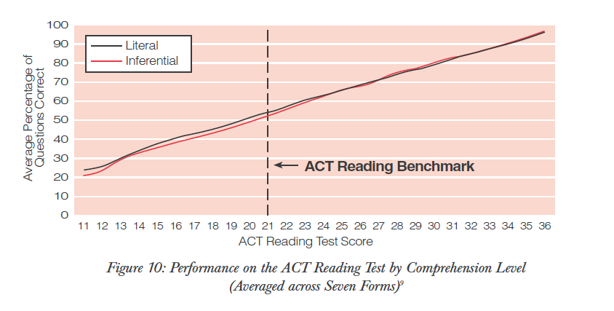
Students who can read literally can read inferentially.
Notes:
Big Idea: The 2006 ACT study, Reading Between the Lines, provided guidance to the team of writers commissioned by the National Governors Association and the Council of Chief State School Officers as they set out to create the next generation of K-12 standards in order to help ensure all students would graduate college and career ready.
Details:
Researchers investigated what factors differentiated college- and career-ready students from those who were not. First, they looked at the ability to make inferences.
Weaker scorers got inferential questions right proportional to the stronger scorers.
That is, if a student were able to answer literal questions, he/she was equally able to answer inferential questions. The lines match equally up the Average Percentage of Questions Correct axis.
Facilitator Note: (Optional) If there is time, the facilitator may choose to tell participants what the axis values measure (average percentage of questions correct and ACT Reading Test Score) and black and red lines (performance on literal and inferential questions) and give them a minute to discuss. This may also be given on the next 2 slides.

Slide 14
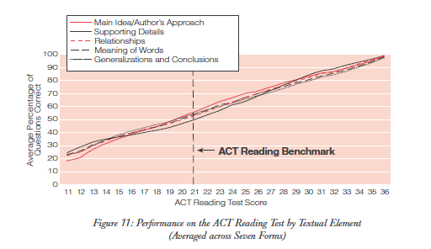
Students who can perform one strategy can perform all strategies.
Notes:
Big Idea: Researchers investigated whether reading strategies were the differentiating factor.
Details:
They were not. Students who could use one strategy, could basically use them all equally well.
If the ability to make inferences and the ability to use reading strategies were not the factors which differentiated those students who (according to this measure) were ready for college-level work from those who were not, what was the factor?

Slide 15
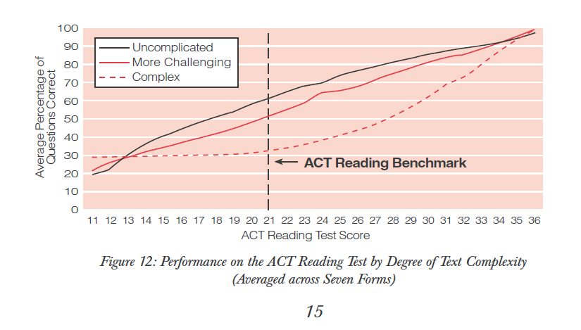
Ability to read complex text differentiates college-ready readers.
Notes:
Big Idea: The lines indicating uncomplicated, more challenging, and complex text separated, indicating the differentiating factor was the ability to read complex text.
Details:
Students with a benchmark score of 21 got only 30% of the complex text questions correct, while they were able to answer 60% correctly in uncomplicated text. 30% is just a bit better than random guessing!
From ACT (2006) Reading Between the Lines, p. 15. This data was pulled from ALL the students who took the ACT in 2005 and the study has been replicated. So the sample size is huge: a half million students take the ACT most years.

Slide 16
Shift 2: Evidence
College and workplace writing
Major emphasis of the ELA Standards
Hallmarks of strong readers and writers
Equity
Reading, writing and
speaking grounded in
evidence from text,
both literary and
informational
Notes:
Big Idea: Requiring evidence gained from reading when speaking and writing is a shift.
Read Aloud (corresponds to the check point bullets on the slide):
Most college and workplace writing requires evidence. A meta analysis of research report by Steve Graham and Michael Hebert of Vanderbilt University (“Evidence for How Writing Can Improve Reading”) highlights empirical evidence for improving reading comprehension through writing (i.e., having students answer TDQs, summarize, take notes, respond to reading, and generally increase opportunities to write, learn spelling, and receive direct instruction on writing).
The ability to cite evidence differentiates strong from weak student performance on the NAEP assessment. Beck, McKeown and their colleagues’ research (detailed below) also pointed to the critical role text dependent questions and evidence from text played in improving student learning. The ability to find and marshal evidence from sources is therefore is a major emphasis of the ELA Standards: Reading Standard 1, Writing Standard 9, Speaking and Listening standards 2, 3, and 4, all focus on the gathering, evaluating, and presenting of evidence from text.
Being able to locate and deploy evidence are hallmarks of strong readers and writers in society.
Requiring evidence from sources leads to equity in education. When students must rely on background knowledge or experience, the playing field is not level. Students having the background or experience are privileged. When evidence is drawn from sources used in the classroom, all have access to the information and it can be debated based on merit.
Details: Note to presenter: These details are for you as background information in presenting this slide.
Instruction over the past decades moved away from requiring evidence in speaking and writing – sometimes students did not even have to read a passage to answer a question. Students with knowledge had a leg up over students without experience or knowledge.
This shift helps level the playing field and teaches students valuable college and career skills.
These are the findings of the McKeown, Beck & Blake (2009) “Rethinking Comprehension Instruction: A Comparison of Instruction for Strategies and Content Approaches” study. The study compared 3 groups of students using a traditional basal program (control group), a comprehension strategies focused approach, and a “content approach” i.e., an approach focused on the text and what it says.
“The effectiveness of the two experimental comprehension instructional approaches (content and strategies) and a control approach were compared.
Content instruction focused student attention on the content of the text through open, meaning-based questions about the text.
Strategies instruction taught specific procedures to guide their access to text during reading of the text.
Control approach lessons were developed using questions available in the teacher's edition of the basal reading program used in the participating classrooms.
Student participants were all fifth graders in a low-performing urban district.”
In all three cases there was conversation, but in classrooms where the questions focused on content, the conversations were longer and better (length and quality of recall and text-focus).

Slide 17
Shift 3: Knowledge
Large research base
Knowledge crucial to comprehension
Very little nonfiction in school
College & workplace focus on nonfiction
Informational text harder
Building knowledge
through content-rich
non-fiction
Notes:
Big Idea: Shift 3 requires the building knowledge through the study of content-rich non-fiction.
Read Aloud (corresponds to the check point bullets on the slide):
According to research, knowledge and vocabulary play big roles in comprehension.
Students are required to read very little informational text in elementary and middle school, yet knowledge is critical to comprehension.
Non-fiction makes up the vast majority of required reading in college/workplace, yet much of what students are asked to read in elementary school has been fiction. Following the report of the National Reading Panel, the literacy block was extended, while Social Studies and Science became something teachers maybe squeezed into elementary classrooms. This shift requires students work with a balance of informational and literary texts to build the knowledge critical for comprehension.
This shift also acknowledges the preparation students need to be ready for the college and workplace focus on nonfiction.
Informational text is harder for students to comprehend than narrative text, so regular instruction and practice is necessary.
Details: Note to presenter: These details are for you as background information in presenting this slide.
Academic language improves when students speak and write using evidence from texts.
This shift restores content and knowledge, especially in elementary grades, to the literacy block.
As we will see, as we dig more deeply into the criteria for alignment, the building of knowledge is a consideration in planning curriculum. This is a critical shift as we prepare students for college and career.

Slide 18

Everyone knows knowledge plays a role in comprehension, but how big of a role?
“The Baseball Study” Recht & Leslie (1988)
Notes:
Big Idea: Recht and Leslie (1988) sought to answer exactly this question, by comparing the relative impact of reading ability to the impact of knowledge of a topic. They had students read a passage about baseball and then tested students’ comprehension of the passage.
Details:
“Effect of Prior Knowledge on Good and Poor Readers‘ Memory of Text” from Journal of Educational Psychology 1988, Vol. SO, No. 1, 16-20.
Had 7th and 8th grade students read a short text about baseball and tested them for comprehension using:
Verbal retelling
Reenactment with figurines
Verbal summary
Rating ideas from the story in terms of importance

Slide 19
The Baseball Study: Recht & Leslie (1988)
Compared reading comprehension for four categories of students:
High reading ability, High knowledge of baseball | High reading ability, Low knowledge of baseball
Low reading ability, High knowledge of baseball | Low reading ability, Low knowledge of baseball
Notes:
Big Idea: To understand the role knowledge played in comprehension, Recht and Leslie undertook a study in 1988. Students were divided into 4 groups as shown and then asked to read a passage about baseball. They then took a test of their comprehension.
Details:
<Ask participants to predict what % of questions on a reading comprehension test each category of student would get right. Participants should draw a grid on their paper and put an actual % of predicted questions correct in each quadrant. Tell them that the colors are so they can quickly match the group with the graphs on the next slide.>
“The high-ability /high-knowledge cell had 10 boys and 6 girls; the high ability/low-knowledge cell had 3 boys and 13 girls; the low-ability/high-knowledge cell had 12 boys and 4 girls; and the low-ability/low knowledge cell had 7 boys and 9 girls.”
High reading ability was defined as 70th percentile or higher on a standardized test of reading. Low reading ability was defined as 30th percentile or lower.
High knowledge of baseball was defined as 70th percentile or higher on a test of baseball knowledge. Low baseball ability was defined as 30th percentile or lower.

Slide 20
Knowledge of the topic had a much bigger impact on comprehension than generalized reading ability did.
Notes:
Big Idea: With sufficient prior knowledge, “low ability” students performed similarly to higher ability students (p. 19, Recht and Leslie). The difference in their performance was not statistically significant. This is why knowledge and content are considered one of the shifts. Content matters!
Details:
After the participants predict percentages, show them this slide and give them a minute to take it in. They should notice that the low reading ability students with high knowledge outperformed the high reading ability students with low knowledge. In addition, there is little difference between the two high knowledge groups and the two low knowledge groups.
From pg. 18, table 1, Recht & Leslie 1988. (Qualitative Measure) Note: conversion from raw numbers to percentages achieved by dividing score by achieved by total possible score.
Frequently Asked Questions:
Is this study generalizable? Yes! In fact a European study replicated the finding exactly with students of a totally different background on the topic of soccer. Additional research has shown similar results on a wide variety of other topic and subject areas.
Is the impact here from knowledge or from interest? Knowledge. It’s hard to disentangle these variables, but a separate study using basketball was able to distinguish the two and found that the one that had the major impact was knowledge.
If knowledge is so important, does this undermine the value of close reading? No. Close reading teaches students how to gain knowledge from text by attending to it carefully. But, as we will soon discuss, high volume reading of informational text is also necessary to build the base of knowledge and vocabulary necessary to succeed with close reading. This is a BOTH, AND type of question, not an either/or.
What topics (or how many) are covered is not that important. What is critical is that students are reading on topics so they build knowledge and vocabulary.

Slide 21

Activity: Color the Shifts
Notes:
Need highlighters on the table – one set per participant (yellow, green and pink).
Estimated time for slides 21 - 23: 10-15 minutes
Big Idea:
Today we will be working with the IMET for grades 3-12 and we’ll now have a chance to open it up. This activity is designed to build familiarity with the tool and structure, and also as an introduction to the content and design.
Details: (Activity Instructions)
Before I turn you loose to scan the IMET, please notice the structure of the document itself. Beginning on page 5, the page with the grey shading across the top, criteria are listed with all of the metrics below. <Show this and instruct participants to read the whole page)>
Take 10 minutes now and examine the pages showing the overview of the criteria with the associated metrics. (Pages 5, 9, 13, 17, 22, 31, and 36 are the criteria overview pages.) There are 7 of them, so don’t read too closely, but look for evidence of the 3 shifts we just reviewed in the IMET criteria.
As you go through, highlight evidence of the 3 shifts, both in the criteria and the metrics. We’ll use the following colors to highlight the evidence you find (shown on the next slide). Yellow for Shift 1, green for Shift 2, and pink for Shift 3.

Slide 22
ELA Shifts
Regular practice with complex text and its academic language
Reading, writing, and speaking grounded from evidence from text, both literary and informational
Building knowledge through content-rich nonfiction
Notes:
Materials: Pink, yellow, green highlighters – one set for each participant.
Big Idea: After the participants have had time to highlight, quickly debrief where participants found evidence of the 3 shifts.
Details:
For example, Non-Negotiable 1 calls for text complexity analysis. Non-Negotiable 2 requires text-dependent questions and the citation of evidence. Alignment Criteria 3 requires evidence in writing, etc.
Some of the criteria do include more than one shift.

Slide 23
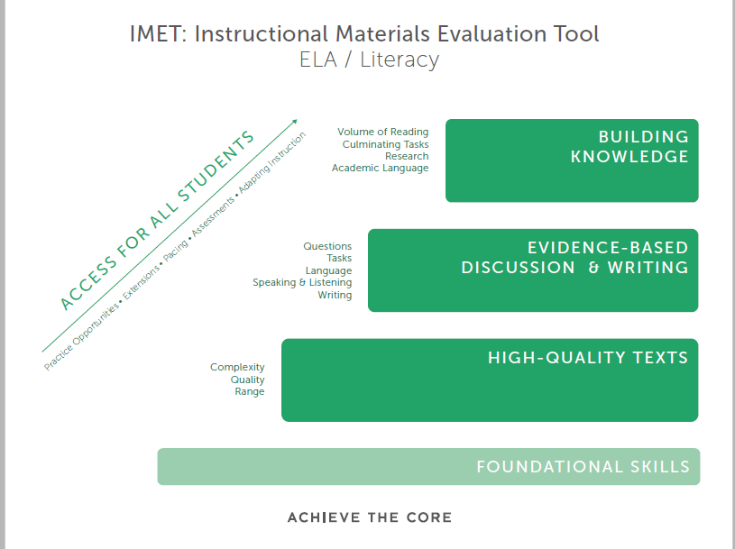
Notes:
Big Idea:
As you can see, the shifts and priorities of the CCSS are represented directly in the IMET. This graphic illustrates the connection between the IMET criteria and the integrated nature of literacy in aligned materials.
Details:
Found on p. 3 in hanout.
Foundational Skills are quite literally the floor, and while they aren’t required in each grade they set up the surface that grounds this work.
High-quality text, evidence-based discussion and writing, and building knowledge each represent a “stair step”. All three are critical in this work.
Access for All Students is a driving force—ultimately, making the work itself worthwhile.
This visual should serve to crystalize the metrics in the IMET document and highlight what matters most.

Slide 24
The Non-Negotiable Alignment Criteria
Notes:
Estimated time for slides 24 - 37: 15-22 minutes
Big Idea: Today we will dive into the IMET tool, beginning with the “gatekeeper” criteria we call the Non-Negotiables.
Details:
For teams wanting to go deeper with the IMET, go to achievethecore.org/imet.
There are professional development Modules to support deeper engagement and understanding of each of the Non-Negotiables and Alignment Criteria.

Slide 25
High-Quality Text
Non-Negotiable 1: Anchor texts are worthy of students’ time and attention. Texts are of quality, containing rich academic language, and are rigorous, meeting the text complexity criteria for each grade.
  Metric 1A: Anchor texts in the materials have the appropriate level of complexity for the grade as defined by the standards, according to quantitative and qualitative analysis.
  Metric 1B: Anchor texts in the materials are of publishable quality and worthy of especially careful reading; the include a mix of informational texts and literature.
IMET p. 5
Notes:
Big Idea:
The first Non-Negotiable focuses on the worthiness of texts included in a submission.
Details:
Found on p. 4 in handout.
Materials need to include the complexity levels of anchor texts, or significant instructional texts for close reading. These should fall within in the grade band requirements as outlined in Appendix A. They should be accompanied by a number of texts at varying levels of complexity in order to grow knowledge and vocabulary. Anchor texts, because they are more complex, will typically require more instructional time and, therefore, may be fewer in number.
If we offer students opportunities to first hear good, rich text read aloud from the earliest grades (there are no complexity guidelines for K-1 in student reading materials), and increasing in complexity as they move through the grades, that gap between end of high school, college, and “regular life” materials we spoke of earlier will be eradicated.
This does not mean that every text in a submission must be complex. It means that all students should be exposed to increasingly complex texts as outlined by Reading Standard 10. Texts will be used for a variety of purposes – developing foundational skills, fluency, independent reading, etc. This metric calls for the provision of evidence regarding the complexity of all texts included to ensure students are increasingly offered opportunities to learn to navigate increasingly complex text, a hallmark of readiness for life.
Again, when considering complexity in the primary grades, it is the complexity of the read alouds being evaluated until 2nd grade, when complexity is considered in student reading material.

Slide 26
Text Complexity: What Is It and Why?
High-Quality Text
CCSS.ELA-Literacy.CCRA.R.10
Read and comprehend complex literary and informational texts independently and proficiently.
For example, in 4th grade:
By the end of the year, read and comprehend informational texts, including history/social studies, science, and technical texts in the grades 4-5 complexity band proficiently, with scaffolding as needed at the high end of the range.
Notes:
Big Idea: Our College- & Career-ready standards map backwards from the complexity of texts in first-year college or entry-level career, creating a staircase of complexity from when students first enter school until they graduate in 12th grade.
Details:
Standard 10 is the complexity standard, shown here, setting the expectation that all students read grade band complexity texts. This is further described in Appendix A of the standards.
Do notice two important phrases in the grade 4 example. First, these are end of year expectations and second, that scaffolding at the high end of the 4-5 range is given as needed. Not all texts have to be complex, but practice and instruction do need to prepare students to meet these expectations.
It‘s important to note that complexity bands have not changed in grades K-1, when students are learning to read. However, primary teachers should be intentional in the texts they read aloud, ensuring they are exposing our youngest learners to rich texts that build a coherent body of knowledge. Texts read aloud in these grades should be 2-3 years above students’ grade level.

Slide 27
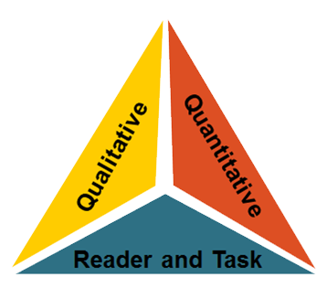
Analyzing Text Quality
High-Quality Text
Notes:
Big Idea: Appendix A of the Standards helps define the factors that we should be using to make text quality assessment: quantitative measures that rely on algorithms to assess “readability,” qualitative measures that rely on skilled readers to consider meaning, knowledge demands, and other factors, and reader and task measures that rely on teachers to make informed judgments about how difficult their group of readers may find the text given their motivation, reading skills, etc.
Details:
Appendix A in the CCSS identifies the following factors as determining text complexity:
Quantitative measures look at factors impacting “readability” as measured by particular computer programs.
Qualitative measures examine levels of meaning, knowledge demands, language features, text structure, and use of graphics as measured by an attentive reader.
Reader and Task considers additional “outside” factors that might impact the difficulty of reading the text.
<Ask: “Why is it difficult to get a true measure of text complexity without considering each of these three dimensions?”>

Slide 28
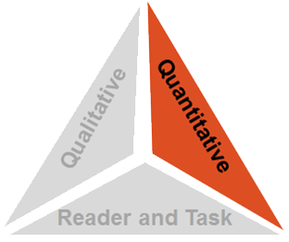
Quantitative Text Complexity
High-Quality Text
Excellent at situating informational texts
Good at offering a starting point for placing narrative fiction
Unable to rate drama and poetry
Not helpful for K-1 texts
Notes:
Big Idea: Quantitative text complexity is determined by a computer algorithm and usually includes readability formulas including sentence length, word frequency, and other measures that can be counted through a computer program.
Details:
Quantitative measures are:
Excellent at situating informational texts
Good at offering a starting point for placing narrative fiction, but obviously can’t take the maturity of meaning and theme into account
Unable to rate drama and poetry
Not helpful for K-1 texts, when there is often too little text to get a readability score, so measures don’t offer scores in this range. Also, there are no requirements for text complexity in student reading material in grades K and 1.

Slide 29
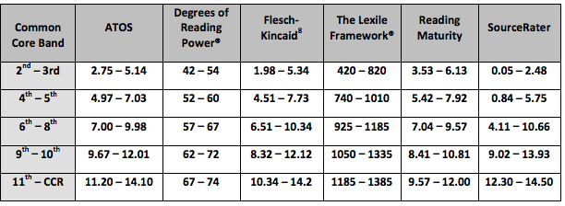
Analyzing Text Complexity: Quantitative
High-Quality Text
Verify that each text has been placed within a grade band based on at least one quantitative measure.
Notes:
Big Idea: When analyzing text complexity, the first step is to consider quantitative text complexity. “The Common Scale for Text Complexity” is a research-based scale used to identify text bands for college and career-ready standards.
Details:
Found on p. 5 in handout.
You probably recognize at least “Lexile” and “Flesch-Kincaid.”
Remember the quantitative complexity can be generated through different formulas, giving different weight to word length, sentence length, etc.
Also notice the overlap in grade bands. The 2,3 Lexile band is 420-820 but the 4,5 begins at 740. This reflects the summer dip that many researchers have found.
Remember, these are the Lexiles we are pressing for by the end of the year for keystone or anchor texts.

Slide 30

High-Quality Text
Quantitative Text Complexity
  Grapes of Wrath:
  Lexile Score: 680L
  Grade Band Placement:
  2-3?
Notes:
Big Idea: But, picking a worthwhile, appropriately complex text does not mean picking any text within a Lexile band!
Details:
This example highlights what quantitative measures can and cannot provide.
Of course, when you consider Steinbeck’s use of simple language and dialogue as a stylistic choice, it makes sense that the text is very readable– but I think we can all agree that second and third graders are not yet prepared to take on the Joads!
Other measures of text complexity should be taken into consideration when choosing and placing instructional texts.

Slide 31
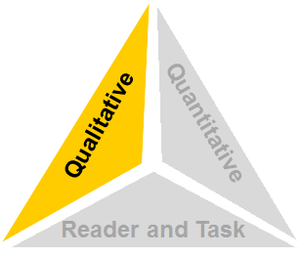
Qualitative Measures
High-Quality Text
Qualitative measures consider:
  Text Structures
  Language Features
  Meaning/Purpose
  Knowledge Demands
Notes:
Big Idea: Qualitative text complexity analysis can also help teachers identify what is going to make the text difficult for students. This helps when planning instruction.
Details:
Qualitative measures add information to the process of determining text complexity that quantitative measures CANNOT assess.
A qualitative analyses of text complexity represents an informed decision about complexity in terms of several factors discernible to a human reader applying trained judgment to the task.
It’s important that this analysis is done systematically. Qualitative analysis is what guides placement in the grade level and time of year.

Slide 32
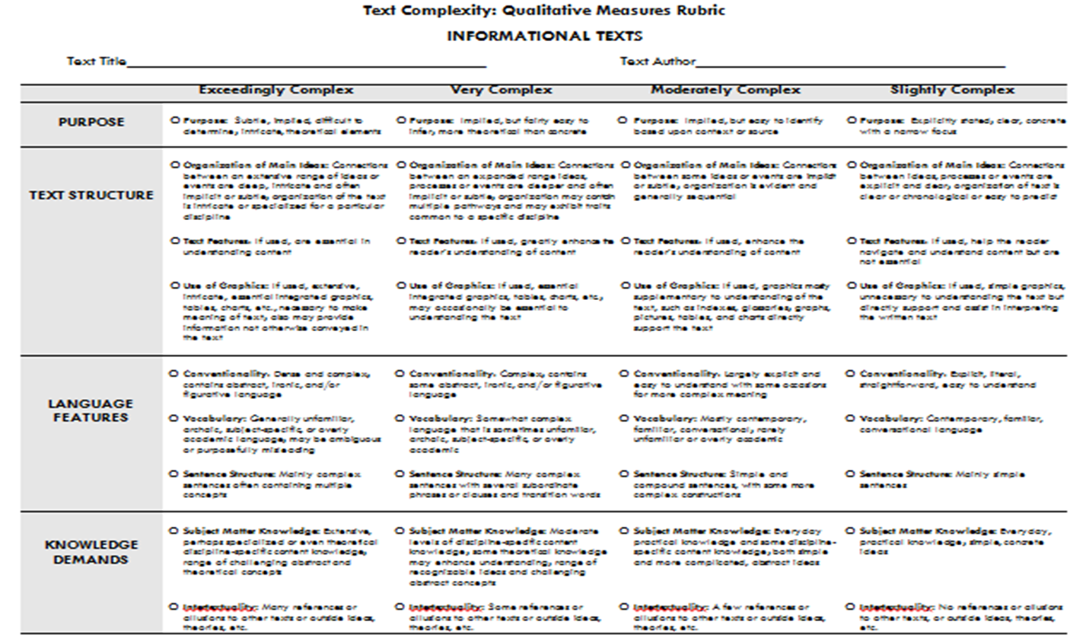
Tool: Analyzing Text Quality
Notes:
Big Idea: Evaluating text for these qualitative features—structure, meaning/purpose, language features and knowledge demands—helps educators decide if a piece is appropriate for the grade band. This rubric can be used to systematically analyze qualitative features of text.
Details:
Informational Text Analysis found on p. 6 and Literature Text Analysis on p. 7.
A qualitative analysis of text complexity represents an informed decision about complexity in terms of several factors discernible to a human reader applying trained judgment to the task. It’s important that this analysis is done systematically.
Relying solely on quantitative measures is not sufficient. Consideration must be given to how accessible the text is for students in broader terms.
Narrative structure is always easiest
Informational structures include: compare and contrast, chronological, problem/solution, goal/action/outcome, descriptive, instructional, opinion, argument, or a text which combines any number of these. The last of these is the hardest, and one reason why textbooks are so difficult for so many people as they employ all of these structures. Nonfiction can have a narrative structure.
When thinking of knowledge think also about “density of knowledge” as this has been shown to also add to complexity
It is not only “Levels of Meaning or Purpose” but how subtle the difference
This rubric was developed by the State Collaboratives on Assessment and Student Standards, a working group of the Council of Chief State School Officers. It is based on the research referenced in Appendix A of the Common Core State Standards, Appendix A, page 6. http://www.corestandards.org/assets/Appendix_A.pdf .
The rubrics are available on achievethecore.org

Slide 33
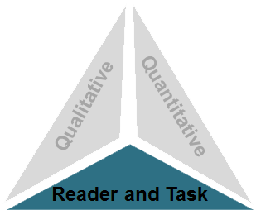
Reader and Task Considerations
High-Quality Text
Finally, there are factors relating to your readers and the task to consider:
  Desired Outcomes/Understandings
  Complexity of Content
  Specific student needs
  Reading Skills
  Motivation & Engagement
  Prior Knowledge
Notes:
Big Idea: Reader and task considerations are the final factor in evaluating text complexity. When evaluating materials, or deciding upon texts for inclusion in curriculum, these factors should be taken into consideration. The reader and task considerations guide the types of scaffolds or supports all the students will need to be successful with the text.
Details:
We need to consider our individual students and the tasks we have in mind before making a final decision about how (if!) to use the text with our students.
On this slide, we’ve outlined six factors to consider in this category.
Engage the whole group in a short discussion of how their consideration of reader and task factors would bear on their judgment regarding a final placement recommendation, and/or whether the reading would be appropriate.
Considering their readers and the task you’re envisioning helps teachers think through the implications of using a particular text in the classroom, and may help fit the text into a specific grade.
Teachers need to be strategic about what they want students to learn by reading a text – and if they can’t answer than in a compelling way, the text probably isn’t worth reading.

Slide 34
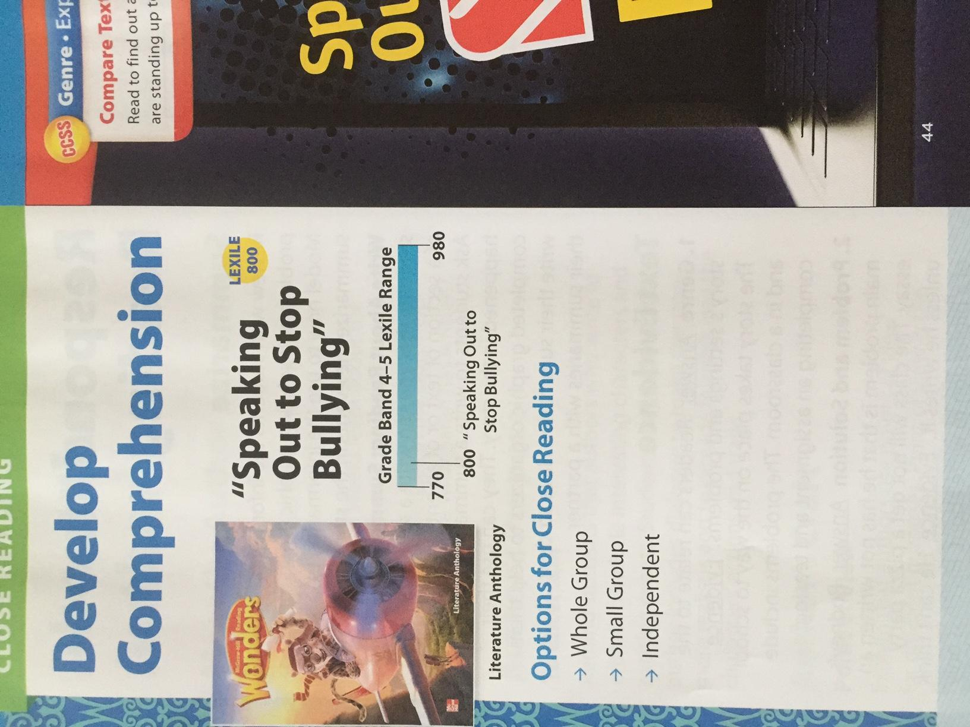
Non-Example
High-Quality Text
Notes:
Big Idea: Considering IMET Non-Negotiable 1A, what might we look for in aligned materials?
Details:
Found on p. 8 in handout.
We’ll begin with a non-example.
This example is drawn from a 4th grade basal series
The teacher is only provided a Lexile measure with the options of whole group, small group, or independent for the close reading lesson. There is no guidance on qualitative text complexity, just a Lexile measure.
Discerning examples from non-examples when reviewing is essential, both to help calibrate and to support ratings with evidence.

Slide 35
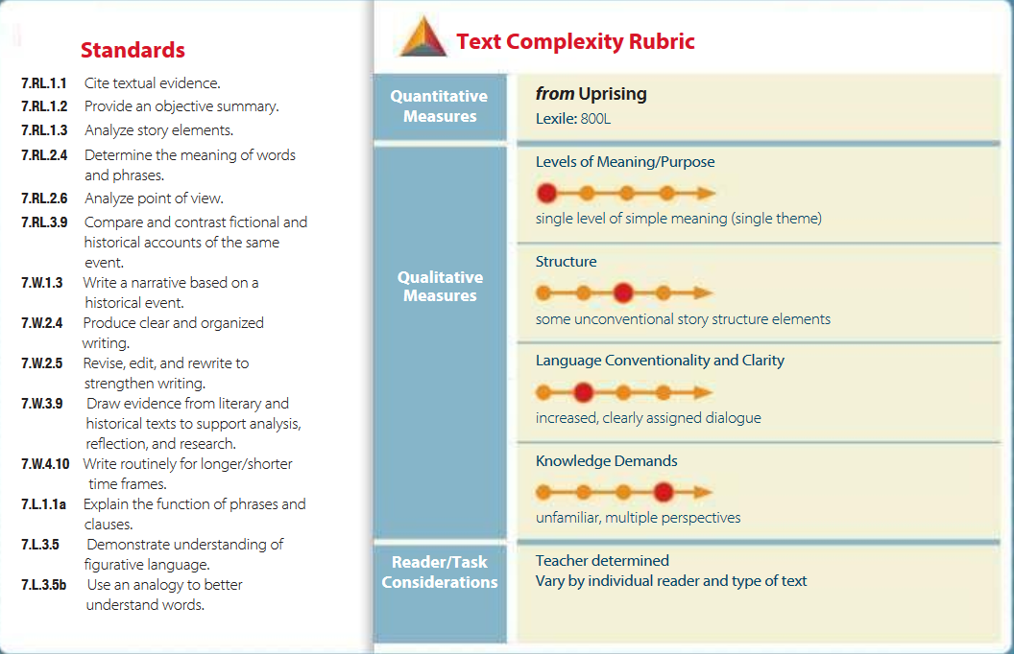
Example
High-Quality Text
Notes:
Big Idea: In materials, there should be evidence that this qualitative analysis has been done on all significant texts. This indicates materials are appropriately placed in terms of complexity building from 2 -12, and that the analysis has been used to guide instruction.
Details:
Found on p. 8 in handout.
This type of systematic analysis takes practice and time. In a comprehensive submission, this information should be provided by the developer.
If the information is not provided, it should be gathered; otherwise, we won’t be sure we are getting rigorous content in front of our students.
In this example, the publisher is providing text complexity information, both quantitative and qualitative, for the teacher. This gives the teacher valuable information about why the text is placed as it is and how to best support students in accessing it.

Slide 36


  Metric 1B: Anchor texts in the materials are of publishable quality and worthy of especially careful reading; they include a mix of informational texts and literature.
Consider: Which of these K-2 read aloud texts are worthy of careful reading?
Discuss: What would instructions supporting careful reading look like for teachers or students? What actions and directions would materials include?
IMET p. 8
Notes:
Facilitator Notes
Big Idea:
The second metric for NN1 is 1B, the quality of the anchor texts--illustrated here with a K-2 example.
Details:
In K-2, the anchor text would be one read aloud; that is something that the students could likely not yet access on their own. So, once included texts are examined for how they are sequenced to build knowledge and vocabulary, we turn our attention to text placement.
The number of instructional minutes is limited. When considering which texts deserve more time and attention, which are featured for reading and rereading, we want to ensure they are really of quality. This does not mean all texts are read closely. This AC checks for the alignment of instructional purpose with the texts included.
Background: As we’ve previously mentioned, the popular basals are filled with literature for Tier 1 instruction. The shifts force us to closely consider our selections and this Alignment Criterion is the check.
Consider the impact of using each of these two texts. Even if you have not read the texts, what do you think reading aloud and work with of each of these texts entail? Which would be considered worthy of reading and rereading to build knowledge and reading comprehension?

Slide 37
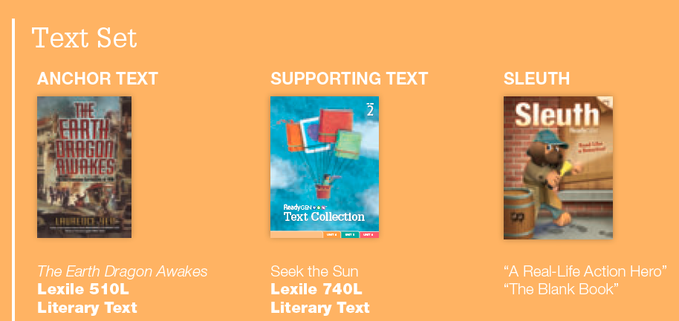
Example or Non-Example?
High Quality Text
Notes:
Big Idea:
This is an example of connected texts included in Ready Gen, grade 2. The text on the left, The Earth Dragon Awakes, is labeled as the anchor text, with other supporting texts placed with it in materials.
Details:
The expectation is that these texts are complex and worthy of spending instructional time with all students.
This is an example of the high-quality text selections you’d expect to see as evidence of AC Metric 1B.
To fully ascertain the quality of texts, it is recommended that reviewers read a representative sample of passages/texts to discern whether the texts are content-rich and are worthy of multiple reads, etc.

Slide 38
Evidence-based Discussion and Writing
Non-Negotiable 2: Materials provide opportunities for rich and rigorous evidence-based discussions and writing about texts to build strong literacy skills.
Metric 2A: At least 80% of all questions, tasks, and assignments in the materials are text-dependent, requiring students to draw on textual evidence to support both what is explicit as well as valid inferences from the text. The overwhelming majority of these questions and tasks are text-specific.
Metric 2B: Materials include frequent opportunities for evidence-based discussions and writing to support careful analyses, well-defended claims, and clear information about texts to address the analytical thinking required by the Standards at each grade level.
IMET p. 9
Notes:
Estimated time for slides 38 - 43: 20-30 minutes
Big Idea:
Reading Standard 1 requires the use of textual evidence to determine what the texts says, to make logical inferences, and to support conclusions in both writing and speaking. If we expect students to become adept with this, we need materials which guide students in gathering evidence to use in discussion and in writing.
Details:
Found on p. 9 in handout.
Briefly discuss with the person sitting next to you what these metrics require for materials to meet Non-Negotiable 2, highlighting or underlining the important words.
Note that while multiple standards will be addressed with every text, not every standard must be addressed with every text. Understanding the text is paramount.
The two metrics under this NN underscore the integrated nature of reading, writing, and speaking.

Slide 39
Considering Text Dependency
Evidence-based Discussion and Writing
Does answering the question require that students have read the passage?
Is the question tied to a passage (not stand-alone)?
Does the question require students to cite or use evidence from the passage to determine the correct answer?
Does the question require students to follow the details of, make inferences from, and/or evaluate what is read?
Notes:
Big Idea: Text-dependent questions help students make meaning from text, solidify learning, and teach them how to better approach reading the next text.
Details:
Background: When surveying elementary basal programs, a large % of the questions asked of students were found to not be text dependent; that is, they could be answered without any evidence of having read.
These criteria can be helpful in determining whether a question can be considered text dependent.

Slide 40
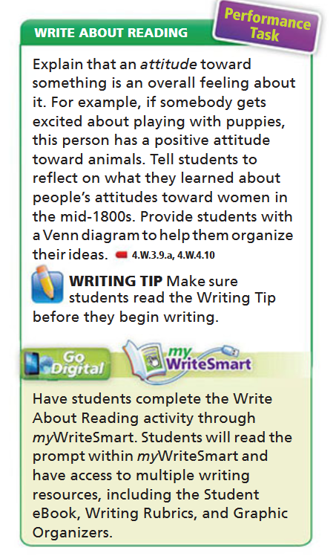
Example or Non-Example?
Evidence-based Discussion and Writing
Notes:
Big Idea: In materials, consider the difference between these next two examples, both of which have come from Common Core-aligned textbooks.
Details:
Found on p. 10 in handout.
Evidence-based discussion and writing are called for as the second non-negotiable criteria for aligned materials.
While text dependency has been a relatively easy shift, in that we are seeing far more teaching and learning anchored in the text, there are fewer (though still some) non-examples, as shown here: This time we’ll start with the non-example.
<Say: “Take a moment to read the example. What do you notice about this task? How could it be improved?”>
Some answers may include:
The task does not require students to go back to the text or to demonstrate a deep understanding of what they have read. There is no direction to refer to any text(s) or to use evidence. It is not clear how the Venn diagram connects to the assignment.
The example is also off because it assumes that if someone gets excited about playing with puppies, then they will have a positive attitude towards animals in general.
Although the instructions do not specifically require or call for evidence/using the text, these could be simply poor instructions. Not sure what grade this is but where, other than the text, would these students likely get much information on this topic? In other words– poor instructions are not the same as failure to require text-based evidence. This example is likely just that.

Slide 41
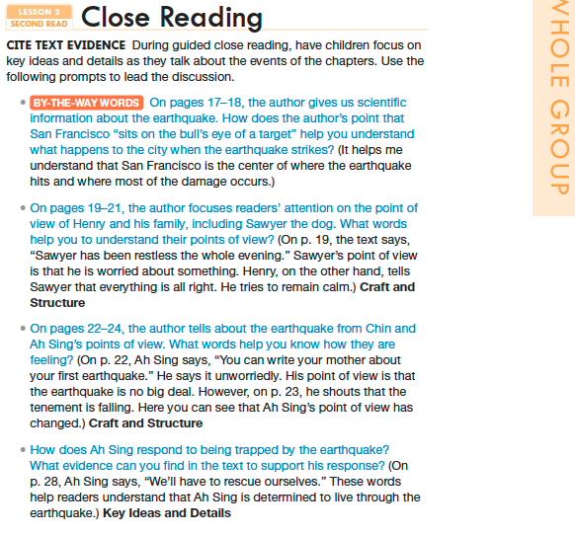
Example
Evidence-based Discussion and Writing
Notes:
Big Idea: This is a grade 2 example of text-dependent questions. Read one or two of the questions aloud.
Details:
Found on p. 10 in handout
This is an example because all of the questions are text dependent and text specific. They drive student attention to, and build understanding of, the text under study.
Question 1 helps students understand the use of a phrase in context. This is a vocabulary standard (L.2.4) – determine or clarify the meaning of unknown and multiple meaning words and phrases based on grade 2 reading and content.
Questions 2 and 3 focus on point of view in craft and structure – acknowledge differences in the points of view of characters.
Question 4 aligns with the expectations of RL.2.3 – describe how characters in a story respond to major events and challenges, as well as RL.1 – using evidence to demonstrate understanding of key details.

Slide 42
Practice: Text-Dependent Questions
Evidence-based Discussion and Writing
Use the passages (Fossil Fish Found! and Earthquakes) and associated question sets to gather evidence for the NN 2 metrics.
Be prepared to share your findings.
Notes:
Activity: Allow 10-15 minutes for reading and collection of evidence from the handouts 2 and 3.
Big Idea: Passages and question sets are in the handout packet. It is time to practice in some passages drawn from grade 5 materials.
Details:
Refer to your handout, pp. 11-23
In your binder, there are two non-fiction lessons, Fossil Fish Found! and Earthquakes (Lexile 1240, above the 5th grade band). Skim and annotate the passages and read the associated question sets. This is what reviewers are instructed to do with occasional sets of questions. Collect evidence – examples and non-examples of alignment from the questions and tasks.
Take 8 -10 minutes to look at the Fossil Fish Found and Earthquakes lessons. Skim the stories and look closely at the questions and tasks. Notice that, with the Earthquakes assignment, the notetaker students are to fill out is filled in (this is the teacher answer key). Students would be working to complete this organizer. Gather evidence of text dependency in the questions and tasks.
Debrief the evidence pairs found using the next slide.
The Earthquakes piece is part of a grade 5 unit on natural disasters. The culminating unit task involves writing an opinion letter to describe how governments should respond to natural disasters.

Slide 43
Let’s reach consensus:
Evidence-based Discussion and Writing
What evidence did you find where your materials were in alignment with the criterion?
What other evidence would you want to collect?
Notes:
Optional Activity: Allow 5-10 minutes to debrief
Big Idea: Debrief their findings from Fossil Fish Found! and Earthquakes.
Details:
Remember that we have just looked at one passage from a submission. The IMET instructs teams to “dip in” and look closely at the quality of texts and the associated task sets every fourth story. So, conclusions about the whole program should not be drawn from one text and task. What we are looking for is quality across the year and years in any given set of materials.
Fossil Fish Found!: The questions in both examples are text dependent. The questions associated with Fossil Fish Found! are very low-level and although they force students to use evidence from the text (RI.5.1), the level of thinking the students must do is not aligned with the intent of the Standards. The writing tasks associated are very low level, merely copying and matching names and letters.
Earthquakes: The questions associated with Earthquakes forces the students to consider the sequence of events and provide evidence from the text in writing.
Today we’ve just taken a brief look. The Alignment Criteria offer reviewers opportunities to look more deeply at the quality of questions and tasks.

Slide 44
Building Knowledge
Non-Negotiable 3: Materials build knowledge systematically through reading, writing, speaking and listening, and language study.
Metric 3A: Materials provide a sequence or series of texts that build knowledge and vocabulary systematically through reading, writing, listening, and speaking. These texts are organized around a variety of topics at each grade level.
Metric 3B: Materials provide instructions, clear design and lightweight student accountability, that guide instructors regarding how students will regularly engage in a volume of independent reading, both assigned, related to the anchor texts, or texts of their own choosing, in or outside of class.
IMET p.13
Notes:
Estimated time for slides 44-50: 10-20 minutes
Big Idea:
The standards are clear about the importance of building knowledge in order to support students with comprehension of increasingly complex texts. If we expect students to become adept with this, we need materials which guide students in growing knowledge.
Details:
Found on p. 24 in handout.
Briefly discuss with the person sitting next to you what these metrics require for materials to meet Non-Negotiable 3, highlighting or underlining the important words.
Note that while multiple standards will be addressed with every text, not every standard must be addressed with every text- the text should drive this.

Slide 45

vocabulary systematically through reading, writing, listening, and texts are organized around a variety of topics at each grade level.
Building Knowledge
“By reading texts in history/social studies, science, and other disciplines, students build a foundation of knowledge in these fields that will also give them the background to be better readers in all content areas.
Students can only gain this foundation when the curriculum is intentionally and coherently structured to develop rich content knowledge within and across grades.”
-- CCSS Anchor Reading Standards
IMET p. 14
Notes:
Optional video –allow 6 minutes to play and 3-4 minutes to debrief
Big Idea:
The two quotes here <have a participant read them aloud> come directly from the Standards:
Details:
David Liben, Senior Literacy Specialist with SAP, has been touring the country sharing this message. In this 6 minute clip, he shares some of the research and also connects the importance of content knowledge to assessment. While he references PARCC and SBAC, the implications hold true to other state CCR assessments.
Good idea to note that selection of examples from tests reflects the time and attention that went into selecting these texts. The complexity of these passages in general, and the words, topics, and references would be true of any texts in the band whether on a test or not. Students need knowledge to improve reading comprehension.
Video: https://vimeo.com/132681353, Minutes 25:51 – 31:39 David Liben, Student Achievement Partners Senior Literacy Content Specialist at a Text Set Project Training describes the research and reasons why we must build knowledge along with focus on vocabulary.
After clip: Go ahead and take 3-4 minutes to debrief what David Liben shared.

Slide 46
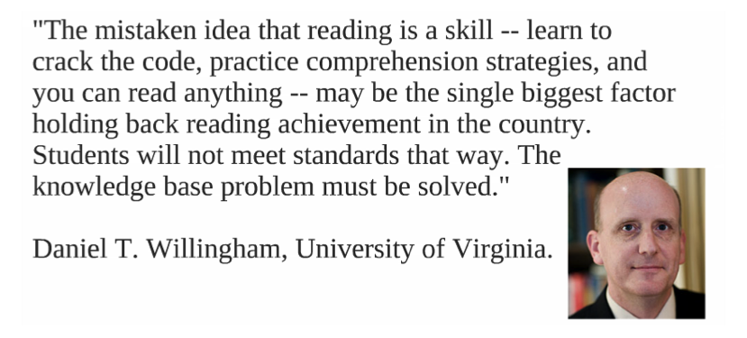
Building Knowledge
IMET p. 14
Notes:
Big Idea:
There are researchers speaking regularly on the importance of building knowledge to improve reading comprehension. This quote is from cognitive scientist Daniel Willingham.
Details:
Take a minute and talk about this with your tablemates.
Willingham’s books include Why Don’t students like school: A Cognitive Scientist Answers Questions and what it means for the Classroom and more recently, Raising Kids Who Read.
If further information is needed regarding the shift to building knowledge, the entire David Liben video: https://vimeo.com/132681353 may be used to build background.

Slide 47
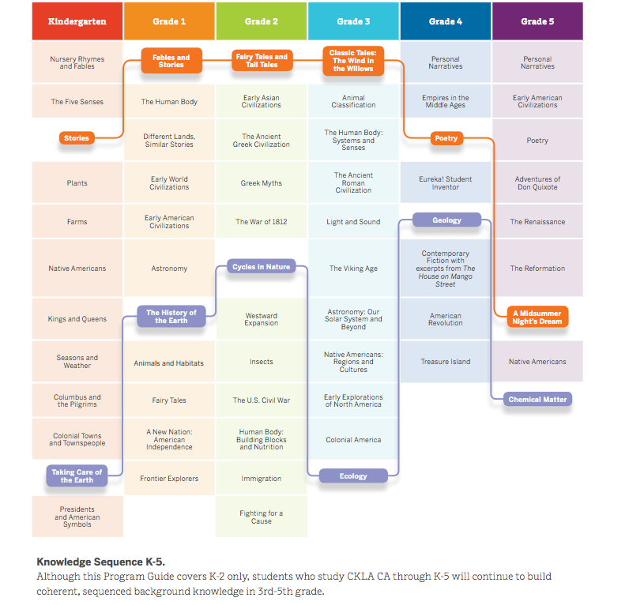
Example
Building Knowledge
Notes:
Big Idea:
In materials, especially K-5, topics would be developed over the years in a visible progression with a focus on growing knowledge.
Details:
In your packet on p. 25, examine the progression of these K-5 topics in the Core Knowledge program. The texts and topics are arranged to strategically build student knowledge, deepening understanding and connecting topics over the years. .
Trace the progression on the page – learning in kindergarten builds through the years by studying topics more in-depth over the years.
Compare this to how content is approached through other programs that you are familiar with.
More information and research is available through the Text Set Project.

Slide 48
Metric 3B: Materials provide instructions, clear design and lightweight student accountability, that guide instructors regarding how students will regularly engage in a volume of independent reading, both assigned, related to the anchor texts, or texts of their own choosing, in or outside of class.
Building Knowledge
Close reading alone
is NOT enough!
In fact, done alone, it can INCREASE the achievement gap.
IMET p. 15
Notes:
Big Idea:
It is important to note that students learn from what they read. This cannot and should not be dependent on anchor texts alone. It is also imperative to determine what resources, support, and texts are included in any given set of materials to address independent reading. Wide independent reading, along with the close reading of complex text, is critical for students to become literate.
Details:
Vocabulary researchers Camille Blachowitz, Freddy Heibert, Linda Diamond agree that wide reading is the best, and really the only way to increase student vocabulary enough to meet the demands of complex text.
It is impossible to teach enough words to close the 30 million word gap existing between your highest and lowest performing students.
If we believe that close reading of complex text alone can mitigate this, we are wrong. In fact, as the slide says, it can increase the achievement gap. Close reading alone will teach your highest students, those with large vocabularies, how to read closely, pull evidence from text and handle complex text.
Students without that background vocabulary and knowledge may try to apply close reading to complex texts, but the deficits in vocabulary, which can only be filled with reading, will still struggle. So if that is all we do, we may make the gap wider!
Catching up without reading a significant volume of texts is extremely difficult (Hiebert 2009).
No matter how much close reading is done, it will not provide this volume.
However, close reading develops familiarity with complex text, provides students with tools to work with many of the features of complex text.
Before the Standards, when less complex texts with less difficult vocabulary were used, students from more affluent households still did better. Now with more complex texts and vocabulary more important, the differential could increase because these more affluent students will be able to navigate complex text and benefit from their greater vocabulary.
Knowledge is also important to proficient reading (Kintsch 1998). Volume of reading is the best way to grow knowledge (Adams 2009).
More affluent students, usually from educated households, come into school with more knowledge. If we don’t grow the knowledge of less affluent students, we are depriving them of this tool as well.

Slide 49
Building Knowledge
A volume of reading should be balanced with the close analytic reading.
Close Reading | Volume of Reading
Fewer pages | More pages
Grade-level complex text | Text at different levels of complexity
All students same text | Student or teacher choice of text
Teaches students to attend to text and to words | Rapidly builds knowledge & vocab
Heavy support | Light support
Solely instructional | Guided or independent
Exposes students to higher level content | Builds knowledge of words, and the world
Gives all students access | Builds love of reading
Notes:
Big Idea:
Close reading alone is not enough. Students must also be engaged in a volume of independent reading. NN3 also includes independent reading opportunities at its core.
Details:
Found on p. 26 in handout.
Close reading is one approach to supporting students with more complex text. But it will not be enough to make proficient readers out of all students.
One of the key points here is that, with close reading, you go deep with a small amount, whereas in volume of reading you do a huge amount on a wide variety of topics. We simply CAN’T do close reading for everything because it takes too long. If you do only close reading, you won’t read enough.
NOTE: There are not only 2 categories. There is a broad spectrum. So really we need “close reading, volume of reading, and everything in between.”

Slide 50
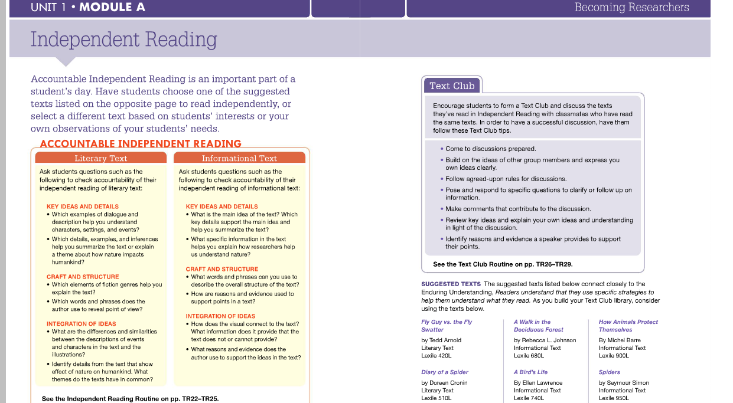
Independent Reading
Building Knowledge
Notes:
Big Idea:
This plan shows an emphasis on supporting independent reading within the program.
Details:
Found on p. 27 in handout.
Directions are provided for accountable independent reading. This should be clearly visible for teachers and students in aligned materials.
One consideration is if the texts are included with the program, or if they must be purchased separately. This is a good question to ask the publisher.

Slide 51
Foundational Skills
Non-Negotiable 4: Materials develop foundational reading skills systematically, using research-based and transparent methods. This means materials provide explicit and systematic instruction and diagnostic support in: concepts of print, letter recognition, phonemic awareness, phonics, word awareness and vocabulary development, syntax, and fluency.
IMET p. 17
Notes:
Estimated time for slides 51-54: 15-20 minutes
Big Idea:
We’ll spend time going into this Non-Negotiable and all of the accompanying metrics today.
Details:
See next slide

Slide 52
Foundational Skills
NN Metric 4A: Provides instruction in concepts of print, letter recognition, phonemic awareness, phonics, word awareness, vocabulary development, syntax, and reading fluency
NN Metric 4B: Variety of student reading material and activities that allows for frequent practice of all foundational skills.
NN Metric 4C: Provides clear, well-structured diagnostic assessment protocols and materials for all foundational skills to guide instruction and remediation.
NN Metric 4D: Materials guide students to read with purpose and understanding.
NN Metric 4E: Grade 2 materials provide opportunities for students to engage in a range and volume of reading to achieve reading fluency.
IMET p. 17
Notes:
Big Idea:
As with the other Non-Negotiables, this series of metrics lays out the details as to what submissions must have present in order to meet the foundational skills criteria.
Details:
Found on p. 28 in handout.
Take a moment to familiarize yourself with the language of this Non-Negotiable, found in the K-2 IMET on page 17. What stands out to you? What key words can you identify when considering Foundational Skills? If you had to choose 1-3 words for each metric, which words would those be?
Some key words might include: concepts of print, letter recognition, phonemic awareness, practice, research-based, transparent, diagnostic assessment, connection, volume of reading

Slide 53
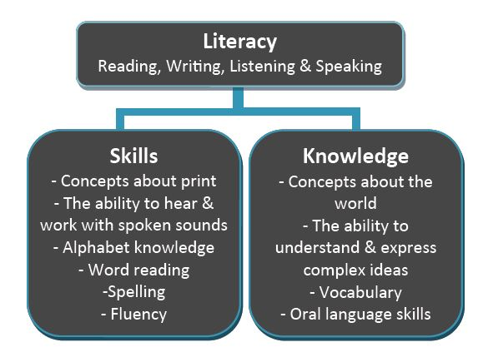
Literacy is…
Notes:
Big Idea: In K-2, literacy is built simultaneously in two areas: skills and knowledge. This is the job of the K-2 educator and system.
Details:
This graphic is included in your packet on p. 29 and comes from the Harvard Graduate School of Education (2012).
Development of both skills and knowledge competencies must be included in K-2 materials.
Knowledge competencies are addressed in the IMET in Non-Negotiables 1- 3 and reinforce the need for students to be involved in discussion and writing around rich read-alouds before and as they acquire skills to read independently.

Slide 54
Practice: Foundational Skills
Foundational Skills
Consider the attached sample lesson from the Core Knowledge Skills Strand, Grade 1, through the lens of Non-Negotiable 4. What evidence for the metrics do you see? Individually write your findings on the IMET.
Then read the Louisiana Believes excerpted review of the program. What do you notice?
What other program components would you want to investigate?
Notes:
Allow 15 minutes for this activity.
Big Idea:
This activity is designed to engage participants in finding evidence for the NN 4 metrics. Although it is only one lesson, participants will get a good idea of what a well-aligned foundational skills lesson should look like.
Details:
For the writing activity, find the Core Knowledge Skills Strand components – grade 1 lesson plan, skills reader, and student practice page on pp. 30-53 of the handout. The Louisiana Believes review is on p. 54.
After participants have written individually, debrief the findings and evidence for the metrics. The Core Knowledge Skills Strand K-3 (which is all foundational skills) was the only elementary program Louisiana found to meet all non-negotiable criteria and score the best possible on all indicators of superior quality. The review includes detailed reasoning for the decision.
Evidence might include:
4A: A scope and sequence document would need to be consulted.
4B: There is student reading material included in the lesson. If this is a regular lesson, there is a lot of reading and practice embedded in the lesson.
4C: There are notes in the margins for additional practice, extension activity if students work quickly. This assumes the teacher is monitoring and assessing as the lesson progresses. The student writing worksheet would also provide the teacher with insight into the students’ grasp of skills.
4D: The questions and discussion of the meaning of the text drives the reading of the story.
If this lesson is a standard lesson, and repeated in this format, that’s a lot of practice! This program is also very supportive for teachers. The box at the end of the lesson provides a lot of information about phonics for the teacher.

Slide 55
Alignment Criteria
Notes:
Estimated time for slides 55-59: 5 minutes
Big Idea: The IMET includes 7 Alignment Criteria which must be each be met for materials to be considered aligned to the Shifts and major features of the CCSS.
Details:
Each of these Alignment Criterion has one or more metrics associated with it; a specific number of these metrics must be met or partially met in order for the criterion as a whole to be met.

Slide 56
Notes:
Big Idea: We’ve looked at the four Non-Negotiable Alignment Criteria today.
Details:
The other 4 Alignment Criteria include: Range and Quality of texts, Questions, Tasks and Assignments, Building Knowledge with Texts, Vocabulary and Access for All Students.
These metrics lend guidance in evaluating how well materials align and how well they support the Non-Negotiable criteria.
Within each Alignment Criteria, several metrics are given to guide teams in evaluating materials. These alignment criteria support the non-negotiables and evaluate how well materials guide instruction around the worthy text provided.
The criteria are covered in more detail in the professional development materials found on achievethecore.org to support IMET use.

Slide 57
Essential Questions
What is the Instructional Materials Evaluation Tool (IMET)? How is it structured?
How does the IMET enable reviewers to evaluate whether instructional materials are aligned to the major features of the Standards and fulfill the Shifts they require?
How could the IMET be useful in a variety of settings to bring the CCSS and Shifts to life for students?
Notes:
Big idea: Return to the Essential Questions to close the session.
Details:
This can be a writing activity in the form of an exit ticket you will collect, a stand and deliver commitment activity, or just a partner reflection with time for group sharing as available.

Slide 58
Use Cases for the IMET
Evaluating current materials
Purchasing decisions
Creation of materials
Professional learning
Discussion question:
How will the IMET be useful to you in your context?
Notes:
Big Idea: There are many ways to use the IMET and the related training materials.
Details:
The IMET was developed with the purpose to help educators determine whether instructional materials are aligned to the Shifts and major features of the Common Core State Standards.
Originally, this meant that its primary use case was by districts who were reviewing materials to be considered for adoption. However, as we’ve talked to people who used the tool, we’ve heard that the learning about the IMET is a very powerful professional development opportunity. Learning about the IMET gives participants a better understand of the CCSS in general, as well as implications for the classroom.
The IMET review can be helpful for districts or schools to identify gaps in their current materials in order to plan how to adapt them. It can also help for teachers or leaders who are developing instructional materials.
<Click to advance the slide.>
Have participants discuss how they might use the IMET in their current context.

Slide 59
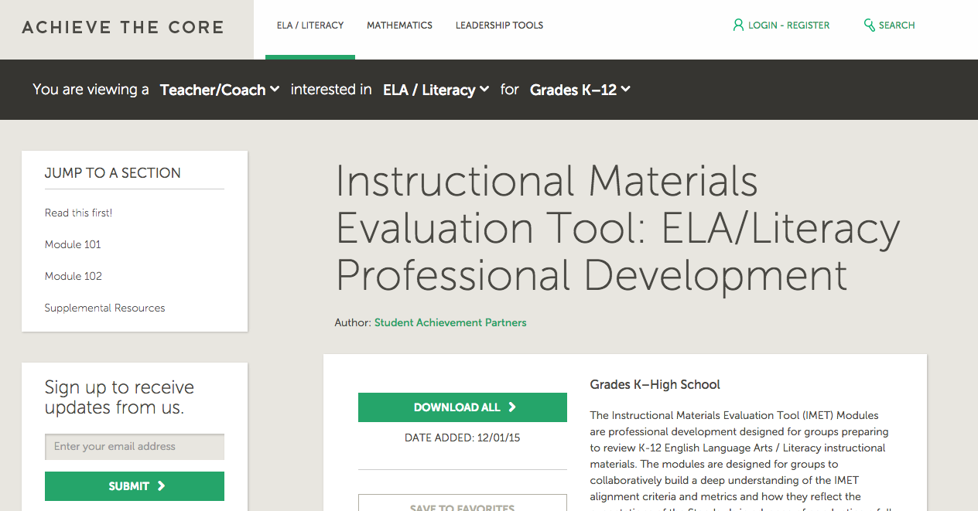
Want to Learn More?
Notes:
Big Idea: There are resources available to support IMET use and reviewing to get aligned materials into teacher and student hands.
Details:
Student Achievement Partners’ website, achievethecore.org, has resources posted for download.
Aligned is a blog devoted to aligned materials. Posts include stories from diverse voices on a variety of topics – case studies from districts working to align materials, guidance from educators working on reviewing, and much guidance for procuring better materials.
The IMET tools are available in fillable PDF as well as downloadable formats.
Professional learning modules for teams establishing review protocols, learning to review using the IMET, and guiding reviewers through a review are posted.
Other resources not pictured are available; mention as needed:
Louisiana Believes – https://www.louisianabelieves.com/academics/instructional-materials-review, the Louisiana Department of Education site, offers completed reviews and materials used for download.

