Slide 1
Building a Deeper Understanding of the Math Standards in PLCs
Core Advocates Monthly Webinar
September 7, 2016
The webinar will begin shortly. You may wish to download the handouts (check the tab on your webinar control panel) while you wait.

Slide 2
Introductions
Your hosts from the Field Impact Team
Sandra Alberti, Director
Janelle Fann, Project Manager
Jennie Beltramini, Teacher Engagement Manager
Joanie Funderburk, Manager of Professional Learning
Lynda Nguyen, Coordinator
This Month’s Guests
Barbara Beske, SAP Math Team
Sarah Galasso, Core Advocate
Jody Guarino, Core Advocate

Slide 3
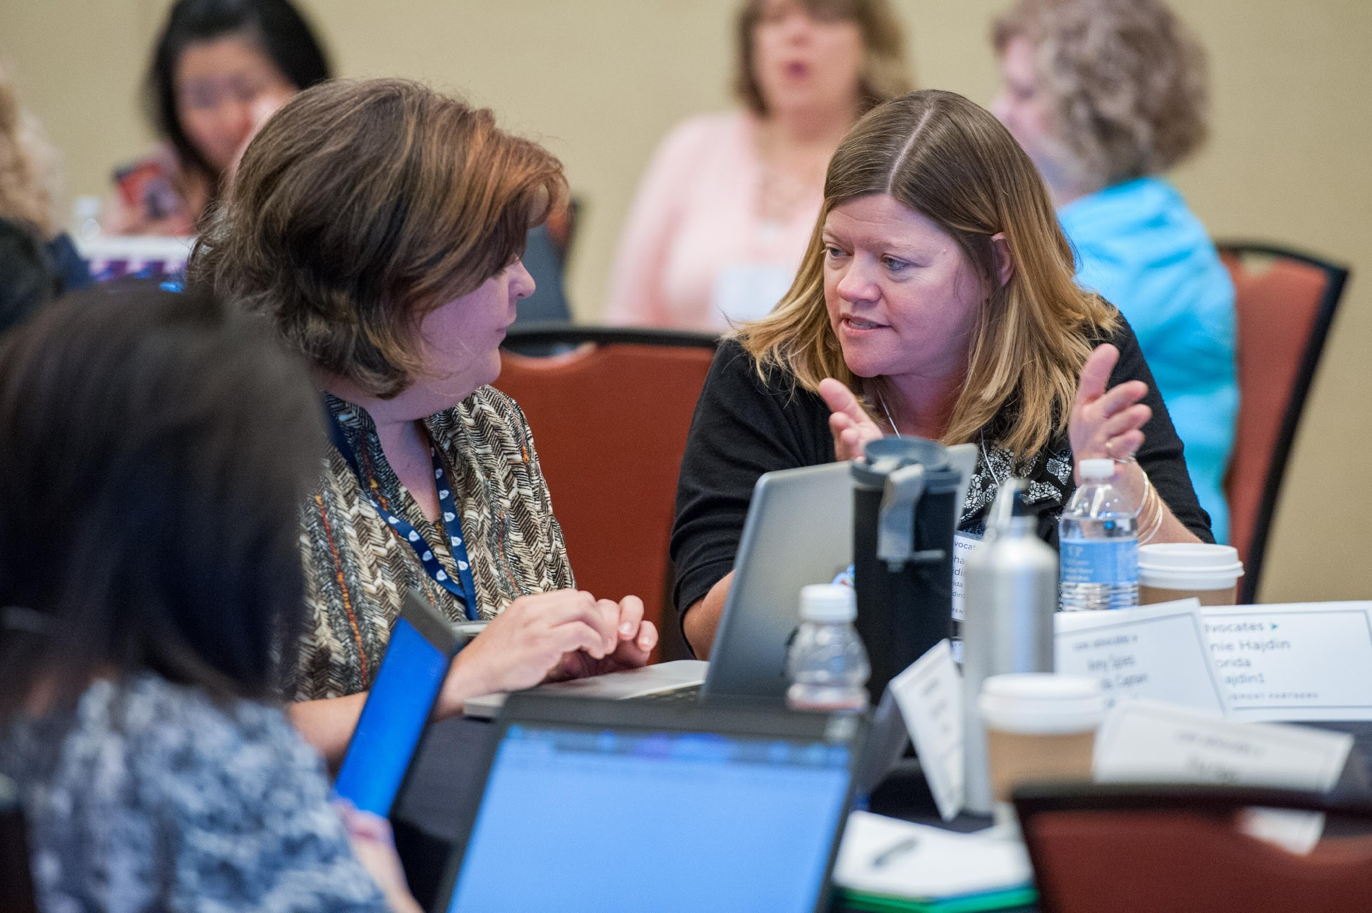
Who are Core Advocates?
Core Advocates are educators who:
  Believe in the potential of the CCSS to prepare all students for college and careers;
  Are eager to support their colleagues and communities in understanding and advocating for the CCSS and CCSS-aligned instruction;
  Understand and embrace the shifts in instruction and assessment required by the CCSS

Slide 4

To learn more about Core Advocates…
Contact Jennie Beltramini (jbeltramini@studentsachieve.net ) or Joanie Funderburk (jfunderburk@studentsachieve.net)
Complete this survey to join our database (and mailing lists): http://bitly.com/joincoreadvocates
Visit our website: www.achievethecore.org

Slide 5

For Tweeters…
Please feel free to tweet during and after the webinar using #coreadvocates
@achievethecore
@JoanieFun, @salberti, @JennieBeltro
@beske3, @jody_guarino, @SarahGMath

Slide 6
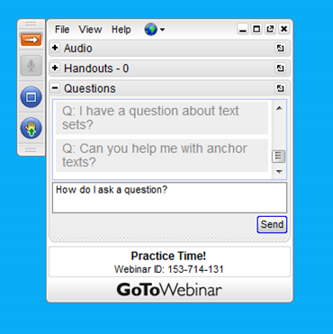
Webinar Protocols
During the webinar
– Accessing Documents
– Questions option
– Polling
After the webinar
– Survey
– Access to recorded webinar

Slide 7
Goals of the Webinar
Goal 1: Consider how analyzing math tasks in PLCs helps anchor teacher work in the Standards
Goal 2: Learn about resources to support your PLCs in effectively studying the progressions in the standards
Goal 3: Gain familiarity with the Lesson Planning tool and how to use it for collaborative planning

Slide 8
Question:
What do PLCs look like in your setting?
What structures exist for teachers to work together on building their content knowledge?
Please use the Questions tab on your control panel to respond.

Slide 9

Language of the Standards
Conceptual Understanding:
  3.NF.A.1 Understand a fraction 1/b as the quantity formed by 1 part when a whole is partitioned into b equal parts; understand a fraction a/b as the quantity formed by a parts of size 1/b.
Procedural Skill and Fluency:
  7.RP.A.1 Compute unit rates associated with ratios of fractions, including ratios of lengths, areas and other quantities measured in like or different units.
Application:
  G-SRT.8 Use trigonometric ratios and the Pythagorean Theorem to solve right triangles in applied problems.

Slide 10
Conceptual Understanding
Teach more than “how to get the answer” and instead support students’ ability to access concepts from a number of perspectives
Students are able to see math as more than a set of mnemonics or discrete procedures
Conceptual understanding is about mathematical ideas, often distinct from context.
Conceptual understanding supports the other aspects of rigor (procedural skill and fluency, and application)

Slide 11

Where We Need to be Looking
Is conceptual understanding attended to in the instructional materials students and teachers are using?
Are students being given tasks and being asked questions that support their conceptual understanding of the mathematics?
Are coherent connections being made for students to connect and build their knowledge of math across lessons/units/grades/topics?

Slide 12
Question:
Why is it important to anchor PLC conversations in math content?
Please use the Questions tab on your control panel to respond.

Slide 13

Guest Core Advocate:
Sarah Galasso
Manager of School Partnerships
Carnegie Learning

Slide 14
How can I use math tasks to help anchor my PLC work in the Standards?

Slide 15
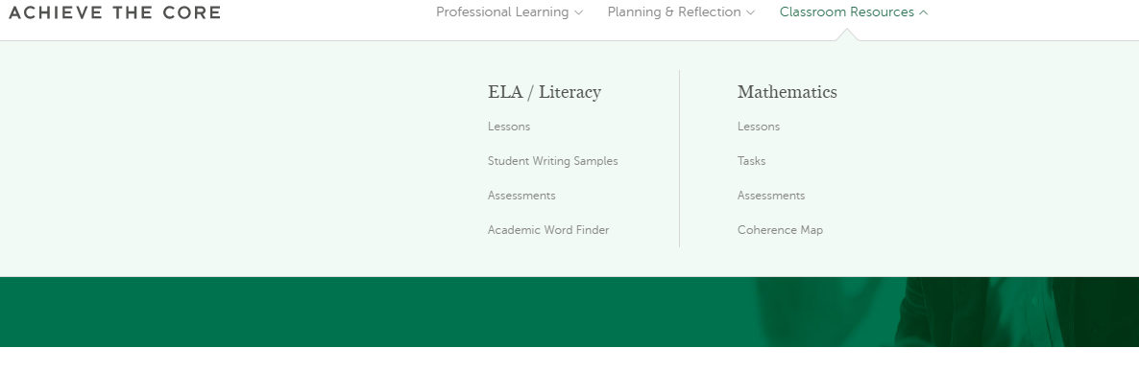
Tasks on Achieve the Core

Slide 16
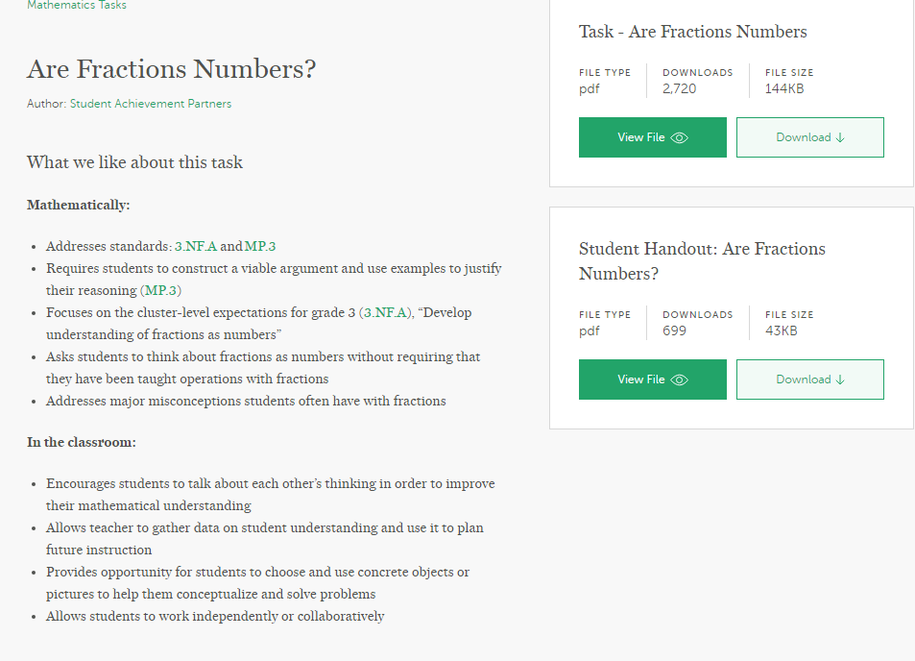

Slide 17
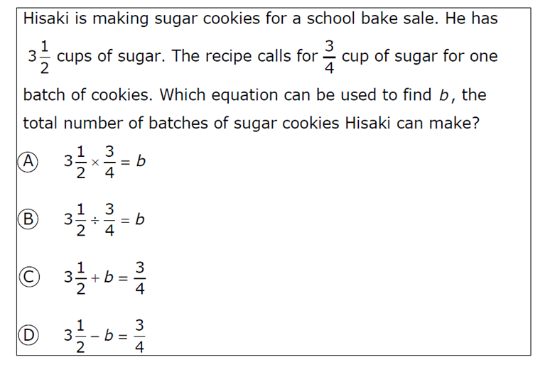

Slide 18
Analyzing Tasks
What standard/cluster is this task aligned to?
What aspect of rigor is required by the standard and the task?
What skills or knowledge do students need to have in order to solve this task?
What do you want students to learn through solving this task?
What are some errors you anticipate students may make? What are some reasons for those errors?
What are some different representations and/or strategies your expect students to use?
What questions will you ask during the debrief of this task?
How will you structure the sharing of student work for this task?

Slide 19
Other Sources for Tasks
Illustrative Mathematics
Engage NY
SBAC
PARCC
Your Curriculum

Slide 20
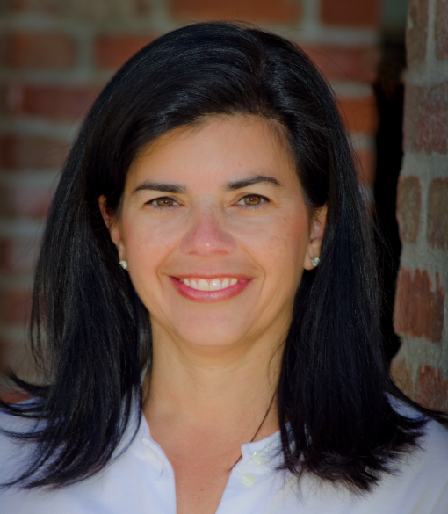
Guest Core Advocate:
Jody Guarino
Mathematics Coordinator
Orange County Department of
Education

Slide 21
Poll:
What percentage of the tasks you use come from resources outside of your purchased curriculum?

Slide 22
Poll:
Which is your favorite resource for finding tasks to use with students?

Slide 23
How can my PLC engage with the progressions in the Standards effectively?

Slide 24
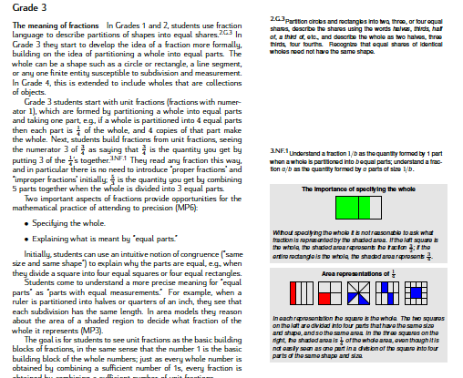
Engaging with the Progressions in the Standards
Progressions documents

Slide 25
Engaging with the Progressions in the Standards
Guiding questions for the progressions documents
Example:
Locate a standard in your grade band that requires students to build upon previous knowledge. Determine what standards from earlier grades must be mastered in order for students to be successful in this new learning. Refer to the progression document that supports your thinking.

Slide 26
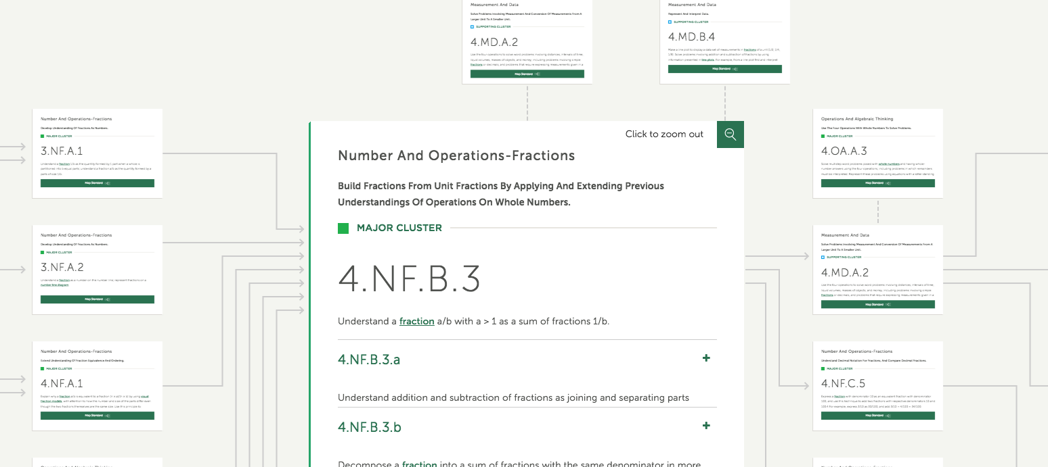
Engaging with the Progressions in the Standards
Coherence Map

Slide 27
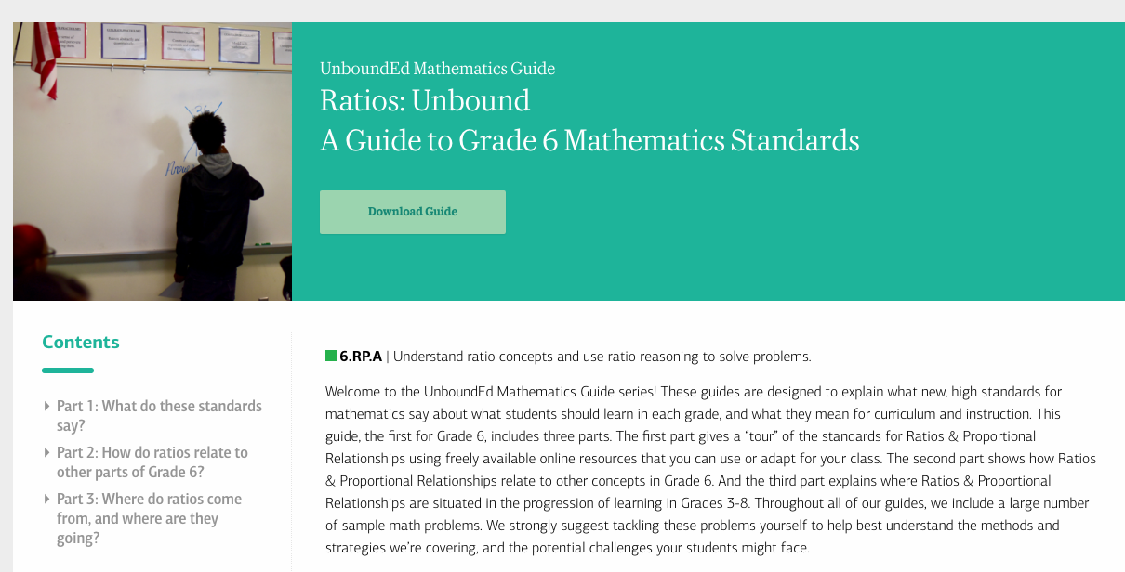
UnboundEd Math Content Guides

Slide 28
Question:
How does understanding the Standards, using the Coherence Map and Progressions documents, and selecting appropriate tasks prepare teachers to support students who struggle with math?
Please use the Questions tab on your control panel to respond.

Slide 29
How can my PLC use the Lesson Planning Tool for collaborative conversations?

Slide 30
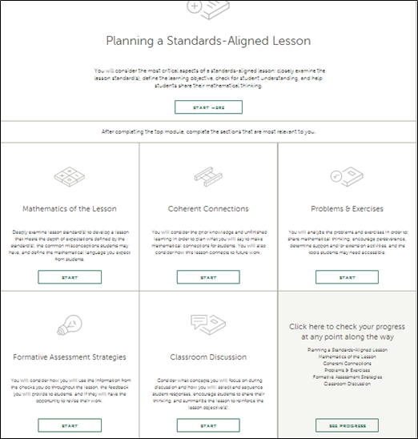

Slide 31
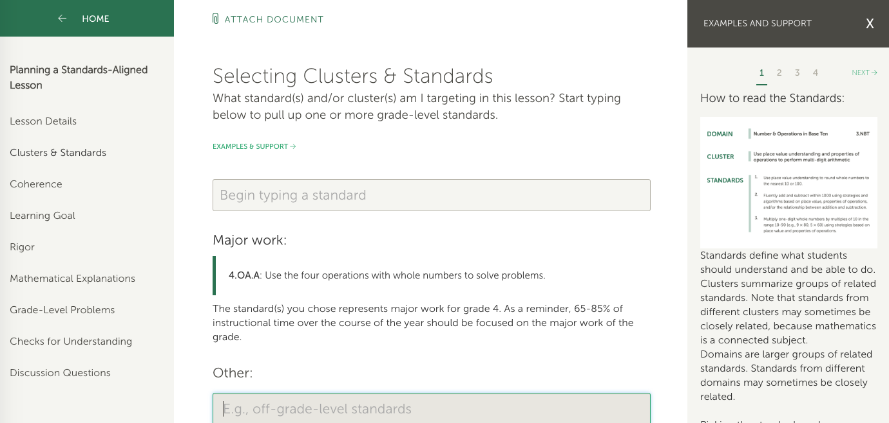

Slide 32
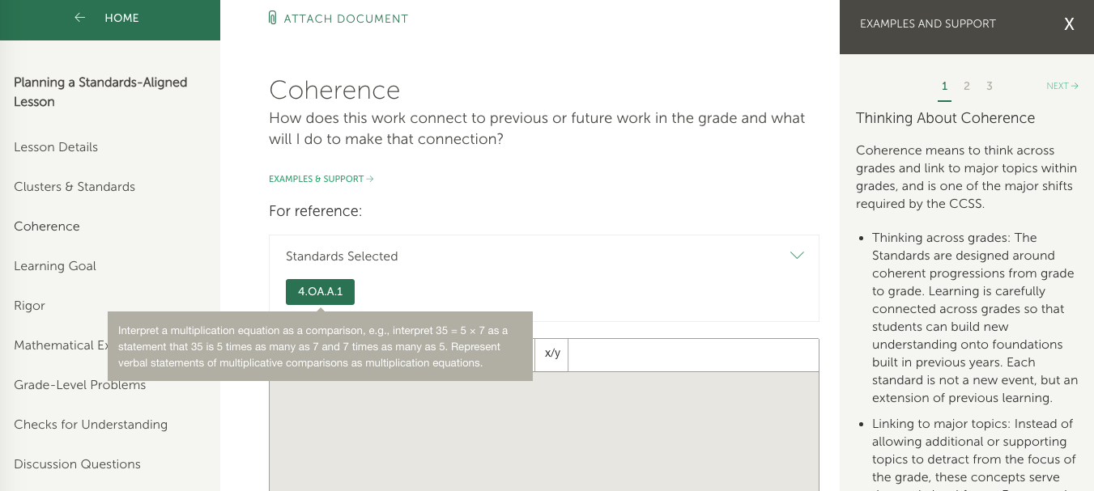

Slide 33
Lesson Planning Tool
What is the objective or learning goal for students in this lesson?
What unfinished learning from earlier grades might I need to address within the context of this lesson? How will the lesson explicitly connect to and build on students’ prior skills and knowledge? What will I say or show my students to make this connection clear?
What is the key mathematical idea or concept from the Standard(s) I am targeting?
What explanations, representations, and/or examples will I share to make the mathematics of this lesson clear?
What common misconceptions related to this topic, including mnemonics or tricks, do I anticipate will arise? How am I going to address these misconceptions to strengthen students’ understanding of the content?

Slide 34
Additional Resources for you to Consider
Study Mini-Assessments from Achieve the Core
Analyze a task with student work using the EQuIP Student Work Protocol
Observe peers using the Instructional Practice Guide Coaching Tool
Answer Beyond the Lesson Discussion Guide questions

Slide 35
Poll:
Which of the tools and resources shared tonight will you explore first?

Slide 36
Instructional Advocacy – A Definition
Grounded in a firm understanding of the Shifts, educators owning, supporting, and promoting the resources, tools, and practices that create learning environments in which students develop college- and career- readiness.

Slide 37
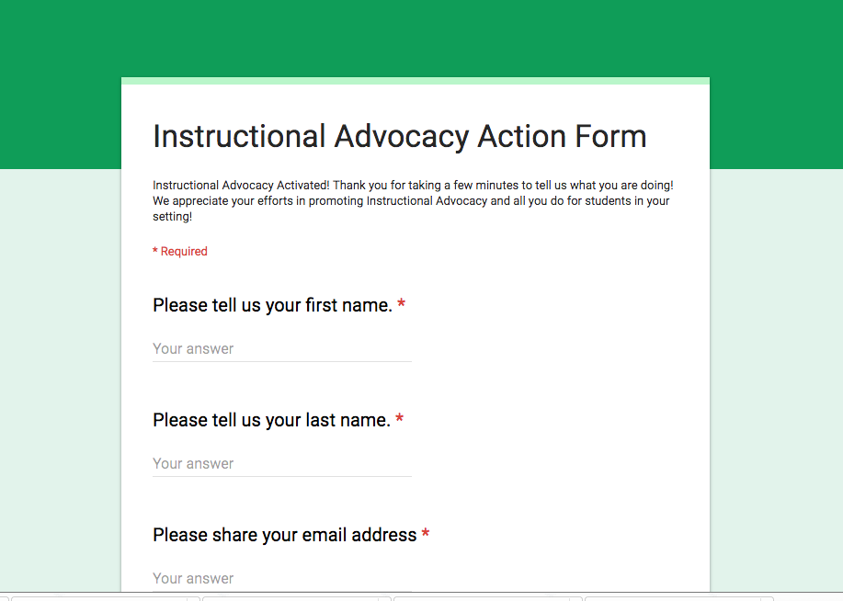
Tell us about your successes

Slide 38
Your Questions?

Slide 39
Please join us again next month!
Building a Deeper Understanding of the ELA Standards in PLCs
Wednesday, October 5, 2016, 7:00-8:00 pm
Register Here: https://attendee.gotowebinar.com/register/854130694280430594

Slide 40
Upcoming opportunities – Math mini-courses
Fall: The Instructional Materials Evaluation Tool

Slide 41
Thank You!

