Slide 1
Reviewing Using the Instructional Materials Evaluation Tool: ELA
Module 103: Building Knowledge
www.achievethecore.org
Notes:
This module was last updated on October 2016.

Slide 2
Essential Questions
How does the Instructional Materials Evaluation Tool (IMET) reflect the major features of the Standards and the Shifts?
What understandings support high-quality, accurate application of the IMET metrics?
Notes:
Estimated time for slides 2-10: 10-15 minutes
Note: these slides are review and should be skimmed quickly if working with the same team over time.
Big Idea:
These are the overarching questions we’ll be considering as we move through the IMET training.
Details:
Have participants read over the Essential Questions (p. 1).
Whether you are here to learn as a future trainer of reviewers, a reviewer yourself, or as a learner, we’ll hope that you will ask questions, let us know if you don’t agree with something, and participate in conversations with your colleagues.
Looking at materials with a critical eye on content and alignment to standards, although done in the past, is more important than ever in ensuring our students are moving through the K-12 system and graduating ready for the demands of career and/or college.
Our major purpose while we are together is to build a deeper understanding of the IMET as a tool to analyze instructional material alignment to the Common Core State Standards (or any state college- and career-ready standards).

Slide 3
Goals
Understand how aligned materials embody the shifts inherent in the Common Core State Standards
Understand the precise meaning of each metric
Recognize examples and non-examples related to each IMET criteria metric
Notes:
Big Idea:
These are our goals for the IMET module training.
Details:
Both the Essential Questions and goals are printed on your agenda and we’ll refer back to them at the conclusion of the training.
Have participants read over the goals (p. 1).
The first goal speaks to the understanding we will build regarding the major shifts, or changes inherent in college- and career-ready standards and how the IMET ensures alignment to them.
The second and third goals reflect the work we’ll begin as we go through the IMET and apply the tool to evaluate actual material examples for alignment to the Standards.
Both the Essential Questions and goals are printed on your agenda and we’ll refer back to them at the conclusion of the training.

Slide 4
The quality of instructional materials in our classrooms has a large impact on student learning.
“There is strong evidence that the choice of instructional materials has large effects on student learning – effects that rival in size those that are associated with differences in teacher effectiveness.”
Chingos & Whitehurst,
Choosing Blindly: Instructional Materials, Teacher Effectiveness, and the Common Core
Notes:
Skip this slide if the team is working through the modules.
Big Idea:
The quality of instructional materials in our classrooms has a large impact on student learning. Why is this work important?
Details:
Instructional materials in classrooms matter. If we are going to realize the promise of college and career readiness, we must pay attention to the choice of materials offered to teachers and students.
We all know the emphasis placed on ensuring effective teaching over the past decades. Perhaps we should be hearing as much about the choice of curricular materials.
With that in mind, we must recognize that reviewing materials is a time-intensive process. And it is an investment that pays off in the long run, because if teachers and students do not have well-aligned materials, the promise of the standards and college and career readiness may not come true.
Quote is drawn from a Brookings Institution report from 2012, available here: https://www.brookings.edu/research/choosing-blindly-instructional-materials-teacher-effectiveness-and-the-common-core/

Slide 5
Agenda
Module 103:
Non-Negotiable 3: Building Knowledge
Alignment Criterion 3: Building Knowledge with Texts, Vocabulary, and Tasks
Alignment Criterion 4: Access to the Standards for All Students
Notes:
Adjust this agenda based on your time allocation.
Big Idea:
This is the frame for the day.
Details:
Today we will work through the final Non-Negotiable criteria in the IMET: Building Knowledge
If you are working with a K-2 review team you will also want to include module 104 at this time, with NN4 Foundational Skills.
We will then look closely at the alignment criteria metrics that go along with this NN.
We will also dig into the alignment indicators around access for all students.

Slide 6
Norms for Our Work
Consider two norms you’d like to see us adhere to for the next two days.
Discuss your thoughts with your shoulder partner.
Be ready to share.
Notes:
Skip this slide if this is a continuation of the IMET training.
Big Idea:
Norms will help groups work effectively with the content in the IMET Modules.
Details:
Optional: If the group has established norms, insert here. If not, take the time to allow table groups to narrow down to 2 suggested norms and then chart the suggestions, noting repeats. Material needed: chart paper, markers

Slide 7
Non-Negotiable 3: Building Knowledge
Notes:
Estimated time for slides 8-14: 35-45 minutes
Big Idea:
We’ve talked already about Shift 3: the idea that students are learning content when they read, not simply a set of skills or strategies. Non-Negotiable 3 is all about Building Knowledge from reading.

Slide 8
Building Knowledge
Non-Negotiable 3: Materials build knowledge systematically through reading, writing, speaking and listening, and language study.
Metric 3A: Materials provide a sequence or series of texts that build knowledge and vocabulary systematically through reading, writing, listening, and speaking. These texts are organized around a variety of topics at each grade level.
Metric 3B: Materials provide instructions, clear design and lightweight student accountability, that guide instructors regarding how students will regularly engage in a volume of independent reading, both assigned, related to the anchor texts, or texts of their own choosing, in or outside of class.
IMET p. 13
Notes:
Big Idea:
The standards are clear about the importance of building knowledge in order to support students with comprehension of increasingly complex texts. If we expect students to become adept with this, we need materials which guide students in growing knowledge and vocabulary.
Details:
Found on p. 2 of handout
Briefly discuss with the person sitting next to you what these metrics require for materials to meet Non-Negotiable 3, highlighting or underlining the important words.
Note that while multiple standards will be addressed with every text, not every standard must be addressed with every text- the text should drive this.

Slide 9
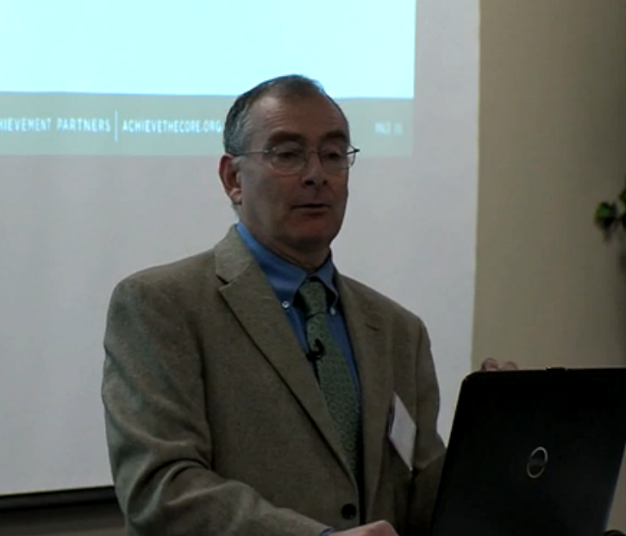
Metric 3A: Materials provide a sequence or series of texts that build knowledge and vocabulary systematically through reading, writing, listening, and speaking. These texts are organized around a variety of topics at each grade level.
Building Knowledge
“By reading texts in history/social studies, science, and other disciplines, students build a foundation of knowledge in these fields that will also give them the background to be better readers in all content areas.
Students can only gain this foundation when the curriculum is intentionally and coherently structured to develop rich content knowledge within and across grades.”
-- CCSS Anchor Reading Standards
IMET p. 14
Notes:
Download video and set up speakers in advance to ensure ease of showing. Allow time to debrief following 8 minute video.
Big Idea:
The two quotes here <have a participant read them aloud> come directly from the Standards:
Details:
David Liben, Senior Literacy Specialist with SAP, has been touring the country sharing this message. In this 6 minute clip, he shares some of the research and also connects the importance of content knowledge to assessment. While he references PARCC and SBAC, the implications hold true to other state CCR assessments.
Good idea to note that selection of examples from tests reflects the time and attention that went into selecting these texts. The complexity of these passages in general, and the words, topics, and references would be true of any texts in the band whether on a test or not. Students need knowledge to improve reading comprehension.
Video: https://vimeo.com/132681353, Minutes 25:51 – 31:39 David Liben, Student Achievement Partners Senior Literacy Content Specialist at a Text Set Project Training describes the research and reasons why we must build knowledge along with focus on vocabulary.
After clip: Go ahead and take 3-4 minutes to debrief what David Liben shared.

Slide 10
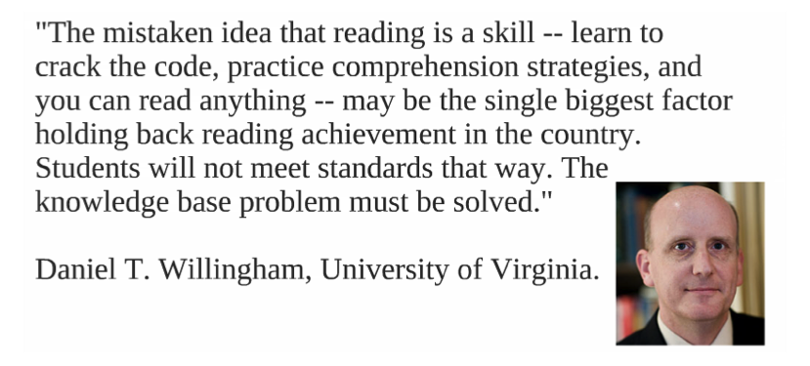
Building Knowledge
Notes:
Big Idea:
There are researchers speaking regularly on the importance of building knowledge to improve reading comprehension. This quote is from cognitive scientist Daniel Willingham.
Details:
Take a minute and talk about this with your tablemates.
Willingham’s books include Why Don’t Students Like School: A Cognitive Scientist Answers Questions and What it Means for the Classroom and more recently, Raising Kids Who Read.
If further information is needed regarding the shift to building knowledge, the entire David Liben video: https://vimeo.com/132681353 may be used to build background.

Slide 11
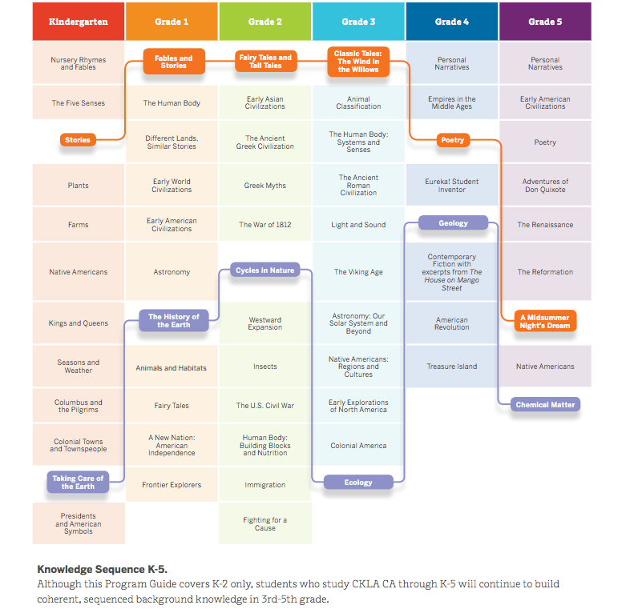
Example
Building Knowledge
Notes:
Big Idea:
In materials, especially K-5, topics would be developed over the years in a visible progression with a focus on growing knowledge.
Details:
In your handout on p. 3, examine the progression of these K-5 topics in the Core Knowledge program. The texts and topics are arranged to strategically build student knowledge, deepening understanding and connecting topics over the years.
Trace the progression on the page – learning in kindergarten builds through the years by studying topics more in-depth over the years.
Compare this to how content is approached through other programs that you are familiar with.
More information and research is available through the Text Set Project (http://achievethecore.org/category/411/ela-literacy-lessons?filter_cat=1112&sort=name)

Slide 12
Metric 3B: Materials provide instructions, clear design and lightweight student accountability, that guide instructors regarding how students will regularly engage in a volume of independent reading, both assigned, related to the anchor texts, or texts of their own choosing, in or outside of class.
Building Knowledge
Close reading alone
is NOT enough!
In fact, done alone, it can INCREASE the achievement gap.
IMET p. 15
Notes:
Big Idea:
It is important to note that students learn from what they read. This cannot and should not be dependent on anchor texts alone. It is also imperative to determine what resources, support, and texts are included in any given set of materials to address independent reading. Wide independent reading, along with the close reading of complex text, is critical for students to become literate.
Details:
Vocabulary researchers Camille Blachowitz, Freddy Heibert, and Linda Diamond agree that wide reading is the best, and really the only way to increase student vocabulary enough to meet the demands of complex text.
It is impossible to teach enough words to close the 30 million word gap existing between your highest and lowest performing students.
If we believe that close reading of complex text alone can mitigate this, we are wrong. In fact, as the slide says, it can increase the achievement gap. Close reading alone will teach your highest students--those with large vocabularies--how to read closely, pull evidence from text, and handle complex text.
Students without that background vocabulary and knowledge may try to apply close reading to complex texts, but the deficits in vocabulary, which can only be filled with reading, will still struggle. So if that is all we do, we may make the gap wider!
Catching up without reading a significant volume of texts is extremely difficult (Hiebert 2009).
No matter how much close reading is done, it will not provide this volume.
However, close reading develops familiarity with complex text, provides students with tools to work with many of the features of complex text.
Before the Standards, when less complex texts with less difficult vocabulary were used, students from more affluent households still did better. Now with more complex texts and vocabulary more important, the differential could increase because these more affluent students will be able to navigate complex text and benefit from their greater vocabulary.
Knowledge is also important to proficient reading (Kintsch 1998). Volume of reading is the best way to grow knowledge (Adams 2009).
More affluent students, usually from educated households, come into school with more knowledge. If we don’t grow the knowledge of less affluent students, we are depriving them of this tool as well.

Slide 13
Building Knowledge
A volume of reading should be balanced with the close analytic reading.
Close Reading | Volume of Reading
Fewer pages | More pages
Grade-level complex text | Text at different levels of complexity
All students same text | Student or teacher choice of text
Teaches students to attend to text and to words | Rapidly builds knowledge & vocab
Heavy support | Light support
Solely instructional | Guided or independent
Exposes students to higher level content | Builds knowledge of words, and the world
Gives all students access | Builds love of reading
Notes:
Big Idea:
When considering the range and quality of texts, it is helpful to consider educational purpose.
Details:
Found in handout on p. 4
Close reading is one approach to supporting students with more complex text. But it will not be enough to make proficient readers out of all students.
One of the key points here is that, with close reading, you go deep with a small amount, whereas in volume of reading you do a huge amount on a wide variety of topics. We simply CAN’T do close reading for everything because it takes too long. If you do only close reading, you won’t read enough.
NOTE: There are not only 2 categories. There is a broad spectrum. So really we need “close reading, volume of reading, and everything in between.”

Slide 14
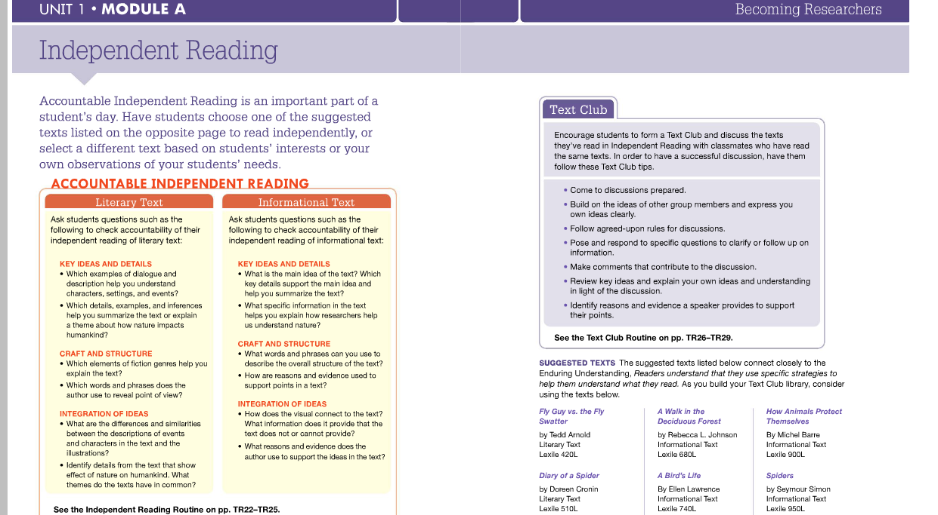
Independent Reading
Building Knowledge
Notes:
Big Idea:
This plan shows an emphasis on supporting independent reading within the program.
Details:
Found in handout on p. 5
Directions are provided for accountable independent reading. This should be clearly visible for teachers and students in aligned materials.
One consideration is if the texts are included with the program, or if they must be purchased separately. This is a good question to ask the publisher.

Slide 15
Alignment Criterion 3: Building Knowledge with Texts, Vocabulary, and Tasks
Notes:
Estimated time for slides 16-25: 30-40 minutes
Big Idea:
The Alignment Criteria must each be met for materials to be considered aligned to the shifts and major features of the Standards. Each AC has metrics associated with it; a specific number of these metrics must be met or partially met in order for the criterion as a whole to be met. AC 3 digs deeply into the texts, vocabulary, and tasks that contribute to knowledge building.

Slide 16
Building Knowledge with Texts, Vocabulary, and Tasks
Alignment Criterion 3: Building Knowledge with Texts, Vocabulary and Tasks: Materials build students’ knowledge across topics and content areas.
    AC Metric 3A: Materials regularly ask students to complete culminating tasks in which they demonstrate their knowledge of a topic.
    AC Metric 3B: Materials require students to engage in many short, focused research projects annually to develop students’ knowledge in a range of areas and to enable students to develop the expertise needed to conduct research independently.
    AC Metric 3C: Materials include a cohesive, year-long plan for students to interact with and build academic vocabulary.
Example | Non-Example
IMET p. 31
Notes:
Big Idea:
We are moving now to Alignment Criterion 3 because we have been working with building knowledge. AC 3 guides reviewers to more deeply examine what students are asked to do in order to build knowledge within any set of materials.
Details:
Found on p. 6 in handout.
The shift to Building Knowledge is emphasized by texts and materials that are linked by a topic, where students are truly learning about content over a period of time.
Alignment Criterion 3 leads reviewers in looking at the systematic plan to build student knowledge, by asking:
Do materials ask students to demonstrate what they’ve learned about the topic studied?
Do materials include research (short, mini projects as well as longer ones?)
Is there a systematic plan to build vocabulary?
We’ll take a closer look at each of the associated metrics now.
<Allow participants to read the Alignment Criterion and metrics on page 31 of the IMET.>

Slide 17
    Alignment Criterion 3A: Materials regularly ask students to complete culminating tasks in which they demonstrate their knowledge of a topic.
Building Knowledge with Texts, Vocabulary, and Tasks
What will students say if you ask: “What did you learn from the reading and study we’ve done?”
IMET p. 32
Notes:
Big Idea:
To truly assess building knowledge, tasks must ask students to show evidence of what they learned from the work that they did. AC 3A focuses on the culminating task and how it reflects the knowledge gained through reading.
Details:
Alignment Criterion 2A required a high-quality sequence of text-dependent questions build to a deep understanding of the knowledge and central ideas of the text.
This criteria asks reviewers to analyze the culminating tasks: do they take advantage of the knowledge students learned and discussed while reading?
A culminating task demonstrating knowledge of a topic also provides feedback to the teacher on the students’ grasp of content. Did the students learn what you intended? And are they able to demonstrate that learning? This is the purpose of culminating tasks that reflect knowledge.
High-quality culminating tasks are often “backward-designed” and matched to the line of inquiry or question introduced before reading.

Slide 18
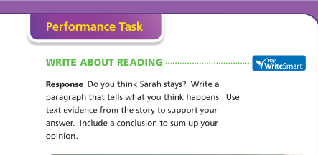
Building Knowledge with Texts, Vocabulary, and Tasks
Building Knowledge: Example or Non-example?
Notes:
Big Idea:
Take a look at this sample grade 3 task, following the reading of an excerpt from Sarah, Plain and Tall in the grade 3 Journeys curriculum
Details:
A slightly more detailed version of this task is available in your packet on p. 7.
Talk with your table-- Does this task meet the expectations of Alignment Criterion 3A?
Note: this task does not reflect the knowledge building requirements of the IMET. Students are asked to create a new narrative, and are given limited guidelines as to how to incorporate the original text. This task is a writing task that alone may have some merit, but highlights the limited way in which the treatment of texts serves to build knowledge in many curricula. Compare this to the example on the next slide

Slide 19
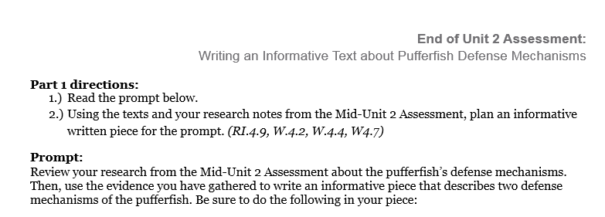
Building Knowledge with Texts, Vocabulary, and Tasks
Building Knowledge: Example
Notes:
Big Idea
A strong culminating task that shows evidence of building knowledge will require students to incorporate a variety of things that they have learned in the completion of the task.
Details
Found on pp. 8-10 in handout.
Take a look at the full task from the grade 4 Expeditionary Learning module, Animal Defense Mechanisms
How are students expected to show what they have learned about a topic in this task?
Are students expected to provide evidence gleaned from reading and discussion?

Slide 20
    Alignment Criterion 3B: Materials require students to engage in many short, focused research projects annually to develop students’ knowledge in a range of areas and to enable students to develop the expertise needed to conduct research independently.
Building Knowledge with Texts, Vocabulary, and Tasks
CCSS Research: Standards 7, 8, 9, 10
Research = inquiry
Time to complete? Short
Spot check for inclusion
IMET p. 33
Notes:
Big Idea:
Beginning in grade 4, students are expected to draw evidence from literary and informational texts to support analysis, reflection, and research; in the primary grades, research is shared.
Details:
And Standard 10, range of writing, which begins in grade 3, spells out the expectation that students are writing routinely for a variety of purposes (including research) and audiences.
<Read over Metric 3B and the How to Find Evidence column now.>
Research involves inquiry – this means there would be a question to answer.
In order for students to learn to research, the time to complete the research should be short – a week or two, so it can be practiced multiple times over the year, with increasing independence. Let’s look at two research assignments on the next two slides (these are in your handout packet on p. 11) and consider if they would be counted as evidence of alignment or not.

Slide 21
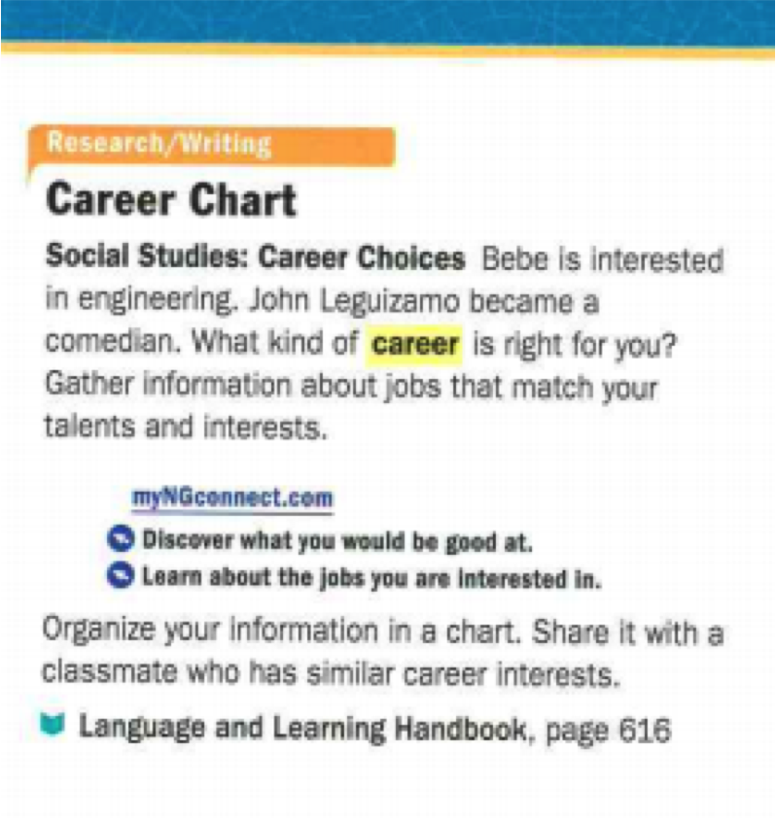
Research: Example or Non-example?
Building Knowledge with Texts, Vocabulary, and Tasks
Notes:
Big Idea:
This is a non-example for metric 3A. Why might this be a non-example of an aligned task?
Details:
In handout on p. 11 (this is the first of 2 assignments shown on that page)
<Allow participants to discuss.>
Some reasons this prompt, as shown, might not measure up include: there is no mention of the text to be used; it is not focused, and students would need quite a bit of expertise in how to research independently.
This is from grade 5.

Slide 22
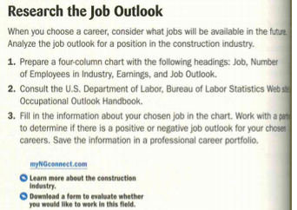
Research: Example or Non-example?
Building Knowledge with Texts, Vocabulary, and Tasks
Notes:
Big Idea:
This grade 9 example of research is a better-aligned sample assignment.
Details:
In handout on p. 11
Students are directed where to access their information, given a chart to support organizing their findings, and work with a partner to determine the job outlook. This assignment is more focused and supportive than the previous one. What questions would you have about the assignment?
Participants might wonder if the students know or have previously practiced saving information in a professional career portfolio, or if they know how to determine the job outlook.
When reviewing, it is advisable to get into the materials and look at the quality of the assignments. Even if they are labeled “research” in the Table of Contents, there can be variety in the quality of the assignments as many reviewers have found.

Slide 23
Building Knowledge with Texts, Vocabulary, and Tasks
    Alignment Criterion Metric 3C: Materials include a cohesive, year-long plan for students to interact with and build academic vocabulary.
Importance of Vocabulary
Nearly a century of research (Whipple 1925, NAEP 2012)
Feature of complex text that likely causes greatest difficulty (Nelson et al 2012)
Having to determine the meaning of too many words slows readers up; problem gets much worse with complex text.
Not knowing words on the page is debilitating.
“30 Million Word Gap”
After much research…
IMET p. 34
Notes:
Big Idea:
Alignment Criterion 3C on the IMET is critical. The focus on academic language is found throughout the CCSS, in the Reading, Language and Speaking and Listening Standards. The reasons for the focus on academic language both in the Standards and in materials include:
Details:
We have nearly a century of research documenting the effect of vocabulary on reading comprehension. Whipple’s study in 1925 showed that if a word encountered and decoded in a text was not in the reader’s oral vocabulary, the reader would not be able to make sense of the reading without figuring out the word. Research showing the correlation between vocabulary and reading continues. The NAEP showed students who scored higher on vocabulary questions also scored higher in reading comprehension.
Unfamiliar vocabulary is the feature of complex text which causes the most difficulty for students.
If a reader has to continually stop and try to figure out word meanings, reading is slow.
Reading is not a pleasure.
30 Million Word Gap refers to the Hart & Risley study (1995) which found that students from low-income backgrounds had much lower vocabularies and exposure to words than their affluent peers. We must focus on vocabulary through wide reading and effective instruction to close the achievement gap.
After much research… we can conclude reading has a lot to do with words!

Slide 24
Building Knowledge with Texts, Vocabulary, and Tasks
Example
With prompting, scaffolding, and support, the students will review the series of pictures and text to determine how water was important to early Asian civilizations. After reviewing the documents, students will write to the prompt independently.
Helpful Vocabulary:
fertile irrigation canals Indus River trade
cultivate sacred Yangtze River transport
source Hinduism Yellow River Himalayan Mountains
Writing Task: Using evidence found the in the following documents, your knowledge of our readings, and at least four of the vocabulary words above, please describe how water was important to early Asian civilizations.
Notes:
Big Idea:
Consider this example of a grade 2 writing task in the Core Knowledge modules (see your handout, p. 12). How does this task support students in learning and using academic vocabulary? How does this relate to the overall goal of building knowledge?
Details:
Allow participants to discuss questions above and share out responses
Be sure to point out that students are supported in learning and using these words and phrases throughout a unit of study. They are then expected to determine the meaning of the content well enough to write about it themselves.
There are supports embedded in this task- both the referenced prompting, scaffolding and support in the directions, the referenced series of pictures and text.
Note: this is also another example of a task that fits the criteria of AC3A. There can absolutely be overlap found between metrics

Slide 25
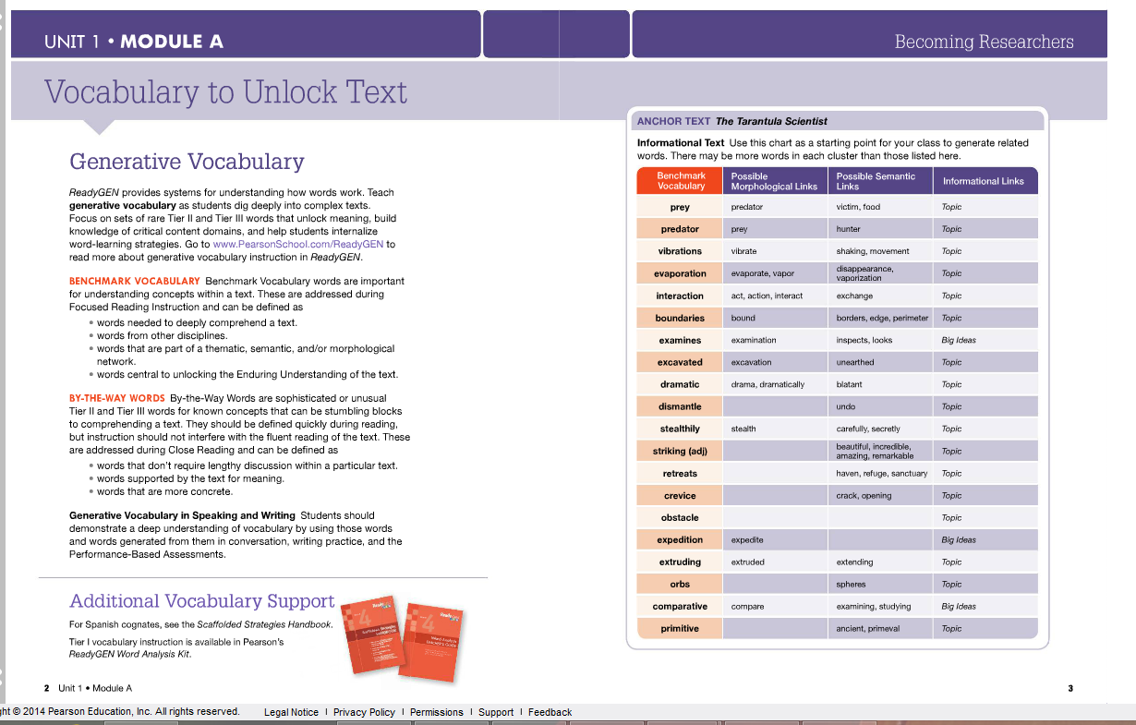
Building Knowledge with Texts, Vocabulary, and Tasks
Example
.
Notes:
Big Idea:
In your packet (see your handout, p. 13) is an example of an approach to vocabulary in a basal program, grade 4.
Details:
Consider how this example would provide evidence for Metric 3C
What else would you want to look for or investigate
“By the Way Words” could be expanded to “words that are a closely related synonym for a concept, idea, event, or process that students likely already know, e.g., “intrude” for breaking into or interrupting; “malicious” for evil or wicked…
This example shows support for understanding and expanding the context for words encountered in the texts across the topic under study.
It also supports students in seeing the morphological and semantic links beyond the individual words. If this is typical support for each unit of study, this is a strong example of part of a cohesive, year-long plan for building academic vocabulary.

Slide 26
Alignment Criterion 4:
Access to the Standards for All Students
Notes:
Estimated time for slides 27-50: 35-50 minutes
Big Idea:
The Alignment Criteria must each be met for materials to be considered aligned to the shifts and major features of the Standards. Each AC has metrics associated with it; a specific number of these metrics must be met or partially met in order for the criterion as a whole to be met. Alignment Criterion 4 does not accompany a Non Negotiable, but is critical in aligned materials.

Slide 27
Access for All Students
Alignment Criterion 4: Materials are designed to provide thoughtful supports/scaffolds to support all students in accessing the Standards.
AC Metric 4A: Content can be completed in a school year
AC Metric 4B: Materials support ELLS and students reading below grade level
AC Metric 4C: Materials include extension opportunities
AC Metric 4D: Materials include adaptations/ remediation strategies
AC Metric 4E: Materials include systematic assessment
Example | Non-Example
IMET p. 36
Notes:
Big Idea:
Alignment Criterion 4 is the access for all students criteria. This includes finding evidence in materials across the year(s) that all students will be offered ample opportunities to meet and exceed grade level standards
Details:
Found on p. 14 in handout.
This criterion is not visible in the Standards themselves and, therefore, requires much more discussion of evidence in materials by the reviewing team. The IMET includes a note to teams which is on the next slide.

Slide 28
As Noted in the IMET:
Access for All Students
Because the Standards are for all students, evaluation requires that careful attention be paid to ensure that all students, including English Language Learners and those with different learning needs, have access to high-quality, aligned materials. The IMET is designed primarily to help educators determine whether instructional materials are aligned to the Shifts and major features of the CCSS. The IMET also allows room for local considerations to ensure that selected materials provide access for the specific set of students who will be using those materials.
IMET p. 36
Notes:
Have a participant read aloud the note on the slide.
Big Idea:
Access for all students, a critical consideration in materials, is not black and white. A note was added to the IMET on p. 36 to support reviewers.
Details:
The Non-Negotiables and previous Alignment Criteria may have illuminated places where core-aligned materials now provide access for all students where previous materials may have inhibited access. Also, there are many research-based or best practice supports and scaffolds that, if a school is committed to using, may provide all the access best suited to local student needs. Reviewers may choose to consider those supports as they review materials.

Slide 29
Alignment Criterion 4A: Teachers and students can reasonably complete the core content within a regular school year to maximize students’ learning.
Access for All Students
Moving from…
A wide range of components without time allotments or scheduling guidance….
Common Core “inserts” or add-ons…
More tasks than can reasonably be completed with students…
Moving to…
Clear instructions on when to use specified materials…
Built in tasks that are aligned and part of the core lesson…
Reasonable time allotments that allow for discussion and task completion…
IMET p. 37
Notes:
Big Idea:
Alignment Criterion 4 helps teams analyze materials in terms of access for all students. Are materials set up so teachers can guide all students to master the grade-level standards? It is not enough to simply have all the components accounted for in a curriculum- it must be reasonable to expect that teachers and students will be able to complete the content in the time allotted. AC 4A ensures that reviewers are looking closely at pacing guides, unit guides, and lessons to determine whether the time allocated is sufficient and realistic.
Details:
In handout packet, p. 15
This slide asks participants to think about the type of teacher instructions pre-CCSS materials might have provided and then consider how these teacher instructions might be different in core-aligned materials. <Give instructions for participants to think first, and then discuss with their tablemates-- Ask: “What does this look like in instructional materials? What would you expect to see in core-aligned materials?”>
Be sure to ask participants to refer to the IMET to read Alignment Criterion 4A to successfully engage in this conversation.
<Allow participants 3-4 minutes to discuss and debrief for 1-2 minutes.>
Participants may respond:
Moving from . . .
Overloading the curriculum with additional components or tasks
Putting in more than can be actually done, in order to “cover” all components
Moving to . . .
Thoughtfully planned decisions about time and tasks that are realistic for educators

Slide 30
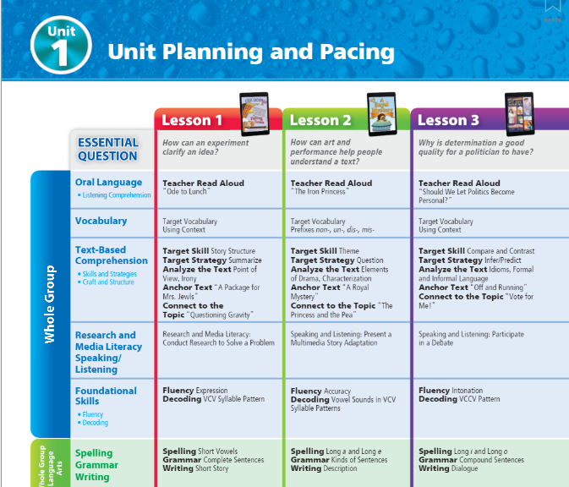

Access for All Students
Notes:
Big Idea:
Pacing guides are a starting point for this work, whether in year-long, weekly, or daily form.
Details:
When reviewing curricular materials, look for evidence that thought has been given to how to pace out all components of the curriculum.
Be sure to be wary of the stone soup phenomenon- simply responding to the expectations set for publishers by throwing everything in somewhere. Part of AC 4A’s value is that it helps assess whether the components can be taught as planned so that students have the opportunity to achieve the outcomes promised. If the material included is not reasonably paced, student learning is limited to what is covered.

Slide 31
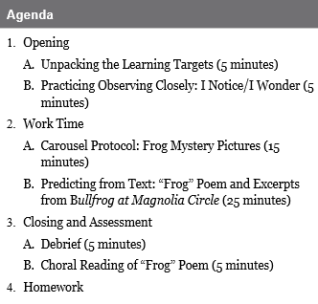
Access for All Students
Example
Notes:
Big Idea:
Beyond looking at pacing guides, AC 4A asks reviewers to sample several lessons, to evaluate whether they can be reasonably completed. Take a look at the sample lesson agenda in your packet on p. 16.
Details:
This is a sample grade 3 lesson from Expeditionary Learning. Your packet lists the agenda and gives brief explanations of the work time. Note that the full lesson plan expands on all items in the agenda.
Take a look at the first two bullets on the IMET on p. 37.
Sample multiple lessons across the year and in different grades to evaluate whether they can reasonably be completed in the recommended time.
Specific recommendations for how much time to allot for student discussion and tasks or in responding to questions. Is a range of time provided such that most students could accomplish the included tasks?
* Reflect on the task and time allotments. How would you determine the evidence needed to meet this metric?

Slide 32
Alignment Criterion 4B: Materials regularly provide all students, including those who read, write, speak, or listen below grade level, or whose first language is other than English, with extensive opportunities to work with and meet grade-level standards.
Access for All Students
Moving from…
Providing a simpler text
Changing the content to speaking tasks
Excusing students from the assignment…
Moving to…
Supporting access to grade level texts
Providing models or frames to help students practice higher level writing…
Provide practice opportunities for speaking and listening with peers…
IMET p. 38
Notes:
Big Idea:
The CCSS were written based on evidence of what students needed to be able to do to be ready for college and/or career. As we discussed earlier, some of the instructional materials and practices in use might actually have been causing an expansion of the achievement gap. For this reason, aligned materials must include clear supports for English Language Learners and students with reading gaps.
Details:
In handout packet, p. 17
This slide asks participants to think about the type of teacher instructions pre-CCSS materials might have provided for ELLs and students below grade level. <Give instructions for participants to think first, and then discuss with their tablemates-- Ask: “What kinds of teacher instructions were provided in the past for supporting ELLs and students below grade level? What would you expect to see in core-aligned materials?”>
Participants may respond:
Moving from . . .
Consistently providing students with simpler texts (e.g., lower level, modified or complete removal of texts) if they are reading below grade level
Changing the content to all speaking related tasks
Excusing students from the text or writing and giving them a different task
Moving to . . .
Providing supports for students so they can access grade-level texts. This might include working with shorter critical chunks of text, allowing opportunities for students to preview or have supported encounters with the text, listening to the text read aloud while following along, discussion.
Providing models and/or frames for students so they can practice the same type of writing that their peers are writing
Provide frames and other supports and many practice opportunities so that students can engage in speaking and listening activities similar to that of their peers that allow them to meet grade-level standards
“Aligned materials will regularly include scaffolds and supports for students working below grade level designed to offer access and increasing ability to meet grade-level standards.”

Slide 33
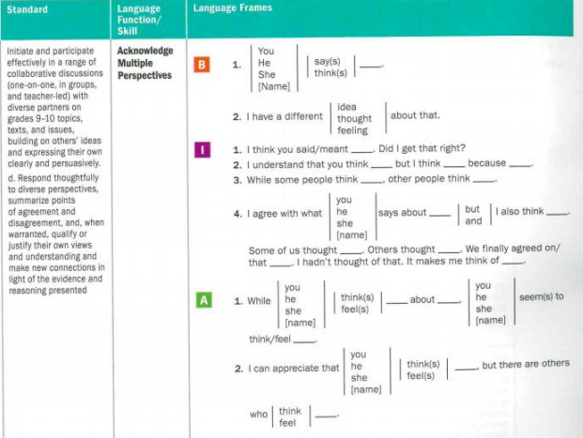
Example
Access for All Students
Notes:
Big Idea:
This is an example from National Geographic’s Edge program for grades 9-10. This frame is provided within the teacher and student materials. Students working at a variety of language levels (B-beginning, I-intermediate, and A-Advanced).
Details:
In handout on p. 18
<Ask them to discuss with a partner or at their tables why this an example of AC 4B.>
<Debrief the discussion adding the following points if they are not raised:>
In this example, teachers and students are provided with structures to use with beginning, intermediate, or advanced learners of English. Students are supported in using increasingly sophisticated language structures during discussion. These structures provide support while still giving student the opportunity to develop the capacity to do grade-level work.
The advice is practical and straightforward to implement as the sentence frames are provided paired with the learning standard they support. Also, students are not pigeon-holed into a level. They see and hear what increasingly sophisticated language looks and sounds like.
There is a wide range of support available for all and illustrations of acknowledging multiple perspectives.
Example drawn from Edge by National Geographic for grades 9-10.

Slide 34
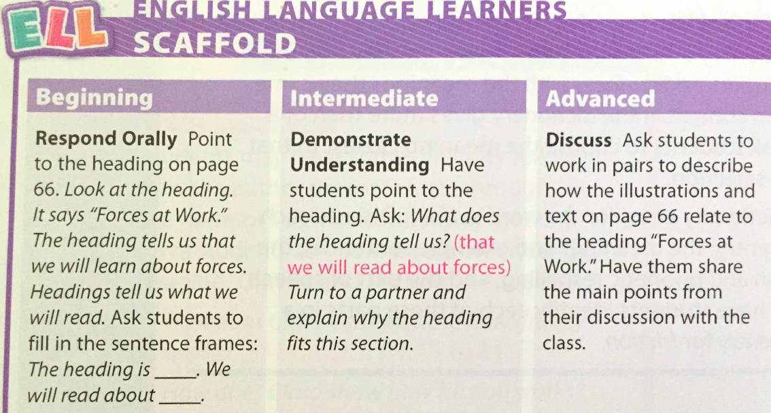
Adapting instruction for varying needs: Example or Non-example?
Access for All Students
Notes:
Big Idea:
Discuss the quality of this EL scaffold. Would this count as an example of an opportunity to work with and meet grade-level standards? Why or why not?
Details:
In handout, p. 19
They should read the task and consider if this is an example or a non-example.
This example does not provide evidence of alignment for metric AC 4B. Although more information is needed to see what is happening over time, the support for beginning level ELL students does not develop student capacity for grade-level work. Students are just asked to repeat after the teacher. They are not learning about the content of the reading nor about text features like headings.
Discussions around this sometimes lead to comments like, “this is appropriate for students just new to the language.” That may be the case, but if this is day after day the instruction in your materials, you’d have a bit of a question about whether these materials were doing enough for the beginning or intermediate student. These recommendations are critical for catching kids up and closing the achievement gap.

Slide 35
Alignment Criterion 4C: Materials regularly include extensions and/or more advanced opportunities for students who read, write, speak, or listen above grade level.
Basic Characteristics of Enrichment Learning
Access for All Students
  Student and teacher select a topic which may be an off-shoot of the regular curriculum or an independent topic based on the student’s interest.
  Student produces a product, project, and/or service that is intended to have an impact on a particular audience.
  Student uses authentic methods, technological resources, and advanced level content to produce the product or service.
IMET p. 39
Notes:
Big Idea:
Enrichment learning, according to research, should allow students to go more deeply with the topic under study or their own interests.
Details:
This list of characteristics is drawn from research done by J. S. Renzulli, from the University of Connecticut.

Slide 36
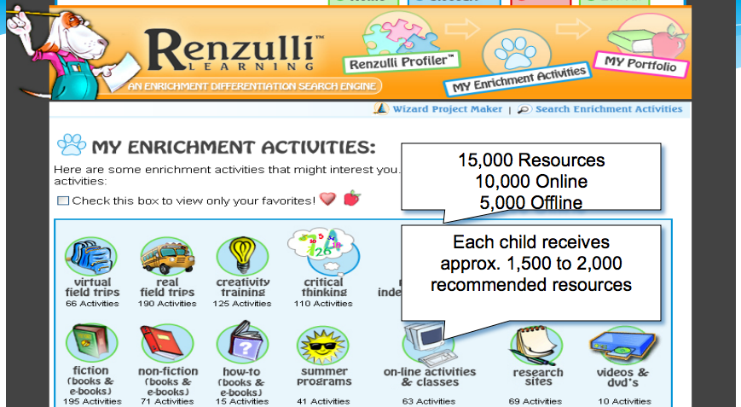
Example
Access for All Students
Notes:
Big Idea:
This example provides evidence for alignment of Metric 4C.
Details:
This example is not in the handout packet.
The Renzulli learning program (now owned by Compass Learning) provided research for improved student outcomes in reading comprehension, oral reading fluency and social studies achievement. Well-aligned materials will regularly include extensions and more advanced opportunities for students working above grade level.
Sources: http://renzullilearning.com/downloads/SEM_research_studies_1-24-08.pdf

Slide 37
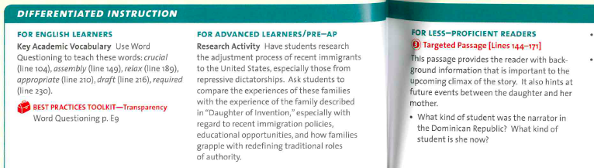
Alignment Criteria 4B and 4C: Example
Access for All Students
Notes:
Big Idea:
This example is drawn from a popular basal, grade 9
Details:
In the handout packet on p. 20
This type of direction in materials offers teachers ideas for adapting instruction easily for advanced students, less-proficient students, and English learners. Reviewers should look carefully for evidence over the submission for this type of support centered on the text under study.

Slide 38
Alignment Criterion 4D: Materials regularly and systematically build in the time, resources, and suggestions required for adapting instruction to allow teachers to guide all students to meet grade-level standards (e.g., alternative teaching approaches, pacing, instructional delivery options, suggestions for addressing common student difficulties, remediation strategies).
Access for All Students
IMET p. 40
Notes:
Big Idea:
Next we’ll consider how well the materials support differentiated instruction through Alignment Criterion 4D.
Details:
Reviewers may look for the inclusion of materials designed for adapting instruction or remediation. These might exist in supplementary materials or be included within the core materials.

Slide 39
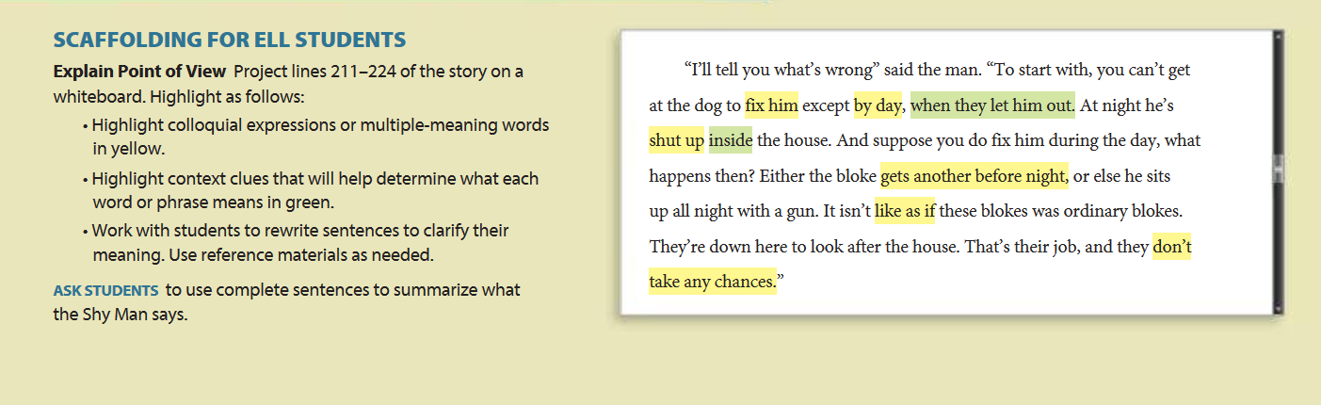
Alignment Criterion 4D Example
Access for All Students
Notes:
Big Idea:
This is an example of embedded support for differentiation.
Details:
Take a look at the example in your packet on p. 21 – suggestions and materials for adapting instruction for varying student needs. In this example, the teacher varies instructional support for ELL students by supporting students with making meaning of the central text--in this case, from Collections, The Mixer, Grade 6.
This is superior and what we want. A couple of points:
It is very much like close reading, in fact it is
That being said it is exactly what is needed and they should know it is extremely rare
If further reference on how to work with complex text with English learners, the work of Lilly Wong Filmore is helpful and can be found online at
http://ell.stanford.edu/publication/what-does-text-complexity-mean-english-learners-and-language-minority-students
Her research and guidance indicates that most ELLs can handle texts with complex language if the texts are clear. She encourages teachers to use the and teach with complex texts so students learn how to deal with them.

Slide 40
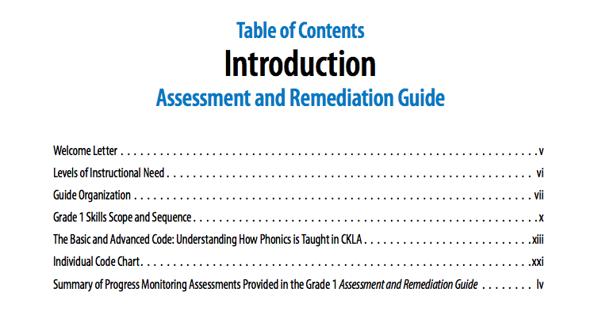
Access for All Students
Notes:
Big Idea:
Aligned materials include accessible, easy to implement remediation. This may include reference and ideas for common misconceptions in the form of an additional handbook.
Details:
Handout on p. 22
This sample from Core Knowledge Skills program provides direct guidance for teachers on what to do when a student is not successful in the sequence of instruction.

Slide 41
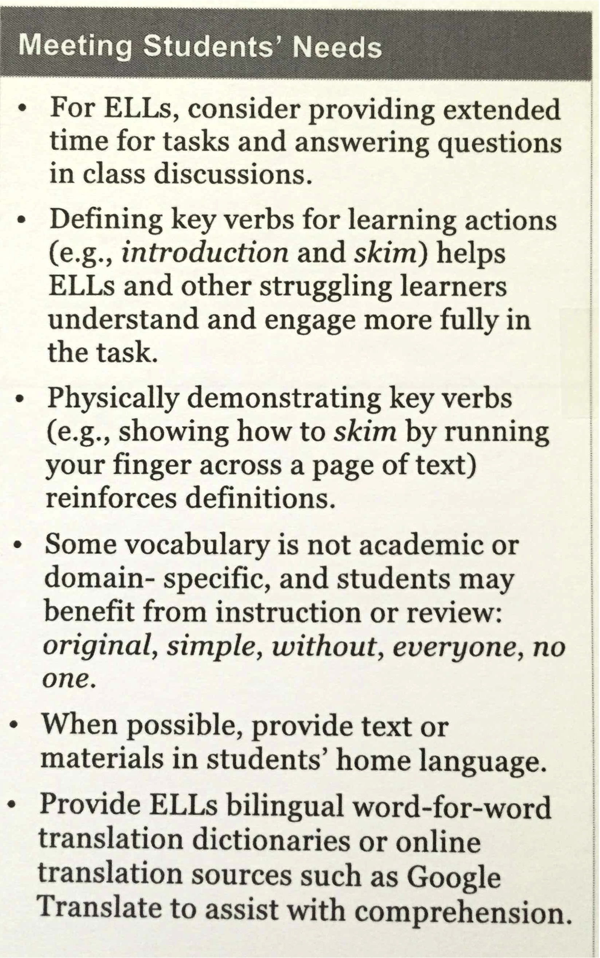
Example or Non-example?
Access for All Students
Notes:
Big Idea:
Discuss how this set of directions for Meeting Students’ Needs from EngageNY Expeditionary Learning grade 5 either does or does not provide evidence of alignment for AC 4D.
Details:
In handout packet on p. 23
Be sure to have participants looking at AC 4D
<Debrief:>
There are many suggestions here. This gives teachers ideas they can use, not just for this lesson, but for other lessons, as well.
Although the fourth bullet says these words are not academic vocabulary, they are! Understanding these words in context will help students in all content areas.
This is a good example of providing access and resources.

Slide 42
Access for All Students
Optional:
In your handout packet on page 24, find the Vermont Writing Collaborative Darwin Germany lesson on habits of mind.
Look over the lesson plan and discuss how this lesson is an example of alignment for AC 4D.
IMET p. 40
Notes:
Depending on time and need, there is an optional lesson from the Vermont Writing Collaborative included in the handout packet on pp. 24-30 that participants may use as a basis for discussion on what materials might look like if they “allowed teachers to guide all students to meet grade-level standards.”
Big Idea:
This is a sample task from the Vermont Writing Collaborative (pp. 24-30 in handout)
Details:
Materials must include the time and resources for teachers to guide all students to meet grade-level standards. Consider what that might look like in materials, and jot your ideas down on a few sticky notes. Be ready to share. Have participants get up and mingle, sharing the ideas they jotted down.
When collecting evidence for this metric, reviewers will have to consider the grade level(s) under consideration and the needs of their students. What evidence can be found that materials are paced so that teachers really have the time to guide all students to meet grade-level standards? What resources are included?
Optional Activity: This grade 7/8 lesson is taught using a complex texts on German scientists of the early 20th century. Using the included materials here, discuss how the student guide and the notetaker, along with the Test Drive model, which is only for the teacher provide evidence of alignment for criteria 4D.
<Allow time for discussion and then debrief.>
Notes for debrief:
1) Encourage participants to use the wording of the metric to support their position.
2) This lesson provides enough support for all students to collect evidence through the notetaker/organizer.
3) The model provided to students help them understand the expectations of the assignment.
4) The test drive for the teacher provides necessary information for the teacher to guide students in completing the assignment.
5) What else would you want to look for in materials?

Slide 43
Alignment Criterion 4E: Materials regularly and systematically offer assessment opportunities that genuinely measure progress on reading comprehension and writing proficiency as well as on mastery of grade level standards. This progress includes gradual release of supporting scaffolds for students to measure their independent abilities.
Access for All Students
Formative, interim, and summative assessments
Aligned to the requirements of the grade-level standards
Reflect the balance of text and writing types
IMET p. 41
Notes:
Big Idea:
Program assessment materials should include formative, interim and summative assessments, aligned to the requirements of the standards that reflect the balance of text and writing types for the grade level. They might also include diagnostic assessment tools for teachers.
Details:
Assessment should show if the students are getting it – whatever the it is – text, video, writing form, etc.
There should be supporting scaffolds to help students hone skills based on the results.
There is a supporting 1 hour PPT from SAP if more support is needed in this area.
It is important to note that assessment increasing in difficulty as the year progresses is a new concept for reviewers. The idea that over the course of the year, the complexity of the text increases is easily understandable. The assessments, however, are based on the standards which remain the same throughout the year. To make it more difficult, writers need to create questions that, as the year progresses, “lead” students less, provide fewer “hints,” or possibly have more components to them. Reviewers may need support in understanding this idea.

Slide 44
Focus and Coherence in Instruction and Assessment
Access for All Students
“While the Standards delineate specific expectations in reading, writing, speaking, listening, and language, each standard need not be a separate focus for instruction and assessment. Often, several standards can be addressed by a single rich task.”
--Common Core State Standards,
Key Design Considerations
Notes:
Big Idea:
<Have a participant read the quote from the Key Design Considerations from the CCSS.>
Details:
This is important because there is a tendency to want to assess standard by standard, and to divide and subdivide each one. The Common Core demands that literacy skills be integrated, and assessment should reflect that integration.

Slide 45
Bottom Line for Reading for Standards
Access for All Students
Questions are…
  based on texts that are of appropriate complexity. They are worthy of students’ attention! (Standard 10)
Questions require…
  students to read closely and think deeply about key ideas and specifics of the texts. They are questions worth answering!
  students to use textual evidence to help them formulate their responses. They help prepare students for the demands of careers and college! (Standard 1)
Notes:
Big Idea:
This is the bottom line for assessment of the reading standards.
Details:
Again, keep in mind that when a student misses a question mapped to a standard, it is impossible to tell why they did not answer correctly. It may have been the vocabulary in the passage, the knowledge required to read it, syntactical complexity, fluency problems, or any combination of these or other things. Repeated practice on the standard will likely not address the issue and further evaluation will be needed. Classroom formative assessment will provide more information.

Slide 46
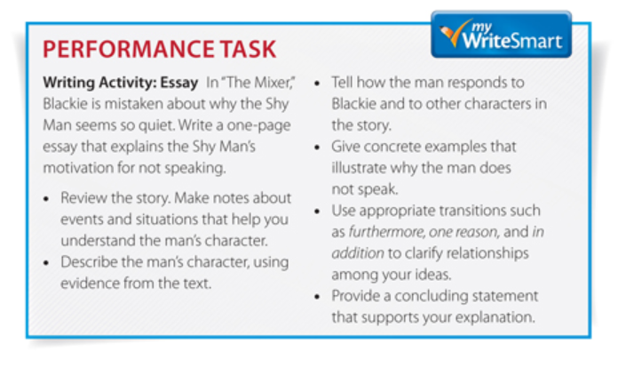
Students should demonstrate “mastery” of the Standards through tasks that require deep understanding of the text under consideration.
Access for All Students
Notes:
Big Idea:
We’ve already seen in Non-Negotiable 2 and Alignment Criterion 2, that questions and tasks are high quality and text dependent and require students to read closely, find the answers within the text, and use textual evidence to support responses. Assessment items within materials should reflect the same.
Details:
In the handout packet on p. 31
This example is from a basal, grade 6.

Slide 47
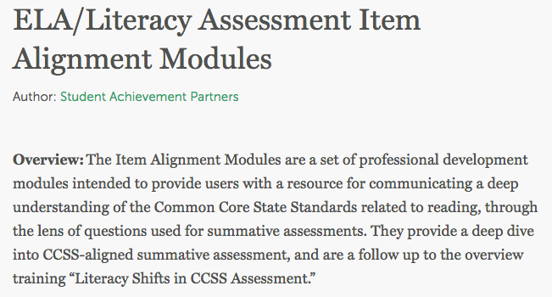
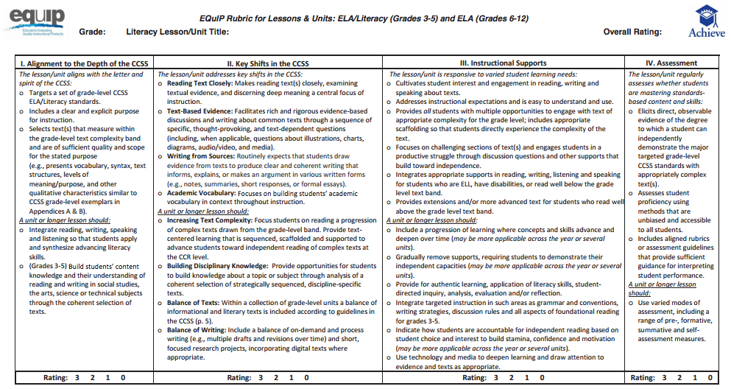
Do assessments genuinely measure progress? If questions linger around assessment, check out these sources!
Access for All Students
Assessment Alignment
EQuIP Rubric
Notes:
Big Idea:
Assessment is a huge topic. There are tools designed to more specifically analyze the quality of embedded assessments. These metrics could be helpful if additional guidance is needed during review.
Details:
Also, we need to address here how assessments are used. With complex text, we cannot determine whether students did not master a standard or were unable to understand the text because of vocabulary, knowledge, fluency, or syntax. This is important because, in the vast majority of schools, teachers bear down on standards after assessments with no way of knowing if that was the problem. This frustrates teachers and students.
More support is available through achievethecore.org, with grade specific assessment item alignment and high quality reading items professional development modules.
The EQuIP rubric is derived from the Tri-Sate Rubric and facilitated by Achieve.
Indicators:
Elicits direct observable evidence of the degree to which a student can independently demonstrate the major targeted grade level CCSS standards with appropriately complex text(s).
Assesses student proficiency using methods that are unbiased and accessible to all students
Includes aligned rubrics or assessment guidelines that provide sufficient guidance for interpreting student performance

Slide 48
Rating: Non-Negotiable vs. Alignment Criteria
Non- Negotiable Criteria | Alignment Criteria
Each metric rated Meets/Does Not Meet | Each metric rated Meets (2 pts)/ Partially Meets (1 pt)/Does Not Meet (0)
Every metric must be met to rate the criterion as Meets | Must receive a specific number of points out of the total to rate the criterion as Meets
Why? Standard 10 and Standard 1
Notes:
K-2 Review teams should complete Module 104 before this slide
Big Idea:
This brings us to the end of the IMET. As a reminder, the 3 Non-Negotiables come first, though in these modules we went through the NNs and ACs side by side. The Non-Negotiables are more important for alignment than the Alignment Criteria.
Details:
Each is treated differently → the Non-Negotiables represent the most important Shifts needed for alignment. This is obvious from Standards 10 and 1.
On the summary page, you will see that the Non-Negotiables are rated either Meets/Does Not Meet.
The scoring is different not only because of the importance of the Non-Negotiables, but also because there is more room for interpretation and professional judgement in the Alignment Criteria, so they can miss 1 point and still meet the criteria.
After evaluating the Non-Negotiables, review leaders may decide to suspend the review or continue to further analyze alignment. This depends on the purpose of the review and time constraints.

Slide 49
Essential Questions
How does the Instructional Materials Evaluation Tool (IMET) reflect the major features of the Standards and the Shifts?
What understandings support high-quality, accurate application of the IMET metrics?
Notes:
Big Idea:
Wherever you end the session, insert these questions and goals to reflect back on what is still unclear and what has been learned.

Slide 50
Goals
Understand how aligned materials embody the shifts inherent in the Common Core State Standards
Understand the precise meaning of each metric
Recognize examples and non-examples related to each IMET criteria metric
Notes:
Big Idea:
How has our work today helped clarify these goals?

