Slide 1
Function Rules
Looking at the Structure of Patterns

Slide 2
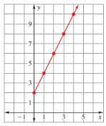
Warm-up
Write a function rule for the table and graph shown below.
1. 2.
Think about it…How did you determine your rule?
x | 1 | 2 | 3 | 4
f (x) | 3 | 7 | 11 | 15

Slide 3
National Library of Virtual Manipulatives: Block Patterns
In your note-taker (for each activity):
Complete the table and scatterplot.
Write a rule for this particular pattern.
Share with a partner.

Slide 4
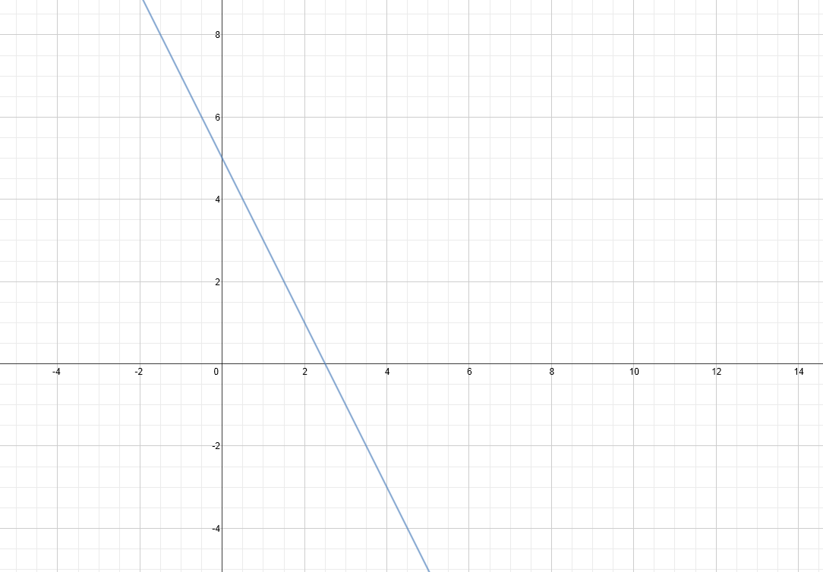
Linear Function (arithmetic)
Graphically
Algebraically (Rule)
$$y= −2x+5$$
Numerically (table)
x | -2 | -1 | 0 | 1 | 2 | 3 | 4
f(x) | 9 | 7 | 5 | 3 | 1 | -1 | -3

Slide 5
Exponential Function (geometric)
Graphically
Algebraically (Rule)
$y=4({3)}^{x}$
Numerically (table)
x | -2 | -1 | 0 | 1 | 2 | 3 | 4
f(x) | 4/9 | 4/3 | 4 | 12 | 36 | 144 | 324

Slide 6
Quadratic Function
Graphically
Algebraically (Rule)
$y=x^{2}+3$
Numerically (table)
x | 0 | 1 | 2 | 3 | 4 | 5
f(x) | 3 | 4 | 7 | 12 | 19 | 28

Slide 7
Check for Understanding
Tonight’s Homework: Complete Function Rules from Tables
Check For Understanding.
Fill in a table with a linear and exponential function
Trade papers with a partner and write the algebraic rule for the function of their table.

