Slide 1
A Year of Action: Impact Through Instructional Advocacy
Core Advocates Monthly Webinar
August 2, 2017
The webinar will begin shortly. You may wish to download the handouts (check the tab on your webinar control panel) while you wait.
Notes:
Handouts:
List of state networks with emails and links to state webpages
upcoming CA webinars flyer
Blank Instructional Advocacy Action planning questions

Slide 2
Introductions
Your hosts from the Field Impact Team
Sandra Alberti, Director
Jennie Beltramini, Teacher Engagement Manager
Janelle Fann, Project Manager
Joanie Funderburk, Manager of Professional Learning
Lynda Nguyen, Team Coordinator
This Month’s Guests - Core Advocate Captains
Angie Miller, WA
Dayna Burke, AZ
Kevin Liner, CT

Slide 3
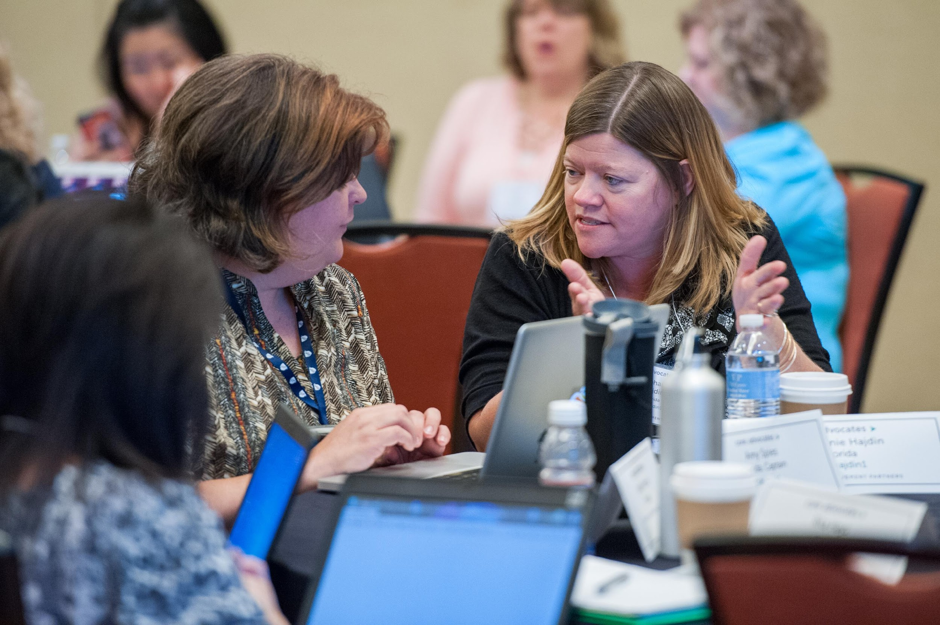
Who are Core Advocates?
Core Advocates are educators who:
Believe in the potential of the CCSS to prepare all students for college and careers;
Are eager to support their colleagues and communities in understanding and advocating for the CCSS and CCSS-aligned instruction;
Understand and embrace the shifts in instruction and assessment required by the CCSS

Slide 4
Learn more about us!
Contact Jennie Beltramini (jbeltramini@studentsachieve.net ) or Joanie Funderburk (jfunderburk@studentsachieve.net)
Complete this survey to join our database (and mailing lists): http://bitly.com/joincoreadvocates
Visit our website: www.achievethecore.org

Slide 5
Tweet with us!
Please feel free to tweet during and after the webinar using #coreadvocates
@achievethecore
@JoanieFun, @salberti, @JennieBeltro, @mrsmillergrade1, @daynaburke2, @kevliner

Slide 6
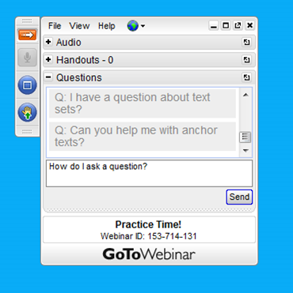
Engage with us!
During the webinar
– Accessing Documents
– Questions option
– Polling
After the webinar
– Survey
– Access to recorded webinar

Slide 7
Goals of the webinar
Learn about the Field Guide for Instructional Advocacy Networks, a set of resources to support Instructional Advocacy in your school, district, state or professional organization
Learn about Instructional Advocacy efforts across the country and how you can get involved
Consider an Instructional Advocacy action you’d like to take this school year and begin planning your actions and how you will build your network

Slide 8
The Field Guide for Instructional Advocacy Networks

Slide 9
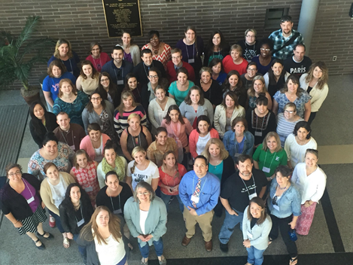
What is Instructional Advocacy?
Grounded in a firm understanding of the Shifts, educators owning, supporting, and promoting the resources, tools, and practices that create learning environments in which students develop college- and career- readiness.
Notes:
Instructional Advocacy by individuals can make a difference for students.

Slide 10
Underlying belief: Teacher leadership can and must be leveraged to support quality instruction and to improve student outcomes!
Notes:
Teachers, coaches, other educators who not only work with student, but lead colleagues, can have huge impacts on schools!

Slide 11
What do we know about professional learning and collaboration?
Center for Public Education
Research suggests that there’s an exceptionally strong relationship between communal learning, collegiality, and collective action (key aspects of professional learning communities) and changes in teacher practice and increases in student learning.
Several studies have shown that professional development that addresses discipline-specific concepts and skills has been shown to both improve teacher practice, as well as student learning. Teachers themselves report that their top priority for professional development is learning more about the content they teach, giving high marks to training that is content-specific.
Notes:
While individual Instructional Advocacy is great, research shows there is power in groups collaborating and working together to change practice and increase student learning.
Also, studies have also shown that what teachers work on when collaborating matters. Professional development that addresses content, discipline-specific concepts and skills, has been shown to improve teacher practice and student learning.

Slide 12
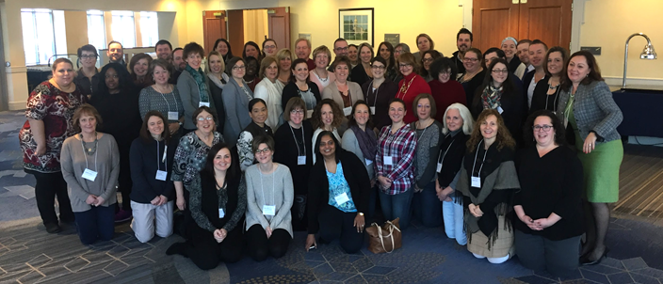
Network Evolution
National meetings and state meetings
State meetings to launch specific needs-based state campaigns
More flexible grassroots networks
Notes:
This brings us to the evolution of Field Impact Team work with educators around the country:
from big national and state meetings with one-size-fits-all content (still important content, Shifts-based, but not necessarily meeting needs of the individual educators)
to state-based Core Advocate Network meetings centered on addressing context-specific challenges of implementing CCR Standards for the educators in those states, addressing the unique needs of the students they serve; we still have those networks, but...
Now, we’ve taken what we’ve learned over the past couple of years and have been thinking about how to support more grassroots networks wanting to do this work, in a variety of contexts

Slide 13
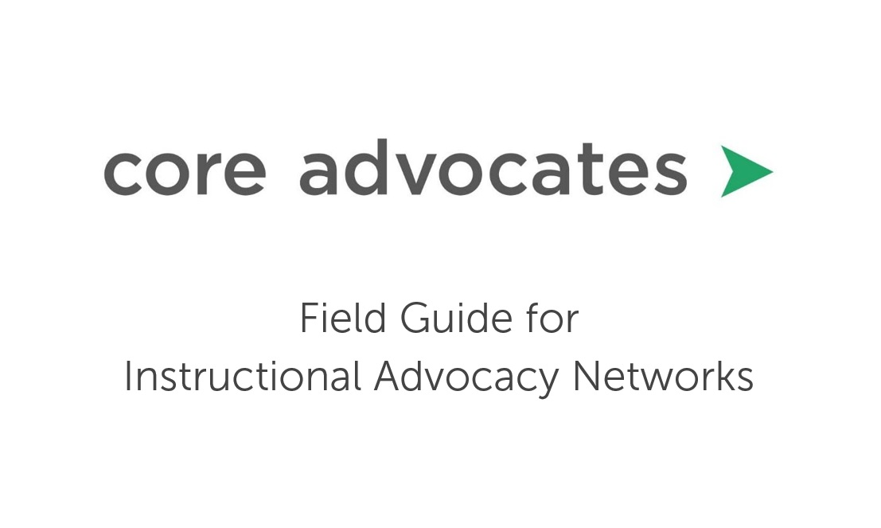
The Field Guide for Instructional Advocacy Networks includes process steps, resources, and tools to support an existing content-based leadership network in their ongoing development and sustainability or to support the launch of a new network.
Notes:
We came up with this!
The Field Impact Team is working on a new guidance document for launching and supporting Instructional Advocacy Networks. The final document is not quite ready to share, but we anticipate being able to attach it to a follow up email from this webinar that you will all get in about 3 or 4 weeks.
It is organized with process steps as well as tools and resources.
While it is organized with clear steps for launching and sustaining a network, it’s not a recipe that is intended to be followed exactly. It is meant to guide a group of teacher leaders, but be flexible enough to meet the needs of a variety of contexts.

Slide 14
1. Identify Leaders
Who wants to help lead the network?
Consider roles (teachers, instructional coaches, etc.)
Consider diversity (geographic, demographic)
Are the leaders representative of the context where the network will exist?
Are there leaders who know the work (content knowledge) and know the people (connections)
Notes:
When thinking about starting an Instructional Advocacy Network, it’s important to start with a small group of people who are interested in leading the work.

Slide 15
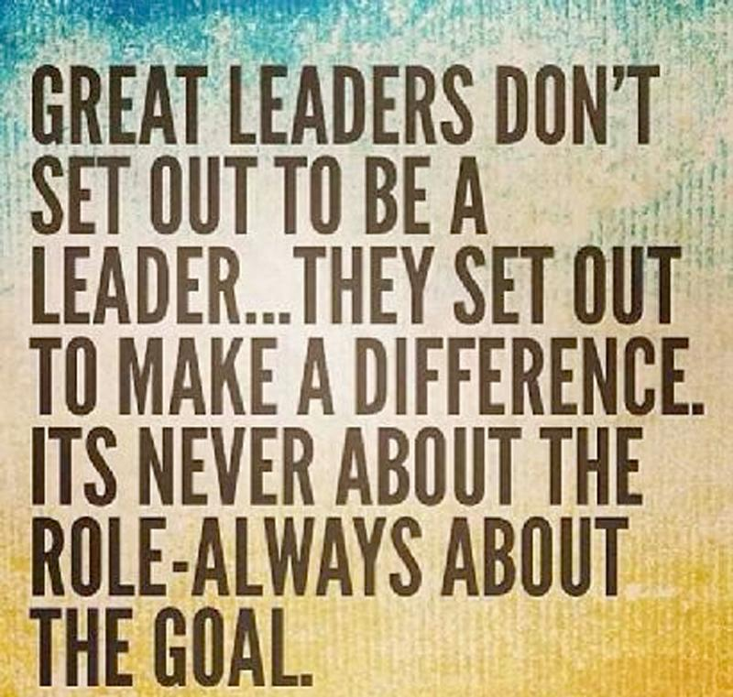
2. Agree on the Priority:
Educators in the network will lead and act on translating the Shifts in instruction required by college- and career-ready standards into action in classrooms and schools.
Notes:
Translating the Shifts into action: What does this mean? Teachers in every classroom are using instructional practices, instructional materials, and assessments aligned to CCR Standards and the Shifts required by those standards.

Slide 16
3. Select Needs-Based Content to Anchor the
Recruitment and Engagement
Addressing real challenges that real teachers have:
What are the problems of practice the educators in the network face related to the students they serve?
- Needs-based specific ELA campaign
- Needs-based specific math campaign
- SAP micro-courses
Content-specific structures to anchor the work:
What do the educators in the network need to learn?
- Intro to the Shifts
- IPT and IPG Suite
- Core Advocate Webinars
Notes:
Network relevance and power comes from addressing real challenges that real educators face, not creating PD for the sake of PD. Challenges should be identified by the teachers in the area of the network and be related to content, implementing math and ELA/literacy CCR Standards. Also, what challenges are specific to the students the teachers in the area serve? English learners? Students with unfinished learning? Students reading below grade level?
Create specific action-oriented campaigns to address the challenge, with direct impact on classrooms, instruction, and student achievement
Also, what is the current status of the teachers and leaders in the network? Is there learning they need on the Shifts, on practice? Could past Core Advocate webinars on a topic be used to help everyone with common learning?

Slide 17
4. Set Focus Goals
Focus Goals: Recruitment
- Who needs to be involved?
- How will we reach them and involve them in the network?
- Have we considered diversity of the people in the network and the students they serve?
Focus Goals: Engagement
- What Shift-based content is needed to engage the members of the network?
* What are the challenges with implementing CCR Standards within the network?
* What knowledge and skills do the educators need?
* What are the challenges specific to serving the students within the network?
Notes:
Specific goals help anchor the work and provide a way to filter actions (do actions serve the goals and lead us to success?)
Think about recruiting educators to join the network; consider, who would like to be a part of this? How do we invite them into the work? Have we considered diversity of perspectives?
Think about engagement: how do we create action around addressing the challenge? Is there a structure for collaborative learning? Is there a structure for implementing, sharing, and reflecting on new practices, materials, or assessments?

Slide 18
5. Outline Action Steps:
What specific actions will help accomplish each goal?
6. Identify Metrics:
How will we measure progress and accomplishment of each action step toward reaching the goals?
Notes:
What action steps will need to be taken to reach the goals?
How will success be measured? What will it look like if the network is successful at addressing the needs and challenges?

Slide 19
Teachers want to see their time and effort be strategically allocated and clearly directed toward a specific challenge or opportunity. Too many times, we have seen states or districts develop “teacher leader” initiatives that may or may not be clear or specific about the issues they are seeking to address or the challenges that need solving. Worse, they may be creating these opportunities just for the sake of creating them or to “check a box.” However, teachers, like all of us, appreciate clear expectations and a clear understanding of the purpose of their efforts. Further, the challenge or issue they are addressing should be a real one, one that the state cannot accomplish without the creativity, innovation, and ideas of those closest to the work.
~The Case for Teacher Leaders, Chiefs for Change
Notes:
This quote is from a recent paper published by Chiefs of Change and is a guide for states on leveraging teacher leaders within new ESSA plans. ESSA provides many opportunities for tapping teacher leaders and teacher expertise. We think this guidance aligns nicely with the work of Instructional Advocacy Networks as well!
Teacher leadership and teacher networks should not exist for the sake of teacher leadership; they should be authentic and address real challenges real teachers face, and they should be lead by those closest to the work, those who spend time with kids in classrooms every day!

Slide 20
Question:
What challenge or issue related to implementing CCR Standards could be an Instructional Advocacy focus among your network of colleagues during the 2017-18 school year? Please use the Questions tab on your control panel to respond.

Slide 21
Instructional Advocacy in the Core Advocates Network

Slide 22
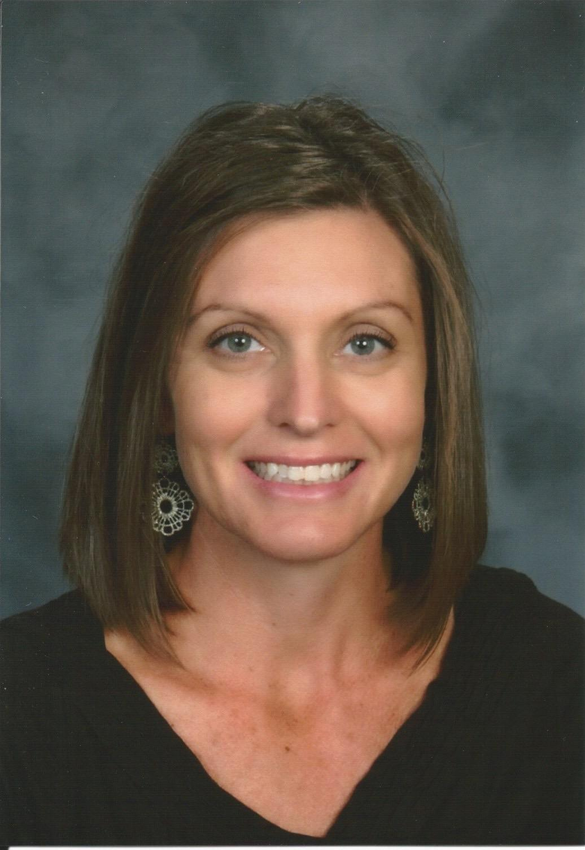
Core Advocate Guest
Angie Miller
WA Captain
K-5 Math Instructional Support Specialist
please upload a headshot here

Slide 23
Tapping Into an Existing Structure:
Notes:
CCSS work in our state began before our catalyst meeting.
Core Advocates were involved in developing Math and ELA training through our State Teachers’ Union Professional Development Network.
There was an identified need for CCSS PD.
6 half day training modules were designed and continue to be refined for Math and ELA. They are offered at a summer ‘jump start’ 3 day training as well as on weekends and evenings during the school year in local regions throughout the state.

Slide 24
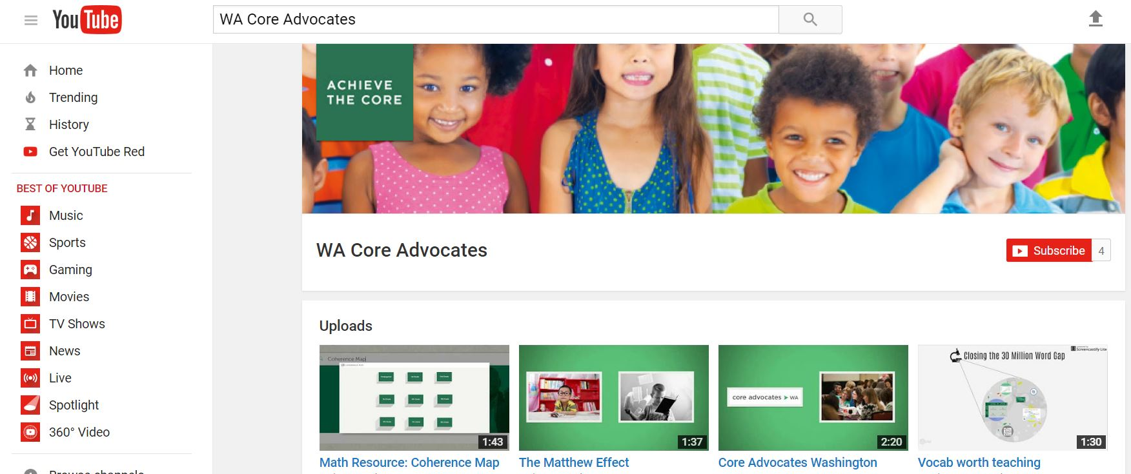
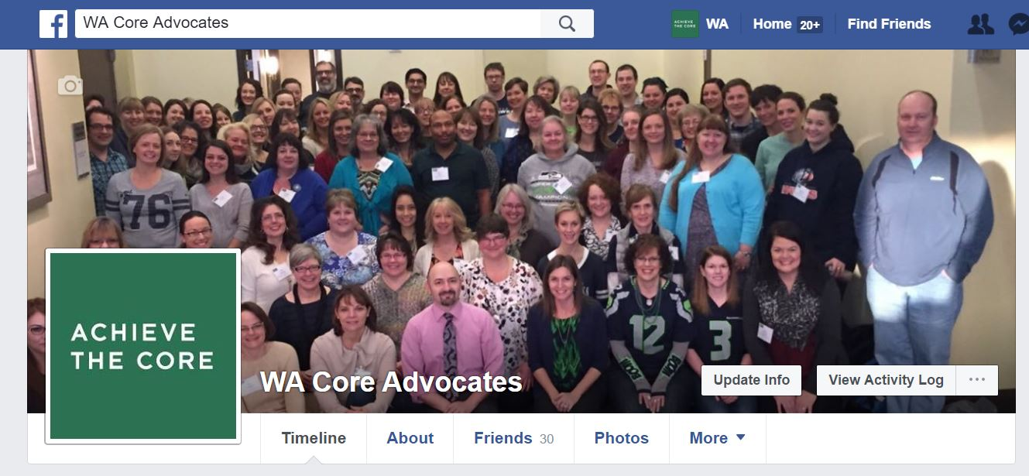
Connecting Since our Convening:
Notes:
Mostly connecting through web based avenues and newsletters.
YouTube Channel with short, informational videos
Social Media: Facebook and Twitter
Newsletters

Slide 25
Upcoming Work and Lessons Learned:
Diversity
Engagement
Conferences

Slide 26
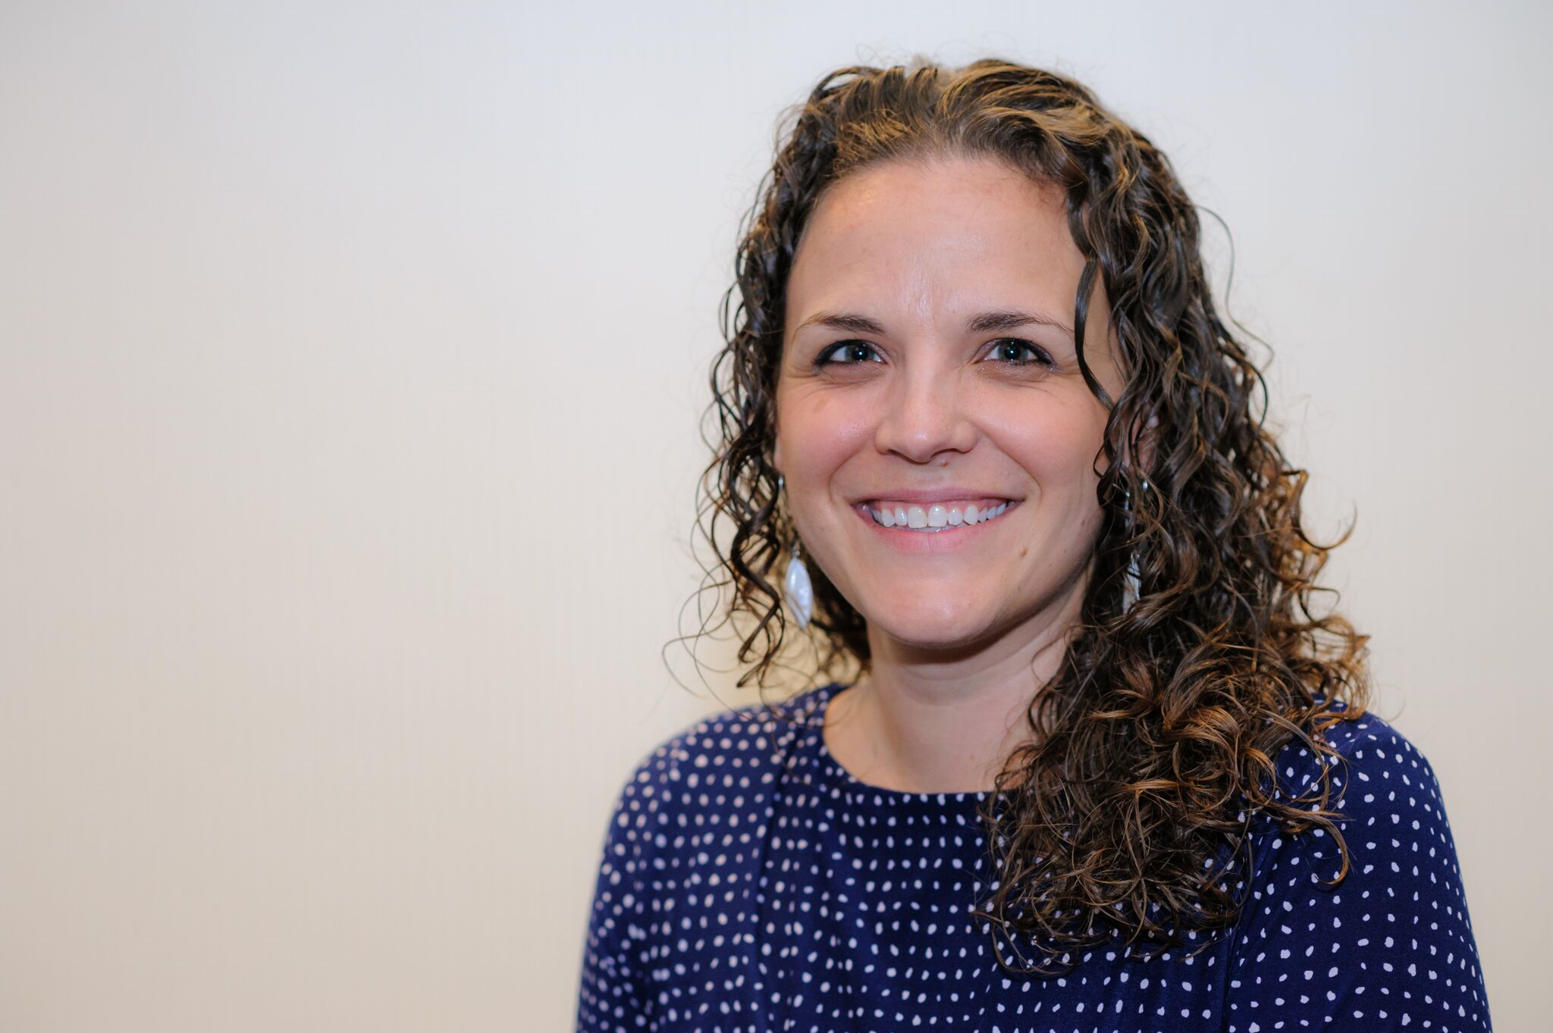
Core Advocate Guest
Dayna Burke
AZ Captain
First Grade Teacher
please upload a headshot here

Slide 27
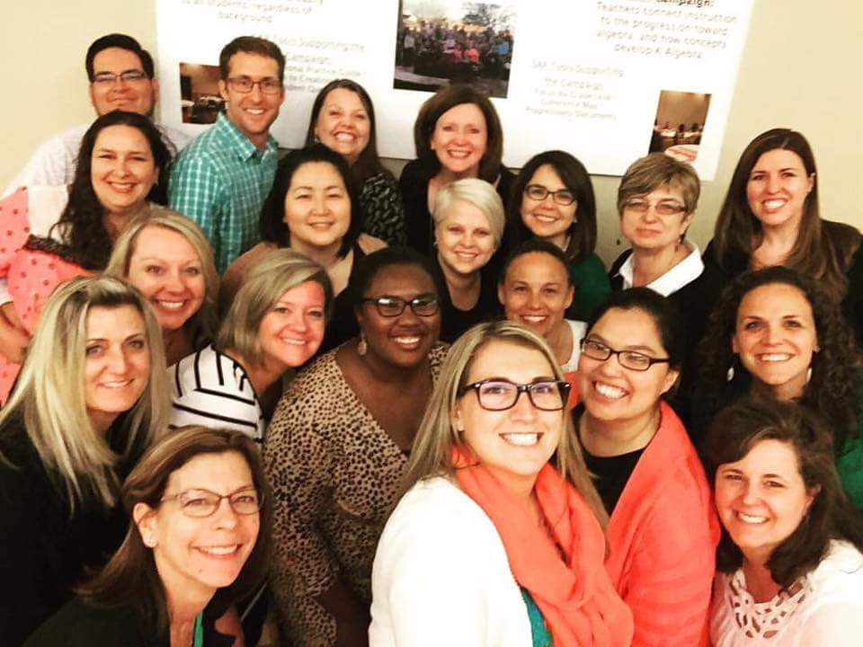
Arizona’s Story
February, 2016
Notes:
Our catalyst convening was in Feb. of 2016. We had approximately 50 participants split between our ELA and Math campaigns. As one of the first states to host their catalyst convening, we have been working to keep our core advocates and catalysts engaged mainly through social media, email and occasional content area check in calls on zoom. The overall feeling was that we were running out of momentum so we began to brainstorm some ways to revitalize our campaigns and network.

Slide 28
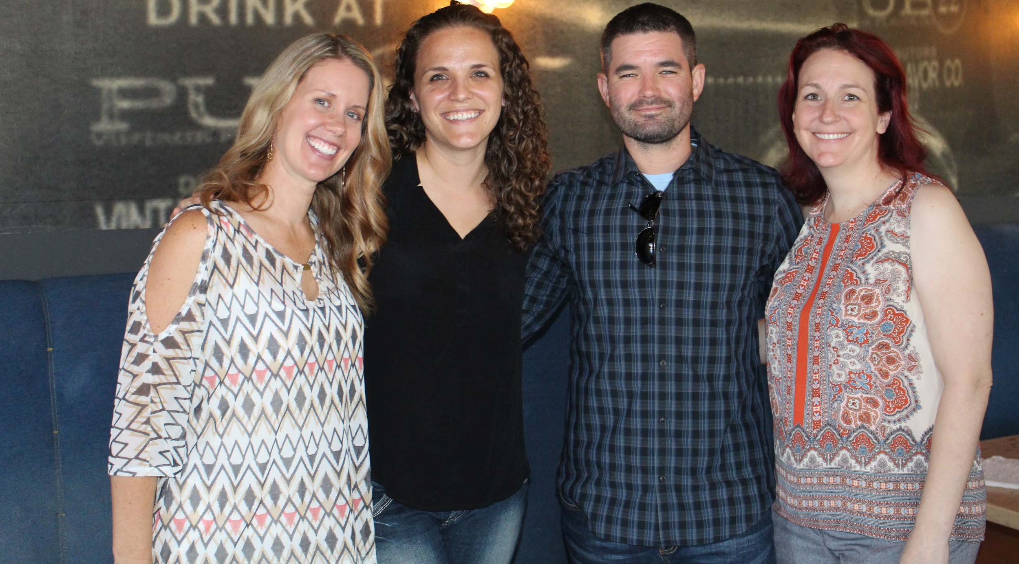
A collaborative effort
Notes:
One engagement goal we have is bringing two initiatives in AZ together.
3 years ago, the four of us pictured, plus a few more including members of our AZ Core Advocate team, created a program called the AEF Teacher Partnership. It is supported by work we do as Teacher Champion Fellows for the Collaborative. The mission of the Teacher Partnership is to partner novice teachers with leaders in Education throughout the state, who have been recognized by the AZ TOY program, to promote retention in the field, promote autonomy, and build future leaders.
The most recent year of the Partnership, which has always had a standards focus, we embedded webinars around the shifts and our ELA and Math campaigns. When we analyzed our end of year data from participants it was clear that they valued these opportunities to learn and collaborate around content.
So, this coming year, we have decided to work smarter, not harder. We will still target new-to-the-profession teachers, but widen our scope beyond AEF TOYs and utilize the wealth of knowledge in our Core Advocate network. We plan to recruit willing CAs to host or cohost a cohort of new teachers regionally. They will be their “go tos” as they collaborate on content, likely to come from the monthly Core Advocate Webinars. Our hope is to keep the spirit of the program in tact, but to include more content as resources along the way.

Slide 29
Lesson learned - It works better in teams!
Notes:
1-collaboration and recruitment of teams is more effective than how we initially recruited for our convening. We have learned to ask CAs to shoulder tap colleagues to build their capacity to effectively implement
3-

Slide 30
Lesson learned - Strategic recruitment.
Notes:
2-strategic recruitment is also necessary. There are too many over-tapped leaders who will commit to helping, with good intentions, but end up not being able to follow through. On the other side of the spectrum are the new teachers, in regards to our partnership, who were too new to have the capacity to do much collaboration/learning beyond their classrooms.

Slide 31
Goals
Notes:
Finally, our broad goal moving forward is to keep the lessons we’ve learned at the forefront as we continue to recruit more AZ Core Advocates. Currently we are one of the smallest states represented and we’re continually brainstorming and how to meaningfully engage more teachers from around the state.

Slide 32
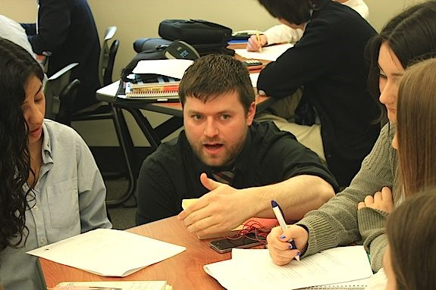
Core Advocate Guest
Kevin Liner
CT Captain
Doctoral Student

Slide 33
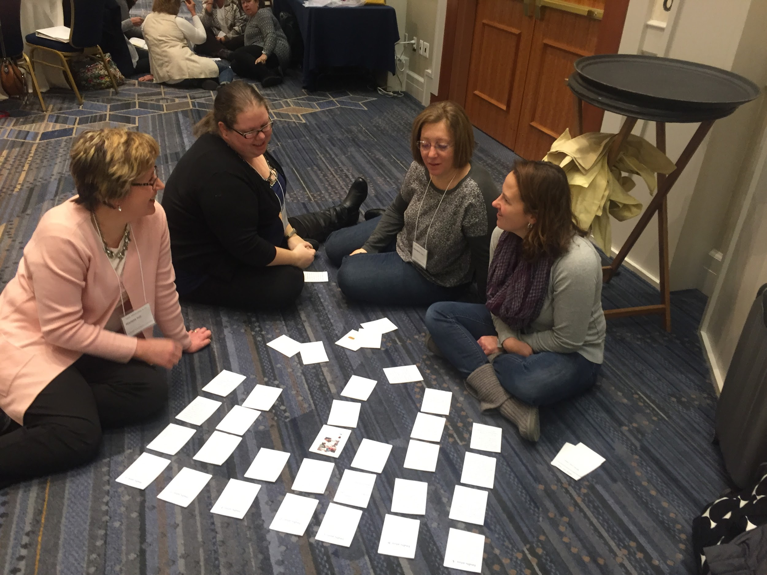
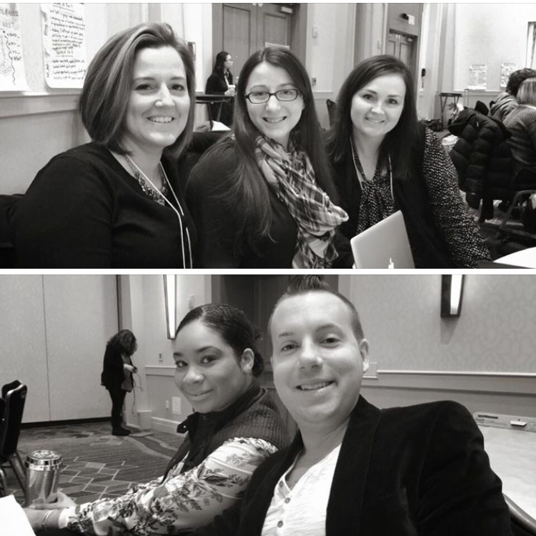
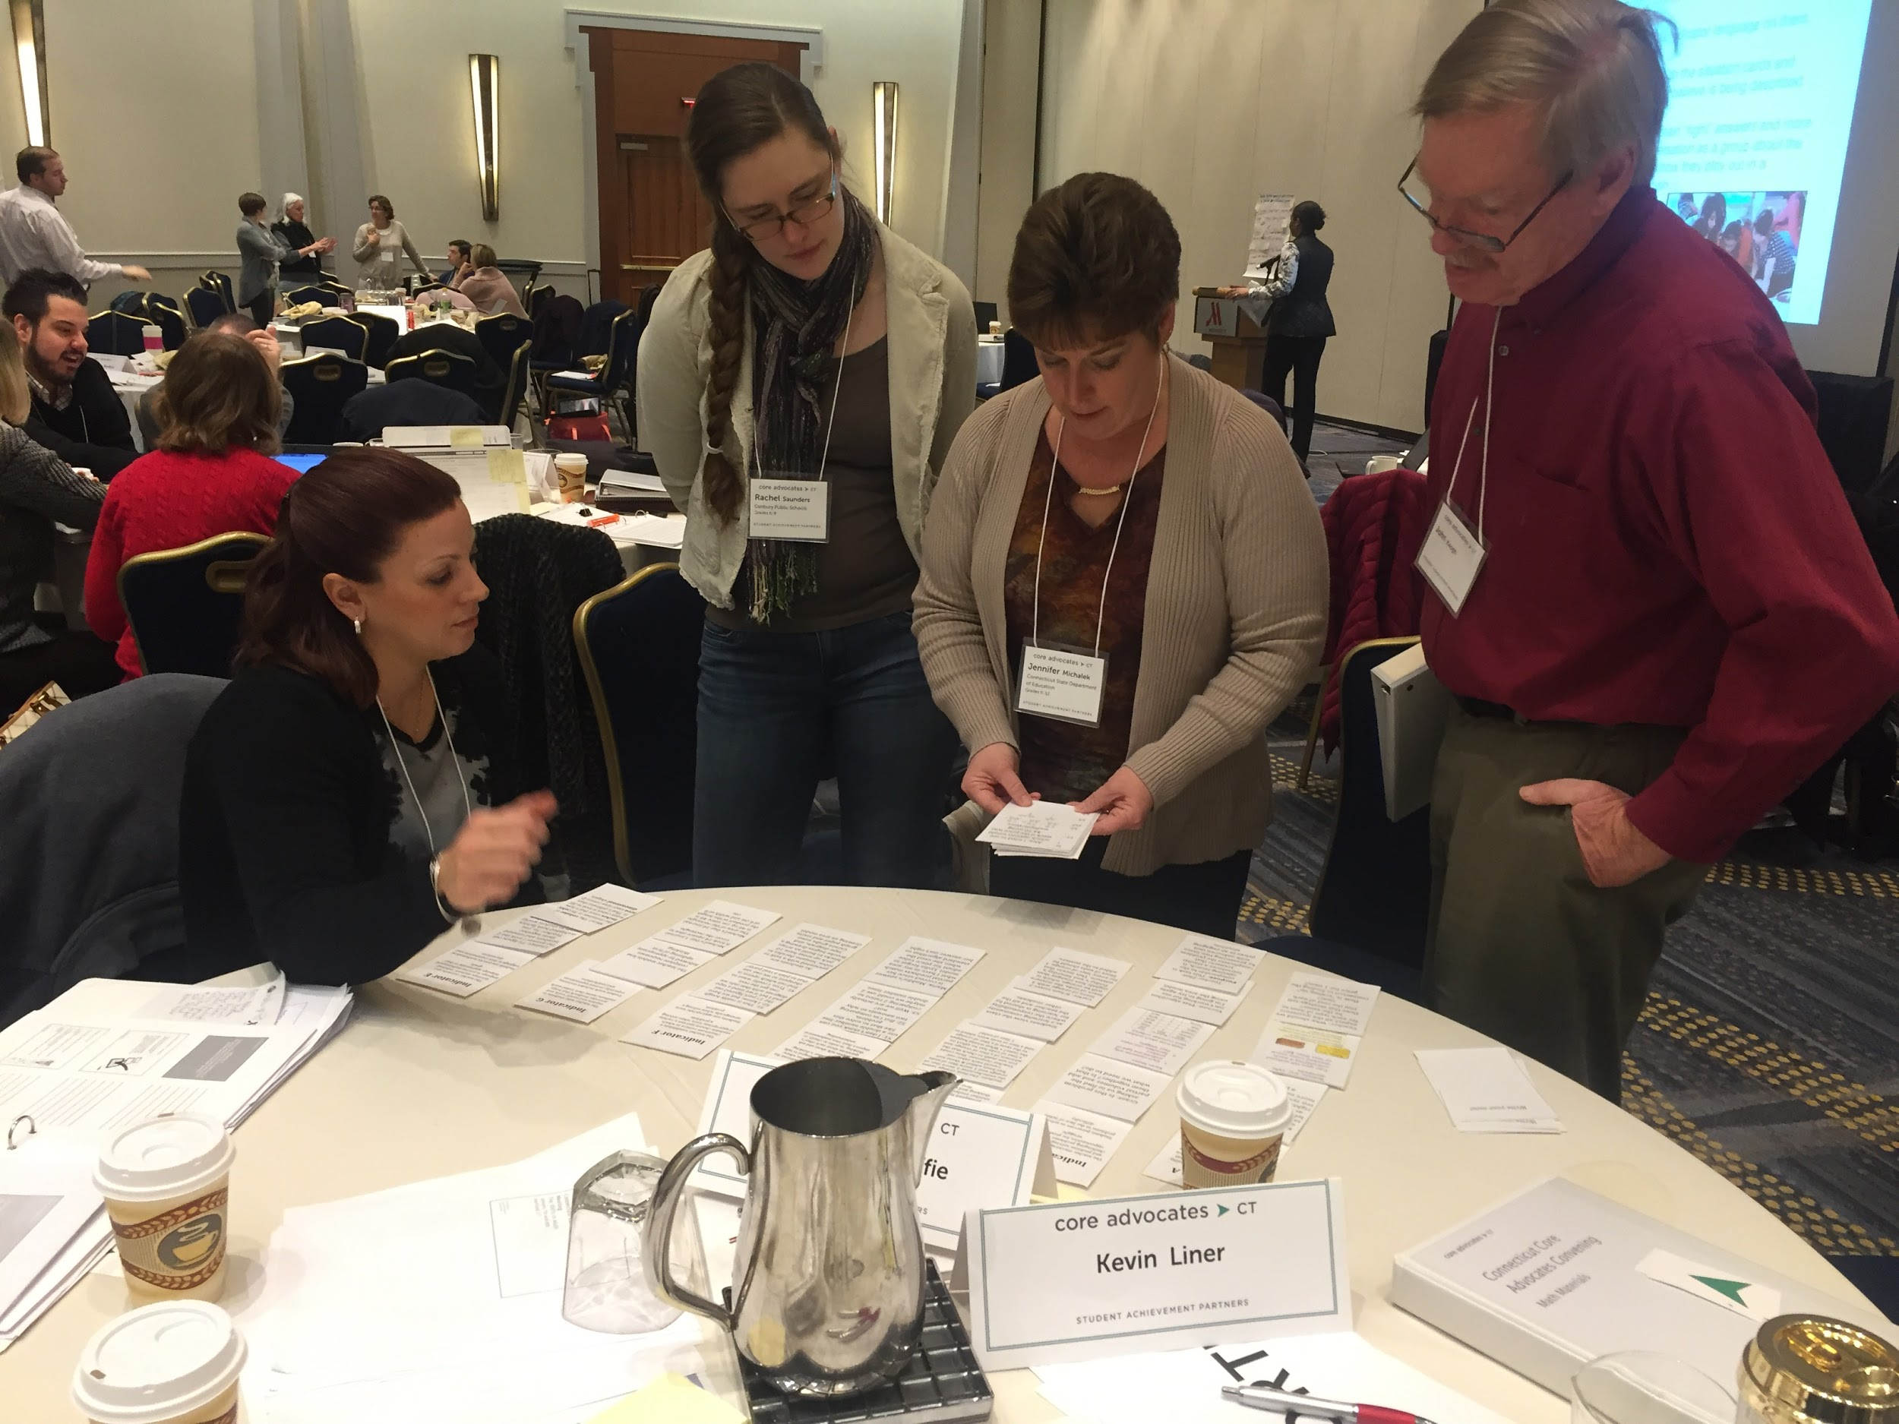
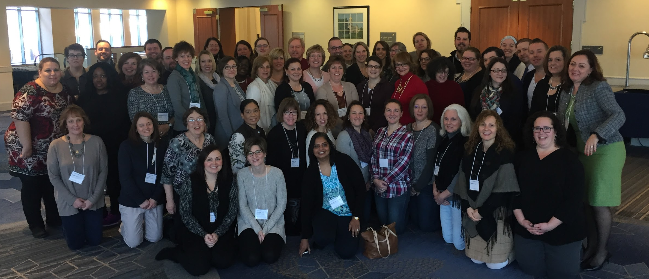
Connecticut Convening
-- January 7-8, 2017

Slide 34
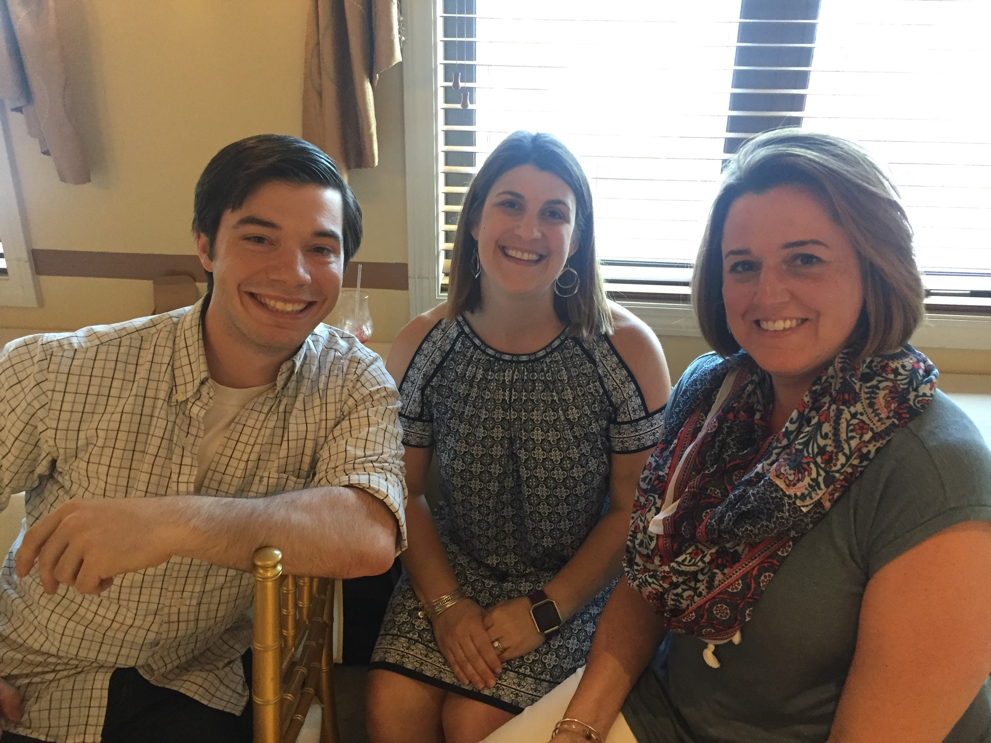
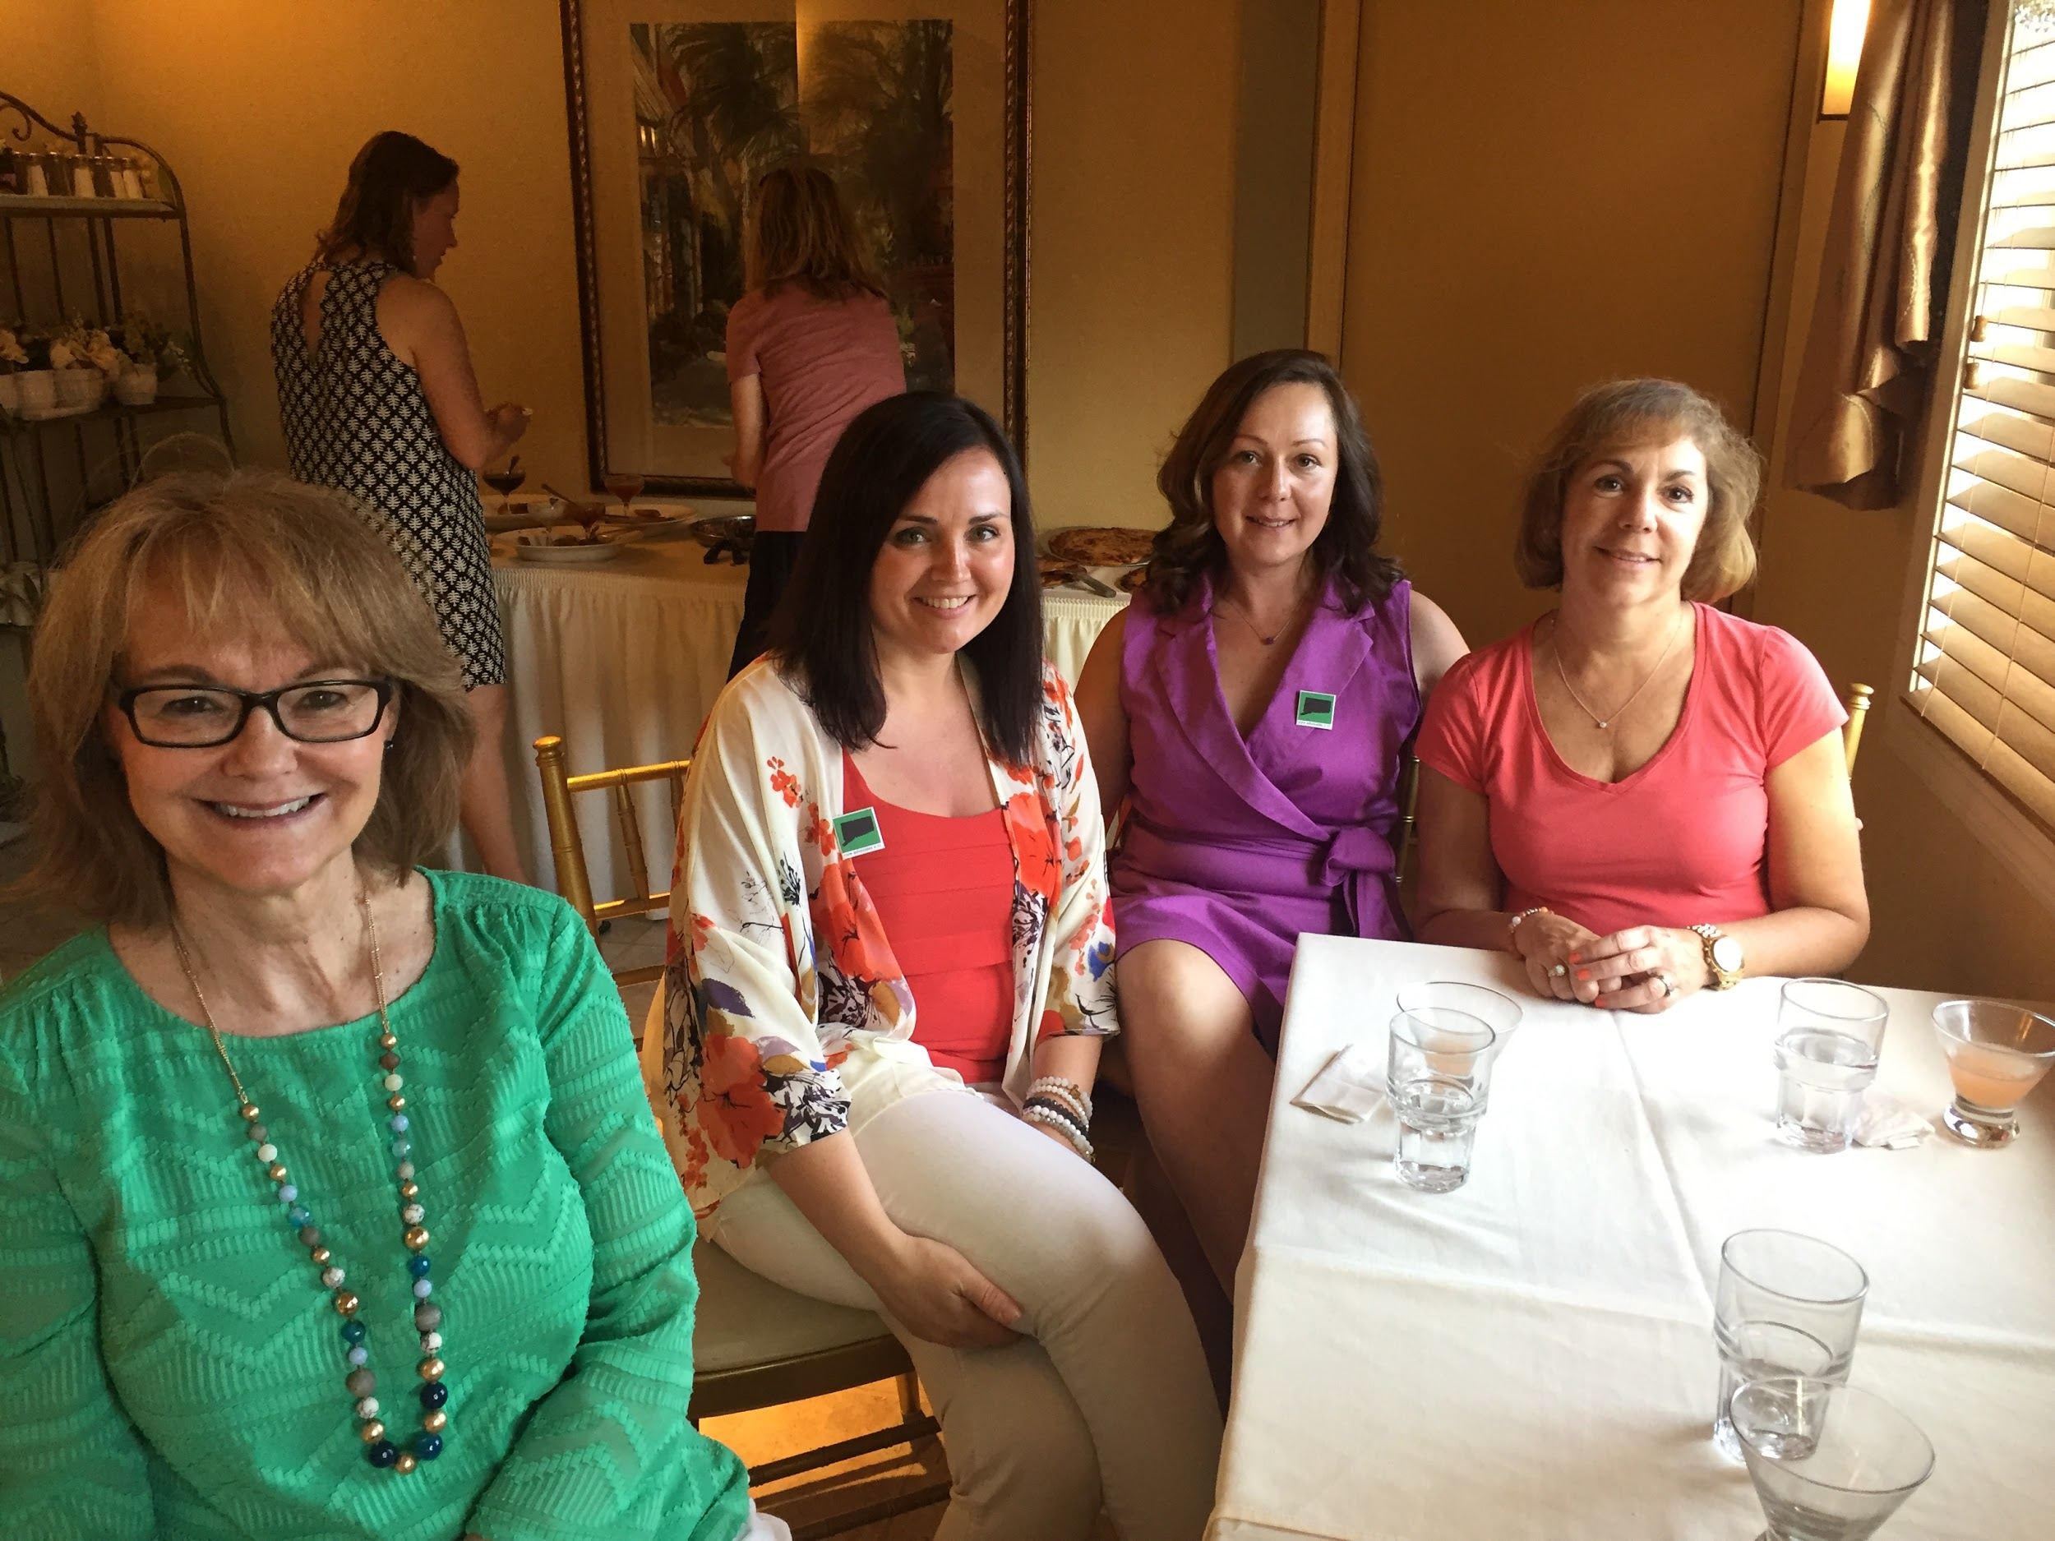
So What Next?
Partnership with ATOMIC (NCTM Affiliate)
Increase ELA Participation
In-person Dine and Discuss

Slide 35
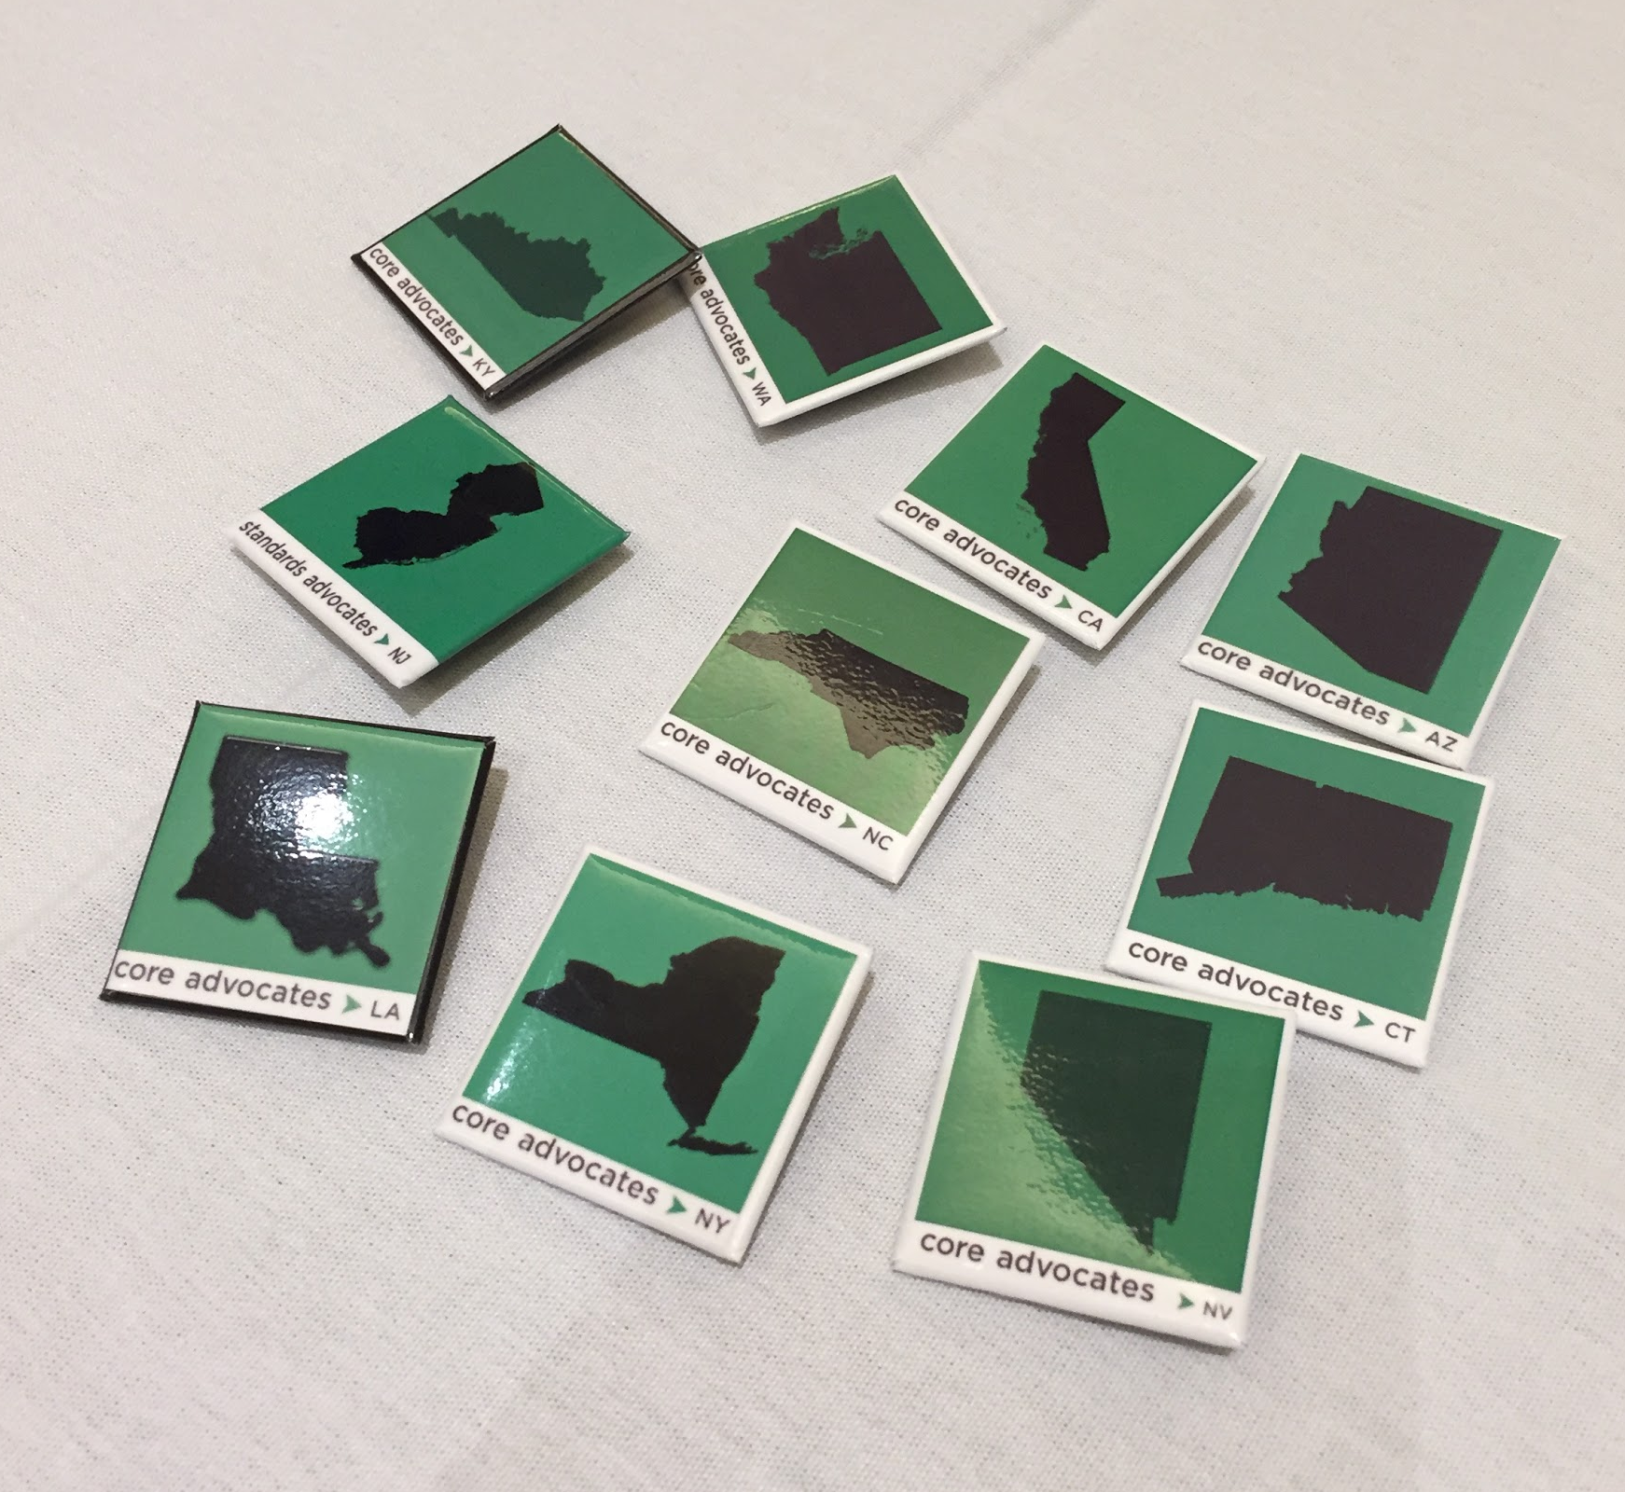
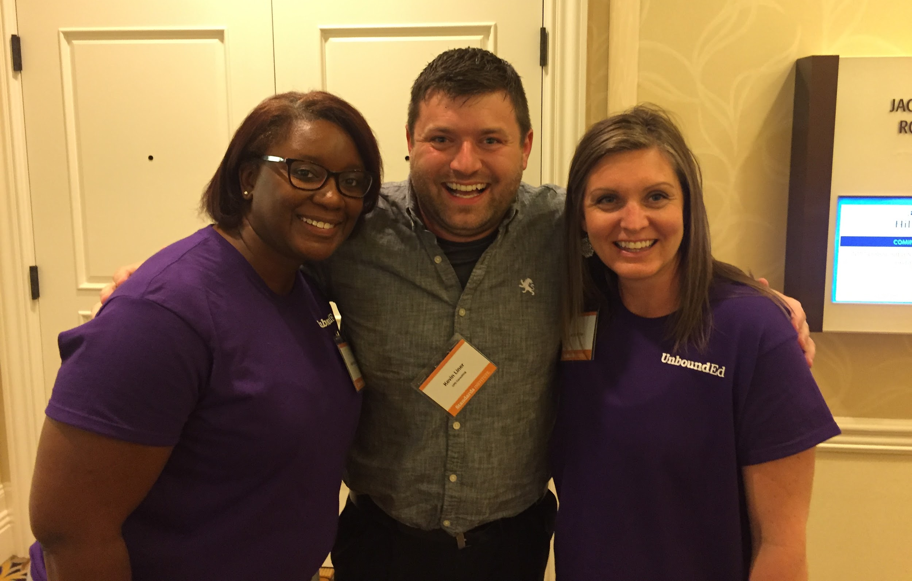
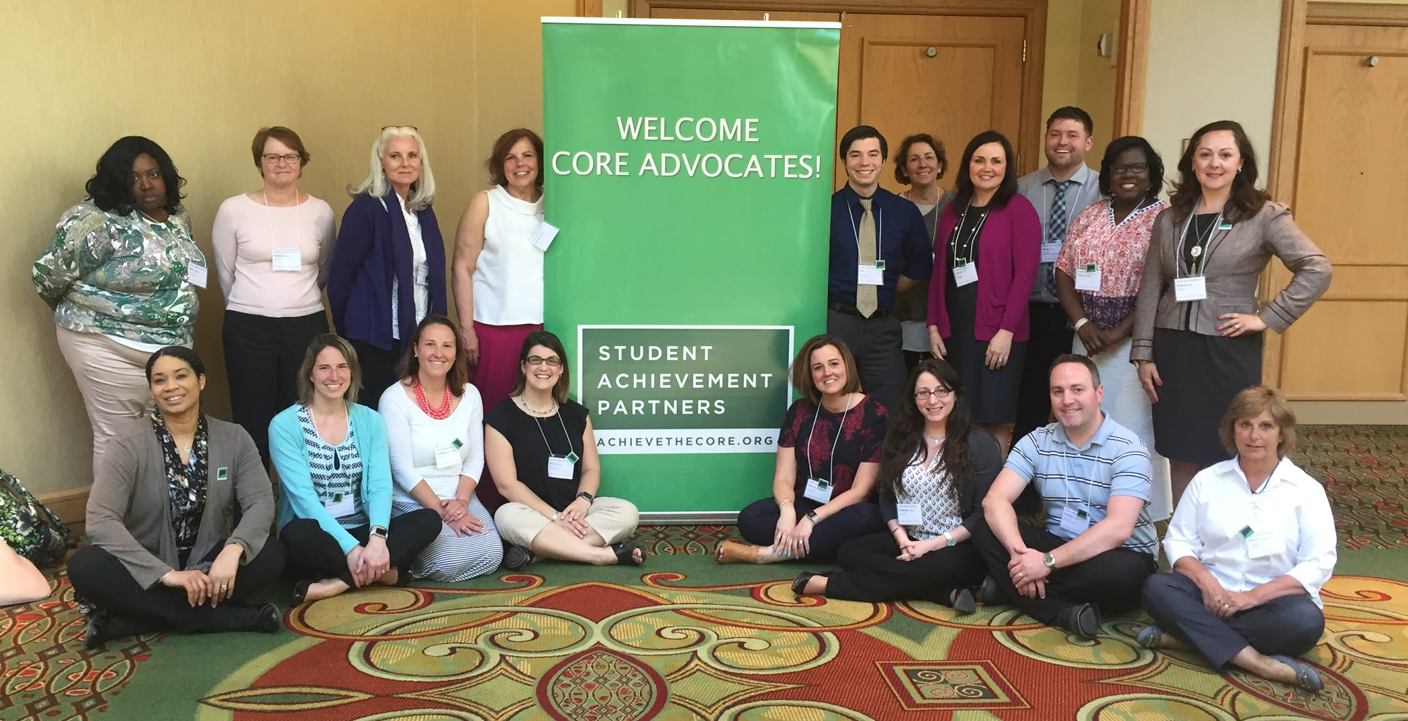
Continuing the work...
Connecting with other network leaders
Building a committed and diverse leadership team

Slide 36
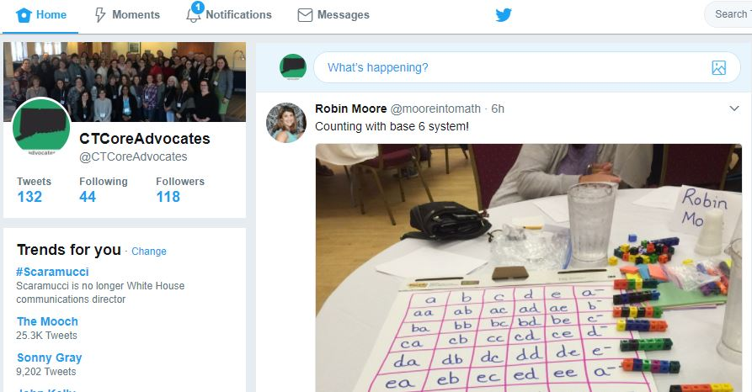
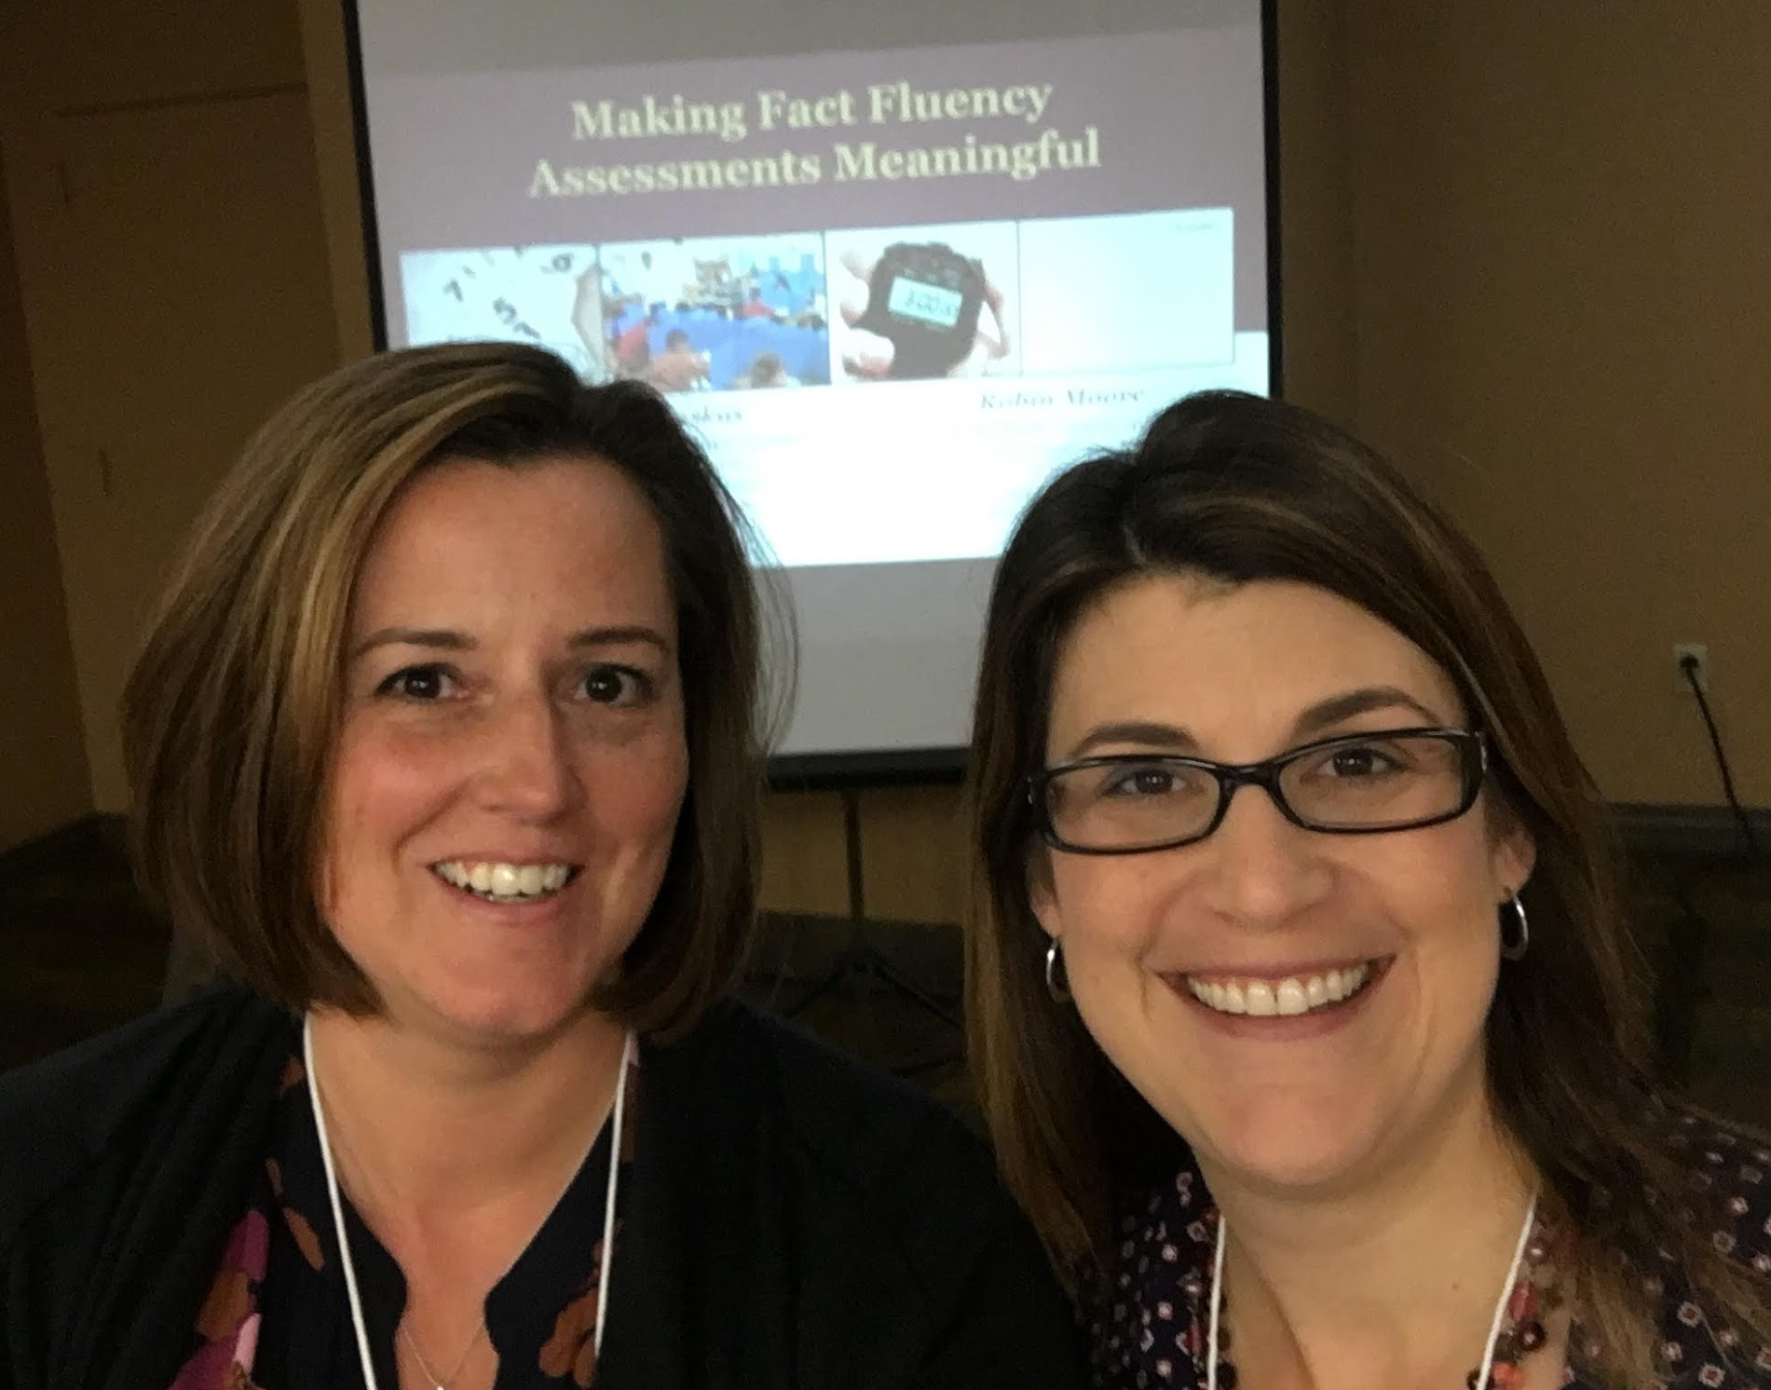
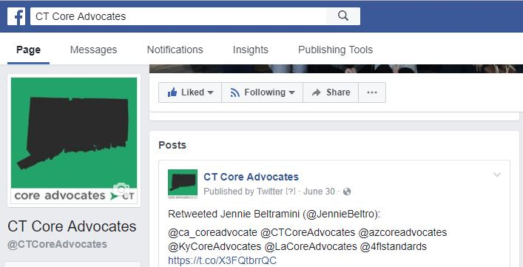
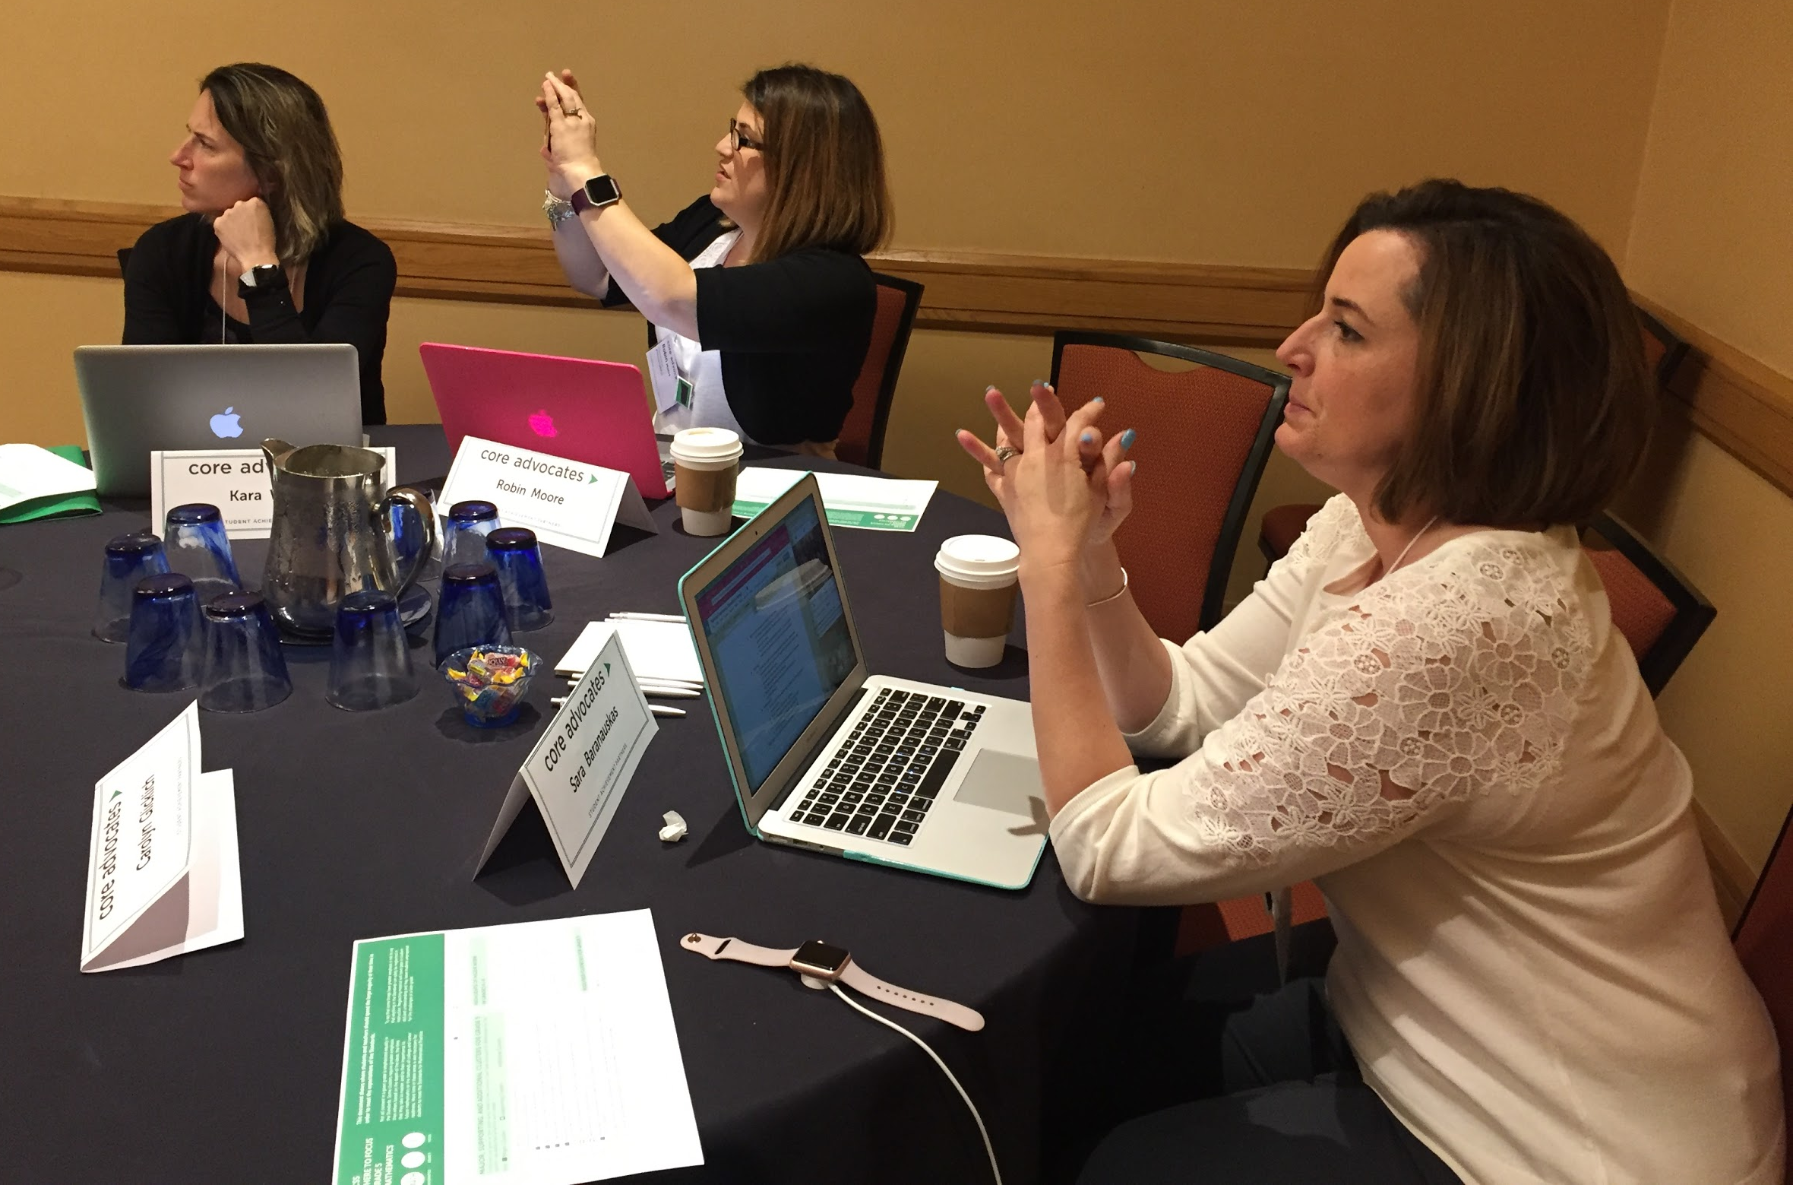
Continuing the work...
Capitalizing on expertise within the state
Collaborating with other state networks

Slide 37
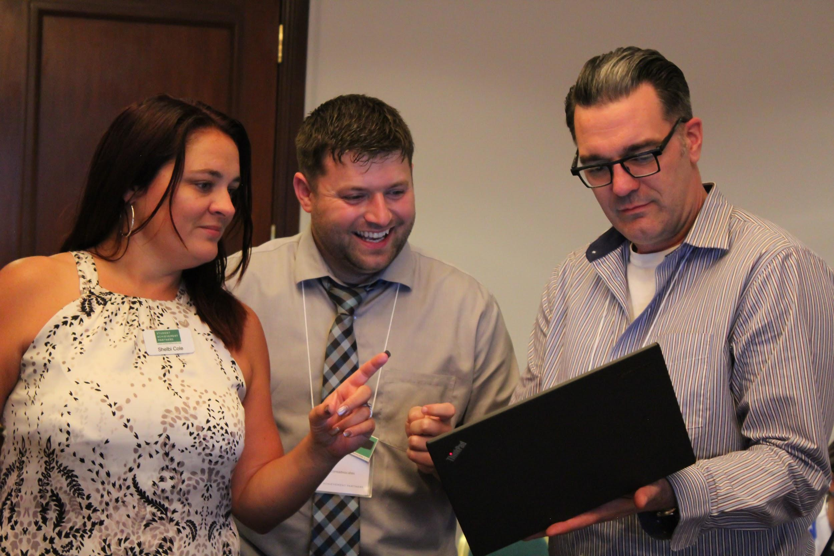
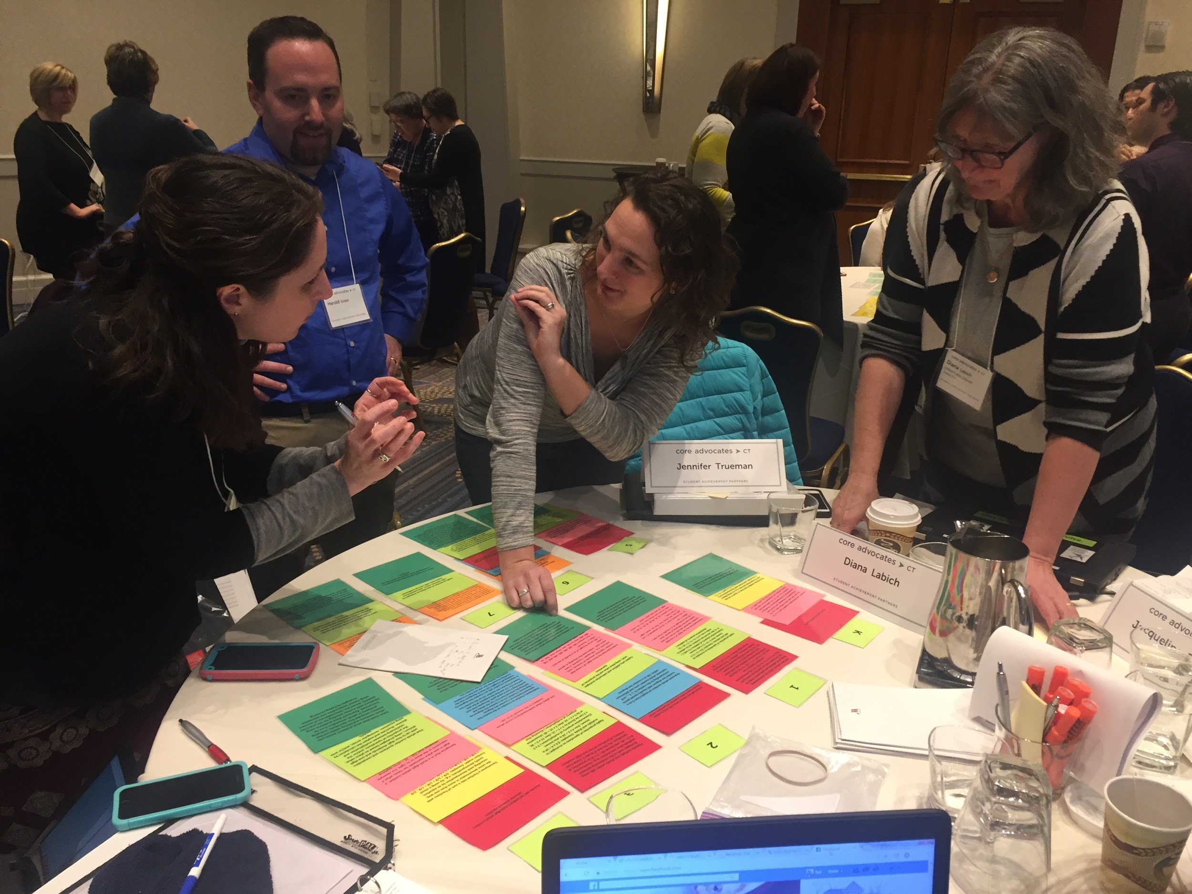
Lessons Learned
Recruitment has been a challenge
In-person meetings have worked better for us
Partnerships are key
Local meetings can be just as powerful as statewide meetings

Slide 38
Questions for our Guests?
Notes:
(Angie) How did you pick the content for your campaign?
What if I don’t have access to teachers across the whole state? How many is too few for a network?
(Dayna) How do you partner with the leaders of a district to help make this work happen in the district?
(Kevin) How did you create the motivation for organizations to partner with you?
selected leadership team members strategically to include members that have connections to those organizations
content is so impressive organizations want to partner

Slide 39
How can you get involved in Instructional Advocacy work?
Notes:
Joanie
So by now we hope we have sparked some ideas for your own Instructional Advocacy work, and that the work of others has inspired you to take your own action this upcoming school year!

Slide 40
Get involved in your state network!
State | Email Contact | State | Email Contact
AZ | AZCoreAdvocates@studentsachieve.net | NV | NVcoreadvocates@studentsachieve.net
CA | CACoreAdvocates@studentsachieve.net | NJ | NJStandardsAdvocates@studentsachieve.net
CO | COCoreAdvocates@studentsachieve.net | NY | NYCoreAdvocates@studentsachieve.net
CT | CTCoreAdvocates@studentsachieve.net | NC | NCCoreAdvocates@studentsachieve.net
FL | FLStandardsAdvocates@studentsachieve.net | OH | OHStandardsAdvocates@studentsachieve.net
KY | KYCoreAdvocates@studentsachieve.net | WA | WACoreAdvocates@studentsachieve.net
LA | LACoreAdvocates@studentsachieve.net | Access state webpages here
Notes:
In addition to WA, AZ, and CT, we have 9 other states who have launched Instructional Advocacy work. If you live in one of these states, we encourage you to get in touch with the leadership team and find out how you can get involved. In your handouts you will find more detailed information about the math and literacy work happening, as well as the folks in those states for you to contact to get involved.
Additionally, we’ve had some other groups helping us out by testing the Field Guide. Iowa, Oregon, Tennessee, Illinois are all in the early stages of new Instructional Advocacy work, so if you live in one of those states, email us and we’ll get you in touch with the leaders who would love to have you join their efforts!

Slide 41
Learn with us this year
Notes:
We also hope that you’ll take advantage of our monthly Core Advocate webinars to support your learning and Instructional Advocacy efforts. Maybe your work for this school year is to gather a small group of your colleagues and attend webinars that connect to your work. You can learn together, then support one another in applying your learning after the webinar. Included in your handouts is a flyer to help you plan to attend upcoming webinars, and you can see that our topics align to the Instructional Advocacy work of many Core Advocates across our network.

Slide 42
Start your own Instructional Advocacy effort
What authentic need will you address?
What will you do to address the need?
What is the first step?
What knowledge or information do you need to begin?
Who will be in your network?
Where will you have influence?
What resources will help you to be successful?
Notes:
So to hold you over until the Field Guide is ready, or to help you with some preliminary thinking, we’ve prepared an additional handout with some guiding questions to consider as you start your Instructional Advocacy this year. We hope that you’ll take some time to consider the questions and what you’ll do in the upcoming weeks to get started, and feel free to connect with us and the entire Core Advocate network on Twitter and Facebook as you need support.

Slide 43
Poll:
What is your immediate plan for getting involved in an Instructional Advocacy network this school year?
Notes:
Poll options - select as many as apply:
I am already involved in a state network.
I am in a state with campaigns and plan to get involved.
I will connect with others in my district or school to launch our own network.
I will connect with an existing professional organization to launch a network.
I will focus on individual work and will seek support from my personal learning network.

Slide 44
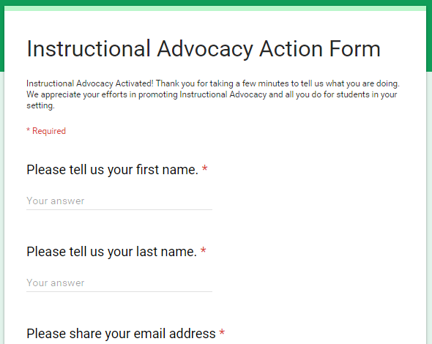
Tell us about your efforts
www.achievethecore.org/educators-taking-action
Notes:
We like to invite Core Advocates who share what they are doing on the IAAF Form to share more broadly, sometimes on CA webinars! Please let us know about your instructional advocacy.
If you start a network, or engage colleagues in Instructional Advocacy, please share with us using this form! We might even reach out to you to find out more about what your’re doing.

Slide 45
Please join us again next month!
Next month’s webinar: Who’s Doing the Work? Shifting the Lift in Math
Wednesday, September 6, 7:00 - 8:00 pm EDT
Register Here: https://register.gotowebinar.com/register/3606749266552136963

Slide 46
Thank You!

