Slide 1
Book Baskets: Optimizing your classroom library
Core Advocates Monthly Webinar
November 1, 2017
The webinar will begin shortly. You may wish to download the handouts (check the tab on your webinar control panel) while you wait.

Slide 2
Introductions
Your hosts from the Field Impact Team
Sandra Alberti, Director
Jennie Beltramini, Teacher Engagement Manager
Janelle Fann, Project Manager
Joanie Funderburk, Manager of Professional Learning
Lynda Nguyen, Team Coordinator
This Month’s Guests -
Claire Rivero, Digital Strategy Manager, SAP
Alicia Cuomo, Core Advocate
Angie Miller, Core Advocate

Slide 3
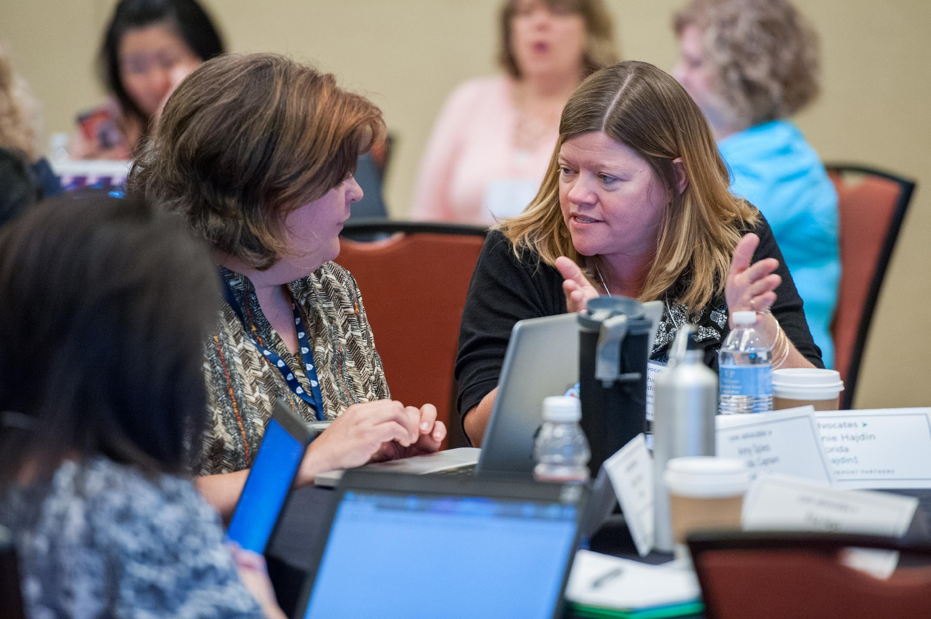
Who are Core Advocates?
Core Advocates are educators who:
  Believe in the potential of high-quality standards to prepare all students for college and careers;
  Are eager to support their colleagues and communities in understanding and advocating for the college- and career-ready standards, and standards-aligned instruction;
  Understand and embrace the Shifts in instruction and assessment required by the college- and career-ready standards

Slide 4

Learn more about us!
Contact Jennie Beltramini (jbeltramini@studentsachieve.net ) or Joanie Funderburk (jfunderburk@studentsachieve.net)
Complete this survey to join our database (and mailing lists): www.achievethecore.org/ca-signup
Visit our website: www.achievethecore.org

Slide 5

Tweet with us!
Please feel free to tweet during and after the webinar using #coreadvocates
@achievethecore
@JoanieFun, @salberti, @JennieBeltro, @MrsMillerGrade1

Slide 6
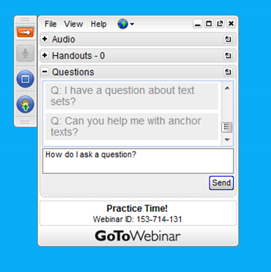
Engage with us!
During the webinar
– Accessing Documents
– Questions option
– Polling
After the webinar
– Survey
– Access to recorded webinar

Slide 7
Goals of the webinar
Understand what book baskets are and how they help students of all grades become stronger readers who LOVE reading
Learn how to design and use book baskets in your classroom
Hear from educators who have successfully reorganized their classroom libraries

Slide 8
Section 1: Why Book Baskets?

Slide 9


Slide 10
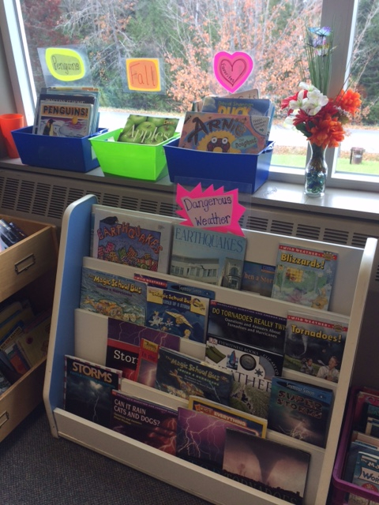
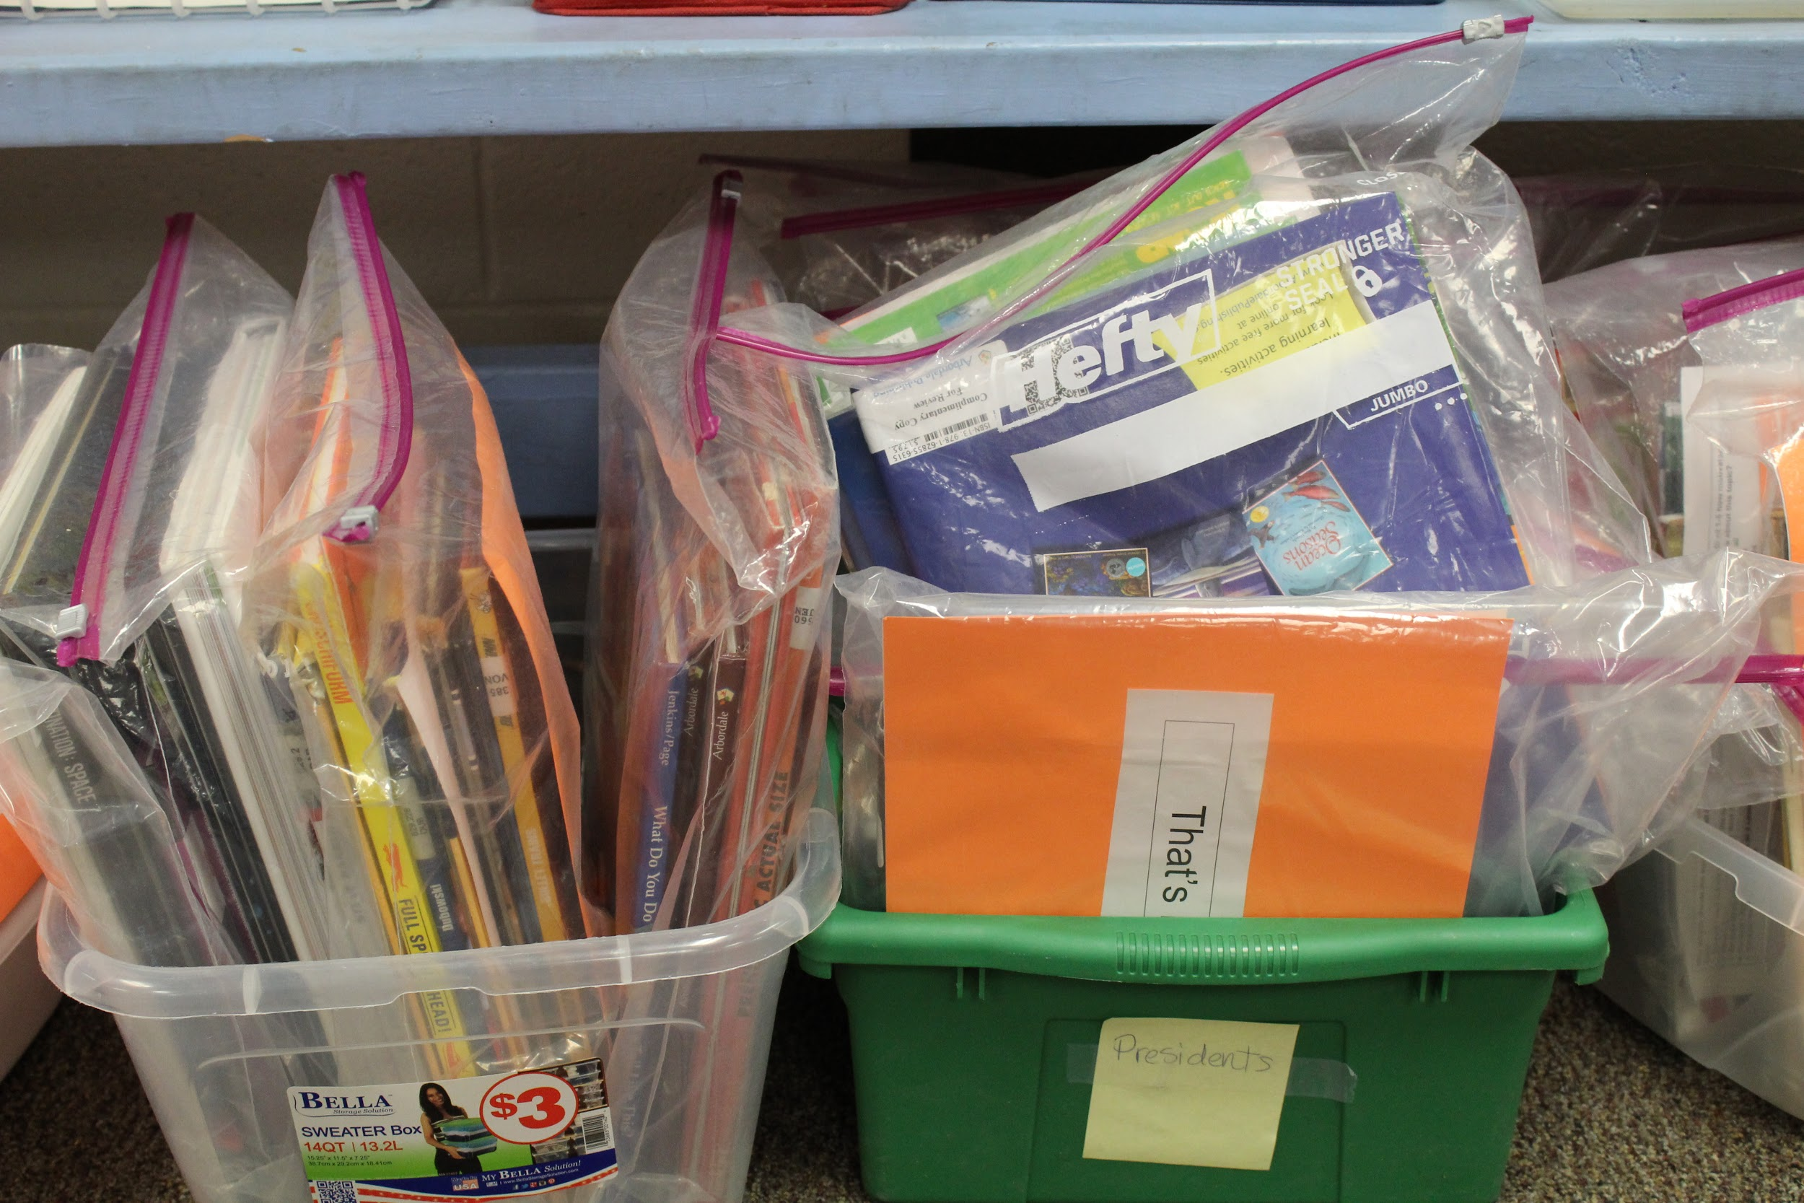
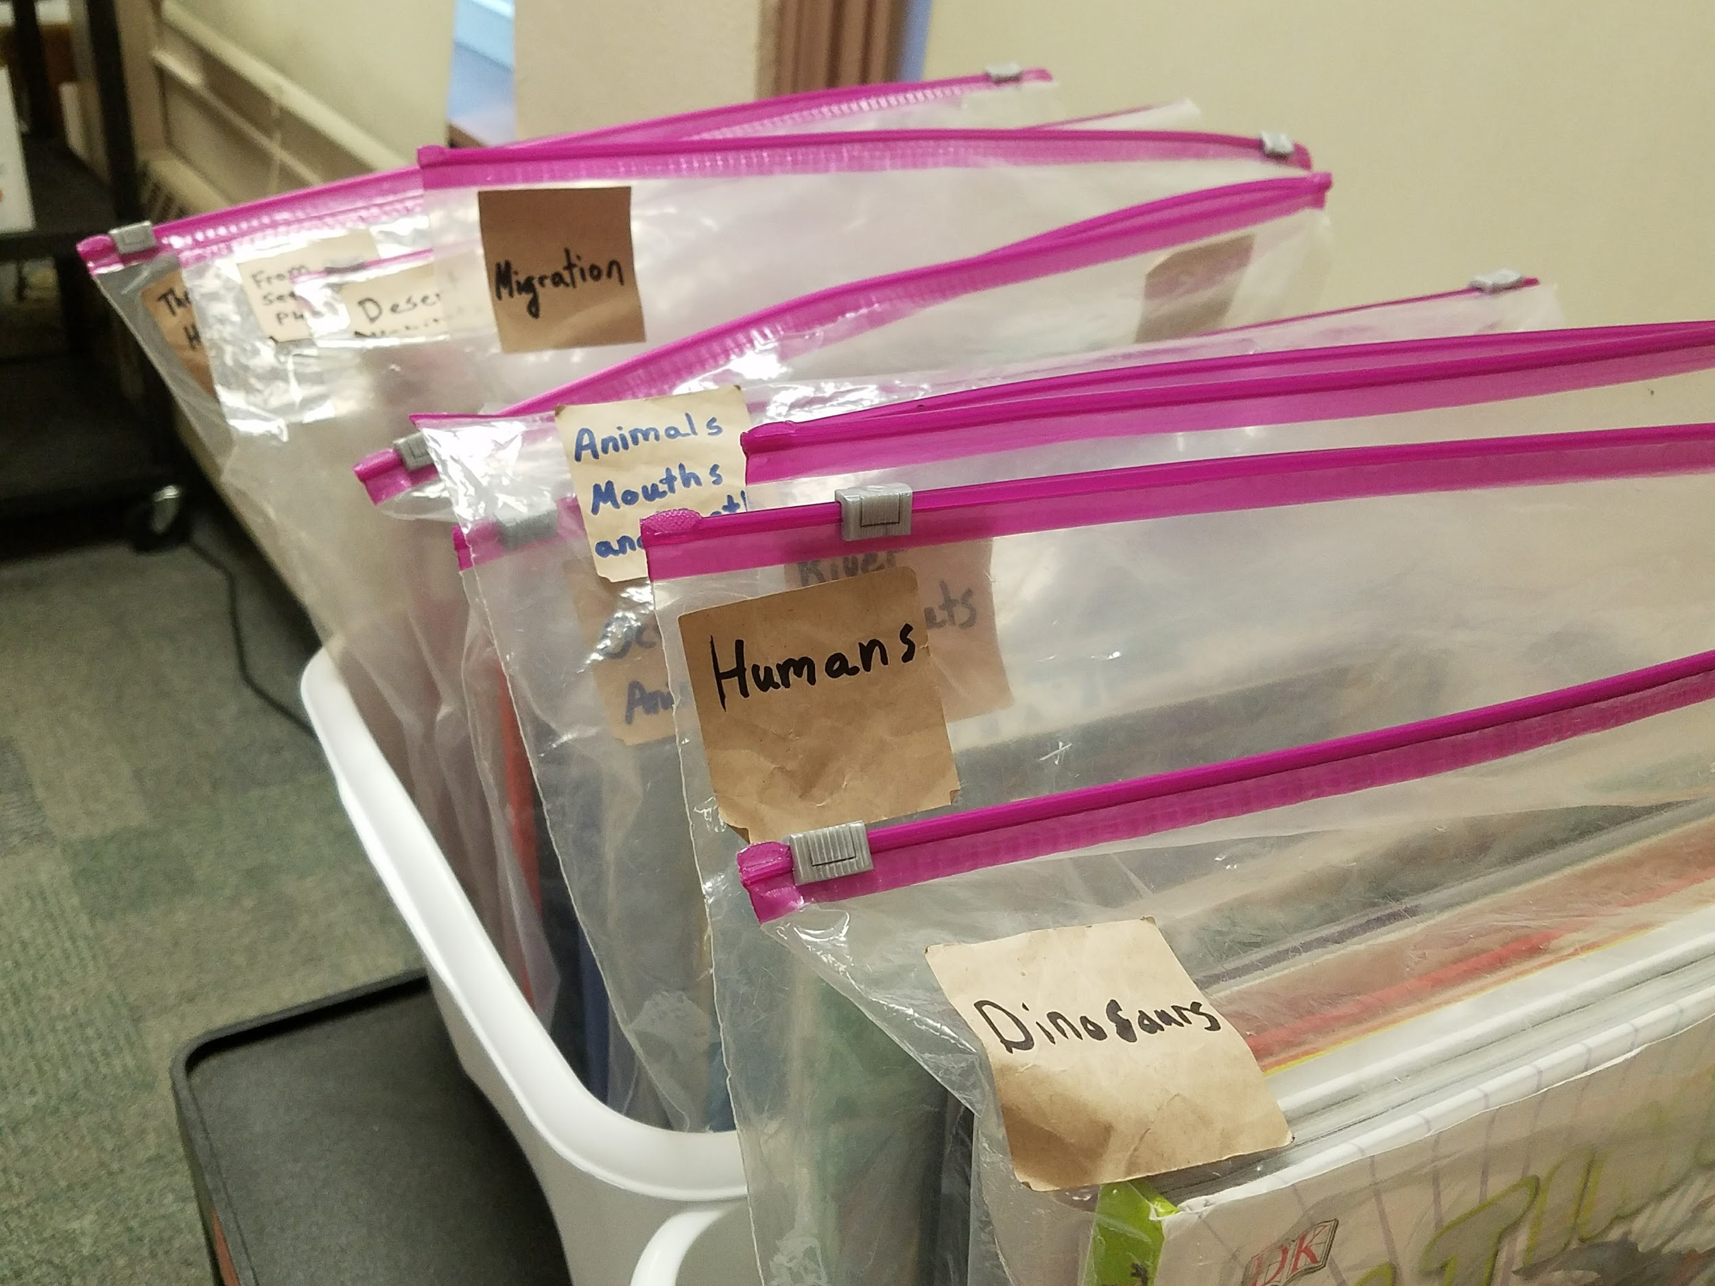
What are Book Baskets?
Topic-based collections of books that help students build knowledge and vocabulary.
These collections are not labeled by reading level.
They are built from books you already have in your classroom or school library

Slide 11
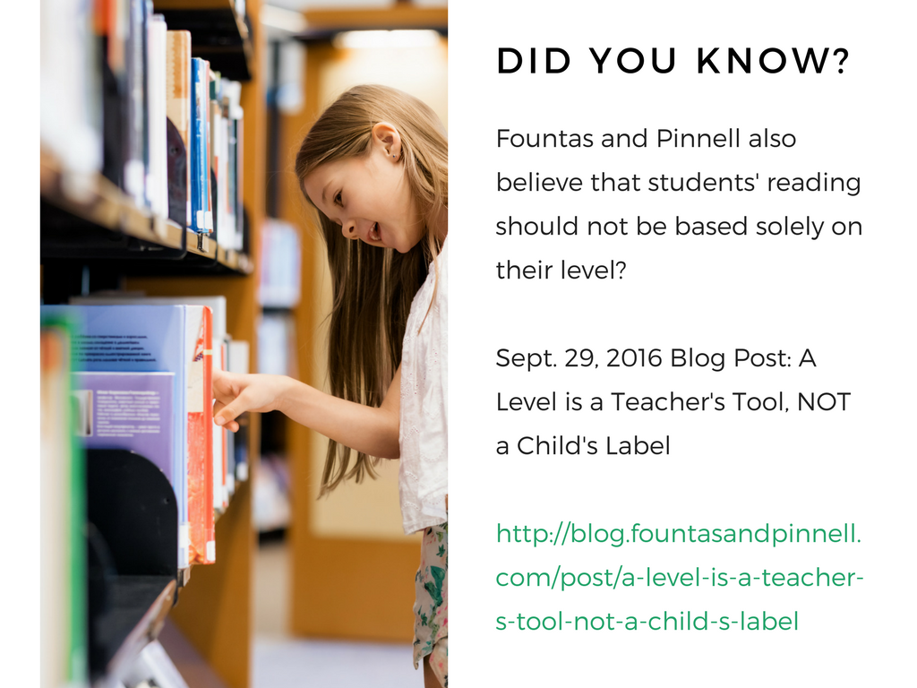

Slide 12

Research says...
Vocabulary and Knowledge Matter
NAEP 2013 -- Students who scored higher on vocab also scored higher on comprehension
Nelson et al 2012 -- Unfamiliar vocab is the complex text feature that causes the most difficulty
Hart & Risley study (1995) -- “30 Million Word Gap” Low-income students have less exposure to words and this begins the achievement gap early

Slide 13
The Baseball Study
Recht & Leslie (1988)
Compared reading comprehension for four categories of students:
High reading ability High knowledge of baseball | High reading ability Low knowledge of baseball
Low reading ability High knowledge of baseball | Low reading ability Low knowledge of baseball

Slide 14
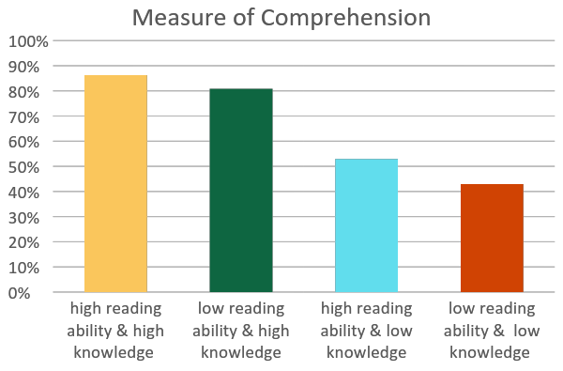

Slide 15
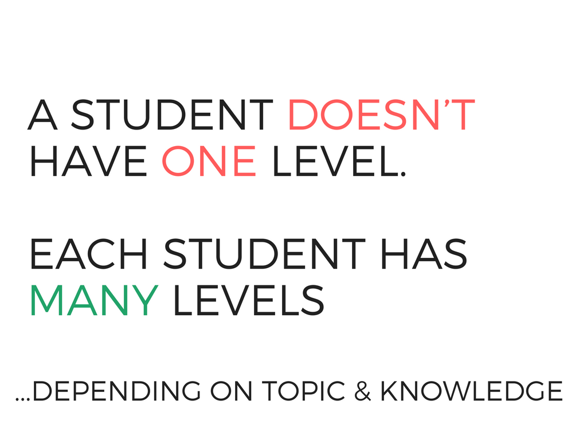

Slide 16


Slide 17


Slide 18
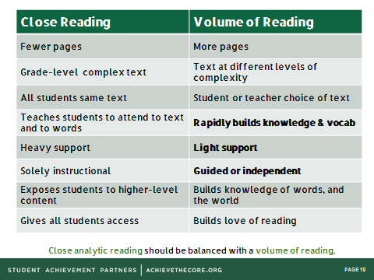
Differences between Close Reading and Volume of Reading

Slide 19
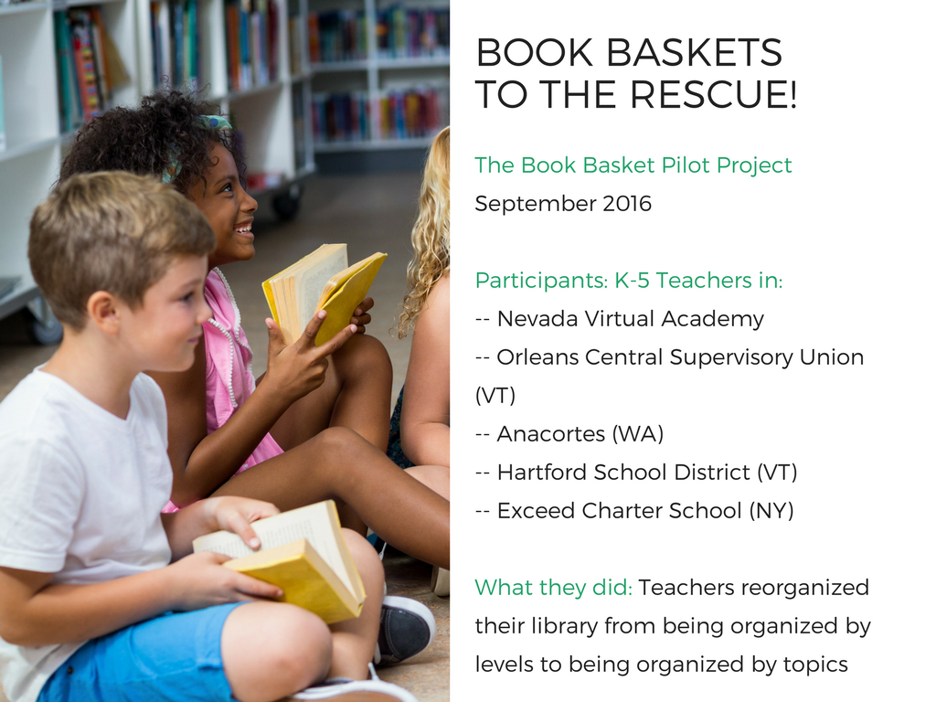

Slide 20
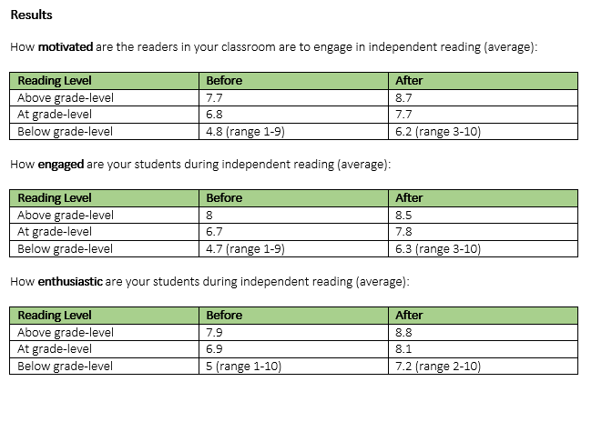
Book Basket Pilot Results
Increases in motivation, engagement, and enthusiasm for all students, especially below-grade readers

Slide 21
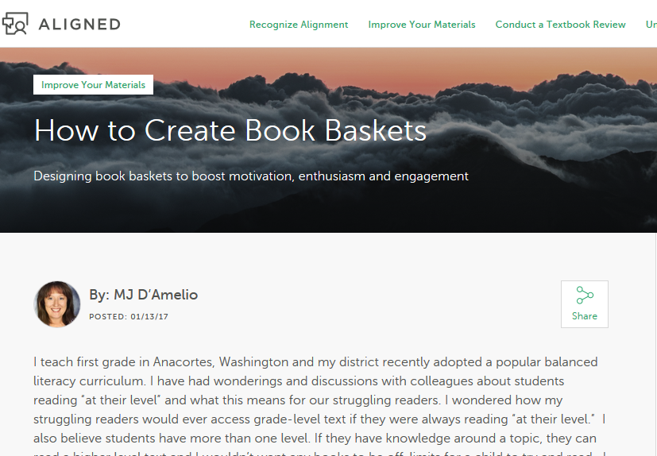
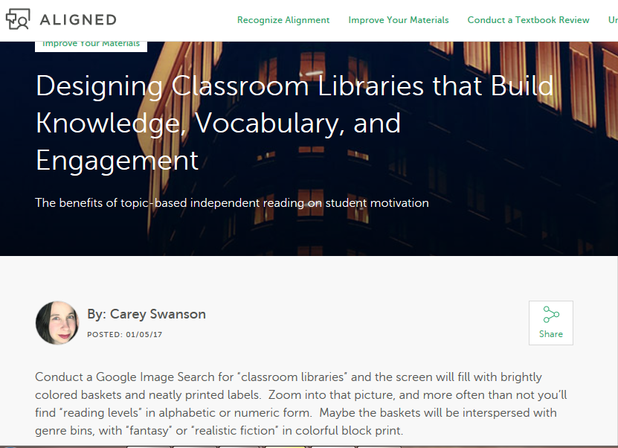
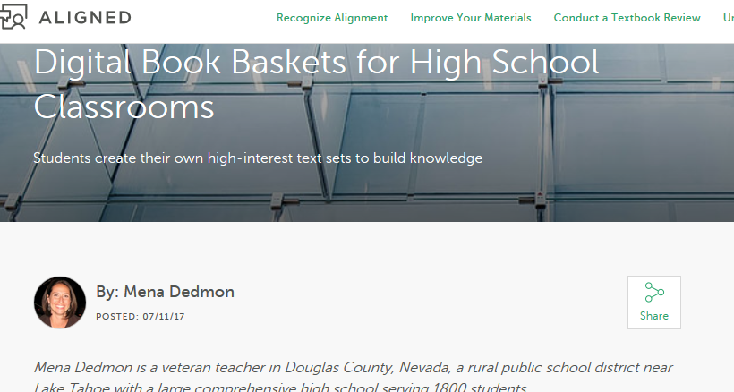
With Book Baskets, Students Enjoy Reading More, So They are Doing it More
Requests for more independent reading time
Requests and suggestions for new topics
Requests to take books home to continue reading
Learn more on the Aligned blog

Slide 22
Question:
What is your biggest challenge when it comes to having students engage in independent reading?
Please use the Questions tab on your control panel to respond.

Slide 23
Section 2: Building Book Baskets

Slide 24
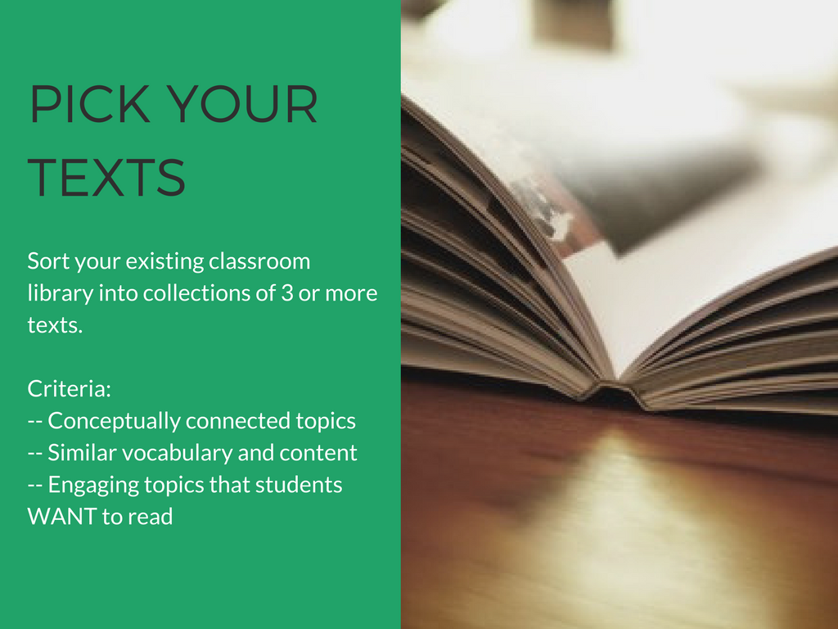

Slide 25
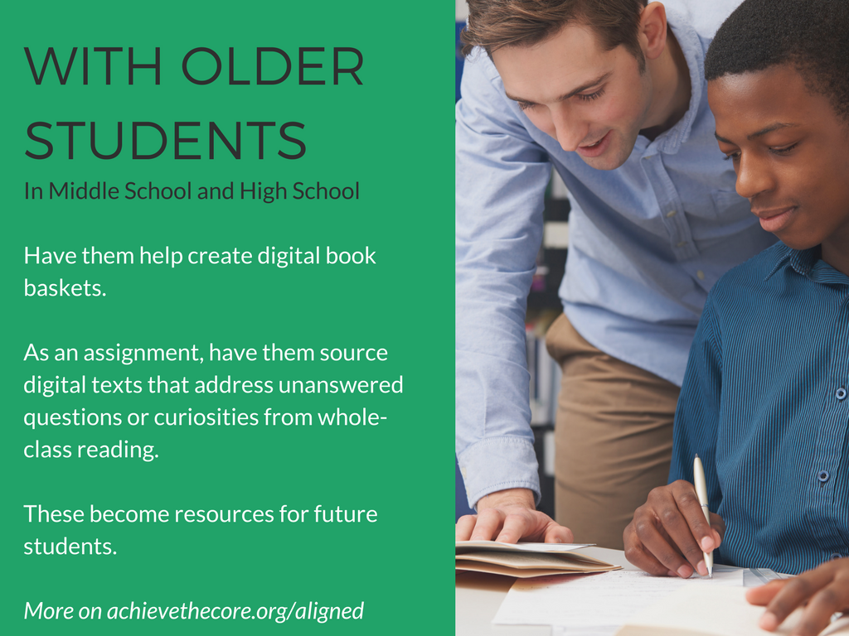

Slide 26


Slide 27
Start with the text the provides the broadest overview of the topic
Order subsequent texts by either simplest to hardest, or by the knowledge demands of the topic. Consider adding videos or websites to either introduce or reinforce content and vocabulary.
When ordering, ask yourself "“Have I provided a resource to help my readers understand an upcoming challenge in the text?”
Order your texts to build knowledge

Slide 28
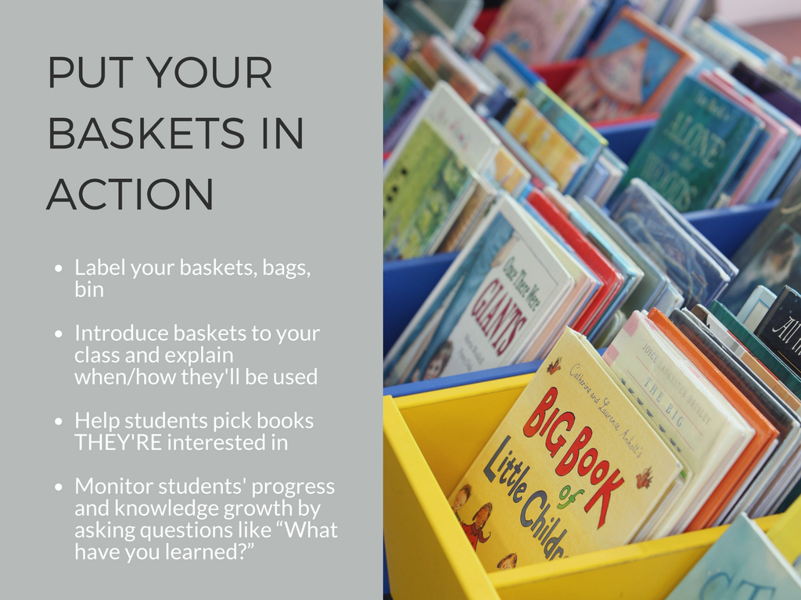

Slide 29
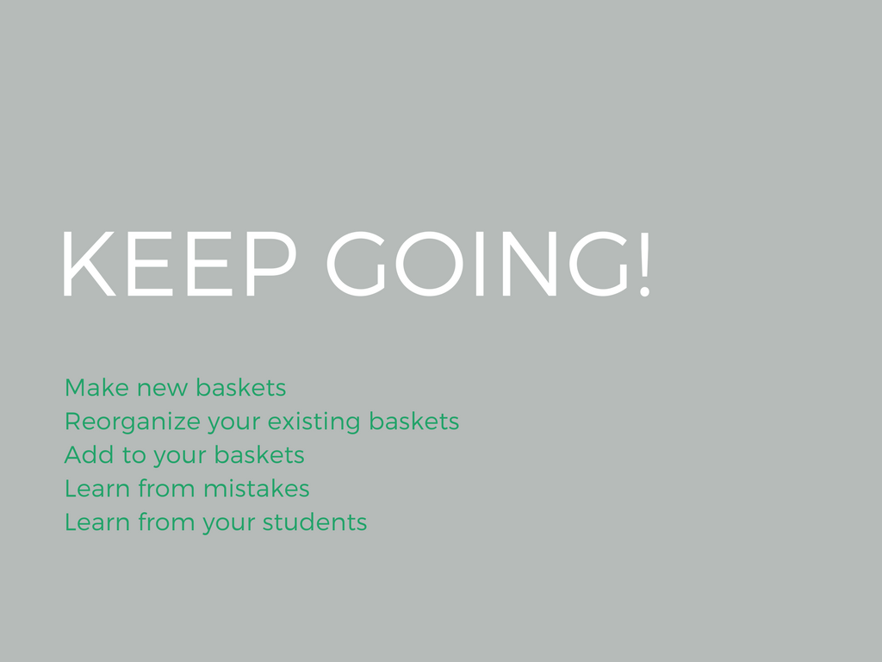

Slide 30
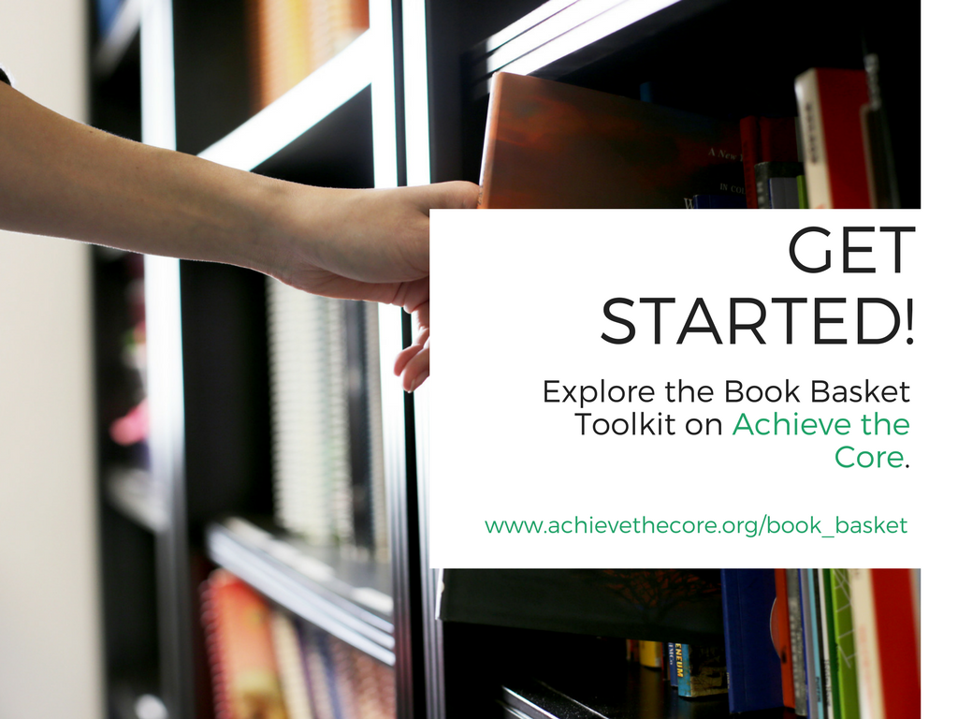
Content - duplicate as needed
content
be judicious with text
add images as appropriate
add talking points below in notes section

Slide 31
Poll:
Where do you get the majority of the texts in your classroom library?

Slide 32
Section 3 -- Success with Book Baskets

Slide 33

Alicia Cuomo
1st Grade Teacher
Exceed Charter School,
Brooklyn, NY

Slide 34
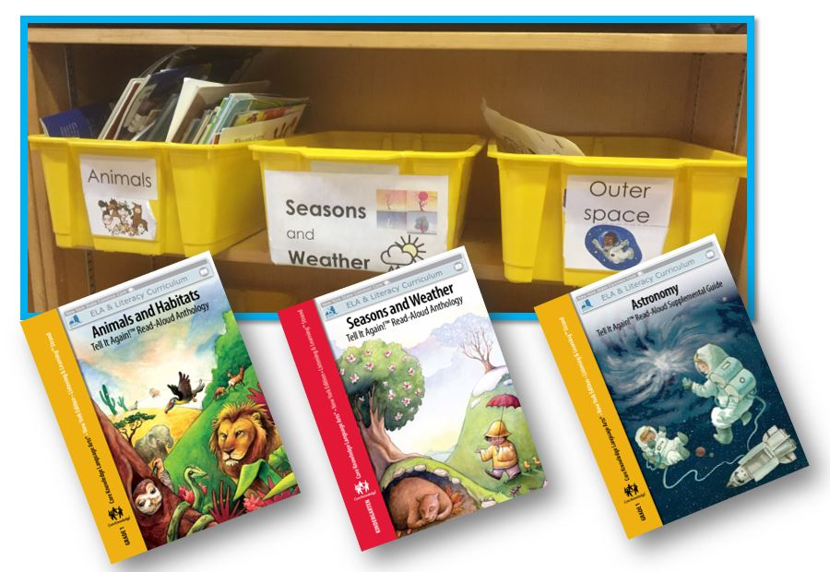
What I did differently in my classroom
Create book baskets that match units of study

Slide 35
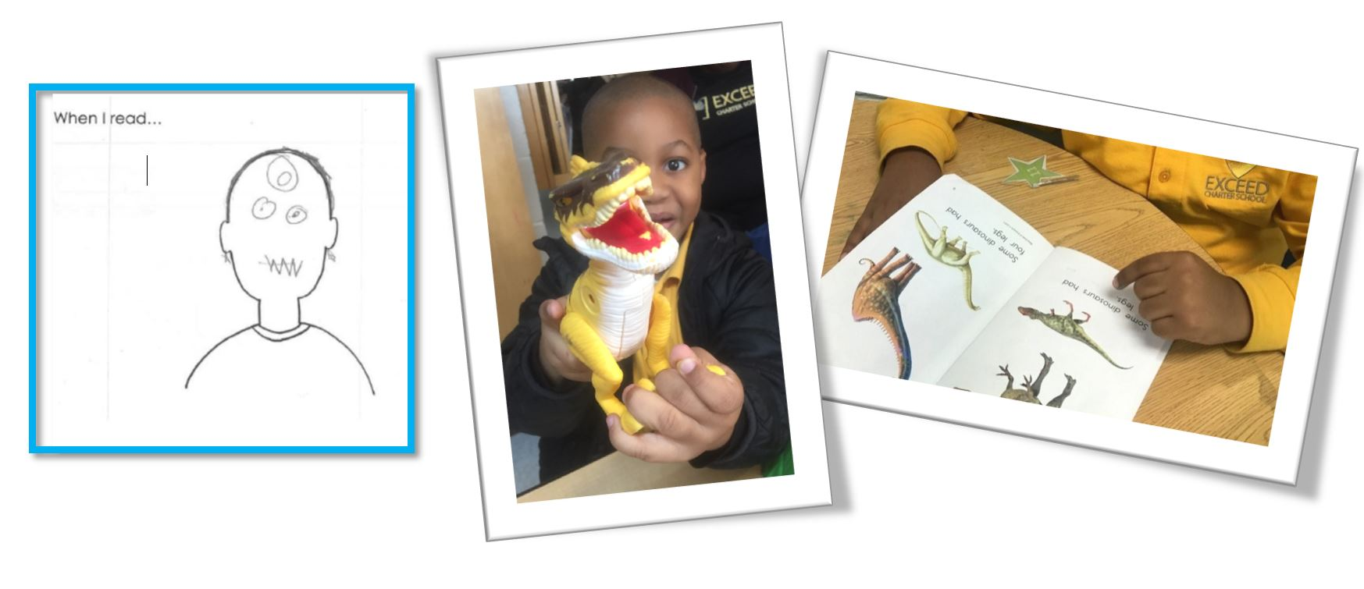
What I did differently in my classroom
Target disengaged readers

Slide 36
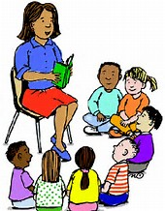

What I did differently in my classroom
Create excitement!
Read book basket texts outloud to the class
Introduce new book baskets in an exciting way
Allow time for kids to share, talk about or trade new books together

Slide 37
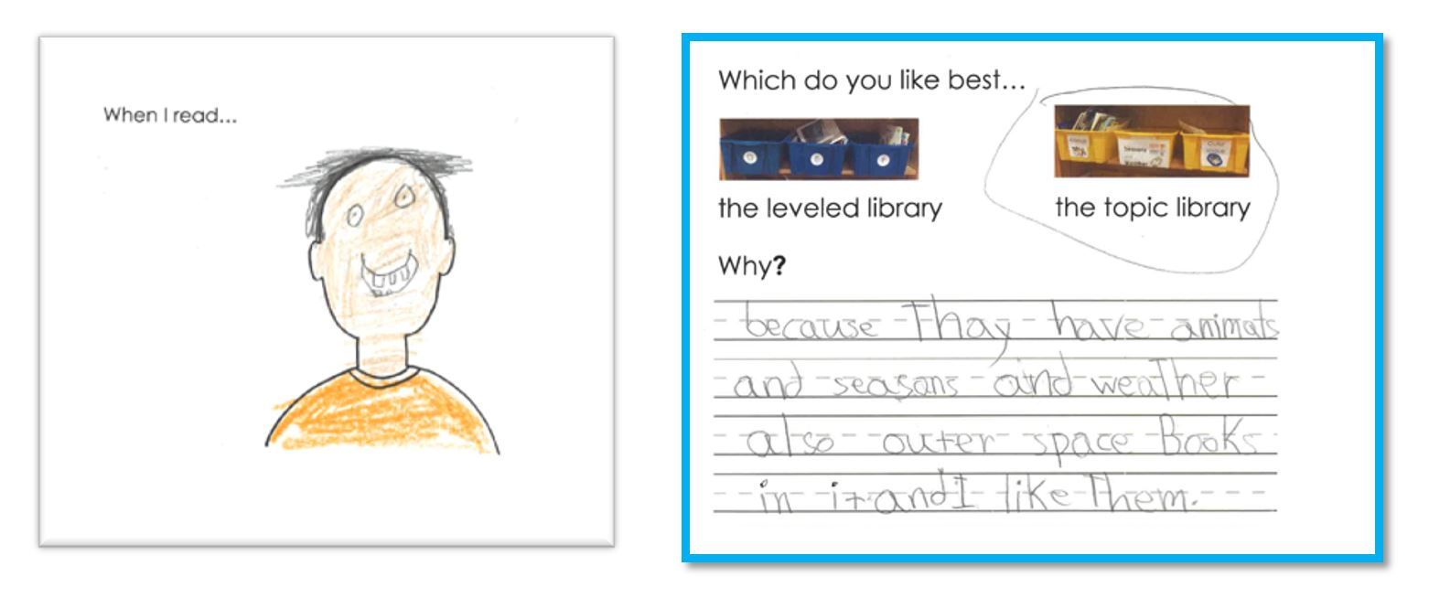
What I saw from my students...

Slide 38

Angie Miller
1st Grade Teacher
Mt. Erie Elementary,
Anacortes, WA

Slide 39
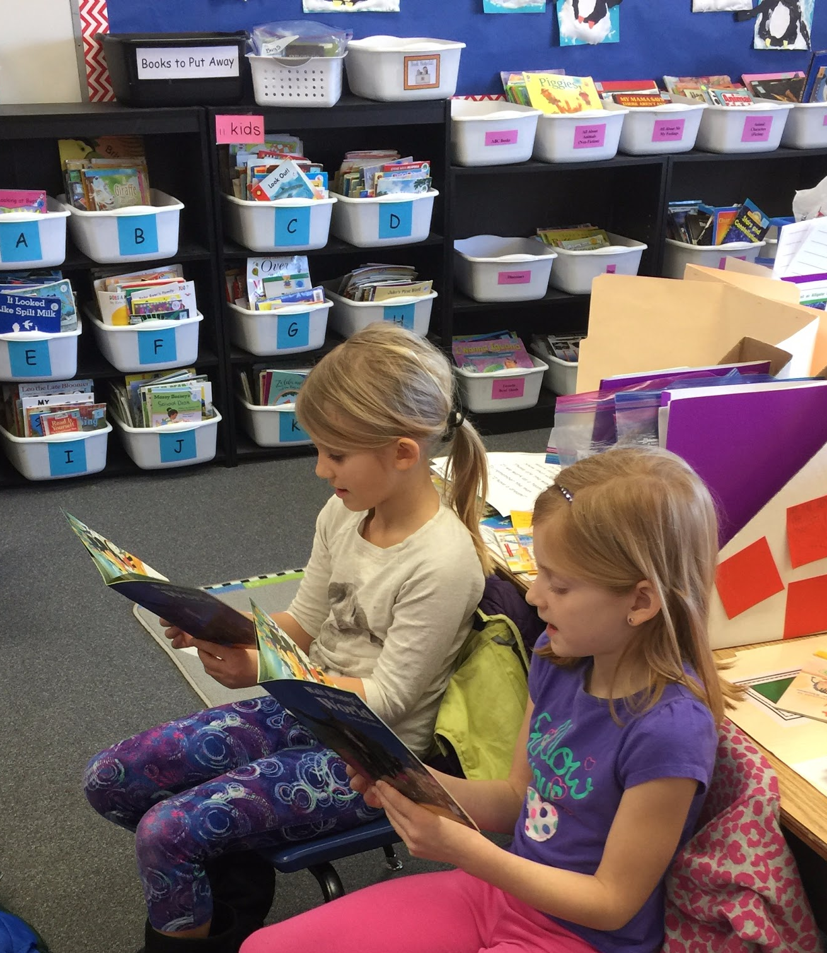
What I did differently in my classroom
Shift from leveled books to choice

Slide 40
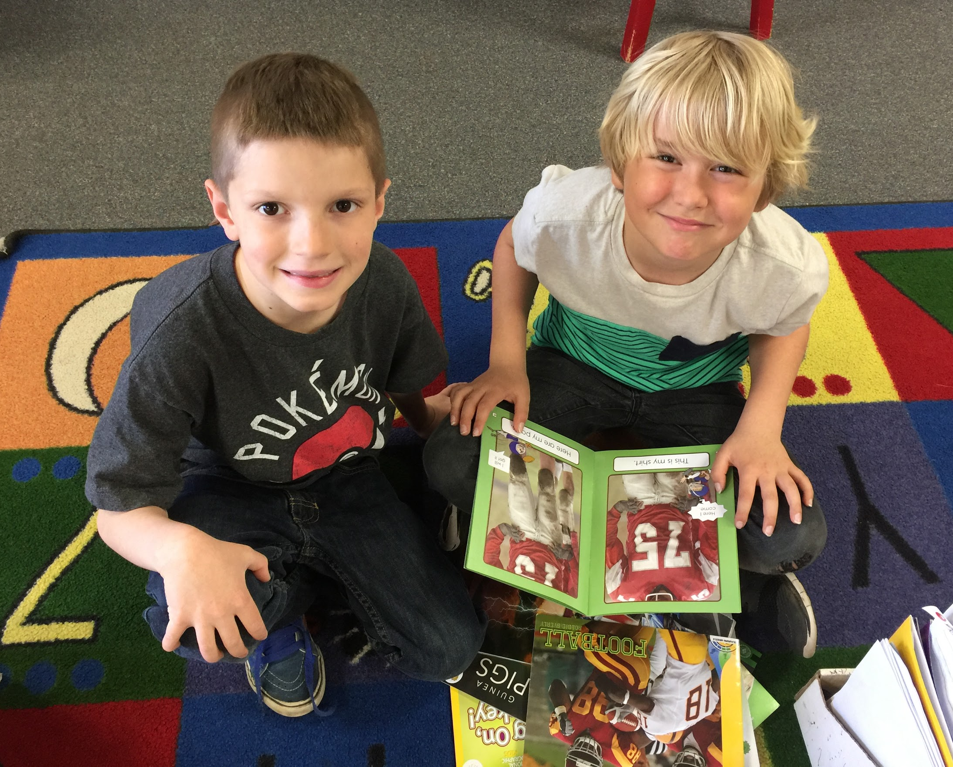
What I did differently in my classroom
Text Sets

Slide 41
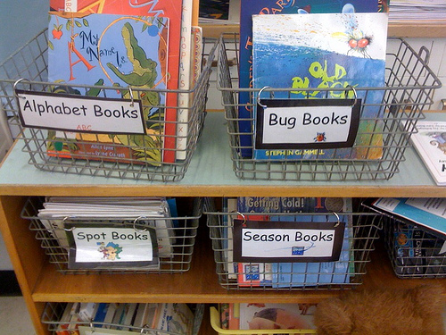
What I did differently in my classroom
Topic based reading

Slide 42
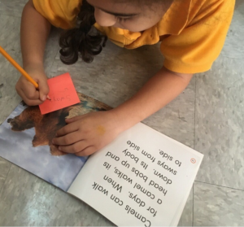
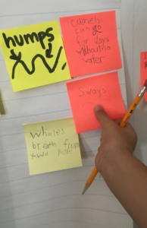
How students reacted
Excitement around reading and building knowledge

Slide 43
Questions for our Guests?

Slide 44
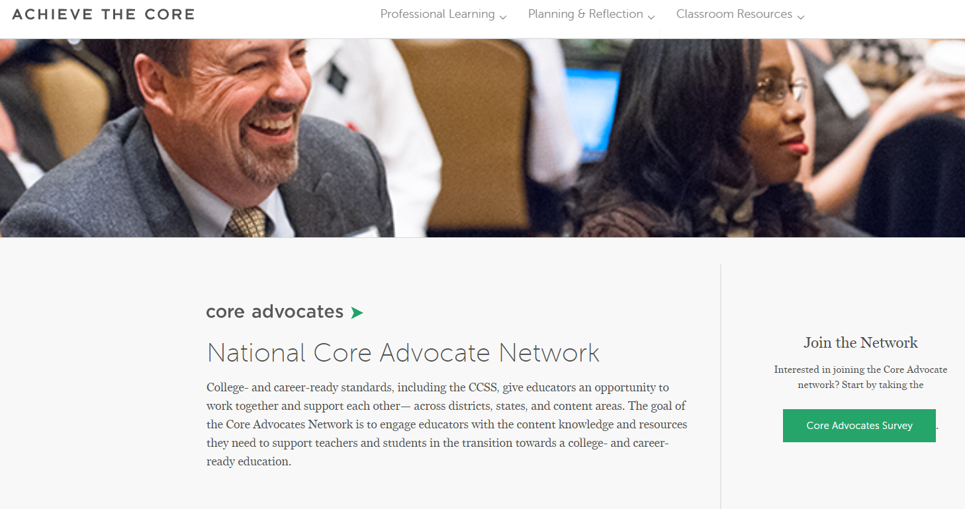
Join our network!
www.achievethecore.org/ca-signup

Slide 45
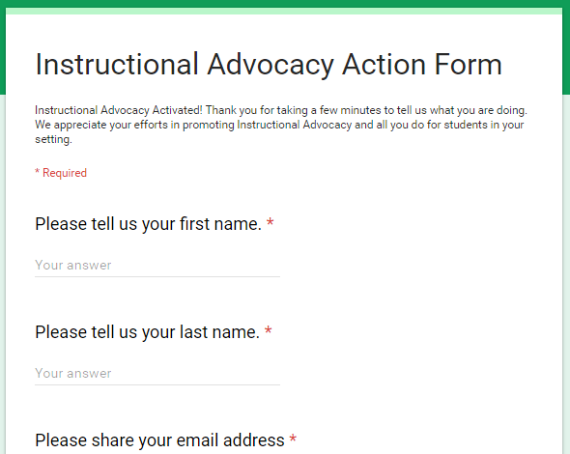
Tell us about your efforts
www.achievethecore.org/educators-taking-action

Slide 46
Please join us again next month!
Next month’s webinar: Using Achieve the Core to Tackle Common Math Issues
Wednesday, December 6, 7:00 - 8:00 p.m. ET
Register Here: https://register.gotowebinar.com/register/4937241899045074179

Slide 47
Thank You!

