Slide 1
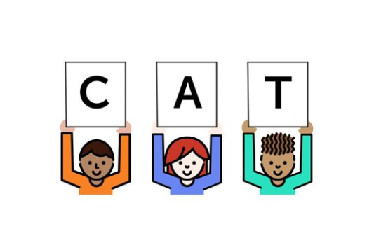
Foundational Skills Mini-Course
Module 3: Phonics (Part 1)
Notes:
This module was last updated on April 2018.
Welcome to the module 3 of the FS mini-course.

Slide 2


Course Instructors
David Liben,
Senior Content Specialist
Carey Swanson, ELA/Literacy Specialist

Slide 3
About Student Achievement Partners
Student Achievement Partners is a nonprofit organization dedicated to helping teachers and school leaders implement high-quality, college- and career-ready standards. We believe that challenging academic standards are the foundation for improved student outcomes, but that standards alone are not enough. Students will only make dramatic gains in achievement if instructional materials, assessments, and classroom practices are true to the expectations of high-quality, college- and career-ready standards.
Our work is grounded in research and evidence, and we are committed to sharing standards-aligned tools and practices freely with educators across the country. Our website, achievethecore.org, offers hundreds of math and literacy instructional resources for teachers and school leaders.

Slide 4
Goals for This Module
Identify how phonemic awareness connects to phonics instruction.
Distinguish how and why phonics patterns must be addressed sequentially.
Notes:
****
Here are the goals for this module.

Slide 5
Phonics and Word
Recognition
K
1
2
Description:
Know and apply grade-level phonics and word analysis skills in decoding words.
Kindergarten:
Knowledge of phonemes/sounds connect to knowledge of graphemes/spelling.
First grade:
Knowledge of sound and spelling patterns for digraphs, long vowels, some endings/irregular spellings.
Decoding regularly spelled one syllable and basic patterned two syllable words.
Second grade:
Knowledge of sound and spelling patterns for vowels and vowel teams and common regular and irregular spelling.
Decoding regularly spelled two syllable words and common prefixes/suffixes.
All – Reading/Recognizing grade level high-frequency words.
Notes:
As a reminder, phonics and word recognition are key areas of study in K, first, and second grades.
Take a moment to refresh your memory on the focus areas for this set of standards, or pause the webinar to look more closely at the grade-specific standards most applicable to your role.

Slide 6
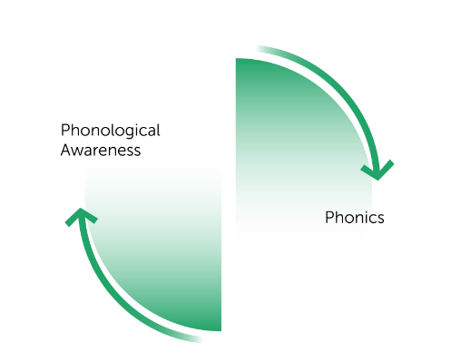
From LISTENING to LETTERS
Learning to decode means asking students to connect sounds to graphemes.
If they haven’t learned to hear sounds, we’ve made it far more difficult for them to do this!
Phonemic
Awareness
Phonics
Notes:
The connection between phonics and PA is critical.
Reading is a process, not a series of disconnected parts. As students move into phonics instruction, the connections they made between early PA skills and the sounds and spelling patterns found in letters will set them up for success.
At the same time, these two reinforce one another. If students did not have strong PA instruction, this does not mean you should keep them from moving into phonics. Just note that the two together reinforce the needs of an early reader.

Slide 7

What Is Phonics?
Phonics is the relationship between the letters of written language and the sounds of spoken language.
Notes:
Let’s be sure we have a normed definition of phonics. Phonics is the relationship between the letters of written language and the sounds of spoken language.

Slide 8
Phonics Is Based on The Alphabetic Principle
The Alphabetic Principle: Letters and letter combinations are symbols that represent speech sounds in words.
OR: The sounds of language are represented by letters and letter combinations.
b makes the /b/ sound in boy
and
“oy” makes the oy sound in boy
Notes:
Phonics is based on the The Alphabetic Principle: Letters and letter combinations are symbols that represent speech sounds in words.
Another way to say this is the sounds of language are represented by letters and letter combinations.
b is a consonant phoneme, and oy is a vowel diphthong. Together, they make the sounds in the word boy.

Slide 9


OR: Letters are Pictures of Sounds
Notes:
Another way to think of it is that letters are pictures of sounds.
These ‘m’ and ‘s’ pictures are from Journeys’ “Alphafriends” picture cards. Kids first listen for the sounds and then they connect the sound /m/ to the letter ‘m’.

Slide 10
Connecting Phonemic Awareness to Reading, Writing, and Spelling
Identifying and isolating phonemes facilitates students’ ability to hear the sounds that make up language.
Hearing the sounds of language will facilitate students’ ability to match language to print.
Notes:
In the last module, you were asked to discuss how phonemic awareness connects to these other literacy skills. This connection is very important.
Identifying and isolating phonemes facilitates students’ ability to hear the sounds that make up language.
Hearing the sounds of language will facilitate students’ ability to match language to print.

Slide 11



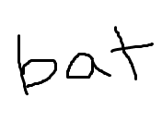

Students Must Be Able to Decode and Encode!
Decode: convert graphemes to sounds, and blend those sounds to make words.
Encode: convert the speech sounds of words into graphemes that they can write.
=
Big Bad Bat!
Read
Write
Notes:
Through this work, we are teaching students to decode as well as to encode. Decoding is changing graphemes (letters or groups of letters that represent sounds) into sounds and blending these together to make words, as in a student reading /b/ /a/ /t/ to get ‘bat.’ Encoding is the opposite: students are changing speech sounds into graphemes, and writing them. In short, decoding is the process of reading, and encoding is the process of writing.

Slide 12

First Things First!
Letter recognition is critical!
All future reading depends on recognizing letters, letter combinations, and the sounds they represent instantaneously!
Notes:
****
As we mentioned in Module 1, letter recognition is an important first step. Students’ ability to read and write depends on their ability to recognize letters and groups of letters, as well as the sounds that they make, instantaneously. This is one of the biggest predictors of young children’s ability to read with proficiency later in life.

Slide 13
Letter Instruction
How do we best help early readers?
Group 1 | Group 2 | Group 3
Instruction on letter names followed by words taught as wholes. | Instruction on words taught as wholes followed by letter names and sounds. | Instruction on letter names and sounds followed by words taught as wholes.
Ohnmacht (1969)
Make a prediction:
Which group will score best on a reading achievement test?
Notes:
Let’s take a look at some related research. This study grouped students and followed the described instructional delivery. Make a quick prediction to yourself after reading the categories– which group will score best on a reading achievement test?
Pause the module if you need a minute to decide or talk this out with your colleagues.
Study: Ohnmacht (1969)
http://files.eric.ed.gov/fulltext/ED028913.pdf

Slide 14
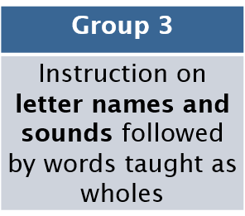

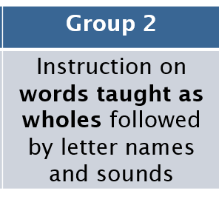
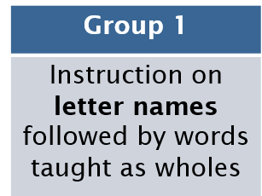
“Letter knowledge and phonemic awareness are critical for the beginning reader. But it seems that some special magic lies in the linking of these two basic skills.” Adams (1990).
Which Group Will Score Best on a Reading Achievement Test?
1st
Preformed significantly better
2nd
3rd
Notes:
As you can see, the group that focused first on letter names and sounds, followed by words taught as wholes (often referred to as high-frequency words) significantly outperformed the other groups. The group that did not connect letters to sounds did the worst. This is summarized well by this Marilyn Adams quote.

Slide 15
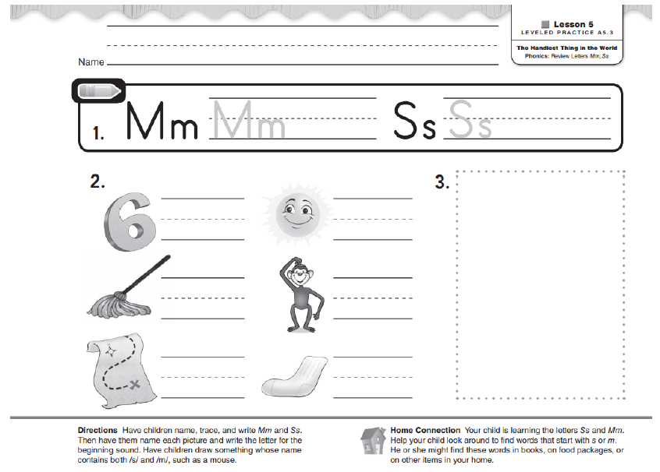
Phonemic Awareness Connects to Phonics
Notes:
When we explicitly connect letter sounds to their printed graphemes, we are providing students with access to print. Note how students are reading and writing these sounds, even at the beginning of K. Here, students write the graphemes they know that they can hear in the pictures on their paper. They do not have to look at words or print that they have not been taught, but they can build their skills around the areas of instruction that have been covered and still hear the related sounds in words like “six” or “monkey.”

Slide 16
Moving to Phonics – Things Are Complicated!
Notes:
As we move into more phonics content, complications grow!

Slide 17
Phonics Instruction Includes
Systematic teaching of sound and spelling patterns.
Systematic teaching of high-frequency words. (coming in a later module)
Notes:
When we talk about phonics instruction, we are talking about the systematic teaching of sound and spelling patterns. Phonics materials also include a systematic approach to high-frequency words, which we’ll talk more about in a later module.

Slide 18

Listen to these words.
What phoneme do you hear at the beginning?
one
olive
/o/
/w/
on
/o/
off
/aw/
Fun Fact!
/aw/ is very close to the /o/ sound and for some people they are basically indistinguishable!
Try saying “cot” and “caught” – can you hear a difference?
Notes:
As each word appears, say the word to yourself out loud. Try to identify the phoneme that you hear.
Review fun fact.
Notes:
From Louisa Moats: Louisa Moats (2014): What teachers don't know and why they aren't learning it: addressing the need for content and pedagogy in teacher education, Australian Journal of Learning Difficulties, DOI: 10.1080/19404158.2014.941093
“Spencer, Schuele, Guillot, and Lee (2008), for example, reported that the instructional materials used by the teachers in their study contained many errors of linguistic analysis. The word ox was identiﬁed as having two phonemes (it has three, /o˘/ /k/ /s/) and off, on, olive, and one were identiﬁed as beginning with “the sound for the letter o,” although these words begin with the phonemes /au/, /o˘/, and /w/. Details matter; with such inaccuracies, both teachers and their students may conclude that the orthographic code is nonsensical.”
From CKLA. Kindergarten Unit 2 end of teacher guide
The sound /aw/ is very close to the sound /o/, and in some regions of the United States /aw/ and /o/ have “fallen together” to such a degree that the two are more or less indistinguishable. In other parts of the country, however, these two sounds are still distinct. Try pronouncing cot and caught, knotty and naughty, and see if you can hear a difference. If you cannot hear a difference, these sounds may have fallen together in your region. Before you decide, you might try looking in a mirror: the /aw/ sound is made with the lips more tightly rounded and the /o/ sound with less rounded lips. The sound /aw/ is not taught in kindergarten. The relationship between /o/ and /aw/ is discussed when the /aw/ sound is first taught, in Grade 1.

Slide 19

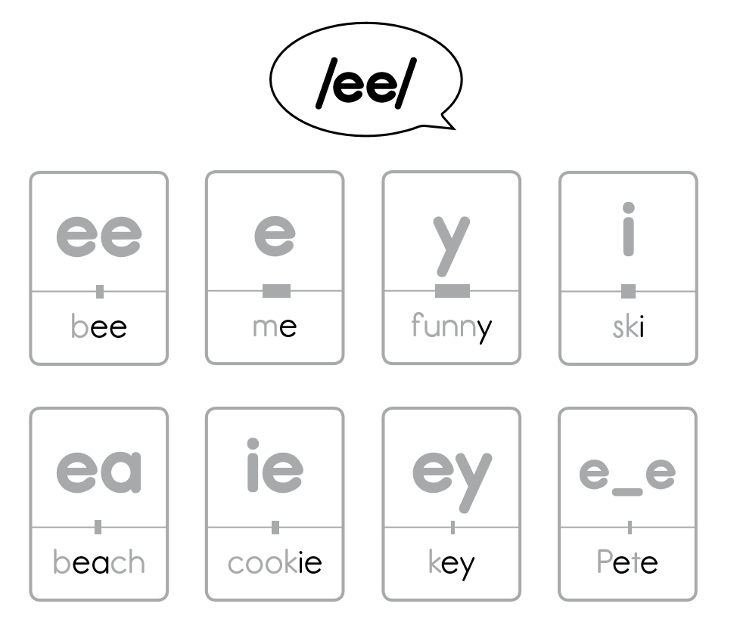
TASK: Things Are Complicated
Can you name all the graphemes associated with the /ee/ phoneme?
?
?
?
?
?
?
?
?
Graphic:
Core Knowledge
Language Arts
Notes:
To further illustrate how complicated phonics instruction can be, let’s see how many ways can you think of to spell /ee/? Pause the webinar to generate a list. Can you get all 8?
We’ll reveal the sounds so that you can cross check your work here. The materials on this slide come from the open educational curriculum Core Knowledge Language Arts. These images are interesting because the bar below each sound represents how frequently the sound spelling pattern is found in words. You can see, for example, that ee spelled with a y at the end is much more common than the spelling “ey”.
Graphic: Core Knowledge Language Arts (https://www.engageny.org/sites/default/files/resource/attachments/ckla_g2_vowels_fb.pdf)

Slide 20
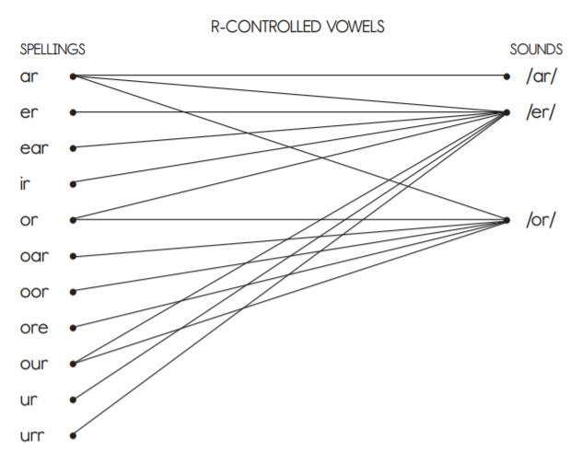
Many Phonemes Have Multiple Graphemes
earth
worm
fur
Graphic: Core Knowledge Language Arts
Notes:
Many phonemes have multiple graphemes. “R-Controlled” vowels illustrate this for us quite clearly. For example, the phoneme /er/ can be spelled ‘ear’ as in earth, ‘or’ as in worm, or ‘ur’ as in fur. It can be spelled MANY other ways as well. As a challenge, feel free to pause the module and try to list some more.
file: ckla_gk_u2_tg.pdf

Slide 21
Also, Some Graphemes Have Multiple Phonemes
cart
hazard
warm
Graphic: Core Knowledge Language Arts
Notes:
The reverse is also true: some graphemes have multiple phonemes. For example, the spelling ar can be pronounced ‘ar’ as in cart, ‘er’ as in hazard, and ‘or’ as in warm.

Slide 22

How Do We Build Phonics Knowledge?
Reading connected texts
+
Systematic
Phonics
Program
Notes:
*****
How will we accomplish building students’ phonics knowledge? The answer is to use a systematic phonics program and utilize connected texts.

Slide 23

Why Systematic Ordering?
CONTENT
52 Letters
Upper and Lower Case
16 Upper- Different from Lower-Case
44 Sounds
150 Spellings
Punctuation
Directionality
A B C D E F G H I J K L M N O P Q R S T U V W X Y Z a b c d e f g h i j k l m n o p q r s t u v w x y z A B D E F G H I J K L M N Q R T /p/ p pp /b/ b bb /t/ t tt ed /d/ d dd ed /k/ c k ck ch cc /g/ g gg gu gh /ch/ ch tch /j/ j g ge dge dg /f/ f ff ph gh /v/ v ve /s/ s c ss ce se st sc /z/ z s se zz ze /th/ th /th/ th /m/ m mm mb /n/ n nn kn gn /ng/ ng n /r/ r rr wr /l/ l ll /h/ h /w/ w wh /y/ y /x/ x /sh/ sh ch /qu/ qu /a/ a /i/ I y /e/ e ea /u/ u o ou o_e /o/ o /ə/ a e /ə/+/l/ al le el ul il /ae/ a_e a ai ay ey eigh ea /ee/ ee e y I ea ie ey e_e /ie/ i_e I y ie igh /oe/ o_e o ow oa oe /ue/ u ue //oo/ oo u u_e ew ue ou ui o o_e /oo/ oo u /ou/ ou ow /oi/ oi oy /aw/ aw au al ough augh /ar/ ar /er/ er or ur ar ir ear /or or ore ar our oar oor , . ? : ; ” ’ !
Source: Standards Institute/UnboundEd
Notes:
To help understand why a systematic ordering of instruction will support students’ decoding ability, let's think about what students need to learn in order to be able to decode accurately:
There are 52 letters of the alphabet comprised of both upper and lowercase letters.
16 uppercase letters have a distinctly different shapes then their lowercase counterparts.
Those 52 shapes can be combined to represent 44 sounds which are spelled with 150 different spellings.
In order to decode proficiently, the reader also has to understand punctuation and directionality (that we read from top to bottom and left to right).
The code is expansive. If we are systematic in our sequencing of instruction, we can ensure thorough coverage of all sounds and spellings.
The goal of code instruction is to build AUTOMATIC and ACCURATE decoding.
AUTOMATIC meaning quickly.
ACCURATE meaning the method is consistently correct.
Even nonsense words and words that one doesn’t know can be decodable.

Slide 24
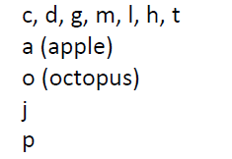
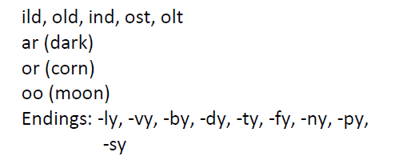
Scope and Sequence Task
Can you make a word list students could DECODE and ENCODE?
Early K
Mid-Late 1st
Note: all consonants, short vowels, and basic long vowel spellings have been introduced at this time.
Notes:
Pause the module here to engage in the text content task.
On the left, you see a list of sound and spelling taught in early K. On the right, you can see a list taught in mid to late 1st grade, along with the note about other taught skills.
Your task is to make a word list for each group. Can you make 10-20 words that students should be able to decode and encode as a result of systematic teaching?
We used the scope and sequence provided in your handout for this task, which comes from the Top Ten Tools resource we have mentioned in other modules. Note that, while a systematic scope and sequence is necessary for phonics instruction, there is no research showing that one scope and sequence is better than another. This is one option that is independent of a core program, which is why we are using it for a sample in this course.

Slide 25
Decodable Text K–5
“The Short Happy Life of Francis Macomber” – 9th grade
"What had I ought to give them?" Macomber asked.
"A quid would be plenty," Wilson told him. "You don't want to spoil them."
"Will the headman distribute it?"
"Absolutely."
Francis Macomber had, half an hour before, been carried to his tent from the edge of the camp in triumph on the arms and shoulders of the cook, the personal boys, the skinner and the porters. The gun-bearers had taken no part in the demonstration. When the native boys put him down at the door of his tent, he had shaken all their hands, received their congratulations, and then gone into the tent and sat on the bed until his wife came in. She did not speak to him when she came in and he left the tent at once to wash his face and hands in the portable wash basin outside and go over to the dining tent to sit in a comfortable canvas chair in the breeze and the shade.
"You've got your lion," Robert Wilson said to him, "and a damned fine one too."
Source: Standards Institute/UnboundEd
Notes:
Take this excerpt from “The Short Happy Life of Francis Macomber,” a grade 9 text.
Let’s look at how it might become accessible as we explicitly teach phonics:
RED will indicate what we’ve taught in kindergarten
GOLD will represent Grade 1 Learning
GREEN will represent Grade 2 Learning
And BLUE will represent words that have become recognizable on sight – that is, they no longer need to be decoded.
<CLICK>

Slide 26
Kindergarten 1st Grade 2nd Grade Memorized
"What had I ought to give them?" Macomber asked.
"A quid would be plenty," Wilson told him. "You don't want to spoil them."
"Will the headman distribute it?"
"Absolutely."
Francis Macomber had, half an hour before, been carried to his tent from the edge of the camp in triumph on the arms and shoulders of the cook, the personal boys, the skinner and the porters. The gun-bearers had taken no part in the demonstration. When the native boys put him down at the door of his tent, he had shaken all their hands, received their congratulations, and then gone into the tent and sat on the bed until his wife came in. She did not speak to him when she came in and he left the tent at once to wash his face and hands in the portable wash basin outside and go over to the dining tent to sit in a comfortable canvas chair in the breeze and the shade.
"You've got your lion," Robert Wilson said to him, "and a damned fine one too."
Source: Standards Institute/UnboundEd
Notes:
RED will indicate what we’ve taught in Kindergarten
GOLD will represent Grade 1 Learning
GREEN will represent Grade 2 Learning
And BLUE will represent words that have become recognizable on sight – that is, they no longer need to be decoded.
<CLICK>

Slide 27
Kindergarten 1st Grade 2nd Grade Memorized
"What had I ought to give them?" Macomber asked.
"A quid would be plenty," Wilson told him. "You don't want to spoil them."
"Will the headman distribute it?"
"Absolutely."
Francis Macomber had, half an hour before, been carried to his tent from the edge of the camp in triumph on the arms and shoulders of the cook, the personal boys, the skinner and the porters. The gun-bearers had taken no part in the demonstration. When the native boys put him down at the door of his tent, he had shaken all their hands, received their congratulations, and then gone into the tent and sat on the bed until his wife came in. She did not speak to him when she came in and he left the tent at once to wash his face and hands in the portable wash basin outside and go over to the dining tent to sit in a comfortable canvas chair in the breeze and the shade.
"You've got your lion," Robert Wilson said to him, "and a damned fine one too."
Source: Standards Institute/UnboundEd
Notes:
If we're systematic in teaching letter-sound correspondences then, by the end of kindergarten, these words and portions of words are decodable.
<CLICK>

Slide 28
Kindergarten 1st Grade 2nd Grade Memorized
"What had I ought to give them?" Macomber asked.
"A quid would be plenty," Wilson told him. "You don't want to spoil them."
"Will the headman distribute it?"
"Absolutely."
Francis Macomber had, half an hour before, been carried to his tent from the edge of the camp in triumph on the arms and shoulders of the cook, the personal boys, the skinner and the porters. The gun-bearers had taken no part in the demonstration. When the native boys put him down at the door of his tent, he had shaken all their hands, received their congratulations, and then gone into the tent and sat on the bed until his wife came in. She did not speak to him when she came in and he left the tent at once to wash his face and hands in the portable wash basin outside and go over to the dining tent to sit in a comfortable canvas chair in the breeze and the shade.
"You've got your lion," Robert Wilson said to him, "and a damned fine one too."
Source: Standards Institute/UnboundEd
Notes:
In addition, if we introduce some high-frequency tricky words (those that are partially decodable) or sight words, this much of the text is decodable
<CLICK>

Slide 29
Kindergarten 1st Grade 2nd Grade Memorized
"What had I ought to give them?" Macomber asked.
"A quid would be plenty," Wilson told him. "You don't want to spoil them."
"Will the headman distribute it?"
"Absolutely."
Francis Macomber had, half an hour before, been carried to his tent from the edge of the camp in triumph on the arms and shoulders of the cook, the personal boys, the skinner and the porters. The gun-bearers had taken no part in the demonstration. When the native boys put him down at the door of his tent, he had shaken all their hands, received their congratulations, and then gone into the tent and sat on the bed until his wife came in. She did not speak to him when she came in and he left the tent at once to wash his face and hands in the portable wash basin outside and go over to the dining tent to sit in a comfortable canvas chair in the breeze and the shade.
"You've got your lion," Robert Wilson said to him, "and a damned fine one too."
Source: Standards Institute/UnboundEd
Notes:
If we continue to teach additional sound-spellings in grade one, then by the end of the year, this much of the text is decodable.
<CLICK>

Slide 30
Kindergarten 1st Grade 2nd Grade Memorized
"What had I ought to give them?" Macomber asked.
"A quid would be plenty," Wilson told him. "You don't want to spoil them."
"Will the headman distribute it?"
"Absolutely."
Francis Macomber had, half an hour before, been carried to his tent from the edge of the camp in triumph on the arms and shoulders of the cook, the personal boys, the skinner and the porters. The gun-bearers had taken no part in the demonstration. When the native boys put him down at the door of his tent, he had shaken all their hands, received their congratulations, and then gone into the tent and sat on the bed until his wife came in. She did not speak to him when she came in and he left the tent at once to wash his face and hands in the portable wash basin outside and go over to the dining tent to sit in a comfortable canvas chair in the breeze and the shade.
"You've got your lion," Robert Wilson said to him, "and a damned fine one too."
Source: Standards Institute/UnboundEd
Notes:
With an additional year of sound-spelling instruction, virtually the entire entire text is decodable.
You'll also notice that most of the tricky words are now decodable words.
<CLICK>

Slide 31
Kindergarten 1st Grade 2nd Grade Memorized
"What had I ought to give them?" Macomber asked.
"A quid would be plenty," Wilson told him. "You don't want to spoil them."
"Will the headman distribute it?"
"Absolutely."
Francis Macomber had, half an hour before, been carried to his tent from the edge of the camp in triumph on the arms and shoulders of the cook, the personal boys, the skinner and the porters. The gun-bearers had taken no part in the demonstration. When the native boys put him down at the door of his tent, he had shaken all their hands, received their congratulations, and then gone into the tent and sat on the bed until his wife came in. She did not speak to him when she came in and he left the tent at once to wash his face and hands in the portable wash basin outside and go over to the dining tent to sit in a comfortable canvas chair in the breeze and the shade.
"You've got your lion," Robert Wilson said to him, "and a damned fine one too."
Source: Standards Institute/UnboundEd
Notes:
With explicit instruction and plenty of time reading, many of the tricky words become recognized—so they no longer need to be sounded out.
<CLICK>

Slide 32
Kindergarten 1st Grade 2nd Grade Memorized
"What had I ought to give them?" Macomber asked.
"A quid would be plenty," Wilson told him. "You don't want to spoil them."
"Will the headman distribute it?"
"Absolutely."
Francis Macomber had, half an hour before, been carried to his tent from the edge of the camp in triumph on the arms and shoulders of the cook, the personal boys, the skinner and the porters. The gun-bearers had taken no part in the demonstration. When the native boys put him down at the door of his tent, he had shaken all their hands, received their congratulations, and then gone into the tent and sat on the bed until his wife came in. She did not speak to him when she came in and he left the tent at once to wash his face and hands in the portable wash basin outside and go over to the dining tent to sit in a comfortable canvas chair in the breeze and the shade.
"You've got your lion," Robert Wilson said to him, "and a damned fine one too."
Source: Standards Institute/UnboundEd
Notes:
With even more reading, high-frequency words that appear over and over again in a variety of texts, become recognizable.
<CLICK>

Slide 33
Kindergarten 1st Grade 2nd Grade Memorized
"What had I ought to give them?" Macomber asked.
"A quid would be plenty," Wilson told him. "You don't want to spoil them."
"Will the headman distribute it?"
"Absolutely."
Francis Macomber had, half an hour before, been carried to his tent from the edge of the camp in triumph on the arms and shoulders of the cook, the personal boys, the skinner and the porters. The gun-bearers had taken no part in the demonstration. When the native boys put him down at the door of his tent, he had shaken all their hands, received their congratulations, and then gone into the tent and sat on the bed until his wife came in. She did not speak to him when she came in and he left the tent at once to wash his face and hands in the portable wash basin outside and go over to the dining tent to sit in a comfortable canvas chair in the breeze and the shade.
"You've got your lion," Robert Wilson said to him, "and a damned fine one too."
Source: Standards Institute/UnboundEd
Notes:
Over time, in addition to sight words and other high-frequency words, students begin to recognize words that have been decodable for a while. That is, there is a transition from decodable words to recognizable words.
<CLICK>

Slide 34
Kindergarten 1st Grade 2nd Grade Memorized
"What had I ought to give them?" Macomber asked.
"A quid would be plenty," Wilson told him. "You don't want to spoil them."
"Will the headman distribute it?"
"Absolutely."
Francis Macomber had, half an hour before, been carried to his tent from the edge of the camp in triumph on the arms and shoulders of the cook, the personal boys, the skinner and the porters. The gun-bearers had taken no part in the demonstration. When the native boys put him down at the door of his tent, he had shaken all their hands, received their congratulations, and then gone into the tent and sat on the bed until his wife came in. She did not speak to him when she came in and he left the tent at once to wash his face and hands in the portable wash basin outside and go over to the dining tent to sit in a comfortable canvas chair in the breeze and the shade.
"You've got your lion," Robert Wilson said to him, "and a damned fine one too."
Source: Standards Institute/UnboundEd
Notes:
And within the text, the names of places and characters that appear repeatedly become recognizable.
<CLICK>

Slide 35
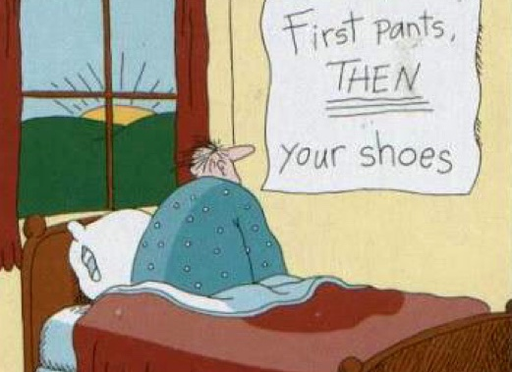
Takeaway
Sequence Matters
Notes:
The order in which students are taught matters, and it will impact their reading and writing abilities.

Slide 36

Most Phonics Programs Do This for Us!
Note: There isn’t a research base for one scope and sequence over the other—you just need to have one!
Notes:
****

Slide 37

Module 3: Connect to Practice Task –
Extended Online Discussion
Read and Respond to the following scenario:
Mr. Sanders approaches phonics instruction through differentiated instruction. Instead of whole group lessons, he uses the first 5 minutes of every guided reading group to teach phonics content that will help students approach the given text they are going to be reading. This way, he is individualizing phonics instruction.
What are the unintentional challenges that this approach might cause?
Notes:
There is only one task this week, and it is an extended online discussion. The scenario here represents one that we see frequently in the field. In fact, there are likely many of you taking this course who may identify with the fictional Mr. Sanders.
We’d like to engage in online discussion of the potential pitfalls of the approach described. This is a great opportunity for you to ask questions of your colleagues and dig into some of the challenges behind connecting research to practice. We plan to talk about what we read and hear in the online discussion during office hours and hope that we’ll wind up with some strong conversations.

Slide 38
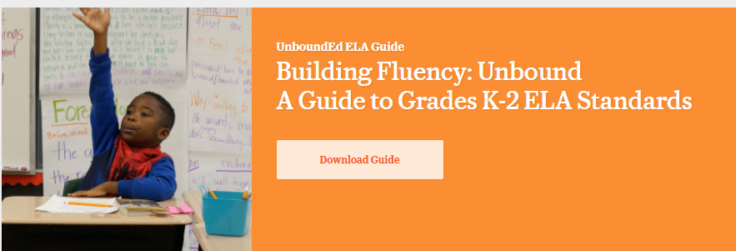
Recommended Reading
https://www.unbounded.org/content_guides/13/building-fluency-unbound-a-guide-to-grades-k-2-ela-standards

Slide 39



About Achieve the Core
Visit achievethecore.org to find:
Professional Learning Content
PD modules
Research
Aligned Blog
Tools for Planning and Reflection
Instructional Practice Toolkit
Instructional Practice Guide
Lesson Planning Tool
Focus Documents
Alignment rubrics and adaptation guidance
Classroom Resources
Math and ELA lessons
Mini-assessments
Writing resources
Coherence Map
Academic Word Finder

Slide 40
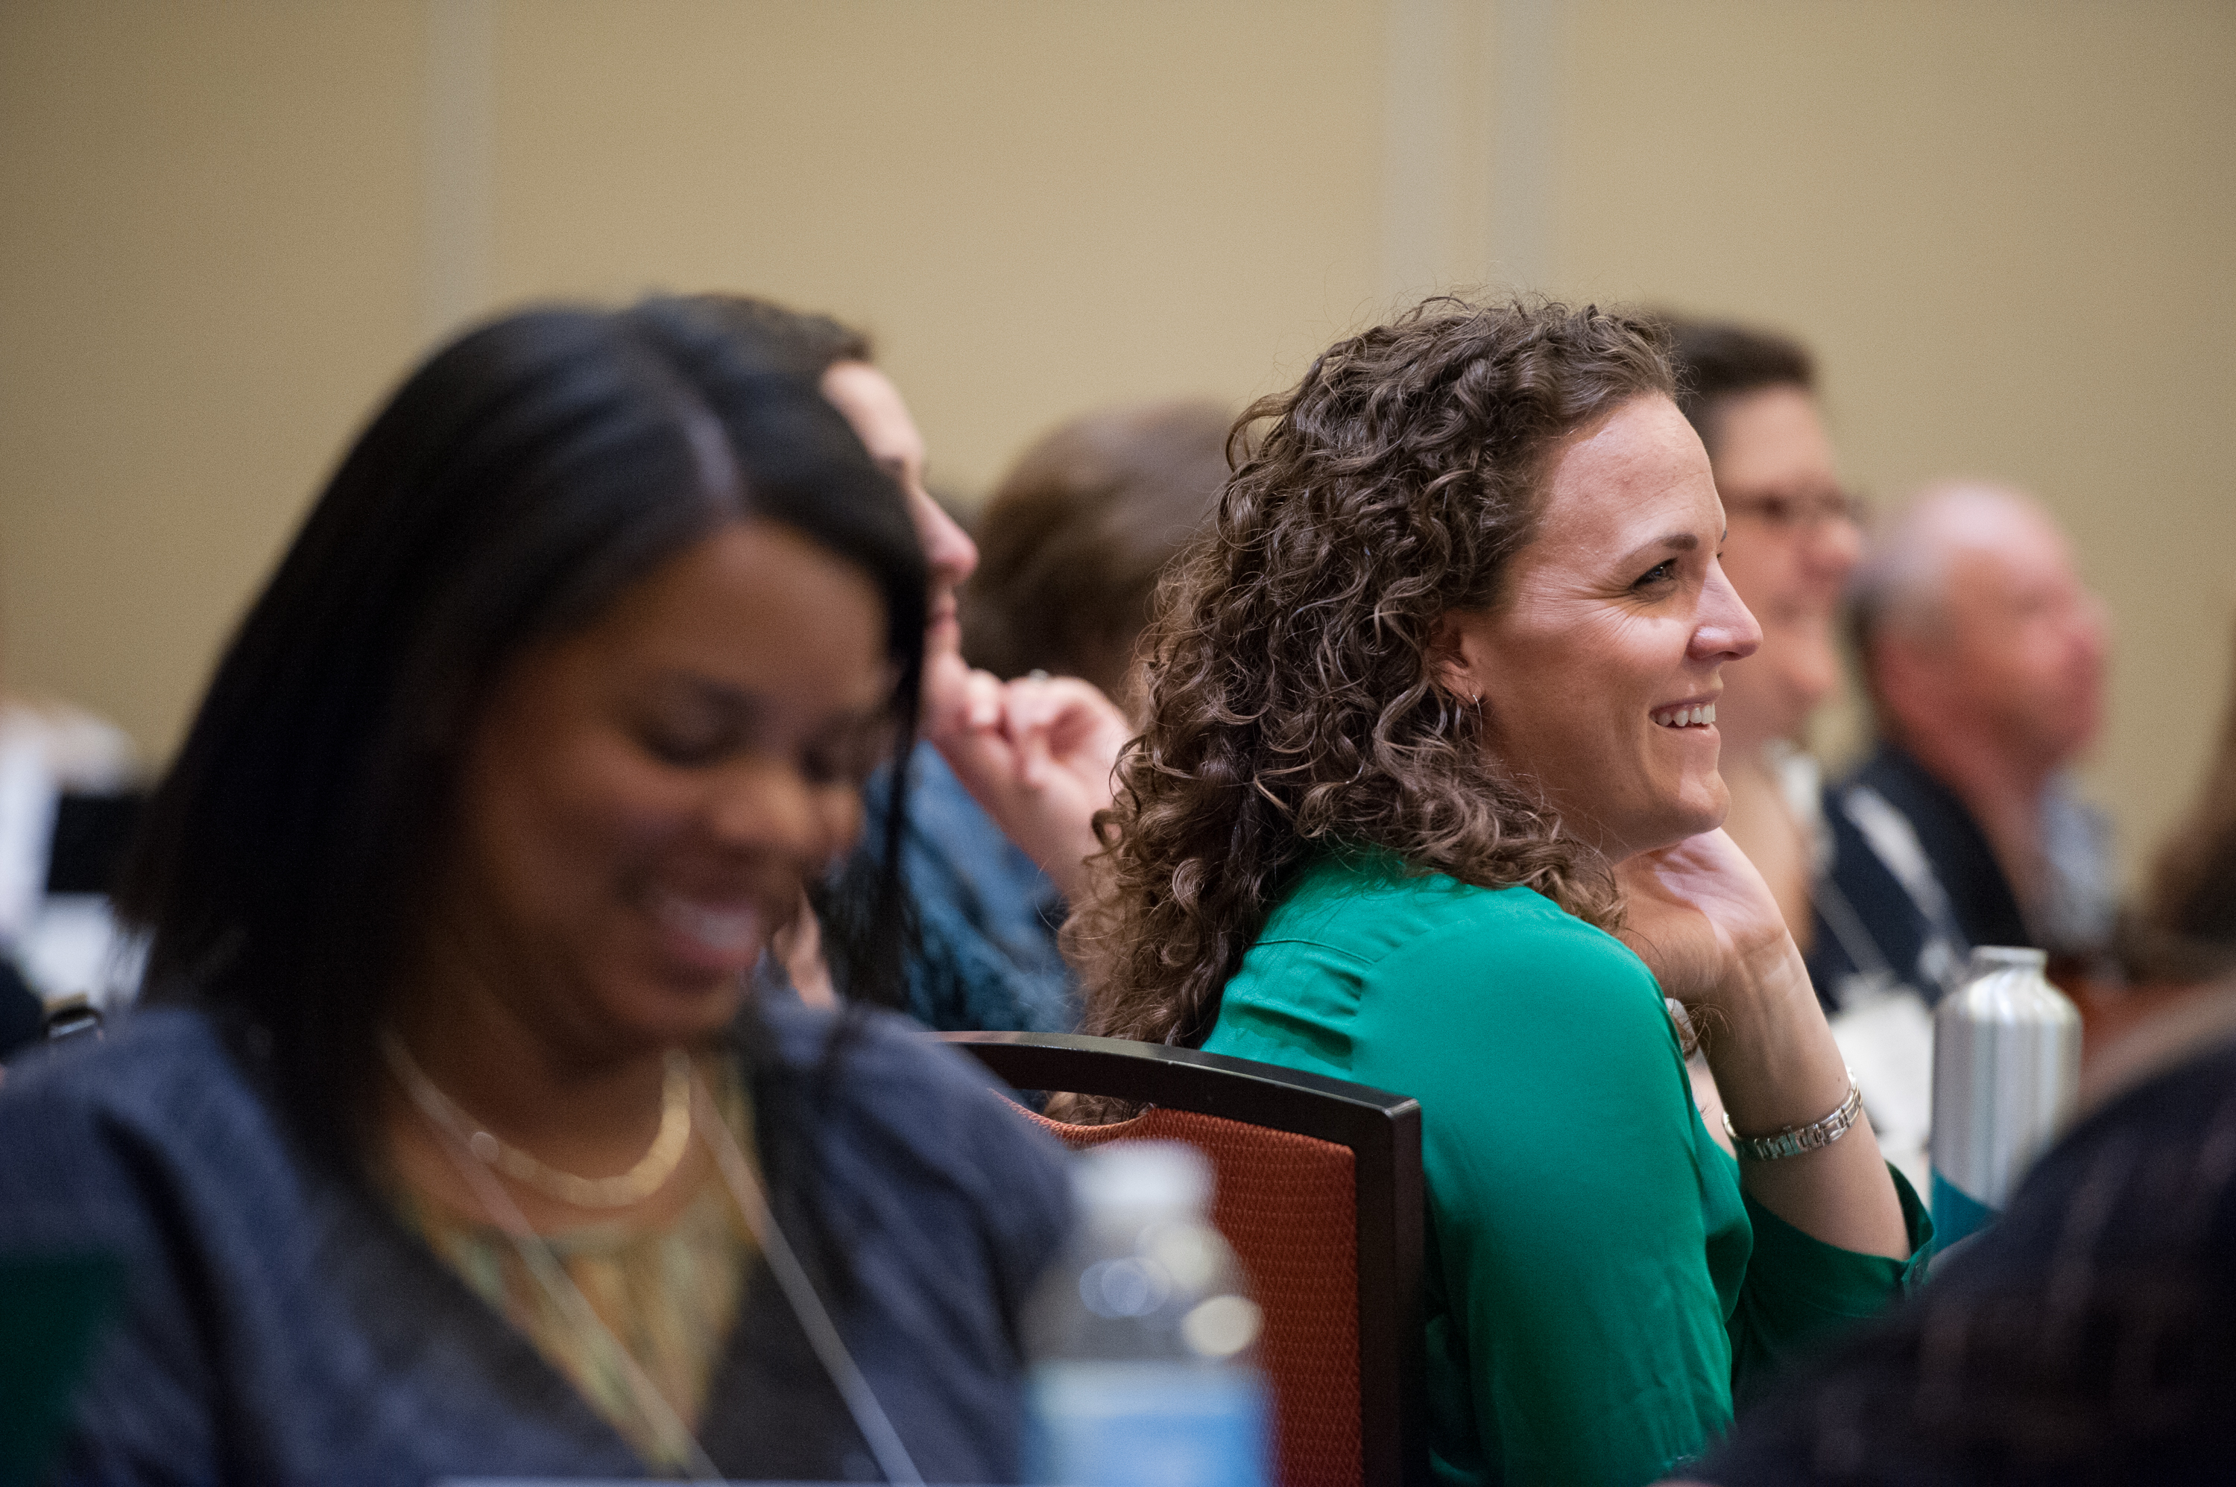
The Core Advocate Network
Who are the Core Advocates?
Core Advocates are educators who:
Believe in the potential of high-quality standards grounded in evidence to prepare all students for college and career.
Understand and embrace the Shifts in instruction and assessment required by college- and career-ready standards.
Are eager to support their colleagues and communities in understanding and translating the Shifts into instructional practice.
What do Core Advocates do?
As instructional advocates, Core Advocates lead other educators in their communities in understanding the Shifts, as well as sharing practices aligned to the Shifts and the standards. Among other actions, Core Advocates:
Lead professional development sessions and professional learning communities.
Create, refine, and share standards-aligned resources with the field.
Advocate for high-quality instruction, instructional resources, and professional learning.
Use and provide feedback on high-quality instructional tools and resources.
How can I get involved?
Join the Core Advocate Network by taking the Core Advocate survey at: www.achievethecore.org/ca-signup
Email coreadvocates@studentsachieve.net with any questions.

Slide 41




Stay Connected
Subscribe for email updates on achievethecore.org
Follow us on social media:
Facebook: facebook.com/achievethecore
Twitter: twitter.com/achievethecore
Pinterest: pinterest.com/achievethecore

Slide 42
Thank You!

