Slide 1
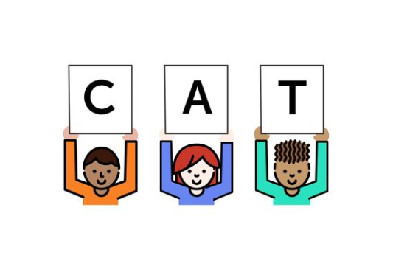
Foundational Skills Mini-Course
Module 5: Early Reading
Notes:
This module was last updated on April 2018.
Welcome back! Today we’re going to be looking closely at how all the work we’ve done so far connects to emergent reading

Slide 2


Course Instructors
David Liben,
Senior Content Specialist
Carey Swanson, ELA/Literacy Specialist

Slide 3
About Student Achievement Partners
Student Achievement Partners is a nonprofit organization dedicated to helping teachers and school leaders implement high-quality, college- and career-ready standards. We believe that challenging academic standards are the foundation for improved student outcomes, but that standards alone are not enough. Students will only make dramatic gains in achievement if instructional materials, assessments, and classroom practices are true to the expectations of high-quality, college- and career-ready standards.
Our work is grounded in research and evidence, and we are committed to sharing standards-aligned tools and practices freely with educators across the country. Our website, achievethecore.org, offers hundreds of math and literacy instructional resources for teachers and school leaders.

Slide 4
Goals for This Module
Identify how decodable readers support phonics skills acquisition.
Identify instructional recommendations for use, including the protocol for use of decodable readers.
Notes:
Here are our goals for this module.

Slide 5

Task Slide: Read This Text
Don and Maria went to the craft store. Maria was fluxeled. Where was the shiangle? She diddled and diddled but couldn’t find it. Finally, Don charteled. The shiangle was right up front by the whodilator. Problem solved!
Work together with your colleagues!
Discuss:
Do you have a sense of what happened?
Can you retell the short text?
How did you know how to read the nonsense words?
Notes:
We’re going to start immediately with a task: we going to take a minute to apply these ideas in context. Pause the webinar to read this text, and discuss with your colleagues or jot to yourself the answers to the questions in green.

Slide 6
Building Blocks of Reading
Gough’s “Simple View of Reading”
Vocabulary
Background Knowledge
Language Structures (Syntax)
Verbal Reasoning
Word Recognition and Decoding
Literacy Knowledge
Notes:
All of these were applied to your reading of that short text.
You likely relied heavily on language structures and syntax to determine the meaning of unfamiliar vocabulary.
There was likely some verbal reasoning as you substituted words you knew for those you didn’t, and you applied your background knowledge to the task.
Gough uses a visual that looks like the separate threads of a rope coming together in his “Simple View of Reading.” This visual is repeated throughout the Top Ten Reading Teachers’ Tools. The point that is made is that all of these strands work together in building a proficient reader. The simple view consists of:
Vocabulary: The words in the text, and the meaning behind those words. This, of course, gets more complex as the text complexity of a piece increases.
Background Knowledge: The knowledge a reader is bringing into a text. Note: we view this as a charge for teachers to simply build the knowledge base of our students, as we can’t control for their background.
Language Structures: The ability to make inferences, understand symbolic, or descriptive language, etc.
Literacy Knowledge: Understanding of print concepts, genre, and text structures
Word Recognition: Phonological awareness, decoding, and sight recognition needed in order to read written words.

Slide 7
Consider some of the words from the text. How were you able to read them?
Word Recognition and Decoding
Don and Maria went to the craft store. Maria was fluxeled. Where was the shiangle? She diddled and diddled but couldn’t find it. Finally, Don charteled. The shiangle was right up front by the whodilator. Problem solved!
Notes:
Let’s think about the bolded words here. Were these sight words? Had you memorized them? NO! But you could likely read them with automaticity. How?
Familiar blends and word parts
Decoding
Analogy to other familiar words

Slide 8
The Myth of “Memorized” Words
No words are actually recognized as wholes on sight!
Reading with automaticity is actually decoding so fast it appears instantaneous.
We can do this faster with familiar sound and spelling patterns– and build more the more we read!
the
which
frighten
shiangle
chaogue
Notes:
We actually know enough from studying eye movement to determine that words are not memorized and then recognized on sight. Reading that appears this way is actually happening so quickly it seems instantaneous.
Additionally, we are able to recognize high-frequency letter combinations more quickly than those that are infrequent. The more exposure readers have to sound and spelling patterns, the more they are able to retain new letter combos quickly.
Of the words on the left, you are likely having the hardest time decoding the last one. This is because it consists of two more uncommon letter combinations- ao and gue.

Slide 9
Teaching “High-Frequency Words”
Low-Frequency Words
thine
ire
gall
High-Frequency Words
the
are
at
Notes:
We DO want students to recognize words that appear frequently in texts.
These words can be taught as wholes: “t h e spells THE” This allows students to learn words that contain sound and spelling patterns not yet taught.
Students will become familiar with and recognize these words after exposure and practice. Combining high-frequency words and those that are decodable allows for students to read meaningful connected text that builds over time.
The term “sight word” is actually a bit misleading. Any word can be a sight word, once it is recognized on sight. However, only words that occur frequently in text are HFW. Sometimes these are decodable, like “at,” and other times they are recognizable, like “the.”

Slide 10
The Reading Process: the relationship between meaning, spelling, and phonics in print.

Slide 11
The Reading Process
Adams (1990)
Context Processor
Meaning Processor
Orthographic Processor
Phonological Processor
Print
Speech
Notes:
*****
This visual is adapted from Adams (1990) (pg. 138). It shows the reading process and the varied processors involved. As you can see, print feeds directly to the orthographic processor. Speech feeds to the phonological processor- which we’ve discussed at length. But there is a interplay between all of these parts. We’ll be looking more closely at how this works when readers interact with print.

Slide 12




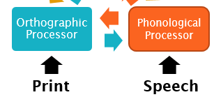
Processing Print:
Processing visual information on the page by using knowledge of individual letters and how letters work together to represent sounds.
The dog met a bat.
Processing spelling (orthography)
and pronunciation/sound (phonography)
Notes:
Let’s see this through eyes of a first grader reading a decodable text about a girl who is out exploring at night with her dog.
The orthographic processor is the only system that receives input from the printed page. This is the VISUAL processing and come before meaning/context.
Adapted from Adams (1990) pg. 138

Slide 13





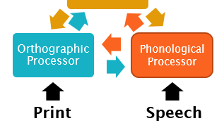
Meaning Processor:
Stores and accesses interconnected meanings of familiar words.
Meaning Processor
The dog met a bat.
Notes:
As the orthographic processor is processing the letters, the meaning processor is storing and accessing the meanings of familiar words. Adams explains that “the brain is simultaneously starting to fire up units representing word meanings. And as the visual information begins to resolve itself and settle in on fewer and fewer meaning candidates, they reciprocally send excitation back to the letter patterns they require.” Adams (1990), p. 137.
The word “dog” is connected to a collective representation of all the experiences with dogs: all the dogs the child has seen, what dogs do, what they eat, what other animals they hang out with etc. The more the child learns about the concept “dog,” the more flexible this meaning becomes.
Each word in the sentence is “excited” in this same way.
(Click for bat example)

Slide 14
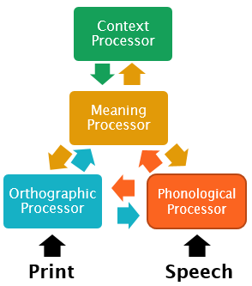
Context Processor:
Constructs a coherent, ongoing interpretation of text.
Previous sentence:
She went into a cave.
The dog met a bat.
Notes:
The context processor sends signals to the meaning processor based on what it expects from its ongoing interpretation of the text. The context processor sends a signal to the meaning processor that the dog meeting an animal bat makes more sense than the dog meeting a baseball bat. This is “compatible” with the reader’s ongoing interpretation of the text because in the story, the dog is out exploring at night. The previous sentence says, “She went into a cave” – so the concepts that have to do with caves are already primed in the system. The reader uses context to select the correct meaning of bat in this sentence.

Slide 15
Summarizing the Process
The dog met a bat.
Notes:
As you can see, there are so many complicated systems at work in reading even simple text! This process becomes more and more fluid as students read, learn new sounds, and read again.
We also know that students must be simultaneously building their knowledge and vocabulary at a much more sophisticated level. This is why the other side of this work for K-2 students must be building knowledge and vocabulary through the read aloud of complex text. Students need this to build up their knowledge bank, allowing them to make meaning and provide or follow context as their reading skill grows. By second grade, we want them to be able to read grade-level complex text with independence and proficiency.

Slide 16

It all starts with the visual processing of PRINT!
Notes:
But, to get there– it all starts with processing print!
Adapted from Adams (1990) pg. 138

Slide 17
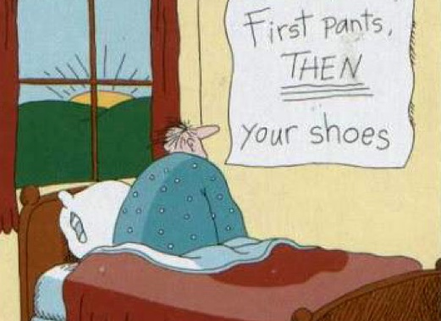
Takeaway from Phonics
Sequence Matters
Notes:
So, once again, we find that sequence matters.

Slide 18

We Know Sequence Matters…
but what should they be reading!?!
Notes:
Now that we’ve established this, let’s look at what it means for the materials in our young readers’ hands.

Slide 19

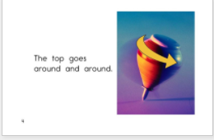

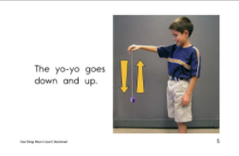
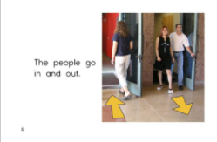
Let’s Compare Texts: Mid-Kindergarten
Leveled or Predictable
Decodable
Things move in many ways. The top goes around and around. The yo-yo goes down and up. The people go in and out.
Pat and Ted had lunch with Meg’s tots. Max got hash on his chin. Wes got hash on his bib. Tim’s milk is on Tom.
Notes:
In early grades, students are usually either reading what is referred to as a “leveled text” or a “decodable reader.” Let’s compare leveled texts to those that are decodable. You have these excerpts on your handout as well.
Details:
Text one is from Reading A-Z, Leveled text. It is listed as a Fountas and Pinnell Level C, placing it in the mid to end range of K according to F and P grade level requirements
Text two is from CKLA’s skills program for K, unit 7 placing it at mid to end of K (CKLA. Engage NY. Unit 7 Reader. Retrieved from https://www.engageny.org/resource/kindergarten-ela-skills-unit-7.)

Slide 20
So, why do so many early readers rely on context to aid their reading?

Slide 21



Early Readers Relying on Context
The dog ran to the forest.
Notes:
Contextual cues prove especially helpful for orthographically difficult words. The Context Processor gives us decoding assistance when we need it most. With early readers in leveled texts, picture cues support context and tend to have a strong correlation with unknown words.
So for early/less skilled readers, context has a much stronger effect on word identification. In this example, /f/ is known but /or/ might be an unfamiliar pattern. The reader can using his ongoing understanding of the text, including the picture, to help decode this unknown word. He may or may not give the correct word using this strategy (“The dog ran to the farm.”), but context steps in because the orthography is so challenging.
BUT overreliance on contextual cues should be a source of concern! This is a warning sign that children are not developing their understanding of sound and spelling patterns. We know that weak readers use context.

Slide 22
What happens when we rely on text that is NOT decodable?
Notes:
Let’s take a look at examples of leveled texts in the early grades.

Slide 23
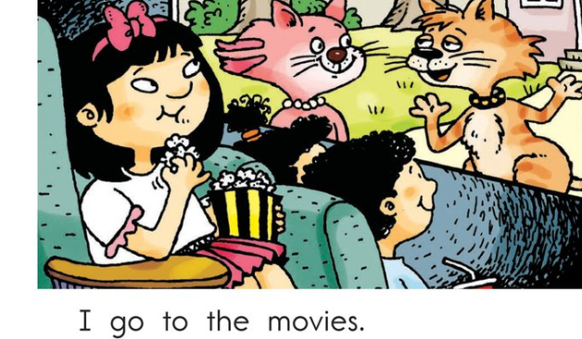
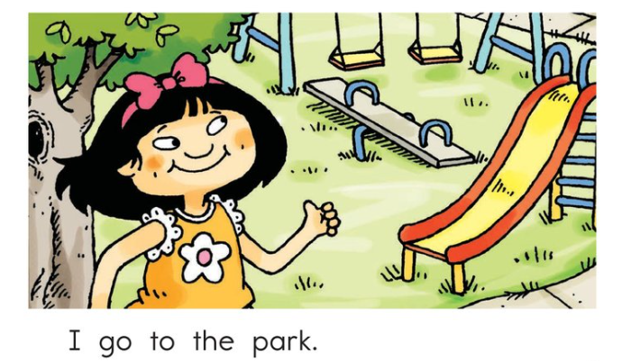
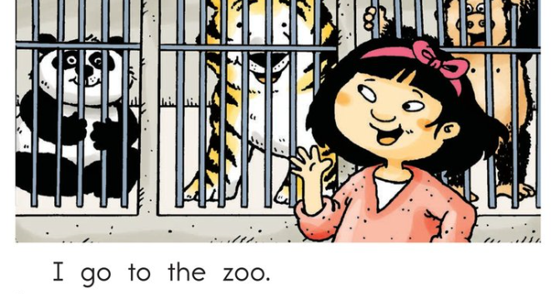

Level A: Early Kindergarten
High-Frequency Words
Picture Cue Words
Notes:
Here, we see a Level A text. When we analyze the words, thinking of familiar sight words and those that are clearly shown through picture cues, we can see how a young reader might be quite successful in reading this text.

Slide 24
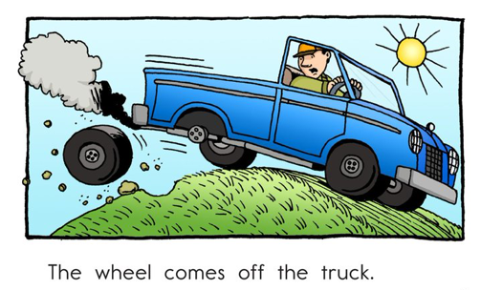
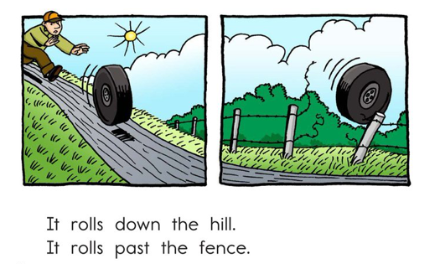
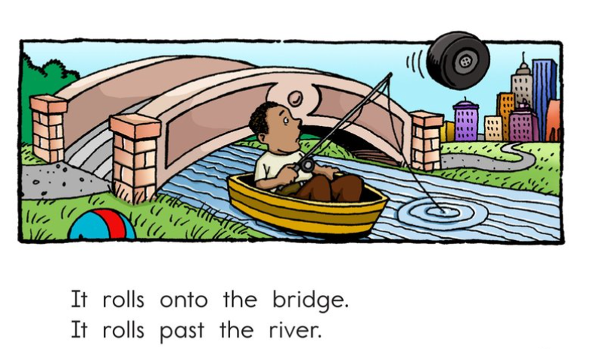
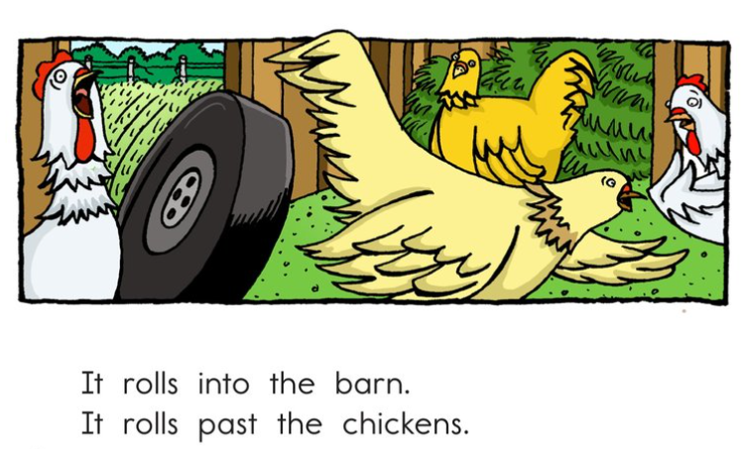
Level D: Late Kindergarten
High-Frequency Words
Picture Cue Words
Notes:
And in later kindergarten, students can do a decent job reading with high-frequency words and picture cues. With a supportive text introduction, a teacher could point out “rolls” and “past” and students could read with almost 100% accuracy.

Slide 25
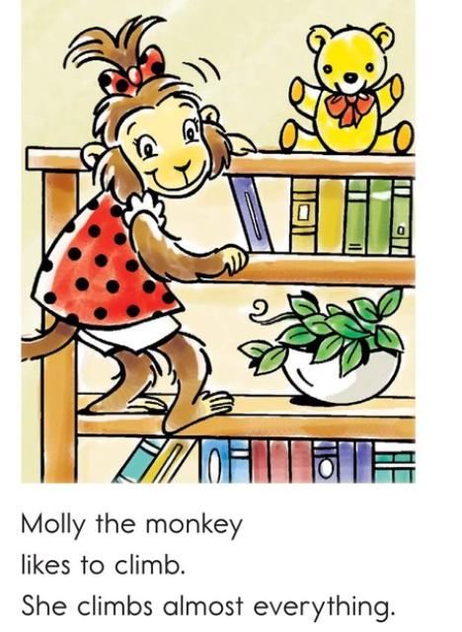
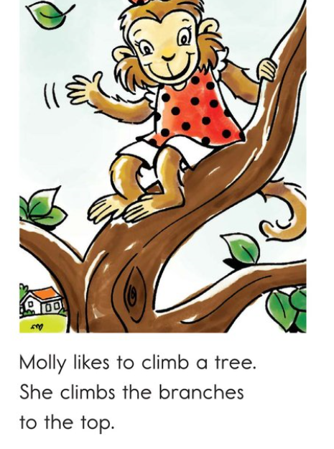
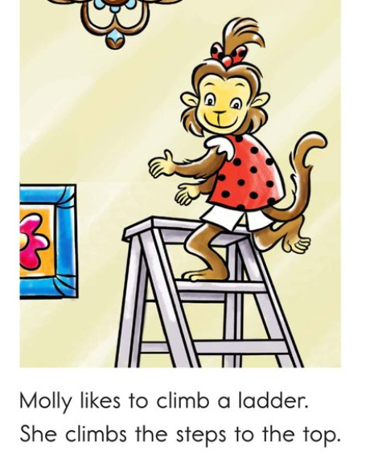
Level F: Early 1st Grade
High-Frequency Words
Picture Cue Words
Notes:
As our texts get more complicated, however, this will start to fail them. Students who have been successful reading using picture cues and words they already know may start guessing randomly when they get to words they don’t know. They may be successful using context and meaning, and may end up with “climb” in this example. However, it unlikely that they are learning the sound and spelling patterns this way.

Slide 26

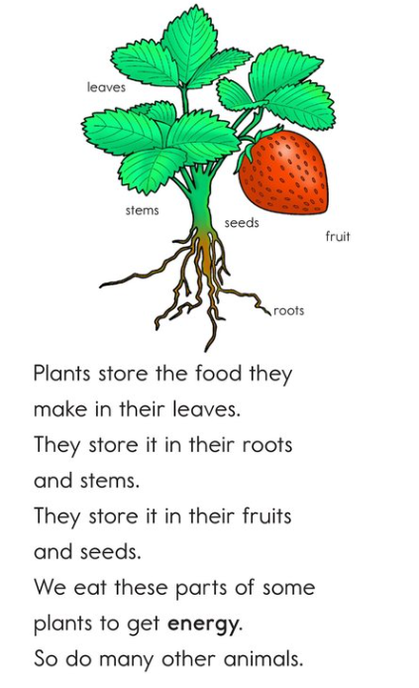
Level J: Late 1st Grade
High-Frequency Words
Picture Cue Words
Notes:
And as texts progress, even if students have been taught systematic phonics, they have not had to use their decoding skills.

Slide 27
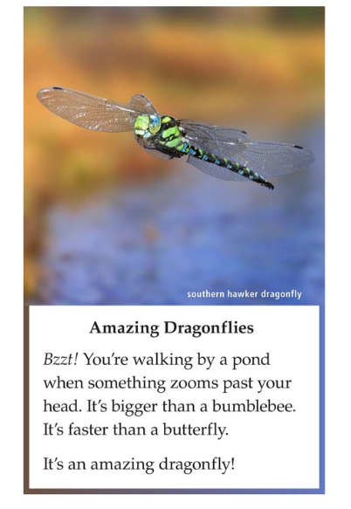
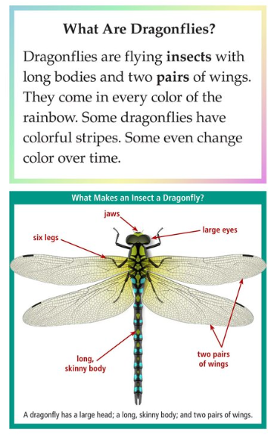
Level L: Mid 2nd Grade
High-Frequency Words
Picture Cue Words
Notes:
This makes this important skill– one that we’ve established proficient readers use– less developed, simply based on the materials they were reading successfully in K and early 1st grade.

Slide 28
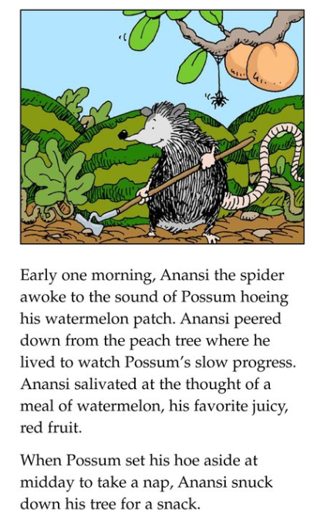
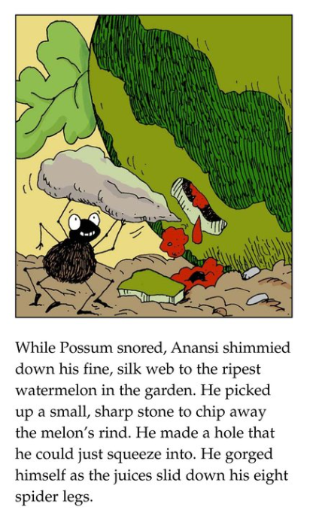
Level O: Mid 3rd Grade
High-Frequency Words
Picture Cue Words
Notes:
By the time they get to 3rd grade, this becomes a real problem.
Perhaps some of you have heard teachers lament, “They did fine in the early grades, but lost it all when they got to 3rd grade!”

Slide 29
They lost it all in 3rd grade!!!
Notes:
*****
David- focus group

Slide 30

Reading decodable text supports students as they learn to read
…and helps develop a habit to use the phonics they’re learning.
The Materials We Use MATTER
Notes:
Here is a key takeaway: materials matter in developing the habits of our early readers.
Decodable texts actually ARE supportive of students!
If a predictable text doesn't require students to use print to decode words, they won't develop that habit.
If they don't develop that habit, they won't use print as texts become more complicated. However, this strategy will not work and won't allow them to be successful as materials become more challenging. Students need materials that support their habits as skillful readers.

Slide 31
Let’s Compare Texts…
Leveled or Predictable
Heavy use of high-frequency words.
Relies on repetition and/or context.
Often relies on picture for meaning.
Some use of first letter sound.
Some dependence on syntax.
Many words that aren’t decodable/don’t match instruction.
Which text is likely to solidify students’ foundational skills? Why?
Decodable
Includes only previously taught skills, such as:
  High-frequency words
  Current sound and spelling patterns
  Previously taught sound and spelling patterns
Does not heavily rely on pictures, context, or repetition.
Notes:
Again, let’s go back to comparing texts. Which type of text is likely to solidify students foundational skills, and why? Allow some discussion. (Answer: decodable texts reinforce taught phonic patterns and will better serve students in the long run)

Slide 32
Decodable Reader Protocols
Multiple Reads Protocol
Comprehension Questions
Foundational Skills Games and Tasks
Notes:
Pause now to read the Decodables protocol and the sample text from McGraw Hill’s Wonders program that we’ve included in your materials.
Many programs include decodable readers, but many fall short in terms of guidance around how to get the most out of these resources.

Slide 33
Decodable Reader Protocol
Teacher reads, student follow
Independent
Buddy
Choral
Echo
Least Support
Most Support
Read | Suggestion
1st | Choral or Echo
2nd | Independent or Buddy
3rd | Choral or Echo
4th | Independent or Buddy
Later | Foundational Skills Games/Activities
Notes:
As you can see, the protocol ensures that students are getting multiple reads of each decodable text. Teacher is LISTENING in on reads and adjusting support as necessary.

Slide 34
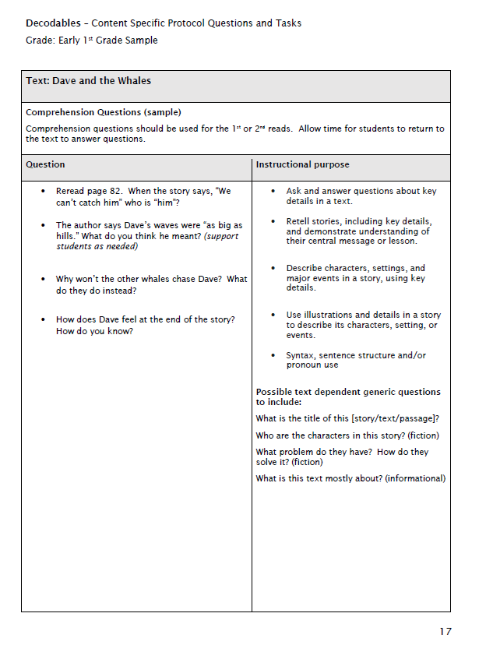
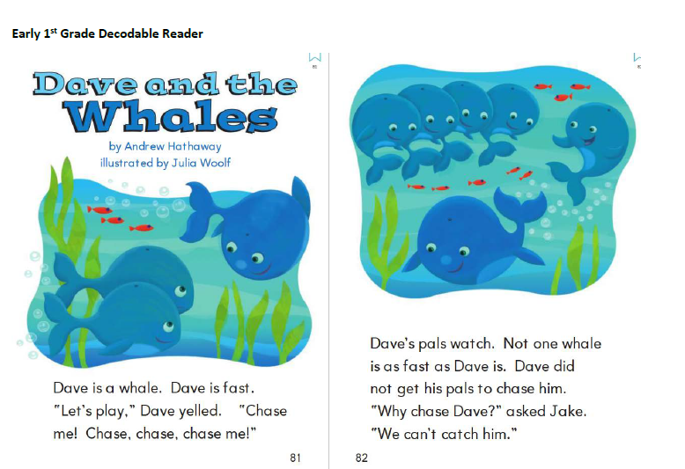
Decodable Reader Questions and Tasks
Notes:
The sample we provided helps to illustrate how the varied reads and associated tasks work. As an aside, if you are a user of the Journeys curriculum, we’ve built out multiple text specific samples for kindergarten and first grade. You can find these resources on Achieve the Core in the materials alignment section, or by typing “journeys’ in the search bar.

Slide 35
Decodable Text Can Be Used to….
Reinforce Comprehension:
Reinforce the connection to making meaning through comprehension questions.
Secure Phonics and High-Frequency Words:
Revisit the text to apply previously taught skills to text through fun tasks and games.
Notes:
This allows decodable readers to serve dual purposes. We want to ensure that students are always making meaning from reading, and comprehension questions support this.

Slide 36

Decodable Texts Provide MANY Opportunities for Practice!
Manipulate or substitute phonemes.
Identify high-frequency words.
Interacting with a current or former sound and spelling pattern.
HIGH ENGAGEMENT
Foundational Skills Games and Tasks
Notes:
At the same time, we recognize that the true value of the readers lies in the strategic use of sound and spelling patterns and high-frequency words. So, we suggest drawing students’ attention to this through fun and engaging tasks and games that can happen after reading for meaning.

Slide 37
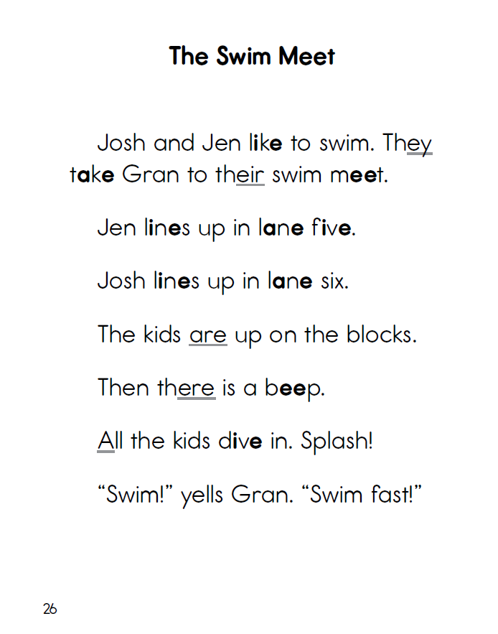
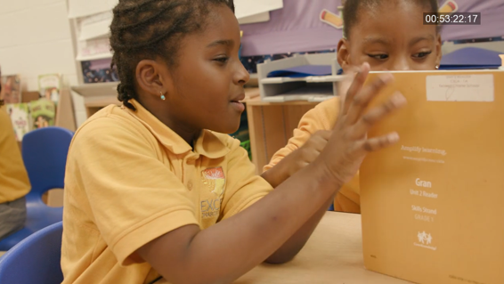
In Context Practice
Decodable Readers with /ie/
Text: Core Knowledge Language Arts
Access the video at https://vimeo.com/254521492
Notes:
Let’s take a quick look at this skill development. Here, we have students working on reading text after learning the long i spelling i_e. You’ll hear this challenge these readers as they are attempting to decode words using the new sound.
Access the video at: https://vimeo.com/254521492

Slide 38
Decodable Reader Protocol
Teacher reads, student follow
Independent
Buddy
Choral
Echo
Least Support
Most Support
Read | Suggestion
1st | Choral or Echo
2nd | Independent or Buddy
3rd | Choral or Echo
4th | Independent or Buddy
Later | Foundational Skills Games/Activities
Notes:
This protocol can be used flexibly in the classroom, based on student needs. We’ll show you this on the next slide.

Slide 39



What/Where/When/How!?!
Use decodables with ALL students
(whole group)
Small and Flexible groups
Got it!
Read the decodable 1 more time to ensure mastery
Move to other text
Shaky
Additional Skills practice
Reread decodables
Not there yet
EXTRA skills practice
EXTRA decodable work (old + current)
Notes:
Getting to the nitty gritty here—let’s review exactly how we suggest using decodable readers in the classroom.

Slide 40

Online Discussion
What is exciting about enhancing the use of decodable readers in the classroom?
What (if anything) is concerning about it?
Notes:
We’d like to ask you to engage in an online discussion about the use of decodable readers. Please push us, and push your colleagues, to think about this deeply.
In our registration survey, we asked you all about your use of decodables, and found a huge range– some people never use them, some occasionally, and some with frequency.
For those of you who don’t use them, we hope we have made a compelling case about their value, and would like to see you discuss what is exciting. At the same time, if you still have concerns, we’d like to be aware of them and will do our best to address them via office hours. Please share freely in your discussion.

Slide 41

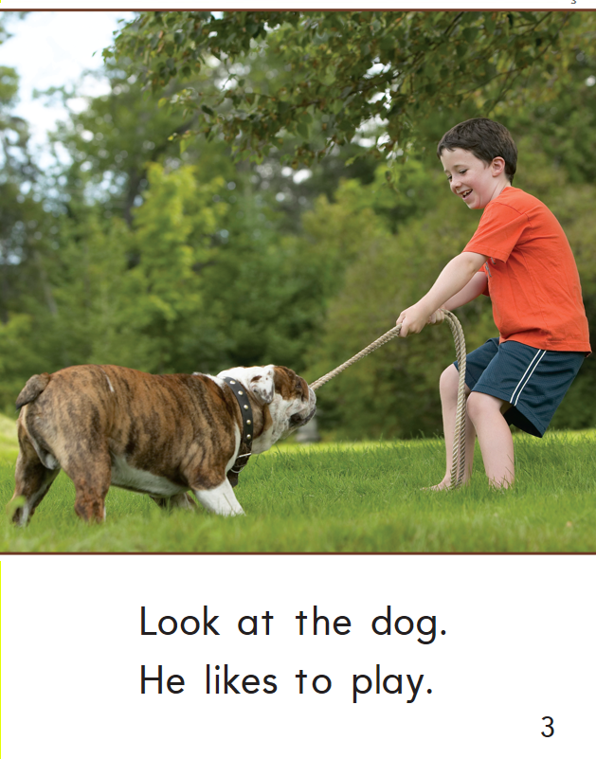
Connecting to All Reading
Source: Journey’s – Houghton Mifflin Harcourt
Notes:
So, what do we do when kids are NOT reading decodable text? How can we still encourage them to use the phonics they know, while supporting them in reading uncontrolled text?
For example, this first grader who gets to the word play might say /p/, /l/, /a/, /y/. What should we do!?

Slide 42
Connecting to All Reading
Preview the texts with your phonics scope and sequence in mind.
  Are there opportunities to reinforce what students have learned, and are learning?
Support students with decoding using sound and spelling patterns they know! And, hold them accountable for these.
Preview new sound and spelling patterns as they come up.
Notes:
Big Idea: You can support phonics while using ANY text – Leveled Readers, environmental print, Reader’s Workshop texts.
Notes:
Keep your current sound spelling patterns in mind – don’t miss an opportunity to point these patterns out anytime you can! (ex: while reading a Shared Read, “Oh! I heard a word with this week’s /m/ sound on this page. Can you find it?”
Even when words are not yet decodable with learned spelling patterns, focus on encouraging students to use what they know while solving words.
And, when learned skills does not yet allow children to access parts of words – teach them as wholes. (ex: in early K, there are no learned sounds in “through”)

Slide 43
Preview New Sound and Spelling Patterns
Word | Known/ Unknown Content | Teacher Support
hide | /h/, /d/ and short /i/ are known CVCe is unknown | “I hear you saying the h sound and the d sound, good. Those sounds are in this word. This word is hide. We don’t say /e/ for the e – that letter doesn’t make any sound in this word…”
where | /wh/, /r/ is known, along with short e and CVCe “where” is not yet a high-frequency word | “This is a tricky word because it doesn’t follow rules. Let’s start it out – what does /wh/ sound like? That’s right. And I heard some of you saying “her” and some of you saying “here”. We start with the /wh/ sound for this word, and we’ll hear the /r/ near the end, but we say this word like this… You say it.”
Notes:
You can use high-frequency words and known sound/spelling patterns to help children learn to decode new words.
In one study, children were taught high-frequency words, such as long, can, and her, either with relatively little attention to the letter–sound relationships within them or with extensive analysis of their letter–sound relationships (Ehri, Satlow, & Gaskins, 2009). Children taught the words with full graphophonemic analysis were better able earlier on to analogize from those words to new words—for example to say, “If I know long, then I know strong.’’
Here are just a couple of examples of what you might do when facing a new sound/spelling pattern in a text.

Slide 44

Module 5: Connect to Practice Task
For all participants
Pull a leveled reader in the grade band you teach, or at random if you span multiple grades.
Analyze 1-3 pages: What varied sound and spelling patterns are included in the words in the reader?
Don’t have texts?
Pull a text from Reading A-Z.
Notes:
This week we are going to ask you to look closely at leveled readers, and analyze the words found in 1-3 pages. This should help reinforce what we’ve been discussing as it relates to phonics and early reading. A template is provided for you.

Slide 45

Recommended Reading
Research that goes deeper:
Decodable Text: Why, When, and How? by Marilyn Jager Adams
The Influence of Basal Readers on First Grade Reading by Connie Juel and Diane Roper/Schneider
A light lift:
http://www.shanahanonliteracy.com/blog/kids-need-to-read-within-instruction#sthash.fk4JDhGv.dpbs

Slide 46



About Achieve the Core
Visit achievethecore.org to find:
Professional Learning Content
PD modules
Research
Aligned Blog
Tools for Planning and Reflection
Instructional Practice Toolkit
Instructional Practice Guide
Lesson Planning Tool
Focus Documents
Alignment rubrics and adaptation guidance
Classroom Resources
Math and ELA lessons
Mini-assessments
Writing resources
Coherence Map
Academic Word Finder

Slide 47

The Core Advocate Network
Who are the Core Advocates?
Core Advocates are educators who:
Believe in the potential of high-quality standards grounded in evidence to prepare all students for college and career.
Understand and embrace the Shifts in instruction and assessment required by college- and career-ready standards.
Are eager to support their colleagues and communities in understanding and translating the Shifts into instructional practice.
What do Core Advocates do?
As instructional advocates, Core Advocates lead other educators in their communities in understanding the Shifts, as well as sharing practices aligned to the Shifts and the standards. Among other actions, Core Advocates:
Lead professional development sessions and professional learning communities.
Create, refine, and share standards-aligned resources with the field.
Advocate for high-quality instruction, instructional resources, and professional learning.
Use and provide feedback on high-quality instructional tools and resources.
How can I get involved?
Join the Core Advocate Network by taking the Core Advocate survey at: www.achievethecore.org/ca-signup
Email coreadvocates@studentsachieve.net with any questions.

Slide 48




Stay Connected
Subscribe for email updates on achievethecore.org
Follow us on social media:
Facebook: facebook.com/achievethecore
Twitter: twitter.com/achievethecore
Pinterest: pinterest.com/achievethecore

Slide 49
About Achieve the Core
Visit achievethecore.org to find:
Professional Learning Content
PD modules
Research
Aligned Blog
Tools for Planning and Reflection
Instructional Practice Toolkit
Instructional Practice Guide
Lesson Planning Tool
Focus Documents
Alignment rubrics and adaptation guidance
Classroom Resources
Math and ELA lessons
Mini-assessments
Writing resources
Coherence Map
Academic Word Finder

Slide 50
The Core Advocate Network
Who are the Core Advocates?
Core Advocates are educators who:
Believe in the potential of high-quality standards grounded in evidence to prepare all students for college and career.
Understand and embrace the Shifts in instruction and assessment required by college- and career-ready standards.
Are eager to support their colleagues and communities in understanding and translating the Shifts into instructional practice.
What do Core Advocates do?
As instructional advocates, Core Advocates lead other educators in their communities in understanding the Shifts, as well as sharing practices aligned to the Shifts and the standards. Among other actions, Core Advocates:
Lead professional development sessions and professional learning communities.
Create, refine, and share standards-aligned resources with the field.
Advocate for high-quality instruction, instructional resources, and professional learning.
Use and provide feedback on high-quality instructional tools and resources.
How can I get involved?
Join the Core Advocate Network by taking the Core Advocate survey at: www.achievethecore.org/ca-signup
Email coreadvocates@studentsachieve.net with any questions.

Slide 51
Stay Connected
Subscribe for email updates on achievethecore.org
Follow us on social media:
Facebook: facebook.com/achievethecore
Twitter: twitter.com/achievethecore
Pinterest: pinterest.com/achievethecore

Slide 52
Thank You!

