Slide 1
Math Modeling Myths
Core Advocates Monthly Webinar
February 7, 2018
The webinar will begin shortly. You may wish to download the handouts (check the tab on your webinar control panel) while you wait.

Slide 2
Introductions
Your hosts from the Field Impact Team
Lynda Nguyen, Team Coordinator
Jennie Beltramini, Teacher Engagement Manager
Janelle Fann, Project Manager
Sandra Alberti, Director
Joanie Funderburk, Manager of Professional Learning
This Month’s Guests -
Sarah Galasso, Core Advocate
Amy Spies, Core Advocate
Karen McPherson, Core Advocate

Slide 3
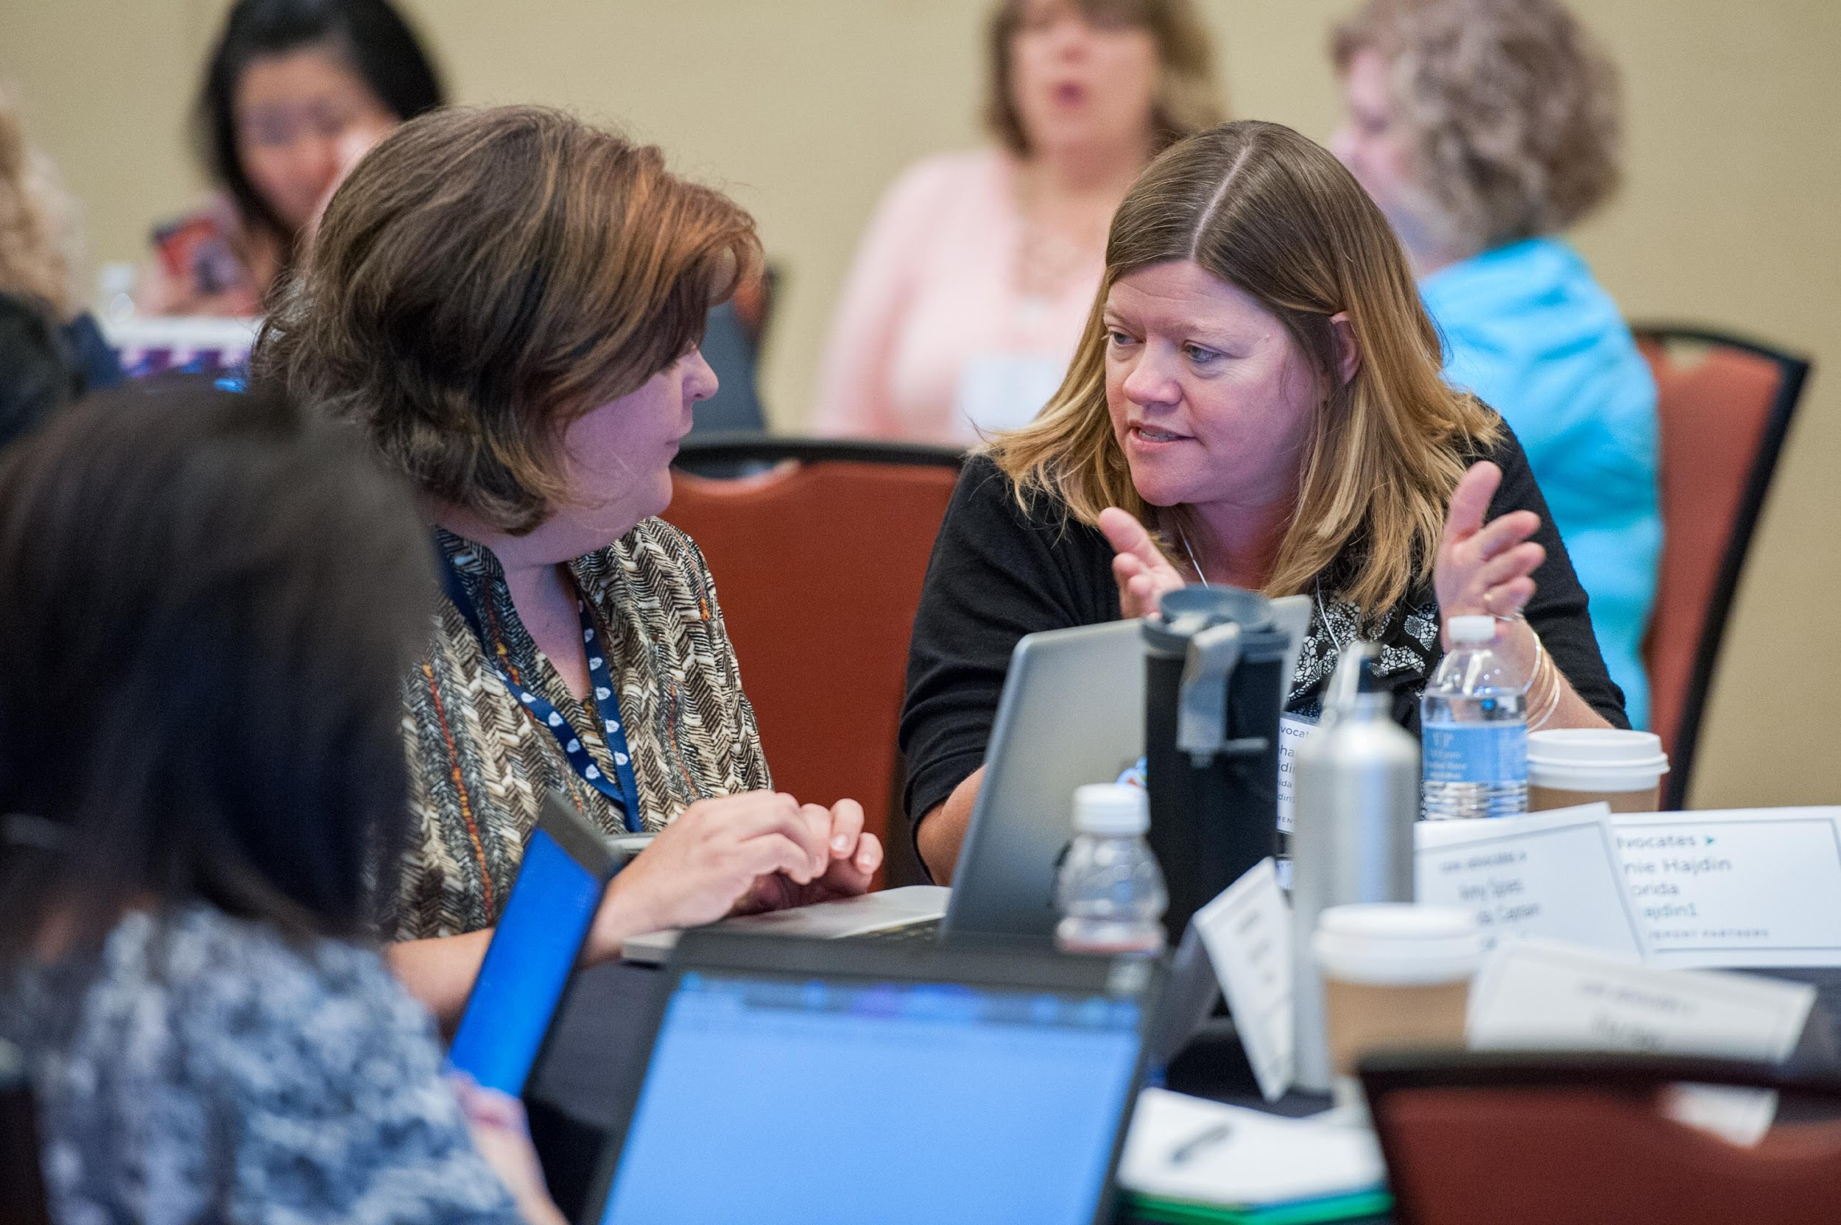
Who are Core Advocates?
Core Advocates are educators who:
  Believe in the potential of high-quality standards to prepare all students for college and careers;
  Are eager to support their colleagues and communities in understanding and advocating for the college- and career-ready standards, and standards-aligned instruction;
  Understand and embrace the Shifts in instruction and assessment required by the college- and career-ready standards

Slide 4

Learn more about us!
Contact Jennie Beltramini (jbeltramini@studentsachieve.net ) or Joanie Funderburk (jfunderburk@studentsachieve.net)
Complete your Core Advocate Profile: www.achievethecore.org/ca-signup
Visit our website: www.achievethecore.org

Slide 5

Tweet with us!
Please feel free to tweet during and after the webinar using #coreadvocates
@achievethecore
@JoanieFun, @salberti, @JennieBeltro,@SarahGMath, @auspies, @nc_teach

Slide 6

Engage with us!
During the webinar
– Accessing Documents
– Questions option
– Polling
After the webinar
– Survey
– Access to recorded webinar

Slide 7
Goals of the webinar
Build a better understanding of what it means to “Model with Mathematics;”
Develop an understanding of the progression of mathematical modeling across grade levels;
Hear how educators are using these ideas in their classrooms.

Slide 8
Section 1: What is meant by “Model with mathematics?”

Slide 9
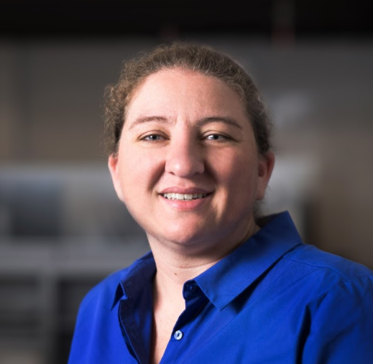
Sarah Galasso
Manager of School Partnerships, Carnegie Learning
Anaheim, CA

Slide 10
Question:
What do you think of when you hear the word “model?”
Please use the Questions tab on your control panel to respond.

Slide 11
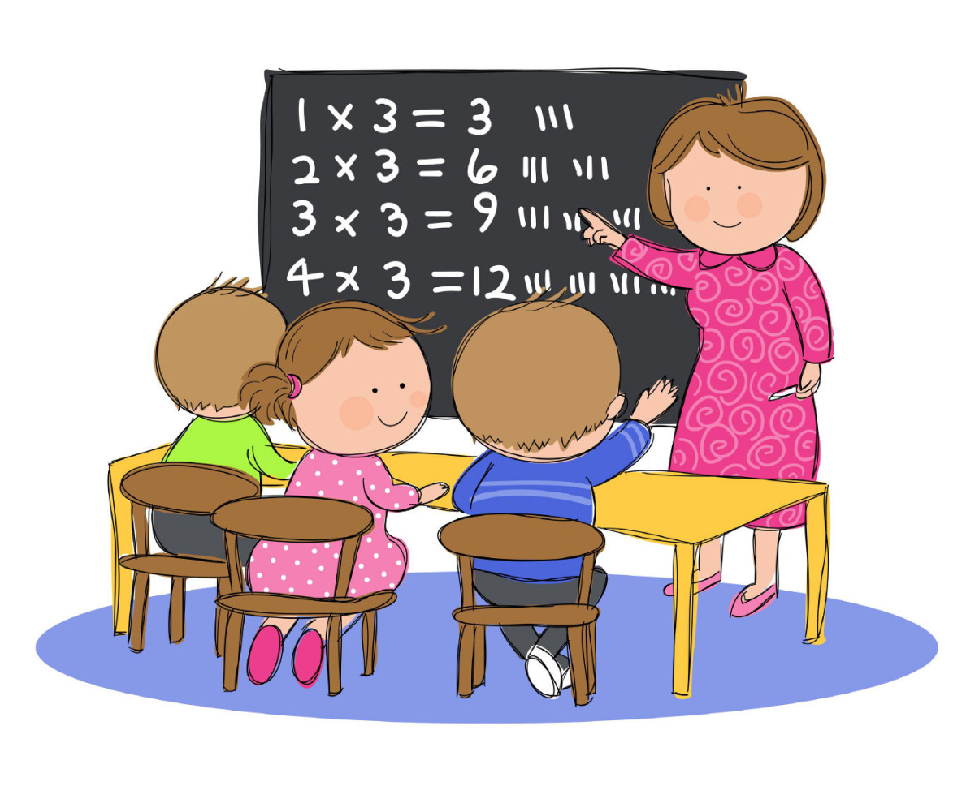
Modeling - A word with different meanings
In math, it could mean:
an instructional strategy where students are shown how to solve a task or do something.

Slide 12
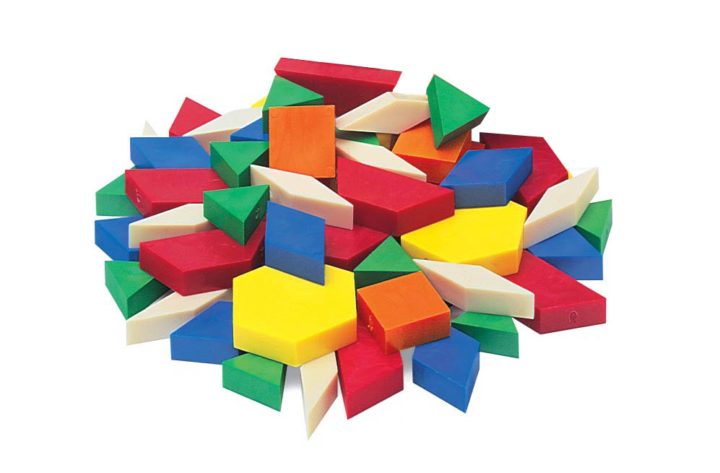
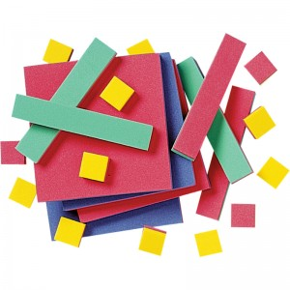
Modeling - A word with different meanings
In math, it could mean:
using manipulatives to represent a math situation.

Slide 13
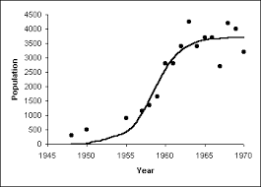
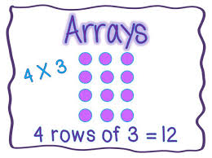
Modeling - A word with different meanings
In math, it could mean:
creating a representation (or “model”) of a math situation.

Slide 14
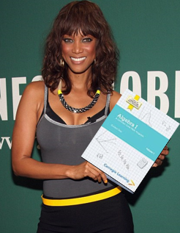
Modeling - A word with different meanings
In math, it could mean:
a (super) model, with mathematics

Slide 15
Tonight we are talking about this one!
In math, it could mean:
an instructional strategy where students are shown how to solve a task or do something.
using manipulatives to represent a math situation.
creating a representation (or “model”) of a math situation.
a (super)model with mathematics
Model with mathematics: use math to model the world, instead of using the world to model the math.

Slide 16
These examples are NOT Modeling with Mathematics
A 500 gallon fish tank is emptied at a rate of 20 gallons per minute. Sketch a graph to model this scenario.
Use an array to model the following multiplication problem:
5 x 7 = ____

Slide 17
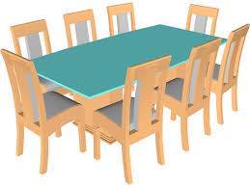
This example illustrate Modeling with Mathematics
Jane wants to host a party for 18 people. She wants everybody to sit at the same rectangular table. Each person needs 2 feet of space at the table to sit and eat comfortably. Jane is asking for your help to design the table.
  What would be the perimeter of the table?
  What dimensions could you use for the design of the table?

Slide 18
Math Practice 4: Model with Mathematics
Mathematically proficient students can apply the mathematics they know to solve problems arising in everyday life, society, and the workplace. In early grades, this might be as simple as writing an addition equation to describe a situation. In middle grades, a student might apply proportional reasoning to plan a school event or analyze a problem in the community. By high school, a student might use geometry to solve a design problem or use a function to describe how one quantity of interest depends on another. Mathematically proficient students who can apply what they know are comfortable making assumptions and approximations to simplify a complicated situation, realizing that these may need revision later. They are able to identify important quantities in a practical situation and map their relationships using such tools as diagrams, two-way tables, graphs, flowcharts and formulas. They can analyze those relationships mathematically to draw conclusions. They routinely interpret their mathematical results in the context of the situation and reflect on whether the results make sense, possibly improving the model if it has not served its purpose.

Slide 19
Math Practice 4: Model with Mathematics
Mathematically proficient students can apply the mathematics they know to solve problems arising in everyday life, society, and the workplace. In early grades, this might be as simple as writing an addition equation to describe a situation. In middle grades, a student might apply proportional reasoning to plan a school event or analyze a problem in the community. By high school, a student might use geometry to solve a design problem or use a function to describe how one quantity of interest depends on another. Mathematically proficient students who can apply what they know are comfortable making assumptions and approximations to simplify a complicated situation, realizing that these may need revision later. They are able to identify important quantities in a practical situation and map their relationships using such tools as diagrams, two-way tables, graphs, flowcharts and formulas. They can analyze those relationships mathematically to draw conclusions. They routinely interpret their mathematical results in the context of the situation and reflect on whether the results make sense, possibly improving the model if it has not served its purpose.

Slide 20
Math Practice 4: Model with Mathematics
Mathematically proficient students can apply the mathematics they know to solve problems arising in everyday life, society, and the workplace. In early grades, this might be as simple as writing an addition equation to describe a situation. In middle grades, a student might apply proportional reasoning to plan a school event or analyze a problem in the community. By high school, a student might use geometry to solve a design problem or use a function to describe how one quantity of interest depends on another. Mathematically proficient students who can apply what they know are comfortable making assumptions and approximations to simplify a complicated situation, realizing that these may need revision later. They are able to identify important quantities in a practical situation and map their relationships using such tools as diagrams, two-way tables, graphs, flowcharts and formulas. They can analyze those relationships mathematically to draw conclusions. They routinely interpret their mathematical results in the context of the situation and reflect on whether the results make sense, possibly improving the model if it has not served its purpose.

Slide 21
Math Practice 4: Model with Mathematics
Mathematically proficient students can apply the mathematics they know to solve problems arising in everyday life, society, and the workplace. In early grades, this might be as simple as writing an addition equation to describe a situation. In middle grades, a student might apply proportional reasoning to plan a school event or analyze a problem in the community. By high school, a student might use geometry to solve a design problem or use a function to describe how one quantity of interest depends on another. Mathematically proficient students who can apply what they know are comfortable making assumptions and approximations to simplify a complicated situation, realizing that these may need revision later. They are able to identify important quantities in a practical situation and map their relationships using such tools as diagrams, two-way tables, graphs, flowcharts and formulas. They can analyze those relationships mathematically to draw conclusions. They routinely interpret their mathematical results in the context of the situation and reflect on whether the results make sense, possibly improving the model if it has not served its purpose.

Slide 22
Math Practice 4: Model with Mathematics
Mathematically proficient students can apply the mathematics they know to solve problems arising in everyday life, society, and the workplace. In early grades, this might be as simple as writing an addition equation to describe a situation. In middle grades, a student might apply proportional reasoning to plan a school event or analyze a problem in the community. By high school, a student might use geometry to solve a design problem or use a function to describe how one quantity of interest depends on another. Mathematically proficient students who can apply what they know are comfortable making assumptions and approximations to simplify a complicated situation, realizing that these may need revision later. They are able to identify important quantities in a practical situation and map their relationships using such tools as diagrams, two-way tables, graphs, flowcharts and formulas. They can analyze those relationships mathematically to draw conclusions. They routinely interpret their mathematical results in the context of the situation and reflect on whether the results make sense, possibly improving the model if it has not served its purpose.

Slide 23
Math Practice 4: Model with Mathematics
Mathematically proficient students can apply the mathematics they know to solve problems arising in everyday life, society, and the workplace. In early grades, this might be as simple as writing an addition equation to describe a situation. In middle grades, a student might apply proportional reasoning to plan a school event or analyze a problem in the community. By high school, a student might use geometry to solve a design problem or use a function to describe how one quantity of interest depends on another. Mathematically proficient students who can apply what they know are comfortable making assumptions and approximations to simplify a complicated situation, realizing that these may need revision later. They are able to identify important quantities in a practical situation and map their relationships using such tools as diagrams, two-way tables, graphs, flowcharts and formulas. They can analyze those relationships mathematically to draw conclusions. They routinely interpret their mathematical results in the context of the situation and reflect on whether the results make sense, possibly improving the model if it has not served its purpose.

Slide 24
Poll:
Which of the statements describe modeling as meant by Math Practice #4?

Slide 25
Section 2: How does modeling with mathematics look different at different grades?

Slide 26
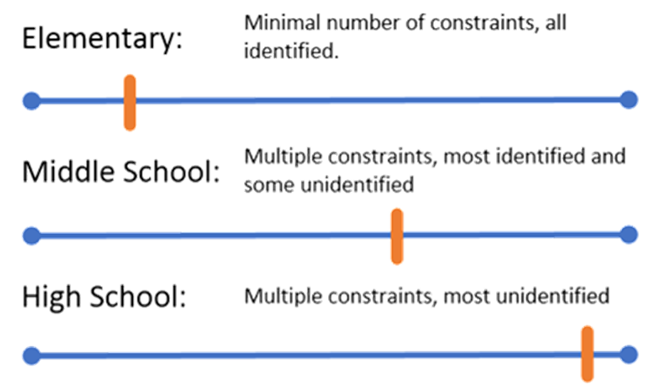
Across the Grades: Constraints

Slide 27
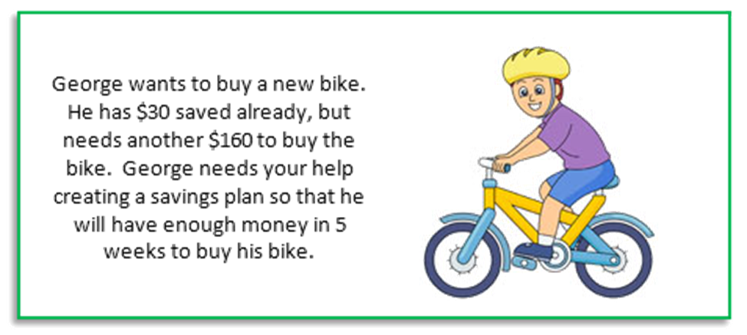
Across the Grades: Constraints - Elementary Example

Slide 28
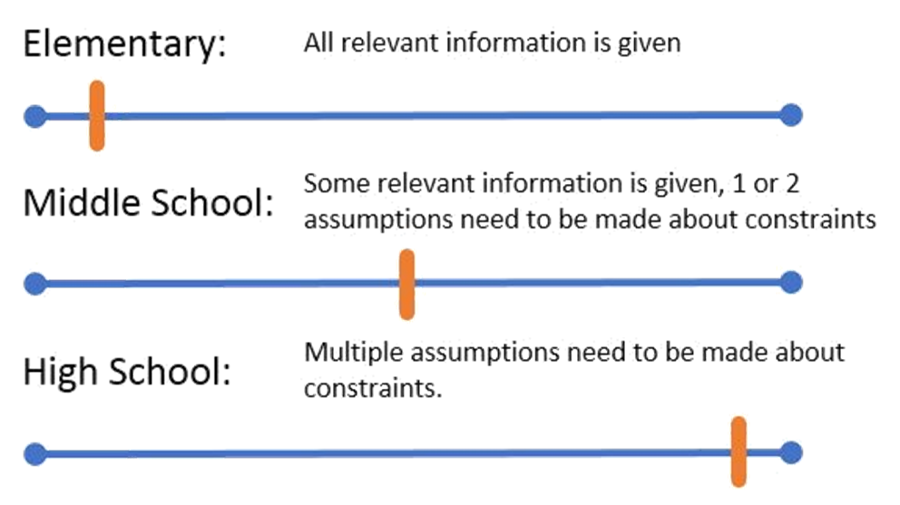
Across the Grades: Assumptions

Slide 29
Across the Grades: Constraints - Elementary Example

Slide 30
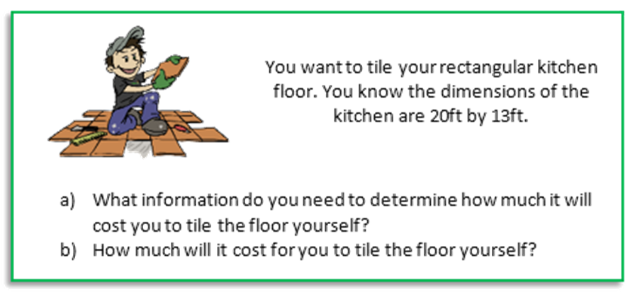
Across the Grades: Assumptions - Middle School Example

Slide 31
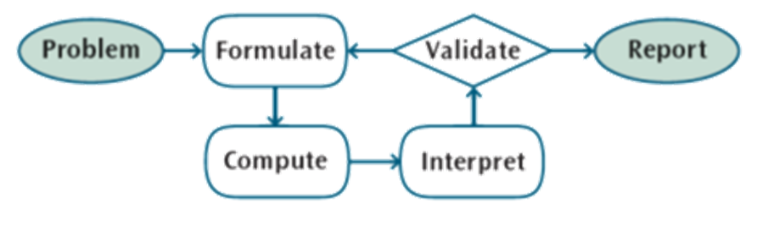
Modeling with mathematics is a process
Moving through the process varies by grade level.

Slide 32
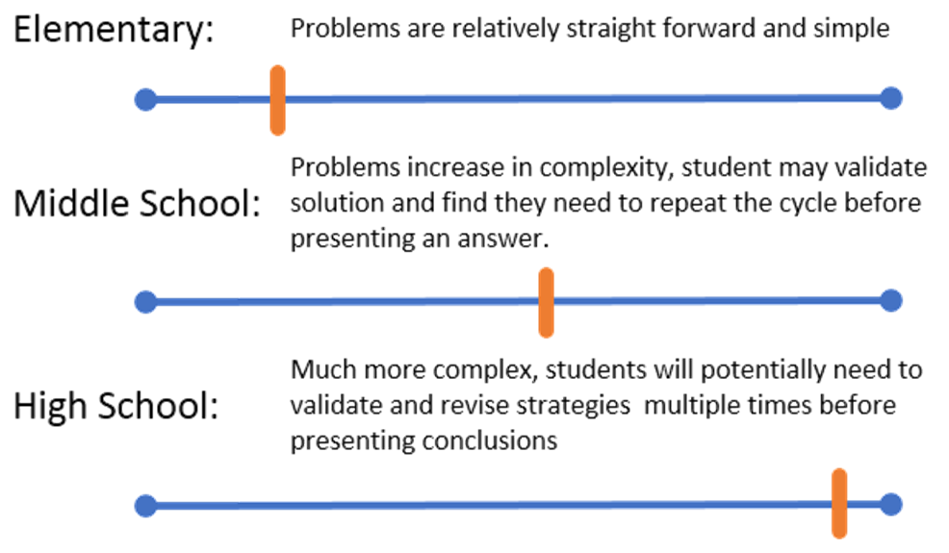
Across the Grades: Problem Complexity

Slide 33
Across the Grades: Constraints - Elementary Example

Slide 34
Across the Grades: Assumptions - Middle School Example

Slide 35
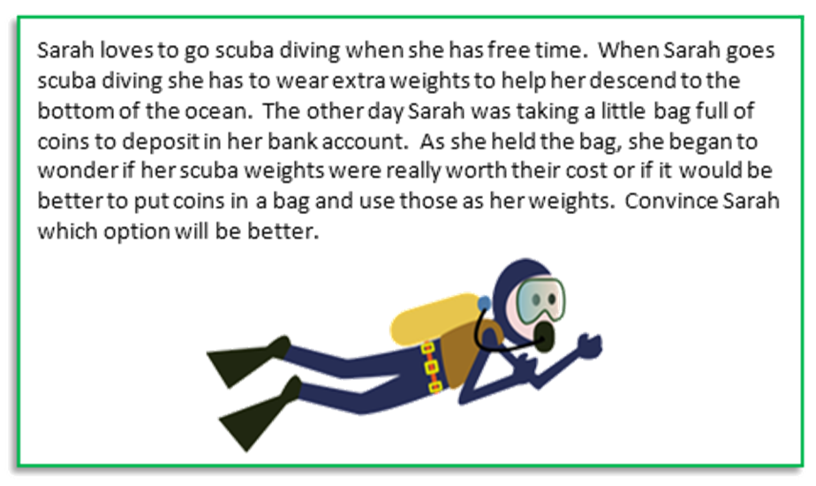
Across the Grades: Problem Complexity - High School Example

Slide 36
Question:
How are you thinking about math modeling differently?
Please use the Questions tab on your control panel to respond.
.

Slide 37
Section 3: Educators working on math modeling

Slide 38
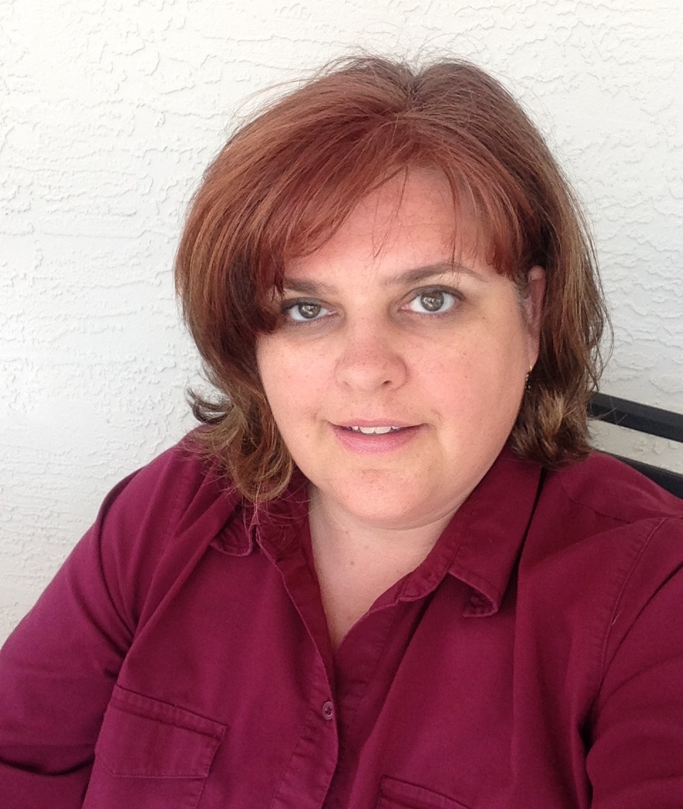
Amy Spies
4th Grade Teacher
Daytona Beach, FL
please enter a head shot here

Slide 39

Modeling Mathematics Process -
How do we move elementary students beyond just “compute?”

Slide 40
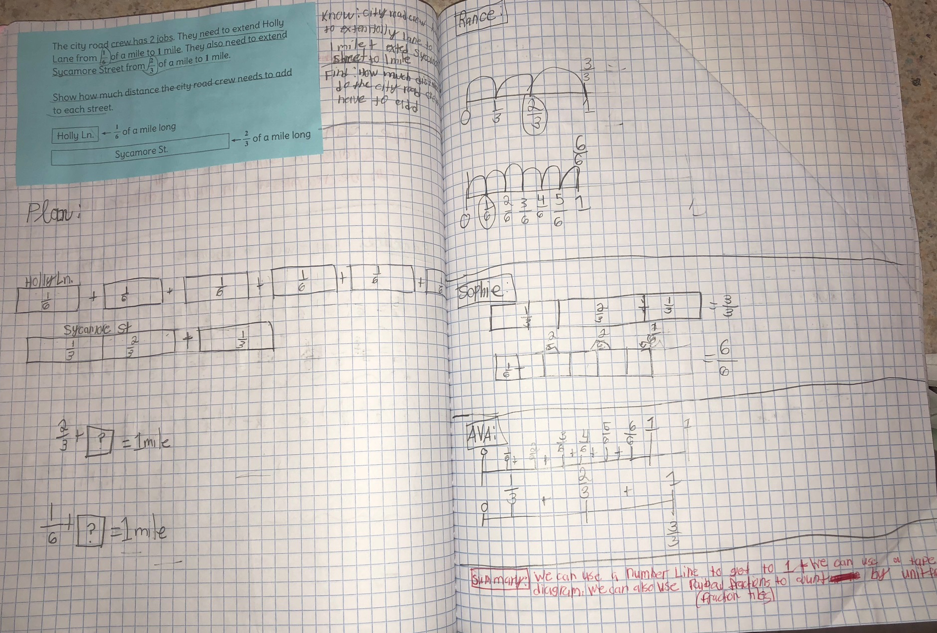
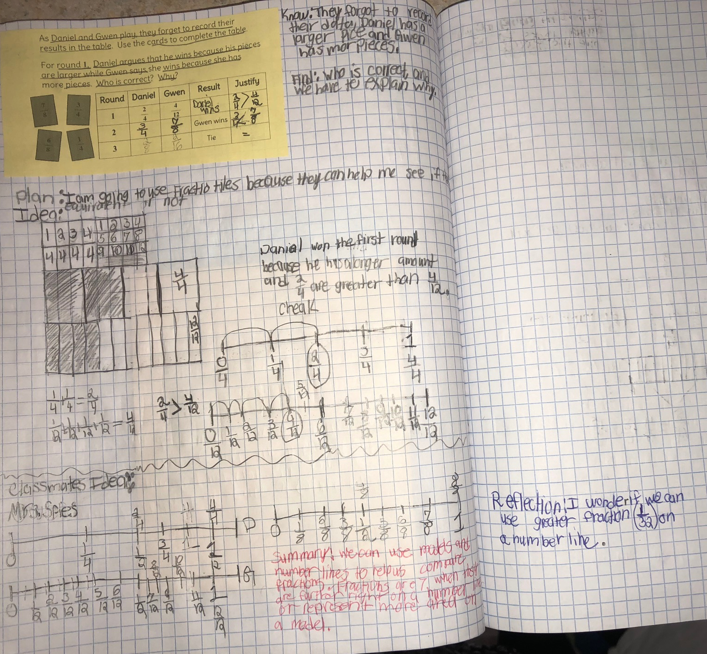
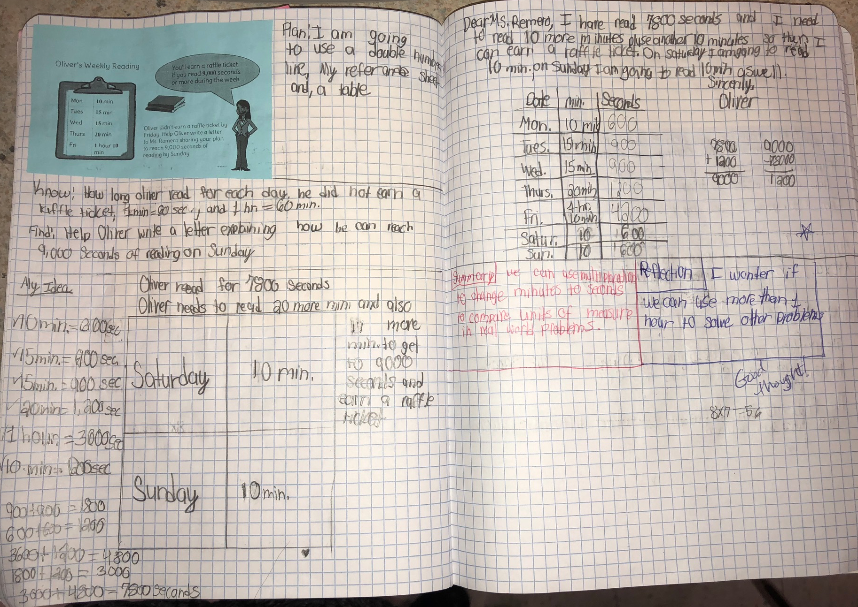
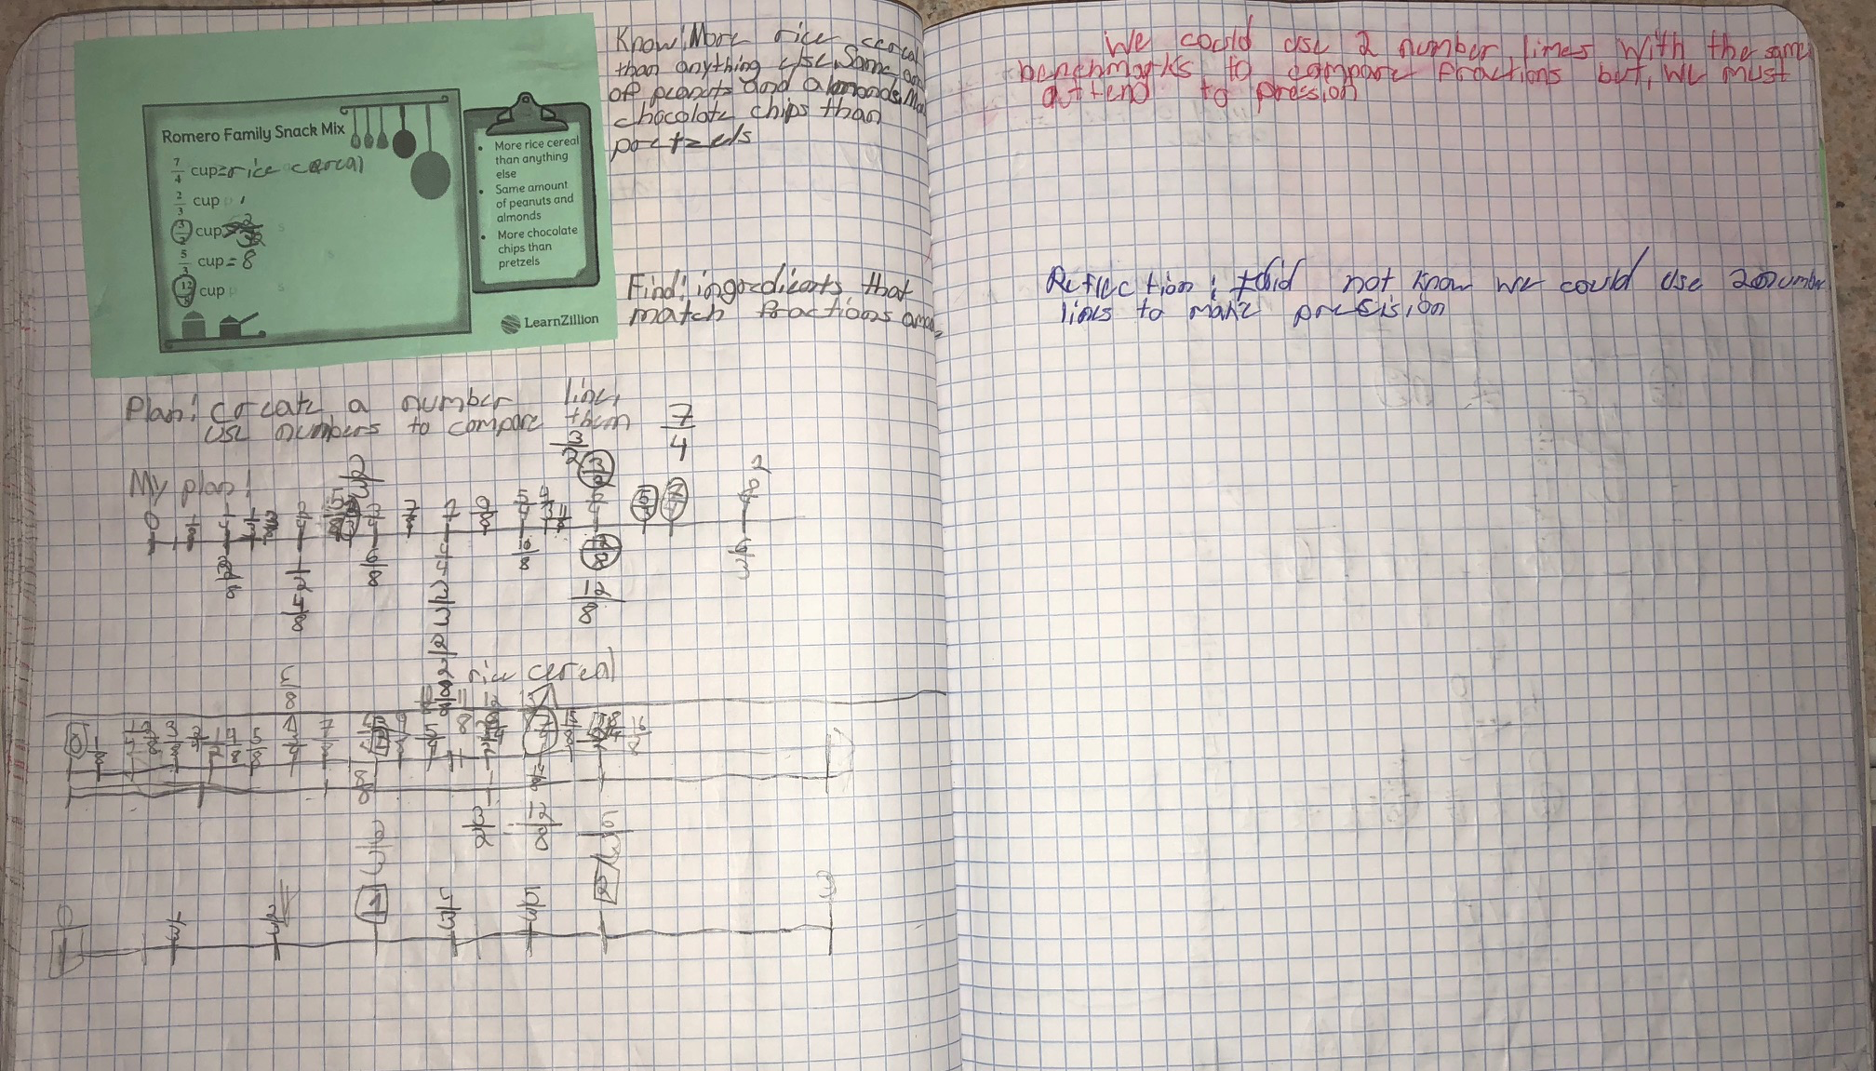
Student Math Journals

Slide 41
Student Math Journals

Slide 42
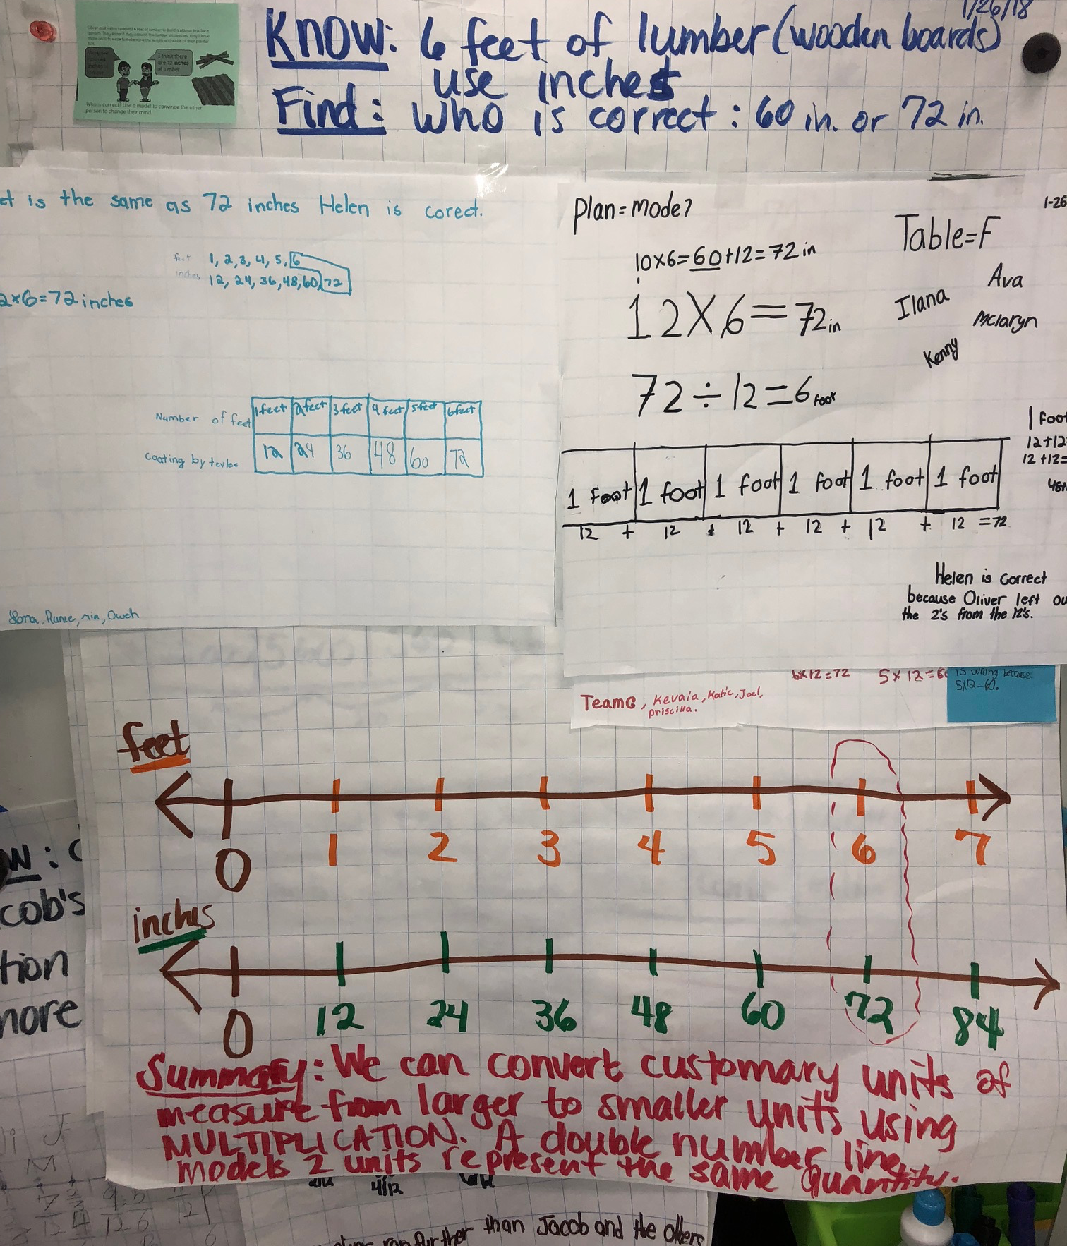
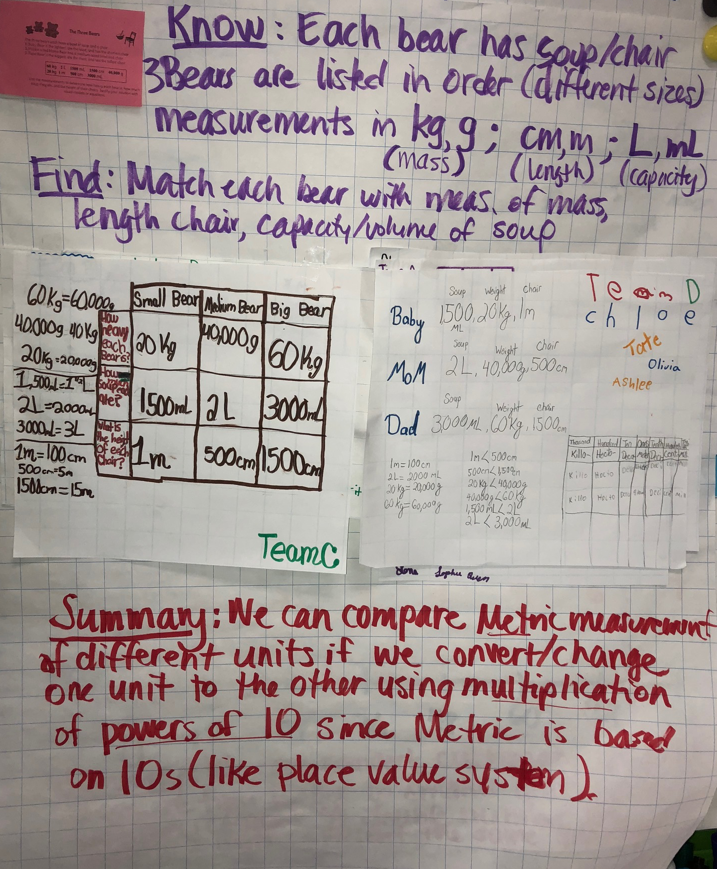
Anchor Charts

Slide 43
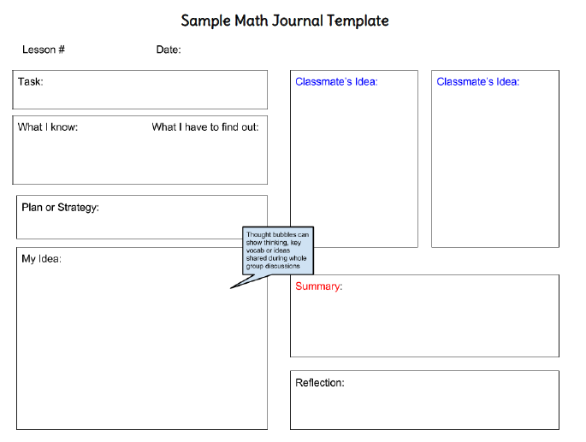

Slide 44
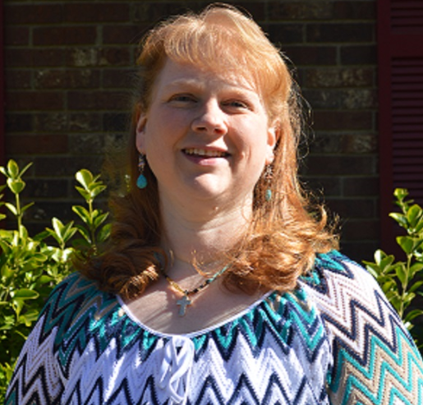
Karen McPherson
High School Math Coach
Asheville, NC

Slide 45
The Big AHAs from Teachers
Modeling the Mathematics
versus
Modeling with Mathematics

Slide 46
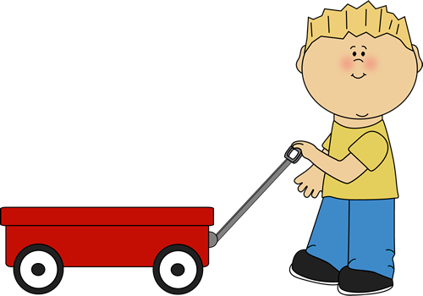





The Big AHAs from Teachers
Students bring the
math to the problem.

Slide 47
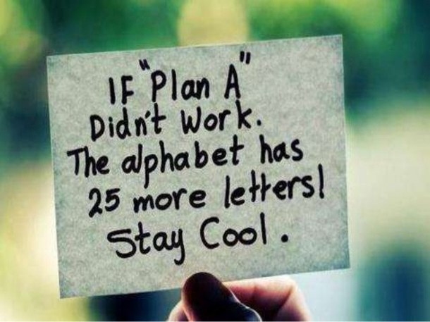
The Big AHAs for Teachers

Slide 48
Questions for our Guests?

Slide 49
Resources mentioned on the webinar
3 Act Math Tasks – Dan Meyer, Graham Fletcher
Illustrative Mathematics
LearnZillion
MARS Tasks
Aligned bloga: Questions to elicit the math practices; Digging Deeper into SMP 4
Mathematics Language Routines (for ELLs and all students)

Slide 50
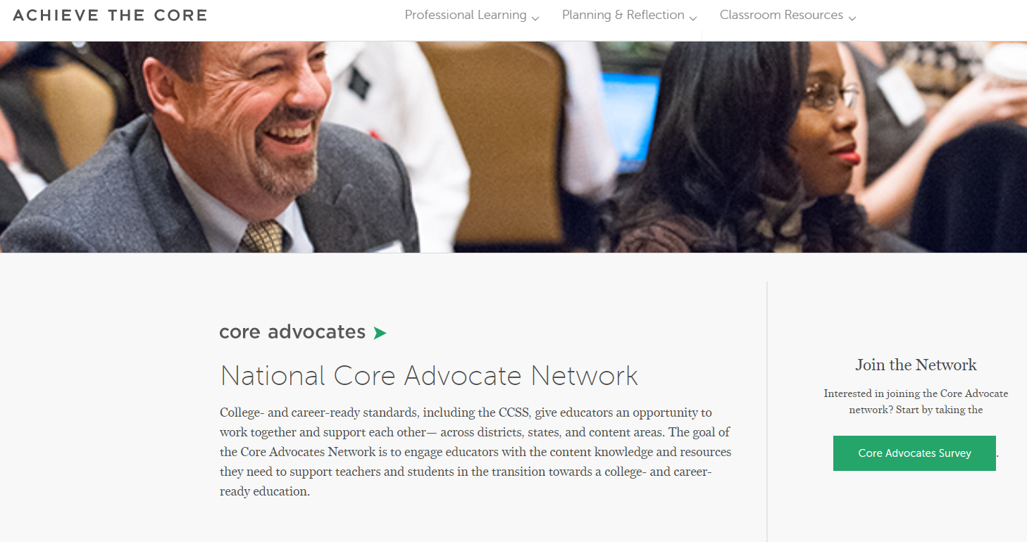
Join our network!
www.achievethecore.org/ca-signup

Slide 51
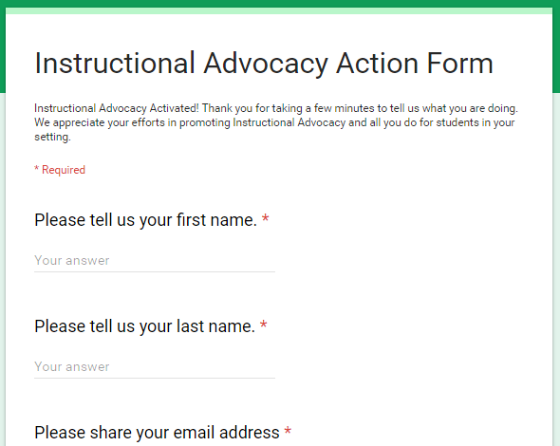
Tell us about your efforts
www.achievethecore.org/educators-taking-action

Slide 52
Please join us again next month!
Next month’s webinar: Making Materials Better: EnVision 2.0 Materials Adaptation Project
Wednesday, March 7, 7:00 - 8:00 p.m. ET
Register Here: https://attendee.gotowebinar.com/register/5943854693262696961

Slide 53
Thank You!

