Slide 1
Supporting English Language Learners with College- and Career-Ready Content
Core Advocates Monthly Webinar
April 4, 2018
The webinar will begin shortly. You may wish to download the handouts (check the tab on your webinar control panel) while you wait.

Slide 2
Introductions
Your hosts from the Field Impact Team
Lynda Nguyen, Team Coordinator
Jennie Beltramini, Teacher Engagement Manager
Janelle Fann, Project Manager
Sandra Alberti, Director
Joanie Funderburk, Manager of Professional Learning

Slide 3
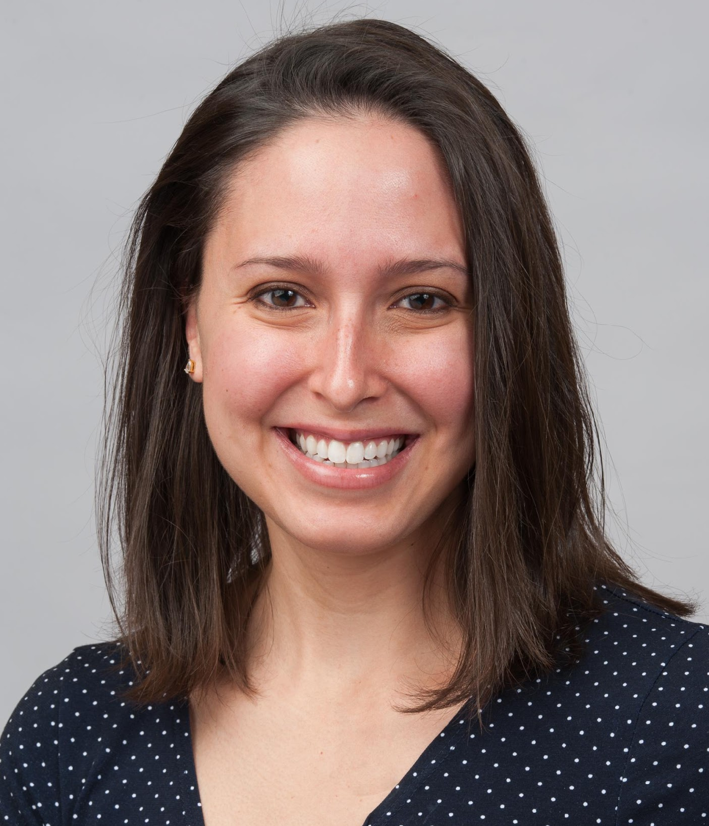
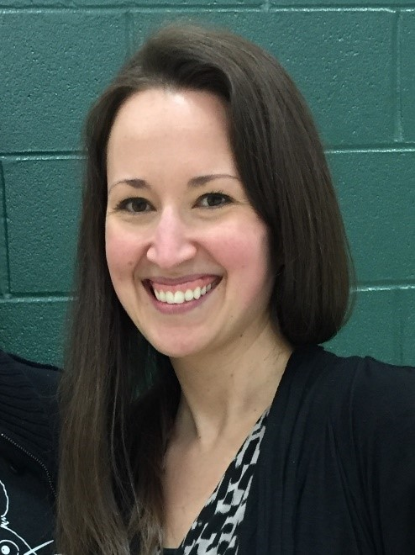

Today’s Presenters
Claire Rivero
Digital Strategy Manager
Project Lead: ELL Adaptation Project
Student Achievement Partners
Tweet @achievethecore
Sarah Webb
ELL and Curriculum Support Specialist
Mad River Local Schools, Ohio
Tweet @MrsWebb1221

Slide 4
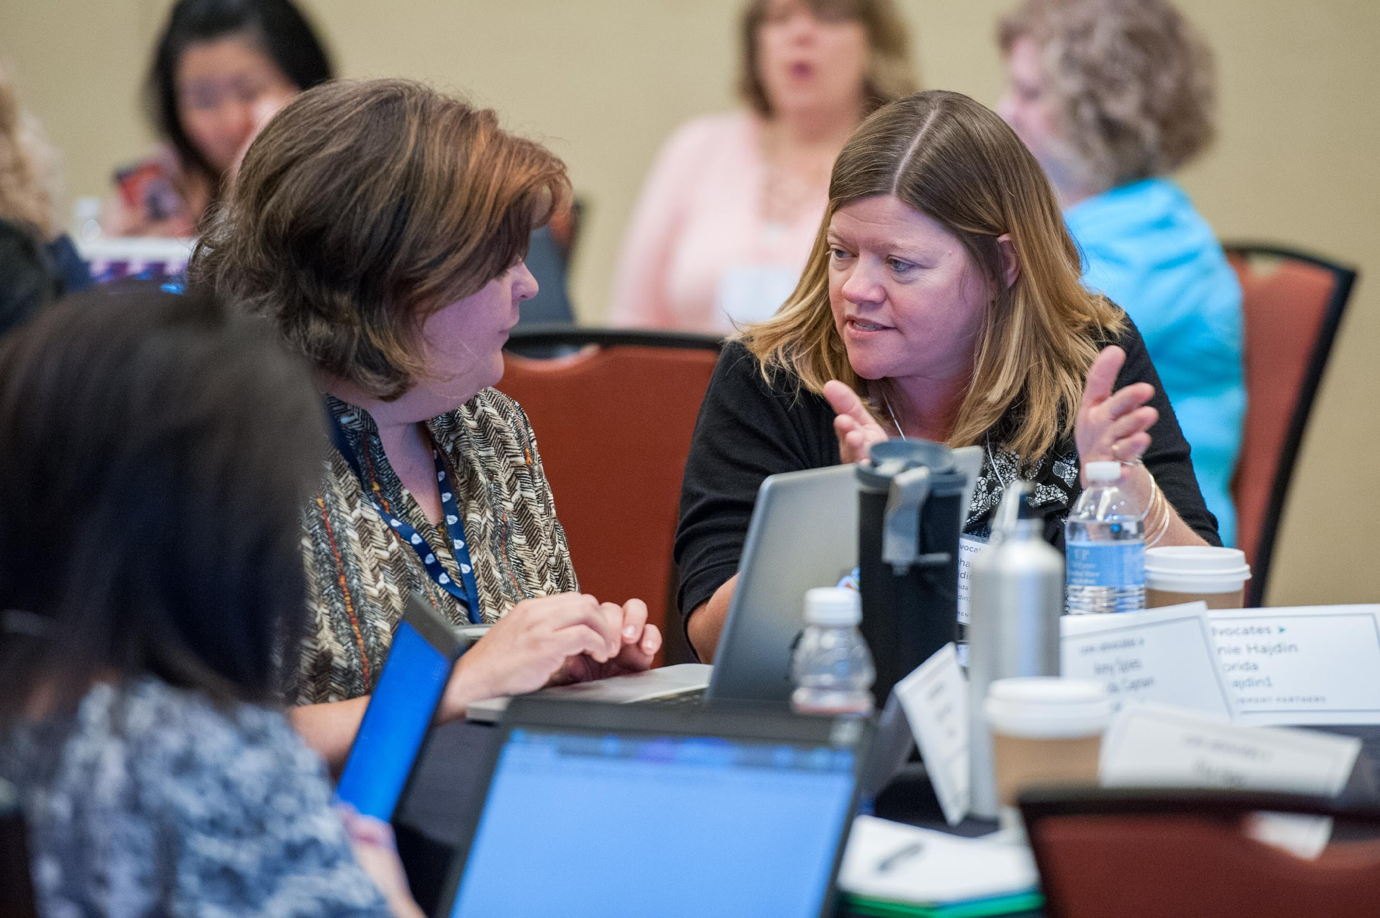
Who are Core Advocates?
Core Advocates are educators who:
  Believe in the potential of high-quality standards to prepare all students for college and careers;
  Are eager to support their colleagues and communities in understanding and advocating for the college- and career-ready standards, and standards-aligned instruction;
  Understand and embrace the Shifts in instruction and assessment required by the college- and career-ready standards

Slide 5

Learn more about us!
Contact Jennie Beltramini (jbeltramini@studentsachieve.net ) or Joanie Funderburk (jfunderburk@studentsachieve.net)
Complete this survey to join our database (and mailing lists): www.achievethecore.org/ca-signup
Visit our website: www.achievethecore.org

Slide 6

Tweet with us!
Please feel free to tweet during and after the webinar using #coreadvocates
@achievethecore
@JoanieFun, @salberti, @JennieBeltro, @MrsWebb1221

Slide 7
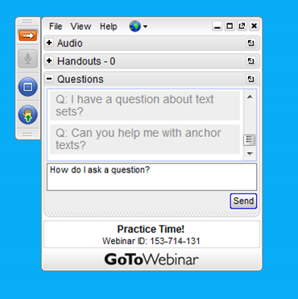
Engage with us!
During the webinar
– Accessing Documents
– Questions option
– Polling
After the webinar
– Survey
– Access to recorded webinar

Slide 8
Goals of the webinar
Learn about Student Achievement Partners’ recent work to adapt resources for instruction with English Language Learners (ELLs)
Engage with some specific ideas for ELL instruction in literacy and math
Learn about other resources available to support ELLs in college- and career-ready instruction

Slide 9
Section 1: Why was this work needed?

Slide 10

College- and career-ready instruction is for ALL students.
But that doesn’t mean students don’t need different supports.

Slide 11



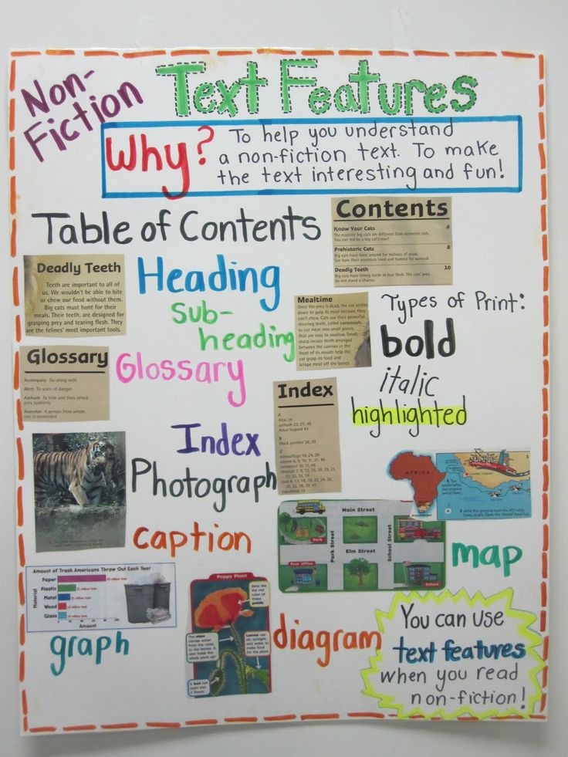
What do the Shifts mean for ELLs?
Accessing complex text
Reading, writing, and speaking
grounded in text evidence
Increased emphasis on
knowledge-building and
nonfiction

Slide 12


What do the Shifts mean for ELLs?

Slide 13
Poll:
What has been your biggest hurdle to supporting your English Language Learners?

Slide 14



How we built our knowledge
Teacher Surveys
  Support needs
  Design preferences
Literature review -- Summer 2017
Conversations with ELL experts and partners

Slide 15

Outcomes of Our Work
Adaptations to our resource collections
Annotated bibliography
Annotated exemplars illustrating our principles
New guidance documents
Curation of more CCR-aligned ELL resources. Watch our communications!

Slide 16

Goals
Give ELLs access to grade-level, CCR-aligned content
Create adaptations that could realistically be used within a whole-class setting. Minimize “extra,” “ELL-only” activities
Remain true to the purpose of each resource. What is the intended usage?

Slide 17

Updated Tools and Resources
ELA: Academic Word Finder
ELA: Basal Alignment Project and Anthology Alignment Project
ELA: Close Reading Lessons
ELA: Decodable Reader Protocol
ELA: Fluency Packets
ELA: Mini-Assessments
ELA: Read Aloud Project Lessons
ELA: Text Sets
Math Lessons
Math Mini-Assessments
Math Tasks
Items in green are updated and available to look at today!

Slide 18

Our Adaptation Model -- Example
Principle 1: Provide English Language Learners with regular opportunities to negotiate meaning from grade-level complex texts, share their analyses, and argue from evidence. Integrate into instruction, features that support English Language Learners to make the content comprehensible.
  Supporting Action 1D. Engage in a read-aloud of the text, perform choral reading, and/or utilize recordings of the text, before having students work with the text alone or in groups. Read-alouds can also be used to reinforce understanding and support fluency at subsequent points in working with a text.
    Adaptation: Provide audio recordings of all passages within our Fluency Packets

Slide 19
Section 2: Exploring some of the new adaptations

Slide 20

Fluency Packets
Grade bands: 2-3, 4-5, 6-8, 9-10.
40 passages in each
Designed to support additional fluency practice
Regular fluency practice is essential for helping ELLs improve their overall literacy skills—allows them practice with decoding, pronunciation, word identification, and prosody.

Slide 21
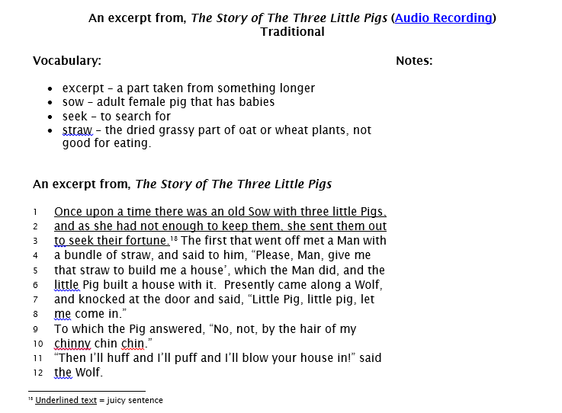
Audio recordings available
Student-friendly definitions
Space for notes and annotations
Juicy sentence call-outs
Line numbers

Slide 22
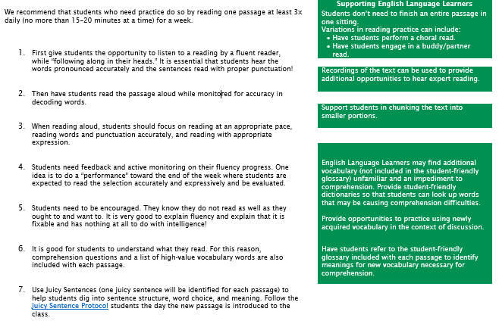
Additional support throughout the fluency protocol—when and where to add extra scaffolding. (from Fluency Packets)

Slide 23




Read Aloud Project
Week-long units for K-2, centered around a high-quality read aloud book
Lessons emphasize text-dependent questions, improved speaking, listening and writing tasks, and a focus on academic vocabulary

Slide 24


Read Aloud Project Adaptations
Engage students in reading auxiliary texts and resources (illustrations, photographs, video clips) on the topic.
Engage in varied rereadings of the text, both for different purposes and in different manners.

Slide 25


Read Aloud Project Adaptations
Explicitly clarify and reinforce defini­tions of words using examples, non-examples, synonyms, antonyms, and concrete representations.
Provide opportunities to practice using newly acquired vocabulary in the context of their discussions and writing.

Slide 26


Read Aloud Project Adaptations
Provide graphic organizers (or other tools such as in-text highlighting and annotating) to help students capture and reflect on new knowledge.
Give students meaningful ideas to write about the text or topic.

Slide 27
Poll:
Which one of these adaptations do you think you could add to your literacy instruction tomorrow?

Slide 28
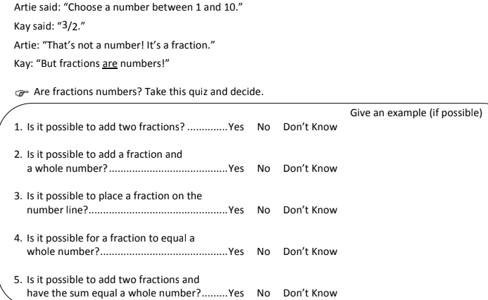
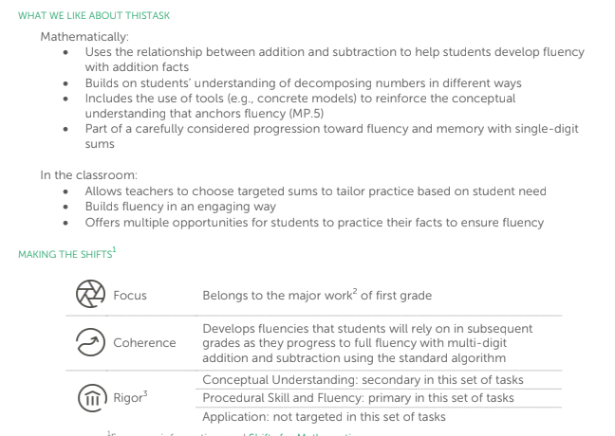
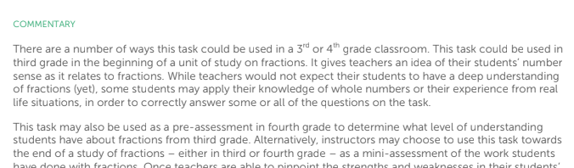
Math Tasks
K-12
Math tasks aligned to college- and career ready standards.
For immediate classroom use or for professional learning discussion

Slide 29
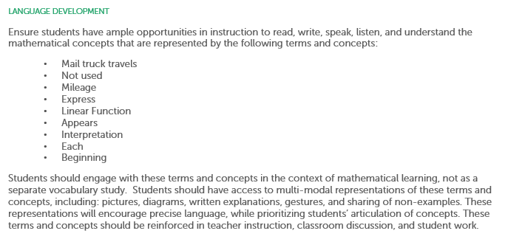
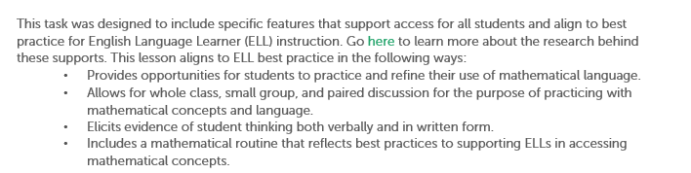
Key Vocabulary
Features good for ELLs

Slide 30
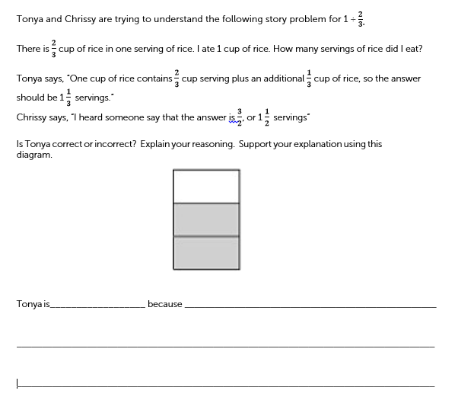
Narrative focused on one character
Clarified wording
Allows for mathematical routine: Decide and Defend
Sentence frame

Slide 31

Mathematical Language Routines
“A 'math language routine' refers to a structured but adaptable format for amplifying, assessing, and developing students' language. The routines emphasize the use of language that is meaningful and purposeful, not inauthentic or simply answer-based.”
-- Principles for the Design of Mathematics Curricula: Promoting Language and Content Development (Stanford University)

Slide 32
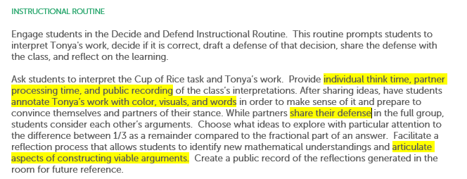
Use of visuals
Multi-modal ways of considering a problem
Opportunity to practice articulating mathematical concepts

Slide 33

Math Mini-Assessments
Grades 2-12
Mini-assessments that reflect the demands of college- and career-ready standards for mathematics
Can be completed in one period
Answer key
For immediate classroom use or professional learning

Slide 34
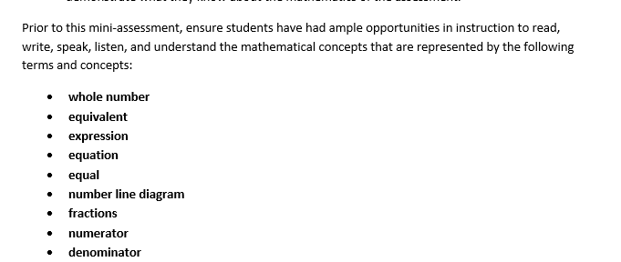
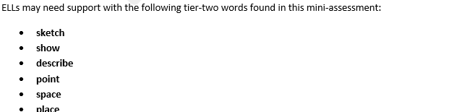
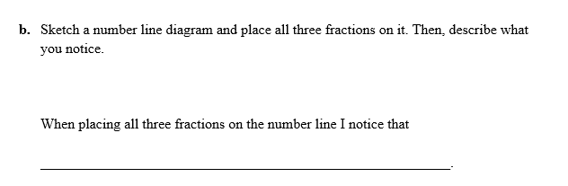
Adaptations to math mini-assessments
Highlighting math terminology
Highlighting tier 2 and additional vocabulary
Sentence frames

Slide 35
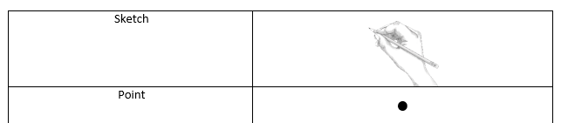
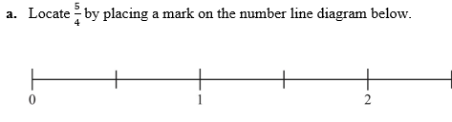
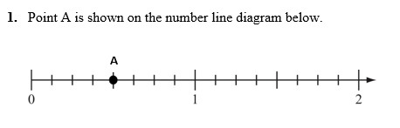
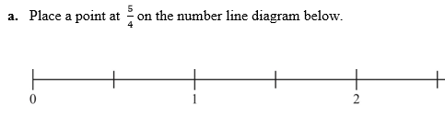
Mini-assessments: Increasing clarity in math items
Before | After

Slide 36
Which question would be clearer for ELLs? Why do you think so?
A | B
Last year, Rob set up the Road Runner Race for his school. The race was 1,200 meters long. This year, the race will be 4 times as long as last year. Rob has 6 water tables to use along the race route. The distance between water tables is the same and the last one will be placed at the finish line. How far apart is the distance between water tables #1 and #2? | Last year, Rob set up the Road Runner Race for his school. The race was 1,200 meters long. This year, the race will be 4 times as long as last year. Rob has 6 tables to use for water along the race route. He will spread the water tables out evenly, and put the last one at the finish line. How far apart will the tables be?
Please use the Questions tab on your control panel to respond.

Slide 37
Section 3: What additional resources are available to support ELLs?

Slide 38
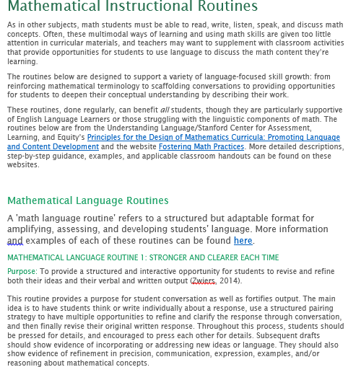
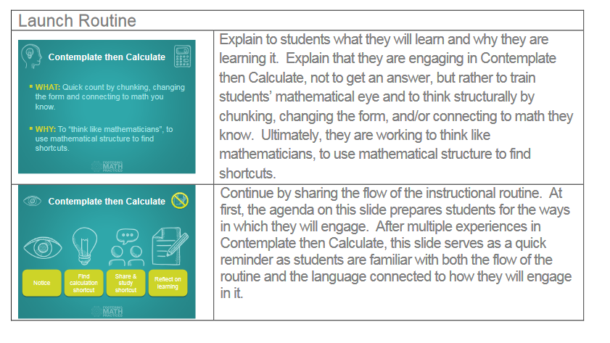
Mathematical Instructional Routines-- Quick Reference Guide
https://achievethecore.org/page/3164/mathematical-language-routines

Slide 39
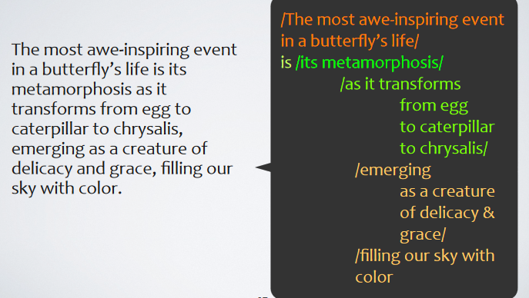
Juicy Sentence Protocol
Juicy sentences are rich in:
Meaning
Vocabulary
Grammar, punctuation, sentence structure
Critical to understanding the meaning of the text.
Protocol explains how to structure quick, learning-packed juicy sentence conversations.
https://achievethecore.org/page/3160/juicy-sentence-protocol

Slide 40
Which sentence would you choose?
Excerpt from: Students Vote: Students share their views on gun laws (Newsela 1040 Lexile)
Many Students Still Figuring Out How They Feel
“Kids are in analysis, figuring-out-how-I-feel mode right now, not so much in I've-drawn-a-final-conclusion mode,” said Alysia Sharief. She teaches 10th grade at Watsonville High in Watsonville, California.
Newsela organized the “Students Vote” poll on gun control and school safety to measure students’ current views on gun law proposals. These views may shape decisions to participate in a protest or contact an elected official. For some students approaching voting age, the views might reflect how they will vote in elections.
Polling was open to all high school students who use Newsela. Students in all 50 states participated, as did many students from international schools. The participants represent more than 3,000 schools.
Kids And Adults Agree
The poll results reveal a majority of students support stricter gun control laws in the U.S. Sixty-seven percent of participating students either agreed or strongly agreed that gun laws in the U.S. should be stricter. Sixty-eight percent of students either agreed or strongly agreed that the minimum age to buy an assault weapon should be raised to 21. Even in rural schools, a majority of students support stricter gun control.
Please use the Questions tab on your control panel to respond.

Slide 41
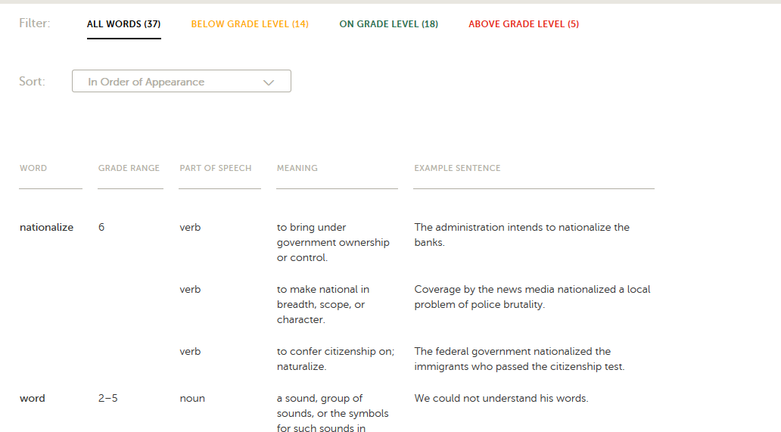
Academic Word Finder Vocabulary Guidance for ELLs

Slide 42
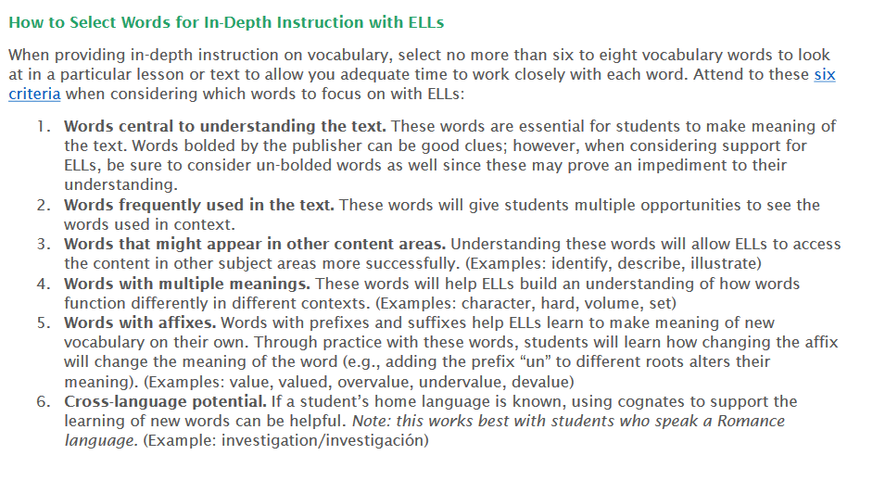

Slide 43
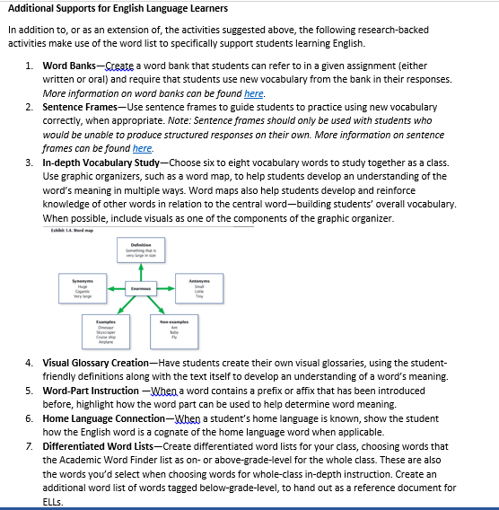

Slide 44
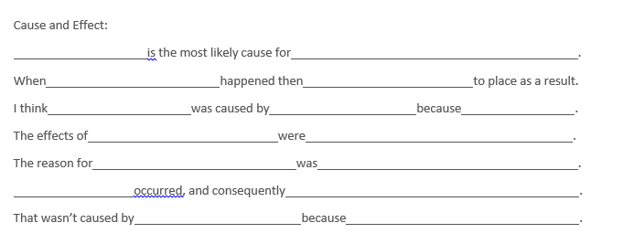
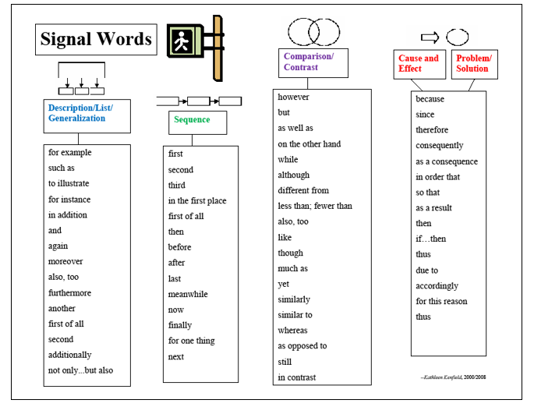
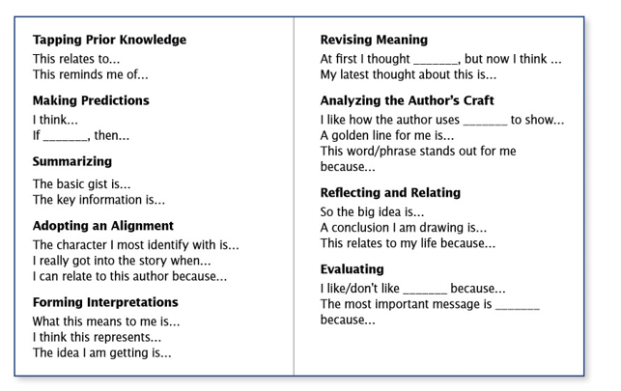
Additional Guidance: Writing and Discussion Supports
https://achievethecore.org/page/3159/ell-supports-for-writing-and-discussion

Slide 45
Questions for our Guests?

Slide 46
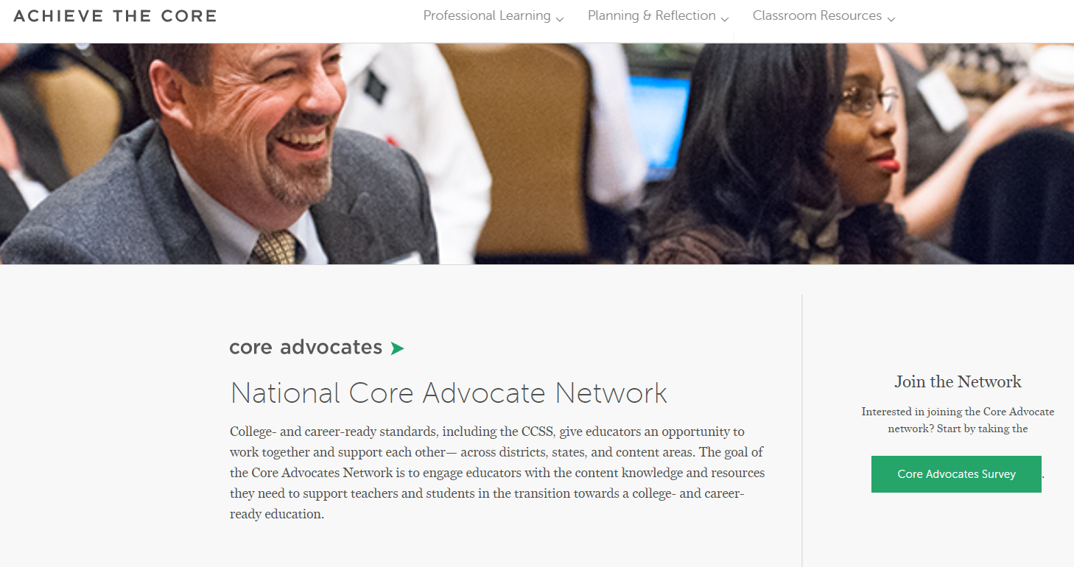
Join our network!
www.achievethecore.org/ca-signup

Slide 47
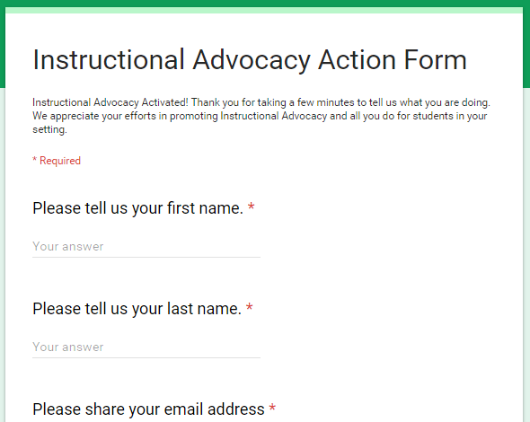
Tell us about your efforts
www.achievethecore.org/educators-taking-action

Slide 48
Please join us again next month!
Next month’s webinar: Assessing Literacy: A Model for using Achieve the Core’s ELA mini-Assessments
Wednesday, May 2, 7:00 - 8:00 p.m. ET
Register Here: https://attendee.gotowebinar.com/register/7016175395099830275

Slide 49
Thank You!

