Slide 1
#BookSnaps
For
Professional Learning
and the Classroom
The webinar will begin shortly.

Slide 2
Tweet with us!
Please feel free to tweet during and after the webinar using #CoreAdvocates
Find us on Twitter!
@achievethecore
@araines_

Slide 3
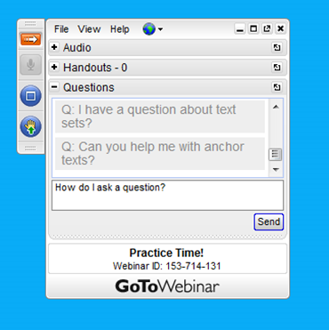
Engage with us!
During the webinar
– Questions option
After the webinar
– Survey
– Access to recorded webinar

Slide 4
Goals of webinar:
Goal 1: Gain an understanding of
BookSnaps
Goal 2: Explore the uses of BookSnaps
in professional learning environments
and the classroom
Goal 3: Learn how to create a
BookSnap using google slides

Slide 5
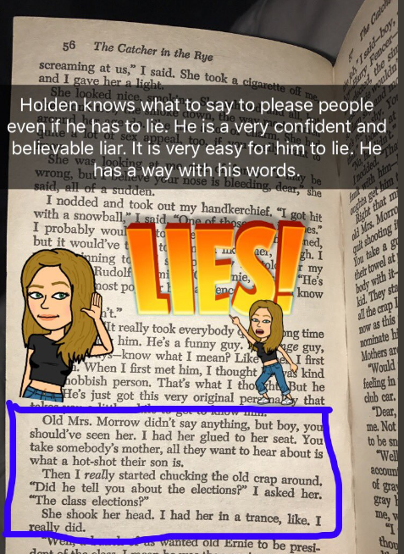
#BookSnaps
Record personal reflections
Creative way to allow annotations and sharing excerpts of books while making personal connections with the content.
Bitmojis to share emotions
Highlight text evidence

Slide 6
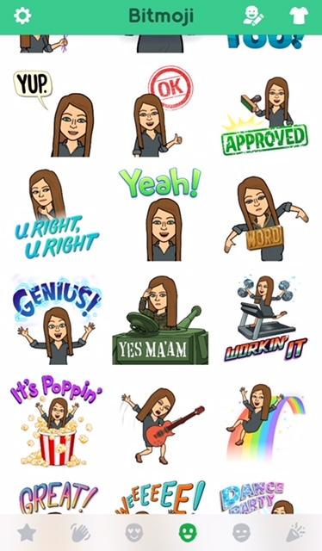
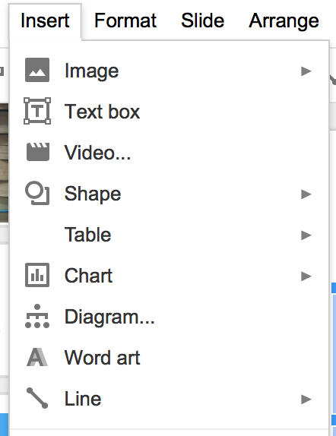
You can insert images, text, shapes, word art and lines into your #BookSnaps
#BookSnaps
Along with your Bitmoji to share emotion

Slide 7
Professional Learning Conversations
#BookSnaps allow for an online discussion centered around a book or article. It allows you to share your own learning digitally.
Through the use of the #BookSnaps, participants are able to see others’ connections to the text and begin dialogue.

Slide 8
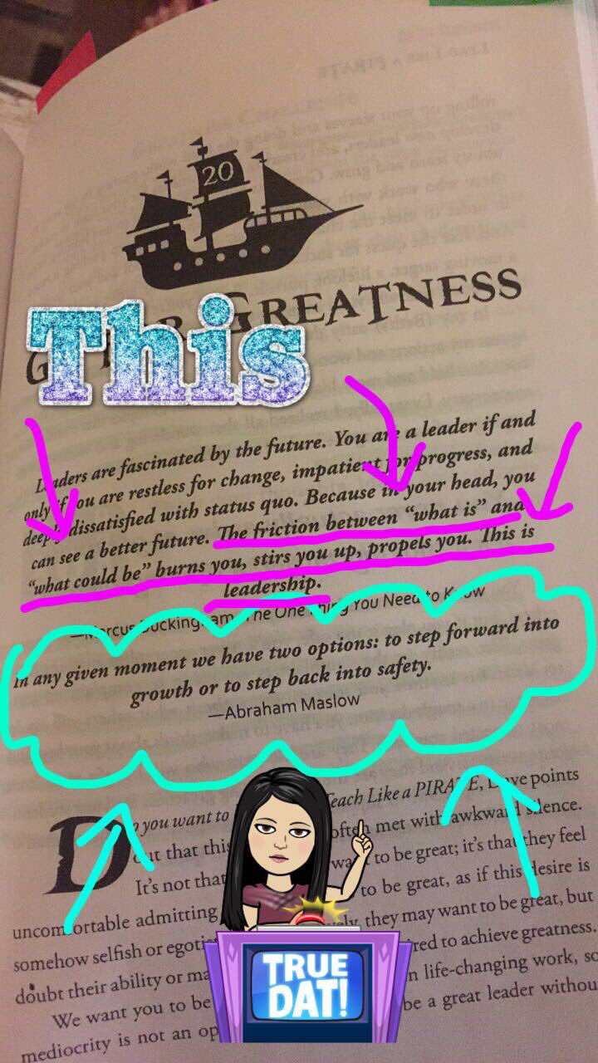
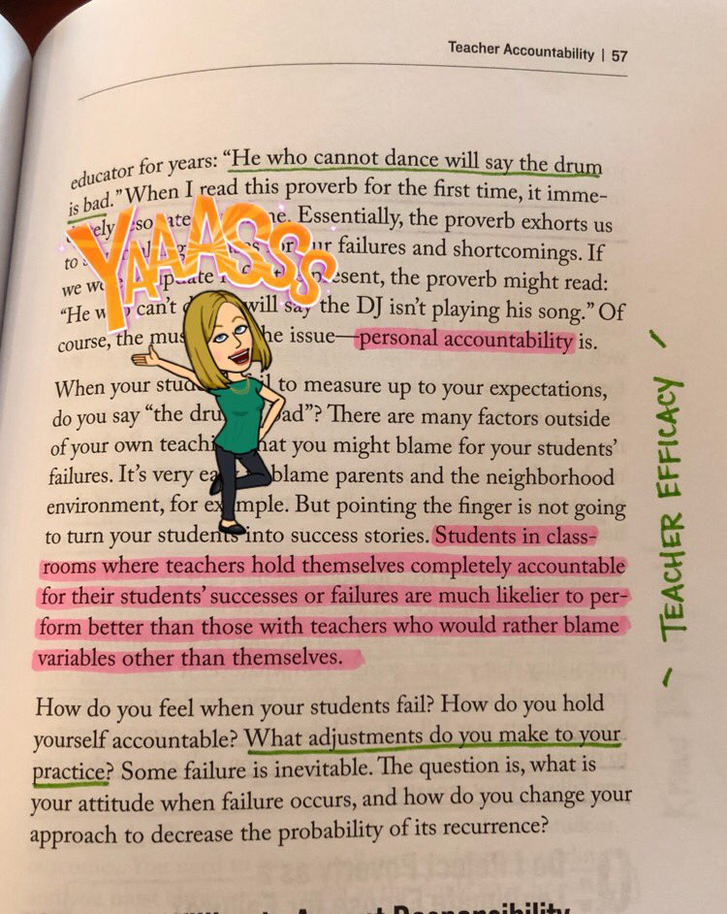
Highlighting a quote that made a personal connection with the reader.
Highlighting evidence that correlates with a central idea for discussion

Slide 9
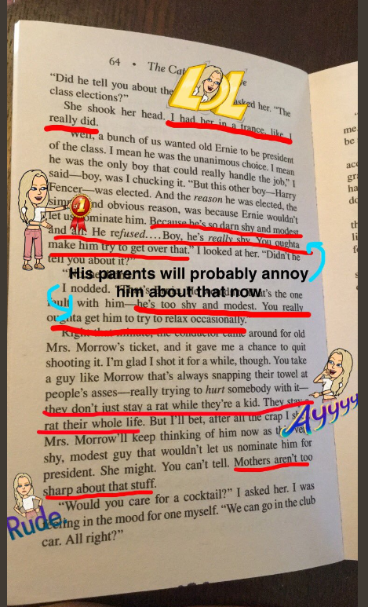
In the Classroom
#BookSnaps allow students to share connections with the text along with evidence to support a central idea or theme.
Students can use Bitmoji to display emotions the text generates.
Through the use of the #BookSnaps, students are able to react to others’ #BookSnaps and create dialogue around a common text.

Slide 10
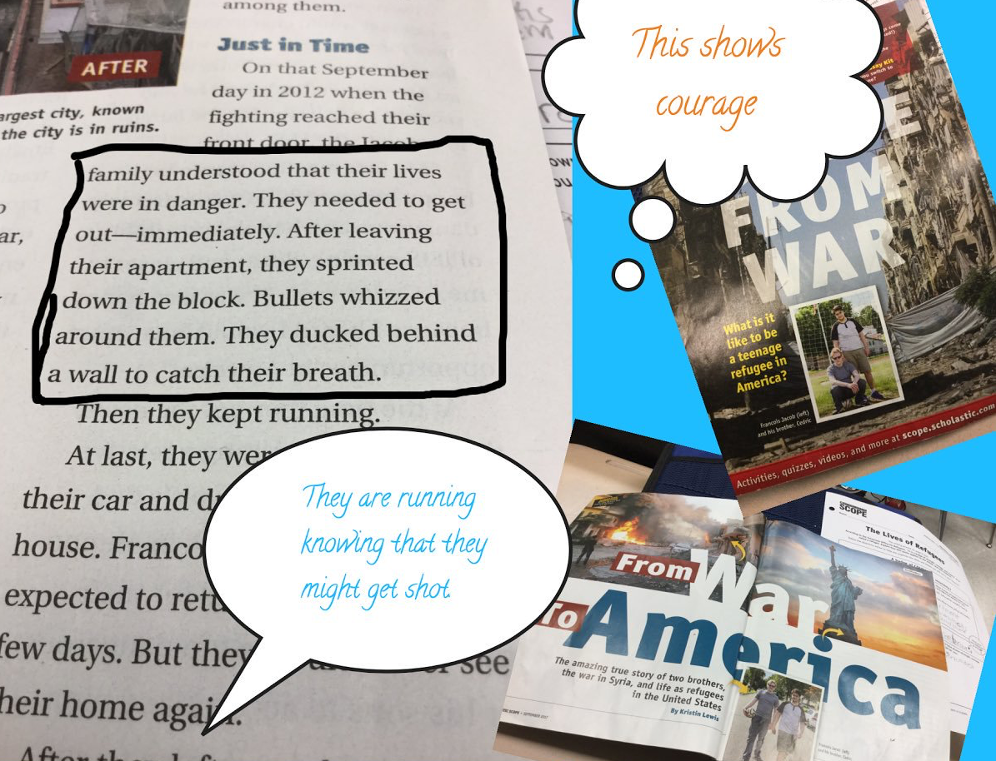
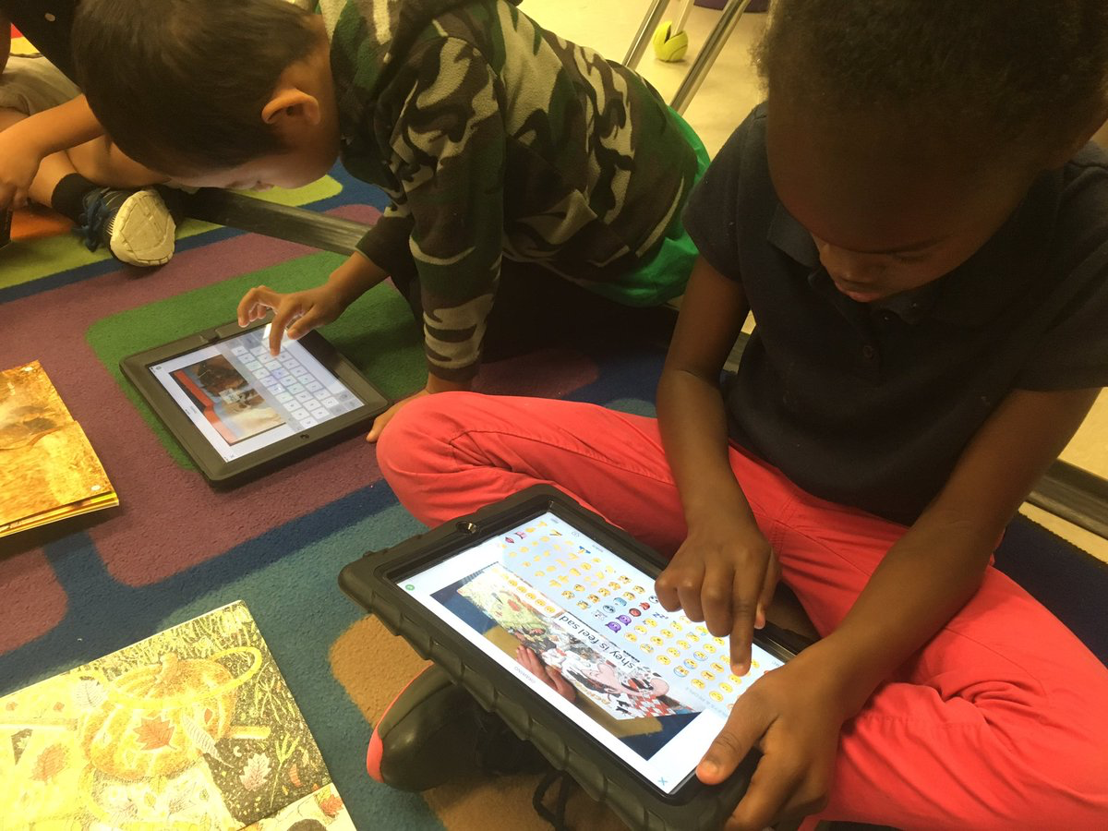
Students highlight evidence and provide their personal thoughts on the text.
Including an emoji that illustrates feelings sparked from the text.

Slide 11
Creating a #BookSnap
Take a picture of book page or section of the article
Upload it to google slides
Add images, emojis and Bitmojis
Add text, drawings or other annotations
Share out using #booksnaps #coreadvocates

Slide 12
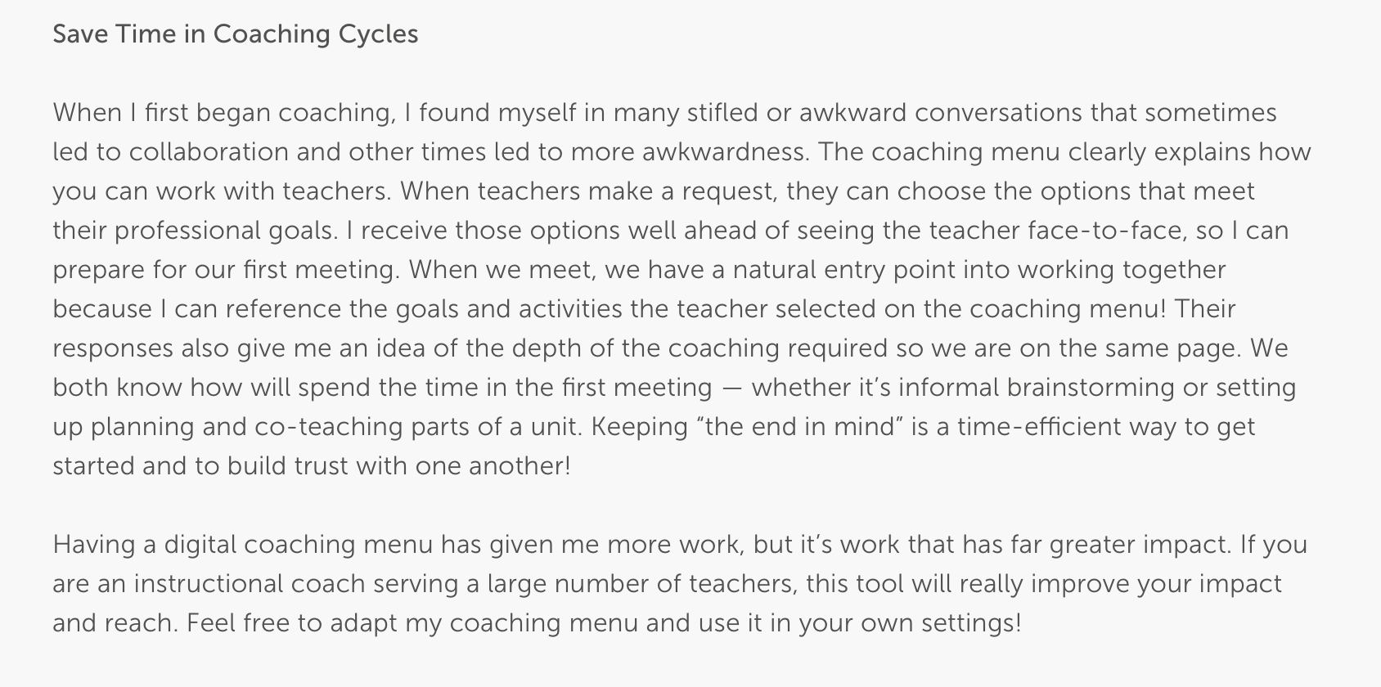
Except from The Digital Coaching Menu: Four Reasons Why You Need One: Kenny McKee

Slide 13
We are all looking for ways to save time!
We have all been there!
I wonder how to incorporate this more
I am constantly reflecting to make sure I am making the greatest impact!
Except from The Digital Coaching Menu: Four Reasons Why You Need One: Kenny McKee

Slide 14
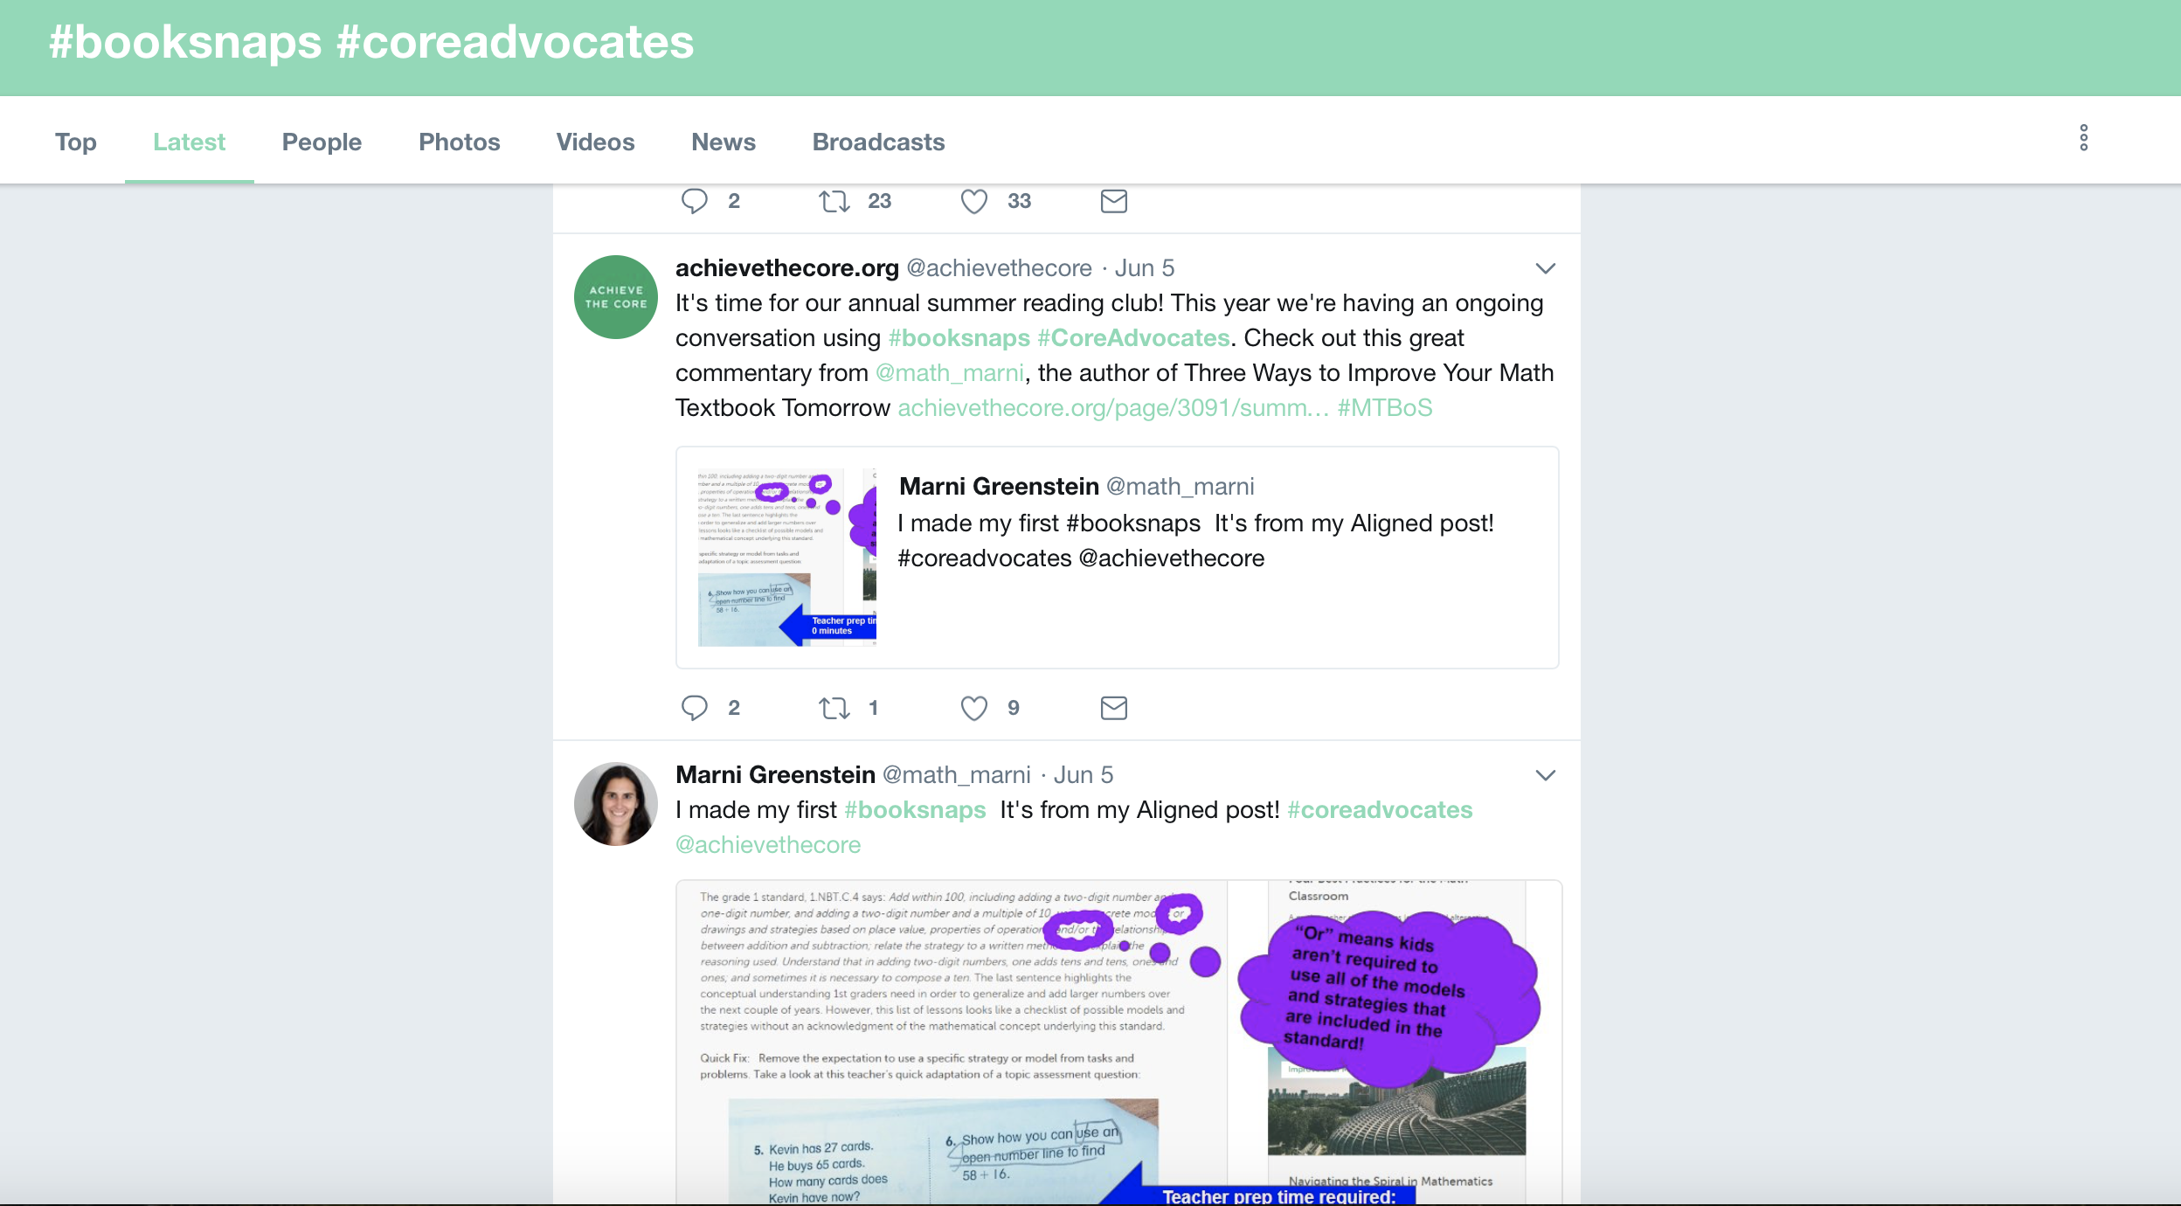
Share out on Twitter using #BookSnaps #Coreadvocates

Slide 15
Other Platforms for #BookSnaps
Seesaw
Google Drawing
Google Slides
Snapchat
Pic Collage
Additional information and resources can be found at: http://www.tarammartin.com/booksnaps/

Slide 16
#Coreadvocates Summer Reading Club
Join the conversation this summer by using your #BookSnaps to read selected articles from the Aligned Blog. Use #BookSnaps #Coreadvocates to jump in!
Make sure to retweet, comment and like others’ #BookSnaps to keep the conversation going!
Find out more information at:
Achieve the Core Summer Reading Club

Slide 17
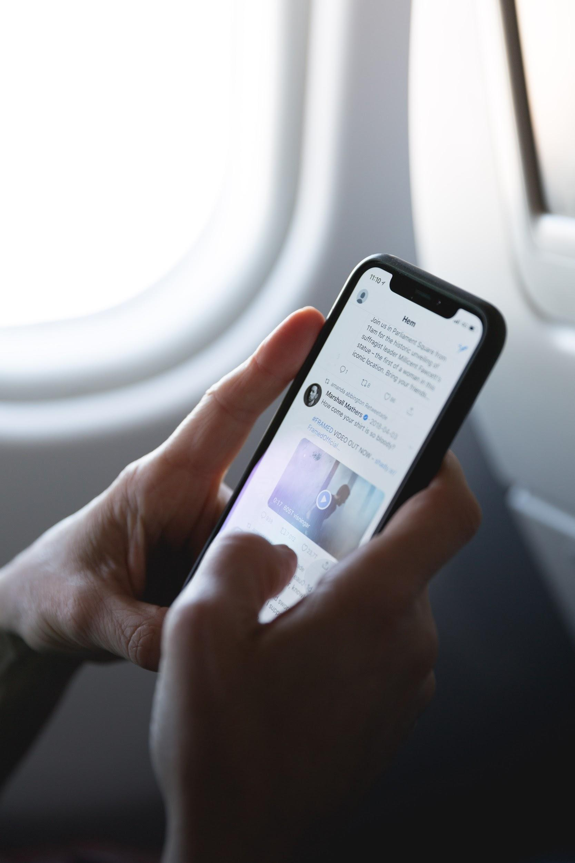
Thank you for joining!

