Slide 1

Reading Instruction with the End in Mind: Rethinking “Reading Levels”
Core Advocates Monthly Webinar
December 5, 2018
The webinar will begin shortly.
Check your Resource widget to preview the resources for today’s session!

Slide 2
Introductions
Your hosts from the Professional Learning Team
Jennie Beltramini, Math Specialist
Nicole Bravo, Project Manager
This Month’s Guests -
Carey Swanson, Senior Literacy Specialist

Slide 3
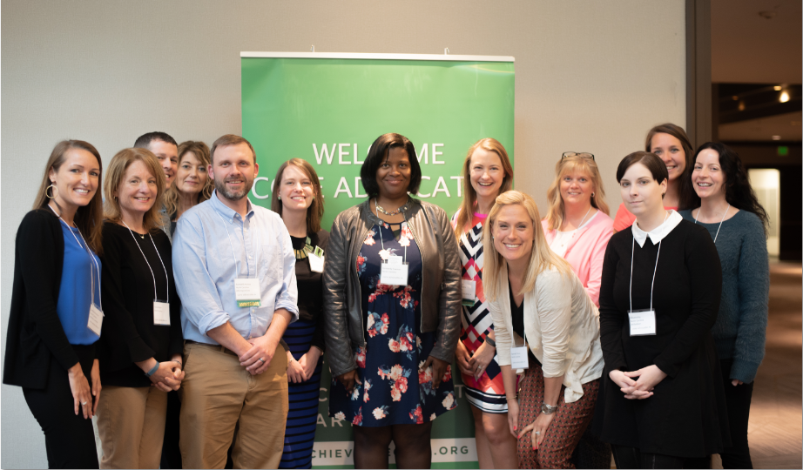

Who Are Core Advocates?
Core Advocates believe in the power of standards to prepare all students for college and/or careers.
They are eager to support and collaborate with their colleagues and communities in understanding and translating the Shifts into instructional practice.
Core Advocates have the tools and knowledge to advocate for high-quality instruction, instructional resources, and professional learning in their communities.

Slide 4

Learn More About Us!
Contact Jennie Beltramini (jbeltramini@studentsachieve.net )
Complete this survey to join our database (and mailing list): www.achievethecore.org/ca-signup
Visit our website: www.achievethecore.org
Notes:
If you’d like to learn more about the network, contact Jennie (her email is here).
We also want to invite you to join the network by signing up at achievethecore.org/ca-signup and visit our website for more info and opportunities

Slide 5

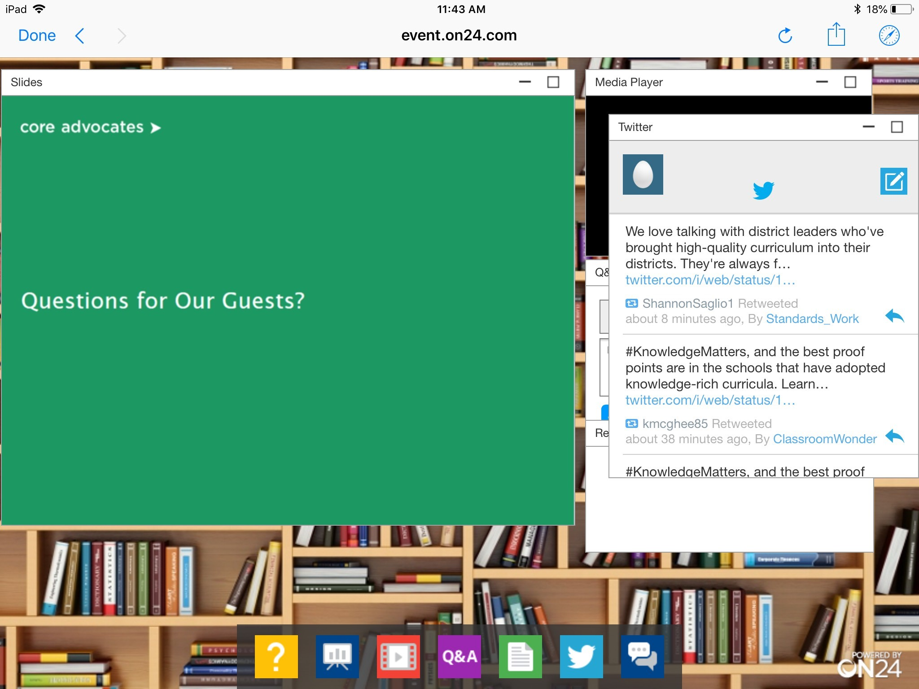
Tweet with Us!
Please feel free to tweet during and after the webinar using #coreadvocates
@achievethecore
@JennieBeltro
@CareySSwanson
Click here!

Slide 6
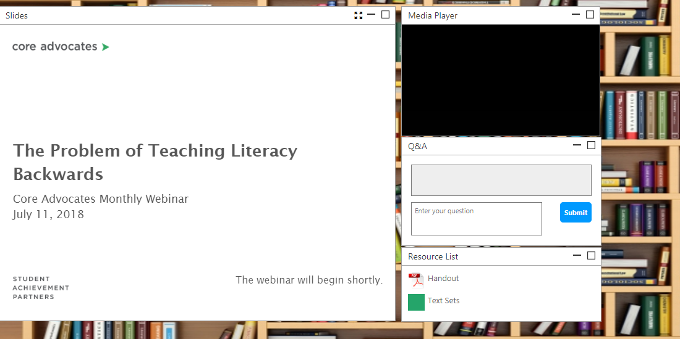
Engage with Us!
During the webinar
Q&A
Resources
Group Chat
Twitter Feed
After the webinar
Access to recorded webinar

Slide 7
Goals of the Webinar
Determine research based best practices for small group instruction.
Identify options for small group instruction that are alternatives to traditional leveled reading.
Understand how and why to use complex text with ALL students.

Slide 8

Carey Swanson
Senior Literacy Specialist
Student Achievement Partners

Slide 9
Section 1: What does research say about leveled reading instruction?

Slide 10
Poll:
My school, district, or educators I work with use reading levels for guided reading instruction:
often
always
rarely
never

Slide 11

Research Does Not Support Leveled Reading Instruction Across All Grades
“...kids taught from grade level materials do as well as those at an instructional level—or the instructional level placements have led to less learning.”
The Instructional Level Concept Revisited: Teaching with Complex Text
Tim Shanahan
Notes:
Over the past decade or so, several researchers have realized that this widely recommended practice is the educational equivalent of fake news, and have started reporting studies on its effectiveness. And, the instructional level has not done well; it either has made no difference—that is the kids taught from grade level materials do as well as those at an instructional level—or the instructional level placements have led to less learning. Instructional level placements have the tendency to limit kids’ exposure to the linguistic and textual features that they don’t yet know how to negotiate; the practice reduces their opportunity to learn. The kids not so protected, often do better.

Slide 12

Leveled Reading is Prominent Across America’s Classrooms
More teachers are selecting texts for their students based on reading level than grade level since 2010.
“Yet research suggests that teachers can’t pinpoint students’ reading levels precisely. And even if they could, giving them a steady diet of relatively easy texts doesn’t support learning effectively.”
If we want teachers to assign texts based on students’ grade levels—rather than their reading levels—we need to do more to help them bridge the gap between the two.
Notes:
https://edexcellence.net/publications/reading-and-writing-instruction-in-americas-schools

Slide 13
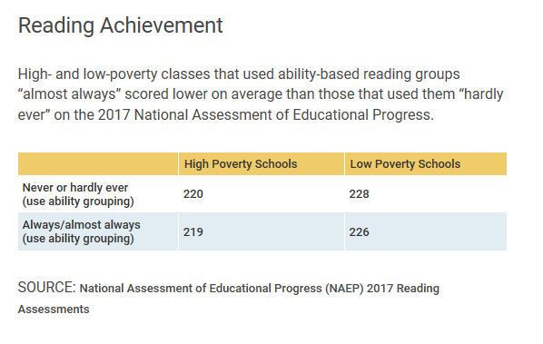
Leveled reading instruction does not close gaps over time
Study followed 12,000 K-3 students over time, looking at guided reading group placement and reading performance.
Found that students placed in the lowest groups in kindergarten never caught up to those placed in the highest group.
Are Classroom Reading Groups the Best Way to Teach Reading? Maybe Not.
By Sarah D. Sparks
Notes:
https://www.edweek.org/ew/articles/2018/08/29/are-classroom-reading-groups-the-best-way.html

Slide 14

This means, we are meeting students where they are...
And staying there.
Notes:
So if we are meeting students where they are….and staying there, then there is clearly a lot to question about this practice.

Slide 15
Section 2: What does it mean to approach reading instruction with the end in mind?
Notes:
How can we think about reading instruction for our kids differently-- how can we think about supporting them where they are but not lose sight of where they are going?

Slide 16



“Green Dot” Book Clubs
Notes:
I was unintentionally perpetuating a culture of haves and have nots, of capped expectations for students when it came to reading.

Slide 17



What If...
Instead of every child reading the text “at their level”...
LevM
Level
M
Level
G
Level
L
Notes:
When we are teaching students “at their level” as the primary means of reading instruction, with all the best educator intention in the world we are actually capping their aptitude and even their access to rich complex text. We’re keeping them out of their hands. So what would happen if we didn’t do this?

Slide 18


What If...
...every student read the same grade level text with varying supports!
The idea is that teacher support and explanation, not text difficulty, is what should be differentiated. Otherwise, struggling readers may never catch up.
- Literacy Lifelines for America’s English Language Arts Teachers, Fordham Report
Notes:
Putting hard texts in students’ hands is not a solve. It takes a great deal of work on the part of the teacher to support ALL students access to text worth reading. I’d argue that for the highest needs students it takes the MOST work-- and, honestly, isn’t that what should be the case? Shouldn’t we be working the hardest to support those students who school is not supporting as is.

Slide 19
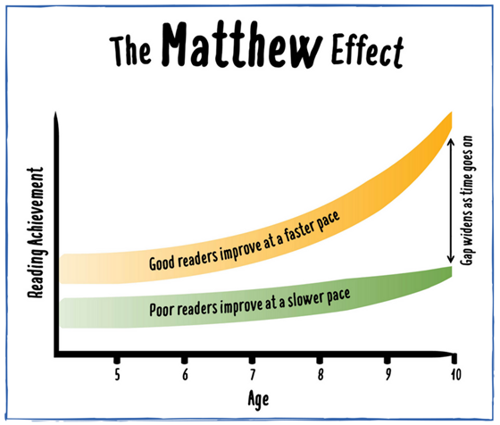

Slide 20
The Opportunity Gap at Work
Below Level | shelter, splattered, fixed, rescue
On Level | journal, tremors, traction, interval, volunteered, retrieve
Above Level | generation, abandoned, languished, terrified, warble, galvanized, debris, hoisted, shuddered
Notes:
This is where we really start to see those unintentional, dire consequences.
We can really think about this in terms of how it is played out in students’ confidence, in how they are perceived in the world, in teacher expectations-- what do you think about the 5th grader using the word languished or galvanized in his or her writing. Aren’t you just primed to see how bright he or she is?

Slide 21

Complex Text as an Equity Tool
Check your Resource widget to view the Text Complexity Rubric.
Links:
https://achievethecore.org/content/upload/SCASS_Info_Text_Complexity_Qualitative_Measures_Info_Rubric_2.8.pdf
https://achievethecore.org/content/upload/SCASS_Text_Complexity_Qualitative_Measures_Lit_Rubric_2.8.pdf
Notes:
If you haven’t already, be sure you have all the resources accessible for tasks throughout this webinar.

Slide 22
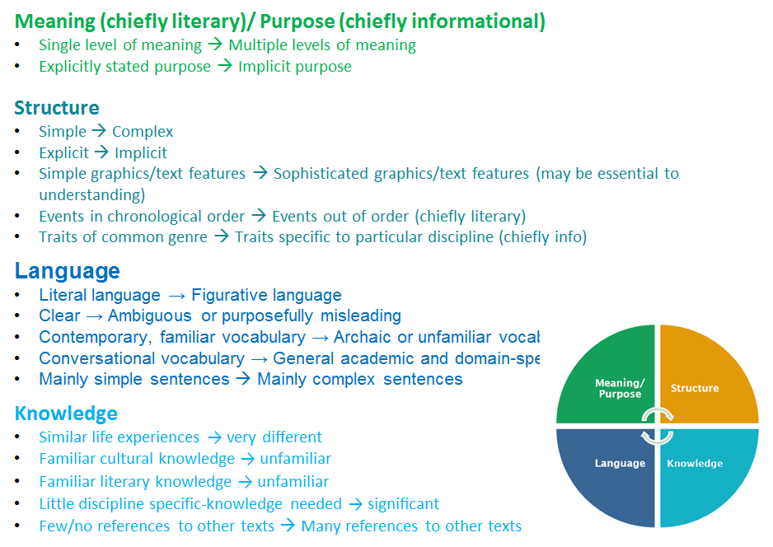

Slide 23

Question:
How do you see the Matthew Effect playing out in your school?
How can instructional practices contribute to or mitigate the effects of the opportunity gap?
P
Type your thoughts in the Group Chat!

Slide 24
Section 3: Then, What?

Slide 25
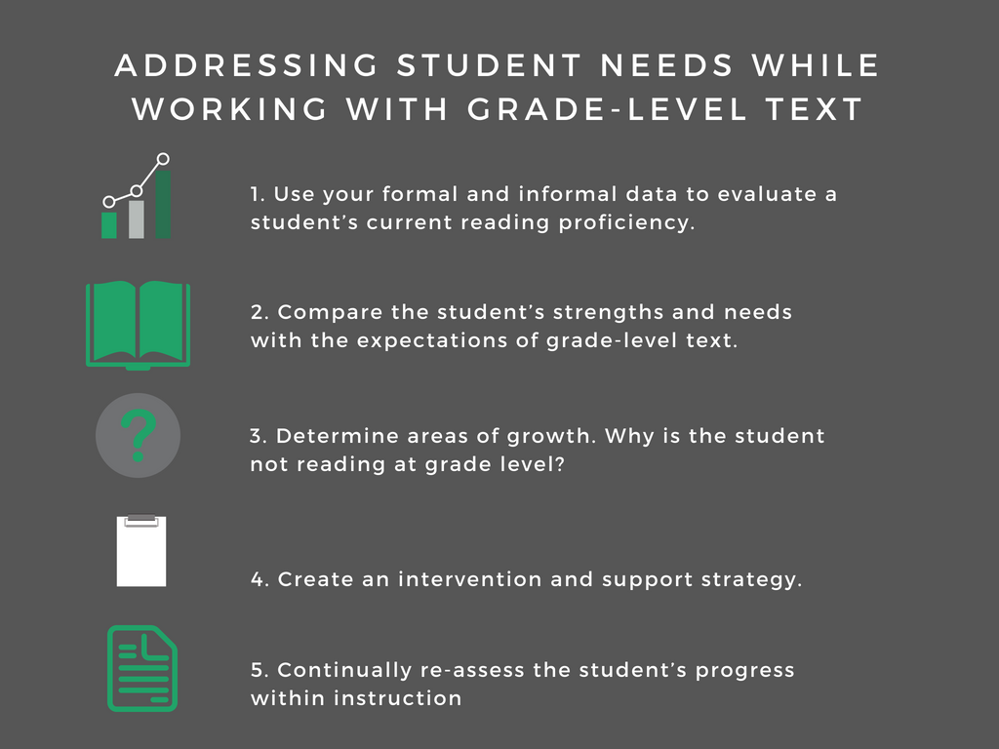

Slide 26


Let’s try this process out, thinking like a teacher about the needs of a classroom...

Slide 27
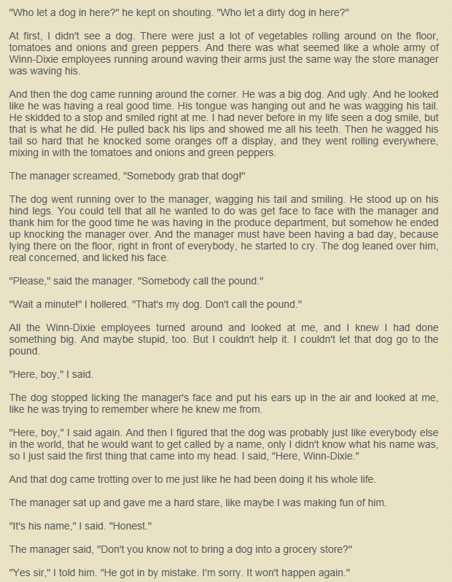

Let’s look at today’s text. What makes it complex?
Check your Resource widget to view the text.
https://drive.google.com/open?id=1-ilGR7yAmVMnK7xcrfnsFaiZDiWf_Gwi
Notes:
Lexile = 670L
We try to ensure that instruction is centered around the text itself, so for this exercise are asking you to start there.

Slide 28
What Makes This Text Complex?
At first, I didn't see a dog. There were just a lot of vegetables rolling around on the floor, tomatoes and onions and green peppers. And there was what seemed like a whole army of Winn-Dixie employees running around waving their arms just the same way the store manager was waving his.
____
"Wait a minute!" I hollered. "That's my dog. Don't call the pound."
_______
"Here, boy," I said again. And then I figured that the dog was probably just like everybody else in the world, that he would want to get called by a name, only I didn't know what his name was, so I just said the first thing that came into my head. I said, "Here, Winn-Dixie."
Notes:
Structure is pretty linear. Language is rich but clear. Where we found the likely struggle was in meaning/purpose-- are real noting what Opal is doing in this section, where the underlying character motivation is unsaid by the author.

Slide 29

Consider this student…
James is scoring ‘below basic’ on the district wide interim assessment.
His teacher had him do an oral read of the grade level fluency passages on achievethecore.org and found his fluency and decoding were not a barrier.
James has trouble answering sophisticated questions about the text that require him to provide evidence to support his thinking.
What’s next for James?

Slide 30

Consider this student…
Stella scored ‘low basic’ on the district wide interim assessment.
Her teacher had her do an oral read of the grade level fluency passages on achievethecore.org and found that her accuracy was strong, but her word by word decoding was extremely slow, and her prosody did not reflect understanding of the text. For example, she lacked expression and read through punctuation. Looking back at the data, her teacher found that Stella had not finished ⅓ of the district interim.
What’s next for Stella?

Slide 31
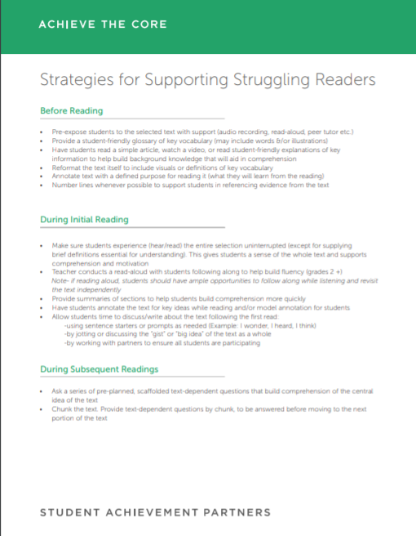
Strategies for Supporting Struggling Readers with Grade-Level Text
Before Reading
During Initial Reading
During Subsequent Readings
After/Between Readings
Check your Resource widget to view!
https://achievethecore.org/aligned/wp-content/uploads/2016/08/Supports-for-Struggling-Readers-Resource.pdf
Notes:
Comprehensive but not exhaustive list of scaffolds you can use to support readers with complex text.

Slide 32
How can we support James and Stella with this grade-level complex text?
Think about the demands of this particular text. What scaffolds might you use to support James and Stella and why?
Stella
Stella scored ‘low basic’ on the district wide interim assessment.
Her teacher had her do an oral read of the grade level fluency passages on achievethecore.org and found that her accuracy was strong, but her word by word decoding was extremely slow, and her prosody did not reflect understanding of the text. For example, she lacked expression and read through punctuation. Looking back at the data, her teacher found that Stella had not finished ⅓ of the district interim.
James
James is scoring ‘below basic’ on the district wide interim assessment.
His teacher had him do an oral read of the grade level fluency passages on achievethecore.org and found his fluency and decoding were not a barrier.
James has trouble answering sophisticated questions about the text that require him to provide evidence to support his thinking.
Use the “Strategies for Supporting Struggling Readers with Grade-Level Text” resource and type your answer in the Group Chat.
Notes:
Key to highlight:
Stella is a great candidate for a first teacher read, an audio recording, or a reading buddy- she needs fluency support so for her to be able to follow along, looking at the words on the page, with a more proficient model will be invaluable.
James is losing track of the text, and we already know where some of the key areas are in terms of complexity. He might need chunking or directing back to the text for specific places to reread in order to keep track of what the text is revealing about Opal.

Slide 33



Every child needs consistent opportunities to work with grade-level text. To accomplish this, we need to vary the supports we provide to each student!
Scaffolding questions in a small group re-read
Buddy second read
Teacher first read

Slide 34

This does NOT MEAN that kids are only ever reading grade-level complex texts!

Slide 35

In Fact, Close Reading of Complex Text is Vital…
but Not Enough on it’s Own!
 | Close Reading | Volume Reading
Text | Grade level text, fewer pages | Variety of text complexity levels, more pages
Support | Heavy support | Lighter support
Purpose | Solely instructional | Guided or independent

Slide 36
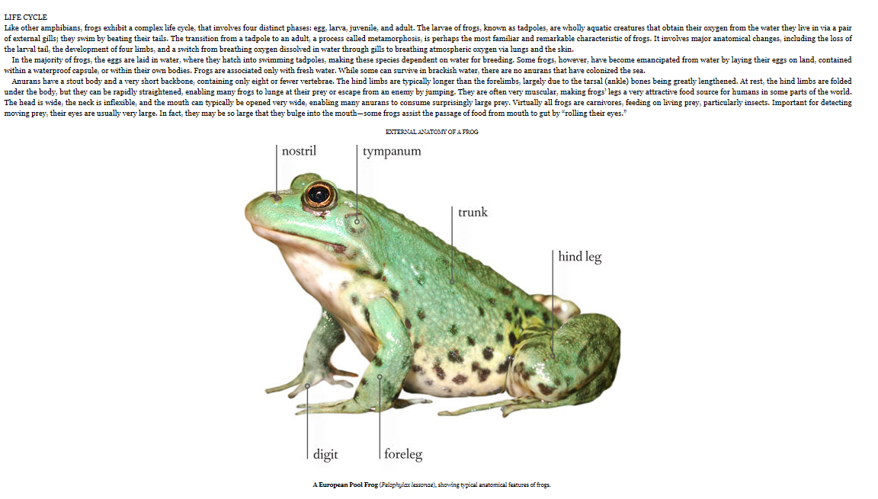
The Role of Knowledge and Vocabulary
This text is full of Tier 2 and Tier 3 academic language!

Slide 37
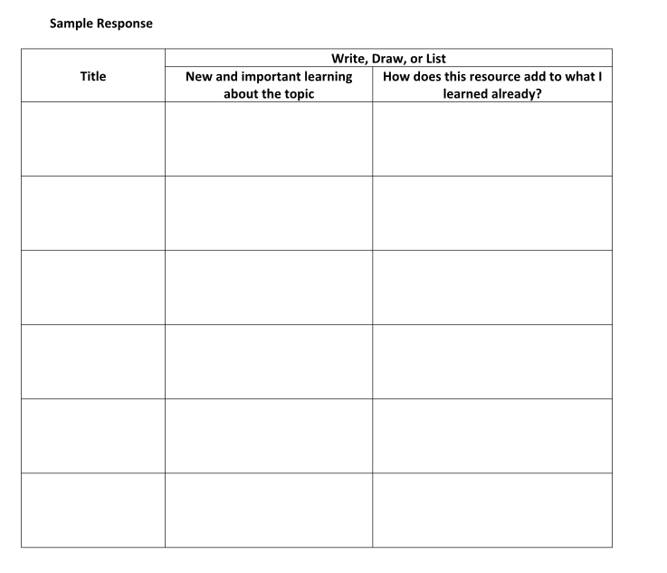

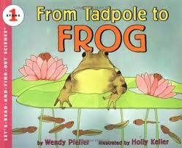

Text Sets Can Serve as a Scaffold
Build content knowledge through text sets on the topic at a range of complexity levels.

Slide 38

Reading texts on a topic accelerates vocabulary growth and is a best practice for supporting ELLS.
(Landauer & Dumais, 1997)
Notes:
Big Idea: Remember, we see much better growth with vocabulary
This normal process of word acquisition occurs up to four times faster for Tier Three words when students have become familiar with the domain of the discourse and encounter the word in different contexts (Landauer & Dumais, 1997). Hence, vocabulary development for these words occurs most effectively through a coherent course of study in which subject matters are integrated and coordinated across the curriculum and domains become familiar to the student over several days or weeks.
Computer simulation study

Slide 39
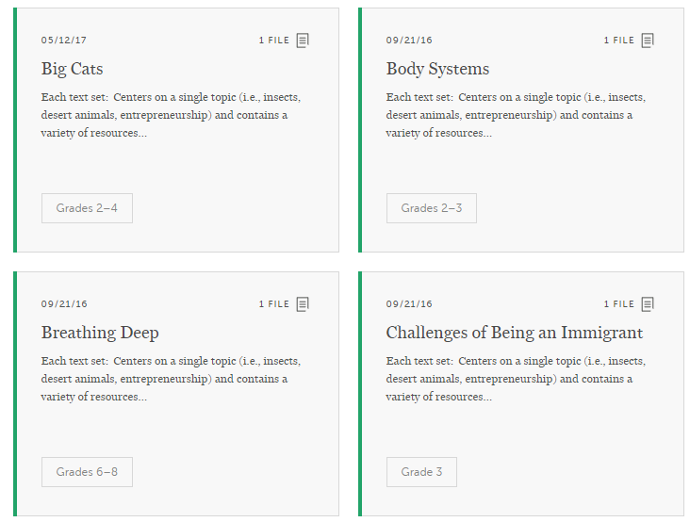
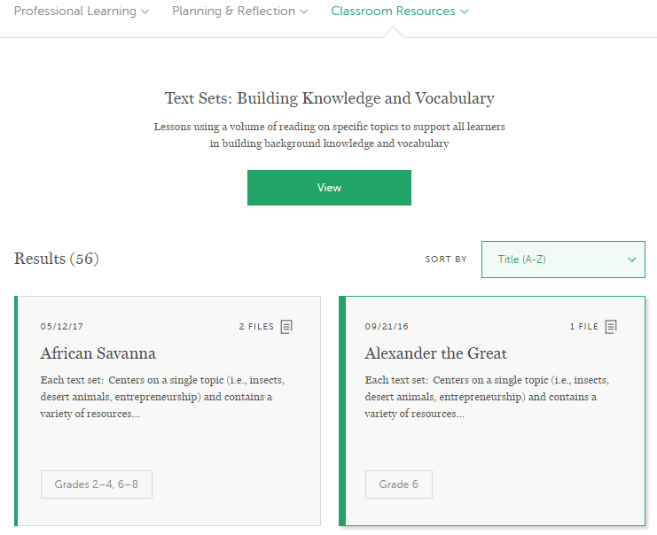
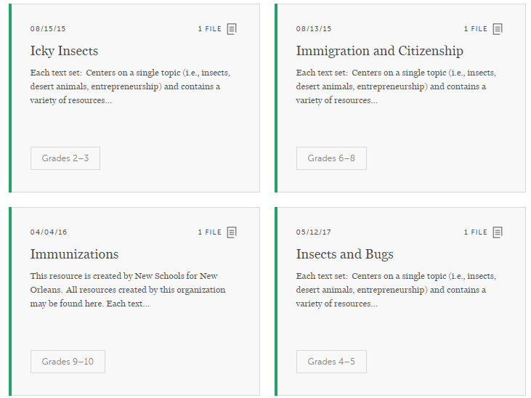
For more resources, check out our Text Set Project

Slide 40
A note regarding intervention and support plans
Our work in this webinar focused on ensuring all students access complex text.
Additional supports may be needed at other times of day to support unfinished learning.
For students like Stella, decoding and fluency supports are likely needed in addition to complex text work (not in place of).

Slide 41
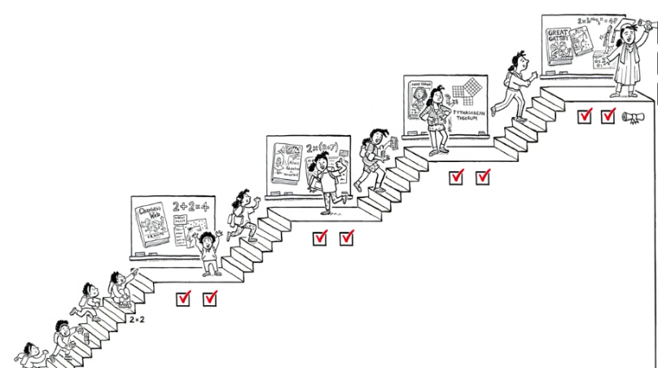
Let's Meet Our Students Where They Are Going

Slide 42
Other Links
Shanahan Blog: https://shanahanonliteracy.com/blog/the-instructional-level-concept-revisited-teaching-with-complex-text#sthash.3oLXN0CP.dpbs
Are Classroom Reading Groups the Best Way?: https://www.edweek.org/ew/articles/2018/08/29/are-classroom-reading-groups-the-best-way.html
Why Complex Text Matters: https://achievethecore.org/page/62/why-complex-text-matters

Slide 43
Questions for Our Guests?

Slide 44
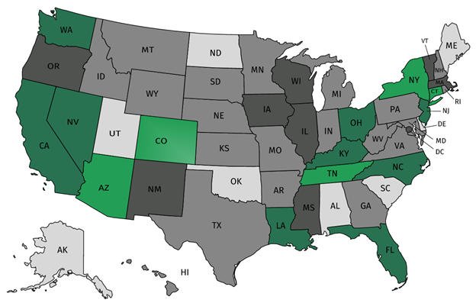




Join Our Network!
Join a national network of educators
Connect with state networks
Be a part of creating new tools and resources in partnership with SAP
Keep up to date on free resources, upcoming SAP webinars/professional learning opportunities, job postings and more!
Notes:
If you found tonight’s webinar helpful, we’d like to invite you to join our Core Advocate network! We’re committed to solving real problems that real teachers have and we know the best way to do this is to know more about what folks are experiencing.
As part of our national network, you have opportunities to connect with educators across the country, maybe even the network in your state! You can keep up to date on tools and resources available on Achieve the Core, as well as a variety of virtual learning opportunities and other ways to engage with us. We also work with educators in our network to help us build tools and resources.
We’d love to learn about who you are, where you work, the types of things you’re interested in and the expertise you already have. This way, we will be able to tailor our webinars and other opportunities to your needs and interests (we may even tap you to be our next webinar panelist).

Slide 45




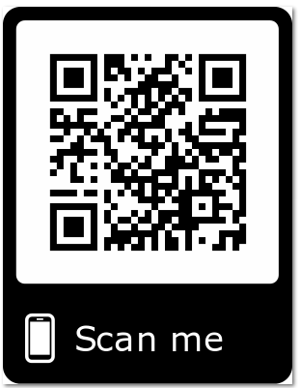
Please Join Us!
https://achievethecore.org/ca-signup
Twitter: twitter.com/achievethecore
Facebook: facebook.com/achievethecore
Pinterest: pinterest.com/achievethecore
Notes:
We encourage you to join the network by filling out this survey completely at atc.org/ca-signup

Slide 46

Please Join Us Again Next Month!
Next month’s webinar:
Foundational Skills Instruction in Action
January 9, 2019 at 7:00 p.m. ET
Register Here: https://event.on24.com/wcc/r/1821775/6B4505162047AF0E8DAACEFCE4A3DD72

Slide 47
Thank You!

