Slide 1
Building Mathematical Content Knowledge
Core Advocates Monthly Webinar
February 6, 2019
The webinar will begin shortly.
Check your Resource widget to preview the resources for today’s session!
Notes:
While we’re waiting, we’d like you to participate in a quick poll so we can get an understanding of who’s on the webinar with us tonight.

Slide 2
Introductions
Your host from the Professional Learning Team
Nicole Bravo, Project Manager
This Month’s Guests -
Jennie Beltramini, Mathematics Specialist
Kristin Gray, Director K-5 Curriculum and Professional Learning, Illustrative Mathematics

Slide 3
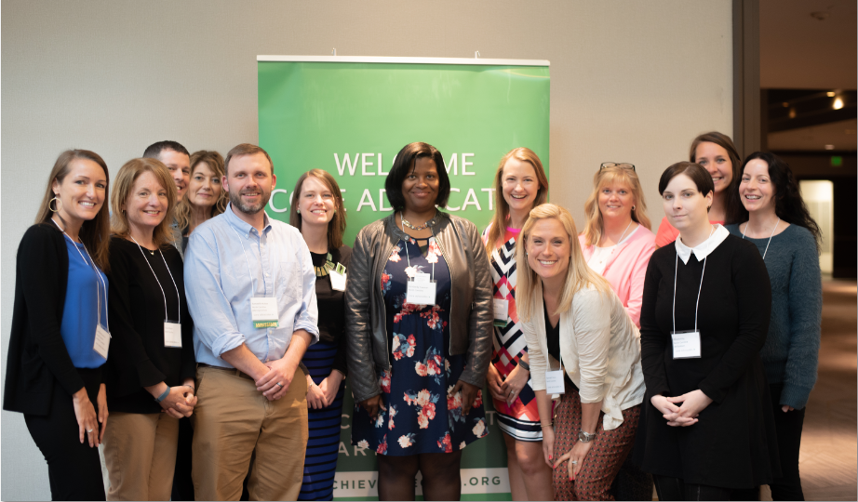
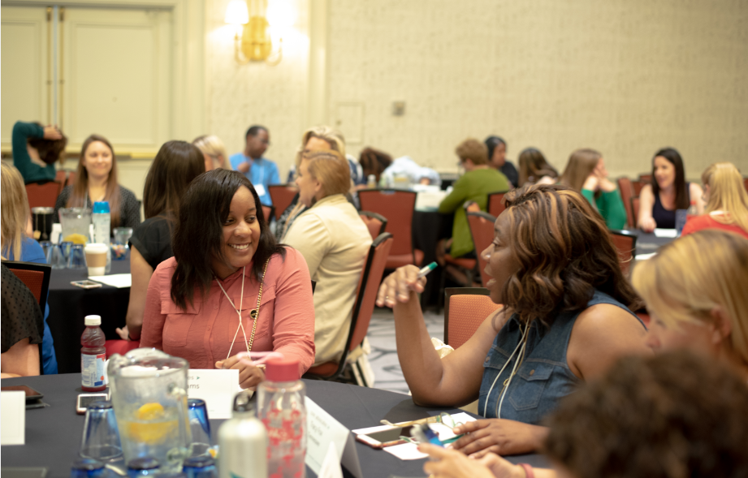
Who Are Core Advocates?
Core Advocates believe in the power of standards to prepare all students for college and/or careers.
They are eager to support and collaborate with their colleagues and communities in understanding and translating the Shifts into instructional practice.
Core Advocates have the tools and knowledge to advocate for high-quality instruction, instructional resources, and professional learning in their communities.
Notes:
CAs are teachers from all over the country who believe in the potential of high quality standards and the importance of all students being prepared for college and careers.
They support their colleagues in understanding and advocating for the standards and embrace the Shifts in instruction
The Core Advocate network is over 10K educator strong and we’d love for you to join us if you have not already

Slide 4
Learn More About Us!
Contact Jennie Beltramini (jbeltramini@studentsachieve.net )
Complete this survey to join our database (and mailing list): www.achievethecore.org/ca-signup
Visit our website: www.achievethecore.org
Notes:
If you’d like to learn more about the network, contact Jennie (her email is here).
We also want to invite you to join the network by signing up at achievethecore.org/ca-signup and visit our website for more info and opportunities

Slide 5
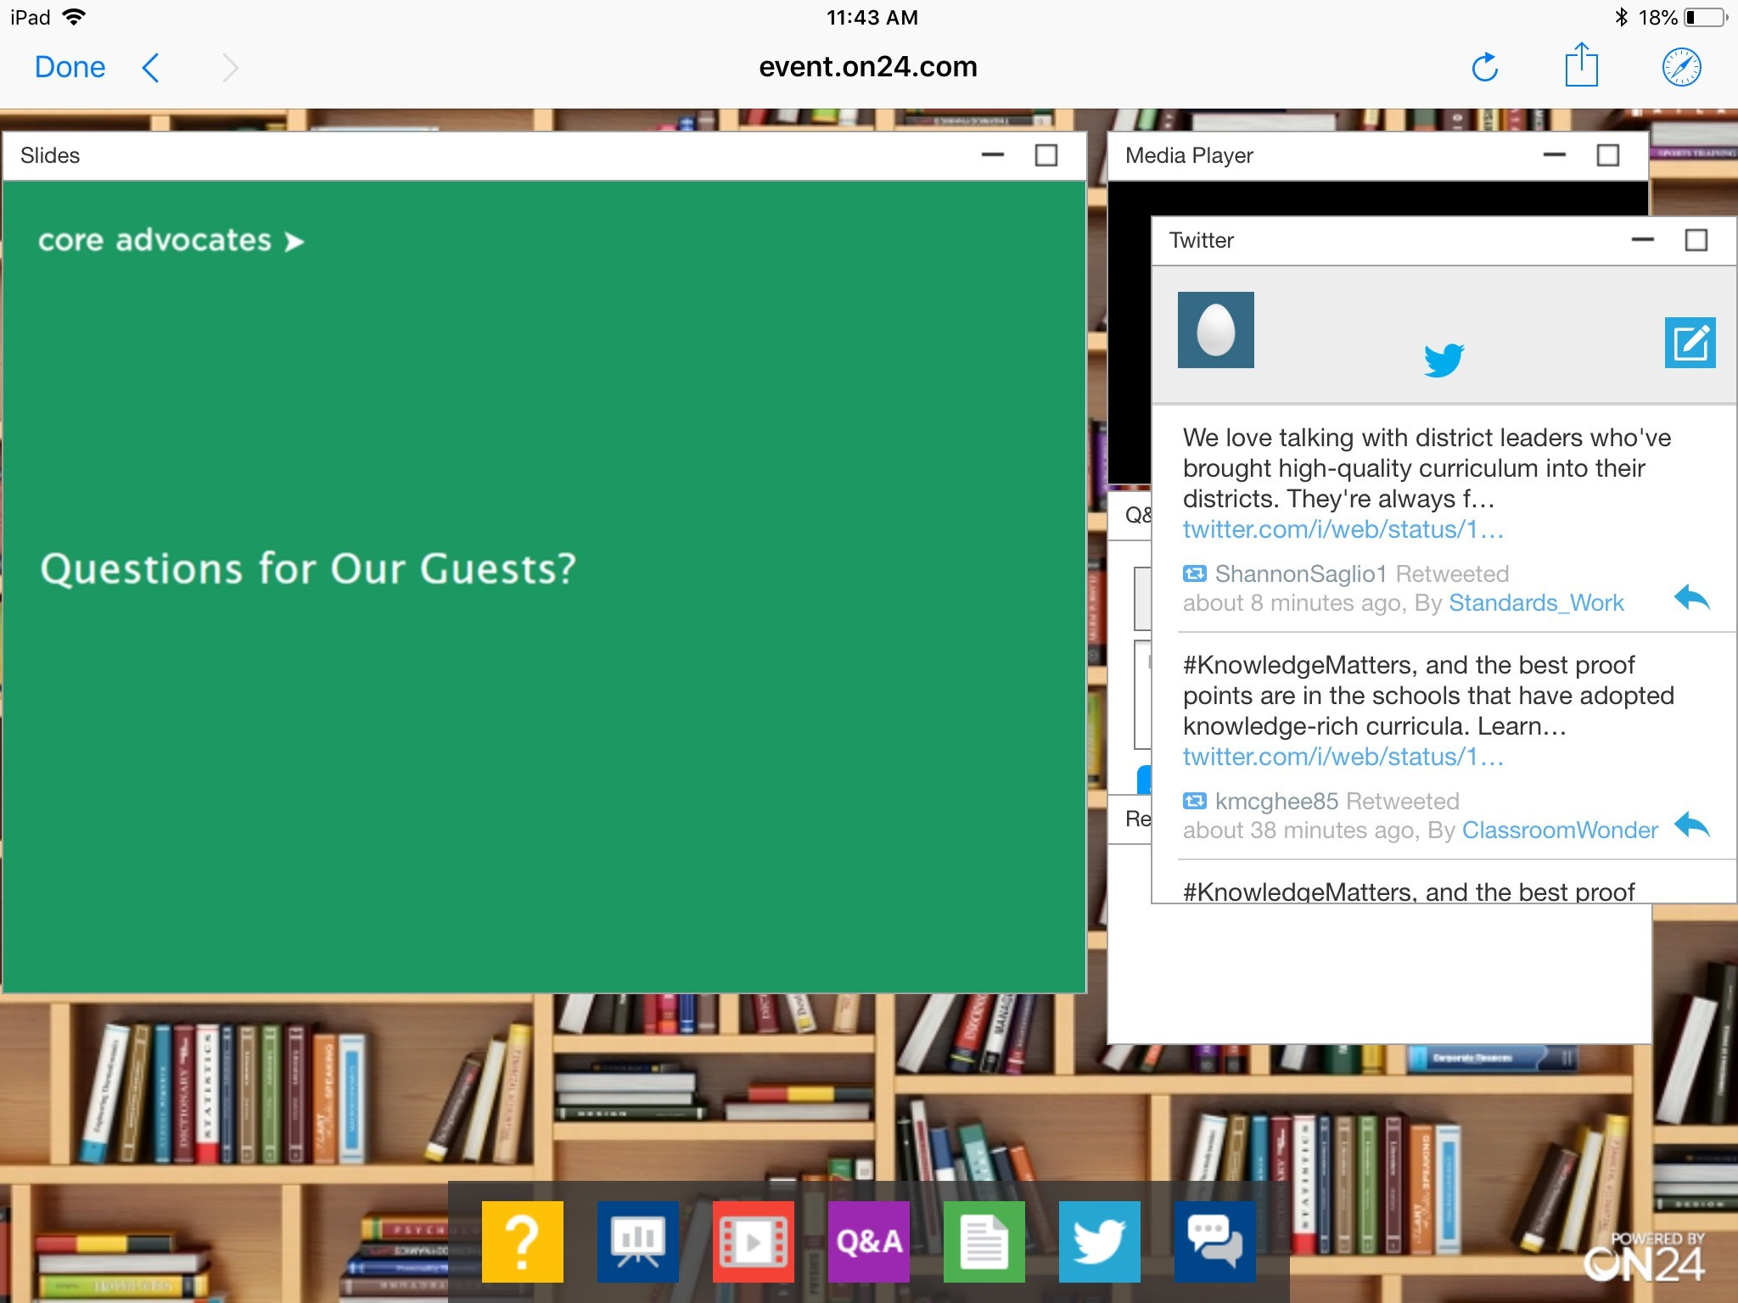
Tweet with Us!
Please feel free to tweet during and after the webinar using #coreadvocates
@achievethecore
@JennieBeltro
@MathMinds
@IllustrateMath
Click here!

Slide 6
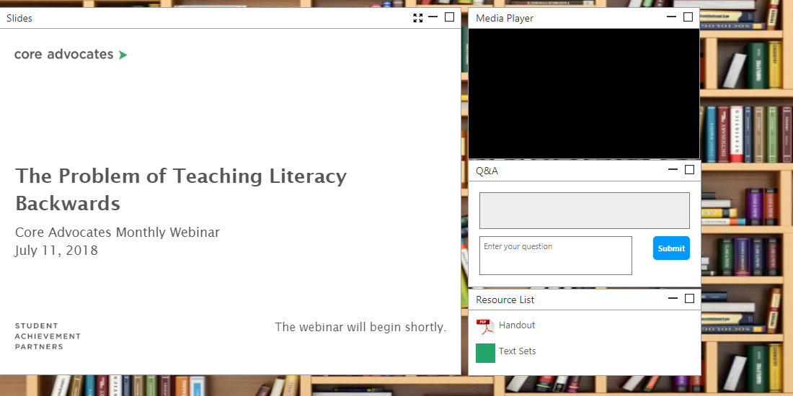
Engage with Us!
During the webinar
– Questions option
– Find the handouts and resources
After the webinar
– Access to recorded
webinar

Slide 7
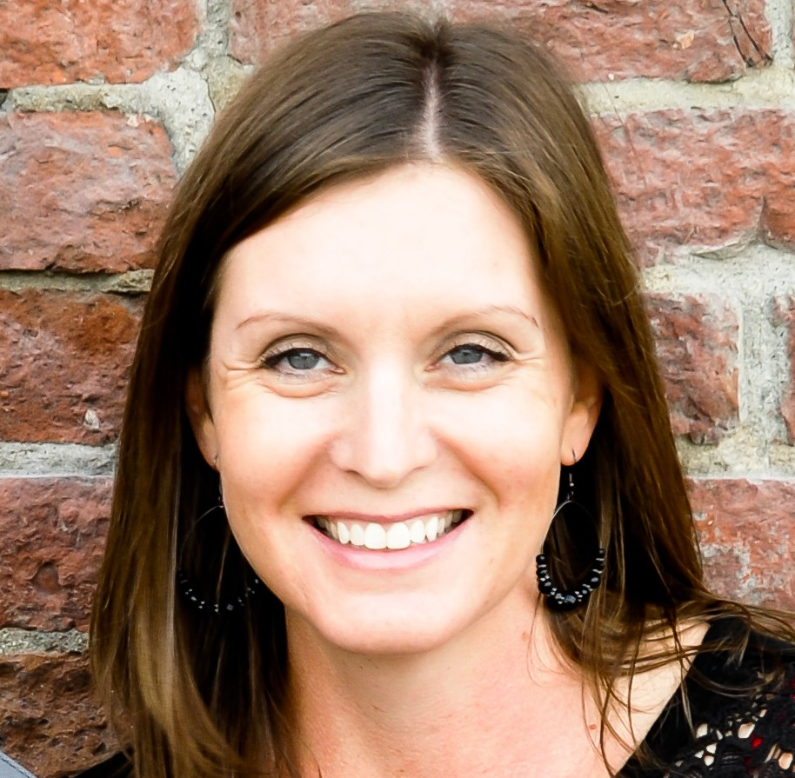
Jennie Beltramini
Mathematics Specialist
Professional Learning Team
Student Achievement Partners

Slide 8
Poll Question:
Which of the following best describes your role?
Teacher (K-5)
Teacher (6-12)
Instructional Coach
Specialist
Administrator
Other

Slide 9
Goals of the Webinar
Understand the importance of math knowledge for teaching
Practice a process to deepen math content knowledge
Understand part of the 3-5 Fraction Learning Progression, and how to select other important topics for deepening understanding

Slide 10
Use the “Group Chat” widget to type your response.
What math topic comes to mind when you think about complex math concepts that require deep teacher knowledge to teach?

Slide 11
Why does mathematical content knowledge matter?

Slide 12
“That the quality of mathematics teaching depends on teachers’ knowledge of the content should not be a surprise. Equally unsurprising is that many U.S. teachers lack sound mathematical understanding and skill. This is to be expected because most teachers—like most other adults in this country—are graduates of the very system that we seek to improve.”
~Deborah Loewenberg Ball

Slide 13
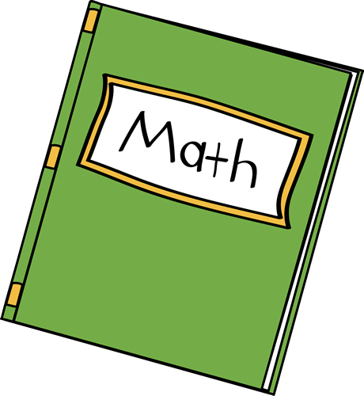
Mathematical Knowledge for Teaching
Deborah Loewenberg Ball

Slide 14
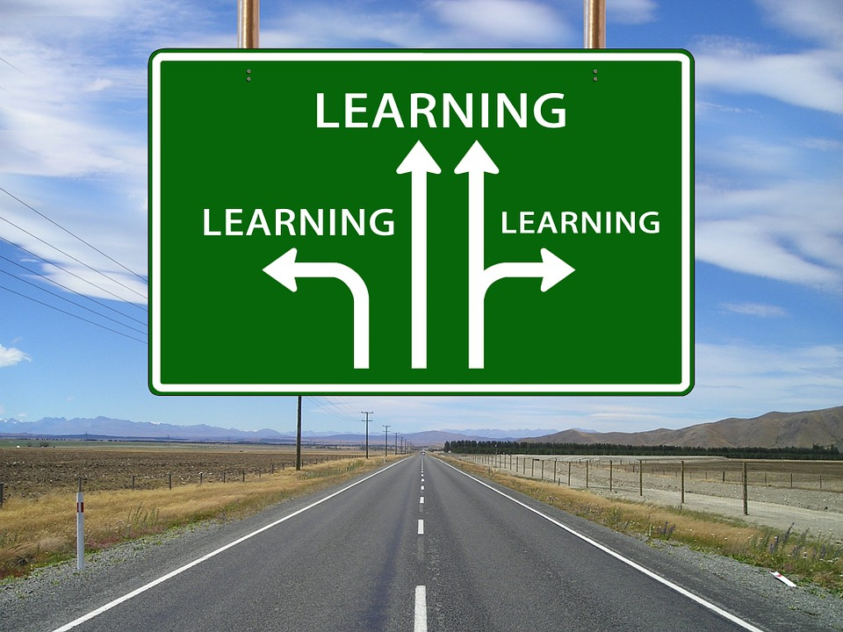
Types of Subject Matter Knowledge
CCK is defined as:
the mathematical knowledge known in common with others who know and use mathematics
the knowledge required in order to solve such tasks as are given to students
the knowledge held by a well-educated adult
SCK is defined as:
mathematical knowledge not typically needed for purposes other than teaching; unique mathematical understanding and reasoning
Teachers must hold unpacked mathematical knowledge because teaching involves making features of particular content visible to and learnable by students.

Slide 15
Strong standards and quality curriculum are important. But no curriculum teaches itself, and standards do not operate independently of professionals’ use of them. To implement standards and curriculum effectively, school systems depend upon the work of skilled teachers who understand the subject matter. How well teachers know mathematics is central to their capacity to use instructional materials wisely, to assess students’ progress, and to make sound judgments about presentation, emphasis, and sequencing.
Deborah Loewenberg Ball

Slide 16
Poll Question:
Have you ever had to dig into a math topic in order to prepare to teach it? How did you (or would you) deepen your content knowledge?
I did the math myself
I worked with a colleague
I watched a video (YouTube, Khan Academy, LearnZillion, etc.)
I read about it (in the textbook, in the Progression Documents, etc.)
Other

Slide 17
How can we deepen our mathematical content knowledge?

Slide 18
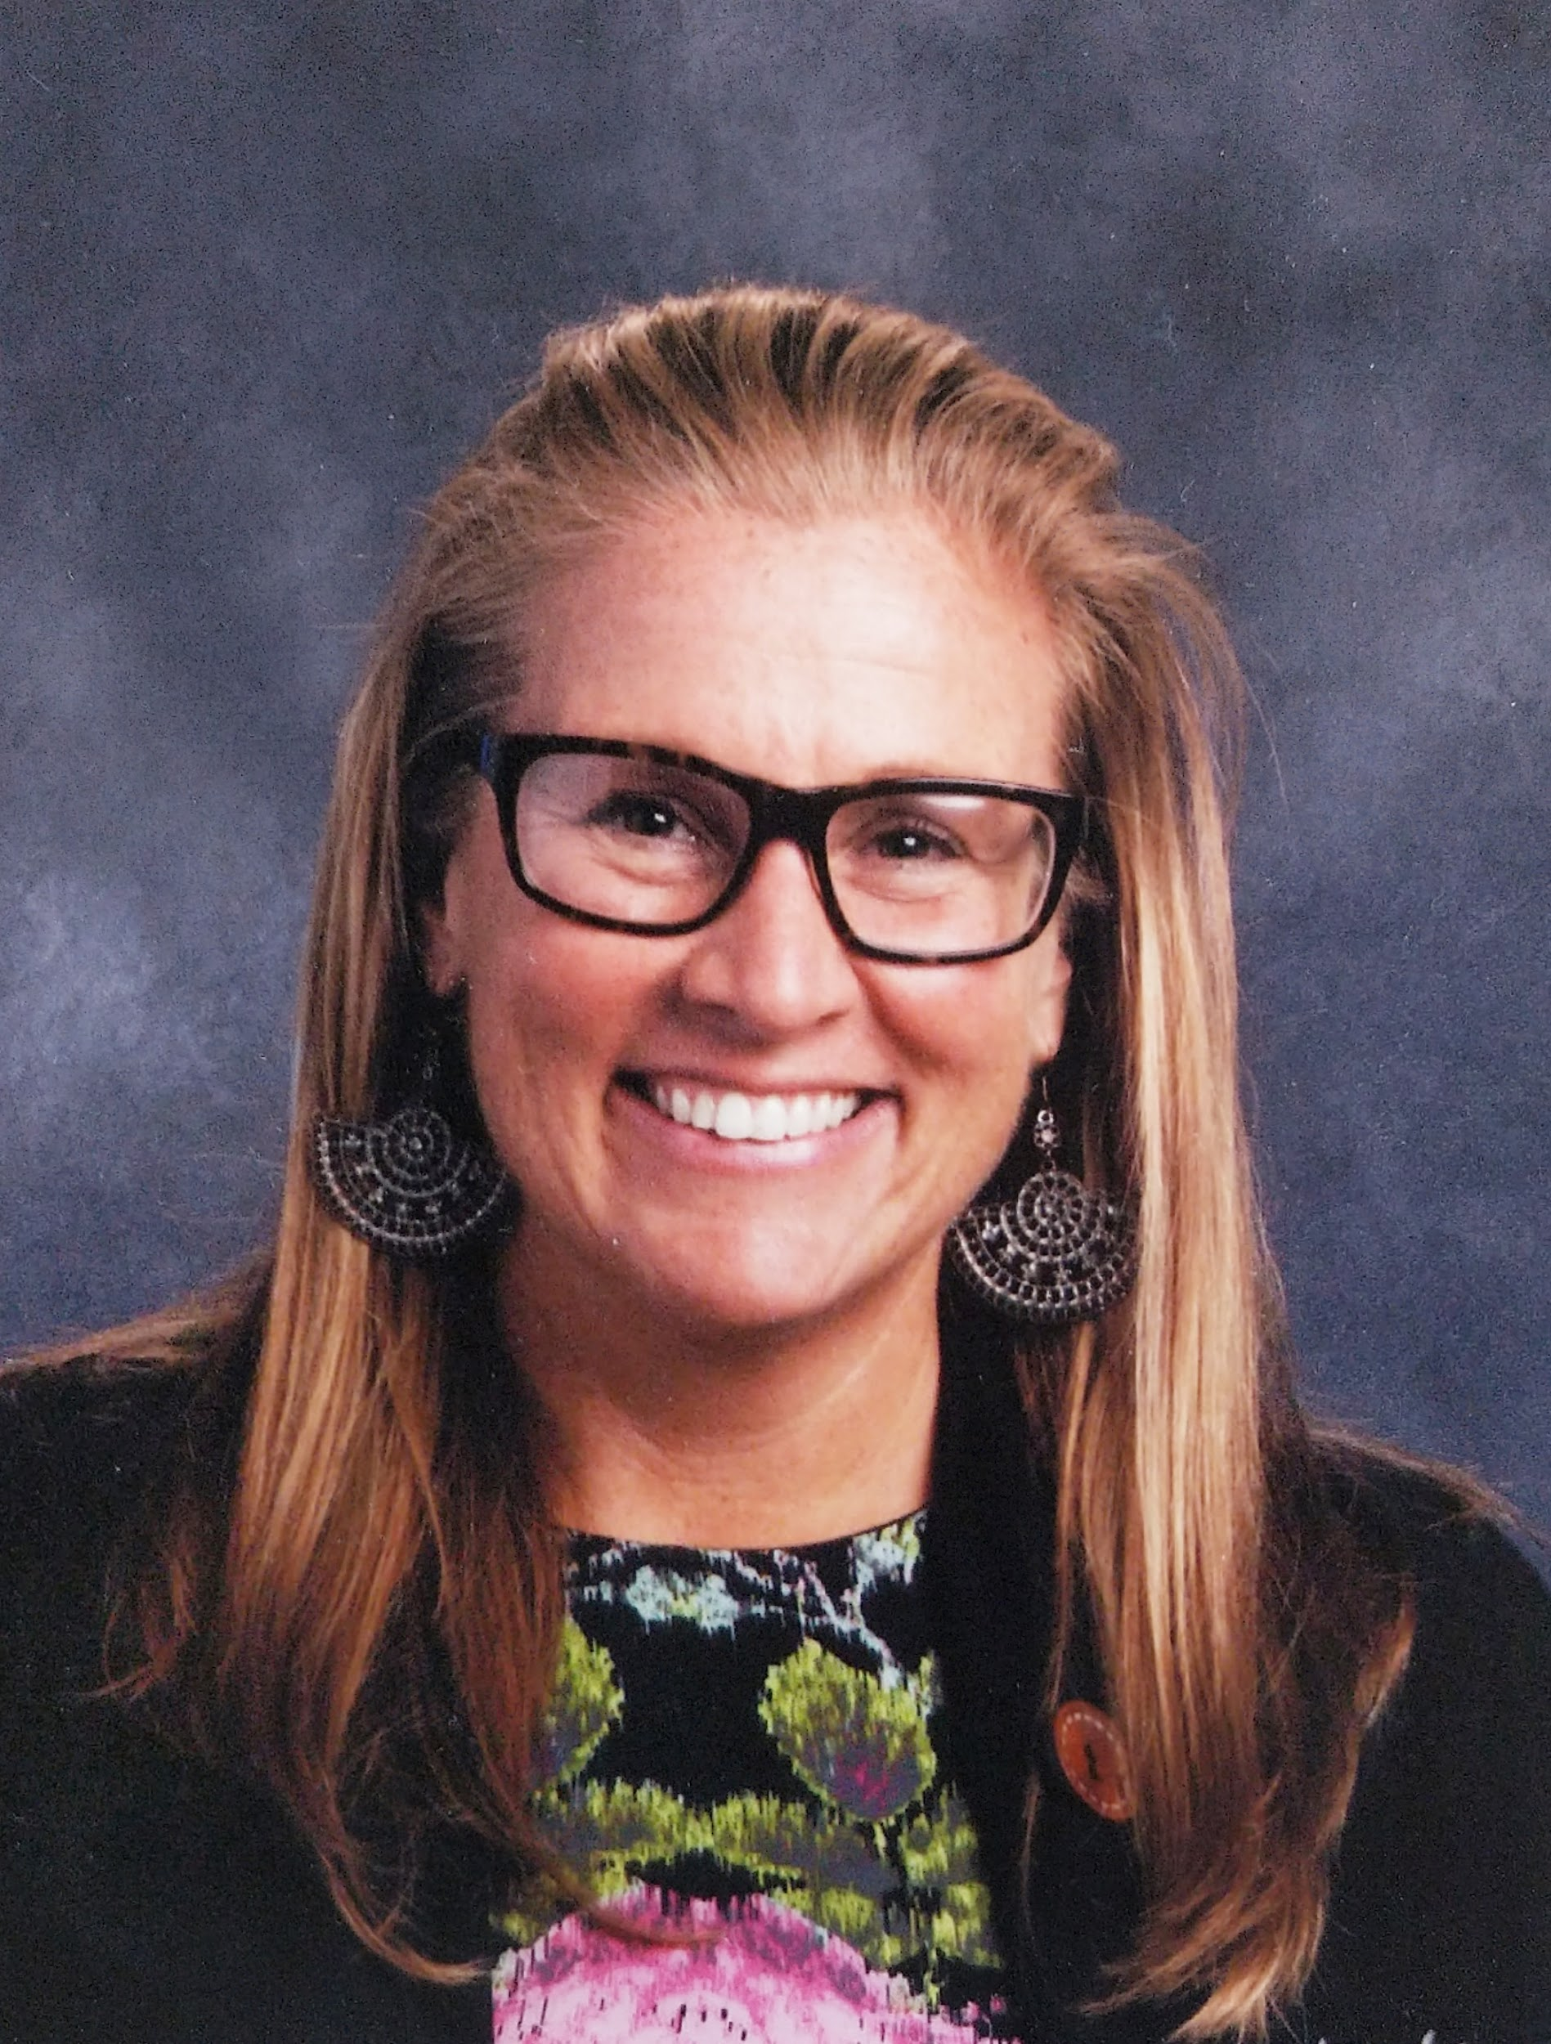
Kristin Gray
Director of K-5 Curriculum &
Professional Learning
Illustrative Mathematics

Slide 20
Reflecting on the Math
What ideas would students need to understand to be successful in this task?
What math was the task addressing specifically?
What understandings is it building on?
What understandings is it building toward?
Use the “Group Chat” widget to share some of your thoughts!

Slide 21
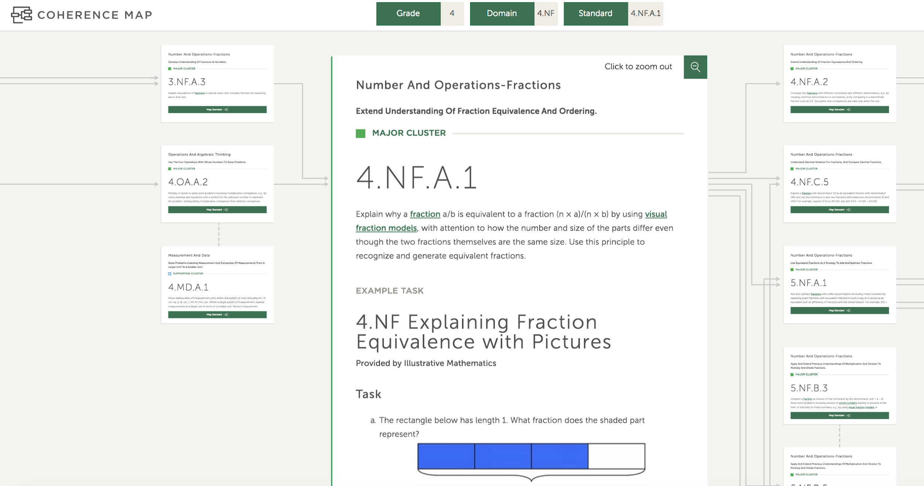
The Coherence Map

Slide 22
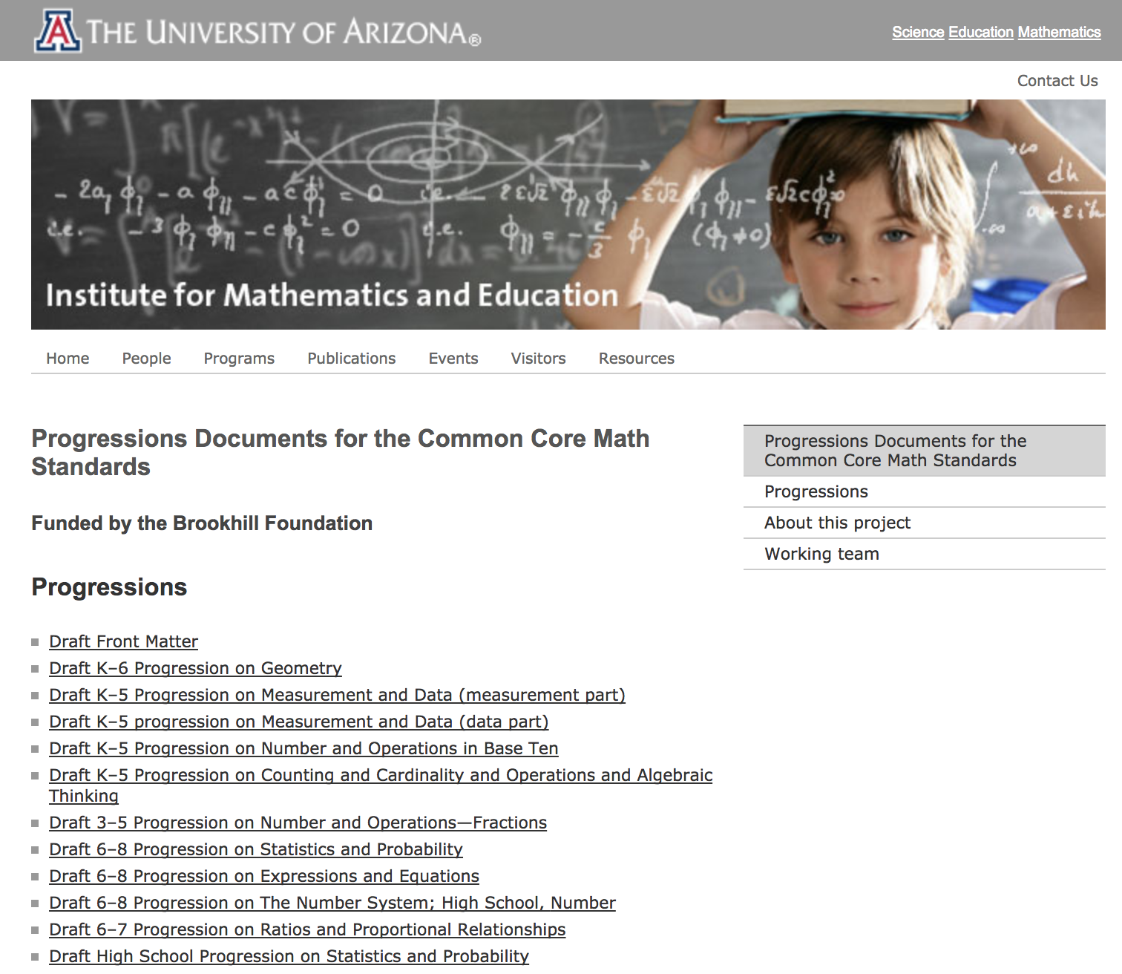
The Progression of Learning

Slide 23
Reading Excerpts and Reflecting
http://ime.math.arizona.edu/progressions/
Read excerpts of the progressions at vertical grade levels:
What big ideas stand out to you while reading your grade level section of the progression?
Where do you see similarities or connections between the grade levels?

Slide 24
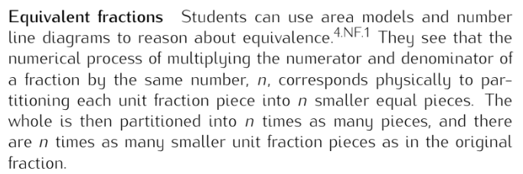

Slide 25
Mathematical Progression in Tasks
http://mathematicalmusings.org/wp-content/uploads/2018/08/ccss_progression_nf_35_2018_08_10.pdf
3rd grade
4th grade
5th grade

Slide 26
IM Commentary and Solutions

Slide 27
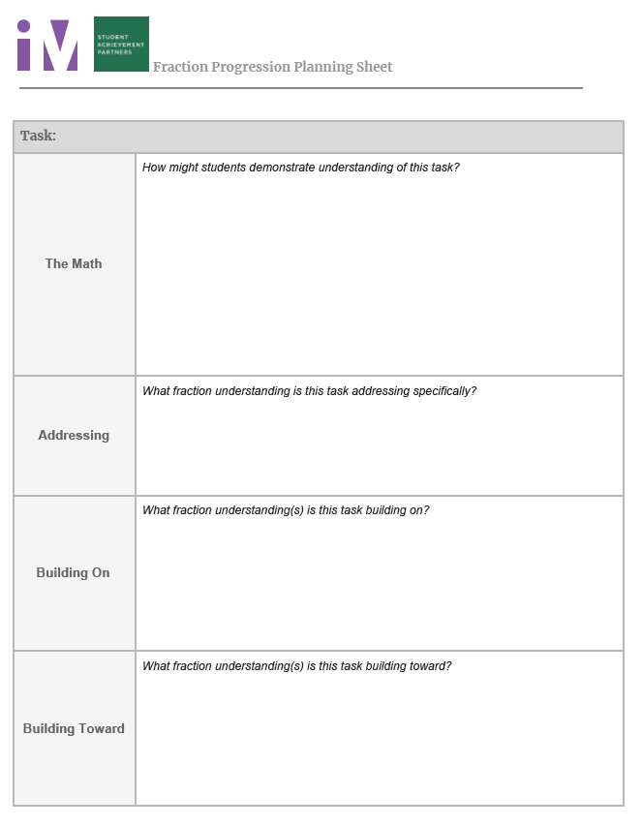
What connections can be made between the original task, the progressions, and the grade level task?

Slide 28
Reflecting on the Progression of the Task
Share the mathematics of your task.
What connections do you see through all of the tasks?
How did your thinking change after reading the progressions?
Use the “Group Chat” widget to share some of your thoughts!

Slide 29
How can we build mathematical content knowledge in any topic?

Slide 30
Poll:
What topic would you be most interested in diving into to build your own math content knowledge?
Place Value
Whole Number Operations
Ratio and Proportional Reasoning
Modeling
Functions
Integer Operations
Expressions and Equations
Other

Slide 31
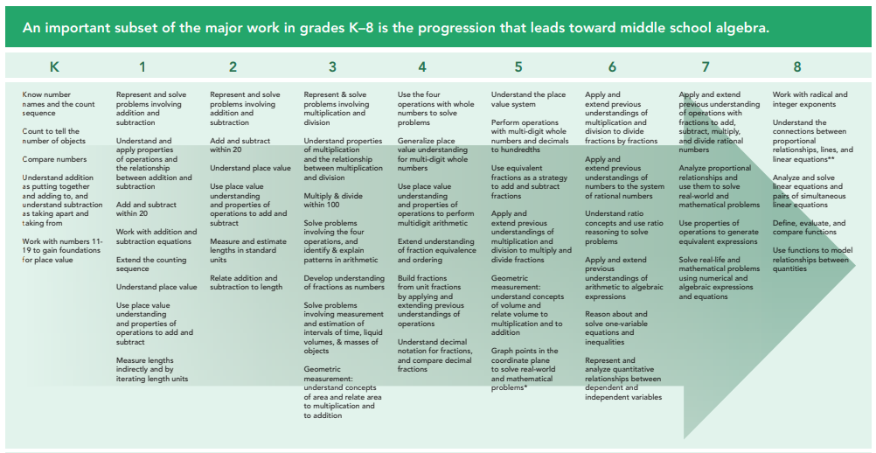
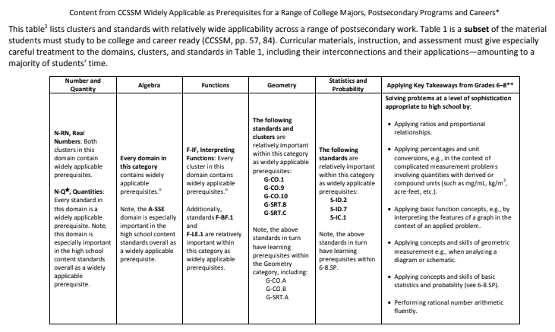
Which topics should we spend time with?

Slide 32
The Process
Select topic to dive into
Find appropriate, standards-aligned tasks
Do the math
Read the Progression Documents
Revisit and revise your thinking
Do vertical math
Make connections

Slide 33
How might you use this process?

Slide 34
Poll:
How might you use this process to build mathematical content knowledge?
For myself, by myself
For myself, in my PLC
Leading it for others, in a PLC
Leading it for others, in another professional learning structure

Slide 35
Closing

Slide 36
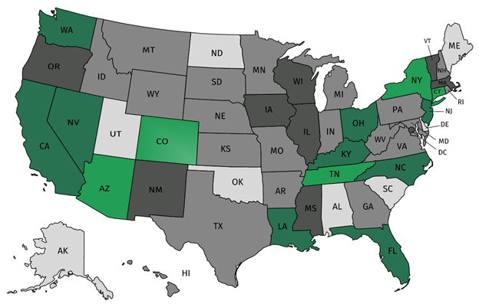
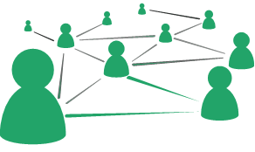
Join Our Network!
Join a national network of educators
Connect with state networks
Be a part of creating new tools and resources in partnership with SAP
Keep up to date on free resources, upcoming SAP webinars/professional learning opportunities, job postings and more!
Notes:
If you found tonight’s webinar helpful, we’d like to invite you to join our Core Advocate network! We’re committed to solving real problems that real teachers have and we know the best way to do this is to know more about what folks are experiencing.
As part of our national network, you have opportunities to connect with educators across the country, maybe even the network in your state! You can keep up to date on tools and resources available on Achieve the Core, as well as a variety of virtual learning opportunities and other ways to engage with us. We also work with educators in our network to help us build tools and resources.
We’d love to learn about who you are, where you work, the types of things you’re interested in and the expertise you already have. This way, we will be able to tailor our webinars and other opportunities to your needs and interests (we may even tap you to be our next webinar panelist).

Slide 37
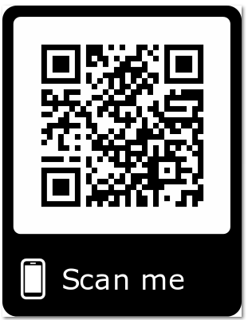
Please Join Us!
Or, sign up right now using the Core Advocate Survey link in your Resource widget!
https://achievethecore.org/ca-signup
Twitter: twitter.com/achievethecore
Facebook: facebook.com/achievethecore
Pinterest: pinterest.com/achievethecore
Notes:
We encourage you to join the network by filling out this survey completely at atc.org/ca-signup.
If you found tonight’s webinar helpful, we’d like to invite you to join our Core Advocate network! We’re committed to solving real problems that real teachers have and we know the best way to do this is to know more about what folks are experiencing.
We’d love to learn about who you are, where you work, the types of things you’re interested in and the expertise you already have. This way, we will be able to tailor our webinars and other opportunities to your needs and interests (we may even tap you to be our next webinar panelist). So we encourage you to join the network by filling out this survey completely at atc.org/ca-signup

Slide 38
Please Join Us Again Next Month!
Next month’s webinar: High School Mathematics: The Reveal of the Extended Coherence Map
Date & Time: March 6, 2019 at 7:00 pm ET
Register Here: https://event.on24.com/wcc/r/1927058/1FBF4E097C5AABD1F550D5B996DFA3DA
Register for Next Month’s Webinar
Notes:
Is the Coherence Map one of your favorite tools on Achieve The Core? In this webinar, you’ll be one of the first to dive into the extension of the map through High School. You’ll learn about decisions that were made regarding course structures, plus standards, and child/parent standards. And you’ll learn why mapping the conceptual category of Modeling for high school may be one of the most intriguing aspects of the revised map.

Slide 39
What to dig deeper into math
content knowledge?
Be on the lookout for our upcoming
virtual mini-course on building mathematical content knowledge:
Course starts early summer
Participants can choose a grade band for participation:
K-2
3-5
6-7
8-HS
Participants will get a certificate of completion with professional learning hours included
Check social media or the Core Advocate Newsletter for more details!

Slide 40
Other Links
Focus by Grade Level Documents: https://achievethecore.org/category/774/mathematics-focus-by-grade-level
Widely Applicable Prerequisites: https://achievethecore.org/content/upload/Widely%20Applicable%20Prerequisites.pdf
Professional Learning Through a Fraction Task Progression: https://illustrativemathematics.blog/2018/10/16/professional-learning-through-a-fraction-task-progression/

Slide 41
Thank You!

