Slide 1

High School Mathematics: The Reveal of the Extended Coherence Map
Core Advocates Monthly Webinar
March 6, 2019
The webinar will begin shortly.
Check your Resource widget to preview the resources for today’s session!
Notes:
First timer poll
Handouts:
While we’re waiting, we’d like you to participate in a quick poll so we can get an understanding of who’s on the webinar with us tonight.

Slide 2
Introductions
Your hosts:
Claire Rivero, Digital Strategy Manager
Barbara Beske, Senior Math Specialist
This Month’s Guest:
Marissa McClish, Professional Growth Systems Project Coordinator, Washoe County School District

Slide 3
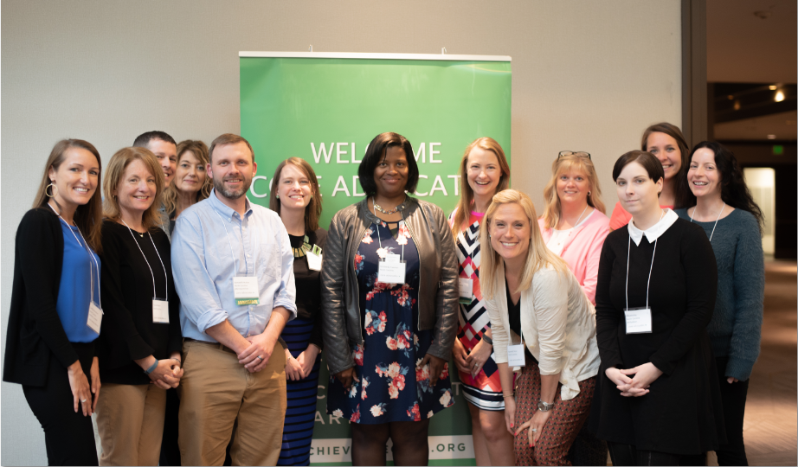
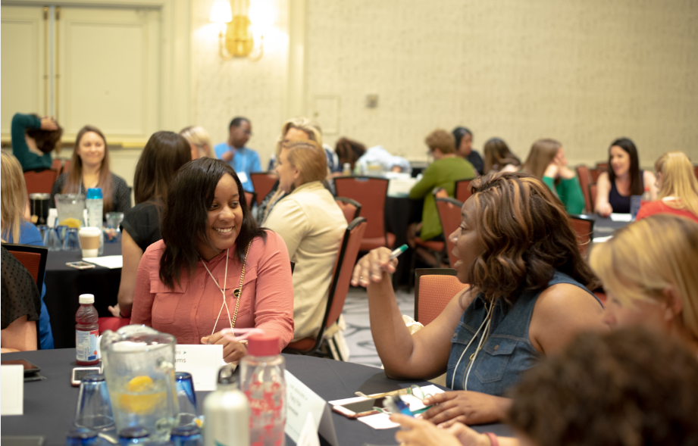
Who Are Core Advocates?
Core Advocates believe in the power of standards to prepare all students for college and/or careers.
They are eager to support and collaborate with their colleagues and communities in understanding and translating the Shifts into instructional practice.
Core Advocates have the tools and knowledge to advocate for high-quality instruction, instructional resources, and professional learning in their communities.
Notes:
CAs are educators from all over the country who believe in the potential of high quality standards and the importance of all students being prepared for college and careers.
They support their colleagues in understanding and advocating for the standards and embrace the Shifts in instruction
The Core Advocate network is over 10K educator strong and we’d love for you to join us if you have not already

Slide 4

Learn More About Us!
Complete this survey to join our database (and mailing list): www.achievethecore.org/ca-signup
Visit our website: www.achievethecore.org
Contact Jennie Beltramini (jbeltramini@studentsachieve.net )
Notes:
We also want to invite you to join the network by signing up at achievethecore.org/ca-signup and visit our website for more info and opportunities
If you’d like to learn more about the network, contact Jennie (her email is here).

Slide 5
Poll: How many Core Advocate Webinars have you attended?
This is my first one!
1-5
6-10
11-15
16+

Slide 6

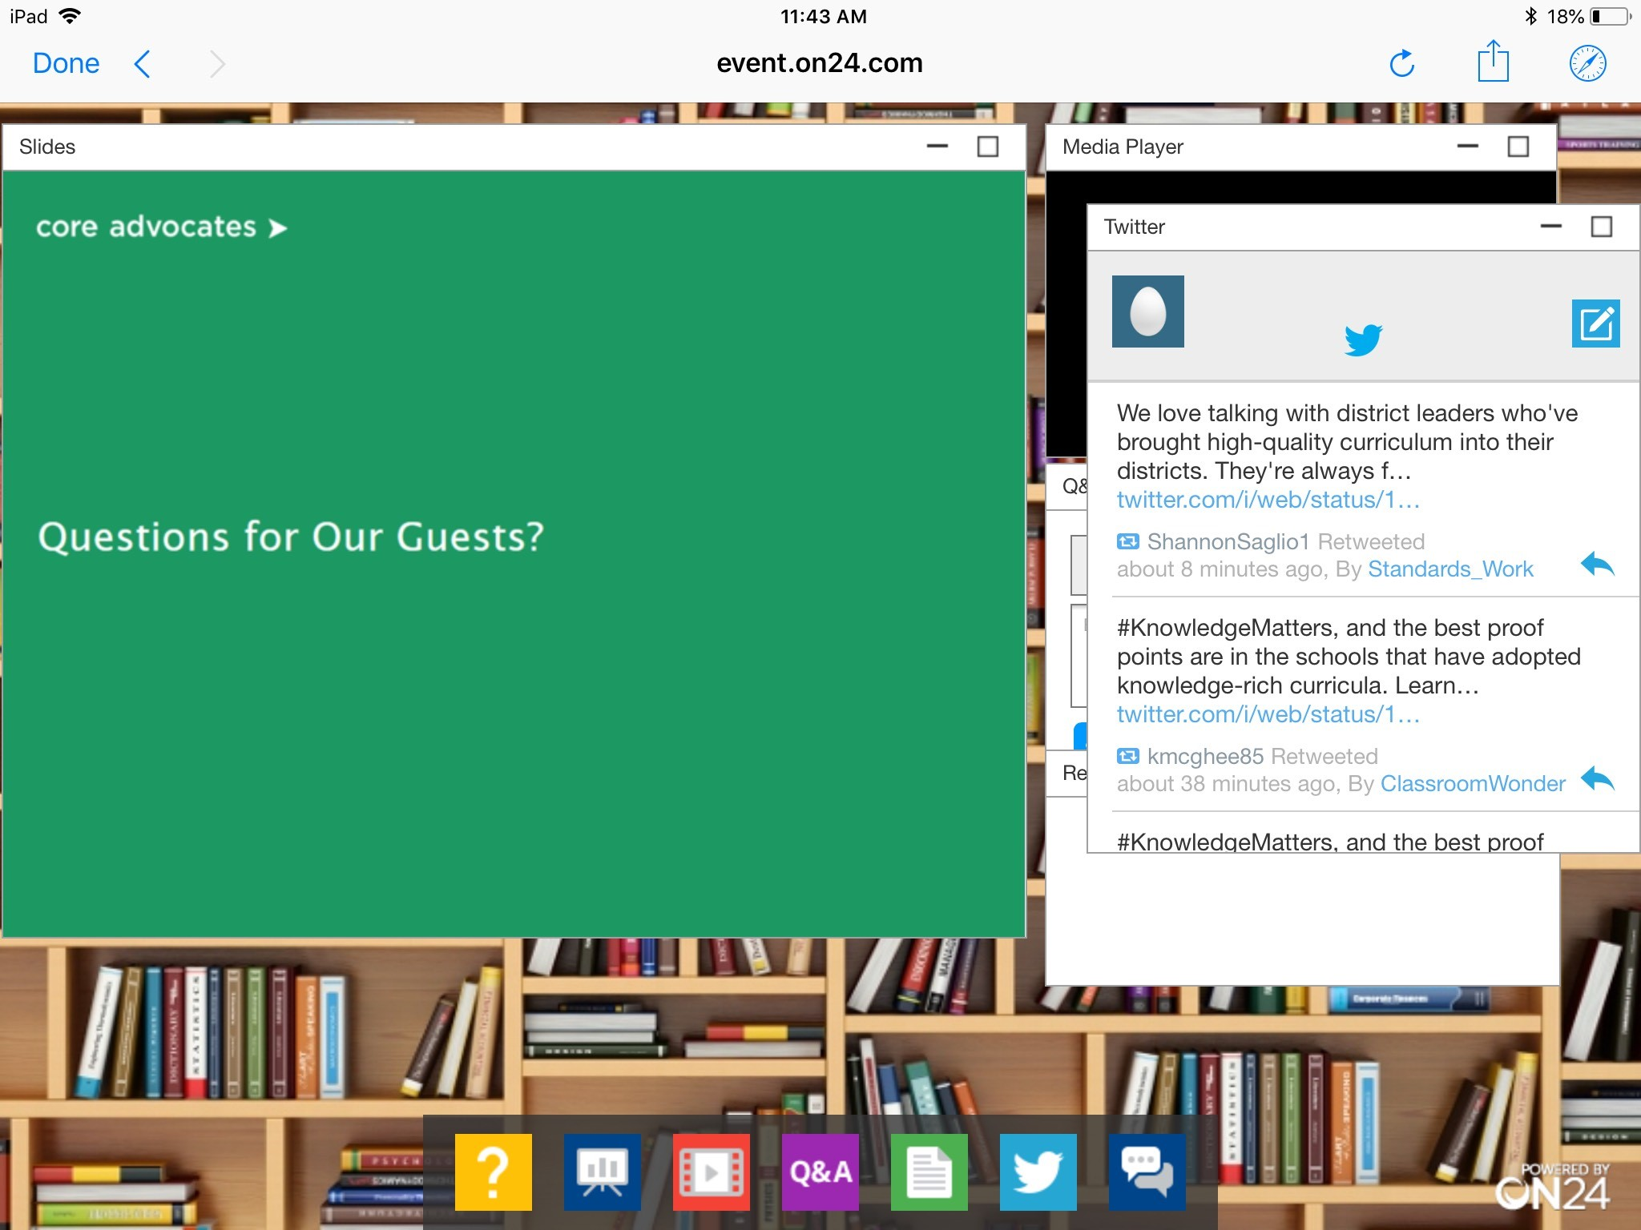
Tweet with Us!
Please feel free to tweet during and after the webinar using #coreadvocates
@achievethecore
@beske3
Click here!

Slide 7
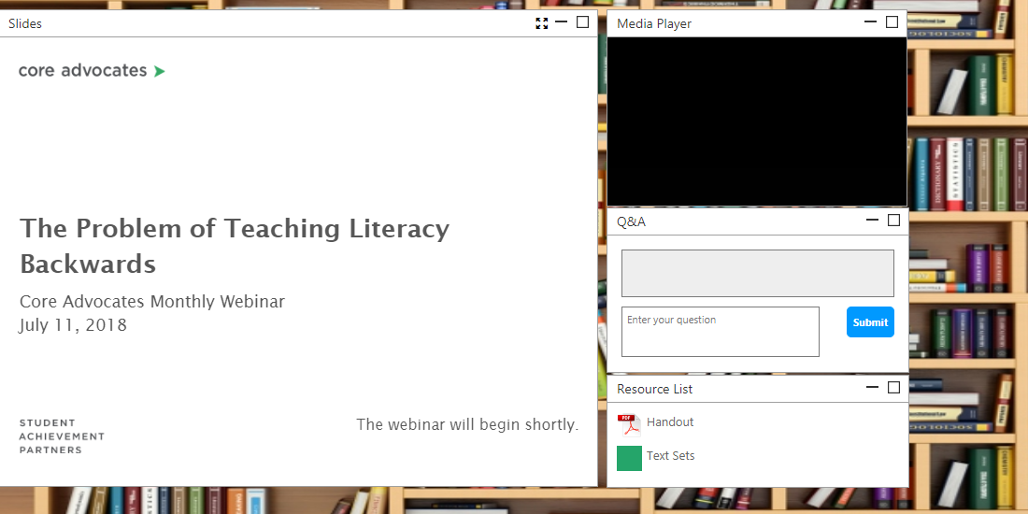
Engage with Us!
During the webinar
Questions option
Group chat
Resource Widget: Find the link to the Coherence Map
After the webinar
Access to recorded webinar via the link emailed to you

Slide 8
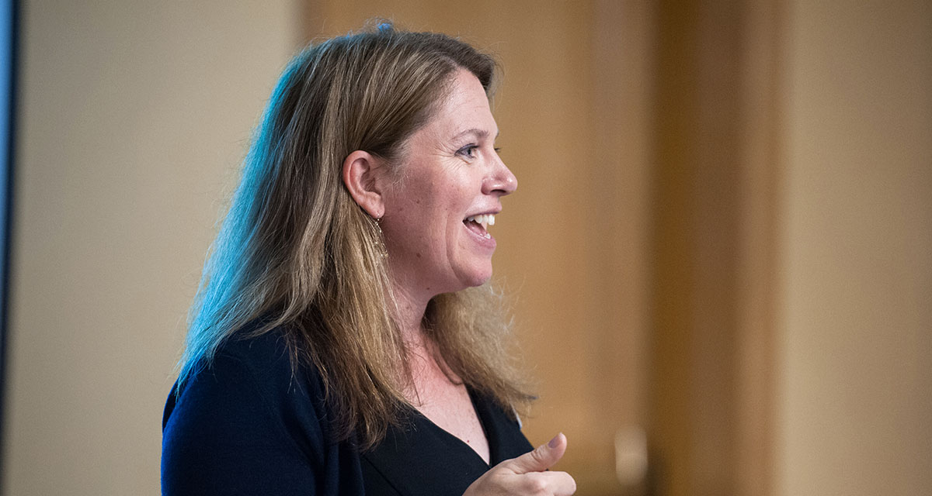
Barbara Beske
Student Achievement Partners Senior Mathematics Specialist, Tools and Classroom Resources

Slide 9

Goals of the Webinar
Learn about some important features of the newly updated Coherence Map
Learn how high school Modeling is represented in the Map
Think about ways the Coherence Map can support your practice

Slide 10
Section 1: How is the extension of the map to fully include high school standards similar and different from the K-8 map?

Slide 11
Poll
What is your experience with the Coherence Map? (choose one)
I’m a frequent user
I’m in the map occasionally
I’ve been in it, but not that often
Little or no experience

Slide 12
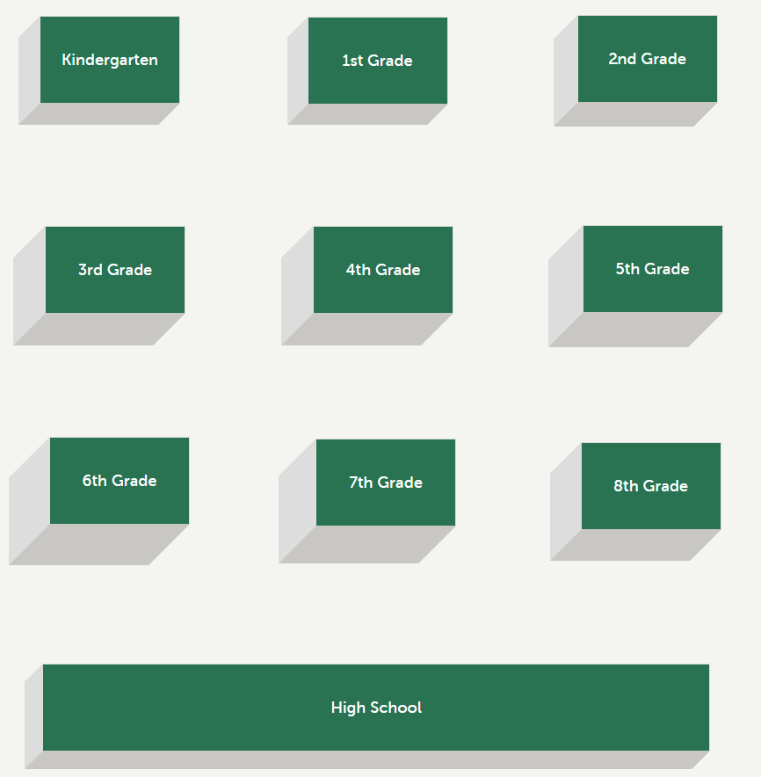
www.achievethecore.org/coherence-map

Slide 13
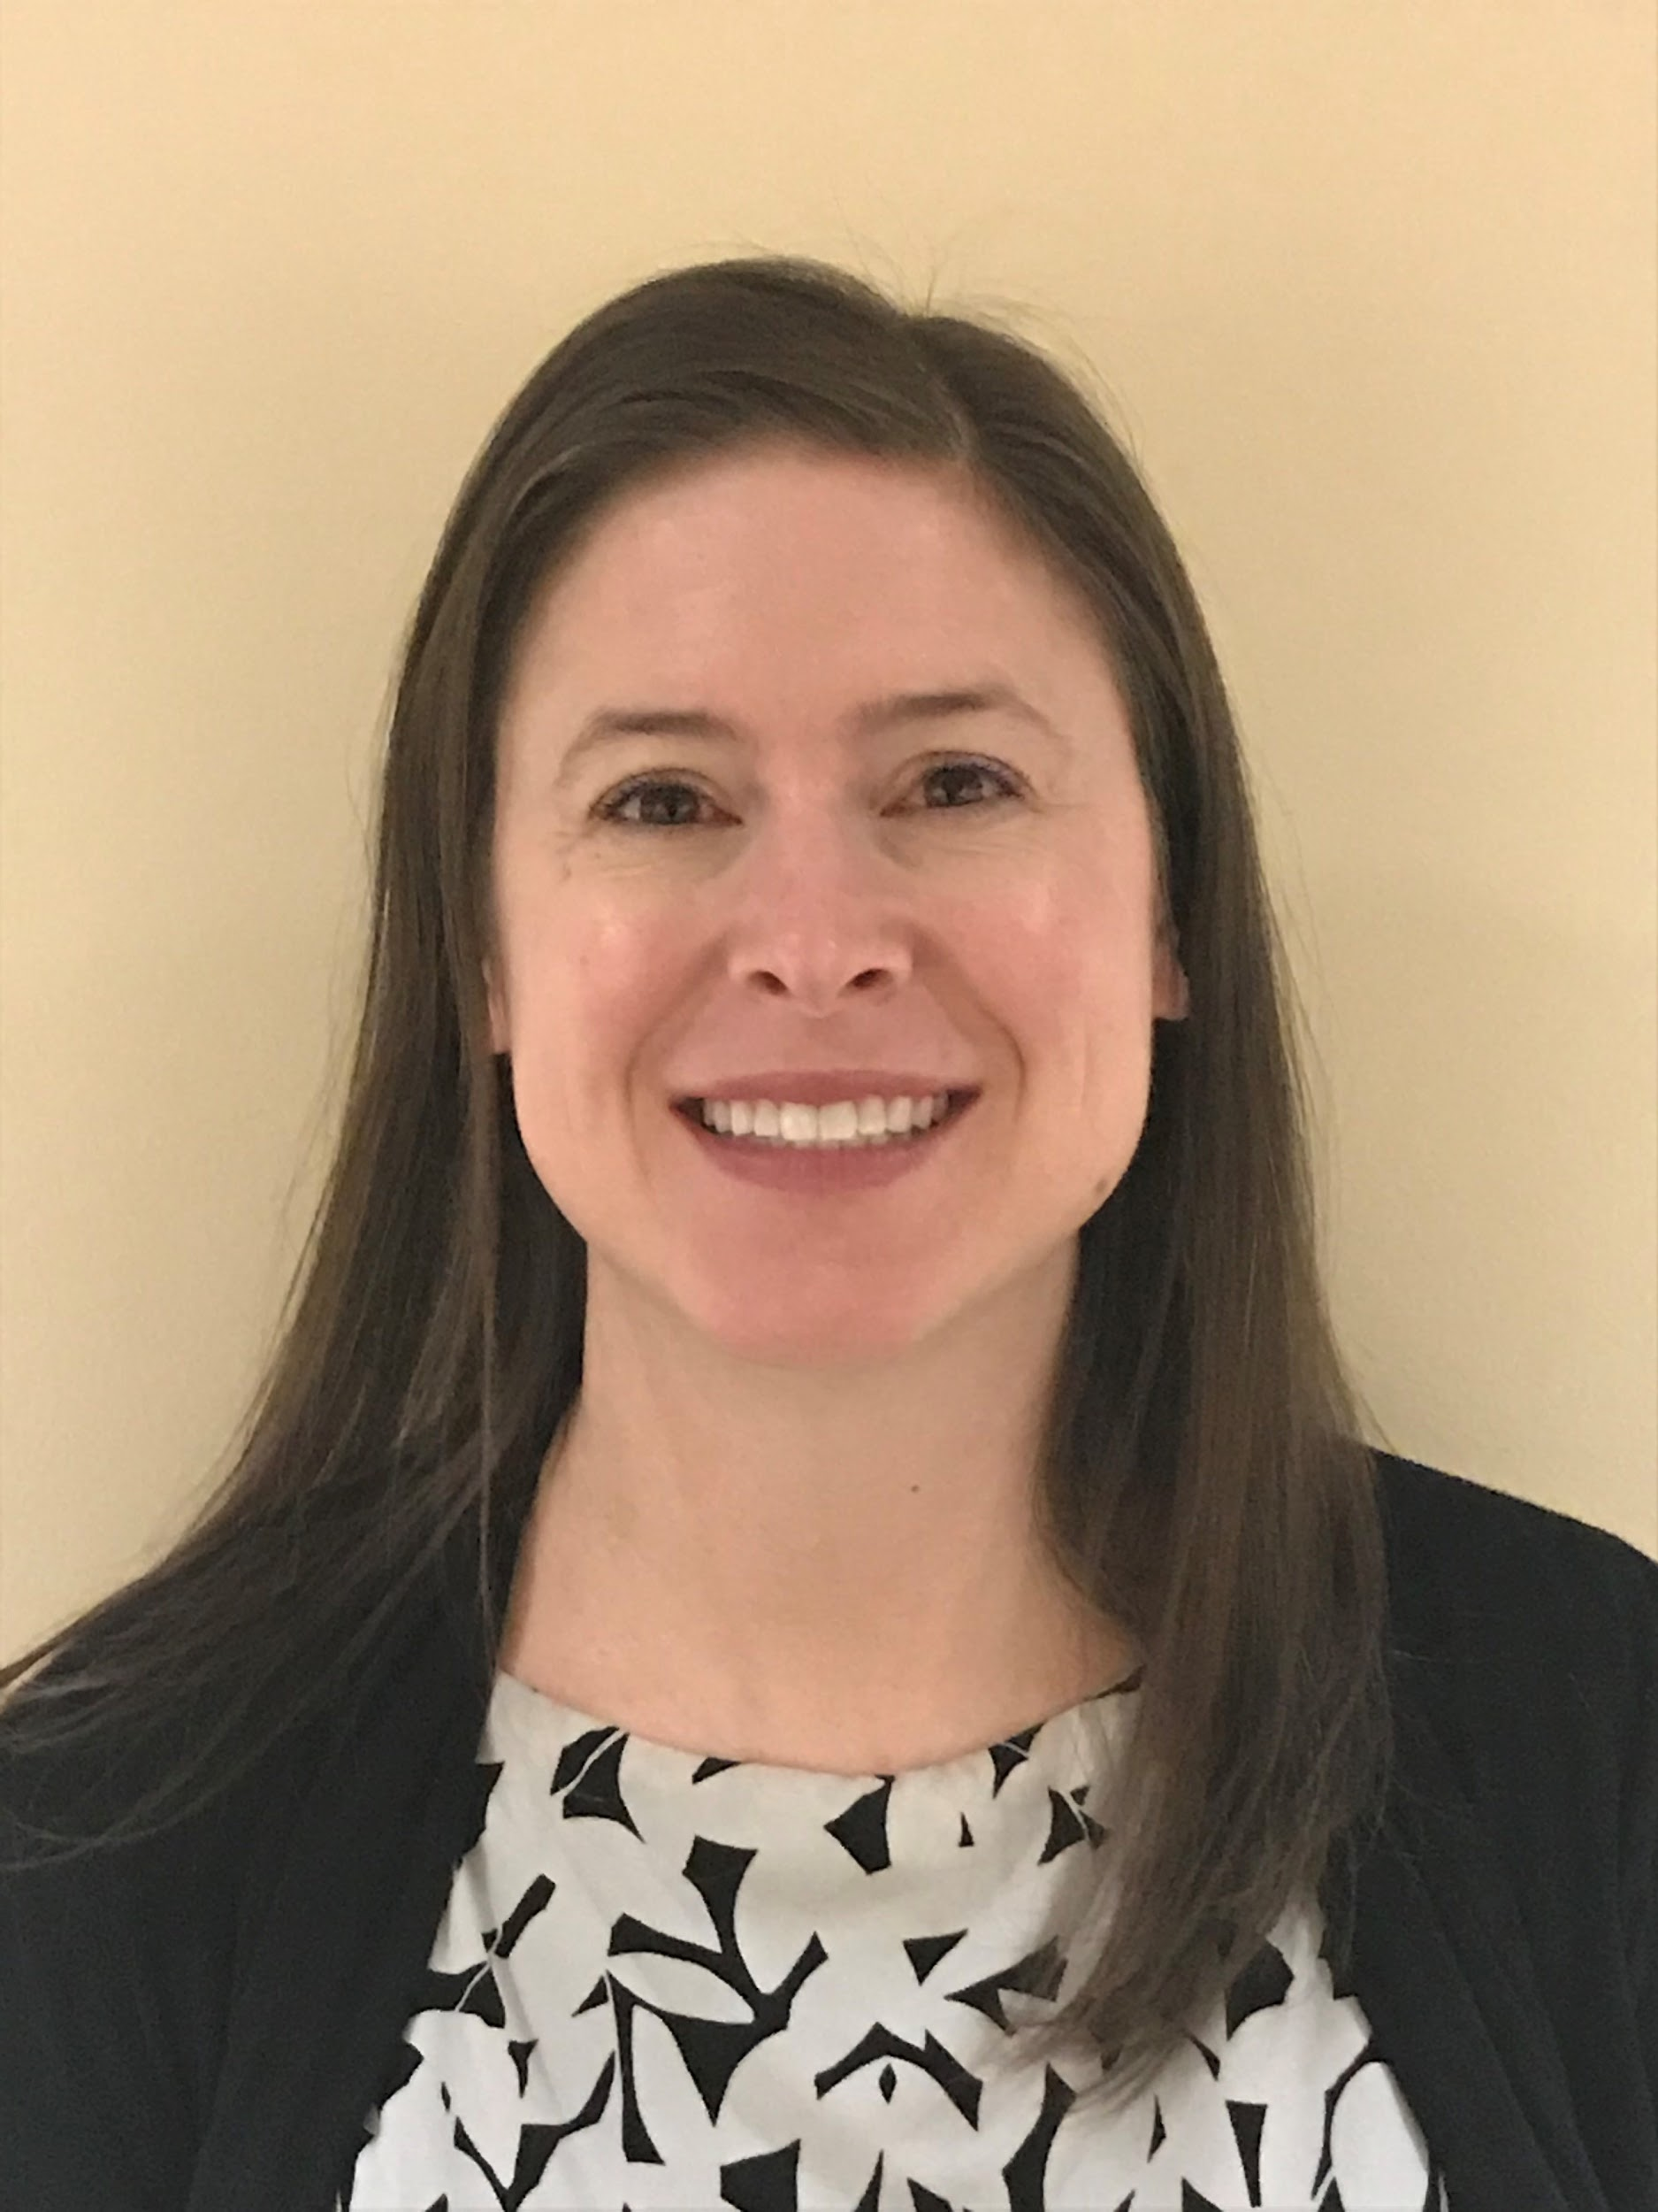
Marissa McClish
Professional Growth Systems Project Coordinator
Washoe County School District
Reno, NV

Slide 14
Each Standard includes:
Identification of Widely Applicable Prerequisite
Course Information
Aligned task(s)
Key language from the Progression Documents

Slide 15
Progressions information:
illuminates the expectations of the standard
includes instructional recommendations
links the standard to prior knowledge
or identifies student misconceptions.

Slide 16
Questions?

Slide 17
Section 2: Modeling

Slide 18
Question:
What is one of your go-to resources for HS Modeling Tasks?
Please use the Group Chat tab on your control panel to respond.

Slide 19
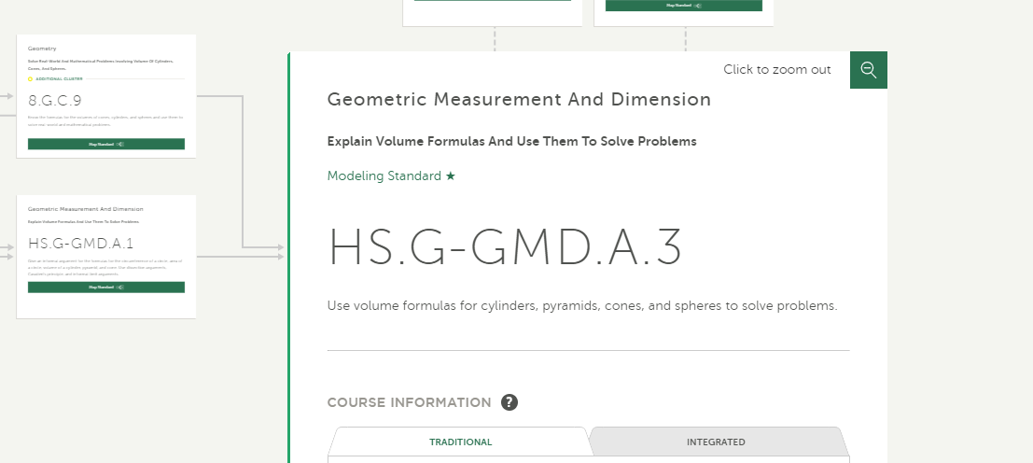
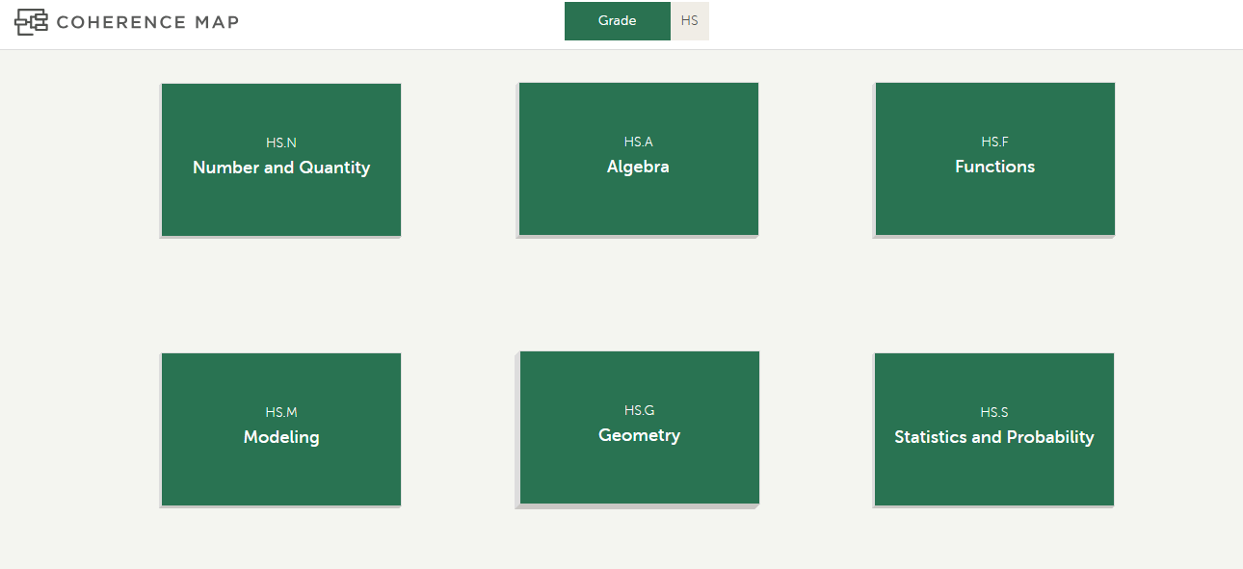
Modeling in the Coherence Map

Slide 20

Modeling Content Standards

Slide 22
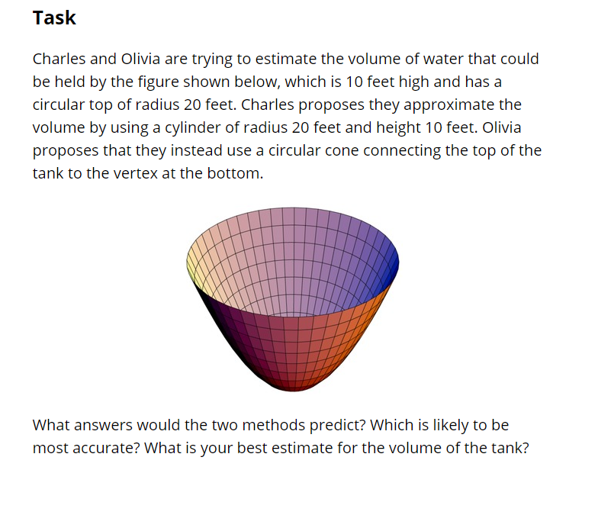
Volume Estimation, Illustrative Mathematics

Slide 23
www.achievethecore.org/coherence-map

Slide 24

How you can help?
We are looking for:
Modeling Tasks
Student Work
modelingtasks@studentsachieve.net

Slide 25
Section 3: Using the Coherence Map to Support your Practice
Notes:
Janelle

Slide 26
Poll
How do you or how can you imagine using the Coherence Map in your practice?
(select all that apply)
Investigate how the standards relate to each other
Determine prerequisite standards to help students tackle unfinished learning
Learn more about a particular standard through looking at tasks and/or reading the progressions blurb
In professional learning settings
For curriculum writing or creating scope and sequence documents
Learn more about modeling and ways to use modeling tasks
Other
Not quite sure yet

Slide 27
Ways to use the map!
Individually or in professional learning settings:
Investigate how the standards relate to each other
Determine prerequisite standards to help students tackle unfinished learning
Learn more about a particular standard through looking at tasks and/or reading the progressions blurb
For curriculum writing or creating scope and sequence documents
Learn more about modeling and ways to include more modeling tasks

Slide 28
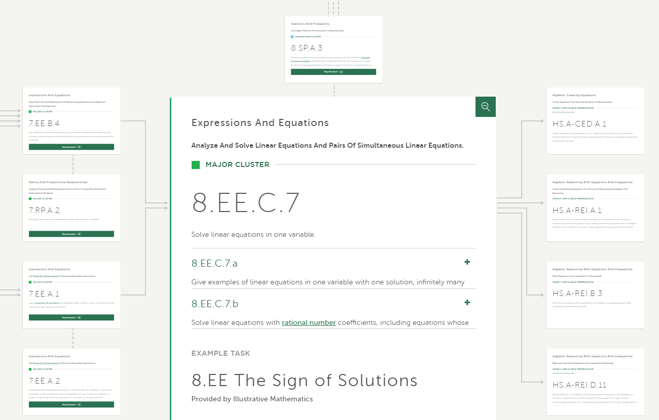
Tackle Unfinished Learning

Slide 29


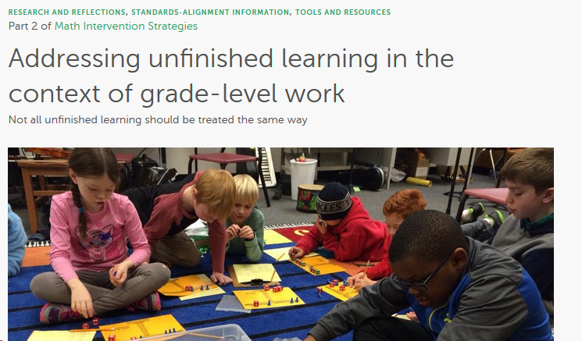
Read more about tackling unfinished learning on Aligned

Slide 30

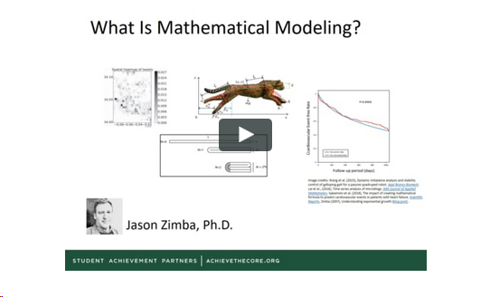
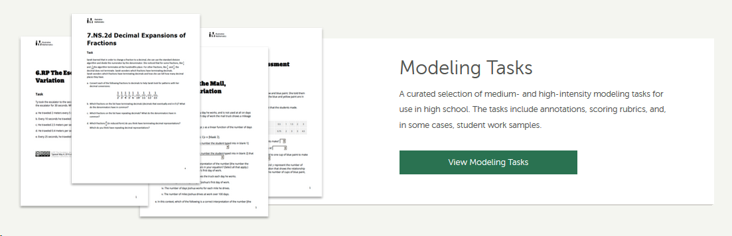
Learn more about modeling and ways to use modeling

Slide 31
Questions?

Slide 32
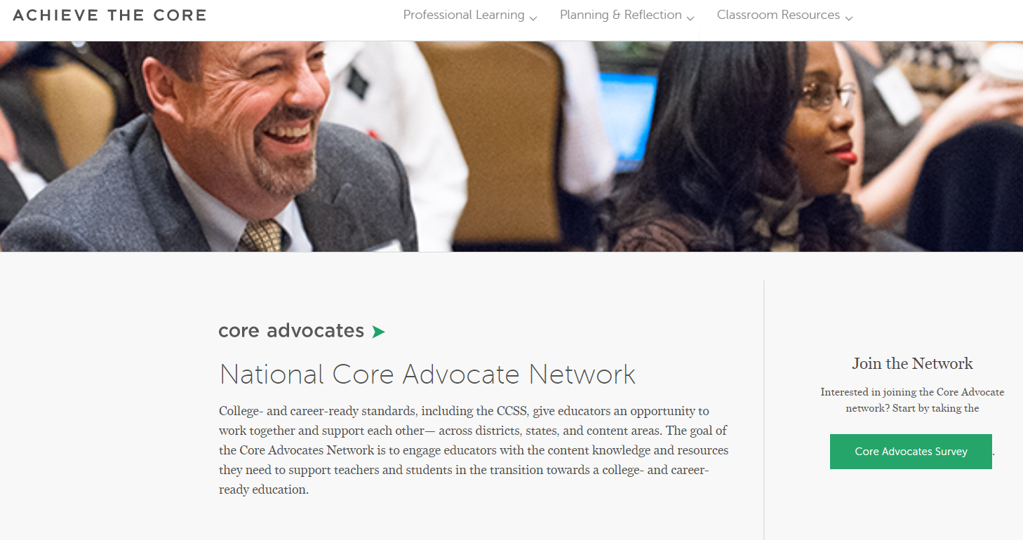
Join Our Network!
www.achievethecore.org/ca-signup
Notes:
If you found tonight’s webinar helpful, we’d like to invite you to join our Core Advocate network! We’re committed to solving real problems that real teachers have and we know the best way to do this is to know more about what folks are experiencing.
We’d love to learn about who you are, where you work, the types of things you’re interested in and the expertise you already have. This way, we will be able to tailor our webinars and other opportunities to your needs and interests (we may even tap you to be our next webinar panelist). So we encourage you to join the network by filling out this survey completely at atc.org/ca-signup

Slide 33
Please Join Us Again Next Month!
Next month’s webinar: Text at the Center
SAP Presenters: Meredith Liben and Sue Pimentel
Register Here: https://event.on24.com/wcc/r/1953354/ACE98FBF8073731D990D637159C80FB8

Slide 34
Thank You!

