Slide 1
Text at the Center
Core Advocates Monthly Webinar
April 3, 2019
The webinar will begin shortly.
Check your Resource widget to preview the resources for today’s session!
Notes:
First timer poll
Handouts:
While we’re waiting, we’d like you to participate in a quick poll so we can get an understanding of who’s on the webinar with us tonight.

Slide 2
Introductions
Your hosts from the Professional Learning Team
Tori Filler, Literacy Specialist
Nicole Bravo, Project Manager
This Month’s Guests
Meredith Liben, Senior Fellow
Sue Pimentel, Founding Partner

Slide 3
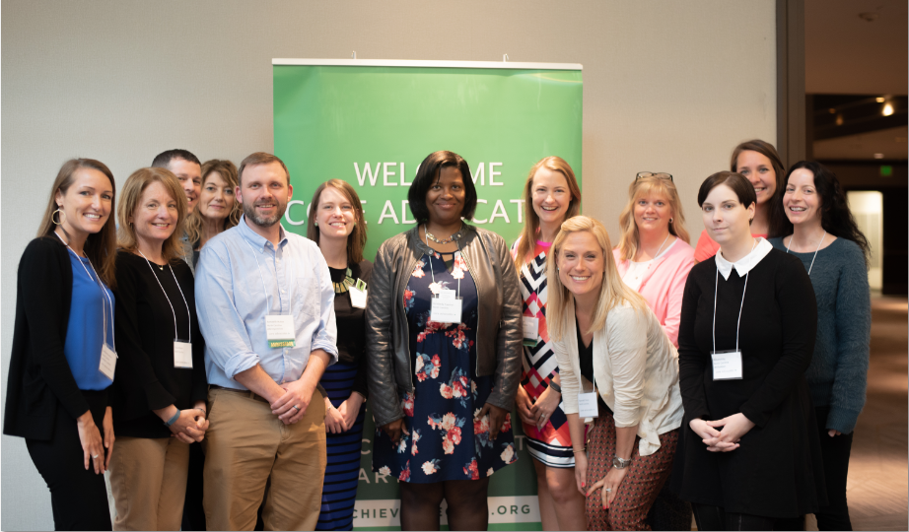
Who Are Core Advocates?
Core Advocates believe in the power of standards to prepare all students for college and/or careers.
They are eager to support and collaborate with their colleagues and communities in understanding and translating the Shifts into instructional practice.
Core Advocates have the tools and knowledge to advocate for high-quality instruction, instructional resources, and professional learning in their communities.
Notes:
CAs are teachers from all over the country who believe in the potential of high quality standards and the importance of all students being prepared for college and careers.
They support their colleagues in understanding and advocating for the standards and embrace the Shifts in instruction
The Core Advocate network is over 10K educator strong and we’d love for you to join us if you have not already

Slide 4
Learn More About Us!
Contact Jennie Beltramini (jbeltramini@studentsachieve.net )
Complete this survey to join our database (and mailing list): www.achievethecore.org/ca-signup
Visit our website: www.achievethecore.org
Notes:
If you’d like to learn more about the network, contact Jennie (her email is here).
We also want to invite you to join the network by signing up at achievethecore.org/ca-signup and visit our website for more info and opportunities

Slide 5
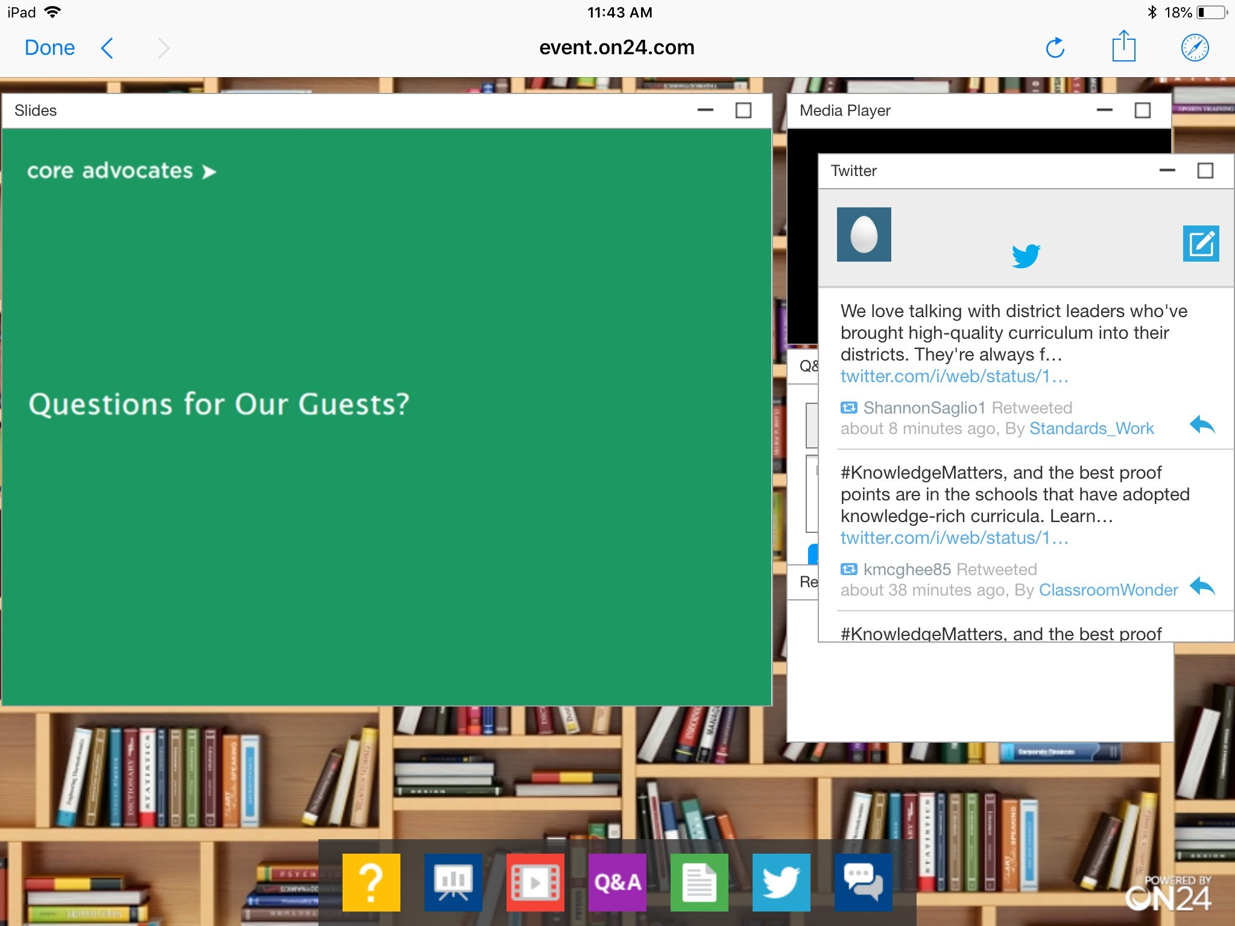
Tweet with Us!
Please feel free to tweet during and after the webinar using #coreadvocates
@achievethecore
@MJLiben
Click here!

Slide 6
Goals of the Webinar
Be able to see and state the case for keeping text at the center of instruction—on strengthening the practices that improve reading comprehension.
Understand why strategy-centered instruction still has such a hold on instruction and assessment.
Wrestle with what a reading test does and does not measure.
Notes:
AS you see, we have 3 main goals for our webinar tonight

Slide 7
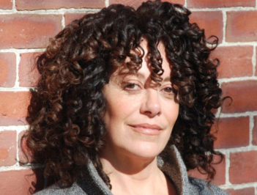
Meredith Liben
Senior Fellow
SAP
Sue Pimentel
Founding Partner
SAP

Slide 8
Section 1: What does it mean to keep text at the center of instruction?

Slide 9
Research tells us that investments in text yields accelerating returns. . .
In the early years, reading aloud and teaching students how to read solidly by grade 2 are crucial.
As students progress, they need to grow their knowledge, vocabulary, and understanding of syntax by:
Spending time actively reading content-rich, complex text so they discover how to learn from reading.
Reading a volume texts on a range of topics and at a variety of complexity levels with little teacher support.

Slide 10
What Constitutes Complex Text Anyway?
Complex sentences
Uncommon vocabulary
Lack of words, sentences, or paragraphs that review or pull things together for the student
Lengthy paragraphs
Text structure that is less narrative and/or mixes structures
Notes:
Big Idea:
There are 10 features that make a text complex; a text with more of these features will be more complex. Reading is a complex endeavor!! They will be shown on the next two slides.
Talking Points:
Complex sentences: sentences with lots of parts to them, or lots of variation in sentence length and styles
Uncommon vocabulary: not likely to be familiar to many students at this level.
Lack of…: the author does not repeat ideas or summarize much. Also may not offer clues to the reader through words and phrases like “next,” “as we just saw,” “in conclusion,” and “because.”
Lengthy paragraphs: long, dense paragraphs
Text structures: Narrative structure is story-like. It is easier to follow than problem and solution or cause and effect. When an author mixes up structures (which textbooks and articles often do), text becomes even trickier to follow.
These qualities, or features of text, can be present in text in any number of ways, 10 factorial ways, actually (factorial =10 x 9 x 8 x 7 … which equals 3,628,800).
Facilitator Note:
Show this slide, then show the next slide long enough to read through and define for participants.

Slide 11
Complex Text, continued?
Subtle and/or frequent transitions
Multiple and/or subtle themes and purposes
Dense information
Unfamiliar settings, topics, or events
Lack of repetition, overlap, or similarity in words and sentences
Notes:
Big Idea: There are 10 features that make a text complex; a text with more of these features will be more complex.
Facilitator Talking Points:
Subtle and/or frequent transitions: The author does not give you clues (next, thus, consequently) before moving to a new idea.
Multiple and/or subtle themes and purposes: The author does not directly state or clearly offer his purpose for writing, or the big ideas are hard to figure out.
Dense information: Informational text tends to pack ideas very tightly, and authors may assume that readers know more about the topic than students might actually know.
Unfamiliar settings, topics, or events: It is harder to visualize and imagine what you have never experienced. This is why contemporary fiction can be read so fast and is considered so enjoyable. Almost everything is familiar.
Lack of repetition, overlap, or similarity in words and sentences: The author keeps moving to new ideas or settings and does not stop to summarize or support what he has just discussed, or he finds new ways to express the same idea. If the reader didn’t understand right away, or doesn’t realize the new phrasing is a restating of the original idea, it is easy in both cases to get lost.
Facilitator Notes:
These qualities, or features of text, can be present in text in any number of ways, 10 factorial ways, actually (factorial =10 x 9 x 8 x 7 … which equals 3,628,800).

Slide 12
Poll: Two of these impact comprehension far more than the others. Which two?
Notes:
See content on next slide and the notes on the next slide for the poll content and how we’d like this set up.

Slide 13
Which Two Features Impact Comprehension Most?
Complex sentences
Lack of words, sentences, or paragraphs that review or pull things together for the students
Lengthy paragraphs
Uncommon vocabulary
Text structure that is less narrative and/or mixes structures
Notes:
Would like this as a poll with everyone allowed to select 2 from these 5. Would then like this slide to be animated(there may be some leftover animation in it already, but it isn’t working properly!) so that lack of words, lengthy paragraphs, text structures disappear and complex sentences and uncommon vocabulary remain. Then we need to animate uncommon vocabulary so it is larger or glows or somehow stands out as the top feature to impact comprehension.
Once poll is complete, say why this matters! Because we need to focus on vocabulary development and understanding complex syntax!!

Slide 14
Section 2: What is the research base for (and for limiting) reading strategies?

Slide 15
Research Confirms That. . .
These strategies should be activated when a text stops making sense and to build deep understanding:
Monitoring your own understanding of text
Questioning the text as you read
Summarizing while reading
Paraphrasing sections of text
(McNamara, 2010)
Notes:
McNamara, D. S. (2010), Strategies to read and learn: overcoming learning by consumption. Medical Education, 44: 340-346. doi:10.1111/j.1365-2923.2009.03550.x
Note: Danielle McNamara’s entire body of work is around the strategies that lead to deep understanding. By comprehension strategies, she and her fellow cognitive psychologists do NOT mean ‘find the main idea’. They mean the activities listed above.
Comprehension strategies are the habits and internalized practices of successful readers. Individuals who enjoy reading expect to understand what they read and do something about it when they do not.
They should be activated when the text stops making sense to a reader.
Strategies that that have scads of evidence supporting their value when confronting difficult text can and should be employed strategically, as the research and their name suggest, and always in service to students’ understanding of the text. Effective strategies involve the suite known generally as comprehension monitoring. Comprehension Monitoring means paying attention to what you’re reading AND whether or not you understand it.

Slide 16
Research By McKeown, Beck, and Blake (2009)...
Tested three approaches in a low-performing urban school. 5th grade students were assigned to either:
Control Group (traditional basal)
or
2. Strategies Focus
or
3. Content Focus (Evidence)
Teacher: What’s going on here? How does that connect to what we read earlier?
Teacher: Can anyone add to that? What does that mean?
Notes:
Big Idea:
A Research study done by McKeown, Beck & Blake (2009) called “Rethinking Comprehension Instruction: A Comparison of Instruction for Strategies and Content Approaches” provided some insight into the effect classroom conversation focused on text has on learning.
https://www.southingtonschools.org/uploaded/faculty/psmolinski/Rethinking_Reading_Comprehension.pdf
Details:
The study compared 3 groups of students using a traditional basal program (control group), a comprehension strategies focused approach, and a “content approach” i.e. an approach focused on the text and what it says (and learning its content).
“The effectiveness of the two experimental comprehension instructional approaches (content and strategies) and a control approach were compared.
Content instruction focused student attention on the content of the text through open, meaning-based questions about the text.
Strategies instruction taught specific procedures to guide their access to text during reading of the text.
Control approach lessons were developed using questions available in the teacher's edition of the basal reading program used in the participating classrooms.
Student participants were all fifth graders in a low-performing urban district.”

Slide 17
Research Confirms That. . .
With the content approach, students performed best:
Both length and quality of student recall was higher.
Student discussion was dramatically more text-focused (97% vs. 66%).
Length of student responses was nearly triple.
With the strategies-based approach, students performed worst:
And students were no more successful in using comprehension strategies than the other groups!
Notes:
Big Idea:
These are the findings of the McKeown, Beck & Blake (2009) “Rethinking Comprehension Instruction: A Comparison of Instruction for Strategies and Content Approaches” study. In all three cases there was conversation, but in classrooms where the questions focused on content the conversations were longer and better (length and quality of recall and text-focus).
Details:
Students had more to say when the discussions focused on the content of the lesson, rather than the use of reading strategies (the content group).
pg. 230-231
pg. 237
pg. 237
pg. 243
Discussion was dramatically more text dependent
Length of response was nearly triple
With strategies-based approach students were no more successful in using comprehension strategies that the other groups – even on a standardized reading test.
Students in the strategies approach fared worst, even worse than the control group! The ‘content’ approach students performed best

Slide 18
Finally, Research Confirms That. . .
A Standard of Coherence is the thing that distinguishes excellent readers from the rest. (Pearson and Liben, 2011)
A Standard of Coherence is an internal disposition that assumes every text can be comprehended—makes readers stubborn in ways that bear fruit for comprehension. They approach the text assuming it will yield its offerings and are then driven to do something about it if they don’t fully understand. (M. Liben, 2019, in press)
Notes:
Pearson, P. David, and David Liben. The progression of reading comprehension. Achieve the Core (2011).

Slide 19
Bottom Line: The Text Itself is Where Teachers and Students Should Spend Their Time
Teachers can assist students in engaging in a close exploration of the text. They can:
Gear instruction to the particulars of the text.
Discern which grade-level standards the text directs them to focus on.
Plan discussions, activities, questions, and tasks guided by students’ needs and strengths.
Have reading strategies running in the background.
Notes:
Briefly teaching strategies early in readers’ careers, and then occasionally having the class notice when a reader in the class has used such a strategy to problem solve their way to understanding, is an effective approach and follows the research.
Thereafter, students can enlist comprehension strategies when they do not understand what they are reading.

Slide 20
Question
What do you know when a student gets a series of reading questions right?
Type your answer in the Group Chat

Slide 21
Million Dollar Question
What have you learned when a student gets a reading comprehension question wrong?
Type your answer in the Group Chat

Slide 22
Section 3: Why is a strategies focus so tenacious?

Slide 23
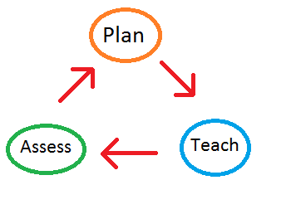
Traditional Literacy Instruction Oversimplifies Reading
Why might a student get the wrong answer??
Notes:
Question from released 3rd grade state assessment.

Slide 24
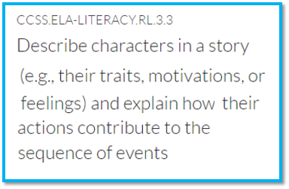
Why Might a Student Get The Wrong Answer?
Could be...
But also could be because of:
Knowledge demands of the text
Vocabulary demands
Fluency issues
Density of information presented
Student stamina
Complicated syntax
...among other things!
Notes:
Most educators have been taught—and therefore teach—that reading better is a matter of assembling a quiver of reading comprehension strategies to aim at any reading task.
Too often, reading strategies are made to be the very objective of a lesson, rather than a means to a larger goal: understanding all that a rich text has to teach and say to us.
Because of that, educators often directly teach comprehension strategies and have students practice and focus on them to the exclusion of gaining a fuller understanding of the texts.

Slide 25
This week we are going to focus on characters’ development with Brown Girl Dreaming.
Notes:
“It’s April 1st, it’s predictions week!”
Too many of us still organize day-to-day learning goals around discrete activities: “let’s practice finding the main character’s point of view on these texts this week and then next week, let’s focus on discerning the text structure,” rather than the richer, text- centered probing: “what is the information this author is presenting to us, how do they present it, and how does that expand or alter my thinking?”

Slide 26
Instead approach the standards holistically and let the text point the way…
CCSS.ELA-LITERACY.SL.1 Engage effectively in a range of collaborative discussions with diverse partners on grade 3 topics and texts, building on others’ ideas and expressing their own clearly.
CCSS.ELA-LITERACY.SL.5.1C
Pose and respond to specific questions by making comments that contribute to the discussion and elaborate on the remarks of others.
CCSS.ELA-LITERACY.RL.5.4
Identify words and phrases in stories or poems that suggest feelings or appeal to the senses.
CCSS.ELA-LITERACY.W.1 Write opinion pieces on topics and texts, supporting a point of view with reasons.
CCSS.ELA-LITERACY.RL.5.2
Retell stories, including key details, and demonstrate understanding of their central message or lesson.
CCSS.ELA-LITERACY.RL.5.7
Use illustrations and details in a story to describe its characters, setting, or events.
Notes:
Reading/writing/speaking & listening standards are designed to be annual targets and reference points. They hold us to a common set of expectations for what well-educated students should be able to know and do by the end of each grade to be on track for success by the time students end their public school careers and move on into careers or more study, and into active engagement in civic affairs.
These standards should be referenced in instructional planning and kept top of mind while teaching students to plumb, at the appropriate challenge, the particular structure(s), concepts, vocabulary, ideas, and details of the texts students are reading in order to consider what standard is being called for by the text demands. But they are not the goal of daily instruction.
Approaching ELA reading, writing, listening and language standards holistically provides students with the fullest understanding of the text
How can I help students understand this text?

Slide 27
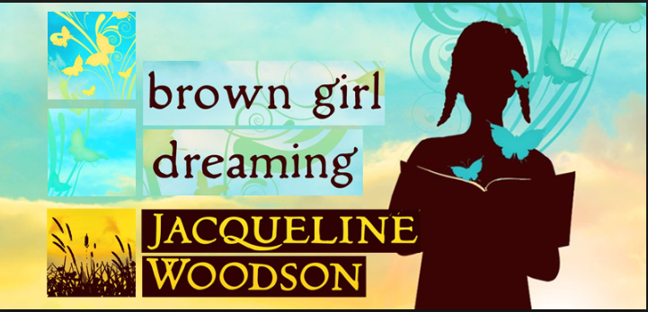
In short (in full!) what makes Brown Girl Dreaming worth reading?
Notes:
show next slide….

Slide 28
Section 4: Why is a strategies focus so tenacious?

Slide 29
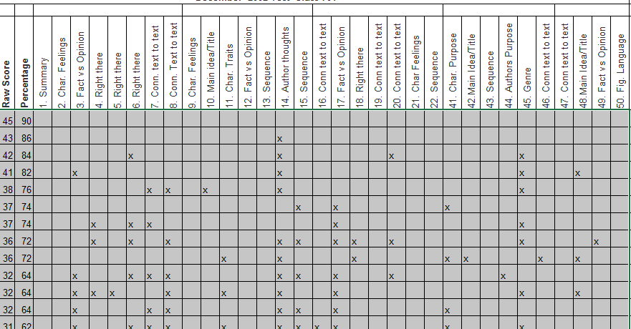
Interim Assessments Reported out Standard by Standard or Strategy Make the Problem Persist
Notes:
If interim or benchmark assessments continue to report out based on strategies or standards, very few schools (or the teachers in them) are going to abandon this form of instruction.

Slide 30
Your Action Step: Kickstart Your Diagnostic Abilities!
Don’t wait for external assessments to tell you what your students can do.
Ask your students what broke down in understanding.
Use questions as quick checks when reading hard stuff
Show your students how to monitor for understanding and hold them to it.
AND - boost your students’ reading abilities in weeks through daily fluency practice, “juicy sentence” practice, and reading, reading, reading!

Slide 31
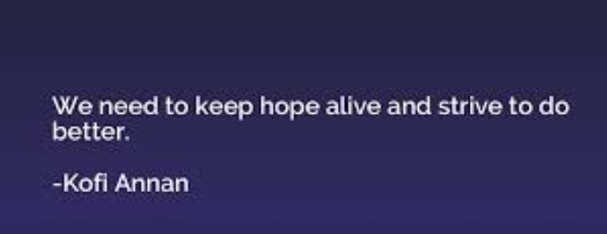
Action Step 2: Lobby for Better Reporting Categories!
We’re working on keeping texts at the center of reporting with innovative interim assessment providers
Stay tuned.

Slide 32
Questions for Our Guests?

Slide 33
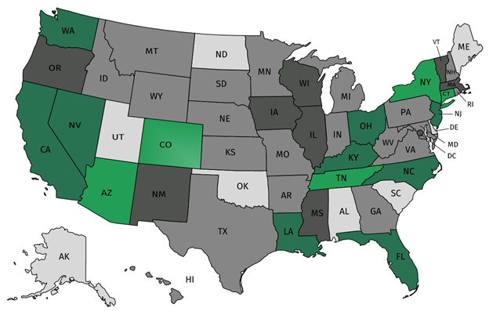
Join Our Network!
Join a national network of educators
Connect with state networks
Be a part of creating new tools and resources in partnership with SAP
Keep up to date on free resources, upcoming SAP webinars/professional learning opportunities, job postings and more!
Notes:
If you found tonight’s webinar helpful, we’d like to invite you to join our Core Advocate network! We’re committed to solving real problems that real teachers have and we know the best way to do this is to know more about what folks are experiencing.
As part of our national network, you have opportunities to connect with educators across the country, maybe even the network in your state! You can keep up to date on tools and resources available on Achieve the Core, as well as a variety of virtual learning opportunities and other ways to engage with us. We also work with educators in our network to help us build tools and resources.
We’d love to learn about who you are, where you work, the types of things you’re interested in and the expertise you already have. This way, we will be able to tailor our webinars and other opportunities to your needs and interests (we may even tap you to be our next webinar panelist).

Slide 34
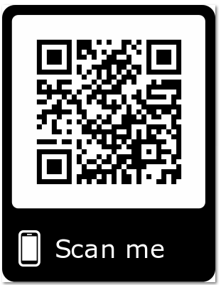
Please Join Us!
https://achievethecore.org/ca-signup
Twitter: twitter.com/achievethecore
Facebook: facebook.com/achievethecore
Pinterest: pinterest.com/achievethecore
Notes:
We encourage you to join the network by filling out this survey completely at atc.org/ca-signup

Slide 35
Please Join Us Again Next Month!
Next month’s webinar: Equity-Focused Professional Learning: A Classroom-Centered Approach
When: May 1 at 7:00 pm ET
Register Here: https://event.on24.com/wcc/r/1973556/C47A57361D6462ACE910391A98AF4203

Slide 36
Thank You!

