Slide 1
Equity-Focused Professional Learning: A Classroom-Centered Approach
Core Advocates Monthly Webinar
May 1, 2019
The webinar will begin shortly.
Check your Resource widget to preview the resources for today’s session!
Notes:
First timer poll
Handouts:
While we’re waiting, we’d like you to participate in a quick poll so we can get an understanding of who’s on the webinar with us tonight.

Slide 2
Introductions
Your hosts from the Professional Learning Team
Tori Filler, Literacy Specialist
Nicole Bravo, Project Manager
This Month’s Guests -
Jennie Beltramini, Math Specialist
Jody Guarino, Core Advocate
Karina Calderon, Core Advocate

Slide 3
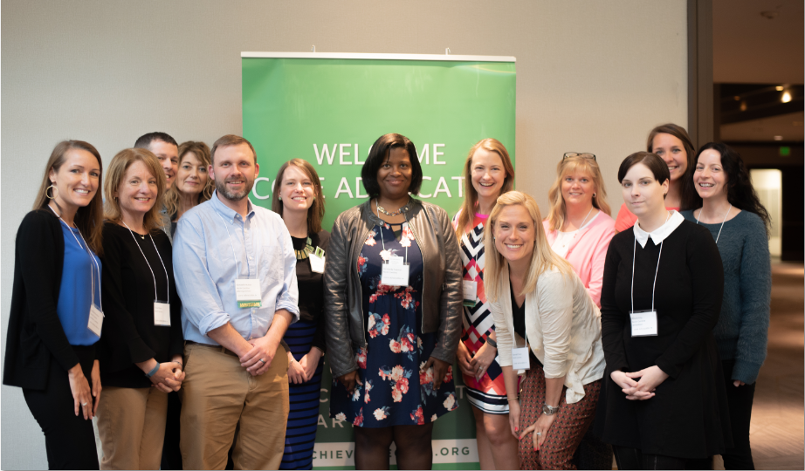
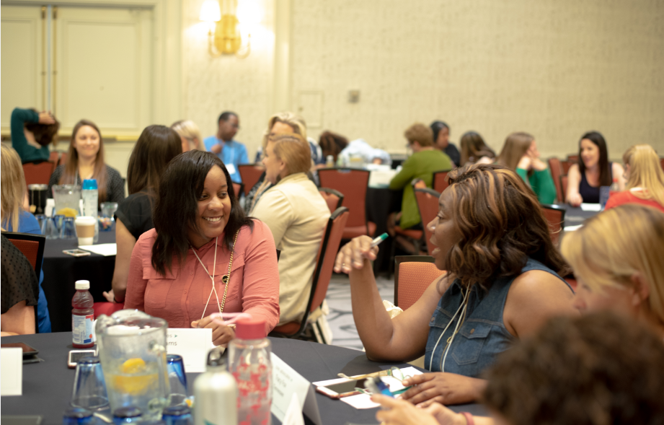
Who Are Core Advocates?
Core Advocates believe in the power of standards to prepare all students for college and/or careers.
They are eager to support and collaborate with their colleagues and communities in understanding and translating the Shifts into instructional practice.
Core Advocates have the tools and knowledge to advocate for high-quality instruction, instructional resources, and professional learning in their communities.
Notes:
CAs are teachers from all over the country who believe in the potential of high quality standards and the importance of all students being prepared for college and careers.
They support their colleagues in understanding and advocating for the standards and embrace the Shifts in instruction
The Core Advocate network is over 10K educator strong and we’d love for you to join us if you have not already

Slide 4
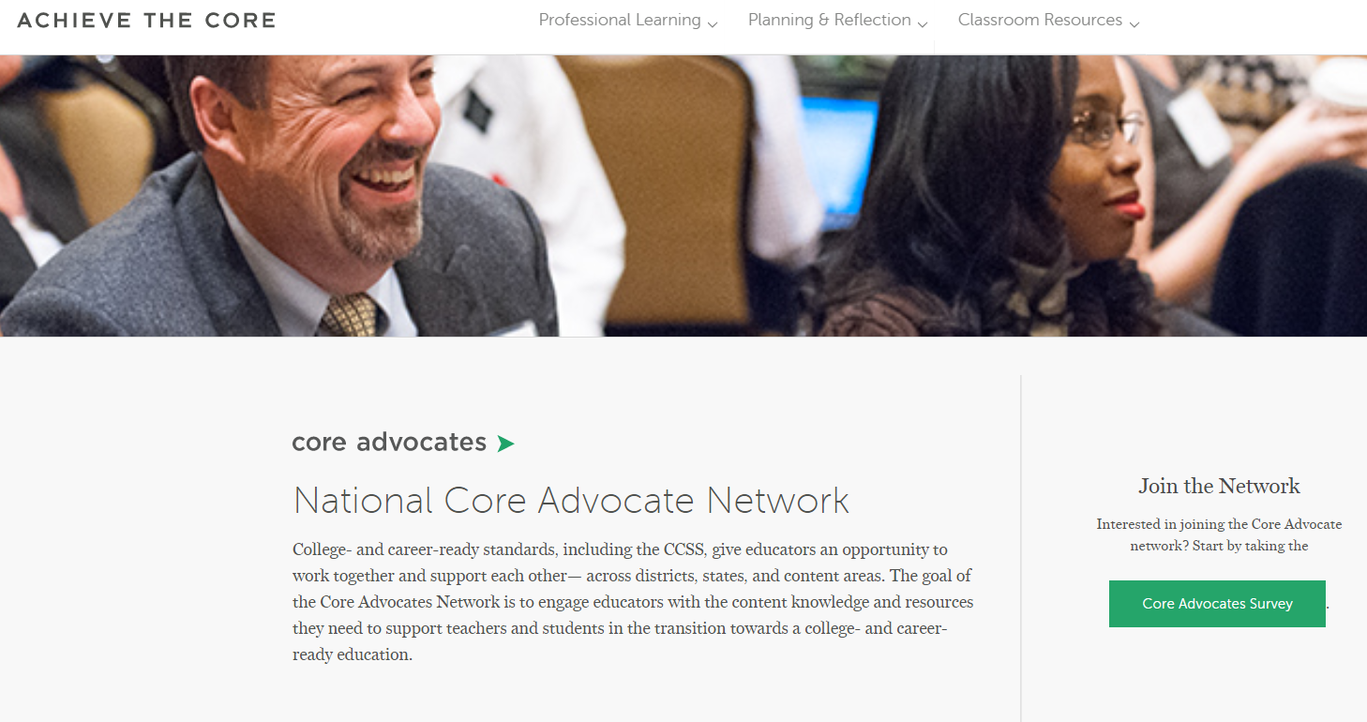
Join Our Network!
www.achievethecore.org/ca-signup
Notes:
If you found tonight’s webinar helpful, we’d like to invite you to join our Core Advocate network! We’re committed to solving real problems that real teachers have and we know the best way to do this is to know more about what folks are experiencing.
We’d love to learn about who you are, where you work, the types of things you’re interested in and the expertise you already have. This way, we will be able to tailor our webinars and other opportunities to your needs and interests (we may even tap you to be our next webinar panelist). So we encourage you to join the network by filling out this survey completely at atc.org/ca-signup

Slide 5
Learn More About Us!
Contact Jennie Beltramini (jbeltramini@studentsachieve.net )
Complete this survey to join our database (and mailing list): www.achievethecore.org/ca-signup
Visit our website: www.achievethecore.org
Notes:
If you’d like to learn more about the network, contact Jennie (her email is here).
We also want to invite you to join the network by signing up at achievethecore.org/ca-signup and visit our website for more info and opportunities

Slide 6
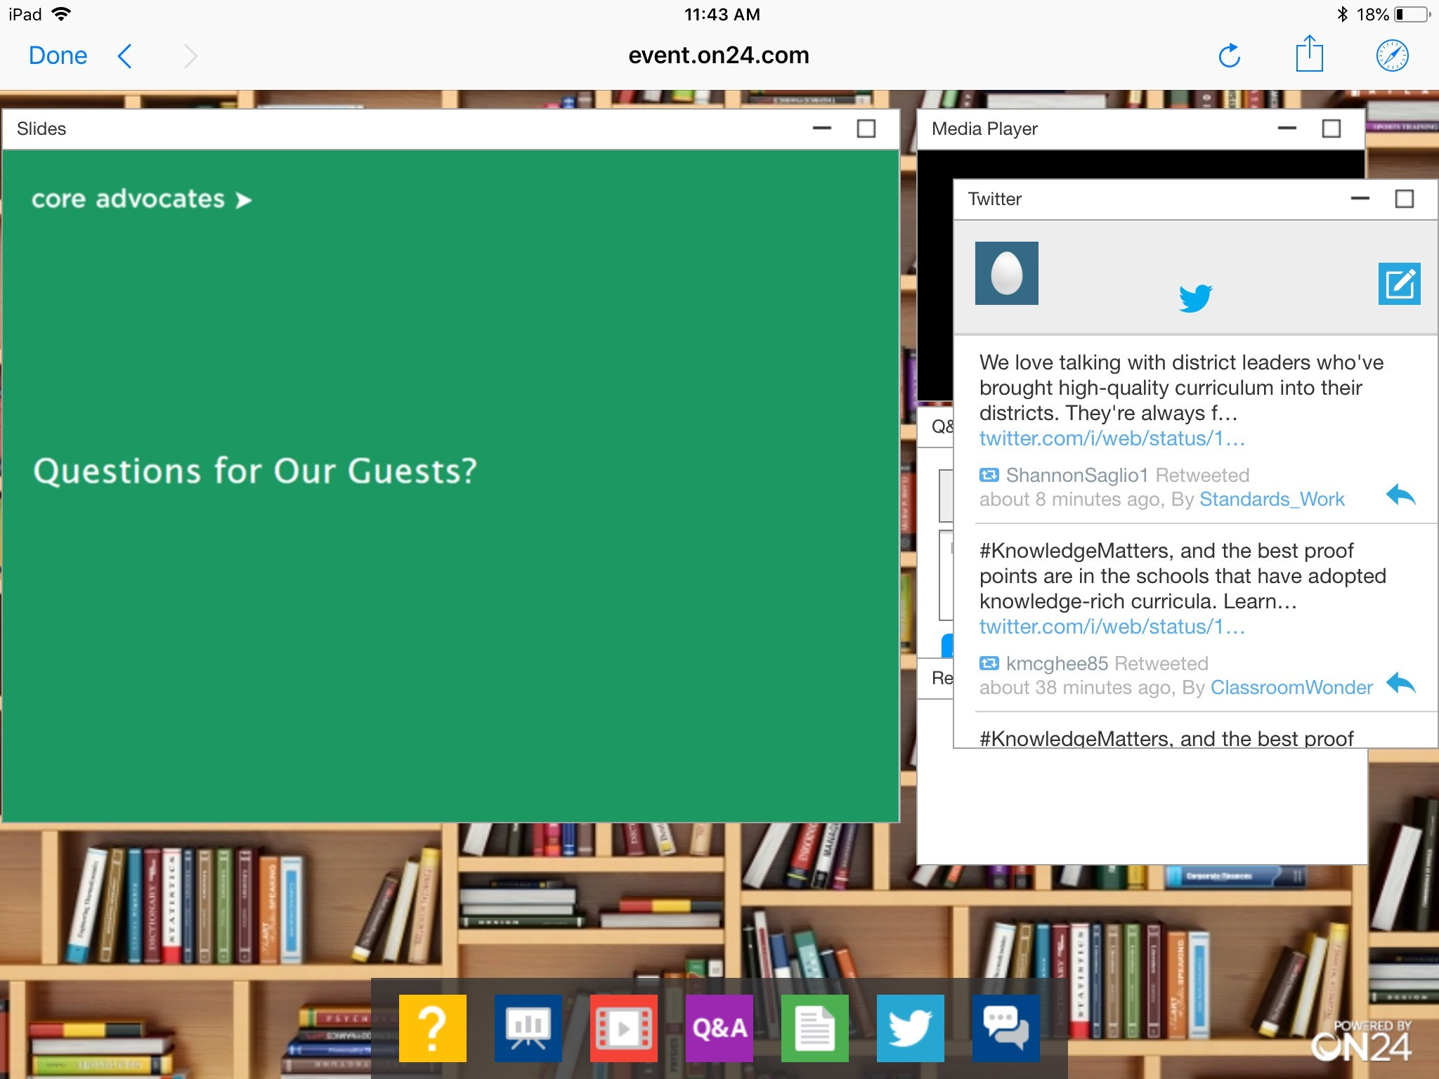
Tweet with Us!
Please feel free to tweet during and after the webinar using #coreadvocates
@achievethecore
@JennieBeltro
@jody_guarino
@srta_kcalderon
Click here!

Slide 7
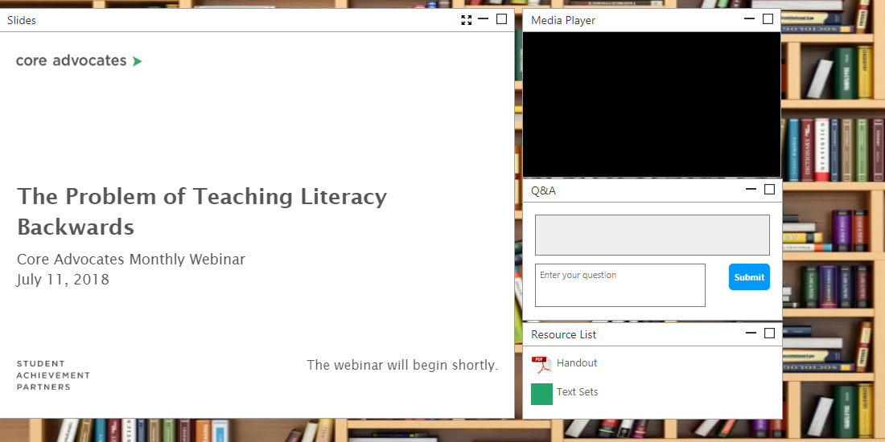
Engage with Us!
During the webinar
– Questions option
– Find the handouts and
resources
After the webinar
– Access to recorded
webinar

Slide 8
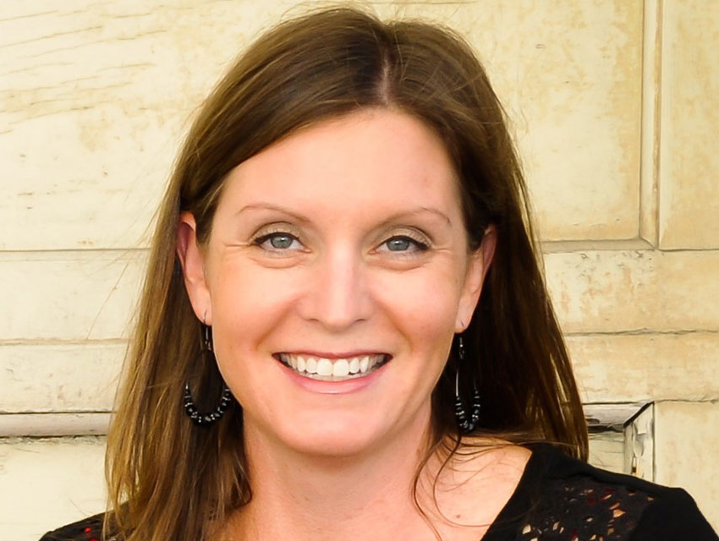
Jennie Beltramini
Mathematics Specialist
SAP

Slide 9
Goals of the Webinar
Learn about a professional learning model in which teacher learning is developed within the actual work of teaching students
Build a deeper understanding of equitable practices and how they can be developed through instructional routines
Learn from a Core Advocate about about implementing the routines in the classroom
Notes:
We have three main goals for our webinar tonight. They are to...

Slide 10
Survey:
What format of professional learning have you participated in most often?
After you complete the poll, share in the group chat which model has impacted or changed your practice the most?
Notes:
Answer Choices:
Off-site PD (for example, a conference)
Pull-out in-district PD (outside of school, but within the district)
School-based PD (not within the classroom)
PLC/Collaborative planning or learning (in a grade band/level/department)
In classroom PD (such as a lab classroom model)
Other

Slide 11
Section 1: Why professional learning within the work of teaching?

Slide 12
“Research suggests that professional development
is most effective when it addresses the concrete, everyday challenges involved in teaching and learning specific academic subject matter, rather than focusing on abstract educational principles or teaching methods taken out of context.”
“Teachers themselves judge professional development to be most valuable when it provides opportunities to do “hands-on” work
that builds their knowledge of academic content and how
to teach it to their students.”
Professional Learning in the Learning Profession: A Status Report on Teacher Development in the United States and Abroad
Notes:
When Jody Guarino and I began planning for a summer professional learning experience for teachers, we leaned on research from Linda Darling Hammond and others around effective professional development. Some design principles that guided us were that professional learning should be grounded in the everyday work of teaching a specific content area, in this case math and even more specifically fractions. Also, teachers feel professional development is most valuable when it provides hands-on opportunities to build both content pedagogical knowledge. Therefore we situated the professional learning experience in the work of teaching.

Slide 13
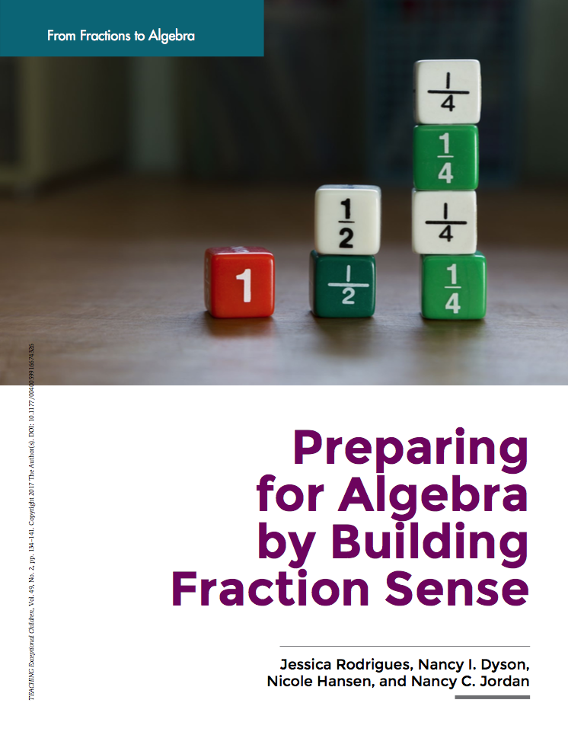
Why Fractions?
Even students’ overall IQ, family income, and family education do not predict future algebra achievement as strongly as does fraction knowledge (Siegler et al., 2012).
Notes:
We chose to focus on fractions both because the district adopted curriculum materials had some identified areas to address in the fraction units within grades 3 through 5, but also because of the clear research on the impact of fraction understanding for students’ success in high school math and beyond.

Slide 14
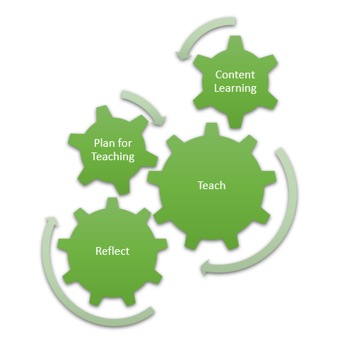
The Model
Notes:
In the model we designed, teachers would have the opportunity to engage in pedagogies of investigation and pedagogies of enactment; We spent 2 days investigating the fraction content knowledge, including the progressions, and then 5 days where students came in the mornings and teachers stayed for the afternoons, going to through a cycle of planning for instruction, and in some cases rehearsing, enacting the plan in the classroom with the students, and then reflecting on the teaching and the student thinking. Then starting the cycle over again to begin planning for the next day. We called the professional learning experience “Fraction Lab.” You can read in depth about it on the Aligned blog post that Jody and I wrote, which is hyperlinked in the resources tab. We will also elaborate more on the model during the webinar.
Also, while we did this learning in 7 days during the summer with elementary school teachers and students, the model could be adopted by any grade level educators, and structured throughout the school year within a PLC and classroom observation or lab classroom structure.

Slide 15
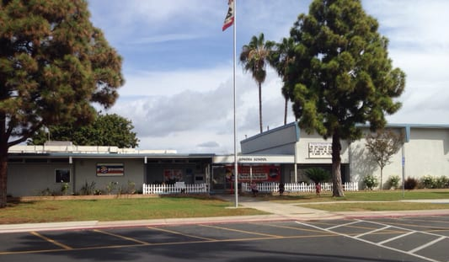
Southern California Elementary School
Enrollment of 465 students
Kindergarten through sixth grade
76% Latinx
77% socioeconomically disadvantaged
44% English learners
10% students with disabilities
Notes:
To situate the context of our work. I’ll share a little bit about the school and the students we worked with.
The school we were in and in which the students came from was in Southern California.
Context (from slide)
12 students attended, all were Latinx
They were entering 4th and 5th grades at the end of the summer
All were recommended by their teachers in the spring as kids who needed more work with fractions.

Slide 16
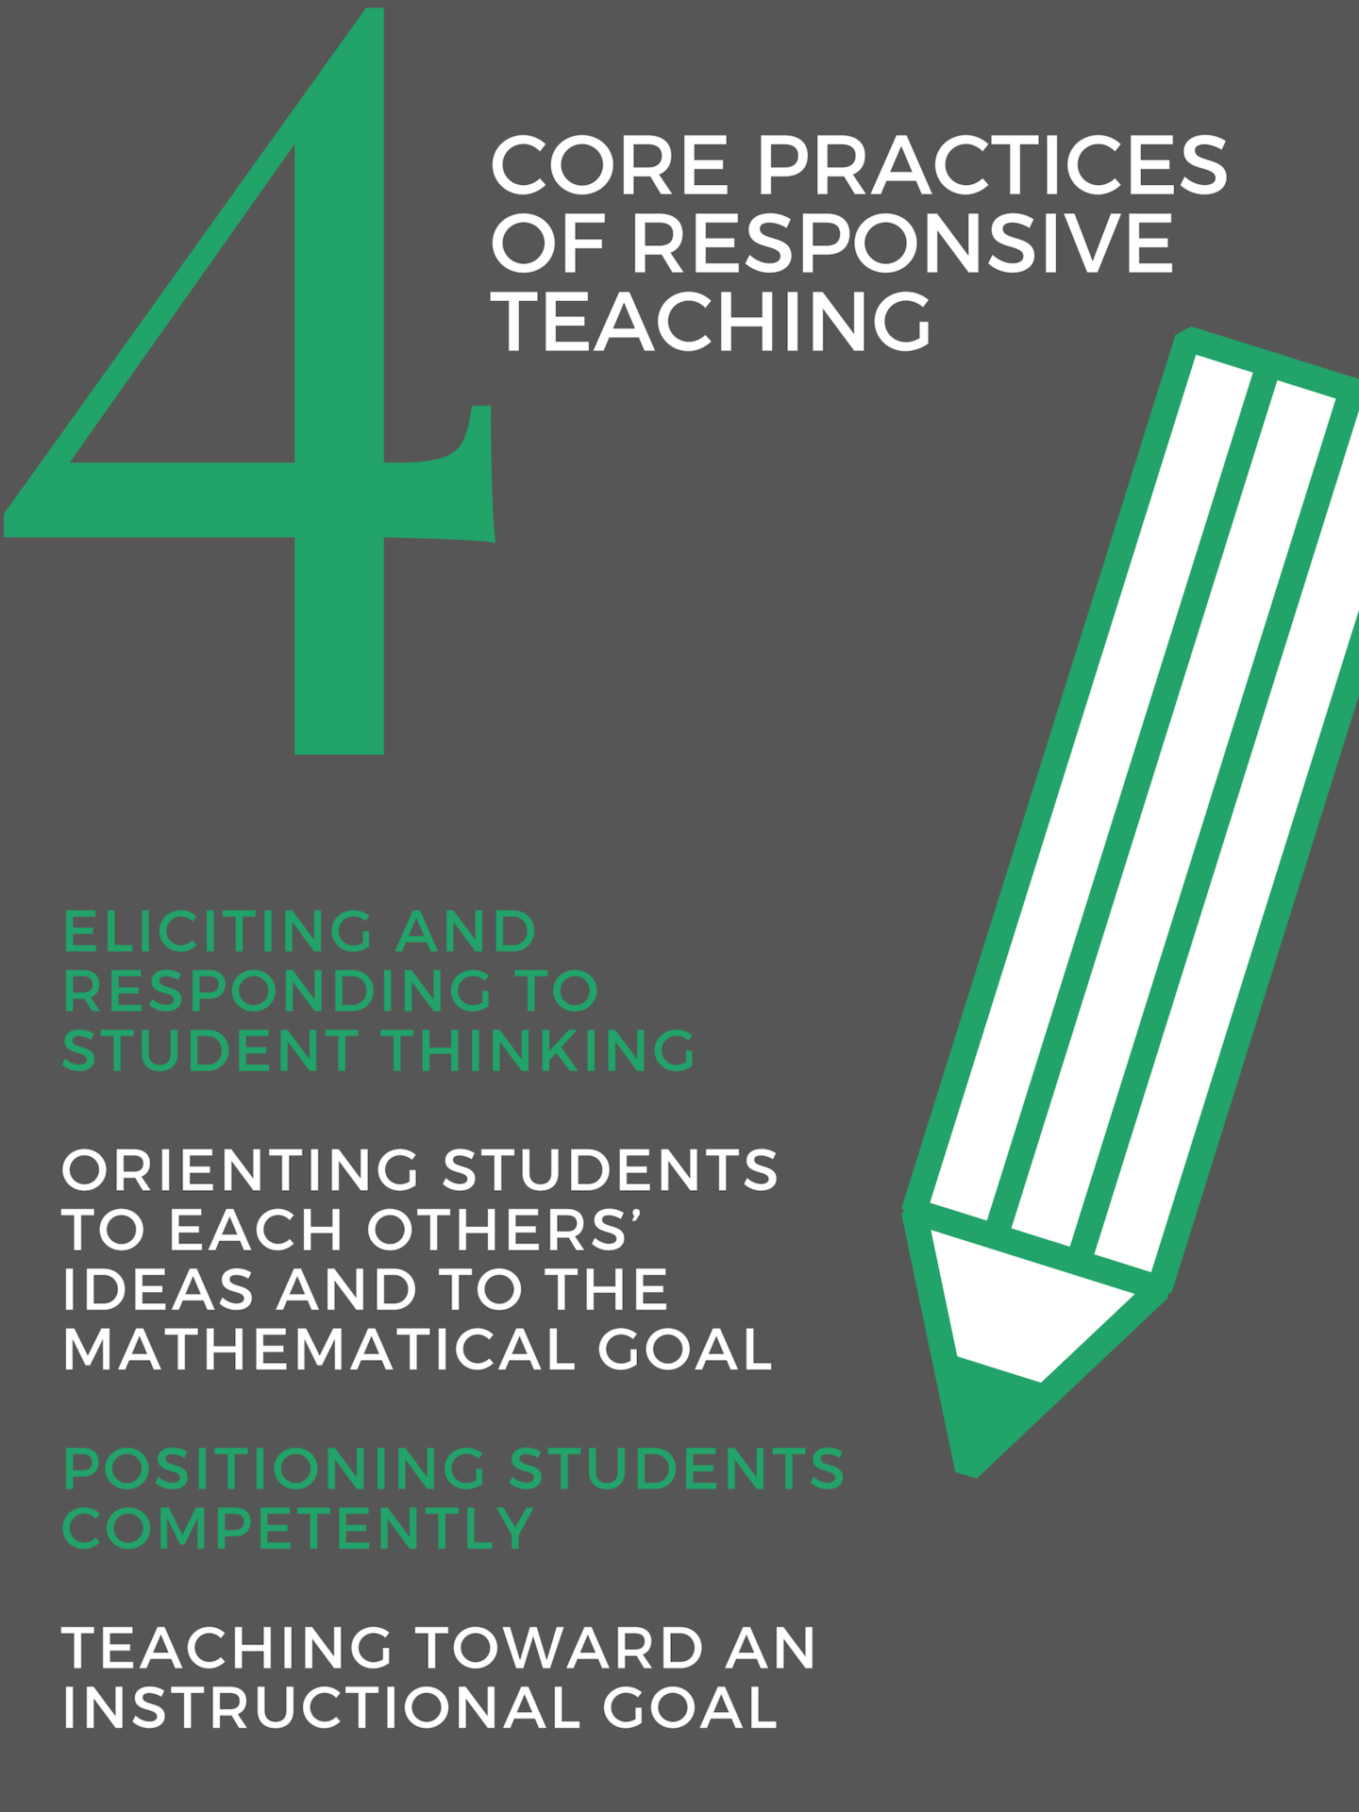
Equitable
Practices
Notes:
When thinking about equitable practices that the we would focus on when planning for teaching, teaching, and reflecting on teaching, Jody and I chose the four Core Practices of Responsive Teaching, which are adapted from the work of Elham Kazemi, Sarah Cavanagh, and others at the University of Washington. Student thinking is at the heart of ambitious and equitable teaching; an assumption of such a vision is that all students have worthwhile ideas on which to build, and that a primary goal of teaching is to find out what students currently know, and build instruction based on this knowledge in order to advance their mathematical understandings. The emphasis on the Core Practices contributed to teacher learning around pedagogy, but also confronted beliefs about students. The emphasis on the practices during instruction cause student identity to shift as well. Jody and I will talk more throughout the webinar tonight about how this happened. You can find more about the Core Practices at the hyperlinked primer in your resources tab, and also at the Core Practices Consortium, which is hyperlinked as well.

Slide 17
Content Learning
“Teachers must know the subject they teach. Indeed, there may be nothing more foundational to teacher competency.”
~Deborah Ball
Notes:
When designing fraction lab, Jody I knew we wanted to allow time for the teachers to dig deeply into content knowledge around fractions. Deborah Ball says, “Beyond being well versed in the content of the curriculum, teachers need significant mathematical skill, perspective, and judgment.” Mathematical knowledge matters for teaching. But it is not a mathematical expertise like that required for research in mathematics or for other kinds of quantitative work. Instead, mathematical knowledge for teaching is a kind of complex mathematical understanding, skill, and fluency used in the work of helping others learn mathematics.” We wanted to dig into fraction concepts with teachers to prepare them for the work of teaching.

Slide 18
Content Learning
Reading the standards and thinking about the big ideas of each grade level in 3-5 fractions.
Reading excerpts from the 3-5 NF Progression Document and pulling out the big ideas of the grade levels.
Engaging in mathematics as learners: completing fraction math tasks from grades 3 to 5, with discussion on the mathematical concepts within the tasks, mapping back to the standards and Progressions.
Notes:
We spent day 1 and part of day 2 immersed in content learning, reading the standards and progressions, pulling out big ideas of the grade levels, and then doing math as learners, mapping the mathematics uncovered in the tasks back to the standards and progressions.

Slide 19
“Opportunity to learn remains one of the best predictors of student learning (NRC, 2001). Differentials in learning outcomes therefore are not a result of inclusion in any demographic group, but rather are significantly a function of disparities in opportunities that different groups of learners have with
respect to access to grade-level
(or more advanced) curriculum,
teacher expectations for students
and beliefs about their potential
for success, exposure to effective
or culturally relevant instructional
strategies, and the instructional
supports provided for students.”
NCTM Position Paper: Closing the Opportunity Gap; http://www.nctm.org/Standards-and-Positions/Position-Statements/Closing-the-Opportunity-Gap-in-Mathematics-Education/
Notes:
After digging deeply into the mathematics, we shifted on day 2 to begin planning for instruction. Guiding the planning and process, Jody and I leaned on this position paper from NCTM about closing the opportunity gap in mathematics education. We find it particularly important to recognize that opportunity to learn, not demographics, remains the best predictor of student learning.
We knew we wanted to give the students an opportunity to access grade-level content - this is where cognitively demanding tasks came in,
we wanted to address teacher beliefs about the potential of the students, so collectively we could communicate in a way that projected our belief in them as capable mathematical sensemakers - Jody will talk more later about the norms we established
and we wanted to expose the students to effective instructional strategies - I’ll share more about how we taught the tasks and Jody will talk about instructional routines.

Slide 20
Teaching Students
Teach:
Instructional routine
Task
Instructional routine
Task
Notes:
Within the Plan - Teach - Reflect cycle, we used two instructional practices each day with students: instructional routines and rich tasks. Jody and I pre-selected tasks and instructional routines to use with students based on a pre-assessment we gave them before fraction lab. Through the pre-assessment, concepts we knew we would need to address with students were, understanding fractions as numbers, naming fractional parts, comparing fractions, understanding equivalence, and plotting fractions on a number line
I’ll talk now about the planning for tasks.

Slide 21
Plan for Teaching
Do the math
Partner share/anticipate student strategies
Unpack the mathematical goal
where does it fit within the progression?
what is prerequisite knowledge?
Notes:
We started by doing the tasks ourselves, and then sharing strategies and thinking in addition to anticipating student thinking. We used this experience to get clear on the mathematical goal for each task, connecting back to the standards and progressions.

Slide 22
Plan for Teaching
Launching of the task:
How will the task be launched?
How will we ensure students understand the task?
How much time will they have to work?
Our role as teachers:
What will we do as students work?
How will we monitor…what will that look like?
How will we keep track of what we hear?
What type of things are we looking for and how will we record what we notice?
“In-action” elements:
How will we would use student work to make the mathematics explicit for all students?
Which solution strategies will we look for to share?
How will we sequence the solution strategies, and how will we make connections between strategies?
Notes:
Then, in the planning to launch the tasks, the teachers collaboratively thought about how they would launch it, ensuring students understood but not taking away the cognitive lift. Some of the time during fraction lab, the teachers were able to rehearse the launch. They also discussed what their roles would be when students were working on the tasks, including how they would monitor student work, and what they would look for in order to orchestrate a discussion of student thinking that would orient students to each others’ thinking and the mathematical goal.

Slide 23
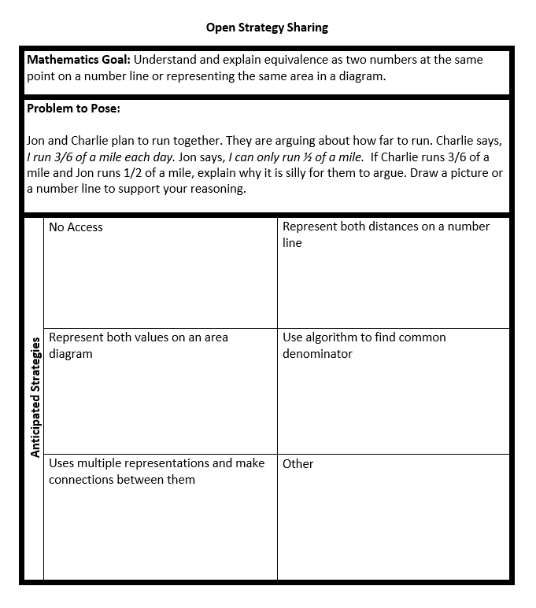
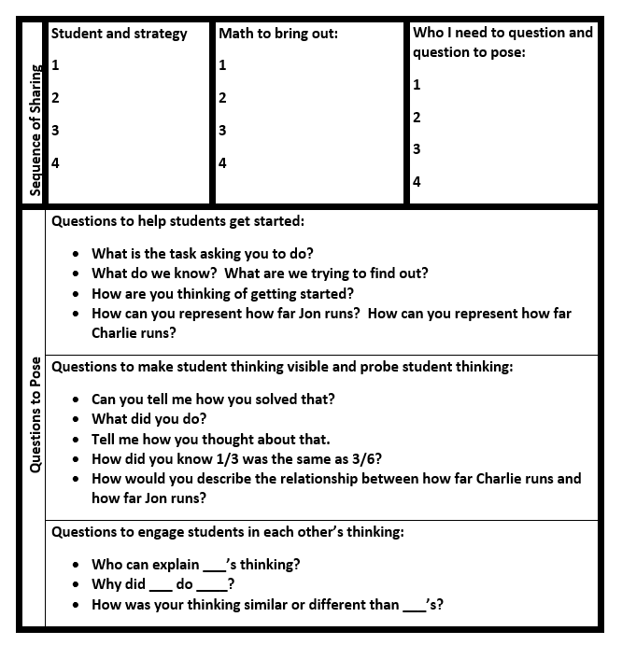
Notes:
We used this strategy share template to plan for anticipated strategies and think about how we might want to select and sequence the strategies for discussion.
Talk about anticipated strategies
We also wrote questions to use when we were monitoring student work to get students started, make thinking visible, and engage students in each others’ thinking. These questions helped the teachers plan for and enact the core practices of responsive teaching. They were used to get make sure all kids had access to the rich tasks, position kids as competent, make thinking visible, but not take away the mathematical thinking, the cognitive demand of the tasks. Through the pre-planning of these questions, we were able to ensure we shifted agency of the learning to the kids.

Slide 24
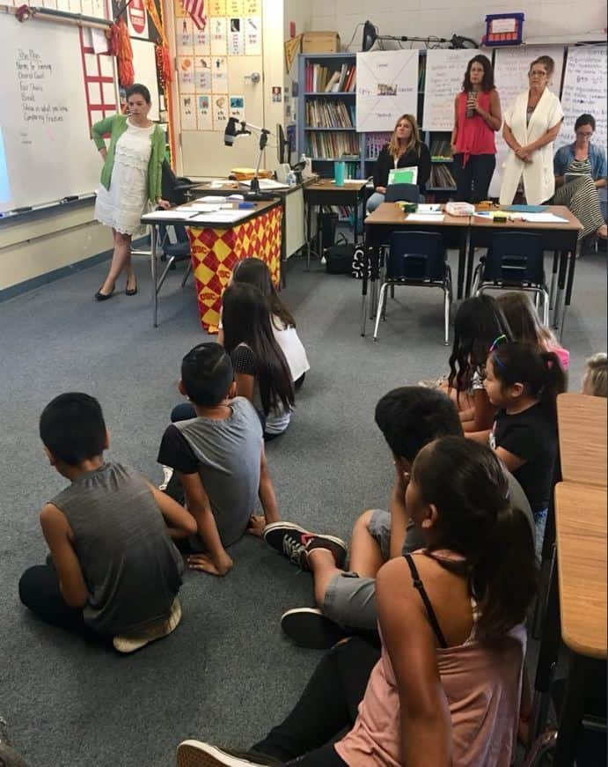
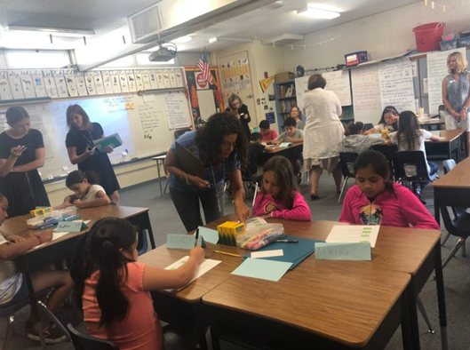
Teach
Notes:
Then we enacted the planned lessons every morning with kids. One or two teachers were responsible for launching the task; a small group of the teachers were responsible for monitoring student work (they huddled up during the work time to share what they were thinking and make a plan for which student strategies would be selected and how they would be sequenced to build toward the mathematical goal during the discussion), and then one or two teachers were responsible for orchestrating the discussion after work time. Some teachers each time were observers, standing toward the back and taking notes.

Slide 25
Reflect
Notes:
When students went home each day, and after lunch, we started the afternoons by reflecting on the lessons. We started by reviewing the core practices and sharing evidence from notes and observations of where they were enacted, and also places we noticed missed opportunities to enact the core practices.

Slide 26
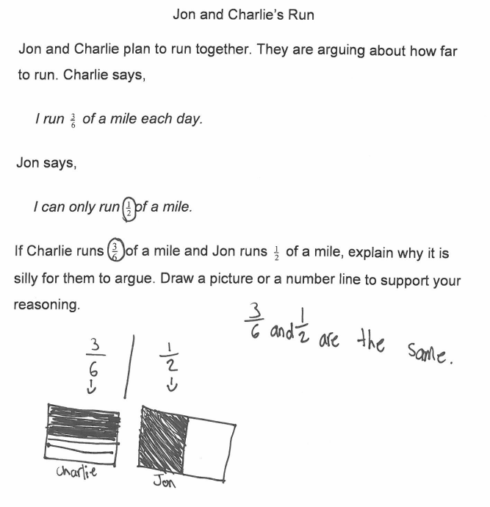
Reflect Using Student Work
Share in the Group Chat:
What do you notice about this student’s work? What does this student understand? What are you wondering about?
Notes:
We also reflected on “What do we know about the student learning?” Since part of the focus was to make student thinking visible (to notice it and act on it), we looked through artifacts of student work each day. Take a look at this piece of student work, from the task on the strategy share template I showed earlier. In the group chat, share what you notice about this student’s work, You might type what the the student understands (we usually started with what they know or understand when unpacking their work), or you might type a question you have. What are you wondering about this student's and his or her understanding?
Share some of the comments from the group chat…
We would use these insights each day to start the process over, and begin planning for the next day of fraction lab.

Slide 27
Notes:
After reflection each day, we started the cycle over, planning for teaching the next day.

Slide 28
Quotes
The students provided us with the ability to immediately practice what we learned and have feedback.
Having the opportunity to hypothetically plan lessons but then see the outcome of the lessons was powerful. The process of anticipating their responses and then seeing their strategies was wonderful.
I felt the most growth in content
knowledge. I enjoyed beginning
this training by mapping the
standards of all the grade levels
where fractions are introduced and
building my knowledge of the
content from these. The tasks that
we administered showed me the
different ways of exposing
students to fractions in varying
ways and thinking about the
relation with the progression of the
standards.
It was crucial to have the students as part of this training so that we could see how they solved the problems. I think what we learned from the students will stick with us so much more than if it had just been a lecture on what concepts students struggle with.
Notes:
At the end of fraction lab, we asked the teachers to share with us their reflections. The teachers found spending time during the first two days growing their content knowledge very valuable, and they were able to see how important it became once they were teaching the students. They all felt having the students there, to practice and enact the learning, was a critical component to their growth. One teacher said, “It was crucial to have the students as part of this training so that we could see how they solved the problems. I think what we learned from the students will stick with us so much more than if it had just been a lecture on what concepts students struggle with.”

Slide 29
Professional Learning Situated in the Work of Teaching
Could this work...
with other grade levels…
with other content areas...
to improve enactment of ambitious and equitable teaching practices?
Pedagogies of investigation and pedagogies of enactment
Core Practices of Responsive Teaching
Build specialized content knowledge
Notes:
While Jody and I implemented this model of professional learning for elementary teachers specifically around math instruction, we think this model could be used within any grade level and content area. Leaders of professional learning can think about the opportunity to build content knowledge and implement pedagogies of investigation and pedagogies of enactment in professional learning days or a PLC structure. Also, even though the core practices we used are specific to math, the practices could be adapted for any content.

Slide 30
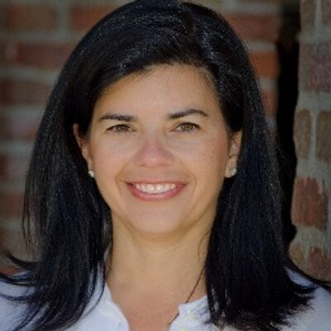
Jody Guarino
Math Coordinator
Orange County Department of Education

Slide 31
Section 2: How can a deeper understanding of equitable practices be developed through instructional routines?
Notes:
Routines and the role of routines

Slide 32
Teaching Students
Teach:
Instructional routine
Task
Instructional routine
Task

Slide 33
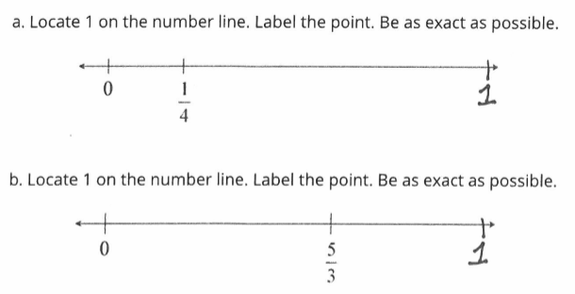
Group Chat: Look at the student work from the Fraction Lab pre-assessment. What do you notice about this student’s thinking? What would you want to focus on in instruction based on the student’s current understanding?
Notes:
Pre-assessment prior to experience. Combination of pencil paper tasks and 1 on 1 interviews.
Included items getting at major work of 3rd and 4th grade NF progression… help us think about the specific fraction work we’d do during fraction lab
Here’s a sample of one task...Take a few minutes to look at the student work sample and hop into the chat... What do you notice about this student’s thinking? What would you want to focus on in instruction based on the student’s current understanding?
This sample is representative of the group. Most students placed 1 at the end of the number line and many said things like, “1 is always at the end of the number line.”
We wondered what led to this and also identified this as something important to work on during fraction lab.
As we searched deeper we realized this was likely a generalization students had made as the instructional materials they were taught from only included number lines with 1 at the end. An important realization we discovered through this work. A realization the district would need to address as what we found was probably not unique to students at the site.
In our work we would include opportunities to develop learning around...
-Plotting fractions on the number line
-Value of fractions… what is the value of ¼?
-Understanding of the magnitude of fractions. For example, 5/3...What is there thinking about this quantity? Greater than 1? Relationship to 1?

Slide 34
Notes:
As Jennie mentioned earlier, we identified 4 core practice of responsive teaching we would be working on throughout the week. These core practices would be the focus of elementary math professional learning within the district for the coming year. Core Practices are: (1) Central to the daily work of teaching, (2) Central to supporting student learning, (3) fundamental to developing other, more complex practice, and (4) Underlie many different curricula or approaches to teaching (Core practice consortium, 2019). They can be unpacked, studied, enacted, study the enactment, and refined.
These core practices come from work at U of Washington. A district goal is to move from viewing and enacting teaching as covering a textbook to...teaching students mathematics. The selected core practices lend themselves to a focus on students and their thinking as well as the intersection of students and mathematics.
They are also central to implementing ambitious and equitable practices, practices that situate the students as competent mathematical thinkers. They were foundational in our work as we thought about how equity plays out in the classroom.
https://www.corepracticeconsortium.com/

Slide 35
Norms
Make sense of mathematics.
Keep trying even when problems are challenging.
Remember that it’s okay to make mistakes and revise our thinking.
Listen to understand someone else’s idea; give each other time to think.
Remember that everyone has good mathematical ideas.
Intentional Talk: How to Structure and Lead Productive Mathematical Discussions. Kazemi, E. & Hintz, A. (2014).
Notes:
We also knew creating a learning community was going to be important. We were bringing together students that didn’t know each other, across two grade levels, with a room full of teachers. How could we develop a positive learning environment? Considering learning theory, knowing that students learn from each other and can be apprenticed into practice... How could we create a safe environment where students learned to participate as they would participate? We would be asking students to engage in math in ways that may be new to them...constructing new ways of thinking and enacting what it means to “do math.”
We selected a set of norms from Elham Kazemi & Allison Hintz’ book Intentional Talk. We saw the norms as an equity move… how can we support students to see themselves as mathematical thinkers, to develop their identity-- how they view themselves and how they view each other. The norms were a way to work on beliefs, develop ways to communicate to students about our beliefs in them, and a way for them to participate as a community of learners.
We introduced the norms and spent time talking about each, eliciting student thinking about what the norm might mean, why it’s important, and what it would look like and sound like in action. The norms were displayed on the board and each day revisited several times. Students would start the morning identifying a particular norm they wanted to work on that day and we’d also revisit the norms at the end of learning experiences to reflect on ways we used, or saw others use the norms. At one point, one of the students shared [pull quote from transcripts].

Slide 36
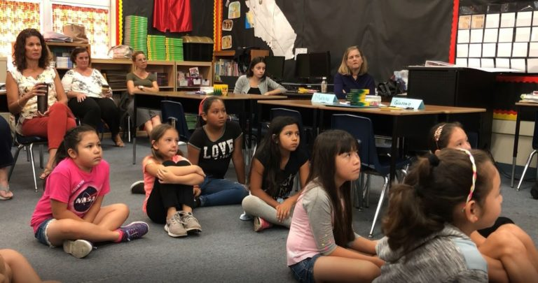
Instructional Routines
Student Learning:
Teacher Learning/Practice:
Opportunity to attend to student learning
Predictable structure allowing focus to be on the mathematics
Connected to mathematical goals (Understand fractions as numbers)
Opportunity for reasoning
All students have access
Opportunity to attend to teacher learning
Opportunity to “practice” the core practices of responsive teaching
Work on participatory structures
Practice posing questions
Notes:
We knew we wanted to focus on instructional routines. Once the routines become familiar, students can attend to the mathematics and participating within a mathematics community and we (teachers) can also work on teacher practice. The routines become predictable, not relying on teacher or student focus to understand what each is supposed to be doing.
Take a minute to notice the affordances for student and teacher learning outlined on the slide.
Building from the work of Kazemi, Franke, and Lampert in their paper, “Developing Pedagogies in Teacher Education to Support Novice Teachers’ Ability to Enact Ambitious Instruction” instructional routines (1) engage students in cognitively demanding mathematical activity, (2) elicit and respect students’ efforts to make sense of important mathematical ideas, and (3) use mathematical knowledge for teaching to interpret student efforts and aim for well-specified goals. Through instructional routines we would work on the understanding of fractions as numbers, counting with fractions and seeing fractions as an extension of the whole number system. We would also work on fraction number sense including magnitude. (all big ideas identified from the standards/progressions) in days 1 and 2, the content learning)
During Fraction Lab, the routines were a way for teachers to rehearse the Core Practices and reinforce the norms. ALso, when engaging in the routines, students were able to practice the norms.

Slide 37
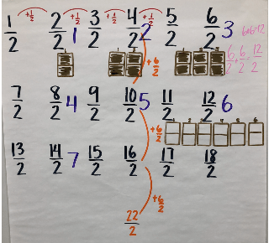
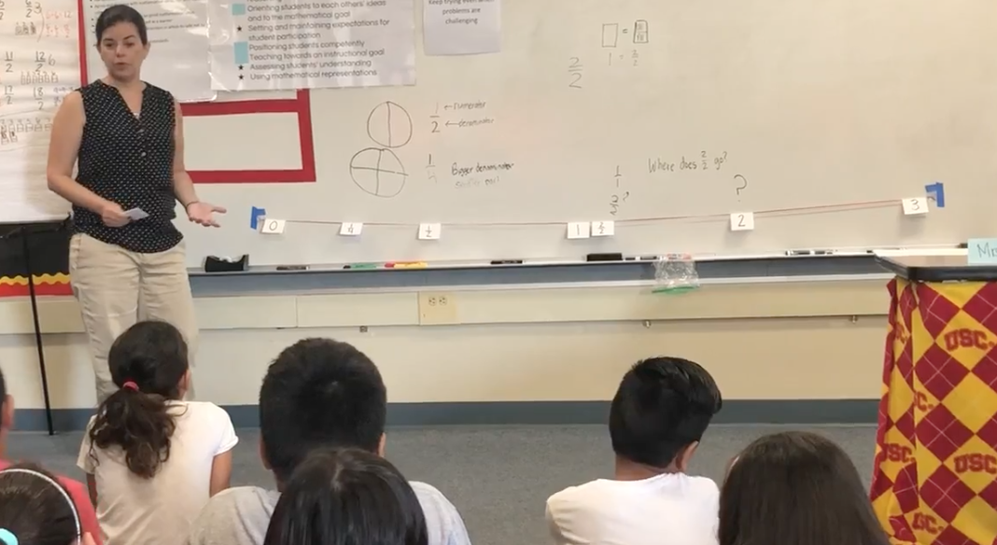
Instructional Routines
Choral Counting
Yarn Number Line
Notes:
We selected two routines to focus on… choral counting and yarn number line. Each of these routines were used daily and could be used to support understanding of fractions as numbers and as an extension of the whole number system.
Choral Counting
Choral counting is an instructional routine in which students count aloud together and the teacher strategically records the counting sequence. Within the routine, students experience the cadence of counting aloud, explore the counting sequence, and notice and make sense of patterns and structures within the count and our number system. The teacher pauses the count at periodic points, inviting students to share strategies for identifying the next number, patterns they notice and why those patterns may be occuring, and other mathematical noticings.
Yarn Number Line
A yarn number line routine is an instructional routine that can be enacted in the classroom in a short amount of time. The teacher simply creates a number line by hanging yarn across a wall or board. Each day the routine is enacted, students place numbers (integers, whole numbers, fractions, decimals, etc.) on the yarn number line, attending to quantities that are already placed on the number line, as well as placement based on magnitude of the numbers. Students then justify the placement of the numbers. This routine develops mathematical concepts of number sense, place value, number magnitude, and number comparing and ordering.
*Both blog posts are linked in the resource tab…. Each blog post includes a description of the routine, dropping into a classroom to see the routine in action, tips on planning the routines, as well as reflecting on it.

Slide 38
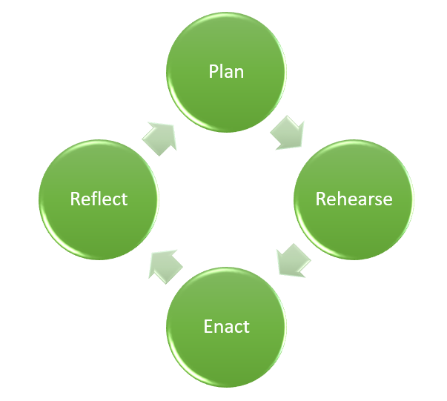
Instructional Routines
Notes:
Within the model of PD, instructional routines provide an opportunity to plan, rehearse, enact, and reflect; focusing on students and their learning. I’ll share what this looked like in the context of choral counting.

Slide 39
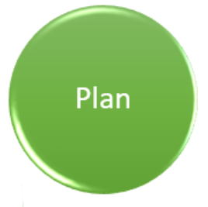
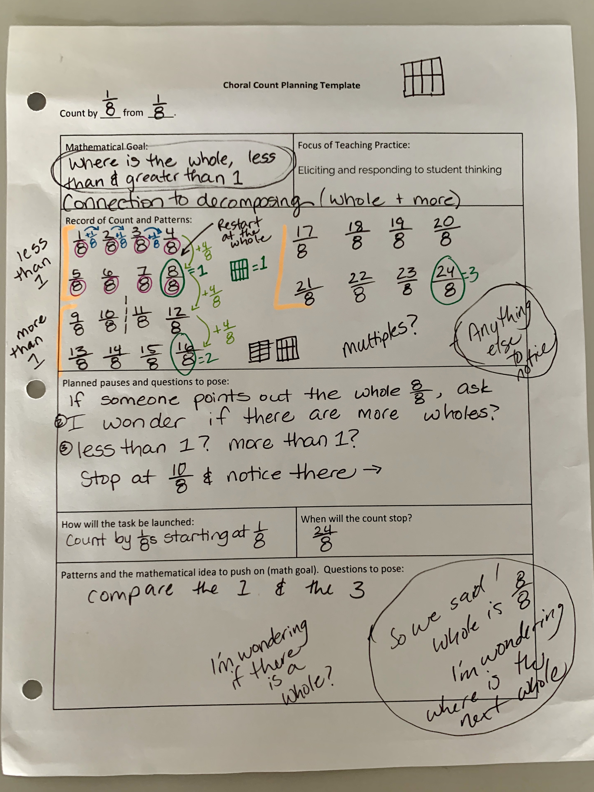
Notes:
Plan
A team of teachers identified a mathematical learning goal and a goal to work on within their own practice.
One team decided to work on the relationship between fourths and eighths and the core practice of eliciting and responding to student thinking.
They decided to have students count by 1/8s. They wrote the count in different ways, predicting how the recording might make patterns more and less visible. They decided to record the count horizontally in rows of 4, so the end of each row would end up with a fraction that is equivalent to a whole number.
The teachers also developed questions they would pose and when they would pause the count to pose those questions. Some of the questions they came up with…
-What do you notice?
-What do you mean by that?
-Why do you think that’s happening?

Slide 40
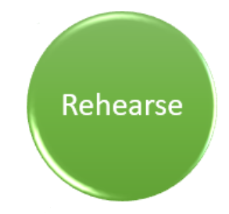
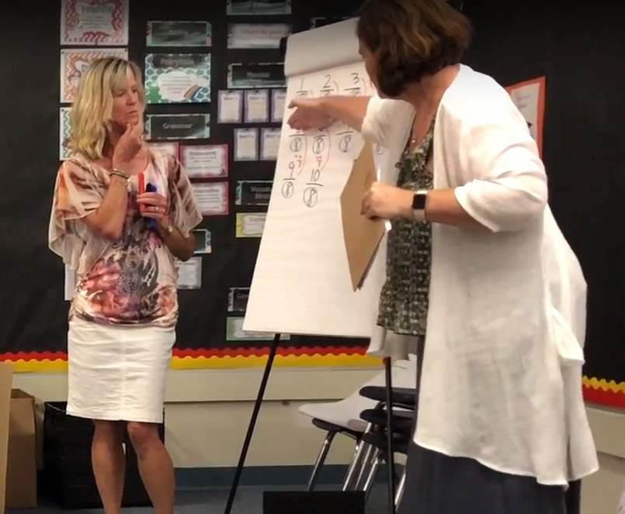
Notes:
Rehearse
They then conducted the choral count with other teachers acting as the students. This gave them the opportunity to practice the plan and work on in the moment questioning. For example when a teacher (acting as a student) responded, it’s going up by 1. The teacher in the moment asked, “What do you mean it’s going up by 1? 1 what? Rehearsing provides an opportunity to respond in the moment.

Slide 41
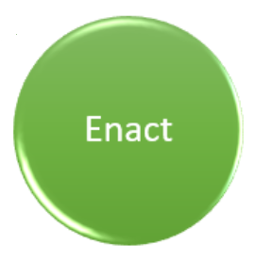
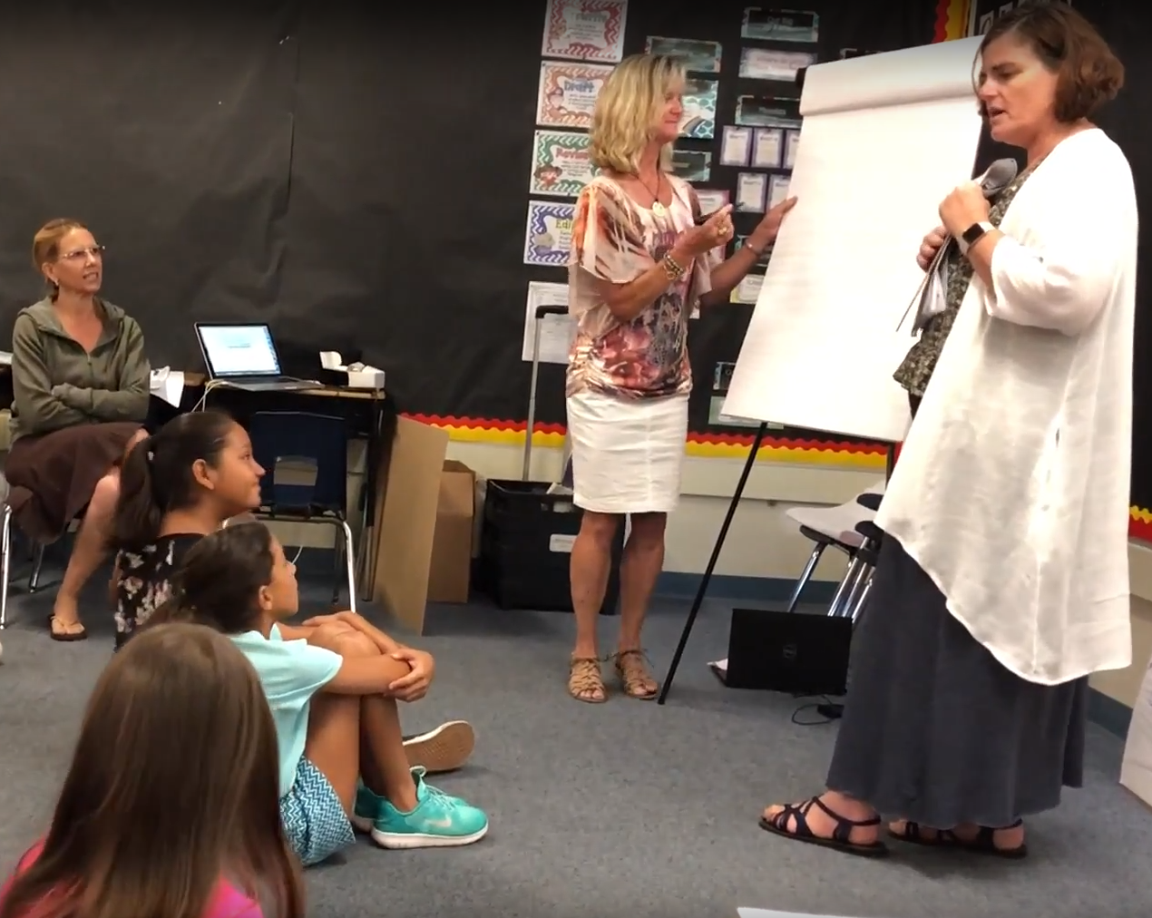
Notes:
Enact
The teachers co-taught the lesson to the students. We also used “teacher time-outs” a technique we learned from Elham Kazemi and Allison Hintz. In teacher time-outs the lesson is paused and teachers have an opportunity to confer and get input on in the moment decisions. When this particular task was enacted, I called a teacher time out. Diego had just shared ….two columns count by fourths. He went up to the chart, pointed to the first column and said, “See here, 1, 5, 9.” He then went on to say, “actually it works on every single one.” At this point there was lots of nodding and kids pointing, everyone was focused on the chart. I called a time out because it seemed like a great opportunity to push for reasoning and sense-making around this idea. I posed the question, “I wonder why that’s happening?” This happened on the fourth day of fraction lab and we were at a point where students were sharing ideas and noticing patterns. Reasoning around those patterns was a next step, a place we wanted to go and this seemed like an opportunity.

Slide 42
Notes:
Reflect
At the end of each day, we reflected on the experience as a group. We started with the core practices and how those played out within the day, giving specific evidence, for example, of times student thinking was elicited and what we learned. We talked about evidence of student learning, again with specific evidence from either the charts or our notes. One thing we tried to do but are thinking about how to do better is using video. We recorded and have artifacts from every lesson. We could have used these better, as a lens for reflecting by actually viewing the clips, or picked sections of the clips to analyze.

Slide 43
Student Growth
From… “1 is always at the end of the number line”
To... using reasoning to place 1 on the number line.
“5/3 is greater than 1 because 3/3 is one whole and then 2/3 more is 5/3”
“I found 1/3, then ⅔ came after that, then at 3/3, I put 1 there…” -
“The 5/3 gave me a huge clue. I looked at 5/3 and the 1 and so I moved the 1 a little bit”
Notes:
As we mentioned we spent the week focusing on fractions as number, the big idea of third grade fractions. Working on a number line was part of this work. As you may recall from earlier in the webinar, when students were given this task as part of the pre-assessment almost all students placed 1 on the end of every number line and many actually stated, “1 always goes at the end of the number line.”
At the end of the week students were given a post-assessment that was identical to the assessment they’d been given in a few months earlier. This example comes from one of the students. As we analyzed this task not only were most students successful now, we saw reasoning in their responses. Students were considering the value of the number, where the number fit within a sequence of numbers, and they communicated their thinking.
So not only did they now have correct answers, their ways of thinking shifted.

Slide 44
Student Growth
From… “No” or “Yes, because it has numbers in it”
To...
explanations that included attributes of numbers, applying whole number knowledge to fractions
use of discipline specific language (subtract, calculate, equation, numerator, denominator, number line)
explanation that included examples…”Say I’m using ½, it has 1 on top which is the numerator and 2 on the bottom which is the denominator…”
Notes:
Here’s another example of student growth. This question was part of the pencil paper assessment and we also posed this question verbally, one-on-one, to each student as they completed the pencil paper assessment.
Prior to fraction lab most students said no a fraction is not a number or if they did say it was a number, their reasoning didn’t show understanding. Responses included things like, “it has numbers in it.” Their reasoning didn’t show understanding prior to the week.
After the week of fraction lab we posed the same question. Not only did students now think about fractions as numbers their reasoning showed understanding. They were seeing fractions as an extension of whole numbers, using discipline specific language, and their explanations were more thorough.

Slide 45
Student Quotes: How did you feel about fraction lab?
Fraction lab really helped me. Before I came here I wasn’t really that good at fractions. This really helped me. It was really fun and I don’t want to leave!
I got to learn new things (at fraction lab). It made me understand fractions more. I got to learn fun games while I actually learned fractions.
I felt good about fraction lab. The first day I went there I was shy. I didn’t really know the stuff I learned before. When school was over I didn’t know things about fractions. Now that I went to fraction lab, I do!
Notes:
The last morning of fraction lab one of the students shared that he was going to miss fraction lab next week and thought he might even cry because it was over. He shared, “I used to think I suck at math, now I think I’m good at it.”
We were shocked that he said this and decided to ask the kids how they felt about fraction lab, we wanted to capture their voices. Reflecting back these kids spent 3 hours a day over the summer working on fractions and they loved it. They were empowered, saw themselves as doers of math and valued what they learned.
This really had us thinking about identity, and the role of identity in mathematics teaching and learning. This is something we really worked on as we positioned students and their ideas as competent and as you can see in the student quotes, this had an impact.

Slide 46
Teacher Quotes: How are you thinking differently about
your teaching practice? What part of this experience contributed to that change in thinking?
I’m going to try to shift my teaching practices in math away from direct instruction and into process that is more centered on student thinking and inquiry.
The way in which I structure my lessons to position students competently. I loved watching the way that students grew when they were given opportunities to share their great ideas.
I plan to use the learning norms to promote equity in learning. Accepting student thinking and understanding as it comes naturally and orienting their learning to to each other and the learning goals. I will refine my teaching practice by eliciting student understanding by posing questions and accepting their ideas as a pathway to their personal thinking.
Notes:
In addition to student learning, this experience was quite different for teachers. Professional learning within the actual work of teaching. Here are some teacher thoughts… how they’re thinking differently about their practice and how the experience contributed to their change of thinking.
As you can see in these teacher quotes, equitable practices were visible in many teacher responses.
As teachers, we engage in all types of PD. There was something about this experience, growing as a learning community of teachers and students throughout the week that really came to life. Beliefs and practices of teachers and students shifted.

Slide 47
Instructional routines to advance equitable practices
Could this work...
with other grade levels…
with other content areas...
to improve enactment of ambitious and equitable teaching practices?
Plan, rehearse, enact, reflect
Learning community norms
Core Practices of Responsive Teaching
Notes:
As Jennie said earlier, our focus for this professional learning was elementary grades math. However, we think the structure and components could be relevant in other grade levels and within other subject areas. We wonder what instructional routines could be used for teachers to focus on equitable practices in their classrooms. Perhaps a socratic seminar routine or feedback protocol? Where within in other disciplines are there opportunities for implementing regular routines in which teachers can practice responsive teaching and reinforce learning community norms? We think this model has value beyond math.

Slide 48
Survey:
What aspect(s) of this model would you like to try out or learn more about? Select all that apply.
Notes:
instructional routines to support student and teacher learning
pedagogies of investigation and enactment together
professional learning model situated in the work of teaching
cycle of planning, teaching, reflecting on tasks
core practices of responsive teaching
building a community of learners (norms)
equity; attending to student identity/status
choral count
yarn number line

Slide 49
Section 3: What is a model for implementing the routines in the classroom, including successes and challenges?

Slide 50
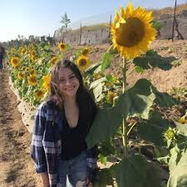
Karina Calderon
Third Grade Teacher, Two Way Immersion Classroom
Saddleback Valley Unified School District

Slide 51
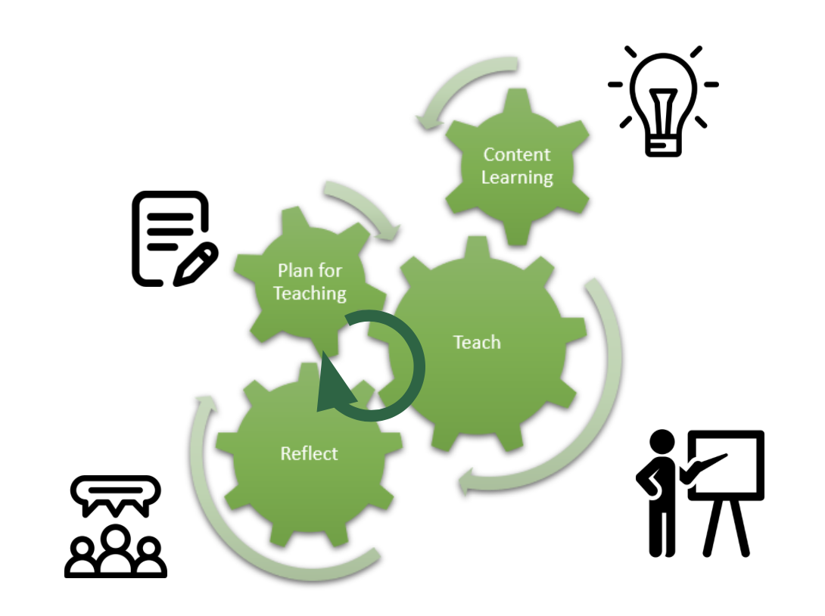
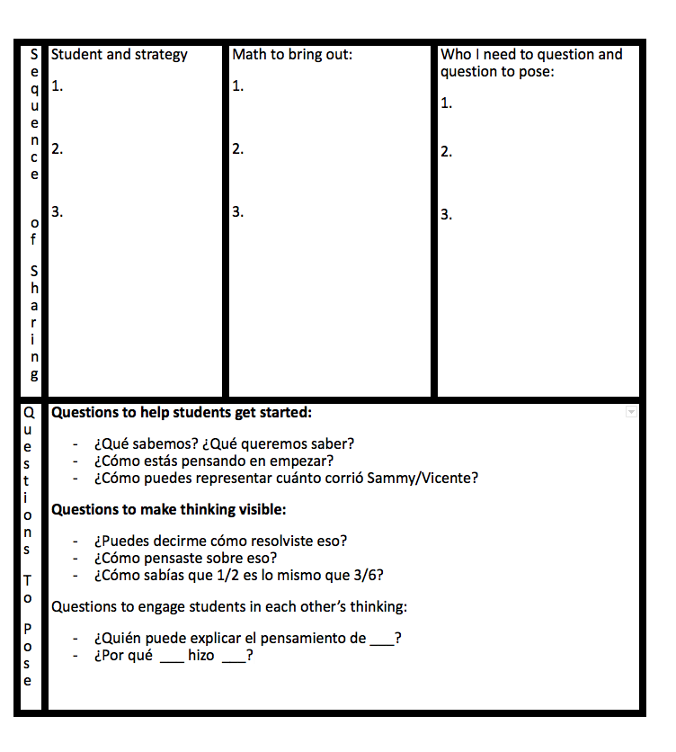
Notes:
As mentioned, I was able to attend fraction lab lead by Jody and Jennie. I was able to learn instructional strategies that I could implement into the classroom to support student engagement and understanding as fractions as numbers. The insight I gained from fraction lab is something that I brought back to my grade level team at my school site. The plan, teach, reflect model is something that can easily be incorporated at your school site among your professional learning community. At my school site my grade level team spent the time discussing the math and the standards of focus for fractions. We spent time thinking about the progression of our fraction unit and how we can best support ss understanding of fractions as numbers. As we plan for teaching our math lessons, we often use the open sharing template as a guide. This template allows us to plan for anticipated strategies, and consider how we might want to select and sequence strategies for discussion. By considering our mathematical goal and planning our questions we prepare for intentional talk around the math task leading to the success of SS having a deeper understanding of math. Lastly, the reflective piece guudes how we continue to teach. Having that time for reflection as a teacher and as a team helps us uncover what is working well, what adjustments we should make, and what should we do as we move forward. By using this model consistently in my classroom I have seen perseverance in my SS as they are accessing the rich task, their confidence with math increasing even when the task seems difficult, and their attentiveness to other’s strategies by noticing connections with each other’s work. As the teacher I have seen growth in my teaching as well. I have seen growth in my questioning as I facilitate a discussion where we discover different entry points to tackle a math task, illuminate mistakes to become stronger mathematicians, and make connections within our models and thinking.

Slide 52
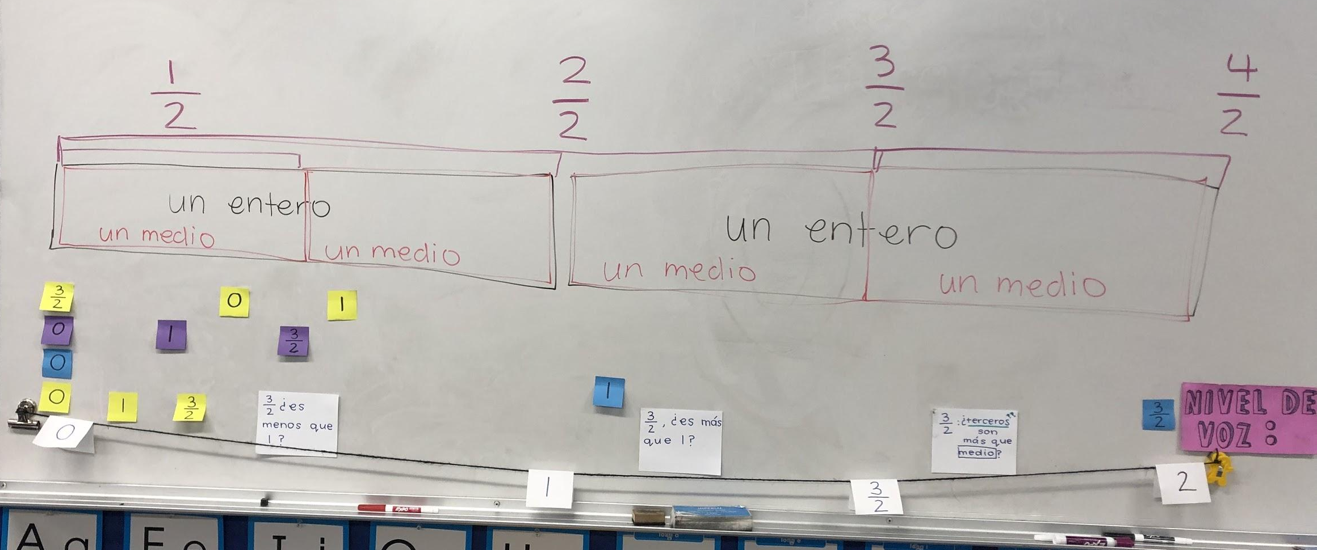
What’s the
CORRECT order?
How do YOU know?
Notes:
The first routine I implemented to support students sense making of fractions as numbers was the number line routine. The number line routine was by far a class favorite activity. Having this open number line at the front of the classroom meant that it was something students kept referencing throughout the day. We start math after recess and as I picked up my students I could hear comments in line like “I figured out the correct order, can I show the class my thinking!” The best part of this routine was the engagement and excitement SS had to share their thinking. SS either participated by placing or shuffling the numbers on the number line or by sharing their reasoning why they agreed or disagreed with a peer’s thinking. There was a sense of security and willingness to keep trying even when the task was challenging. As a community our knowledge kepto expanding. There were several days where we would end our number line routine and the numbers were ordered incorrectly and that was OK. It was an activity that we kept returning to and continued to get closer into ordering correctly with a strong justification. As SS began to understand fractions as equal parts, they attended to precision with this routine. I loved the flexibility with this instructional routine. It was a concrete model for the SS as they shuffled the numbers along the yard line. It allowed flexibility with the numbers of focus. We worked to different sets of numbers to ensure SS did not develop misconceptions such as a number line always ending in 1 or fractions are always less than 1.

Slide 53
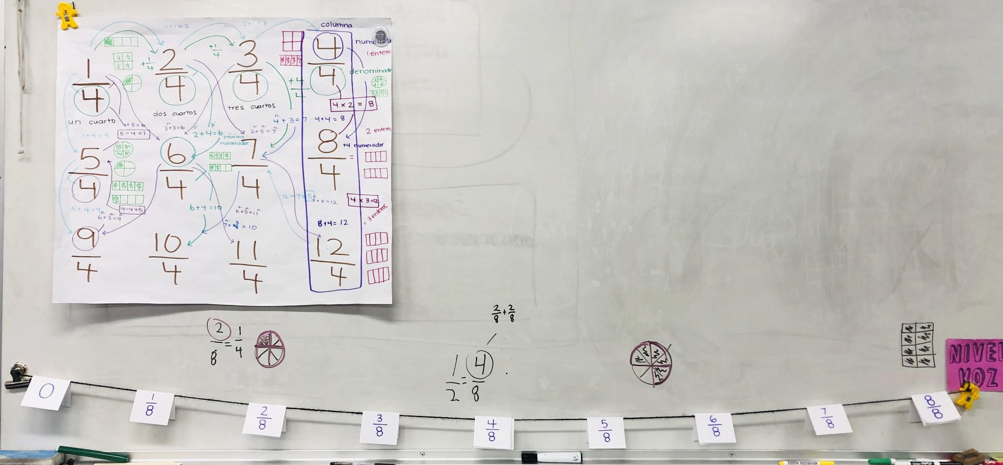
Exploring a counting sequence
Notes:
The choral count routine was also an engaging routine. It was a routine where SS could make connections to a number line as they both are counting a sequence. SS were able to share other knowledge as well such as models that represent the fractions and other fractions to which they are equivalent to. In the picture is our first fraction choral count. This choral count was charted over three days. I decided to take it slow and focus on academic language. SS kept building on each other’s idea by adding academic vocabulary to the patterns they noticed. For instance, a student noticed that it was going up by 1. Another student added that the numerator was going up by 1. Spending our time with one choral count before moving on allowed us to dive deep and show what we know about these numbers.
A challenge with choral counts is ensuring you are charting SS thinking and not your own thinking. Going back to the example i mentioned, if i had interjected and said “oh you see that the numerator was the one increasing by 1” I would have taken the voice of another student in my class. Taking that step back and providing as little of your own thoughts can be challenging but with time I find myself just writing and having my SS doing all the talking. Using talk moves where students can show that they want to add on or share a new idea helps with thee selecting process. An additional challenge with both instructional routines (the choral count and number line) is ensuring ALL voices and thinking is heard. As I’m doing these activities whole group, I want to ensure my SS who aren’t sharing have the opportunity to share their thinking as well. My recommendation is to take notes of these SS to later pull for a small group to ensure ALL SS ideas are heard.
Both routines contributed to so much success in my SS understanding of fractions as #s. I truly hope you all take the chance to implement in your own classroom.

Slide 54
Questions for Our Guests?

Slide 55
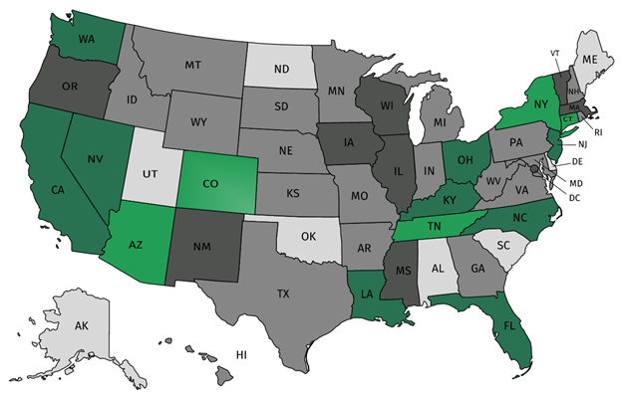
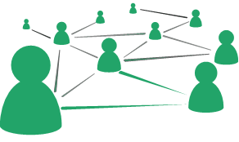
Join Our Network!
Join a national network of educators
Connect with state networks
Be a part of creating new tools and resources in partnership with SAP
Keep up to date on free resources, upcoming SAP webinars/professional learning opportunities, job postings and more!
Notes:
If you found tonight’s webinar helpful, we’d like to invite you to join our Core Advocate network! We’re committed to solving real problems that real teachers have and we know the best way to do this is to know more about what folks are experiencing.
As part of our national network, you have opportunities to connect with educators across the country, maybe even the network in your state! You can keep up to date on tools and resources available on Achieve the Core, as well as a variety of virtual learning opportunities and other ways to engage with us. We also work with educators in our network to help us build tools and resources.
We’d love to learn about who you are, where you work, the types of things you’re interested in and the expertise you already have. This way, we will be able to tailor our webinars and other opportunities to your needs and interests (we may even tap you to be our next webinar panelist).

Slide 56
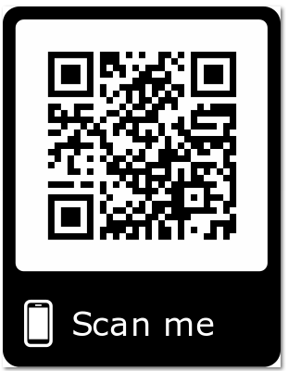
Please Join Us!
https://achievethecore.org/ca-signup
Twitter: twitter.com/achievethecore
Facebook: facebook.com/achievethecore
Pinterest: pinterest.com/achievethecore
Notes:
We encourage you to join the network by filling out this survey completely at atc.org/ca-signup

Slide 57
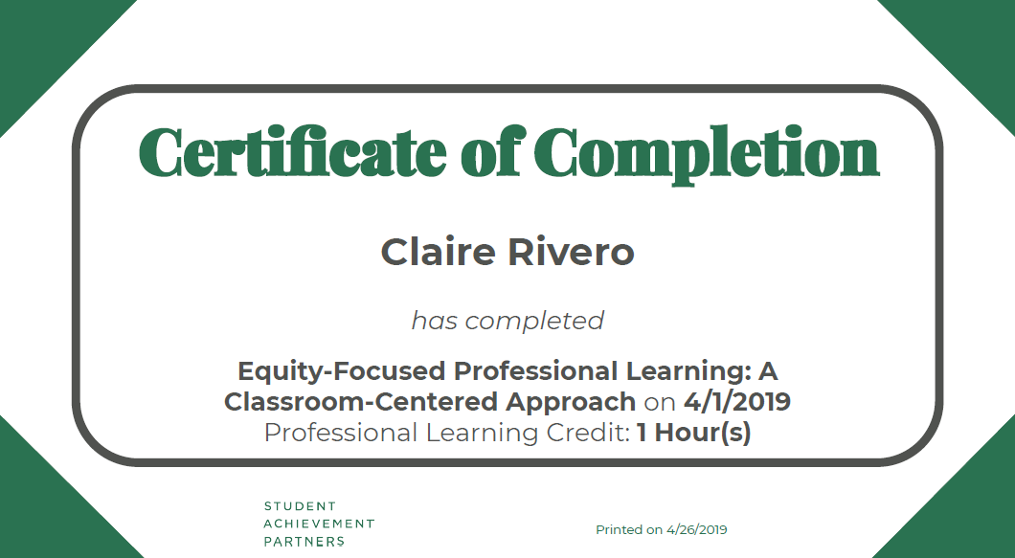
Take our Survey: Receive a Webinar Completion Certificate
You’ll receive a survey via email in 2 weeks.
Completing the survey lets us know about your experience and whether the content was useful to you in your work.
You’ll receive a certificate of completion showing one credit hour.

Slide 58
Please Join Us Again Next Month!
Next month’s webinar: Kick off to the Summer Reading Challenge--5 guest authors share their expertise and blog posts
Date/Time: June 5 at 7:00pm ET
Register Here: https://event.on24.com/wcc/r/1977043/DC53C6D0941B86C0122A84F6D6661EF1

Slide 59
Resource List
Resource Name | Link
Core Advocate Survey | http://bit.ly/webinar-ca
Professional Learning in the Learning Profession: A Status Report on Teacher Development in the United States and Abroad | https://learningforward.org/docs/default-source/pdf/nsdcstudy2009.pdf
Preparing for Algebra by Building Fraction Sense | https://www.howardschool.org/uploaded/personal/2881/Fractions.pdf
Aligned: Creating a Model Process for Hands-On Professional Learning | https://achievethecore.org/aligned/creating-model-process-hands-professional-learning/
Core Practices of Teaching: A Primer | https://coetedd-wpengine.netdna-ssl.com/wp-content/uploads/2017/09/core_practice_primer.pdf
Closing the Opportunity Gap in Mathematics Education: A Position of the National Council of Teachers of Mathematics | https://www.nctm.org/uploadedFiles/Standards_and_Positions/Position_Statements/Opportunity%20Gap.pdf
Core Practices Consortium | https://www.corepracticeconsortium.com/
Choral Counting: A Lever to Develop Fraction Understanding | https://achievethecore.org/aligned/choral-counting-lever-develop-fraction-understanding/
Yarn Number Line: A Lever to Develop Fraction Understanding | https://achievethecore.org/aligned/yarn-number-line-lever-develop-fraction-understanding/

Slide 60
Thank You!

