Slide 1
A Celebration of Teacher Voice
Perspectives and Strategies from the Classroom
June 5, 2019
The webinar will begin shortly.
Check your Resource widget to preview the resources for today’s session!
Notes:
First timer poll
Handouts:
While we’re waiting, we’d like you to participate in a quick poll so we can get an understanding of who’s on the webinar with us tonight.

Slide 2
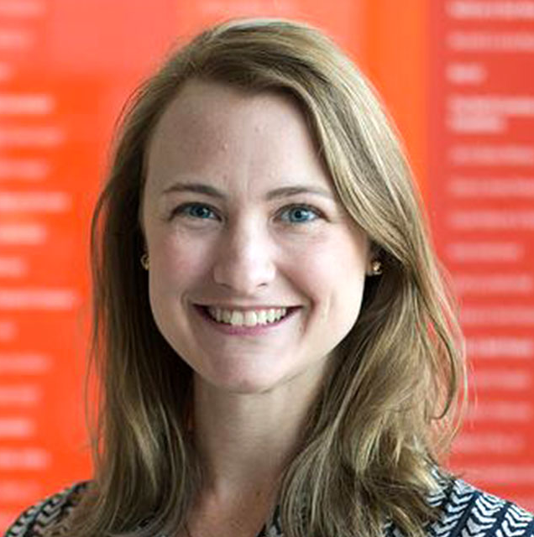
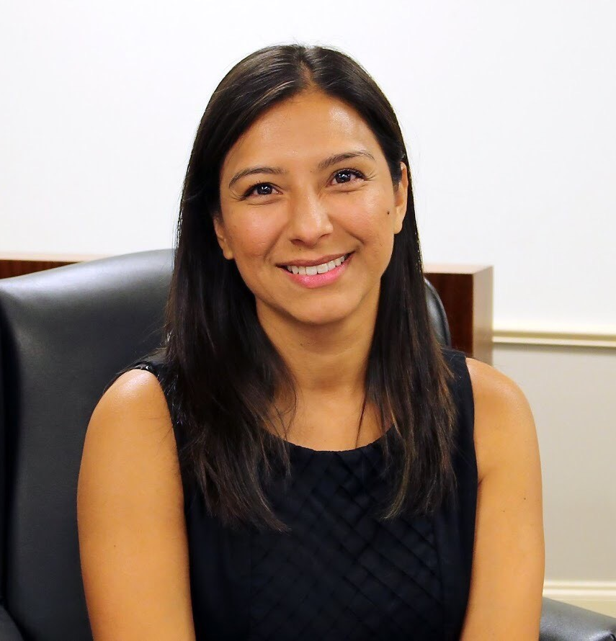
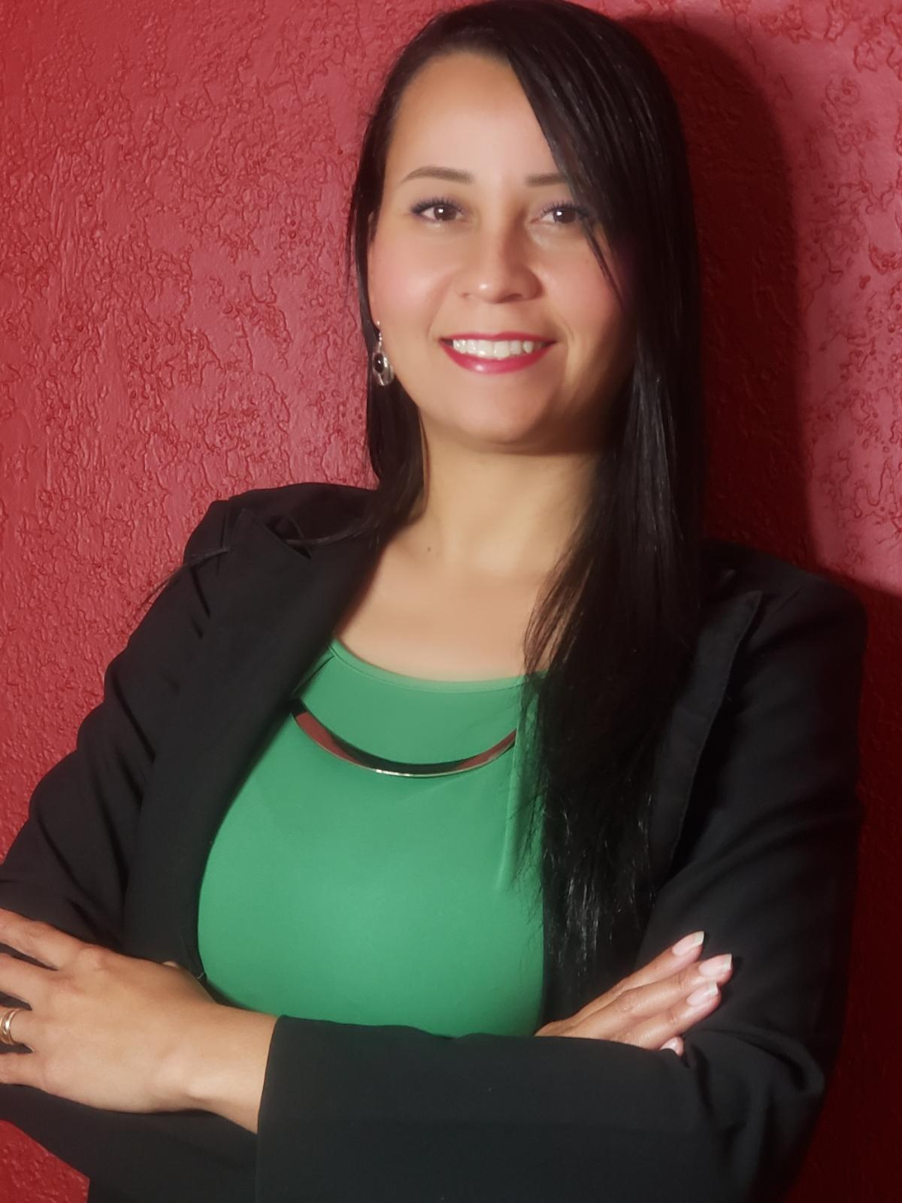
Introductions
Your host:
Susan Hitt
Digital Content Associate,
Student Achievement Partners
This Month’s Guests -
Rebecca Few Astrid Emily Francis Celia Jimenez Kenny McKee

Slide 3
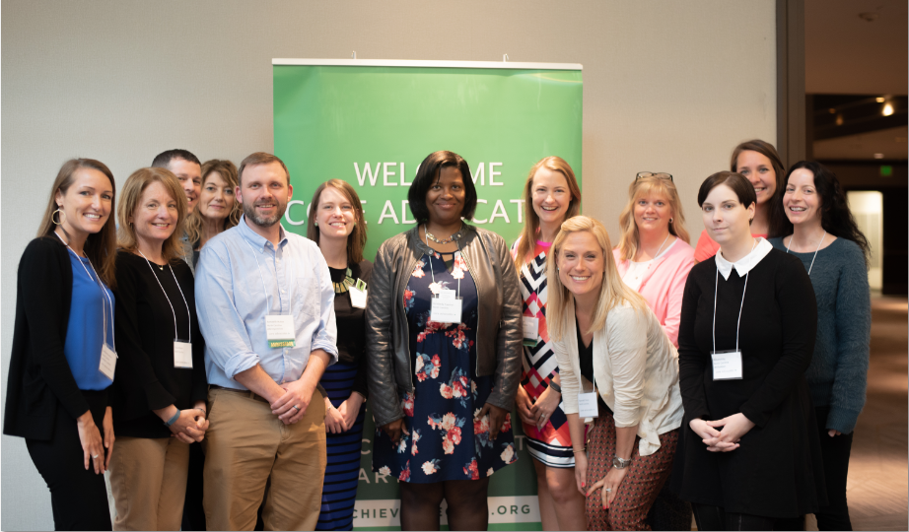
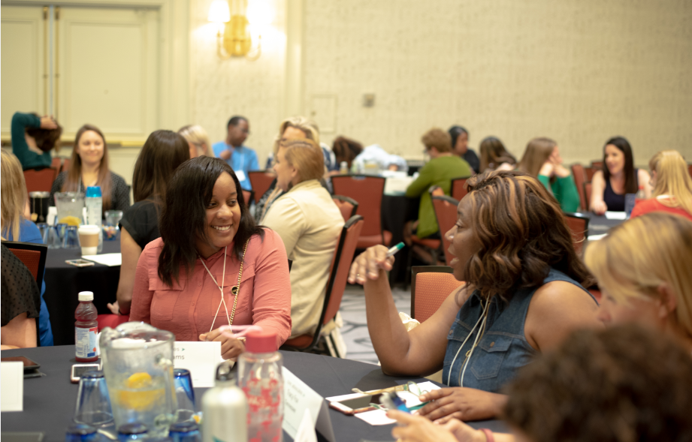
Who Are Core Advocates?
Core Advocates believe in the power of standards to prepare all students for college and/or careers.
They are eager to support and collaborate with their colleagues and communities in understanding and translating the Shifts into instructional practice.
Core Advocates have the tools and knowledge to advocate for high-quality instruction, instructional resources, and professional learning in their communities.
Notes:
CAs are teachers from all over the country who believe in the potential of high quality standards and the importance of all students being prepared for college and careers.
They support their colleagues in understanding and advocating for the standards and embrace the Shifts in instruction
The Core Advocate network is over 10K educator strong and we’d love for you to join us if you have not already

Slide 4
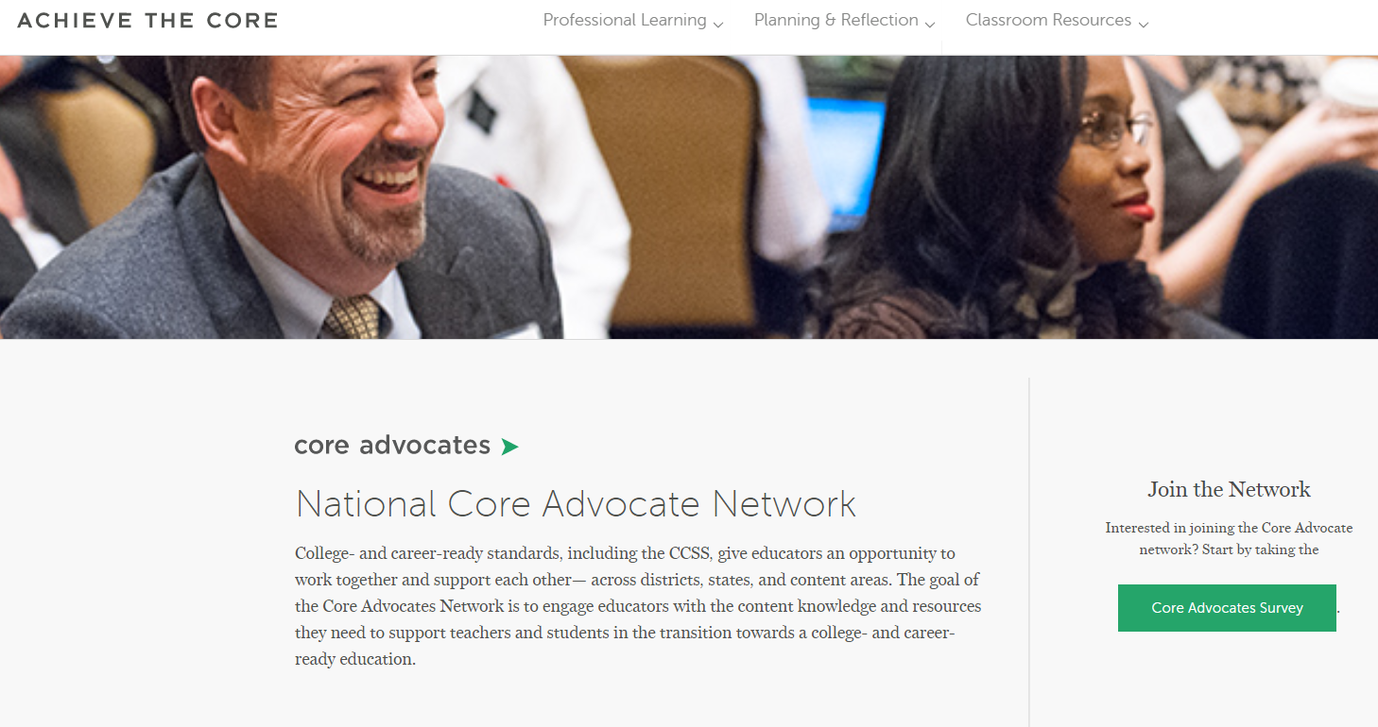
Join Our Network!
www.achievethecore.org/ca-signup
Notes:
If you found tonight’s webinar helpful, we’d like to invite you to join our Core Advocate network! We’re committed to solving real problems that real teachers have and we know the best way to do this is to know more about what folks are experiencing.
We’d love to learn about who you are, where you work, the types of things you’re interested in and the expertise you already have. This way, we will be able to tailor our webinars and other opportunities to your needs and interests (we may even tap you to be our next webinar panelist). So we encourage you to join the network by filling out this survey completely at atc.org/ca-signup

Slide 5
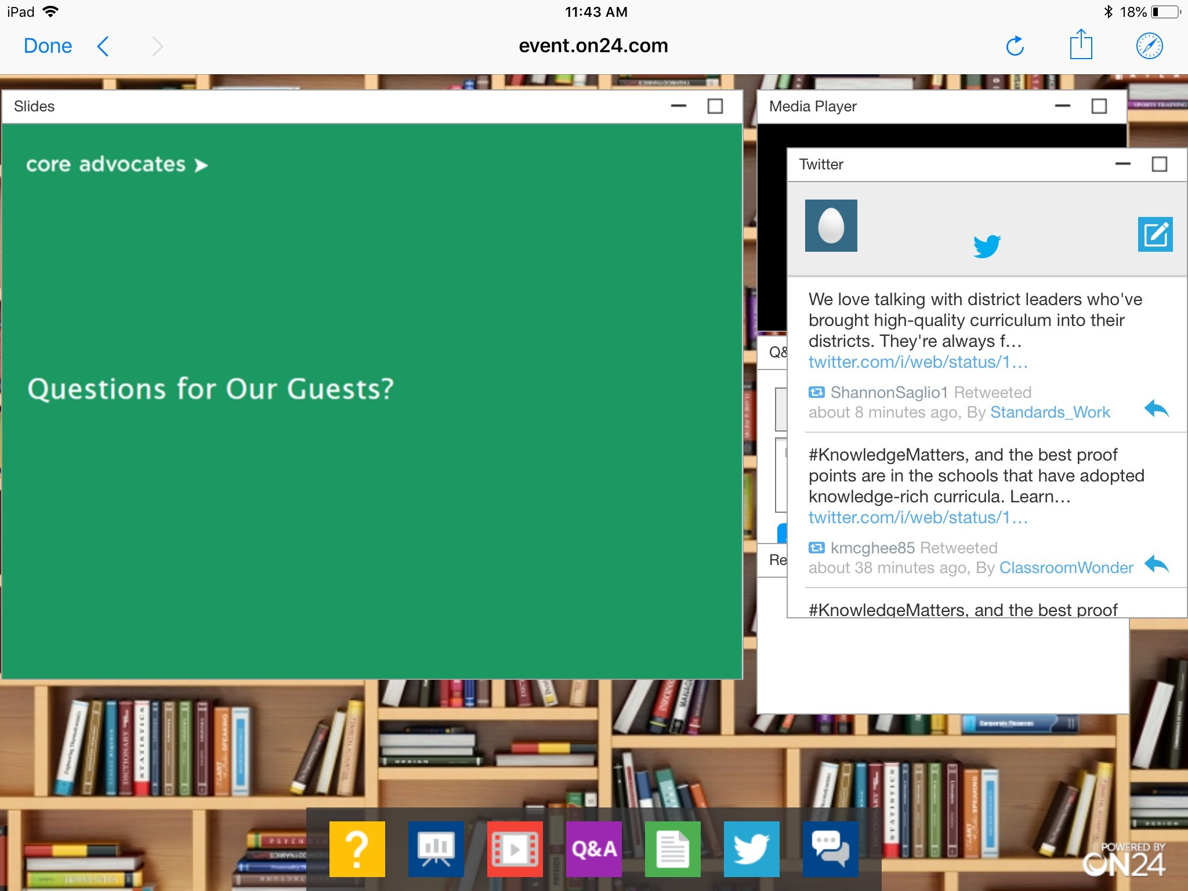
Tweet with Us!
Please feel free to tweet during and after the webinar using #coreadvocates
@achievethecore
@kennycmckee
@emilyfranESL
@segarrac
Click here!

Slide 6
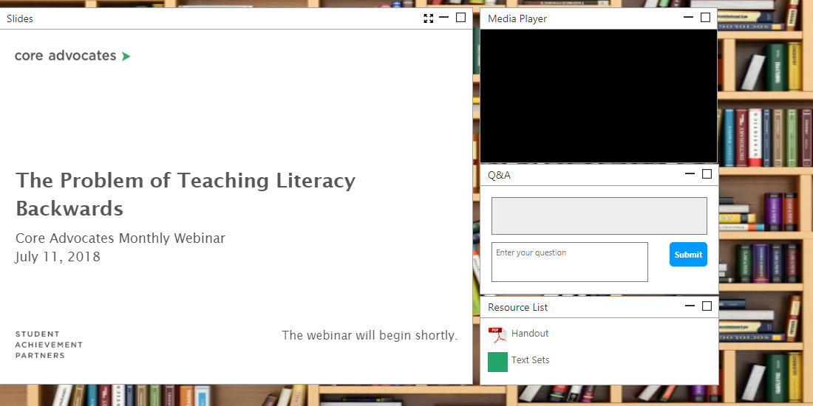
Engage with Us!
During the webinar
– Questions (Q&A) option
– Group chat
– Resources tab
After the webinar
– Access to recorded
webinar will be emailed to you.
Take our survey in 2 weeks and receive a certificate verifying 1 hour of professional learning.

Slide 7
Goals of the Webinar
Kick off our Summer Reading Challenge!
Learn some of the most often mis-taught math standards (and how to avoid the pitfalls)
Develop strategies for supporting English Language Learners with writing
Discover how to use closing statements as an end-of-class routine in math
Learn strategies for using morphology to enhance word learning
Notes:
We have a couple of goals for our webinar tonight. They are to...

Slide 8
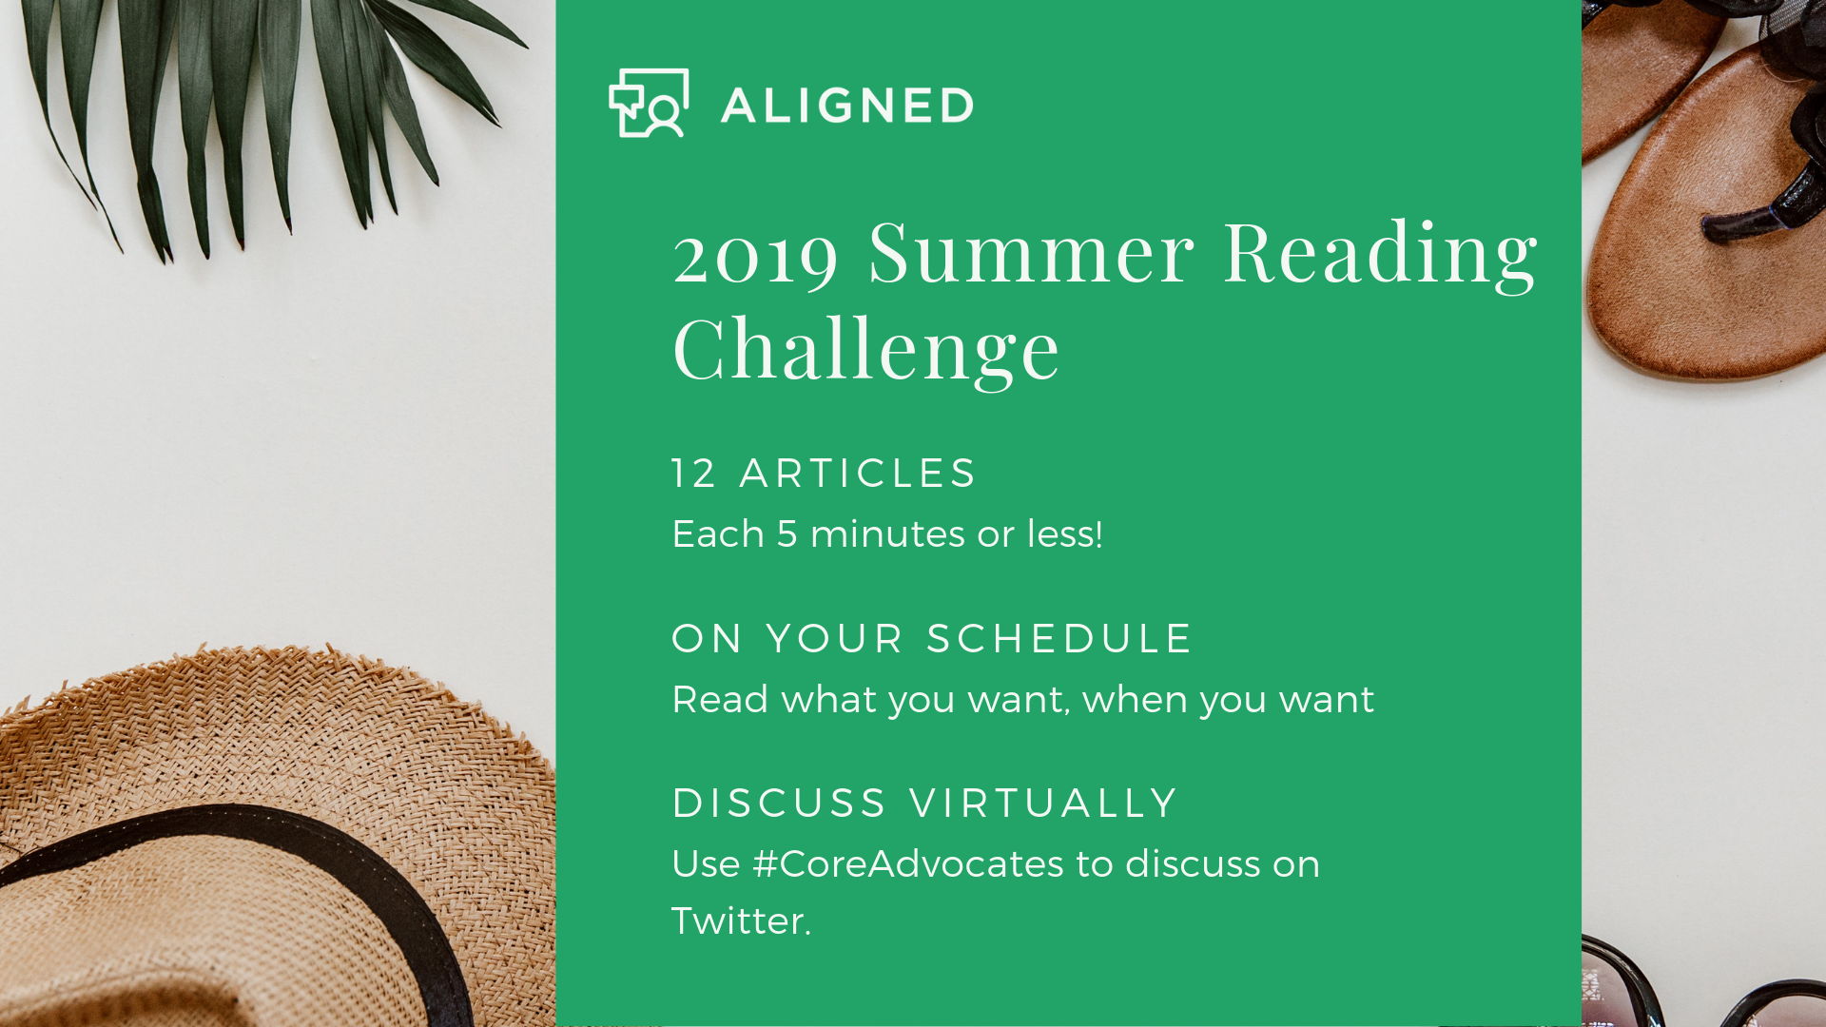
bit.ly/AchievetheCoreSummerReading

Slide 9
Which third grade standard do you think is the most misunderstood?
3.NF.A.3- Explain equivalence of fractions in special cases and compare fractions by reasoning about their size.
3.OA.B.5- Apply properties of operations as strategies to multiply and divide.² Example: Knowing that 8 × 5 = 40 and 8 × 2 = 16, one can find 8 × 7 as 8 × (5 + 2) = (8 × 5) + (8 × 2) = 40 + 16 = 56. (Distributive property.)
3.NBT.A.1- Use place value understanding to round whole numbers to the nearest 10 or 100.
3.NF.A.1- Understand a fraction 1/b as the quantity formed by 1 part when a whole is partitioned into b equal parts; understand a fraction a/b as the quantity formed by a parts of size 1/b.
Please use the Questions tab on your control panel to respond.

Slide 10
Rebecca Few
Content, Lead,
Instruction Partners
Murfreesboro, TN

Slide 11
Why did we write the series?
Teachers want to do the right thing- when we know better, we do better!
Notes:
As an instructional coach, I observed classrooms in which instruction didn’t meet the rigor called for by the standard; therefore, students weren’t moving from a conceptual understanding to procedural skill and fluency with important math concepts.
Teach the concept the way we were taught it- procedurally.
Unlearn the procedures, and relearn the concepts
Series illuminates the progression of learning and the importance of coherence.

Slide 12
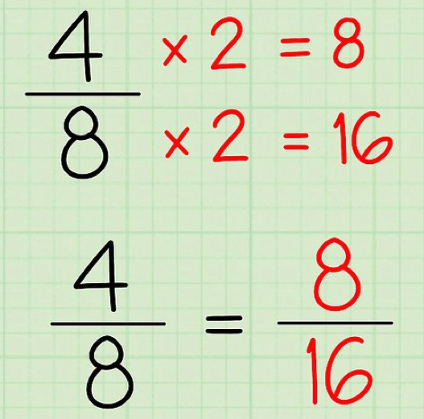
Grade 3- Explain equivalence of fractions in special cases and compare fractions by reasoning about their size. 3.NF.A.3
Instructions focuses on multiplying the “top and bottom” by the same number to name equivalent fractions.
Notes:
Models are used to support the concept of fraction equivalency by helping students “recognize” that equivalent fractions are the same size, or they name the same point on the number line.

Slide 13
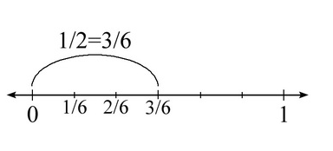
Jon and Charlie
Jon and Charlie plan to run together. They are arguing about how far to run.
Charlie says, I run 3/6 of a mile each day. Jon says, I can only run 1/2 of a mile.
If Charlie runs 3/6 of a mile and Jon runs 1/2 of a mile, explain why it is silly for them to argue. Draw a model or a number line to support your reasoning.
From Illustrative Mathematics
Notes:
What do we want students to do?
Consider which model is the best to use, linear or area.
Draw models to reason about the length each boy runs using same size wholes to compare
Recognize the distances are equivalent
Make a conjecture about fraction equivalence- equal area, same point on number line

Slide 14
What are the implications if students don’t learn the concept of fraction equivalency?
Achieve the Core: Coherence Map

Slide 15
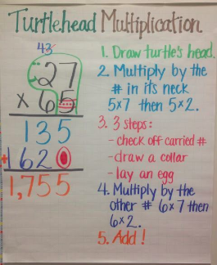
Grade 4- Multiply a whole number of up to four digits by a one-digit whole number, and multiply two two-digit numbers, using strategies based on place value and the properties of operations (4.NBT.B.5)
Instruction focuses on the standard algorithm
Connections to place value are not made
Notes:
Grade 4- Multiply a whole number of up to four digits by a one-digit whole number, and multiply two two-digit numbers, using strategies based on place value and the properties of operations. Illustrate and explain the calculation by using equations, rectangular arrays, and/or area models. (4.NBT.B.5)
The language, using the standard algorithm, (for multi digit multiplication) is not introduced in the standards until grade 5.

Slide 16
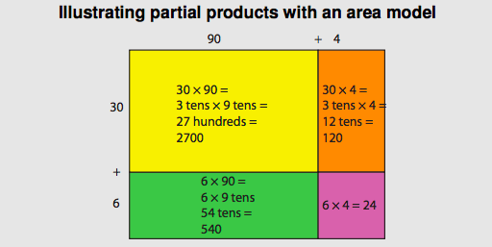
… using strategies based on place value and the properties of operations. Illustrate and explain by using equations, rectangular arrays, and/or area models.
Model from the Progressions Document
Notes:
The example on the left is an area model illustrating partial products. Partial products uses place value concepts to solve multi digit multiplication problems. It based on the distributive (grouping) property of multiplication. “The distributive property allows numbers to be decomposed into base-ten units, products of the units to be computed, then combined. By decomposing the factors into base-ten units and applying the distributive property, multiplication computations are reduced to single-digit multiplications and products of numbers with multiples of 10, of 100, and of 1000. Students can connect diagrams of areas or arrays to numerical work to develop understanding of general base-ten multiplication methods.” The area model provides us with a pictorial representation of the concept we want students to understand and makes the important connections to place value explicit for students.

Slide 17
Grade 5- Apply and extend previous understandings of multiplication to multiply a fraction or whole number by a fraction. 5.NF.B.4
Steps in a procedure:
Multiply the numerators of the fractions.
Multiply the denominators of the fractions.
Simplify your answer if necessary
Notes:
How many times have we heard someone say “when we multiply, the product is always larger” or “when I divide, my answer is always smaller.” Probably several times during our tenure in education. When I hear these statements, my initial response is “really? Always?”
Making generalizations about mathematics that are inaccurate promote misunderstandings about important math concepts. These misconceptions can have unintended consequences for our students. I want to dig into two standards that disprove the statements above and challenge all of us to be more precise with our math language and communication.
Absent from instruction is the use of concrete manipulatives or the drawing of models to demonstrate multiplication of proper fractions as taking a fraction of a fraction. (This supports the conceptual understanding and provides visual evidence that the product is less than the factors.)

Slide 18
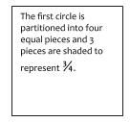
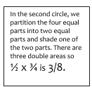
When I see a problem like ½ x ¾ I say to myself what is ½ of ¾?

Slide 19
Now that we know better, we will do better.

Slide 20
How confident are you understanding the term Compelling Comprehensible Input?
A: Very confident
B: Fairly confident
C: Not particularly confident
D: I’m completely unfamiliar with the term Please use the Questions tab on your control panel to respond.
If using a poll, please put up to 5 answer choices in the notes section below and indicate if attendees should choose only one response or multiple responses.

Slide 21
Astrid Emily Francis
HS ESL Teacher
Concord, North Carolina

Slide 22
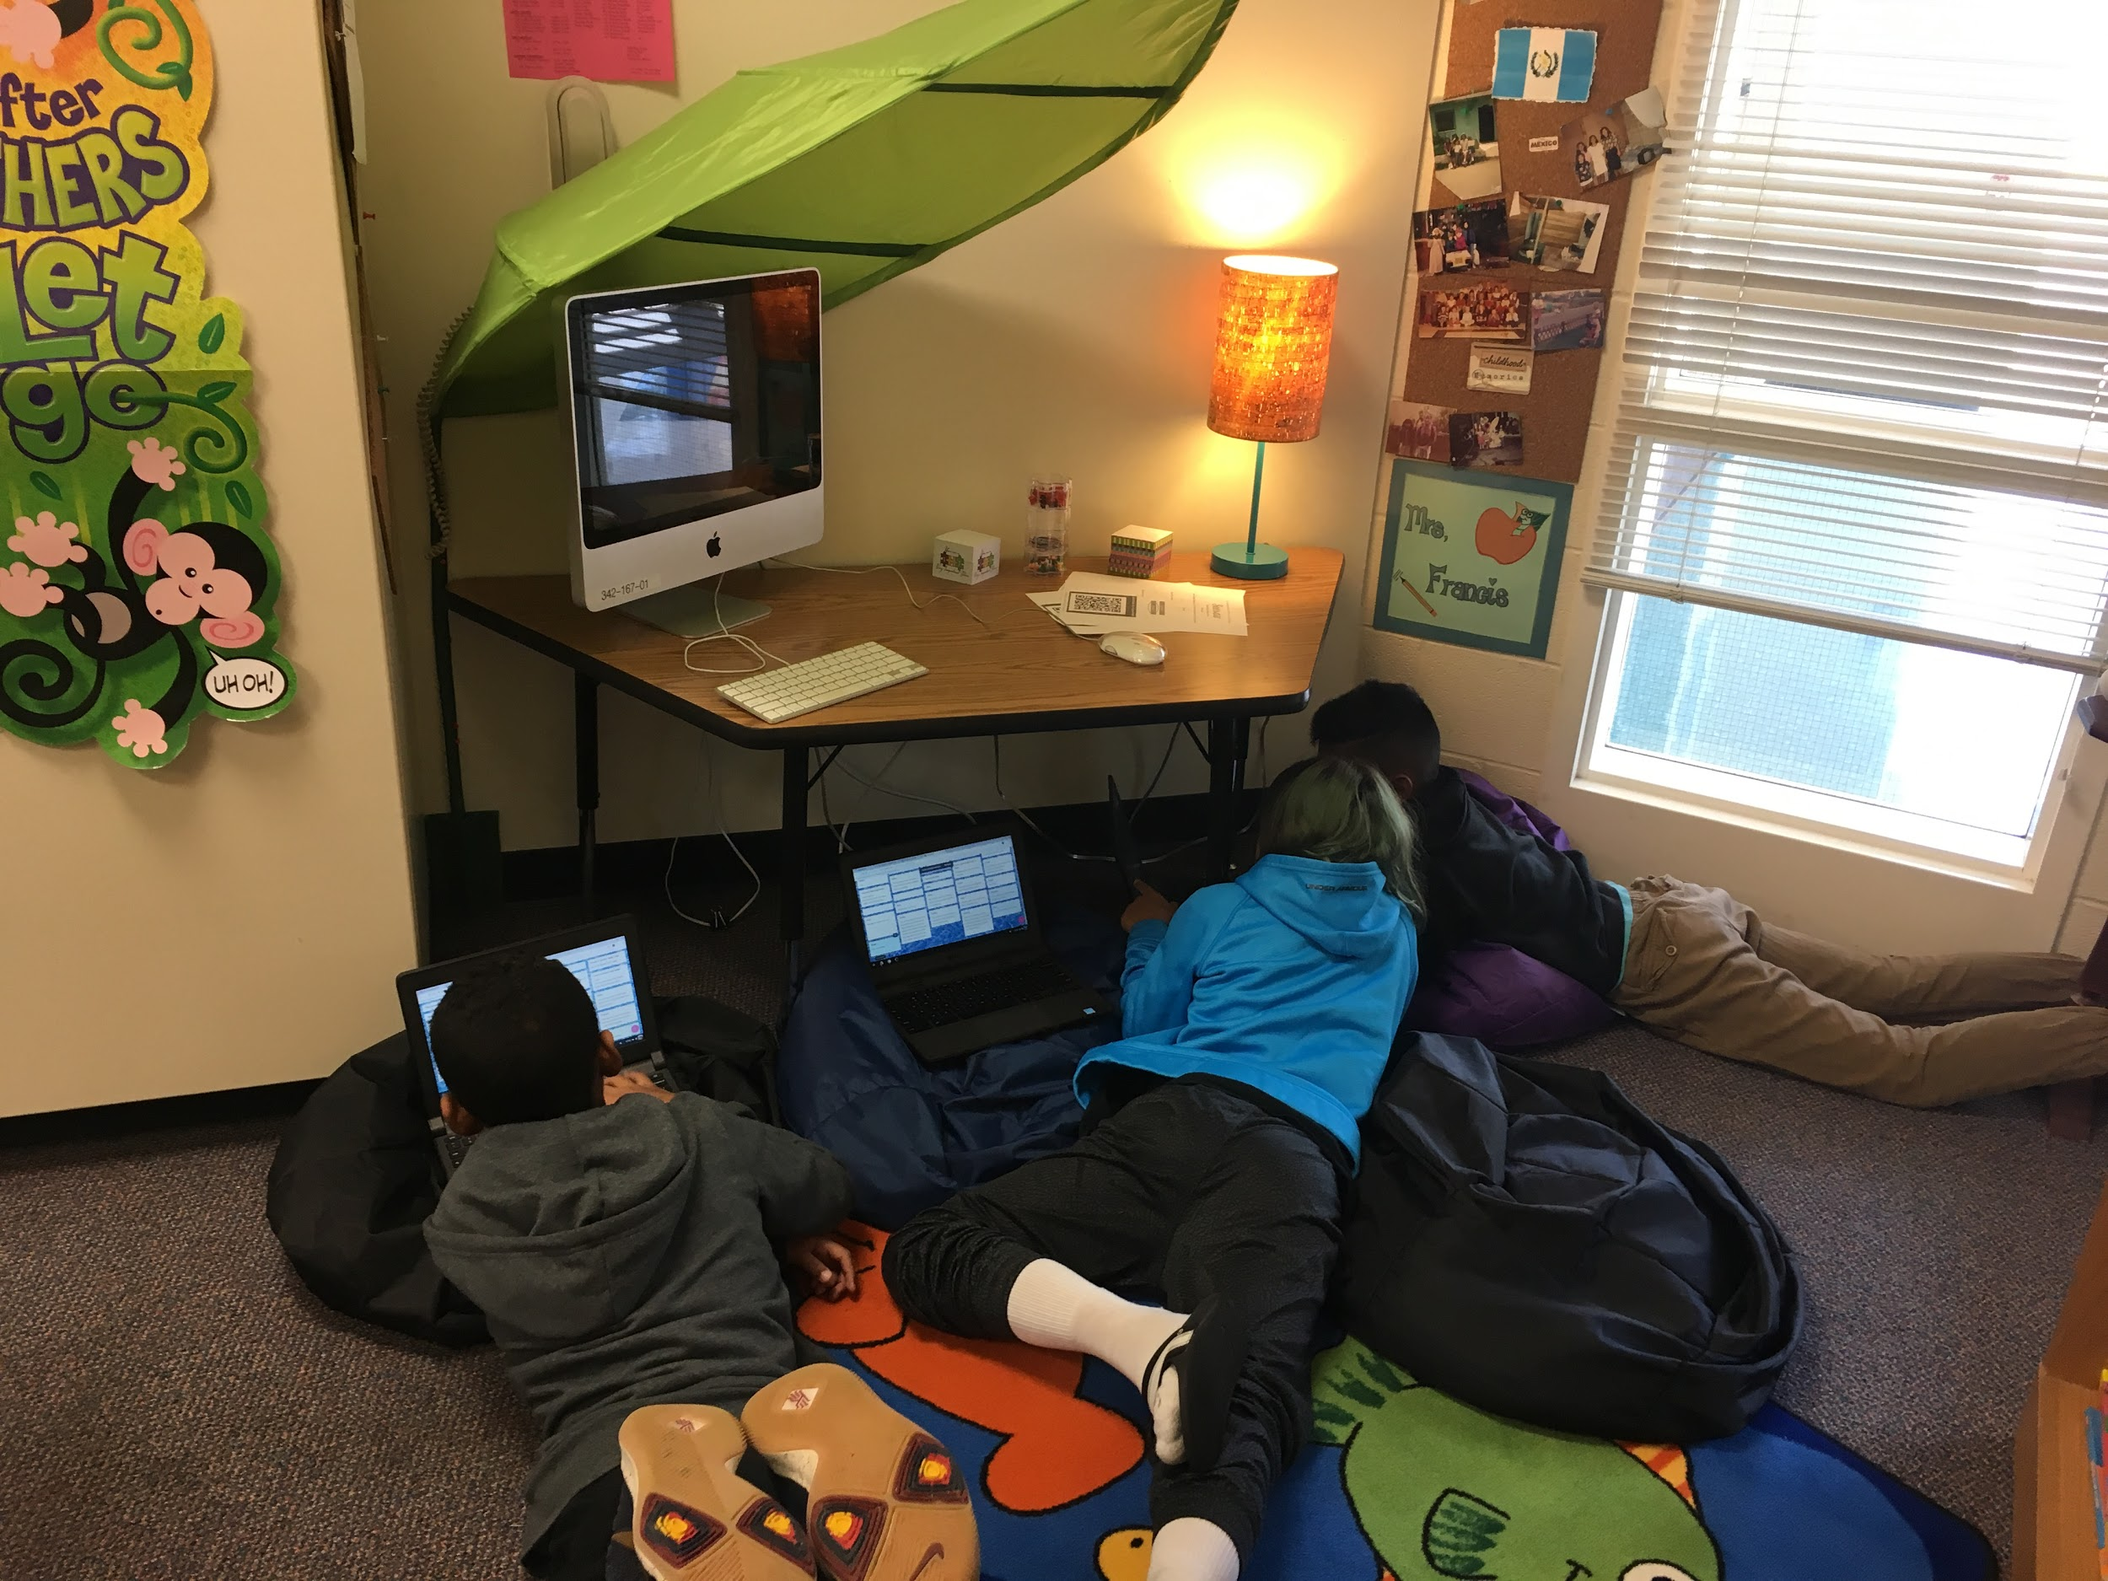
WriteReader app
Supporting Young ELs with Writing

Slide 23
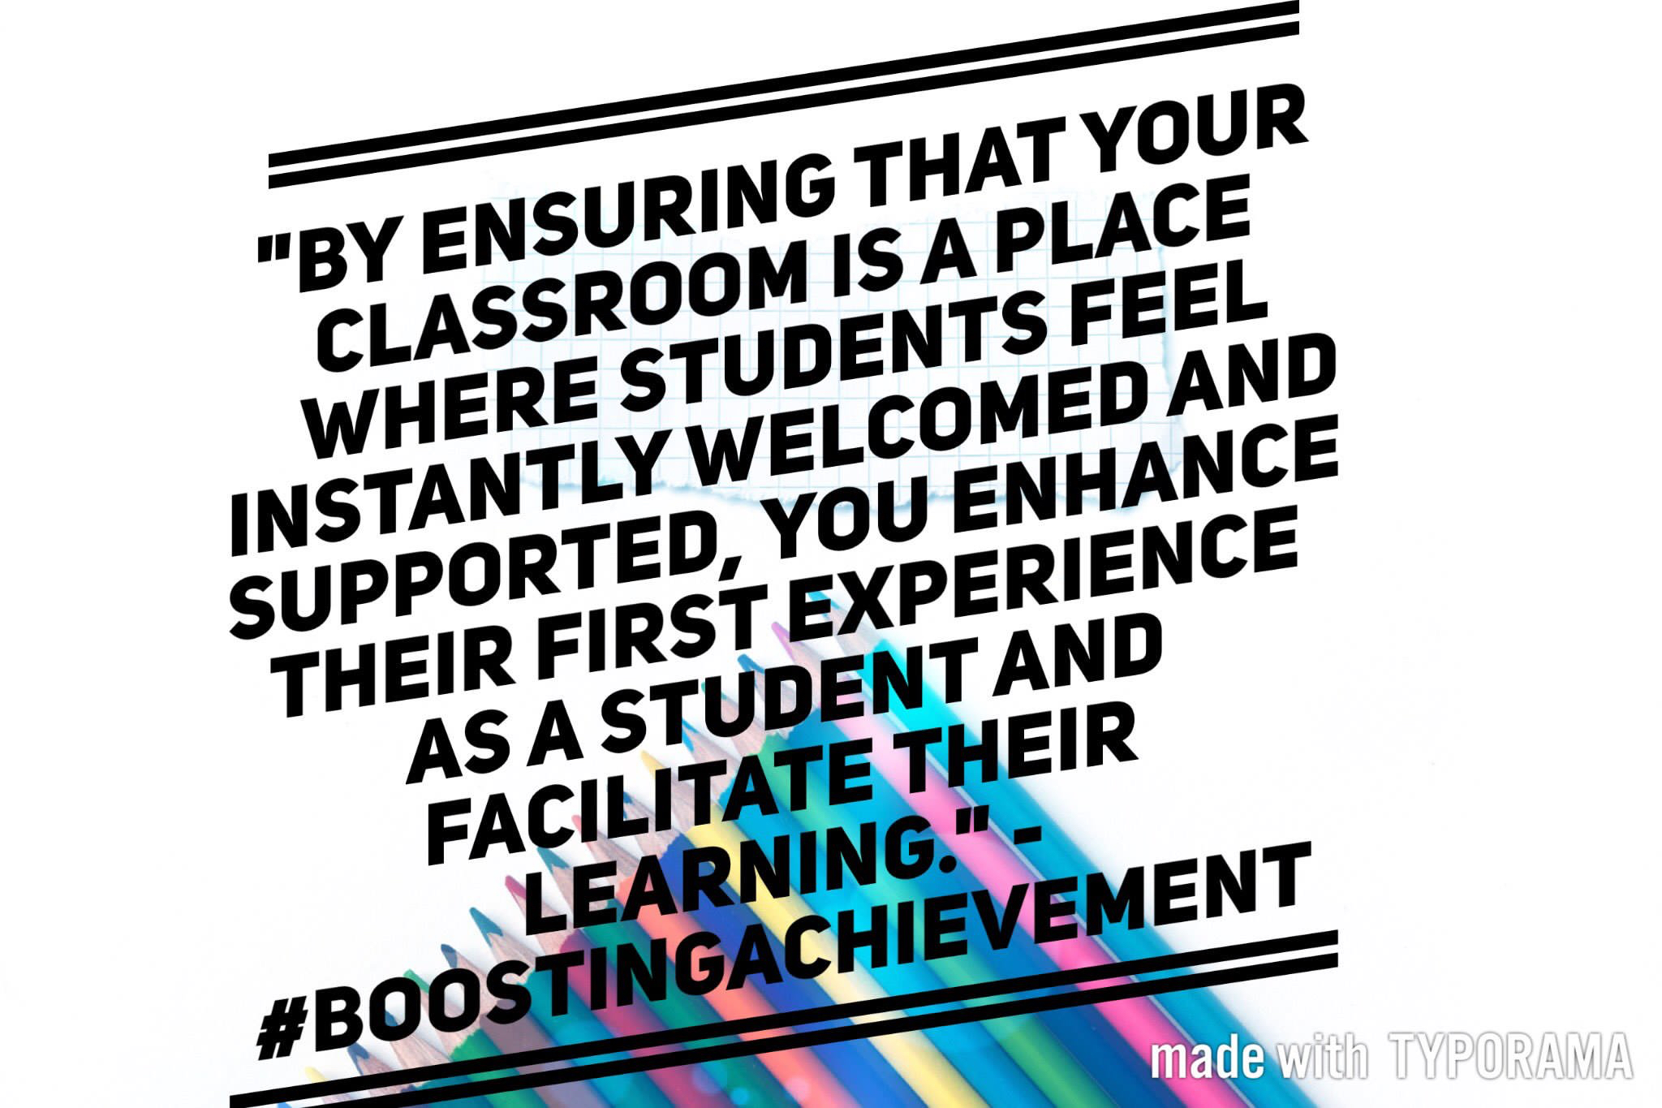
Compelling Comprehensible Input
Understanding of culturally responsive teaching
Pedagogy - the way we teach
Validate students’ experiences and assets
Notes:
(CRT) in order to establish a comfortable and interactive environment for ELLs
For language acquisition and literacy development , our lessons must be so interesting that students are not aware they’re learning a new language.

Slide 24
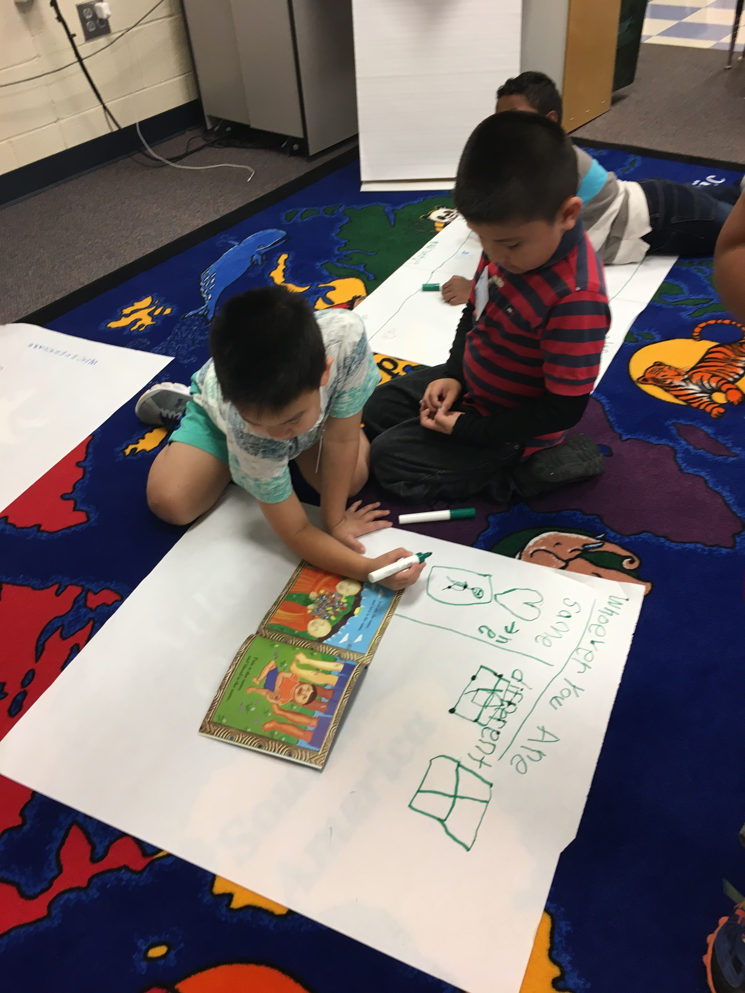
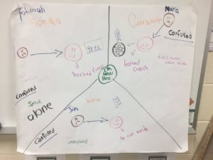
Balanced Lessons
Balance between teacher presentation & opportunities for students to practice and apply in meaningful ways.
Think-Pair-Share
Chunk & Chew

Slide 25
Students Need an Authentic Audience!
?!?
family
friends
principal
Former
teachers
parents
president

Slide 26
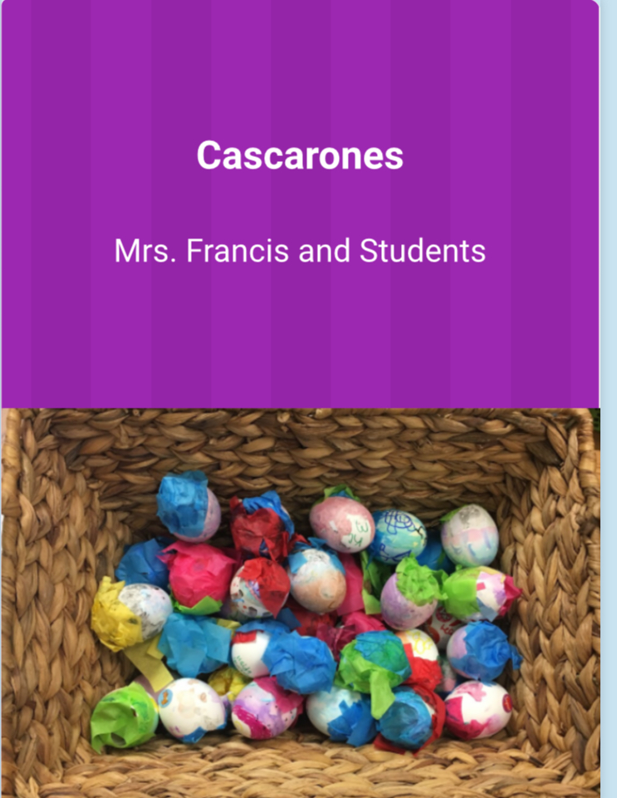
WriteReader is the Perfect Platform

Slide 27
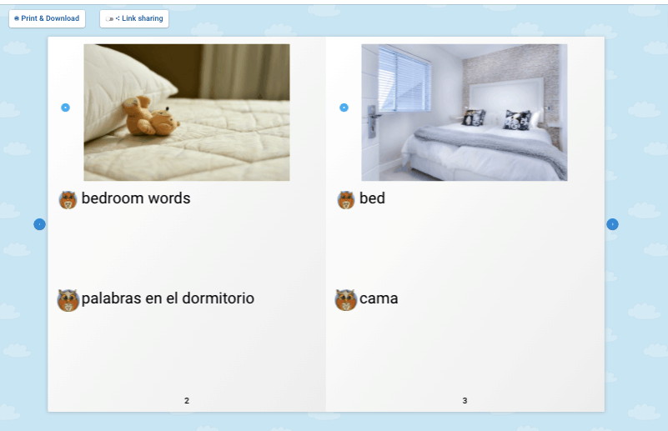
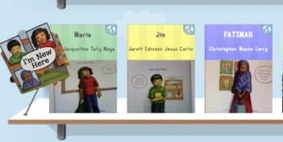
Supporting Multi-level Students
Instruction that is understandable for ELs
Opportunities for students to talk
Provide hands-on activities to reinforce learning
Digital Glossaries
“The more actively students participate in the instructional process, the MORE they achieve.” MCC5
Authoring Books
Notes:
Capturing students’ attention and keep them more actively engaged

Slide 28
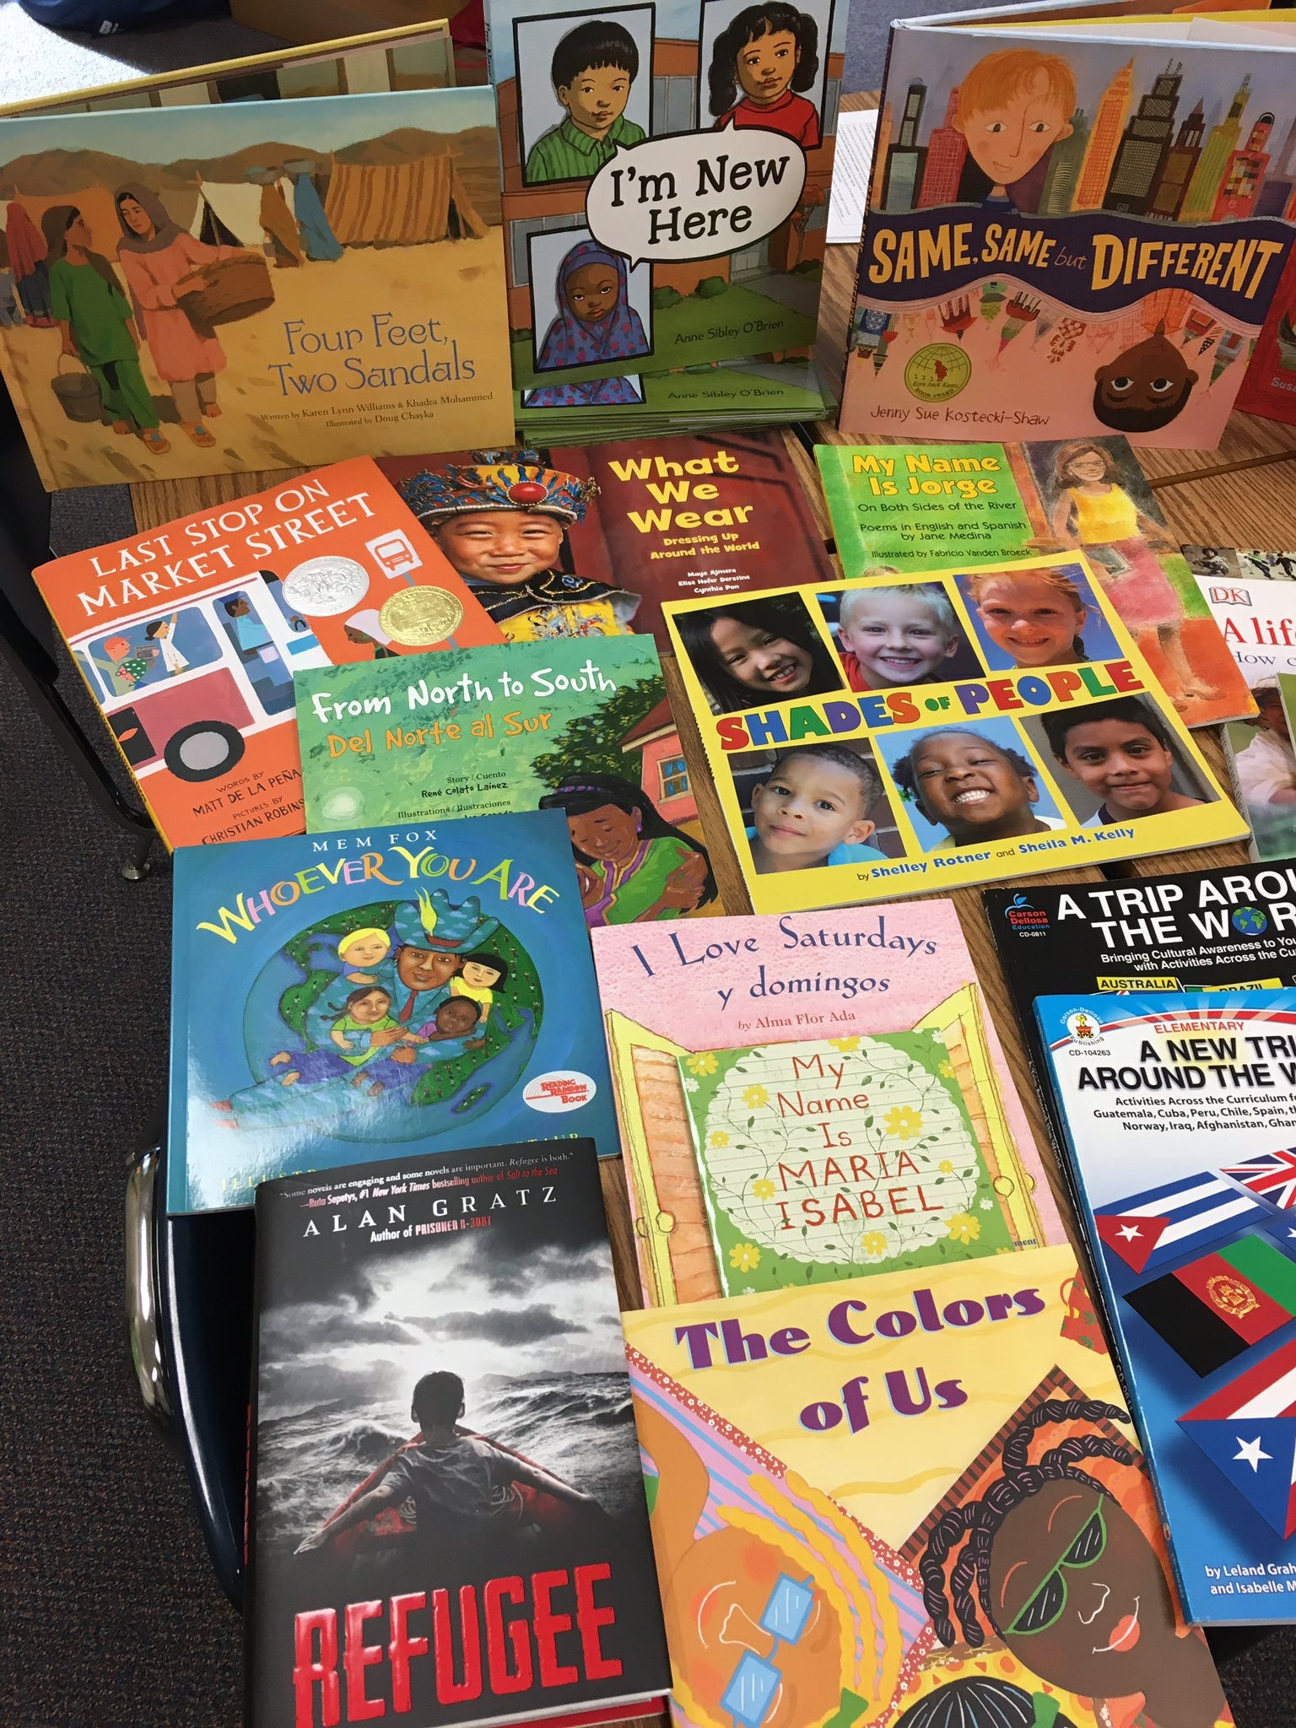
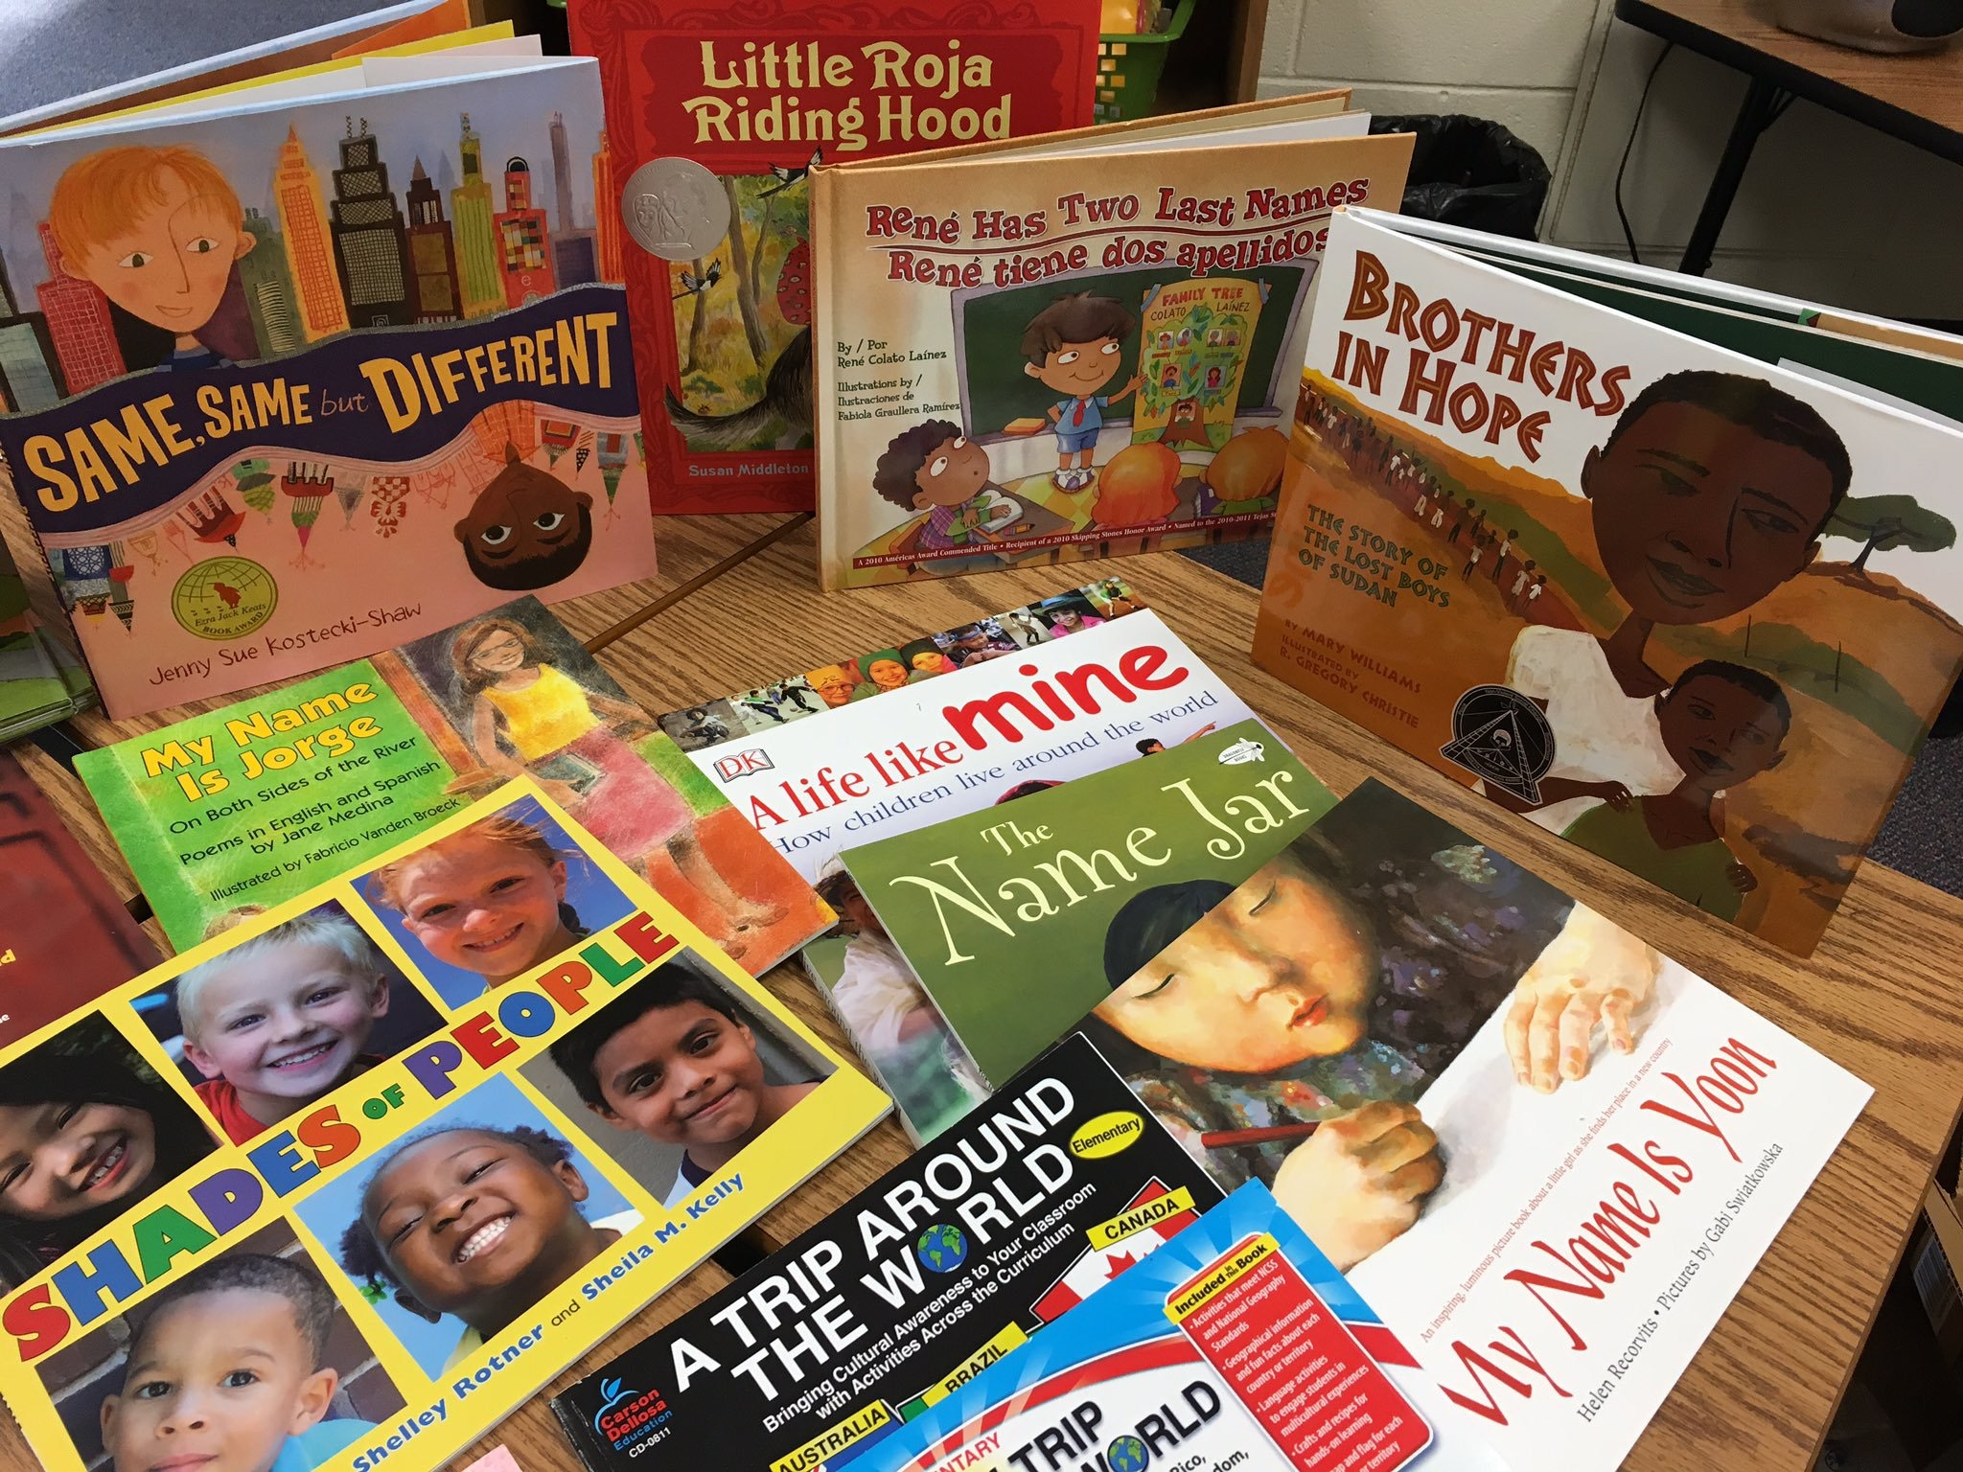
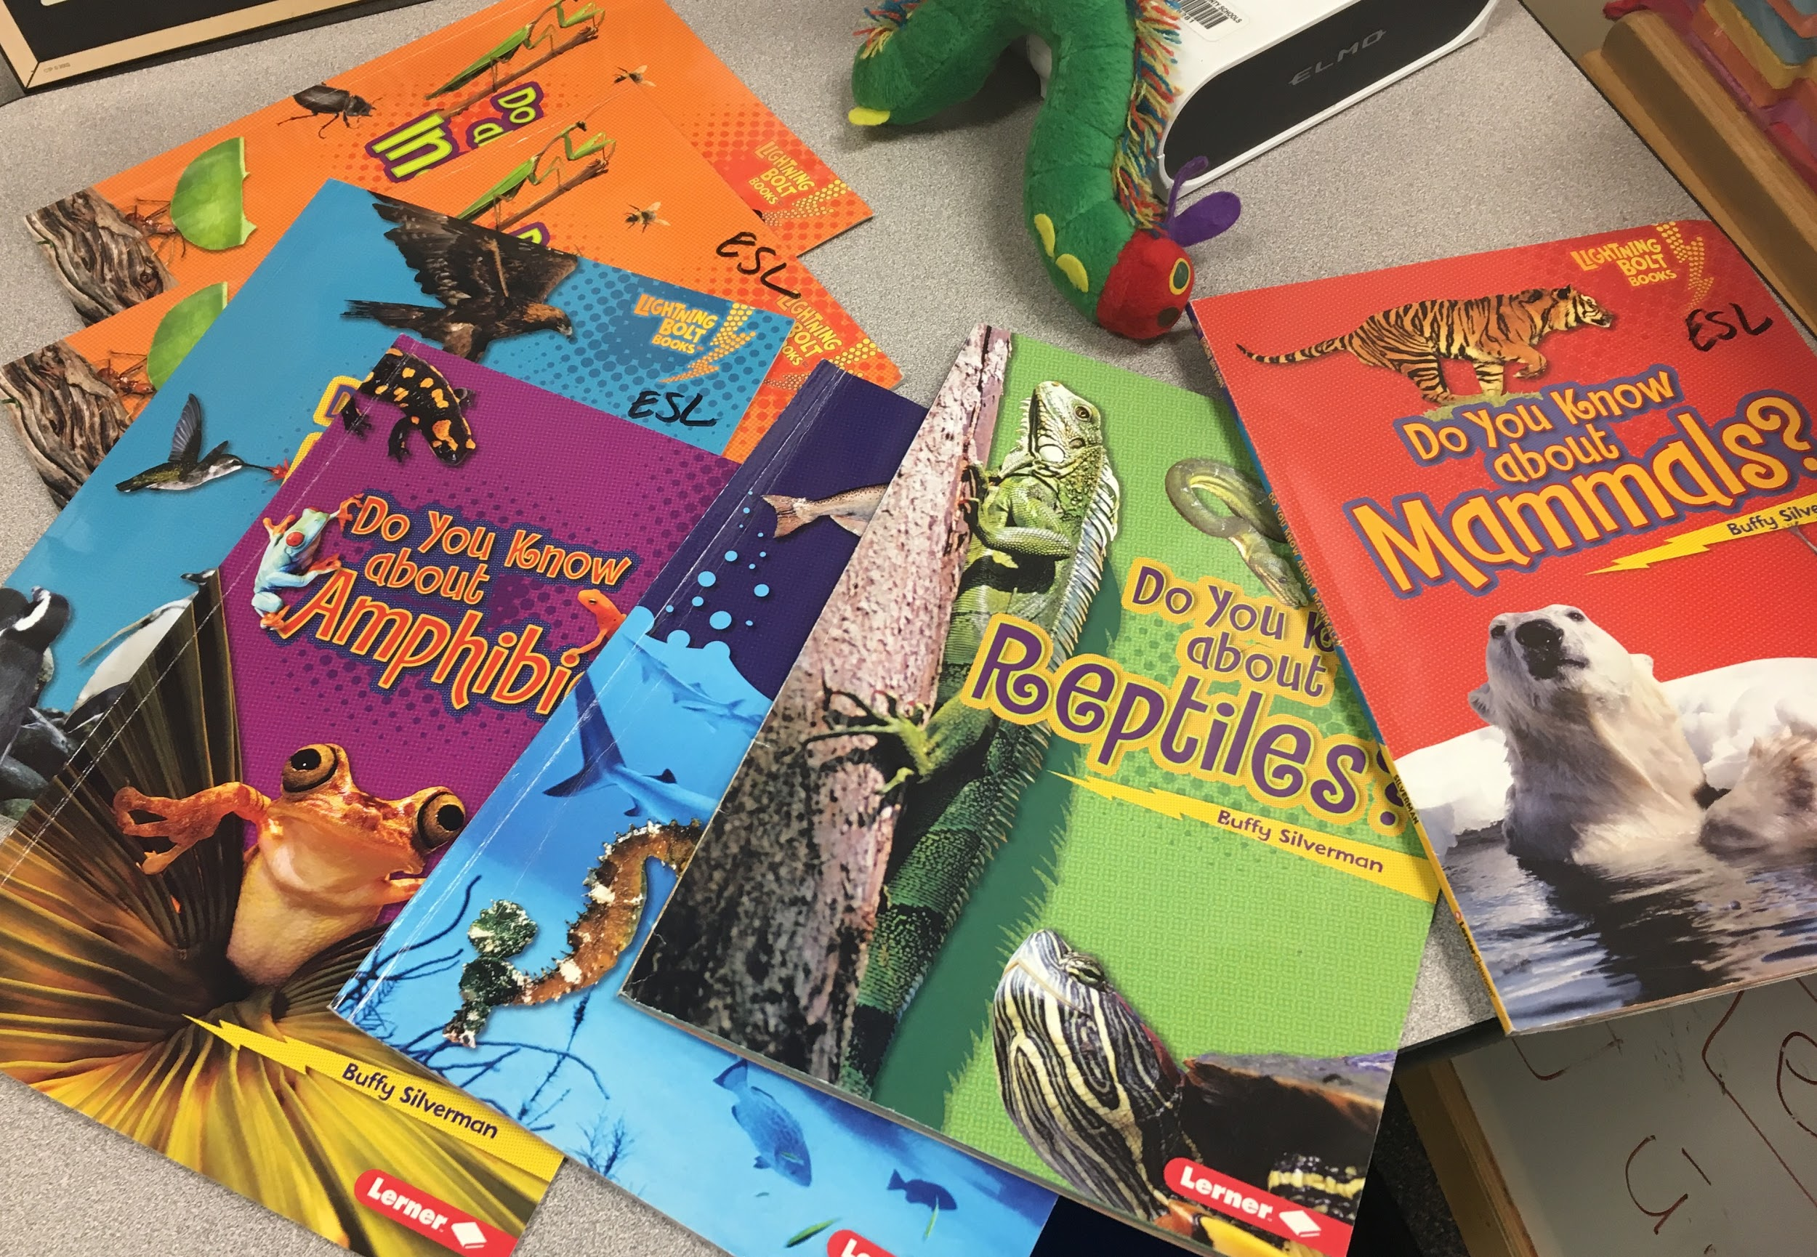
Compelling Text
Notes:
Capturing students’ attention and keep them more actively engaged

Slide 29
How confident do you feel using aClosing Statements routine to wrap up your lesson?
Very confident
Fairly confident
Not particularly confident
I’m completely unfamiliar with the routine
Please use the Questions tab on your control panel to respond.
If using a poll, please put up to 5 answer choices in the notes section below and indicate if attendees should choose only one response or multiple responses.

Slide 30
Celia Jimenez
Intern Mathematics Curriculum Supervisor
Fort Lauderdale, FL

Slide 31
What is a Closing Statement Routine?
Notes:
A closing statement routine is a manageable way to peacefully wrap up the lesson and send students off feeling a sense of accomplishment and belonging. A closing statement routine are either written or verbal statements that help students self-reflect on their own learning, while checking for understanding. This routine not only helps students to further process their learning but it give students a voice on their learning experience where they can share how they feel at the end of a lesson.

Slide 32
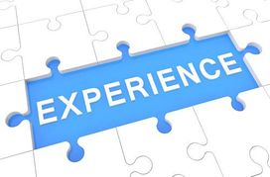
Closing Statements Routine must...
be about the content
reflect students’ learning experience
clear and concise
authentic
Notes:
When students are writing closing statements, they must keep it around the content they learned on that day. Their statements must show a reflection of their learning experience in a clear and concise way. Students are asked to clearly state what are they able to do and what are they still struggling with. This will give teachers enough information to later decide which students may need intervention or if the lesson needs to be re-teach.

Slide 33
Closing Statements Examples
Notes:
These are some examples of students’ closing statements. This was given after a lesson on finding the area of trapezoid that was divided into four sections. At the end of the class students were asked to write a closing statement that reflects their learning experience on this task. As you can see in these examples, students clearly described what they were able to do and what they still struggling with. When a teacher reads their closing statement, it makes it easy for the teacher to identify students misconceptions. The use of this routine brings up some teachers and students benefits. For example:

Slide 34
Teacher’s Benefit
Formatively assess students’ learning
adjust next day’s lesson to meet students’ needs
anticipate future misconceptions
Notes:
When teachers use closing statements to wrap up lessons they will have an opportunity to formatively assess students learning, check for understanding and anticipate future misconceptions. Closing statements provides teachers with on-time information on students learning. It gives teachers an opportunity to self-reflect on teaching practices opening the doors to adjust next day lesson to ensure the needs of the students are met. It also allows to clarify misconceptions before students are dismissed.

Slide 35
Student’s Benefit:
Notes:
For students, using closing statements give them the opportunity to self-reflect on their own work, giving them ownership of their own learning and allow them to use their students voice. It also allows for think-pair share and collaboration with their classmates.

Slide 36
How confident do you feel using morphology to support students’ vocabulary growth?
A: Very confident
B: Fairly confident
C: Not particularly confident.
D: I’m completely unfamiliar with the concept. Please use the Questions tab on your control panel to respond.
If using a poll, please put up to 5 answer choices in the notes section below and indicate if attendees should choose only one response or multiple responses.

Slide 37
Kenny Mckee
High School Literacy Coach
Asheville, NC

Slide 38
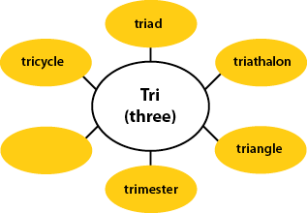
Three Simple Steps to Empowered Word Learning
Morphology
Context Clues
Reference Materials/People
Notes:
The current 3 step process: I realized that these three strategies are not ones to use randomly or in piecemeal fashions. They are actually a sequence that helps students use word-solving skills efficiently and effectively.
When students approach unfamiliar words in a text, they should:
Look for morphological clues (inside word clues)
Look for context clues (outside word clues)
Consult an outside resource (outside text help)

Slide 39
Why Morphology Before Context?
20% to 35% of the time
=
How often context clues reveal word meaning!
Notes:
“Context assists with confirming the meaning of a word, but it does not replace the need to use letter and sound knowledge.” McCormack and Zutell, 2011

Slide 40
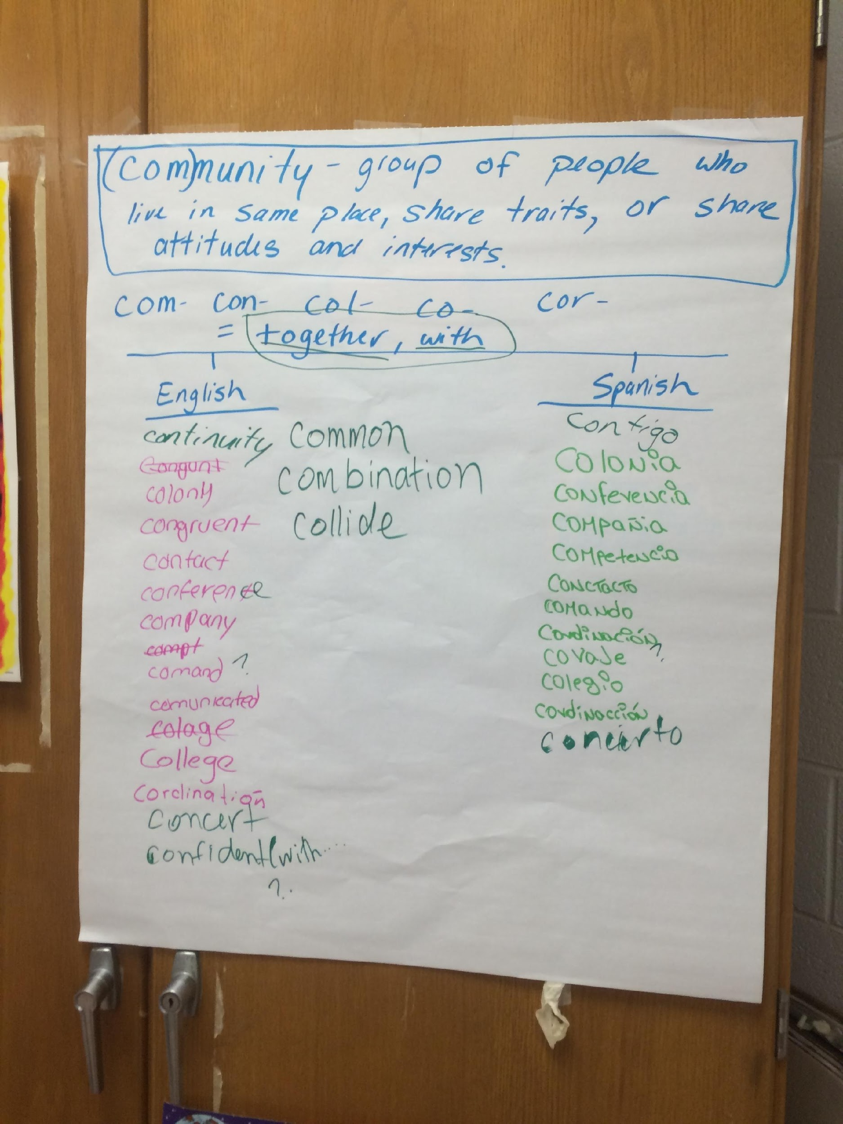
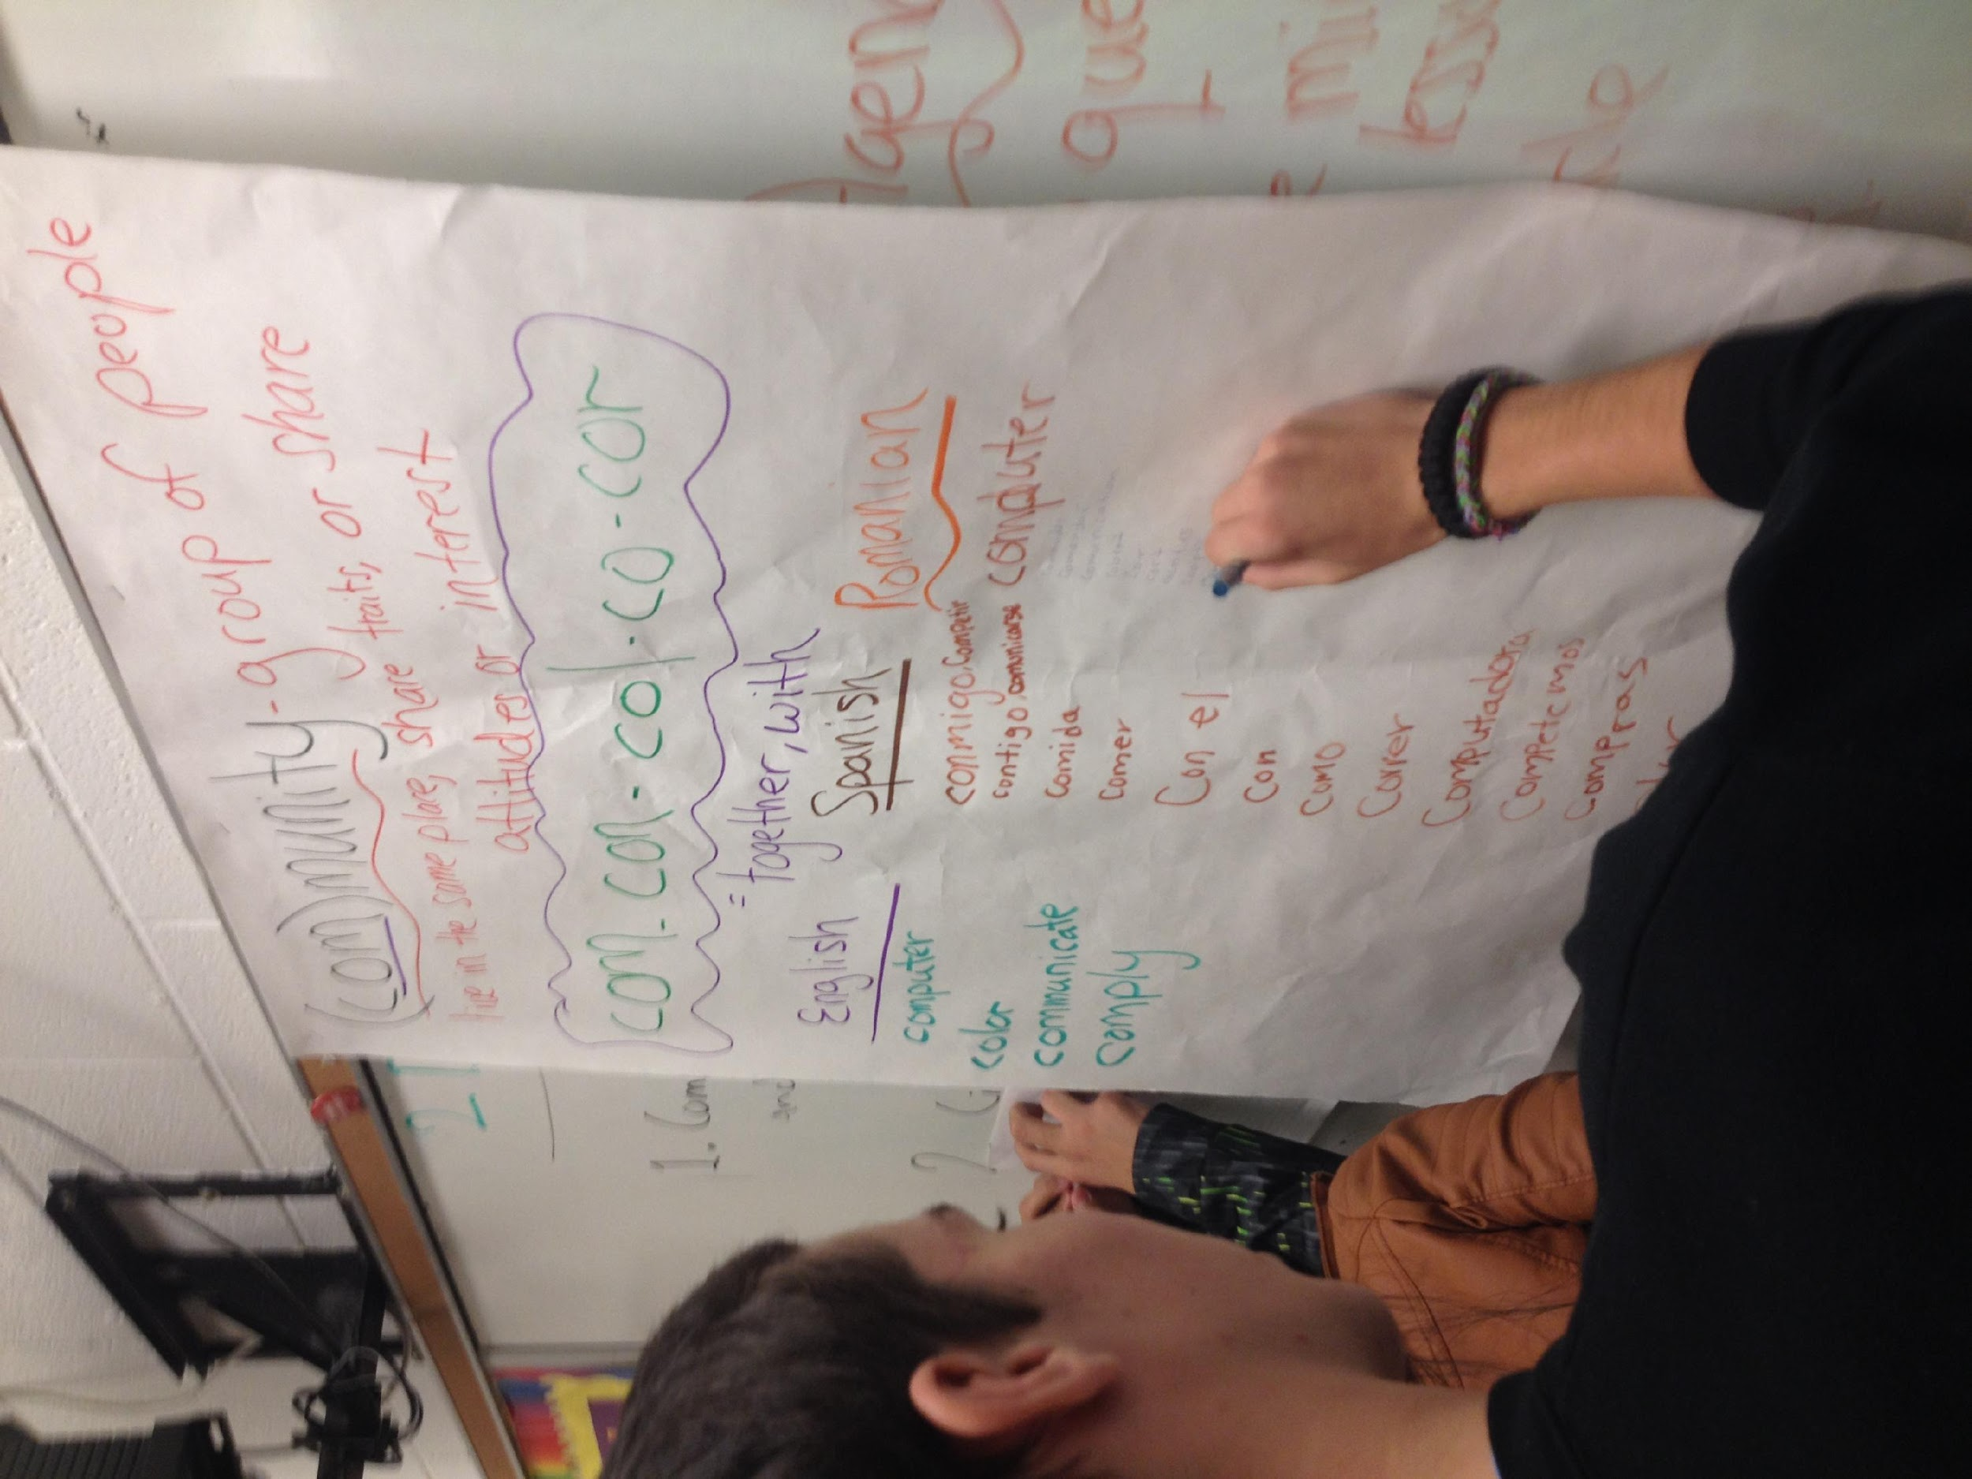
Word Generation to Support English Learners
Notes:
Meaning is retained in morphemes regardless of how they are pronounced in English and other languages.
Teacher provides explicit instruction on the meaning of morphemes within the word.
Student groups generate English and Spanish (and other languages) words that share morphemes and meaning with the target morpheme. These words are collected on a poster.
Teacher will introduce other words to students that are morphologically related.

Slide 41
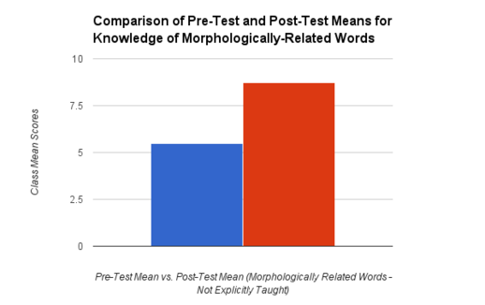
Impact on Vocabulary Acquisition
Vocabulary lessons had a positive impact on Tier 2 word knowledge. (46%)
Notes:
Students received explicitly taught words and related words that were not part of the focus lesson. Students received points for defining a word and/or giving an example of each word.

Slide 42
Students Said...
Studying word parts helps them learn new words.
Studying word parts is interesting.
Talking about words helps them learn.
Making words with word parts is enjoyable.
Comparing how words parts are used in English and Spanish helps me learn words.
Notes:
Likert-scale questionnaire given after the study.

Slide 43
Questions for Our Guests?

Slide 44
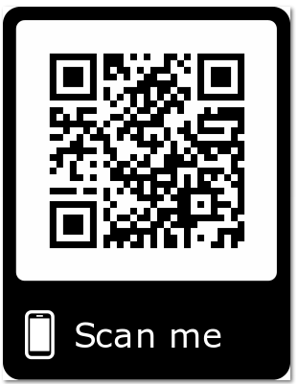
Please Join Us!
https://achievethecore.org/ca-signup
Twitter: twitter.com/achievethecore
Facebook: facebook.com/achievethecore
Pinterest: pinterest.com/achievethecore
Notes:
We encourage you to join the network by filling out this survey completely at atc.org/ca-signup

Slide 45
Please Join Us Again Next Month!
Next month’s mini-webinar (30 mins): Designing a School Environment That Supports Students’ Social, Emotional and Academic Needs
Wednesday, July 10, 2019, 7 p.m. ET
Register Here: https://event.on24.com/wcc/r/2020857/67391E7CF4A6E837A6B675E4D1BF636F

Slide 46
Thank You!

Slide 47
Resource List
Achieve the Core’s Summer Reading Challenge Reading List | bit.ly/AchievetheCoreSummerReading
Core Advocate Network Sign-Up | www.achievethecore.org/ca-signup
Most Misunderstood Math Standards Series | https://achievethecore.org/aligned/series/?series=Most%20Misunderstood%20Math%20Standards
Compelling Digital Lessons for English Learners | https://achievethecore.org/aligned/compelling-digital-lessons-english-learners/
Write Reader App (free) | https://www.writereader.com/en
Student Closing Statements | https://achievethecore.org/aligned/student-closing-statements/
Three Simple Steps to Empowered Word Learning | https://achievethecore.org/aligned/three-simple-steps-empowered-word-learning/

