Slide 1
Designing a School Environment That Supports Students’ Social, Emotional and Academic Needs
Core Advocates Monthly Webinar
July 10, 2019
The webinar will begin shortly.
Check your Resource widget to preview the resources for today’s session!

Slide 2
Introductions
Your presenter:
Astrid Fossum
Senior Mathematics Specialist, Advisory Support
Co-author: Integrating Social, Emotional, and Academic Development: An Action Guide for School Leadership Teams

Slide 3
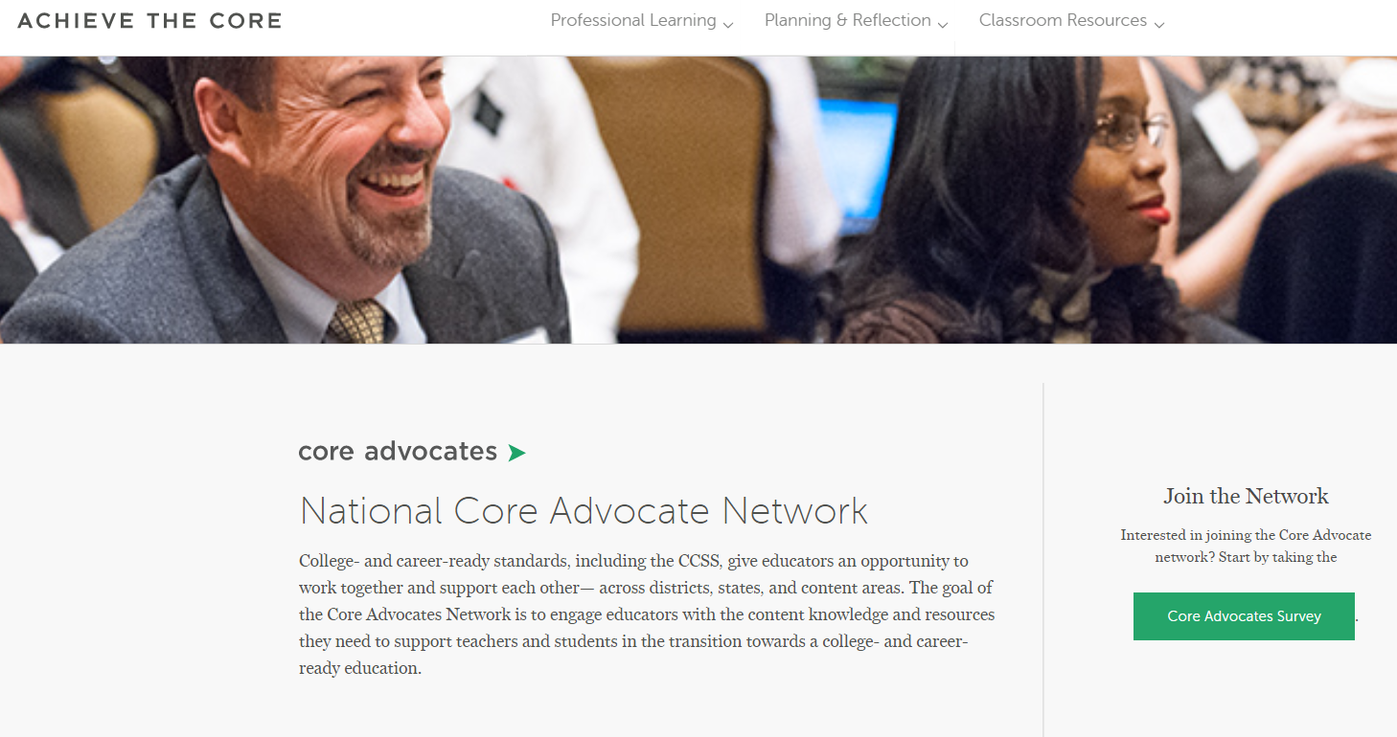
Join Our Network!
www.achievethecore.org/ca-signup

Slide 4
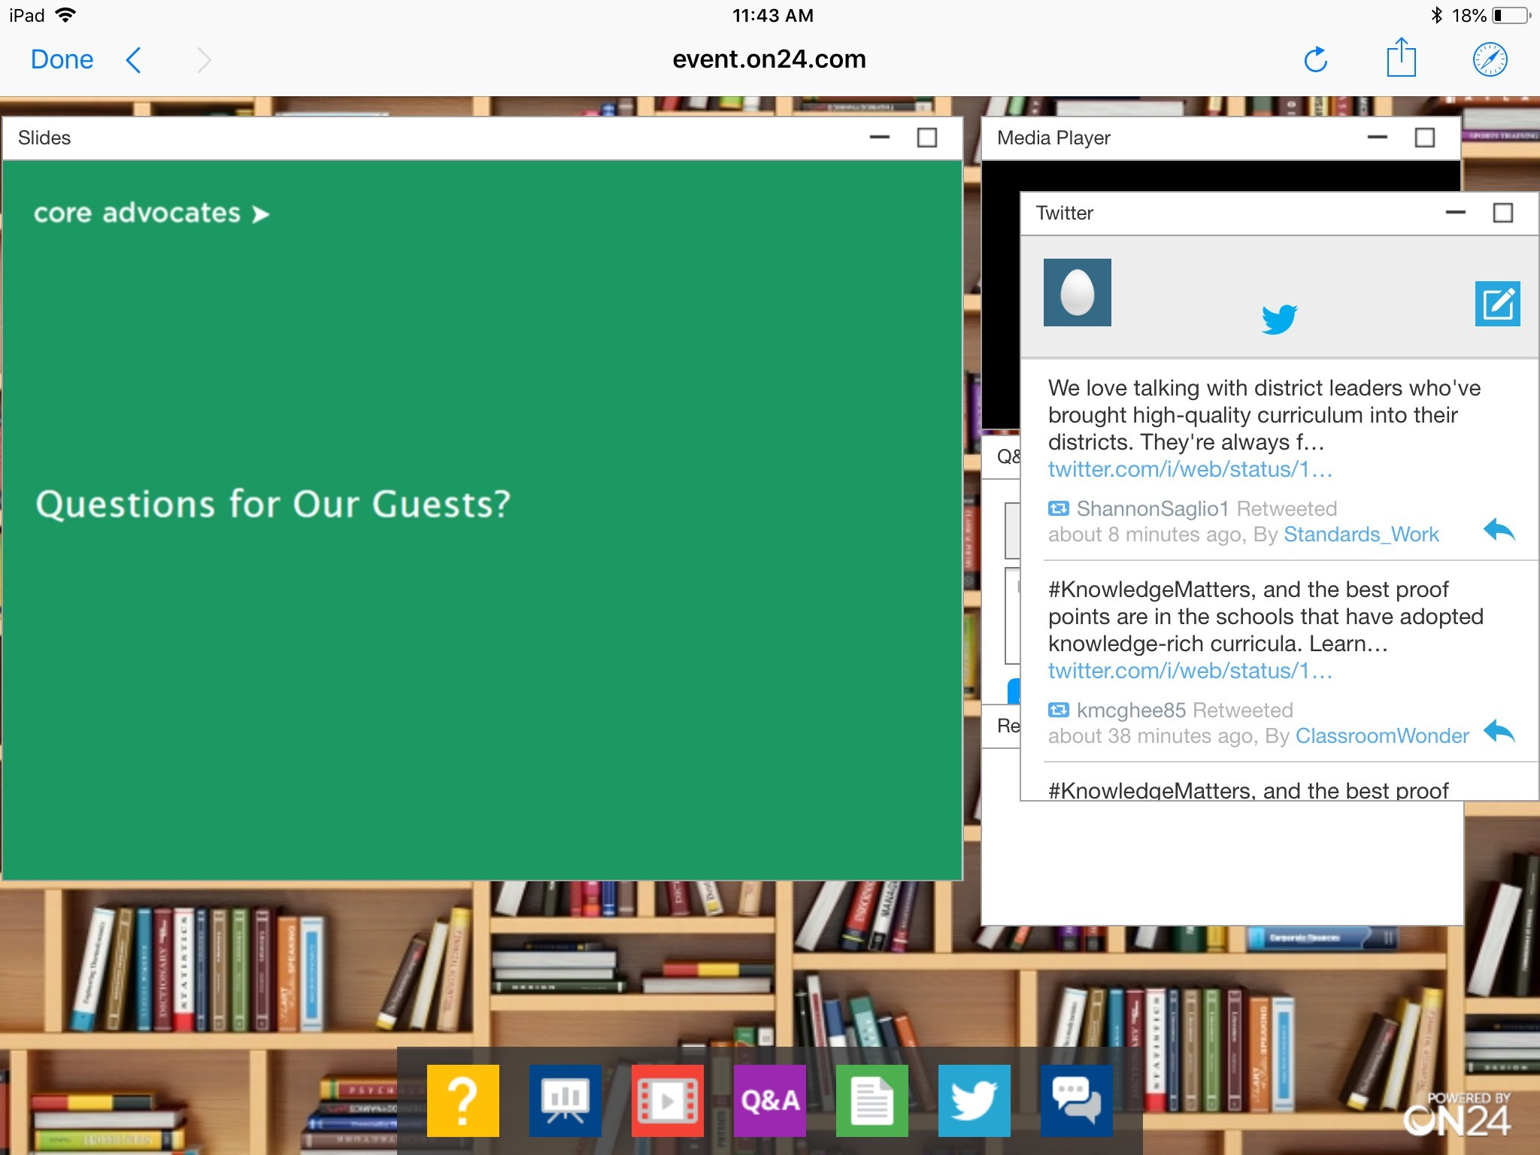
Tweet with Us!
Please feel free to tweet during and after the webinar using #coreadvocates
@achievethecore
@AstridFossum
@AspenEdSociety
#SEAD
#coreadvocates
Click here!

Slide 5
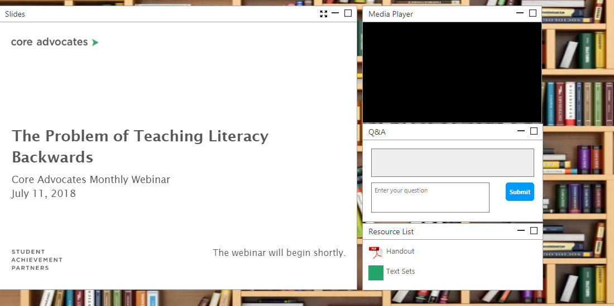
Engage with Us!
During the webinar
Group chat
Questions option
Resources tab
After the webinar
Access to recorded webinar will be emailed to you.
Take our survey in 2 weeks and receive a certificate verifying 30 minutes of professional learning.

Slide 6
Goals of the Webinar
Understand the interrelatedness of academics to Social-Emotional Learning. SEL ---> SEAD
Learn about a new resource created to help educators think about creating an empowering, respectful, and safe school environment.
Examine principles of Social, Emotional, and Academic Development and how they can be woven into the daily fabric of schools.

Slide 7
Section 1: How do we incorporate Social-Emotional Learning into academic content?

Slide 8
Poll:
Does your school or district currently engage in Social-Emotional Learning initiatives? If yes, to what degree do the initiatives blend with academic instruction?

Slide 9
Do any of these sound familiar...
What do we do…..?
I don’t have time to teach the SEL program. How do I fit in all in?
How do I even do this? SEL isn’t my content.
The kids had such a great time working together today. What can we do to maintain this high level of engagement?

Slide 10
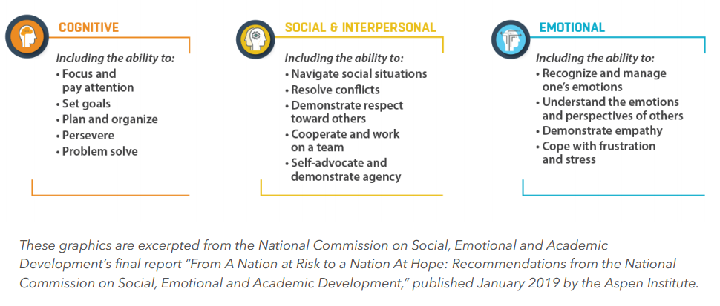
Examples of SEAD Skills and Competencies

Slide 11
Section 2: Where do we begin?

Slide 12
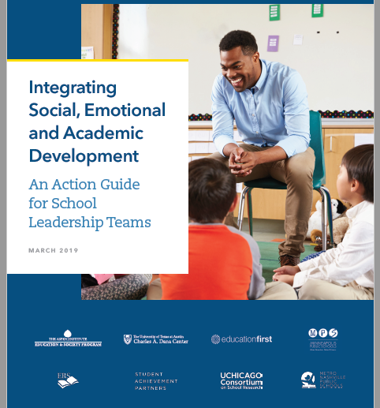
Notes:
https://assets.aspeninstitute.org/content/uploads/2019/03/UPDATED-FINAL-Aspen_Integrating-Report_4_Single.pdf?_ga=2.57408810.1637579352.1557758989-580193211.1556206710

Slide 13
What’s Included in the Guide
Five Sections:
Vision of Student Success
Student Learning Experience
Adult Learning in Support of Student Success
Learning Environment and School Climate
Asset Mapping
Each section summarizes:
foundational research
equity implications
guiding questions
high impact actions

Slide 14
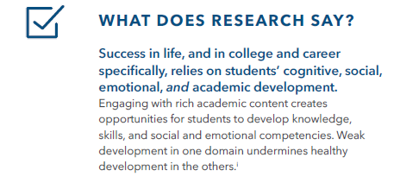
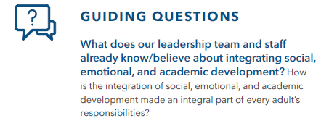
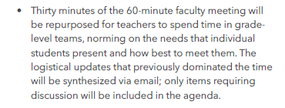

Slide 15
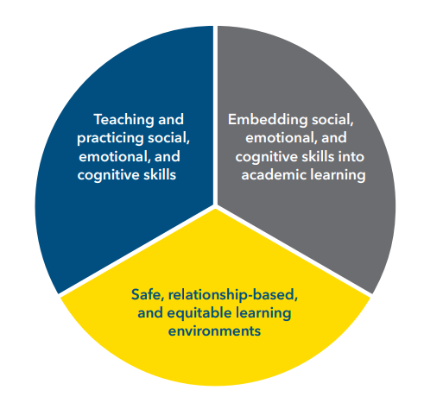
Enacting SEAD Rests on a Three-Legged Stool

Slide 16
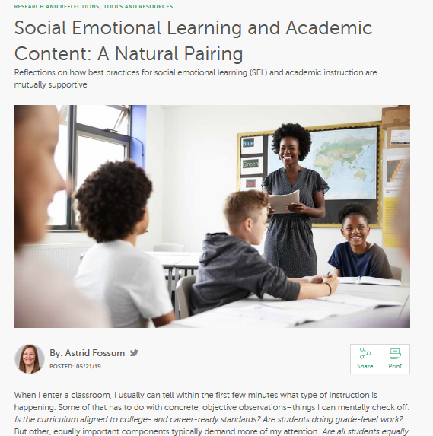
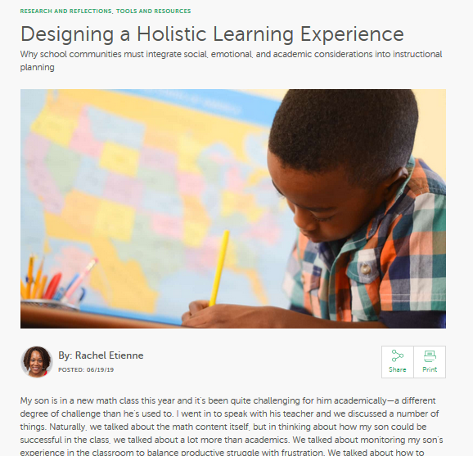
Learn more about the guide via Aligned
Social Emotional Learning and Academic Content: A Natural Pairing
Designing a Holistic Learning Experience

Slide 17
Question:
How will you bring this back to your school or district? Please use the Group Chat to respond.

Slide 18
Questions?

Slide 19
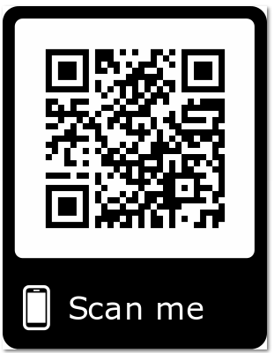
Please Join Us!
https://achievethecore.org/ca-signup
Twitter: twitter.com/achievethecore
Facebook: facebook.com/achievethecore
Pinterest: pinterest.com/achievethecore
Notes:
We encourage you to join the network by filling out this survey completely at atc.org/ca-signup

Slide 20
Please Join Us Again Next Month!
Next month’s webinar: The Most Misunderstood Math Standards in K-8
Wednesday, August 7, 2019, 7 p.m. ET
Register Here: https://event.on24.com/wcc/r/2045923/3F94DC47157077E31234096C786456BE

Slide 21
Thank You!

