Slide 1

The Most Misunderstood Math Standards
Core Advocates Monthly Webinar
August 7, 2019
The webinar will begin shortly.
Check your Resource widget to preview the resources for today’s session!

Slide 2
Introductions
Your hosts from the Professional Learning Team
Jennie Beltramini, Math Specialist
Nicole Bravo, Project Manager
This Month’s Guests -
Rebecca Few, Core Advocate
Brian Dean, Core Advocate

Slide 3
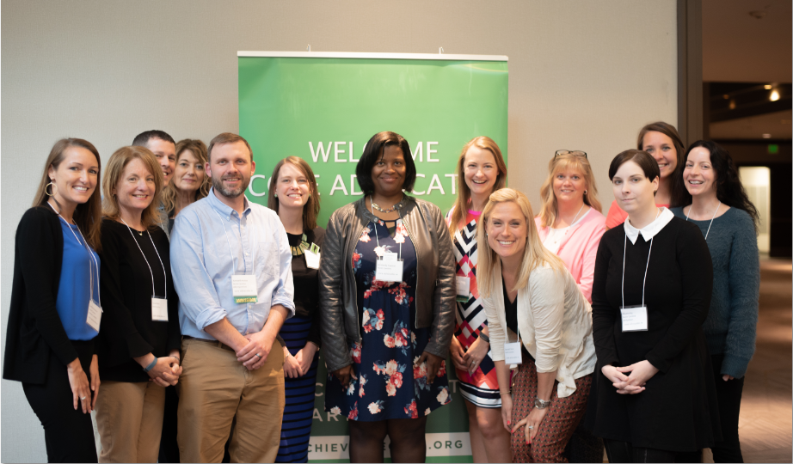
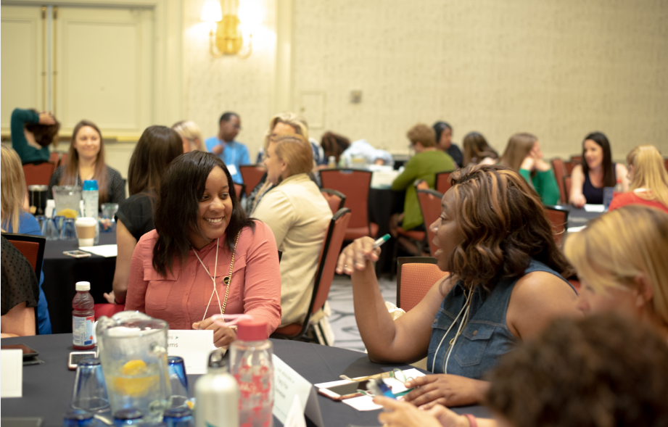
Who Are Core Advocates?
Core Advocates believe in the power of standards to prepare all students for college and/or careers.
They are eager to support and collaborate with their colleagues and communities in understanding and translating the Shifts into instructional practice.
Core Advocates have the tools and knowledge to advocate for high-quality instruction, instructional resources, and professional learning in their communities.

Slide 4

Learn More About Us!
Contact Jennie Beltramini (jbeltramini@studentsachieve.net )
Complete this survey to join our database (and mailing list): www.achievethecore.org/ca-signup
Visit our website: www.achievethecore.org

Slide 5

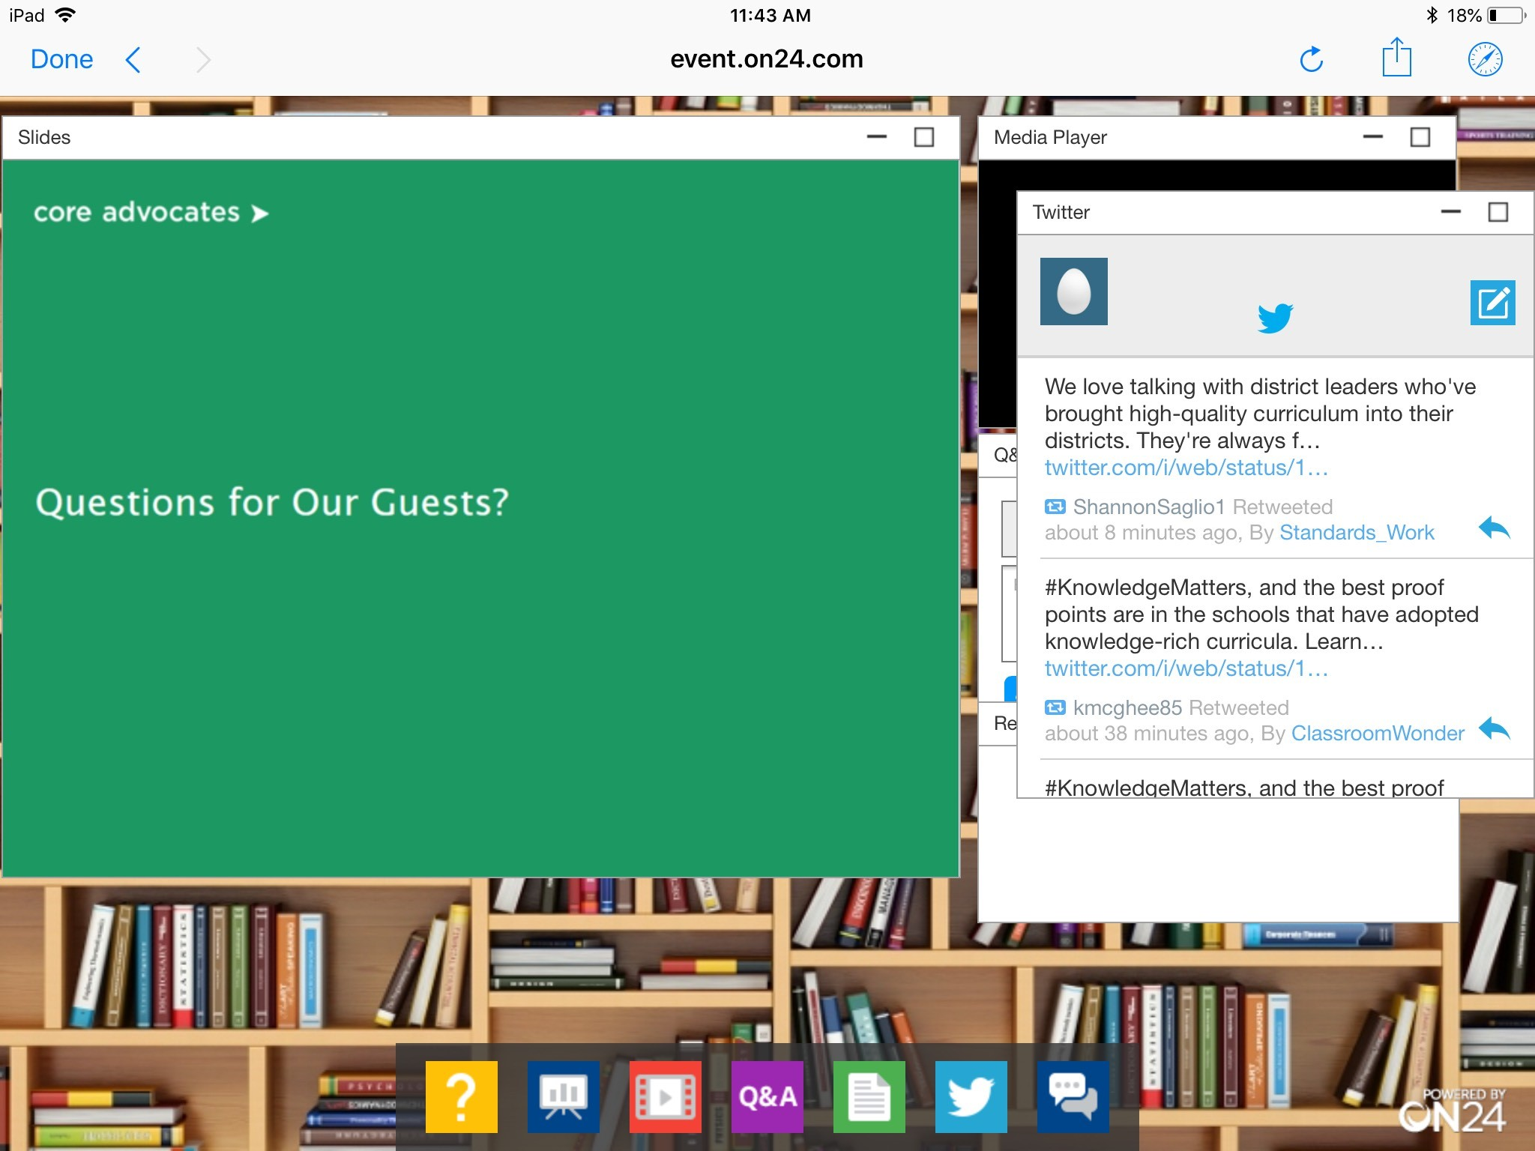
Tweet with Us!
Please feel free to tweet during and after the webinar using #coreadvocates
@achievethecore
@JennieBeltro
@few_rebecca
@FLMathNinja
Click here!

Slide 6
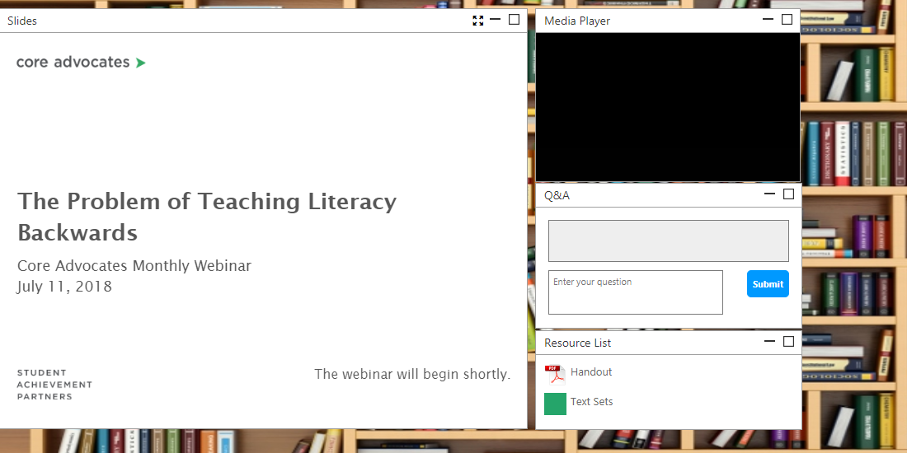
Engage with Us!
During the webinar
– Questions option
– Group chat
– Resources tab
After the webinar
– Access to recorded
webinar will be emailed to you.
Take our survey in 2 weeks and receive a certificate verifying 1 hour of professional learning.

Slide 7
Goals of the Webinar
How does understanding the mathematics and pedagogical implications of misunderstood standards help teachers make great instructional decisions and support equitable instruction?
What are commonly misunderstood standards in grades 3-5 and how does understanding them help teachers and students?
What are commonly misunderstood standards in grades 6-8 and how does understanding them help teachers and students?

Slide 8
Section 1: How does understanding the mathematics and pedagogical implications of misunderstood standards help teachers make great instructional decisions and support equitable instruction?

Slide 9
Poll:
How much professional learning/collaboration time during the last school year did you spend building mathematical and pedagogical content knowledge tied to grade-level standards (doing math, reading the progressions, learning mathematics)?

Slide 10

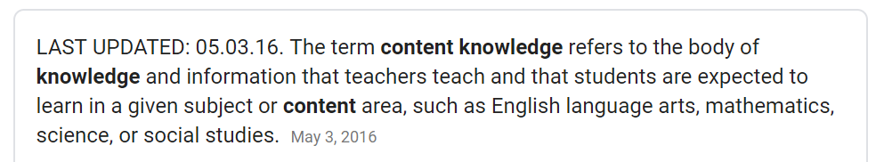
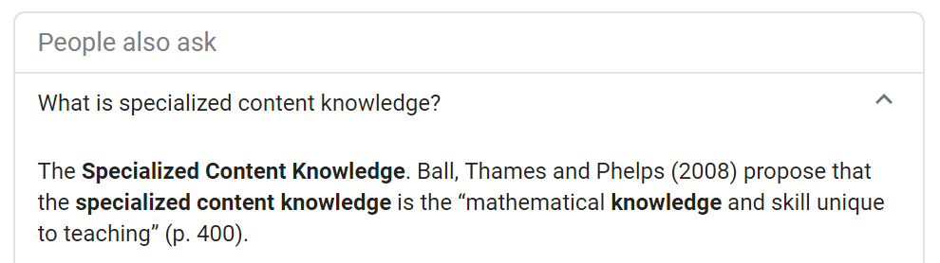
Content Knowledge

Slide 11
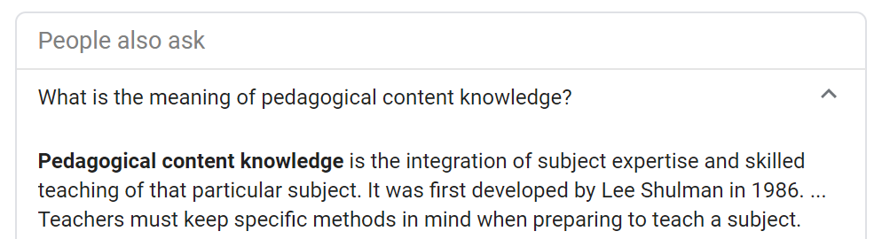

Pedagogical Content Knowledge

Slide 12
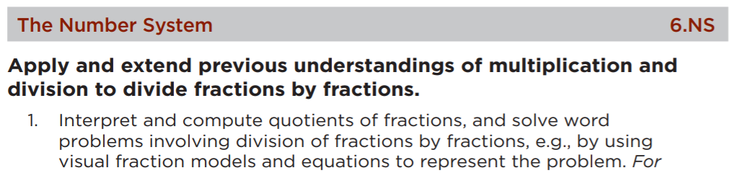

What specialized and pedagogical content knowledge do teachers need to have to teach this to students?
What might be misunderstood about this standard?
What aspect(s) of Rigor does this cluster and standard
call for: conceptual understanding, procedural skill and fluency, and/or application?

Slide 13
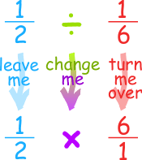

Slide 14
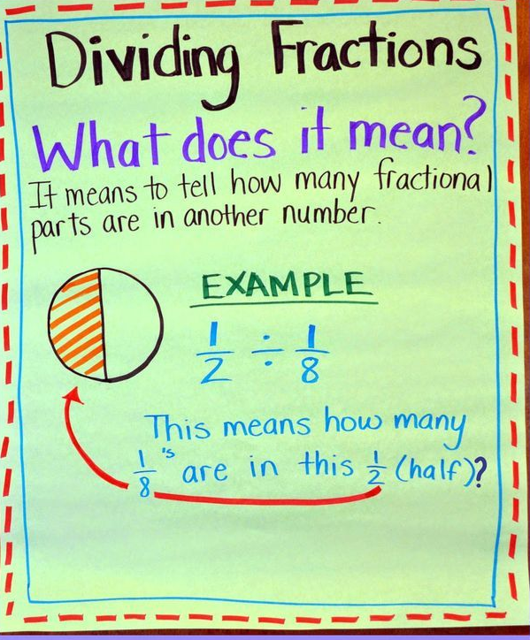
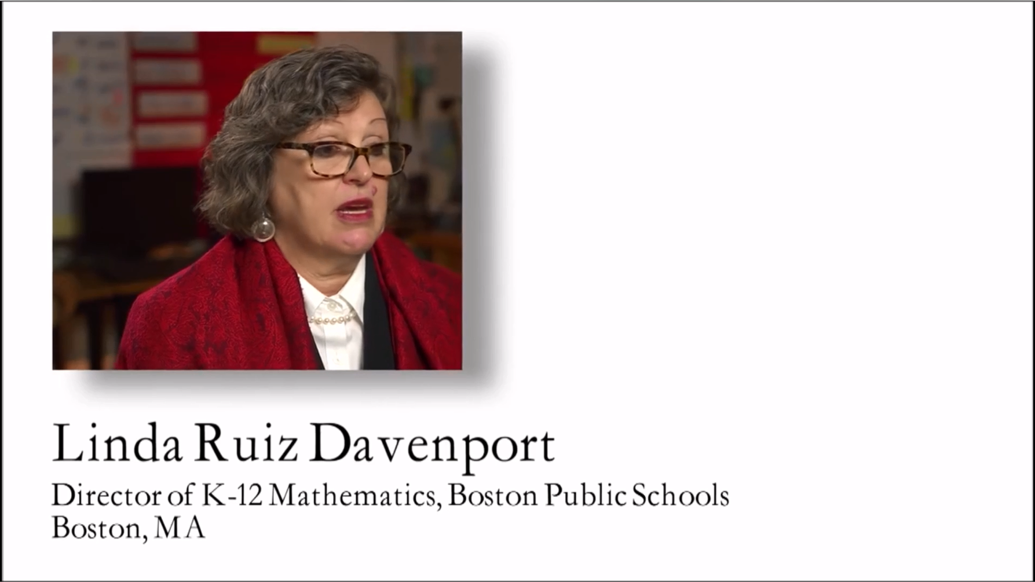

Video from NCTM

Slide 15
Reflect
How will the experiences of students in these two classrooms be different? What are the implications for students and their mathematical futures?
What does the difference in these two approaches communicate to students about our belief in their ability to understand math concepts?

Slide 16
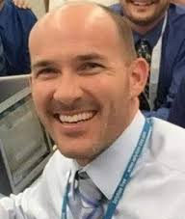
During my [classroom] visits, I definitely have noticed some trends in instruction. There are some standards, regardless of the teacher, the school, or the district that seem to be commonly misunderstood. Somehow the intent of these standards is lost during instruction. I do not believe this is ever done intentionally, but could be a byproduct of many factors. Maybe it is because old standards are still lingering in the current curriculum; maybe lessons and/or materials have been recycled or repurposed from before new college- and career-ready standards; or maybe there is a lack of understanding of what the standard actually means.
Brian Dean, Core Advocate

Slide 17
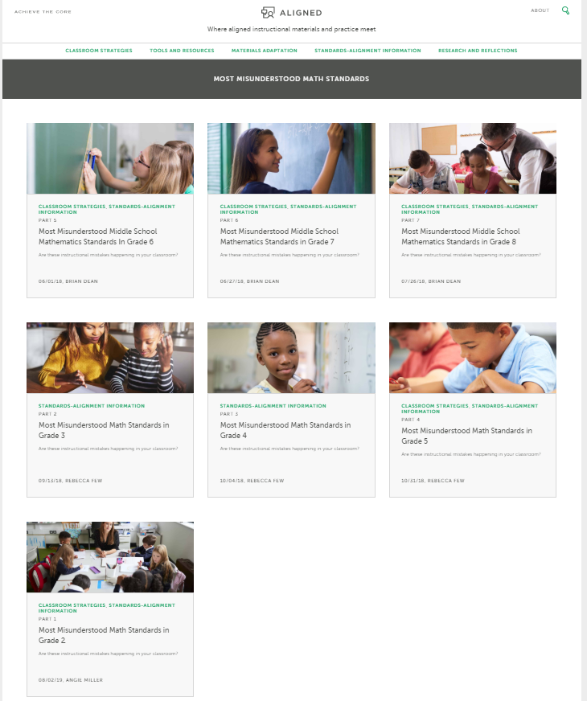

Slide 18
Section 2: What are commonly misunderstood standards in grades 3-5 and how does understanding them help teachers and students?

Slide 19

Rebecca Few
Content Lead,
Instruction Partners
Murfreesboro, TN

Slide 20
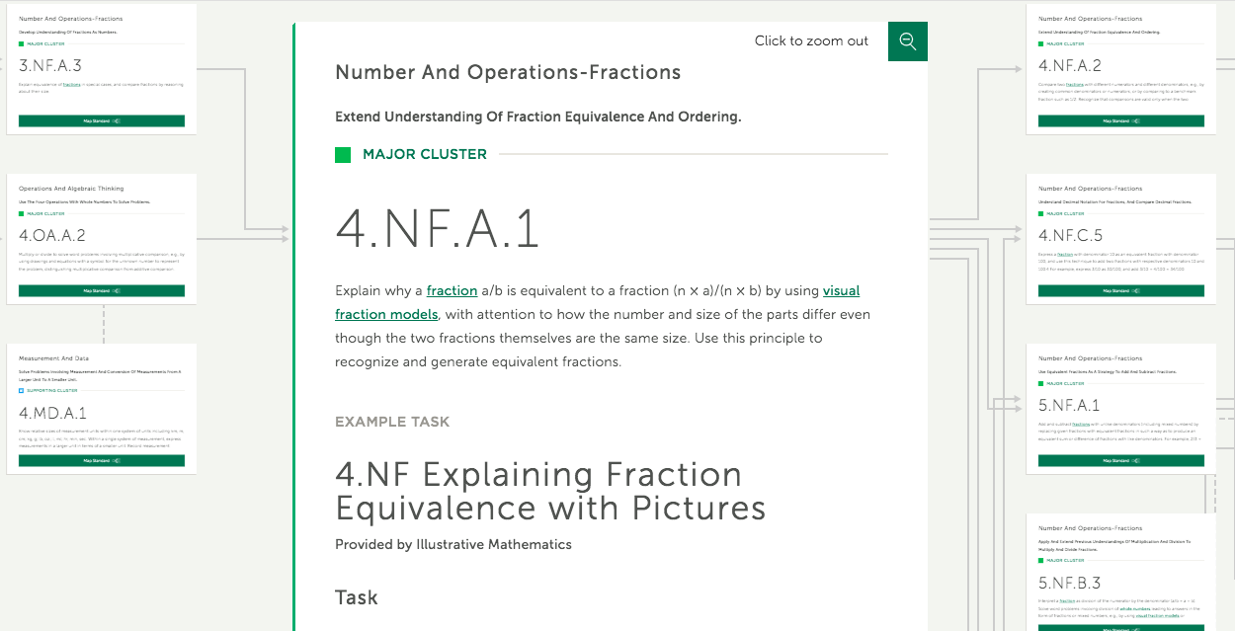
Looking at the progression

Slide 21
“Connections are useful because they help students see mathematics as a unified body of knowledge rather than a set of complex and disjointed concepts, procedures and processes. Real world contexts provide opportunities for students to connect what they are learning to their own environment. Their mathematics may also be connected to other disciplines which provides opportunities to enrich their learning.”

Slide 22
Grade 3
3.NF.A.3
Explain equivalence of fractions in special cases, and compare fractions by reasoning about their size.

Slide 23

Jon and Charlie
Jon and Charlie plan to run together. They are arguing about how far to run.
Charlie says, I run 3/6 of a mile each day. Jon says, I can only run 1/2 of a mile.
If Charlie runs 3/6 of a mile and Jon runs 1/2 of a mile, explain why it is silly for them to argue. Draw a model or a number line to support your reasoning.
What prior knowledge will students need to solve Jon and Charlie’s dilemma?
From Illustrative Mathematics

Slide 24
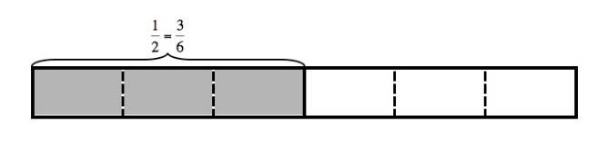
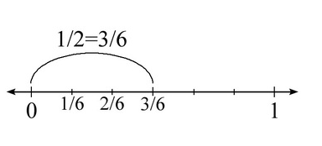
Solution
Area Model
Linear Model
What do we want students to understand?
What misconceptions might students have?

Slide 25
Grade 4
4.NF.A.1
Explain why a fraction a/b is equivalent to a fraction (n × a)/(n × b) by using visual fraction models, with attention to how the number and size of the parts differ even though the two fractions themselves are the same size. Use this principle to recognize and generate equivalent fractions.

Slide 26
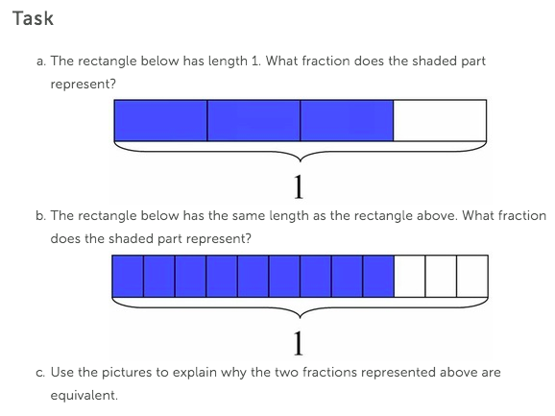

Slide 27
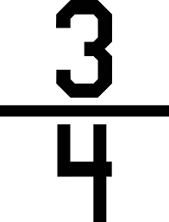
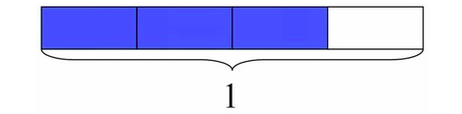

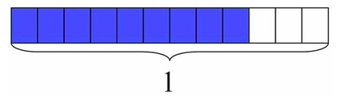
Solution
What do we want students to understand?
Part C is all about the understanding!
a.
b.
c.

Slide 28
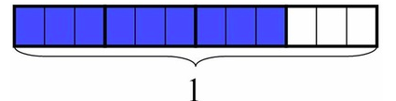


Solution
c. Since the shaded portion is the same in each case but we just look at it in a different way and describe it with a different fraction, the fractions are equal.

Slide 29
Coherence
How did we use what we knew from the third grade problem to solve the fourth grade problem?

Slide 30
Grade 5
5.NF.A.1
Add and subtract fractions with unlike denominators (including mixed numbers) by replacing given fractions with equivalent fractions in such a way as to produce an equivalent sum or difference of fractions with like denominators. For example, 2/3 + 5/4 = 8/12 + 15/12 = 23/12. (In general, a/b + c/d = (ad + bc)/bd.)

Slide 31
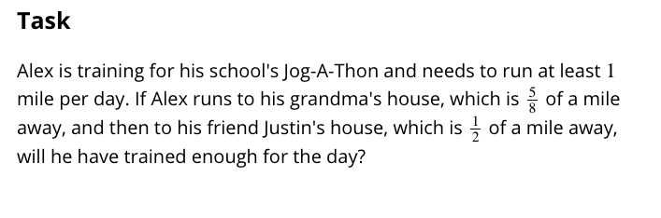

Slide 32
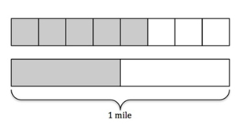
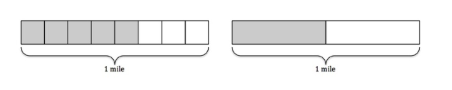
Solution Methods
Estimating
“It is not necessary to find a least common denominator to calculate sums of fractions, and in fact the effort of finding a least common denominator is a distraction from understanding algorithms for adding fractions. Students make sense of fractional quantities when solving word problems, estimating answers mentally to see if they make sense.”
Fraction Progressions

Slide 33


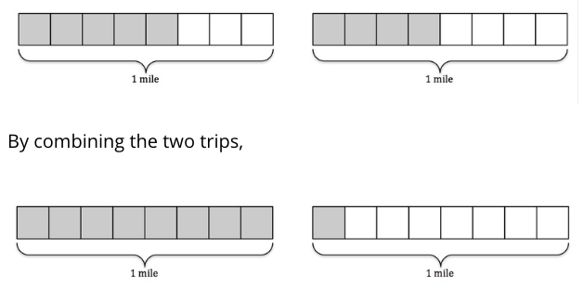
Solution Methods
Calculating using common denominators

Slide 34
Looking at the progression

Slide 35
Question or Poll:
?
Please use the Questions tab on your control panel to respond.
If using a poll, please put up to 5 answer choices in the notes section below and indicate if attendees should choose only one response or multiple responses.

Slide 36
Section 3: What are commonly misunderstood standards in grades 6-8 and how does understanding them help teachers and students?

Slide 37
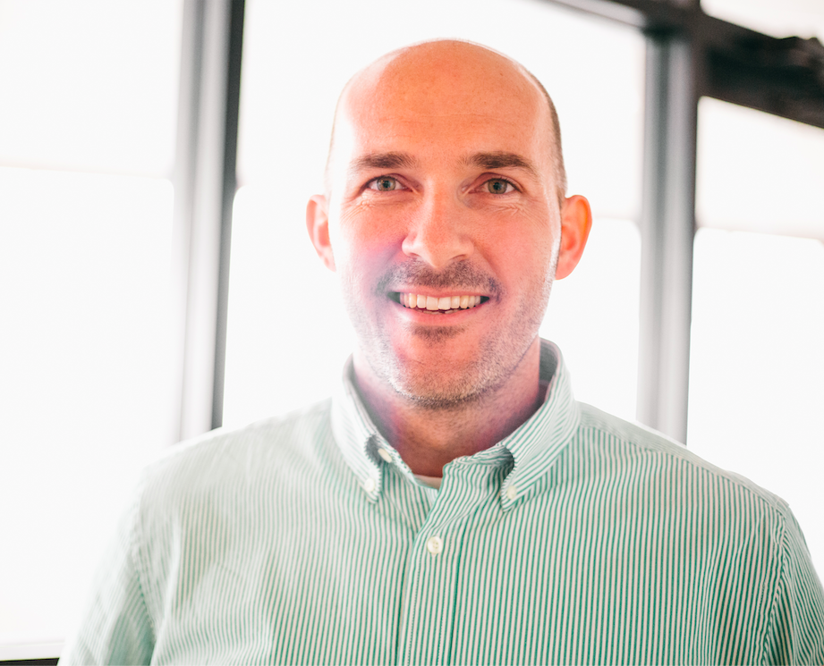
Brian Dean (he/him/his)
Math Content Lead
Tampa, FL
@FLMathNinja

Slide 38
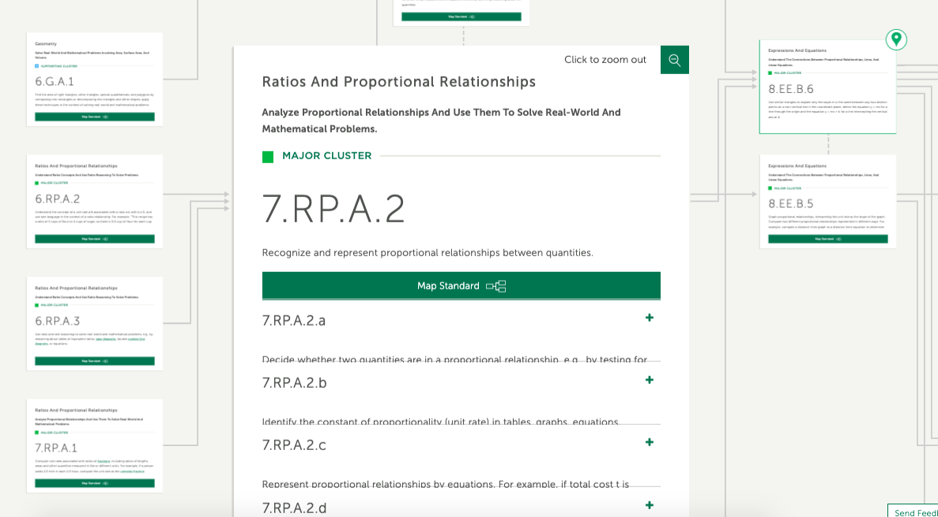
Looking at the progression

Slide 39
Grade 6
6.RP.A.3: Use ratio and rate reasoning to solve real-world and mathematical problems, e.g., by reasoning about tables of equivalent ratios, tape diagrams, double number line diagrams, or equations.
6.RP.A.3c: Find a percent of a quantity as a rate per 100 (e.g., 30% of a quantity means 30/100 times the quantity); solve problems involving finding the whole, given a part and the percent.

Slide 40
Grade 6 | 6.RP.A.3c
What would you expect to see in terms of student work in order to demonstrate mastery of this standard?
Jasmine has taken an online boating safety course and is now completing her end-of-course exam. As she answers each question, the progress bar at the bottom of the screen shows what portion of the test she has finished. She has just completed Question 16, and the progress bar shows she is 20% complete. How many total questions are on the test? Use a table, diagram, or equation to justify your answer.
https://nysed-prod.engageny.org/resource/grade-6-mathematics-module-1/file/110561

Slide 41
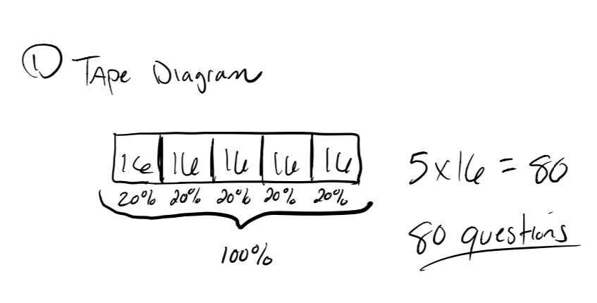
Grade 6

Slide 42
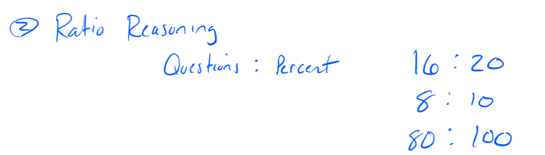

Grade 6

Slide 43
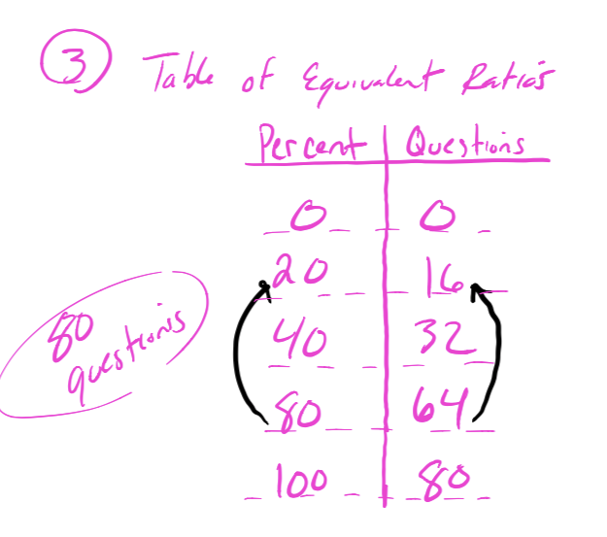
Grade 6

Slide 44
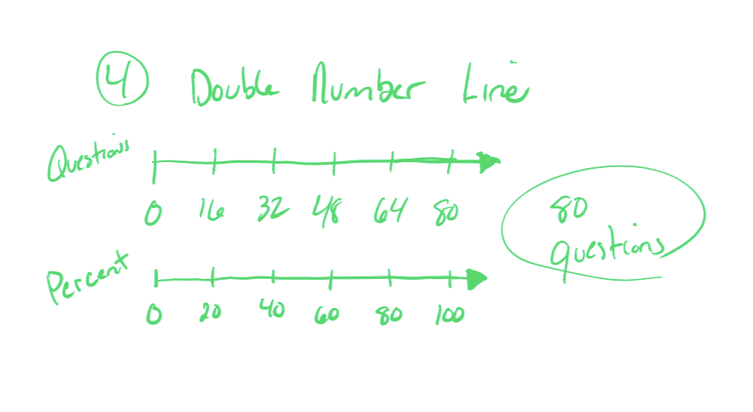
Grade 6

Slide 45
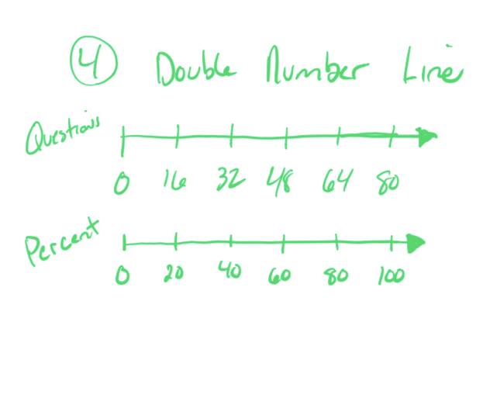
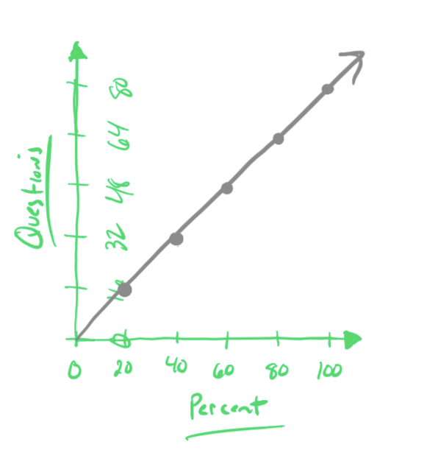
Grade 6

Slide 46
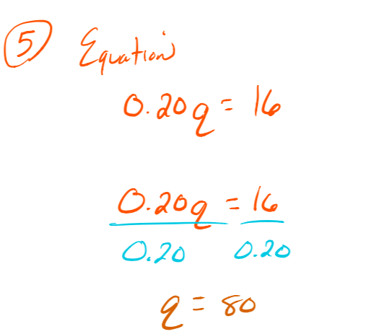

Grade 6

Slide 47
Grade 6 | 6.RP.A.3c
What would you expect to see in terms of student work in order to demonstrate mastery of this standard?
Jasmine has taken an online boating safety course and is now completing her end-of-course exam. As she answers each question, the progress bar at the bottom of the screen shows what portion of the test she has finished. She has just completed Question 16, and the progress bar shows she is 20% complete. How many total questions are on the test? Use a table, diagram, or equation to justify your answer.
https://nysed-prod.engageny.org/resource/grade-6-mathematics-module-1/file/110561

Slide 48
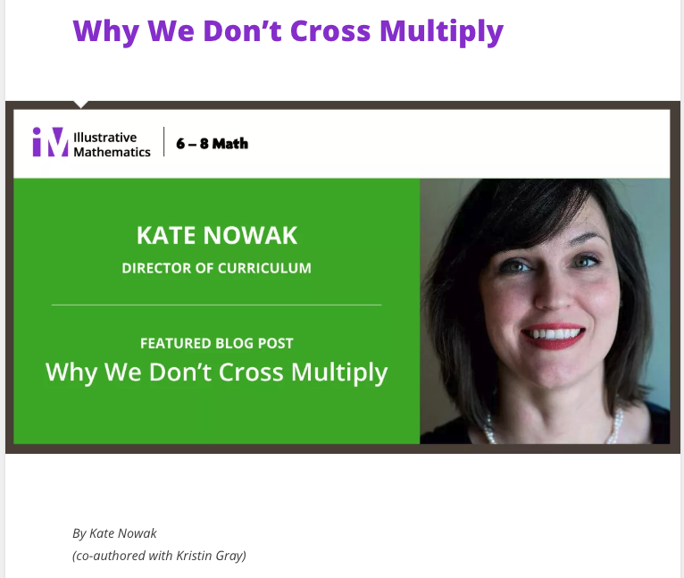
Grade 6 | 6.RP.A.3c
What would you expect to see in terms of student work in order to demonstrate mastery of this standard?
https://illustrativemathematics.blog/2018/02/06/why-we-dont-cross-multiply/

Slide 49
Grade 7
7.RP.A.2a: Decide whether two quantities are in a proportional relationship, e.g., by testing for equivalent ratios in a table or graphing on a coordinate plane and observing whether the graph is a straight line through the origin.
7.RP.A.2d: Explain what a point (x, y) on the graph of a proportional relationship means in terms of the situation, with special attention to the points (0, 0) and (1, r) where r is the unit rate.

Slide 50
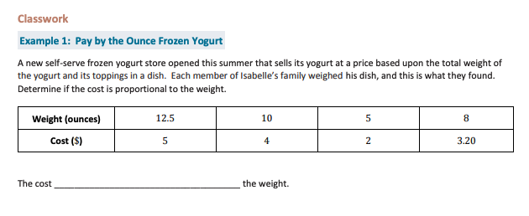
Grade 7 | 7.RP.A.2a
https://nysed-prod.engageny.org/resource/grade-7-mathematics-module-1-topic-lesson-2/file/55966

Slide 51
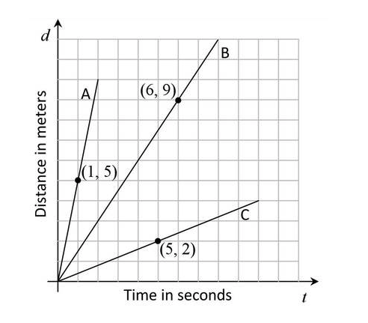
Grade 7 | 7.RP.A.2d
Carli’s class built some solar-powered robots. They raced the robots in the parking lot of the school. The graphs below are all line segments that show the distance d, in meters, that each of three robots traveled after t seconds.
Each graph has a point labeled. What does the point tell you about how far that robot has traveled?
Carli said that the ratio between the number of seconds each robot travels and the number of meters it has traveled is constant. Is she correct? Explain.
How fast is each robot traveling? How did you compute this from the graph?
https://tasks.illustrativemathematics.org/content-standards/7/RP/A/2/tasks/181

Slide 52
Grade 8
8.EE.B.6: Use similar triangles to explain why the slope m is the same between any two distinct points on a non-vertical line in the coordinate plane; derive the equation y = mx for a line through the origin and the equation y = mx + b for a line intercepting the vertical axis at b.

Slide 53
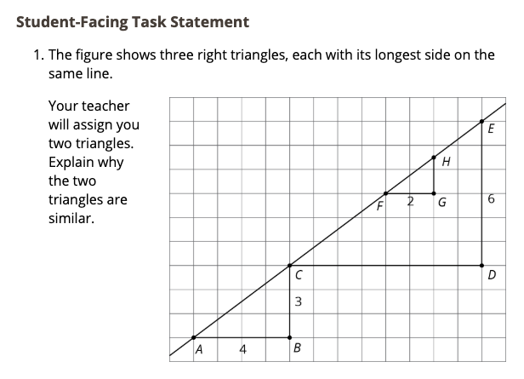
Grade 8
https://im.openupresources.org/8/teachers/2/10.html

Slide 54
Questions for Our Guests?

Slide 55
Resource Name | Link
Core Advocate Survey | http://bit.ly/webinar-ca
NCTM Video: Building Conceptual Understanding for Mathematics | https://www.nctm.org/Standards-and-Positions/Common-Core-State-Standards/Teaching-and-Learning-Mathematics-with-the-Common-Core/#1
The Most Misunderstood Math Standards Aligned Blog Series | https://achievethecore.org/aligned/series/?series=Most%20Misunderstood%20Math%20Standards
Coherence Map | https://achievethecore.org/coherence-map/
Why We Don’t Cross Multiply IM Blog | https://illustrativemathematics.blog/2018/02/06/why-we-dont-cross-multiply/
An Evening with the Authors: Q&A with Meredith and David Liben | https://event.on24.com/wcc/r/2045117/8D96DBE93DB4B729124C3EAE7DEDA2AB
Join Our Network! | www.achievethecore.org/ca-signup
September Core Advocate Webinar Registration | https://event.on24.com/wcc/r/2062144/C9F6E1A62E752F9FCA3F576548C9C946

Slide 56
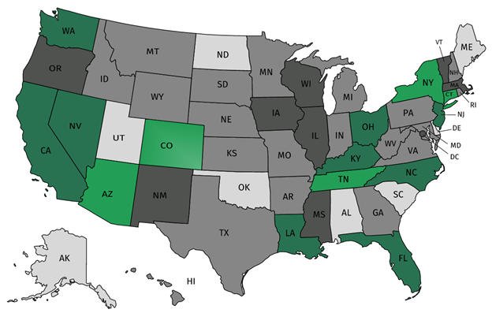
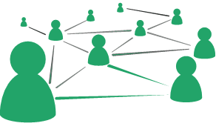



Join our network!
Join a national network of educators
Connect with state networks
Be a part of creating new tools and resources in partnership with SAP
Keep up to date on free resources, upcoming SAP webinars/professional learning opportunities, job postings and more!

Slide 57




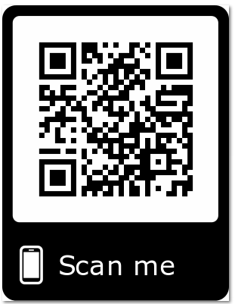
Please Join Us!
https://achievethecore.org/ca-signup
Twitter: twitter.com/achievethecore
Facebook: facebook.com/achievethecore
Pinterest: pinterest.com/achievethecore

Slide 58
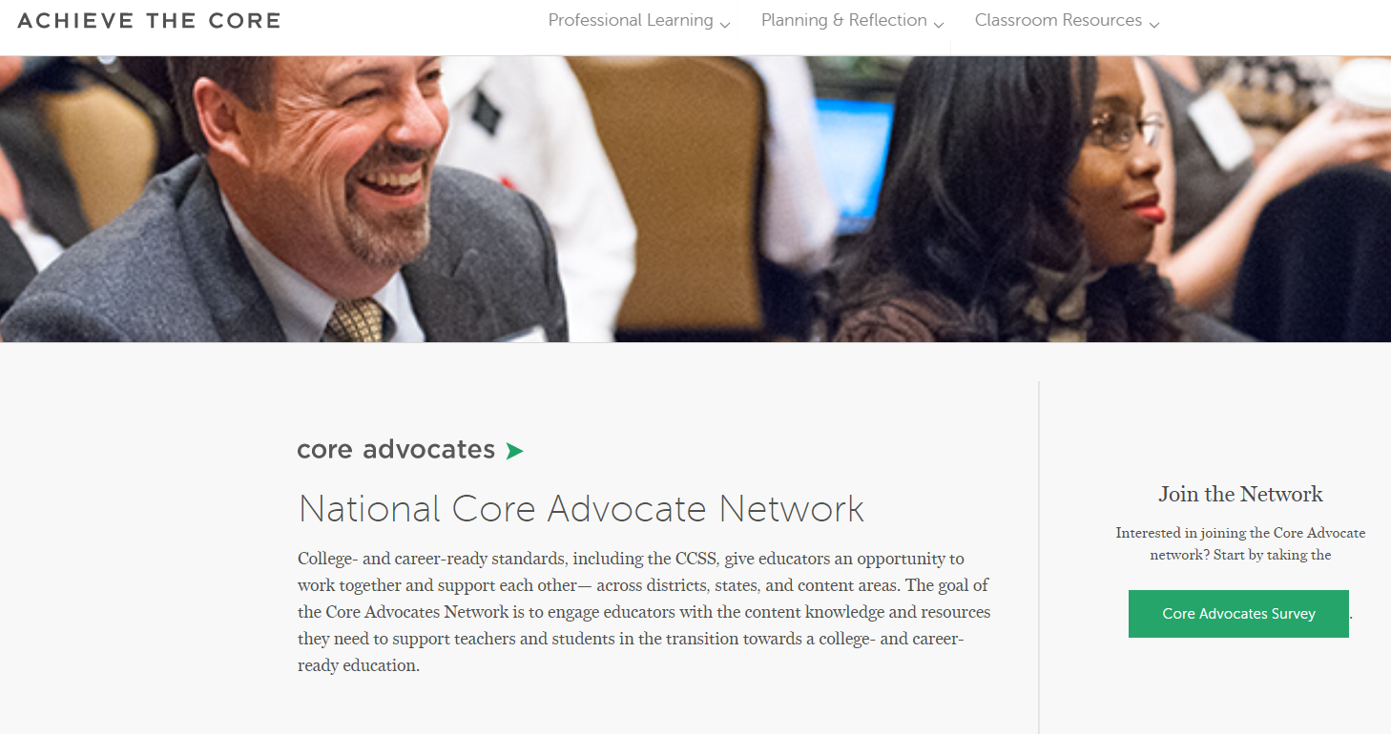
Join Our Network!
www.achievethecore.org/ca-signup

Slide 59
Thank You!

