Slide 1

Math Language Routines: Vibrant Discussions in the Math Classroom
Core Advocates Monthly Webinar
October 2, 2019
The webinar will begin shortly.
Check your Resource widget to preview the resources for today’s session! Use the Group Chat to introduce yourself!

Slide 2
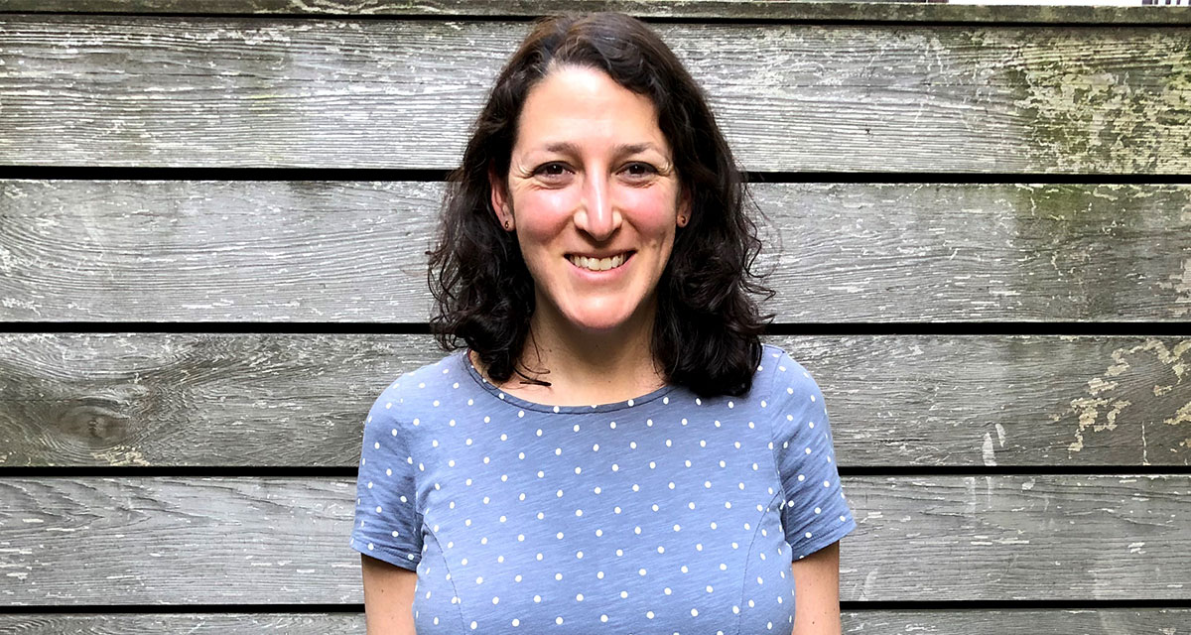
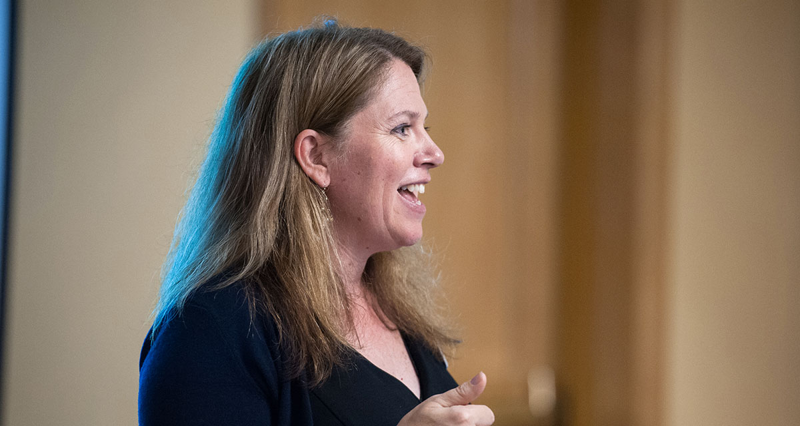
Introductions
Your hosts from Student Achievement Partners:
Lisa Goldschmidt
Executive Vice President, Tools and Classroom Resources
Barbara Beske,
Senior Mathematics Specialist
@beske3
This Month’s Guests -
Renae Skarin
Jack Dieckmann
Anne Agostinelli
Chrissy Newell
Karina Calderon

Slide 3
How many Core Advocate Webinars have you attended?
Please use the Questions tab on your control panel to respond.
If using a poll, please put up to 5 answer choices in the notes section below and indicate if attendees should choose only one response or multiple responses.

Slide 4
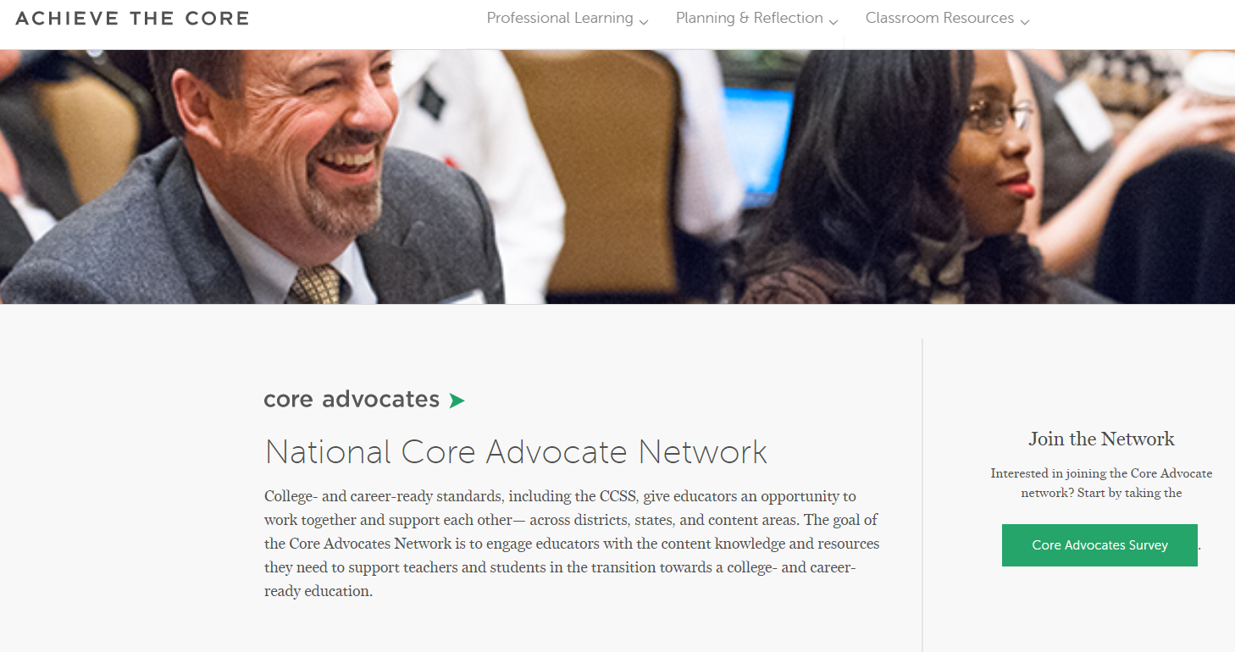
Join Our Network!
www.achievethecore.org/ca-signup

Slide 5


Learn More About Us!
Contact Jennie Beltramini (jbeltramini@studentsachieve.net )
Complete this survey to join our database (and mailing list): www.achievethecore.org/ca-signup
Visit our website: www.achievethecore.org

Slide 6

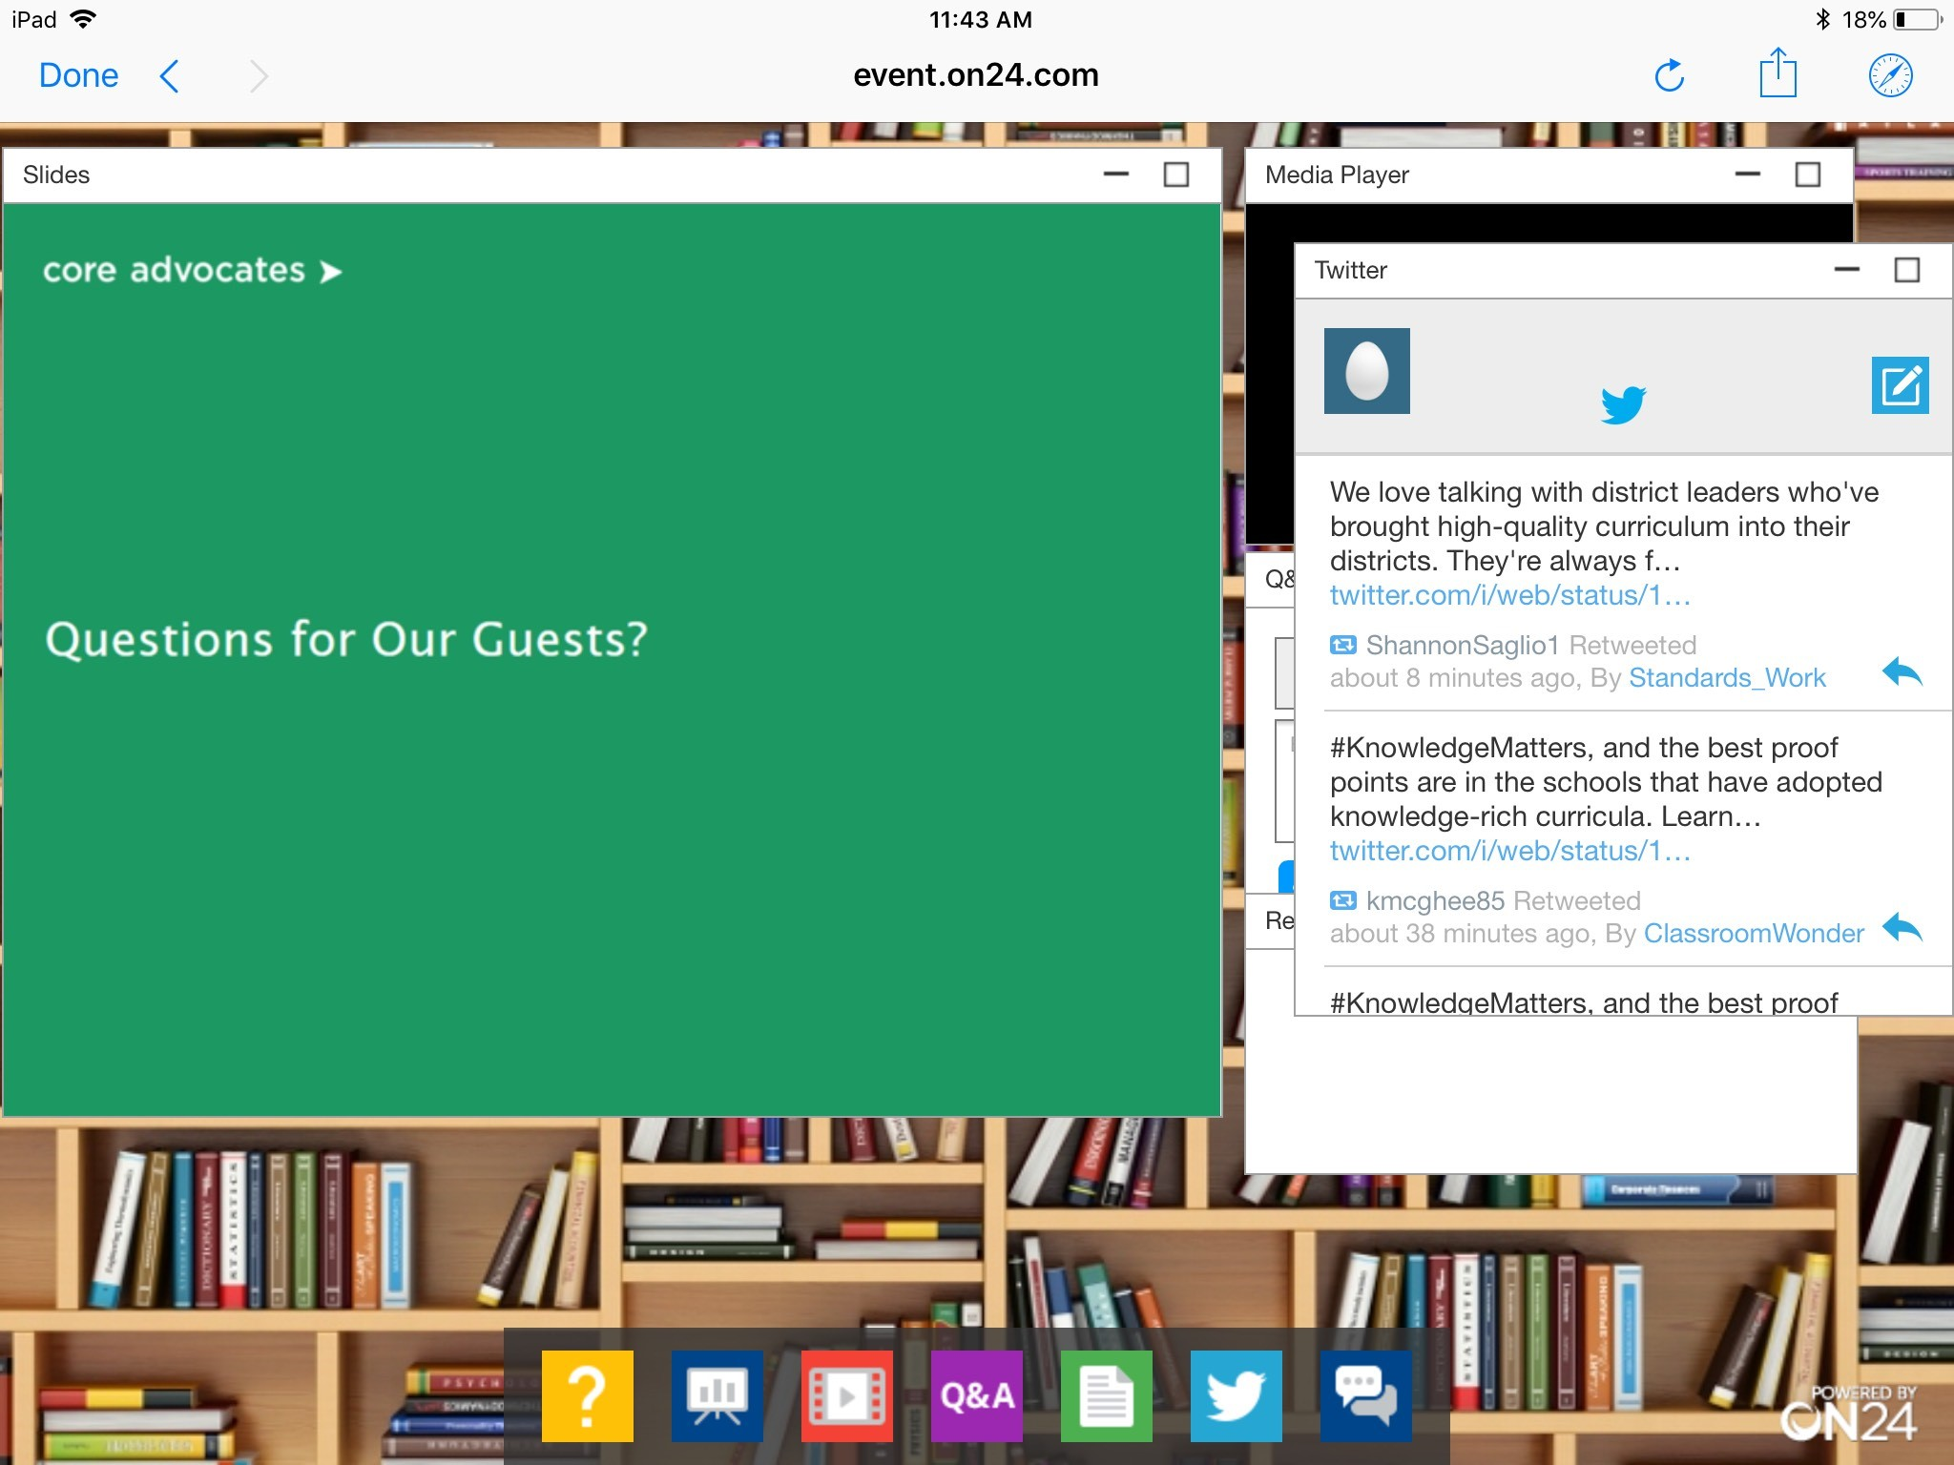
Tweet with Us!
Please feel free to tweet during and after the webinar using #coreadvocates
@achievethecore
@renae_skarin
@JackDieckmann
@anneagost
@MrsNewell22
@srta_kcalderon
Click here!

Slide 7
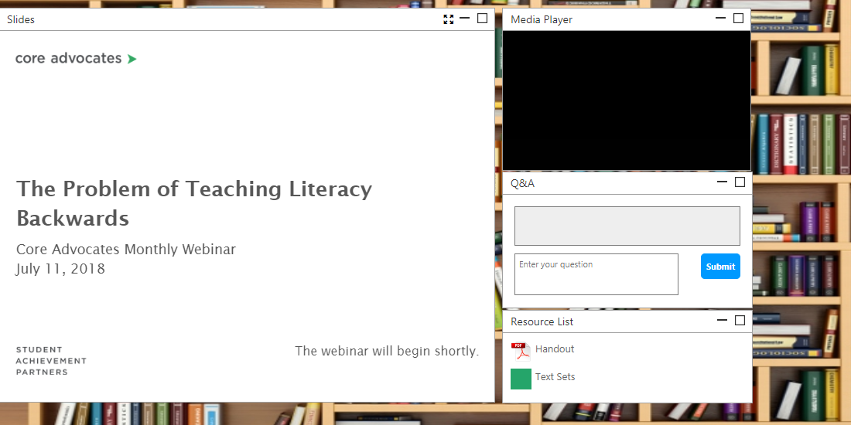
Engage with Us!
During the webinar
– Questions option
– Group chat
– Resources tab
After the webinar
– Access to recording will be emailed to you.
Take our survey in 2 weeks and receive a certificate verifying 1 hour of professional learning.

Slide 8
Goals of the Webinar
Learn what mathematical language routines are
Understand the history of the mathematical language routines designed by Stanford’s Understanding Language Project
Discover how mathematical language routines can support math instruction for all students, especially English Language Learners
Hear about models of successful use from teachers
Identify practical strategies for implementing the routines in your classroom

Slide 9
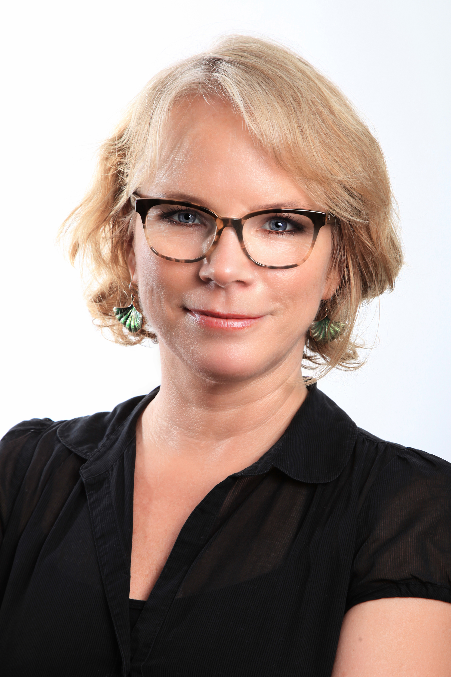

Renae Skarin
Director
Curriculum Review Process
English Learners Success Forum
Jack Dieckmann
ELSF Math Consultant
Research Director, youcubed
Stanford University
Renae and Jack were co-authors of the Principles for the Design of Mathematics Curriculum: Promoting Language and Content” at Understanding Language, a research center at Stanford University, Graduate School of Education.
please enter a head shots here

Slide 10
Section 1: Introduction to Mathematical Language Routines

Slide 11


Math Language Routines
Collaboration between math publisher and Understanding Language
Needed language support strategies relevant to math
Strategies that could be baked in throughout learning materials

Slide 12
What is new about the MLRs?
Co-developed by a team of language specialists AND math content specialists
Takes into consideration math discipline-specific features of academic language
Not just support language, but develop language and content simultaneously
Routines are meant to be baked into the curriculum, not an afterthought.

Slide 13
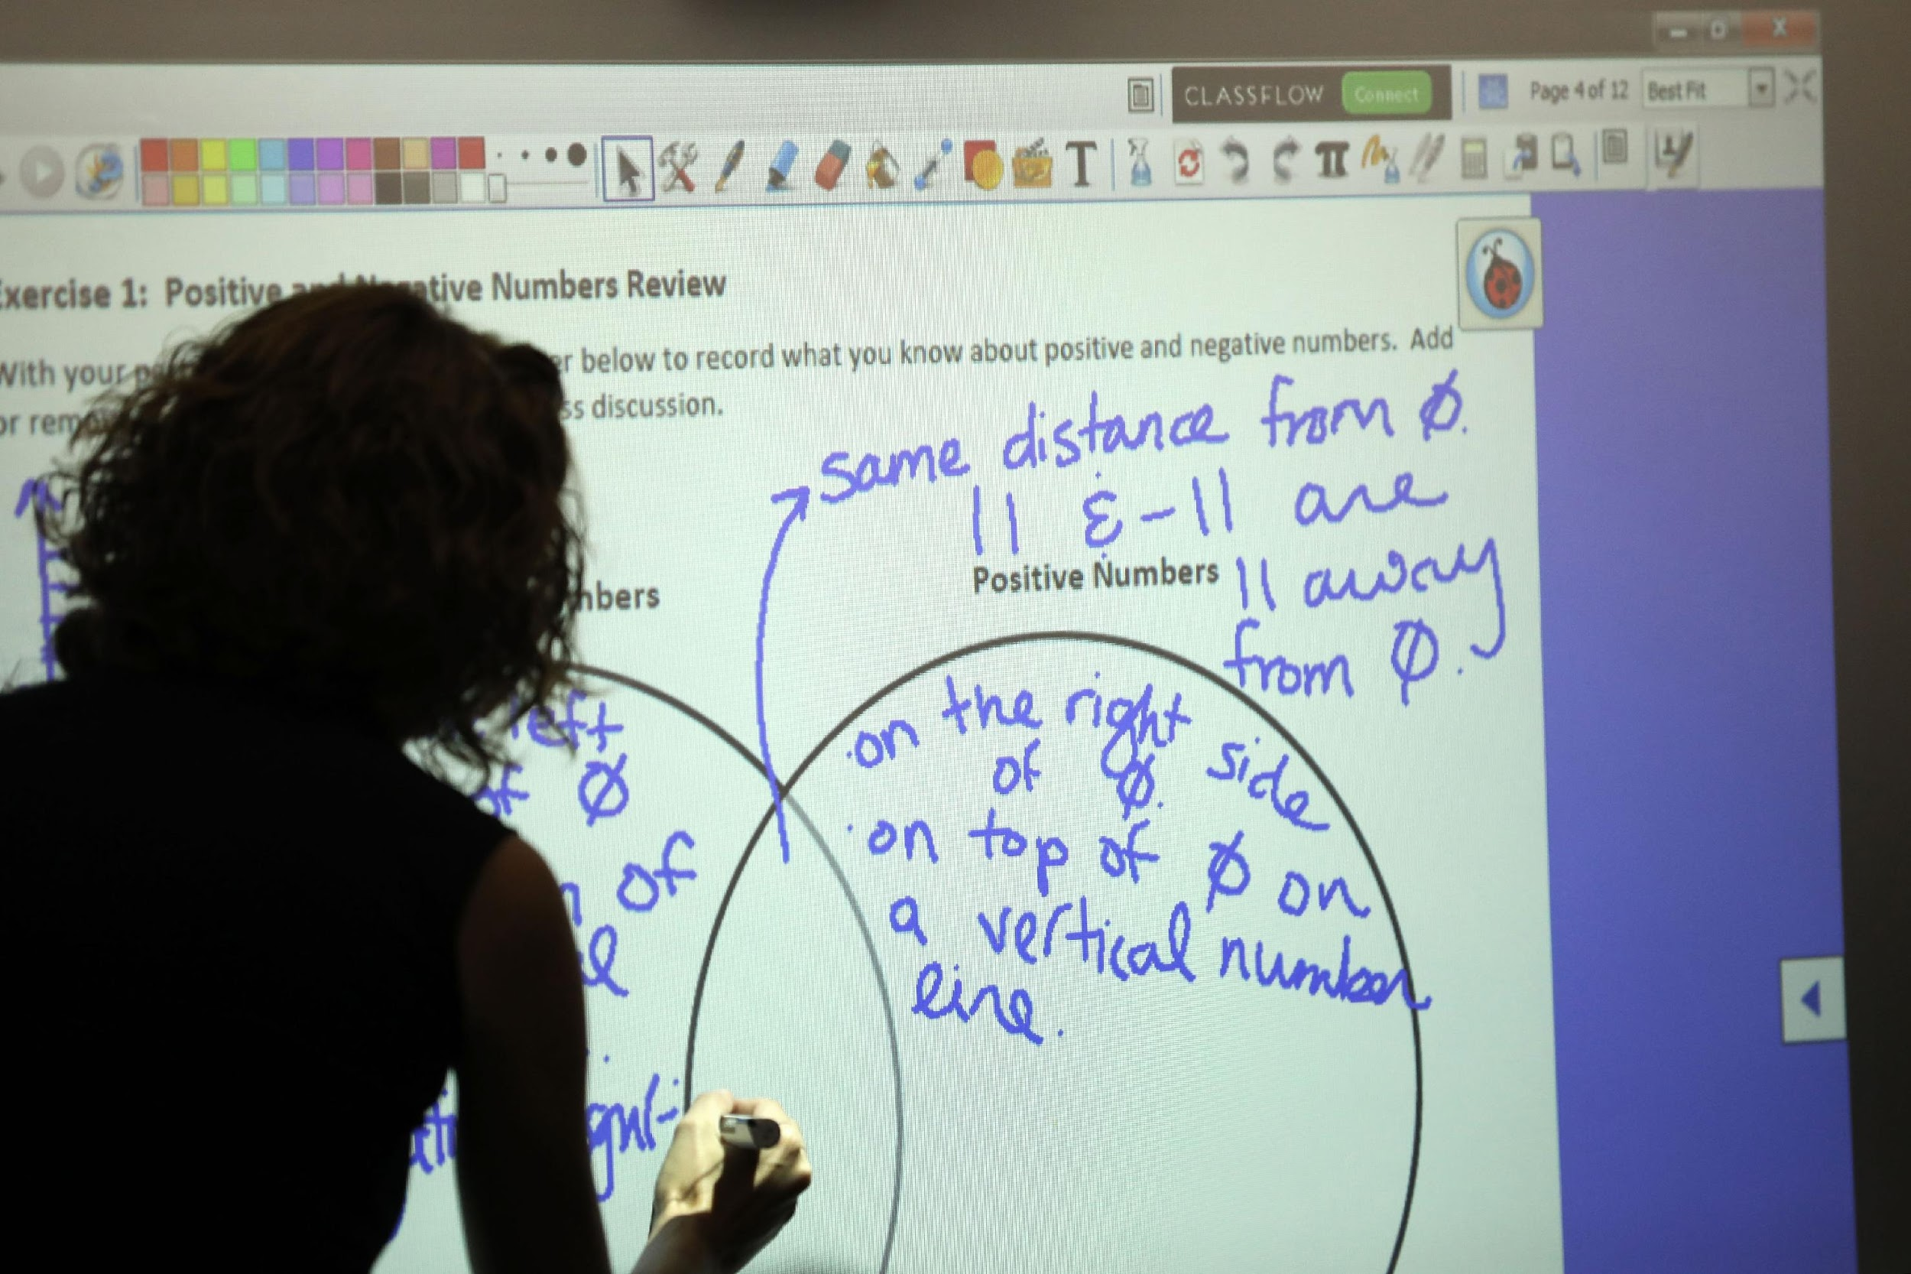
What process was used to create the MLRs?
The collaborative EL expert and math content specialists:
1. Created a Framework
2. Developed Design Principles
3. Crafted Routines

Slide 14
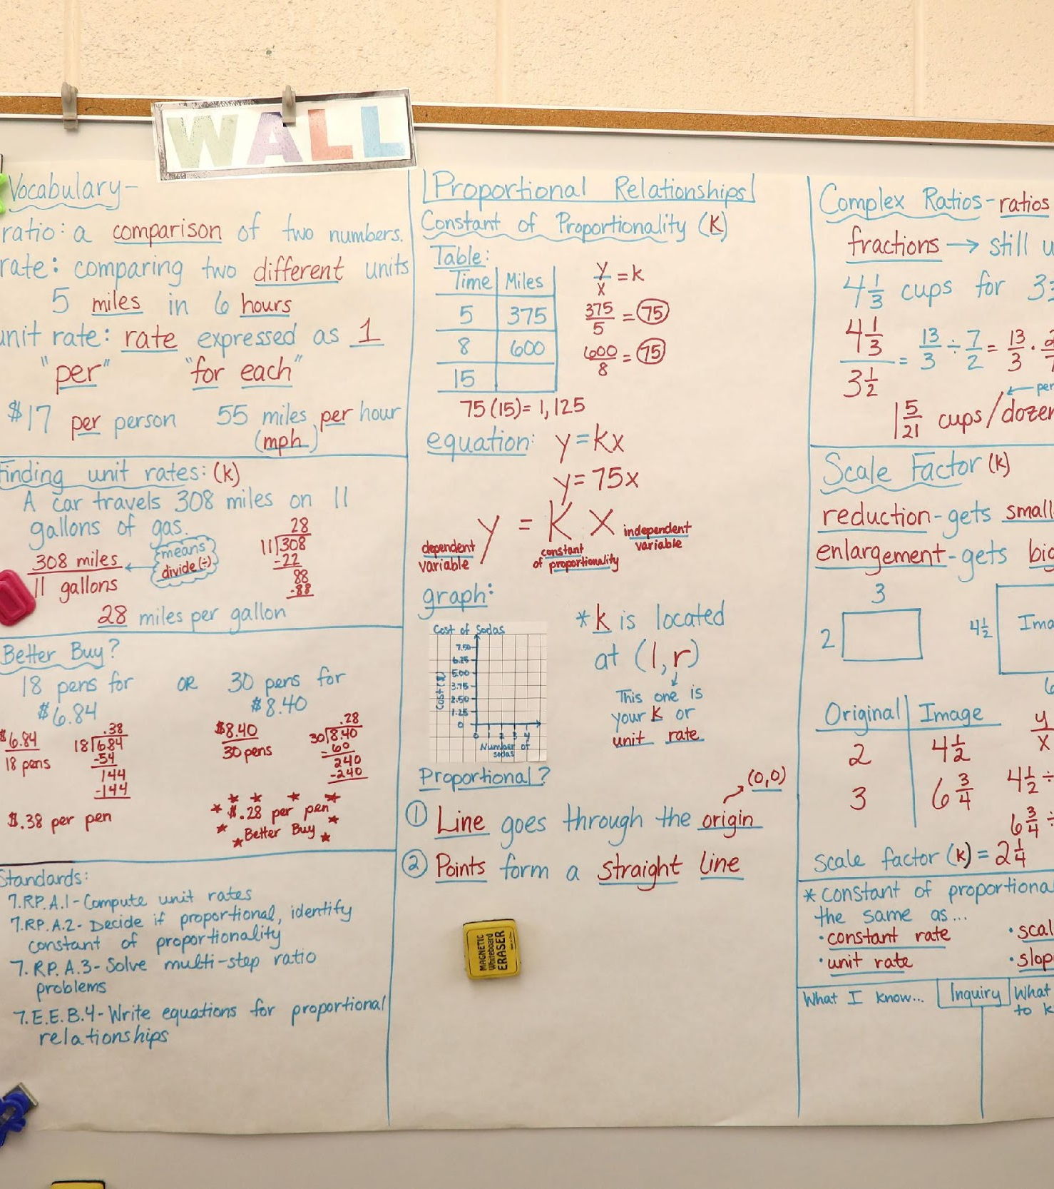
What process is used to embed the MLRs?
Unit Analysis
What is the main math content of the unit?
What are the language demands (implicit/explicit) of the unit?
What supports are in place to develop language? Where are opportunities to develop language?
Does the language routine directly support content? Can it be used for other math topics?

Slide 15
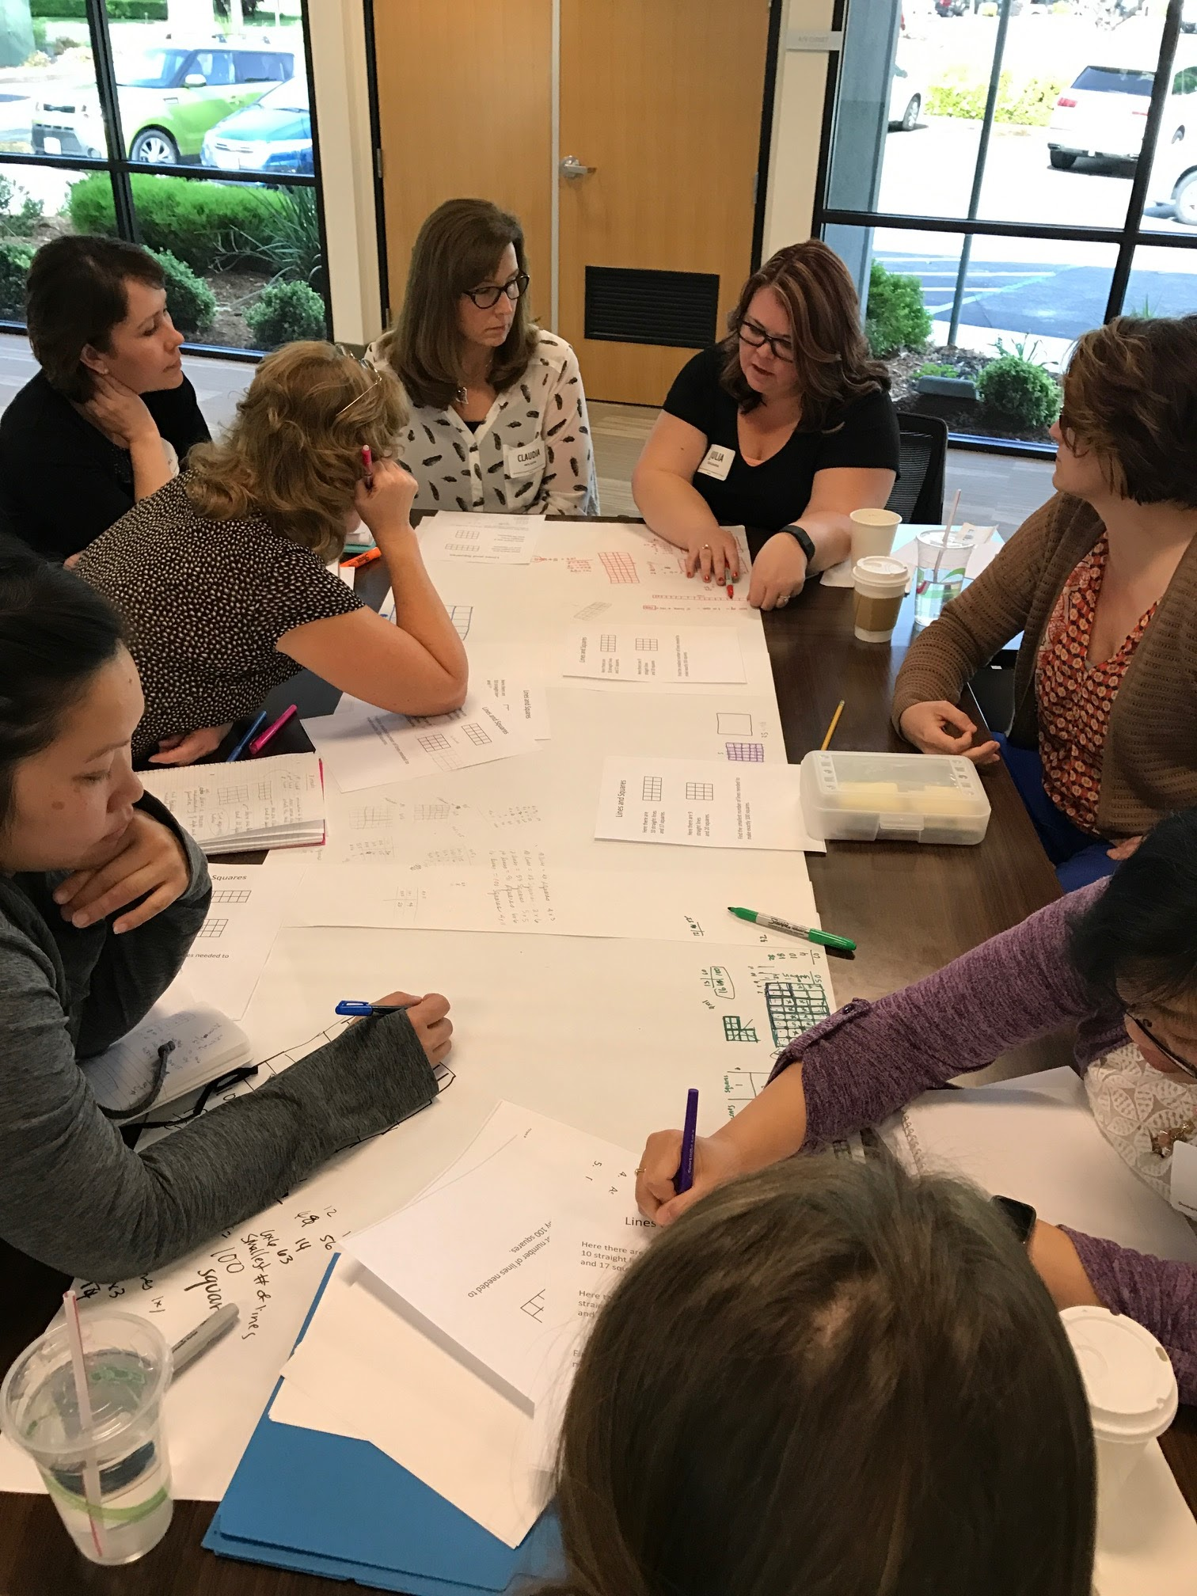
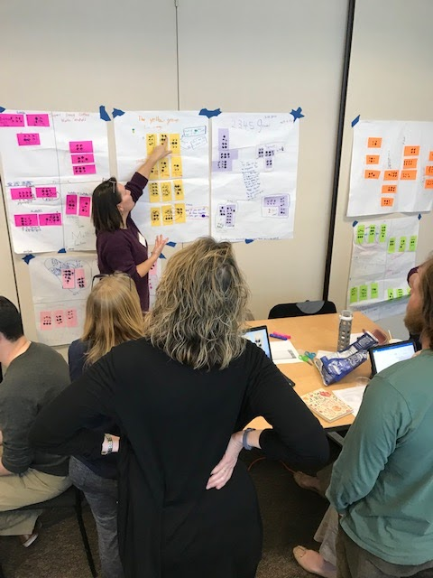
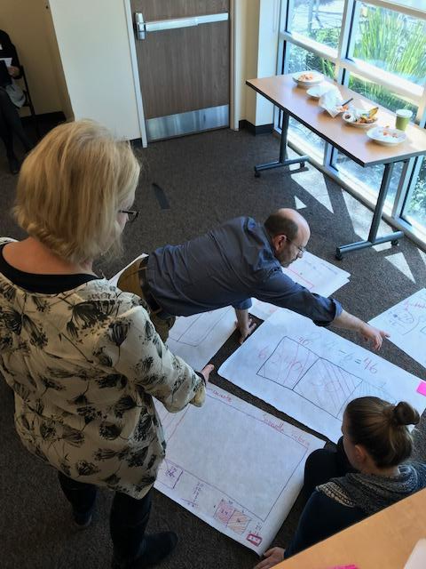
MLRs in Professional Learning
An example in California County Offices of Education
Day 1 - Learn about MLRs and plan for class implementation
Day 2 – Bring classroom artifacts and analyze student language

Slide 16
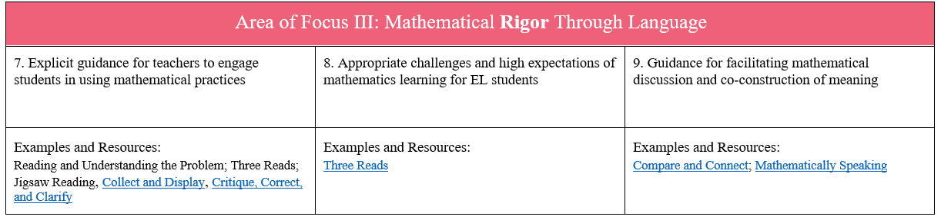
How have they been used by content developers?
As part of ELSF review process, content developers are starting to incorporate the Math Language Routines into unit architecture.
Excerpt from ELSF Math Guidelines

Slide 17
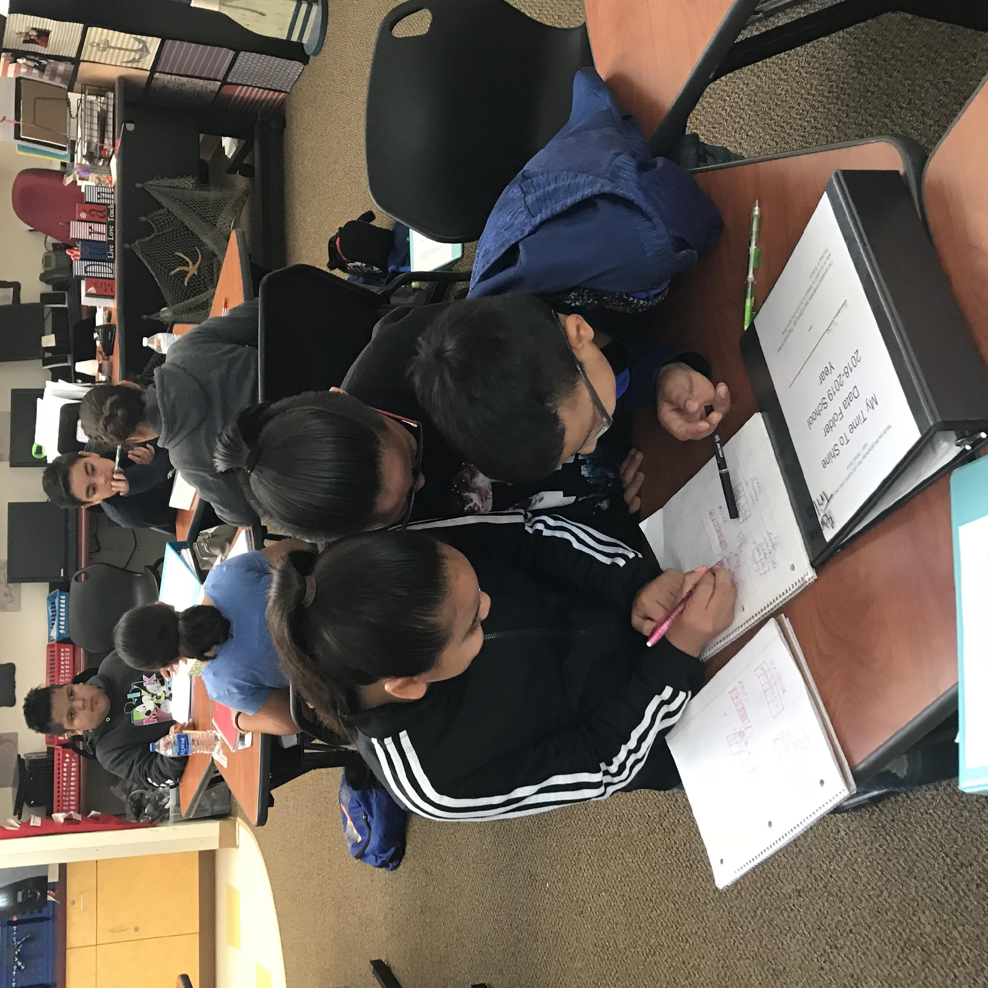
MLRs contributing to the national conversations about supporting English Learners
It is possible to design curriculum with English language variability and proficiencies in mind, not as an afterthought.
Disciplinary language support and development helps all learners, including English learners
Training, tools, resources are readily available to build capacity for content developers, curriculum designers and other educators

Slide 18
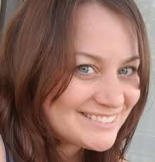
Anne Agostinelli
Middle School Math Teacher
Chicago, Illinois
@anneagost

Slide 19
Section 2: Stronger and Clearer

Slide 20

Stronger and Clearer Each Time
Purpose:
To provide a structured and interactive opportunity for students to revise and refine both their ideas and their verbal and written output (Zwiers, 2014).

Slide 21



Stronger and Clearer Each Time
Initial Draft
Rounds of Collaboration and Notes
Revised Draft

Slide 22
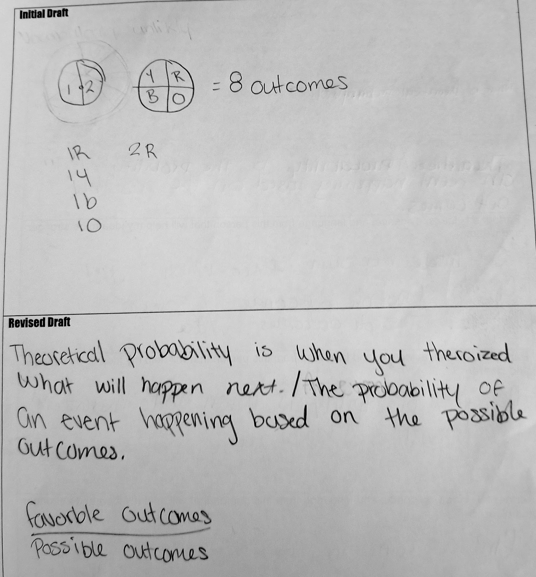
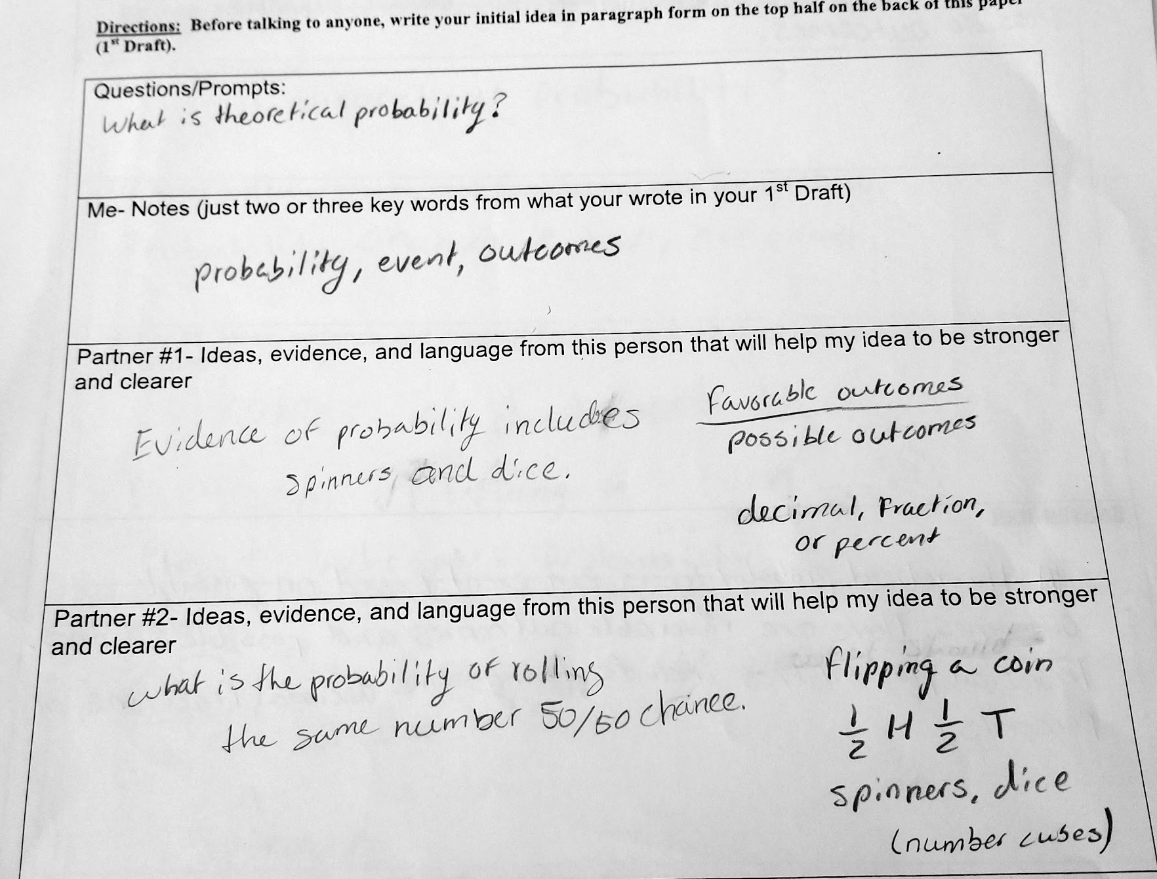
Stronger and Clearer Each Time
Example 1a: Vocabulary

Slide 23
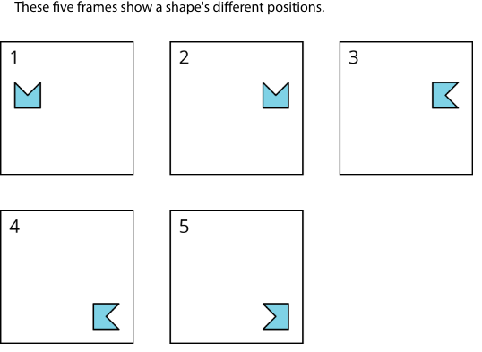
Stronger and Clearer Each Time
Example 1b: Vocabulary
Problem from IM Grade 8 curriculum
https://im.kendallhunt.com/MS/students/3/1/1/practice.html

Slide 24
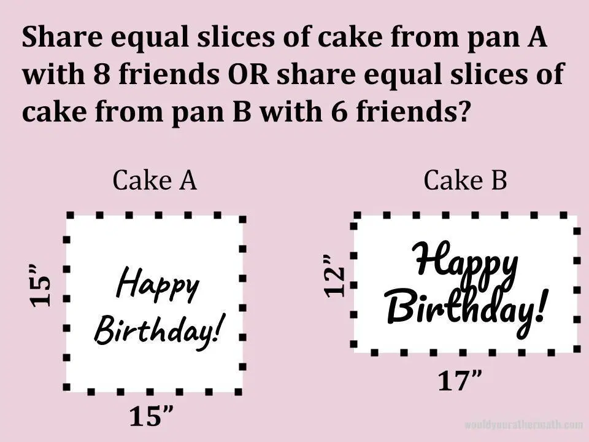
Stronger and Clearer Each Time
Example 2: Problem Solving
Problem from Would You Rather Math
https://www.wouldyourathermath.com/birthday-cake/

Slide 25
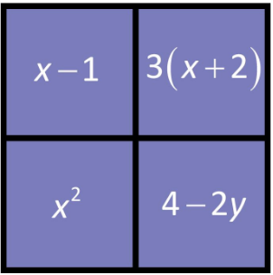
Stronger and Clearer Each Time
Example 3: Introducing an Instructional Routine
Find a reason why each expression doesn’t belong.
Image from Jon James Treby via
http://wodb.ca/numbers.html

Slide 26
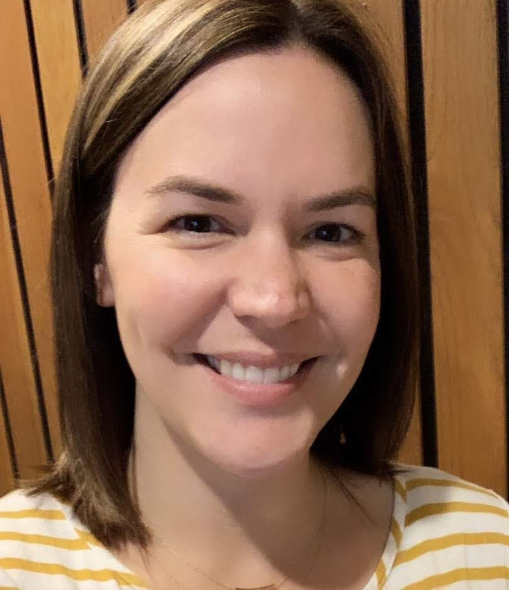
Chrissy Newell
Math Project Coordinator
Stanislaus County Office of Education
Turlock, CA

Slide 27
Section 3: Information Gap

Slide 28

Information Gap
Purpose: To create a need for students to communicate.
Image: cooperativelearner.com

Slide 29


Information Gap
Cultivate
Conversation
Optimize
Output
Source: UL/SCALE, Stanford

Slide 30

Information Gap in early 4th Grade
4.OA.3 Solve multistep word problems posed with whole numbers and having whole number answers using the four operations…
Image from: cooperativelearner.com
Cam sorts all his lego wheels into three piles: small, medium and large. He has 4 small wheels, 12 medium wheels and 8 large wheels.
If Cam uses half of his wheels to build motorcycles and half of his wheels to build cars, how many vehicles does he build with all his wheels?
Image from: cooperativelearner.com

Slide 31
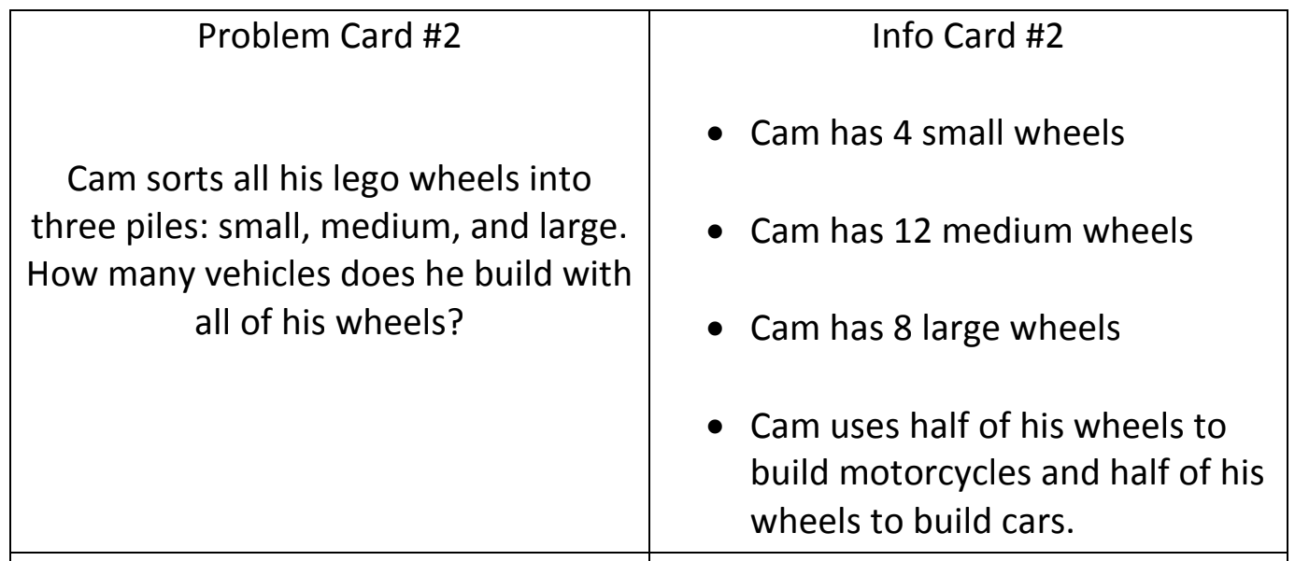
Information Gap

Slide 32
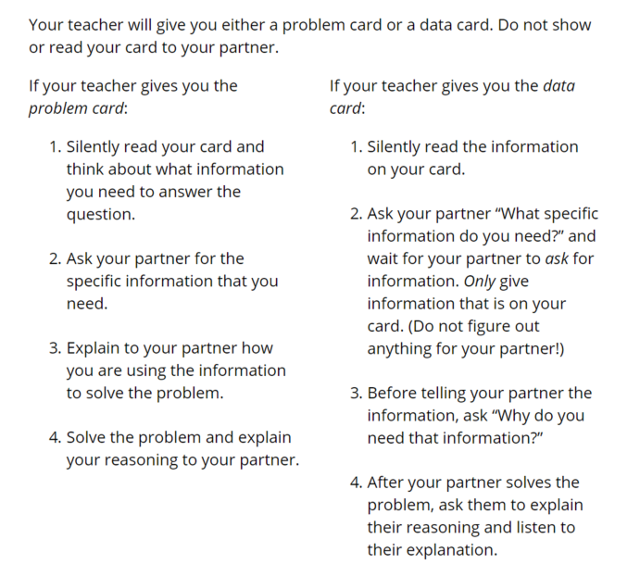
Source: Illustrative Mathematics 6-8 Math

Slide 33
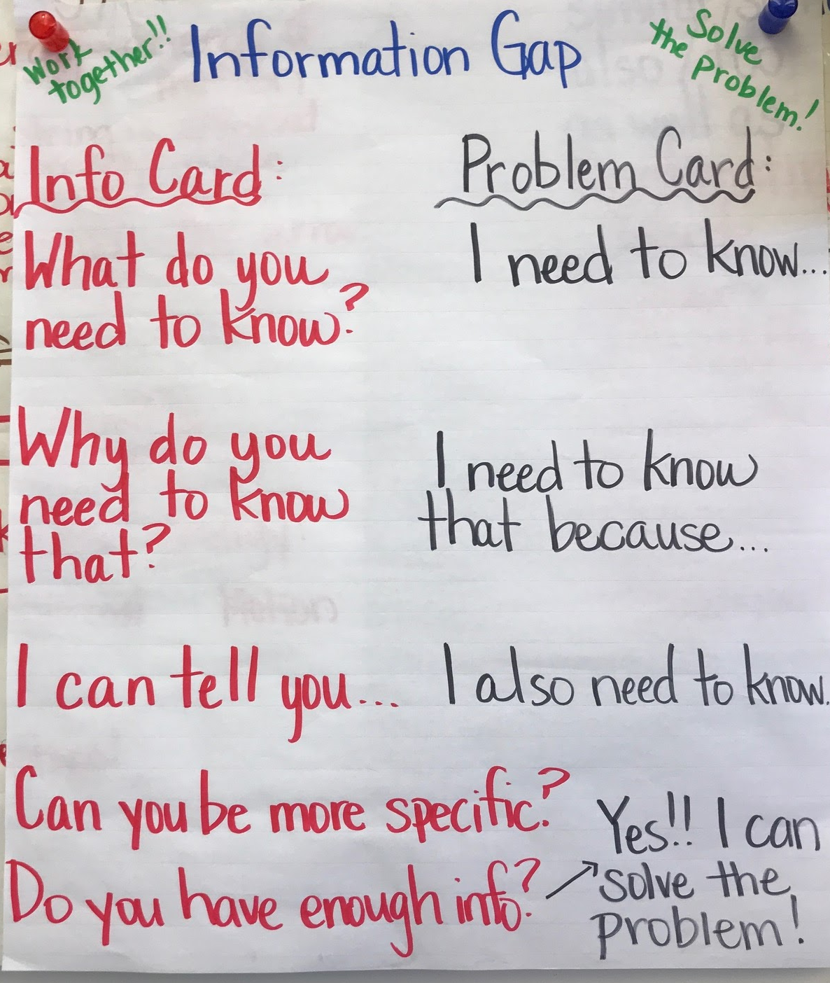
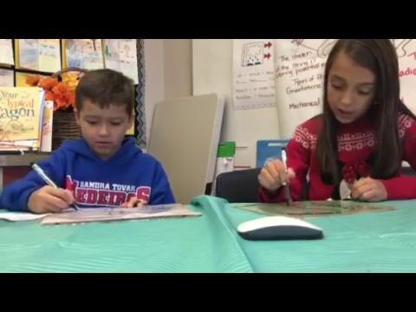
Information Gap
Source: Mandie Avila, 4th grade teacher

Slide 34
Poll:
I am most likely to ask questions when I...
… am trying to solve a problem
… feel like I’m missing information
… am curious about something
… don’t fully understanding something
… disagree with a statement or position
Tweet me!
@MrsNewell22
.

Slide 35
How might you use Information Gap
to build language and collaboration?
Answer in the Group Chat!
Tweet me!
@MrsNewell22
.

Slide 36
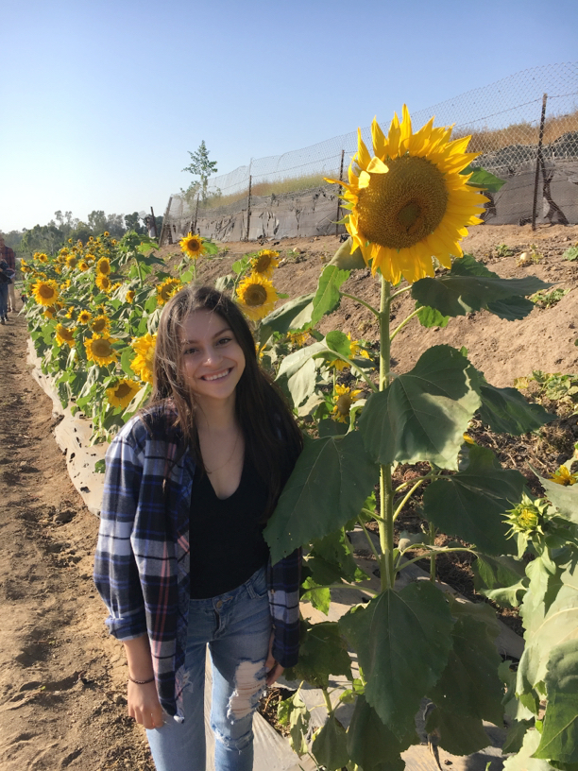
Karina Calderón
Two Way Immersion
Fifth Grade Teacher
Lake Forest, CA

Slide 37
Section 4: Collect and Display

Slide 38


Collect and Display
Purpose: To capture students’ oral words and phrases into a stable, collective reference.
Zwiers, J., Dieckmann, J., Rutherford-Quach, S., Daro, V., Skarin, R., Weiss, S., & Malamut, J. (2017). Principles for the Design of Mathematics Curricula:
Promoting Language and Content Development.

Slide 39
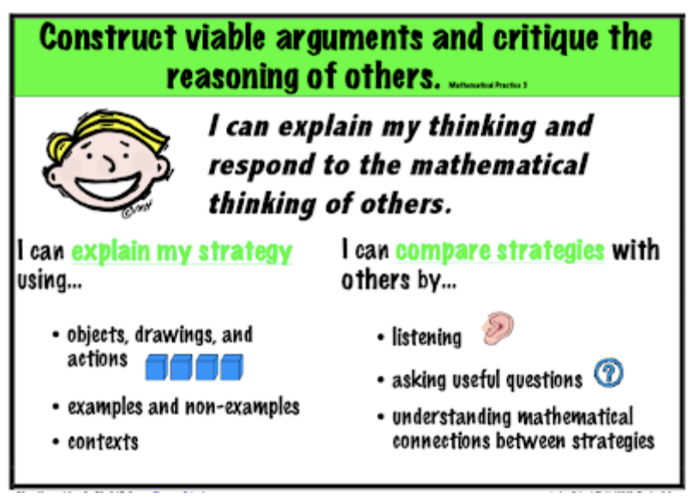
Collect and Display
Notes:
The reason I have used the routine of collect and display is to promote student agency and voice in my classroom. I want my students to feel like their voice and their thinking is valuable for others. By establishing this routine in my classroom, students feel valued in their ideas and thinking.
This routine also aligns wonderfully with the mathematical practice 3 and cultivates a classroom where student talk is valued.

Slide 40
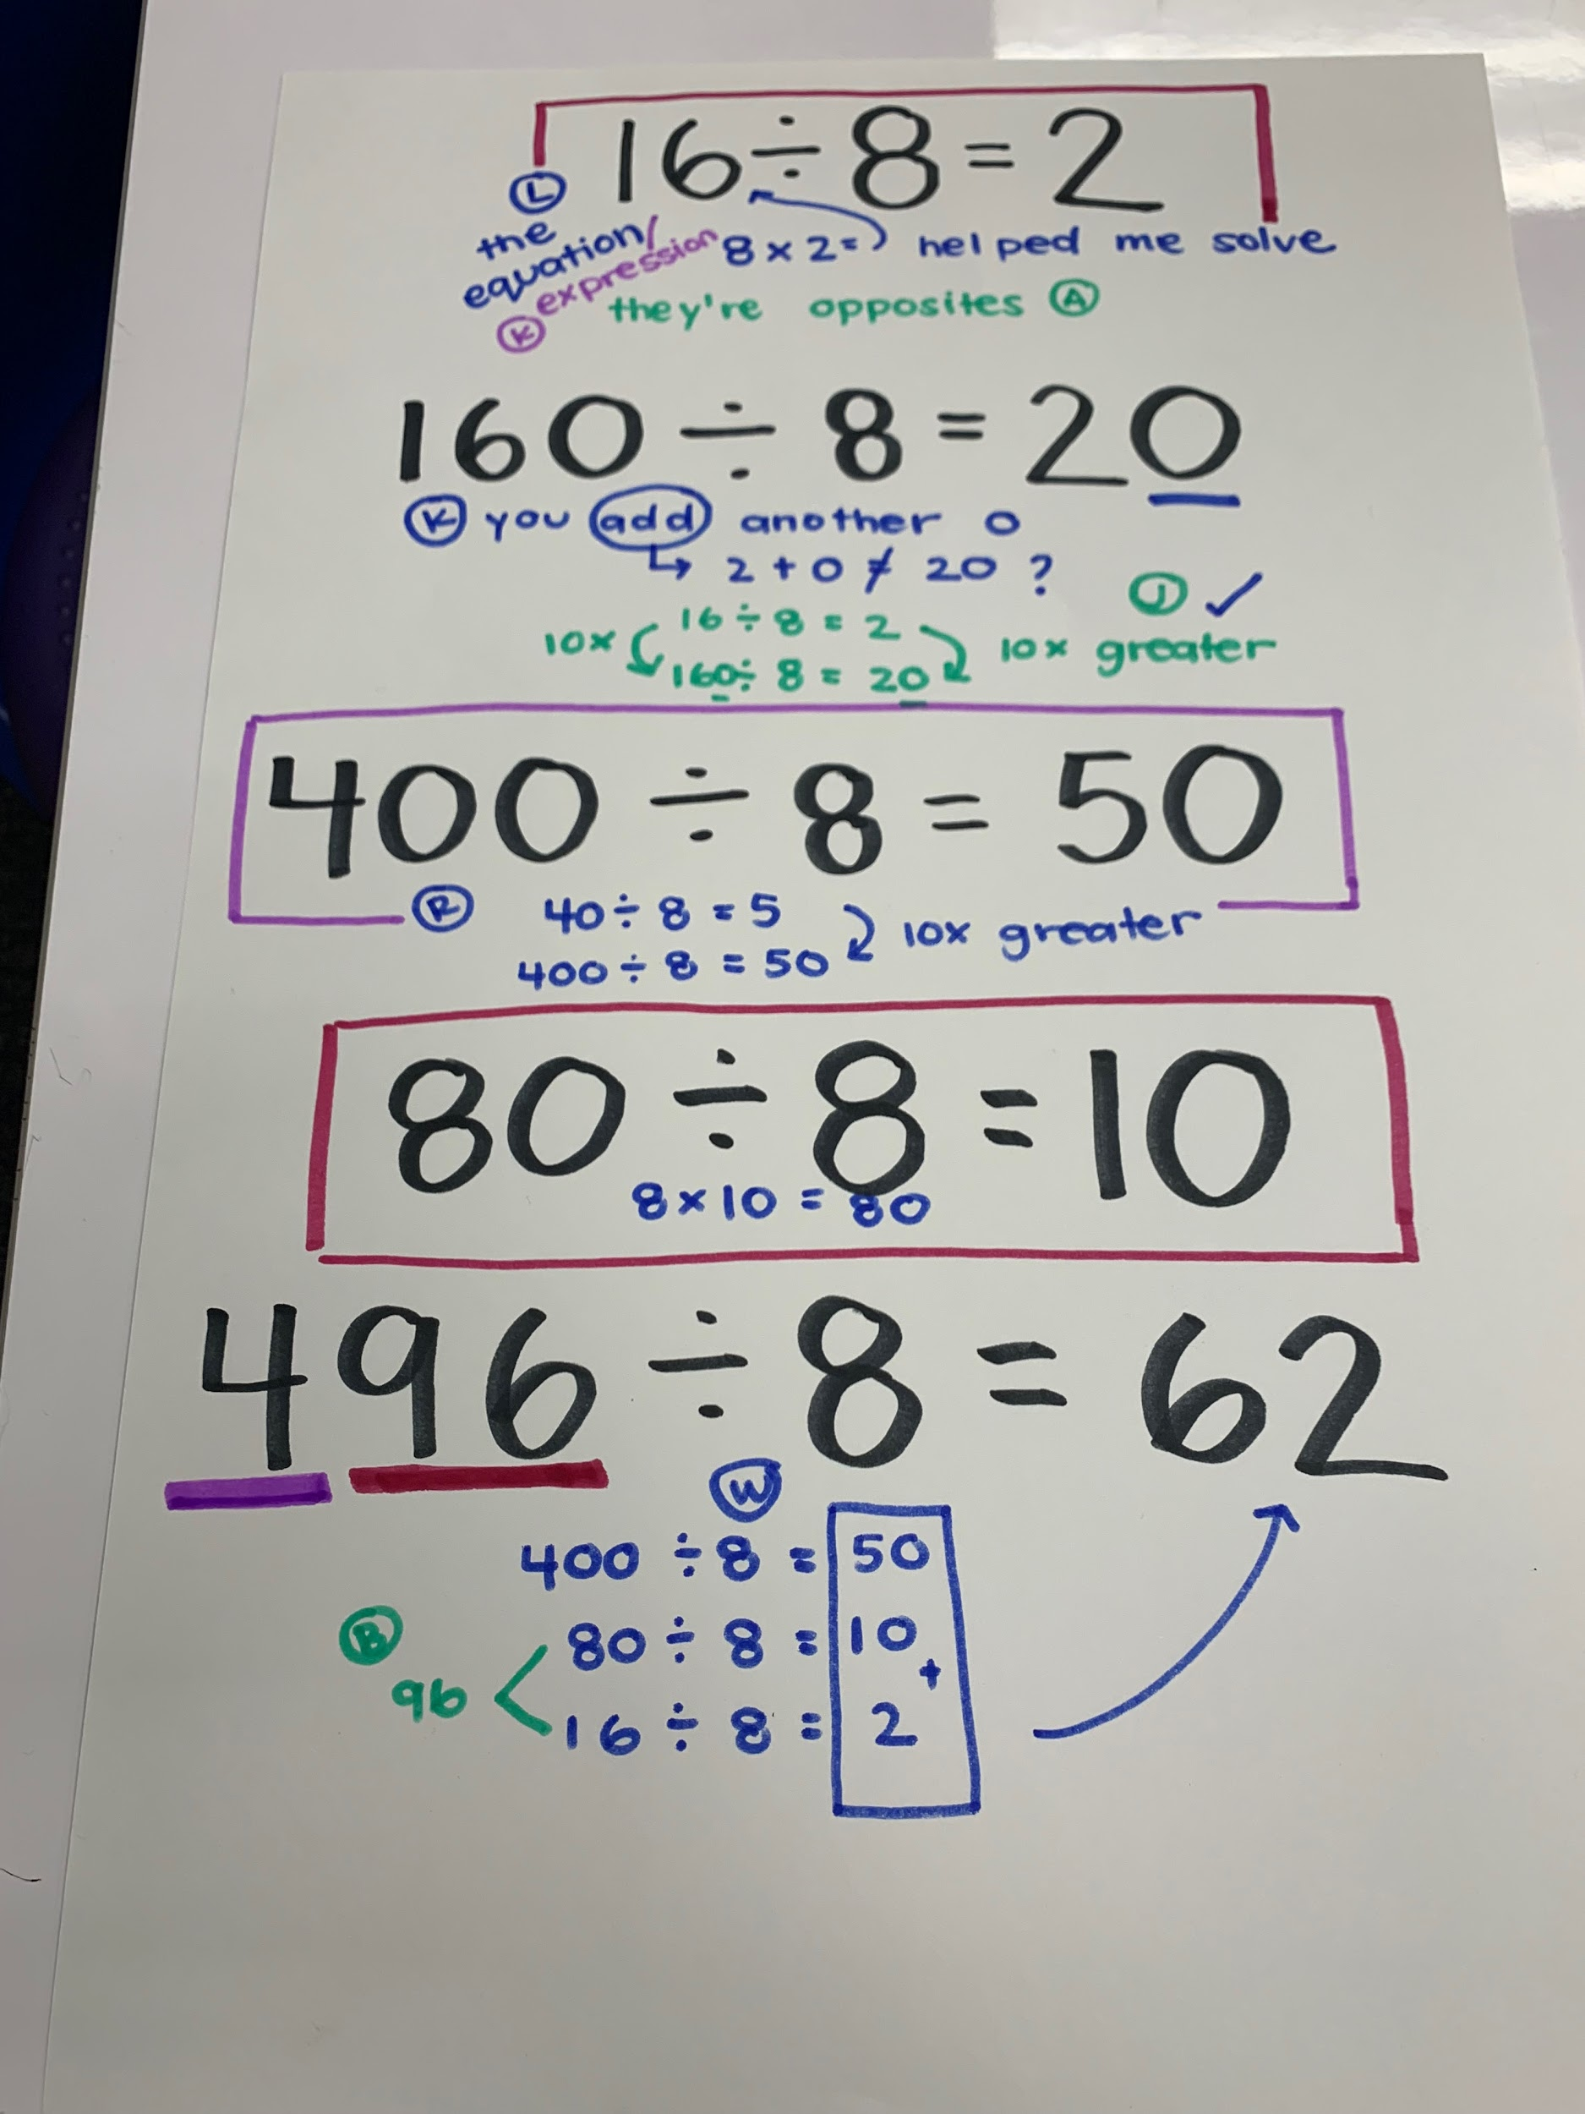
Collect and Display

Slide 41
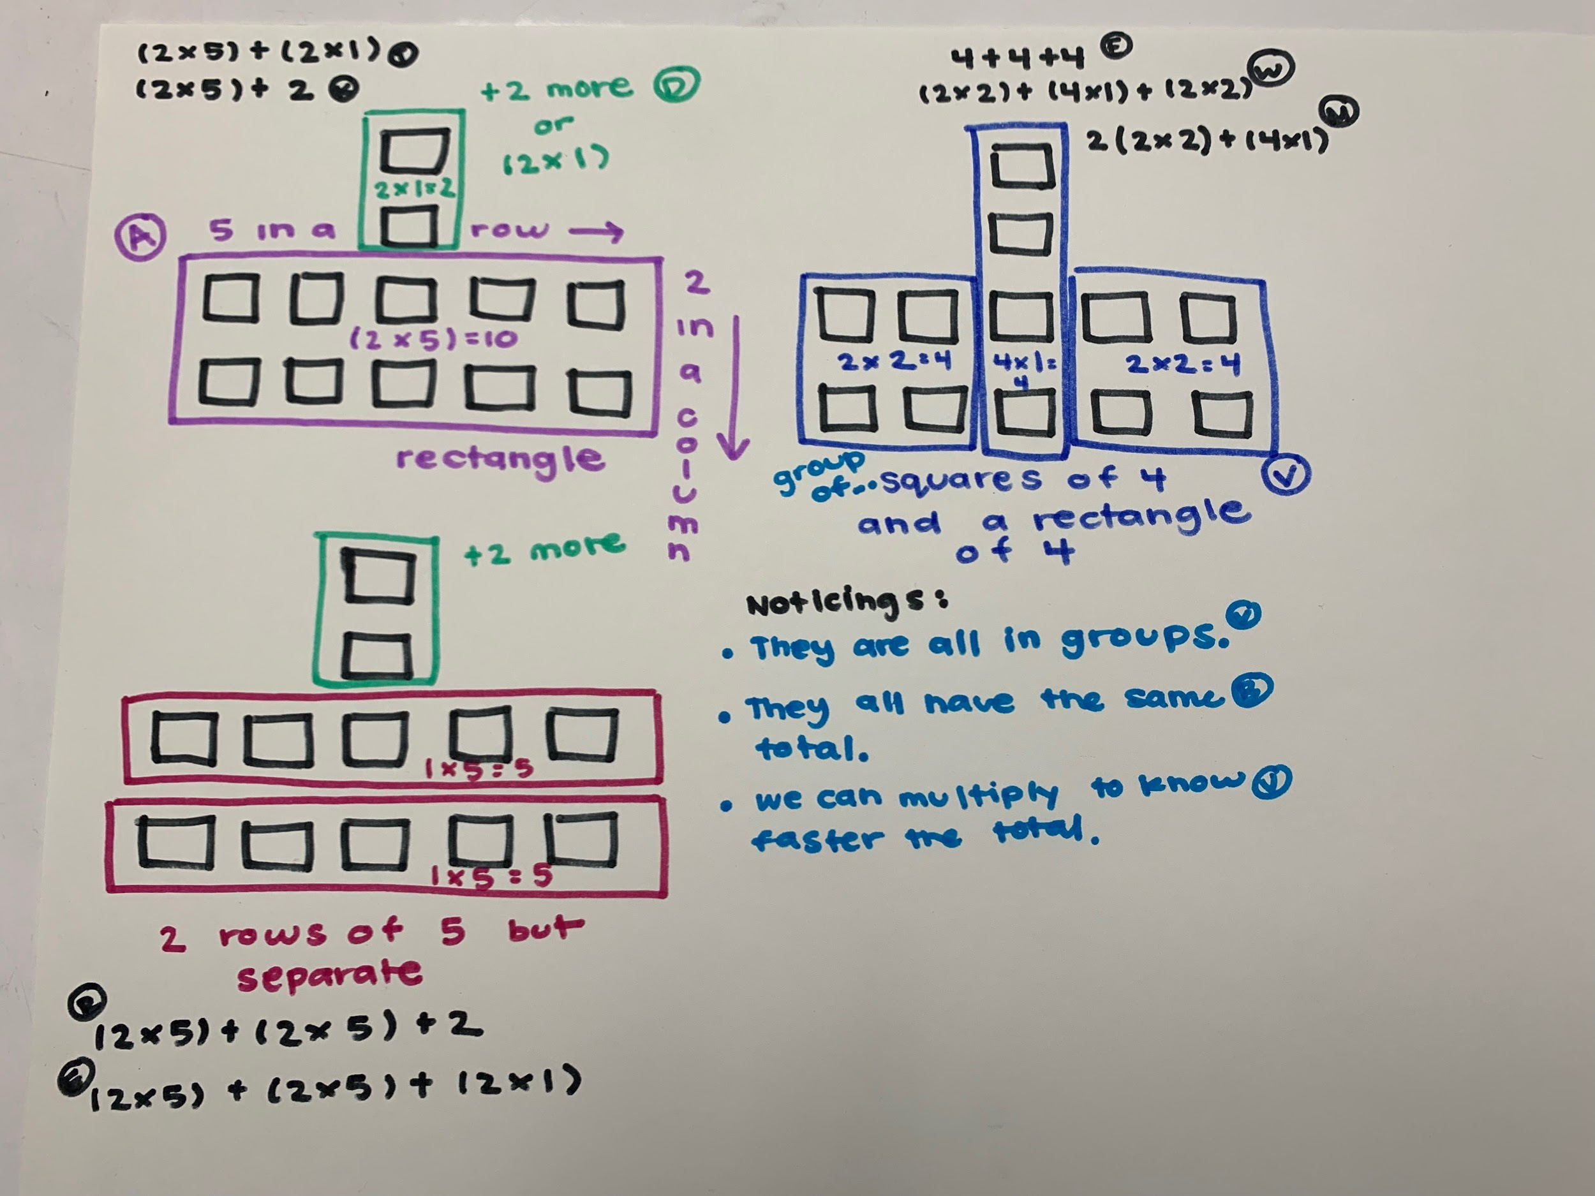
Collect and Display

Slide 42
Questions for Our Guests?

Slide 43
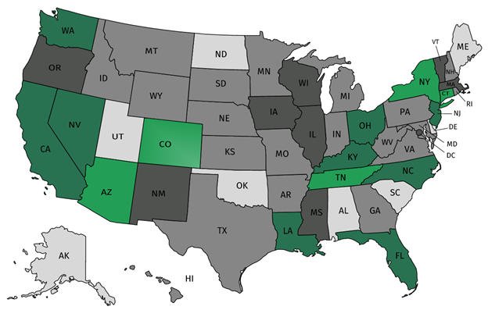
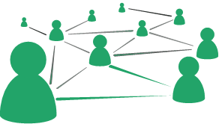



Join our network!
Join a national network of educators
Connect with state networks
Be a part of creating new tools and resources in partnership with SAP
Keep up to date on free resources, upcoming SAP webinars/professional learning opportunities, job postings and more!

Slide 44





Please Join Us!
https://achievethecore.org/ca-signup
Twitter: twitter.com/achievethecore
Facebook: facebook.com/achievethecore
Pinterest: pinterest.com/achievethecore

Slide 45
Please Join Us Again Next Month!
Next month’s webinar:
Supporting Excellent and Equitable Foundational Skills Instruction with the Foundational Skills Observation Tool
November 6, 2019, 7PM ET
Register Here:
https://event.on24.com/wcc/r/2103305/4C721C37341A48B1CED88EF5A6CA114D

Slide 46
Thank You!

