Slide 1
Supporting Excellent and Equitable Foundational Skills Instruction with the Foundational Skills Observation Tool
Core Advocates Monthly Webinar
November 6, 2019
The webinar will begin shortly.
Check your Resource widget to preview the resources for today’s session! Use the Group Chat to introduce yourself!

Slide 2
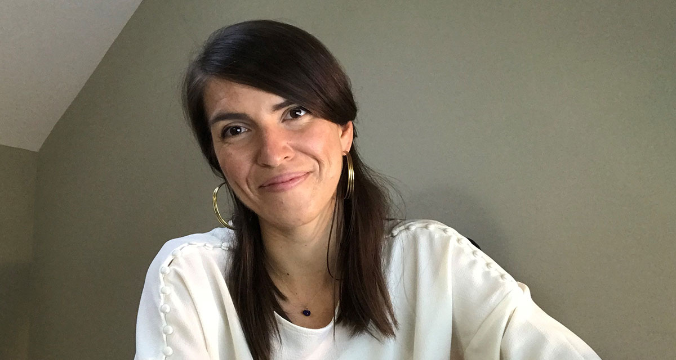
Introductions
Your hosts from Student Achievement Partners:
Pascale Joseph Project Coordinator,
Tools and Classroom Resources
This month’s guests:
Tori Filler ELA/Literacy Specialist
Professional Learning Team, SAP
Dr. LaShanda Simmons Fason Senior Manager for Early Literacy
Shelby County Schools, TN

Slide 3
How many Core Advocate Webinars have you attended?
Please use the Questions tab on your control panel to respond.
If using a poll, please put up to 5 answer choices in the notes section below and indicate if attendees should choose only one response or multiple responses.

Slide 4
Join Our Network!
www.achievethecore.org/ca-signup

Slide 5
POLL 1 RESULTS

Slide 6
Learn More About Us!
Contact Jennie Beltramini (jbeltramini@studentsachieve.net )
Complete this survey to join our database (and mailing list): www.achievethecore.org/ca-signup
Visit our website: www.achievethecore.org

Slide 7
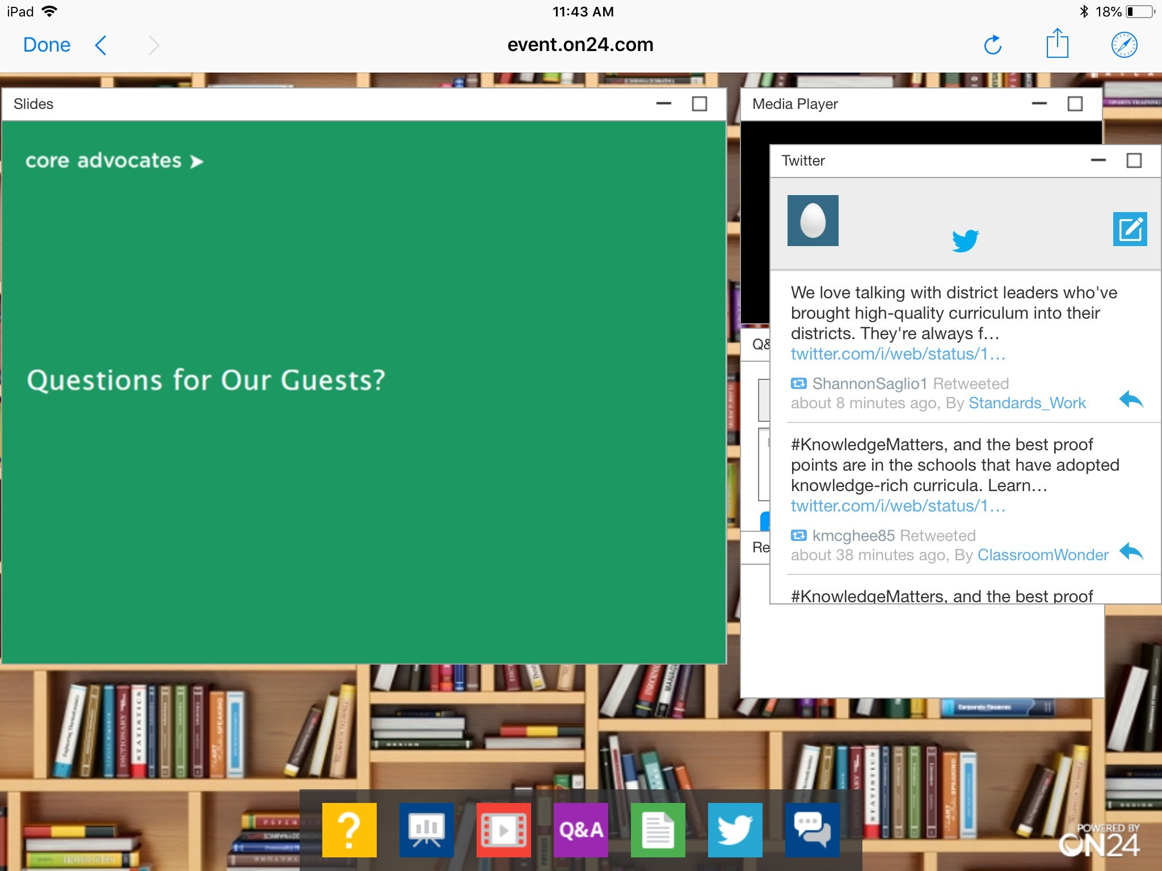
Tweet with Us!
Please feel free to tweet during and after the webinar using #coreadvocates
@achievethecore
Click here!

Slide 8
Engage with Us!
During the webinar:
Question just for the presenters/ tech help
Resources
Group chat
After the webinar:
– Access to recording will be emailed to you.
Take our survey in 2 weeks and receive a certificate verifying 1 hour of professional learning.

Slide 9
Goals of the Webinar
Describe the structure and goals of the Foundational Skills Observation Tool
Practice using the Foundational Skills Observation Tool to observe a lesson by providing low inference evidence for selected indicators
Identify how you could use the Foundational Skills Observation Tool in your setting

Slide 10
What is the Foundational Skills Observation Tool?

Slide 11
Explicit teaching of alphabetic decoding skills is
helpful for all children,
harmful for none,
and crucial for some.
Snow & Juel (2005)
Notes:
Big Idea: Setting the stage for the work.
Notes:
“Necessary but not sufficient” comes from the Common Core State Standards. Mastering foundational skills is necessary but not ALL that we need to do for our youngest readers. But, we also cannot forget about all of the work we talked about with the Shifts: regular access to complex text through read aloud, text-first instruction with questions/tasks that require evidence, and building knowledge through content-rich texts.
Snow and Juel remind us that YES some children do learn to read without explicit phonics instruction, BUT that this instruction is helpful for everyone (think spelling and facilitating the process more quickly than kids figuring it out on their own) and is essential for some students who will not learn to read without it. Unfortunately, as reading expert Tim Shanahan reminds us (more below), we cannot know until too late who this instruction is essential for. This is like a vaccine for early reading.
More for facilitators:
https://shanahanonliteracy.com/blog/more-on-the-pbs-news-hour-dyslexia-segment
But let’s be perfectly honest. There have been entire generations that have learned to read English without phonics instruction. Research studies show that kids who have been taught little more than word memorization have learned to read. Let’s be careful with our language and circumscribed in our claims. To do this it can help to distinguish phonics, which is a type of instruction, and decoding (which is the ability to read words based on the spellings). Learning to decode is an essential of reading. If you don’t learn to decode, you won’t learn to read. (There is more to reading than decoding, so decoding is an essential, but not sufficient condition for reading). Phonics instruction can help kids to figure out how to decode. As such phonics is helpful, but not necessary. That is, it is possible to figure out decoding without explicit instruction in phonics. Phonics helps many kids to figure out decoding earlier and easier than would be the case without it, and there are kids who would never figure it out without that help (like those kids on PBS). For them, phonics is truly essential. That sounds pretty straightforward. Some kids need phonics instruction, and some can get by without it. So, all that teachers need to do is identify who will benefit from what and then provide such teaching. But that’s the crux of the problem. We have no way of sorting out ahead of time who needs phonics, who would gain some benefit, and who would do fine without it. This is similar to the issues of vaccination. We don’t know which kids are going to be exposed to polio and who is susceptible to it, so we vaccinate everyone.

Slide 12
Poll 1: Do you currently use an observation tool to support foundational skills?
Instructional Practice Guide
Foundational Skills Observation Tool
District or state created tool
Curriculum-based tool
Do not currently use a tool / other

Slide 13
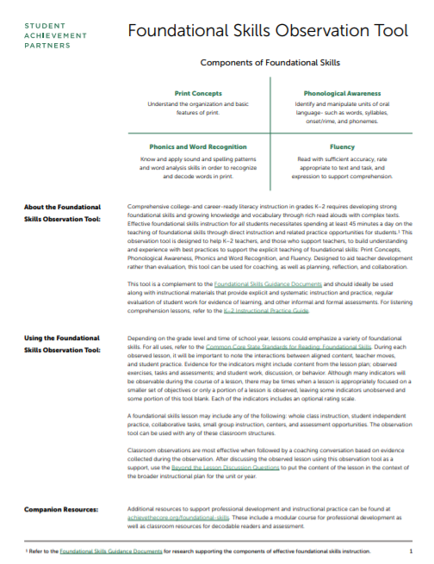
Introducing (or Re-Introducing) the Foundational Skills Observation Tool
Open the Foundational Skills Observation Tool from the Resource widget:
Foundational Skills Observation Tool
New to the tool?
Listen in as we give you an overview!
Familiar with the FSOT?
Take a look through the tool for updated changes

Slide 14
POLL 1 RESULTS

Slide 15
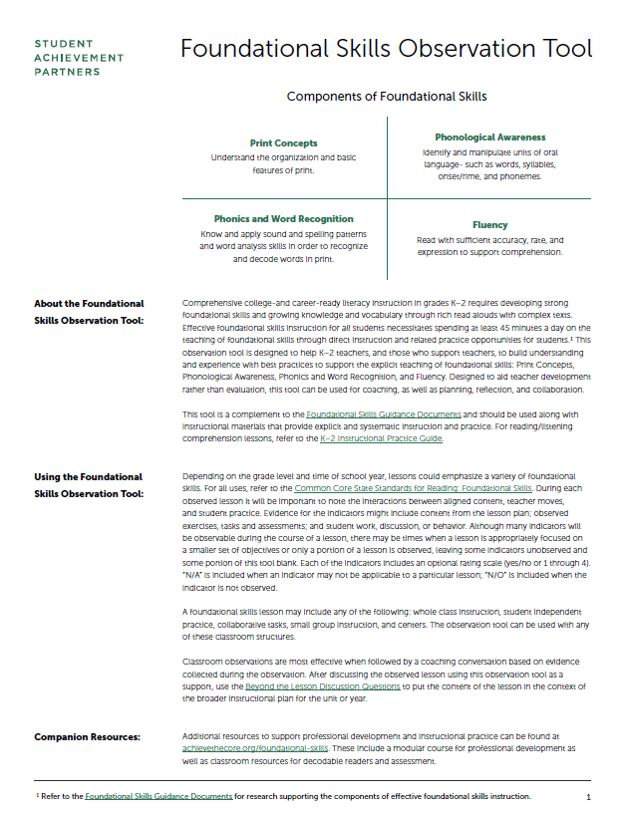
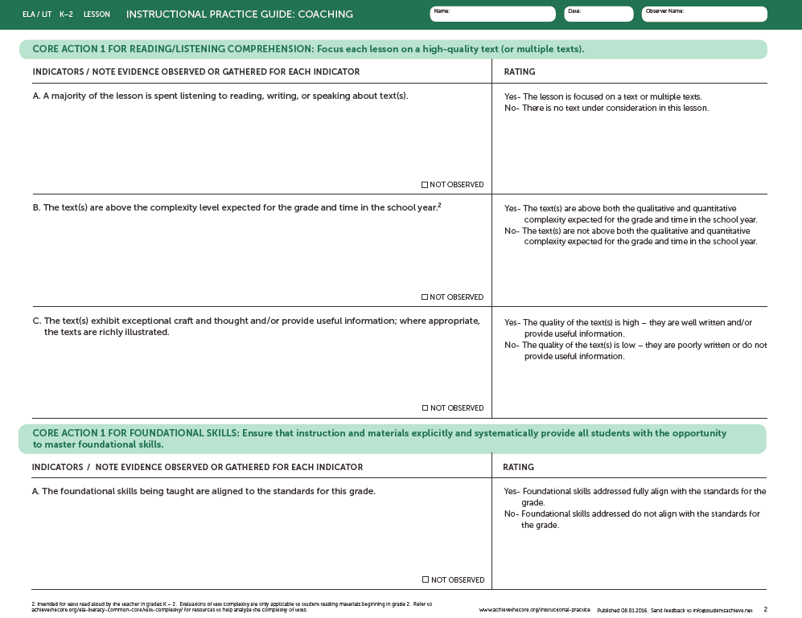
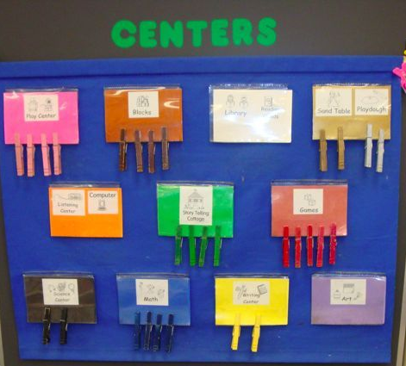
Student Achievement Partners Observation Tools for K-2
Instructional Practice Guide
Foundational Skills Observation Tool
Notes:
So now here with two tools - the updated version of the K-2 IPT for Reading/Listening Comprehension and the Foundational Skills Observation Tool - which is still developing!
IPG: Observing reading comprehension lessons with rich texts - often read aloud.
FS: Lessons focused on explicit direct foundational skills instruction and related practice opportunities.

Slide 16
Meet the Foundational Skills Observation Tool
Content-focused tool that can be used for coaching, planning, reflection, collaboration, professional learning
Designed for use with K-2 instruction utilizing a systematic foundational skills program
Can be used to with whole group, small group, centers, or independent tasks

Slide 17
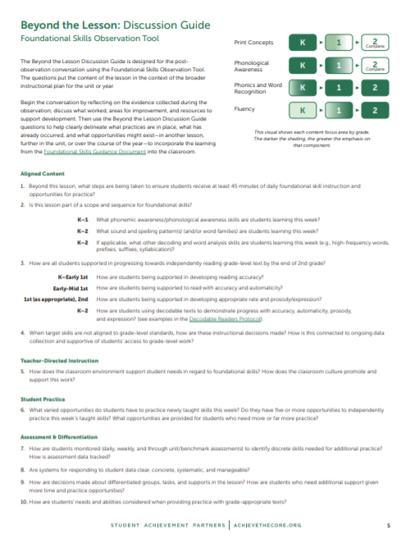
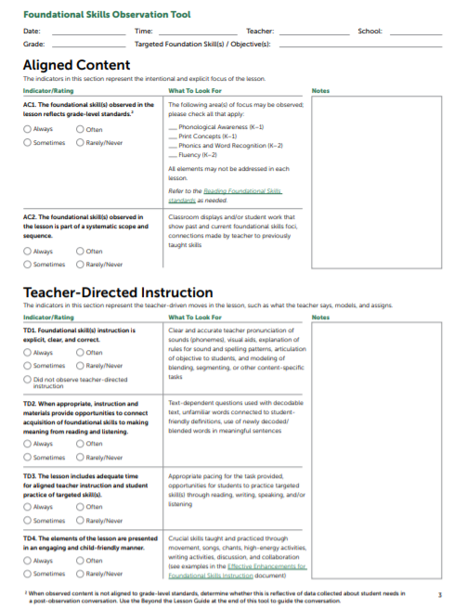
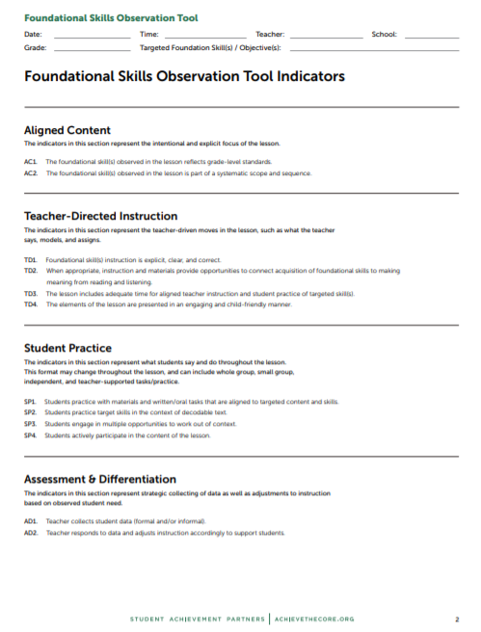
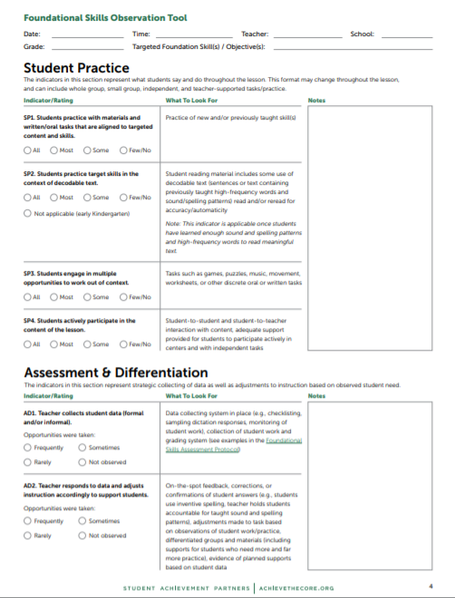
FS Observation Tool Structure
Page 1: Introduction
Page 2: All indicators 1-pager
Pages 3-4: Indicators with rating language and “What to Look for”
Page 5: Beyond the Lesson: Discussion Guide
Notes:
Note: may also want to keep new K-2 IPG 1-pager handy in case you do not know what type of instruction you might see in a K-2 classroom!

Slide 18
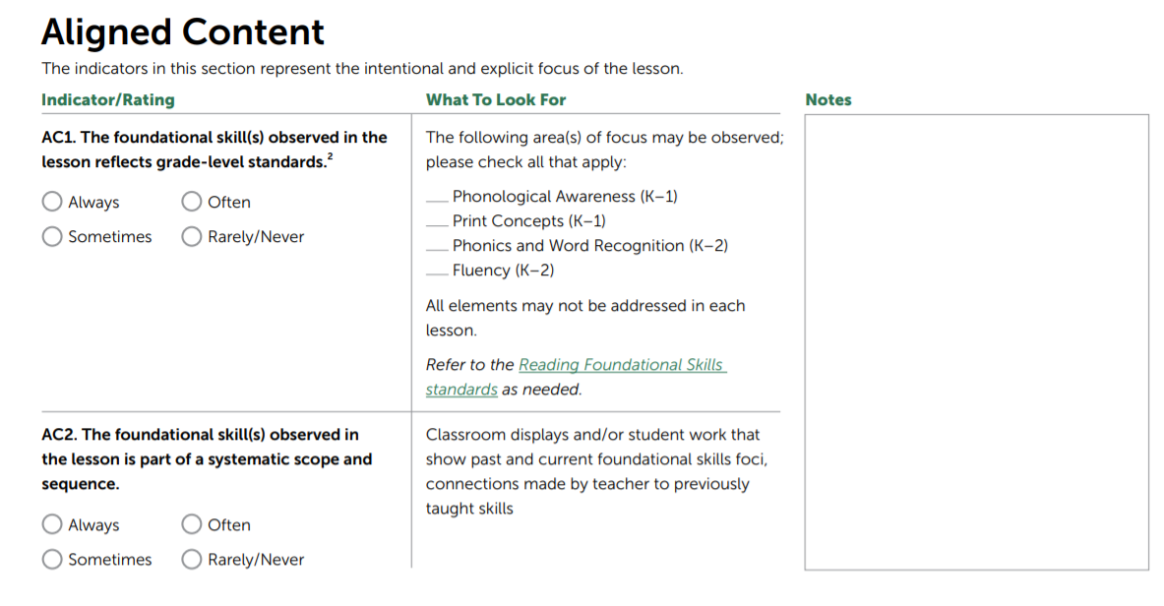
FS Observation Tool: Design
Category of indicators (lens for observation)
Evidence of indicators
Indicator
Rating
Look Fors:
-not exhaustive
-not a checklist
Companion resources
Notes:
Indicator language slightly different to reflect lack of Core Actions and differentiate from IPG.

Slide 19
What’s New in This Version?
Notes moved to the side for more room to capture evidence
Expanded ratings on many indicators
Removed numbers (not an evaluation tool)
Additional support for considering students with unfinished learning

Slide 20
Let’s Use the FSOT Together

Slide 21
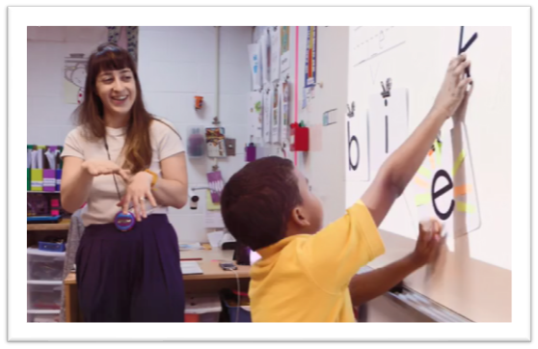
Observation Background
to this teacher!
Grade 1 - October
Materials: CKLA

Slide 22
Review The Lesson Plan
Our Observation Today
Introduce i_e
Writing i_e
Lesson Plan
Notes:
We’re not going to get a chance to see this whole lesson today, but will see a couple of sections of this lesson. The sections of the lesson we’ll get to say are the sections highlighted in blue (introducing the spelling and reading time). In this case the teacher made a choice to use whiteboards during introducing the spelling, so what you see is not exactly what will be in the lesson plan.

Slide 23
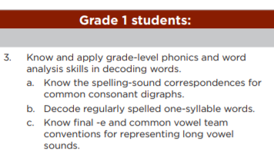
✅
Sound and Spelling Pattern Focus:
i_e
✅

Slide 24
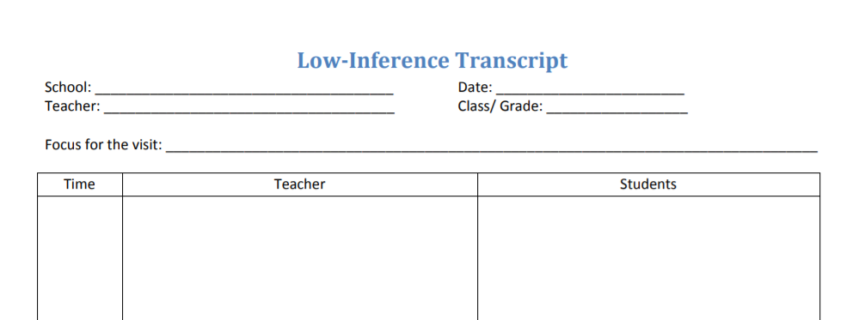
Low Inference Notes
Describe what is taking place without drawing conclusions or making value judgements.
During each observation plan to script as much as you can including:
What is the teacher doing? What are students doing?
Note tasks/materials
Best Practice for Low Inference Notes

Slide 25
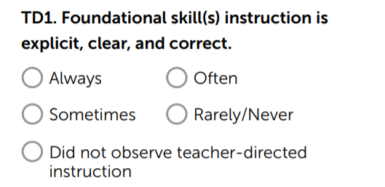
Low Inference Notes
Observe with the TD1 indicator in mind.
In a minute, we’ll ask you to vote and then chat out your evidence.

Slide 26
Poll 2:
TD1: Foundational skills instruction is clear, explicit, and correct.
Always
Often
Sometimes
Rarely/Never
Did not observe teacher-directed instruction

Slide 27
Why?
In a moment, use the Group Chat feature to chat out the low inference evidence you observed for TD1.

Slide 28
Poll 2 Results

Slide 29
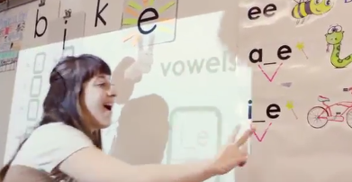
Anchor chart - ee, a_e, i_e
Teacher states lesson focus with connection to previously taught skill (a_e)
Today we're going to learn a new magic E sound, just like E makes A say its own name, it's A when they're in a team. This magic E sound is I.
Teacher models “magic e” with example word ‘bike’
Teacher: “There is an i, we leave a space for another sound, and then magic e.”
Teacher: “You'll also be seeing me do this a lot with my fingers because this i only says i when it's working as a team with magic e. Magic e makes i say its own name. So if we spell i, like this, with space for a sound in the middle and maybe a sound in the beginning.”
Teacher phoneme support /b/
Teacher: Make sure when you're saying it's not, buh. You can't actually say the real sound very loudly, the last part is a puff of air. Say "buh."
Wondering:
Clear connection to short i sound?
Notes:
Relatively new concept. Know and have reviewed short vowels. Been taught a_e this week as well.
This segment of the lesson is focused on instruction and so I’m really thinking about this piece.

Slide 30
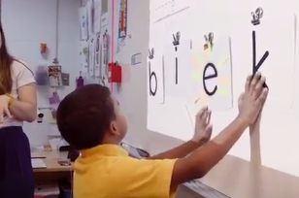
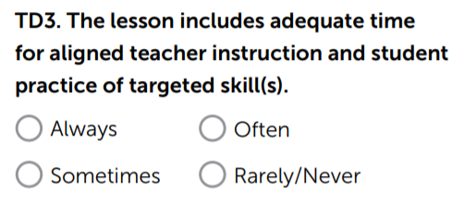
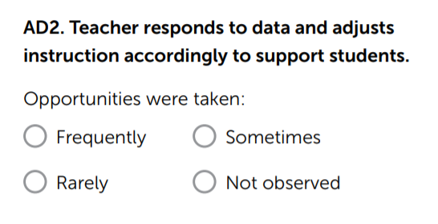
Wonderings
Chat out: What wonderings did you have about this lesson?
Wonderings:
Chart with picture cue and letter cards had the target word already correctly spelled. How could students have been provided with additional decoding practice opportunities? (TD3)
Alex’s misconception (‘biek’) a missed opportunity? (AD2)

Slide 31
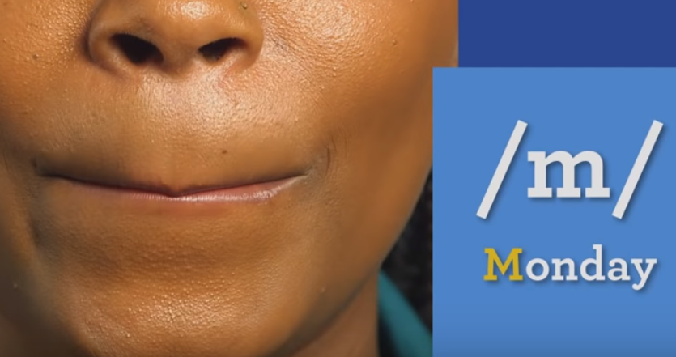
Bonus Resource
Rollins Phoneme Pronunciation Guide
Notes:
https://www.youtube.com/watch?v=wBuA589kfMg

Slide 32
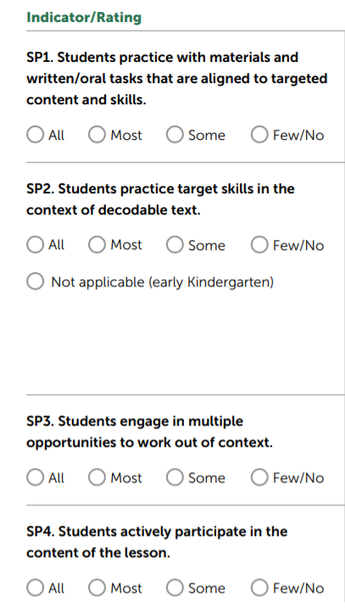
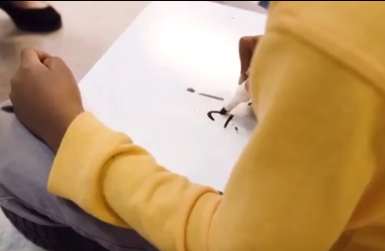
Low Inference Notes
Observe the next section of the lesson with the Student Practice indicators in mind.
After we observe, we’ll ask you to chat out some low inference notes that you collected.

Slide 33
Low Inference Notes
Chat now:
What evidence did you collect for the Student Practice indicators?
What wonderings do you have?

Slide 34
Whiteboards
Aligned to target skills (SP1)
Out of context w/ whiteboards (SP3)
All students with whiteboards (SP4)
Wonderings:
When will students practice with decodable text? (SP2)
When will students have more opportunities to work out of context?

Slide 35
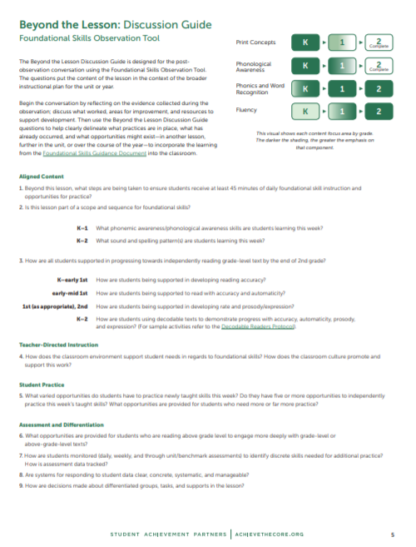
Beyond the Lesson
The Beyond the Lesson Discussion Guide helps to put the lesson in context. Use this to guide a post-observation discussion or self-reflection.

Slide 36
Poll 4: Which Beyond the Lesson Discussion Guide question might you plan to focus on in your debrief with Ms. Cuomo?
4. How does the classroom environment support student needs in regards to foundational skills?
5. What varied opportunities do students have to practice newly taught skills this week?
7. How are students monitored (daily, weekly, and through unit/benchmark assessments) to identify discrete skills needed for additional practice? How is assessment data tracked?
OTHER

Slide 37
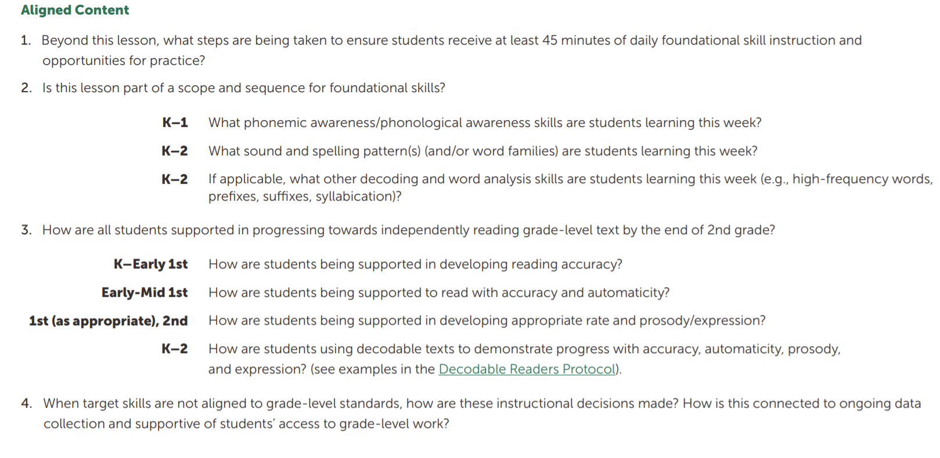
Questions by bucket (Aligned Content, Teacher-Directed Instruction, Student Practice, Assessment & Differentiation)
Meant to put the lesson in the broader context of the unit or year
Not an exhaustive list

Slide 38
Poll 4 results

Slide 39
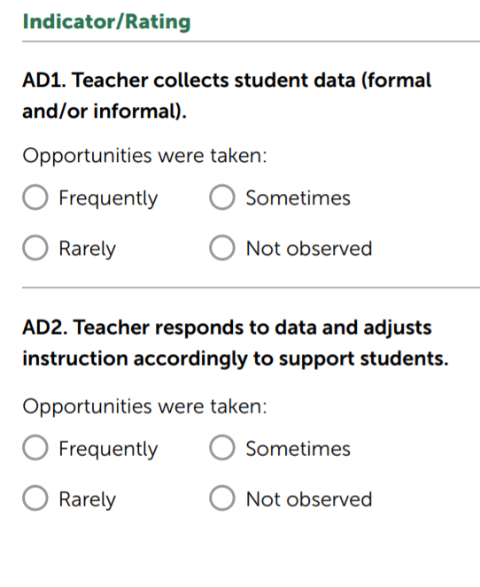
Beyond the Lesson
Visual monitoring of student slates
Dropping teacher voice to hear student “tapping it out”
Students know if they are accurate (correct spelling given each time) Wondering - tracking data?
Student 1-1 coaching (e.g., “right now it says bit”)
Wondering - Did students require scaffolding given? (full group segmenting of each word, not erasing i_e)

Slide 40
How Can the FSOT Support Our Ongoing Work?

Slide 41
How Can We Use the FSOT?
Teacher
Leader
Specialist
Coach

Slide 42
How Can We Use the FSOT?
Self-reflection Lesson planning PLC time | Lesson observation & debrief Co-planning Goal setting | Build common language and vision Learning walks Professional learning
Teacher
Coach
Leader

Slide 43
Poll 5: Select all that apply
How are you thinking about using the Foundational Skills Observation Tool in your setting?
Reflection
Lesson planning
Learning together
Coaching
Observations
Other

Slide 44
Reminder: Completion Certificate
Take our survey in 2 weeks and receive a certificate verifying 1 hour of professional learning.

Slide 45
Poll 5: Results

Slide 46
Questions for Our Guests?

Slide 47
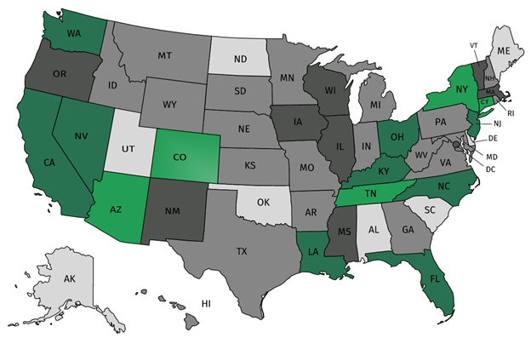
Join our network!
Join a national network of educators
Connect with state networks
Be a part of creating new tools and resources in partnership with SAP
Keep up to date on free resources, upcoming SAP webinars/professional learning opportunities, job postings and more!

Slide 48
Please Join Us!
https://achievethecore.org/ca-signup
Twitter: twitter.com/achievethecore
Facebook: facebook.com/achievethecore
Pinterest: pinterest.com/achievethecore

Slide 49
Please Join Us Again Next Month!
Next month’s webinar:
High School Modeling: Best Practices for Implementing High-Intensity Tasks for All Students
December 4, 2019 @ 7PM EST
Register Here:
https://event.on24.com/wcc/r/2130116/0864B2B65C1C1AD7C4FE6BCB1CCD58DE

Slide 50
Thank You!

