Slide 1



Delivering Virtual Mini-Assessments
Thursday, March 19th @ 5:00pm EDT
After the webinar:
Access to recording will be emailed to you.
Take our survey in 2 weeks and receive a certificate verifying 1 hour of professional learning.
Questions just for presenters & tech help
Resources
Group Chat
#RemoteLearning #CoreAdvocates
@achievethecore | @edciteteam

Slide 2
Goals:
Every participant will be able to…
→ Send the Achieve the Core Mini-Assessments to students virtually and printed when needed.
→ Build standards-aligned assignments and formative assessments for students.
Agenda
Introductions
Remote Learning
Achieve the Core
Edcite
Questions
#RemoteLearning #CoreAdvocates
@achievethecore | @edciteteam

Slide 3



Introductions
Claire Rivero
Brian McIntosh
Julia Sweeney

Slide 4
To Start...
Thank you for all that you are doing.
We know that this is unprecedented and high-pressure—especially on the front line supports of our communities. Educators and administrators are absolutely on the front lines of keeping kids safe, fed, and engaged.
Our students, families, and communities are better served during this crisis because of the relentless work and infinite care that educators provide.

Slide 5
#RemoteLearning
Delivering content in a remote learning setting is logistically challenging and can increase education inequality if not intentionally addressed.
Important considerations:
Internet Access and Printed Packets
Device Access & Fairness
Structuring of the content and meeting students’ needs
Notes:
While districts are tackling the aspects of meeting students’ needs, this webinar is focusing on delivering academic materials to students.

Slide 6







Hoboken Public Schools (NJ)
Immediate Needs
Wifi?
Laptop or Desktop?
Cable television?
Digital Instruction and Communication
Addressing Gaps

Slide 7
Logistics & Equity
Rostering & Single Sign On
Google Classroom
Clever
Canvas
and more
Additional Free Resources
Zoom & Clever Package
Google Hangouts
Youtube, Twitter, Facebook
Local Internet Companies
Ready-to-use materials paper & digital
Achieve the Core & Edcite

Slide 8


Slide 9

Mini-Assessments
WHAT ARE THEY?
  80+ formative assessments for Math and ELA /Literacy (including language and grammar conventions)
  Grade-specific and standards-aligned
  Designed to be completed in one class period
  Reflect the Shifts for college- and career-ready instruction
Junior Gardening Class 2020
Notes:
Ways to hold students accountable if you’re concerned about the students’ work being their own.

Slide 10




ELA/Literacy Mini-Assessments: What's Included?
PASSAGE OR TEXT INFORMATION
TEXT-DEPENDENT QUESTIONS
When permissible, full texts are included, otherwise directions are given for where to find the applicable passage within the text teachers secure independently
A variety of text-dependent question types including opportunities to practice writing
ANSWER KEY AND DISTRACTOR ANALYSIS
GUIDANCE FOR ELLS
Guidance and accommodations for using the assessments with English Language Learners
Rationales for each distractor associated with a test question, detailing why each option would be considered correct or incorrect. Useful for class discussions

Slide 11


Assessing Language (Grammar and Conventions
  Assessment of language via embedded error passages
  Designed to assess mastery of language convention skills
  Grade-specific and standards-aligned
  Include texts
  Include answer keys

Slide 12
Math Mini-Assessments: What's Included?
GRADE- AND STANDARDS-SPECIFIC ITEMS
DETAILED OVERVIEW
Detailed overview of how the assessment items support students' increasing mastery of the standards to which the assessment is aligned.
GUIDANCE FOR ELLS
ANSWER KEY AND MODEL POTENTIAL SOLUTIONS
Guidance and scaffolds to help English Language Learners access the mathematics of the assessment

Slide 13
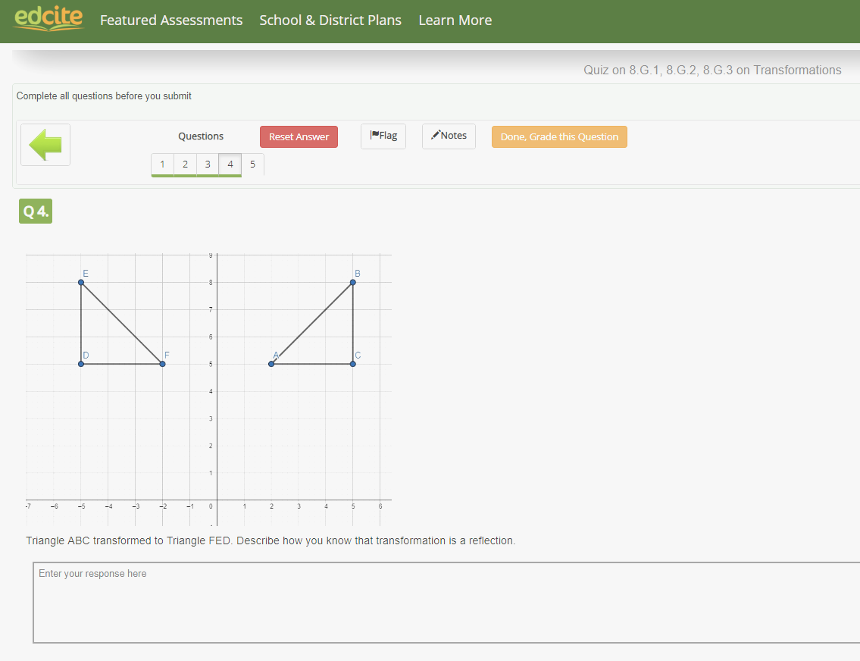
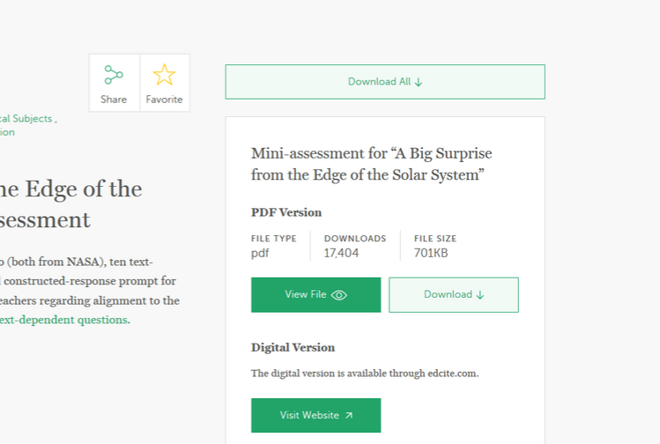
AND NOW!
Most of our mini-assessments are available digitally on Edcite.com

Slide 14





Core Advocate Content Developers
MATH AND ELA/LITERACY ASSESSMENTS
BRIAN DEAN
JENNI ABERLI
JESSICA HUNTER
AMY DEMPSEY
7.EE.A.1 and 7.EE.A.2 Mini-Assessments
9/10th Grade: Frankenstein
8.G.1, 8.G.2, 8.G.3-- Transformations
Annabel Lee Quiz

Slide 15
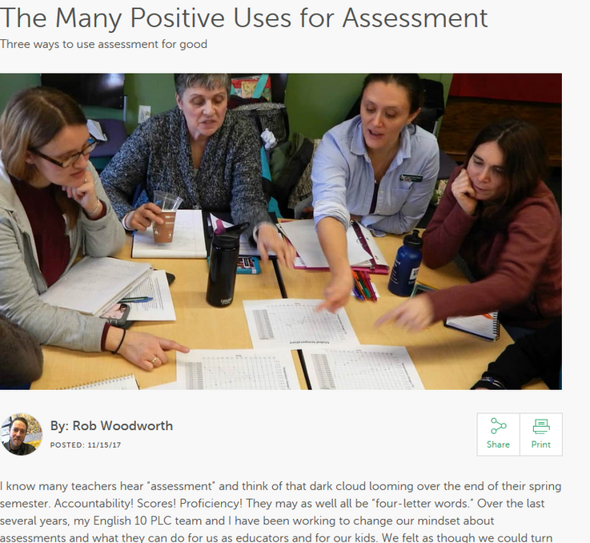
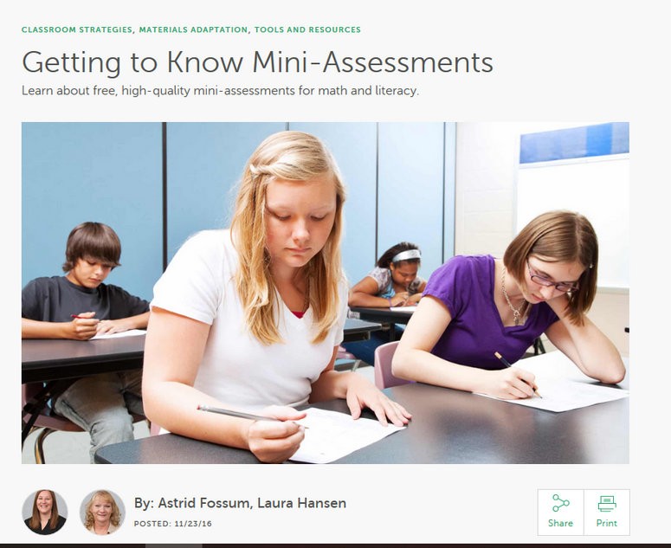
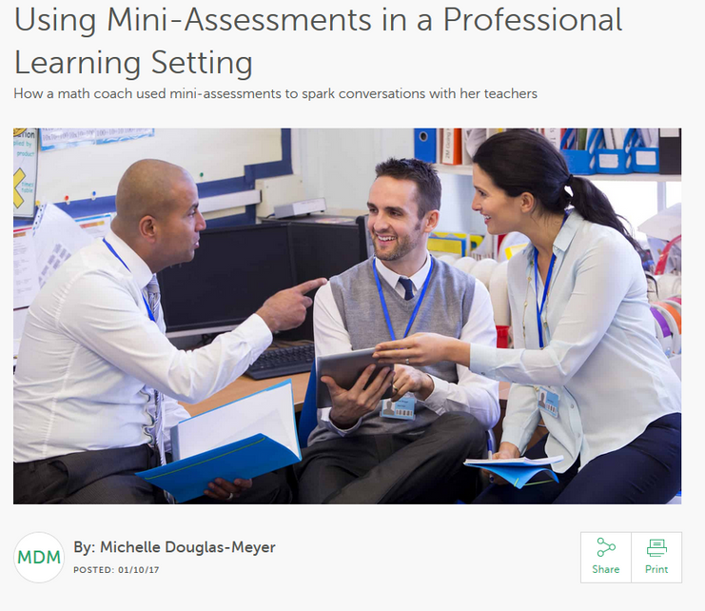

Learn more about mini-assessments
achievethecore.org/aligned

Slide 16
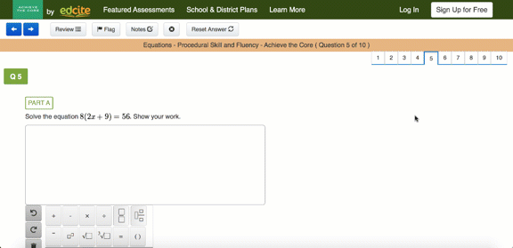
Mini-Assessments on Edcite
From achievethecore.org,
click “Sign Up For Free” to create a new account or “Log In” if you already have an account.

Slide 17
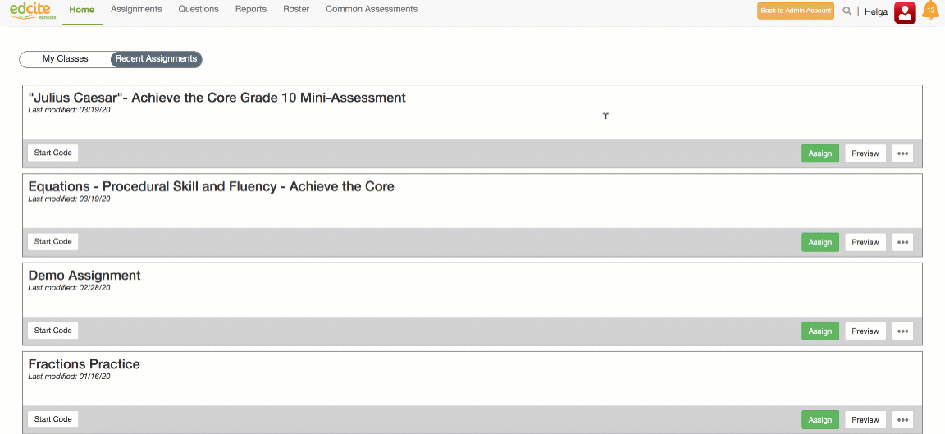
Mini-Assessments on Edcite
You can use the “Assign” button or use “Start Code” to send to students.
Easily push to Google Classroom.
Notes:
Add a screenshot of Start Code & Assign to Classes

Slide 18
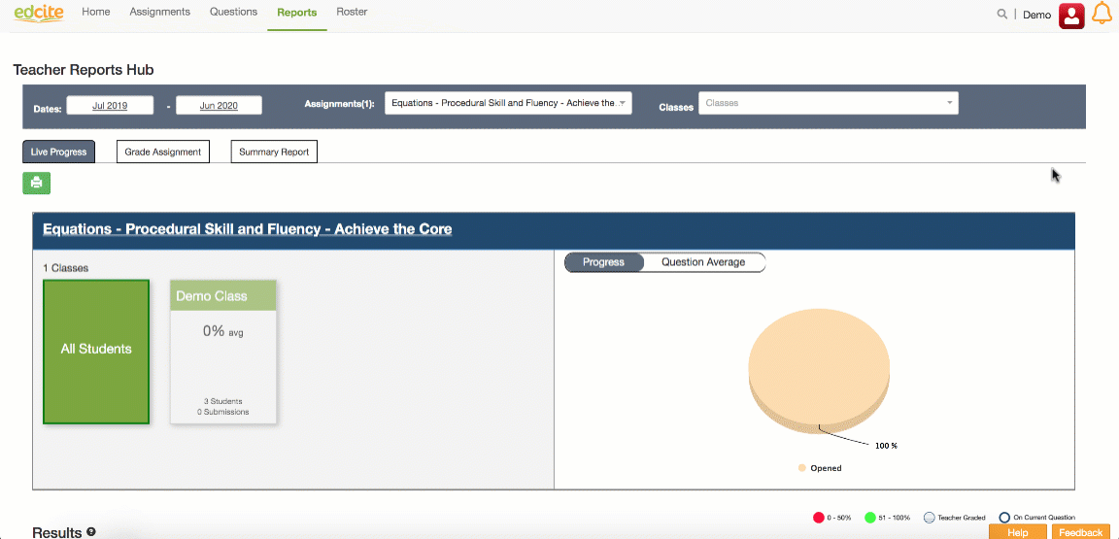
Mini-Assessments on Edcite
Live Progress is available in the reports section and you can see how students are doing in real time.

Slide 19
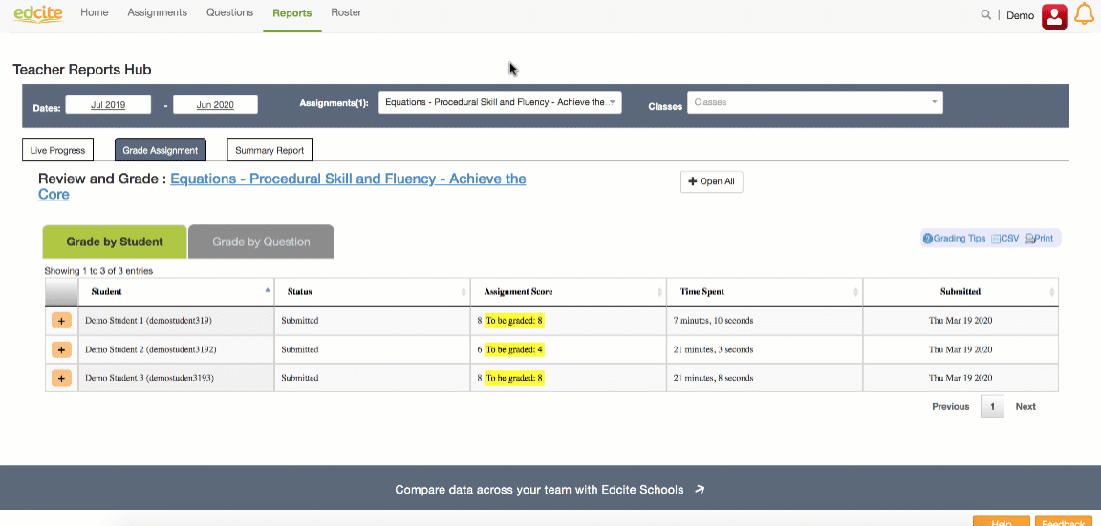
Mini-Assessments on Edcite
Grading can be done by student or by question. Anything that can be auto-graded is—but many of the Achieve the Core Mini-Assessments leverage open response questions which are teacher-graded.
You can also add rubrics to questions and score on a rubric.

Slide 20
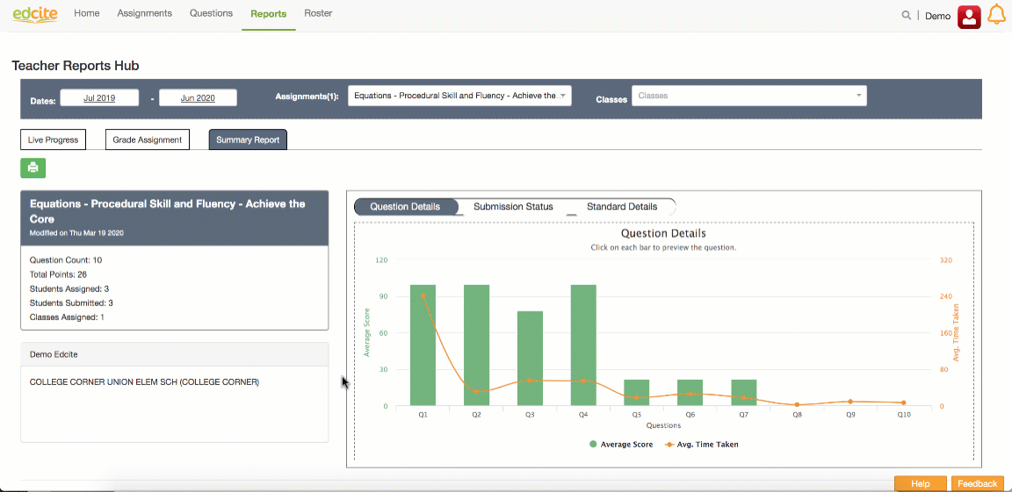
Mini-Assessments on Edcite
The Summary Report allows you to see how the class did on each question, how much time the spent on each question, and how they performed by standard.
You can view this data summarized by class and click to view an individual's full report.
These can be printed, exported, or copied to clipboard.
Notes:
Student Back-ups and work history

Slide 21
Mini-Assessments on Edcite
Copy from Achieve the Core
Assign to my students
Monitor live progress
Complete any grading
Respond to the data
What if I want to use more content on Edcite?
Notes:
Student Back-ups and work history

Slide 22
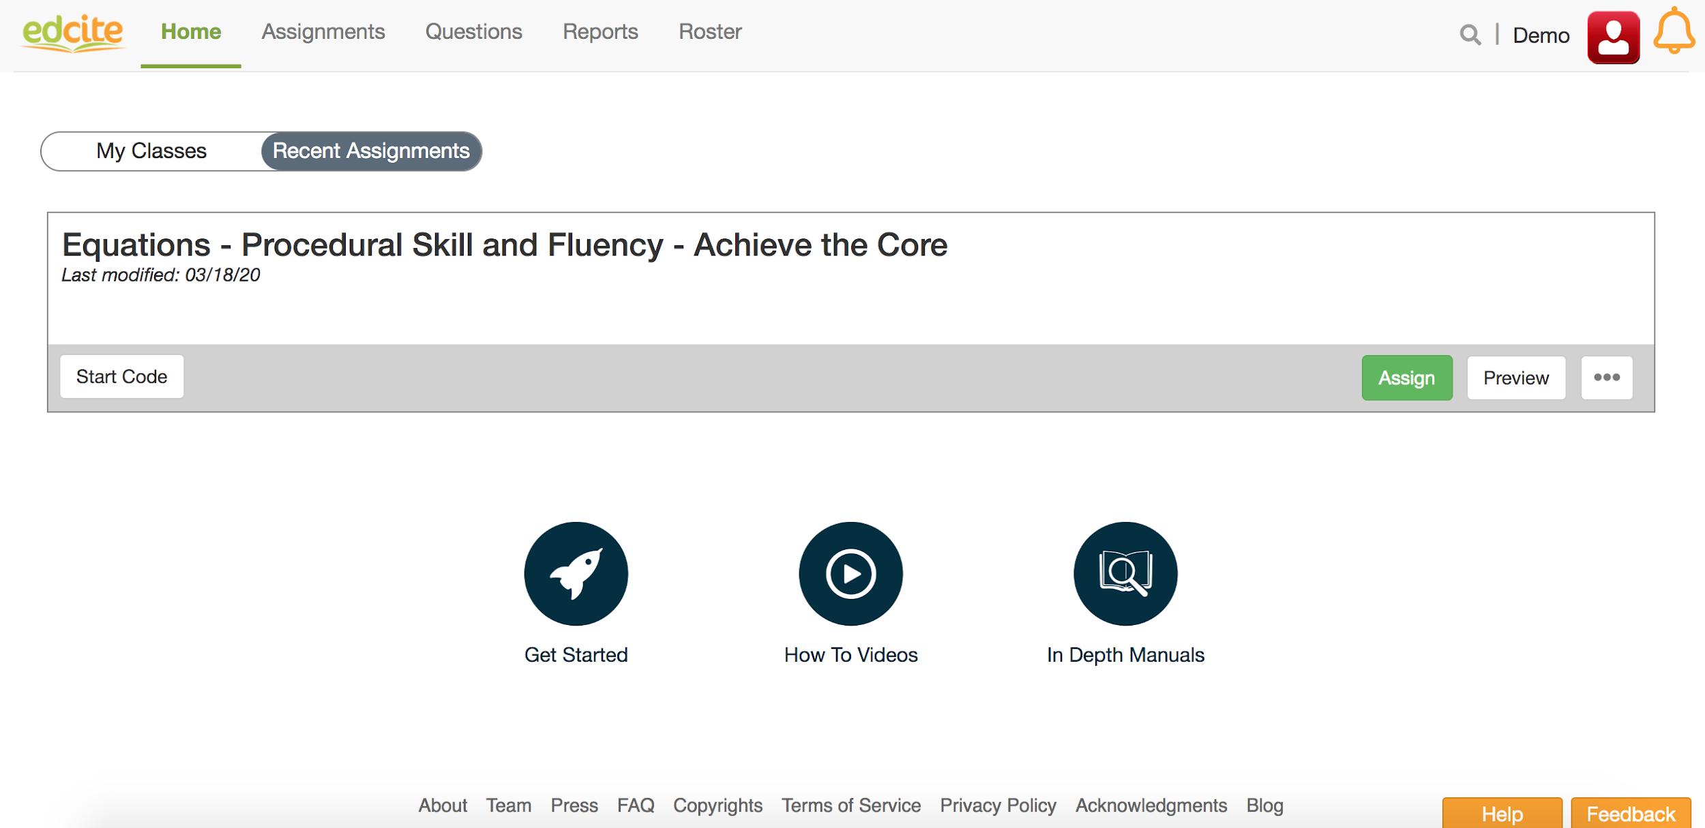
Edcite Basics

Slide 23
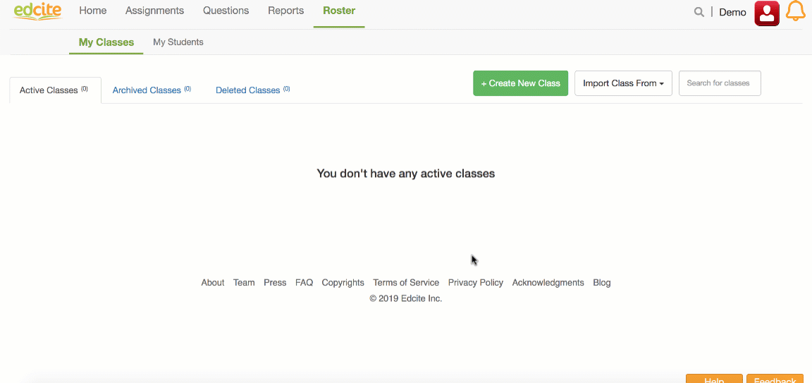
Edcite Basics: Rosters

Slide 24
Edcite Basics: Content
Questions: Individual items students will answer
Assignments: Set of questions you assign to students
Collections: Group of assignments to browse or schedule in bulk

Slide 25
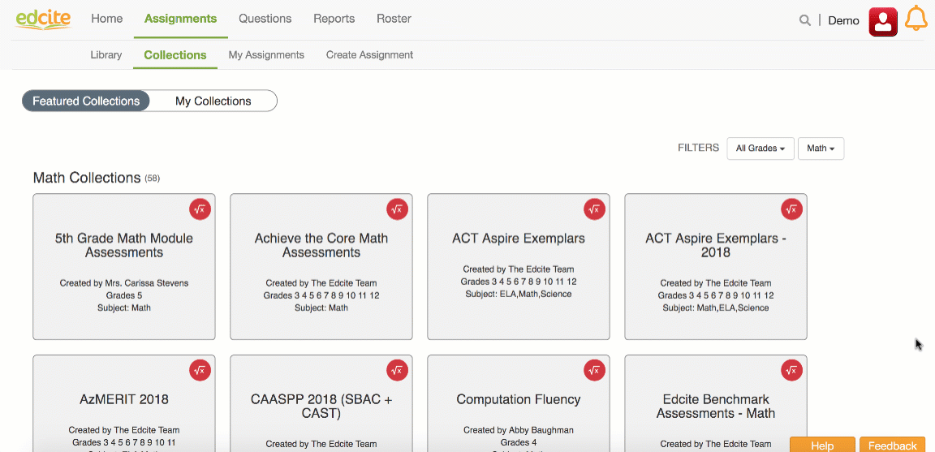
Edcite Basics: Collections
Collections are groups of assignments that you can browse or schedule in bulk.
Core Advocates have made some collections and you can too!

Slide 26
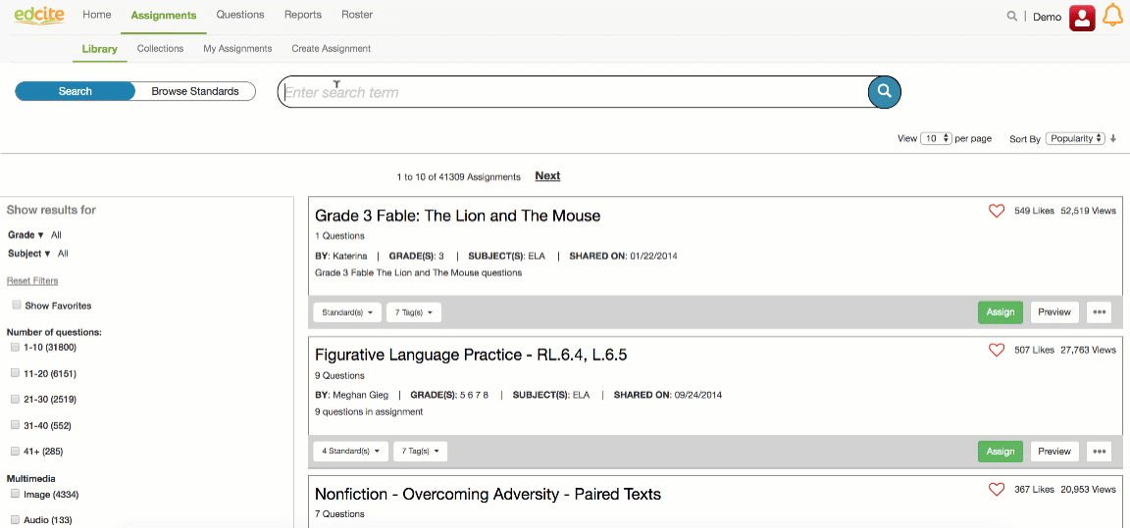
Edcite Basics: Assignments Library
The Assignments LIbrary allow you to search by standard or term for ready-to-use assignments. You can filter on the left by grade & subject.
Everything can be customized. :)

Slide 27
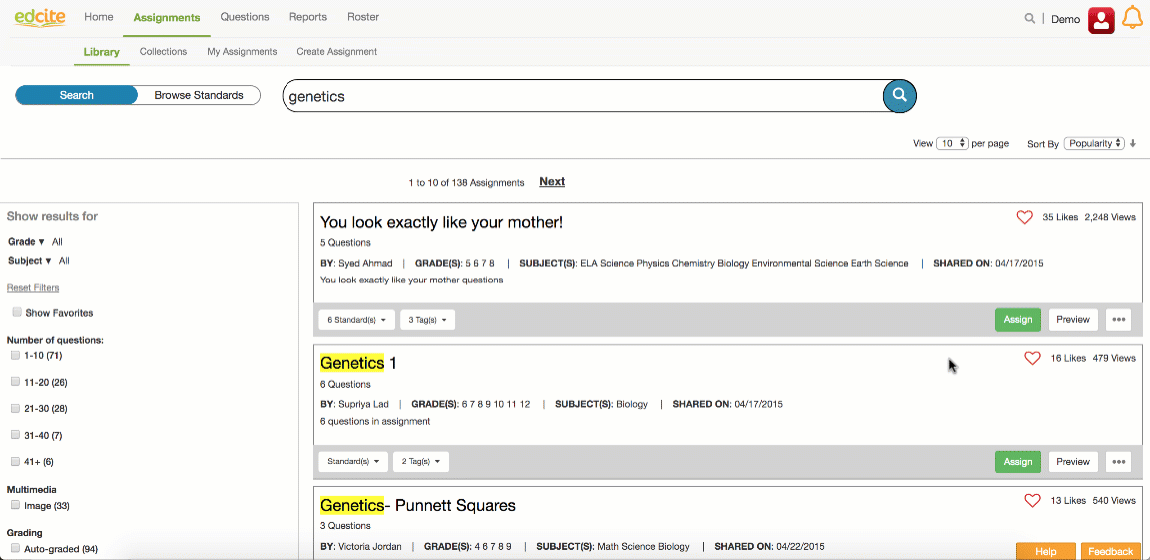
Edcite Basics: Customizing Assignments
The Assignment Editor allows you to remove, edit, reorder, and add questions.

Slide 28
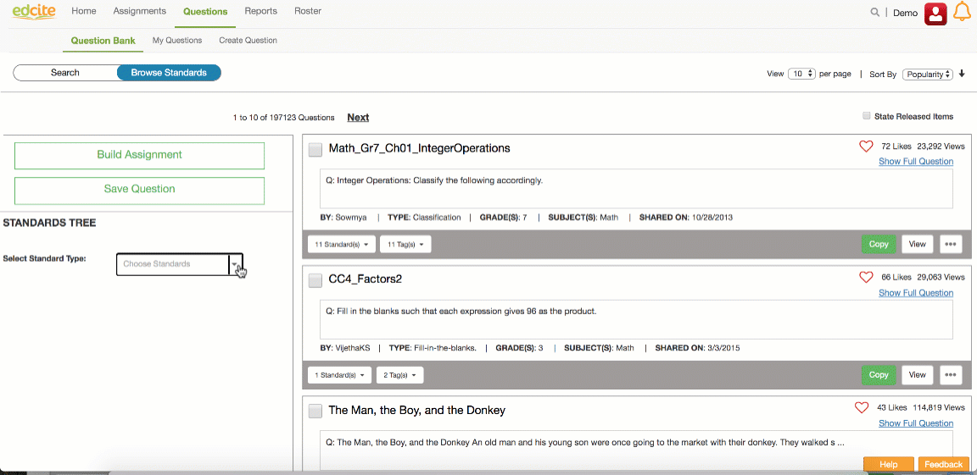
Edcite Basics: Question Bank
The Item Bank allows you to search by keyword or standard and you can filter by released state test items.

Slide 29
Edcite: Creating Questions
Creating Questions → Create Assignment → Assign
All creations you create will live in “My Questions”
60+ types of questions to ensure alignment to the skill being taught

Slide 30
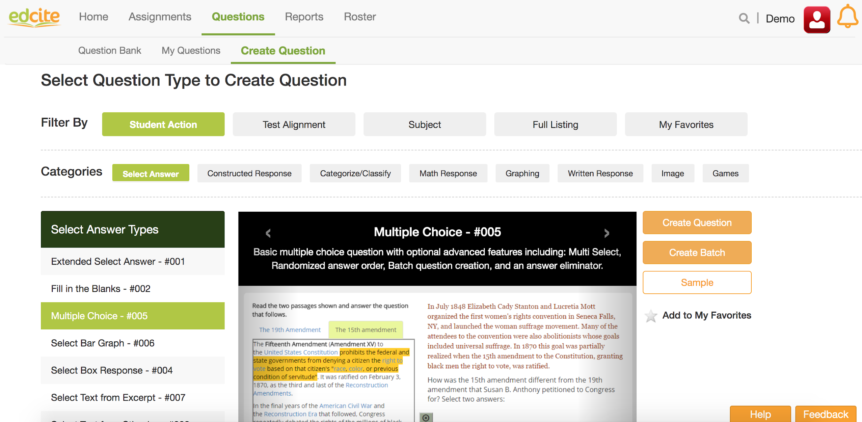
Edcite: Creating Questions

Slide 31
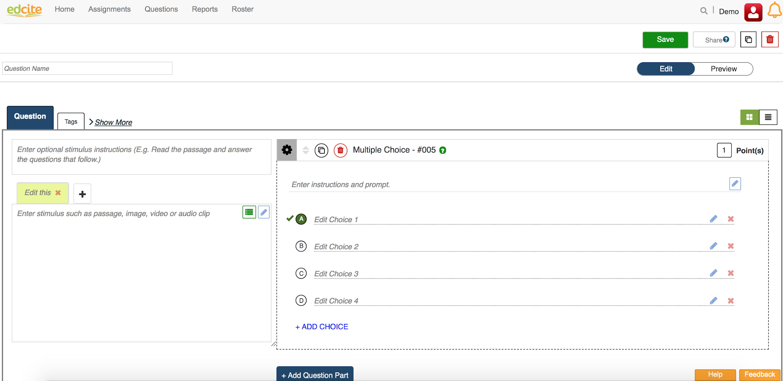
Edcite: Creating Questions

Slide 32
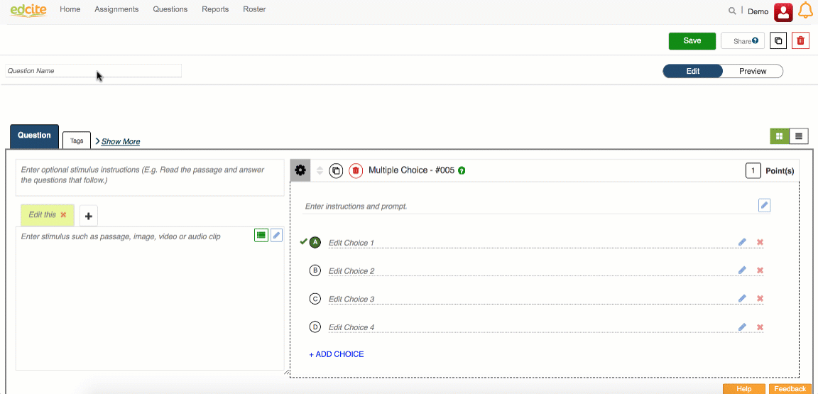
Edcite: Creating Questions
You can easily in-line edit and click to select answers on multiple choice (#005) questions.
You can also easily number paragraphs and turn a question into a dependent Part A/B question.
Notes:
Editor

Slide 33
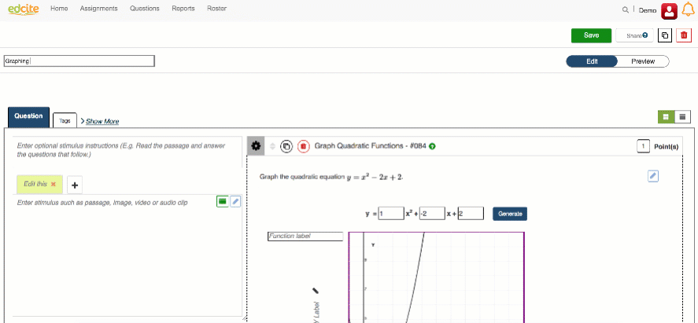
Edcite: Creating Questions
Make advanced math keypad and graphing questions and easily embed instructional videos to support!
Wide range of math questions available with the option to allow equivalents.
Notes:
Tags

Slide 34
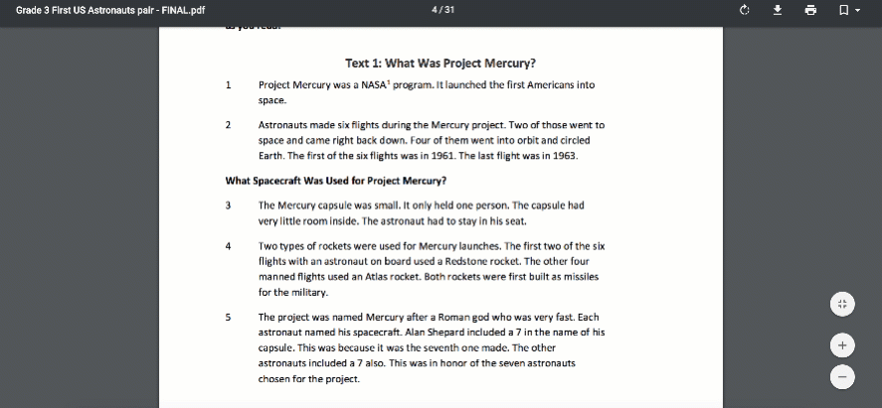
Edcite: Creating Questions
Make game-style questions easily and leverage the Academic Word Finder from Achieve the Core to build some great vocab questions.

Slide 35
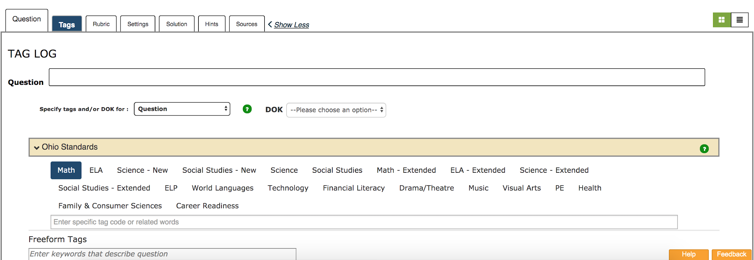
Edcite: Creating Questions
Notes:
Other Q types

Slide 36
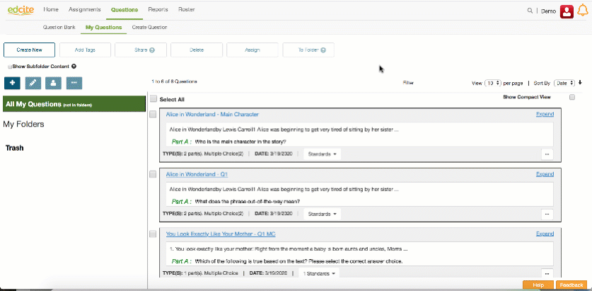
Edcite Basics: Building Assignments

Slide 37
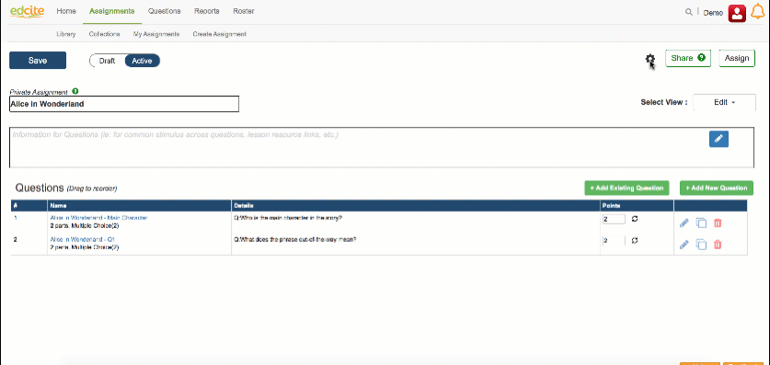
Edcite: Assignment Settings

Slide 38
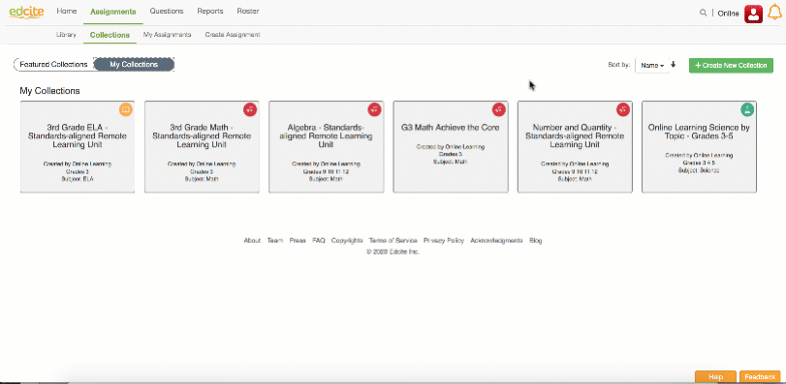
Edcite: Using Collections for Efficiency

Slide 39
Questions
You can connect further with the Edcite Team about remote learning. Email support@edcite.com
to set up a call.

Slide 40

Next Steps:
Help us understand your needs and the current reality in your district by completing this quick survey:
http://bit.ly/EducatorNeeds

