Slide 1
Reading Practice in a Time of Remote Learning
Core Advocates Monthly Webinar
April 15, 2020
The webinar will begin shortly.
Check your Resource widget to preview the resources for today’s session! Use the Group Chat to introduce yourself!
Notes:
First timer poll
Handouts:
While we’re waiting, we’d like you to participate in a quick poll so we can get an understanding of who’s on the webinar with us tonight.

Slide 2
Introductions
Your hosts from Student Achievement Partners:
Pascale Joseph Project Coordinator,
Tools and Classroom Resources
Student Achievement Partners
This month’s presenters:
Meredith Liben Senior Fellow and Consultant
Student Achievement Partners
David Liben Advisor
Student Achievement Partners
Jody Guarino Lecturer
University of California, Irvine
Katie Key Thomas Graduate Student, School of Education
University of California-Irvine
Duane Cox Site Administrator, Rea Elementary
Newport-Mesa Unified School District
Megan Merrick First Grade Teacher, Rea Elementary
Newport-Mesa Unified School District

Slide 3
How many Core Advocate Webinars have you attended?
Please use the Questions tab on your control panel to respond.
If using a poll, please put up to 5 answer choices in the notes section below and indicate if attendees should choose only one response or multiple responses.

Slide 4
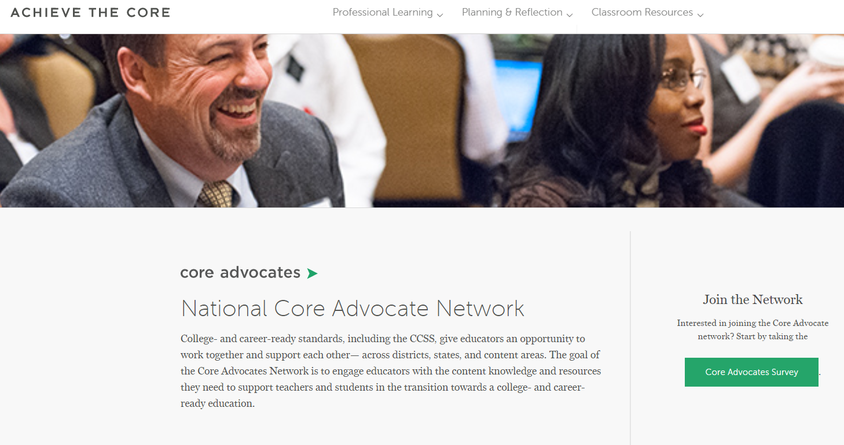
Join Our Network!
www.achievethecore.org/ca-signup
Notes:
If you find tonight’s webinar helpful, we’d like to invite you to join our Core Advocate network! We’re committed to solving real problems that real teachers have and we know the best way to do this is to know more about what folks are experiencing.
We’d love to learn about who you are, where you work, the types of things you’re interested in and the expertise you already have. This way, we will be able to tailor our webinars and other opportunities to your needs and interests (we may even tap you to be our next webinar panelist). So we encourage you to join the network by filling out this survey completely at atc.org/ca-signup

Slide 5
Learn More About Us!
Contact Jennie Beltramini (jbeltramini@studentsachieve.net ) Joy Delizo-Osborne
(jdelizo-osborne@studentsachieve.net)
Complete this survey to join our database (and mailing list): www.achievethecore.org/ca-signup
Visit our website: www.achievethecore.org
Notes:
If you’d like to learn more about the network, contact Jennie (her email is here).
We also want to invite you to join the network by signing up at achievethecore.org/ca-signup and visit our website for more info and opportunities

Slide 6
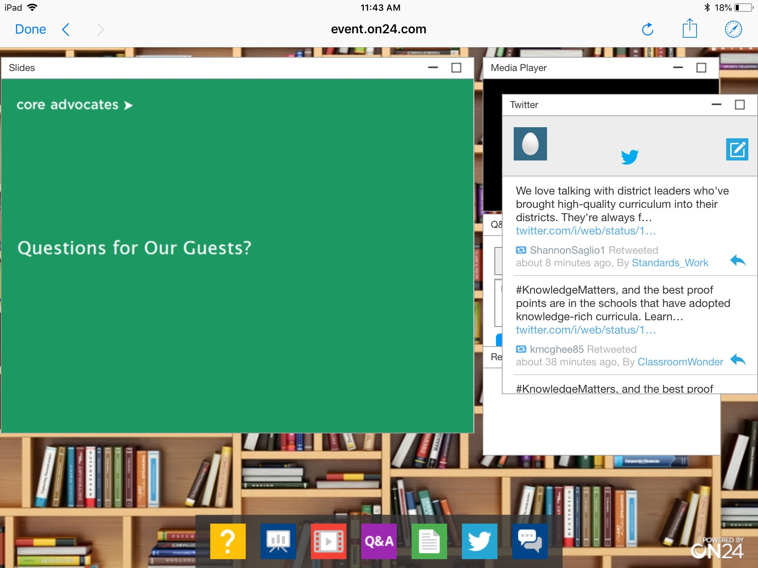
Tweet with Us!
Please feel free to tweet during and after the webinar using #coreadvocates
@achievethecore
@JennieBeltro
@jody_guarino
@KatieKeyThomas
@MJLiben
Click here!

Slide 7
Engage with Us!
During the webinar:
Question just for the presenters/ tech help
Resources
Group chat
After the webinar:
– Access to recording will be emailed to you.
Take our survey in 2 weeks and receive a certificate verifying 1 hour of professional learning.

Slide 8
Goals of the Webinar
Consider why a reading practice routine during distance learning
Develop a vision of what a 5-Day reading practice routine looks like and sounds like in a distance learning setting
Understand the affordances of a reading practice routine from multiple perspectives
Evaluate resources for implementation in your context
Notes:
We have three main goals for our webinar tonight. They are to...

Slide 9
Section 1: We’re Excited About This Resource!

Slide 10
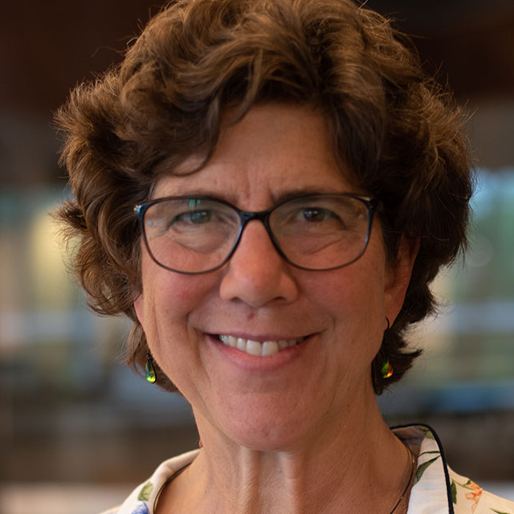
Meredith Liben and David Liben
Senior Fellow and Consultant
Student Achievement Partners
Notes:
I look so big!

Slide 11
Section 2: Why a reading practice routine during distance learning?

Slide 12
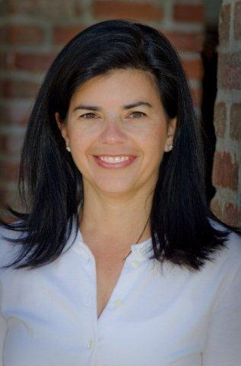
Jody Guarino
Lecturer
University of California, Irvine
Mathematics Coordinator
Orange County Department of Education

Slide 13
Our Why
Decades of research exists on how children learn to read and the type of instructional experiences that support reading development
What we don’t necessarily know…
How to enact research within distance learning with whatever tools we and our students have access to….
What this might look and sound like across different platforms
Notes:
Teaching reading in ways guided by research may not be new, however, to many of us, distance learning is new. We’ve gone from having 6 hours a day with students to now far more limited interaction. In the time and space we have, what do we prioritize? In our opinion, reading should be at the top of the priority list.
How do we develop a professional vision of what this looks and sounds like? What tools do we, and our students, have access to? What might this look like across a variety of platforms? Many teachers are using platforms like zoom to connect with students in a synchronous environment. Time on zoom is often limited, so how do we decide what to do in a synchronous environment such as zoom and what can be done on other platforms.
And there are many students that don’t have access to synchronous spaces, how do we create learning opportunities for them grounded in the same research and learning principles? That’s what we set out to do.

Slide 14
Our Why
Ensure ALL students have access to grade level reading materials at home
Ensure access to technology isn’t a barrier to reading practice
Provide families with a routine, grounded in research, that can be used with children at all grade levels
Notes:
We know there are children and families with limited access to texts and even more specific, limited access to texts they can read. Schools and libraries are closed, for some children, this may be the only access they have.
There’s also technology access, whether that’s access to devices or connectivity, our goal is to think about and provide opportunities across three distinct learning platforms to ensure all students have access.

Slide 15
Instructional Routines
Beneficial to teachers and students
Offer a predictable structure
Focus on the practice and content, not how to participate in the activity
Helpful for families
Predictable routine
Simple for parents or siblings
Appropriate for children of varying ages
Notes:
We use instructructional routines in our classrooms, what does it look like to use or implement instructional routines in distance learning and what are the affordances?
In a time where very little is routine or normal, how can we rely upon structures to relieve the stress on ourselves, students, and families while still ensuring students engage in the learning opportunities we know they need to become proficient readers?
We know students need to hear models of fluent reading, practice decoding, engage in repeated readings of text. In the routine we developed, students engage in all of these experiences, working with texts that are at grade level, in ways that they will be to do independently or with a sibling or family member. Students will develop an awareness and automaticity of the routine. For families with multiple children, this routine also supports fluency development and can be used by children of all ages.

Slide 16
How often are your students currently engaging in fluency practice/fluency work?
0-1 times per week
2-3 times per week
4-5 times per week
unsure
Notes:
We know that things have changed quite a bit since distance learning, now that we’re in this new space, how often are students currently engaging in fluency work.

Slide 17
Section 3: What does a 5-Day Reading Practice Instructional Routine Look Like and Sound Like?

Slide 18
5-Day Instructional Routine for Reading Practice
Day 1 | Day 2 | Day 3 | Day 4 | Day 5
-Modeled reading -Choral reading -Repeated reading aloud -Comprehension | -Modeled reading -Echo reading -Repeated reading aloud | -Reading aloud with optional feedback | -Repeated reading and self reflection | -Perform passage, possible assessment
Notes:
Here’s an overview of the 5-day instructional routine. Take a minute and read through each day.
You’ll notice the routine begins with modeled and choral reading, providing students with a model of fluent reading. Throughout the week students will engage in repeated readings of the text and attend to their word recognition, expression, and automaticity.
On day 1, the teacher will model reading with fluency and students will be participating in a choral read. There’s also a comprehension element. It’s important for students to always know that comprehension is the main goal of reading. On day 2, the teacher and students will engage in echo reading. On day 3, students will be reading aloud and receiving peer feedback through partner or buddy reading. On day 4, students will continue to practice with repeated readings of the passage and then complete a self evaluation. On day 5, students will be performing the passage, which can offer teachers assessment information to guide further instruction.
We’re going to share the ideas using open educational resources including the Student Achievement Fluency Packet. This routine can also be used with your adopted instructional materials.

Slide 19
Three Platforms
Synchronous Interacting with students in real-time through Zoom, Google Hangout, or another video conferencing platform | Asynchronous Posting assignments/lessons for students to access at a later time through Google Classroom, Seesaw, or another educational technology platform
Limited or No Technology Distributing paper-and-pencil packets and/or having access to engage with students over the phone (voice call or voicemail systems) | More Than One Utilizing more than one platform for a single day or week (for example: synchronous with some students being limited or technology-free)
Notes:
There are three different platforms that are currently being used in distance learning: synchronous, asynchronous, and limited or no technology. Synchronous platforms involve interacting with students in real-time through Zoom, Google Hangout, or another video conferencing platform. Asynchronous platforms are ones where teachers can post assignments/lessons for students to access at a later time, such as Google Classroom, Seesaw, or other educational technology platforms likes those.
Limited or no technology refers to environments with no access to technological devices, such as Chromebooks, as well as environments with no access to WiFi. This platform includes distributing paper and pencil packets and/or having access to students over the phone through voice call or voicemail systems. According to research from the Pew Research Center, in February of 2019, 96% of U.S. adults owned a cell phone. This statistic includes mobile phones that are not considered smartphones. In our work, we’ve taken cell phone use into consideration and included ways to engage via cellphone as well as options for those without cellphone access.
In many cases teachers are incorporating more than one of these platforms into their distance learning curriculum. For example, some teachers may push out assignments through Google Classroom and also have weekly Zoom sessions with students.

Slide 20
Day 1- Modeled and Choral Reading
Synchronous | Asynchronous | Limited/No Technology
(T) Modeled reading of passage (S) Choral reading (S) Repeated reading (S) Answers comprehension questions | (T) Modeled reading of passage via Screencastify or other platform (S) Choral read along with teacher model (S) Repeated reading (S) Answers comprehension questions through digital platform | (T&S) Modeled reading of passage by phone call/voice message or parent reads passage to student. Replay recording and read along chorally or choral read with a parent. (S) Repeated reading (S) Answers comprehension questions on paper
Notes:
We’re going to look at day 1 across the three platforms to get a sense of the student experiences and consistency in outcomes across those three platforms.
Notice within each platform, the students start by having the passage model read and then choral reading with the teacher. This might be in a synchronous experience, like this webinar, where I read the passage to you and then we read it together chorally. In an asynchronous setting I might pre-record myself reading the story, you listen to the story in its entirety, then play the recording again, this time chorally reading.
We’ve thought about the limited or no-technology platform in a few different ways. As we mentioned earlier, many students have access to phones and we’ve found a way to push this out through phones using Desmos. We’ll share that a bit later. This could also look like a phone call from the teacher, pre-recorded outgoing message on the teacher’s classroom phone extension, or parent or older sibling modeling the reading.
Following the modeled and choral reading, students independently engage in repeated readings. This happens daily. Students read the text aloud and on day 1 answer some comprehension questions. This first day is the most robust.
What we hope you notice is that the student experience, while it looks different across the settings, all lead to the same outcomes.

Slide 21
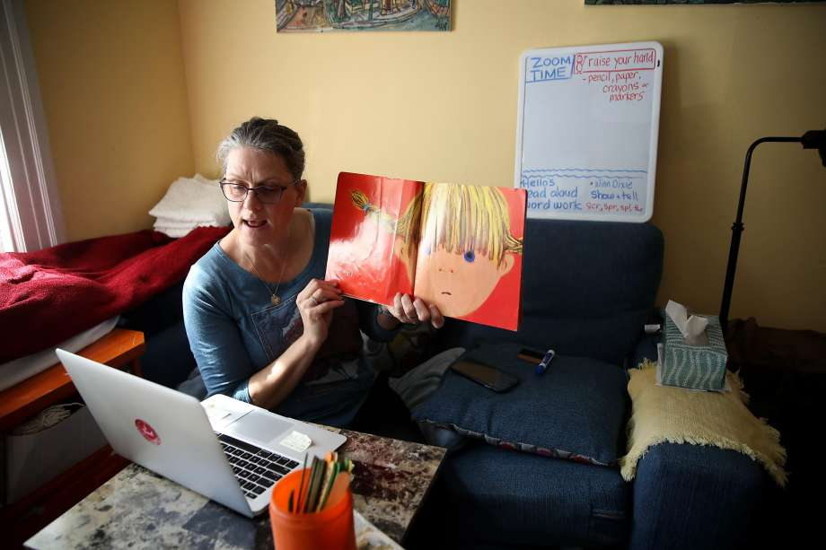
Day 1 - Modeled and Choral Reading
What is it?
Passage is read aloud by the teacher
Whole class reads the passage together following along with the teacher
Why?
Students hear prosodic
reading
Immediate assistance
with difficult words
Praise/corrections
given to whole class
Notes:
Now let’s talk about each element and why its part of the routine. We start with modeled and choral reading for students to hear what fluent reading sounds like and have an opportunity to practice alongside a fluent reader. We also know that choral reading helps both proficient and struggling readers.
We’ll talk briefly about each element and at the end of the webinar we’ll share a list of resources. One of those resources includes a description of each component and the research that supports it. If some of these routines are new to you, this might be of interest.
STOP HERE: Pascale will move to video.
VIDEO INTRO:
Earlier today we mentioned students with limited technology - those with smartphone access, here we’ll show you what the same experience looks like within Desmos, a platform that students can experience through a smartphone and other technology devices such as chromebooks or laptops.
Here’s an example of what choral reading might look and sound like in an asynchronous setting. To frame the video before we show it, we’ll hear the teacher first pre-teach vocabulary before modeled reading and then explain how to participate in choral reading. This will be important at the beginning, but after a few weeks, the students will be familiar with how to participate. You’ll also notice the text students will work with followed up with a few comprehension questions.

Slide 22
Day 1- Modeled and Choral Reading
Example of Asynchronous Environment
Notes:
Earlier today we mentioned students with limited technology - those with smartphone access, here we’ll show you what the same experience looks like within Desmos, a platform that students can experience through a smartphone and other technology devices such as chromebooks or laptops.
Here’s an example of what choral reading might look and sound like in an asynchronous setting. To frame the video before we show it, we’ll hear the teacher first pre-teach vocabulary before modeled reading and then explain how to participate in choral reading. This will be important at the beginning, but after a few weeks, the students will be familiar with how to participate. You’ll also notice the text students will work with followed up with a few comprehension questions.

Slide 23
Day 2 - Echo Reading
Synchronous | Asynchronous | Limited/No Technology
(T) Read passage (T/S) Echo read passage (S) Repeated reading | (T) Echo reading of passage via Screencastify or other platform (S) Repeated reading | (T) Echo reading of passage by phone call/voice message or parent echo reads passage with student (S) Repeated reading
Notes:
Day 2 includes echo reading with a more fluent reader (the teacher, parent, or sibling) along with students independently engaging in repeated reading.

Slide 24
Day 2 - Echo Reading
What is it?
Teacher will read a section of the text and students echo the teacher by reading the same section aloud
Why?
New and insecure
readers benefit
because it segments the passage
Notes:
Echo reading is when students echo the teacher. To start echo reading, the teacher will first read the whole passage with students following. After that, the teacher will, “read a section of the text and stop so the children get a turn at reading the same section” (4). Echo reading is especially beneficial and supportive of “new or insecure readers” because “it takes the passage you’re reading for fluency practice and chunks, or segments it” (4).
STOP HERE: Pascale will move to video.
VIDEO INTRO:
Here’s an example of what echo reading might look and sound like in an asynchronous setting. To frame the video before we show it, we’ll hear the teacher first explaining what echo reading is and how to participate. Similar to choral reading, this will be important at the beginning of implementing a process like this, but after a few weeks, students will be familiar with how to participate.
We know there are a wide variety of asynchronous platforms being used. We are showing just one way platform that could be used.

Slide 25
Day 2 - Echo Reading
Brief Example of Asynchronous Environment
Notes:
Here’s an example of what echo reading might look and sound like in an asynchronous setting. To frame the video before we show it, we’ll hear the teacher first explaining what echo reading is and how to participate. Similar to choral reading, this will be important at the beginning of implementing a process like this, but after a few weeks, students will be familiar with how to participate.
We know there are a wide variety of asynchronous platforms being used. We are showing just one way platform that could be used.

Slide 26
Day 3 - Peer Reading & Optional Feedback
Synchronous | Asynchronous | Limited/No Technology
(S) Read passage aloud to peers (could be in a breakout room) and peers provide feedback | (S) Read passage and record on Seesaw or other platform. Peers or teacher gives feedback | (S) Read passage to a family member and ask them for feedback
Notes:
On day three, students engage in peer reading. Within peer reading, one student reads while the other follows along and then they switch roles. This can happen in all of the platforms. It can happen live, students can listen to each others’ recorded readings, or read the passage to a family member.

Slide 27
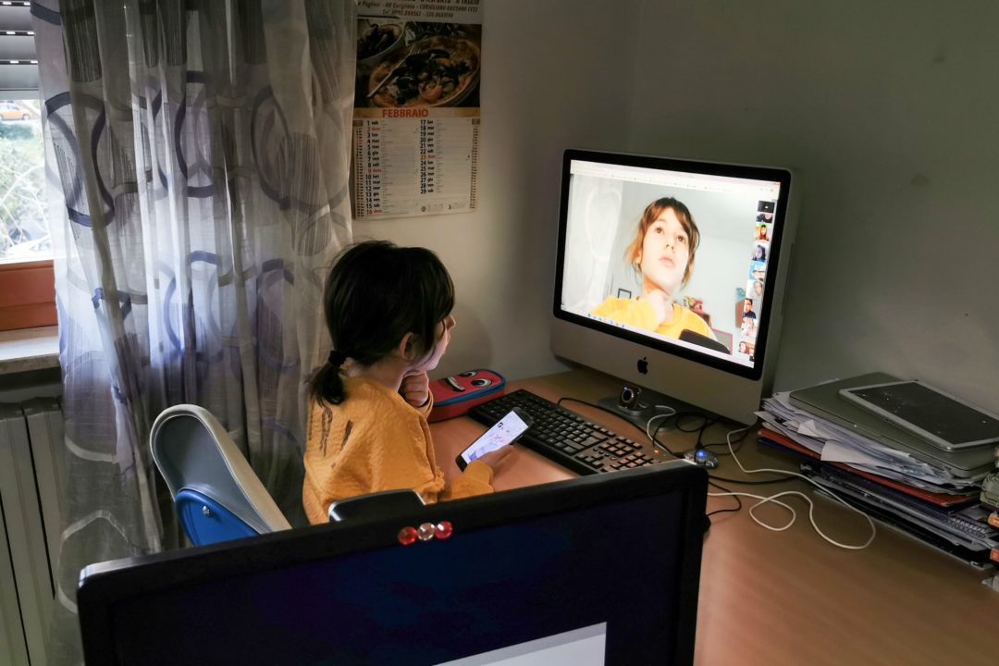
Day 3 - Peer Reading & Optional Feedback
What is it?
One student reads while the other follows along and then they switch roles. Optional: Students provide feedback to each other.
Why?
Peers model fluent reading
for each other
Peer encouragement
Notes:
Notice the option to get feedback here. The feedback could be from the teacher, peers, or family members. This looks a bit different across the platforms. In a synchronous setting, students may read aloud and the teacher can listen in on particular students (for example: using the mute feature) or students can read to peers in breakout rooms. In an asynchronous setting, students can record themselves reading and listen to recordings of peers. Without technology, students can read the passage to a family member or stuffed animal. Again, all students are practicing reading aloud with an option of getting feedback.

Slide 28
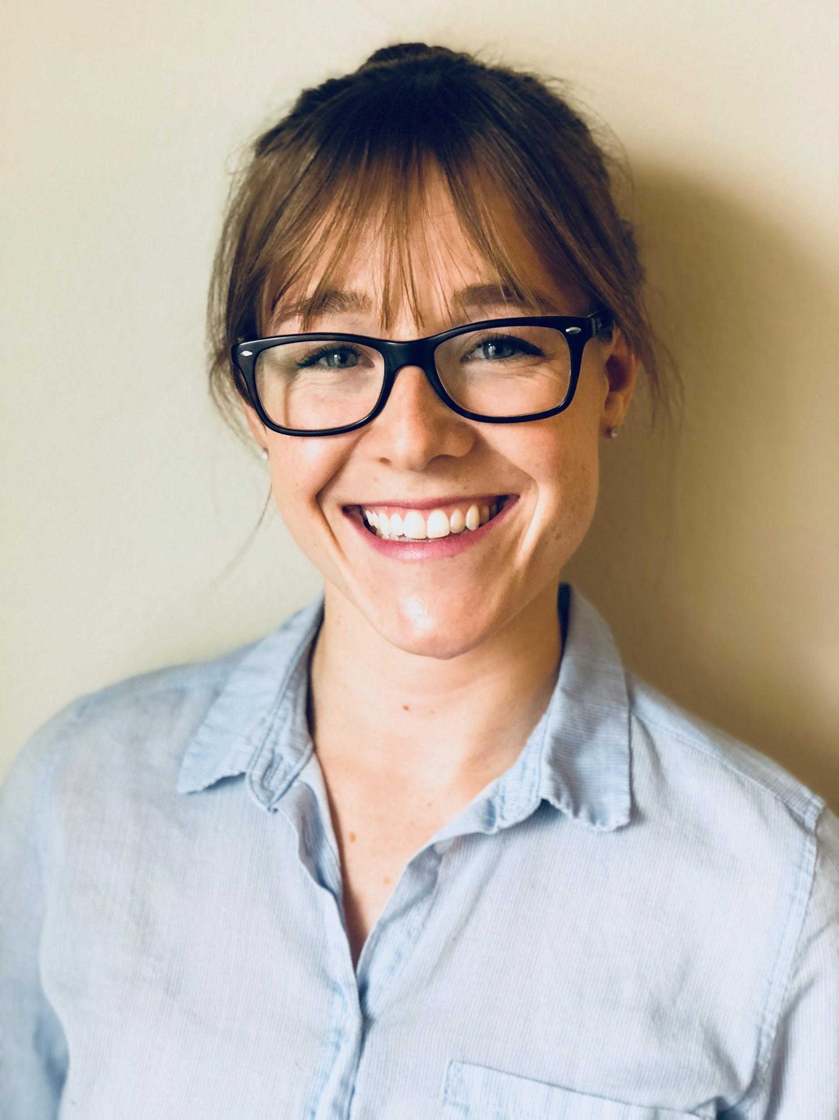
Katie Key Thomas
Graduate Student
School of Education
University of California-Irvine

Slide 29
Day 4 - Repeated Reading & Self-Evaluation
Synchronous | Asynchronous | Limited/No Technology
(S) Repeated reading and self evaluation and share with classmates/teacher | (S) Repeated reading and self evaluation on digital platform | (S) Repeated reading. Write down self evaluation and share with family member
Notes:
KATIE STARTS HERE
On day 4, students again do repeated reading aloud and, on this day, they complete a self-evaluation.
As you consider what repeated reading and self evaluation or reflection might look like and sound like, this might be a place to think about pedagogy and learning platforms. Do you want additional time to listen to particular students read, then maybe a synchronous setting makes sense. Is your synchronous time with students at a premium? Would you get the same outcomes from an asynchronous experience?
These are things to consider.

Slide 30
Day 4 - Repeated Reading & Self-Evaluation
What is it?
Reading same text
multiple times across several days
Why?
Reinforces proper pronunciation and phrase
Increases automaticity with words and phrases for repeated text, which will transfer to automaticity with other texts
Notes:
Repeated reading involves reading the same text multiple times across several days, allowing students additional practice opportunities.
Thinking about the self evaluation component, students might reflect on how their reading has improved over the week, words that they’ve now learned, or how they’re attending to punctuation as they read. This gives students an opportunity to think about the progress they’re making and build on their awareness of themselves as readers.

Slide 31
Day 5 - Perform Passage / Optional Assessment
Synchronous | Asynchronous | Limited/No Technology
(S) Perform passage to peers (could be through breakout rooms) | (S) Perform passage and records on digital platform | (S) Perform passage to family members
Notes:
The final day includes students reading aloud to an audience. That audience could be the teacher, peers in a breakout room, peers that listen to a digital recording, or a family member.

Slide 32
Day 5 - Perform Passage / Optional Assessment
What is it?
Opportunity to read aloud to an audience
Possible fluency assessment
Why?
Assess students’ development of fluent reading skills
Developing reading fluency is a growth process
Give encouragement
Notes:
Performing the passage for others creates another opportunity for additional feedback, commendation, and teacher assessment.
We’ve developed a parent resource to go with the model and that resource includes specific day to day guidelines for students and parents or family members. The resource will be shared in english and spanish.

Slide 33
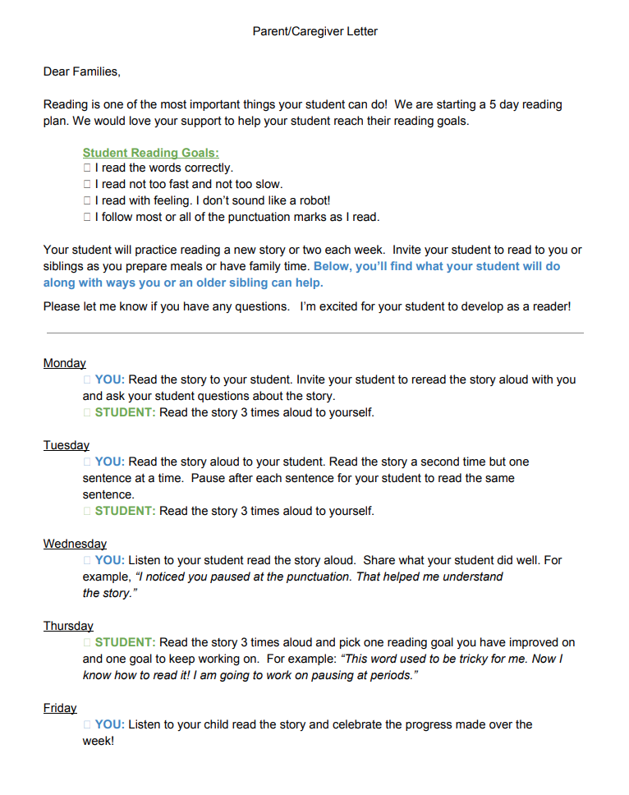
Family Engagement
Simple, easy to follow process
Communication with clear family and student roles
Notes:
We wanted to keep the routine and communication as simple as possible. The focus is on what students are doing and how families might engage. We also see this as being part of the parent engagement opportunities teachers and schools are facilitating, such as parent zooms and digital back to school nights.

Slide 34
Tech-Free Remote Environment Training
Notes:
In addition to family engagement and a parent resource for students in a no tech environment and phone calls for limited tech environments, there is also the option to send reading practice lessons or activities to students using Desmos, as mentioned earlier. The Desmos activity can be texted to families who have access to a smartphone. Desmos does not require WiFi. However, it does use data, which is something to keep in mind.
The video of the training is provided at the end of the webinar with other “Resources”. The video explains how to create a reading practice lesson in Desmos for students in a tech-free remote environment, which is defined here as no access to computers or tablets and no access to WiFi.

Slide 35
What’s one benefit this model offers to students?
Please respond using your blue Group Chat widget.
Notes:
Using the blue Group Chat widget, please share what you see is one benefit this model offers to students.

Slide 36
Section 4 Perspectives from a Site Administrator and First Grade Teacher
Notes:
We’ll now hear perspectives of this instructional routine from a site administrator and first grade teacher.

Slide 37
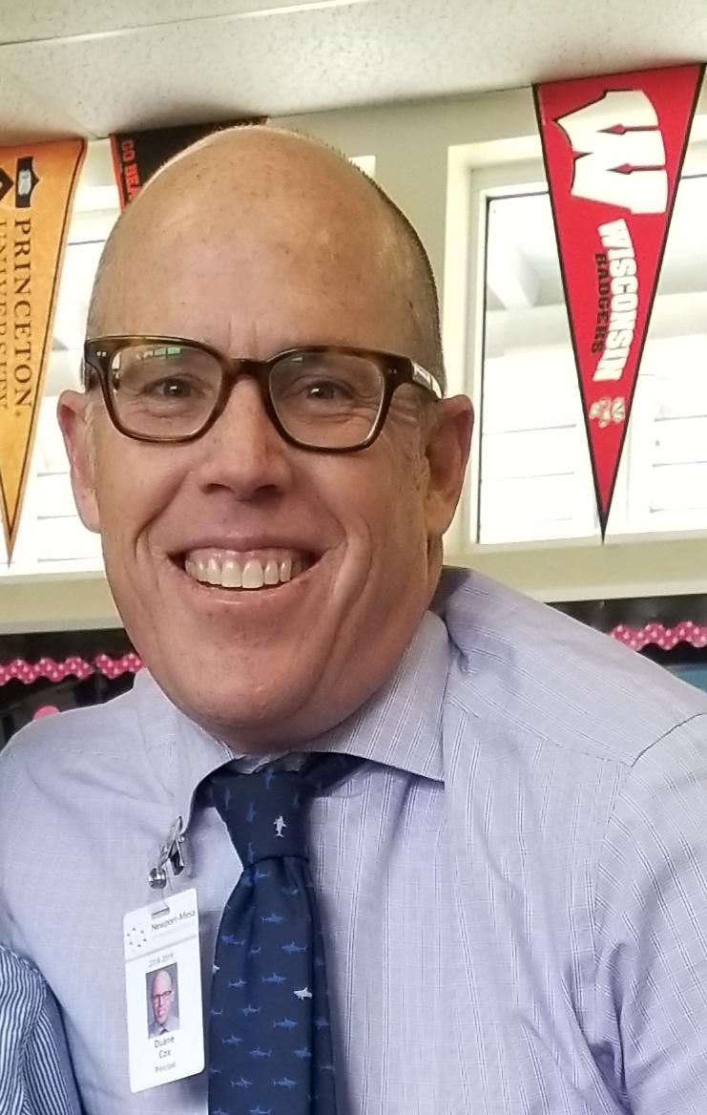
Duane Cox
Site Administrator
Rea Elementary
Newport-Mesa Unified School District
Notes:
First, we’ll hear from Dr. Duane Cox who is the site administrator for Rea Elementary in the Newport-Mesa Unified School District.

Slide 38
An Administrator’s Perspective: Duane D. Cox, Ed.D.
Building a Vision for Teaching and Learning:
Building on what we know about teaching reading
Repeated reading
Modeled Reading
Practice and feedback
Access to grade level texts
Reaching ALL children
Provide teachers with the experience of learning
Collaboration around practices
Notes:
Duane’s Notes: What I see as the benefit to this. Excited about… looking forward to… From my perspective.
Duane introduce Megan

Slide 39
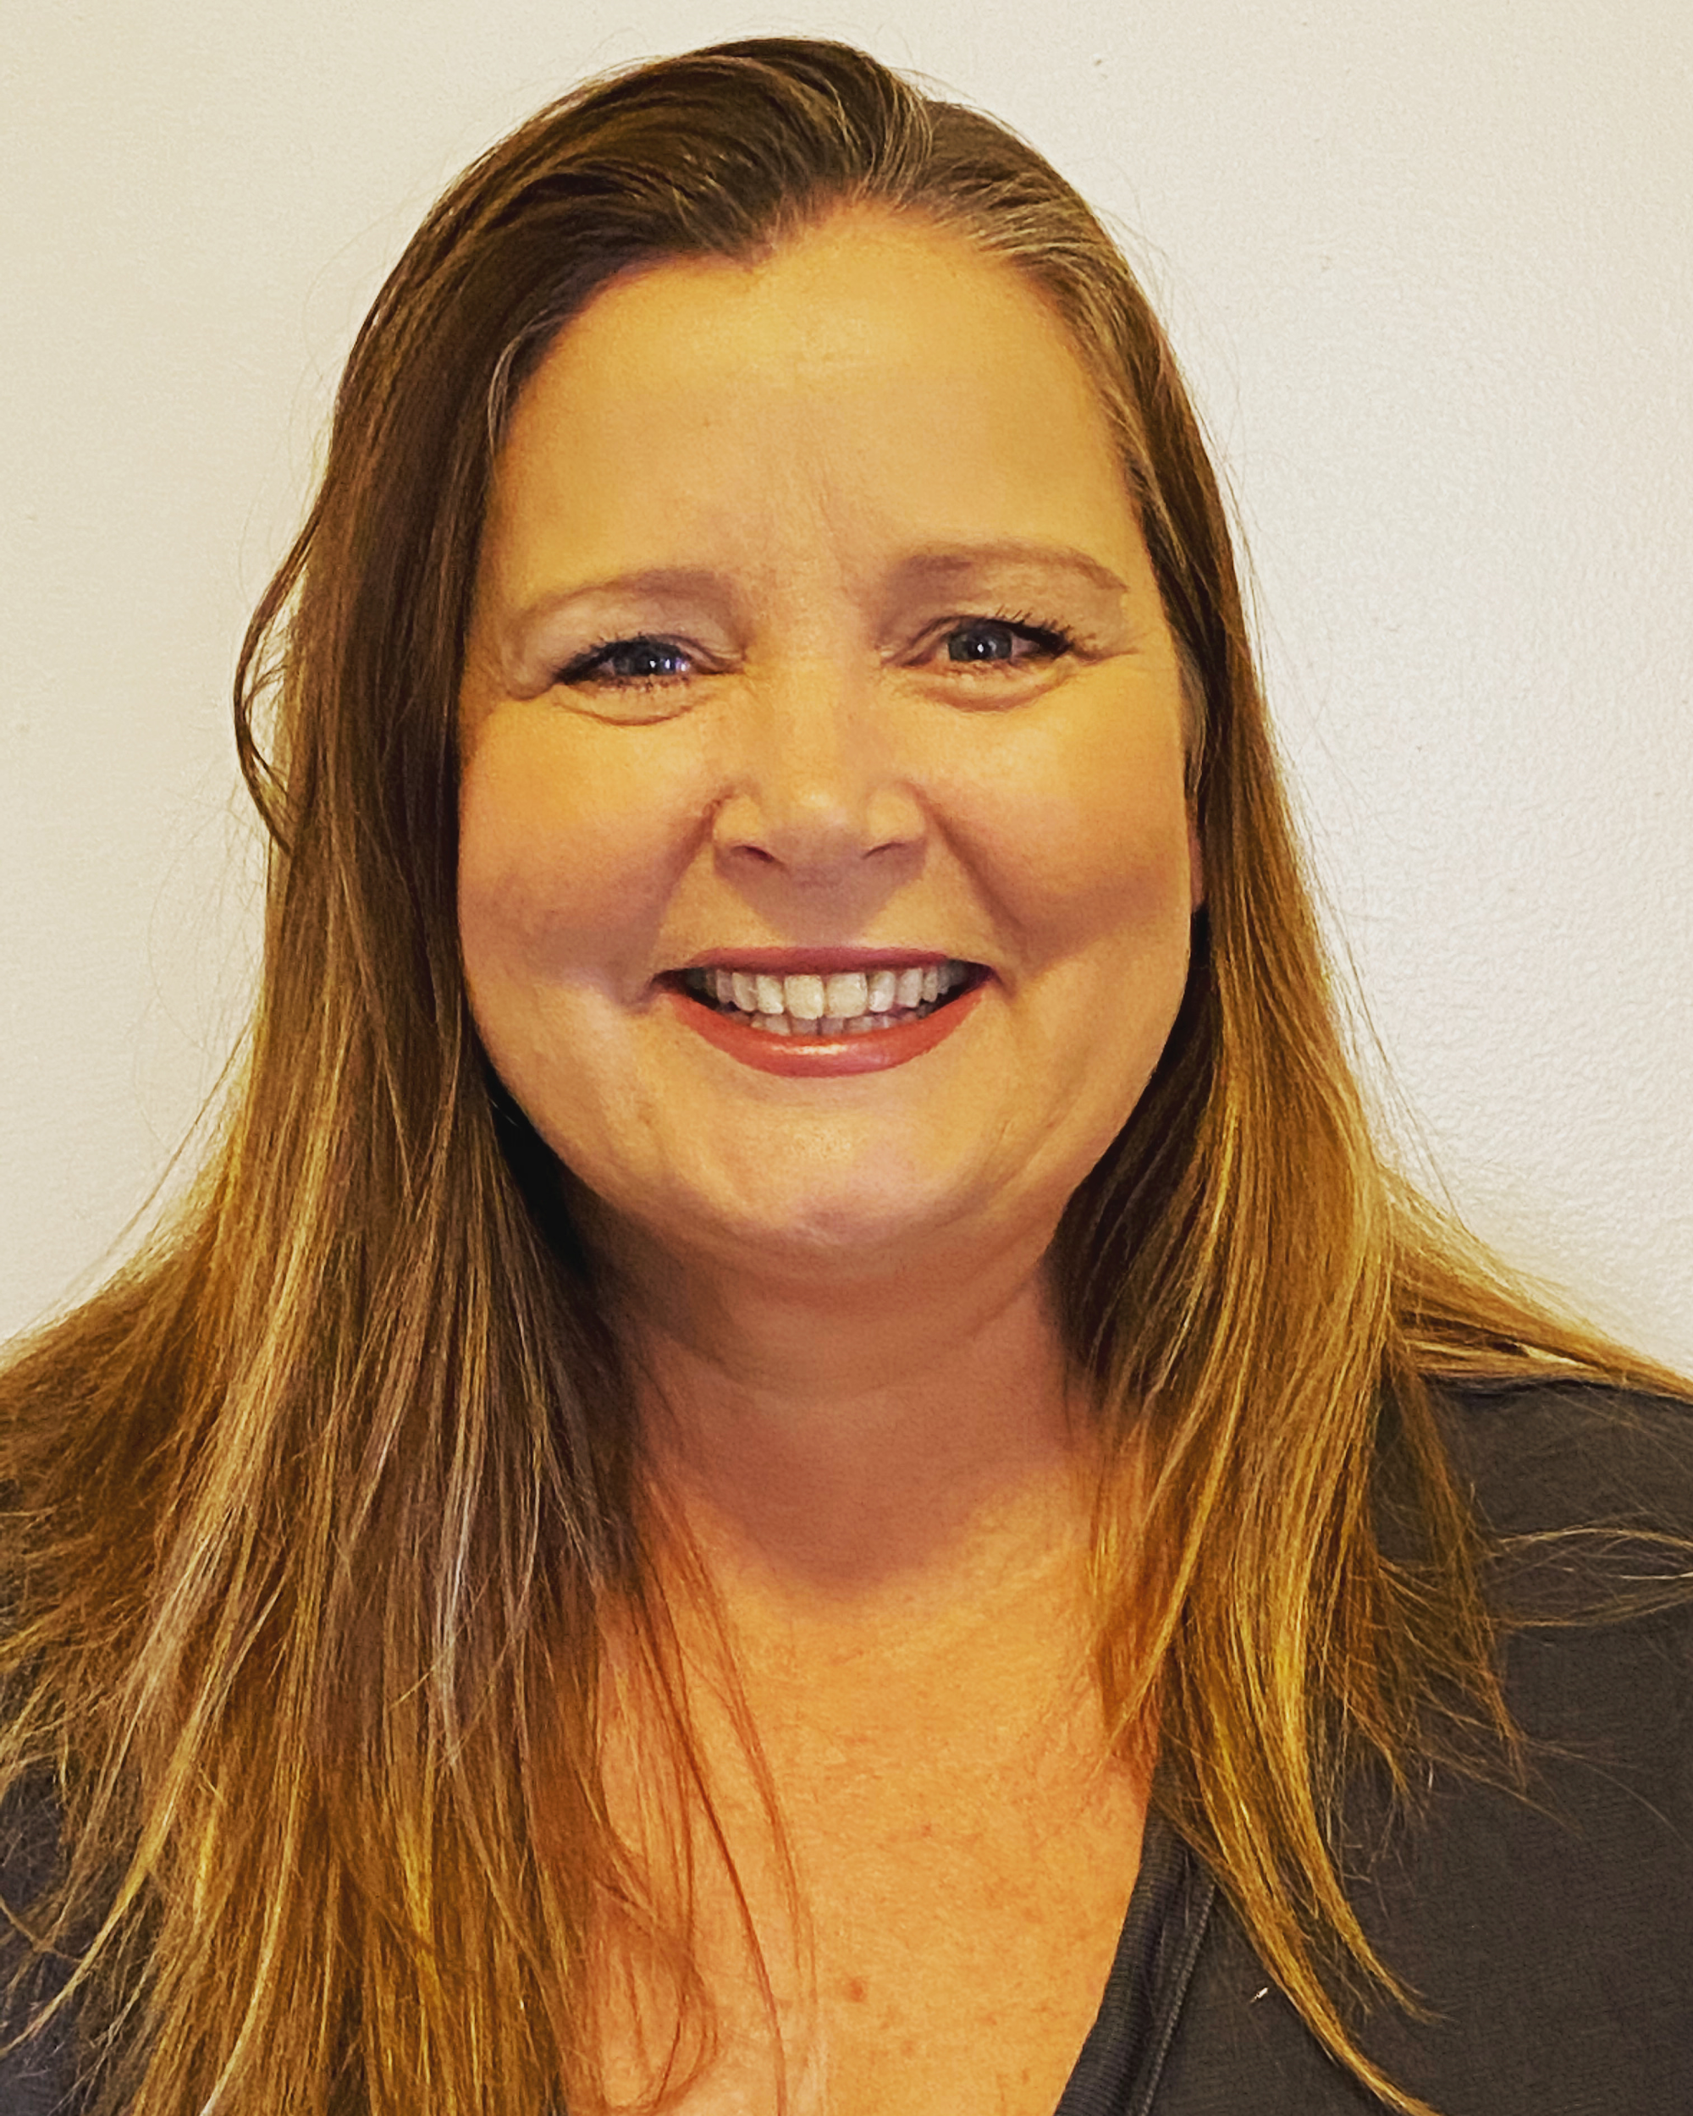
Megan Merrick
First Grade Teacher
Rea Elementary
Newport-Mesa Unified School District

Slide 40
Getting Started - Megan Merrick
First Day: Model read story on screencastify
Posted screencastify on google
classroom
Discussed expectations during zoom
session
Second Day: Echo read in small groups
Allows teacher to listen to students read
Third Day: Today students recorded themselves
reading on Seesaw
Notes:
First grade team are all using the process, we’re each doing it a bit differently depending on our lifestyles and schedules. All of our students are getting the same reading practice and it’s the same reading practice they would be getting in the classroom. We’re delivering curriculum they would have had.

Slide 41
Questions for Our Guests?

Slide 42
Resource Name | Link
Join Our Network! | www.achievethecore.org/ca-signup
Google Certified Educator | Certified Educator Level 1
Screencastify Certification | Certification Courses | The #1 Screen Recorder for Chrome
Zoom Video Tutorials | Zoom Video Tutorials
Seesaw Tutorials | Seesaw Help Center
Fluency Packets from SAP | ELA / Literacy
Desmos Collection - Days 1 & 2 | Reading Practice Collection in Desmos
Rationale for Activities | Routine Overview & Rationale
Tech Free Training | Screencastify & Desmos
Notes:
ask SAP….

Slide 43
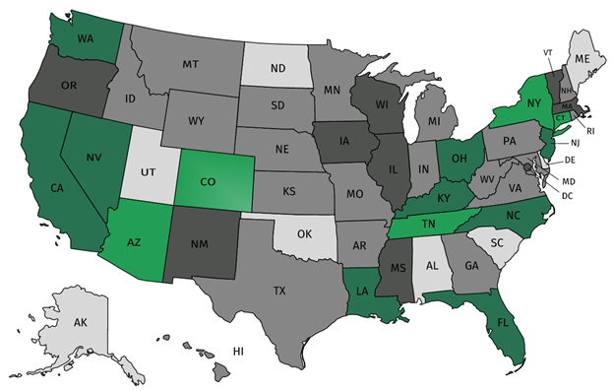
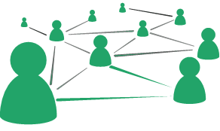
Join our network!
Join a national network of educators
Connect with state networks
Be a part of creating new tools and resources in partnership with SAP
Keep up to date on free resources, upcoming SAP webinars/professional learning opportunities, job postings and more!
Notes:
If you found tonight’s webinar helpful, we’d like to invite you to join our Core Advocate network! We’re committed to solving real problems that real teachers have and we know the best way to do this is to know more about what folks are experiencing.
As part of our national network, you have opportunities to connect with educators across the country, maybe even the network in your state! You can keep up to date on tools and resources available on Achieve the Core, as well as a variety of virtual learning opportunities and other ways to engage with us. We also work with educators in our network to help us build tools and resources.
We’d love to learn about who you are, where you work, the types of things you’re interested in and the expertise you already have. This way, we will be able to tailor our webinars and other opportunities to your needs and interests (we may even tap you to be our next webinar panelist).

Slide 44
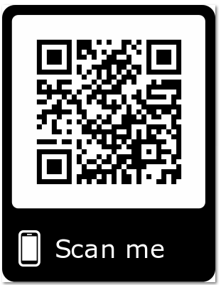
Please Join Us!
https://achievethecore.org/ca-signup
Twitter: twitter.com/achievethecore
Facebook: facebook.com/achievethecore
Pinterest: pinterest.com/achievethecore
Notes:
We encourage you to join the network by filling out this survey completely at atc.org/ca-signup

Slide 45
Please Join Us Again Next Month!
Next month’s webinar:
Math Resource Fixers Uppers with Jason Zimba
May 6, 2020 @ 7pm EST
Register Here: https://event.on24.com/wcc/r/2258898/4892BBD9D5CC0AA4607F8118466C2798

Slide 46
Thank You!

