Slide 1
Structuring Synchronous and Asynchronous Learning in the 2020-21 School Year: Strategies for Inclusive Engagement
Core Advocates Monthly Webinar
July 15, 2020
The webinar will begin shortly.
Check your Resource widget to preview the resources for today’s session! Use the Group Chat to introduce yourself!
Notes:
First timer poll
Handouts:
While we’re waiting, we’d like you to participate in a quick poll so we can get an understanding of who’s on the webinar with us tonight.

Slide 2
Introductions
Your hosts from Student Achievement Partners:
Pascale Joseph Project Coordinator,
Tools and Classroom Resources, SAP
This month’s presenters:
Bethany Lockhart Johnson Kindergarten Teacher
Downey Unified School District
Matt Kerrigan 4th Grade Math Teacher
Mastery Charter Schools
Eric Garnier 4th Grade Math & Science Teacher
Mastery Charter Schools
Claire Rivero Digital Strategy Manager
Student Achievement Partners

Slide 3
How many Core Advocate Webinars have you attended?
Please use the Questions tab on your control panel to respond.
If using a poll, please put up to 5 answer choices in the notes section below and indicate if attendees should choose only one response or multiple responses.

Slide 4
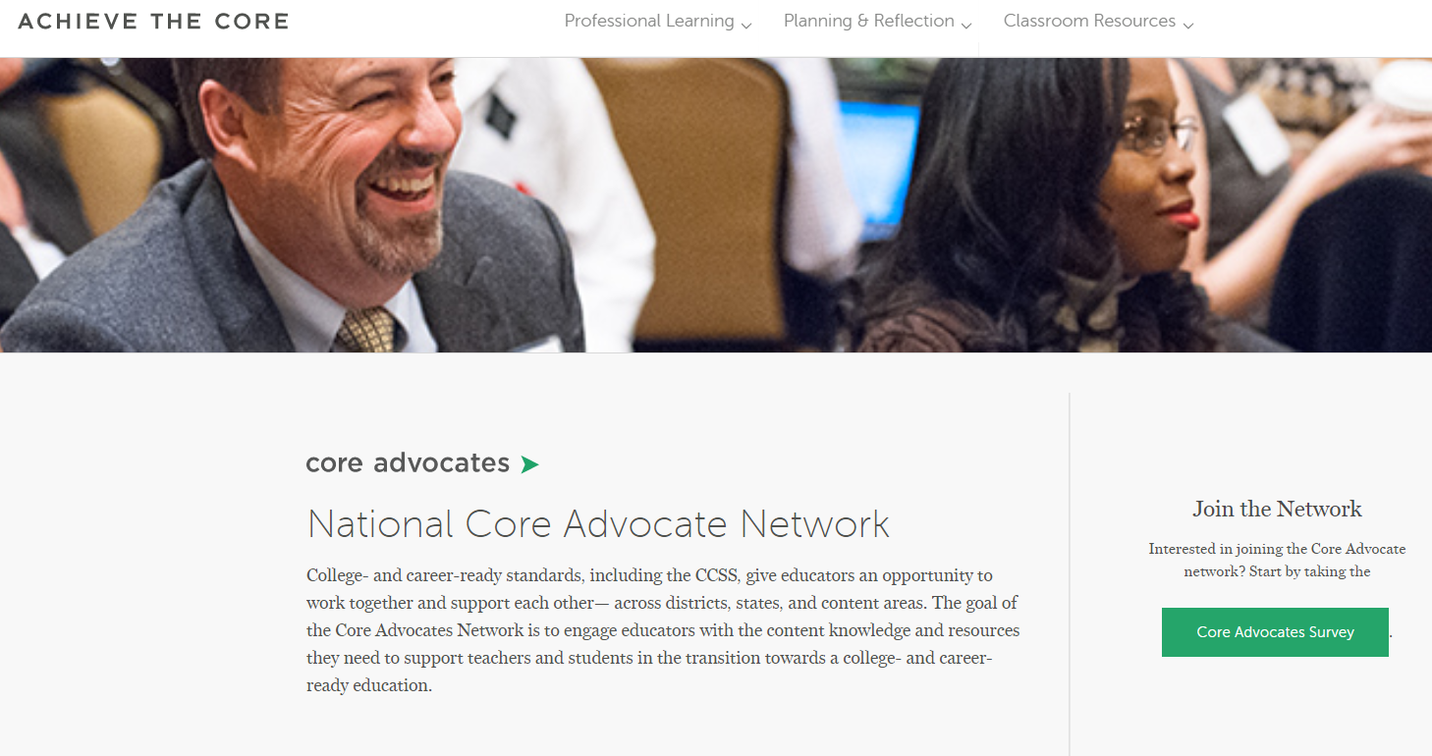
Join Our Network!
www.achievethecore.org/ca-signup
Notes:
If you find tonight’s webinar helpful, we’d like to invite you to join our Core Advocate network! We’re committed to solving real problems that real teachers have and we know the best way to do this is to know more about what folks are experiencing.
We’d love to learn about who you are, where you work, the types of things you’re interested in and the expertise you already have. This way, we will be able to tailor our webinars and other opportunities to your needs and interests (we may even tap you to be our next webinar panelist). So we encourage you to join the network by filling out this survey completely at atc.org/ca-signup

Slide 5
Learn More About Us!
Contact Jennie Beltramini (jbeltramini@studentsachieve.net ) Joy Delizo-Osborne
(jdelizo-osborne@studentsachieve.net)
Complete this survey to join our database (and mailing list): www.achievethecore.org/ca-signup
Visit our website: www.achievethecore.org
Notes:
If you’d like to learn more about the network, contact Jennie (her email is here).
We also want to invite you to join the network by signing up at achievethecore.org/ca-signup and visit our website for more info and opportunities

Slide 6
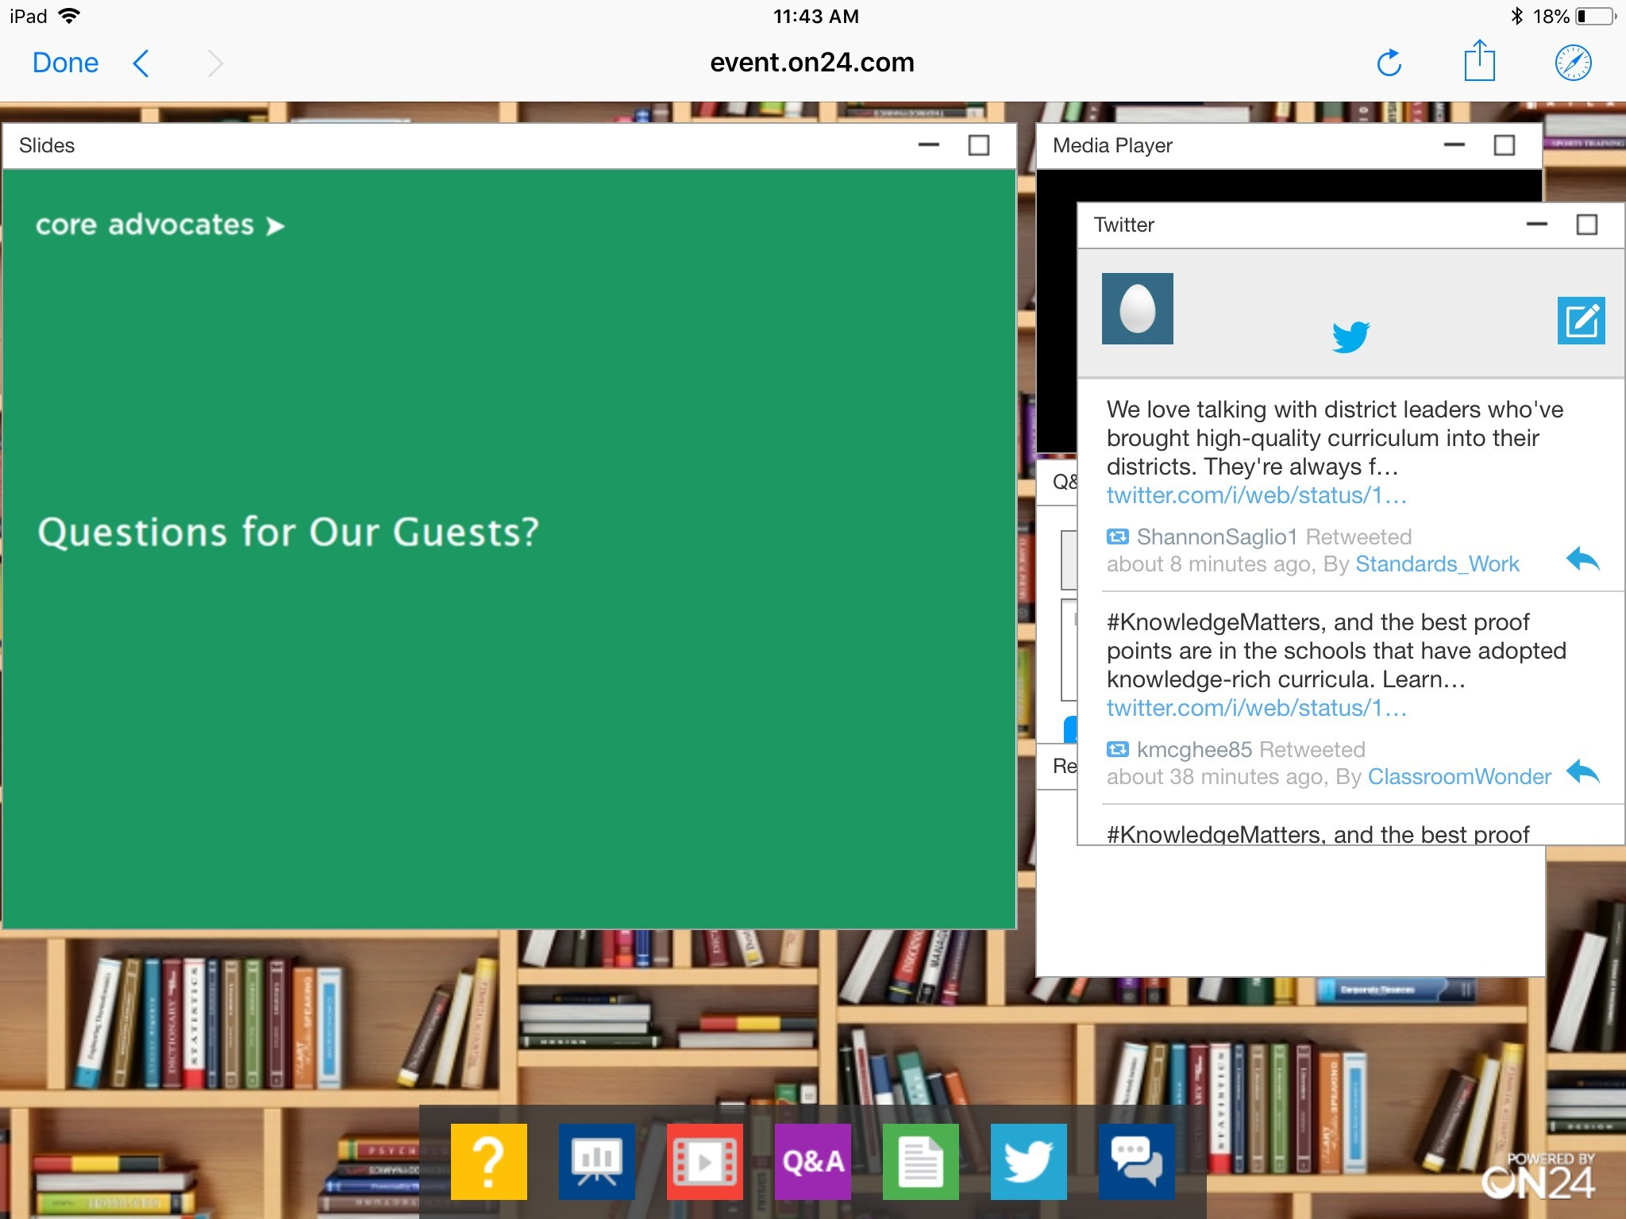
Tweet with Us!
Please feel free to tweet during and after the webinar using #coreadvocates
@achievethecore
@JennieBeltro
@lockhartedu
Click here!

Slide 7
Engage with Us!
During the webinar:
Question just for the presenters/ tech help
Resources
Group chat
After the webinar:
– Access to recording will be emailed to you.
Take our survey in 2 weeks and receive a certificate verifying 1 hour of professional learning.

Slide 8
Goals of the Webinar
Reimagine math share outs as asynchronous opportunities to leverage student voices
Identify co-teacher model in online classrooms
Leverage synchronous online platforms to increase student engagement and participation
Introduce the Illustrative Mathematics K-8 Talking Math discussion resources
Notes:
We have four main goals for our webinar tonight. They are to...

Slide 9
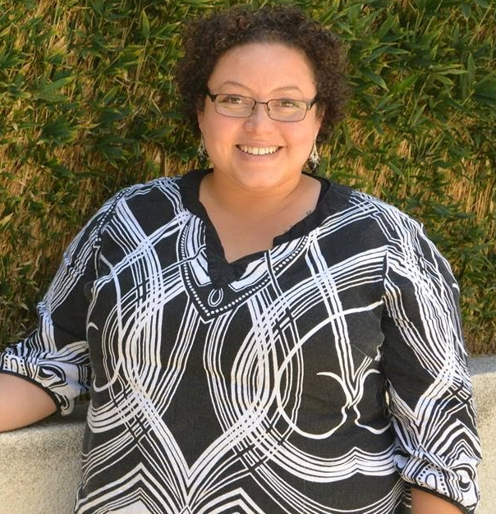
Bethany Lockhart Johnson
Kindergarten Teacher
Long Beach, CA

Slide 10
Section 1: How can teachers utilize technology to amplify student voices and ideas?

Slide 11
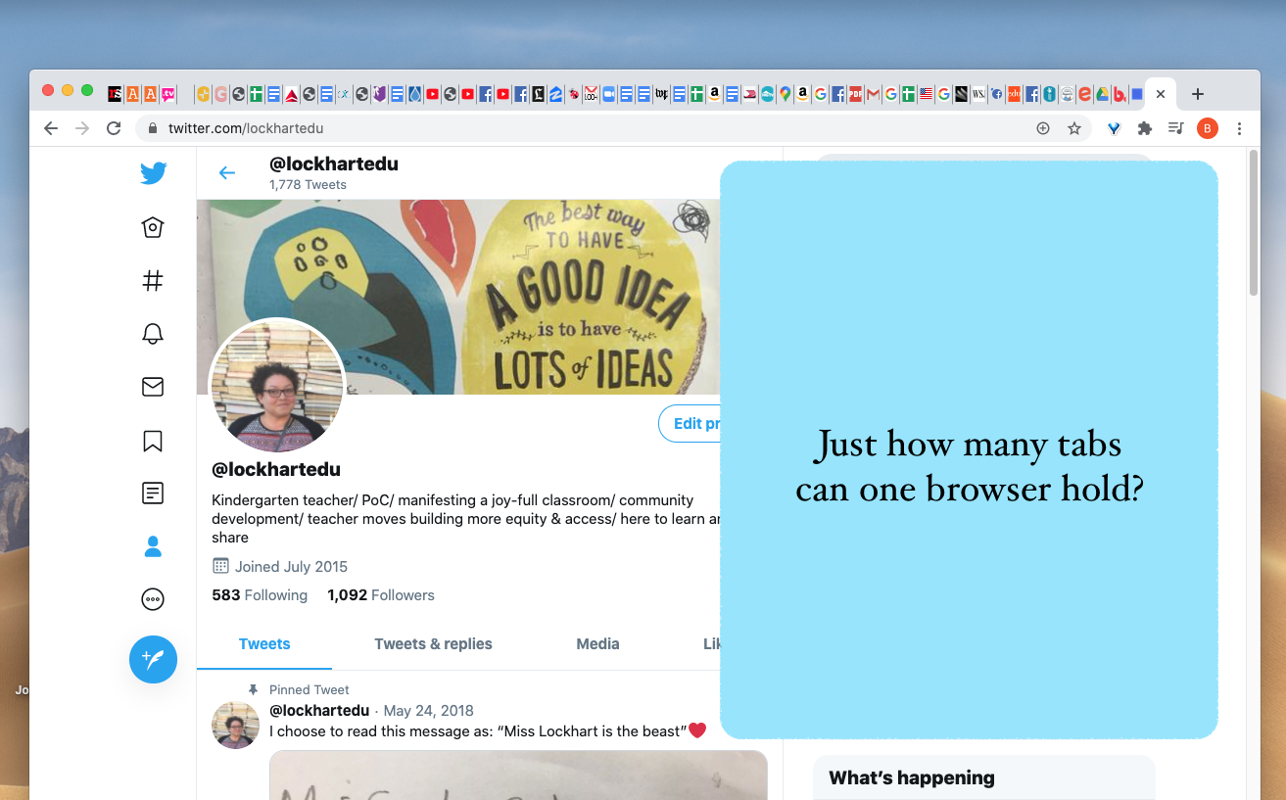

Slide 12
My considerations for distance learning
District/ school site expectations
Teacher trust
What did learning look like in our classroom v. what does it look like now?
Focus on socio-emotional and community building

Slide 13
Mapping our time together
Monday | Tuesday | Wednesday | Thursday | Friday
Small group synchronous zoom calls (focus ELA: reading, word work) | Recorded read-alouds | Small group synchronous zoom calls (focus ELA: reading, word work) | Recorded read-alouds | Small group synchronous zoom calls (focus ELA: reading, word work)
 | SeeSaw assignments |  | SeeSaw assignments | All class zoom call (focus: art, science, games, community development)
 | One-on-one sessions as needed, Parent/ caregiver communication |  | One-on-one sessions as needed, Parent/ caregiver communication

Slide 14
Creating an asynchronous math share out
Major work of the grade is prioritized
Operations and Algebraic Thinking
K.OA.A.3 Decompose numbers less than or equal to 10 into pairs in more than one way, e.g., by using objects or drawings, and record each decomposition by a drawing or equation (e.g., 5 = 2 + 3 and 5 = 4 + 1).
K.OA.A.1 Represent addition and subtraction with objects, fingers, mental images, drawings, sounds (e.g., claps), acting out situations, verbal explanations, expressions, or equations.
Multiple points of entry within problem for students
Apps that are easy for students to interface with/ students are familiar with (Flipgrid, Seesaw)
Students voices heard and prioritized
Students engaged in each others thinking
achievethecore.org

Slide 15
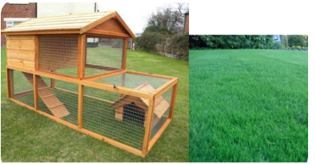
Mrs. Minton has 10 rabbits in her backyard.
Sometimes the rabbits are in the hutch and sometimes they are out on the grass.
Show the different ways the rabbits can be in Mrs. Minton’s backyard.

Slide 16
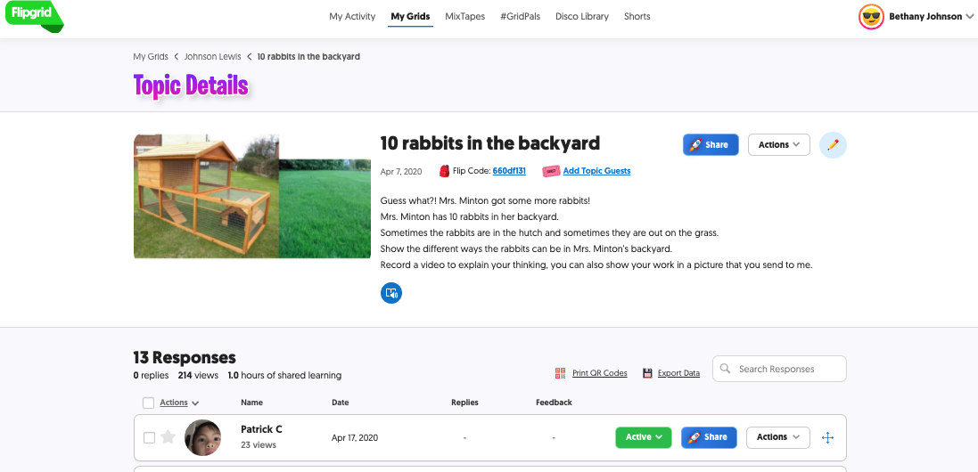
Creating an asynchronous math share out

Slide 17
VIDEO HERE

Slide 18
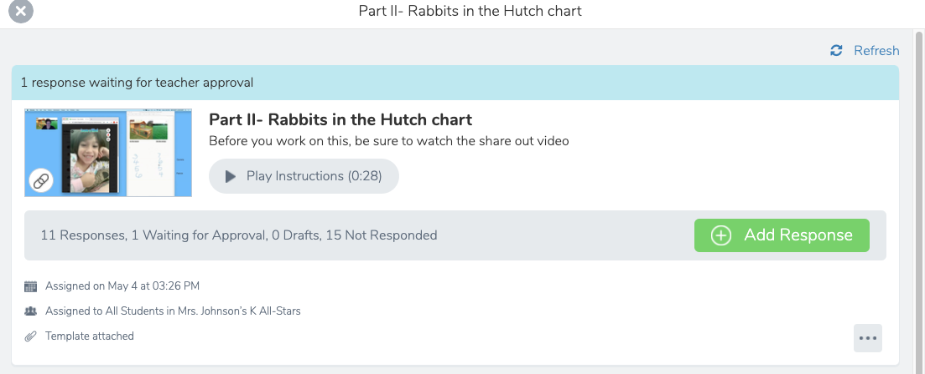
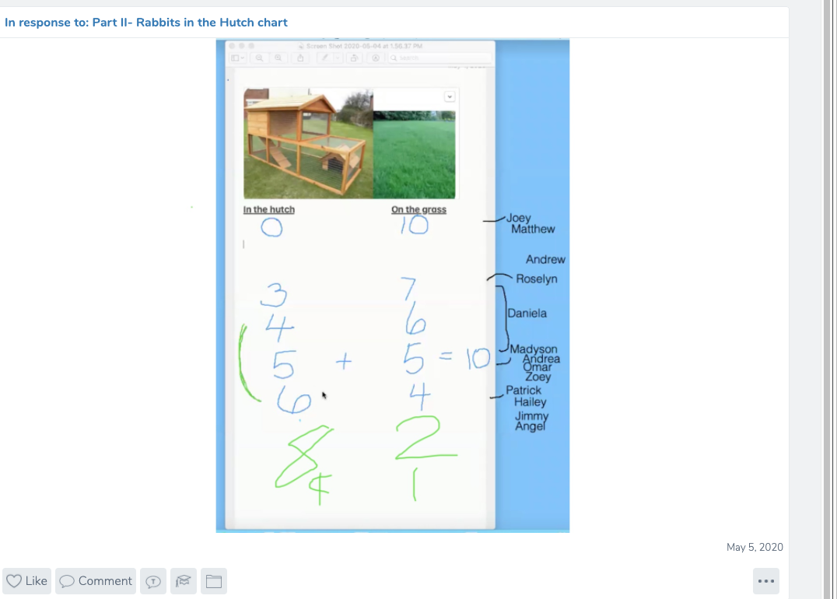
Next steps

Slide 19
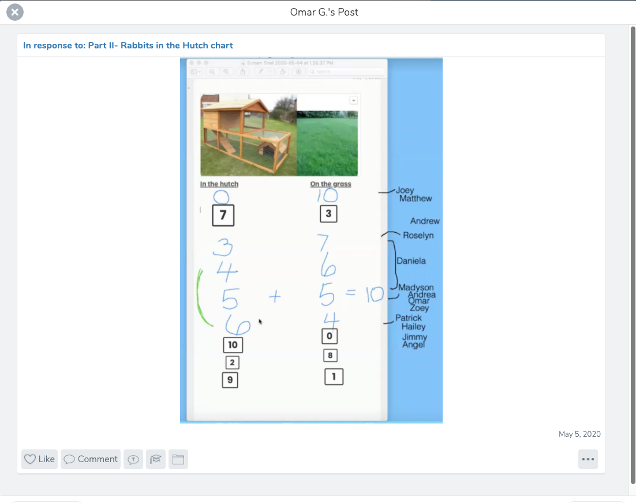
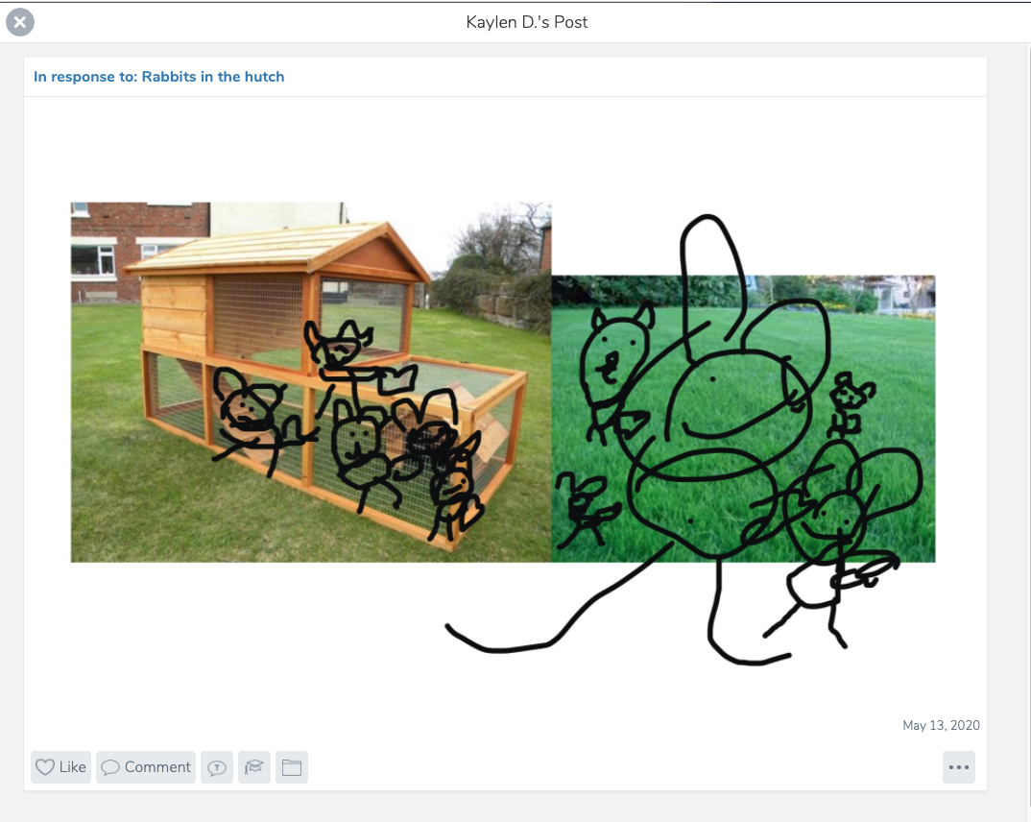
Next steps

Slide 20
Creating an asynchronous math share out
Major work of the grade is prioritized
Operations and Algebraic Thinking
K.OA.A.3 Decompose numbers less than or equal to 10 into pairs in more than one way, e.g., by using objects or drawings, and record each decomposition by a drawing or equation (e.g., 5 = 2 + 3 and 5 = 4 + 1).
K.OA.A.1 Represent addition and subtraction with objects, fingers, mental images, drawings, sounds (e.g., claps), acting out situations, verbal explanations, expressions, or equations.
Multiple points of entry within problem for students
Apps that are easy for students to interface with/ students are familiar with (Flipgrid, Seesaw)
Students voices heard and prioritized
Students engaged in each others thinking
achievethecore.org

Slide 21
Thinking about the activity you just learned about:
What opportunities do you see for student sensemaking as they work through the number problem about rabbits in the backyard?
Please respond in the group chat

Slide 22
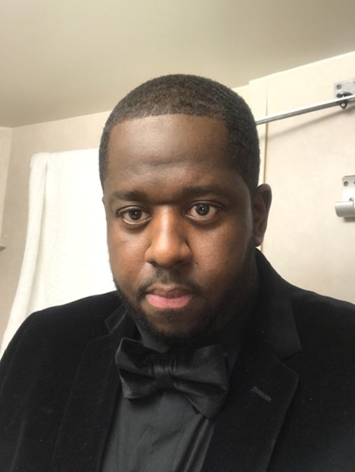
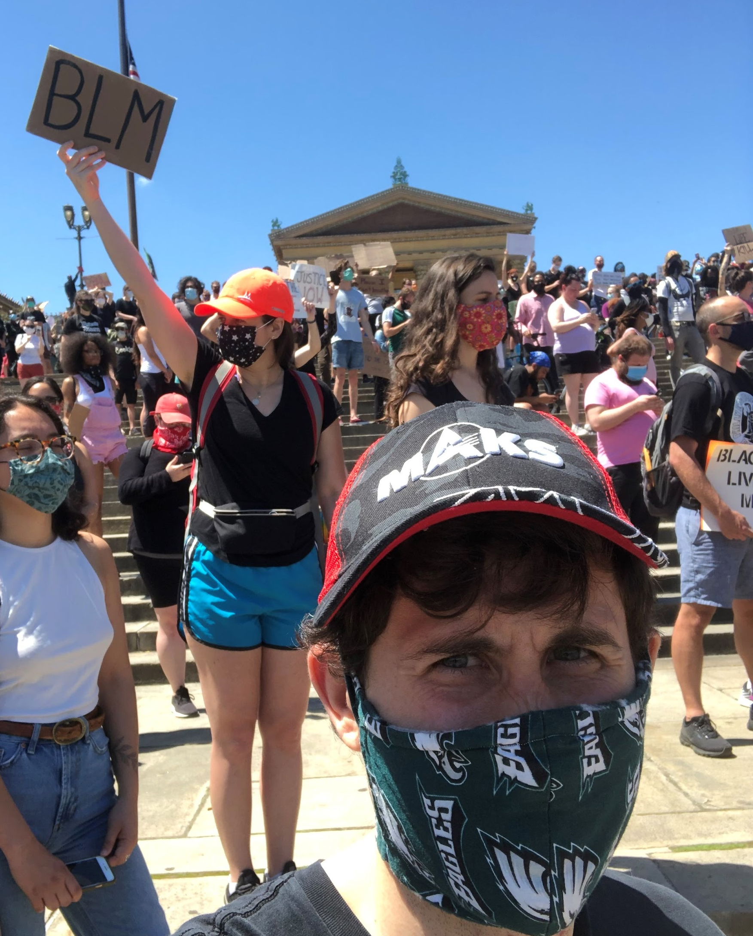
Matt Kerrigan
4th Grade
Math Teacher
Philadelphia, PA
Eric Garnier
4th Grade
Math & Sci. Teacher
Mastery Charter Schools

Slide 23
Section 2: How can you deepen student engagement during online live lessons?

Slide 24
Co-Teaching Roles and Responsibilities
Lead Presenter
Behind The Scenes Manager
Focus on delivery of content and student understanding
Facilitate lesson
Respond and adjust instruction to real time student data
Focus on student engagement
Manage Online Platform (mute, waiting room)
Respond to private messages from students
Troubleshoot and Communicate with Families
Notes:
G*Synchronous Online Learning presents additional tasks and responsibilities for a teacher. We found ourselves often getting hung up on troubleshooting individual issues and having to slow the lesson to a crawl. Not a very fun or engaging class if students have to wait while you have to respond to a single issue.
So we created 2 clear co-teaching responsibilities: lead presenter focus on delivery of content and student understanding and the behind the scenes manager focuses on student engagement. This freed up the class to move much more smoothly and get students engaged.
These roles can be set for the entire lesson or you can swap depending on the moment in the class.

Slide 25
After the honeymoon phase on online learning wore off...
Notes:
G*

Slide 26
Nearpod
Free (with $$ tiers) presentation platform
Can host live or asynchronous lessons
Compatible with Google Slides & PPT
Can embed interactive features (external websites, Youtube videos, written responses, Virtual Field Trips, Flocabulary, Flipgrid) into presentation
Notes:
G*

Slide 27
Nearpod Draw It Feature
Allows any slide to turn into a background where students can then interact with the canvas.
Perfect for: Solving math problems, highlighting text, vocabulary matching games, marking up music sheets
Notes:
Kerrigan

Slide 28
Strategy 1: Real-Time Feedback
Notes:
Kerrigan

Slide 29
Strategy 2: Student Work Explanations
Notes:
Kerrigan

Slide 30
How could you use Nearpod in a virtual classroom to engage your students?
Please respond in the group chat.

Slide 31
Claire Rivero
Digital Strategy Manager,
Tools and Classroom Resources
Student Achievement Partners

Slide 32
Section 3: “Talking Math” Discussion Questions Illustrative Mathematics

Slide 33
What are the “Talking Math” prompts?
Open-ended prompts or images to spark conversation
Thought-provoking daily questions
K-5 -- 70 days of grade-specific questions
6-8 -- 9 weeks of daily questions for 6-8 grade-band
Available in English and Spanish
Notes:
We have three main goals for our webinar tonight. They are to...

Slide 34
What we love about these….
Deepens understanding of key math topics that represent the Major Work of the Grade
Strategic design for inclusive learning:
All students will have an entry point
All students will find some aspects that are familiar and some aspects that are new/challenging
Guidance on how to deliver
Asynchronously (independently)
Asynchronously (with family/caregiver involvement)
Synchronously (virtual or in-person) teacher-led implementation
In K-5: standards alignment across related domains to demonstrate a potential progression of questions across grades (great for cross-grade planning!)

Slide 35
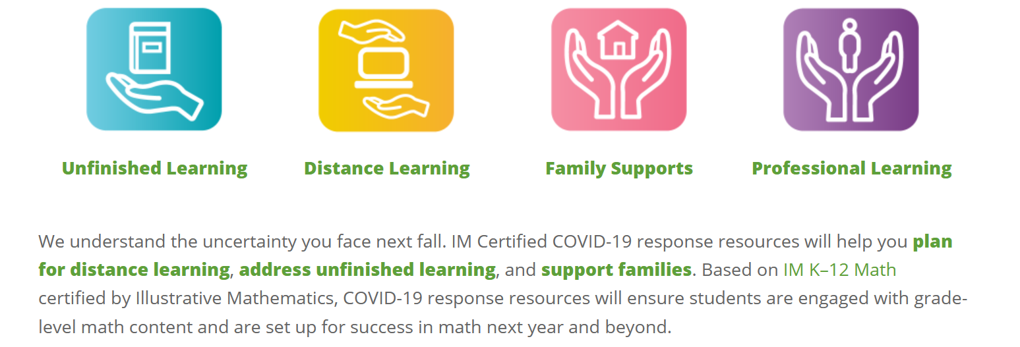
Keep an eye out!
We’ll be sharing more ways to support middle school and high school learners (synchronously and asynchronously) in the coming weeks!
In the meantime, check out Illustrative Mathematics’ Distance Learning Resource Hub

Slide 36
Questions for Our Guests?

Slide 37
Resource Name | Link
Nearpod- online platform to build interactive lessons | https://nearpod.com/
FlipGrid- a platform where students can record and share video responses to prompts | https://info.flipgrid.com/
Which Number Doesn’t Not Belong: A great prompt to stimulate math discussions | https://wodb.ca/numbers.html
SeeSaw- a platform where students can complete and share teacher created assignments | https://web.seesaw.me
Illustrative Mathematics K-5 Talking Math Slide Deck | https://docs.google.com/presentation/d/1R0ob2DEuh2QRYAGKECMzbTnoswr3bbM_B6Dp_AHkoNg/edit#slide=id.g8275916e8d_21_10
Illustrative Mathematics 6-8 Talking Math Slide Deck | https://docs.google.com/presentation/d/1A386qthrf-nqWWTw0mhlthVUw0I7Ui2f15zfcF5RFwQ/edit#slide=id.g74a1aaae70_520_8
Illustrative Mathematics Distance Learning Resources | https://www.illustrativemathematics.org/distance-learning/#DL

Slide 38
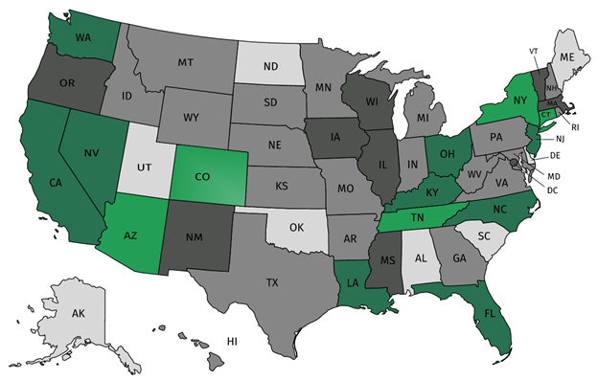
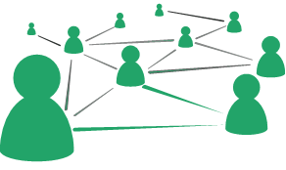
Join our network!
Join a national network of educators
Connect with state networks
Be a part of creating new tools and resources in partnership with SAP
Keep up to date on free resources, upcoming SAP webinars/professional learning opportunities, job postings and more!
Notes:
If you found tonight’s webinar helpful, we’d like to invite you to join our Core Advocate network! We’re committed to solving real problems that real teachers have and we know the best way to do this is to know more about what folks are experiencing.
As part of our national network, you have opportunities to connect with educators across the country, maybe even the network in your state! You can keep up to date on tools and resources available on Achieve the Core, as well as a variety of virtual learning opportunities and other ways to engage with us. We also work with educators in our network to help us build tools and resources.
We’d love to learn about who you are, where you work, the types of things you’re interested in and the expertise you already have. This way, we will be able to tailor our webinars and other opportunities to your needs and interests (we may even tap you to be our next webinar panelist).

Slide 39
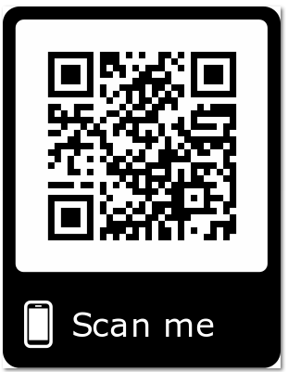
Please Join Us!
https://achievethecore.org/ca-signup
Twitter: twitter.com/achievethecore
Facebook: facebook.com/achievethecore
Pinterest: pinterest.com/achievethecore
Notes:
We encourage you to join the network by filling out this survey completely at atc.org/ca-signup

Slide 40
How did you enjoy this evening’s webinar?
Rate 1 - 5

Slide 41
Please Join Us Again Next Month!
Next month’s webinar:
Priority Instructional Content: Leveraging the Structure of College- and Career-Ready Mathematics and ELA/Literacy Standards. August 5, 2020 @7PM EST
Register Here: https://event.on24.com/wcc/r/2451578/D0772285C0F6D175DB64A5754B616591

Slide 42
Thank You!

