Slide 1

Supporting Students: Remote Observation, Just-in-Time Instruction, and Edcite's Real Time Connect
Core Advocates Monthly Webinar
August 27, 2020
The webinar will begin shortly.
Check your Resource widget to preview the resources for today’s session! Use the Group Chat to introduce yourself!
Notes:
First timer poll
Handouts:
While we’re waiting, we’d like you to participate in a quick poll so we can get an understanding of who’s on the webinar with us tonight.

Slide 2

Introductions
Your hosts from Student Achievement Partners:
Pascale Joseph
Project Coordinator,
Tools and Classroom Resources, SAP
This month’s presenters:
Katie Keown
Senior Literacy Specialist
Advisory Support, SAP
Julia Sweeney
Director of Sales
Edcite
Brian McIntosh
Product Manager
Edcite

Slide 3
How many Core Advocate Webinars have you attended?
Please use the Questions tab on your control panel to respond.
If using a poll, please put up to 5 answer choices in the notes section below and indicate if attendees should choose only one response or multiple responses.

Slide 4


Join Our Network!
Complete this survey & join our mailing list: www.achievethecore.org/ca-signup
Questions? Contact:
  Jennie Beltramini
  (jbeltramini@studentsachieve.net)
  Joy Delizo-Osborne
  (jdelizo-osborne@studentsachieve.net)
Learn more about us on our website: https://achievethecore.org/page/1026/national-core-advocate-network
Notes:
If you’d like to learn more about the network, contact Jennie (her email is here).
We also want to invite you to join the network by signing up at achievethecore.org/ca-signup and visit our website for more info and opportunities

Slide 5

Engage with Us!
During the webinar:
Question just for the presenters/ tech help
Resources
Group chat
Twitter
Certificate
Feel free to tweet during and after the webinar using #coreadvocates
@achievethecore
@edciteteam
@kckeown
@juliasween

Slide 6
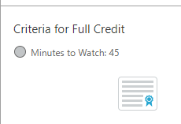
After the webinar
A certificate will be available via the Certification box to the right.
Click on the blue-ribbon icon to print or download the certificate at the end of the webinar.
Access to recording will be available via your registration link & posted on Achieve the Core
Take our short survey at the end of the month and be entered into a raffle for a $25 Amazon gift card.

Slide 7
Goals of the Webinar
develop a shared understanding of the purpose of assessment as a tool for learning
consider some content-specific recommendations for assessment practices
review the Edcite platform and how to support students from a distance
Notes:
We have three main goals for our webinar tonight. They are to...

Slide 8
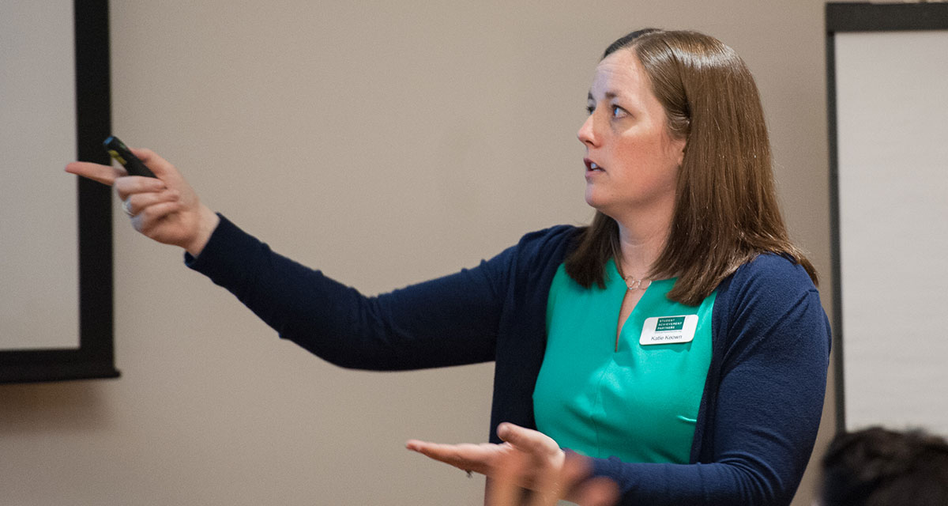
Katie Keown
Senior Literacy Specialist
Wheaton, Illinois
please enter a head shot here

Slide 9
Section 1: How should we view assessment for the 2020-21 school year?

Slide 10
Assessment is a tool to support grade-level work
Guiding Principle
Assessment should ...
be used to determine how to bring students into grade-level instruction, not whether to bring them into it.
center on formative practices (exit tickets, student work, and student discussions, etc.) to inform instruction.
include targeted checks for specific subject and grade-level instructional purposes (specifically, phonics or math fluency inventories, checks for reading fluency).
Source: 2020-21 Priority Instructional Content in ELA/Literacy and Mathematics
Notes:
Big Idea: Assessment should be used in service of grade-level instruction and should NOT be the first thing we ‘do to students’ when the return to learning in the fall.
Notes:
Focus on using assessment as a tool, a way for you and your educators to determine what students already know and can do. When you have a good understanding of your kiddos strengths, you can then determine what supports are needed to bring them into grade-level work.
So how do you do this? In a word - formative practices. This is formal tools like the exit tickets, but it is also listening to students converse in small Zoom groups or listening to how they respond to
Targeted skills check when appropriate for instructional purposes
Notice what we haven’t encouraged: interim assessments divorced from instructional materials, sorting/leveling/grouping/tracking students according to assessment results

Slide 11
Formative Assessment PRACTICES
“Formative assessment is a planned, ongoing process used by all students and teachers during learning and teaching to elicit and use evidence of student learning to improve student understanding of intended disciplinary learning outcomes and support students to become self-directed learners.
Effective use of the formative assessment process requires students and teachers to integrate and embed the following practices in a collaborative and respectful classroom environment:
Clarifying learning goals and success criteria within a broader progression of learning;
Eliciting and analyzing evidence of student thinking;
Engaging in self-assessment and peer feedback;
Providing actionable feedback;
Using evidence and feedback to move learning forward by adjusting learning strategies, goals, or next instructional steps.”
Source: Revising the Definition of Formative Assessment
Notes:
Big Idea: Because so much of assessment this year must center on those formative practices, it is helpful to have a clear definition of what we mean when we say formative.
Notes:
This definition from the FAST SCASS, which is a group of researchers and state leaders who meet three times a year to think about formative assessment, provides a clear picture to ground ourselves on.
Key ideas to pull out:
Formative assessment is a planned, ongoing process. This is happening all day, every lesson.
The other big point is that this is about adjusting learning strategies, goals, or next steps. This year, it will be essential to really live that portion of the definition in order to ensure that every single student has the support necessary to access grade-level work.

Slide 12
Implementing the guidance on assessment....
Educators DO this | Educators DO NOT do this
Engage immediately and consistently in learning new ideas (affirms students) and building on prior learning | Test for placement as part of the start of the school year (alienates students)
Use assessments that are embedded in standards-aligned instructional materials | Use curriculum agnostic interim assessments to place students in groups or track that deny them access to grade-level work
Use targeted checks for fluency and foundational skills to inform supports | Use these checks as gatekeepers to rich, grade-level content
Use student work to gauge how to bring students into grade-level instruction | Use student work to determine students “aren’t ready” for a unit or lesson
For details, see Priority Instructional Content, page 5.
Notes:
Big idea: Implementing the assessment guidance from the PIC requires leaders to give their teachers the authority to use formative assessment practices and makes clear leaders and teachers should not spend time testing students ad-nauseum.
Notes: We are going to spend some time in the lower ½ of this chart, but there are a couple of key points of practical guidance to take from the first two rows.
To center formative practices, it is really important to begin the year engaging with kids in content. In other words, don’t start this academic year with a battery of tests to determine what “learning loss” exists as a result of the school closures in the spring. Additionally, don’t start the year using test data to “sort” students into groups. This prevents students from seeing themselves as anything other than a number on a test. Students need to connect with their peers, teachers, and schools (be they in-person, virtual, or hybrid), so it is tremendously important to begin the year reaffirming students identities as people and learners.
Another practical tip - if you are fortunate enough to use standards aligned instructional materials, then you have assessment tools at your disposal. Use them! These are going to be the best measure of what students have learned and are learning over the course of the unit of study.
Let’s dig in to this third row a little more closely!

Slide 13

Mathematics
Rely on assessment tools from standards-aligned instructional materials.
Strategically choose a few problems to use when observing students
When possible, engage in one-on-one check ins to understand how students are thinking about mathematics
Use pre-assessment on an as-needed basis
Source: 2020-21 Priority Instructional Content in ELA/Literacy and Mathematics (pg. 65-66)
Notes:
Big Idea: In mathematics, the guidance is primarily centered around those formative practices that are so essential.
Notes:
The core principle of using assessment that is close to instruction, via, for example, the assessment tools provided in standards-aligned instructional materials, will provide teachers with the greatest opportunity to get a sense of how well students are doing with the content being taught.
Also important to note is that you do not need to do a pre-assessment for every unit. In some cases the prerequisites to a unit are few. Indeed some topics are well thought of as making their first appearance in a given grade, and diagnosing about such topics is inappropriate. In many cases, the prerequisites for a unit are naturally and efficiently prompted by the content of the unit itself (remediating just-in-time, not just-in-case). And in some cases, students’ entry is based on a longer trajectory over multiple years

Slide 14
ELA/Literacy
In K-2:
Frequently check in on student progress with foundational skills using program-specific tools
In K-12:
Every 6 weeks (or so) check in on student fluency with grade-level text for students who demonstrate a need
Informally pre-assess knowledge students bring to the topic under study
Source: 2020-21 Priority Instructional Content in ELA/Literacy and Mathematics (pg. 65-66)
Notes:
Big Idea: In literacy there are some specific areas where tracking student progress can be tremendously useful instructionally. These areas are k-2 foundational skills, fluency in grades k-12, and knowledge in grades k-12.
Talking Points:
These these areas are the places where teachers can get information that can be used to change instruction quickly.
In grades k-2, check in on student progress with their foundational skills. Giving something like a dictation at the end of each week allows teachers to see how well students are doing with the sound/spelling patterns for the week. Teachers can use what they learn from this type of assessment to adjust their student partnerships or groupings for the following week to account for students who may need some additional practice with specific sound/spelling relationships.
In grades k-12, it also makes sense to check in on how fluently students are reading grade-level text. Fluency is often one of the biggest stumbling blocks to comprehension, if a student is devoting all of their mental energy to sounding out the words, they will not have mental energy left to make sense of how the words work together to form sentences, paragraphs, and meaning. Checking on on student fluency with grade-level text allows teachers to determine which students need additional support in this area.
Pre-assessing knowledge before the start of the unit can be a quick way to see where you as an instructor might need to spend additional time and energy building student understanding of the topic of the unit. Teachers can do this quickly and informally, for example, asking students to fill in a KWL chart, asking students to jot down everything they know about birds, or having one-on-one conversations (if time/technology allows) with students about their pre-existing knowledge of the topic of the anchor texts of the unit. What teachers learn from such checks can be used to change instruction - if students indicate that they have never heard of the Dust Bowl before a unit on The Grapes of Wrath, then teachers can adjust planning to build in time to help students develop a deeper understanding of this time period.

Slide 15
Implementing the guidance on assessment....
Educators DO this | Educators DO NOT do this
Engage immediately and consistently in learning new ideas (affirms students) and building on prior learning | Test for placement as part of the start of the school year (alienates students)
Use assessments that are embedded in standards-aligned instructional materials | Use curriculum agnostic interim assessments to place students in groups or track that deny them access to grade-level work
Use targeted checks for fluency and foundational skills to inform supports | Use these checks as gatekeepers to rich, grade-level content
Use evidence from student work to gauge how to bring students into grade-level instruction | Use student work to determine students “aren’t ready” for a unit or lesson
For details, see Priority Instructional Content, page 5.
Notes:
Big idea: Returning to this slide - the other area where it is important to Zoom in is around using student work to get a picture of what students know and can do!
Notes:
Student work is an amazing tool to help you understand all of the great knowledge that your students bring to grade-level work.
Student work is data!
This means looking at work NOT to see who isn’t ready, but rather, to see what work you as an educator need to do to ensure that all kids can access the grade level-work.

Slide 16

Look for evidence of what a student already understands about a concept, topic, or text
Spend time thinking about the knowledge students are bringing with them to the topic, content, or text.
Use student work to determine what additional knowledge, scaffolds, or supports about the concept, topic, or text you can provide
Look for evidence of mastery of a standard
Use student work to determine how to break down the standard into sub-skills that a student is lacking
Notes:
Big Idea: When you are reflecting on the work students are doing, think of it as an opportunity to figure out what they already know.
Notes:
This means looking at student writing, listening to how they respond to questions from the teacher or in conversation with their peers, looking at the work they do as they engage with a math problem etc. in order to get a deeper understanding of what they are bringing to the work.
As you think about what they know, think about the relevant knowledge, skills, or supports you can provide in order to get them into the work. This does not mean breaking down standards (especially in ELA, we aren’t thinking about the sub-skills), instead, the goal is to think about what additional pieces of knowledge you can bring to build on the assets students already have.
In mathematics, a tool like the coherence map is tremendously helpful here, because it can help you think about the content that leads up to the grade-level work you want to engage students in

Slide 17
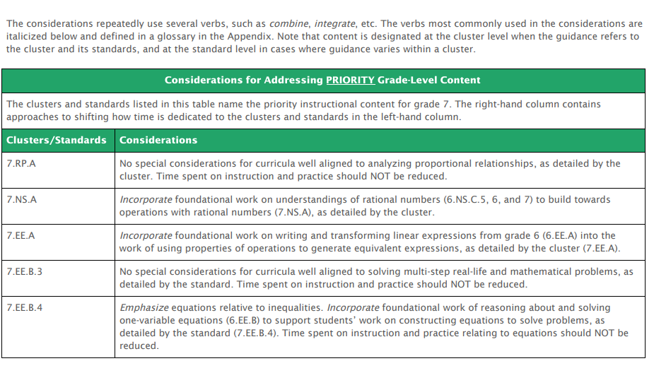
Mathematics: What do I do when I identify a need?
Focus on Major Work connected to the content under study!
2020-21 Priority Instructional Content in ELA/Literacy and Mathematics
Coherence Map
Don’t forget the Coherence Map!
Notes:
Key Idea - You will identify unfinished learning this year, that’s okay! We don’t have time today to dig into every single area where you may identify students needing support, but we do want to point you to the priority instructional content document, which gives you some specific areas to focus for this year within each grade.
Notes:
Standards listed in the priority instructional content give you some specific guidance for this year, they even further narrow the focus of major work. If you see a student struggling with a specific element of grade-level content,
Aligned Blogs are included in the resource widget:
https://achievethecore.org/aligned/taking-first-step-designing-mathematics-intervention/
https://achievethecore.org/aligned/select-math-intervention-content/
https://achievethecore.org/aligned/designing-shifts-aligned-interventions-in-the-math-classroom/
https://achievethecore.org/aligned/unfinished-learning-in-math-how-do-you-address-it/

Slide 18
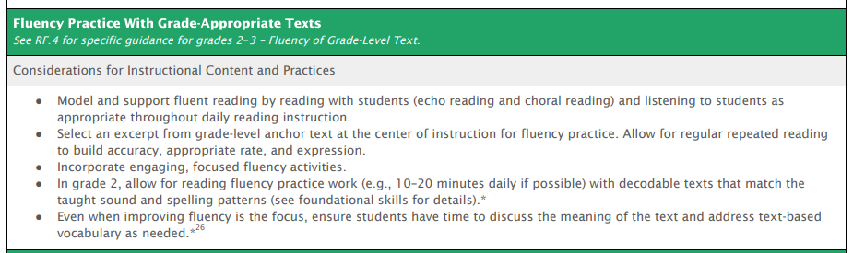
Literacy: What do I do when I identify a need?
Support students where the need is!
2020-21 Priority Instructional Content in ELA/Literacy and Mathematics
Notes:
Big Idea: When you are adjusting your planning based on what your students already know and can do, focus your supports on the area of identified need, specifically places like foundational skills and fluency, knowledge about the topic, vocabulary, etc.
Notes:
This slide lists some tools and resources that can be supportive as you dig into this work. In the Priority Instructional Content, check out the grade-band specific sections, which includes some concrete suggestions for ways that teachers can support the targeted area of growth
Some aligned blogs to reference:
https://achievethecore.org/aligned/supporting-all-learners-with-complex-texts/
https://achievethecore.org/aligned/using-complex-texts-with-all-readers/
https://achievethecore.org/aligned/strategies-to-support-learners-who-are-below-grade-level/

Slide 19
Question:
What is one key takeaway you will consider as you think about assessing students this year?

Slide 20


Julia Sweeney
Director of Sales
Edcite
Brian McIntosh
Product Manager
Edcite

Slide 21
Section 2: How can technology help us support students in accessing grade level material?

Slide 22

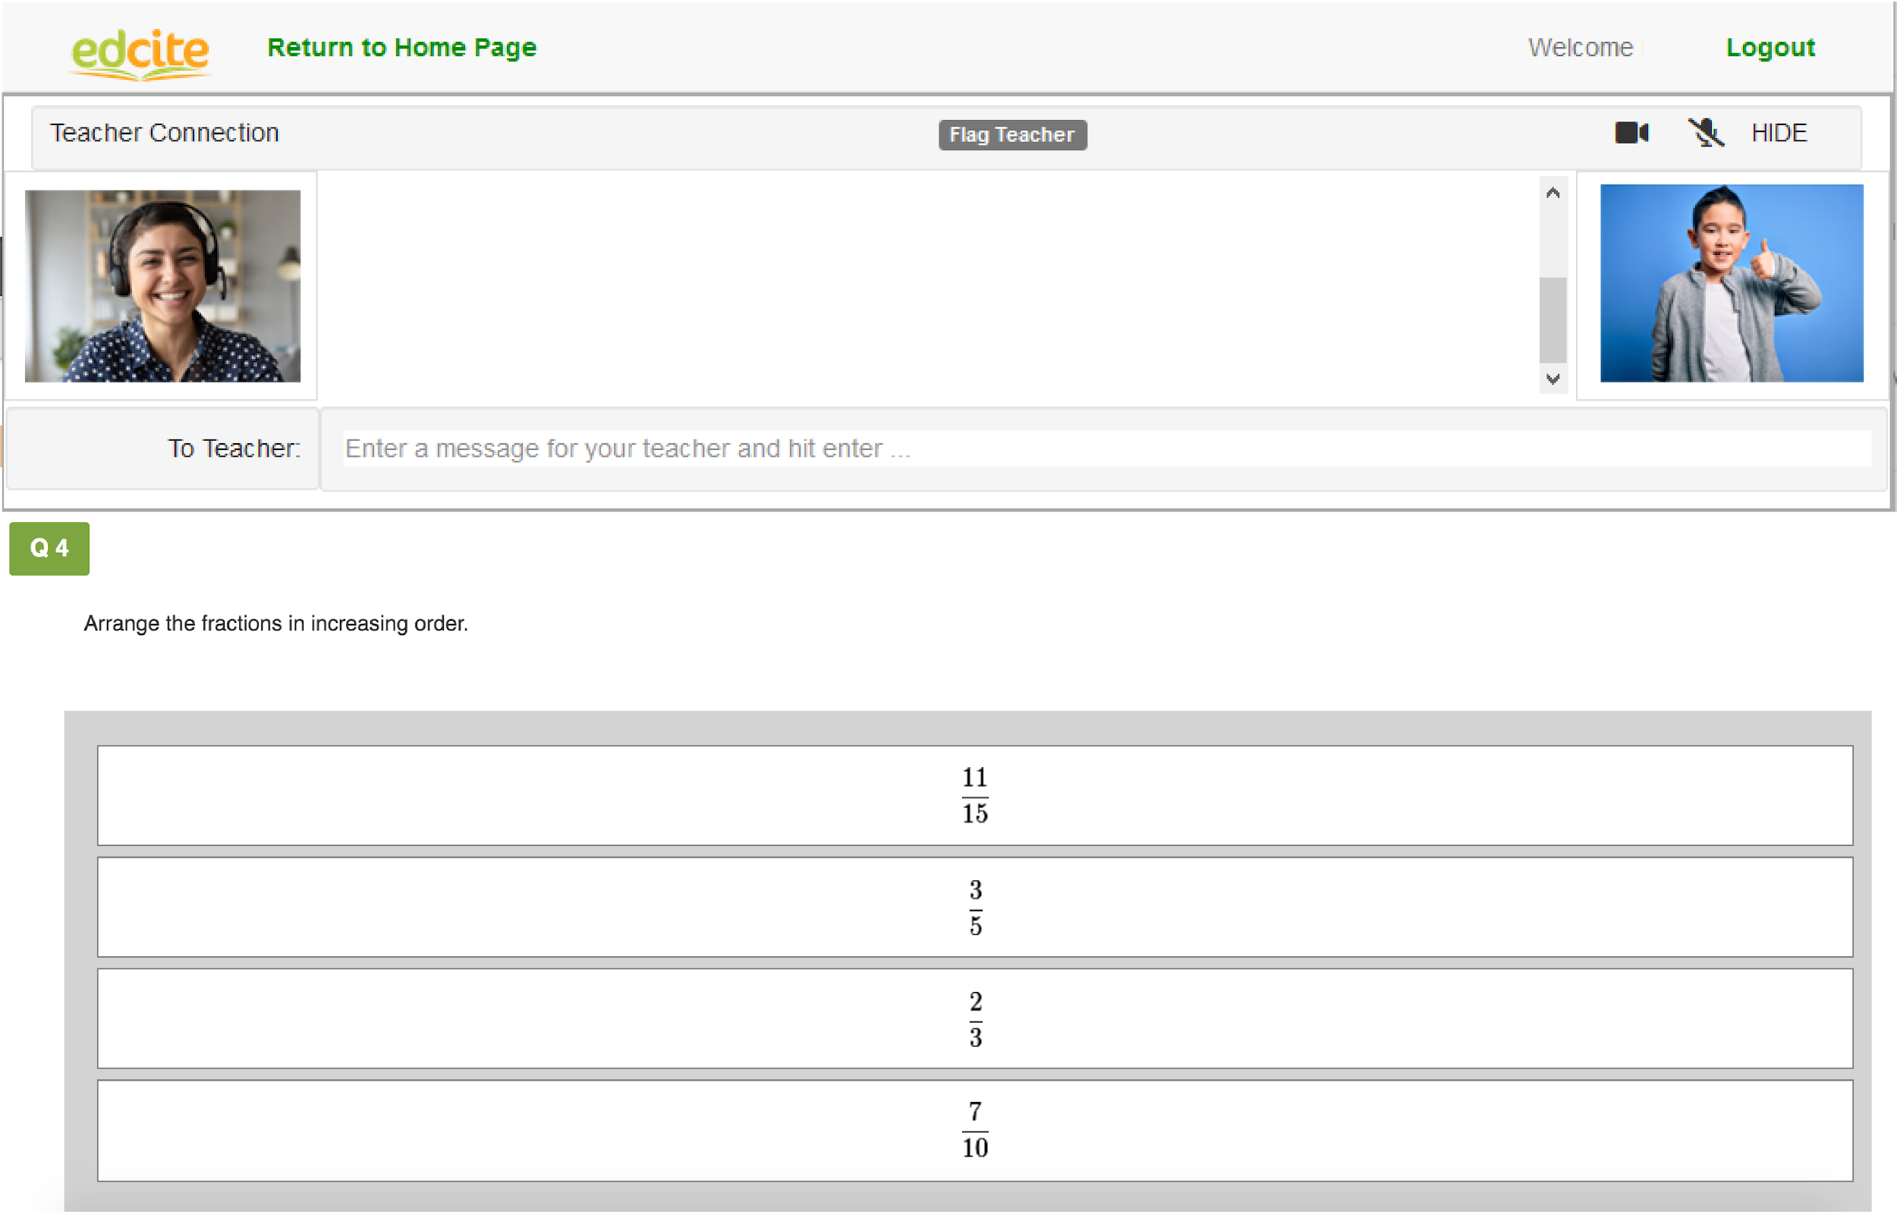

Meet students where they are...
academically
&
literally
...to support them in accessing grade level work.

Slide 23
Respond to Data
Design Content
Assessments for
Learning
Send to Students

Slide 24
Design Content:
Leverage existing standards-aligned materials
  Example: Achieve the Core Mini-Assessments
Build targeted checks using question types that align with the skills
Use multimedia to provide additional supports around foundational skills or content knowledge
Respond to Data
Design Content
Assessments for
Learning
Send to Students

Slide 25
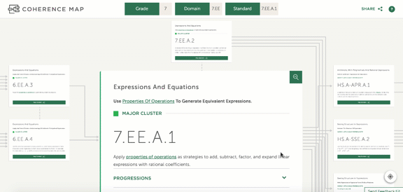
Achieve the Core Mini-assessments

Slide 26
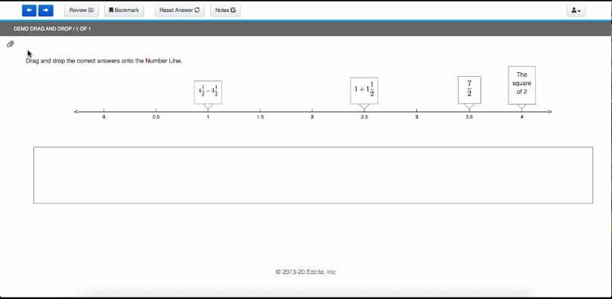
Attaching Student Work

Slide 27
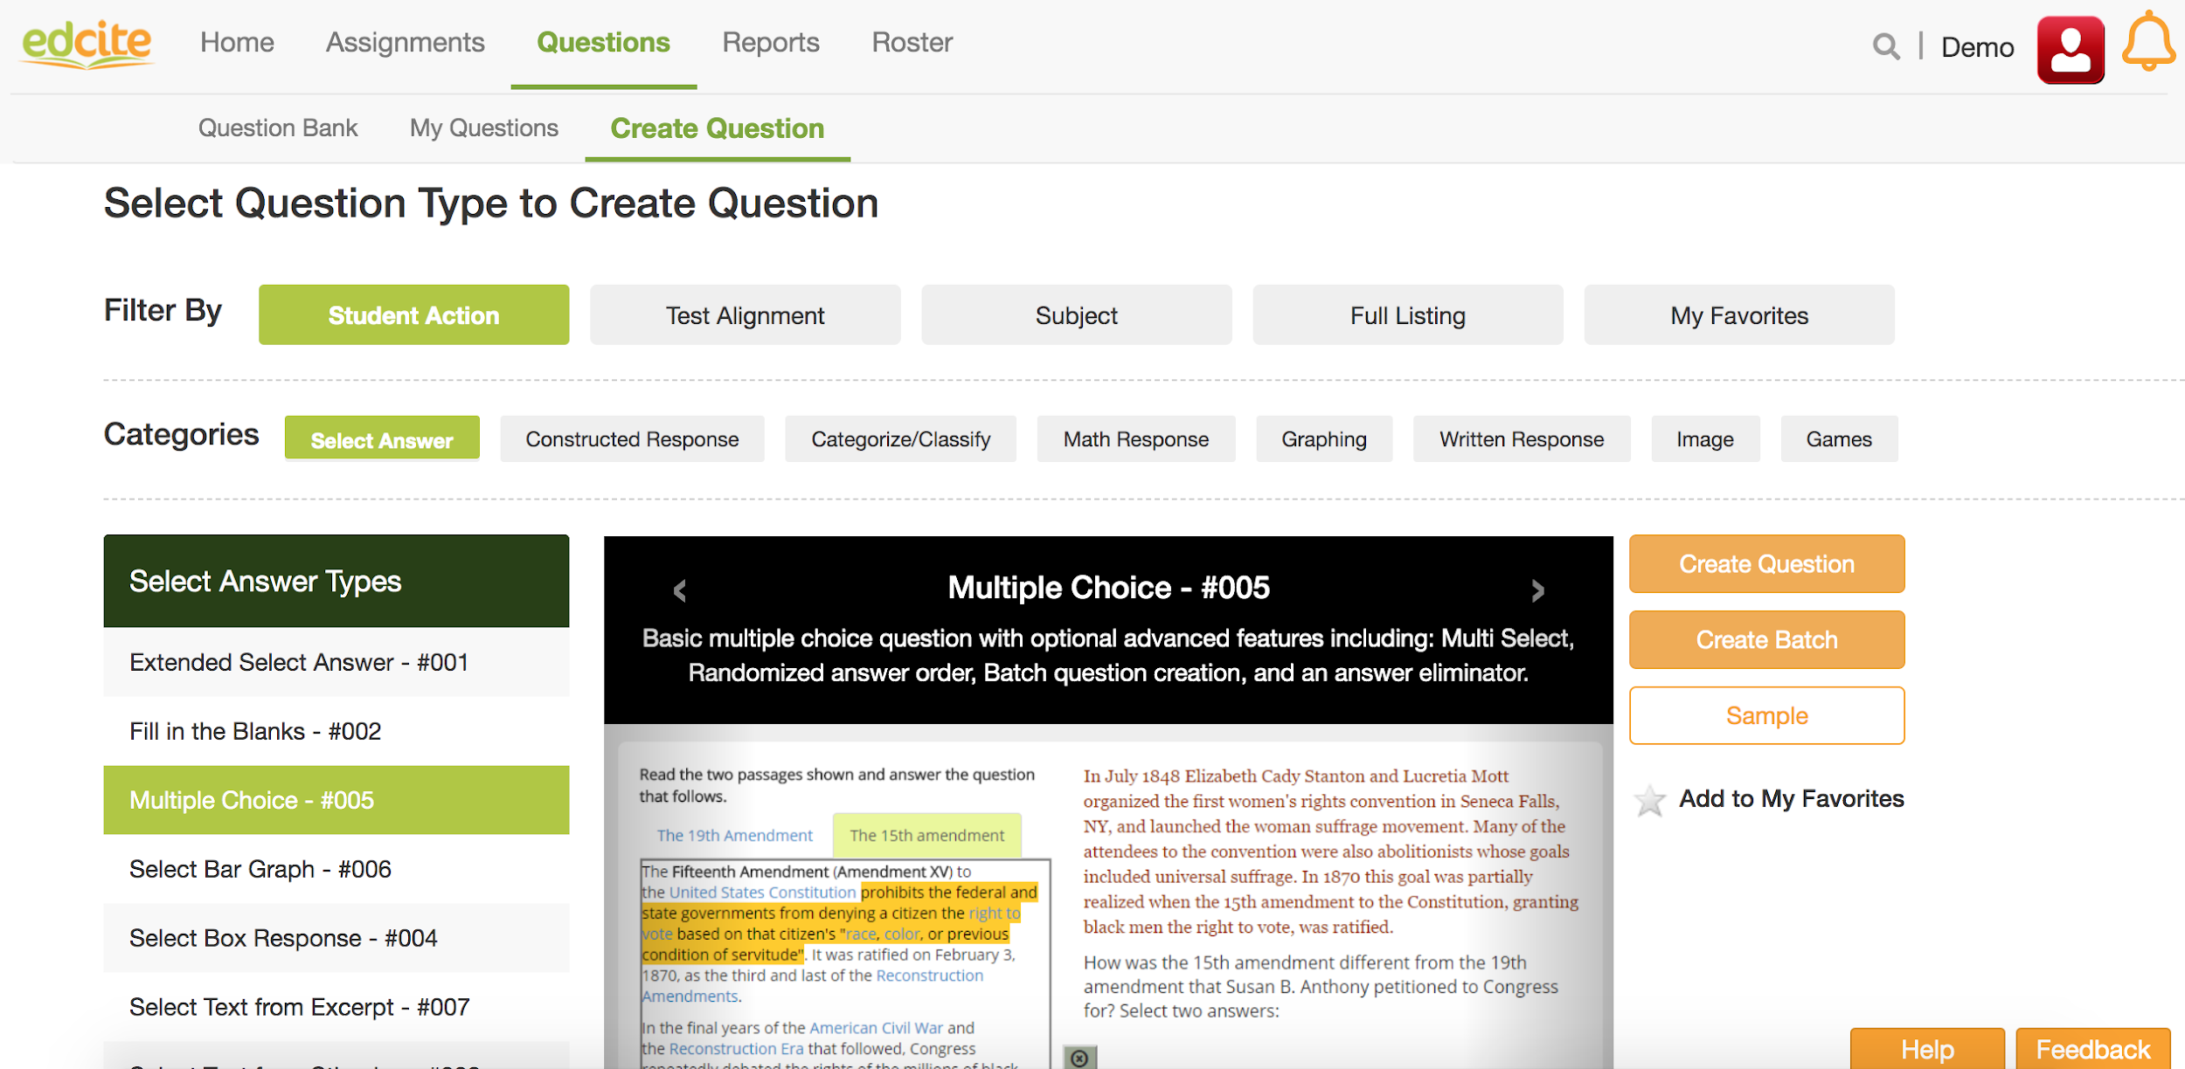
Design with Aligned Question Types

Slide 28
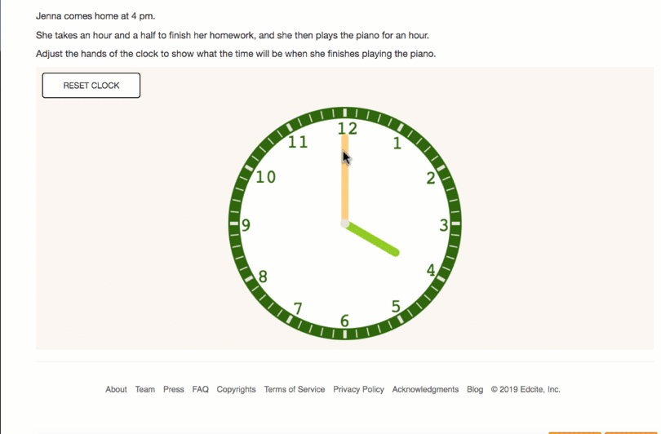
Design with Aligned Question Types

Slide 29
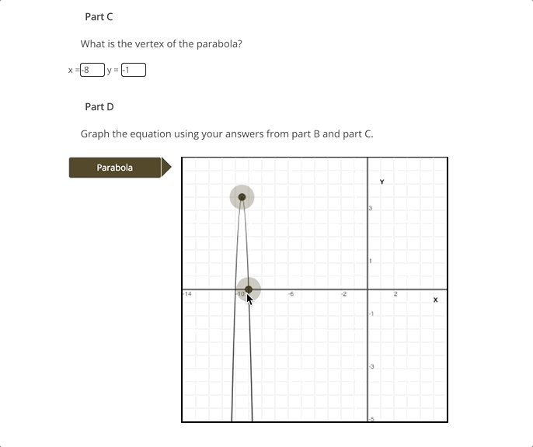
Design with Aligned Question Types

Slide 30
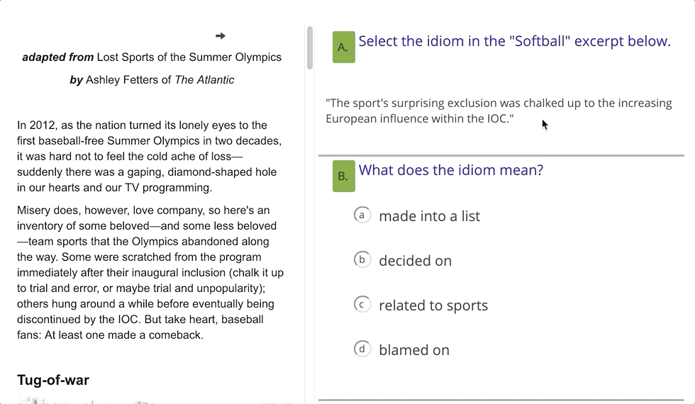
Design with Aligned Question Types

Slide 31
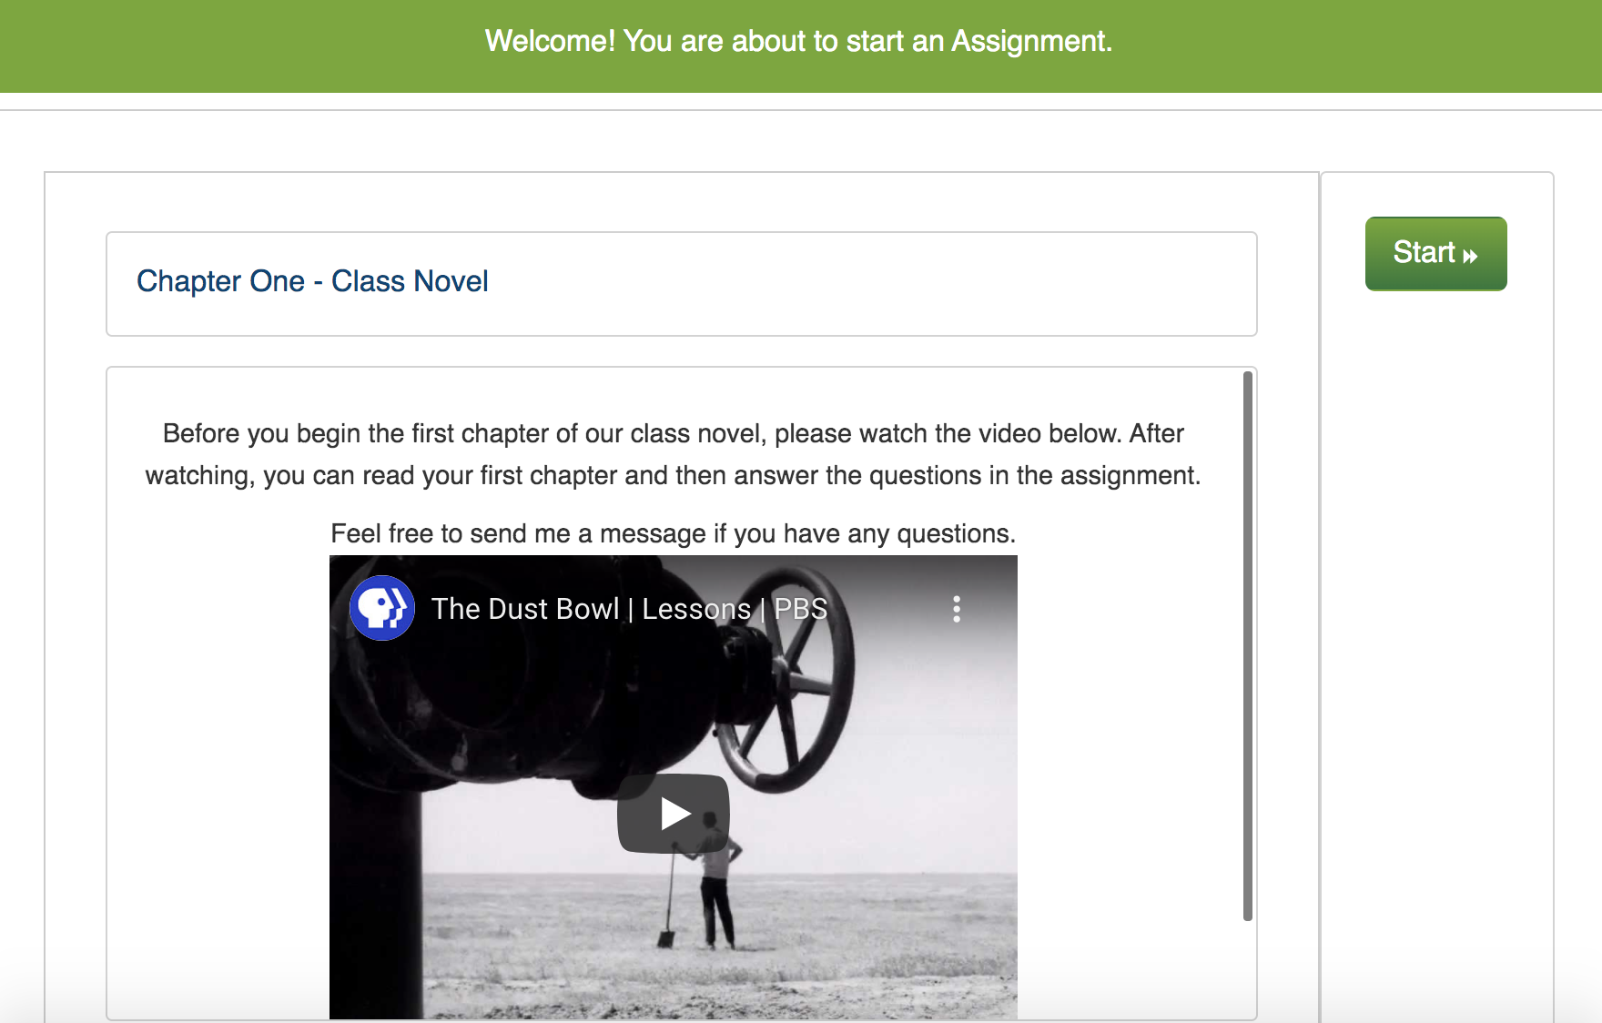
Provide Foundational Supports

Slide 32
Design Content:
Leverage existing standards-aligned materials
  Example: Achieve the Core Mini-Assessments
Build targeted checks using question types that align with the skills
Use multimedia to provide additional supports around foundational skills or content knowledge
Respond to Data
Design Content
Assessments for
Learning
Send to Students

Slide 33
Send to Students:
Assign materials to classes, students, or groups of students
Instruct students to access materials on their www.edcite.com homepage or post links to your LMS (example: Google Classroom)
Use Real-time Connect to provide live support to the class or specific students
Respond to Data
Design Content
Assessments for
Learning
Send to Students

Slide 34
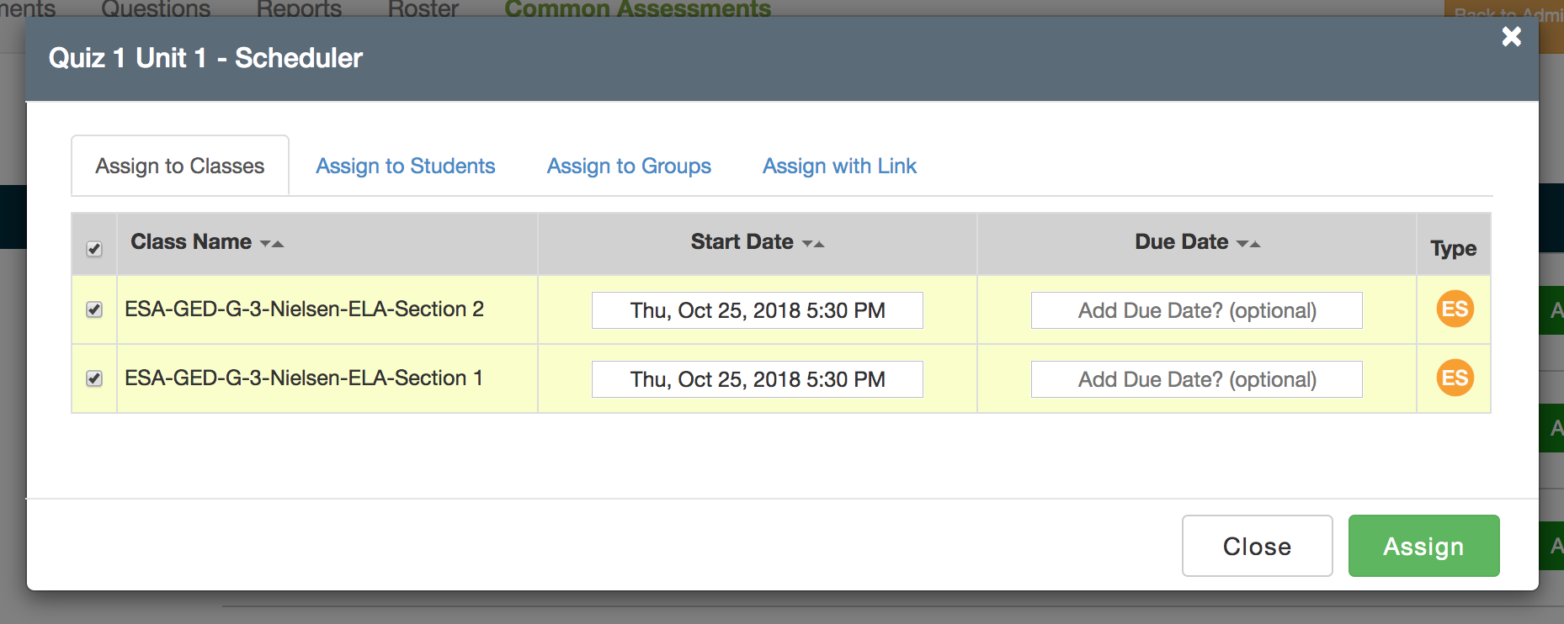
Assign by class, student, or group

Slide 35
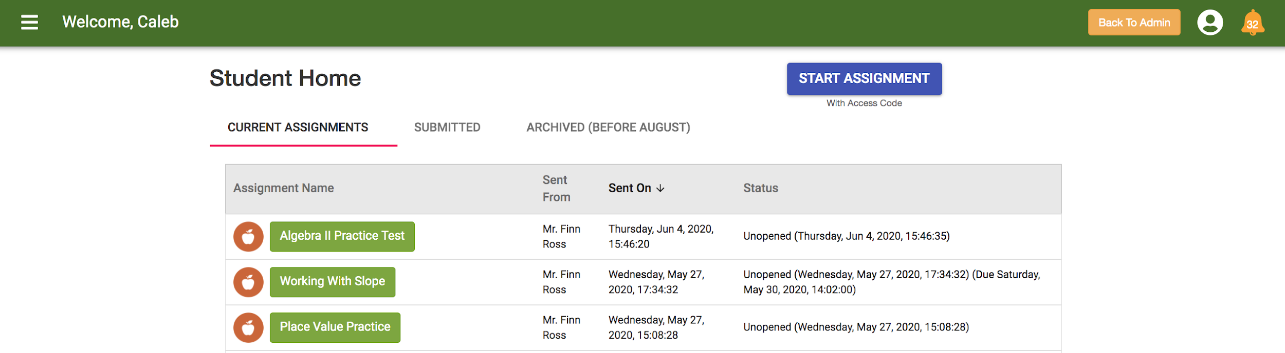
Students can access from www.edcite.com or with a link

Slide 36
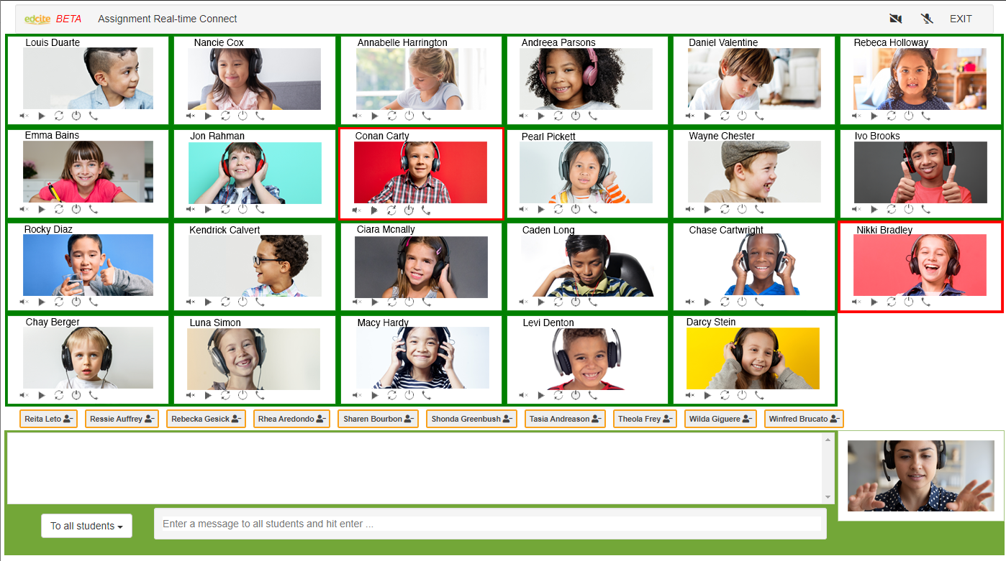
Support Students with Real-time Connect

Slide 37
Support Students with Real-time Connect

Slide 38
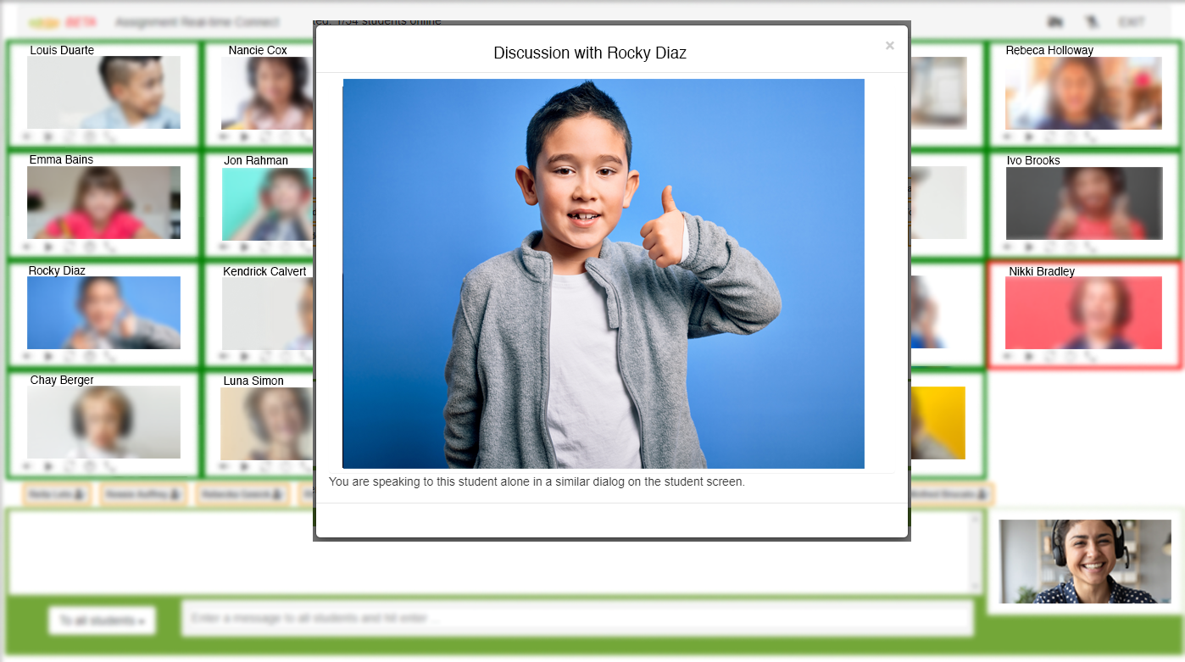
Support Students with Real-time Connect

Slide 39
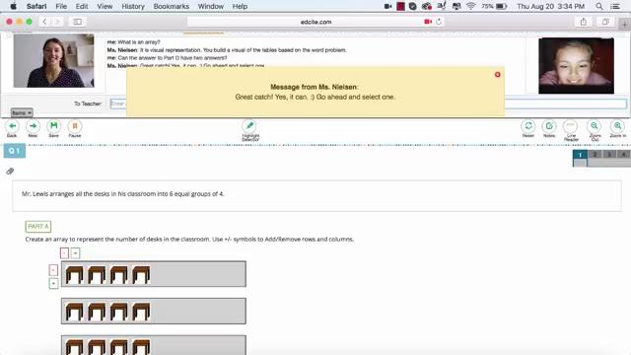
Support Students with Real-time Connect

Slide 40
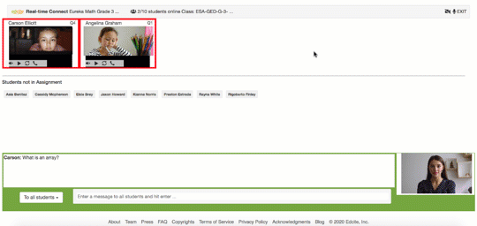
Support Students with Real-time Connect

Slide 41
Send to Students:
Assign materials to classes, students, or groups of students
Instruct students to access materials on their www.edcite.com homepage or post links to your LMS (example: Google Classroom)
Use Real-time Connect to provide live support to the class or specific students
Respond to Data
Design Content
Assessments for
Learning
Send to Students

Slide 42
Respond to Data:
Use Real-time Connect to provide supports while students are working
Review scratch work and student thinking
Use the summary report to understand where students need more support
Respond to Data
Design Content
Assessments for
Learning
Send to Students

Slide 43
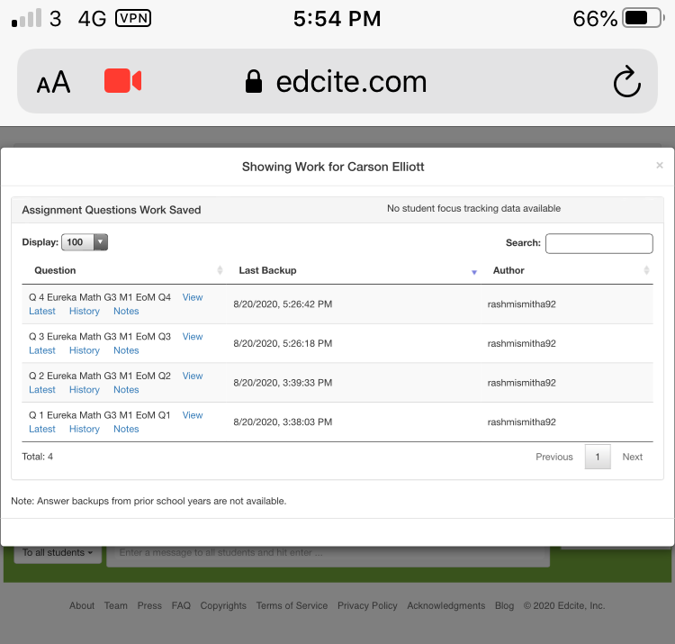
Support Students with Real-time Connect

Slide 44
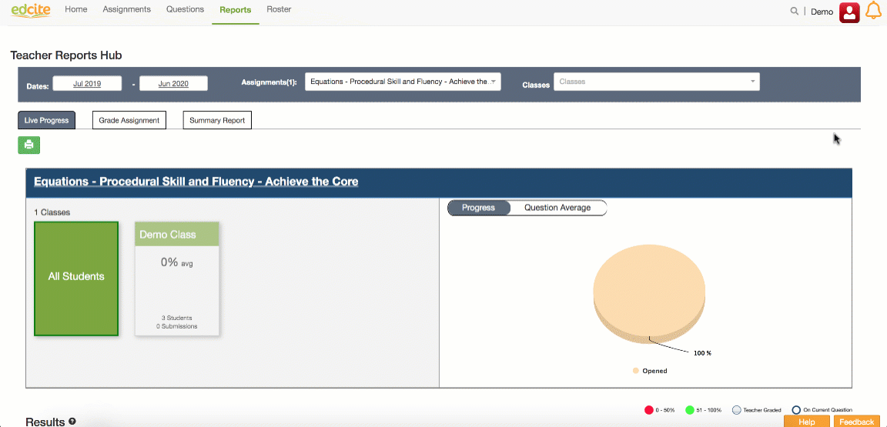
Use the Live Progress Dashboard

Slide 45
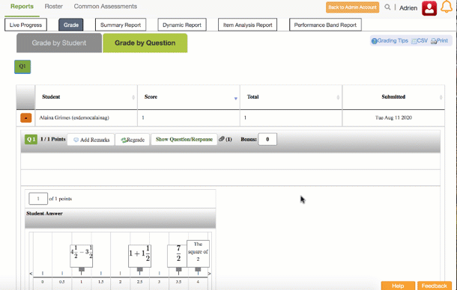
Review Scratch Work & Student Thinking

Slide 46
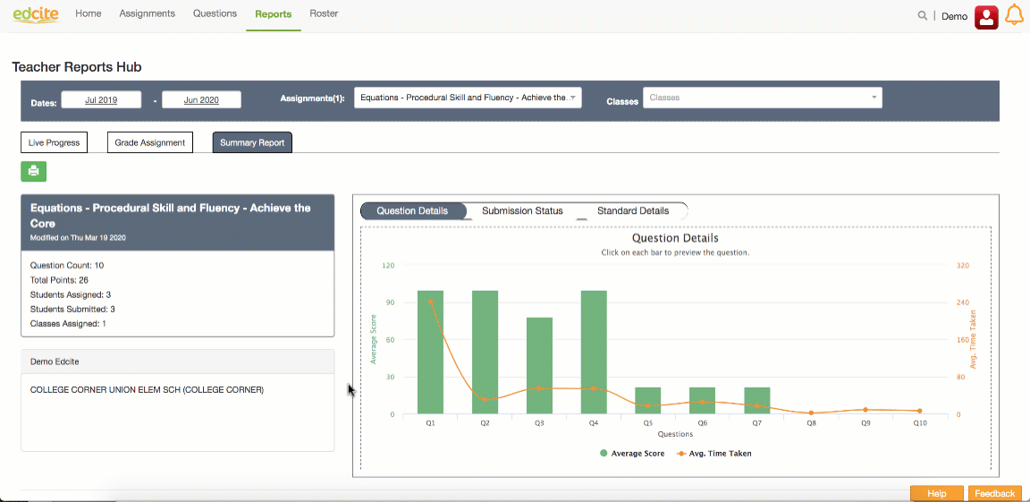
Use the Summary Report to Identify Needs

Slide 47
Educators DO this
Engage immediately and consistently in learning new ideas (affirms students) and building on prior learning
Use assessments that are embedded in standards-aligned instructional materials
Use targeted checks for fluency and foundational skills to inform supports
Use student work to gauge how to bring students into grade-level instruction

Slide 48
Achieve the Core Mini-assessments
Respond to Data
Analyze the live progress dashboard and provide in the moment intervention & do targeted analysis of student work
Design Content
Copy the Mini-Assessments for just-in-time checks.
Assessments for
Learning
Send to Students
Turn on Real-time Connect and ask students to attach pictures of work

Slide 49
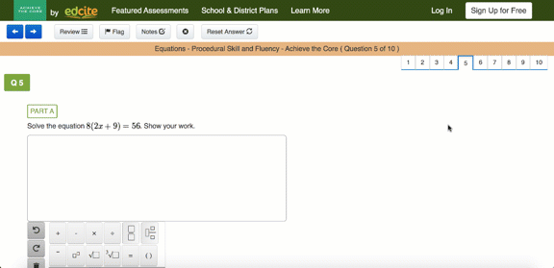
Achieve the Core Mini-assessments
Design Content
Send to Students
Respond to Data

Slide 50
Achieve the Core Mini-assessments
Design Content
Send to Students
Respond to Data

Slide 51
Achieve the Core Mini-assessments
Design Content
Send to Students
Respond to Data

Slide 52
Question:
Besides the mini-assessments, what other content could you use with Edcite’s Real-time Connect?

Slide 53
Build Targeted Checks from the Bank
Respond to Data
Analyze live progress & question by question performance
Design Content
Build a standards-aligned assignment from the Edcite Question Bank
Assessments for
Learning
Send to Students
Turn on Real-time Connect (attaching student work is on by default)

Slide 54
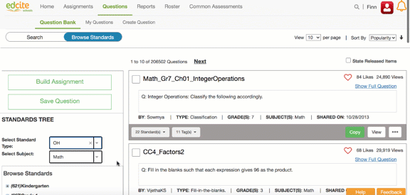
Build Targeted Checks from the Bank

Slide 55
Build Targeted Checks from Scratch
Respond to Data
Analyze live progress & question by question performance
Design Content
Build questions from scratch!
Assessments for
Learning
Send to Students
Turn on Real-time Connect

Slide 56
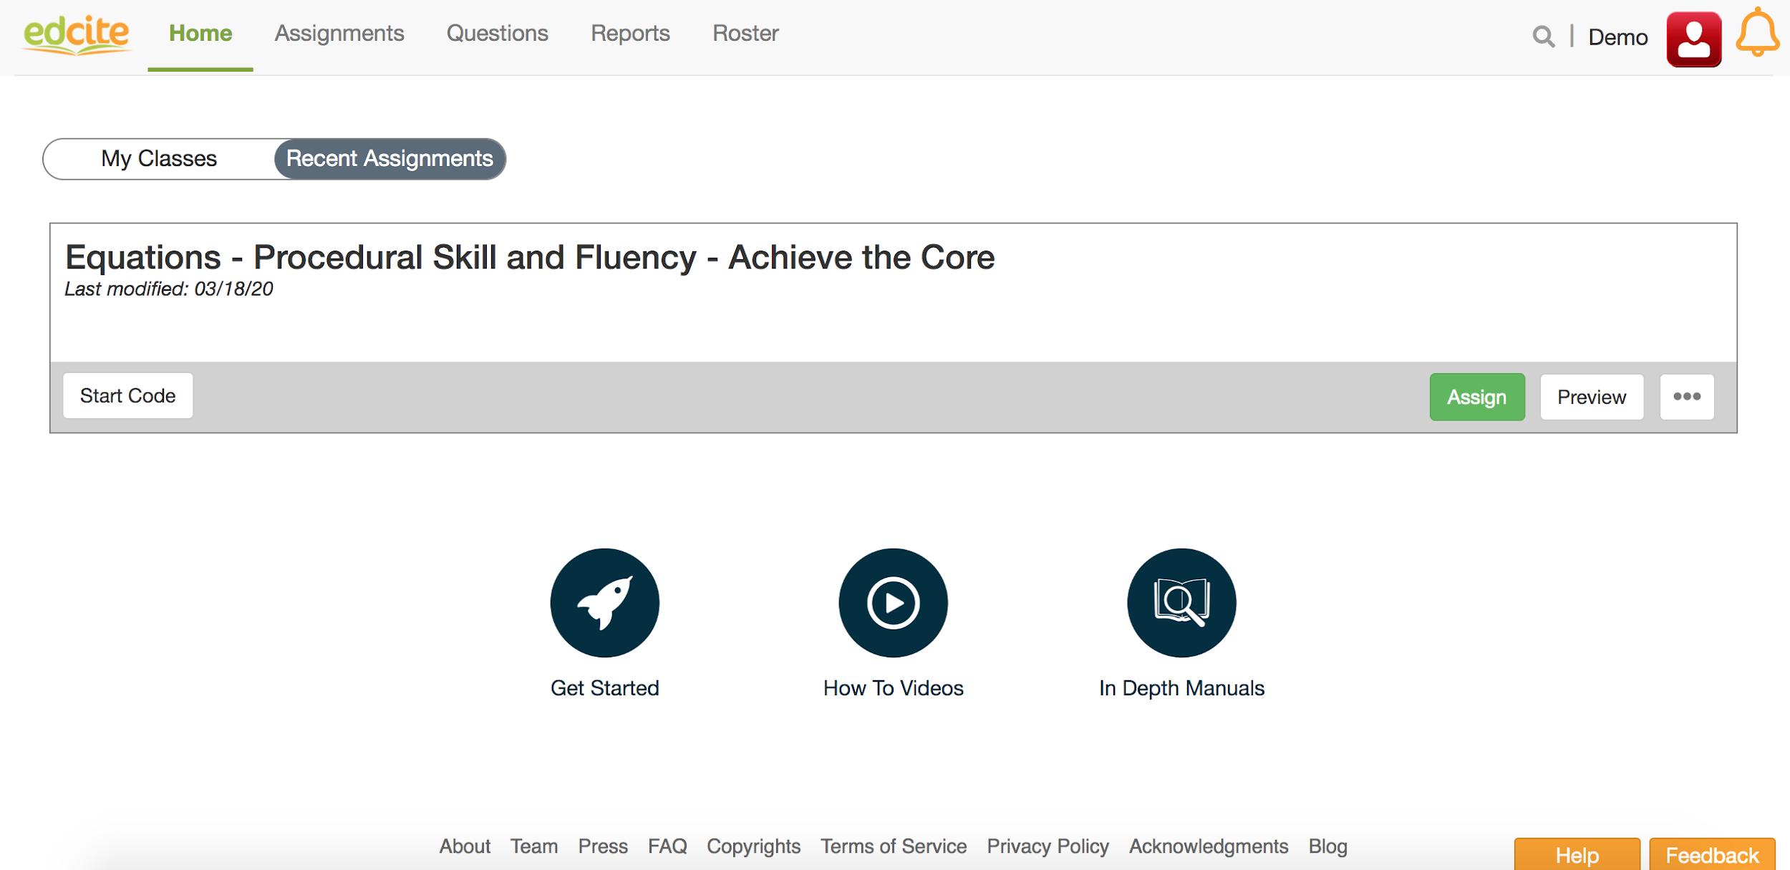
Edcite Basics

Slide 57
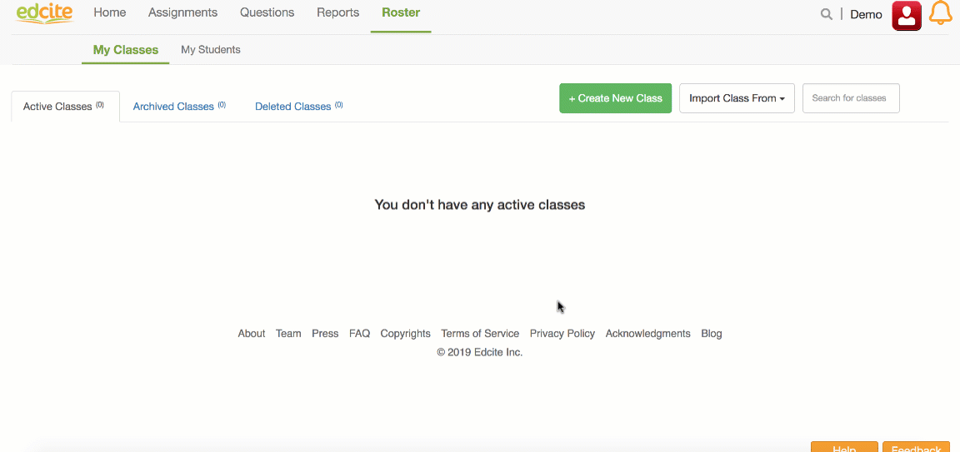
Edcite Basics

Slide 58
Edcite Basics
Questions: Individual items students will answer
Assignments: Set of questions you assign to students
Collections: Group of assignments to browse or schedule in bulk

Slide 59
Edcite Basics
Creating Questions → Create Assignment → Assign
All creations you create will live in “My Questions”
60+ types of questions to ensure alignment to the skill being taught

Slide 60
Edcite Basics

Slide 61
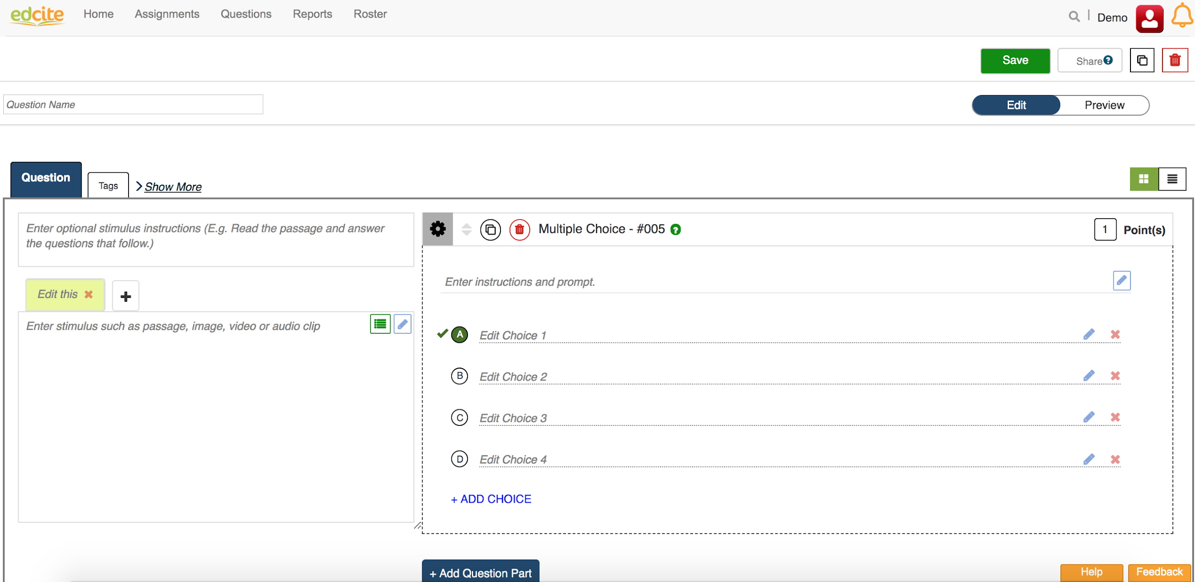
Edcite Basics

Slide 62
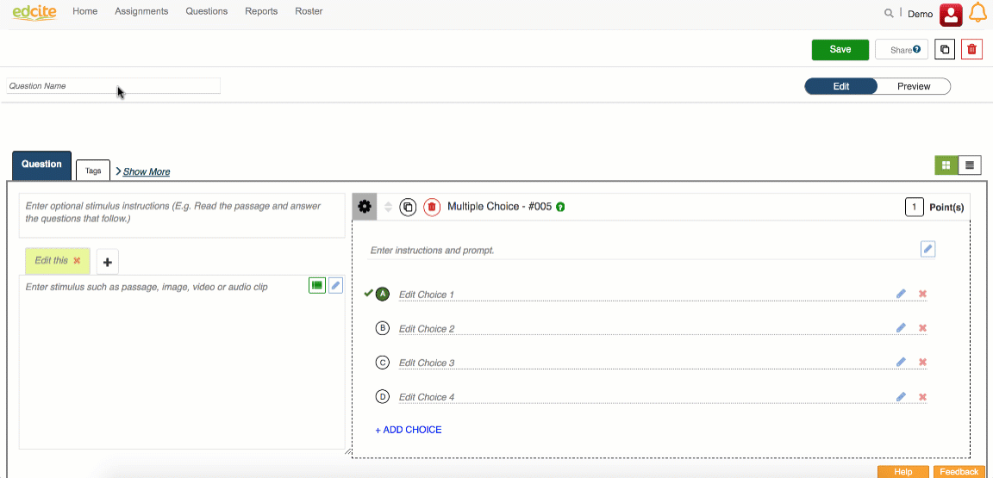
Edcite Basics

Slide 63
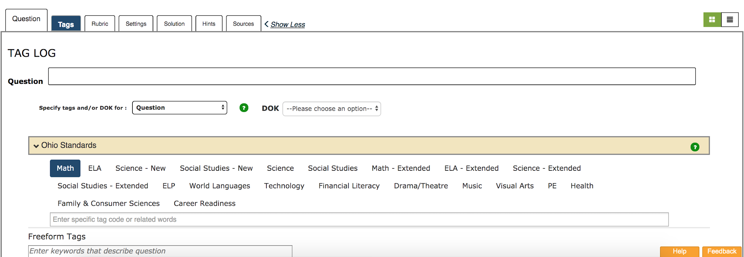
Edcite Basics

Slide 64
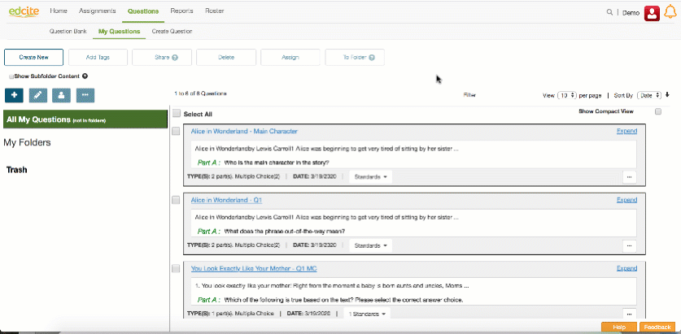
Edcite Basics

Slide 65
Key Edcite Points
Lots of content available or you can build your own
Turn on Real-time Connect to provide live support to students as they are working
Analyze attached student work and standards data

Slide 66
Contact us for more information!
support@edcite.com
Sign-up for office hours with our team here:
http://bit.ly/EdciteOfficeHours

Slide 67
Questions for Our Guests?

Slide 68
Resource Name | Link
Join Our Network! | www.achievethecore.org/ca-signup
COherence Map | https://achievethecore.org/coherence-map/
Focus Documents | https://achievethecore.org/category/774/mathematics-focus-by-grade-level
Aligned Blogs Math | https://achievethecore.org/aligned/taking-first-step-designing-mathematics-intervention/ https://achievethecore.org/aligned/select-math-intervention-content/ https://achievethecore.org/aligned/designing-shifts-aligned-interventions-in-the-math-classroom/ https://achievethecore.org/aligned/unfinished-learning-in-math-how-do-you-address-it/
Aligned Blogs ELA | https://achievethecore.org/aligned/supporting-all-learners-with-complex-texts/ https://achievethecore.org/aligned/using-complex-texts-with-all-readers/ https://achievethecore.org/aligned/strategies-to-support-learners-who-are-below-grade-level/
Priority Instructional Content Document | https://achievethecore.org/page/3267/2020-21-priority-instructional-content-in-english-language-arts-literacy-and-mathematics
Edcite Real-Time Connect | https://blog.edcite.com/2020/05/28/real-time-connect-communication-tools-for-formative-and-summative-assessments/
Edcite.com | https://www.edcite.com/
Edcite Office Hours | http://bit.ly/EdciteOfficeHours

Slide 69
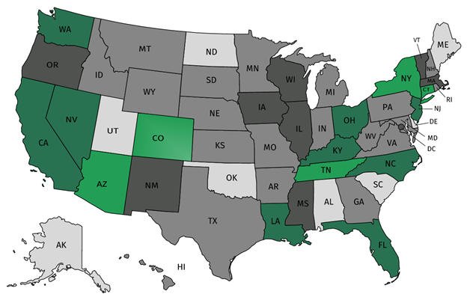
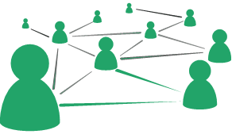



Join our network!
Join a national network of educators
Connect with state networks
Be a part of creating new tools and resources in partnership with SAP
Keep up to date on free resources, upcoming SAP webinars/professional learning opportunities, job postings and more!
Notes:
If you found tonight’s webinar helpful, we’d like to invite you to join our Core Advocate network! We’re committed to solving real problems that real teachers have and we know the best way to do this is to know more about what folks are experiencing.
As part of our national network, you have opportunities to connect with educators across the country, maybe even the network in your state! You can keep up to date on tools and resources available on Achieve the Core, as well as a variety of virtual learning opportunities and other ways to engage with us. We also work with educators in our network to help us build tools and resources.
We’d love to learn about who you are, where you work, the types of things you’re interested in and the expertise you already have. This way, we will be able to tailor our webinars and other opportunities to your needs and interests (we may even tap you to be our next webinar panelist).

Slide 70




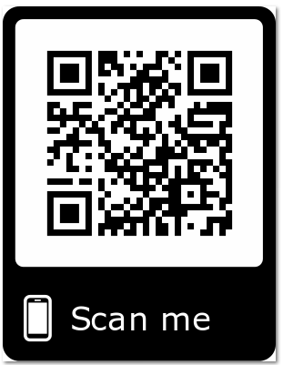
Please Join Us!
https://achievethecore.org/ca-signup
Twitter: twitter.com/achievethecore
Facebook: facebook.com/achievethecore
Pinterest: pinterest.com/achievethecore
Notes:
We encourage you to join the network by filling out this survey completely at atc.org/ca-signup

Slide 71
Please Join Us Again Next Month!
Next month’s webinar:
Fostering Culturally Responsive Classrooms in the Age of COVID
Wednesday, September 2 @ 7PM ET
Register Here:
https://event.on24.com/wcc/r/2494927/04E2762A168035E20E5F42E927F5E964

Slide 72
Thank You!

