Slide 1
Fostering Culturally Responsive Classrooms in the Age of COVID
Core Advocates Monthly Webinar
September 2020
The webinar will begin shortly.
Check your Resource widget to preview the resources for today’s session! Use the Group Chat to introduce yourself!
Notes:
First timer poll
Handouts:
While we’re waiting, we’d like you to participate in a quick poll so we can get an understanding of who’s on the webinar with us tonight.

Slide 2
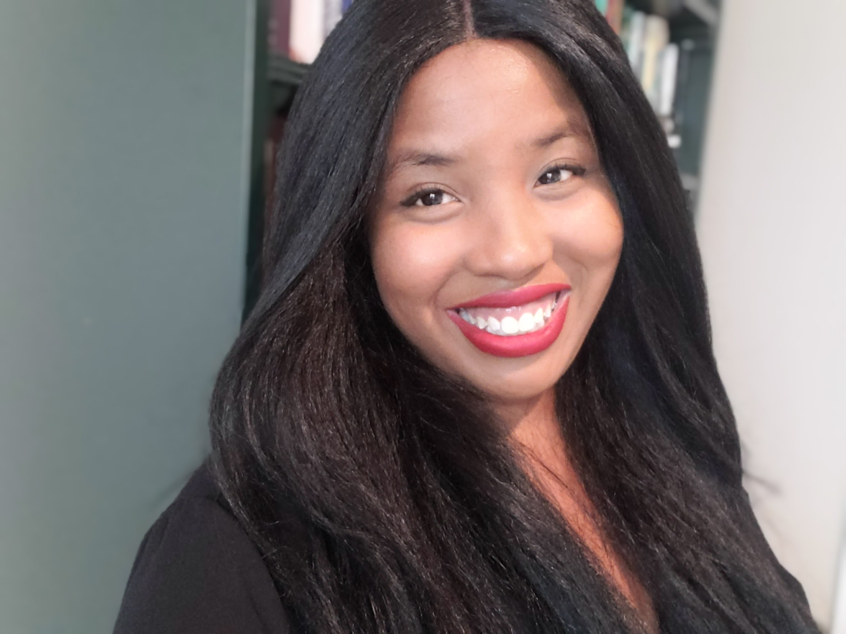
Introductions
Your hosts from Student Achievement Partners:
Pascale Joseph Project Coordinator,
Tools and Classroom Resources, SAP
This month’s presenters:
Marya Hay Instructional Specialist in Equity & Race
Montgomery County Public Schools
Olivia Mulcahy Education Specialist
Illinois Resource Center

Slide 3
How many Core Advocate Webinars have you attended?
Please use the Questions tab on your control panel to respond.
If using a poll, please put up to 5 answer choices in the notes section below and indicate if attendees should choose only one response or multiple responses.

Slide 4
Join Our Network!
Complete this survey & join our mailing list: www.achievethecore.org/ca-signup
Questions? Contact:
Jennie Beltramini (jbeltramini@studentsachieve.net)
Joy Delizo-Osborne (jdelizo-osborne@studentsachieve.net)
Learn more about us on our website: https://achievethecore.org/page/1026/national-core-advocate-network
Notes:
If you’d like to learn more about the network, contact Jennie (her email is here).
We also want to invite you to join the network by signing up at achievethecore.org/ca-signup and visit our website for more info and opportunities

Slide 5
Engage with Us!
During the webinar:
Question just for the presenters/ tech help
Resources
Group chat
Twitter
Certificate
Feel free to tweet during and after the webinar using #coreadvocates
@achievethecore
@JennieBeltro
@MaestraOlivia
@Marya_Hay

Slide 6
After the webinar
A certificate will be available via the Certification box to the right. Click on the blue-ribbon icon to print or download the certificate at the end of the webinar.
Access to recording will be available via your registration link & posted on Achieve the Core
Take our short survey at the end of the month and be entered into a raffle for a $25 Amazon gift card.

Slide 7
Goals of the Webinar
Examine the impact of culture on teaching, learning and leading.
Explore connections between culture and care in the classroom
Reflect on how to apply these concepts in our own teaching and learning settings in context of COVID-19
Notes:
We have three main goals for our webinar tonight. They are to...
Participants will have Recognize the impact of culture on the teaching, learning and leading.

Slide 8
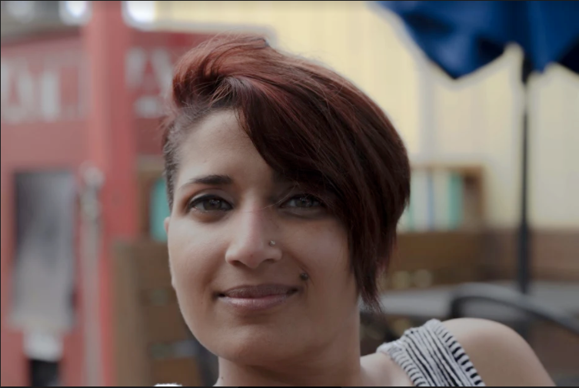
Marya Hay (she, her, hers)
Instructional Specialist
Equity Initiatives Unit
Montgomery County Public Schools
Rockville, MD
please enter a head shot here

Slide 9
Section 1: How are the Brain and Culture Connected?

Slide 10
How are the Brain and Culture Connected?

Slide 11
What is Culture?
The Three Levels of Culture
Culture tree
Notes:
Ask everyone to enter what they think culture is in the chat.
Share a few out with the group
Say: Culture is how we make meaning of the world and although most of the things we may think about with culture is visible differences that distinguish one culture from another.
With that limited perspective we can think that not everyone possesses a culture. But culture is in fact how we make meaning of the world around us.
The author Zaretta Hammond uses the image of a tree to help illustrate how culture impacts all of us in the way we take in the world around us and interactions with others.
The leaves are the surface level- visible, changing, can vary in appearance
Scotish crest, bangaldeshi clothing, hijab
( we feel very comfortable sharing and engaging in conversations on this level, there is low risk-low threat)
The trunk is the The shallow level- unspoken rules, Interactions with others
Practices: ( eye contact, handshaking, modesty, physical proximity)
This is where we being to feel more emotions associated with following or breaking the rules-
Initial feelings of trust can be built or erode on this level, start to feel a threat
The third level is the roots. They provide sustenance and give the tree life, they are deeply embedded into the ground and hold the tree up
This level is our unconscious deep beliefs and norms
How we view fairness, defining family and kinship, emphasis of collective or individual, valuing competition/cooperation
Our roots are often so innate and internalized that we may not even realize they ground us and provide a familiar safety until they are challenged or conflicting values are placed in front of us.
The power they possess to create mistrust and impact building authentic relationships is more impactful than any of the other levels if culture.
We feel threatened and triggered to respond
Wordle Idea
Students whose cultures are not centered in the curriculum culture of school

Slide 12
“A fish is born into water and so simply experiences the water as one with itself; a fish has no way of knowing that it is actually separate from the water. And although the fish is separate, it still can’t survive without the water. In the same way that the fish cannot survive without water we cannot make sense of the world without the meaning making system that our culture provides. Yet this system is hard to see, because we have always been swimming within it; we just take for granted that what we see is real, rather than a particular perception of reality.”
DiAngelo,R. (2012). What Does It Mean to be White? Developing Racial Literacy (p. 17). New York; Peter Lang
Notes:
Robin Diangelo also speaks to the power, influence and invisibility of culture.

Slide 13
Race and Culture have a powerful influence on teaching, learning and leading.
Know ourselves
Know
Others
Know Environment

Slide 14
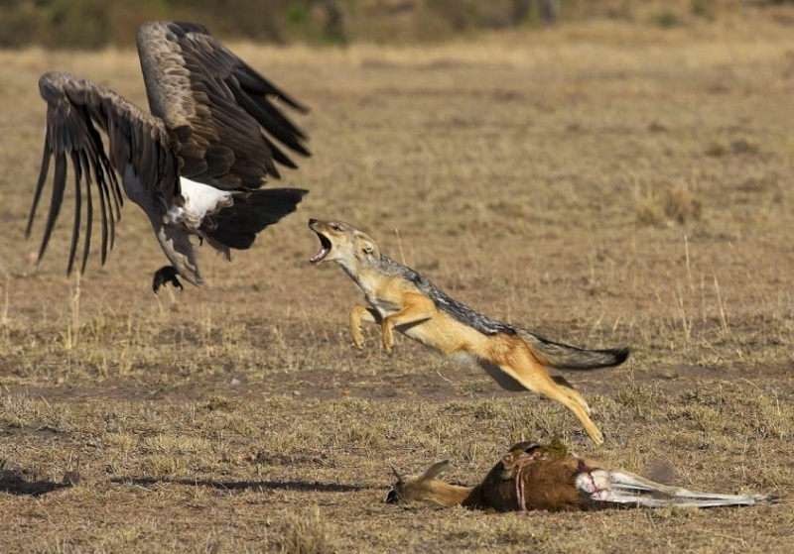
What happens when we are threatened?
How do animals respond to threat?
Notes:
Give participants a few moments to share their responses to the question in the chat.
The point here is to make the point that people have brains that are wired much like those of animals.
We are on constant look out for threat, and our brain has evolved ways to spot and avoid danger.
Today we are going to explore this neurological connection as well as how culture connects to our brain’s responses to threats

Slide 15
The brain uses cultural information to turn everyday happenings into meaningful events.
“Cultural neuroscience gives us a window into how much the brain can be changed by the environment,” says University of Texas at Dallas psychologist Dr. Denise C. Park, who has conducted several cultural neuroscience studies. “It will deepen our understanding of how environment and beliefs can shape cognitive function.”
Why It Is Important to Understand The Culture-Brain Connection
Adapted from: Hammond, Z. (2015). Culturally Responsive Teaching and the Brain. Thousand Oaks, CA: Corwin Press. and https://www.apa.org/monitor/2010/11/neuroscience.aspx

Slide 16
The Brain’s Filtering System
The Watcher: Reticular Activating System or RAS
The Guard Dog: Amygdala
The Storage/Cloud: Hippocampus
Notes:
What is happening in our brains as we navigate the world?
The three parts of the brain functions we will focus on are the RAS, The amygdala and the Hippocampus
We start by taking in data through the RAS.
It’s just scanning our environment for data of what we see, hear, feel and then sending signals to indicate if they are threats or rewards to the amygdala
This information is filtered the amygdala.
If the information is seen as safe, it moves on the hippocampus where it is processed before being stored in long term memory.
If the brain perceives a threat, the amygdala is hijacked, and the brain directs the body to protect itself from harm.
The interesting thing, the brain interprets emotional stress the same way it treats a potential physical threat, as danger and our brain is hardwired to avoid threats to safety at all costs and seeks well-being at every opportunity.
So when a student enters an environment that does not reflect any of his or her deep cultural norms, or when students experience microaggressions, bias they feel threatened and the amygdala has gone into a response mode. We call this the amygdala hijack.

Slide 17
The Amygdala
The Amygdala is deep within the limbic layer of the brain.
It is involved in emotional processing, memory, and decision making.
Designed to react to even the hint of a social or physical threat.

Slide 18
Amygdala Hijack
An Amygdala Hijack is an immediate and overwhelming emotional response out of proportion to the stimulus because
it has triggered a more significant emotional threat.
Reacts in less than a second
Floods the brain with the stress hormone cortisol
Other cognitive functions such as learning, creative thinking, and problem solving stop.
Notes:
An Amygdala Hijack leads to our natural “fight, flight, freeze, or appease” responses to protect oneself!

Slide 19
The amygdala’s responses are . . .
Fight
Flight
Appease
Freeze
Notes:
Once the amygdala has been hijacked, the body responds in one of four ways.
Fight, flight, freeze, or appease.
When teachers are having discipline issue, it is often the result of an amygdala hijack.
Combative students are often in a fight response, and when they push teachers to point of being put out of class, often students are moving to a flight response, attempting to flee the uncomfortable situation.
Freeze and appease response are harder to see. A students in a freeze response can’t move or think. This is the deer in headlights response. They tend to get quiet and try to be unseen.
Students in the appease response seek to ameliorate teachers through “desirable behavior. Sometimes, students in an appease response are seen as amiable students.
Regardless of the response, once the amygdala has been hijacked, student are unavailable to learning for up 20 minutes because the brain is in survival mode and is actively trying to avoid the perceived threat.

Slide 20
What happens when we sense threats?. . .
Cognitive performance decreases
Make more mistakes
Assume and make more assumptions that are biased
Avoid opportunities
Don’t take risks
Become defensive
Mistrust

Slide 21
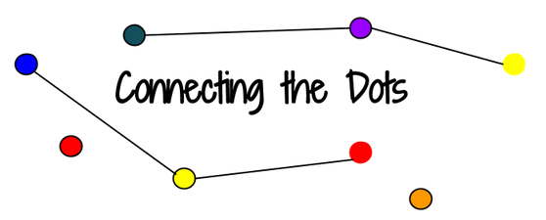
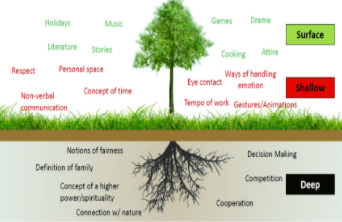

Slide 22
How does culture impact the way educators make meaning and assign value in the classroom?
What’s the impact on students and learning?
Notes:
How are we interpreting behaviors from our perspectives

Slide 23
What happens when we feel rewards?. . .
Increased engagement
Willingness to do difficult things
Seizing opportunities and taking risks
Increased interest in learning
Work collaboratively
Move towards the experience or individual
Notes:
How can reframing our understanding of culture and recognizing our own triggers and lens help create effective learning environments for our students.
What do these rewards look like in distance learning?

Slide 24
Notes:
We are all on a journey of being better educators and recognizing how we can address inequities and structural racism in our schools.
We have to begin with awareness. Awareness of ourselves and others and also about the impacts of our practices, decisions and beliefs.
Then we move to capacity building.
Read, research
Gather students and parent voices
Build your toolbox of strategies with intention and purpose
Finally, we move to action, where will you implement the change?
Will i be purposeful in getting to know my students identis and creating space
Will I create opportunities that are safe and open students to take risks
Will I incorporate varying culture norms beyond my familiarity into processes and classroom culture
Action can be in the micro moments on classroom, or larger policy decisions as a system and school.

Slide 25
How can I build trust in a culturally responsive classroom?
How do I create opportunities that are safe and open students to take risks?
Where do I see areas we can create more inclusive practices and policies for students and families?
Notes:
Finally, we move to action, where will you implement the change?
This can be on both the macro and the micro level. Where is your locus of control and sphere of influence?
Ask yourself some questions to start thinking about the culture you are fostering for students.
How can I build trust in a culturally responsive classroom?
How do I create opportunities that are safe and open students to take risks?
Where do I see areas we can create more inclusive practices and policies for students and families?

Slide 26
Build Trust
Be vulnerable
Acknowledge your own biases
Genuine concern
Ask questions without assumptions
Affirm and validate students
Foster Risk Taking
Build community
Productive struggle
Facilitate don’t direct
Honor background knowledge
Relevant and purposeful
Create Inclusive School Culture
Include all voices in decisions
Foster Partnerships
Be accessible and flexible
Invite them in
Ask don;t assume
Notes:
Additional resources:
Zaretta Hammonds Blog Culturally Responsive Teaching and the Brain
Edutopia Article: Culturally Responsive Teaching and Online Learning
Teaching Tolerance CRT Lesson Plans

Slide 27
Why is it important to understand culture in teaching and learning?
Please respond in the Group Chat

Slide 28
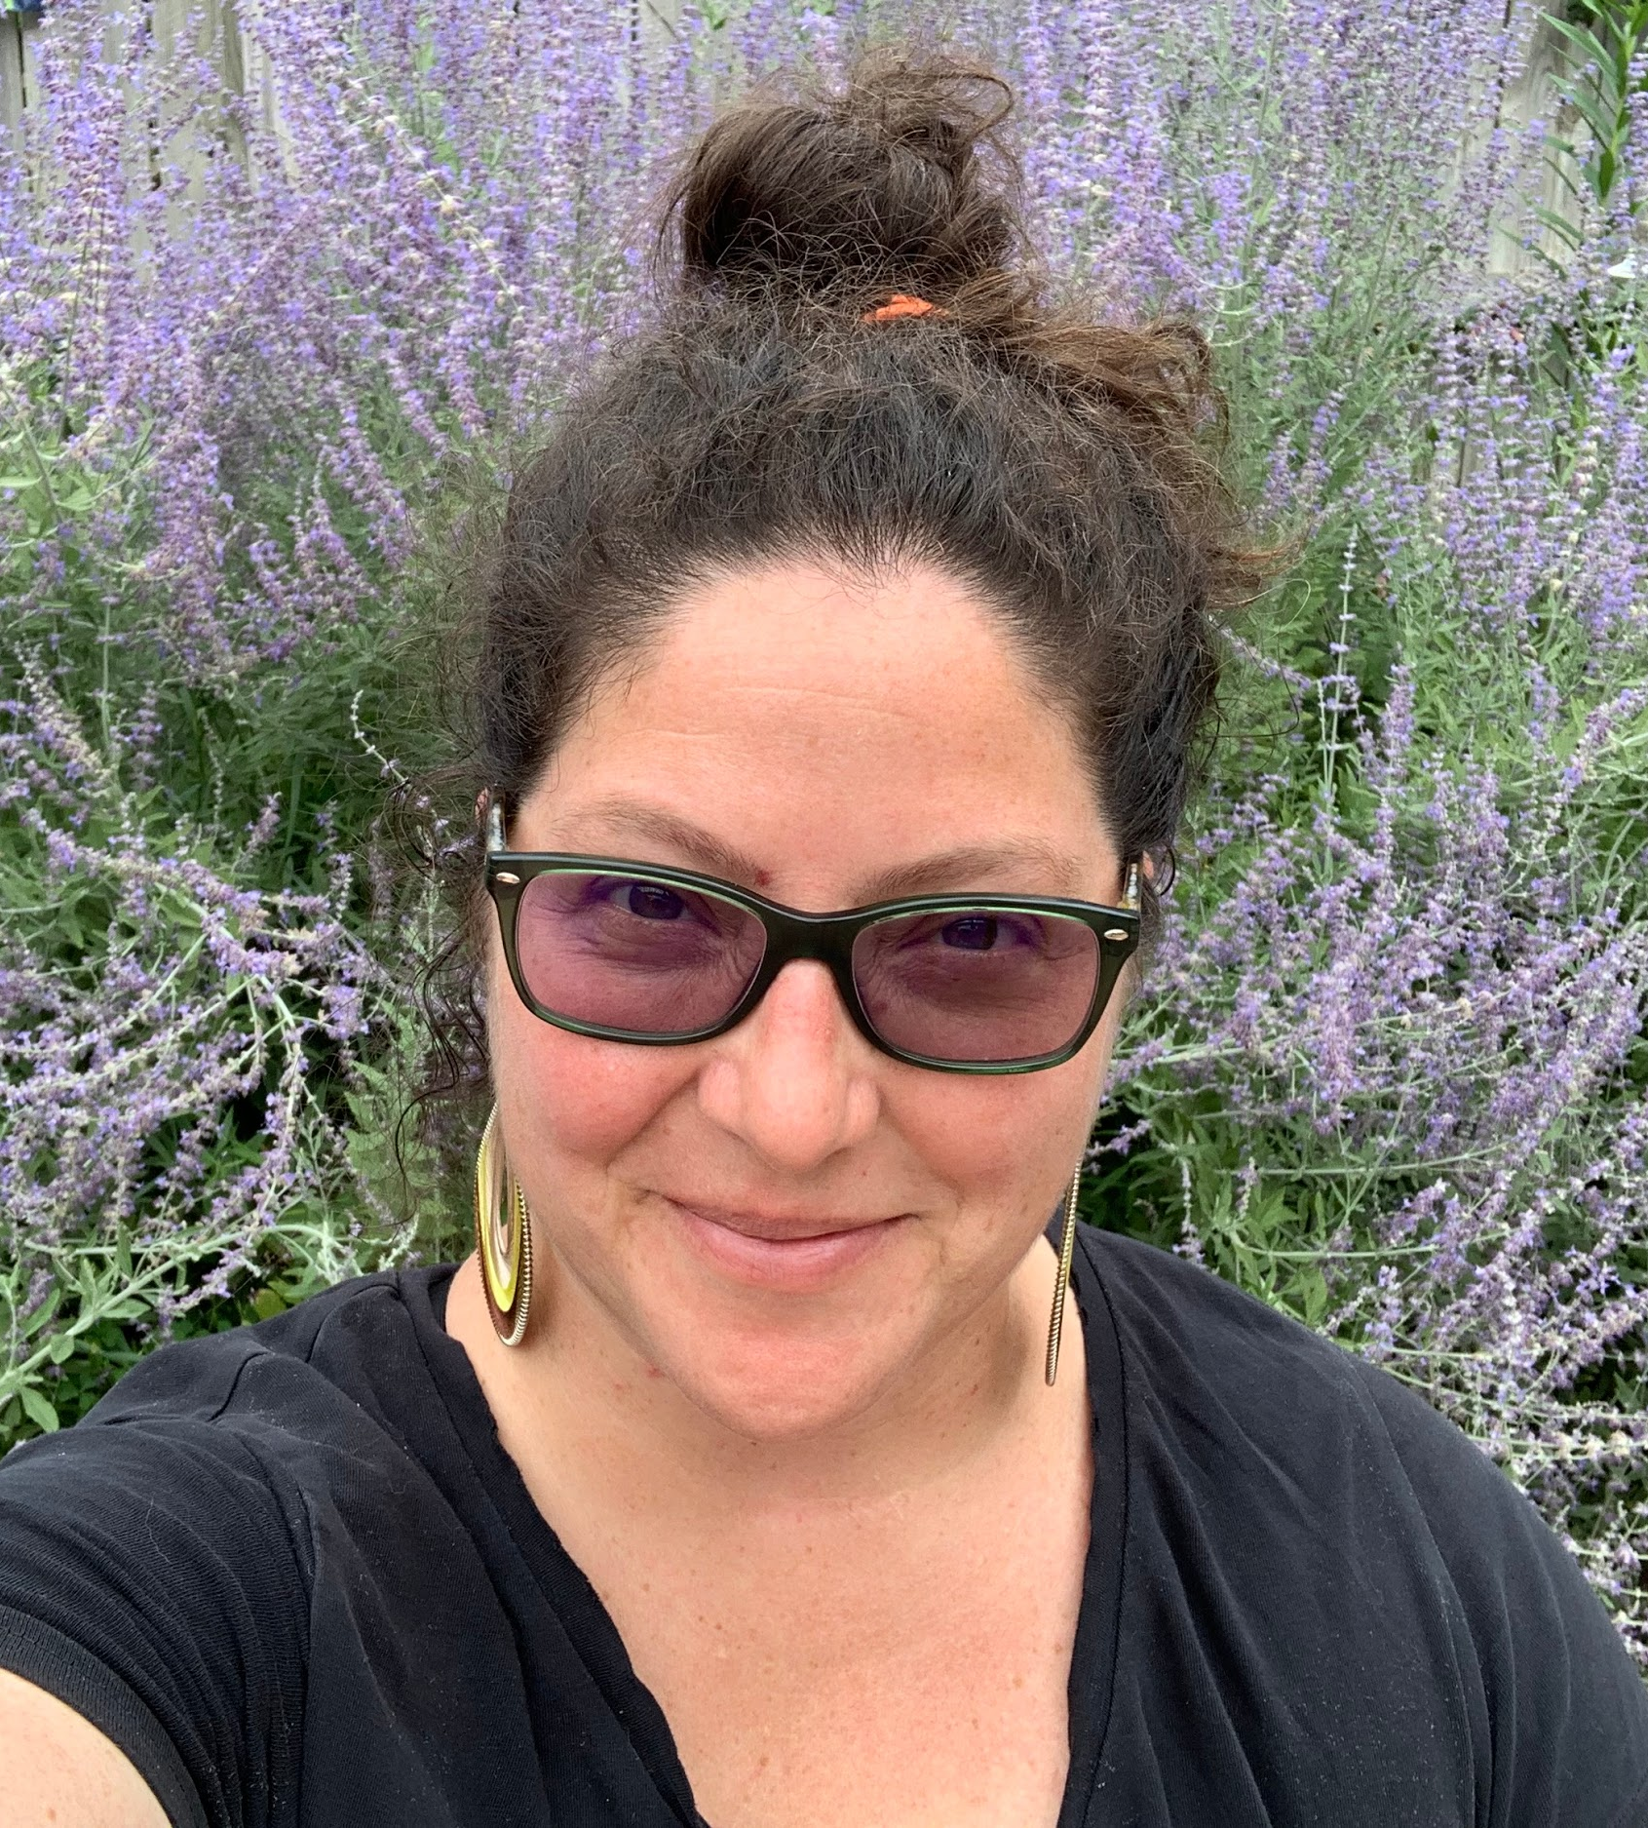
Olivia Mulcahy (she/her/ella)
Education Specialist
Illinois Resource Center
Chicago, Illinois
#TakeCareIsTheCurriculum
please enter a head shot here

Slide 29
Section 2: Culture, Care, and the Curriculum--how do these connect?

Slide 30
Acknowledging Where I Am Coming From...
Identity & Culture
How do our individual & community...
Experiences
Perceptions
Ways of knowing
Ways of sensemaking
Language practices
Biologies
Roles
Affinities
...influence our perspective and practice?
parent
partner
auntie
Latinx &
white &
white- presenting
educator
middle school teacher
district leader
professional developer
graduate instructor
cishet
she/her/ella
(they/them/elle are singular options too)

Slide 31
Acknowledging the Land
I would like to begin by acknowledging that the place where I live and work stands within the traditional homelands of many Indigenous nations:
Kiikaapoi (Kickapoo)
Peoria
Bodéwadmiakiwen (Potawatomi)
Miami
Očeti Šakówiŋ (Sioux)
I invite us to offer gratitude and respect for the Original Peoples of this land where we live; for the diverse Indigenous nations living here today and for their ancestors. Please take time to learn about territory acknowledgement and the native land where you reside at https://native-land.ca/
Notes:
One of the ways we enact care is through acknowledgement. Seeing others.

Slide 32
Acknowledging this Unique Moment
Variability in how we & our students & their families are
Experiencing the pandemic
Experiencing violence
Making meaning of the world
Bringing these experiences, perceptions, and understandings to teaching & learning
Awareness of the lenses we might refine
Anti-Bias Anti-Racist
Trauma-informed
Disability Justice
LGBTQ2S Inclusive
Culturally and linguistically relevant, responsive & sustaining
Notes:
Acknowledge police violence, Pride, pandemic. Acknowledge intersectionality. Acknowledge mix of emotions and responsibilities. Take a moment to pause and connect with those emotions, check in with our bodies, breathe.

Slide 33
What is the purpose of education?
How do we define success?
What do we value and prioritize?
What are the key components of a successful school?
Notes:
prompt responses in chat

Slide 34
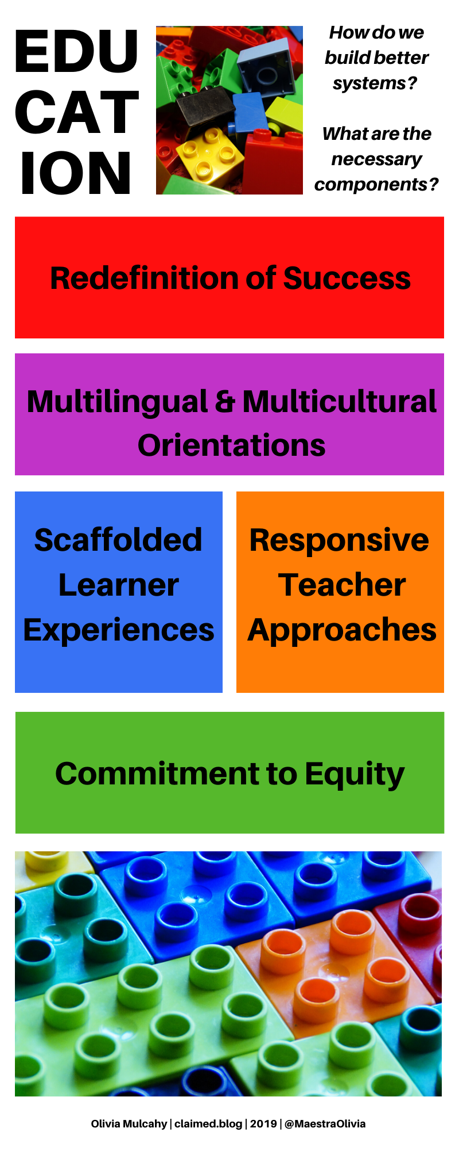
The school system I dream of will...
...redefine success to encompass more than just a narrow set of metrics & instead root it in how well we have realized the potential to make people, individually and collectively, more free.
Notes:
reveal this as one schema for thinking about what’s truly important

Slide 35
Being an advocate for Black lives does not mean that I am an advocate against any other lives. When we make the conscious decision to address persisting injustices, this broadens access to justice for everyone.
Cornelius Minor
Why #BlackLivesMatter in Your Classroom Too, 2017

Slide 36
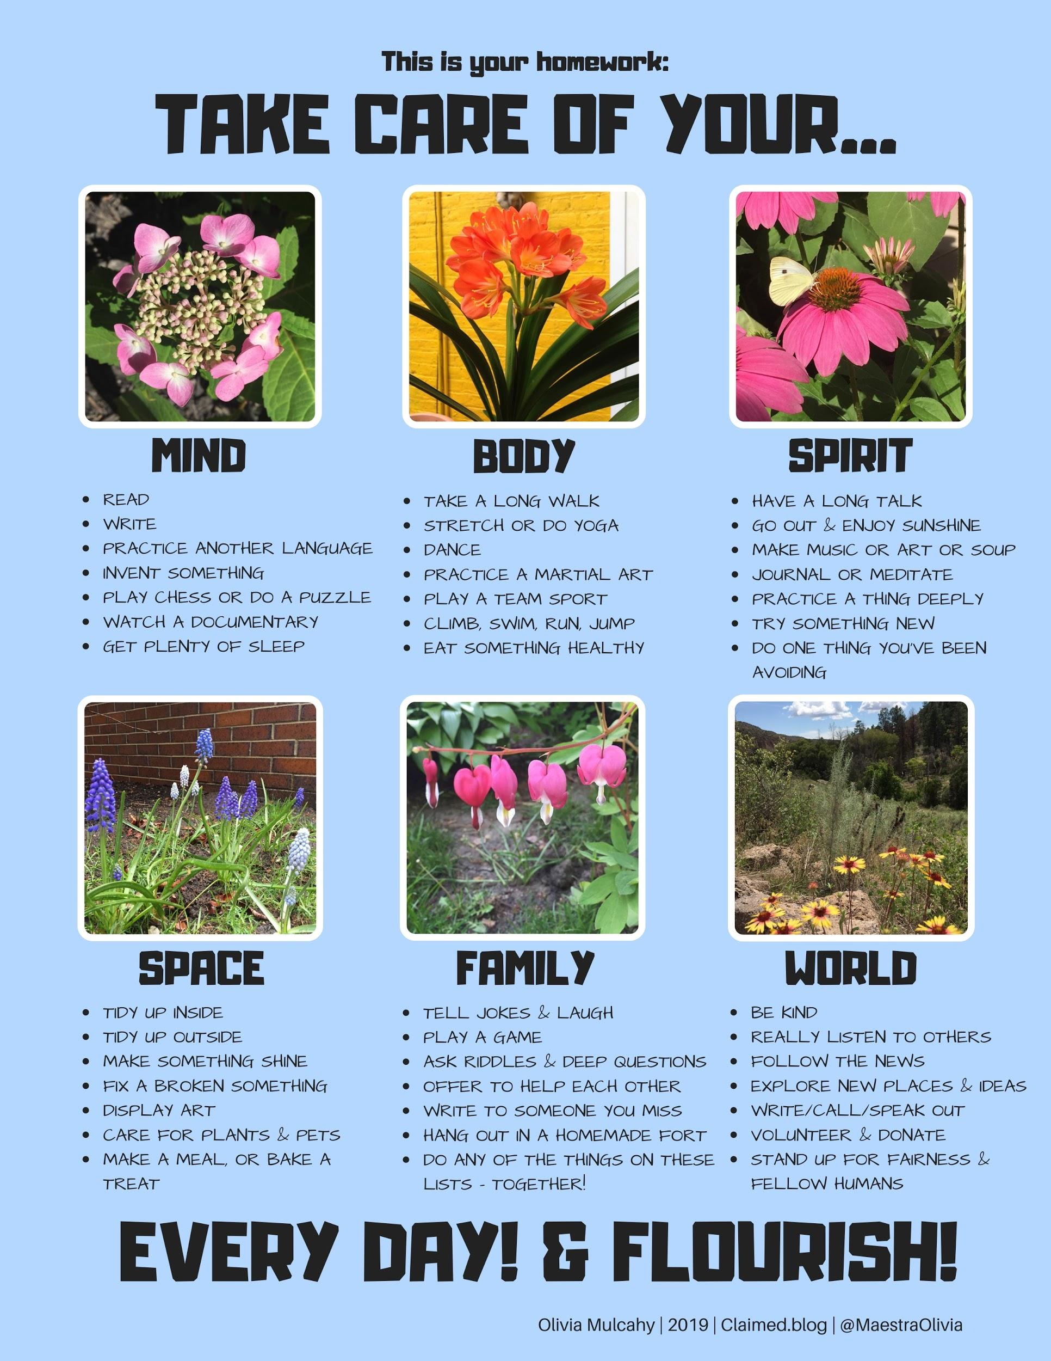
Using the Take Care Chart to Create Curriculum
Design Principles:
worthy
collective
possible
co-constructed
flexible and fluid
hefty but not heavy

Slide 37
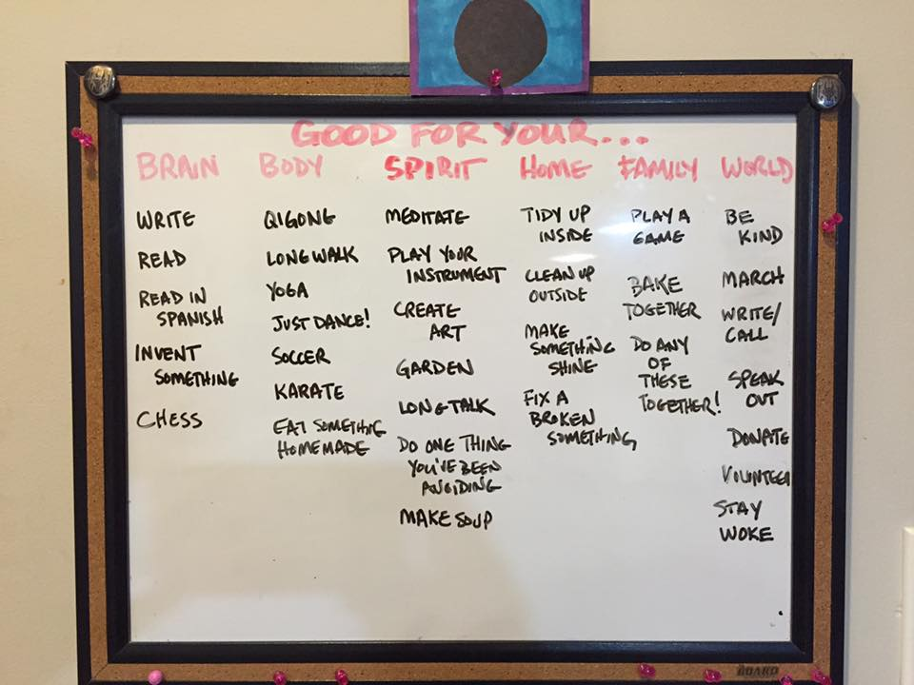
Taking Care at Home & at School
Teachers use the Take Care chart to brainstorm with students and families lots of possible and engaging options in each category, including options that can be collectively undertaken.
Notes:
(Please note: Not all kids have access to tech, so in the chart with my examples there is no tech necessary, though one can imagine where e-learning options and such could have a role.)

Slide 38
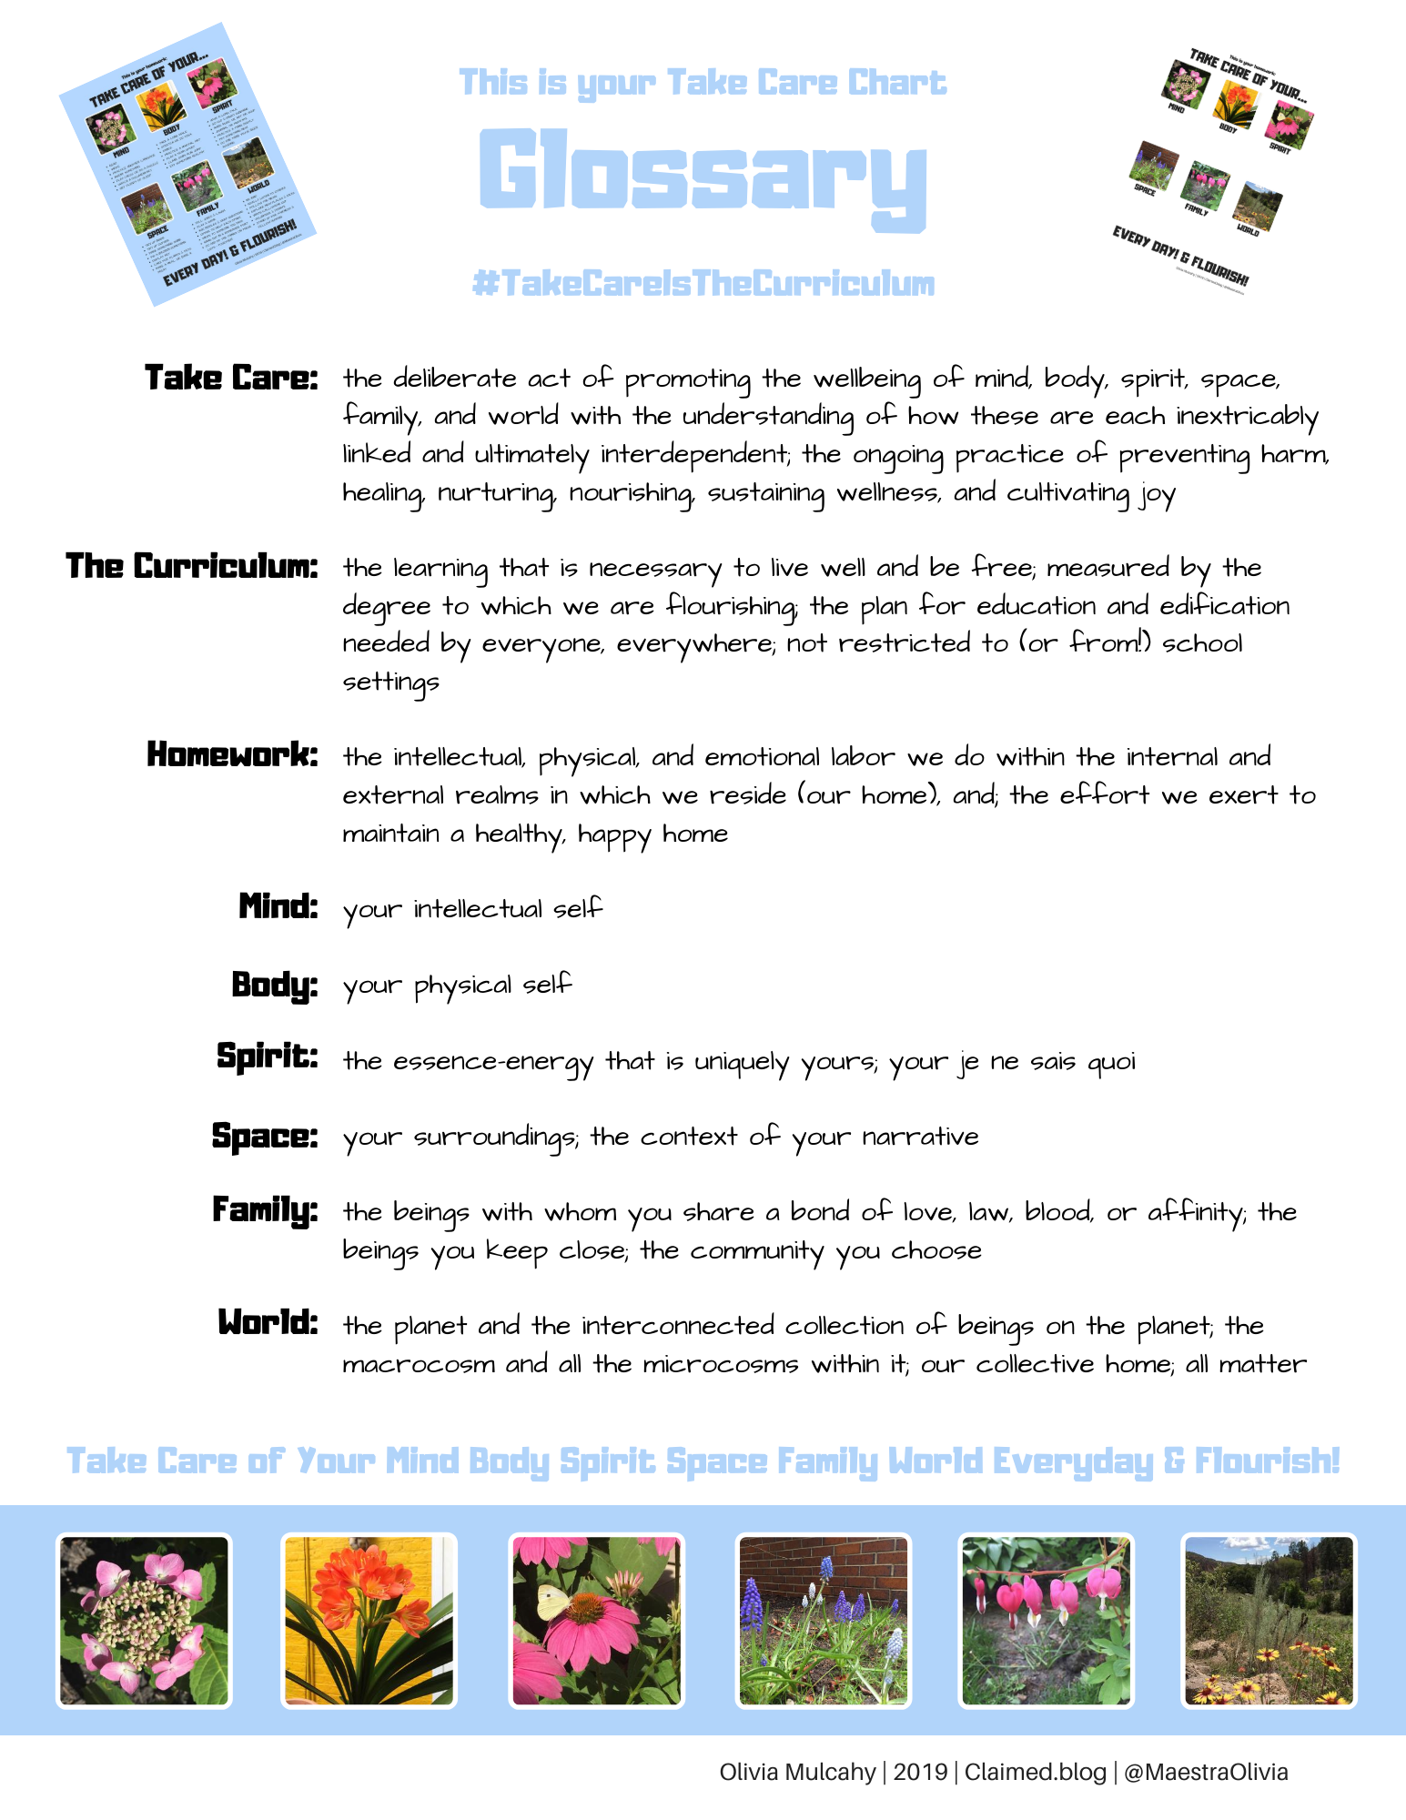
Take Care:
The deliberate act of promoting the wellbeing of mind, body, spirit, space, family, and world with the understanding of how these are each inextricably linked and ultimately interdependent;
The ongoing practice of preventing harm, healing, nurturing, nourishing, sustaining wellness, and cultivating joy

Slide 39
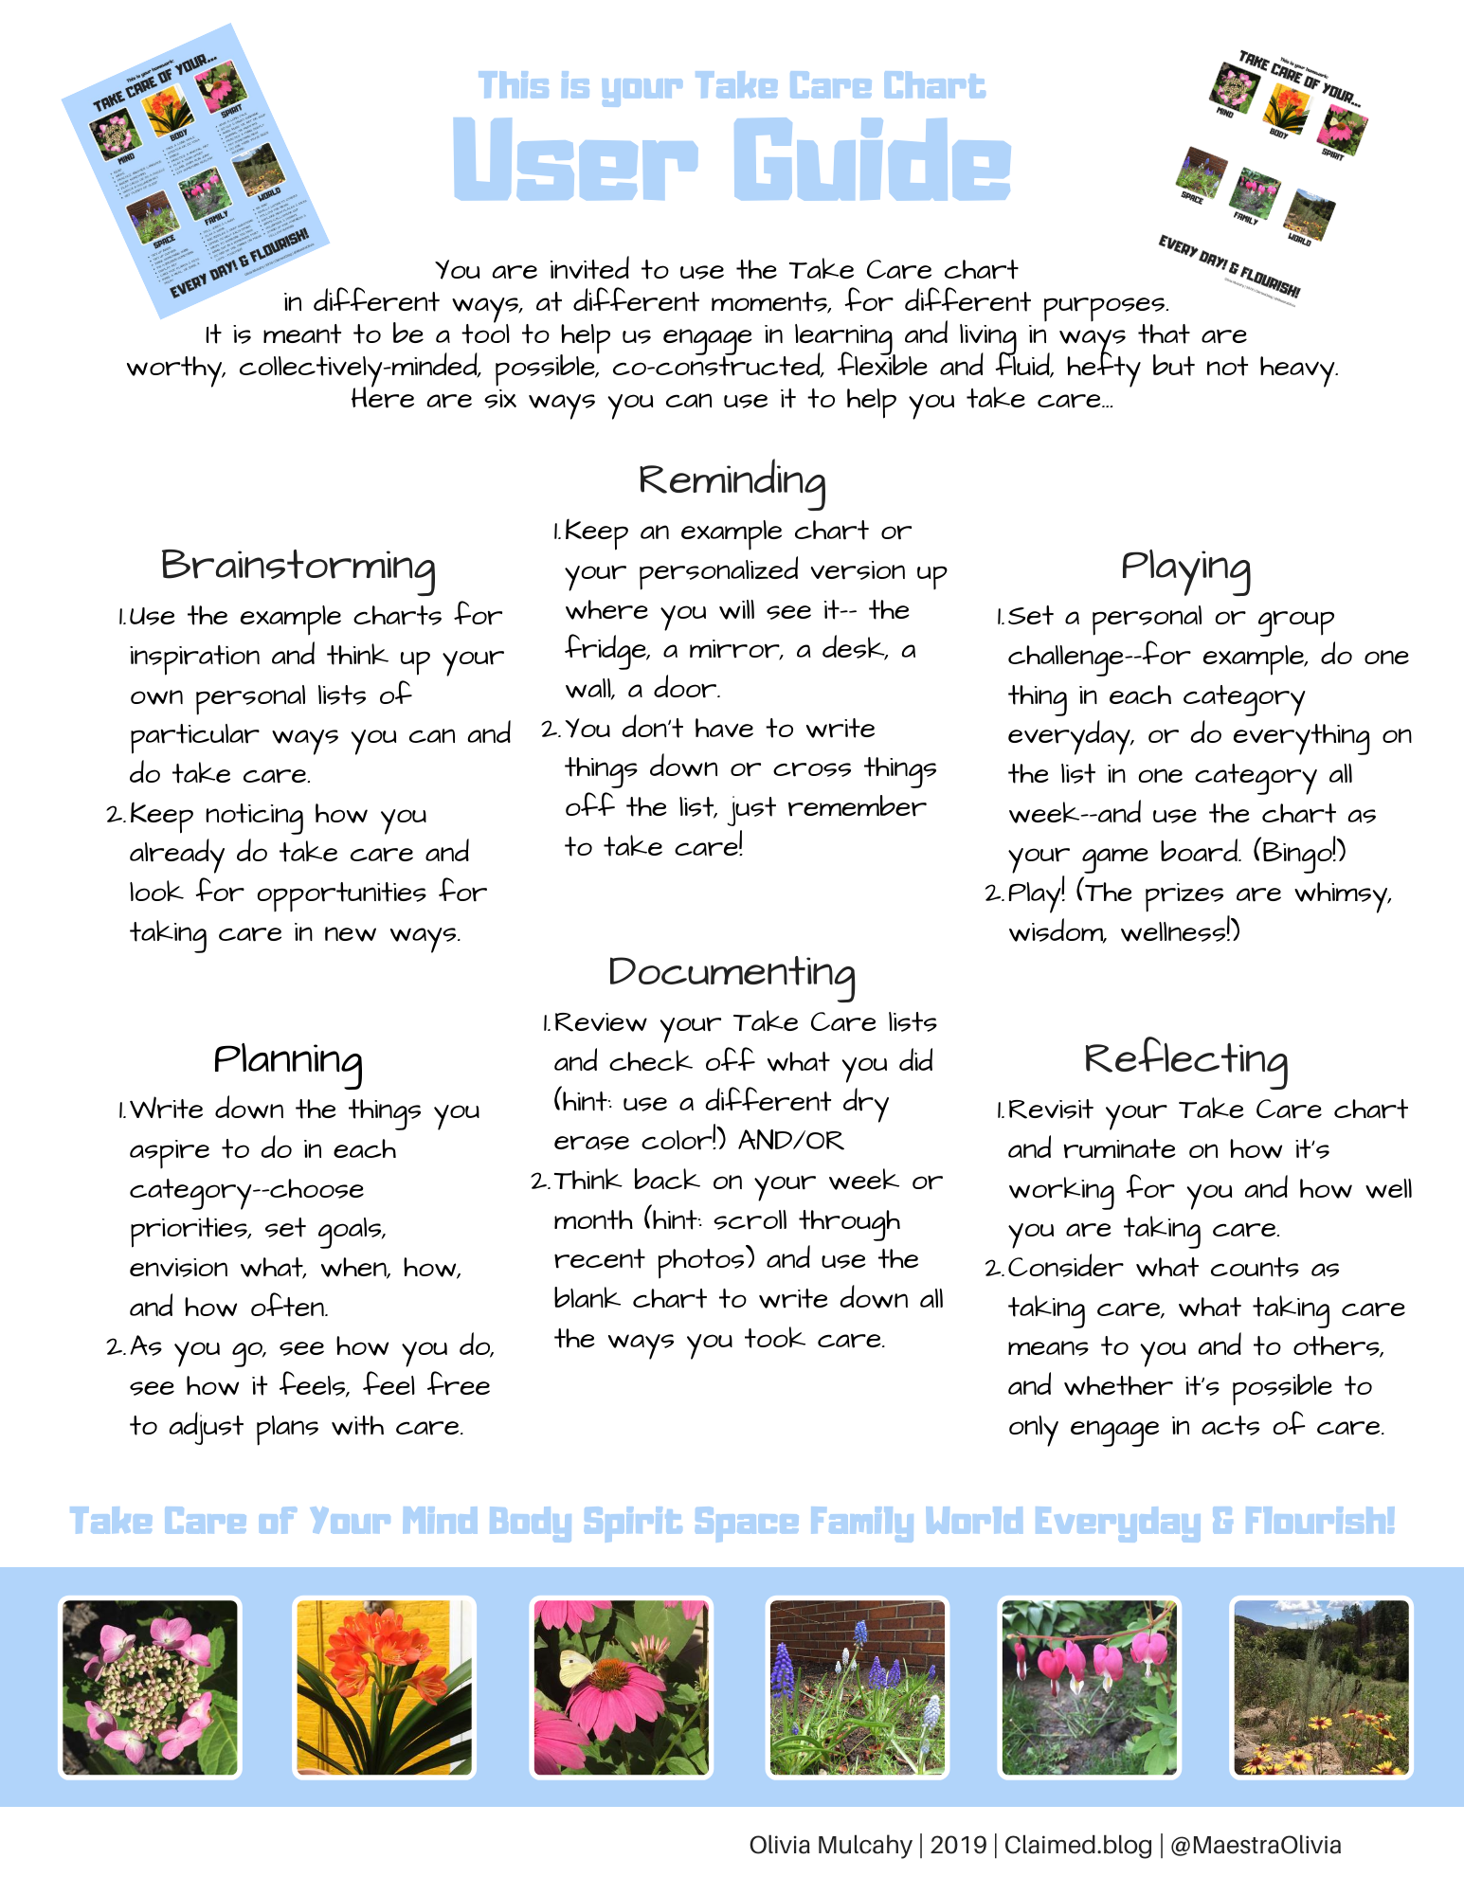
The Curriculum:
The learning that is necessary to live well and be free;
Measured by the degree to which we are flourishing;
The plan for education and edification needed by everyone, everywhere;
Not restricted to (or from!) school settings

Slide 40
What Are the Ways of Caring?
How do cultures around the world conceive of care and understand the importance of care to their communities?
How do these align with the values, beliefs, practices in our own communities? In our schools?
Notes:
ways of knowing, caring, healing,

Slide 41
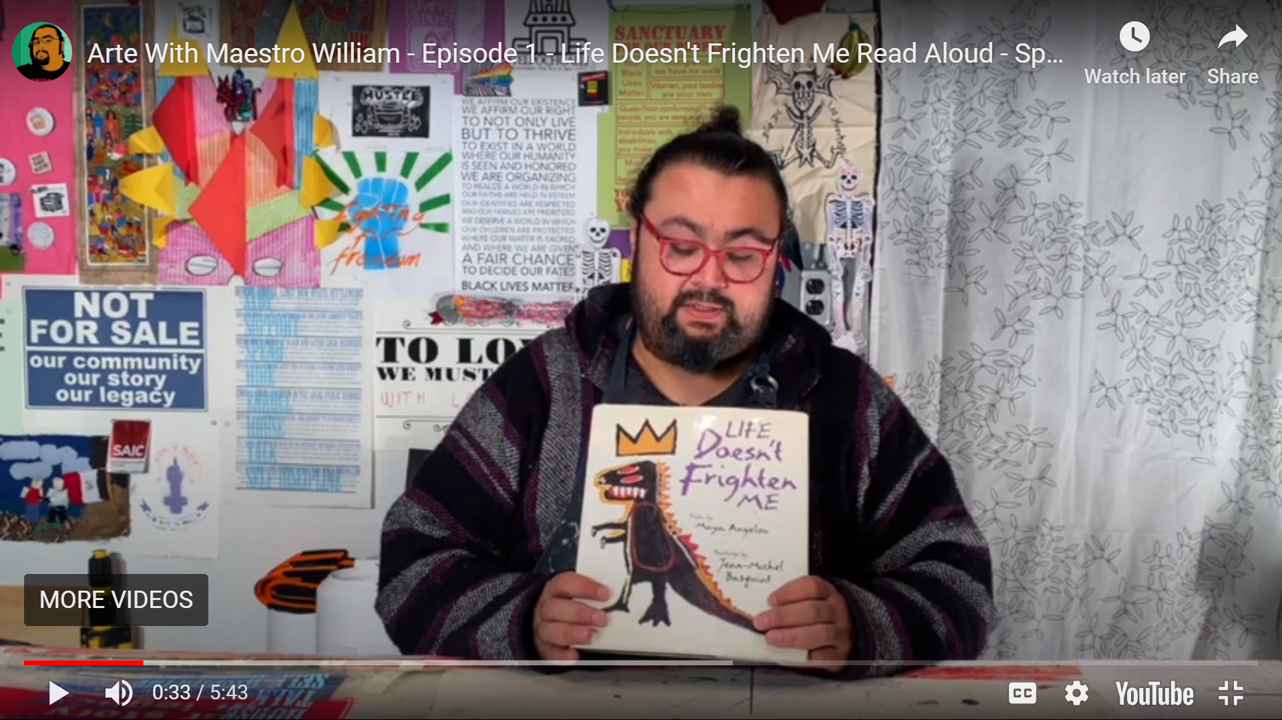
IN LAK’ECH
by Luís Valdez &
Domingo Martinez Paredes
Tú eres mi otro yo.
You are my other me.
Si te hago daño a ti,
If I do harm to you,
Me hago daño a mi mismo.
I do harm to myself.
Si te amo y respeto,
If I love and respect you,
Me amo y respeto yo.
I love and respect myself.
Notes:
Maestro William reads poem 0:34 - 1:22

Slide 42
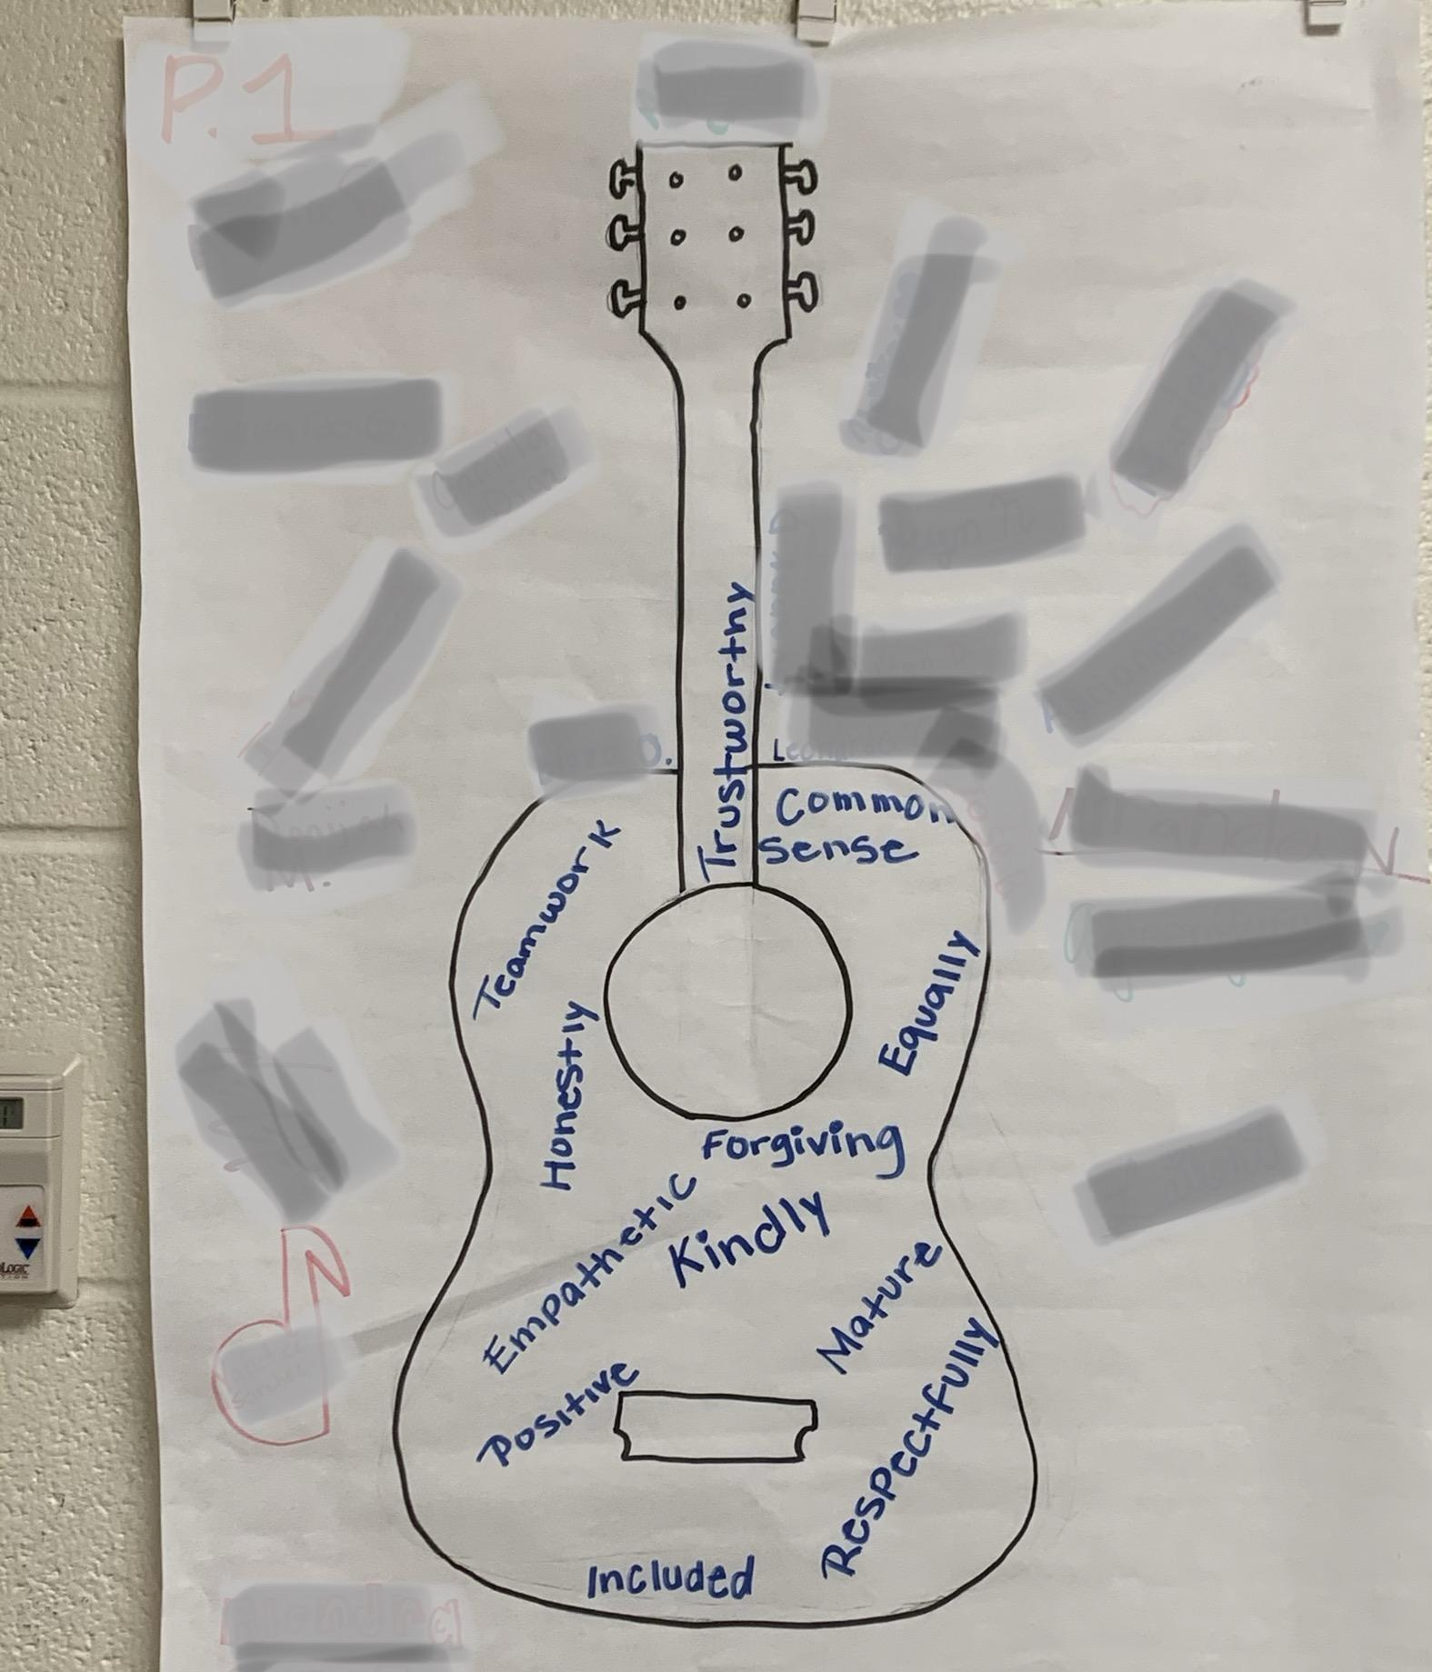
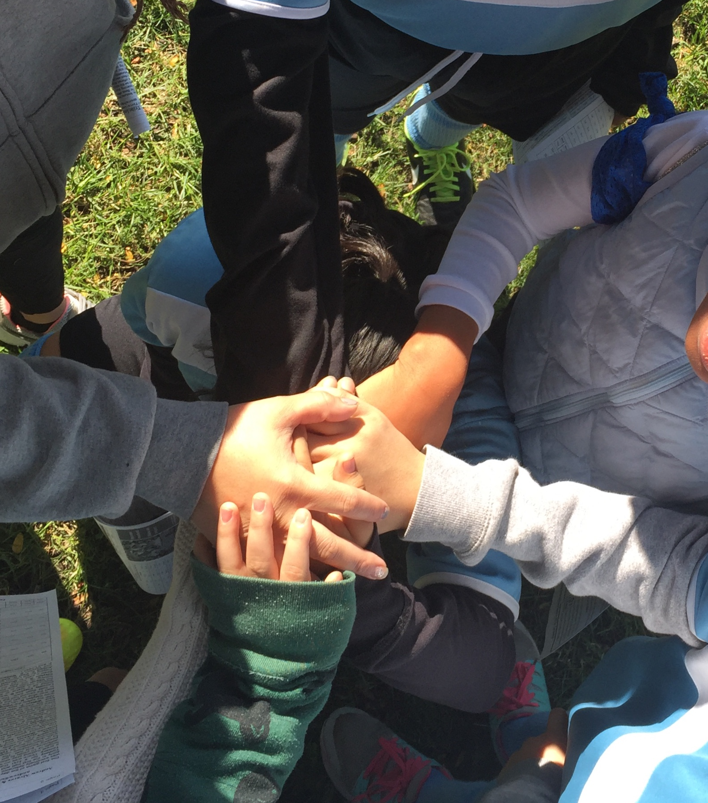
Co-construction of Agreements
Listed Rules (What are rules from other places you think are important for us?)
Review 1: Do we like this list?
Review 2: Does it ALWAYS apply to EVERYONE?
Revised list
Learned about ourselves as learners
Discussed how this information can help us learn individually & collectively
Revised list, renamed it: Agreements (or Norms)
Revisited list and adjusted it over the whole year
Notes:
Walk through how we did it in my classroom, taking time, and the benefit over the year of investing that time

Slide 43
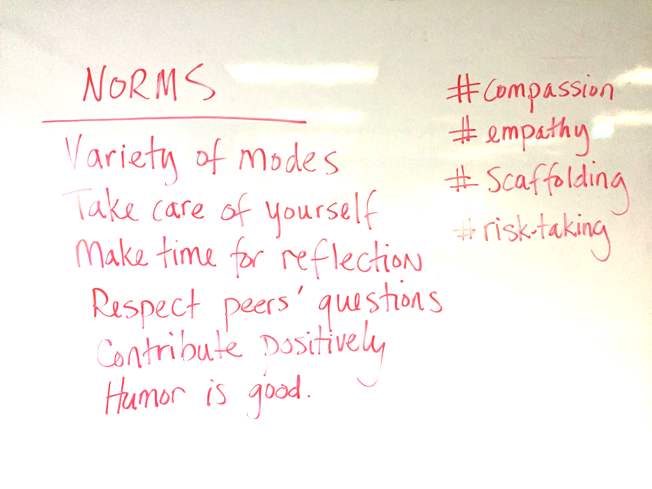
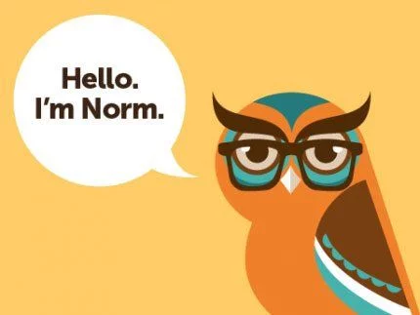
Sample
Norms
Take care
Trust your experience and expertise
Make room for multiple ways of knowing
Be resources to each other
Observe and enjoy languages and languaging
Notes:
Importance of building norms, not just by decree

Slide 44
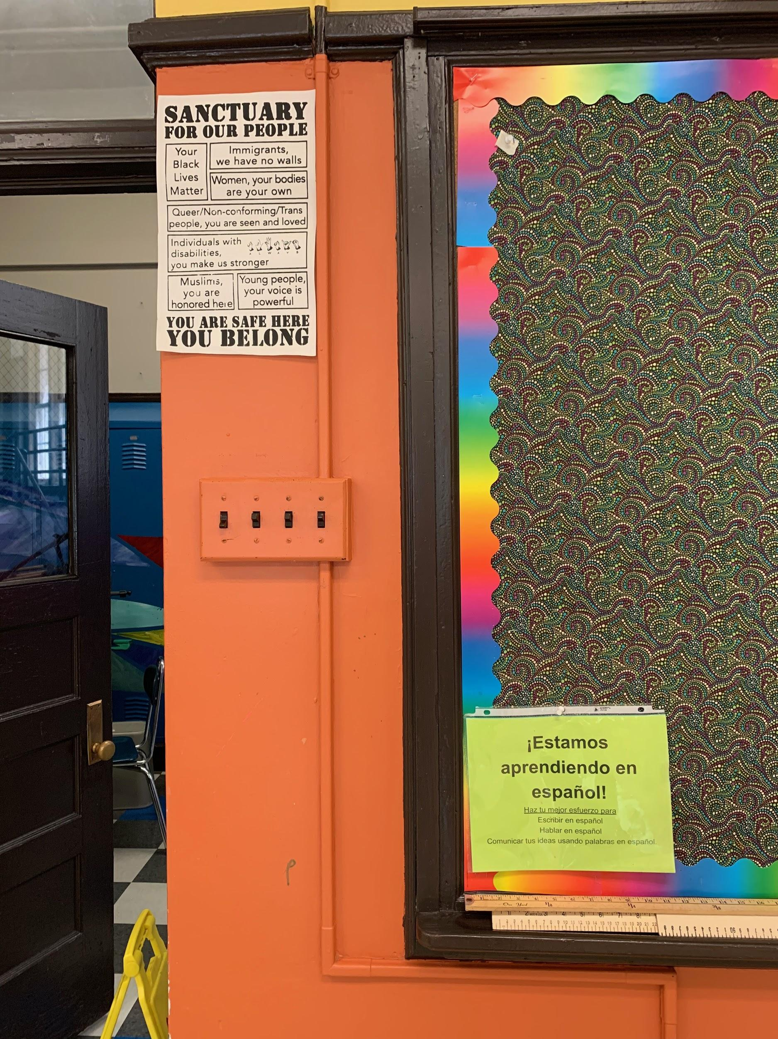
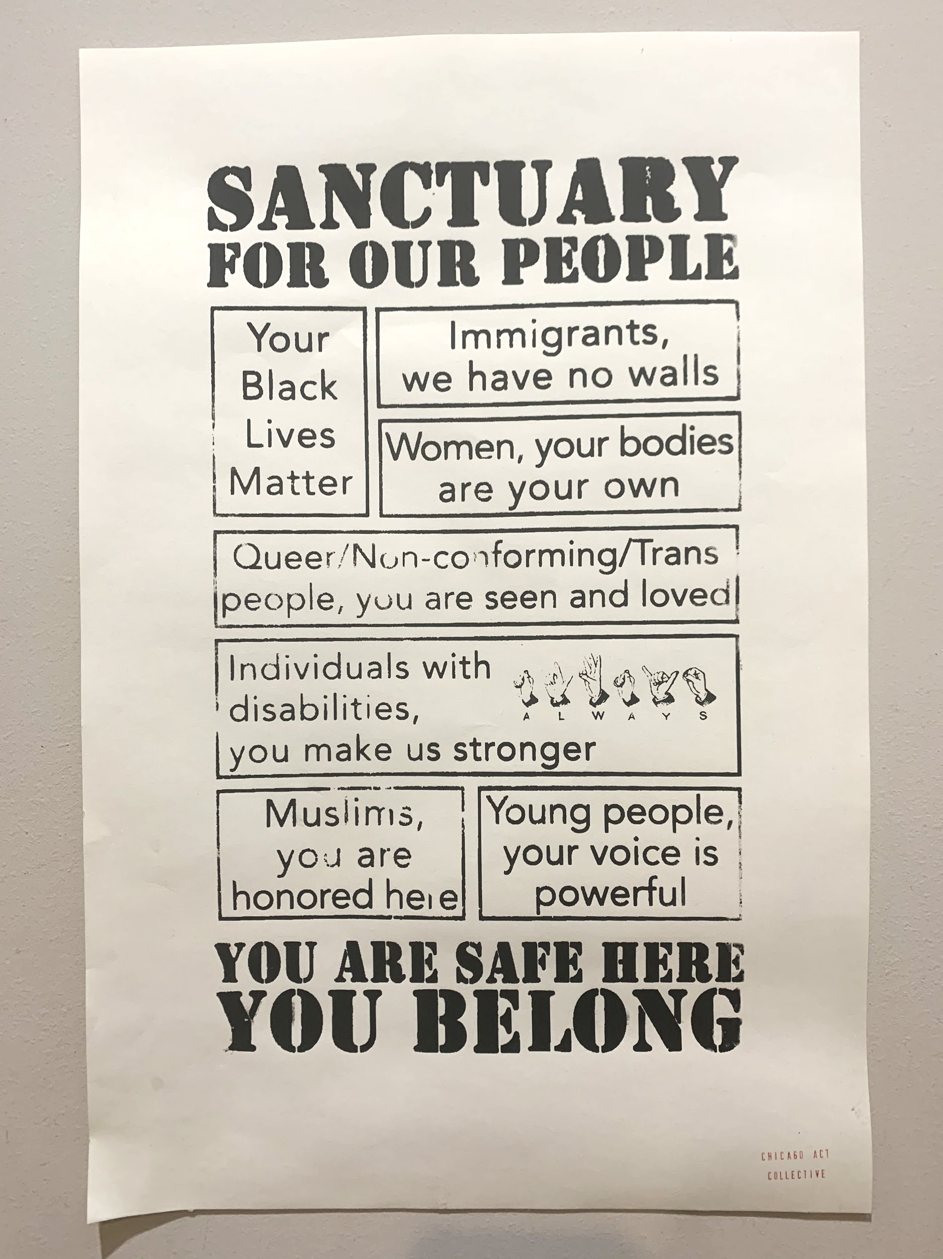
No One at the Margins
How can we overtly and subtly send messages of safety, affirmation, and support to our most vulnerable students?
Notes:
Selecting texts that represent the cultures and languages of our community
Sharing our pronouns
Metalinguistic conversations - discussing the why and how of inclusive language

Slide 45
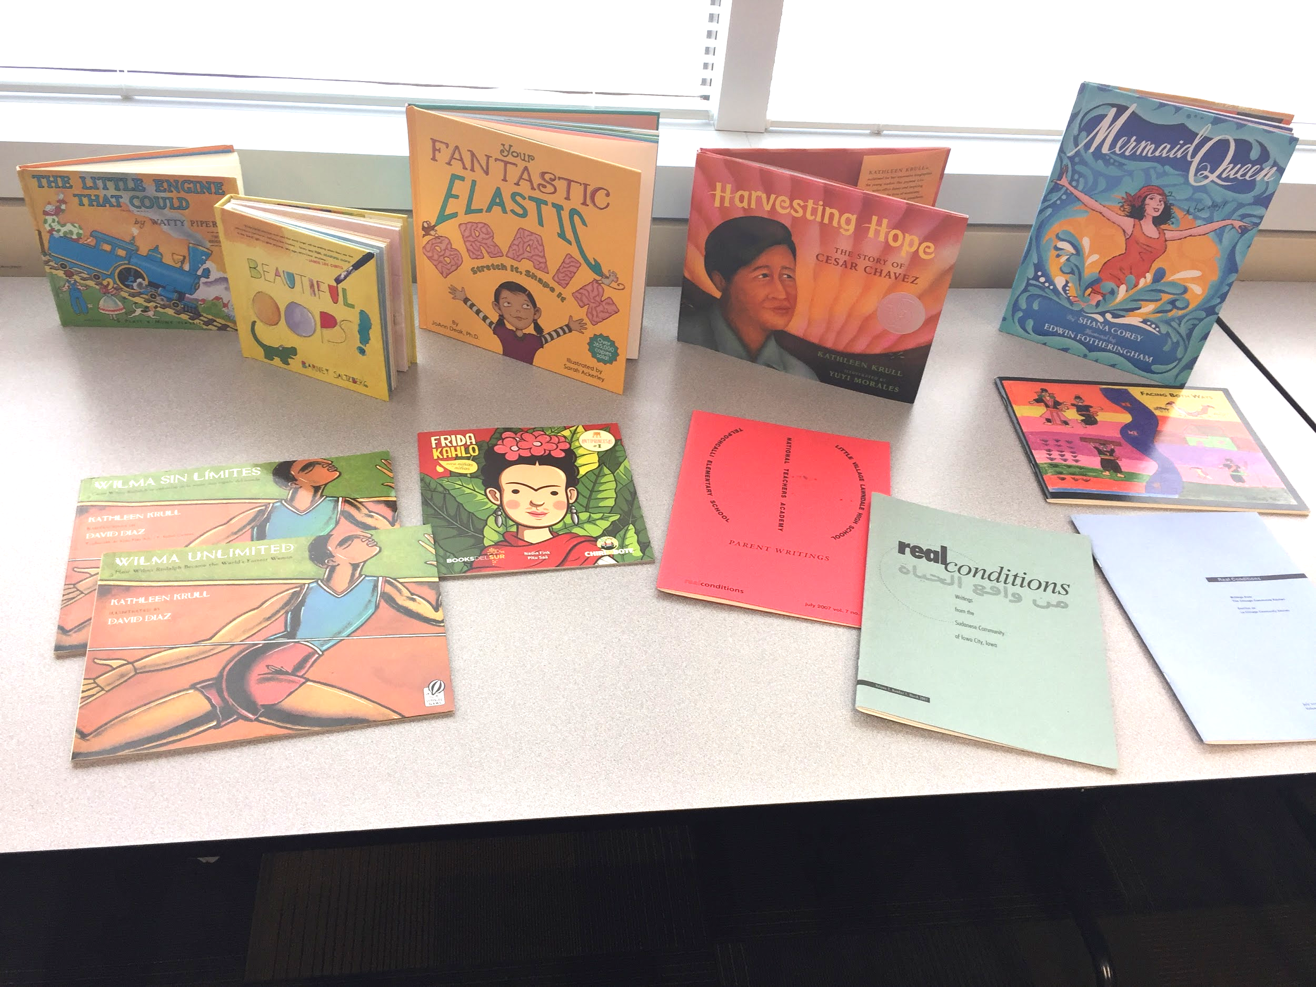
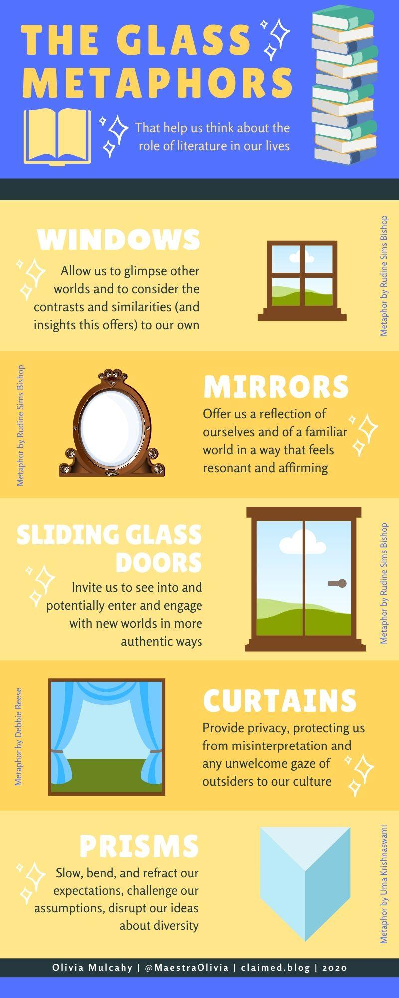
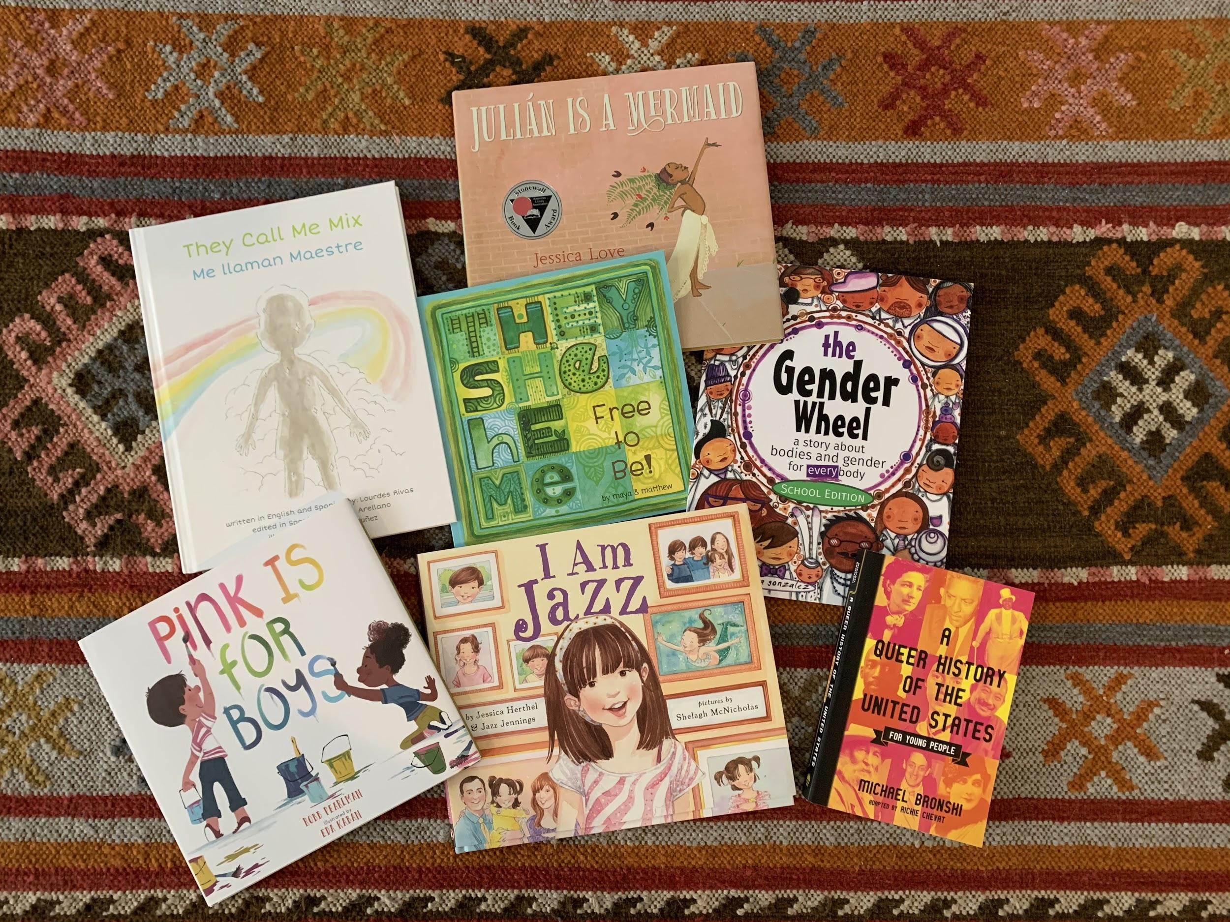
Rudine Sims Bishop’s
Windows & Mirrors
How can our text selections provide students with windows and mirrors to see new worlds and see themselves in the curriculum?

Slide 46
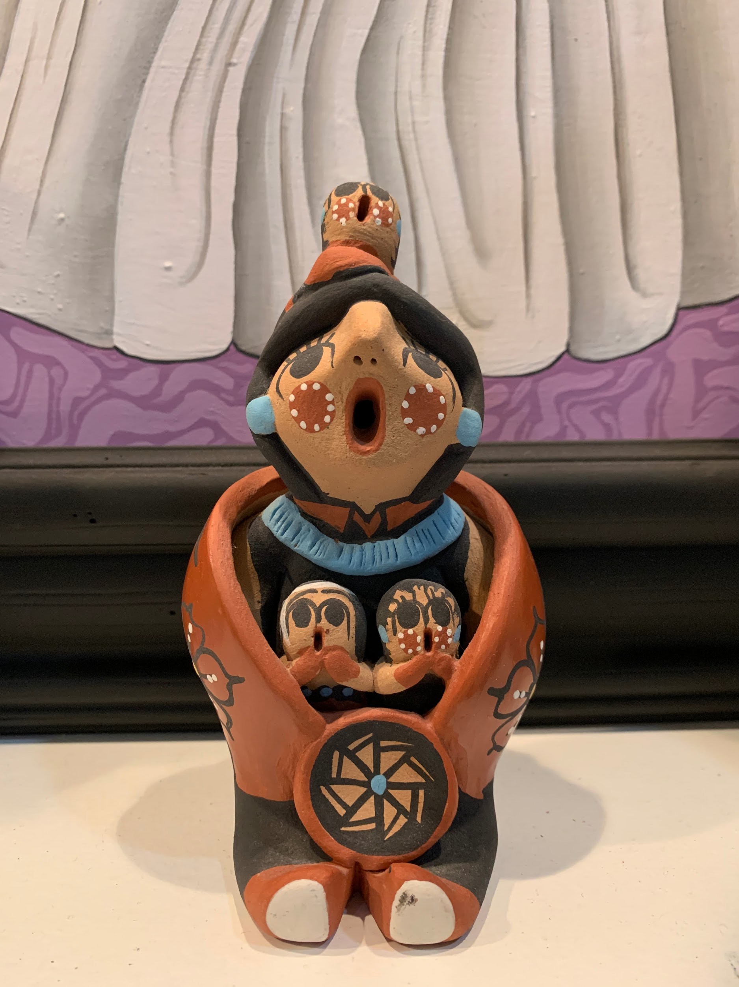
Luis Moll’s Funds of
Identity & Knowledge
Funds of identity—the historically accumulated, culturally developed, and socially distributed resources that are essential for a person’s self-definition, self-expression, and self-understanding.
Funds of knowledge—bodies of knowledge and skills that are essential for the well-being of an entire household

Slide 47
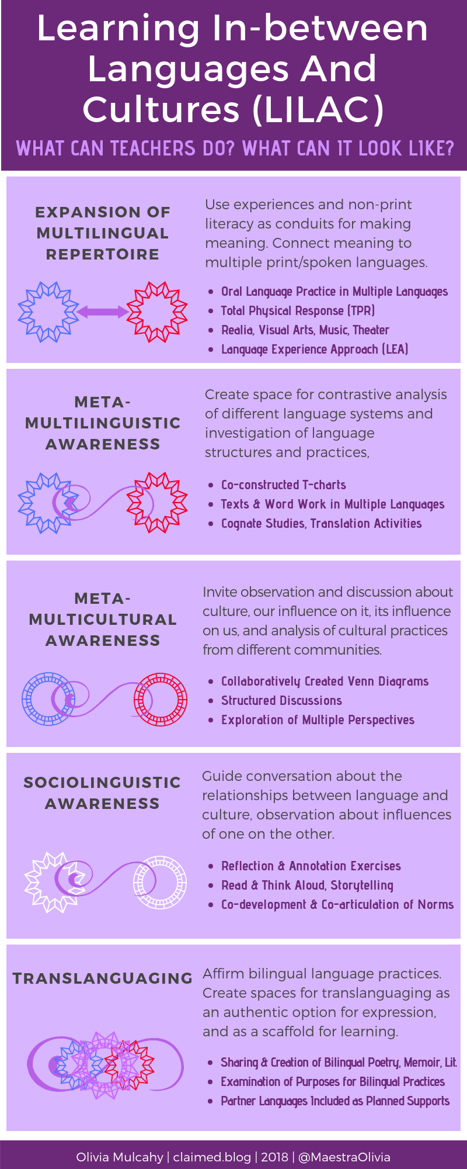
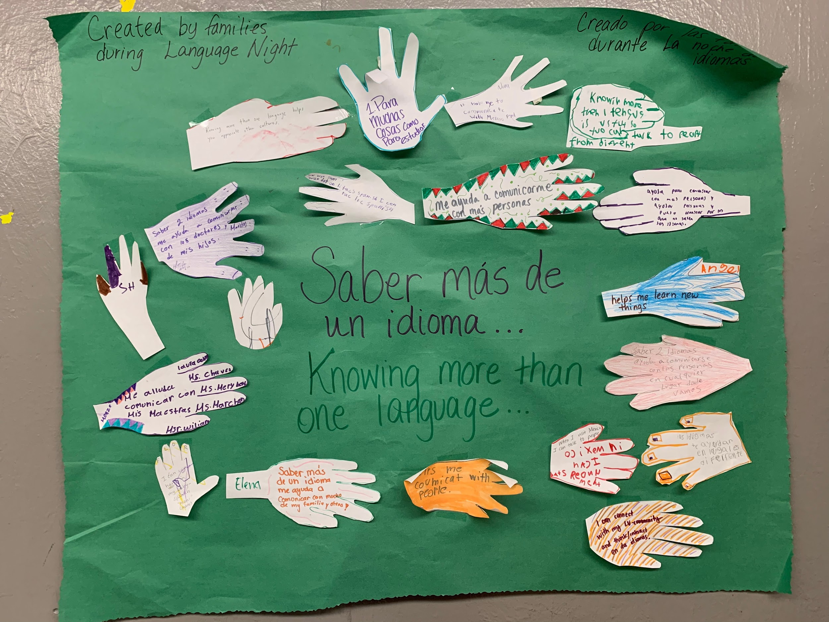
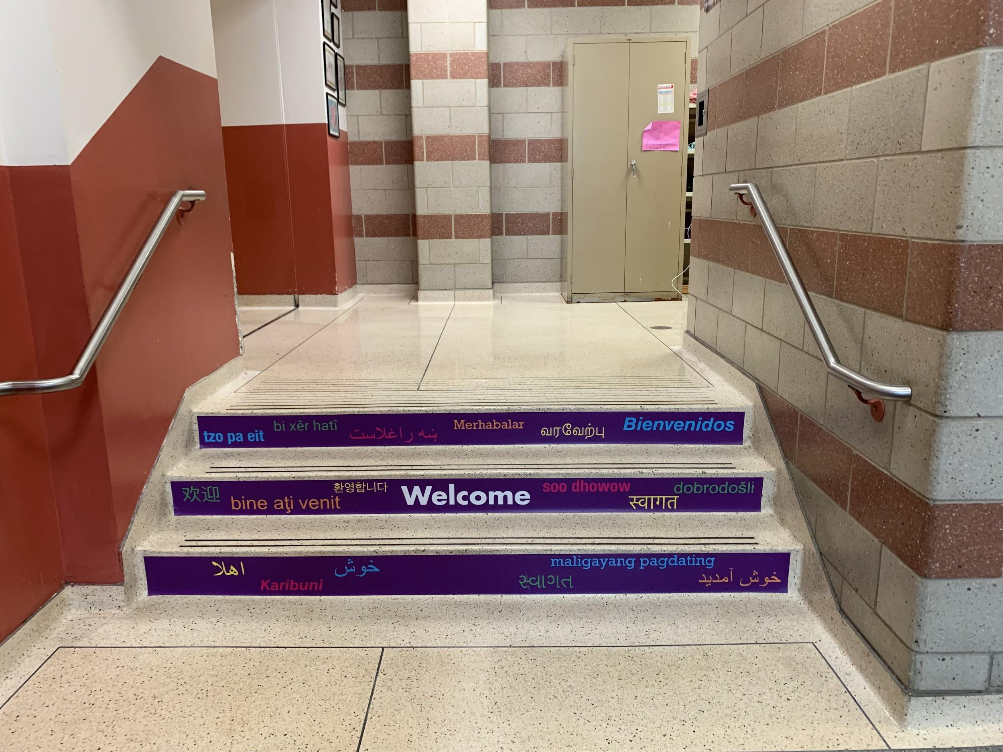
Multilingual
Ecology
How are we representing, welcoming, amplifying, centering, affirming, uplifting, normalizing...all the language practices of our community?
Notes:
in physical and virtual spaces?
closed captioning options, text choices, verbal language use, “tambien se dice”
CUNY NYSIEB

Slide 48
Inquiry and
Integration
Encourage careful observation
Use inquiry
Prompt use of available “texts”
Notice how ideas map on to content areas
Make room for authenticity and joy.
Notes:
authentic, organic
not compartmentalized

Slide 49
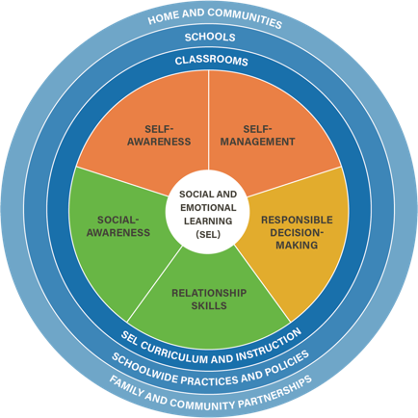
Wellness as
the purpose
Where are the opportunities for students to reflect and contribute, pause to process their emotions and thoughts, connect and collaborate with their peers, and promote empathy?
Notes:
Wellness as prerequisite and definitional to freedom
Back to the idea of redefining our vision for success

Slide 50
“…we all need to work especially hard to resurrect our capacity for human being, as a verb. That is, these are times that call upon us to sometimes break the rules of institutions and traditions…in favor of resurrecting our capacity to better see, hear, and talk to one another as human beings.”
A Letter From Carla Shalaby, Author of Troublemakers
Mid-Atlantic Education Review, Vol. 6, No. 1 (28-30), 2018

Slide 51
What Will You Do? What Will You...
KEEP & SUSTAIN? | TWEAK ? | PHASE OUT ? | THROW OUT ? | ADD ?
Notes:
Extending the metaphor…generative work - creating authentic clothing (learning to knit, sew, crochet, etc. for your particular fashion needs)

Slide 52
https://claimed.blog/infographics/infographics-takecarecharts/
Notes:
If they want to explore more...

Slide 53
Questions for Our Guests?

Slide 54
Resource Name | Link
Claimed | https://claimed.blog/
Culturally Responsive Teaching and the Brain Blog | https://crtandthebrain.com/blog/
Edutopia: Culturally Responsive Teaching and Online Learning | https://www.edutopia.org/article/value-culturally-responsive-teaching-distance-learning
Teaching Tolerance CRT Lesson Plans | https://www.tolerance.org/node/119977

Slide 55
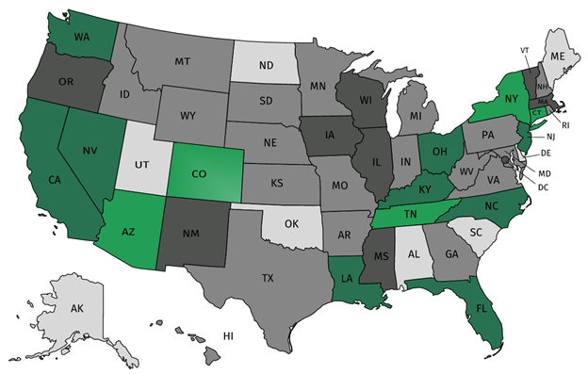
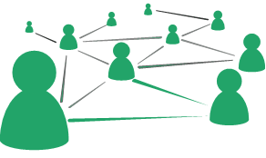
Join our network!
Join a national network of educators
Connect with state networks
Be a part of creating new tools and resources in partnership with SAP
Keep up to date on free resources, upcoming SAP webinars/professional learning opportunities, job postings and more!
Notes:
If you found tonight’s webinar helpful, we’d like to invite you to join our Core Advocate network! We’re committed to solving real problems that real teachers have and we know the best way to do this is to know more about what folks are experiencing.
As part of our national network, you have opportunities to connect with educators across the country, maybe even the network in your state! You can keep up to date on tools and resources available on Achieve the Core, as well as a variety of virtual learning opportunities and other ways to engage with us. We also work with educators in our network to help us build tools and resources.
We’d love to learn about who you are, where you work, the types of things you’re interested in and the expertise you already have. This way, we will be able to tailor our webinars and other opportunities to your needs and interests (we may even tap you to be our next webinar panelist).

Slide 56
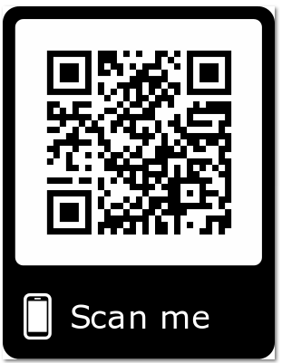
Please Join Us!
https://achievethecore.org/ca-signup
Twitter: twitter.com/achievethecore
Facebook: facebook.com/achievethecore
Pinterest: pinterest.com/achievethecore
Notes:
We encourage you to join the network by filling out this survey completely at atc.org/ca-signup

Slide 57
Please Join Us Again Next Month!
Next month’s webinar: The Early Reading Accelerators Thursday October 8, 2020 @7pm
Register Here: https://event.on24.com/wcc/r/2628843/B691457FC052821ACA270072CFF2A7B4

Slide 58
Thank You!

