Slide 1
The Early Reading Accelerators
Core Advocates Monthly Webinar
October 8, 2020
The webinar will begin shortly.
Check your Resource widget to preview the resources for today’s session! Use the Group Chat to introduce yourself!
Notes:
First timer poll
Handouts:
While we’re waiting, we’d like you to participate in a quick poll so we can get an understanding of who’s on the webinar with us tonight.

Slide 2
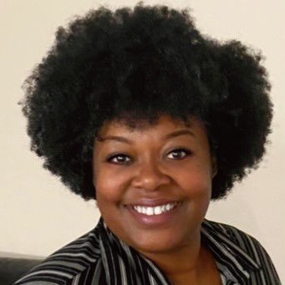
Your hosts:
Tori Filler Literacy Specialist Student Achievement Partners
Adrianne Sublett
EL Content Manager
Teaching Lab

Slide 3
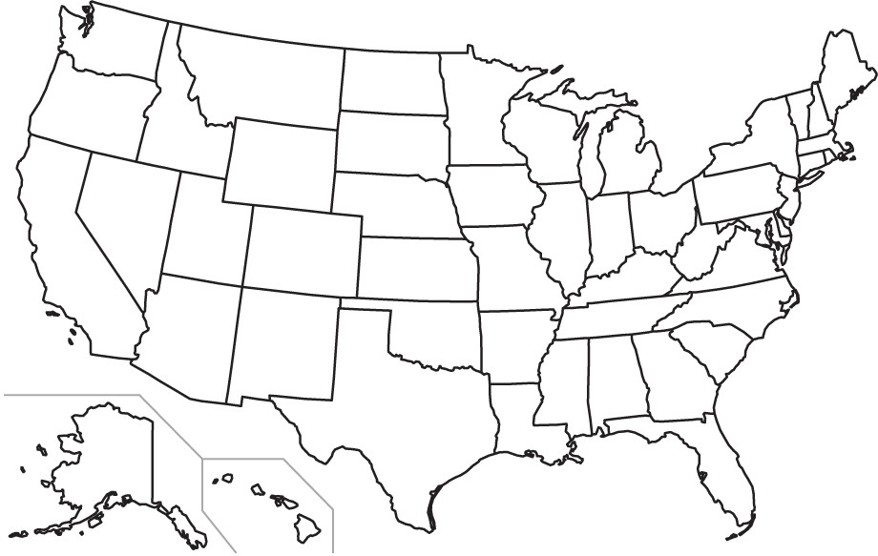
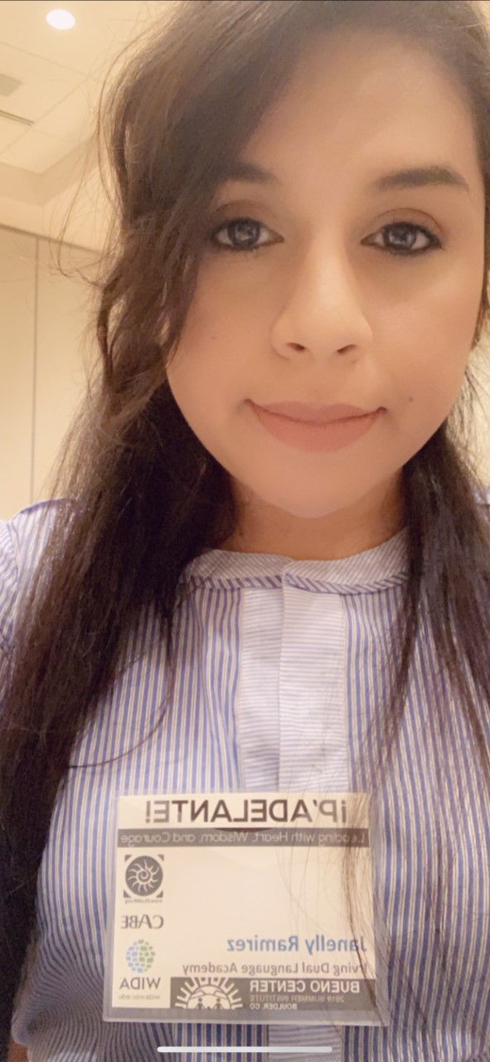
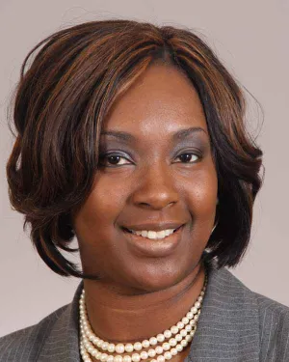
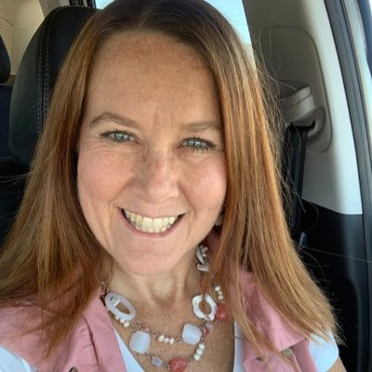
You’ll hear from these fabulous educators today!
Adrian
Austin
Charlotte-
Mecklenburg Schools,
NC
Janelly Ramirez
San Antonio Independent School District, TX
Dr. melissa collins
TONI CLYMER
Memphis, TN

Slide 4
How many Core Advocate Webinars have you attended?
Please use the Questions tab on your control panel to respond.
If using a poll, please put up to 5 answer choices in the notes section below and indicate if attendees should choose only one response or multiple responses.
Notes:
Tori

Slide 5
Join Our Network!
Core Advocates Sign Up
Find the link to sign up in your resource widget
https://achievethecore.org/ca-signup
Keep up to date on free resources, upcoming SAP webinars/professional learning opportunities, job postings and more!
Notes:
Tori
We also want to invite you to join the network by signing up at achievethecore.org/ca-signup and visit our website for more info and opportunities

Slide 6
Engage with Us!
During the webinar:
Question just for the presenters/ tech help
Resources
Group chat
Twitter
Certificate
Feel free to tweet during and after the webinar using #coreadvocates
@achievethecore
@JennieBeltro
Notes:
Tori

Slide 7
After the webinar
A certificate will be available via the Certification box to the right. Click on the blue-ribbon icon to print or download the certificate at the end of the webinar.
Access to recording will be available via your registration link & posted on Achieve the Core
Take our short survey at the end of the month and be entered into a raffle for a $25 Amazon gift card.
Notes:
Tori

Slide 8
Goals of the Webinar
Identify the “Early Reading Accelerators”
Share best practices and resources for engaging the work of the Early Reading Accelerators, with a focus on virtual learning
Notes:
Tori
We have two main goals for our webinar tonight. They are to...

Slide 9
Question or Poll:
How are you currently engaging in instruction?
All virtual
Blended
All in person
Not applicable for me Please use the Questions tab on your control panel to respond.
If using a poll, please put up to 5 answer choices in the notes section below and indicate if attendees should choose only one response or multiple responses.
Notes:
Adrianne

Slide 10
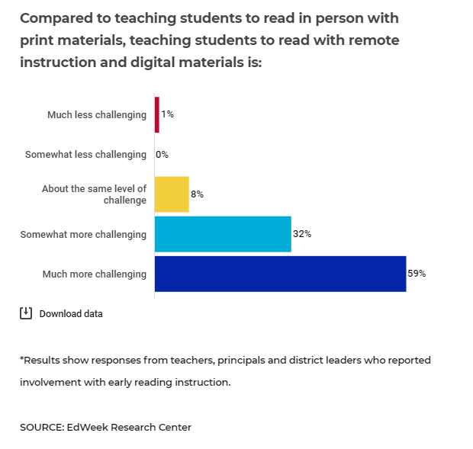
Notes:
Adrianne
Whatever your structure of instruction right now - you are amazing humans. This poll from the EdWeek Research Center came out recently, and early grades teachers overwhelmingly identified that teaching students to read with remote instruction is much more challenging that it is in person. We’re here to learn together and support one another as we all pursue the goal of ensuring that each and every student in our care has access to high-quality early reading instruction, despite the obstacles in our way.
https://www.edweek.org/ew/articles/2020/09/30/how-to-use-digital-reading-programs-during.html

Slide 11
Prioritization and Challenges for Early Reading Instruction this Year
Share in the chat.
Which content have you been prioritizing with your early readers this year?
Notes:
Adrianne

Slide 12
What are the Early Reading Accelerators?
Notes:
Tori
Reading science emphasizes two critical pieces in systematic early reading instruction: securing foundational skills and building knowledge and vocabulary. These "Early Reading Accelerators" are essential content that all readers need access to in order to become proficient. While each student and their experiences are unique, we can accelerate the development of reading proficiency for all students by implementing these practices strategically through classroom instruction and materials.

Slide 13
As the building blocks of early reading and writing, secure foundational skills are crucial for students' success in literacy and so are key enablers of equity.
Notes:
Tori
For foundational skills:
Scope and sequence of skills including print concepts, phonological/phonemic awareness, phonics & word recognition, and fluency.
Using your scope and sequence and students needs to determine instructional foci, student practice opportunities, and differentiation. This is so important this school year as we think about school interruptions and potential limited instructional time.

Slide 14
Building Knowledge &
Vocabulary
of complex texts
multiple resources on a topic
books organized by topic (not level)
Notes:
Tori
For building knowledge & vocabulary, the early reading accelerator identifies three key ingredients in a K-2 classroom:
Read-aloud with content-rich, complex texts that are read and reread a
Text sets - collections of texts and resources on a topic, representing a range of complexity levels. A topic might be Serena Williams, sharks, or outer space.
Book baskets used for independent/choice reading texts organized by topic, not levels. The idea is not to restrict students by level but to promote knowledge building AND student choice by arranging books by topic.
For each of these knowledge-building ingredients, we see a focus on building knowledge and vocabulary through topic-based study.

Slide 15
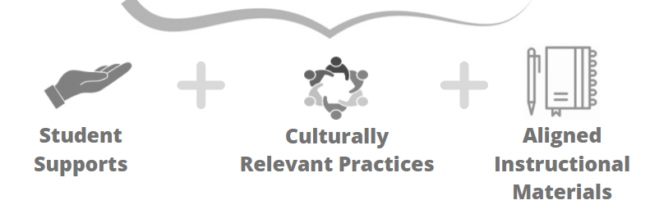
Equitable Implementation of the Early Reading Accelerators
How can we best support all K-2 students' learning, amplify what matters most for early reading, and foster students' social-emotional development?
Notes:
Tori
To implement the Early Reading Accelerators equitably and let each child’s brilliance shine, we must consider student supports, culturally relevant content and practices, and aligned instructional materials.
Many students need support with reading, but students of color, students from families experiencing poverty, and English learners are less likely to have access to resources that support reading success, including: effective instructional practices, appropriate individualized supports, or teachers and materials that reflect their identities.

Slide 16
Three new pages of resources!
Resources:
Early Reading Accelerators website
Foundational Skills website
Building Knowledge & Vocabulary website
Notes:
Tori

Slide 17
Let’s Hear from Teachers!
Share in the chat.
What are your biggest challenges with early reading instruction right now?
How do we engage in the critical work of the Early Reading Accelerators while engaging in remote or blended learning?
Notes:
Tori

Slide 18
Dr. Melissa Collins
Grade 2 Teacher
Shelby County Schools,
Memphis, TN
please enter a head shot here
Notes:
Adrianne
2014 West Tennessee Teacher of the Year
2020 Inductee into the Teacher Hall of Fame
Discussion questions:
First, could you tell us a bit about yourself, your school, and the students you serve?
What has been working for you to engage in early literacy work virtually?
What benefits have you seen of this work on the students you work with? Are there students where this work has had more or less impact, and can you trace why?
Are there things you’ve learned haven’t worked for you or the students in your class?

Slide 19
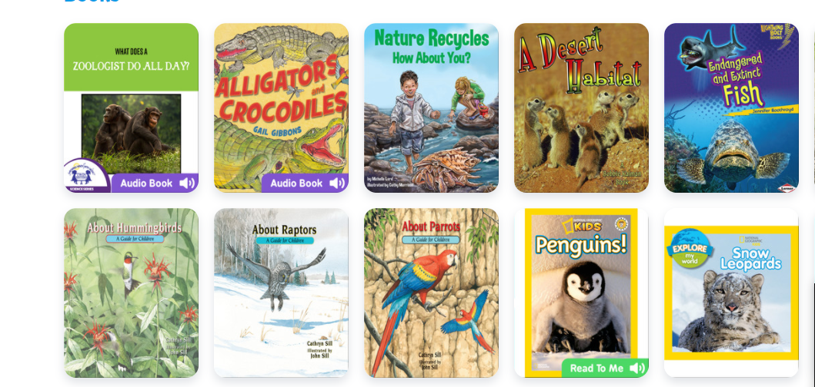
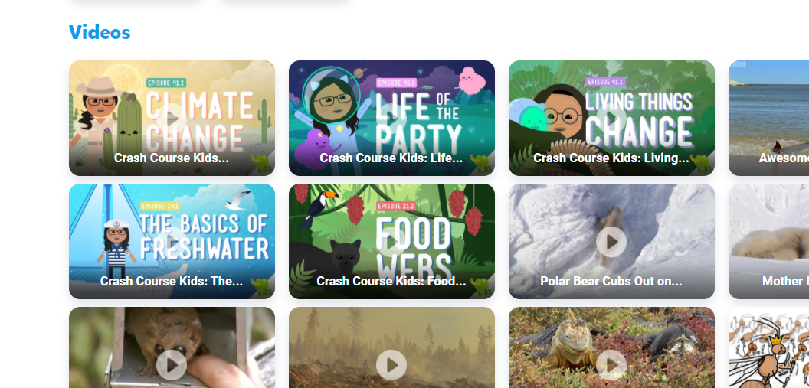
Epic Book Baskets and Class Project
Creating book collections by topic
Notes:
Adrianne

Slide 20
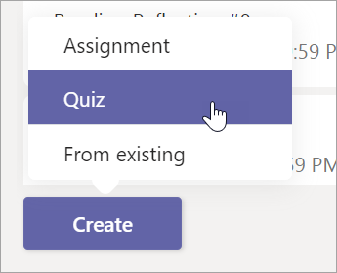
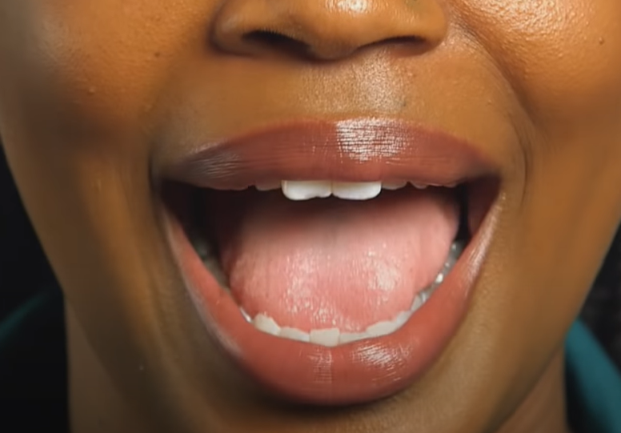
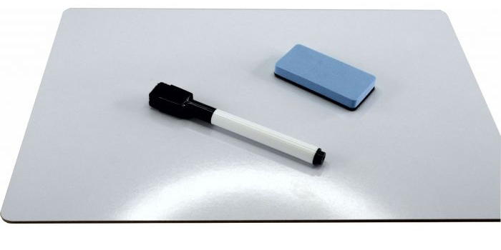
Tips for Virtual Foundational Skills Instruction
Formative feedback through:
Close ups for sound articulation!
Quick quiz on Teams
Student whiteboards
(or paper)
Notes:
Adrianne
Video for articulation: 44 Phonemes Pronunciation Guide (Rollins Center for Language & Literacy)

Slide 21
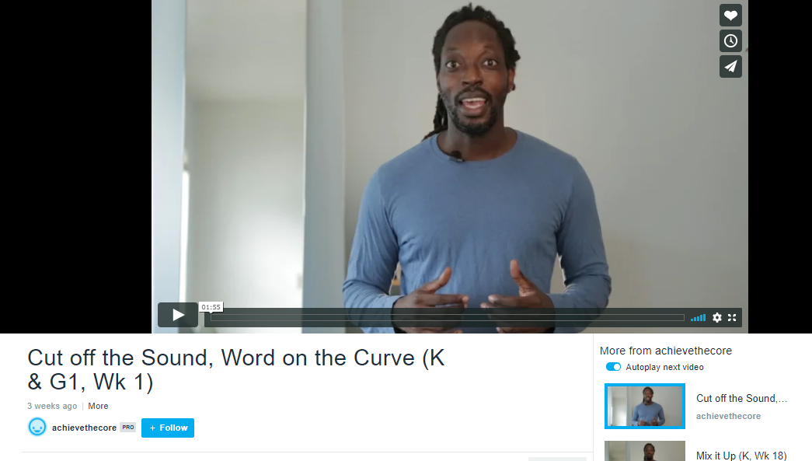
Related Resources in the Early Reading Accelerators’ Collection
5. Text Sets Guide
6. Best for All: Sounds First Phonemic Awareness Program
How to make your own, or get a pre-made set online!
Notes:
Adrianne
These are in your resource widget Resources #5 & #6

Slide 22
Janelly Ramirez
Grade 1 Dual Language Teacher
San Antonio Independent
School District, TX
please enter a head shot here

Slide 23
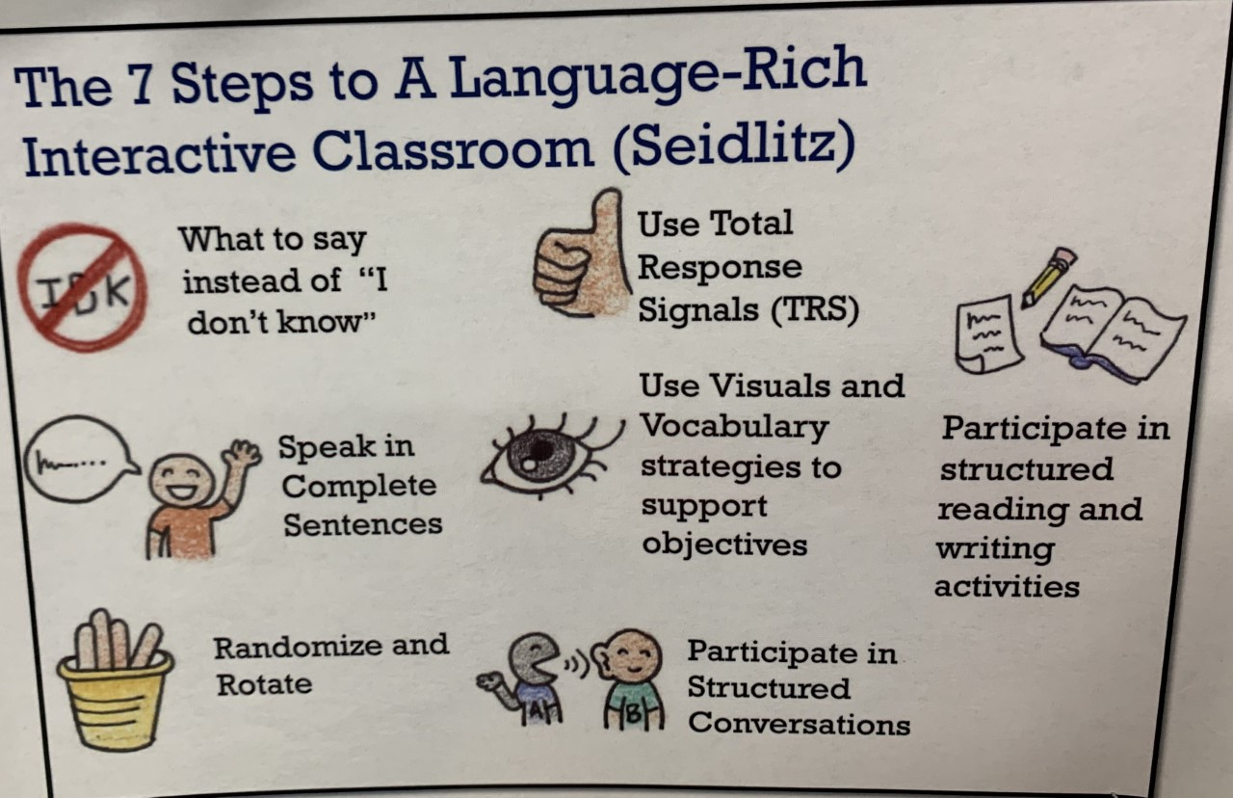
Supporting English Learners with the 7 steps
(John Seidlitz)

Slide 24
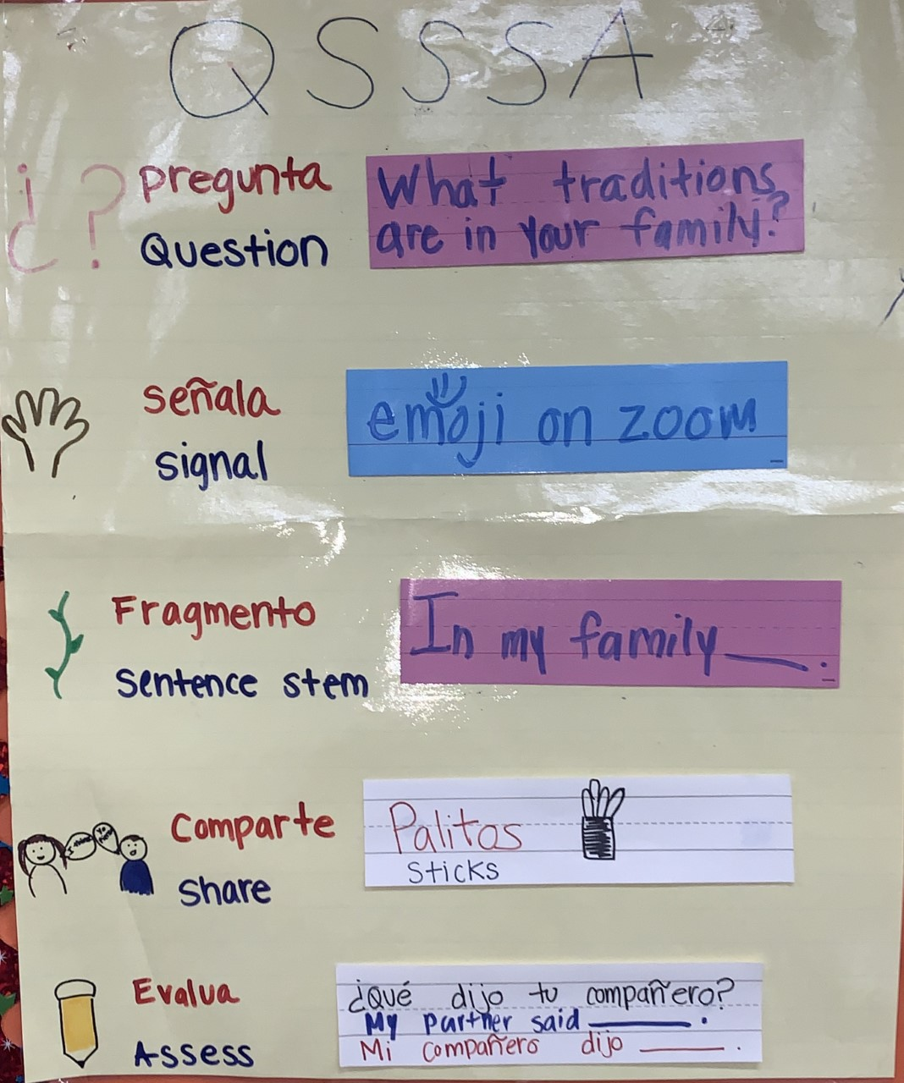
Supporting English Learners with QSSSA

Slide 25
Guiding question:
How do we implement QSSSA into virtual learning?
--Set clear expectations / procedures
--Use Zoom features (break out rooms/ reactions/ emojis)
--Make it fun :)

Slide 26
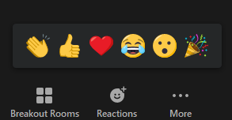
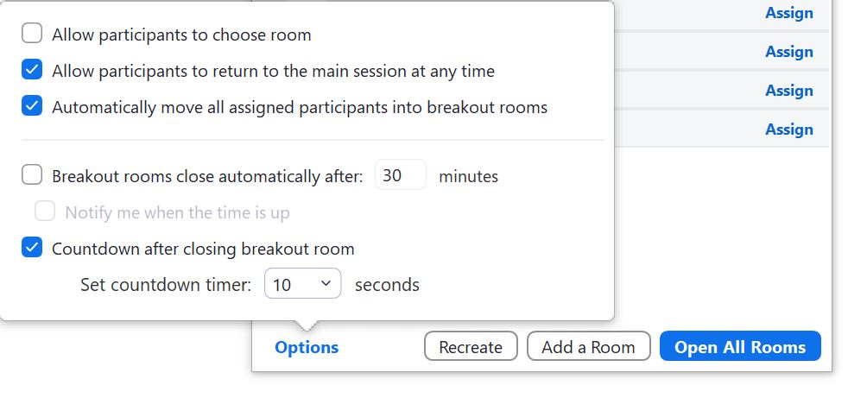
How to use Zoom features for QSSSA
Emojis
Breakout rooms tips:

Slide 27
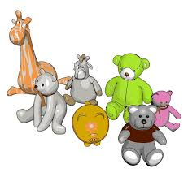
Conversación estructurada en Zoom / Structured conversations on Zoom
Habla con tu mono de peluche
(usando una oración completa)
Talk to your stuffed animal
(using a complete sentence when you are done use an Emoji)
Habla con un compañero/a
Talk to your friend
(breakout room)
Comparte con la clase
Share with the class
(main Zoom session)

Slide 28
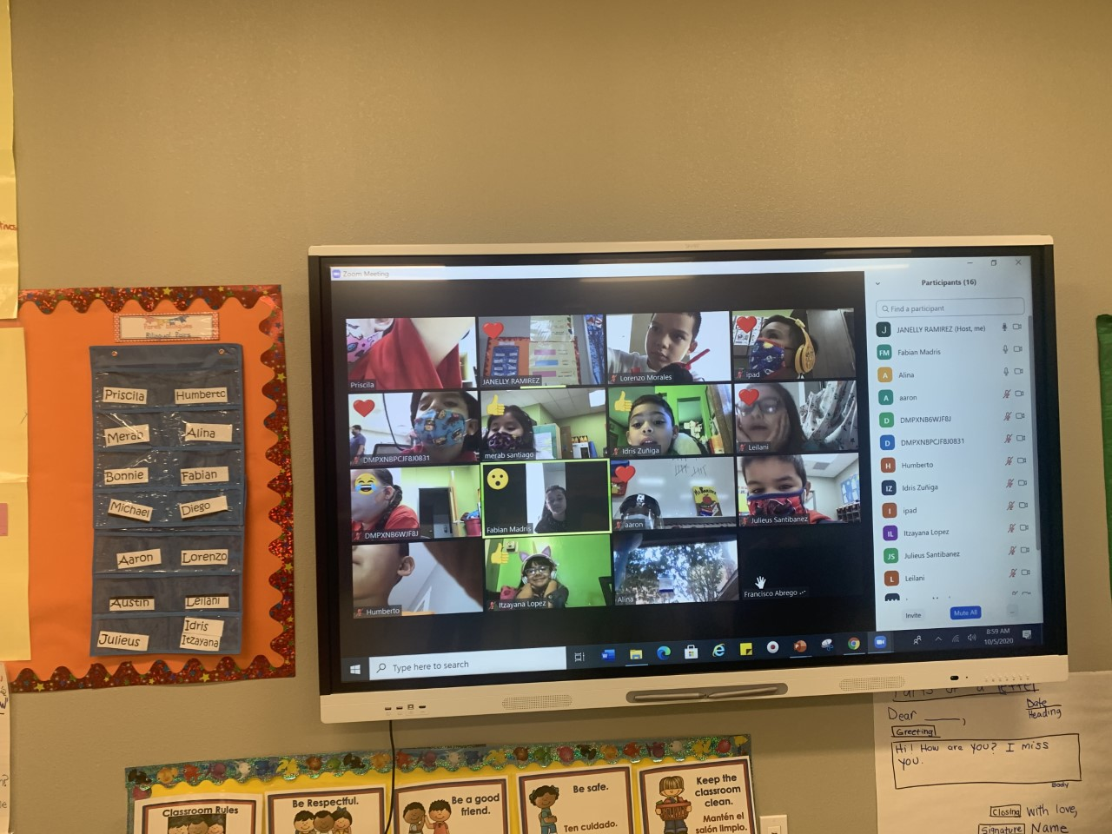
Using Emojis for Signals

Slide 29
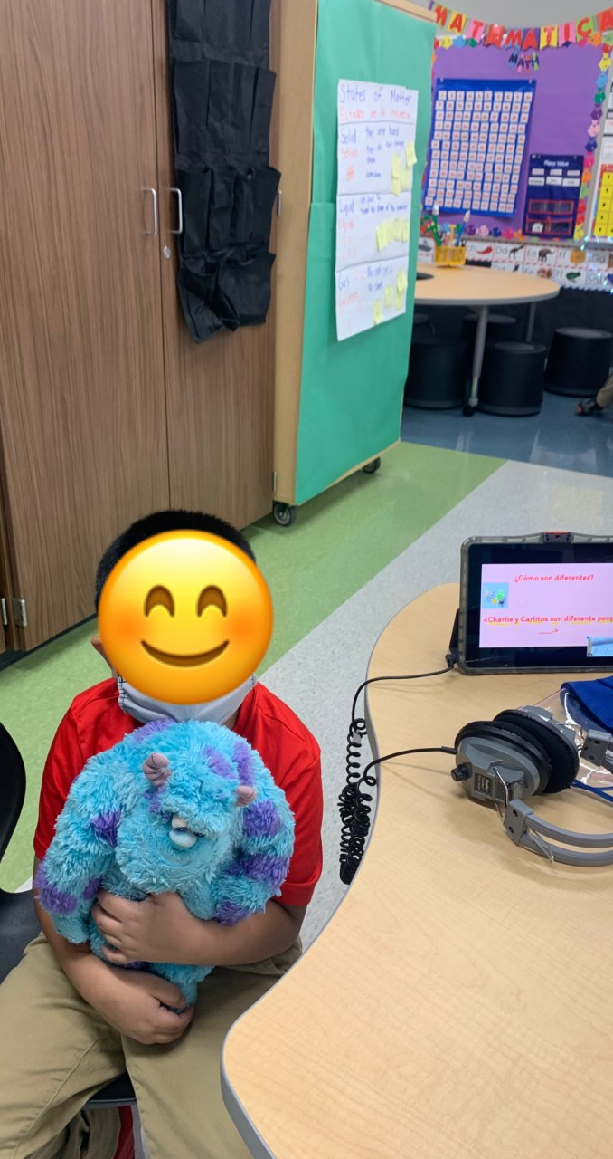
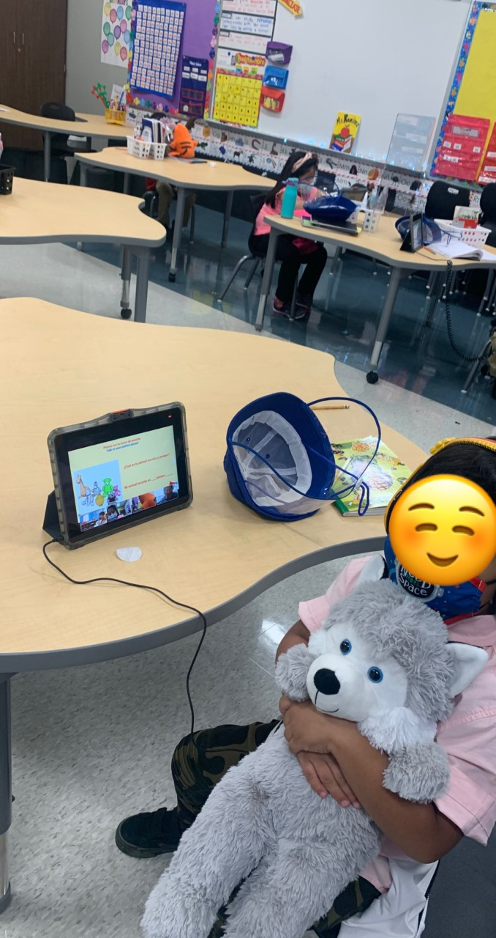
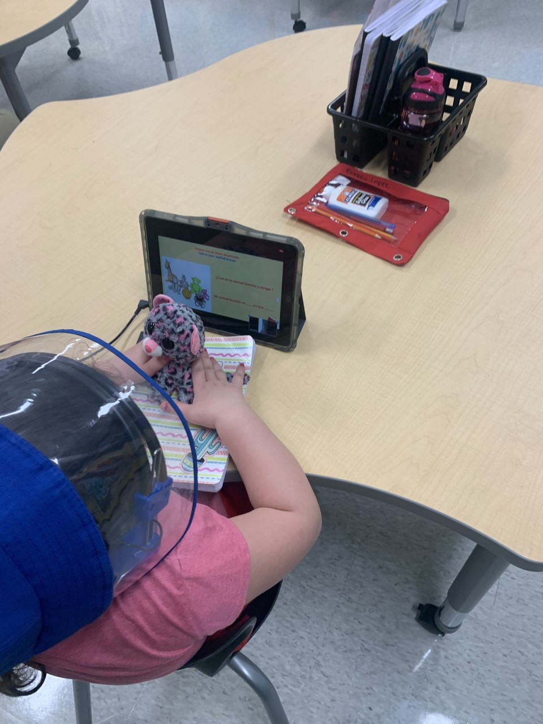
Using a Stuffed Animal for QSSSA

Slide 30
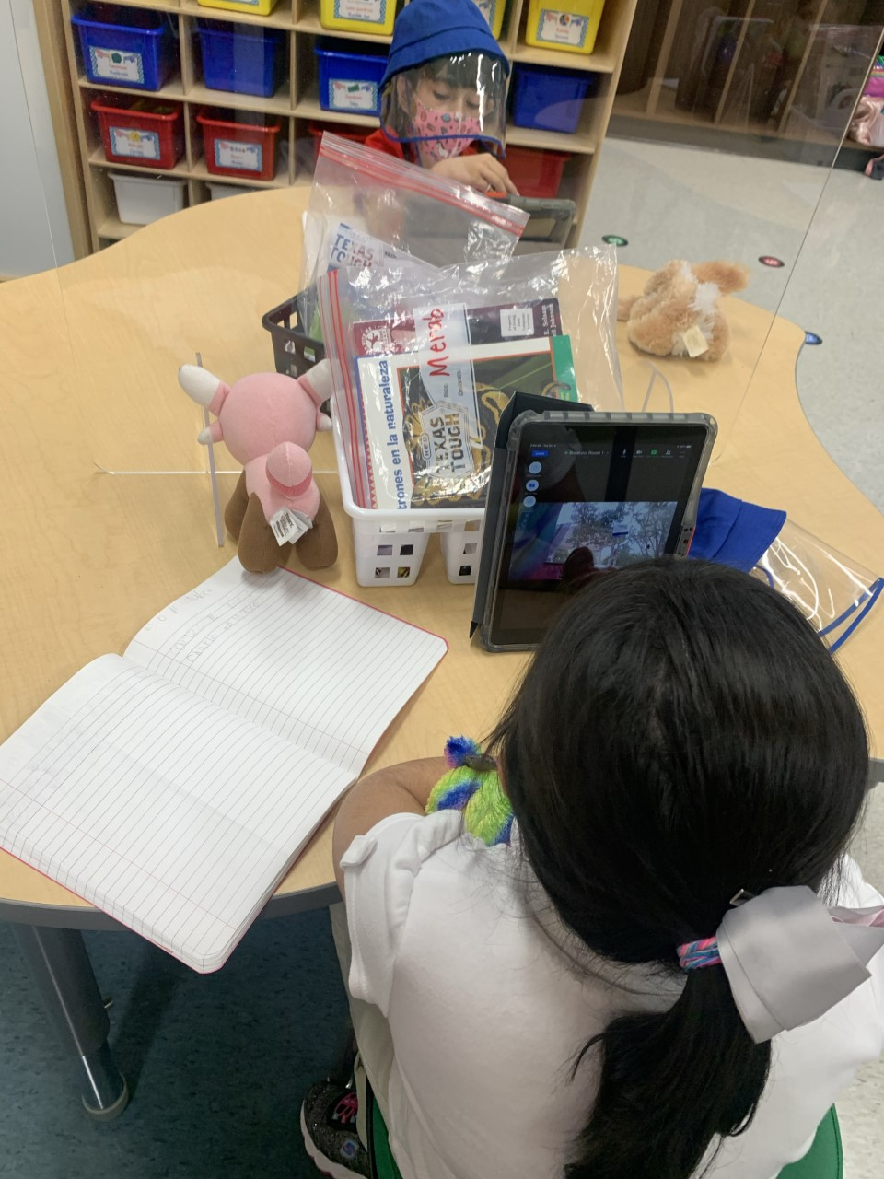
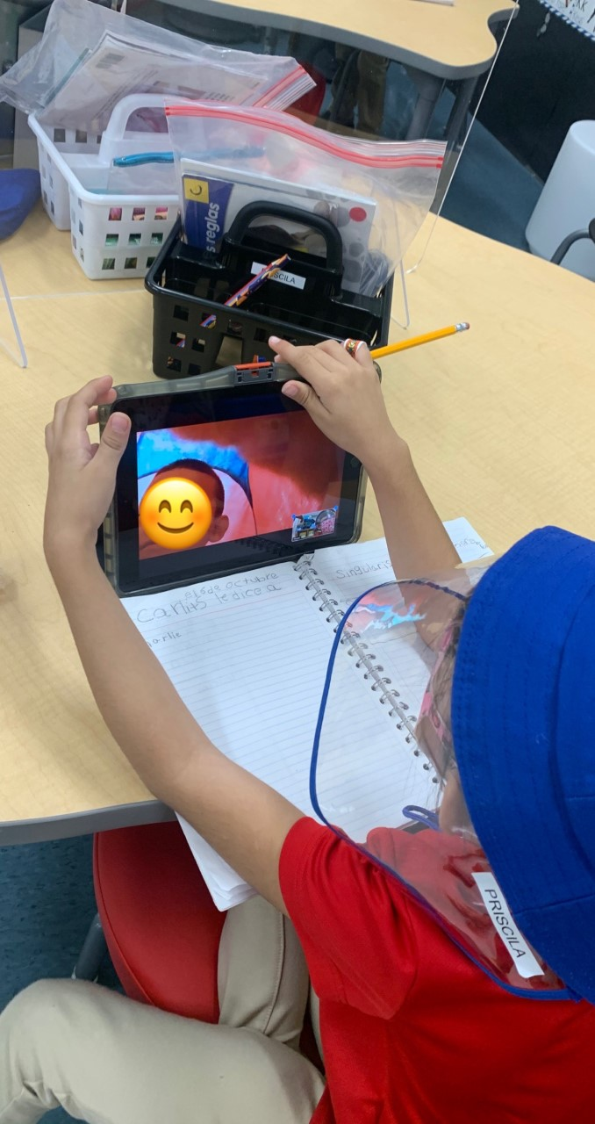
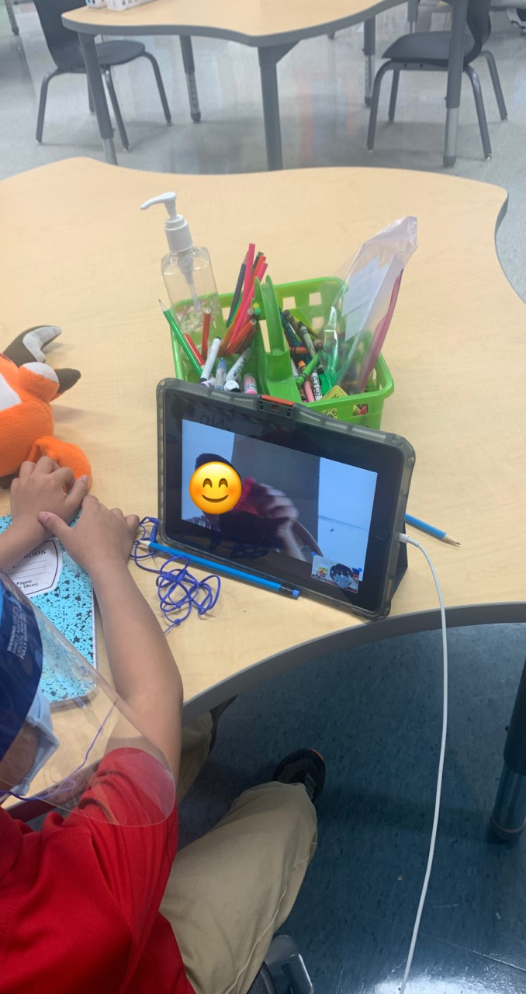
Using break out rooms for QSSSA

Slide 31
Related Resources in the Early Reading Accelerators’ Collection
7. English Learner Supports (Virtual Learning)

Slide 32
Toni Clymer
Grade 1 Teacher
Harmony Schools Academy
Memphis, TN
please enter a head shot here
Notes:
Adrianne

Slide 33
Partnering with Families
Foundational Skills
Diagnostic Assessments
Relationship building with 1:1 family calls
Platform options to meet families’ needs
Sign up Genius for open slots for a certain amount of time to meet
Notes:
Adrianne
What have you learned about connecting with families for foundational skills diagnostic?

Slide 34
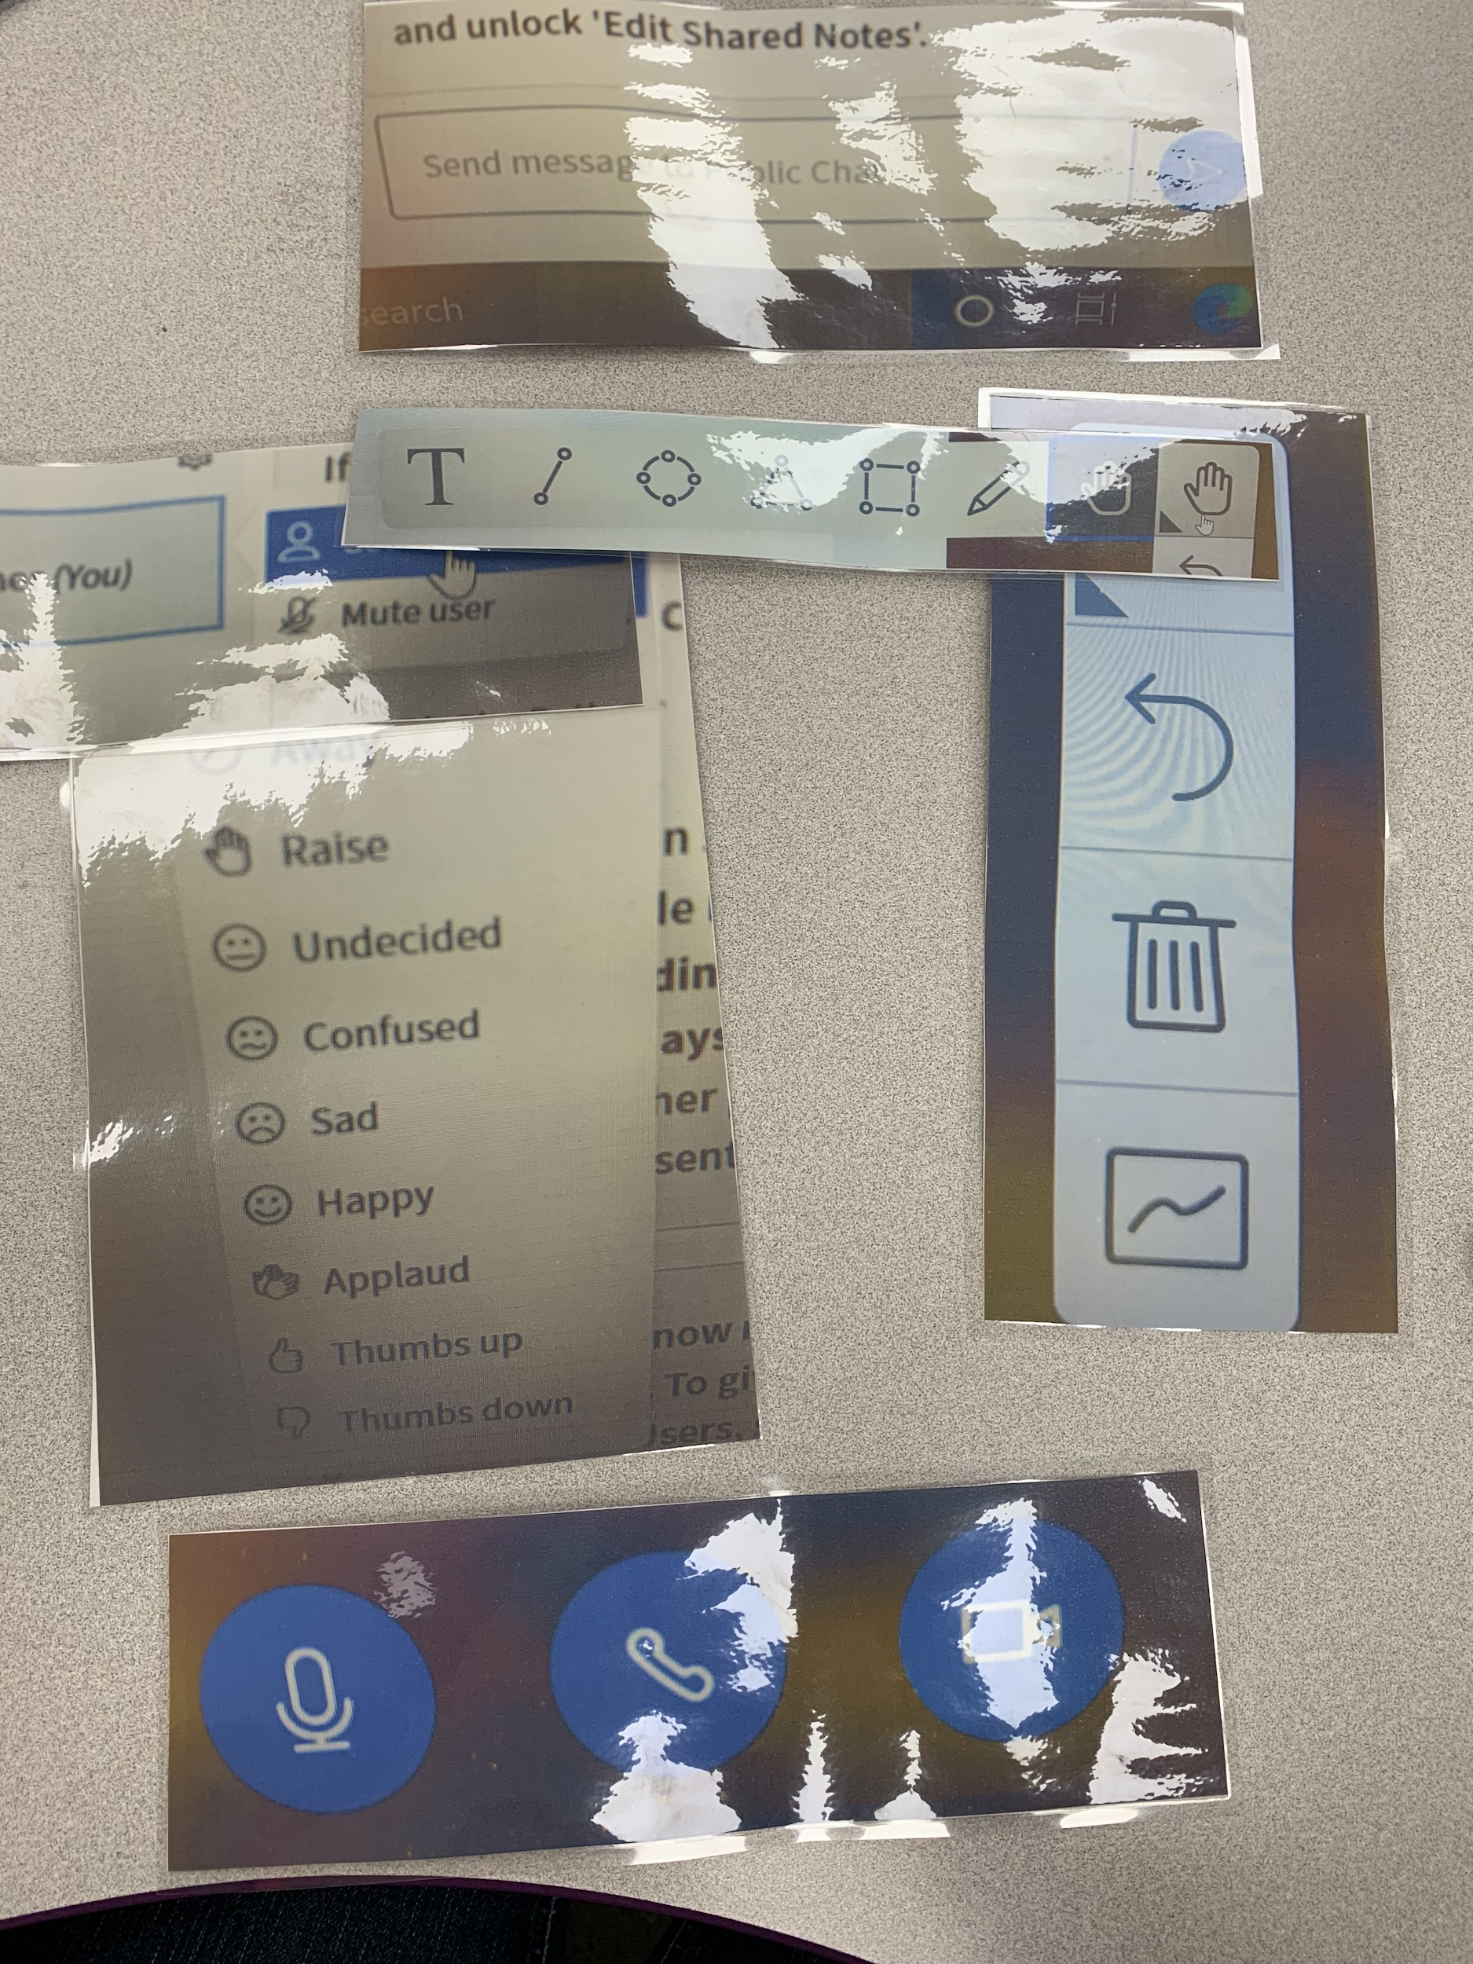
Visual
Support for
Technology Use
Notes:
Adrianne

Slide 35
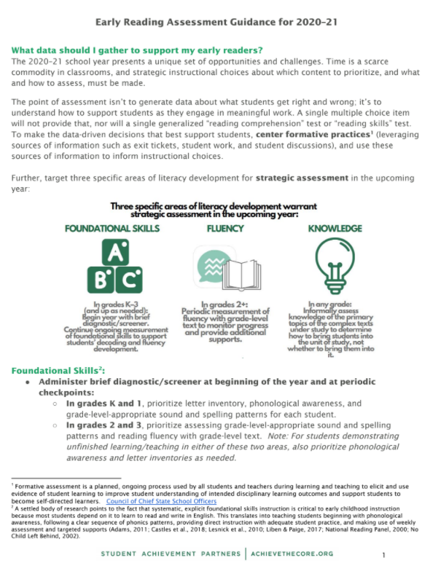
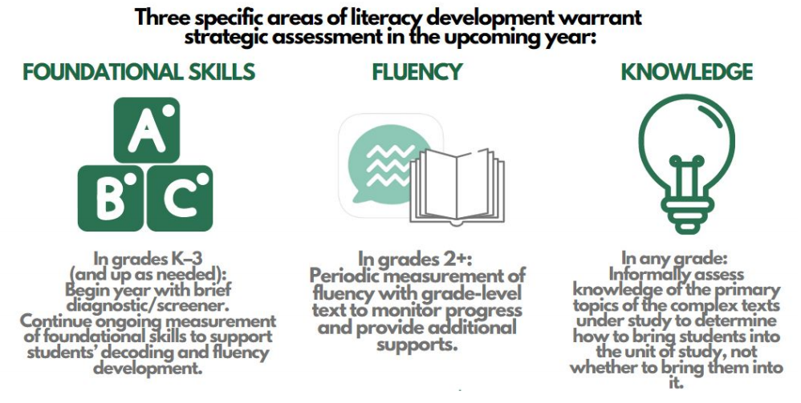
Related Resources in the Early Reading Accelerators’ Collection
9. Early Reading Assessment Guidance for 2020-21
Notes:
Adrianne

Slide 36
Adrian Austin
Grade 2 Teacher
Charlotte-Mecklenburg Schools
Charlotte, NC
please enter a head shot here
Notes:
Tori

Slide 37
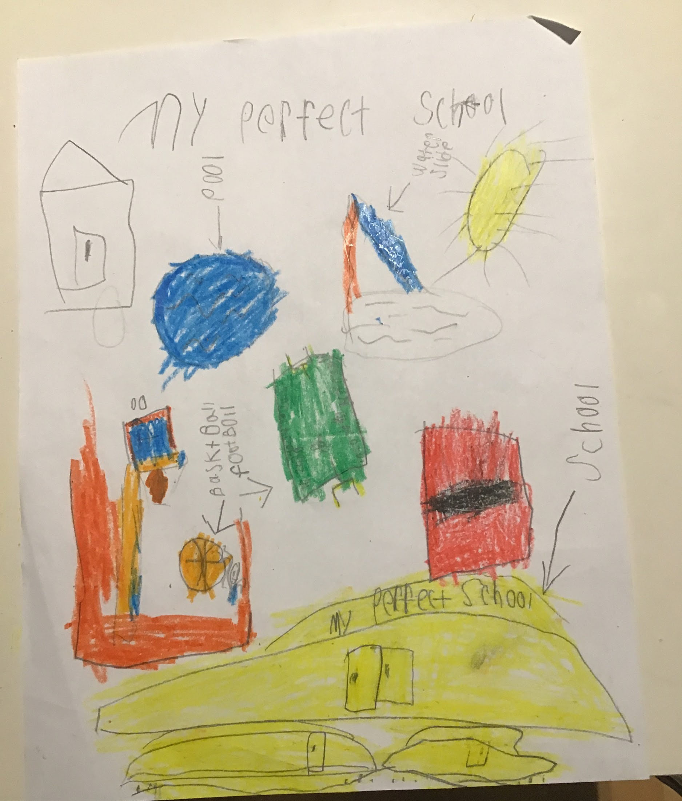
Utilizing Project Based Learning
If I Built A School PBL
Notes:
Tori

Slide 38
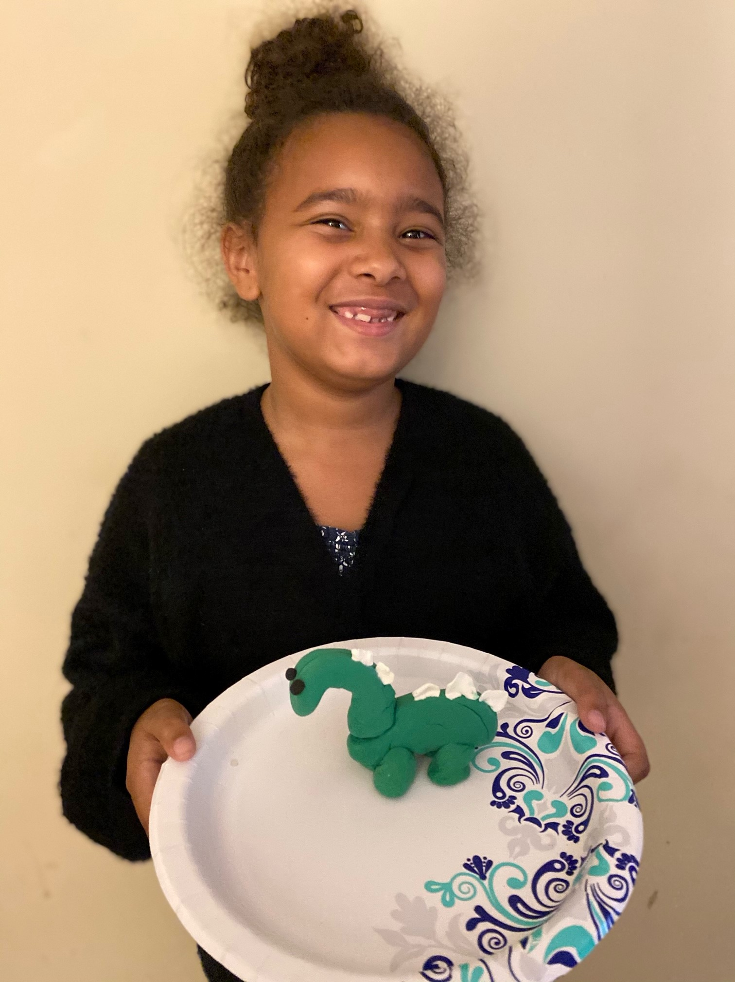
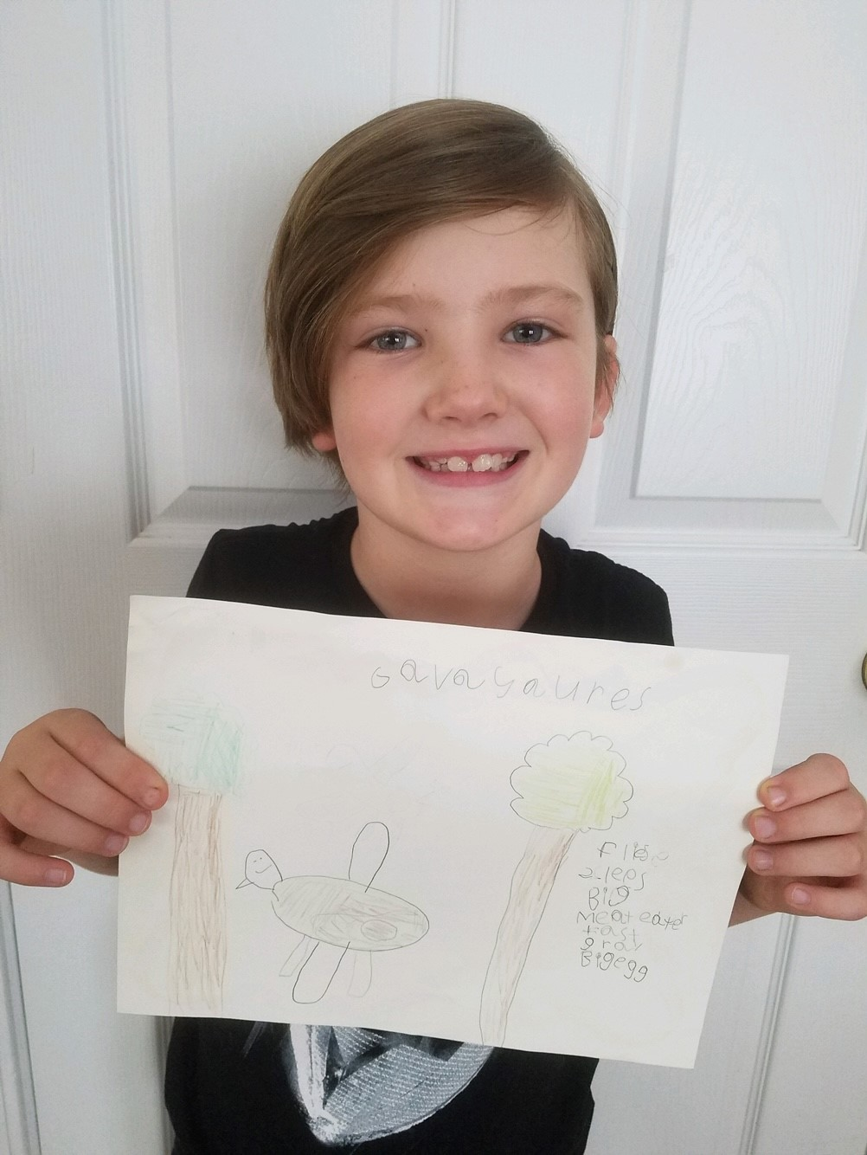
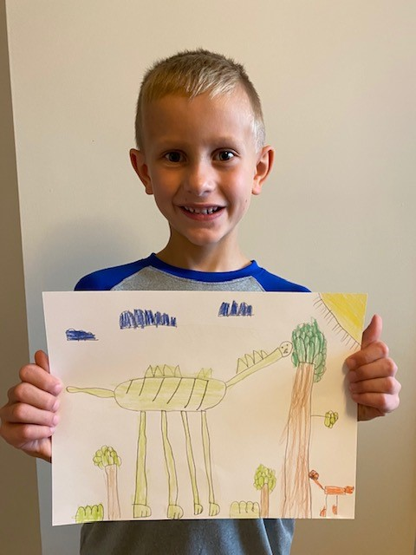
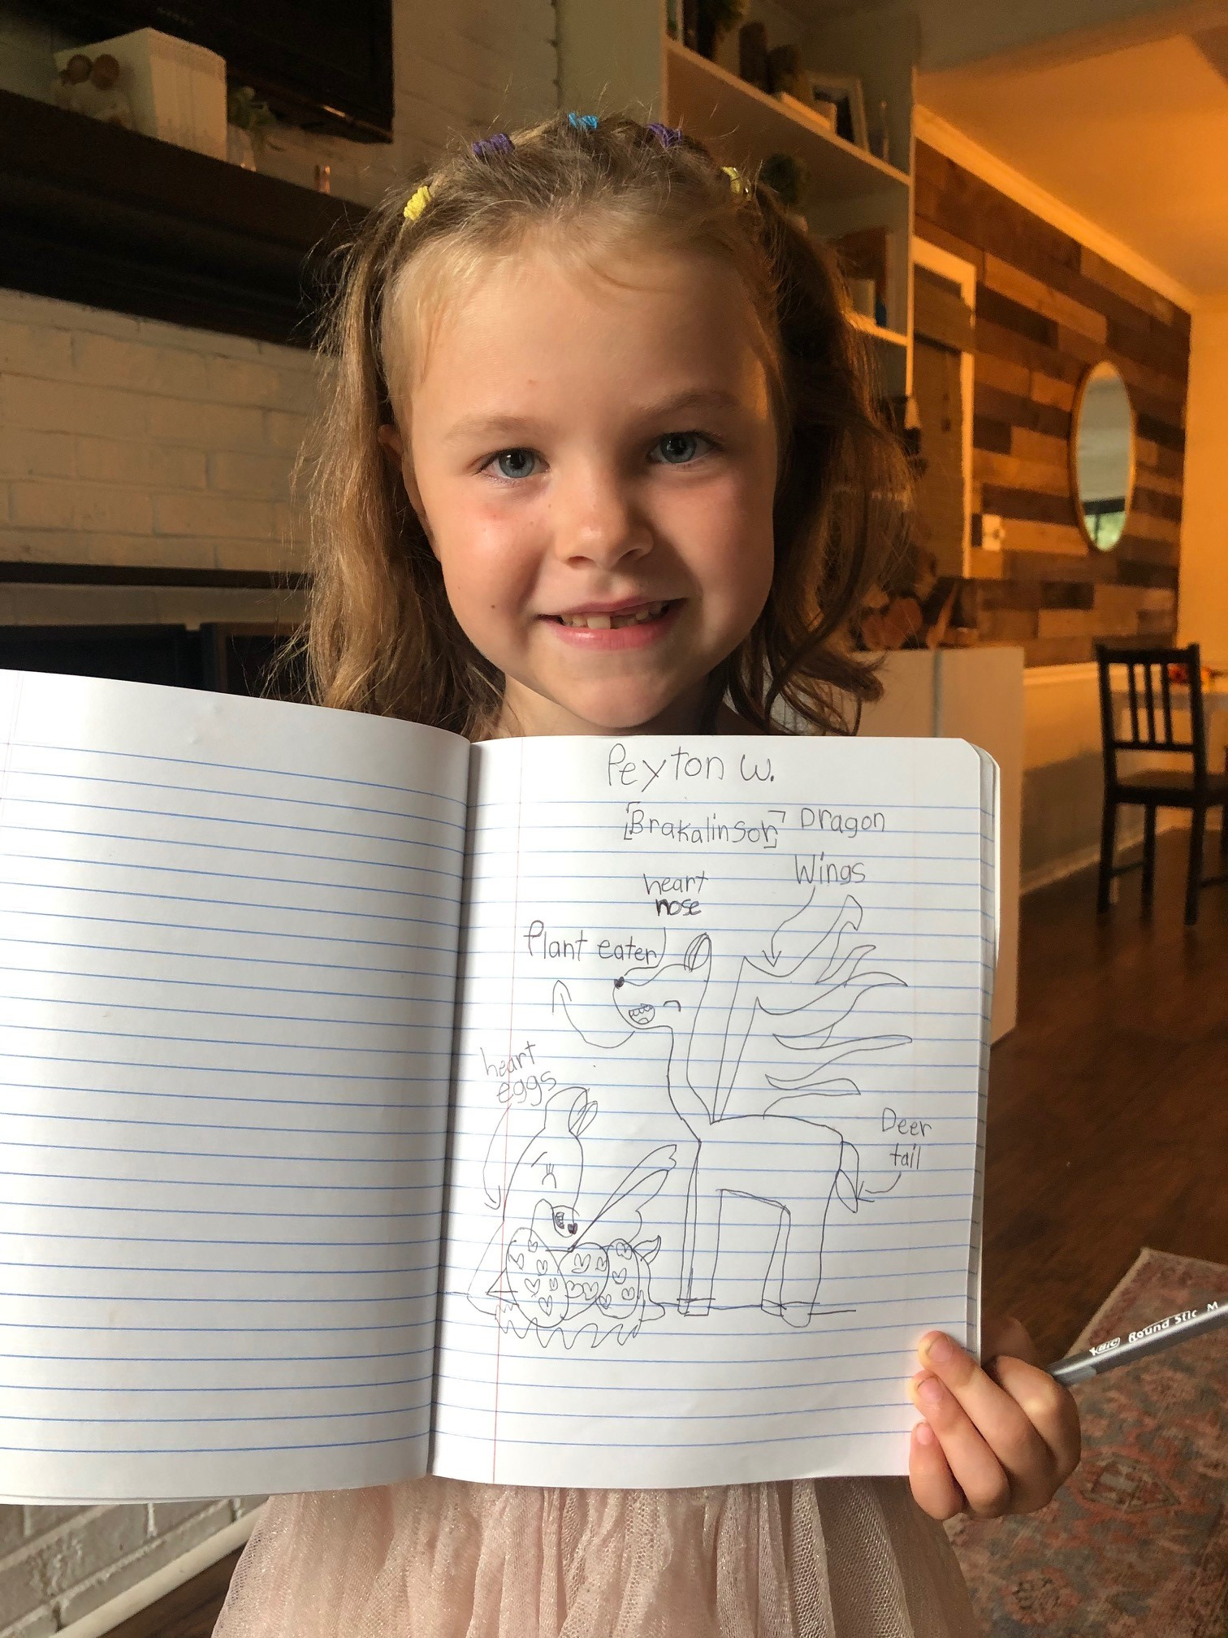
Knowledge Morning Meeting
Create Your Own Dinosaur
If I Built A School PBL
Notes:
Tori

Slide 39
Foundational Skills Bingo!
Choose these words to fill in your board:
skirt burp flower
hurt chirp her
fern dirt burst
turn burn stir
bird birth after
shirt jerk girl

Slide 40
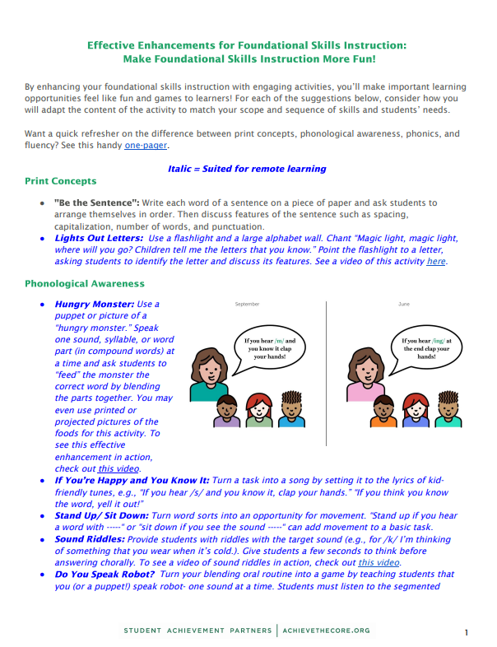
Related Resources in the Early Reading Accelerators’ Collection
8. Effective Enhancements: Make Foundational Skills More Fun!
Games and activities like…
Sound Riddles
Do You Speak Robot?
Whisper It...Shout It!

Slide 41
Questions for Our Guests?

Slide 42
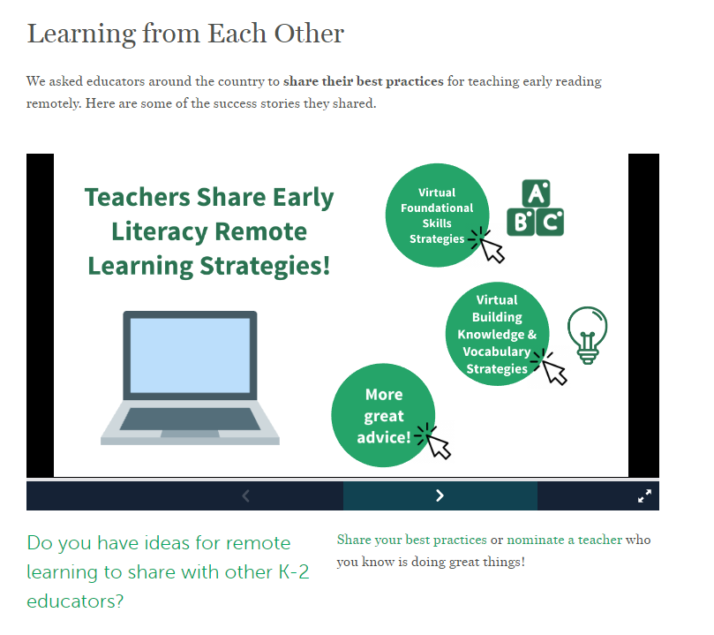
Tell us about your great ideas!
10. Share Your K-2 Teacher Knowledge!
http://bit.ly/K-2TeacherShare

Slide 43
Resource Name | Link
Sign up for Core Advocates | https://achievethecore.org/ca-signup
2. Early Reading Accelerators website | https://achievethecore.org/collection/5/early-reading-accelerators
3. Foundational Skills website | https://achievethecore.org/collection/6/foundational-skills-k-2#foundational-skills-k-2
4. Building Knowledge & Vocabulary website | https://achievethecore.org/collection/7/knowledge-vocabulary-k-2
5. Text Sets Guide | https://achievethecore.org/content/upload/Text%20Set%20Guidance.pdf?utm_source=Subscriber+Master+List&utm_campaign=825f01c19f-EMAIL_CAMPAIGN_2020_04_09_07_59&utm_medium=email&utm_term=0_a3f2445f50-825f01c19f-320962437
6. Best for All: Sounds First Phonemic Awareness Program | https://achievethecore.org/page/3300/best-for-all-sounds-first-phonemic-awareness-program
7. English Learner Supports (Virtual Learning) | https://achievethecore.org/collection/5/early-reading-accelerators#supporting-english-learners61
8. Effective Enhancements: Make Foundational Skills More Fun | https://achievethecore.org/content/upload/Effective%20Enhancements%20for%20Foundational%20Skills.pdf
9. Early Reading Assessment Guidance for 2020-21 | https://achievethecore.org/page/3296/2020-21-early-reading-assessment-guidance
10. Share Your K-2 Teacher Knowledge! | http://bit.ly/K-2TeacherShare
11. All Webinar Resources Google Doc | https://docs.google.com/document/d/1a1GDqvbeZi7oEF8VVkK6rPZ3vdCzKZ7yGLqHOfRXBAc/edit?usp=sharing

Slide 44
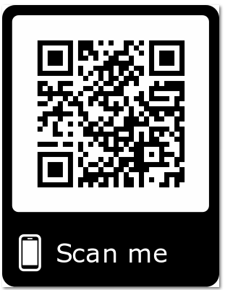
Please Join Us!
https://achievethecore.org/ca-signup
Twitter: twitter.com/achievethecore
Facebook: facebook.com/achievethecore
Pinterest: pinterest.com/achievethecore
Notes:
We encourage you to join the network by filling out this survey completely at atc.org/ca-signup

Slide 45
Please Join Us Again!
Next webinar:
Fraction Content Collection Thursday October 22 @7 p.m. ET
Register Here: https://event.on24.com/wcc/r/2560805/57C107E98A8AF513C50B38160EB35EB6

Slide 46
Thank You!

