Slide 1

Welcome to the Early Reading Accelerators Webinar Series

Slide 2
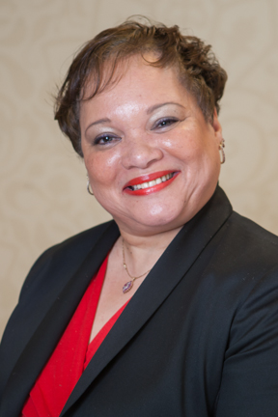



Welcome and Overview
Carey Swanson, SAP
Robin Hall, CGCS
Stacy Wetcher Gad, SAP
Gabriela Uro, CGCS

Slide 3


Virtual tips!
This session is being recorded and the recording will be shared
Because of our large group size today, participants will be muted
Use the chat box for logistical questions
Use the Q&A google doc for presenter questions
Some of the ways we’ll engage together today
Interactive poll
Chat questions!
Collaborative
Q&A google doc
http://bit.ly/QuestionsERA1
http://bit.ly/ResourceListERA

Slide 4

Today’s Agenda!
Welcome and Overview (10 minutes)
Part 1: Lily Wong Fillmore- Foundational Skills for Young Children (30 minutes)
Part 2: Meredith Liben- What Does This Look Like in the Classroom? (25 minutes)
Reflection/Prep for Q&A (5 minutes)
Q&A (15 minutes)
What’s Next? (5 minutes)
http://bit.ly/QuestionsERA1
A space to jot down ?s
along the way

Slide 5

Guiding Questions for the Webinar
What is the role of phonemic awareness for young English proficient students and ELs?
When and how are children ready to associate symbols (letters) to the sounds they know?
What do educators need to know to support learning to read complex text? How can complex read aloud play a role in building knowledge and vocabulary for young English proficient students and ELs?
How are educators currently thinking about and approaching these areas of instruction? What practices are working, and what might need to change?

Slide 6
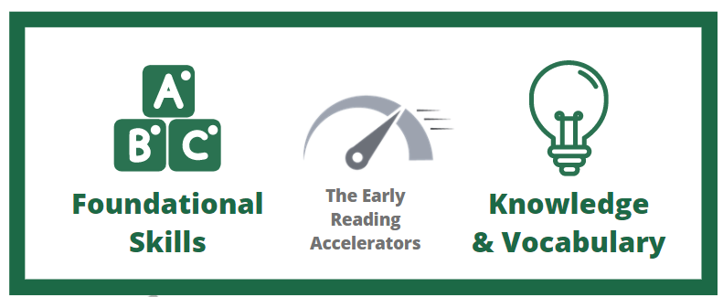

Equitable Implementation of the Early Reading Accelerators
How can we best support all K-2 students' learning, amplify what matters most for early reading, and foster students' social-emotional development?
Notes:
(for more information, see https://achievethecore.org/collection/9/early-reading-accelerators-k-2)
While research has longed showed us that foundational skills and building knowledge & vocabulary matter - these things alone are not enough for equitable experiences for all students, and in particular for historically marginalized students whose needs have not been met by school. So, how can we best support all K-2 students’ learning, amplifying what matters most for early reading, and foster students’ social-emotional development?
To implement the Early Reading Accelerators equitably and let each child’s innate brilliance shine, we must also consider student supports, culturally relevant content and practices, and aligned instructional materials. This is always important and it especially important today, as we have seen this pandemic exacerbate existing inequities in our education system.

Slide 7
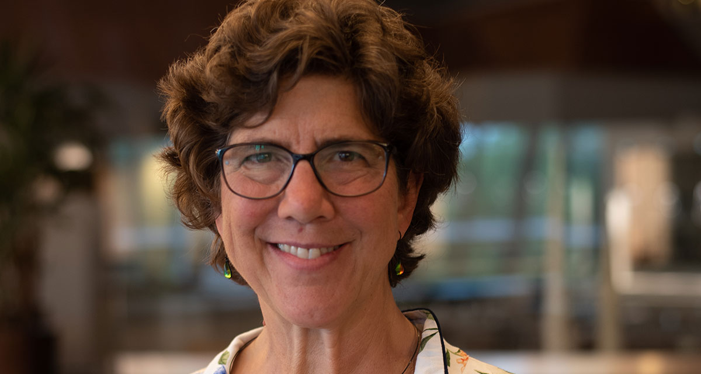
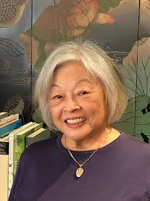
Today’s Presenters
Meredith Liben
Lily Wong Fillmore
Notes:
About the presenters:
Lily Wong Fillmore is a linguist whose research and professional endeavors have focused on language learning and development in linguistic-minority children in school settings. Lily has studied cognitive and social processes in second language learning by English language learners, the loss of family languages by immigrant and indigenous students as they acquire English in school, language revitalization efforts in indigenous communities, and the role played by literacy in language development in school-age students.
Meredith Liben is currently a reading consultant and a staff member at Student Achievement Partners. Meredith has taught and coached in a wide range of settings and across grade levels over the past 35 years. Meredith recently co-authored the book Know Better, Do Better with David Liben.

Slide 8


Foundational Skills for Young Children
What about English learners? What about speakers of English dialects? What do teachers need to know about language to provide support to all children?
Notes:
The ideal--teach English learners to read in their home languages, provide opportunities to learn English, and once they have a firm grasp of reading in their L1, add on reading instruction in English. This is the approach in districts that have strong bilingual or dual language programs. San Antonio TX is a good example of that approach. But not all districts or schools have such programs, so English is the language of instruction children learn to read in.

Slide 9
Before I begin
In preparing these remarks, I had in mind children who are English learners and speakers of English dialects. Both groups require time and support for learning the variety of English that figures in literacy, that is, “book English”.
For English learners, the ideal is to learn to read in their home language first, have opportunities to learn to speak English, and once they have a firm grasp of reading in their L1, to add on reading instruction in English.
This is the approach in school districts and schools with bilingual or dual language programs, such as San Antonio, TX and Chula Vista, CA. But not all districts have such programs, so children learn to read in English from the start.

Slide 10
Introduction
This webinar is about young children learning to read in English, and equally important—what educators need to know in order to support their doing it successfully.
Happily, reading in English means dealing with just one streamlined writing system (just 26 “letter” symbols to learn), unlike Japanese where children must learn three systems, one of which, based on Chinese, is logographic.
Streamlined, but not perfect: there are 44 sounds in English that combine to convey meanings, there are letters (26) to represent them, especially with respect to vowels (5 letters, 20 sounds).

Slide 11
Tough job, but getting it right is critical…
Tough job...but getting it right is critical!
What children must learn (and what they most need help learning):
  How to hear sounds in words (not as easy as it seems);
  How to match up those sounds to the symbols that sometimes imperfectly or ambiguously encode them;
  How to relate those decoded sounds to the configurations (letters) that represent meaning or concepts in the language;
  How to work out the specific meaning a configuration of sounds has in the environment it appears in—i.e., what is the meaning of a word in its phrasal context?
  Applying what one “knows” or has learned about reading and any background knowledge one might have on the text’s topic to make sense of it.

Slide 12
How to make it happen….?
Many beliefs and views on how to do it—thus, a lot of variation in practices, and a lot of variability in outcome: large percentages of children do not learn what they must by grade 3.
What research says is absolutely necessary:
  Support in becoming aware of the sounds that make up words (phonemic awareness);
  Support in learning the set of symbols used to represent sounds in writing (alphabetic and the graphemic principles of phonics) and how they work;
  Support in learning to decode the information conveyed by written texts, and to use those symbols to encode information for communication to others.
What all of this assumes: knowledge of the language of reading.

Slide 13
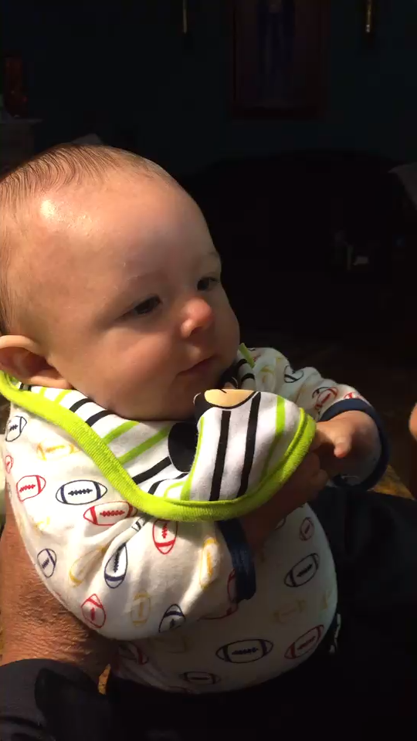
What does it mean to “know” a language?
A critical question, but not one that can be answered simply.
It is the central focus for the study of linguistics: the grammatical knowledge of the speakers of a language by which they communicate with one another.
So what does that mean?
What does a person who knows a language possess? How is it acquired?
Baby power & the power of socialization.

Slide 14
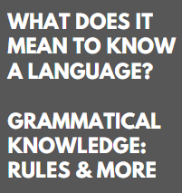
Phonetics
How we produce, transmit and perceive speech sounds
The sound system of a language—the ones differentiate meaning, stress, rhythm and intonation
Phonology
Morphology
Word structure, word formation, how meaning is expressed in the language.
Syntax
How words form phrases, how phrases form clauses, sentence structure & constructions
Semantics
How meaning is conveyed by words, phrases, idioms, constructions & sentences
Pragmatics
How social and cultural context figures in communication and influences language interpretation

Slide 15
Learning a language as an infant is a different task than learning a language at 4 or 5
The language that is already in place takes precedence over other systems for a time;
However, it is the most natural and easy thing in the world for children to learn another language, as long as they have the need and the opportunity to do so.
In fact, it is too easy, so easy that steps must be taken to keep the new language from overwhelming the first language!
The sad story of language shift and loss—and a few words about steps we must take to prevent that from happening!

Slide 16
Confronting an unfamiliar or new language
Getting enough familiarity with the sounds, rhythm, and cadences of the language.
How do kids find their way into another language?
They listen, they observe, they try to make sense of what’s being said by speakers of the language as they interact with one another, and most importantly, when those speakers interact directly with them (the learners).
They assume things have names & they try to learn what things are called.
They latch on to things they hear people saying & think they understand:(e.g., “Ay unno.” ”wunna play?” “Shaddup.” “S’mine.” “ay doanwunna”)
They gradually begin to figure out the pieces of those utterances, and only gradually sort out how they relate: ay + doan + wunna; doan + want + to, etc.

Slide 17
Working on language for young learners
Not just sounds—sounds in the context of syllables
Not just syllables—syllables as morphemes, meaningful units
Not just morphemes—morphemes as stand-alone words, and parts of words.
Not just words—words in the context of phrases
Not just phrases—phrases in the context of sentences
Not just sentences—sentence in the context of texts!
What matters to children is meaning, communication and knowing what’s going on, belonging.

Slide 18
A prerequisite for learning to read: age appropriate language development!
There may be variability in that regard, but by the time reading instruction begins, native speakers have the fundamentals down: they can hear and recognize the sounds of their language, if not form them perfectly.
Depending on their exposure to the written word of their language, they realize that language from books sounds somewhat different from the language people ordinarily use but associate it with pleasure and joy.
Then, and only then, are they ready to tackle the business of developing an awareness of how and where sounds in their language show up in words, the various graphemic representations for them, and to begin learning how they go together to form the meaningful units in text.
Notes:
Kids can perceive the sounds before they can produce them--e.g., child: I wanna go fwimming. Adult: You want to go fwimming? Child: That’s not the way to say it!

Slide 19
What makes learning to read in English a bigger job for English Learners?
Let’s go back to the question of what it means to know a language—no two languages are exactly the same. ELs have all the fixings in their own L1s, but they have to learn to hear what English speakers do.
It is hard for English speakers to believe than anyone can really have trouble hearing the sounds of English that they hear!
So what does it mean to have trouble hearing what to a native speaker is perfectly clear and distinctive?
I speak a language which makes use of sounds I think many of you would have difficulty hearing or differentiating.
Notes:
Tones—Putonghua or Mandarin has 4, Cantonese is said to have between 6 and 9. Often characterized as Chinese dialects, these are different languages—not mutually intelligible. Mandarin speakers describe the system of tones in Cantonese as ”the nine tones of hell”: “There are some Cantonese tones only dogs can hear.” Sigh. Cantonese is the mother tongue of some 62 million people. Lots of prejudice between languages.

Slide 20
Want a demo of what it’s like to have difficulty perceiving sounds?
Notes:
Tones—Putonghua or Mandarin has 4, Cantonese is said to have between 6 and 9. Often characterized as Chinese dialects, these are different languages—not mutually intelligible. Mandarin speakers describe the system of tones in Cantonese as ”the nine tones of hell”: “There are some Cantonese tones only dogs can hear.” Cantonese is the mother tongue of some 62 million people. Lots of prejudice between languages.

Slide 21

Notes:
Si1 (poetry) Si2 (history), Si3 (try_ Si4 (time) si5 (market) si6 (be)

Slide 22
Several points to make here!
It takes time to wrap your ears, head, and tongue around a new language.
Ideally, the learner has the clearest possible models.
Getting used to the sounds call for the crispest, clearest, truest pronunciations from models.
Ideally, learners can see—as close-up as possible the lip and facial movement in speech.
Speech perception is not limited to hearing: there are also gestures, lip configuration, and tension of the facial muscles, particularly around the jaw—and especially when there is background noise or poor acoustics!

Slide 23

And now, masks make that more difficult for ELs and speakers of English dialects to see and hear what others are saying

Slide 24
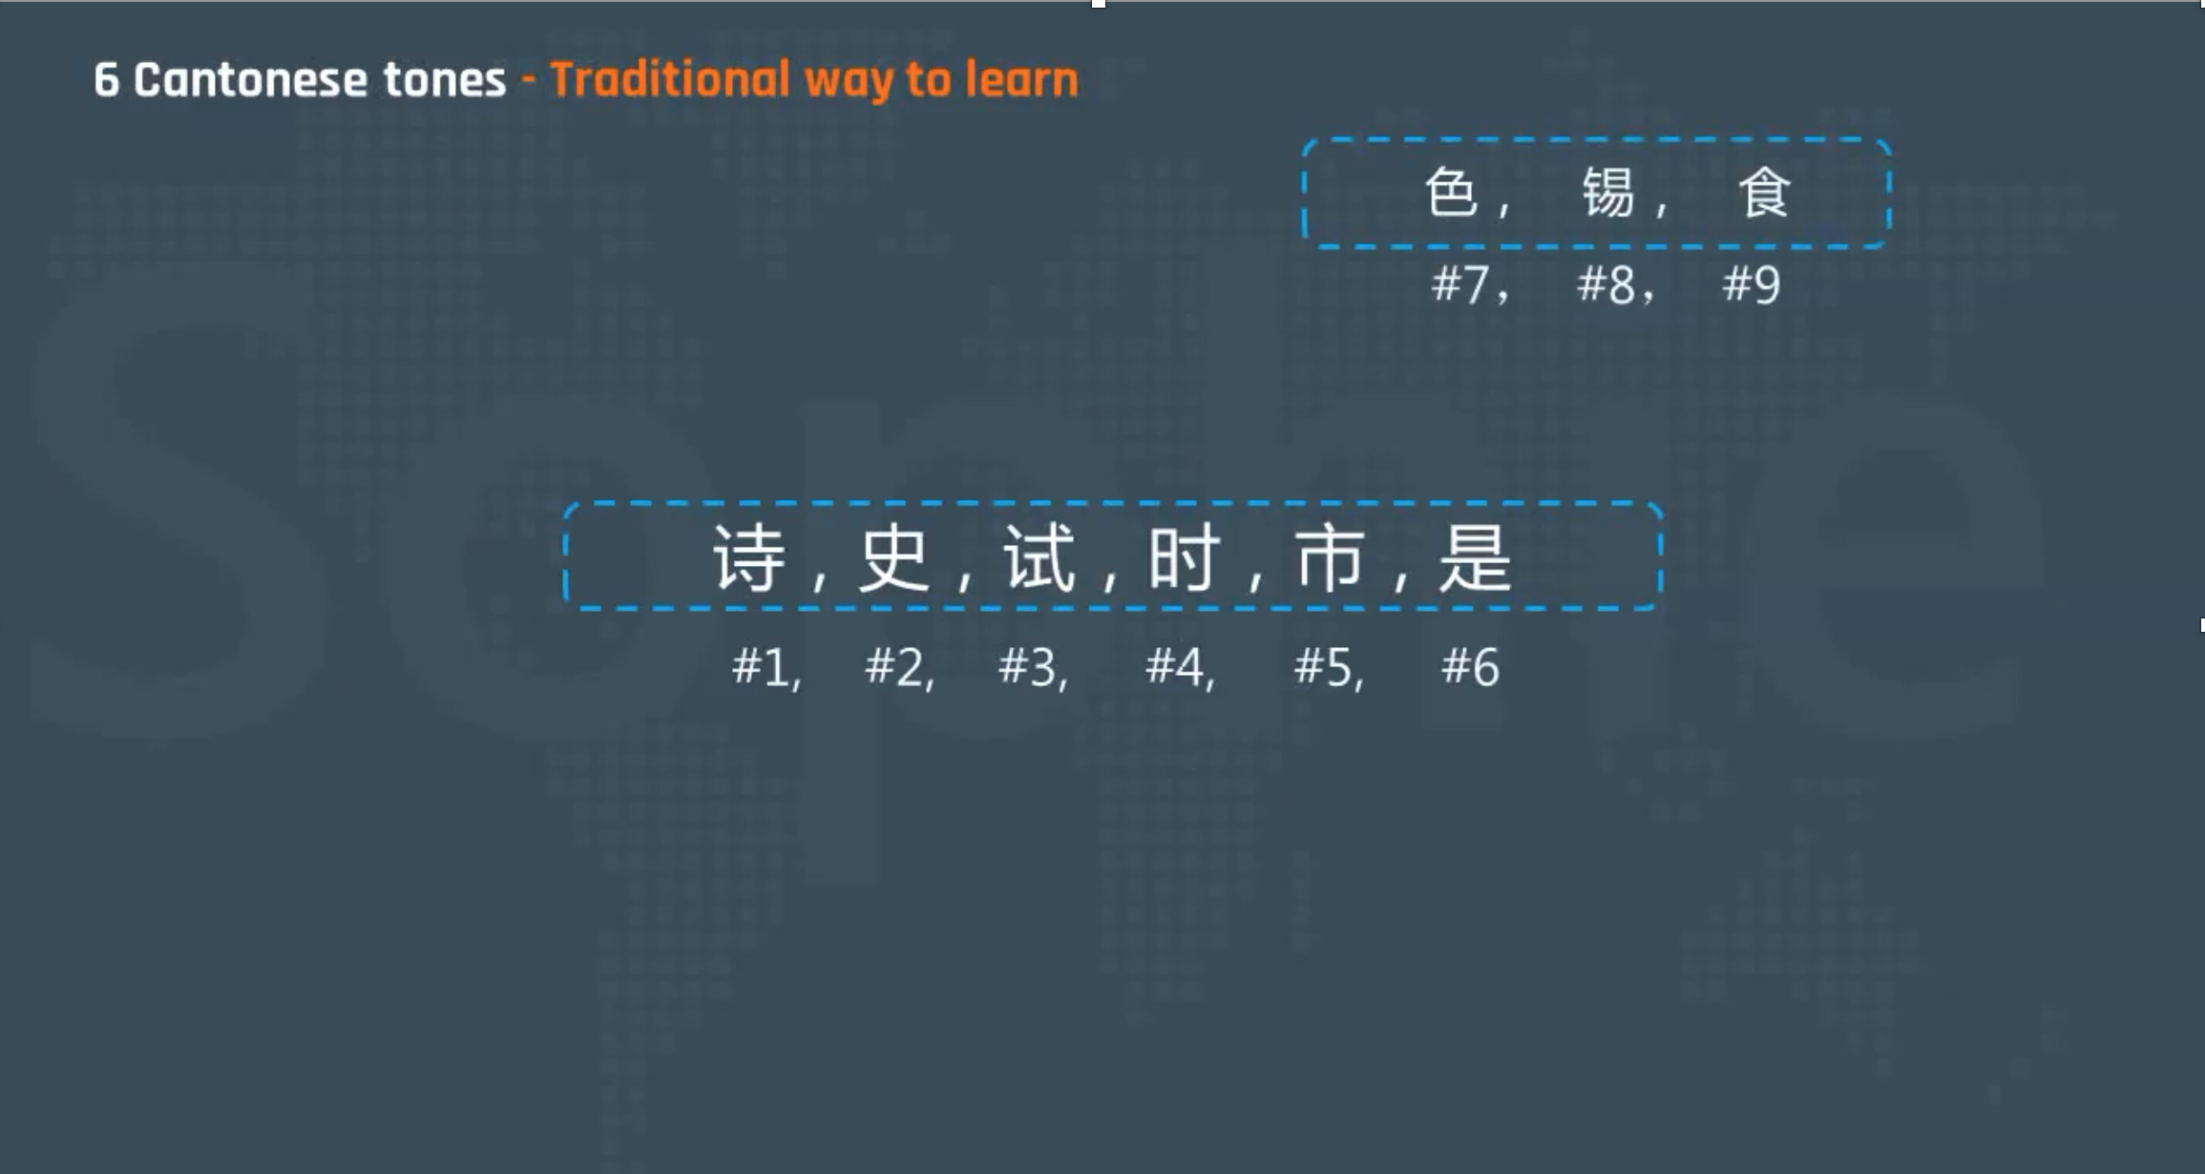
Back to our sound demo --- a point about orthographies and decoding

Slide 25


Slide 26
Many near homophones
We have homophones in English, of course: sea and see, for example, sound alike, although spelled differently, and some words, such as “see” can have different meanings: perceive with eyes, discern visually, regard, discern mentally, experience or witness, meet, visit, consult, date, ensure, etc.
Writing systems place different demands on learners, and while the alphabetic system of English does not require the memorization of thousands of “characters,” it is not exactly a piece of cake either.
Want to know what many children, English learners especially, might find difficult about learning to read in English?
Notes:
Children usually go to grade 1 at the age of 6 or 7 in China.
According to "全日制义务教育语文课程标准", the character number that children should learn is:
Grade 1 to Grade 2: can read 1600 characters, and write 800 characters;
Grade 3 to Grade 4: can read 2500 characters, and write 2000 characters;
Grade 5 to Grade 6: can read 3000 characters, and write 2500 characters;
Grade 7 to Grade 9: can read 3500 characters, and write 3000 characters.

Slide 27
Let’s think about sound systems
This is often thought of as the difference of inventory of sounds in one language compared to another: e.g., Spanish & English, Cantonese and Putonghua, Cantonese and English, etc.
Let’s think of the kinds of differences that can exist between languages and even within languages:
  E.g., There are sounds that occur in one language that are absent in the other:
  Eng: th /θ/,/ð/, sh /ʃ/, su /ʒ/; Span: rr /r/, /ɾ/, ñ /ɲ/
  Spanish and English both have the sound /p/--as in “pan” and “pan”, but they aren’t produced exactly the same! Same for /v/--e.g., “verse” ‘ver’
  Differences in phonotactics too--how phonemes in a language can be combined and arranged—and therefore spoken and heard!
Notes:
Differences between languages even when same sounds occur, not the same at all. Place of articulation, closure of lips, how much aspiration, etc., etc., etc.

Slide 28
Phonotactics- say what?
Let’s think in terms of syllables—a key unit of consideration:
SYLLABLE
ONSET
RHYME
CONSONANT (S)
NUCLEUS
CODA
VOWEL(S)
CONSONANT(S)
Notes:
THE QUESTION—WHICH CONSONANTS CAN BE USED AS ONSET, IN WHAT COMBINATIONS? And which ones can serve as codas—and what about more than one consonant?

Slide 29
Compared to languages like Spanish or the various Chinese languages...
American English | Spanish | Chinese
Onset C, CC CCC (limited—first C is /s/, and third is /l/, /r/, /j/, /w/ | Onset C, CC (more than meets the eye: C+/l, R, w, j/ but not with /s/ | C, CC (very limited: /kw, /k^{h}w/)
Non-word final coda: C CC (very limited--e.g., sanction, function /ŋk/, | Coda C /p/ opción, /b/ abnegar, /k/ actual, /g/ segmento, /m/ amnistía
Word or root final coda: CC CCC, CCCC (limited, e.g., strengths /ŋkθs/, glimpsed /mpst/, texts /ksts/ | Word final coda C (a few more: /l/ tal, /d/ edad, /s/ sopas, /n/ tan, R / ver | C (very limited: /p/,/t/, /k/,/n/, /m/, /ŋ/

Slide 30
What consonants (and consonant clusters) can be onsets or codas?
Onsets or the beginning of syllables can be:
  C (any English consonant phoneme except /ŋ/ can serve as an onset)
  CC (clusters as onsets—nearly all consonants + l, r, w, j; and s + m, n, p, t, k, f, (e.g., /sf/ as in sphere)
  CCC (very restricted—first C has to be /s/ the third must be /l/ split, /ɹ/ string, /j/ skew, or /w/ squeeze.
Codas or the ends of syllables can be C, CC (rare at non-word-coda)
but CC and CCC are not rare at word-end codas.
Codas at the ends of words can have CCCC as in bursts /rsts/, texts /ksts/, glimpsed /mpst/.
Notes:
English just has a lot more syllable structures, and more complex ones than languages like Spanish and Chinese. At the same time, English has a lot more one syllable words in use.

Slide 31
Back to the question of what kids need to be ready for reading instruction in English:
This will take time, and some special attention to building up some familiarity with the language of literacy.
  For English learners, opportunities to learn enough of the oral language to avoid being lost! (Trying to teach young children a language through its writing system is an exercise in futility!)
  For speakers of varieties of English, opportunities to gain some familiarity with the language of written texts before commencing on reading instruction.
How to do all that? Meredith will discuss some specifics, but my advice and approach?
  Front-loading tons of language-rich activities—games, artwork, music, drama, chants, poetry, read-alouds of rich books that invite participation and repetition, etc.

Slide 32
How to help children learn to hear such sounds and sound combinations?
Not in isolation or in meaningless texts. Instead, familiarize children with sounds and sound combos through read-alouds, participatory chants, poems, call and response, and kiddie and folk-songs (there are many online, on pinterest, teachers pay teachers, youtube, etc.)*
Select ones that are fun, and especially that are memorable to use.
Pull words from songs with sound combos to work on: e.g., from “This land is your land, ” words such as land, island, forest, gulf stream waters, etc. (Smithsonian has a big collection of kid-friendly folk-songs)
Hearing, singing, and acting out interesting sounds make them impactful and memorable for children in ways that mindless drills that are disconnected from meaning do not.
And once kids can hear and attend to these sounds, they are ready to match them up with graphemic representations

Slide 33
Some resources you might find useful
Resources
American Speech and Hearing Association has some excellent resources—the phonemic inventories of many languages—including English, Spanish, etc. https://www.asha.org/practice/multicultural/phono/
Dr. Alberto Villanueva Reyes (U of Puerto Rico)’s slides comparing English and Spanish phonology.
Fillmore, L.W. & Snow, C.E. (2018), What teachers need to know about language. In Adger, C.T., Snow, C.E., and Christian, D., Eds. What teacher need to know about language, 2nd Ed. (pp. 8-51). CAL Series on Language Education. Bristol: Multilingual Matter.
Fillmore, L.W. (2009) English language development: Acquiring the language needed for literacy and learning. Research into Practice. <http://assets.pearsonschool.com/asset_mgr/current/201010/
English%20Language%20Development.pdf>

Slide 34

What does this look like in the classroom?
What to prioritize?
What resources can help you do so?

Slide 35
What to prioritize: Literacy Accelerators
Access to full suite of foundational skills
Opportunities to grow knowledge and develop vocabulary
Developing comprehension through rich, interactive read aloud

Slide 36
Foundational Skills
Phonemic awareness – travels home easily!
Phonics learning and practice: a systematic, structured program and direct teaching are essential.
But practice can flex in all directions – AND BE FUN!!
instruction – in person/synchronous.
Practice – travels home easily
Fluency with grade level text: clever hybrid models exist; parents can help regardless of language base!
– travels home fairly easily

Slide 37
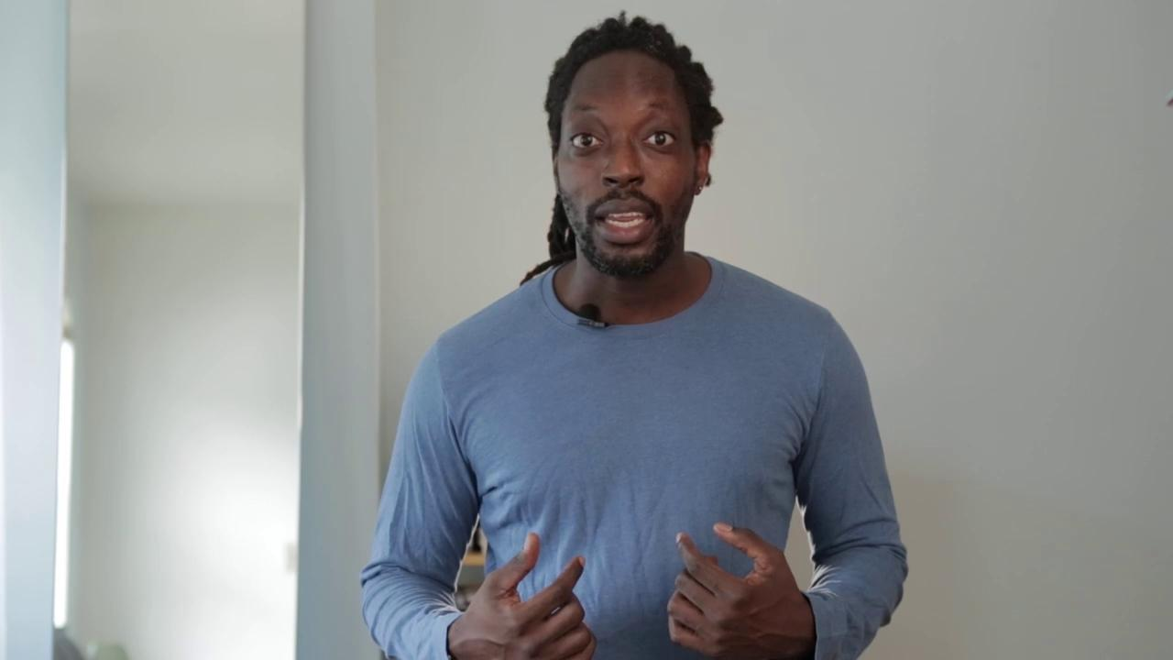
How to ensure Foundational Skills (Phonemic Awareness)?
Do a fun, lively phonemic awareness lesson daily!
It’s essential that pronunciation be
crisp and clear to model for students.
Best for All/Sounds First is free, easy and lively. It can be taught to families or done in person/synchronously.
Heggerty is not free, but they have taped every lesson so the full program can be streamed.
INSERT VIDEO FROM SLIDE NOTES
Notes:
Link to resources:
-Video https://vimeo.com/452881456
(from Best for All/Sounds First free program PreK – 2nd. ATC link here: https://achievethecore.org/page/3300/best-for-all-sounds-first-phonemic-awareness-program

Slide 38
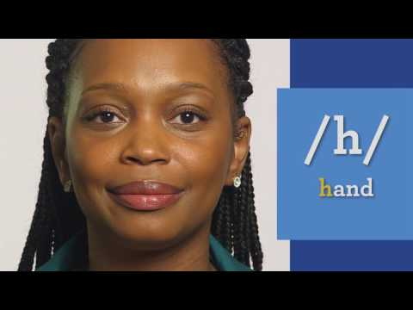
How to ensure Foundational Skills (Systematic Structured Phonics)?
You MUST have a program and materials that are systematic and provide the variety of practice to ensure EVERY child gets what s/he needs.
Don’t shortchange assessment. Weekly! Down to the skill level who has mastered what.
Pronunciation and clarity matter. Here is the best model we’ve found: 44 phonemes.
INSERT VIDEO FROM SLIDE NOTES
Notes:
Link to 44 phonemes:
This video, graciously developed by Rollins Center for Language and Literacy, is an excellent guide to pronouncing the 44 phonemes of the English language. The presenter is easy to learn from and demonstrates clearly how to make each sound.
https://www.youtube.com/watch?v=wBuA589kfMg

Slide 39
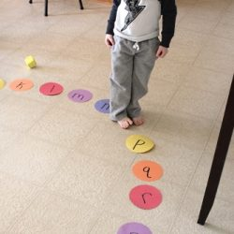
Joy and full body movement matter too!
Learning to read is fun!
Exploring the code of a language is intriguing and satisfying.

Slide 40
How to ensure Foundational Skills (Reading Fluency )?
Should be a focus of early grades, especially 2nd
(or until students are fluent regardless of grade.)
Fluency means reading accurately, with appropriate speed (matching the text complexity) and expressiveness.
Students aren’t fluent unless they can read GRADE LEVEL texts fluently.
It can be fun and useful!
(Think performance and public speaking).
Families can easily help with fluency practice, regardless of home language (practice travels home easily)
Notes:
This weekly protocol, developed by Orange County, CA, lays out 3 models for continuing fluency in person, offline or online. https://achievethecore.org/page/3259/weekly-reading-practice-routine
Here is a link to all of Achieve the Core’s fluency resources: https://achievethecore.org/category/411/ela-literacy-lessons?filter_cat=1153&sort=name

Slide 41
Opportunities to grow knowledge and develop vocabulary
  Breadth – achieved through a volume of reading/being read to (text sets)
  Coherent and connected to core content so knowledge builds on itself
  Depth through focused instruction during read alouds

Slide 42
How to develop breadth of Vocabulary and Knowledge (Conceptually Coherent Text Sets)?
Knowledge and Vocabulary are tightly interwoven
(they grow together)
Text sets build knowledge in a coherent way
As much as 4X more vocabulary is learned when the content is stable and coherent
Children love to learn about the world, themselves and others
Notes:
Here is a link to Achieve the Core’s text set resources: https://achievethecore.org/content/upload/Text%20Set%20Guidance.pdf

Slide 43
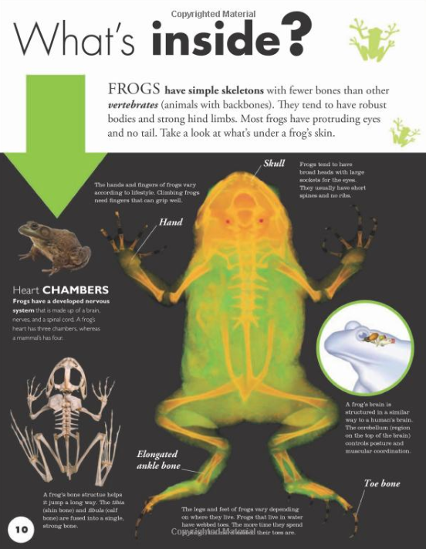
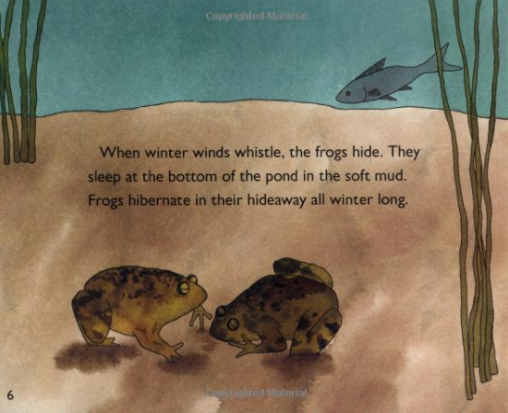
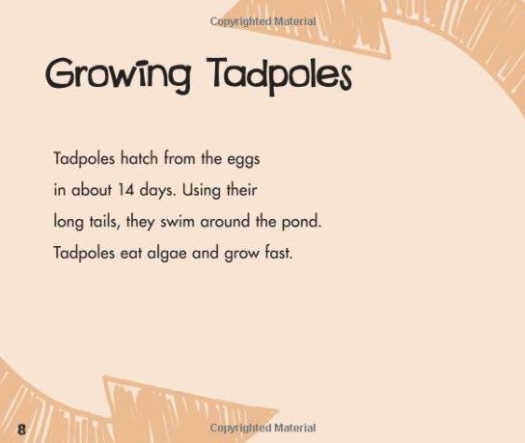
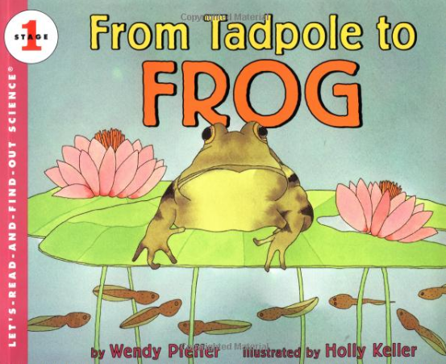

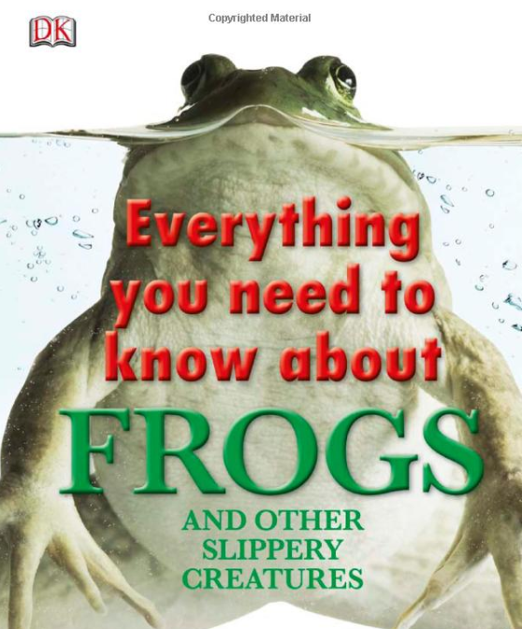
How a frog’s body supports its needs
Frog habitat, life cycle, and behaviors
Life cycle of a frog
Notes:
This does not mean that the key decision is WHAT the content knowledge is, but that reading on a topic can build knowledge and vocabulary that will support the reader in making meaning from progressively more complex text. Language and concepts from one text will support students’ understanding in the next text, scaffolding their access.

Slide 44
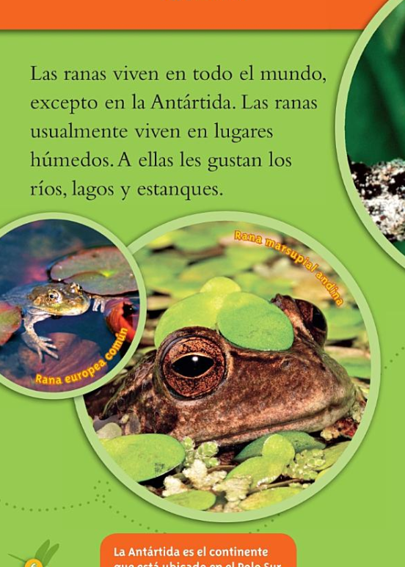


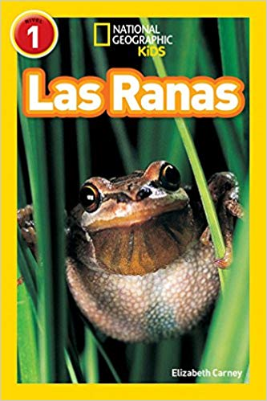
What’s known in one language contributes to what’s known in another language:
Frog habitat, life cycle, and behaviors
Las ranas viven en lugares humedos.
Life cycle of a frog…..la vida de una rana.
Notes:
As we are considering the impact of this work in dual language classrooms, consider the oracy skills that can be developed in either language of instruction when there is overlapping content!

Slide 45
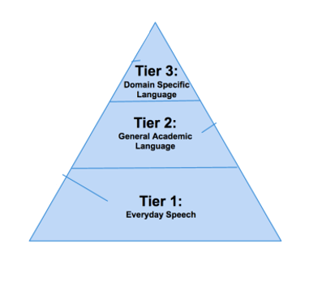

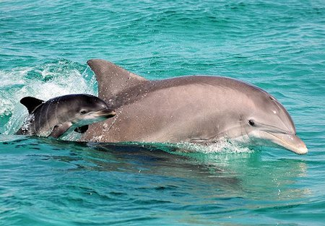
“Dolphins ascend to the surface to breathe through their blowholes and descend once again to locate their prey underwater. Some large dolphins eat marine mammals, but most dolphins feed on fish.”
Building knowledge also builds vocabulary!
Tier 3: domain-specific vocabulary
Tier 2: high-leverage academic vocabulary

Slide 46
How to develop depth of vocabulary (paying close attention to words and phrases)
Focusing at the on the work words do at the sentence level (‘Juicy Sentences’)
Focusing on a selected word and examining it (‘Weighty Words’)
These both need to be in-person or synchronous
Notes:
Juicy Sentence resource on ATC: https://achievethecore.org/page/3160/juicy-sentence-guidance

Slide 47
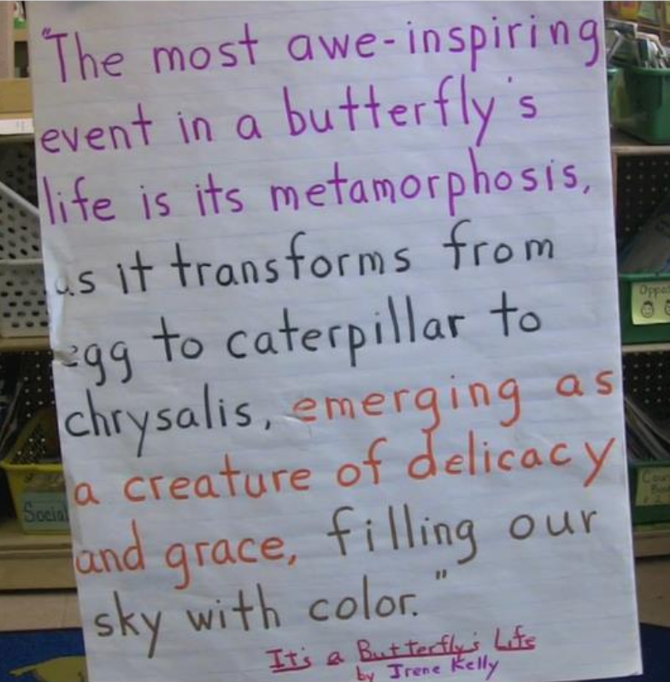
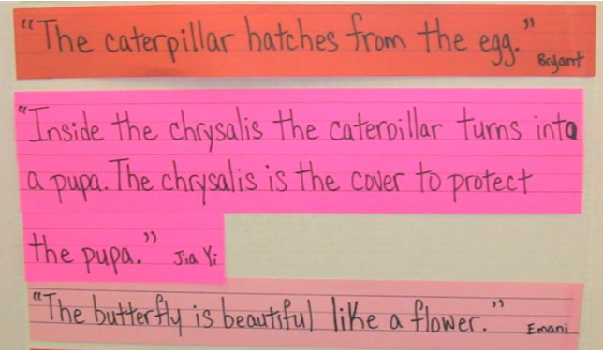
Juicy sentences - credit to my co-presenter!
From this sentence…
To this kind of student production (dictated)
Notes:
Lesson video: https://vimeo.com/47315992

Slide 48
Take the word: Introduction
1) Stretch to hear all the phonemes:
/I/--/N/--/T/--/R/--/O/--D/--/U/--/K/--/SH/--/U/--/N/
2) Look at it together to study the phonics patterns:
In-tr-O-duc-tion
3) Say it so students can hear/see the syllabication and how that helps them sound it out:
in/tro/duc/tion
Point out –‘tion’ is always pronounced “shun” and turns verbs into nouns (to introduce is an action. An introduction is a thing, a noun. Give other examples:
  construct – construction;
  inspire – inspiration
4) Pick it apart for meaning:
intro (inter) means ‘in through’; ‘duc’ is from Latin to lead.
To lead someone in through something is to expose them, or introduce them, to something.
5) Add on! Use affixes. Re- means again.
Reintroduce means to expose someone to something again.

Slide 49
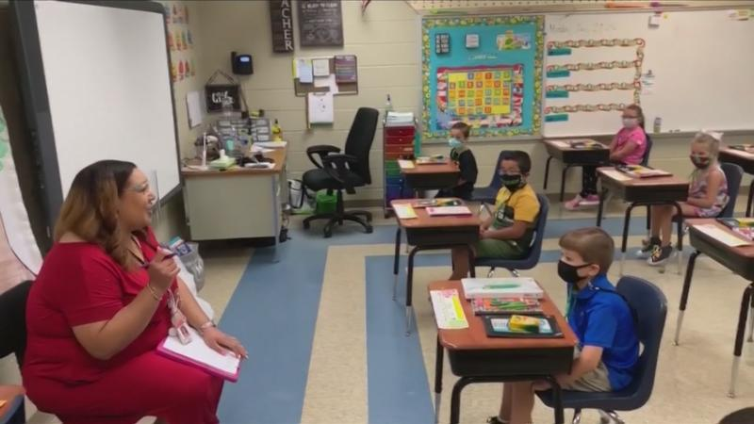
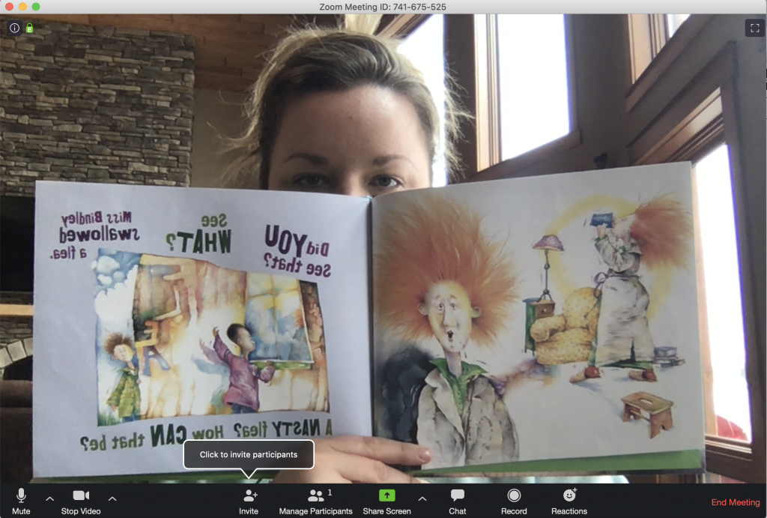
Developing Comprehension through Rich, Interactive, Read-alouds
  Teaches students about rich syntax, word choice and language
  Brings all students into the same conversation
  Builds standard of coherence and
  Provides joy in reading

Slide 50
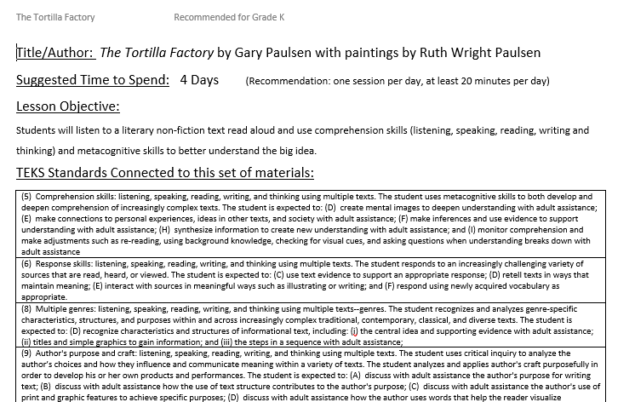




What is a Read Aloud Project (RAP) Lesson Plan?
Focused on a complex text used for read aloud
Read and reread over multiple days with text-dependent questions
Finishing with a culminating task

Slide 51
How to develop comprehension for students not yet reading on their own?
Rich Interactive Read Alouds
Read alouds can be crowdsourced, located on streaming media or the internet and delivered to students remotely/asynchronously or in-person.
Rereading (listening) can be done anywhere
Discussion must be in person/synchronously, and;
Students must have the opportunity to talk with and hear from their peers!
Notes:
Achieve the Core’s Read Aloud Project resources are here: https://achievethecore.org/category/411/ela-literacy-lessons?filter_cat=788&sort=name

Slide 52



Three new pages of resources!
Resources:
Early Reading Accelerators website
Foundational Skills website
Building Knowledge & Vocabulary website
Notes:
The Early Reading Accelerators page has content that helps introduce the accelerators’ content and many resources to support teaching early literacy in 2020-21 in particular, including model remote learning videos and many resources for virtual instruction. The foundational skills page focuses on the foundational skills accelerator and has resources for your own learning about foundational skills, materials to use with your students, and things to support your practice and students. The knowledge & vocabulary page focuses on that accelerator and has resources for read aloud, text, sets and book baskets, as well as resources about culturally responsive practices, critically evaluating your texts for responsiveness, representation, potential bias, and supports for students including English learners. WOO - that’s a lot! We encourage you to bookmark these pages as places to come back to, and let us know what feedback you may have about the pages as well!

Slide 53


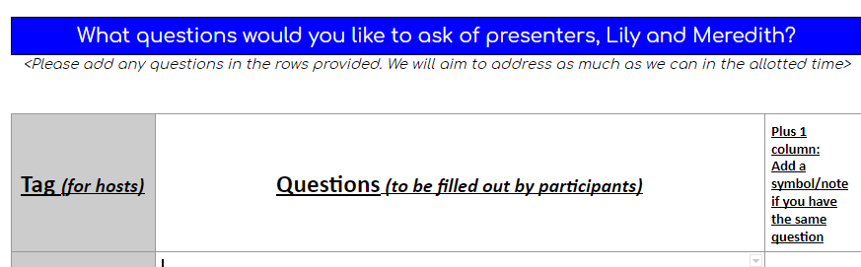

Reflect and Prepare for Q&A:
Take a look at the Q&A document- if there is a question you really want to flag, be sure to add a plus 1.
Add any new questions to the document!
Review/ react to questions here: http://bit.ly/QuestionsERA1
Notes:
http://bit.ly/QuestionsERA1

Slide 54

Hosted by Lily Wong Fillmore and Meredith Liben

Slide 55

http://bit.ly/ERAWEB1FEEDBACK

Slide 56

Early Reading Accelerators - Webinar Series
Session 2:
Sharing District Perspectives on Equitable Reading Instruction
Monday, November 9th
2:00 PM EST
Presenters: San Antonio ISD, Charlotte-Mecklenburg Schools
Session 3:
Considerations for Equitable Instruction from Educator Voices
Monday, December 7th
Time TBD
Stay tuned for sign up info!

Slide 57

Share your feedback and resources!
http://bit.ly/ERAWEB1FEEDBACK

