Slide 1

Welcome to the Early Reading Accelerators Webinar Series

Slide 2
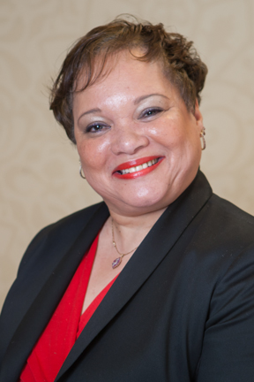
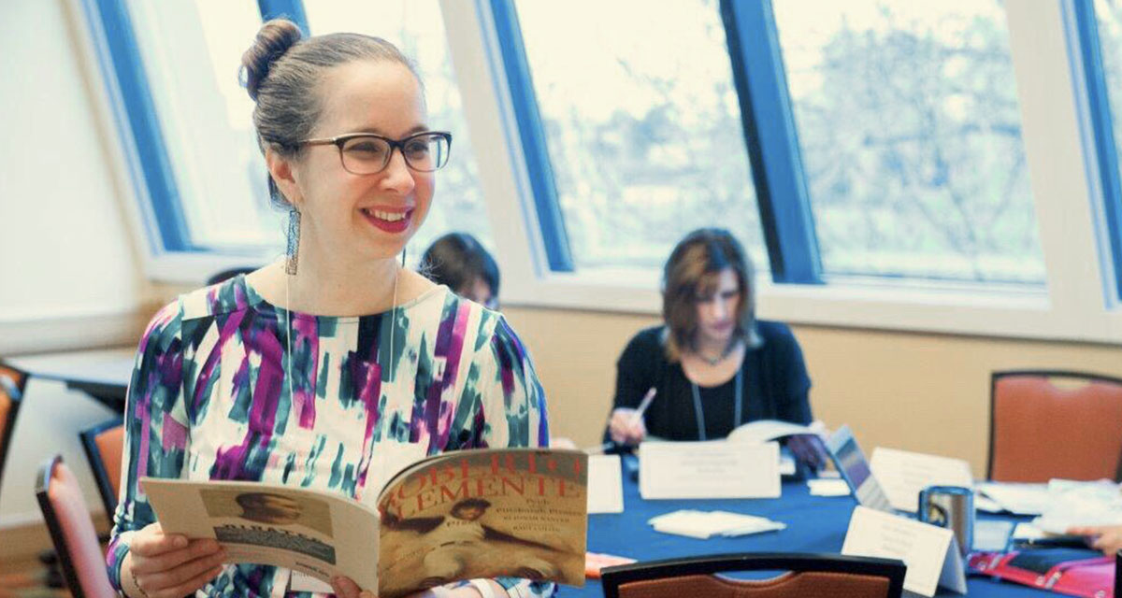
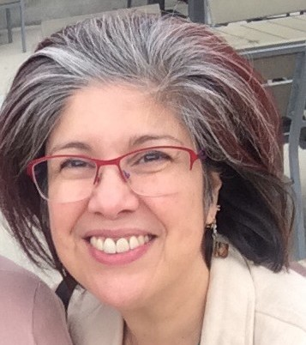

Welcome and Overview
Carey Swanson, SAP
Robin Hall, CGCS
Stacy Wetcher Gad, SAP
Gabriela Uro, CGCS

Slide 3


Virtual tips!
This session is being recorded and the recording will be shared
Because of our large group size today, participants will be muted
Use the chat box for logistical questions
Use the Q&A google doc for presenter questions
Some of the ways we’ll engage together today
Interactive poll
Chat questions!
Collaborative
Q&A google doc
http://bit.ly/QuestionsERA2
https://bit.ly/ERAWebinar2

Slide 4

Today’s Agenda!
Welcome and Overview
San Antonio Independent School District
Charlotte Mecklenburg Schools
Reflection/Prep for Q&A
Q&A
What’s Next?
http://bit.ly/QuestionsERA2
A space to jot down ?s
along the way

Slide 5
Rationale from CGCS
Central to student success is strong, standards-aligned instruction in literacy in early grades. Support is needed for educators and students in classroom settings that employ balanced literacy models. Supports may include:
addressing the gaps in both foundational skills and use of complex text observed in traditional balanced literacy structures
creating high quality professional development resources and support structures that can be implemented easily by other districts
adding to the body of research supporting college and career-ready standards-aligned approaches to common balanced literacy models in both monolingual and bilingual instructional contexts

Slide 6

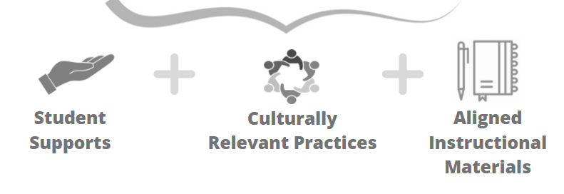
Equitable Implementation of the Early Reading Accelerators
How can we best support all K-2 students' learning, amplify what matters most for early reading, and foster students' social-emotional development?
Notes:
(for more information, see https://achievethecore.org/collection/9/early-reading-accelerators-k-2)
While research has longed showed us that foundational skills and building knowledge & vocabulary matter - these things alone are not enough for equitable experiences for all students, and in particular for historically marginalized students whose needs have not been met by school. So, how can we best support all K-2 students’ learning, amplifying what matters most for early reading, and foster students’ social-emotional development?
To implement the Early Reading Accelerators equitably and let each child’s innate brilliance shine, we must also consider student supports, culturally relevant content and practices, and aligned instructional materials. This is always important and it especially important today, as we have seen this pandemic exacerbate existing inequities in our education system.

Slide 7
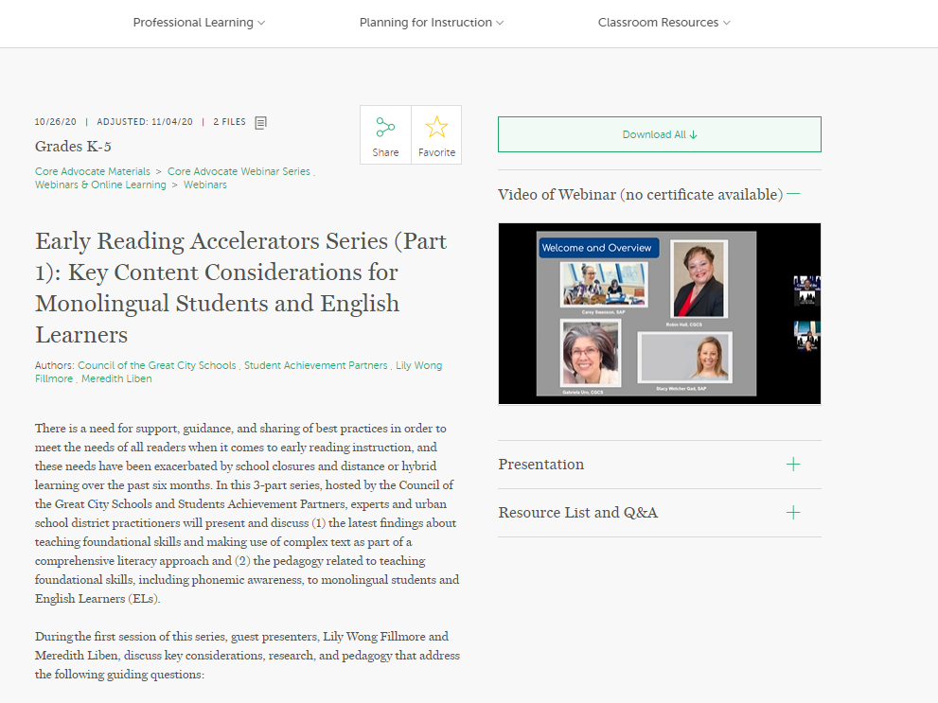
An overview of Webinar 1:
Key Content Considerations for Monolingual Students and English Learners
http://bit.ly/Webinar1ERA
Notes:
https://achievethecore.org/page/3314/early-reading-accelerators-series-part-1-key-content-considerations-for-monolingual-students-and-english-learners

Slide 8

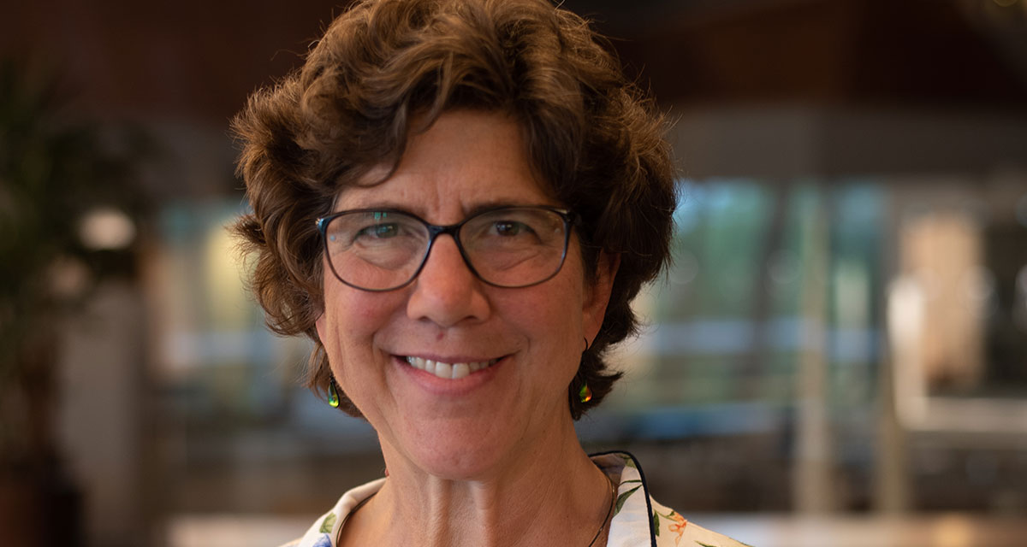
Webinar 1 Recap
Meredith Liben
Lily Wong Fillmore
What is the role of phonemic awareness for young English proficient students and ELs?
When and how are children ready to associate symbols (letters) to the sounds they know?
What do educators need to know to support learning to read complex text? How can complex read aloud play a role in building knowledge and vocabulary for young English proficient students and ELs?
How are educators currently thinking about and approaching these areas of instruction? What practices are working, and what might need to change?
Notes:
Dr. Fillmore spoke about the unique and important needs of ELs as they are developing English proficiency.
Meredith Liben spoke to practical tips and tricks for implementation in the classrooms.

Slide 9

Guiding Questions for Today’s Webinar
How are districts complementing, amplifying, modifying their instructional frameworks, curriculum, and approach to attend to best practices in early reading?
How are districts specifically supporting English Learners in these practices?
What do teachers need to know about English and ELs’ home language in order to teach foundational skills in meaningful ways?
How are districts attending to equitable instructional practice and the student experience?

Slide 10
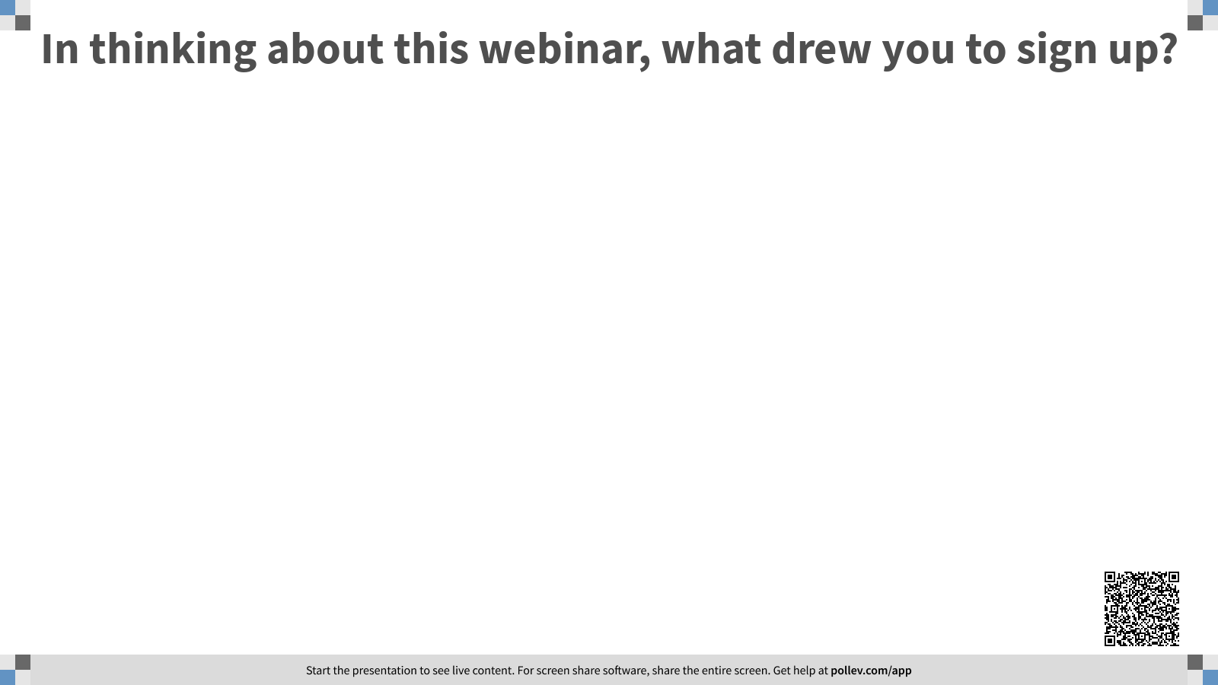

Slide 11
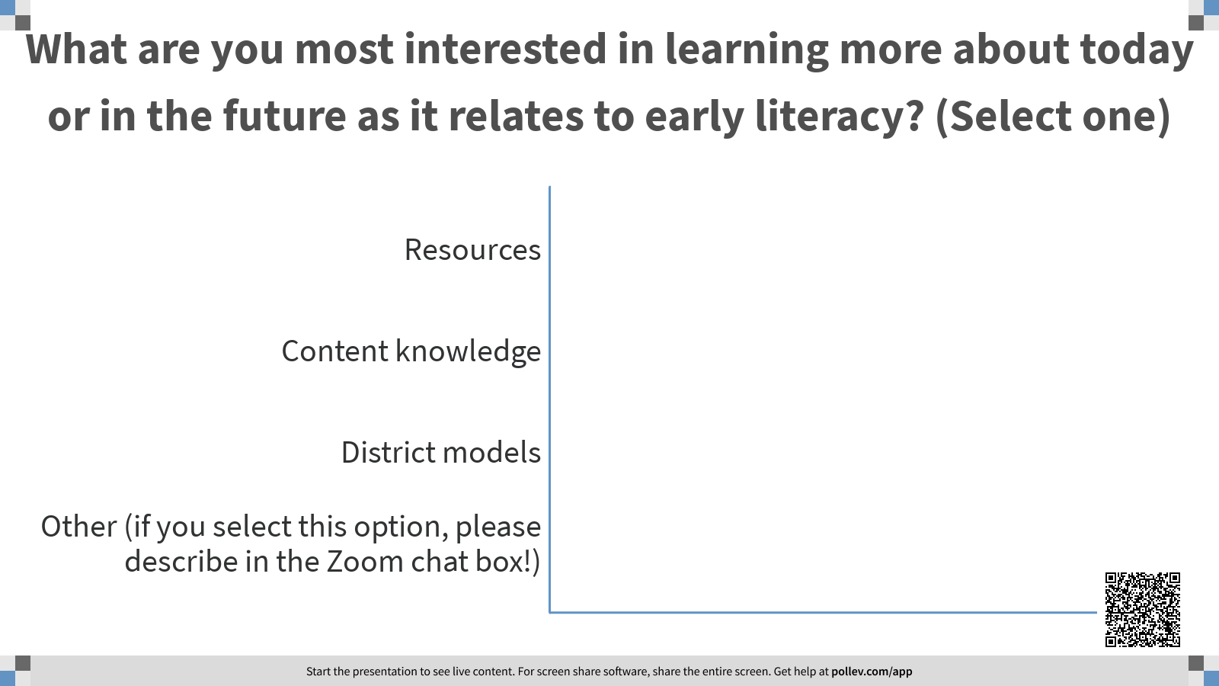

Slide 12
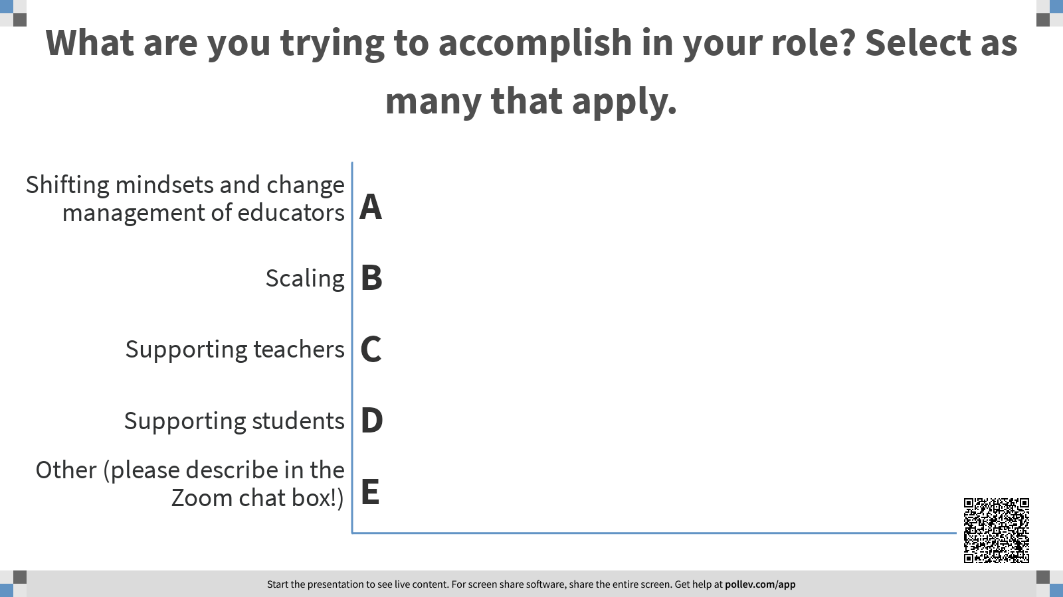

Slide 13


Today’s Presenters
San Antonio Independent
School District
Charlotte-Mecklenburg
Schools

Slide 14


San Antonio Independent School District
Notes:
STACY STOPS SCREENSHARING
Dr. Olivia Hernandez, Patti Salzman, Rebecca Deleon
San Antonio Independent School District (SAISD) sits in the heart of the city of San Antonio, Texas. Currently serving close to 50,000 students with a 90% Hispanic community of which 20% are English Learners. We have tremendous pride in the cultural and linguistic assets that our community has to offer. We began a pilot two years ago with new district leadership to explore our early literacy practices and policies. In a deeply collaborative approach, we engaged in the creation of Spanish Read Alouds and adjusted to meet the needs of our 42 Elementary and Academy Dual Language programs. We have reflected on the "why" behind our instructional decisions and have brought in stakeholders to co-construct how we define literacy in SAISD.

Slide 15

Challenging Assumptions about Early Literacy
Effective Strategies for Kinder and First Grade Classrooms

Slide 16
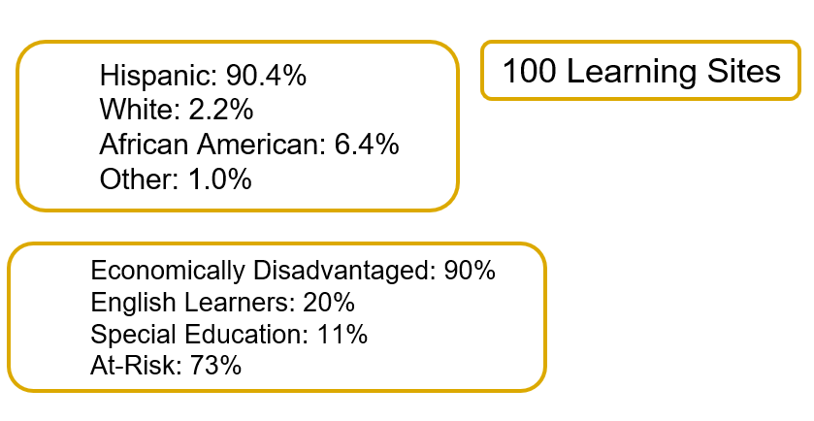
San Antonio ISD Demographics
Notes:
We are in the heart of San Antonio Tx serving a 90% Hispanic Population and 90% Economically Disadvantaged across 100 learning sites.

Slide 17



The Partnership and The Pilot
Notes:
Starting in the Fall of 2018 we began a partnership for the Early Readers Accelerator Pilot with a targeted goal of improving early literacy practices centered around complex texts, explicit and systematic phonics instruction, and text centered lessons with text sets and written student tasks. Through this unique partnership we engaged in deep conversations about research, policy, and classroom practice. We reflected on some deeply held assumptions (misconceptions) around literacy instruction.

Slide 18
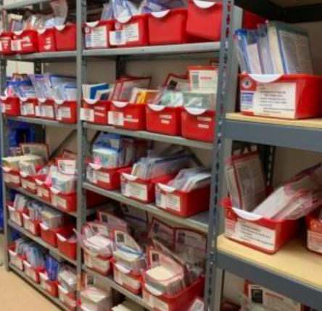
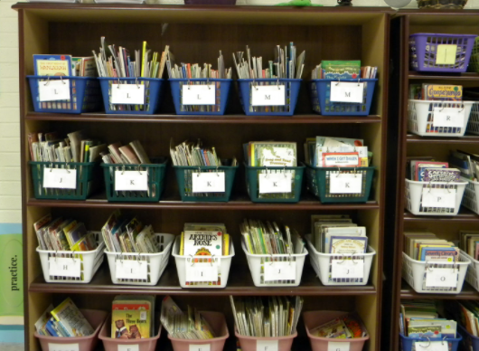
Assumption #1: Leveled Literacy is Core Instruction
“Leveled texts lead to leveled lives.” Dr. Alfred Tatum, author of Reading for their Lives
Outside the Bin Limiting Students
Notes:
Historically, our district had invested in large leveled libraries and provided in-depth professional development based on those libraries and assessment that utilized systematized literacy. Our Literacy Scores did not improve. The research around this practice was beginning to be questioned, but our district had made a large investment in this classroom practice with little yield. How do we shift classroom practice 180 degrees.

Slide 19
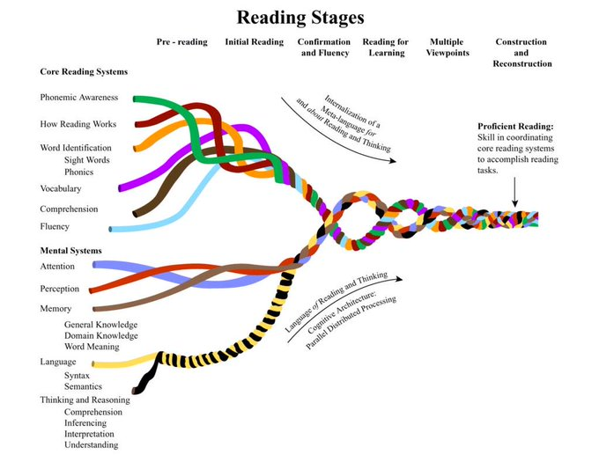
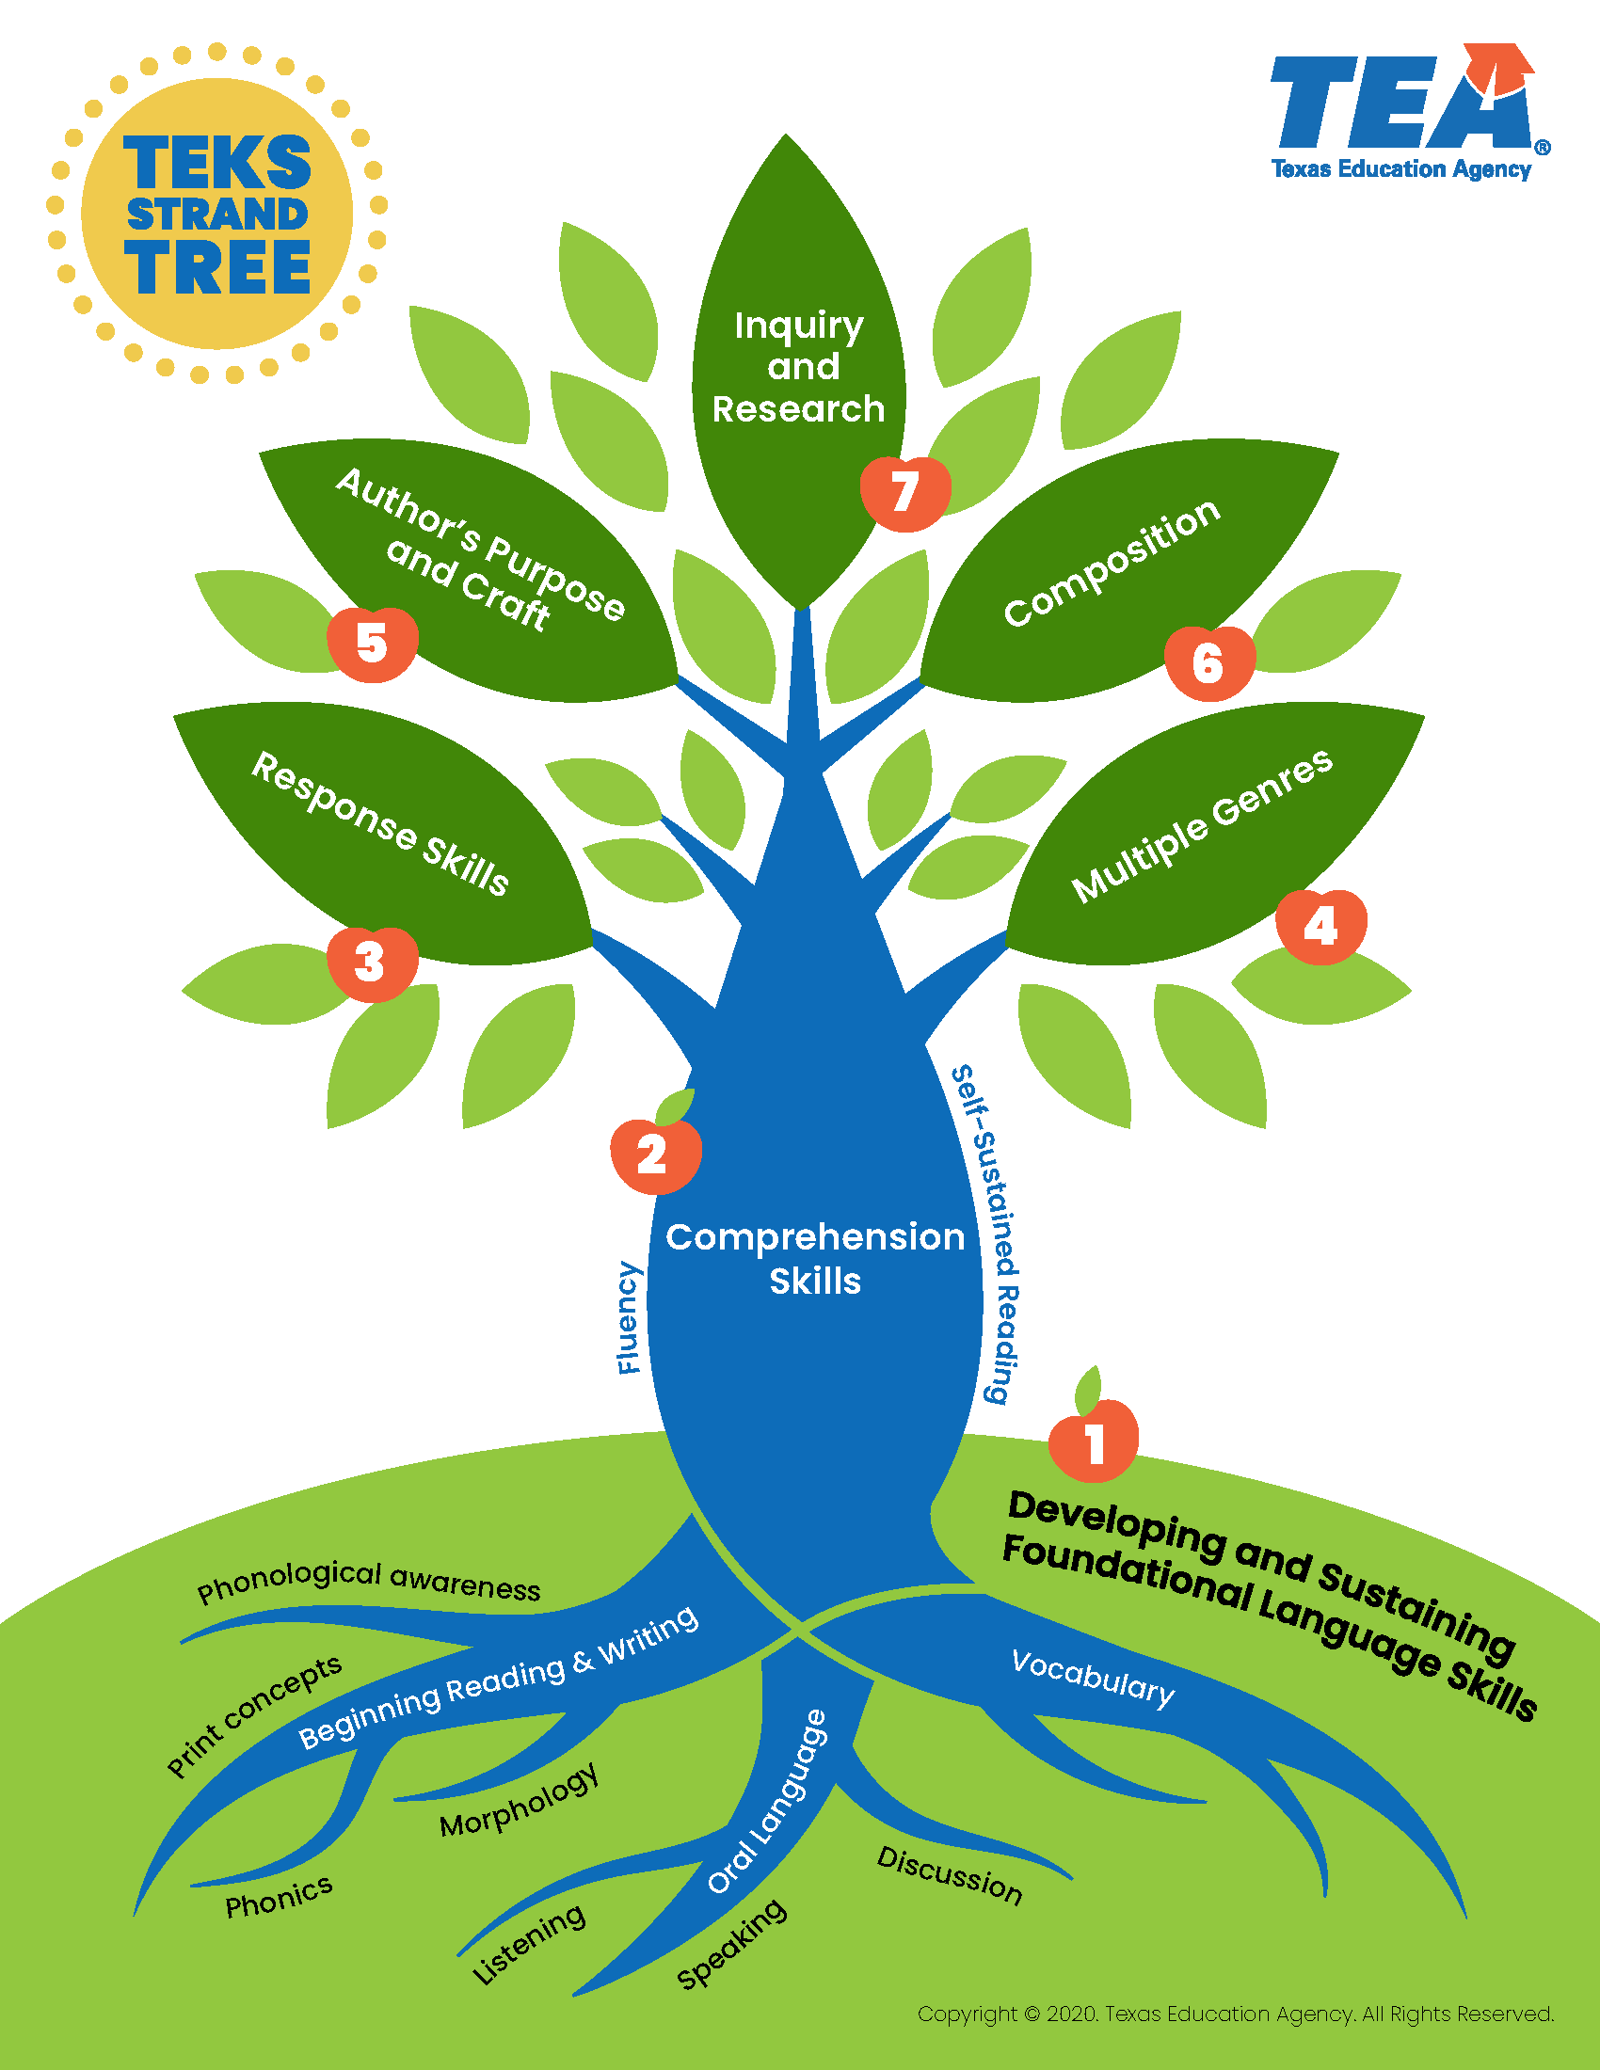
Assumption #2: Reading Lessons are skill-based
The strands focus on academic oracy (proficiency in oral expression and comprehension), authentic reading, and reflective writing to ensure a literate Texas. - TEKS
Text complexity Drop “Finding the Main Idea”
Notes:
Our state curriculum was previously structured to teach skills in isolation. Teachers were trained in targeting one skill at a time(main idea) for an extended period of time like a week or two. Genres were also targeted as a focus, in isolation, for an extended period of time(month or two). In 2017 our state adopted new literacy standards that asked teacher to reformulate how they teach reading and writing. Now our state standards push text complexity and the integration of reading skills.This major shift in policy aligned better with research but didn’t shift classroom practice. Our teachers needed guidance on what this looked like in a lesson.

Slide 20
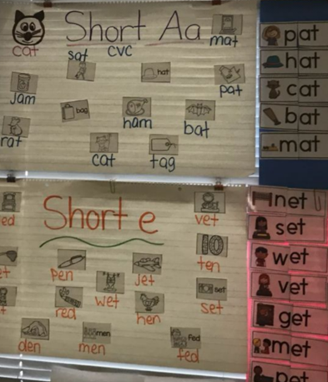
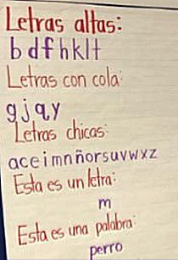
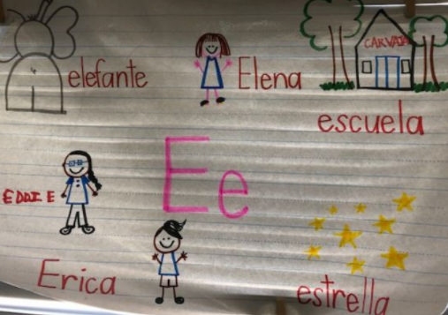
Assumption #3: Alignment is automatic for Foundational Skills
“Joy is one letter away from job.” - Kristen Olsen
Explaining Phonics Instruction Importance of PA in Spanish
Notes:
We had not defined what foundations skills needed to be taught systematically and explicitly. We had an inconsistent scope and sequence for phonics instruction. Without a clear path, phonics and phonological awareness wasn’t fun for many teachers or students. Our Bilingual teachers often followed with Mainstream colleagues, despite the research that what works for phonics instruction in English, doesn’t necessarily work in Spanish.
We had trust in our resources without an in-depth analysis to see if it served our purpose in a centralized way. The unintended consequences were schools and classrooms making their own decisions around this important component. We allowed classroom practice to lead without the research to back it.

Slide 21
Assumption #3: Alignment in Foundational Skills
Kinder Spanish TEKS | CV | VC | CVC | VCV | CCV
Primary Resource | CV
Adopted Curriculum | CV (indirect) | VC (indirect) | CVC (indirect) | VCV (indirect)

Slide 22
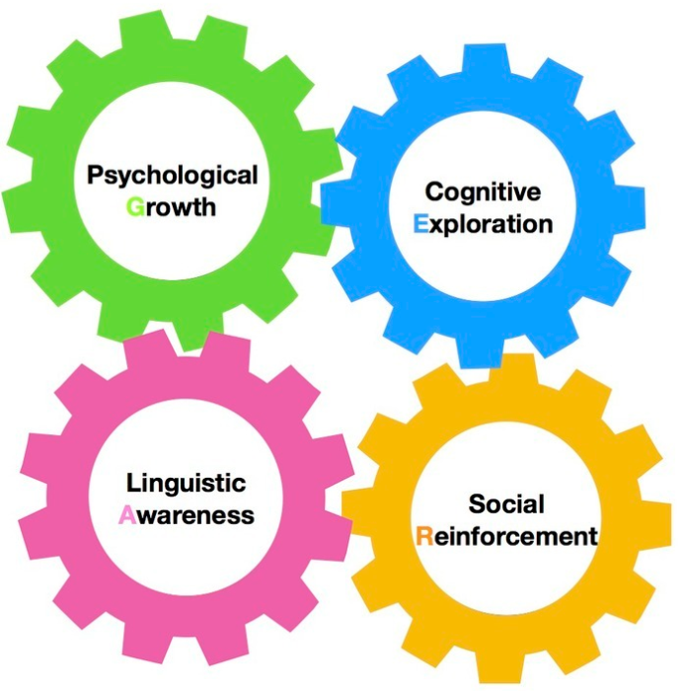

Assumption #4: We can instruct without culturally & linguistically relevant pedagogy
…all our children need to believe they have something interesting to say. Literature plays a key role in helping children’s voices take the floor. Literature triggers thoughts, unlocks memories, and helps create the kind of community in which it’s safe to tell our stories.” -Shelley Harwayne
Bilingualism is good for you Paired Literacy
Notes:
When we were presented with the pilot, it only address a portion of our schools. We paused to reflect if the materials being presented aligned to ourselves and our students. Then we acted by providing feedback and research around our students needs for culturally relevant pedagogy and biliteracy. We begin to advocate for critical consciousness in our construction of lessons that increased student engagement by thinking through the mirrors, windows, and sliding doors. SAP worked on Spanish lessons for their website.

Slide 23
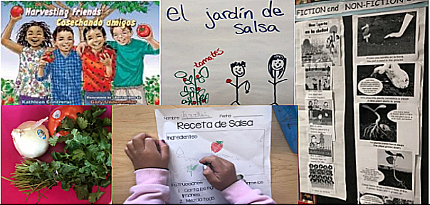
Assumption #5: Separating Literacies in Needed
“Making meaning should be the goal of every instructional action and every activity in which we engage students.” - Mary Howard
Funds of Knowledge Multimodal Approach
Notes:
We had drifted from the meaning-making process that anchors good literacy practices. The layering of multiple ways of knowing, funds of knowledge, and, multimodal literacies. This was really reflected in the tasks students engaged in the content, to the text, new vocabulary, shared experiences. Here we the real triangulation of policy, research and classroom practice visibly, tangibly in student work. Show pictures of salsa making lessons, of lunar exploration. Excetera

Slide 24
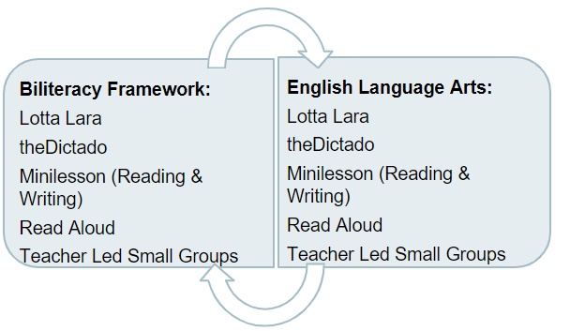
Impact #1: Aligned Literacy Frameworks
Biliteracy Framework
ELAR Framework
Notes:
Through this work we internally aligned our frameworks to reflect great practices not just English Learners but for all. We assured strong practice was integrated in both frameworks.

Slide 25

Impact #1: Who knows the why?
The research base for our Biliteracy framework
The research base for our English Language Arts framework
Notes:
This slide is really about who has access to and know the why behind district decisions for their literacy instruction. This creates transparency and buy-in for all stakeholders, it also creates stability between transitions in leadership. Linked is our annotated bibliography.

Slide 26
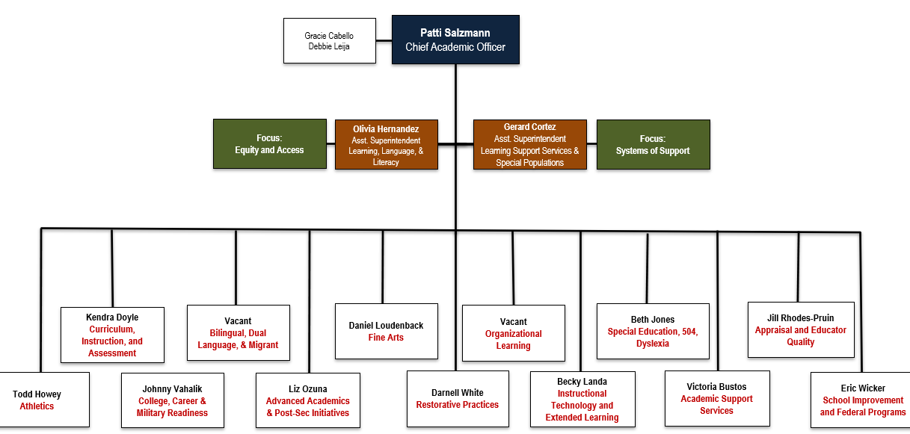
Impact #2: Re-Structuring for Equity

Slide 27

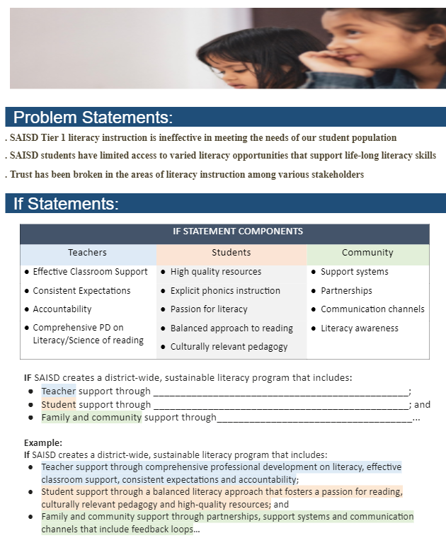
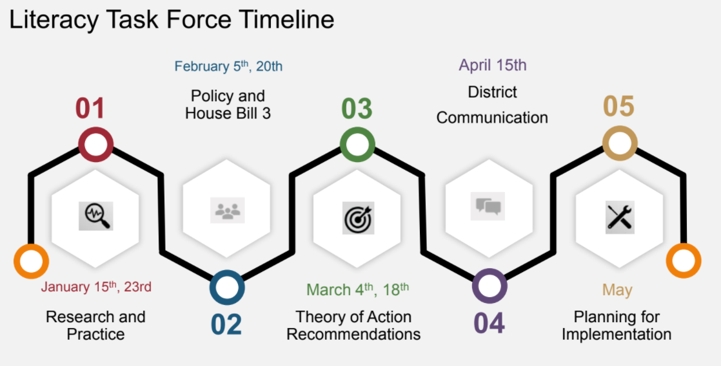
Impact #3: Literacy Task Force - Theory of Action
IF San Antonio ISD creates a district-wide, sustainable literacy program that includes support for teachers, students and the community…
THEN, all San Antonio ISD students will become critical thinkers empowered through literacy to advocate for themselves and their communities.

Slide 28
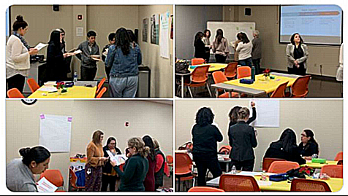
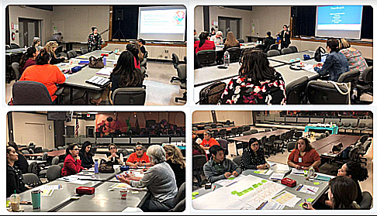
Literacy Task Force
Literacy Task Force
Executive Summary

Slide 29
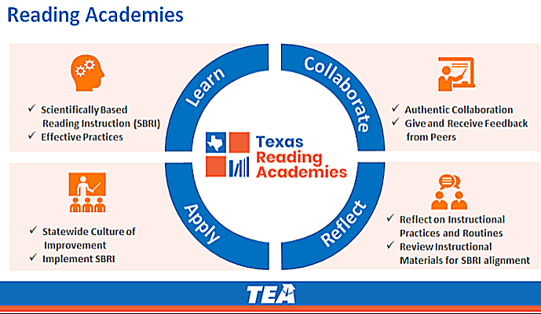

Impact #4: Texas House Bill 3
Summary
Notes:
In 2019,Texas House Bill 3 legislation required professional development statewide for all k-3 teacher and principals to be trained in scientifically based reading instruction. Our pilot allowed for our district to be ahead of curve and prepared for these instructional shifts. We could visual and articulate what this meant in shifts for classroom practice. This was key in preparing for a major state initiative. Only 44% of the 356,913 students who took the 3rd Grade STAAR achieved MEETS or MASTERS(on or above grade level).

Slide 30
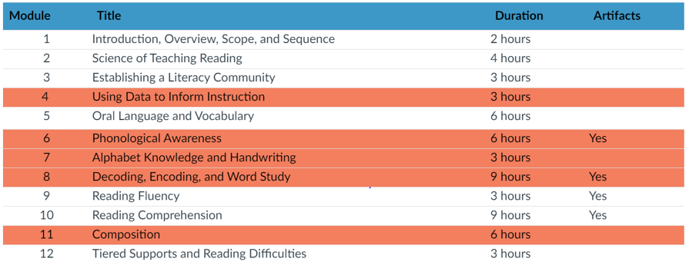
Texas Reading Academies Biliteracy Pathway
Science of Teaching Reading Competencies
Notes:
The Areas highlighted in Salmon color indicate the Biliteracy Pathways additional content. It is important to consider English Learners' literacy needs because 28% of PK-3 students in Texas are English learners, with 89% of these children coming from Spanish-speaking backgrounds.

Slide 31
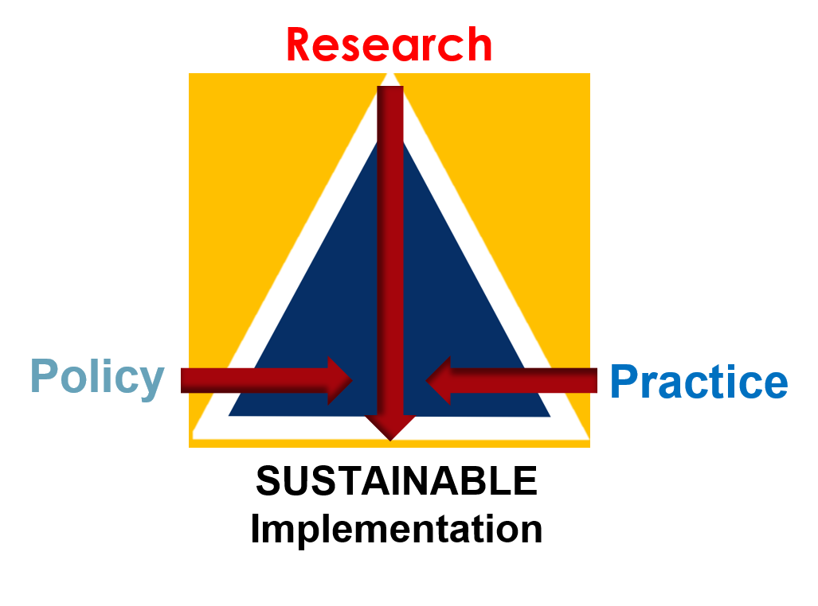
In Closing
And, because of the enormous inequities in our society, providing each child an equitable opportunity to revel in an abundance of books in which they both see themselves and are introduced to the world is no small task.
-Randi Weingarten
Notes:
Research was thrown off due to Covid but we are doing a case study. Our plans for literacy plan.
San Antonio ISD’s literacy plan serves as a tool to realize the District’s vision for literacy created by the SAISD Literacy Task Force:
All students become critical readers and thinkers empowered through literacy to advocate for themselves and their communities through a comprehensive evidence-based literacy approach.
The SAISD Literacy Plan provides common goals, best practices, and strategies necessary for an effective, efficient and sustainable implementation of a comprehensive evidence-based literacy (CEL) approach for driving policy, professional learning, and instruction. This plan is designed to support teachers, students and the community through a literacy approach that is aligned to research and state mandates. The SAISD comprehensive evidence-based literacy approach provides every student with the opportunity to learn and demonstrate knowledge. Through CEL instruction, all students, including struggling readers, will develop fluency and language comprehension at or above grade level. CEL instruction supports closing achievement gaps in literacy through systematic phonics instruction, on grade level instruction with scaffolds, modeling, progress monitoring, knowledge building and cultural and linguistic responsive practices. The SAISD literacy plan supports a biliteracy model for students in Dual Language programs with the goal of bilingualism & biliteracy, academic achievement and cultural competen

Slide 32
Thank you

Slide 33

Charlotte-Mecklenburg Schools
Notes:
Trish Sexton, Kathryn Pedrotty, Alyssa Mannella
Charlotte Mecklenburg School District (CMS) serves 148,299 students from 183 countries, speaking 197 languages and dialects across 175 schools. What Matters Most in CMS is the focus on the instructional core- including, students, teachers, and content. The district has been on an early literacy journey the past two years focusing specifically on the student experience and access to foundational skills through a standards-aligned curriculum. The collaboration between the Equity department and Learning and Teaching department has allowed for aligned messaging to school leaders and streamlined professional development for instructional staff. CMS is committed to constant action to ensure excellent educational opportunities for every child at every school.

Slide 34

Equity and Science of Reading
Slide Deck
Click Here t.ly/CIzq
Optional Note Catcher
Click Here t.ly/2ckK
Notes:
TS
*Record*

Slide 35
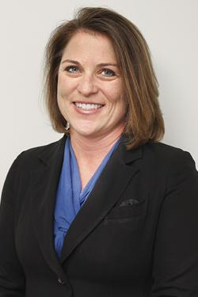
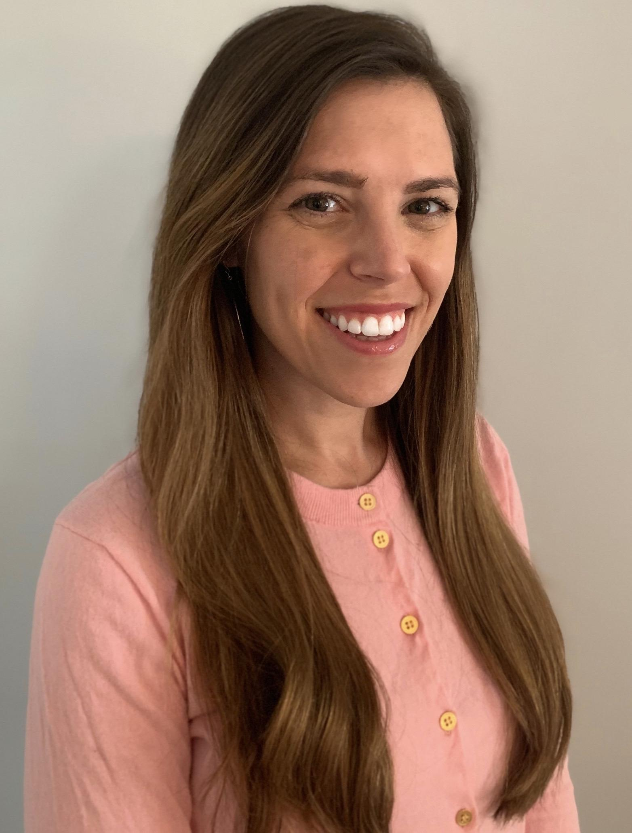
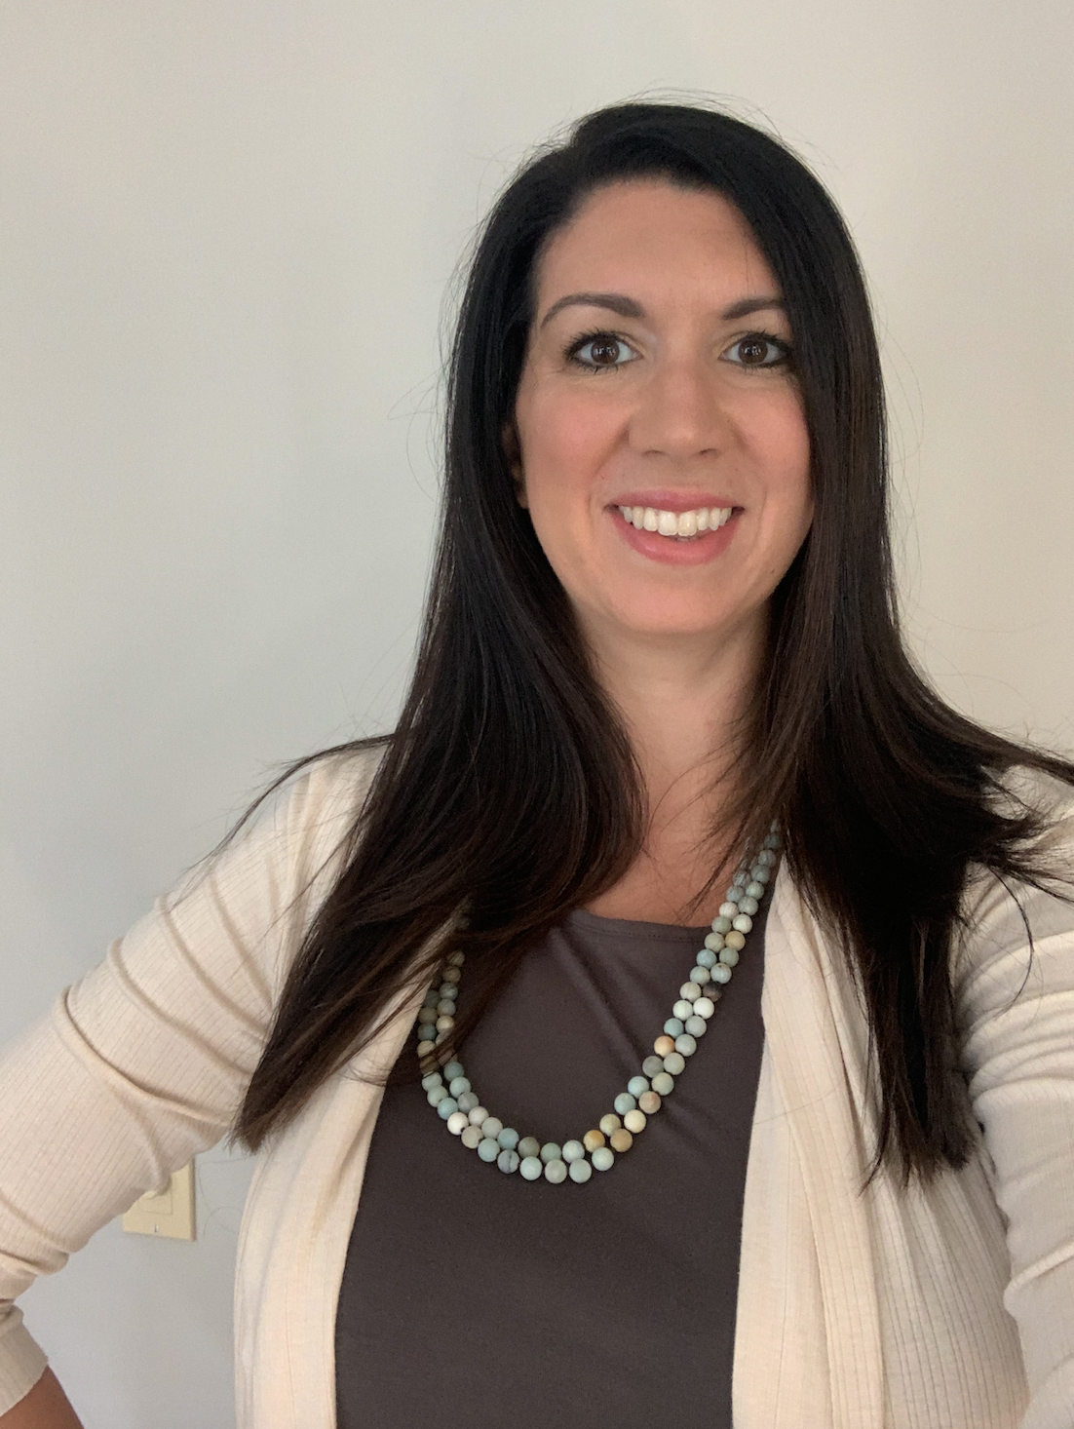
Trish Sexton
Associate Superintendent Elementary Equity
  Support school leadership teams to: ensure access and opportunity for all students, eliminate the predictability of who will succeed, and provide a positive, challenge, and supportive learning experience for all.
Prior Roles: Principal Supervisor, Elementary Principal, Elementary Assistant Principal, Teacher
Kathryn Pedrotty
Elementary Equity Specialist
  Support school leadership teams to: ensure access and opportunity for all students, eliminate the predictability of who will succeed, and provide a positive, challenge, and supportive learning experience for all.
Prior Roles: Elementary School Assistant Principal, Elementary Dean, Facilitator, and Teacher
Alyssa Arrowsmith
Elementary Literacy and Dual Language Specialist
  Support school-based literacy facilitators and teachers with effective implementation of written and taught curriculum while building knowledge of Science of Reading
Prior Roles: English Learner Services department, former elementary ESL teacher and classroom teacher.
Notes:
TS
We have been fortunate to work closely with the Council of Great City Schools, Student Achievement Partners and the San Antonio School district.
KP, AA introduce self

Slide 36





Agenda
Charlotte Mecklenburg Fast Facts
How We Got Here
Building Common Understanding
Current Work
Notes:
TS
How we got here
Building Common Understanding (trainings, core actions, foundational skills)
Current Work

Slide 37
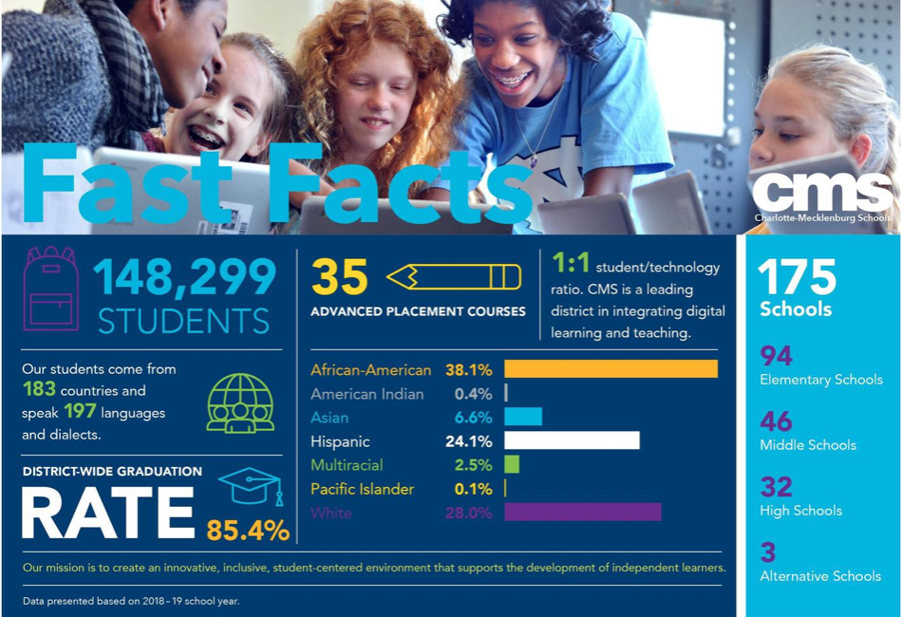
Charlotte Mecklenburg School District
177
Schools
98
Elementary Schools
14
K-8 Schools
32
Middle Schools
32
High Schools
1
Alternative School
Notes:
As you can see the district we are a large school district. We are the second largest district in the state serving over 148,000 students. Our team serves the 112 elementary schools in the district.
We have 183 countries represented and 197 languages.

Slide 38
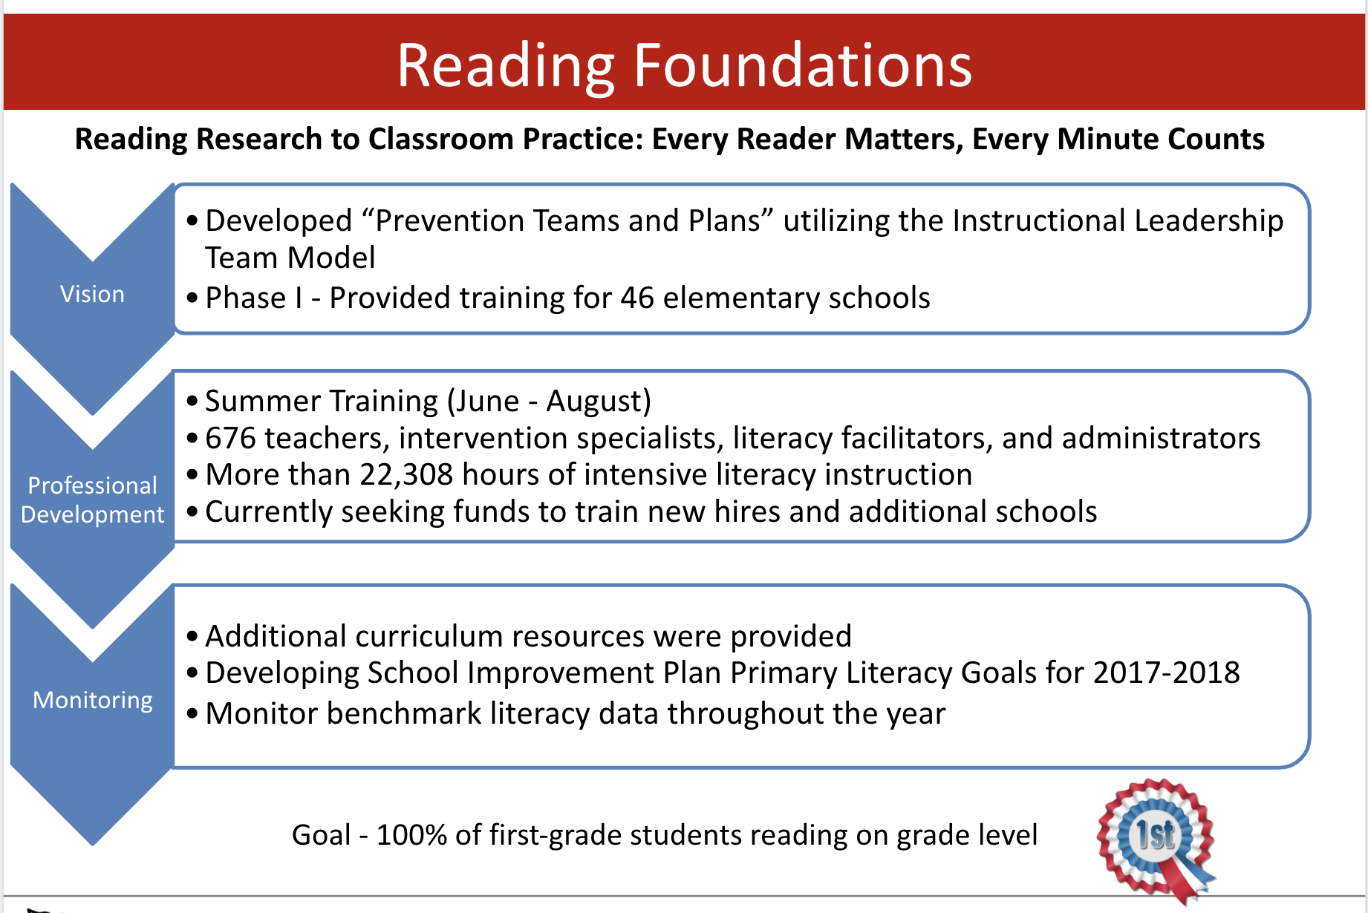
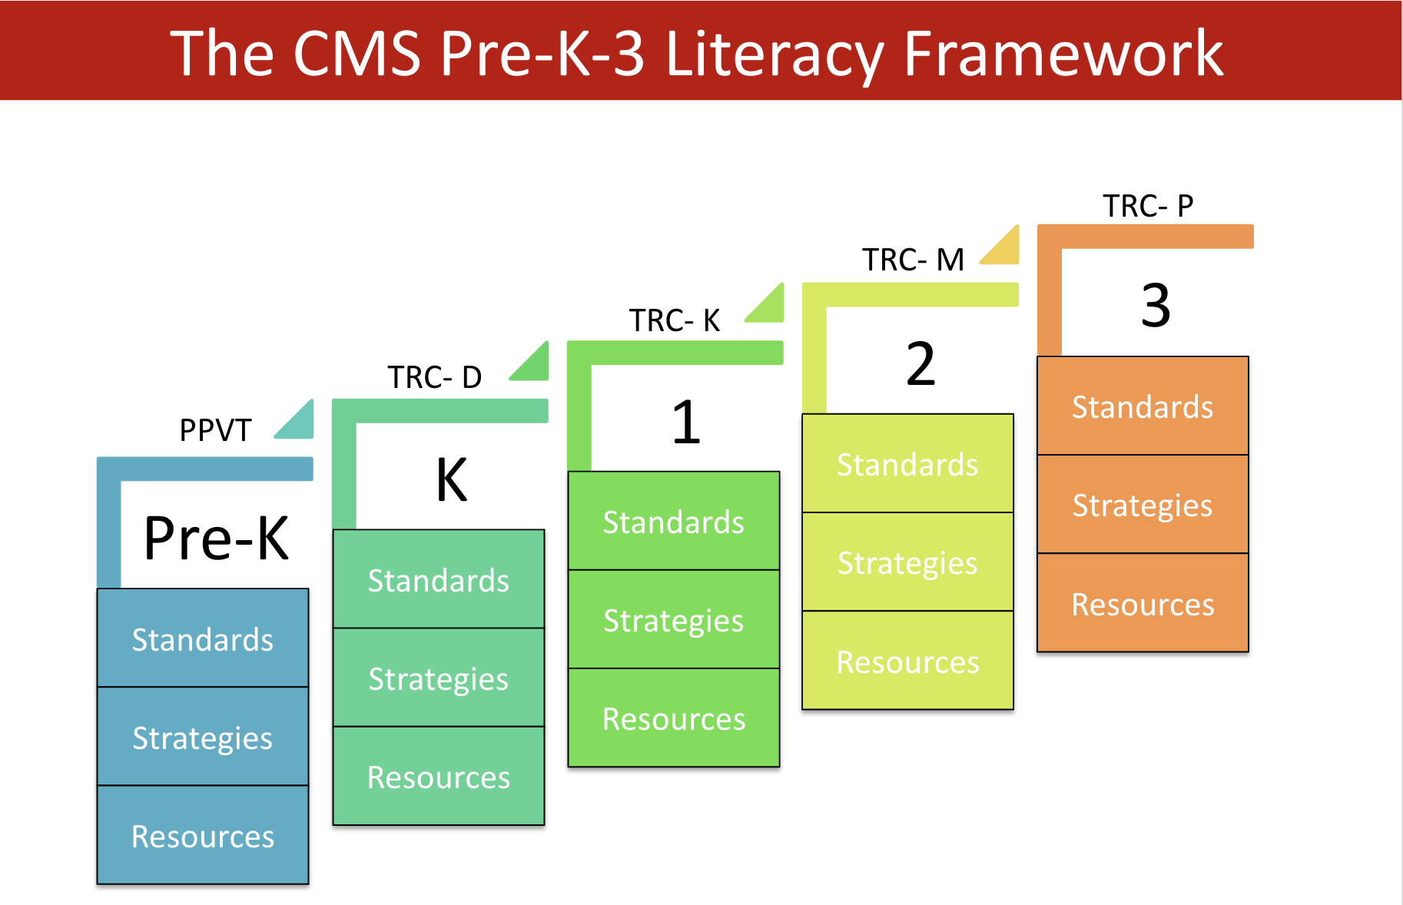

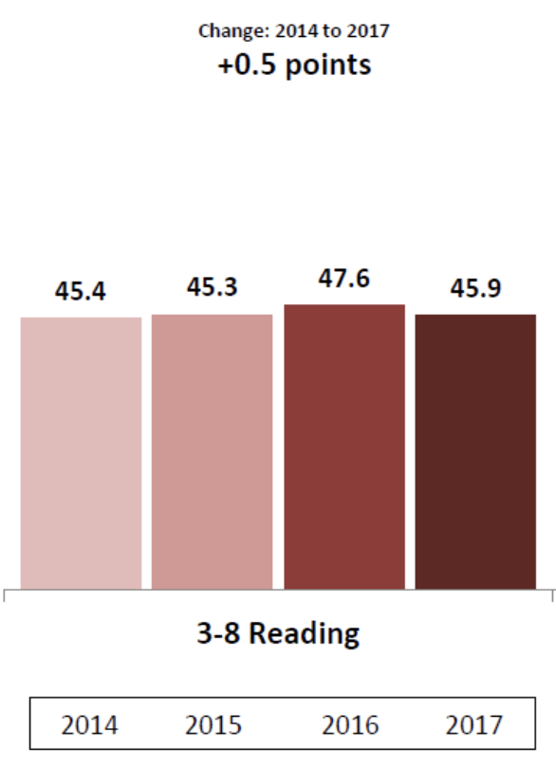
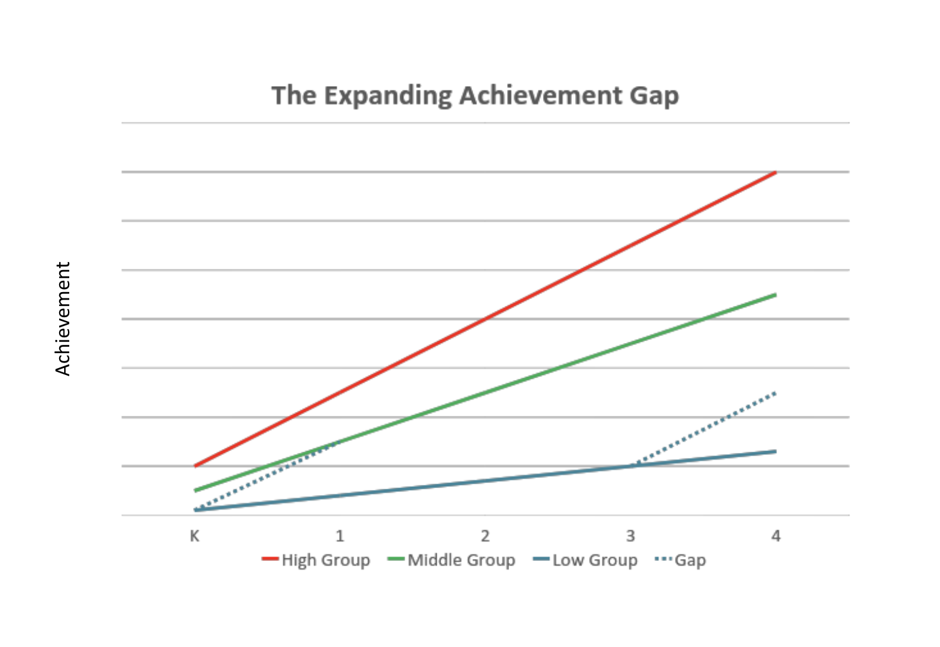
Previous Focus - Literacy Instruction
Background of reading foundations training
Balanced Literacy
Reading scores were stagnant!
Notes:
To get started, wanted to share a little background on our last 10 years as a school district. For several years, we were a balanced literacy district. Pilot schools participated in the reading foundations training offered by district and the state. Schools had autonomy in resource selection. Student achievement scores remained stagnant.

Slide 39



Acknowledging and Moving Forward
Notes:
In Pursuit of Equity
A 2013 study conducted by Harvard University and the University of California, Berkeley, examined economic mobility in the largest 50 cities in the United States. Charlotte was 50th, a finding that confirmed what many have observed anecdotally: If you are born poor in Charlotte, you are likely to stay that way.
The economic-mobility study's findings sparked alarm and resulted in the formation of an Opportunity Task Force which issued a report in March 2017. That report included a set of broad findings and recommendations. The Opportunity Task Force emphasized that it is the community's collective responsibility to create paths to prosperity. Schools and school districts have an important role to play in building pathways to prosperity but they cannot do this work alone.
Charlotte-Mecklenburg Schools is committed to playing a significant role in the community-wide conversation begun by the Opportunity Task Force. We want to increase equity and excellence in our schools and in our community.
Any challenging effort for meaningful change must begin with acknowledgement of hard truths. Thus, this report purposely does not offer proposals or policies for reform, but instead seeks to provide a solid, data-based picture of our schools with the most recent data available. These data will help the district, and the community, make wise and informed decisions on reform and advance our understanding of how to break the link between poverty, race, and academic performance.
Breaking the Link is an annual examination of our progress on Equity. Why Equity Matters is a summary that provides context.
This report and work informed the direction of our strategic plan as well as restructuring of our central office to include an equity division reporting to accountability. Three Equity Superintendent roles were created with specialists.

Slide 40
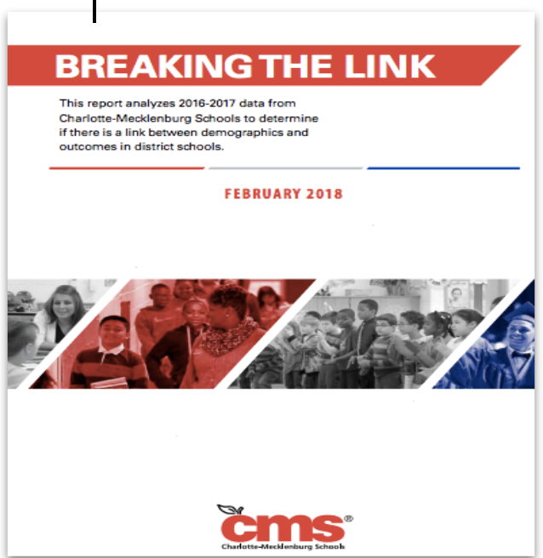
Breaking the Link Findings February 2018 and May 2019
Performance on nearly every academic measure decreased as the percent of students in poverty increased.
Black, White and Hispanic students in low poverty schools outperformed their peers of the same race in moderate and high poverty schools.
Sizeable achievement gaps between racial groups were seen in low, moderate and high poverty schools.
Notes:
TS
Performance on nearly every academic measure decreased as the percent of students in poverty increased.
Black, White and Hispanic students in low poverty schools outperformed their peers of the same race in moderate and high poverty schools.
Sizeable achievement gaps between racial groups were seen in low, moderate and high poverty schools.

Slide 41




Breaking the Link Findings February 2018 and May 2019
Time
Great Teachers
Access to Advanced Coursework
Notes:
Three key levers, that research indicates can break the predictive link between student demographics and academic outcomes, were identified:
Time
Great Teachers
Access to Advanced Coursework- to the code for reading- foundational and comprehension skills needed to be a proficent reader.

Slide 42

Opportunity Myth
Grade-Appropriate Assignments
Content that reflects college- and career- ready academic standards.
Strong Instruction
Teaching that asks students to do the intellectual heavy lifting.
Deep Engagement
Lessons that students find interesting, enjoyable, and worth deep concentration.
Teachers with High Expectations
Adults who believe students can meet the demands of rigorous standards.
Notes:
As our district was publishing the Breaking the Link Report Nationally TNTP In sep 2018, TNTP published a report about the quality of students academic experiences in school and its effect on their long term success.
4 key resources that influence a students school experience and outcomes….
Grade appropriate assignments
Strong instruction
Deep engagement
Teacher with High Expectation
Unfortunately, these resources are few and far between for most students- and particularly for students of color, those from low income families, english language learners, and students with mild to moderate disabilities.

Slide 43
Equity and The Student Experience
Classroom Walks
950+ individual classrooms visited
Structure:
School Leaders + Equity Team Members LC Supes + Additional Departmental Staff
Classroom visits using common data collection tool
Goals:
Describe each school’s current state related to standards alignment, rigor, engagement, and beliefs and expectations
Gather information about trends across schools related to our current state
53 Elementary, 44 Middle & K-8, 9 High Schools Visited
All Learning Communities
Various content areas
Participation of members from other CMS departments
Scheduling of follow up visits focused on PLCs and planning
Notes:
In 2018 we began the work of our strategic plan and a new team was formed in the district- the Equity Department- by levels.
Because we decided to start with ensuring every child had access to a standards-aligned, rigorous curriculum, we first had to have an understanding of the level of instruction taking place in our schools. We tried to schedule our initial walks with an administrator so we could have a shared understanding of what we were looking for and how to measure it. Our equity team used a common data collection tool that allowed us to capture descriptions about planned and taught objectives, their alignment to the full depth of the standard, students’ level of engagement, who was doing the majority of thinking during instruction, and classroom environment and its level of inclusiveness. The use of the data collection tool became a common practice for many of the learning community and learning and teaching staff who partnered with us throughout the year. Collecting and analyzing this data provided us with a unique perspective because we were able to see trends across the district. Throughout the year, we visited over 950 classrooms, 106 schools, and schools in every learning community. Early in the year, we recognized that in most classes, our students were compliant and doing exactly what the teacher asked of them but the level of the instructional tasks were not aligned to the full depth and rigor the standards called for. The descriptive data also helped us to level set our meaning of rigor in literacy and math instruction and develop a common language. Recognizing the current state of instruction across the district in the first quarter helped to drive our work priorities for the rest of the year. Continuing to collect data throughout the year also gave us a lens to support the implementation of a gvc.

Slide 44
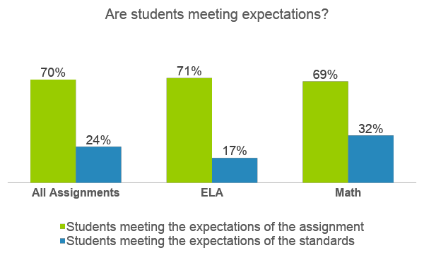
Opportunity Myth & CMS Findings
 | Students meeting the expectations of ASSIGNMENT
 | Students meeting the expectations of the STANDARD
1
While CMS students are consistently engaged in the content and tasks of lessons, most tasks are unaligned to the demands of grade-level standards.
As CMS teachers use a wide range of materials in their instruction, students have inconsistent and inequitable access to grade-level standards.
CMS teachers report inconsistent experiences with curriculum guidance and support, leading teachers to spend a significant proportion of their planning time gathering, creating and adapting materials.
2
3
Notes:
Most students meet expectations of their assignments, but since most assignments fall short of the standards, students don't have the opportunity to meet expectations of the standards.
#2 – since the materials that teachers are using vary in their alignment to the standards. At one school, when they're using... vs. Another school where they’re using something.
#3 – Teachers could be using that time, analyzing student data, identifying and planning for student misconceptions, etc.

Slide 45
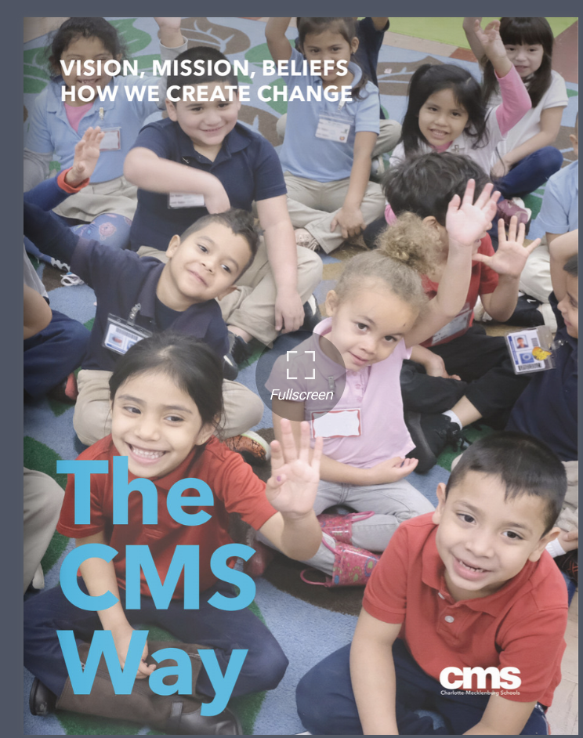
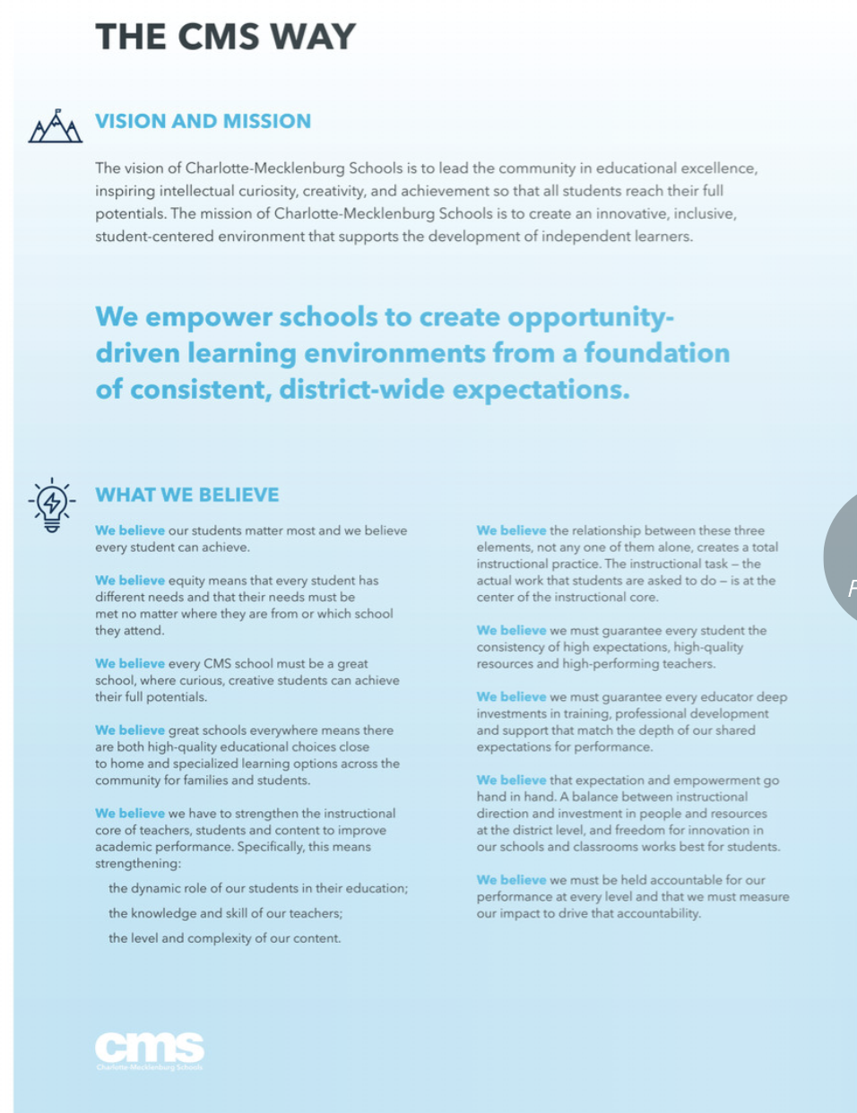
Theory of Action
We empower schools to create opportunity- driven learning environments from a foundation of consistent, district-wide expectations.
Notes:
Information from the Breaking the Link Report, equity visits, helped our district to create the theory of action.
We empower schools to create opportunity- driven learning environments from a foundation of consistent district-wide expectations.

Slide 46
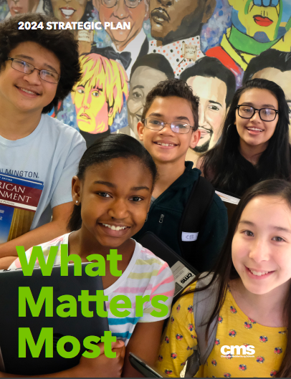
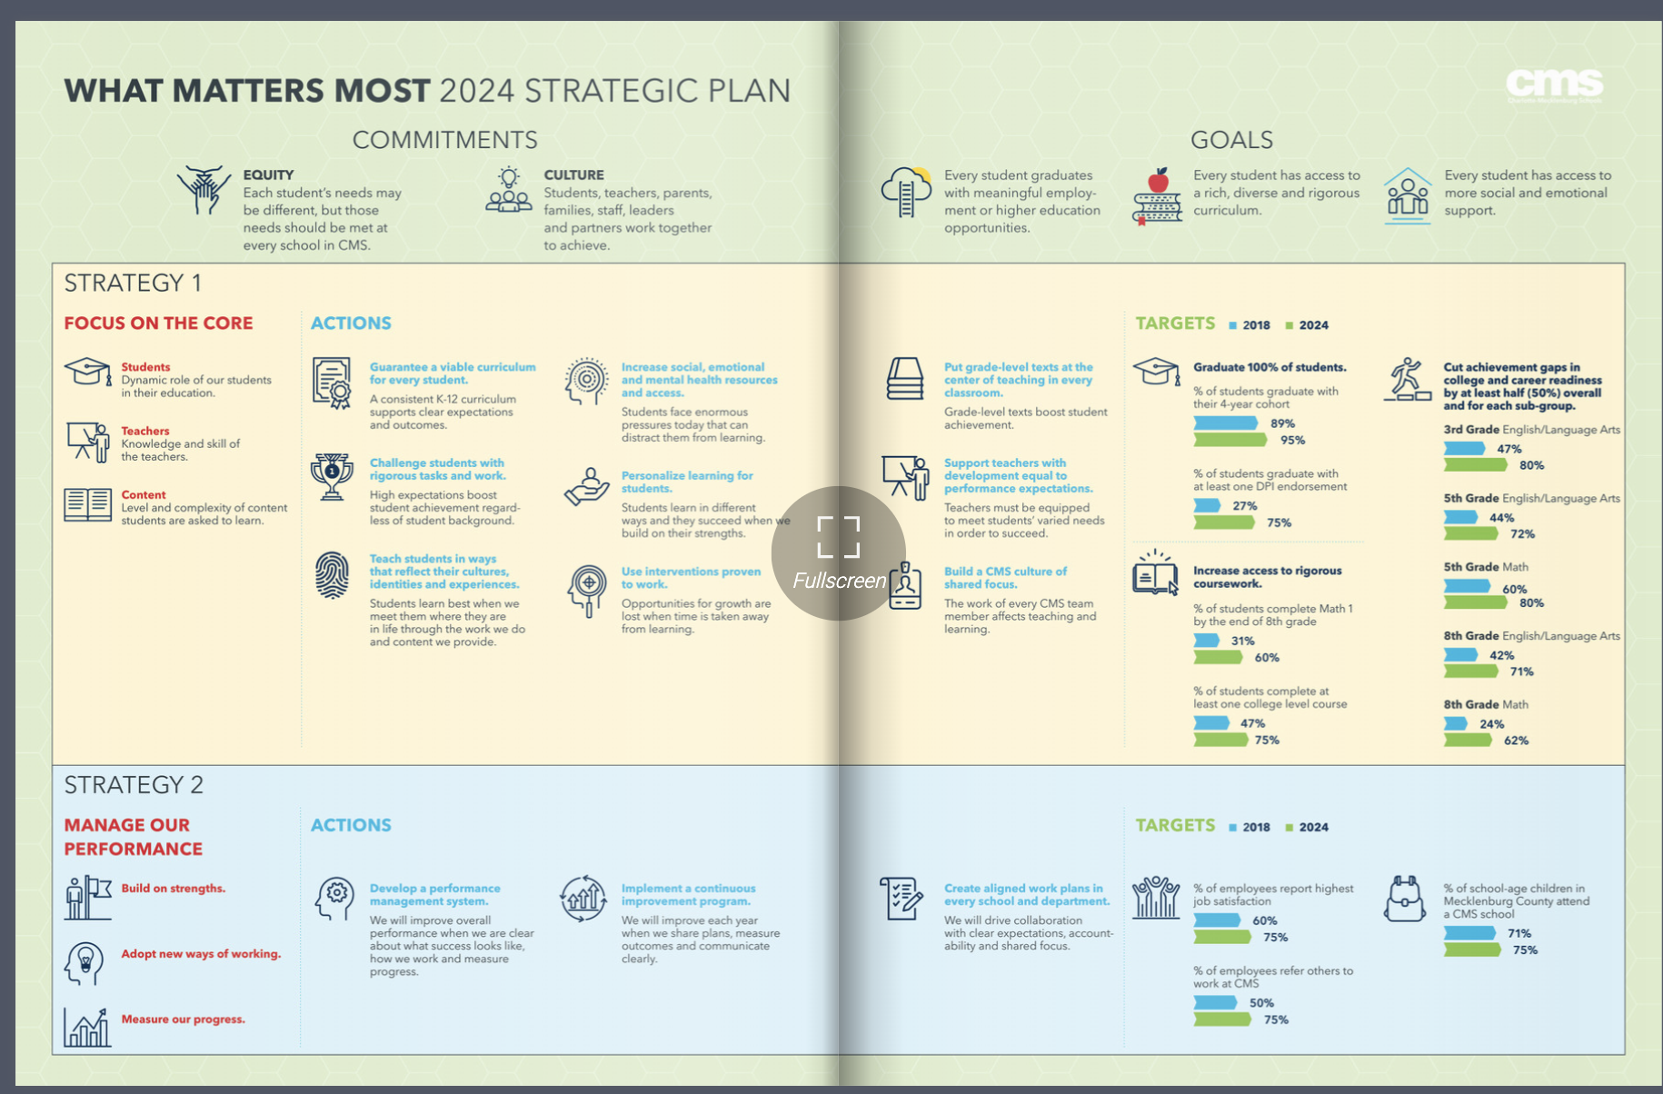
What Matters Most
Focus on Instructional Core
Performance Management
1
2
Student
Teacher
Content
Notes:
Also this work allows us to create focusing what mattered the most- the focus on the instructional core- with students at the top- engaged and inspired, support with having content that all students have access to and building the knowledge and skills of teachers in order to achieve our goals.

Slide 47
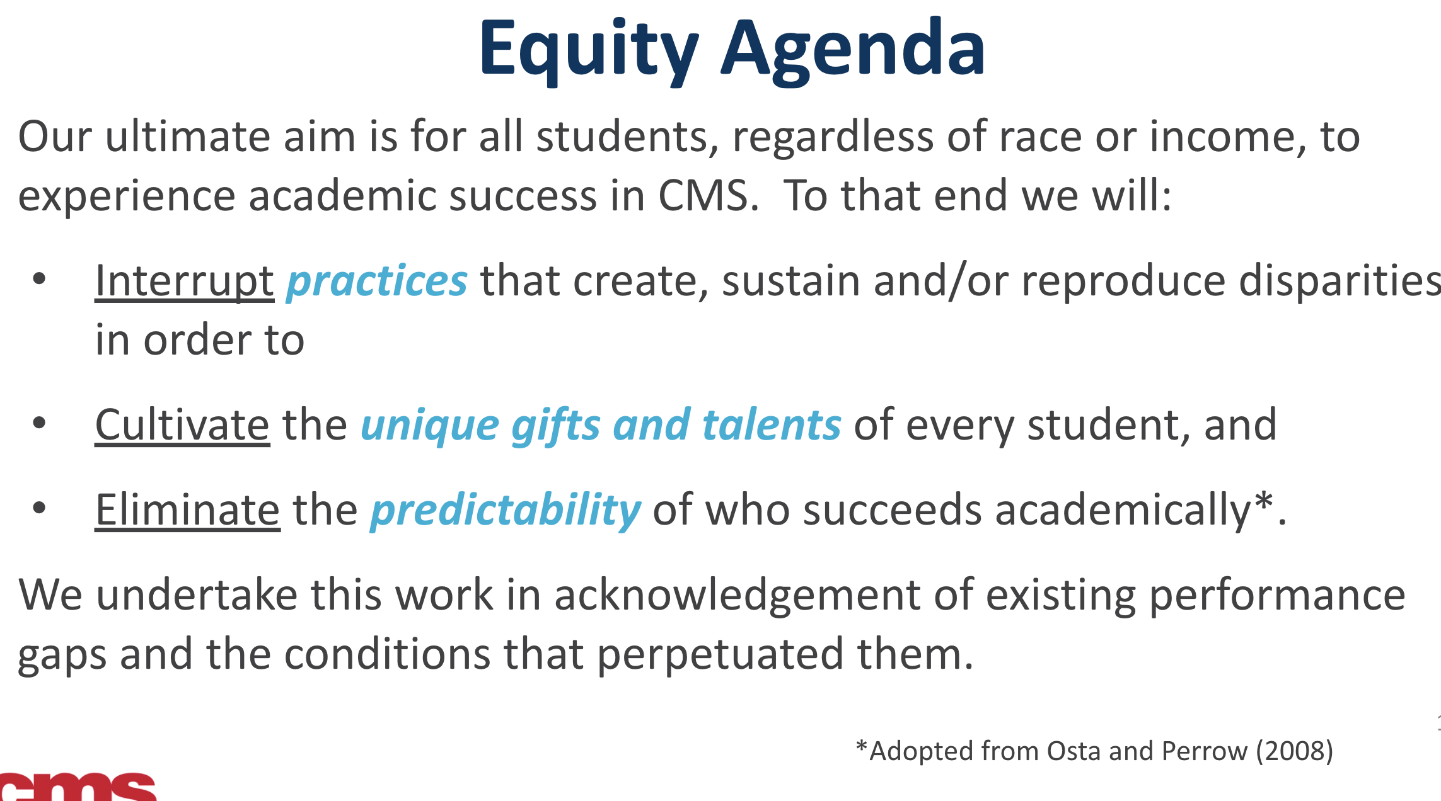
What Matters Most
We believe that to break the link between poverty, race and academic performance, equality of high expectations must be met by equitable allocation of talented educators, leaders, resources and supports.

Slide 48
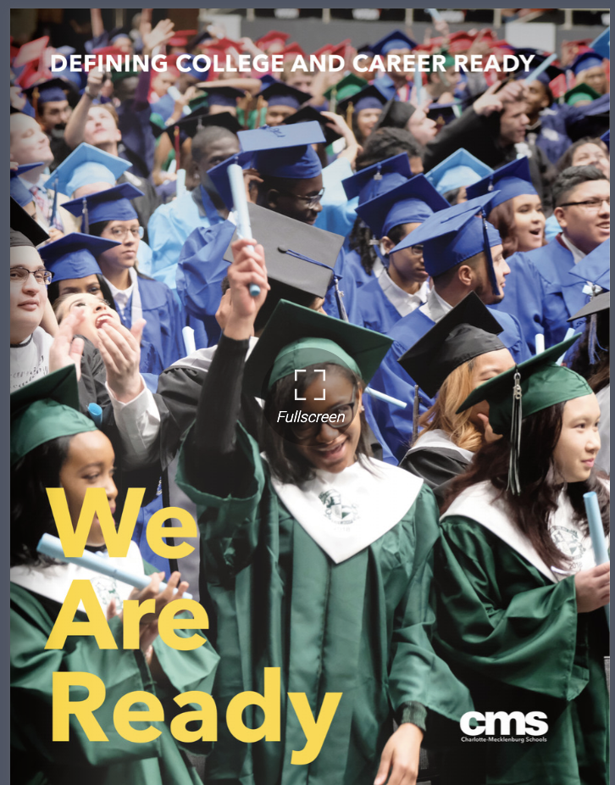
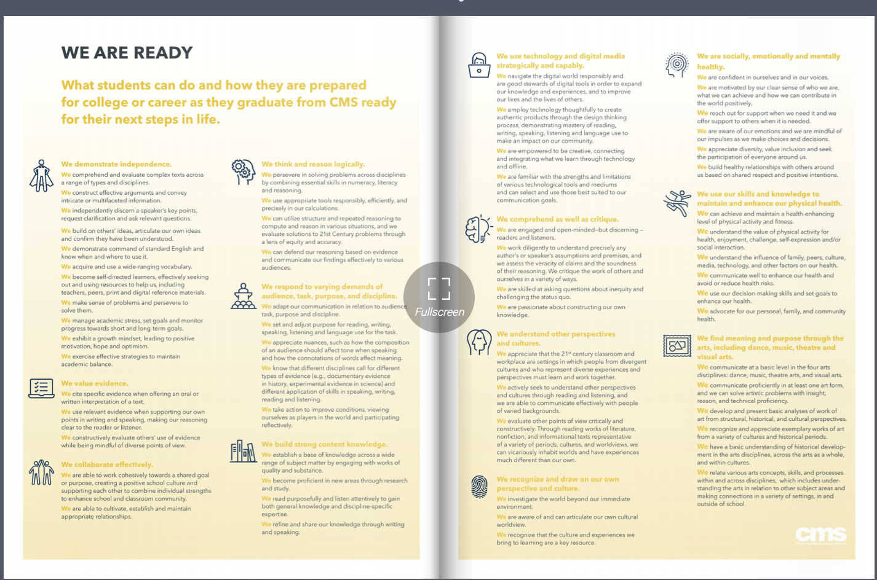
We Are Ready
What students can do and how they are prepared for college or career as they graduate from CMS ready for their next steps in life.
Notes:
Our We are ready document outlines what we want every CMS student to graduate read for their next steps.
To include- demonstrating independence
Valuing evidence,
Working collaboratively
Think and reason logically
Being able to respond to the varying demands of audience, taks, purpose and discipline,
Building strong content knowledge
Comprhending and critiquing
Valuing different perspectives

Slide 49

Operationalize
Learn the work by doing the work as an Organization.
Share the “current reality” with other support staff and determining next steps.
Acknowledge a knowledge gap around best practices and support of the core actions of literacy instruction to include foundational skills.
Notes:
In order to operationalize our strategic plan- we understood the importance of learning the work by doing the work.
Understanding our current reality

Slide 50
Building Common Understanding
Notes:
KP
So now we will jump into how we moved into executing our strategic plan by leveraging our partnership with Student Achievement Partners and Council of Great City Schools and building common understanding and language between central office, school leadership teams, and teachers.

Slide 51

Continuous Improvement through ERA Pilot
Year 1 : 2018-2019
CMS Observing San Antonio School District
Professional development with SAISD, CGCS, & SAP
Cycle of Learn, Walk, Learn
Notes:
In our first year with the Early reading accelerator pilot, we were able to observe the san antonio school district and participate in the professional development led by student achievement partners. The cycle of learning, walking classrooms, then learning again helped to create the initial support of the equity school visits that were mentioned before. This partnership continued to support our work moving forward.

Slide 52

Curriculum Adoption : 2019-2021
2019-2020
Kindergarten-3rd grade and 6th grade adopted EL Education (Module, Skills Block/ALL Block, Labs).
Professional development focused on curriculum implementation.
2020-2021
4th-5th grade and 7th-8th grade adopted EL Education.
Professional development focused on the intersection of...
  Race, Bias, Power, and Equity
  Written Curriculum
  Taught Curriculum
  Content Standards
Notes:
Last year, in the 2019- 2020 school year, the district adopted EL Education curriculum. We knew that the piece that was missing was a common curriculum that provided consistency and access to standards aligned instruction and grade level text.
We first adopted for K-3rd and 6th grade and our professional development was focused around curriculum implementation, including foundational skills.
The focus then shifted this year to how teacher biases can impact instructional moves and decisions and the impact on student learning.

Slide 53
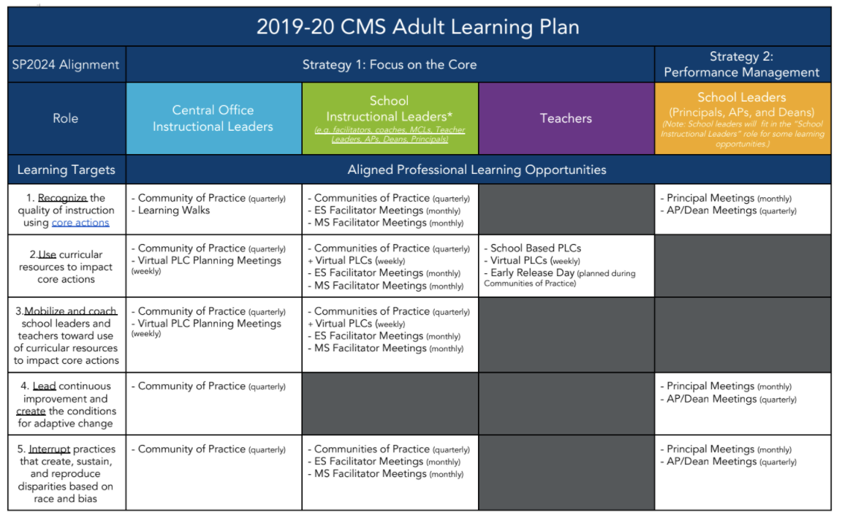

Adult Learning
Notes:
An adult learning plan was created to determine the professional development needs and avenues for all staff members. Communities of practice, a quarterly professional development, was an avenue for all schools to bring representatives, both from their leadership teams, and teachers.
During this time district members, specifically content specialists, and EL Education members provided professional development, first focusing on modules and internalization, then later focusing on foundational skills. All of the professional development, including the foundational skills was grounded in the Core Actions.
This method taught the instructional leaders who were then able to bring it back into their school and teach the remaining staff members. It also ensured that everyone was hearing the same messaging and language from district to school house.

Slide 54
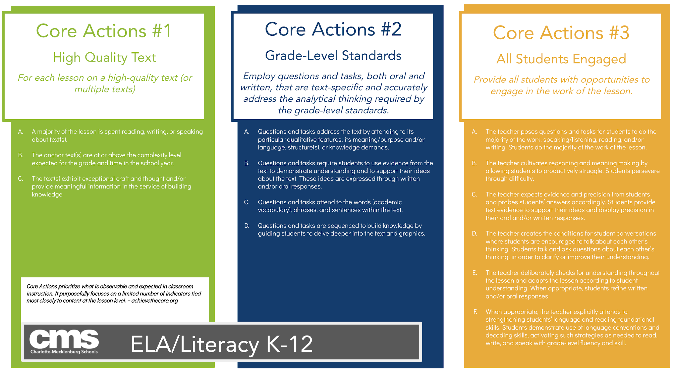
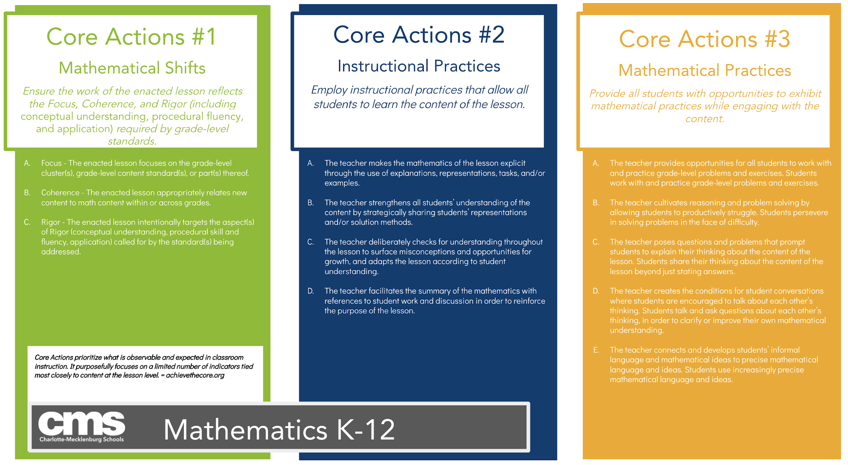
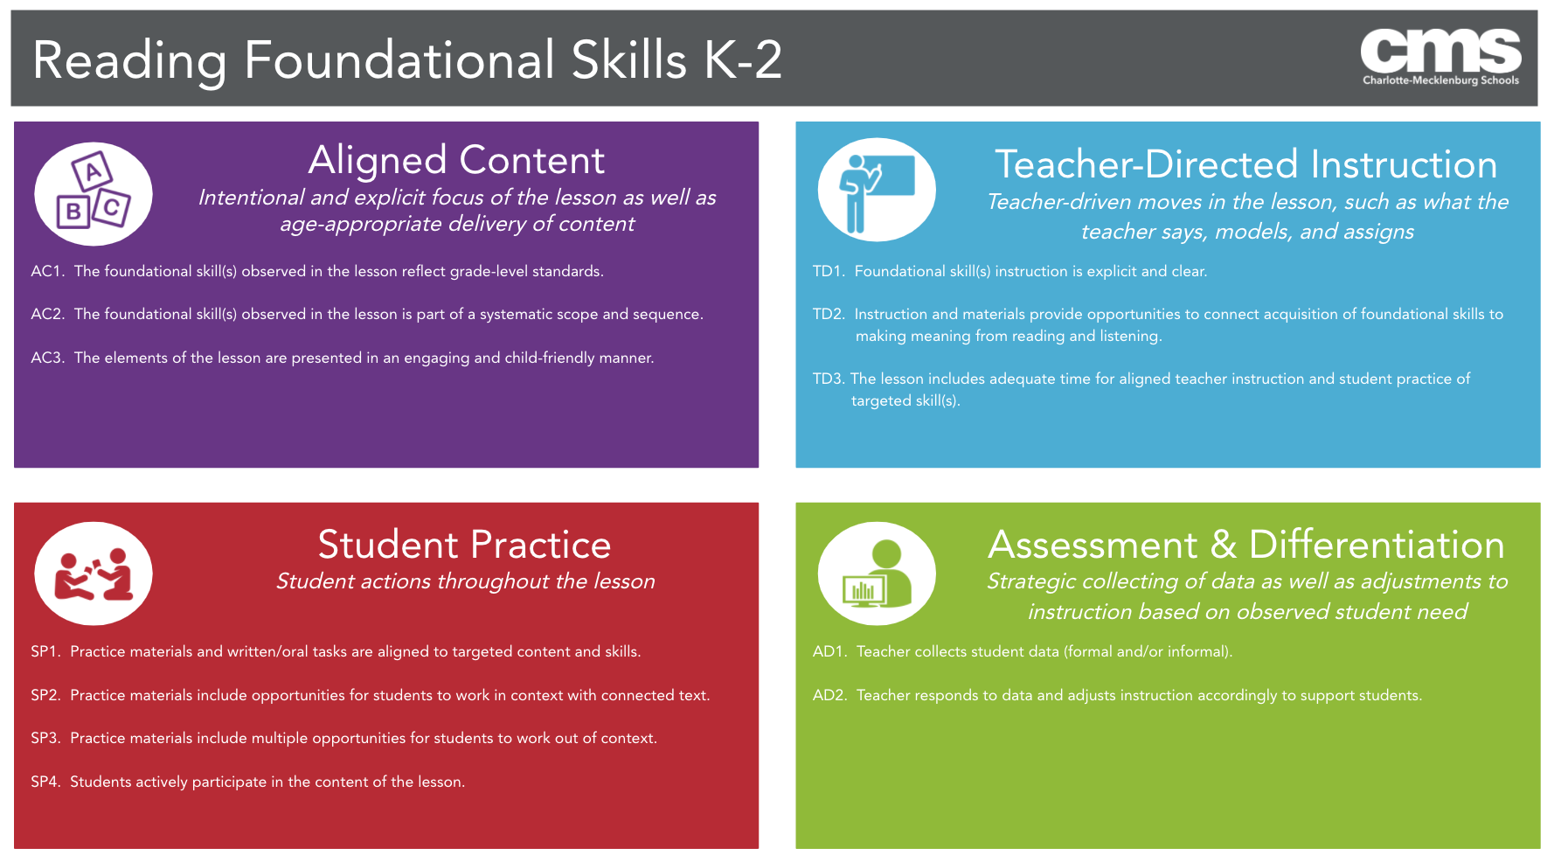
Core Actions
Notes:
The core actions, for literacy, math, and foundational skills, were a huge priority as everything was and continues to be grounded in them.
As a district we focused on core actions in literacy, math, and of course- foundational skills.
You’ll see the core actions continue to come in while we discuss the next few methods we utilized to build common understanding.

Slide 55
Instructional Core Data Collection Tool
Current Reality of Instructional Experiences
Systematic
Strategic
Support
Provides Leading Indicators
How support is delivered
Professional Learning
  Learn the work by doing the work.
  Build the knowledge and skills across departments.
  Common language
Core Actions & Equitable Practices
All in service of CONTINUOUS IMPROVEMENT.
Notes:
A instructional core data collection tool was created to help us assess the current reality of the instruction experience for students. This then lead to thr professional development needs of our teachers and leaders. It ensured all things were grounded in core actions and equitable practices.
The function of the tool enabled us to learn by doing the work and provide consistency in understanding of instructional excellence.

Slide 56
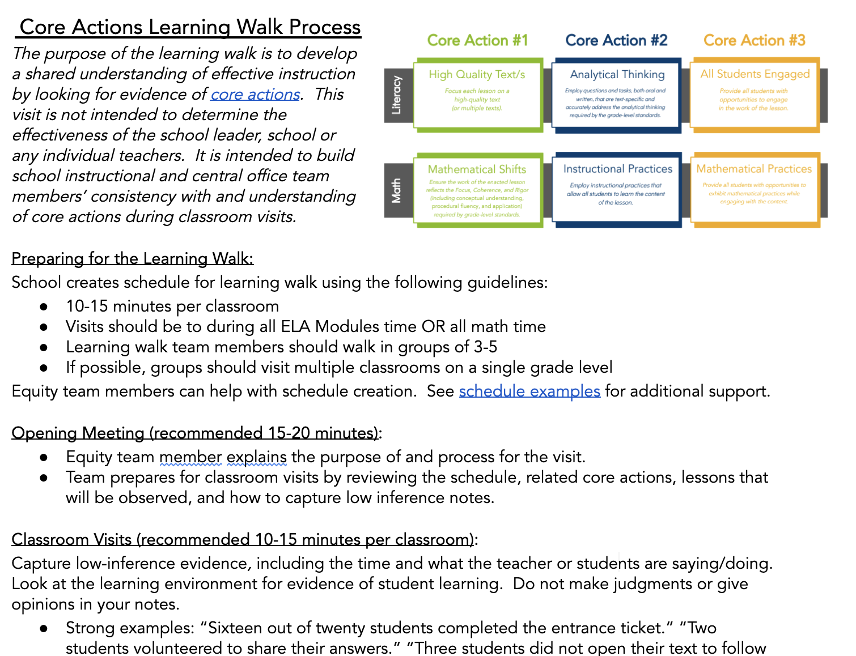

Common Understanding
1st
Central Office
School Leadership Teams
2nd
Notes:
Learning Walks were then created with the instructional core data collection tool to support and build central office staff knowledge and understanding and calibrate with school leadership teams. This system ensured learning the work by being directly in the work.
In the initial Learning Walks, knowledge and common language was built around the Core Actions and analyzing Lesson Plans within the new curriculum, then seeing it in action in classes and coming back to calibrate around what was seen and where it fell with expectations.
Learning walks continued to take place throughout the year at school levels, always with a focus around ensuring student experience and connecting the necessary support to what the district was providing for Professional development.

Slide 57






Slide 58
Continuous Improvement through ERA Pilot
Year 2 : 2019-2020
Continued observing SAISD & professional development with SAISD, CGCS, & SAP
Learning informed District professional development
Mirrored Foundations Professional Development
Notes:
In our second year with the early reading accelerator pilot we continued with our observations of san antonio and the professional development with student achievement partners. This work allowed for us to better inform our professional development and strategies that we just spoke up and ensure we were continuously building common language and understanding with all stakeholders.

Slide 59
Current Work
Notes:
That takes us into our current school year. Let’s talk about the work our district is currently doing.

Slide 60
2020-2021 Focus Areas
Curriculum Development:
Content Specialists worked to digitize our core curriculum and move assessments into an online platform to measure the effectiveness of the curriculum and analyze district trends.
Professional Learning:
Our goal is to develop and deliver professional learning focused on...
the intersection of written and taught curriculum
Race, Bias, Power and Equity
building knowledge of the Science of Reading and how it shows up in our curriculum
Year 3
School Support:
We added Content Specialists to expand each team to six (one per Learning Community) in order to best support schools.
Each Content Specialist is also an expert on the content for each grade level in K-5.
Notes:
Despite the pandemic, we kept our focus on the student experience.
Our work can be grouped into three main buckets:
Curriculum Development
School support
And Professional Learning
Let’s dive a little deeper into each of these buckets on the next slides.

Slide 61


Curriculum Development & Remote Learning
Curriculum Development:
Content Specialists worked to digitize our core curriculum and move assessments into an online platform to measure the effectiveness of the curriculum and analyze district trends.
Notes:
Our first bucket is Curriculum development (CLICK)
In March, When Covid struck and our district had to shift to remote learning, content specialists created remote learning packets for families using our core curriculum.
We knew the sudden shift to remote learning in the spring could cause gaps in student learning from the 2019-2020 school year. To support students and families, we provided summer learning resources to ensure students had access to learning opportunities over the summer which included additional learning packets and a hyperdoc full of free online learning websites and resources by content area and grade band.
These items are linked in the slides for you to explore.

Slide 62







Curriculum Development & Remote Learning
Components of a Literacy EL Education Canvas Course Lesson
Curriculum Development:
Content Specialists worked to digitize our core curriculum and move assessments into an online platform to measure the effectiveness of the curriculum and analyze district trends.
Module - Part 1
Check for Understanding
Module Part 2
Student Response Sheet
Skills Block
Notes:
As time passed and we realized remote learning would most likely be continuing into the 2020-21 school year.
Content Specialists worked over the summer to digitized our core curriculum in order to create Canvas courses for remote learning.
We created a course per grade level and content area that contained pre-recorded instructional videos for each lesson using the core curriculum for each content area.
We also worked collaboratively as a CMS team across departments to ensure the courses had supports for all types of learners built in including EL, EC, and gifted and talented.
An example remote learning instructional video is linked on this slide for 1st grade literacy for you which features a modified module lesson and language dive to check out later.
(CLICK)
This graphic shows the flow of a lesson in Canvas. To keep students engaged, we broke longer lessons into multiple short videos followed by checks for understanding, and ending with the student’s assignment from the curriculum workbook for that day. Specialists worked to ensure all student tasks and assignments were high-quality and standards-aligned, and that digital instructional materials and resources were available to support remote student learning.
We blueprinted these Canvas courses for all of our teachers to be used across our district in order to ensure an equitable and consistent student experience across schools even during remote learning.

Slide 63



English Learner Supports
Notes:
During the pandemic, our English Learner Services department has also found ways to ensure our English learner students are able to access remote learning resources.
The department has provisioned resources for teachers and students that can be used for differentiated core support.
In addition to instructional resources designed to support English learner students and their teachers, we are also offering Virtual Family Nights on relevant topics to help families prepare for the changing landscape of full remote and hybrid learning environments, an English Learner Tutoring Program, and Personalized Academic Command of Language Parent Classes which combines language and content integration.

Slide 64



Curriculum Development & Remote Learning
Curriculum Development:
Content Specialists worked to digitize our core curriculum and move assessments into an online platform to measure the effectiveness of the curriculum and analyze district trends.
Notes:
Content specialists also worked to create Curriculum Guides to support teachers and school leaders, not only during remote learning, but also in moving forward with effective implementation of our core curriculum. The Curriculum Guides contain pacing calendars, student supports, aligned texts connected to grade level topics, and rubrics, data trackers and grading guidance.
(CLICK)
In order to measure the effectiveness of the curriculum and to be able to analyze district trends using assessment data, another decision we made was to move all content assessments into SchoolNet, an online platform, that allows us to pull reports and quickly see how students are doing with various standards across our district and by subgroup.

Slide 65

School Support
School Support
 | Specialist 1 | Specialist 2 | Specialist 3 | Specialist 4 | Specialist 5 | Specialist 6
Grade | K | 1 | 2 | 3 | 4 | 5
Learning Community | Southeast | Central 2 | Central 1 | Northwest | Northeast | Southwest
School Support:
We added Content Specialists to expand each team to six (one per Learning Community) in order to best support schools.
Each Content Specialist is also an expert on the content for each grade level in K-5.
School Support Plan Framework
Initial Meeting
Visit PLC or Classrooms
Develop Support Plan (short term goals)
Model & Debrief
Safe
Practice
Observe & Feedback
6-10 weeks
Notes:
Our 2nd bucket is School Support (CLICK)
We added literacy and math specialists to expand each team to 6- which matches the number of LCs we have within our larger district. This gave schools a direct line of support with the content teams. The 6 specialist model also allowed for us to have one expert per grade level.
(CLICK)
This also allows for more intensive school support through a 6-10 week coaching model where the content specialist is meeting with the school to determine an area of need, visiting classrooms or PLC meetings to observe, developing a support plan, modeling best practices, allowing teachers a sage practice period to try out new learning, and then have the specialist observe and give feedback to determine next steps.

Slide 66

Professional Learning - Science of Reading
 | Prior to 2020-2021 | 2020-2021 | Beyond
North Carolina Department of Public Instruction (NCDPI) - Reading Foundations
Friday Institute - Reading Foundations
Charlotte-Mecklenburg Schools Reading Institute
Institute of Multi-Sensory Education - Orton Gillingham (OG)
Language Essentials for Teachers of Reading and Spelling (LETRS)
Professional Learning:
Our goal is to develop and deliver professional learning focused on...
the intersection of written and taught curriculum
Race, Bias, Power and Equity
building knowledge of the Science of Reading and how it shows up in our curriculum
NCDPI Pilot- postponed due to COVID-19
Notes:
Our 3rd bucket is Professional learning - (CLICK)
You may remember this table from the beginning of the presentation. Let’s take a look at the professional learning our district is focused on this school year.
From our work with ERA, CGCS and SAP, we have continued to refine our focus on the Science of Reading and the connection to our core curriculum as we worked to revise our Adult Learning Plan this school year.
We are also continuing to partner with our state department of education to offer Reading Foundations training, while also expanding the CMS Reading Institute, and adding on Orton-Gillingham training for schools in alignment with our revised Standard Treatment Protocol (both of which we will talk more about later).

Slide 67
Professional Development: Adult Learning Plan
Race, Bias, Equity, & Power On-going Training
Central Office
School Leaders
Teachers
Focus on the Science of Reading and how this shows up in our curriculum:
Building teachers’ knowledge of teaching foundational skills while continuing to deepen our understanding of the curriculum.
Curriculum Implementation
(Year 1 and Year 2)
Ongoing support with unpacking and effective implementation of the curriculum.
Principal
AP & Dean
Instructional Leaders
Teachers
All focused on the same goals!
Notes:
Our Adult Learning Plan is derived from our district’s Strategic Plan which you heard a lot about earlier in the presentation.
In the past, our focus was on teacher behaviors. Now, we have shifted our focus from teacher practices to focusing on the student experience and how our biases and beliefs impact student learning. We are also looking more deeply at the intersection of the written and taught curriculum and continuing to build teacher knowledge around the Science of Reading and how it is shows up in our curriculum.
We have several areas of focus for professional learning for this school year:
First- Race, Bias, Power and Equity training for school leaders including central office staff, principals, APs and deans, and instructional leaders, as well as teachers through asynchronous PD opportunities in Canvas.
Second, a continued Focus on the Science of Reading and how it shows up in our curriculum
And third, continued learning and support with curriculum implementation (Remember we have both Year 1 & Year 2 curriculum adopters depending on the grade level)

Slide 68


Reading Institute
Notes:
When it comes to designing professional learning around the Science of Reading, our work with Student Achievement Partners continues to strengthen our approach to foundational professional development.
Being able to observe another district’s journey, supported ours by looking at how we needed to review and strengthen professional development of teachers, specifically around foundational skills.
We created the CMS Reading Institute, where we connected theory with our curriculum and putting research directly into action. The goal of our CMS Reading Institute is Connecting the Science of Reading with our literacy curriculum (the E-L Education Skills Block) and strengthening teacher knowledge of how to teach foundational skills. This was piloted on our central office specialists and was about to be piloted with schools when the pandemic began.

Slide 69
Aligning Core Curriculum & MTSS Framework
Tier 1: Core Instruction using EL Education
Tier 2: Supplemental Instruction using EL Education
Tier 3: Intensive Intervention using Orton-Gillingham
Notes:
We have also worked to Revise our Standard Treatment Protocol to align with our core curriculum and ensure all interventions are aligned with grade-level work.
We added Orton-Gillingham as our Tier 3 intervention and are providing District-wide professional learning for schools on Orton-Gillingham to support effective implementation.

Slide 70
Thank you! Questions?
Slide Deck
Click Here t.ly/CIzq
Optional Note Catcher
Click Here t.ly/2ckK
Notes:
Thank you for allowing us to share our journey with you. We hope hearing our process resonated in some way with you and the work you are doing in your districts. We look forward to your questions and learning from you in the future!

Slide 71



Three new pages of resources!
Resources:
Early Reading Accelerators website
Foundational Skills website
Building Knowledge & Vocabulary website
Notes:
The Early Reading Accelerators page has content that helps introduce the accelerators’ content and many resources to support teaching early literacy in 2020-21 in particular, including model remote learning videos and many resources for virtual instruction. The foundational skills page focuses on the foundational skills accelerator and has resources for your own learning about foundational skills, materials to use with your students, and things to support your practice and students. The knowledge & vocabulary page focuses on that accelerator and has resources for read aloud, text, sets and book baskets, as well as resources about culturally responsive practices, critically evaluating your texts for responsiveness, representation, potential bias, and supports for students including English learners. WOO - that’s a lot! We encourage you to bookmark these pages as places to come back to, and let us know what feedback you may have about the pages as well!

Slide 72




Reflect and Prepare for Q&A:
Take a look at the Q&A document- if there is a question you really want to flag, be sure to add a plus 1.
Add any new questions to the document!
Review/ react to questions here: http://bit.ly/QuestionsERA2
Notes:
http://bit.ly/QuestionsERA2

Slide 73

Questions for SAISD & CMS

Slide 74

http://bit.ly/ERAWEB2FEEDBACK
Notes:
Stacy add bit.ly in chat - http://bit.ly/ERAWEB2FEEDBACK
FEEDBACK on today’s session
Encourage you to share things in your district

Slide 75

Early Reading Accelerators - Webinar Series
Session 3:
Considerations for Equitable Instruction from Educator Voices
Monday, December 7th
Time: 12:00-1:30pm ET
Stay tuned for sign up info!

Slide 76

Share your feedback and resources!
http://bit.ly/ERAWEB2FEEDBACK
Notes:
Carey to chat: http://bit.ly/ERAWEB2FEEDBACK

