Slide 1



The Council of the Great City Schools and Student Achievement Partners welcome you to:
Addressing Unfinished Learning:
Providing Equitable Access to Grade-Level Learning
November 18, 2020
The webinar will begin shortly.
Check your Resource widget to preview the resources for today’s session! Use the Group Chat to introduce yourself!

Slide 2
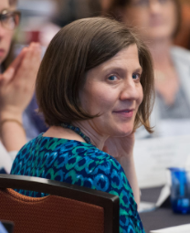

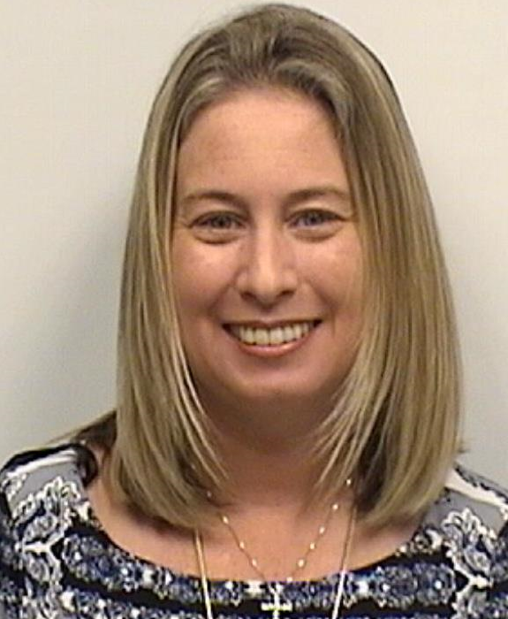
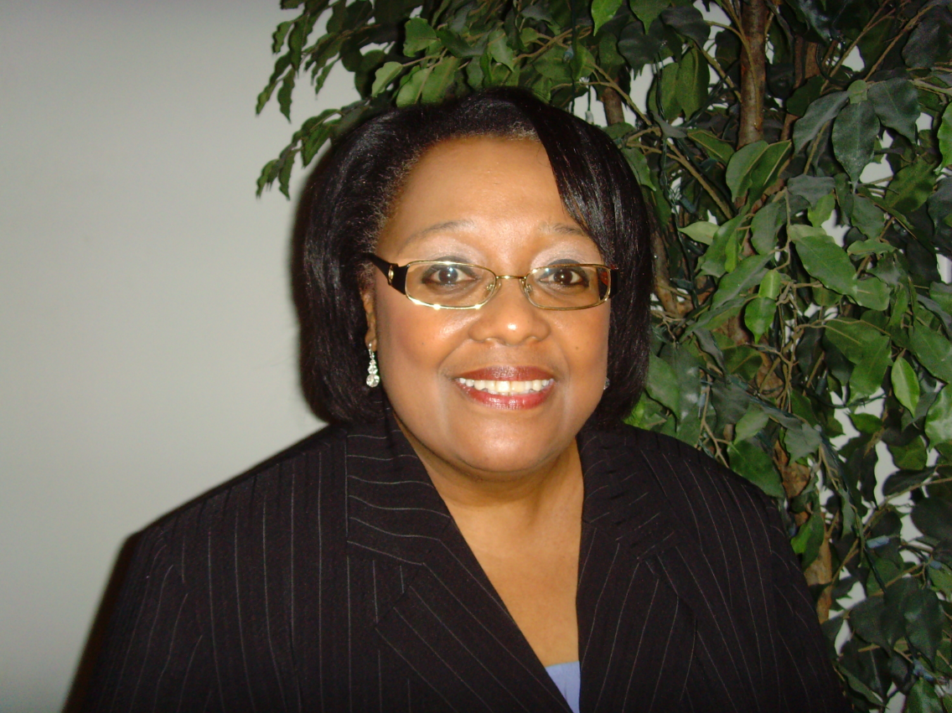
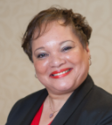

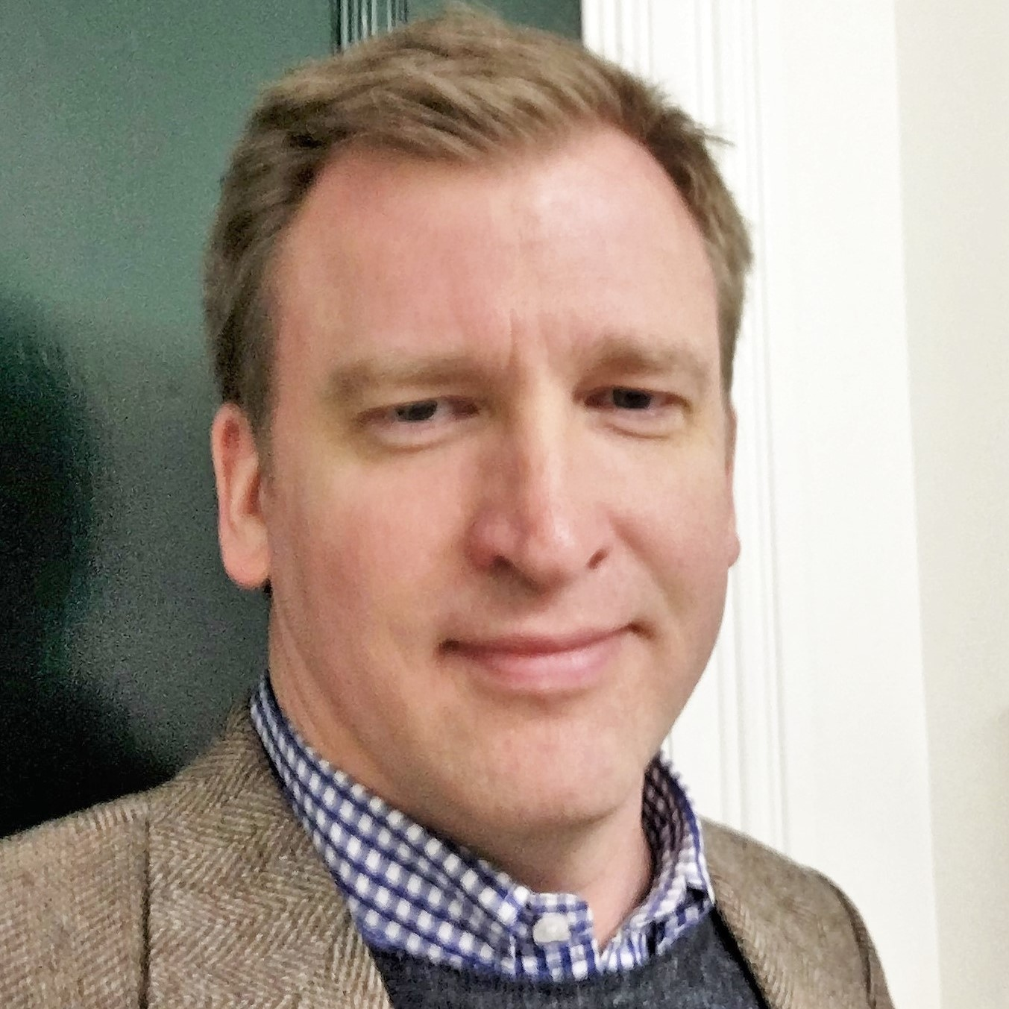
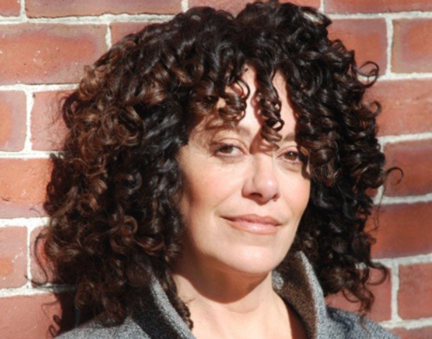



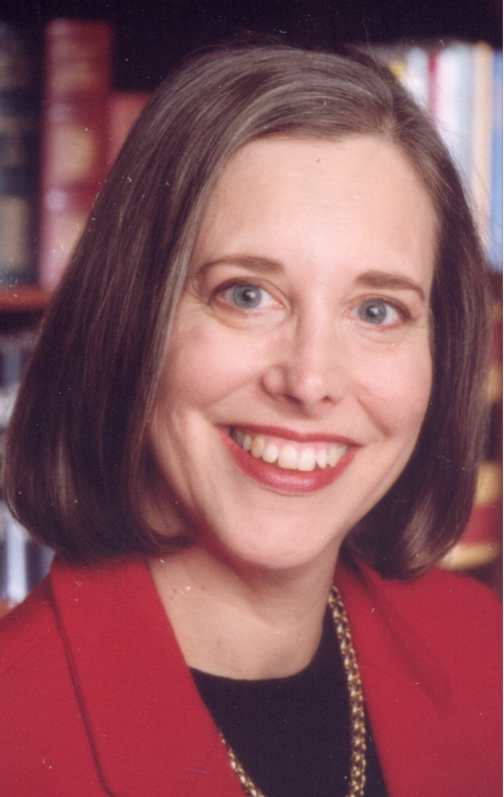
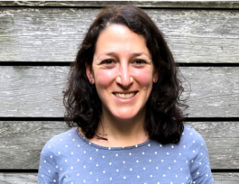

Welcome
Our Presenters:
Amy Briggs
Denise Walston
Robin Hall
Lily Wong Fillmore,
University of California at Berkeley
Dr. Nicole Mancini,
Broward County
Public Schools
Michael Casserly
Jason Zimba
Sue Pimentel
Phil Daro,
SERP Institute
Your Hosts:
Jun Li
Kate Crist
Ricki Price Baugh
Lisa Goldschmidt
Stacy Wetcher Gad

Slide 3
Joining Question:
What insights are you hoping to gain from today’s webinar?
Please use the Group Chat on your control panel to respond.

Slide 4

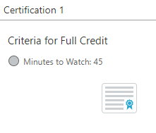
Engage with Us!
Question just for the presenters/ tech help
Resources
Group chat
Certificate
Tweet with us
@achievethecore
@GreatCitySchls

Slide 5
Today’s Conversation
Setting the Stage (5 min)
Math Key Messages (15 min)
ELA/Literacy Key Messages (15 min)
Practical Issues for Implementation (15 min)
Q&A (5 min)

Slide 6
Amy Briggs
President
Student Achievement Partners
Michael Casserly
Executive Director
Council of the Great City Schools

Slide 7
Setting the Stage

Slide 8
Denise Walston
Director of Mathematics
Council of the Great City Schools
Jason Zimba
Founding Partner
Student Achievement Partners
Phil Daro
Vice Chair
SERP Institute

Slide 9
Math Key Messages

Slide 10
Prioritizing Content: Some Guiding Questions
Does the content extend work from earlier units and grade levels?
Does the content extend into future content?
Does the unit help students deepen conceptual understanding and subject area expertise, such as expertise with mathematical practices or reading comprehension?
Is this content that students need to know right now in order to continue learning grade-level subject matter?

Slide 11
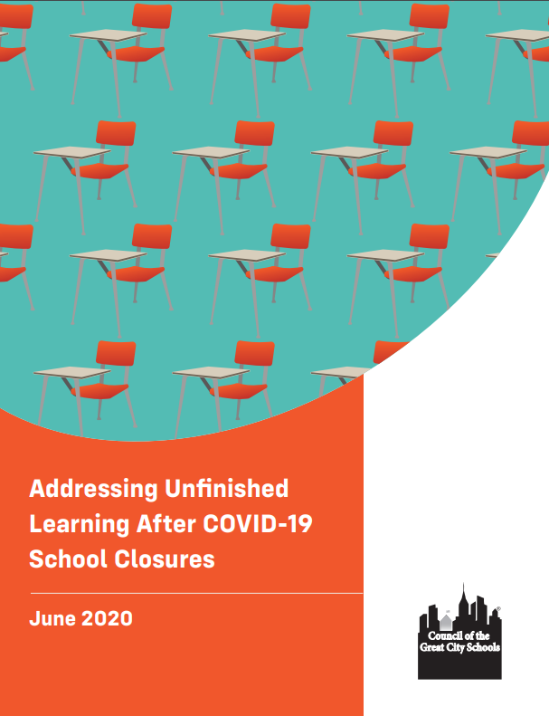

Companion Documents
Two resources to be aware of for meeting the extraordinary circumstances of 2020-21 school year provided by the Council of the Great City Schools and Student Achievement Partners
2020–21 Priority Instructional Content in English Language Arts/Literacy and Mathematics
Addressing Unfinished Learning After COVID-19 School Closures

Slide 12
Priority Instructional Content
Provides detailed guidance about content priorities by leveraging the structure and emphases of college- and career-ready mathematics and ELA/literacy standards.
Intended to help publishers, other designers of instructional materials, and instructional leaders find new efficiencies in the curriculum given school closures and disruptions.
Keeping at the forefront principles of equitable instruction that support all students.

Slide 13
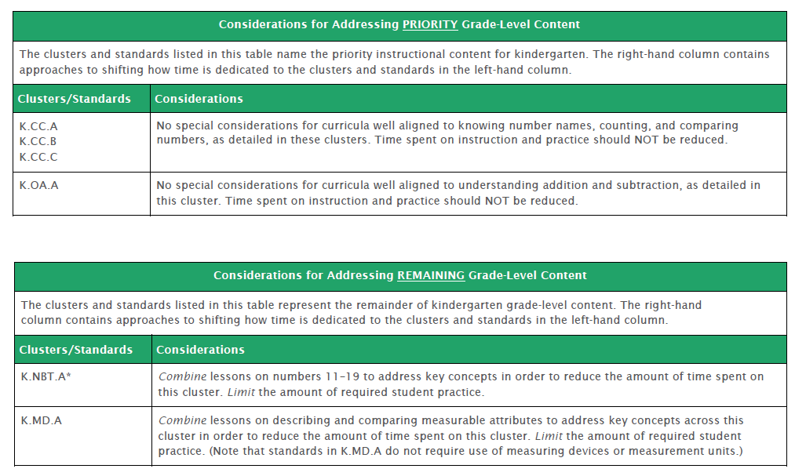
Priority Instructional Content in Mathematics

Slide 14
Grade-level work in mathematics makes extensive use of knowledge and skills taught in prior grades.
The key to prioritizing learning is to move beyond grade-level check-lists and instead think of progressions of important learning that cut across grade levels.

Slide 15
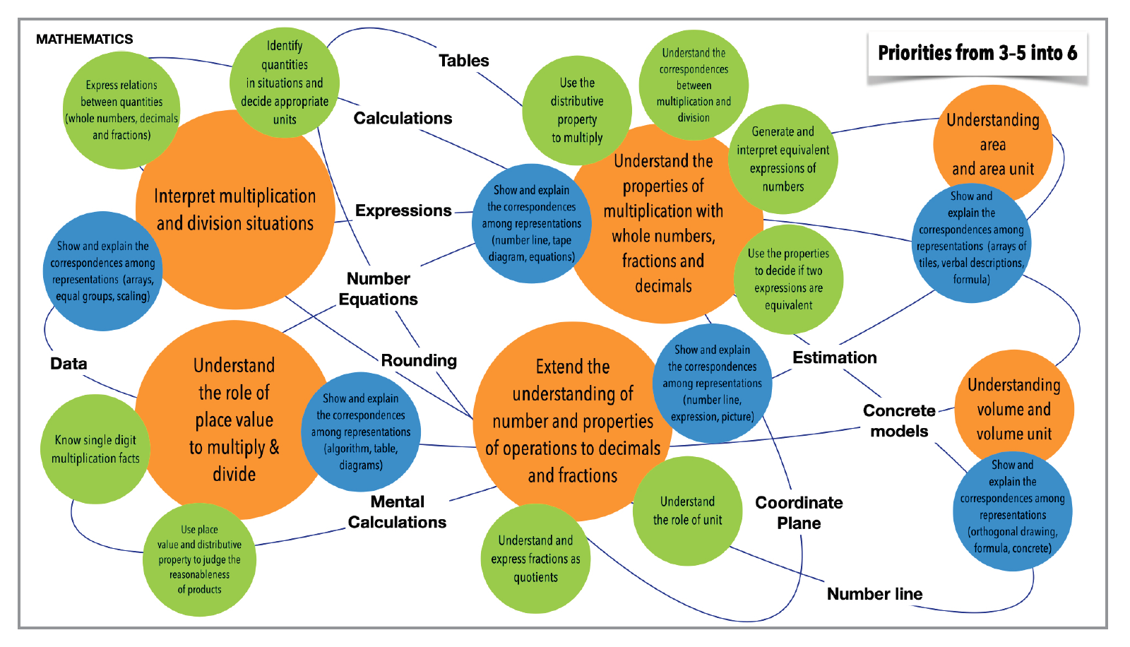

Slide 16
Prioritize Content and Learning
“...what is most important to teach within the major curricular domains at each grade level? It is important that teachers know where to invest their time and effort, what areas can be cut, and where they should teach only to awareness level to save time for priorities. What is most important deserves more time, and teachers need to be given the latitude to provide responsive feedback and allow time for constructive struggle—a very different proposition than merely offering a superficial ‘right’ or ‘wrong.’ This additional time has to come from somewhere.”

Slide 17
For example...
“...what’s important about adding fractions with unlike denominators? This mathematical computation extends students’ developing ideas of addition from whole numbers to unit fractions. The purpose is to help students develop deeper insights into the number line, which will eventually provide a basis for coordinate graphs in algebra. So math teachers should focus their efforts on building this understanding, not on honing students’ ability to add fractions quickly or to handle particularly awkward numbers such as 3/17 + 5/12. “

Slide 18
Connections between Prioritizing Learning and Addressing Unfinished Learning

Slide 19
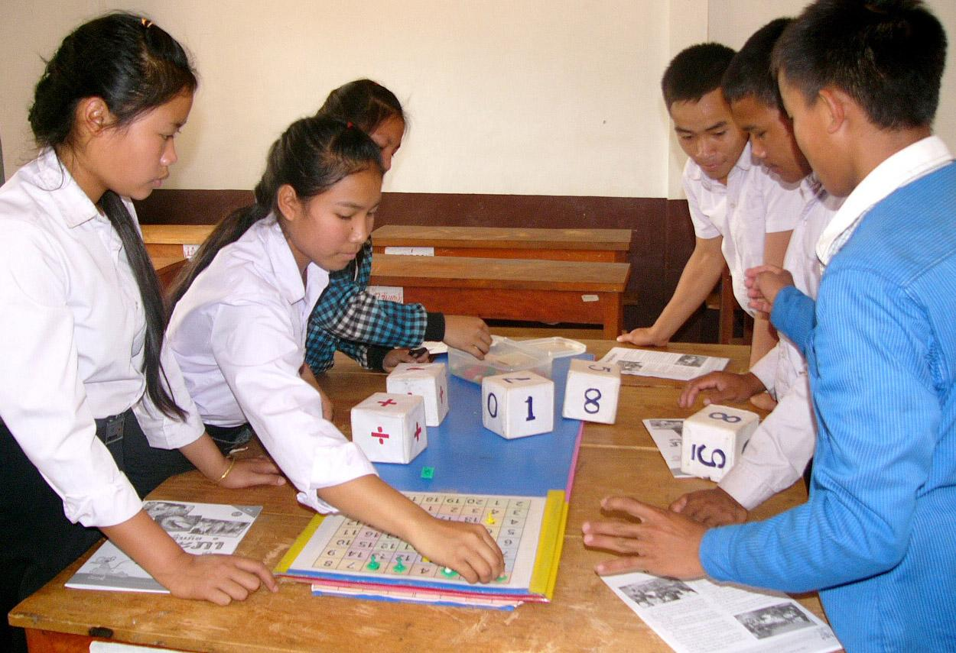
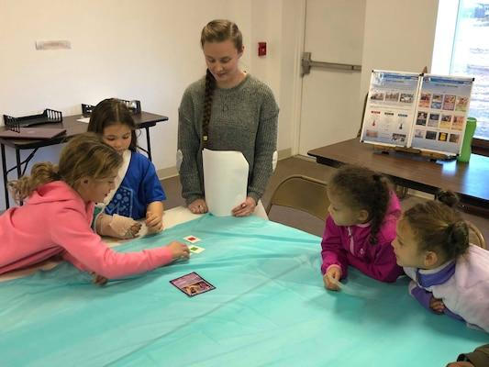
Mathematics Learning

Slide 20
Key Points
Unfinished learning has always been very common
Every teacher has dealt with it
Make the progression – elementary to middle - a progression that is designed for most kids, rather than for just a few kids
How do I know what is important in math – math that is connected from one grade level to another; look at the progression to algebra
Horizonal thinking

Slide 21
Consider How Multiplication Stays in the Curriculum Yearly
Example: Students may solve 12 x 4, by decomposing 12 as (10 + 2); students do 10 x 4 + 4 x 2 which is 4(10 + 2), 4 x 10 + 4 x 2; extend this to multiplying binomials in algebra one to illustrating the distributive property;
  How do you help students see their thinking in another person’s thinking; how do we move student thinking from the most simplistic to one of elegance/or of greater complexity
Attend to student’s development of agency

Slide 22
Principles and Strategies for Addressing Unfinished Learning
Stick to grade-level content and instructional rigor
Focus on the depth of instruction, not on the pace
Prioritize content and learning
Ensure inclusion of each and every learner
Identify and address gaps in learning through instruction, avoiding the misuse of standardized testing
Capitalize on commonalities, not differences

Slide 23
Re-engage Prior Knowledge
“...daily re-engagement of prior knowledge in the context of grade-level assignments will add up over time, resulting in more functional learning than if we resort to watered down instruction or try to reteach topics out of context.”

Slide 24
Gaps
“...avoid the temptation to rush to cover all of the ‘gaps’ in learning from the last school year. The pace required to cover all of this content will mean rushing ahead of many students, leaving them abandoned and discouraged. It will also feed students a steady diet of curricular junk food: shallow engagement with the content, low standards for understanding, and low cognitive demand—all bad learning habits “

Slide 25
Some Key Points
Use assessment to decide how to enter grade-level topics, not to decide who gets to study grade-level topics.
Push formative assessment closer to the curriculum in action; closer to the classroom – the need is not to generate a lot of data about topics, but to listen to students’ thinking on the most important topics.
Not everything depends strongly on previous grades; take advantage of fresh starts.
Just in time learning, not just-in-case reteaching

Slide 26
Addressing Unfinished Learning Just-in-Time: Example
Suppose that in an upcoming grade 6 lesson, students will use geometric arguments to establish that the area of any triangle is given by the expression ½ · b · h.
Context: It is near the beginning of the school year. A district-wide diagnostic assessment was given at the beginning of the year, and the report for your class indicates that many students in the class “have weaknesses in fractions.”
What might be a productive approach instead of reacting to the assessment report by (for example) revisiting a grade 5 unit on fractions?

Slide 27
Addressing Unfinished Learning Just-in-Time: Example
Provide a task that a student, or a group of students, could work on ahead of time. For example:
Stresses multiplication by ½ and the link to dividing by 2.
Gives exposure to expressions that are a product of three numbers.
Teases the idea for the special case of a right-triangle.
(A do-now at the beginning of the lesson, as the focus of instruction in a support setting well synchronized with in-class instruction, as homework the day or week before.)

Slide 28
Robin Hall
Director of Language Arts and Literacy
Council of the Great City Schools
Sue Pimentel
Founding Partner
Student Achievement Partners
Lily Wong Fillmore
Professor Emeritus
University of California at Berkeley
San Francisco, CA

Slide 29
ELA/Literacy: Key Messages

Slide 30
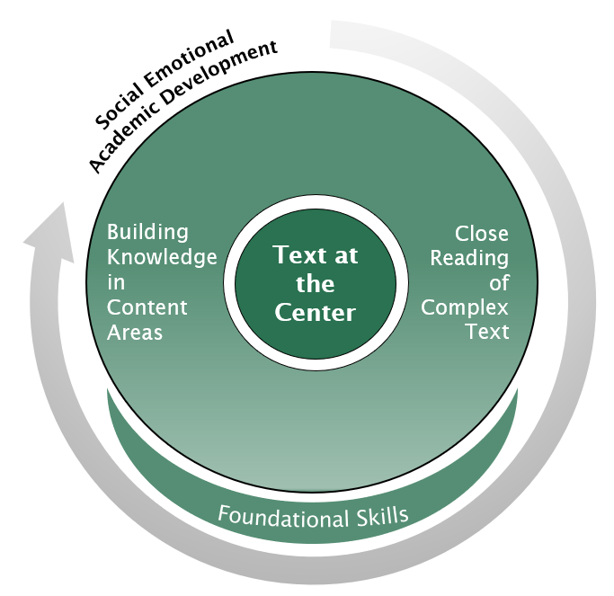
Priority Instructional Content in ELA/Literacy
“...each of our students in every learning community needs to be engaged in college- and career-ready study. What’s always been important is especially important now.”
Priority Instructional Content, p. 61

Slide 31
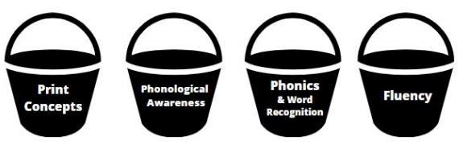


Explicit, research-based instruction and practice following a clear scope and sequence.
Learning
to Read

Slide 32
Opportunity Gap at Work for 5th Graders
from Leveled Readers (one week!)
Close Reading of Complex Text
Below Level Reader | On Level Reader | Above Level Reader
shelter splattered fixed rescue | journal tremors traction interval volunteered retrieve | generation abandoned languished terrified warble galvanized debris hoisted shuddered

Slide 33
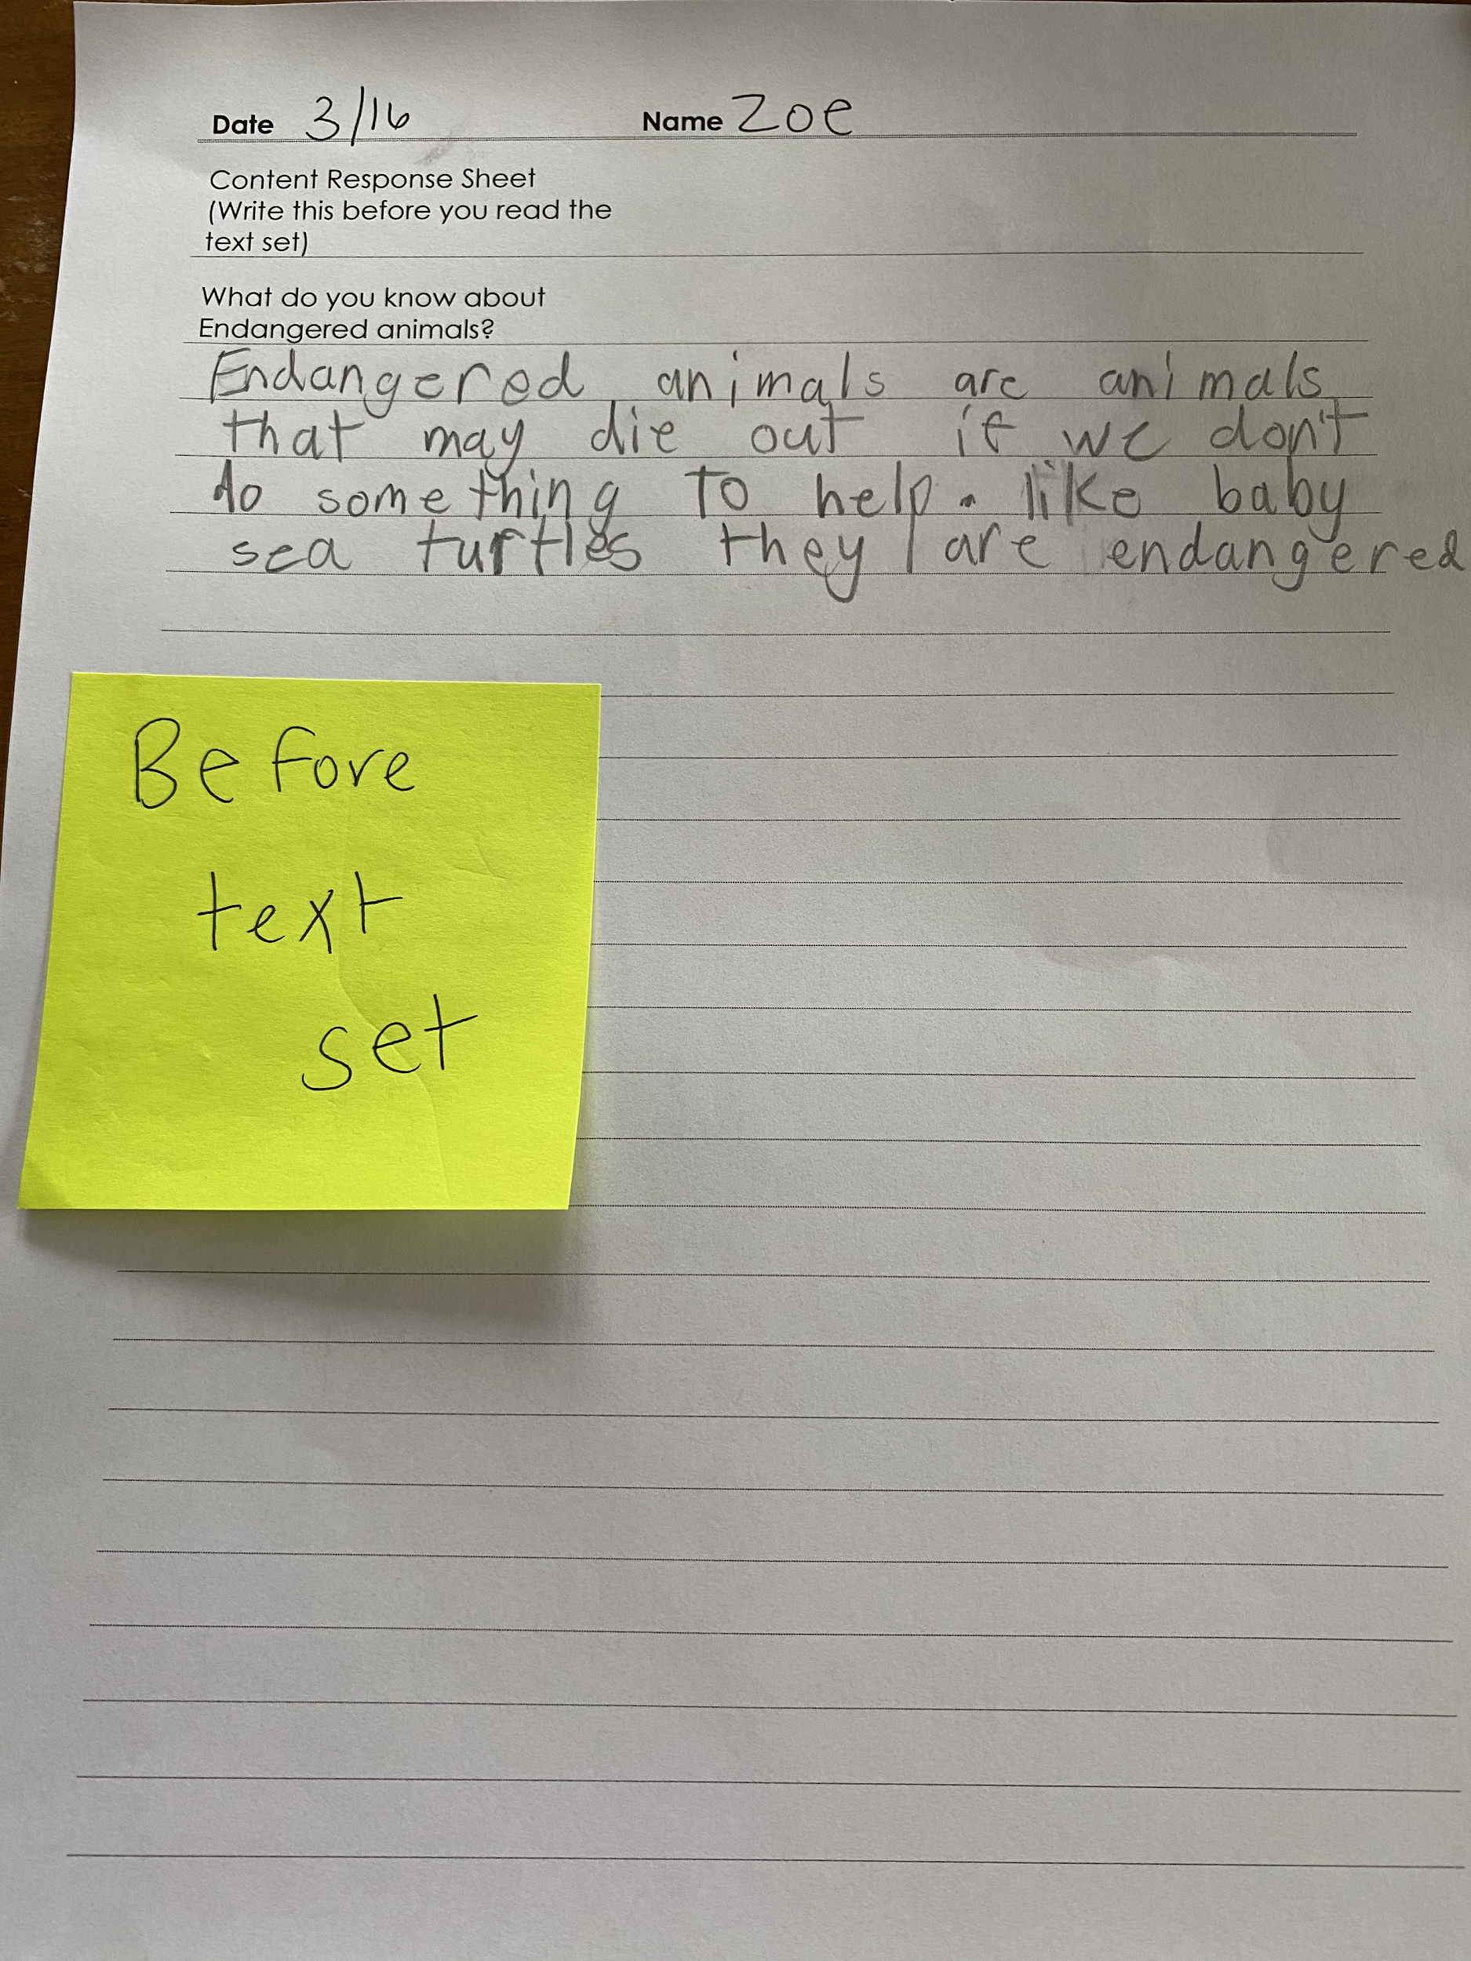
Building Knowledge
“Endangered animals are animals that may die out if we don’t do something to help. Like baby sea turtles they are endangered”

Slide 34

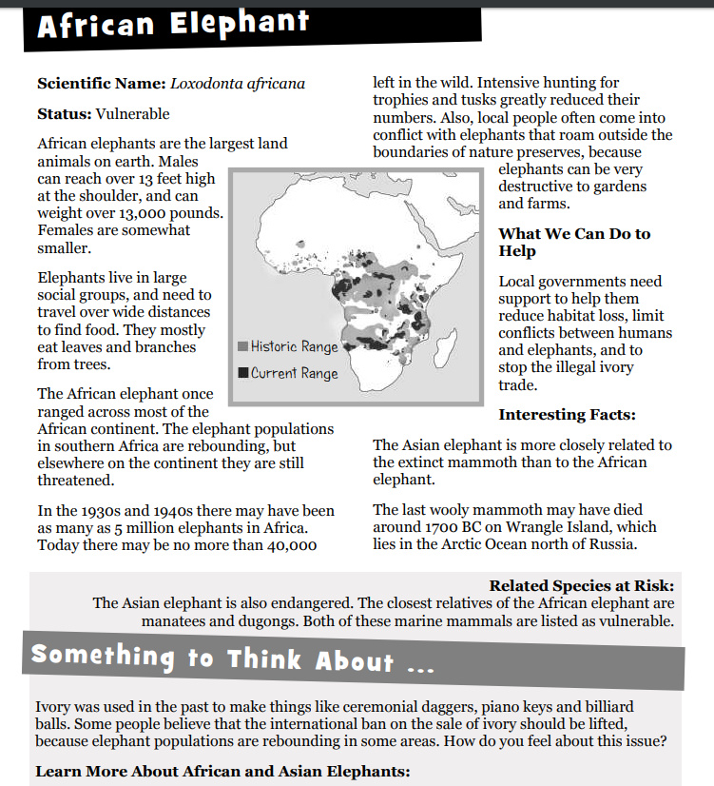

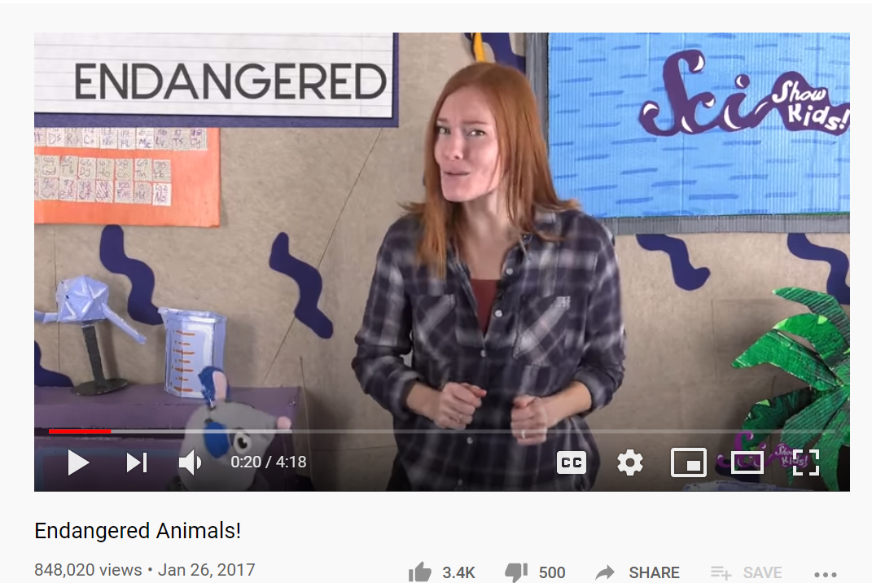
Reading and Learning about Endangered Animals

Slide 35
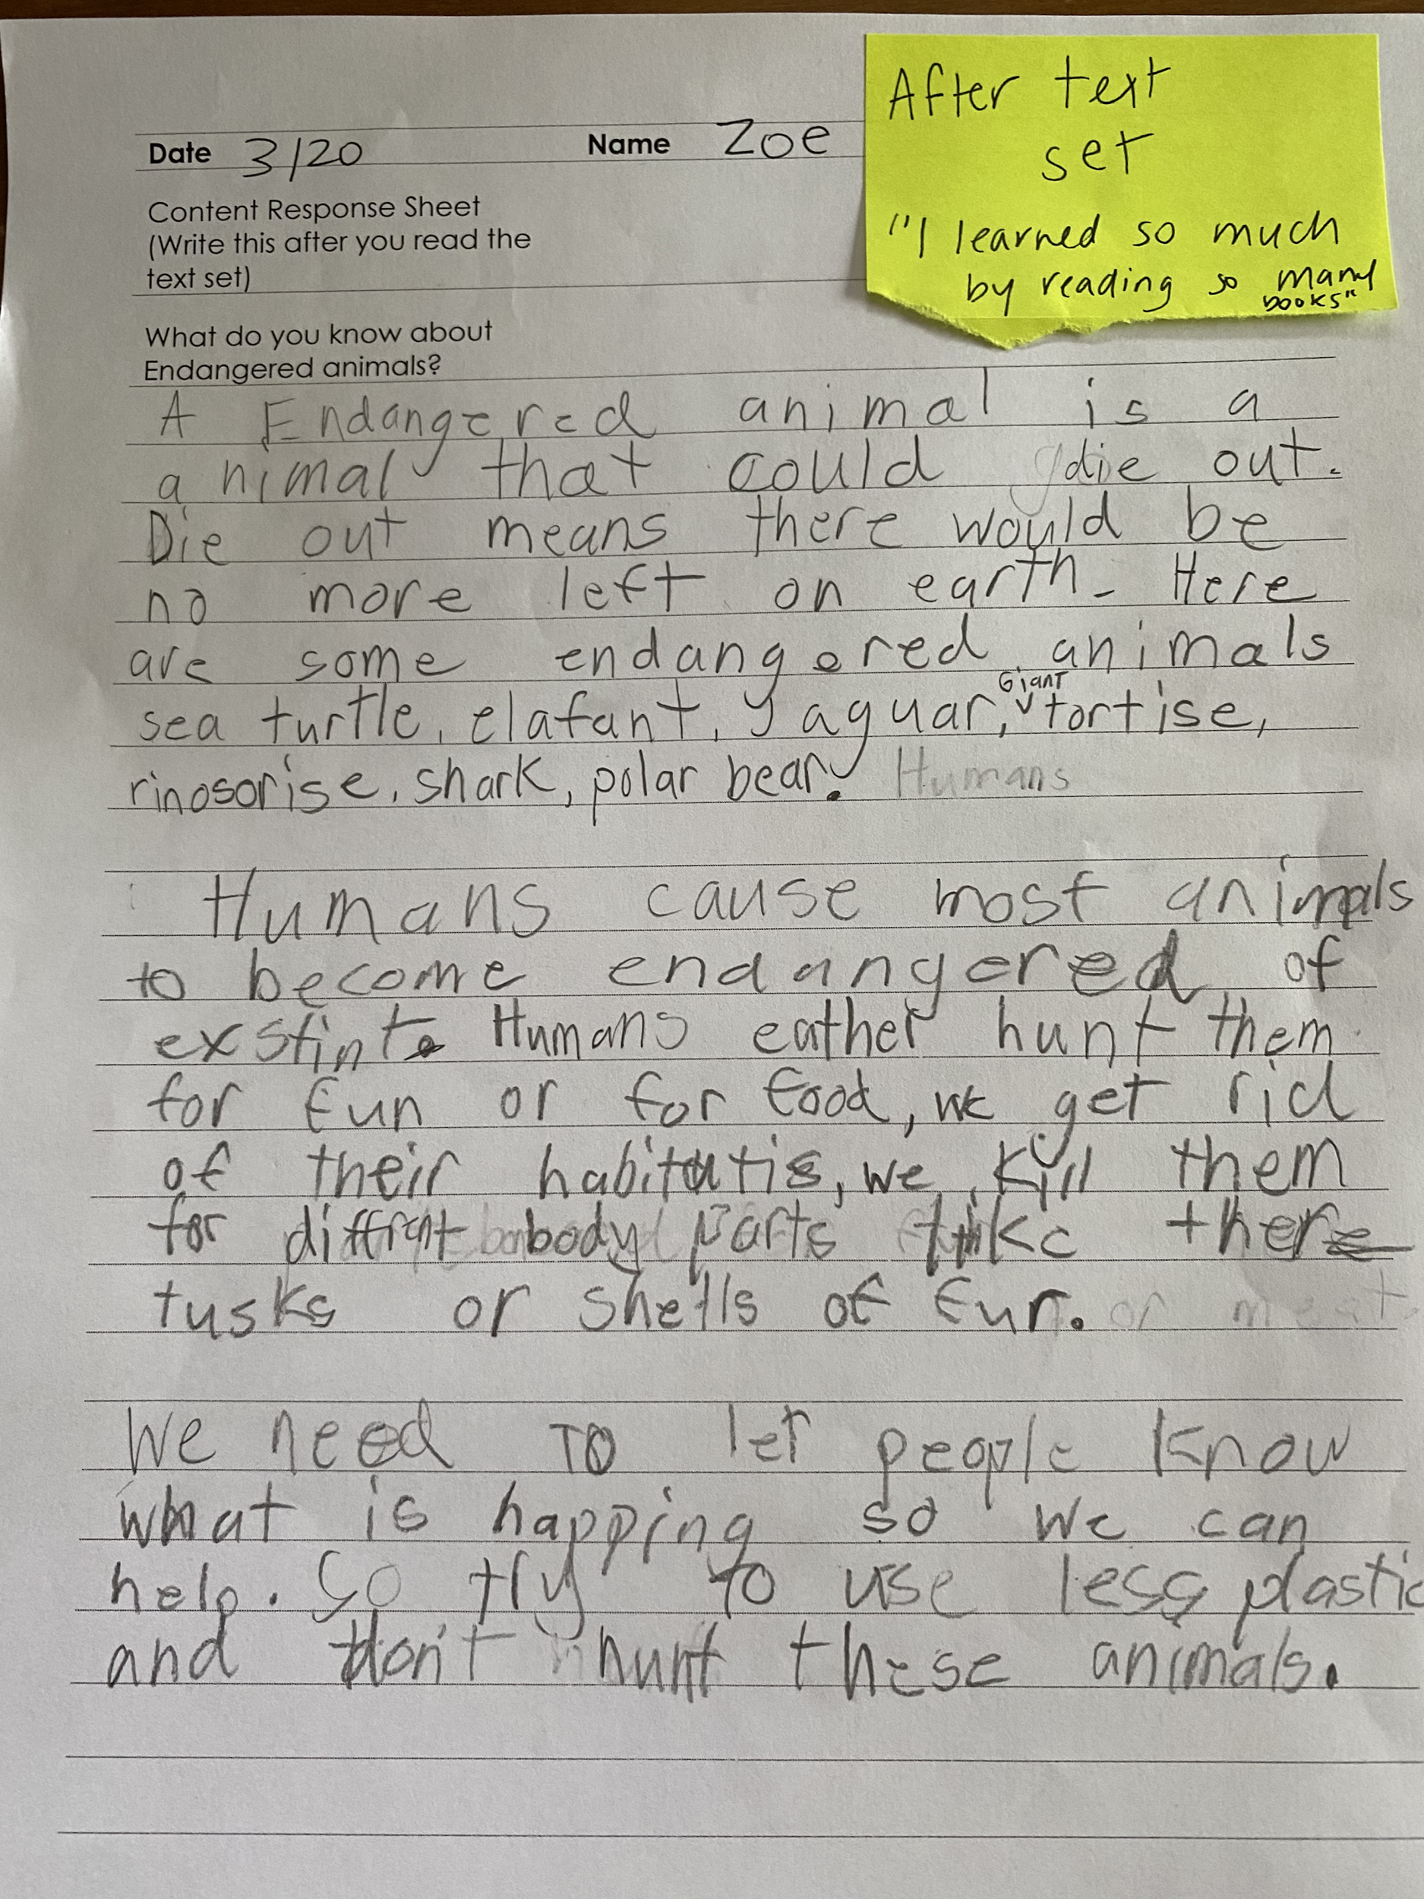
“A Endangered animal is a animal that could die out. Die out means there would be no more left on earth. Here are some endangered animals sea turtle, elafant, jaguar, Giant torise, rinosorise, shark, polar bear.
Humans cause most animals to become endangered or exstint. Humans eather hunt them for fun or for food, we get rid of their habitats, we kill them for different body parts like there tusks or shells or fur.
We need to let people know what is happing so we can help. So try to use less plastic and don’t hunt these animals.

Slide 36



Addressing Unfinished Learning after COVID-19 School Closures
What is critical to make sure students access grade level content?
Can we really do this?
How do we make the time?
How do we know this will work?
Yes

Slide 37


What is critical to make sure students access grade level content?
Give all students access to grade level instruction. Build on assets. Do not focus on deficits.
Key strategy - Inclusion. Provide just-in-time scaffolds and instruction to offer students multiple entry points into grade level learning.
A crucial concern: Students who need extra help should not be placed in dead-end remedial classes - doing so only widens the opportunity gap.
Educators need time to review
Grouping practices (heterogenous or homogenous groupings for instruction)
How student needs are identified
The necessity of teacher-guided instruction—what for, how much, for whom, and how often?
Students vary in the pace at which they learn, and they vary in what they get out of any experience.

Slide 38
Is it realistic to expect all kids to handle grade level instruction and materials?
Yes
(even after months of uncertain learning experiences)
Provide students the help needed to participate in the work of the class and to learn from the materials under study.
Stoke student motivation to tackle difficult materials - this is the first instructional step teachers take in introducing materials.
Build a learning community that nurtures engagement and learning by including all students.
Remember
Some students may get more out of the experience than others, but everyone gets more out of grade level materials than they would in subpar materials.
Students rise to the occasion if they feel valued and supported. (Fresno middle school example)

Slide 39
Such instructional efforts take a lot of time—
where does this time come from? What about the curriculum and pacing guides?
It will require instructional decisions: what in the curriculum should be given priority and what can be put on hold?
This may call for a restructuring of time allocated to instructional activities during class: how much time for teacher-led instruction, how much time for student individual or group work?
Maximizing student learning calls for flexibility to provide just-in-time support as needed by individuals or the class.
Re-engaging students in learning does take extra time and requires attention to content that students find worthwhile learning about.
Consider
Remember

Slide 40

How do we know this will work, that this is the way to go?
We have ample hard evidence that placing students into remedial classes is a dead-end for many if not most students.
We have observational and anecdotal evidence from districts where we have observed practices such as those described in the unfinished learning guidance document.
Boston
District 25 Queens, NY
Denver, CA
Charlotte-Mecklenburg & Guilford Co.,NC
San Antonio, TX

Slide 41
Extended Q & A
Can you both talk a bit about the intersection between teacher confidence in their students and providing just in time scaffolding so students meet grade level expectations successfully?
What kind of assessment data should teachers be collecting and using to monitor student progress in ELA/Literacy?

Slide 42
Dr. Nicole Mancini
Director, Elementary Learning
Broward County Public Schools
Denise Walston
Director of Mathematics
Council of the Great City Schools
Robin Hall
Director of Language Arts and Literacy
Council of the Great City Schools

Slide 43
Practice Issues for Implementation

Slide 44
OFFICE OF ACADEMICS
District Lessons Learned
November 18, 2020

Slide 45
Essential Learning:
Focusing on the Student & Teacher Experience
What did we learn from Quarter 4 and Summer 2020 that transformed Quarter 1 experiences?
Lessons learned informed decisions made regarding:
Incoming Kindergarten Students
Early Literacy and Impact on Specific Student Populations
COVID-19 AND Summer Slides
Changes to curriculum and instruction at all levels
Shifts in Pedagogy
Professional Learning and Training Needs
New Florida Standards in Grades K and 1; Implications for Grades 2-12
Notes:
Essential learning was approached both for the students AND the adults.
What did we learn from Quarter 4 and Summer 2020 that transformed Quarter 1 experiences?
Lessons learned informed decisions made regarding:
Incoming Kindergarten Students
Early Literacy and Impact on Specific Student Populations
COVID-19 AND Summer Slides
Changes to curriculum and instruction at all levels
Crosswalks and Correlations
Guidance Documents
Shifts in Pedagogy
Professional Learning and Training
New Florida Standards in Grades K and 1; Implications for Grades 2-12

Slide 46
Learning Acceleration Plan
Operational Game Plan: Framework for Birth through College & Career
Added Operational Game Plan for Students with Disabilities
Summaries
Ensuring High Quality eLearning | Focus on grade-level content while addressing unfinished learning
Assessing and Understanding Readiness for Grade Level Learning | Use assessments with a clear purpose linked to actions that will benefit students and help teachers know what to do next
Addressing Commonalities | Focus on shared commonalities and maintain the inclusion of each and every learner, including Students with Disabilities and English Language Learners
Nourishing Teacher and Student Relationships | Establish and maintain relationships throughout all transitions; Focus on SEL and mindfulness
Providing Outreach and Guidance for Parents | Openly communicate with families to support student access to classes/courses

Slide 47
Addressing Unfinished Learning: Leveraging the Pandemic
Focused on how to implement grade level instruction and address unfinished learning along the way
Defined Just-in-Time Instruction
Approached curriculum design and instruction with flexibility for any learning environment
Redefined purpose of and streamlined assessments
Looked to Grade Level Teams in Elementary and Content Areas in Secondary as the levers for communication and change
Moved Social Emotional Learning and Mindfulness to the forefront
Adapted and Leveraged Resources and Partners
Notes:
How did we leverage the pandemic to accomplish years of work in the making and propel some of that work forward?
Remediation for a majority of students was never an option
Focused on abilities to teach and supervise in the virtual learning space to provide high-quality instruction
Revised approach to building Content Modules in the Learning Management System
Designed a detailed Scope and Sequence for grade levels and content areas
Encouraged two-way communication as part of the ongoing feedback loop for continuous improvement early on
Adapted and Leveraged Resources and Partners:
Council of Great City Schools, CCSSO
Student Achievement Partners, Instructure, TNTP
NIET Rubric Companions for Virtual Instruction
University of Florida, Children’s Literacy Initiative, FCRR
Vendor Partners (Nearpod, Newsela, Scholastic, BrainPOP, etc.)

Slide 48
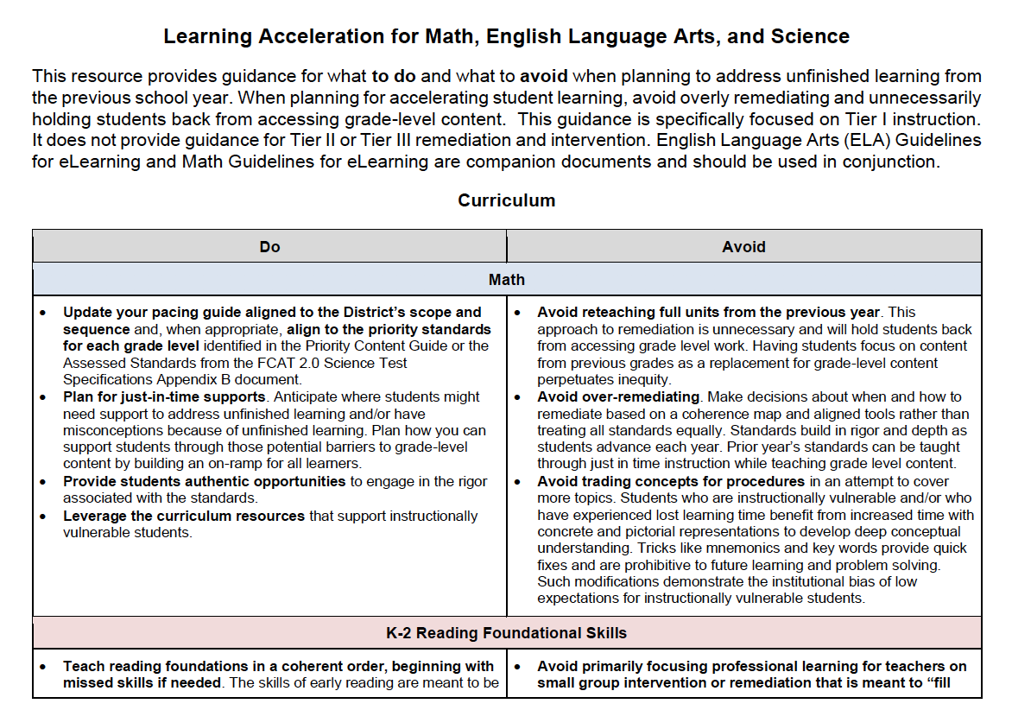
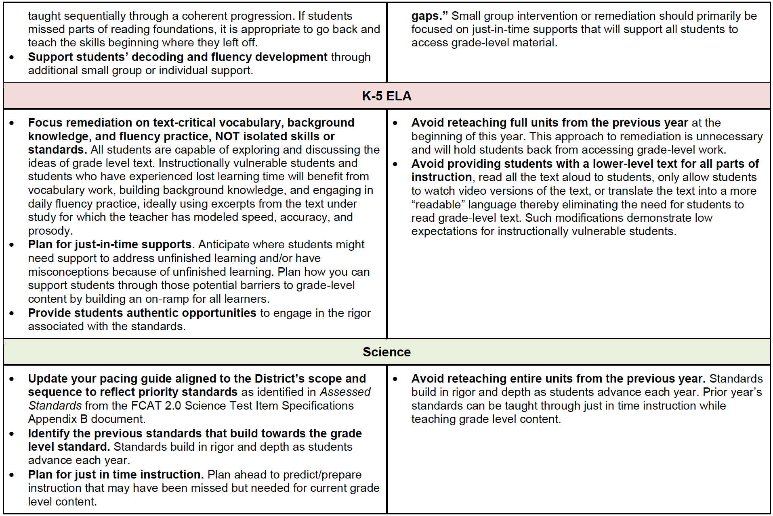
Learning Acceleration

Slide 49
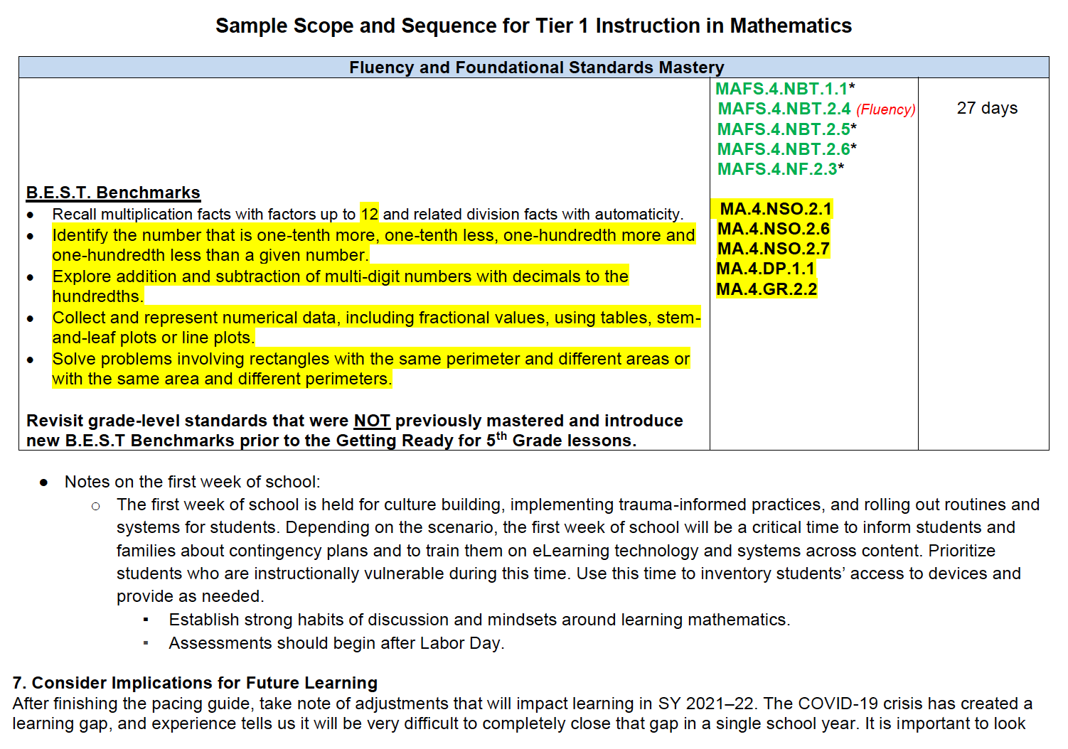
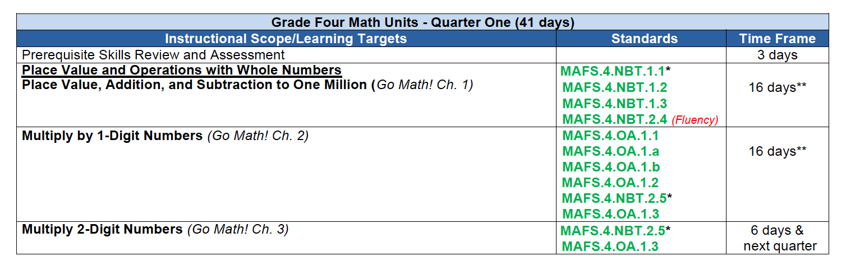
Learning Acceleration

Slide 50
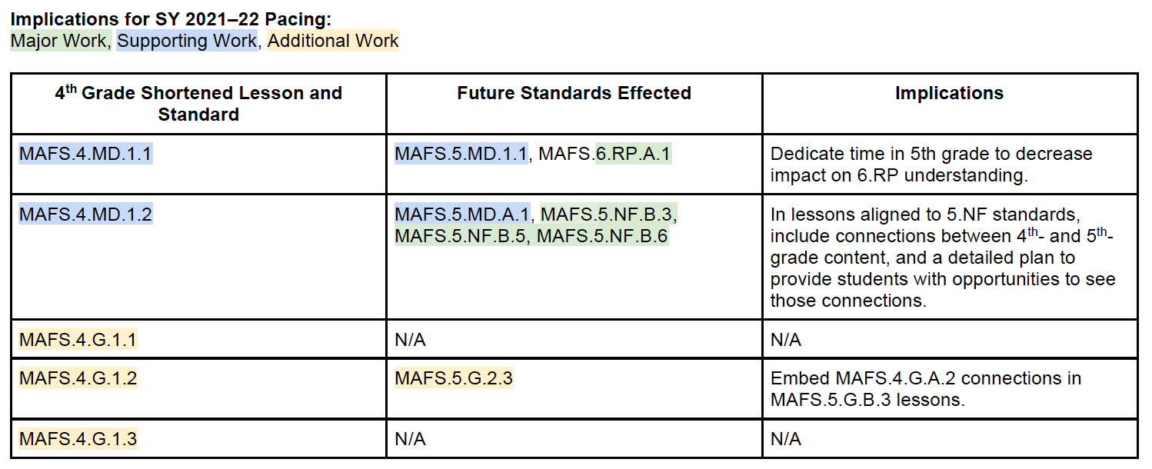
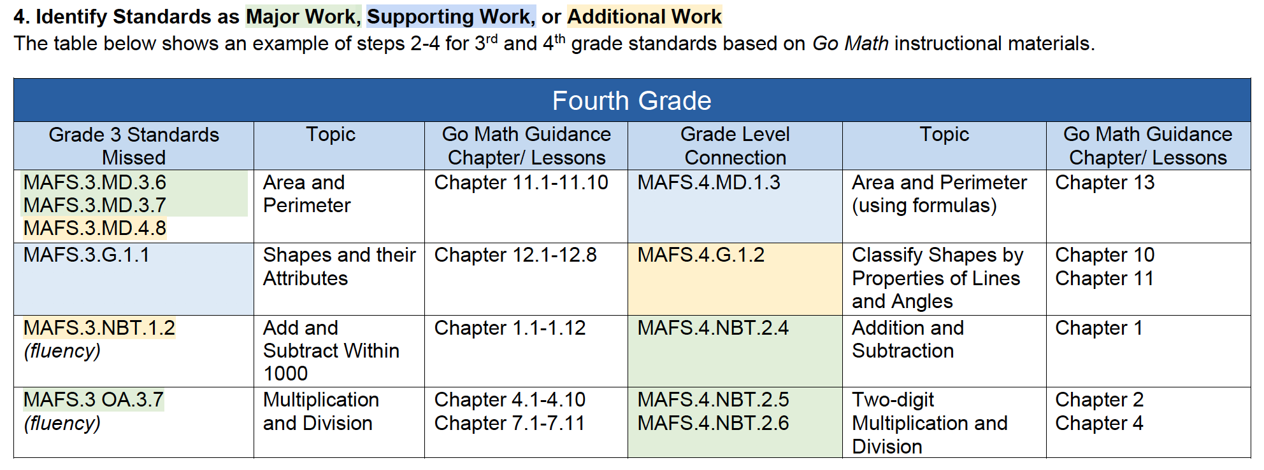
Learning Acceleration

Slide 51
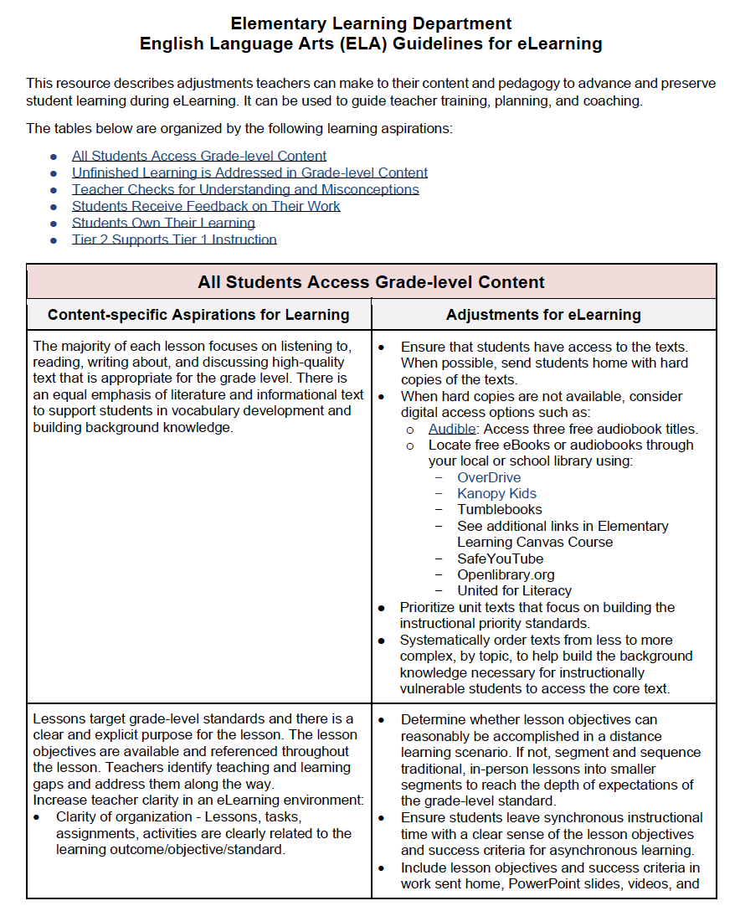

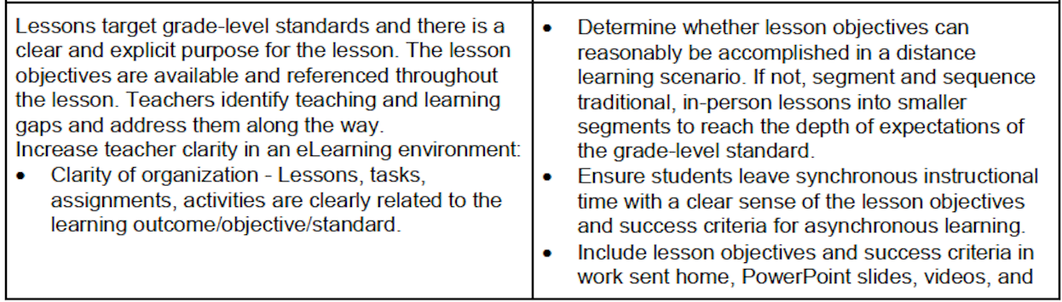
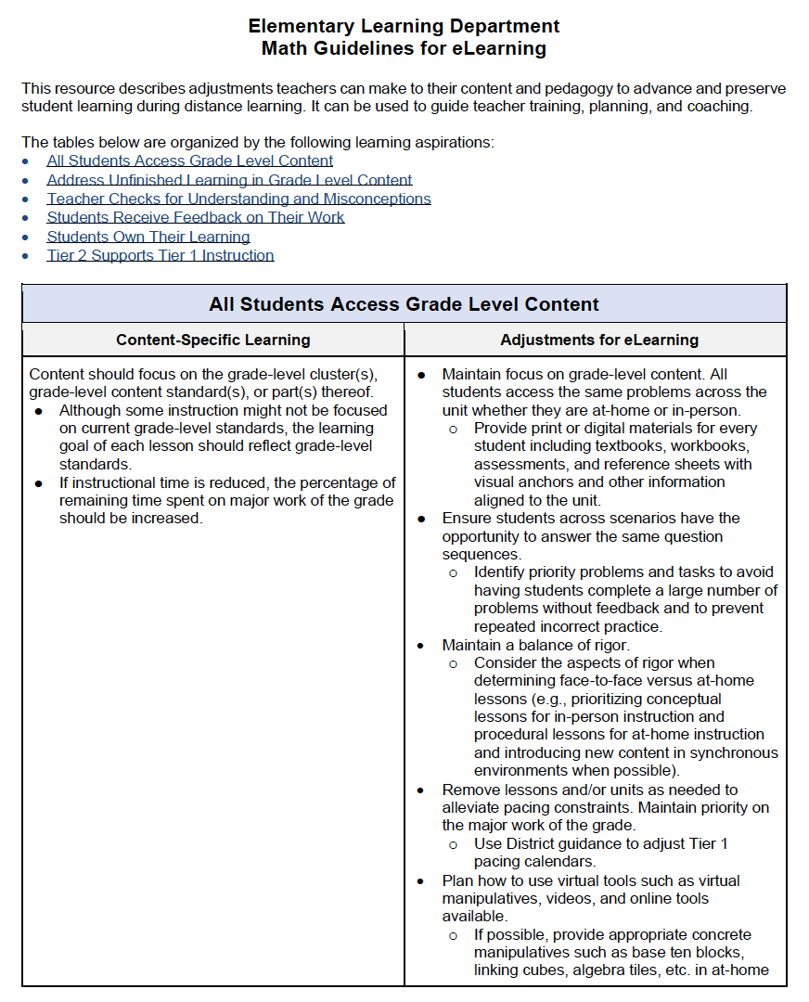
Learning Acceleration

Slide 52
Challenges & Solutions
Use of Technology – Laptops and Cameras
Capacity to deliver professional learning and training
Balancing synchronous instruction with asynchronous activities
Scheduling for Grades PK, K, and 1
How to teach reading and conduct assessments virtually
Coming to an agreement on sensitive, non-academic issues that impact teaching and learning in the end, with all parties involved
Substitutes for teachers and paraprofessionals
Meeting various and unique student and teacher needs

Slide 53
Successes
Breaking down the silos with shifts in collaboration!
Smoother transitions between learning environments as the District moves between phases of reopening
Identification of exemplary teaching practices among teachers at all grade levels and in all content areas
Leveraging technology to meet the needs of all learners (including the adults!)
Expanded and deepened knowledge and focus on the importance and role of social emotional learning, mindfulness, equity, and communication
Enhanced communication with parents and community
  Learning Never Closes
  Supporting Young Learners & Supporting Secondary Learners
  Parent University
Notes:
Breaking down the silos with shifts in collaboration!
Examples - Student Assessment and Research, Communications, Bilingual/ESOL, Exceptional Student Learning Support, etc.

Slide 54
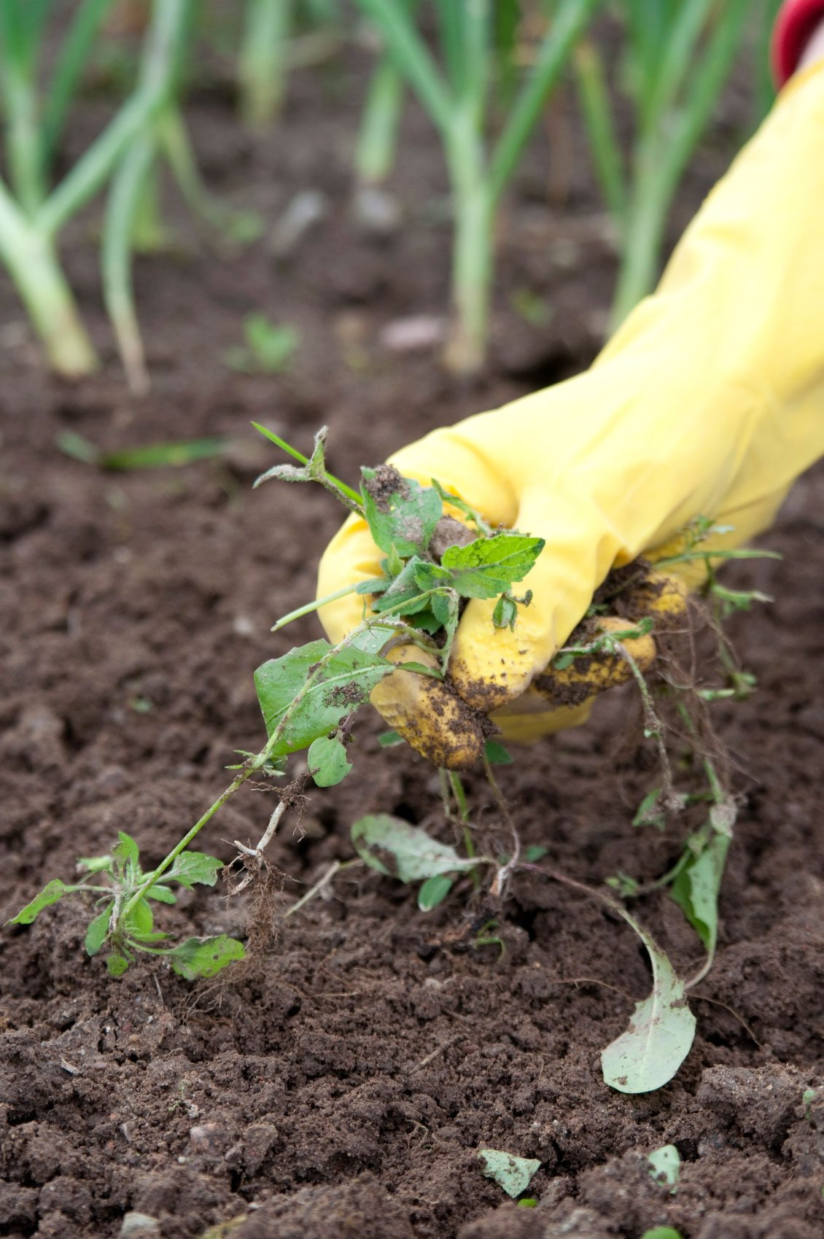


Next Steps for Continuous Improvement
Enhance existing Distance Learning Teacher Series programs with Live Broadcasting of Instruction, including the Arts and singleton courses
Continue focus on Equity and Social Emotional Learning
Expand the use of cameras for teaching, learning, coaching, and professional development
Continue to develop embedded formative assessment items aligned to the curriculum to guide just-in-time instruction
Transformation of the teaching and learning environment moving forward
WEED
FEED
SEED
Remove what is no longer working or viable
Nourish what is working and adding value
Plant new ideas on how to come back better
Notes:
Next Steps:
Virtual ELA adoption
Can the COVID-19 crisis be a breakthrough opportunity to transform schools and education?
What can we learn from our experiences during remote and blended learning to build back better?
What can we “weed, feed, and seed” from this experience?
Weed out the educational practices that do not work any longer.
Feed those learning opportunities that are showing promise.
Seed some new, innovative ideas to transform education to where it needs to be.

Slide 55
Questions for Our Guests?

Slide 56
Please Join Us Again for the Rest of this Series!
Session 2
Educator Perspectives: Guidance on Addressing Unfinished Learning
Wednesday 12/2
7:00p ET
Panelists: San Antonio ISD, San Diego Unified, Denver Public Schools
Session 3
Leadership Perspectives: Best Practices & A Path Forward
Wednesday 12/16
7:00p ET
Panelists: Orange County Public Schools, San Diego Unified, Denver Public Schools, LAUSD
Registration links coming soon!

Slide 57





Join our networks!
https://achievethecore.org/ca-signup
twitter.com/achievethecore
twitter.com/GreatCitySchls
Facebook: facebook.com/achievethecore
Pinterest: pinterest.com/achievethecore

Slide 58
Thank You!

