Slide 1
The Council of the Great City Schools and Student Achievement Partners welcome you to:
Educator Perspectives
Guidance on Addressing Unfinished Learning and
Essential Content
December 2, 2020
The webinar will begin shortly.
Use the Group Chat to introduce yourself!

Slide 2
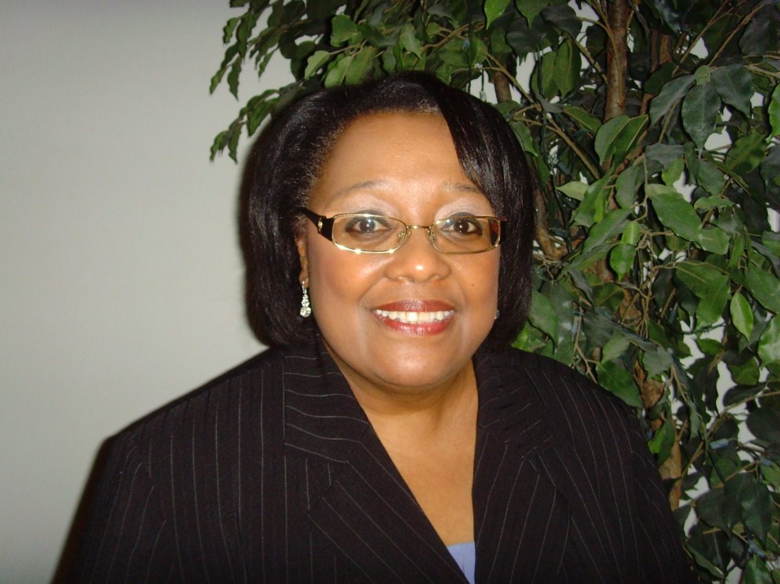
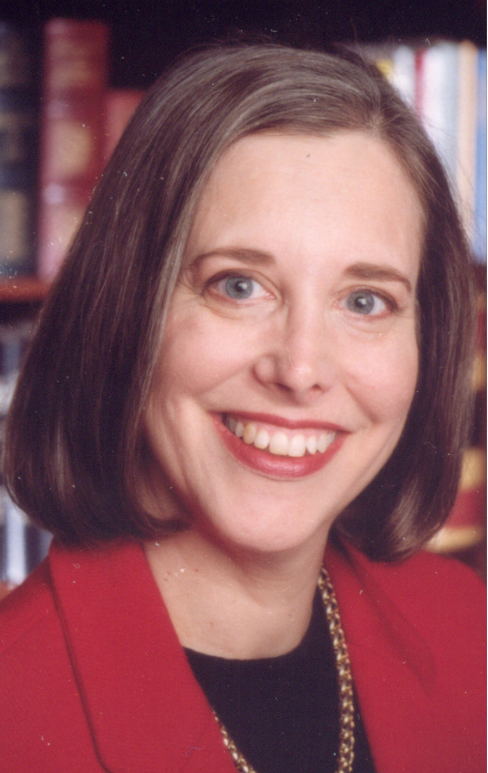
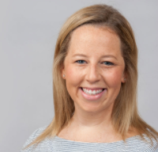
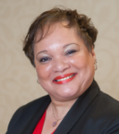
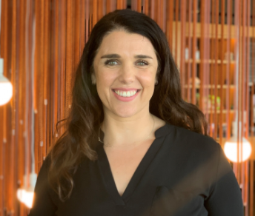
Welcome
Our Presenters:
Your Hosts:
Denise Walston
Director of Mathematics
Council of the Great City Schools
Ricki Price-Baugh
Stacy Wetcher Gad
Robin Hall
Director of Language Arts and Literacy
Council of the Great City Schools
Jun Li
Kate Crist

Slide 3
Joining Question:
What insights are you hoping to gain from today’s webinar?
Please use the Group Chat to respond.

Slide 4
Today’s Conversation
Welcome (5 min)
Denver Public Schools (15 min)
San Diego Unified School District (15 min)
San Antonio Independent School District (15 min)
Q&A (10 min)

Slide 5
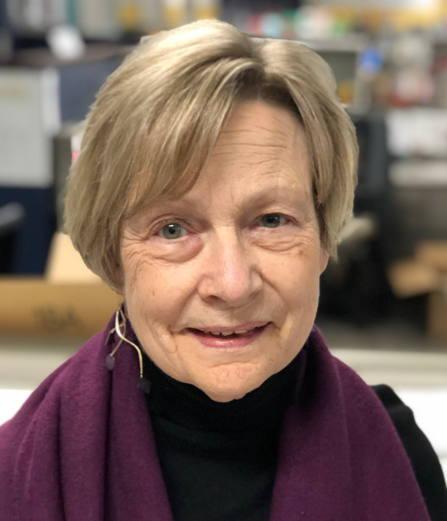
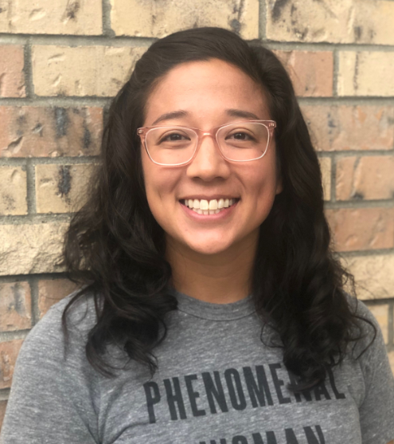
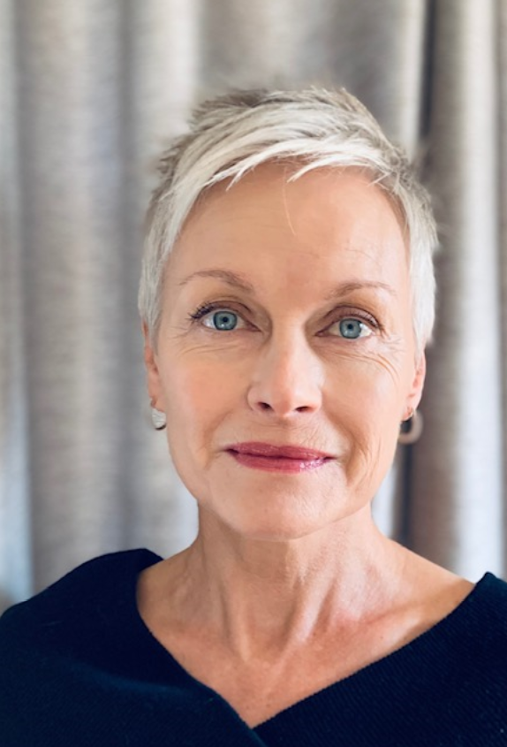
Cathy Martin
Associate Chief of Academics
Denver Public Schools
Emily Felsenthal
Senior Team Lead & 8th Grade Math Teacher
Denver Public Schools
Laura Neuberg
3rd Grade Math Teacher
Denver Public Schools

Slide 6
Denver Public Schools

Slide 7
Accelerating Unfinished Learning

Slide 8
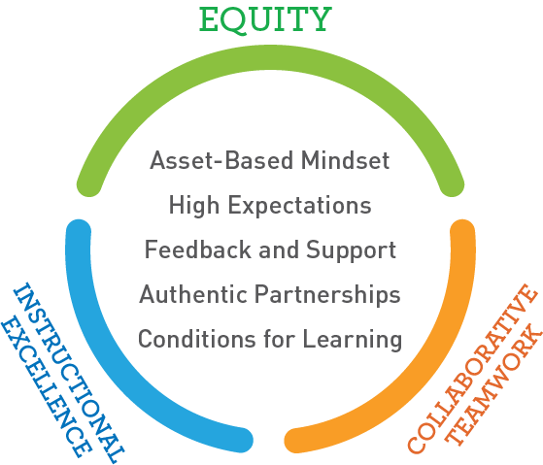

Slide 9
Spring 2020—Anticipating 20-21 School Year
Identification of In-Depth Focus for Each Grade Level
Example: Third Grade Math In-Depth Focus
Word problems involving equal groups arrays, and measurement quantities to build student understanding of and skill with multiplication and division
Fluency with single-digit products and related quotients
Concept of area, area models and relation to multiplication and division
Fluency with addition and subtraction within 1000
Understanding of fractions as numbers
Descriptive Feedback to Support Instruction
Frequency: Schools develop a cadence of providing descriptive feedback to students based on individual context; should set common expectations across the school.
Focus: Feedback to focus on the most essential understandings in the unit of study, not the full scope and sequence articulated in the curriculum.
Language learning: Focus on expanding vocabulary use, language forms, and linguistic complexity

Slide 10
Summer Leader Learning Objectives
June Leadership Week
Leaders will be able to identify what it looks like to support unfinished learning within a classroom and make connection to the educator mindsets and social emotional practices.
Leaders will be able to identify the upcoming district resources that will accelerate unfinished learning.
Leaders will connect the internalization processes with accelerating unfinished learning.
July Leadership Week
Leaders create the schoolwide expectations and systems for accelerating unfinished learning.
Leaders facilitate unit internalization with teachers in which they plan for supporting students’ unfinished learning.

Slide 11
Remediation vs Acceleration
Remediation | Acceleration
Deficit-Based Mindset about Students | Asset-Based Mindset about Students
Focuses on Gaps | Focuses on Opportunities
Backward movement leads to a sense of futility and lack of progress | Academic progress is evident
Focuses on mastering concepts of the past | Strategically prepares students for success in the present
Instruction attempts to reteach every missing skill: Just in Case | Skills are hand-picked just in time for new concepts: Just in Time
Skills are taught in isolation and not applied to current learning | Students apply skills immediately

Slide 12
What Will Teachers Need?
Deep understanding of . . .
Standards: grade level, previous grade level(s), and next grade
Learning trajectory over the course of the year
Demands of grade-level texts
Attributes of rigorous mathematics tasks
Their curriculum materials and all accompanying resources
Effective and equitable instructional best practices (e.g., engage students in discourse, pose purposeful questions)

Slide 13
What is Unit Internalization?
Unit internalization supports educators to actualize the culturally responsive mindset of high expectations by understanding
the learning purpose of the unit lessons
when and where students are doing the heavy lifting
how to support all students in engaging in rigorous and meaningful work.

Slide 14
Unit Internalization
Prework: Take unit assessment and preview mid-unit assessments and/or problem sets
Reflect on Culturally Responsive Education Mindsets
Orient to the unit’s essential learning: Big Ideas Unpack priority standards Debrief assessments Reflect on where students might grapple with the mathematics, language, or context during this unit
Internalize the Scope and Sequence Understand each Investigation Determine key times to provide just-in-time support for unfinished learning
Follow Up & Reflection Identify next steps Reflect on key takeaways from unit internalization

Slide 15
Accelerating Unfinished Learning at Park Hill Elementary
Laura Neuberg

Slide 16
Resources for Team Planning
Scope and Sequence documents
Approach to address unfinished learning
Third Grade Focus Standards
Accelerating Unfinished Learning by unit
Unit overview from Scope and Sequence: includes a section for accelerating unfinished learning with identification of prerequisite skills
Unit overview from Bridges in Mathematics: Skills Across the Grade Levels chart, Support & Intervention page for each unit

Slide 17
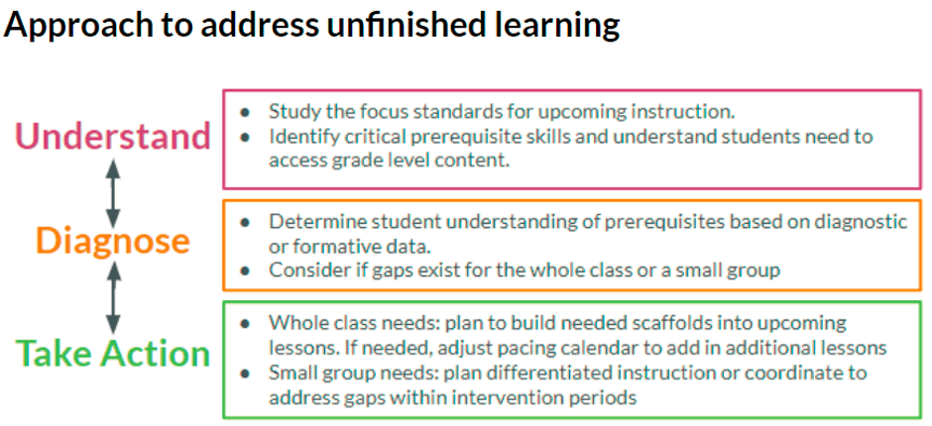

Slide 18
Accelerating Mathematics Learning
Third Grade Focus Standards
Understand 3rd grade Focus Standards | Diagnose Opportunities to diagnose critical prerequisite conceptual understanding & skills. | Take Action Just in time opportunities to address unfinished learning of prerequisites.
● 3.OA.A Represent and solve problems involving multiplication and division. ● 3.OA.B Understand properties of multiplication and the relationship between multiplication and division. ● 3.OA.C Multiply and divide within 100. ● 3.OA.D.8 Solve two-step word problems using the four operations. Represent these problems using equations with a letter standing for the unknown quantity. Assess the reasonableness of answers using mental computation and estimation strategies including rounding. ● 3.NF.A Develop understanding of fractions as numbers. | New Bridges Unit Screeners and/or Selected items from 3rd grade Number Corner Baseline Assessment Selected items from 2nd grade Comprehensive Growth Assessment | Unit 1 Unit 2 Unit 3 Unit 4

Slide 19
Accelerating Unfinished Learning Unit 1
Accelerating Unfinished Learning Unit 1
Priority Instructional Content: 3.OA.D.8 (Addition and Subtraction)
Understand What are the critical prerequisite knowledge and skills students need to access the grade level content? | Diagnose What do your students currently know and understand? New Bridges Unit 1 Screener and/or suggestions below: | Take Action What just in time interventions will support students in engaging with grade-level content?
 |  | Actions to select from, if necessary What does assessment and observation tell me students need in order to access the unit’s content? | Student & Teacher supports
2.OA.A.1 Use + and - within 100 to solve one-and two-step word problems involving . . . | 3rd grade NCBL Item 6a-b | Bridges Intervention Volume 4, Modules 7-9, selected activities | Student scaffolds: Word Problem Graphic Organizers change part-part-whole compare multi-step

Slide 20
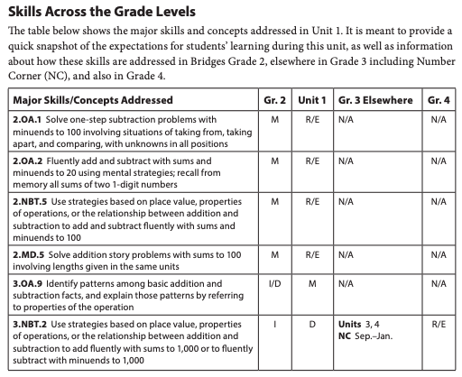
Accelerating Unfinished Learning Unit 1

Slide 21
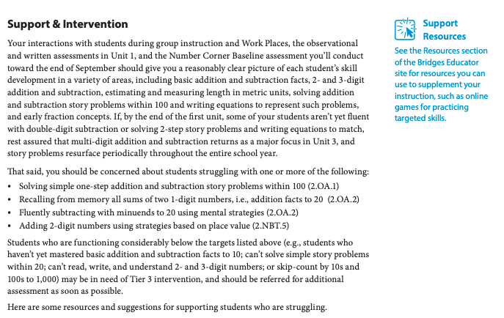
Accelerating Unfinished Learning Unit 1

Slide 22
Team Planning
Teachers and interventionists meet weekly
Plan out schedule of lessons from scope and sequence
Discuss trends in student data
Teams discuss
What tools to use to determine students’ current understanding (e.g, unit screeners as well as other suggestions from Scope & Sequence)
What in-time interventions/supports to include in lesson to ensure students access grade-level content and what to collect to determine student understanding and success
Examine whole group lessons--strategies, models, and scaffolds
Consistency in all third grade lessons
Small group sessions
Provide additional support with prerequisite skills and/or support with daily lesson and daily practice

Slide 23
Unit Internalization at Lake Middle School
Emily Felsenthal

Slide 24
Three Big Takeaways
Lessons from a Semester of Unit Internalization
Equity can be at the core of math conversations.
Language matters.
Dig for the gold (i.e. find the big ideas)

Slide 25
Takeaway #1
Equity can be at the core of math conversations.
START
END
How does this process help us plan effective instruction for ALL of our students?
How will you support productive struggle for our Black, Indigenous, People of Color and language learners?

Slide 26
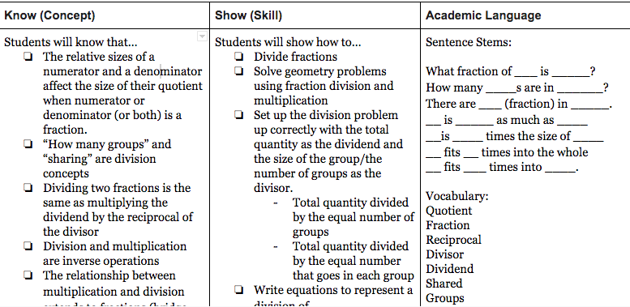
Takeaway #2
Language Matters

Slide 27
Takeaway #3
Dig for the Gold (i.e. find the big ideas)

Slide 28
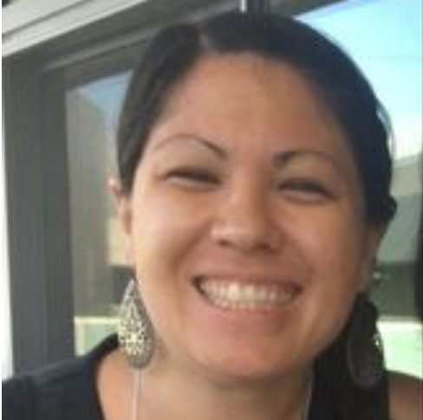
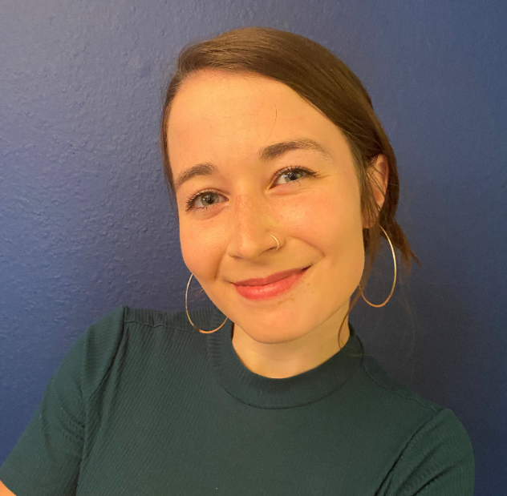
Alexandra Martinez
Instructional Coordinator TK-12 Mathematics
San Diego Unified School District
Sara Feiteira
Middle School Math Teacher
San Diego Unified School District
Molly Keimach
High School Math Teacher
San Diego Unified School District

Slide 29
San Diego Unified SD

Slide 30
San Diego Unified School District Addressing Unfinished Learning and Prioritization in Mathematics
Notes:
This template is free to use under Creative Commons Attribution license. You can keep the Credits slide or mention SlidesCarnival and other resources used in a slide footer.

Slide 31
Our Story
1
Introductions, Our Context
SDUSD Math Principles of Instructional Design
Our Agenda
Sharing the story of our approach to rigorous and engaging mathematics during a pandemic
From the field: Sara Feiteira
2
Middle School Math Teacher
Farb Middle School
From the Field: Molly Keimach
Alexandra Martinez
Sara Feiteira
Molly Keimach
3
High School Math Teacher
Kearny High School
Setting the Stage for Student Agency
4
Building a Community of Math Learners

Slide 32
Principles for Instructional Design 20-21
Instruction and resources are designed to be flexibly implemented
Unfinished learning is addressed in “just in time” supports
Focus on high priority content
Cut low priority content
Moving forward with rigorous grade level content
Move forward with rigorous grade level content
Focus teaching and learning on high priority content and cut lowest priority topics
Unfinished learning will be addressed through “just in time” support, as it relates to essential learning goals, rather than reteaching or remediating previous grade level content
Instruction and resources will be designed so that they can be flexibly implemented in a variety of contexts (face-to-face, distance learning, blended hybrids, etc.)

Slide 33
Prioritization Process
We consulted the guidelines in the following documents:
Major Work of the Grade + Widely Applicable Prerequisites (Student Achievement Partners)
Addressing Unfinished Learning (Council of Great City Schools)
Illustrative Guidance for Prioritizing for Distance Learning + Prioritized Activities (Illustrative Mathematics)

Slide 34
Prioritization Process
Leveraging math language routines, modeling tasks and projects to best represent the prioritized domains from national experts in the field
Triangulating lesson and unit narratives and learning objectives from IM Curriculum
Focus on activities that highlight experiences to foster SMPs
We did NOT prioritize standards as we did not want to focus on lists of independent standards or skills.
Rather, we are encouraging larger conceptual understandings of connected ideas, presented as “Domains”.

Slide 35
SD Enhanced Public Website
Explore San Diego Enhanced Mathematics
Vision, Guiding Principles, and Prioritization
Notes:
For Chat: https://sites.google.com/sandi.net/sdenhancedmath/home

Slide 36
From the field: Sara Feiteira
What are you doing w/ prioritization?
What is working? What are your challenges?
What have you learned during the pandemic?

Slide 37
Prioritization:
Community
Math Practices/Reasoning/Communication
Math Content Standards
Sara Feiteira
Jean Farb Middle School
Teaching 6th Grade for 6 years
Addressing Unfinished Learning:
Small scale assessment
Check Your Readiness (Illustrative Math)
Prioritize what is needed to access curriculum “just in time” supports
Using formative data and thoughtful planning
2020 Success
Students writing about math.
2020 Challenge
Students talking about math on Zoom (but it is a work in progress!)
What I have learned through distance learning...
Amazing strategies for building relationships and powerful tools for assessment

Slide 38
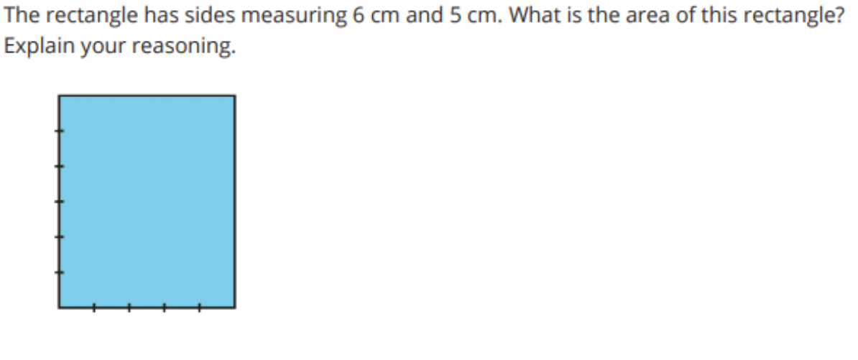
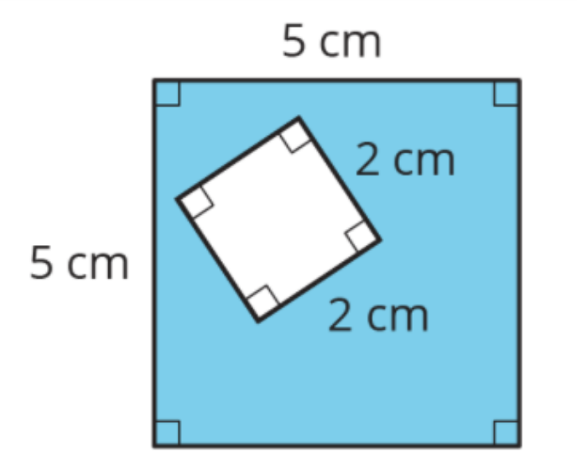
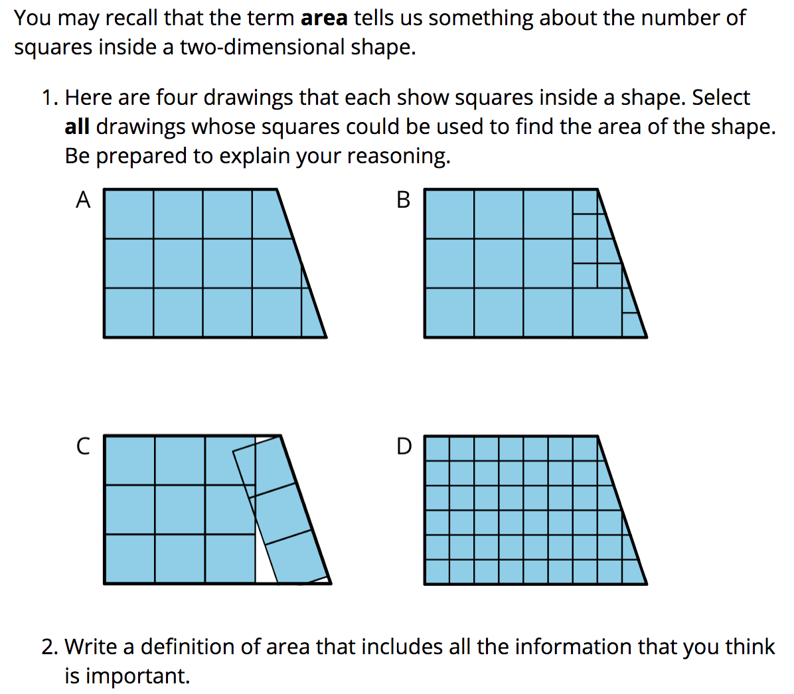
Check Your Readiness
Quick Review Whole Class Approach (Lesson Warm-Up)
Small Group Feedback and Mini-Lesson

Slide 39
From the field: Molly Keimach
What are you doing w/ prioritization?
What is working? What are your challenges?
What have you learned during the pandemic?

Slide 40
Molly Keimach
Who Am I?
Kearny High School
Integrated Math 1
6th year
Prioritization & Unfinished Learning
Low floor/High ceiling tasks
Addressing as we go
Utilizing asynchronous time
Successes
Math explanations
Building confidence /
growth mindset
Engagement
Challenges
Group work
Giving Feedback
Student Accountability
What have I learned?
Mathematical reasoning > Specific standards
Technology is great partner, but not a replacement

Slide 41
Example:
Intro to Domain and Range Card Sort
Main Topic:
Domain and Range
Also Addresses:
Fraction vs Decimal form
Area
Negative numbers

Slide 42
Setting the Stage for Student Agency
Building a Community of Math Learners

Slide 43
A Community = Mathematically Powerful Classrooms
Communities are the foundation for our learning and the vehicle by which we make connections to others and our world.
Love and Belonging
Shared Beliefs, Ideas, and Norms
A Growth Mindset
Discourse and Feedback as a Vehicle for Growth
Reciprocal Risk-taking
Honoring the Process
First Draft ≠ Final Draft
Freedom and Respect
Duty and Responsibility

Slide 44
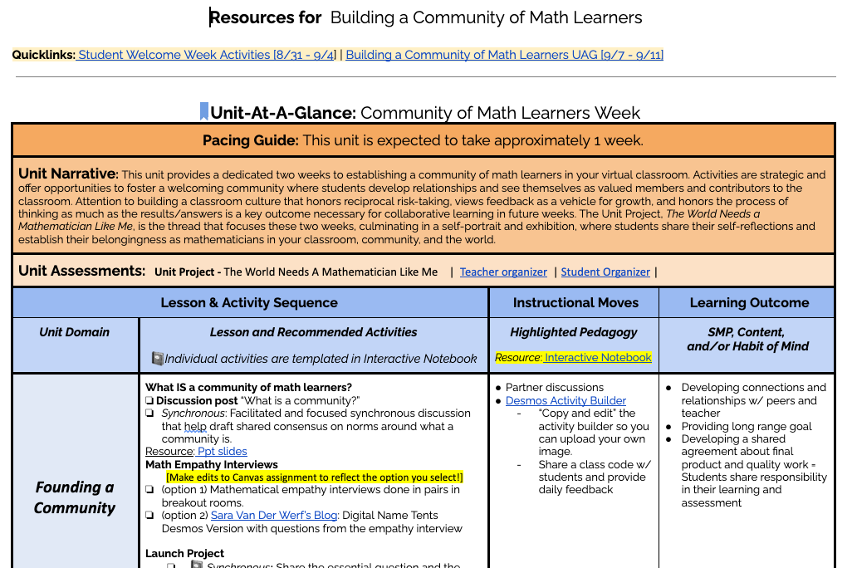
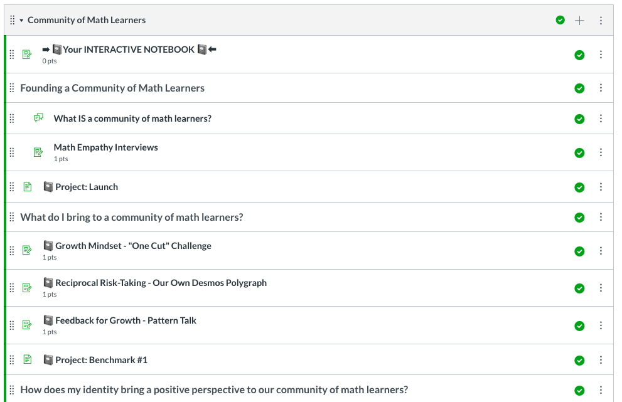
Module: Community of Math Learners
Student Welcome Week
8/31 - 9/4
Five math lesson choices grounded in SMPs and fostering positive math identify
Building a Community of Math Learners
2 Week Module
Develop common definition of community
Unit Project: The World Needs a Mathematician Like Me
Opportunities to develop relationships and reflect on diverse mathematical strengths

Slide 45
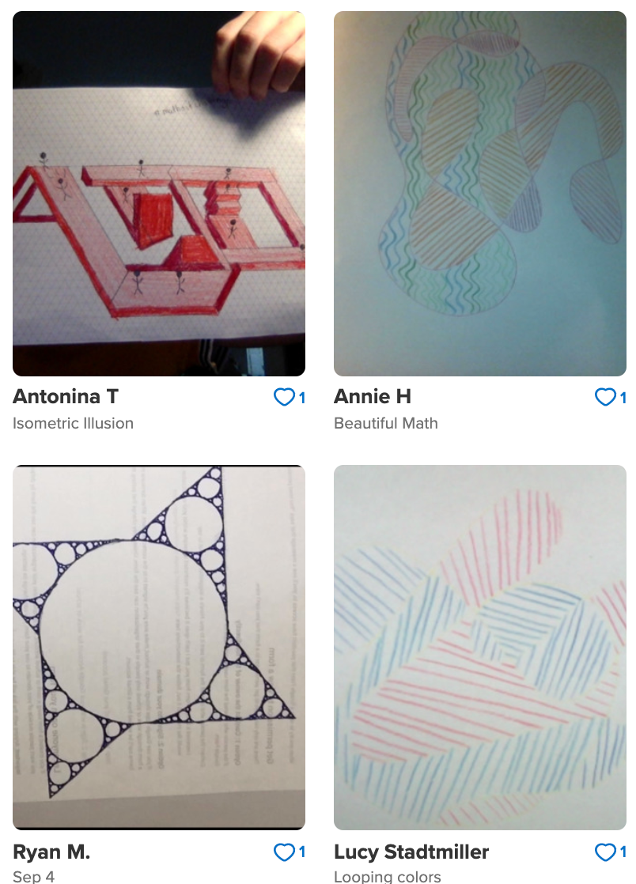
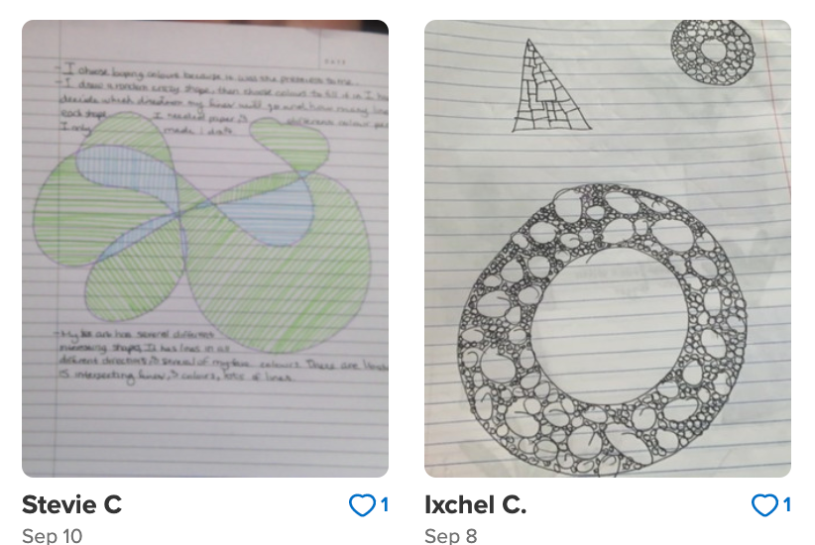
Thank You!

Slide 46
Credits
Special thanks to all the people who made and released these awesome resources for free:
Presentation template by SlidesCarnival
Photographs by Unsplash

Slide 47
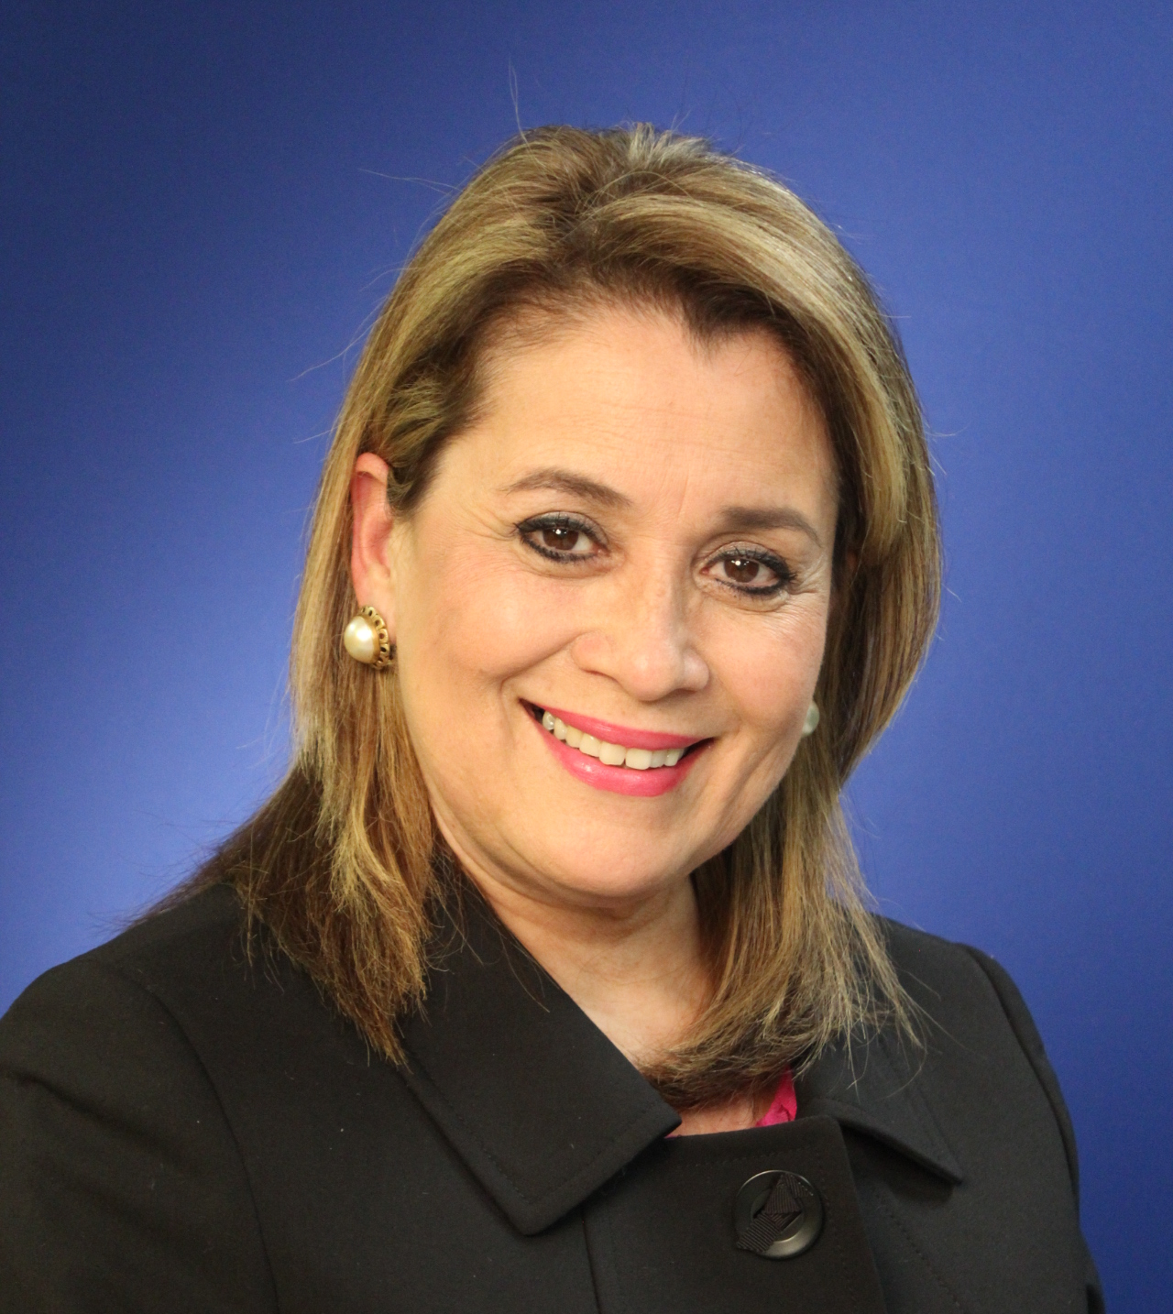
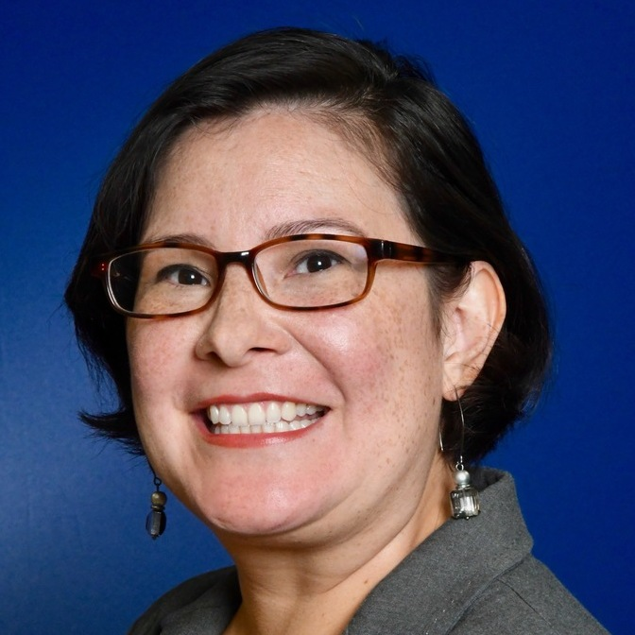
Dr. Olivia Hernández
Assistant Superintendent
Learning, Language & Literacy
San Antonio ISD
Rebecca De Leon
Principal, Graebner Elementary
San Antonio ISD

Slide 48
San Antonio ISD

Slide 49
Addressing Unfinished Learning
Depth Over Breadth
Assessments & Grading in Differentiated Classrooms
Literacy Practices
Equity and Access
Social and Emotional

Slide 50
San Antonio ISD Support Timeline
A Total Team Effort
Digital PD Choice Board
SAISD Digital Playground
Student and Educator Mental Health & Wellness
Self-Care During COVID-19
Clerical Academy
Curriculum Day
Canvas 2.0
Professional Development
Digital Citizenship
Formative Assessment
Summer 2020
Spring 2021
Spring 2020
Fall 2020
ED Tech & Design Summer PD
Learning Management System (Canvas)
Master Teacher Jumpstart
Leadership Summit
Social, Emotional and Academic (SEAD) Development
Instructional Leadership Academy
20-21 Focus Standards
New School Calendar with Two Intersessions
SAISD Reading & Math Acceleration Plan
SAISD (Bi)Literacy Plan
Professional Development
PLN Support
Texas Reading Academies
Winter Break Choice Boards

Slide 51
Plans to Address Unfinished Learning
School Opening and Instructional Continuity Plan
SAISD Academic and Instructional Continuity Plan
SAISD TEA Asynchronous Plan
Digital Learning Plan: A Guide to Lesson Design for the Digital Environment
Social, Emotional and Academic Development (SEAD) Companion Guide

Slide 52
Online Lesson Templates Pre-Learning Management System
MASTER TEMPLATE Includes embedded Assistive Technology | INTERACTIVE EXEMPLAR Includes Asynchronous Interactivity with Pear Deck

Slide 53
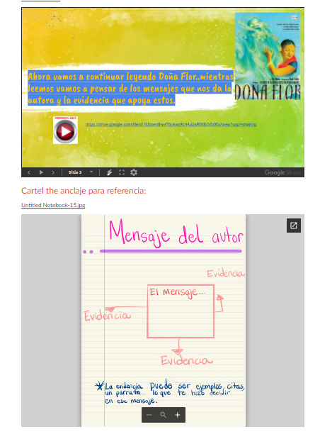
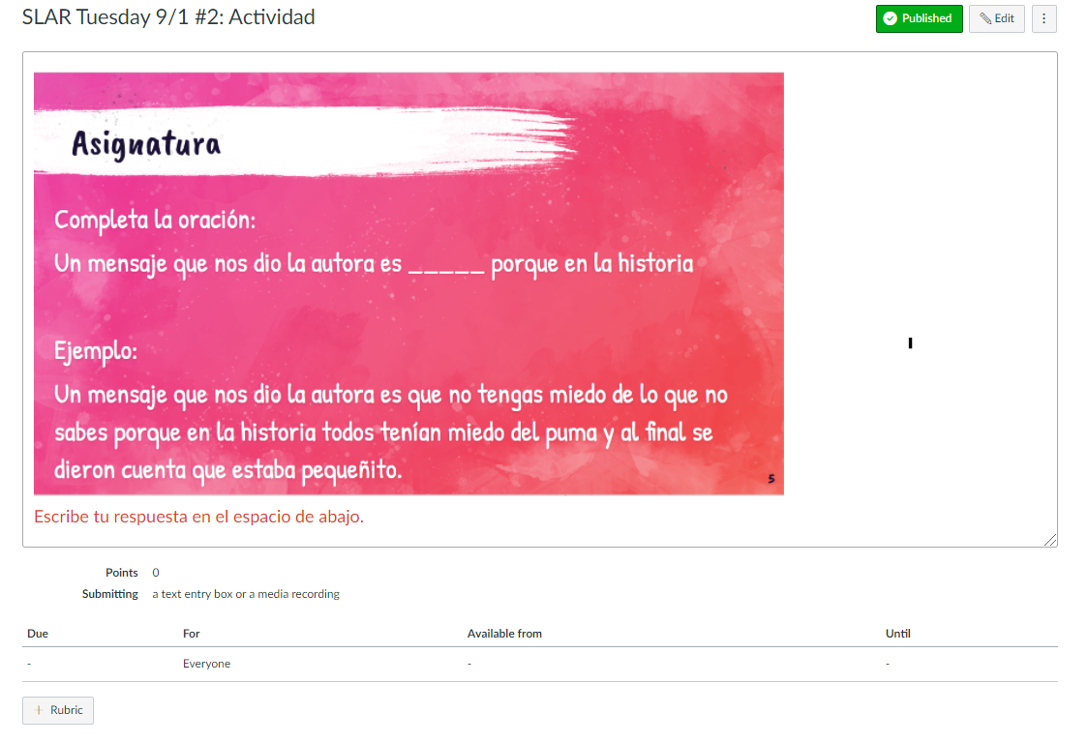
Sample Canvas Lessons
District Support in building English and Spanish online lessons on learning management system (Canvas) for first 4 weeks of school.

Slide 54
DEPTH OVER BREADTH

Slide 55
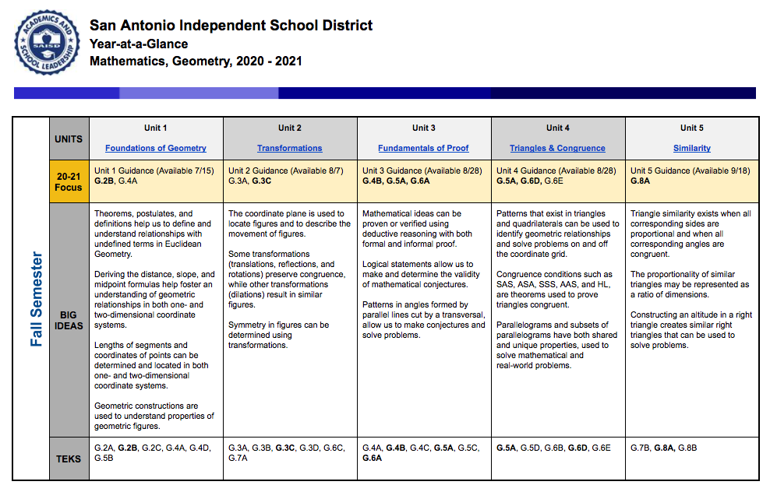
Year-at-a-Glance 2020-21
Features
Unit Titles & Access
20-21 Focus Standards
20-21 Focus Guidance
Unit Big Ideas
Unit Priority TEKS
Unit Ancillary TEKS
Revision Date
NEW!!!

Slide 56
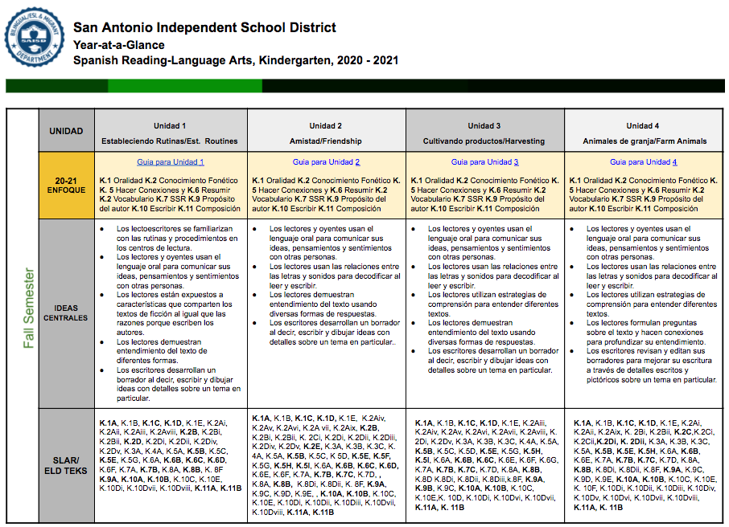
Dual Language Year-at-a-Glance 2020-21
Features
Unit Titles & Access
20-21 Focus Standards
20-21 Focus Guidance
Paired Literacy Focus
Unit Big Ideas
Unit Priority TEKS
Unit Ancillary TEKS
Revision Date
SLAR/ ELD TEKS
NEW!!!

Slide 57
2020-21 Priority Focus Standards
UNITS | Unit 1 Reading and Writing All Around Us | Unit 2 Author’s Purpose & Craft | Unit 3 Telling a Story | Unit 4 Interactive Readers make Interactive Writers
20-21 Focus | Unit 1 Guidance Foundational Skills:3.2A(ii), 3.2B(i) Vocabulary:3.3B Independent Reading: 3.5A Comprehension Focus: 3.6B, 3.6E, 3.6G Response Skills: 3.7A, 3.7D Multiple Genres: 3.8C, 3.9A Author’s Purpose: 3.10A Composition: 3.11A | Unit 2 Guidance Foundational Skills:3.2A(ii), 3.2B(i) Vocabulary: 3.3A,3.3B, 3.3C Independent Reading: 3.5A Comprehension Focus: 3.6E, 3.6F, 3.6G Response Skills: 3.7C, 3.7D Multiple Genres: 3.8A, 3.8C Author’s Purpose: 3.10A, 3.10C Composition: 3.11A | Unit 3 Guidance Foundational Skills:3.2A(ii), 3.2B(i) Vocabulary: 3.3B, 3.3D Independent Reading: 3.5A Comprehension Focus: 3.6F, 3.6G Response Skills: 3.7D Multiple Genres: 3.8A, 3.8B, 3.8C 3.9B, Author’s Purpose: 3.10D Composition: 3.11A | Unit 4 Guidance Foundational Skills:3.2A(ii), 3.2B(i) Vocabulary: 3.3B. 3.3C Independent Reading: 3.5A Comprehension Focus: 3.6F, 3.6G, 3.6H Response Skills: 3.7B, 3.7E, 3.7F, 3.7G Multiple Genres: 3.9D(i), 3.9D(ii) Author’s Purpose: 3.10C Composition: 3.11A
Big Ideas | Readers will develop foundational decoding skills while deepening comprehension. Readers use context to determine the meaning of unfamiliar words. Readers generate questions to deepen their comprehension of text. Readers/Writers establish routines and procedures to structure, meaning and motivation for learning. | Readers use strategies to determine the meaning of unfamiliar words and phrases. Readers use background knowledge and personal connections with a text to create meaning and deepen understanding. Readers can enhance their understanding of a text when they examine and analyze the author's craft. Readers can locate evidence from a text to support their understanding. | Readers are engaged throughout the plot development which develops characterization, and reveals themes. Readers use context clues to determine meaning of words, phrases, and concepts. Readers identify significant details in a text and evaluate them to help make decisions about key ideas. Writers analyze an author's writer’s craft in order to apply those skills in their own writing. | Readers understand informational texts are a genre of nonfiction that objectively explain, describe, or define a topic. Readers enhance understanding of a text by examining and analyzing the author’s craft. Authors convey the message (central idea) of a text either directly or indirectly through language and literary elements. Readers use text/print and graphic features to support the author’s purpose and message.
TEKS | 3.1A, 3.1C, 3.1D, 3.1E, 3.2A(i), 3.2A(ii), 3.2A(vii), 3.2B(i), 3.2B(v), 3.2B(vii), 3.2C, 3.2D, 3.3A, 3.3B, 3.3C, 3.4A, 3.5A, 3.6A, 3.6B, 3.6D, 3.6E, 3.6G, 3.7A, 3.7D, 3.7F, 3.7G, 3.8C, 3.9A, 3.10A, 3.11A, 3.11B(i), 3.11C, 3.11D(i), 3.11D(ii), 3.11D(iii), 3.11D(ix), 3.11D(xi), 3.12A, 3.13A | 3.1A, 3.1B 3.1D, 3.2A(ii), 3.2A(iii), 3.2A(vii), 3.2A(iv), 3.2A(v), 3.2A(vi), 3.2B(i), 3.2B(iii), 3.2B(iv), 3.2B(vi), 3.2B(vii), 3.2D, 3.3A, 3.3B, 3.3C, 3.4A, 3.6A, 3.6B, 3.6E, 3.6F, 3.6G, 3.7C, 3.7D, 3.8A, 3.8C, 3.8D, 3.9Di, 3.9E(iii), 3.9F, 3.10A, 3.10C, 3.10G, 3.11A, 3.11B(i),3.11B(ii), 3.11C, 3.11D(i), 3.11D(ix), 3.11D(x), 3.12A, 3.13A, 3.13B, 3.13C,3.13E, 3.13F | 3.1C, 3.1D, 3.1E, 3.2A(ii), 3.2A(iii), 3.2A(v), 3.2B(i), 3.2B(iii), 3.2B(v), 3.2D, 3.3B,3.3D, 3.5A, 3.6A, 3.6C, 3.6F, 3.6G, 3.6I, 3.7A, 3.7B, 3.7D, 3.8A, 3.8B, 3.8C, 3.8D, 3.9A, 3.9B, 3.10D, 3.10E, 3.10F, 3.11A, 3.11B(i), 3.11B(ii), 3.11C, 3.11D(i), 3.11D(ii), 3.11D(iii), 3.11D(v), 3.11D(vi), 3.11D(vii),3.11D(viii), 3.11E, 3.12A | 3.1B, 3.1D, 3.2A(ii), 3.2A(vii), 3.2B(i), 3.2B(vii), 3.2D,3.3B, 3.3C, 3.6B, 3.6C 3.6F, 3.6G, 3.6H, 3.7B, 3.7E, 3.7F, 3.7G, 3.9D(i), 3.9D(ii), 3.9D(iii), 3.9E(i), 3.9E(ii), 3.10B, 3.10C, 3.11A, 311B(i), 3.11B(ii), 3.11C, 3.11D(i), 3.11D(ix), 3.11D(x), 3.12B, 3.12C, 3.12D, 3.13A, 3.13C, 3.13E, 3.13F

Slide 58
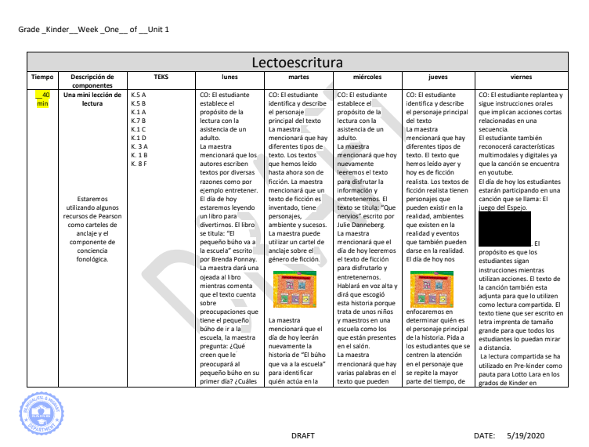
SAISD BILITERACY UNITS
Design Features - Dual Language
Paired Text for Each Unit
Culturally Responsive, student centered
Spanish / English
Weekly M-F Lessons
Integrated 7 Steps
Content & Language Objectives
Built on Literacy Squared Framework
Remote Learning Considerations

Slide 59
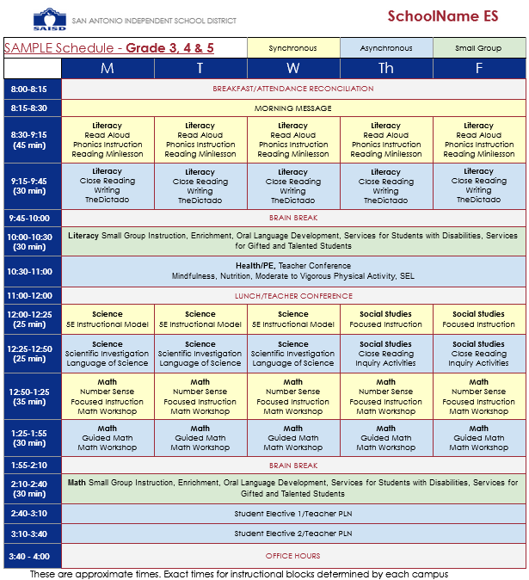
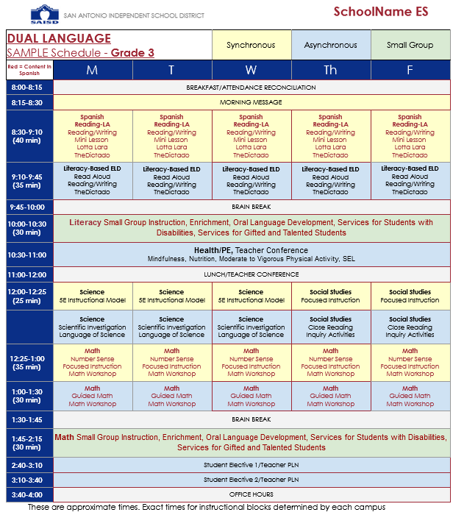
Sample Remote Learning Schedules

Slide 60
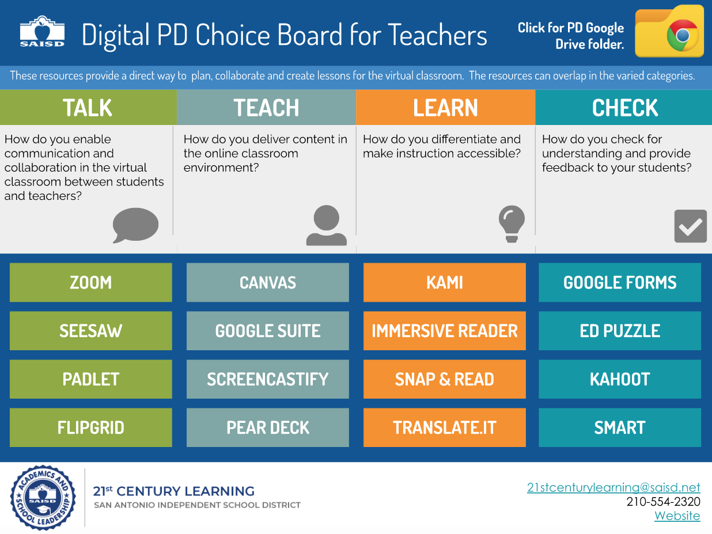
Professional Development
Modules were designed to support learners with interactive software applications applied in the Spring 2020 and in preparation for summer and fall lesson design and instructional programming.
Outlined in the Digital Learning Plan: A Guide to Lesson Design for the Digital Environment.
Building Student Engagement
Sheltered Instruction

Slide 61
Academic Acceleration Plan
Mathematics
High-Quality Initial On-Grade-Level Instruction
Adaptive Curriculum Software
Strategic Small Group Instruction
Supplemental Curriculum Planning Tools
Targeted Professional Development
Reading
High-Quality Initial On-Grade-Level Instruction
Adaptive Curriculum Software
Strategic Small Group Instruction
Targeted Professional Development
Sheltered Instruction in Blended Settings

Slide 62
MASTERY-BASED
ASSESSMENTS AND GRADING

Slide 63
Ethical and Accurate Assessment/Grading
Operational Tenets for Assessment and Grading:
Accurate Communication, Ethics, and Integrity
Expressing school performance as a report of evidence of specific standards.
Assessments and grades report learning, not doing.
Primary function of assessment is student learning, not documentation.
We can be mindful of:
What does an “A” performance really mean?
Are we grading solely on performance or behavior, or both?
How do we communicate assessment expectations to students and parents?
We can only achieve ethical assessment through vigilant attention to equity, differentiation and multiple pathways to achievement.

Slide 64
LITERACY PRACTICES

Slide 65
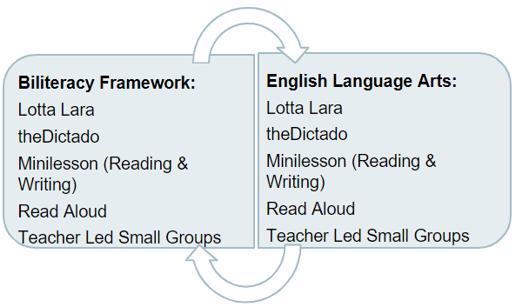
Aligned Literacy Frameworks

Slide 66
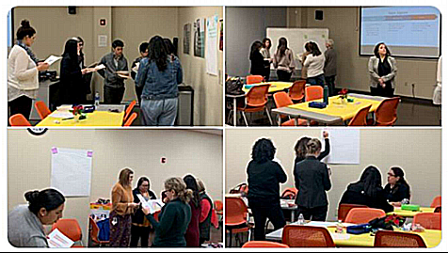
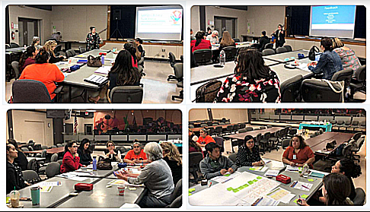
SAISD Literacy Task Force
Literacy Task Force
Executive Summary

Slide 67
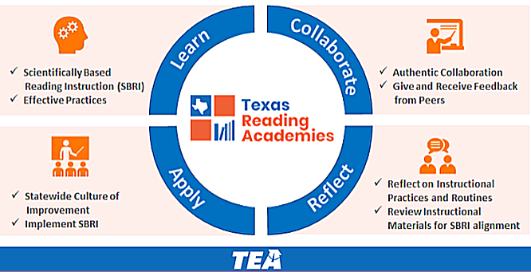
Texas Reading Academies
San Antonio ISD
Total Active Members: 1,075
Total Cohorts: 16
Biliteracy Cohorts: 4
K-3 Teachers: 661
Principals/APs: 128
SPED/Dyslexia: 161
Other: 125
Participants are required to complete 12 Modules and submit artifacts to demonstrate mastery of key Literacy, Oracy and Science of Teaching Reading concepts.

Slide 68
EQUITY AND ACCESS

Slide 69
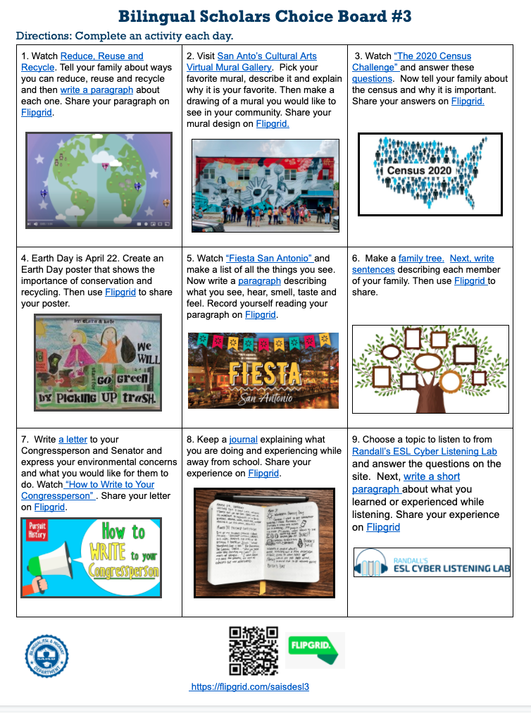
SHELTERED/LANGUAGE-CENTERED LESSON
Digital Design Features:
4+1 language domains are developed
Foster self-regulation through specific instruction
Promote student agency with choice
Provide clear expectations for working online and for collaboration
Utilize video tutorials to provide clear instructions and to model
Use lesson design features to build interactivity

Slide 70
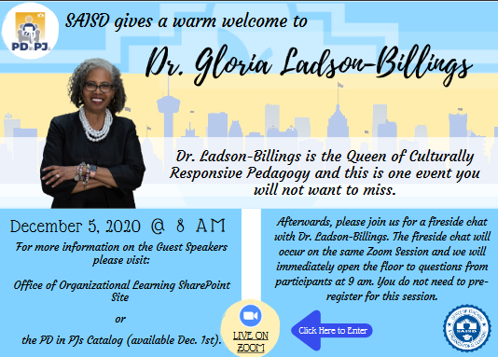
Racial Equity & Access
African American Studies
Culturally Responsive Education Cohort w/Dr. Gholdy Muhammad
Overview
50 Teachers
2 Meetings per Month
Cultivating Genius
Presenters, Film Screenings, & Firesides
Instructional Leadership Academy
Dr. Victor Rios | Paul Gorski
Dr. Dena Simmons | Jeff Duncan Andrade
Lynmara Colón | Hamish Brewer
Dr. Olla Hajah Al-Shalchi | Dr. Monique Morris
Gloria Ladson-Billings | Bettina Love

Slide 71
SOCIAL AND EMOTIONAL

Slide 72
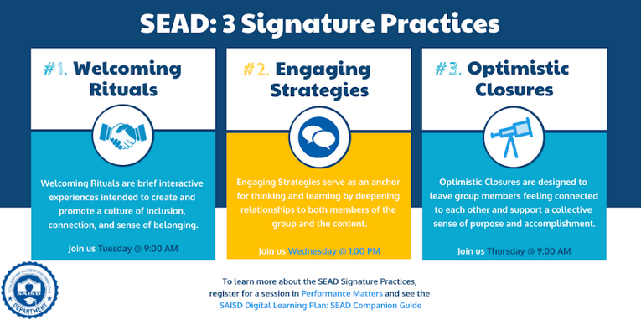
Student and Educator
Mental Health & Wellness

Slide 73
Engaging with Families
Learning Resources for Families
https://www.saisd.net/page/parentteacherconferences
Parent/Teacher Conference Window and Resources
Learning Outcomes by Nine-Weeks
Canvas Parent Toolkit
Parent & Students Webpage
Parent Workshops
Student Code of Conduct Resources

Slide 74
Questions for Our Guests?

Slide 75
Audience Question
Question:
How are you and fellow teachers incorporating lessons you have learned from addressing your students unfinished learning?

Slide 76
Audience Question
Question:
For all: How are you engaging your parents?

Slide 77
Audience Question
Question:
For Denver - For the unit internalization work, did all grade levels participate in this work or just some grade levels?
Notes:
Resources links from the chat
From Aly Martinez (She/Her) SDUSD to Everyone: 04:37 PM Hi! This will take you directly to our scope and sequence: https://sites.google.com/sandi.net/sdenhancedmath/prioritized-year-at-a-glance?authuser=0
From Aly Martinez (She/Her) SDUSD to Everyone: 04:27 PM SDUSD Prioritization public website: https://sites.google.com/sandi.net/sdenhancedmath/home Use tab on the upper right corner :)
From Kendra Doyle to Everyone: 04:50 PM The SAISD Year-at-a-Glance documents are found on our website: https://www.saisd.net/page/curriculum

Slide 78
Audience Question
Question:
For math educators: Do you have any plans to revise enrollment in advanced math courses next year due to students not completing accelerated pacing this year?

Slide 79
Audience Question
Question:
How did your district enhance distance learning for the arts courses?

Slide 80
Audience Question
Question (one per slide):
Denver: What does a remote lesson look like?

Slide 81
Please Join Us Again for the Rest of this Series!
Session 3
Leadership Perspectives: Best Practices & A Path Forward
Wednesday 12/16
7:00p ET
Panelists: Orange County Public Schools, San Diego Unified, Denver Public Schools, LAUSD
Registration link coming soon!

Slide 82
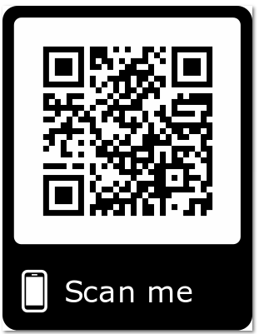
Join our networks!
https://achievethecore.org/ca-signup
twitter.com/achievethecore
twitter.com/GreatCitySchls
Facebook: facebook.com/achievethecore
Pinterest: pinterest.com/achievethecore

Slide 83
Thank You!

