Slide 1

Welcome to the Early Reading Accelerators Webinar Series

Slide 2
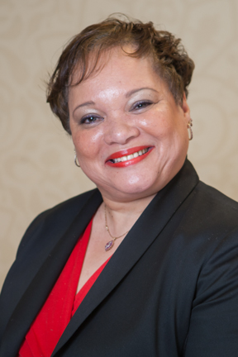



Welcome and Overview
Carey Swanson, SAP
Robin Hall, CGCS
Stacy Wetcher Gad, SAP
Gabriela Uro, CGCS

Slide 3


Virtual tips!
This session is being recorded and the recording will be shared
Because of our large group size today, participants will be muted
Use the chat box for logistical questions or to share with the audience. We will not have a Q&A for this session.
Some of the ways we’ll engage together today
Interactive poll
Chat questions!
Collaborative
Q&A google doc
Resource List
Notes:
https://docs.google.com/document/d/1ODT8fryfTJYd_t_3V53ImkKMQOUscM6gMI3QaqHlA4w/edit

Slide 4
Today’s Agenda!
Welcome and Overview
San Antonio Independent School District
Charlotte Mecklenburg Schools
PS 182, New York City
Guilford County
Now, what?

Slide 5
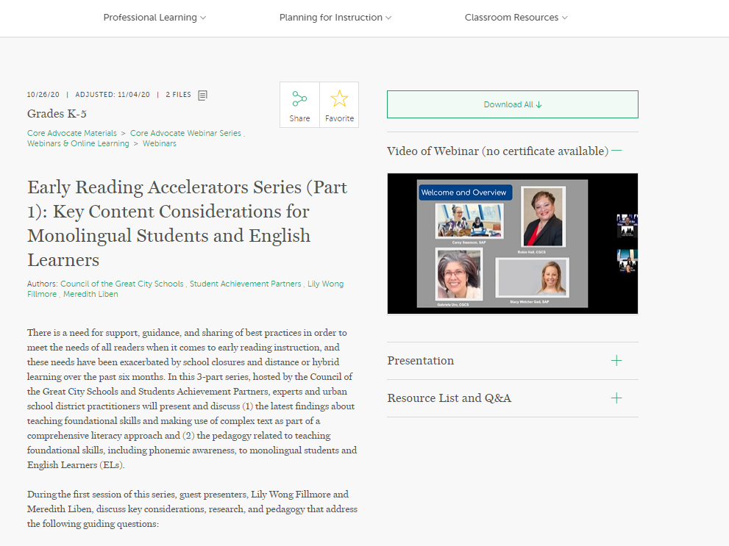
An overview of Webinar 1:
Key Content Considerations for Monolingual Students and English Learners
http://bit.ly/Webinar1ERA
Notes:
https://achievethecore.org/page/3314/early-reading-accelerators-series-part-1-key-content-considerations-for-monolingual-students-and-english-learners

Slide 6
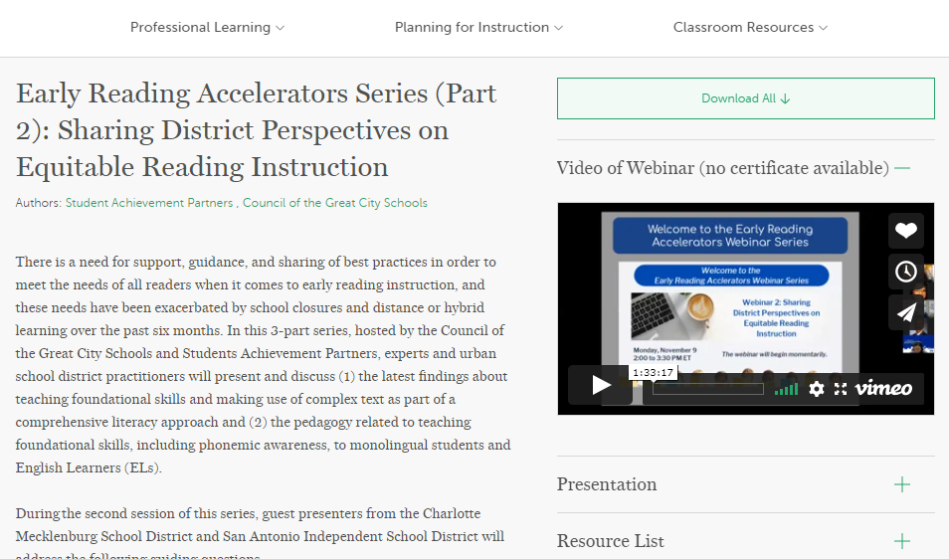
An overview of Webinar 2:
Sharing District Perspectives on Equitable Reading Instruction
Notes:
https://achievethecore.org/page/3316/early-reading-accelerators-series-part-2-sharing-district-perspectives-on-equitable-reading-instruction

Slide 7

Guiding Questions for Today’s Webinar
What are examples of innovative practice that teachers are using in hybrid, remote, and face to face early literacy instruction?
What benefits are educators seeing on the students they work with? Are there students where this work has had more or less impact, and can educators trace why?
What things have educators learned that haven’t worked for the students in their class?

Slide 8
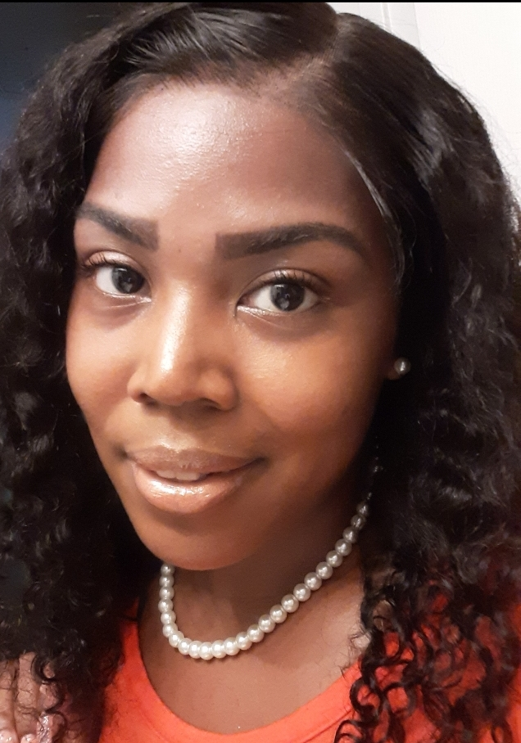

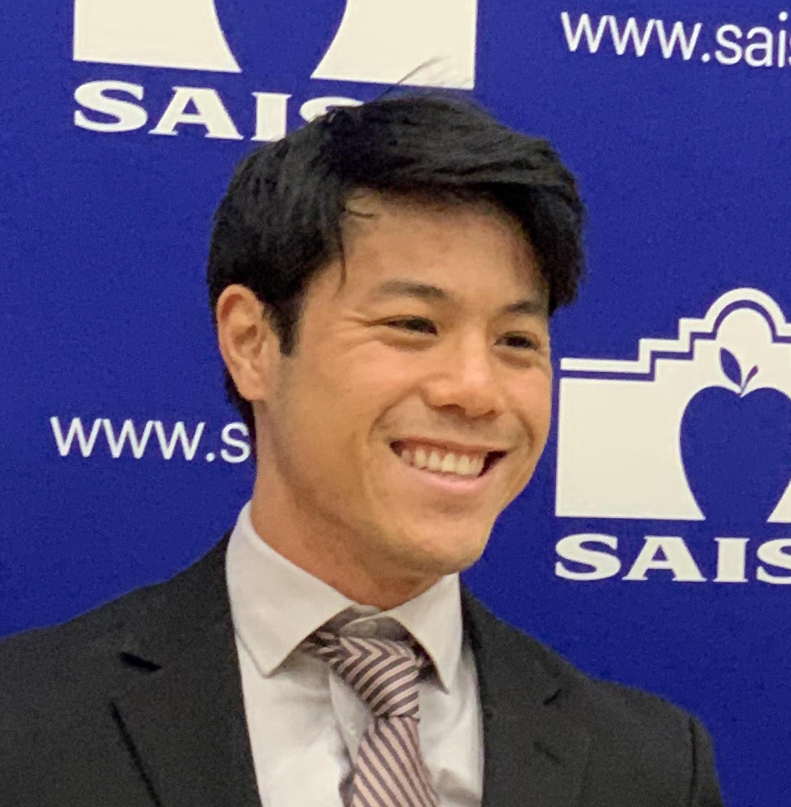

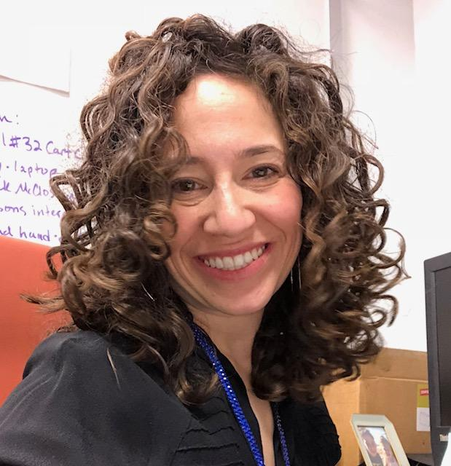
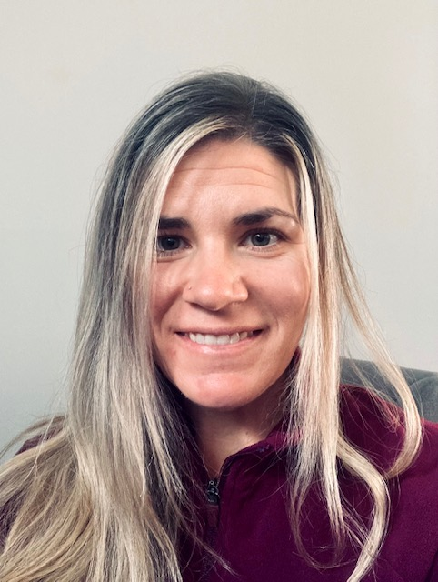

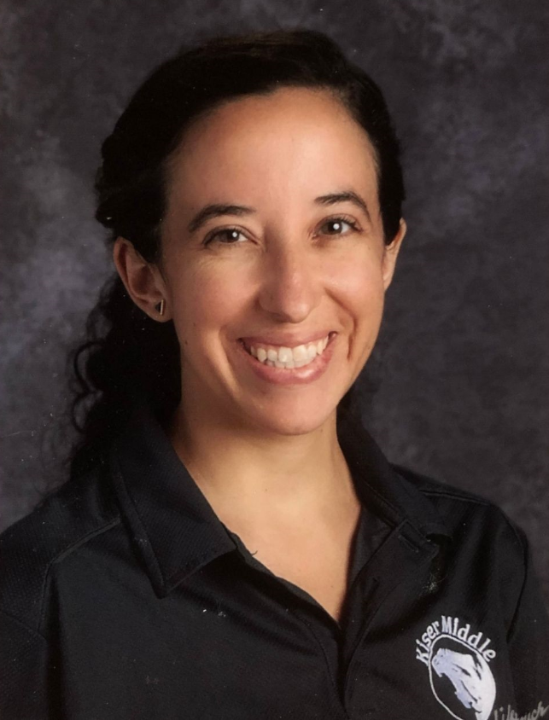
Today’s Presenters
Zach Chan, Rebecca De Leon
San Antonio ISD
Crystal Graham, Anna Renne
Charlotte Mecklenburg Schools
Rachel Rosenbaum, Allison Velez
PS 182, NYC Public Schools
Heidi Davis, Alegria Rodriguez
Guilford County Public Schools

Slide 9

Zach Chan and Rebecca De Leon,
San Antonio Independent School District
Zach Chan
3rd grade teacher
Irving Dual Language Academy
Rebecca De Leon
Principal
Graebner Elementary

Slide 10

Biliteracy Framework for Early Reading Accelerators

Slide 11
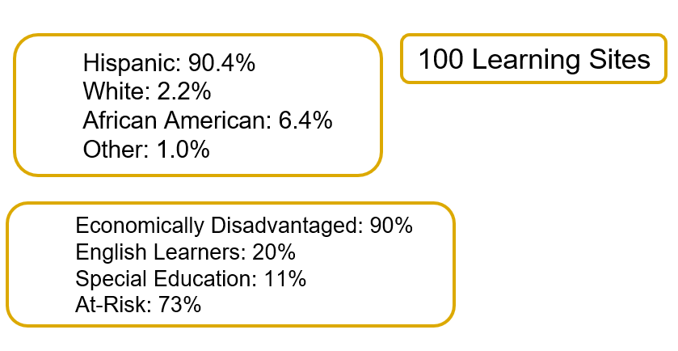
San Antonio ISD Demographics
Notes:
We are in the heart of San Antonio Tx serving a 90% Hispanic Population and 90% Economically Disadvantaged across 100 learning sites.

Slide 12
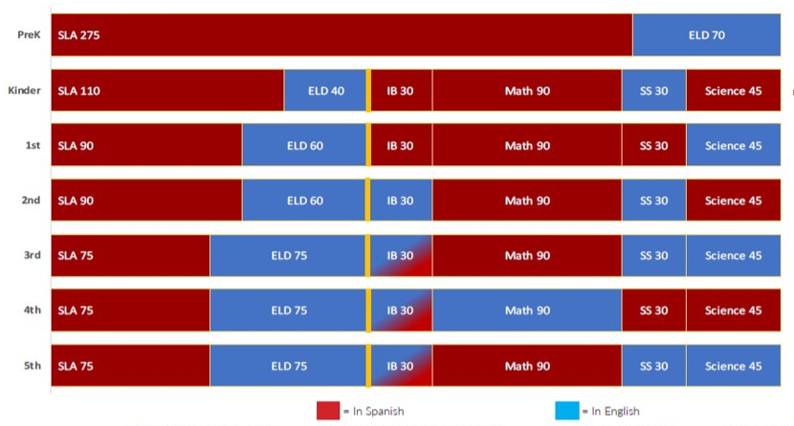
Dual Language Model
Notes:
We are in the heart of San Antonio Tx serving a 90% Hispanic Population and 90% Economically Disadvantaged across 100 learning sites.

Slide 13
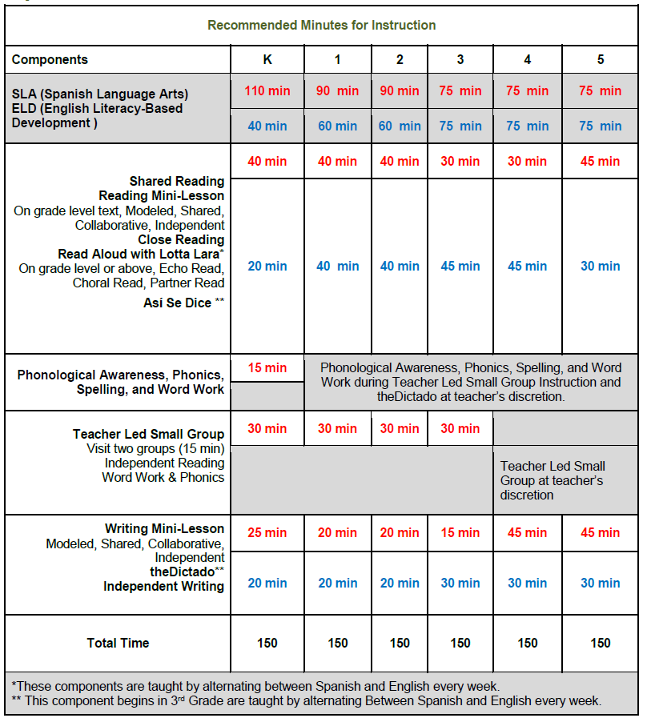
Biliteracy Framework
Notes:
We are in the heart of San Antonio Tx serving a 90% Hispanic Population and 90% Economically Disadvantaged across 100 learning sites.

Slide 14



The Partnership and The Pilot
Notes:
Starting in the Fall of 2018 we began a partnership for the Early Readers Accelerator Pilot with a targeted goal of improving early literacy practices centered around complex texts, explicit and systematic phonics instruction, and text centered lessons with text sets and written student tasks. Through this unique partnership we engaged in deep conversations about research, policy, and classroom practice. We reflected on some deeply held assumptions (misconceptions) around literacy instruction.

Slide 15
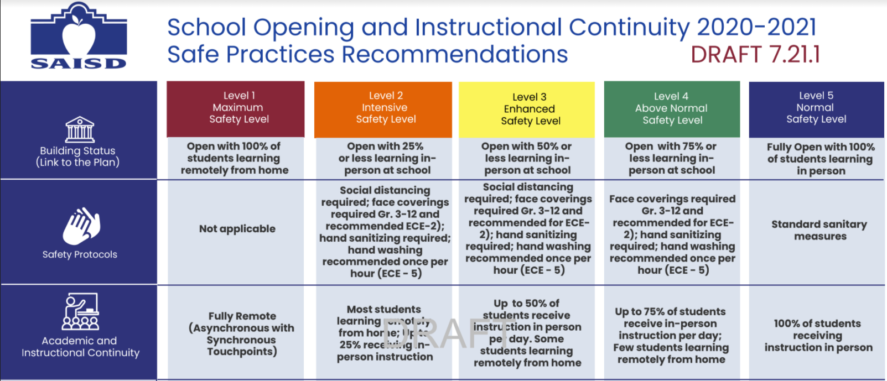
COVID-19 Response
March 2020 - 100% virtual for the rest of the academic year
August 2020 - 100% virtual for the first three weeks of school
Notes:
We are in the heart of San Antonio Tx serving a 90% Hispanic Population and 90% Economically Disadvantaged across 100 learning sites.

Slide 16
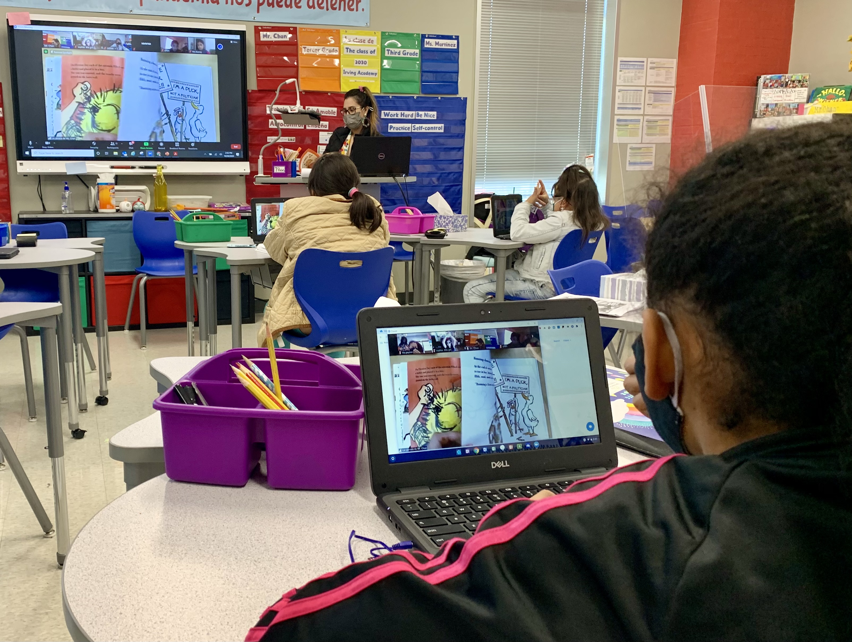
COVID-19 Response
September 2020 - present
Most classrooms have been operating a hybrid model.
All K-1st classrooms use ZOOM for synchronous learning and CANVAS/SeeSaw for asynchronous learning.
Notes:
We are in the heart of San Antonio Tx serving a 90% Hispanic Population and 90% Economically Disadvantaged across 100 learning sites.

Slide 17
Guiding Questions for Today’s Webinar
What things have educators learned that haven’t worked for the students in their class?
What are examples of innovative practice that teachers are using in hybrid, remote, and face to face early literacy instruction?
What benefits are educators seeing on the students they work with? Are there students where this work has had more or less impact, and can educators trace why?
Notes:
We will tackle these questions in a different order

Slide 18


Lessons learned
Teachers were told to read a complex, above grade level text.
Teachers were instructed to create knowledge building text set units that were to last for 2 weeks.
So they chose books based solely on complexity - complexity for complexity’s sake.
Then they tended to focus on knowledge building and not on foundational skills.
Text selection is key.
Direct phonics instruction is integrated.

Slide 19




Examples of Innovative Practice
Text selection is key.
Relevancy has many different aspects to it.
Teachers continued seasonal/holiday based texts, only now with complexity.
Current events, both global and local, made texts interesting and pertinent.
Notes:
If it gets high engagement, go for it!

Slide 20
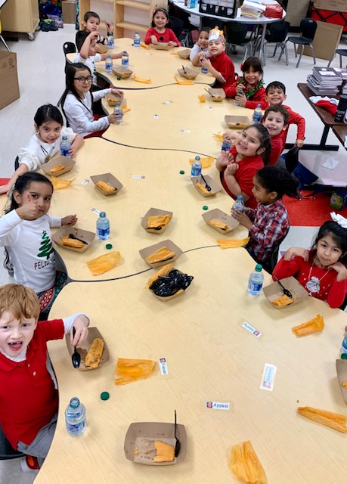
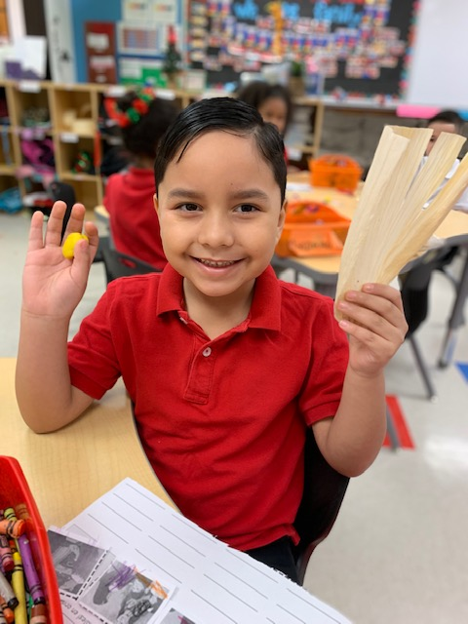
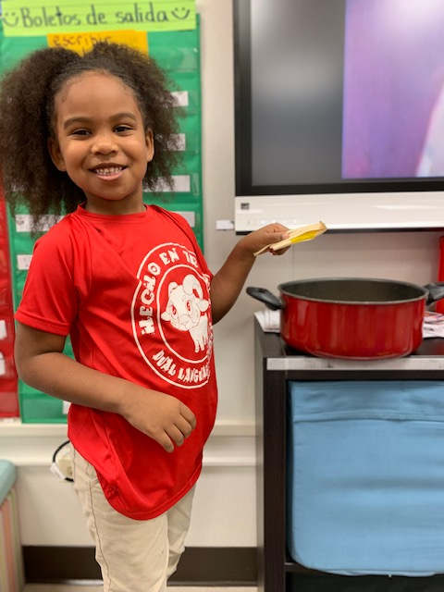
Examples of Innovative Practice
Notes:
Add pictures here!

Slide 21
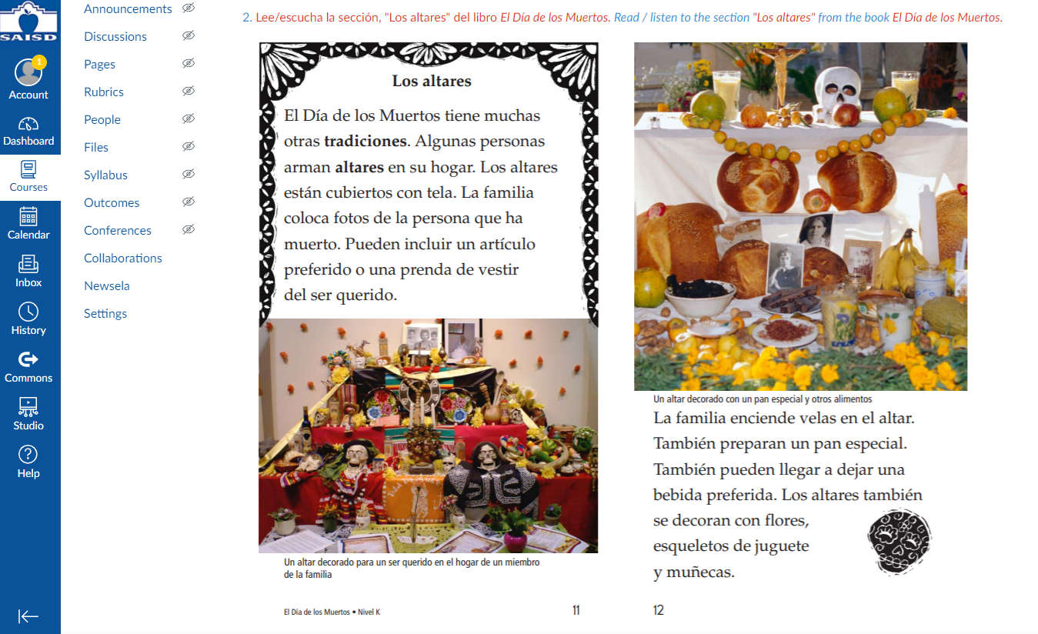
Examples of Innovative Practice
Text selection is key.
Complexity can be scaled and scaffolded.
Aided by technology, students became skilled in “diving deep” into a text.
Notes:
Self efficacy played a role in

Slide 22

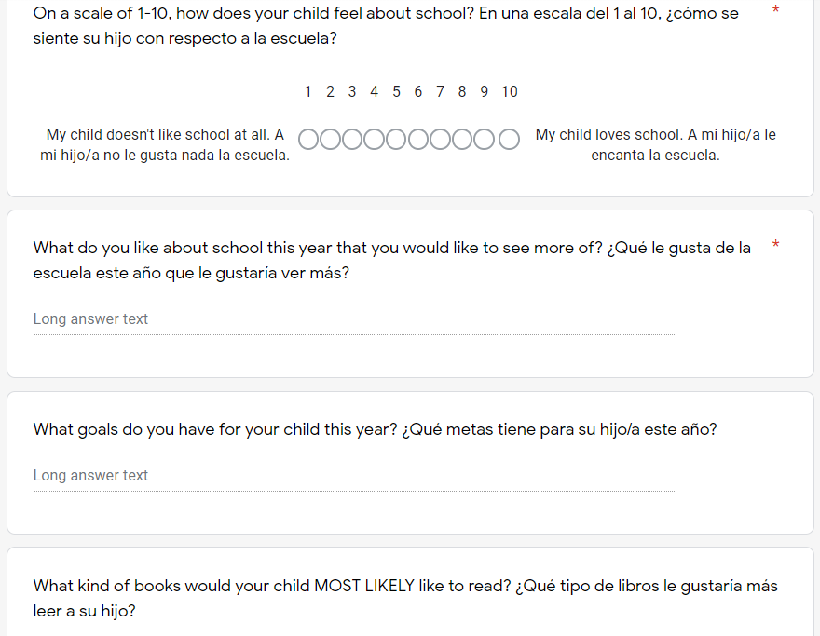
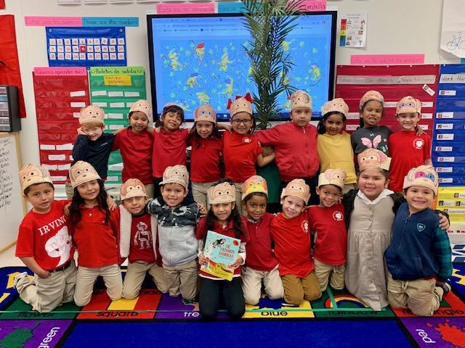
Examples of Innovative Practice
Text selection is key.
Authentic interest cannot be faked.
Teachers have created electronic interest surveys for both students and parents.
Teachers chose books that they were excited to teach.

Slide 23




Examples of Innovative Practice
Teachers chose books that they were excited to teach.

Slide 24
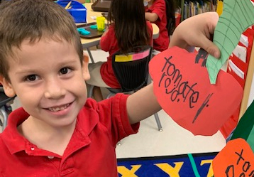
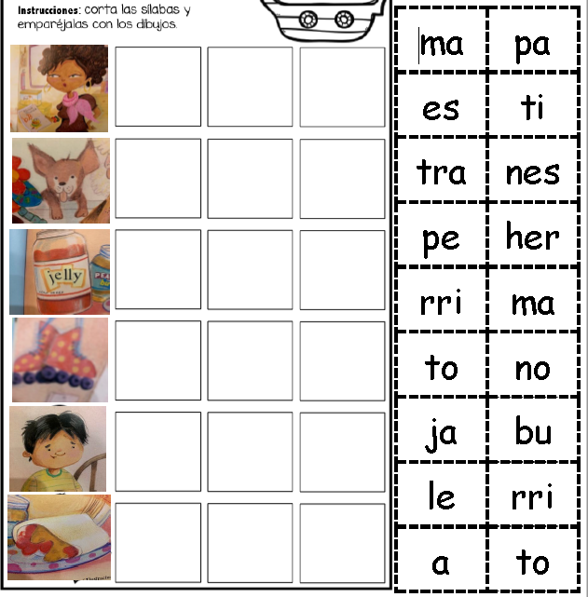
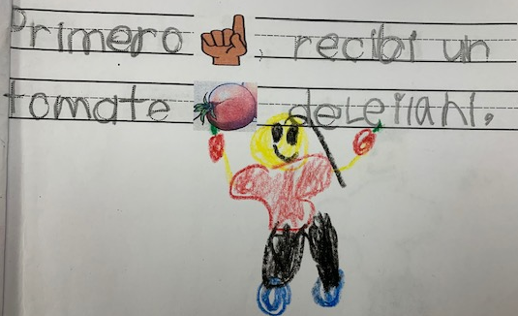
Examples of Innovative Practice
Direct phonics instruction is integrated.
Anchor texts provided the nails; teachers had to choose which to hammer.
Teachers and students made connections to the words in the anchor text.
Teachers have used technology to create activities based on the phonics of the words from the text.

Slide 25
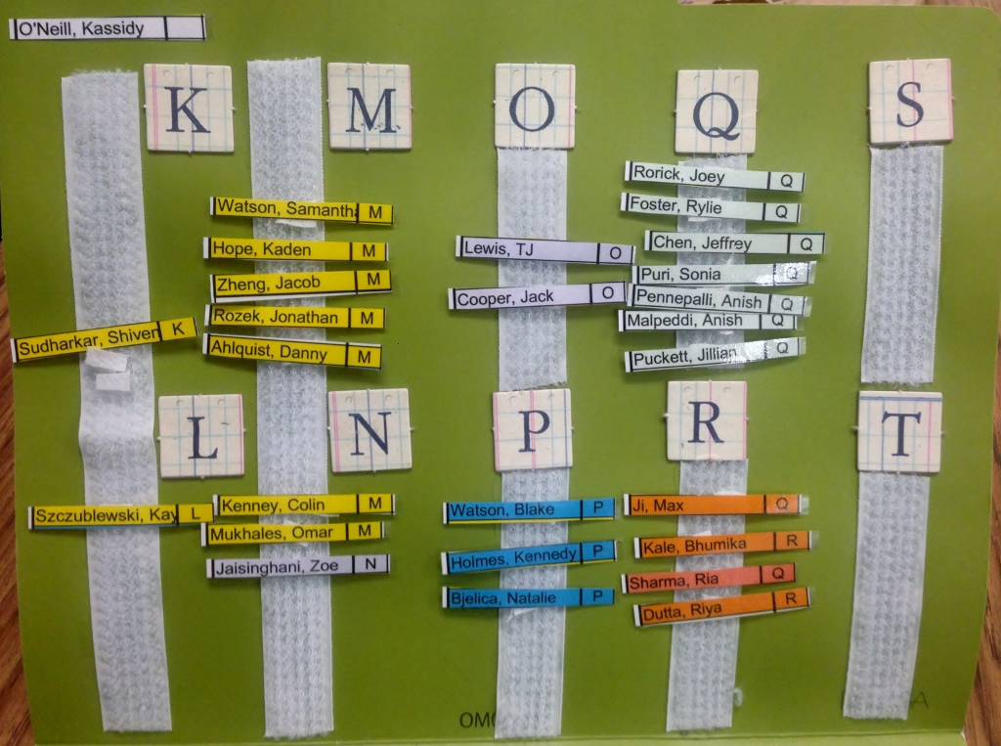
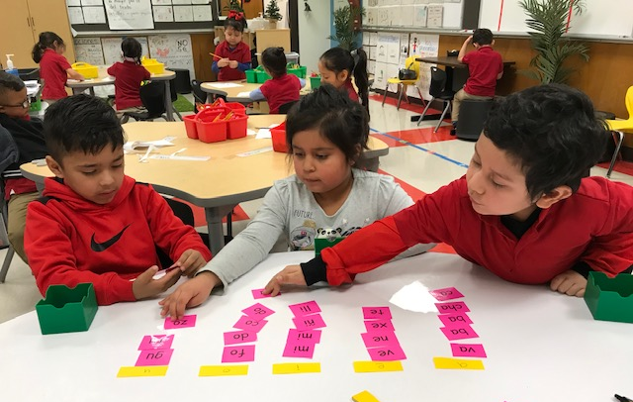
Examples of Innovative Practice
Direct phonics instruction is integrated.
Small group instruction is targeted and phonics driven.
Teachers stopped heavy reliance on leveling.
Teachers instead focused on skills, which has sharpened instruction and made it more effective.
Notes:
Reasons why for leveling:
Smooth vs. effective
Knowledge gap in phonics instruction

Slide 26
Examples of Innovative Practice
Direct phonics instruction is integrated.
Small group instruction is targeted and phonics driven.
Teachers focused on skills, which sharpened instruction and made it more effective.
Notes:
Reasons why for leveling:
Smooth vs. effective
Knowledge gap in phonics instruction

Slide 27
Examples of Innovative Practice
Direct phonics instruction is integrated.
Small group instruction is targeted and phonics driven.
Teachers focused on skills, which sharpened instruction and made it more effective.
Notes:
Reasons why for leveling:
Smooth vs. effective
Knowledge gap in phonics instruction

Slide 28
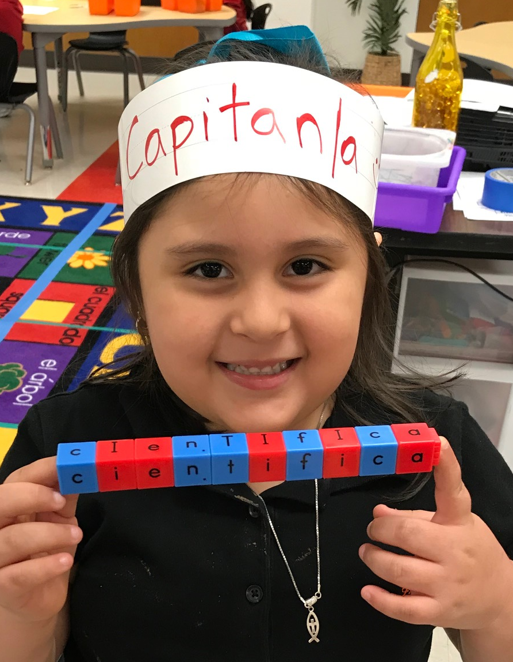
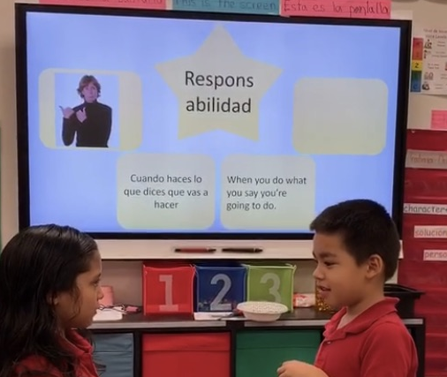
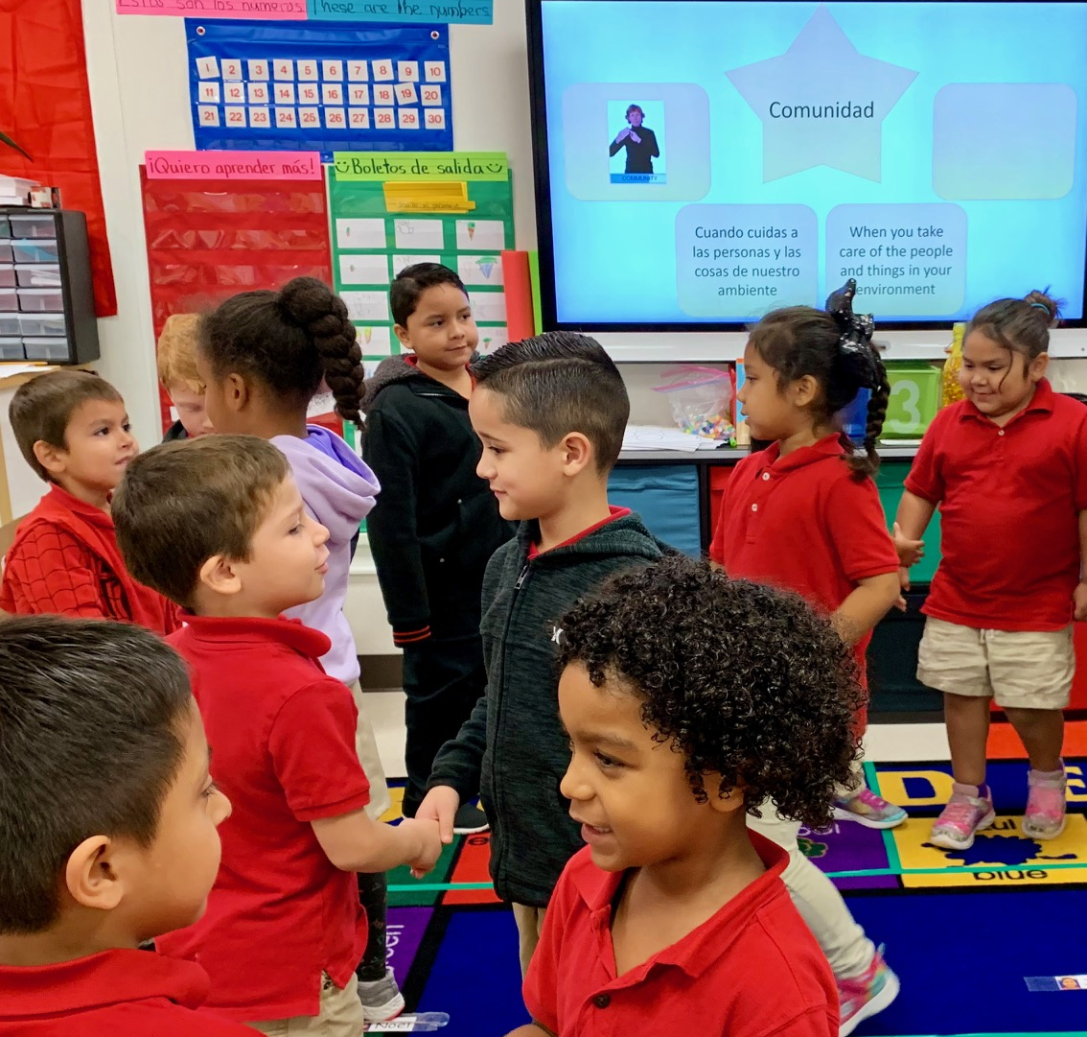
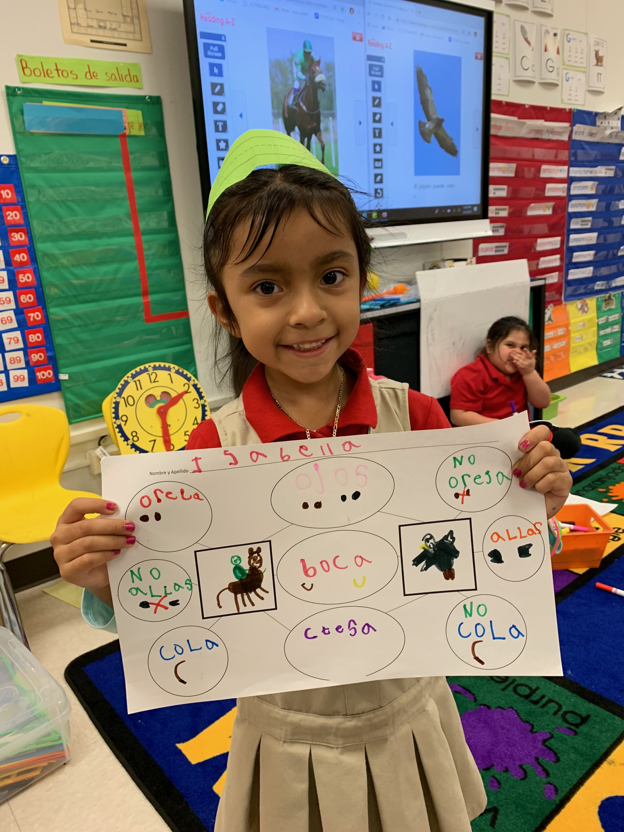
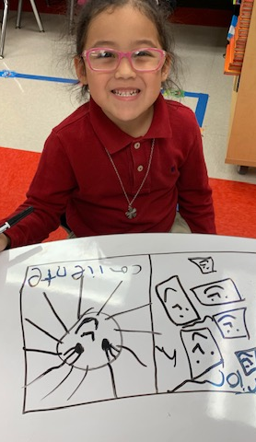
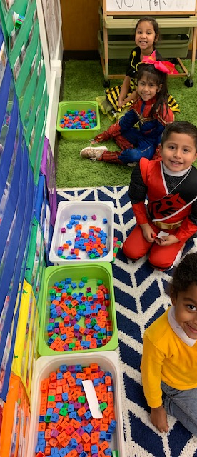
Student Benefits
Vocabulary acquisition has started very early on in a students’ literary journey, at very high levels.
Notes:
Creating a language rich environment IN CONTEXT.

Slide 29

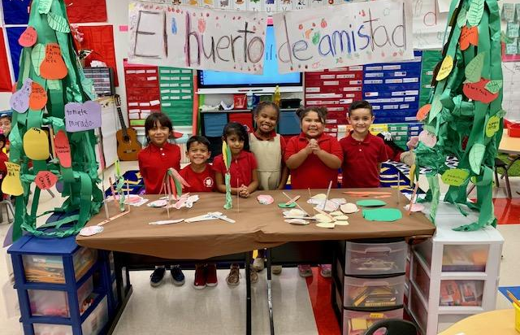
Student Benefits
Enjoyment of reading has risen significantly, especially with the low-achieving 25% of the class.

Slide 30
Charlotte-Mecklenburg Schools

Slide 31

The Early Reading Accelerators: Considerations for Equitable Instruction from Educator Voice
Slide Deck
Click Here t.ly/iVUT

Slide 32
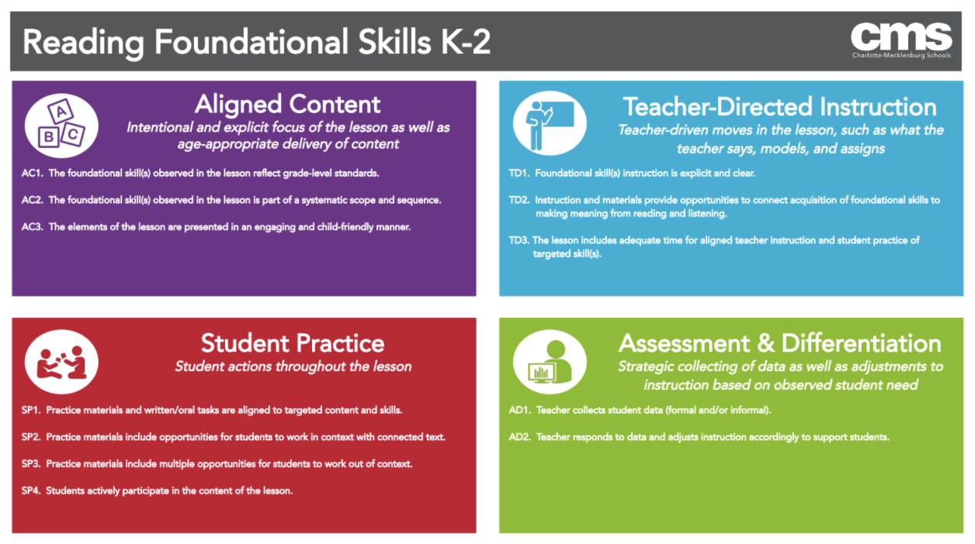
Notes:
Trish

Slide 33
Anna Renne
I obtained my elementary education degree at UNC Charlotte with a concentration in english and communications. This is my second year as part of the Success by Design program as an EIT1.
I am a first grade teacher at Paw Creek Elementary. This year, I am fully remote with my students and my school is a Title I STEM magnet.
On my PLC, I am the literacy lead and part of the school’s ILT team.

Slide 34

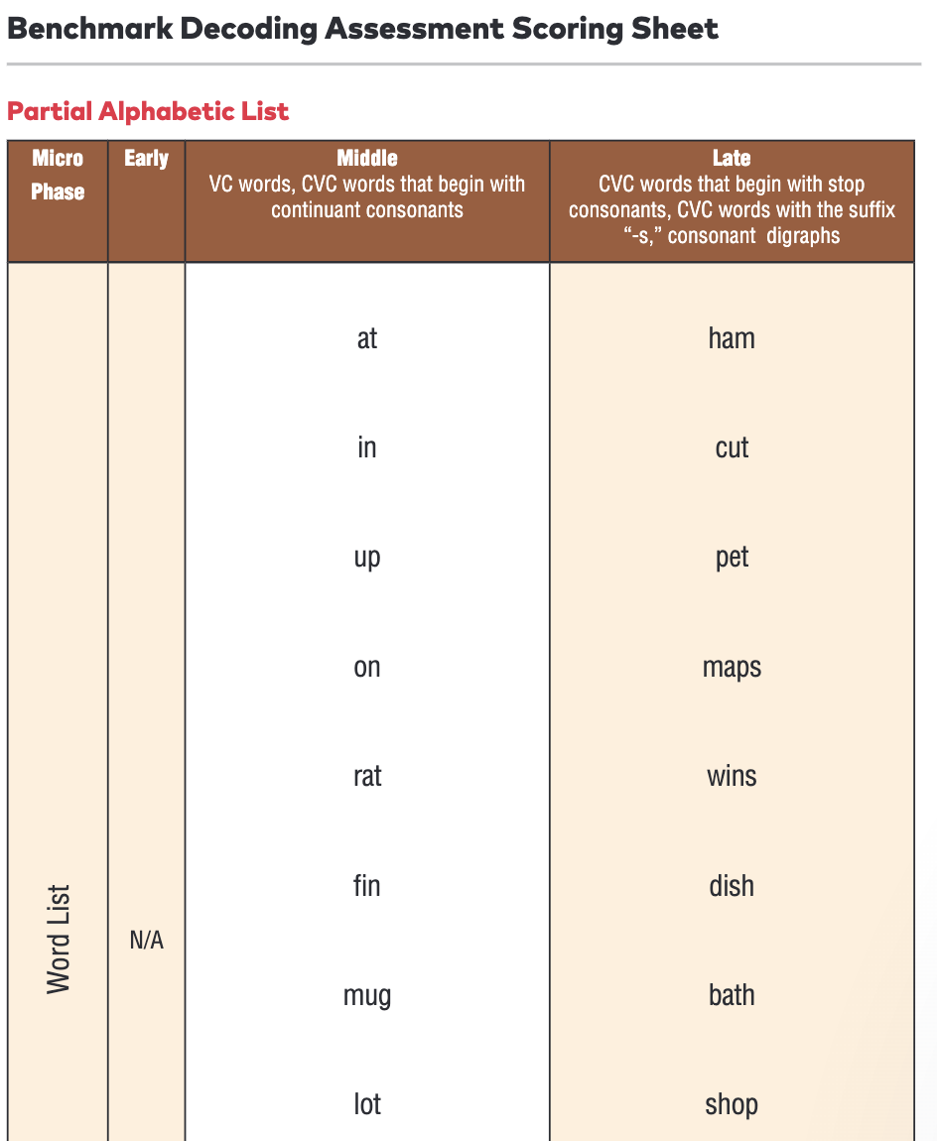
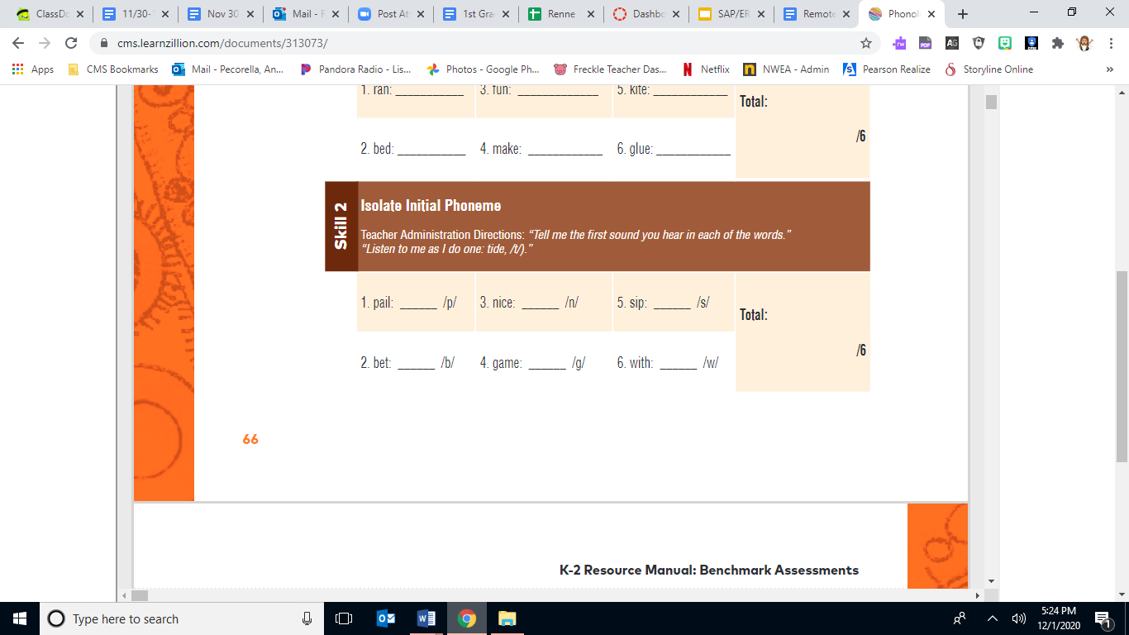
Innovative Practices
Assessment
BOY, MOY, EOY (Example on next slide)
Phonological skills
Notes:
Testing is the same from school to school and follows the student. The teacher assessing the student knows exactly what the student struggles or does well on the day they walk in the door. Examples include: letter name and sound identification, rhyming, isolating BME phonemes, adding BME phonemes, substituting BME phonemes, deleting BME phonemes, as well as counting and blending phonemes.
Letter name and sound identification- TRC was great at telling us a student’s fluency level and annotating mistakes as they read was helpful but knowing exactly which letters, blends, and digraphs students do not know makes it easier to understand where to begin to fix misconceptions and problem areas as opposed to looking at such a broad scope. I have seen students walk in as an ELL not knowing very much about the English language begin to speak, know all of their letter names/ sounds, and be able to spell/ decode simple CVC words by mid year with the practices we use now because we have a true idea of what they know and don’t know when they come to us. We know if we need to start as basic as, what letter is this? To as extensive as let’s write paragraphs or read books with complex patterns.
Phonological testing allows us to see which skills they obtain with taking all of their knowledge and manipulating it.
The reason I love encoding is because it gives us a great foundation of true letter name and sound understanding. When we work on this students not only become better writers and spellers they can use the skill of breaking words down to their smallest component when they come to a difficult word when reading. I have had plenty of conversations with parents and they have also seen the switch between their child solely relying on pictures, which does not always help, to taking the time to tap out each sound in a word and looking for parts they know and using the picture to check kind of like math. They have a strategy to solve and a strategy to check their work.
With every cycle we spend the first day introducing the topic to be learned such as syllables, the digraph th, etc. The second day we incorporate comprehension and high frequency words through decodable readers. The third day is spent spelling to complement reading such as chaining such as if working on short A we might chain cat to sat to mat. The fourth day we used everything we have learned to practice sentence dictation. The fifth day is used for assessment. Everyone in every school follows the same slides and daily practices during this time. I have had students come from other schools able to pick up the next day's lesson alongside my class which a full understand of what skill we are working on, who the character is in the decodable this week, and how the lessons flow without a problem. In these lessons we work on high frequency words, encoding, decoding, nonsense words, and decodable readers. With the readers we incorporate comprehension skills and can easily adapt it to fit the needs of the student or group we are working with.
In the teacher group we work on activities like using magnetic letters to substitute, add, delete, or chain words based on spelling patterns we are learning or concepts to be taught such as that, hat, hatch or yell, yells, yelled, yelling. We also work in the decodable readers where we can use books based on where they students are in their understanding of letter and sound knowledge from any level we need. Every teacher in every school has access to the same resources.

Slide 35
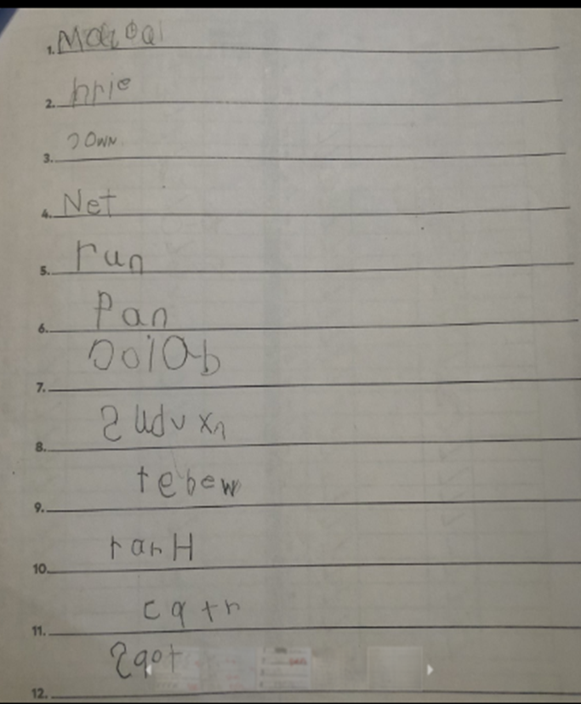
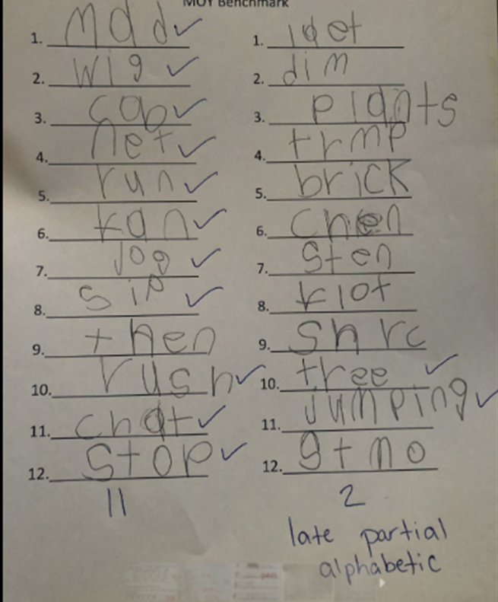


Notes:
Pre- Alphabetic, 3 words correctly spelled, inventive spelling
Moved up 3 levels by mid- year. Wrote letter sounds and blends we learned. Most only missing a letter or two such as dim for dime

Slide 36
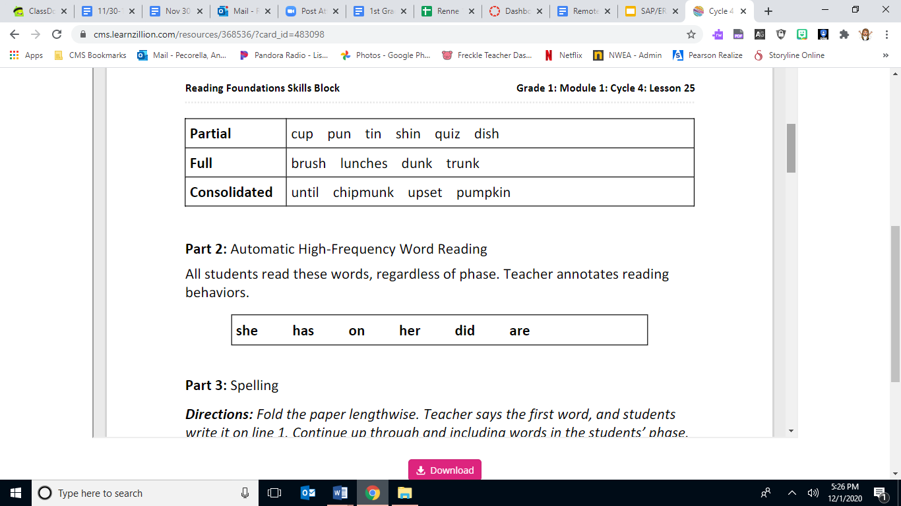
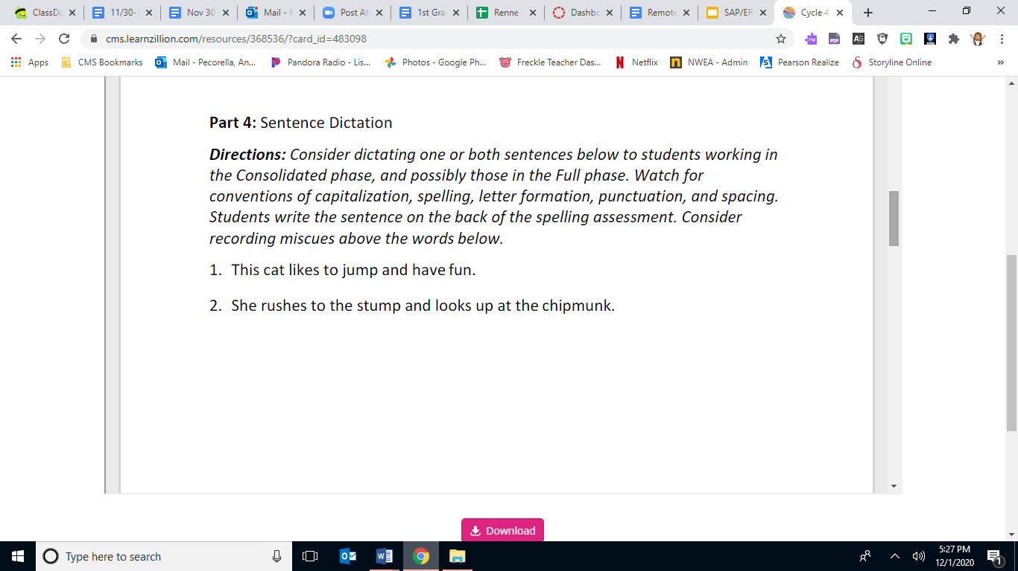
Innovative Practices
End of cycle testing allows us to see mastery of patterns student’s are currently working on. Students are tested on high frequency words, decodable words, spelling, sentence dictation, and fluency.
Part 1- Decodable Words
Notes:
Cycle testing- every teacher in every school uses the same cycle testing.

Slide 37
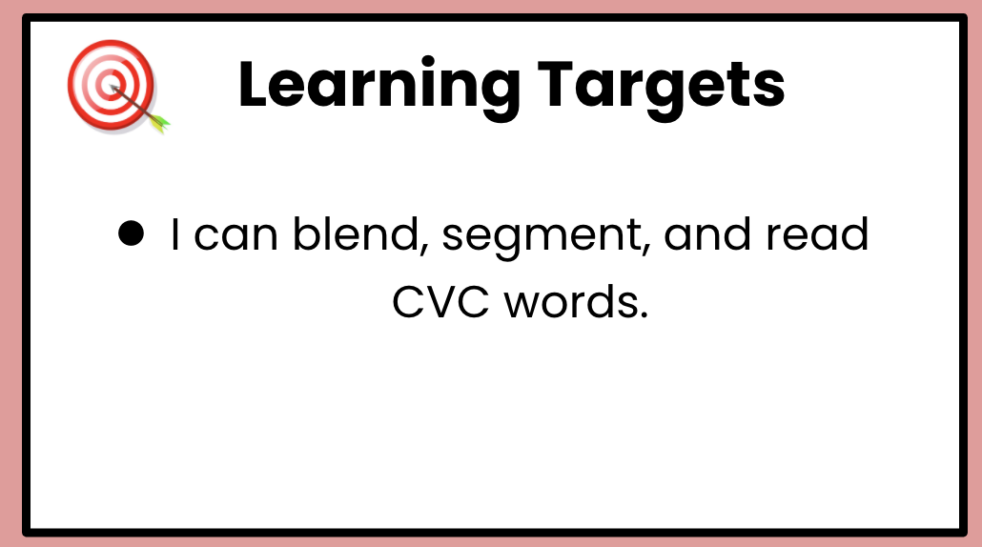
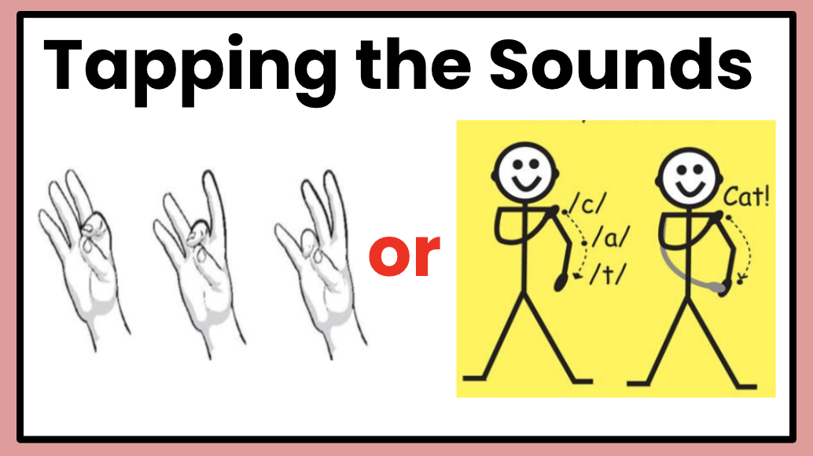
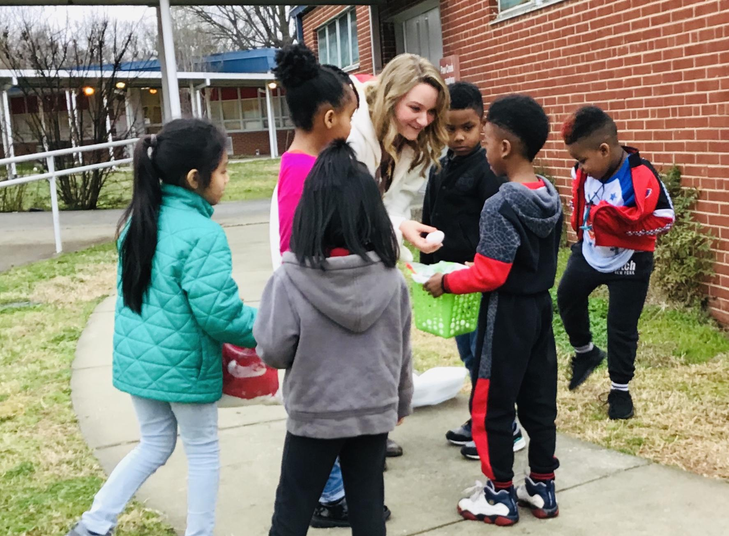
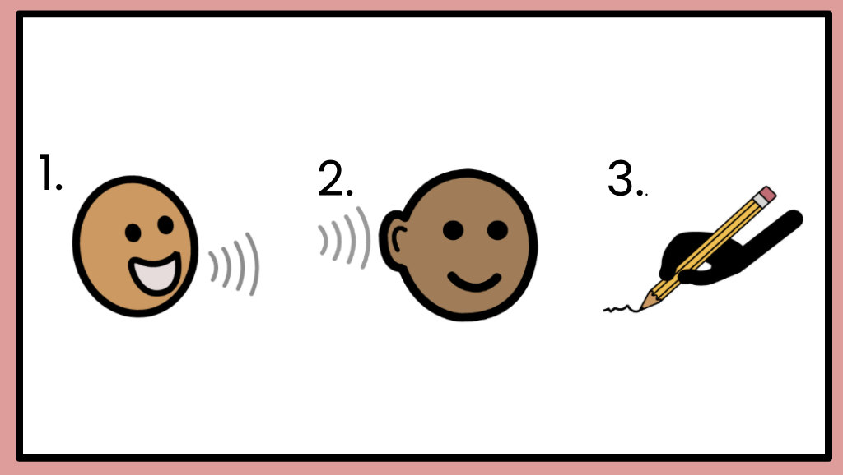
Innovative Practices
Instruction
15 Min- Grade Level Mini Lesson
45 Min- Small Group Microphase
Notes:
Testing is the same from school to school and follows the student. The teacher assessing the student knows exactly what the student struggles or does well on the day they walk in the door. Examples include: letter name and sound identification, rhyming, isolating BME phonemes, adding BME phonemes, substituting BME phonemes, deleting BME phonemes, as well as counting and blending phonemes.
Letter name and sound identification- TRC was great at telling us a student’s fluency level and annotating mistakes as they read was helpful but knowing exactly which letters, blends, and digraphs students do not know makes it easier to understand where to begin to fix misconceptions and problem areas as opposed to looking at such a broad scope. I have seen students walk in as an ELL not knowing very much about the English language begin to speak, know all of their letter names/ sounds, and be able to spell/ decode simple CVC words by mid year with the practices we use now because we have a true idea of what they know and don’t know when they come to us. We know if we need to start as basic as, what letter is this? To as extensive as let’s write paragraphs or read books with complex patterns.
Phonological testing allows us to see which skills they obtain with taking all of their knowledge and manipulating it.
The reason I love encoding is because it gives us a great foundation of true letter name and sound understanding. When we work on this students not only become better writers and spellers they can use the skill of breaking words down to their smallest component when they come to a difficult word when reading. I have had plenty of conversations with parents and they have also seen the switch between their child solely relying on pictures, which does not always help, to taking the time to tap out each sound in a word and looking for parts they know and using the picture to check kind of like math. They have a strategy to solve and a strategy to check their work.
With every cycle we spend the first day introducing the topic to be learned such as syllables, the digraph th, etc. The second day we incorporate comprehension and high frequency words through decodable readers. The third day is spent spelling to complement reading such as chaining such as if working on short A we might chain cat to sat to mat. The fourth day we used everything we have learned to practice sentence dictation. The fifth day is used for assessment. Everyone in every school follows the same slides and daily practices during this time. I have had students come from other schools able to pick up the next day's lesson alongside my class which a full understand of what skill we are working on, who the character is in the decodable this week, and how the lessons flow without a problem. In these lessons we work on high frequency words, encoding, decoding, nonsense words, and decodable readers. With the readers we incorporate comprehension skills and can easily adapt it to fit the needs of the student or group we are working with.
In the teacher group we work on activities like using magnetic letters to substitute, add, delete, or chain words based on spelling patterns we are learning or concepts to be taught such as that, hat, hatch or yell, yells, yelled, yelling. We also work in the decodable readers where we can use books based on where they students are in their understanding of letter and sound knowledge from any level we need. Every teacher in every school has access to the same resources.

Slide 38
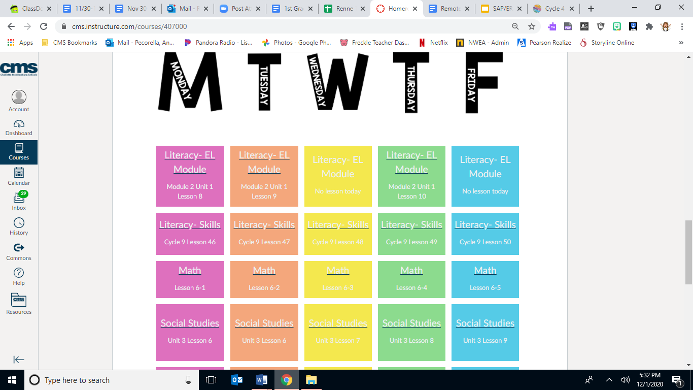
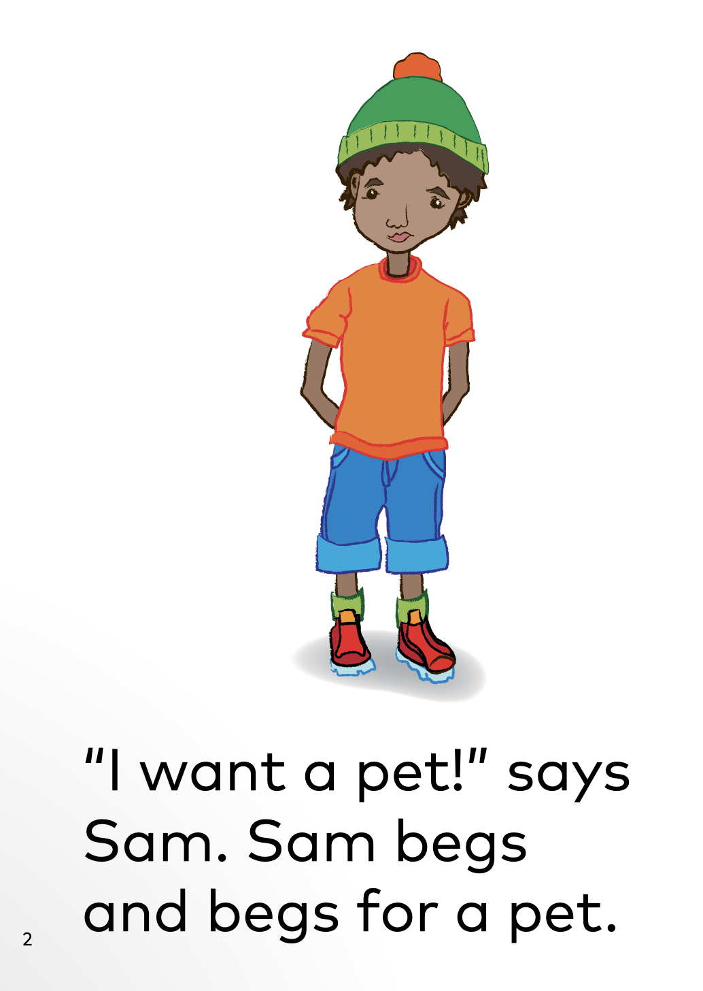

Virtual Practices for Access
Canvas (Example on next slide) Decodable Readers At-home supplies Supplemental games/websites
Notes:
Students are utilizing Canvas where they all have access to the same lessons being taught in the same order we would do if we were in school.
When the students are live with us we continue to work on the grade level skills being taught in the lessons and then focus on what they need individually in small groups or during one on one check- ins throughout the week.
When in small groups students
still have access to decodable
readers, cycle and benchmark testing,
whiteboards/ markers to manipulate
spelling patterns and show what they
know, as well as online games or
websites we can send to practice encoding or decoding.

Slide 39
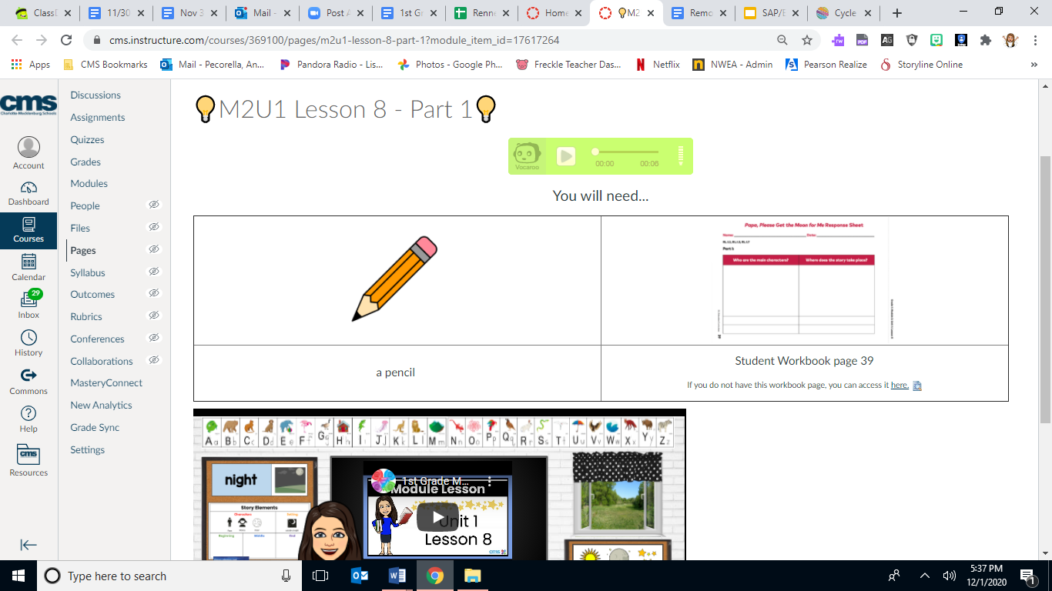

Slide 40
Student Benefits
For ELL learners we are now focusing on building a strong core understanding of the English language while building in and up to comprehension skills. (Example on next slide) Students experience writing, reading, and spelling daily. No matter what school they come from we are all learning and progressing at the same rate. Rigorous activities are expected and are constantly analyzed to make sure they truly match the standards being taught as well as the needs of the student. Truly thinking about the whole literate student, their background, and what we can do to help both in and out of school.
Notes:
Parents now receive information on how to improve students reading, spelling, speaking, etc. They know exactly where to begin helping their student because we now know exactly where to begin.
If it does not match it is not done. Everything done from what the student sees to what they work on is intentional with them in mind.
We are no longer strictly focusing on comprehension and fluency. We are focusing on improving them in every aspect.

Slide 41
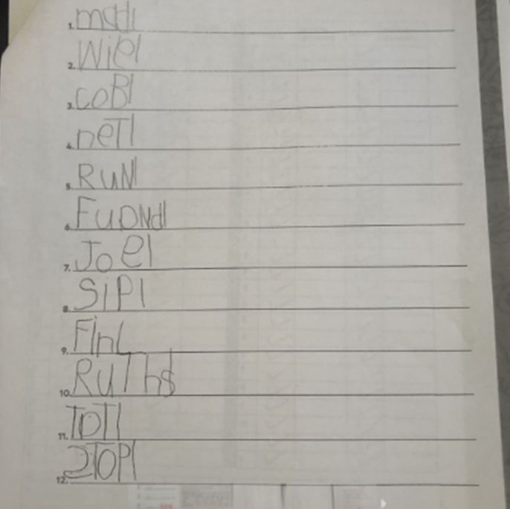
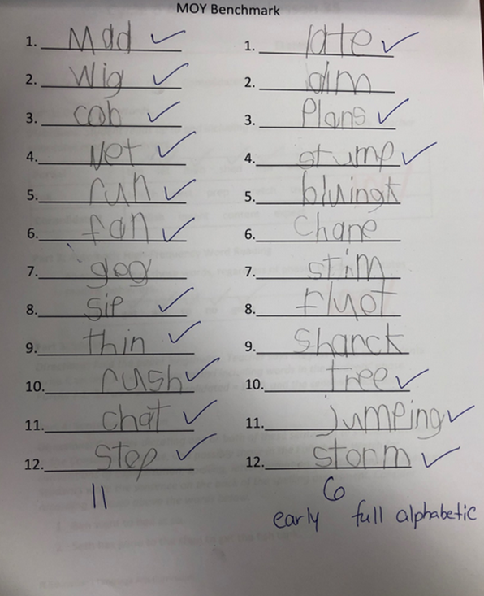


Notes:
ELL Student Example- Male student from African whose first language was French
BOY- added a L to represent a space after each word. Did better at simple CVC words.
MOY- moved 3 levels by mid year to early full alphabetic. Understands grammar/ using letter sounds

Slide 42
Lessons Learned
Before focusing on the foundational skills everything was centered on comprehension. Now that we have gone back to filling in the holes and connect the gaps with foundational skills I notice the student’s ability to read fluently easier and spend less time stuck on a word since they now use their strategies to sound out the words. I saw a tendency in myself to stick strictly to “the script.” However, now that I have a better understanding of how to analyze the data and use the cycle assessments and benchmarks to measure growth, each group receives what they truly need.
Notes:
I currently have my lowest group working on words with all short vowels included and have began to introduce beginning digraphs. Whereas, my middle group is working on wh- and -ck. My high flyers are working on closed, 2- syllables words. I am using the conversion chart which every teacher in the district has access to in order to help me know how each group should be progressing. If there is a pattern I see a struggle with, I can spend more time or go back to a previous cycle to fill in anything they may be missing that hinders them from understanding the new goals.
Before-
Could the student answer questions about what they just read? However, students cannot understand what they cannot read.
When I first began this program, I was completing the second half of my National Board for Early Childhood Generalist. Whatever the on grade level skill was, that is what I also practiced in small groups.

Slide 43
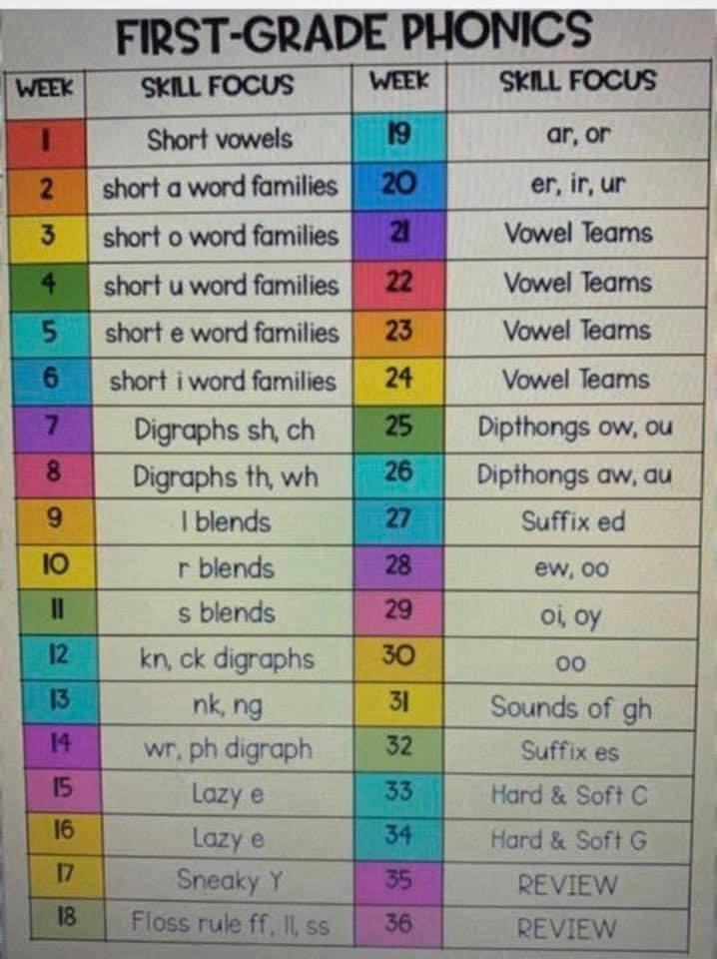
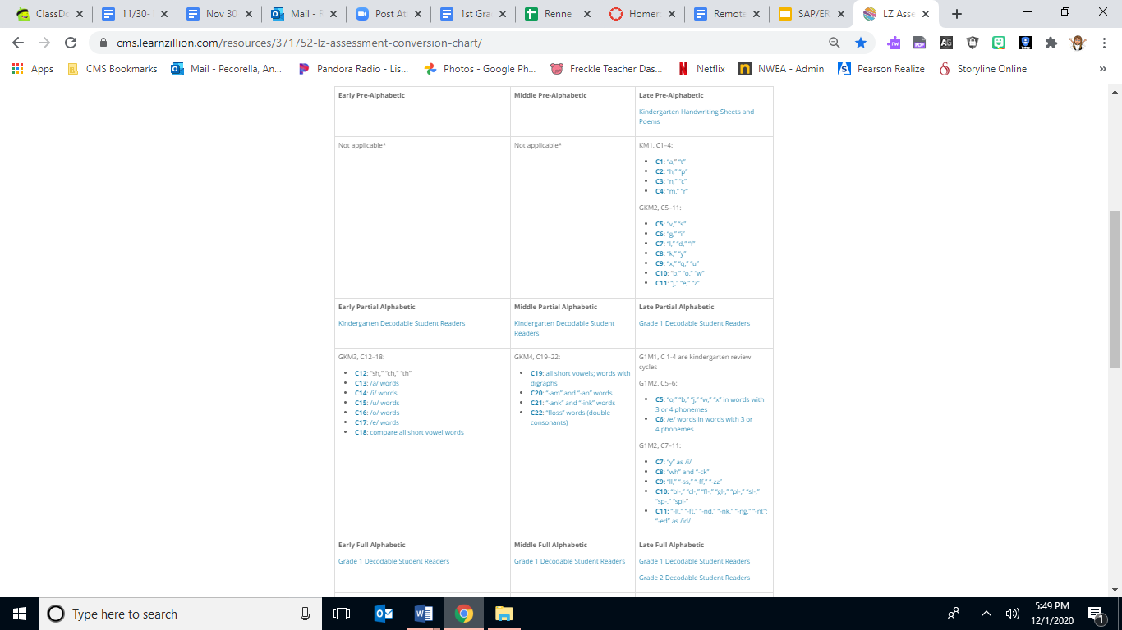

Slide 44
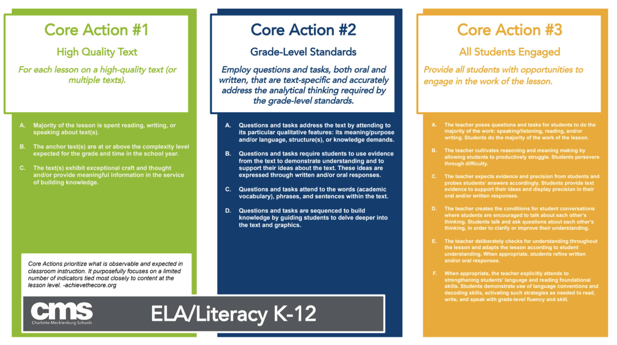
Literacy Core Actions

Slide 45

Crystal A. Graham
Hello, my name is Ms. Graham and I am a first grade teacher at Westerly Hills Academy in Charlotte, NC. We are a proud Title 1 school and in addition to being one of the fully remote teachers for my grade level, I am also the foundational skills content lead.
Some of my other roles this year are: First grade curriculum-based content creator for the district and ELL tutor for the district.
I have been teaching for seven years in North Carolinian Title 1 schools. I have a passion for literacy. I received my B.A. from NYU in 2007 and my Graduate Certificate in Teaching from UNCC in 2012.
Looking ahead: I am currently a National Board Certified candidate and hope to achieve certification next year. I am also taking the Reading Specialist praxis next year.

Slide 46





Culturally Responsive Teaching

Slide 47

Work for the District Access, & Equity

Slide 48

Turn Any Lesson into a Culturally Responsive One

Slide 49


Storify It (story elements)

Slide 50


Storify It (story elements)

Slide 51




Gamifying It (story elements)

Slide 52

Gamify It\Socialize It

Slide 53




Socializing It (story elements)

Slide 54


Socialize It
Talk about it:
Using text vocabulary
Use the chat box & zoom “reactions”
Use collaboration boards: digital gallery walks

Slide 55
Gamify It
How our curriculum lends itself to Culturally Responsive Teaching and gamifying foundational skills...

Slide 56



Gamify It
Cycle 7: Sly Y, Sort It Out Game

Slide 57




Gamify It
Cycle 7: Sly Y, Sort It Out Game

Slide 58

Sort it Out Game

Slide 59
Student Benefits
Students are active participants in their own learning.
With well placed scaffolding and support students will do the ‘heavy lifting.’
Student knowledge is built through complex text (modules)
Learning is interconnected. Students utilize what they learn in skills block when engaging in complex texts during modules.
Students engage in discussions surrounding complex texts. These discussions are especially beneficial for ELL students.
Students think critically and analytically about complex texts.

Slide 60
Lessons Learned
Accomplished teaching of literacy can happen on any platform - trial and error must ensue so that you know what works.
Zoom is a powerful tool. You don’t always need additional apps to get student engagement.
Survey students and families throughout the year to continue shaping your practices and approaches to student engagement.
Have a strong teaching team, share ideas during PLC and engage in PD.

Slide 61








Literacy Resources
Resource List

Slide 62
Thank you! Questions?
Slide Deck
Click Here t.ly/iVUT
Notes:
Thank you for allowing us to share our journey with you. We hope hearing our process resonated in some way with you and the work you are doing in your districts. We look forward to your questions and learning from you in the future!

Slide 63
PS 182, New York City Public Schools
Rachel Rosenbaum, Assistant Principal
Allison Velez,
Teacher

Slide 64

P.S. 182, Jamaica, New York
~ 635 Students, PK-5
~40% ELLs
Spanish & Bengali
~ 90% Free/Reduced Lunch
Hybrid Model

Slide 65

Raising the bar

Slide 66

The Essence of the 3Ls
Integrates Language and Literacy within grade-level content.
Regular and routine access to complex and compelling texts are the bedrock of our work.
Learning is contextualized and embedded in rich Science & Social Studies units of study.
We explore BIG essential questions.
No matter what the proficiency level, all ELLs and non-ELLs develop their foundational skills within the elements of a 3 Ls lesson.
Challenges our thinking about how ELLs learn.

Slide 67

How does the buildup of tension lead to war?

Slide 68

How do bridges connect people, places, and cultures?

Slide 69






Complex
Compelling
Connected
Cohesive

Slide 70


Slide 71

Supporting the
Foundational Skills
Contextualized Word Play
Juicy Sentence Work

Slide 72

Contextualized Word Play
Access to complex & compelling texts
Deep understanding of academic vocabulary that spans content areas
Contextualized and interactive
Connected to BIG ideas

Slide 73

Essential Question:
How do past and present interactions of people, cultures, and the environment shape our nation?

Slide 74
Sentences have parts! We’ve learned this in class and saw it again during our study of Westward Expansion.
REVIEW:A lead in is a phrase (group of words) that is said or done as an introduction before the main subject in a sentence. It leads to the main part of the sentence (the subject or what the sentence is about)! You can see the lead in is separated from the main part with a comma. I underlined the lead in so you can see it:
As long as people dream of freedom, many will be willing to move to a new country to find it.
Grow it from the Blend
Dream
Drum
Drill
Drink
Drip
Can you think of any other dr- words?
Grow it from the word family
Dream
Stream
Cream
Beam
Can you think of any other -eam words?

Slide 75

Essential Question:
In what ways can change, progress, and growth be both positive and negative?

Slide 76
Grow it : Transformed
In the nineteenth century, the United States expanded its territory westward at a dramatic pace, leading to conflict, national growth, and ongoing cultural exchange within a transformed continent.
 | Trans (prefix having to do with across, through, beyond, or changed thoroughly)
 | Transform (verb) (make a dramatic change in the form, appearance, or character of)
 | Transform | Ing | Transforming
 | Transform | able | Transformable
 | Transform | ation | Transformation

Slide 77
Stretch It : Transformed
In the nineteenth century, the United States expanded its territory westward at a dramatic pace, leading to conflict, national growth, and ongoing cultural exchange within a transformed continent.
How would you organize these words?
Tweak, Transform, Adjust, Change
Tweaked
Changed
Adjusted
Transformed

Slide 78
Grow It: Expanded- grew
expand
expands
expanding
expanded
Expansion
How does the ending change the meaning of the word?
In the nineteenth century, the United States expanded its territory westward at a dramatic pace, leading to conflict, national growth, and ongoing cultural exchange within a transformed continent

Slide 79

Juicy Sentence Work
Juicy sentence work was developed by Dr. Wong Fillmore, who elevated the importance of providing access to ELLs and all students to the features of academic language-rich, long, and embedded sentences that include phrases and grammatical structures used to convey complex ideas and the content of academic disciplines.
-The Council of the Great City Schools

Slide 80
In the nineteenth century, the United States expanded its territory westward at a dramatic pace, leading to conflict, national growth, and ongoing cultural exchange within a transformed continent.
Who or what is the sentence about?
What about it? (Cause)
How did it happen?
What does the word dramatic make you think about the rate in which the United States expanded?
What was the result? (effect) How many were there?
When?

Slide 81
In the nineteenth century, the United States expanded its territory westward at a dramatic pace, leading to conflict, national growth, and ongoing cultural exchange within a transformed continent.
Where might you chunk this sentence?
What questions would you ask to help you deconstruct this sentence?
What kind of sentence is this?
Then practice writing sentences using the frame.
In ______, the ______ ______leading to _______.
Examples:
In the beginning of the school year, the students were working hard leading to success for the rest of the year.
In the nineteenth century, President Jefferson negotiated a monumental deal leading to the purchase of land that doubled the size of the country.

Slide 82

Remote Considerations

Slide 83
Cause and Effect Frame
Weathering and erosion slowly chisel, polish, and buff Earth's rock into ever evolving works of art—and then wash the remains into the sea.
______ and ______ ___ly____ into _______ - and then _______.
Mom and Dad quickly clean the toys up into neat piles - and then start putting the toys away.
Constructive and deconstructive forces slowly shift and shape Earth’s many physical features into new landforms - and then reshape or take away land on Earth.
Subject
Describe
how
Cause
Effect
Something else the subject does
Now try writing your own cause and effect sentence here or upload a picture of your work:

Slide 84
Guilford County

Slide 85
Foundational skills can be taught through 3Ls elements Word Play, Juicy Sentences, and Differentiated Tasks.
Audience
Grades 6-8
Content
Science & Social Studies
Standards
ELA/NC SCoS
Framework
3Ls

Slide 86




Slide 87








2021-2025

Slide 88

Word
Play
STRATEGIES:
Grow It &
Stretch It

Slide 89
Word
Play
Morphology:
Affixes

Slide 90



Marvel will immortalize these young heroes in their
very own comic books.
-ize
=
to change, make, or turn something into a verb (an action)
to moisturize
to accessorize
to deodorize

Slide 91
Things Teachers Say
to add something to your memory
to memorize
to use a capital letter
to capitalize
to put in alphabetical order
to alphabetize
to give a summary of a story
to summarize
to think of a visual from the story
to visualize
to give an apology
to apologize
to make your hands sanitary
to sanitize

Slide 92
Word
Play
Morphology:
Deconstruction

Slide 93
inhospitable
prefix
root
suffix
in
hospit
able
“not”
“host”
“able”

Slide 94
Word
Play
VOCABULARY:
Compound Words

Slide 95
Compound Words
a craft that flies through space
spacecraft
a way that passes through a gate
gateway
a stone that helps you carefully step
Stepping stone

Slide 96
Word
Play
VOCABULARY:
Synonyms

Slide 97
People continue to destroy their forest homes and hunt them for their stunning coats, which are dotted with spots and dark rosettes.
destroy
stunning
ruin
magnificent
People continue to ruin their forest homes and hunt them for their magnificent coats, which are dotted with spots and dark rosettes.

Slide 98

In addition to boosting your brain power, being bilingual has many benefits!
increasing
expanding
reducing

Slide 99
Word
Play
VOCABULARY:
Shades of Meaning

Slide 100

TikTok is the _______ popular app that young people use to make quick, funny videos, often set to music.
somewhat
really
wildly

Slide 101


Furless and ____________ well before spooky season, the cub has started to look increasingly like a giant panda in recent weeks.
screeching
squealing
whimpering

Slide 102

Juicy
Sentences
SYNTAX:
Deconstruction & Reconstruction

Slide 103
Fortunately for aspiring Martians, humans have spent a lot of time thinking about how to live on an inhospitable planet millions of miles away from Earth.
WHO
WHAT
WHERE
FOR WHOM
is this sentence about?
The sentence is about humans.
have humans spent a lot of time doing?
They have been thinking about how to live on an inhospitable planet.
is this planet?
The planet is millions of miles away from Earth.
is all of this thinking fortunate?
It is fortunate for aspiring Martians.

Slide 104
Fortunately for aspiring Martians,
on an inhospitable planet
a lot of time
how to live
humans have spent
thinking about
millions of miles away from Earth.

Slide 105

Differentiated
Tasks
SYNTAX:
Semantics (meaning) and Pragmatics (context)

Slide 106
In life, it doesn’t take wearing a suit of iron, carrying a mythical hammer, or swinging from spider webs to be a real hero. Sometimes the person who can make a positive difference in the world is the person who simply sees a problem and has the passion to find a creative solution.
Marvel’s Hero Project is a documentary streaming series that shares the positive impact several young, real life heroes are making in their own communities across the country. These extraordinary, inspiring kids have dedicated their lives to a variety of remarkable efforts, and now Marvel celebrates them as the true Superheroes they are, each immortalized in their very own comic book.
Sponsored by Disney+, Marvel’s Hero Project began streaming episodes on November 12, 2019. Twenty episodes later, Season One ended on March 20, 2020. Will there be a Season Two? Neither Disney nor Marvel has answered that question, but here’s hoping that the Hero Project, featuring “real kids making a real difference”, will be renewed for another season.

Slide 107
Fill-In-The-Blanks
Sometimes the ________ who can make a ________ difference in the world is the person who simply sees a ________ and has the ________ to find a creative solution.
positive
passion
person
problem

Slide 108
Backwards design
Using Authentic tasks and culminating projects, to engage students In the 3Ls.
Notes:
Hello, my name is Alegria Rodriguez and I teach English Language Development at Kiser Middle School in Greensboro, NC. The English Learner cohort at Kiser is diverse in many ways, I have students newly mainstreamed from our Newcomers school as well as students who are very close to exiting the program. After Heidi has given us such a wonderful micro-view of the ways the 3 Ls framework can be used to build foundational skills I want to take a more macro approach. How can we design a multi-flow unit that not only engages our students but also helps each of them achieve at their level?
I believe that one of the great strengths of the framework is that it allows us to help students produce similar outcomes through differentiated paths. An excellent method for planning a unit that cohesively connects various lesson flows is through utilizing a culminating project and backwards design. When I unit plan, I like to begin by thinking about what my students need at that moment. Is there a skill they are struggling with? A current event affecting them? A topic of interest in a core class that they need support to internalize?

Slide 109




Culminating projects based on student needs
This Photo by Unknown Author is licensed under CC BY-SA-NC
This Photo by Unknown Author is licensed under CC BY-SA
Notes:
Last fall, my first year at Kiser Middle school three parallel needs were the inspiration for a 3 Ls unit. I learned that many of my new students felt extremely uncomfortable recording themselves in our annual ACCESS test to evaluate their English proficiency. There was also the convergence of a hurricane in the news, and my 7th grade students studying weather in their science classes. It struck me that I could address all these needs with a culminating project where students wrote and starred in a newscast about hurricanes. They would be able to get practice recording themselves speaking, while also focusing on a topic that was both affecting their daily lives and appearing in their core classes.

Slide 110



Backwards design first steps
choosing texts that support, the culminating project.
Notes:
Now that I had a strong culminating project, the backwards unit design could begin. Looking at my student body, how could I help each student get to a place where they could produce this project? I knew I wanted the newscast to include information on hurricane formation, and a first person account of surviving the storm. I began by choosing texts that would give students the information they needed to create these segments. An article interviewing children who survived Hurricane Michael in Florida would fuel the imagination processes they would need to write the first hand account, and two segments from an article from Science News for Kids would provide academic language
https://www.tampabay.com/news/publicsafety/kids-share-hurricane-michael-stories-we-were-crawling-through-the-trees-and-jumping-20190111/
https://www.sciencenewsforstudents.org/article/explainer-what-is-eyewall-of-hurricane-or-typhoon

Slide 111

Using the 3Ls to build the project foundation
Notes:
My next step was to develop 3Ls tasks that would prepare students for their final project. I want to show how the activities throughout the unit gave one student the tools he needed to be successful in the final project. This student, Mo, was less than a year out of Newcomers. He had some history of interrupted schooling, and because his home language was Arabic he had the added challenge of not only learning a new language but also a new writing system.

Slide 112






Building skills and knowledge
Notes:
Mo eventually became responsible for the segment explaining the formation of a hurricane. If we look at the unit’s third text flow we can see how Mo acquired the skills and knowledge he needed to complete his part of the project. In the Framed Motivation Mo watched some animation showing a hurricane forming. He then practiced using academic language by explaining the video he watched with this sentence frame, “In order for a hurricane to form, there must be….”. During the word play portion he embodied a key vocabulary word by acting out the definition of “counterclockwise”. Our Reading Closely and Juicy Sentence activities allowed him to analyze how a professional scientific writer describes a hurricane’s formation Finally, in his differentiated task activity, he worked at a level he was comfortable with- using vocabulary words to label a hurricane diagram. During that lesson’s closure students were broken in to groups and got to choose the final project segment they would be responsible for. Mo, having gotten comfortable with hurricane formation chose to contribute to his group as an expert on a topic he now understood.

Slide 113

Using the 3ls to challenge
Notes:
A common struggle for teachers is not only how to differentiate for struggling students, but also how to maintain rigour for students with higher proficiency. Let’s examine how backwards design can help us differentiate for higher proficiency students by following Juan, as student who had been in US schools all his life and was very close to exiting the program.

Slide 114





Sparking creativity
Notes:
Juan chose to write and perform the first person account of a survivor. In our first lesson flow, his creativity was sparked by a first person video of Hurricane Michael in the framed motivation. In Word Play he used his prior vocabulary knowledge to understand the word ravage through shades of meaning. Through the Reading Closely Juan read the first person accounts of child hurricane survivors. By re-writing the Juicy Sentence Juan was supported in his writing about the impact of hurricanes on people, which he then extended in the differentiated task where he practiced writing in first person by re-writing a survivor’s account in his own words.

Slide 115

Achieving the final product
Notes:
When it came time to write and film their newscast the students were armed with the experience of their prior work in the unit. As we watch the final product of this unit, you will be able to spot the students’ use of sentence frames, vocabulary, and content level knowledge.

Slide 116

See video here: https://www.dropbox.com/s/l9c97hphqwt7jyb/Media1.mp4?dl=0

Slide 117
Achieving the final product
Notes:
The 3Ls framework allowed both of these students to work at their own speed, practicing foundational writing skills. Both were integral parts of their groups. Though their point of access to the work was different, both were able to find success. Using backwards design and the 3Ls framework teachers can differentiate for all levels and allow students to engage in authentic literacy tasks.

Slide 118

Notes:
While we did not have time to share these resources on our webinar, we’re leaving them in the deck for folks who would like to access the resources at another date.

Slide 119


Slide 120


Slide 121


Slide 122


Slide 123


Slide 124


Slide 125


Slide 126

https://bit.ly/ERAWEB3FEEDBACK

Slide 127
Early Reading Accelerators - Webinar Series
Session 1:
Key Content Considerations for Monolingual Students and English Learners
Session 2:
Sharing District Perspectives on Equitable Literacy Instruction
Session 3:
Considerations for Equitable Instruction from Educator Voices
Notes:
Early Reading Accelerators Series (Part 1): Key Content Considerations for Monolingual Students and English Learners: https://achievethecore.org/page/3314/early-reading-accelerators-series-part-1-key-content-considerations-for-monolingual-students-and-english-learners
Early Reading Accelerators Series (Part 2): Sharing District Perspectives on Equitable Reading Instruction: https://achievethecore.org/page/3316/early-reading-accelerators-series-part-2-sharing-district-perspectives-on-equitable-reading-instruction

Slide 128

Share your feedback and resources!
https://bit.ly/ERAWEB3FEEDBACK
Notes:
Do you have feedback, including what you’d like to support your work? Please fill out this survey and let us know how we can support you beyond these webinars: https://bit.ly/ERAWEB3FEEDBACK

