Slide 1


The Council of the Great City Schools and Student Achievement Partners welcome you to:
Leadership Perspectives:
Best Practices & A Path Forward on Addressing Unfinished Learning and Essential Content
December 16, 2020
The webinar will begin shortly.
Use the Chat to introduce yourself!
This session is being recorded, and the recording will be shared.
.

Slide 2




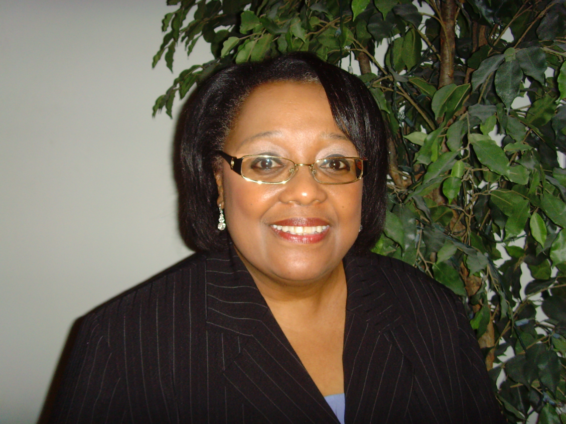
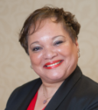
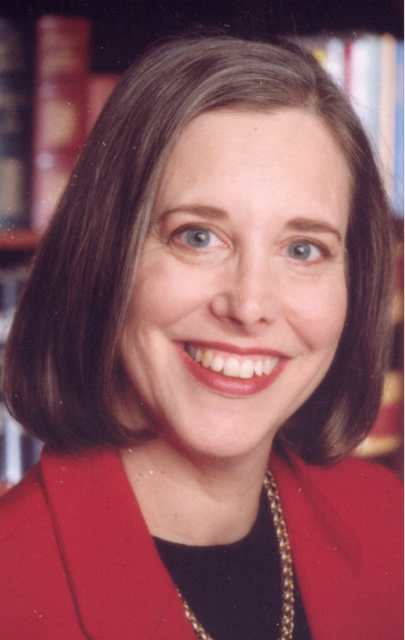

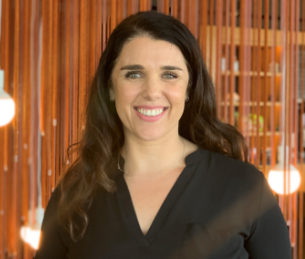
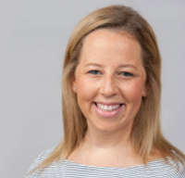
Welcome
Our Presenters:
Your Hosts:
Ricki Price-Baugh
Director of Academic Achievement
Council of the Great City Schools
Denise Walston
Robin Hall
Jun Li
Kate Crist
Stacy Wetcher Gad

Slide 3
Joining Question:
What insights are you hoping to gain from today’s webinar?
Please use the Group Chat to respond.

Slide 4
Today’s Conversation
Welcome (5 min)
Panel Discussion (40 min)
Q&A (10 min)

Slide 5
Background Information
 | LAUSD | San Diego Unified SD | Orange County, FL | Denver PS
Current School Model | Remote | Remote | Choice Remote Hybrid In-person Virtual Async | Remote currently
Demo-graphics | 72.4% FRL 18.6% ELLs 73.4% Latino 10% African American 8.8% White 3.9% Asian 2.2% Filipino 0.04% Pacific Islander 0.04% American Indian 1% Two+ races | 58.1% FRL 20.9% ELLs 44% Hispanic 7.5% African American 24.1% White 9.6% Asian 5.2%Filipino 0.4% Pacific Islander 0.3% American Indian 8.1% Two+ races | 75% FRL 13.9% ELLS 43% Hispanic 25% White 24% African American 5% Asian 3% Multi-Cultural | 63.4% FRL 36.4% MLS 53.0% Hispanic 25.3% White 13.4% African American 3.1% Asian 3.9% Two+ races 0.7% American Indian 0.4% Pacific Islander
Notes:
All PK-12

Slide 6
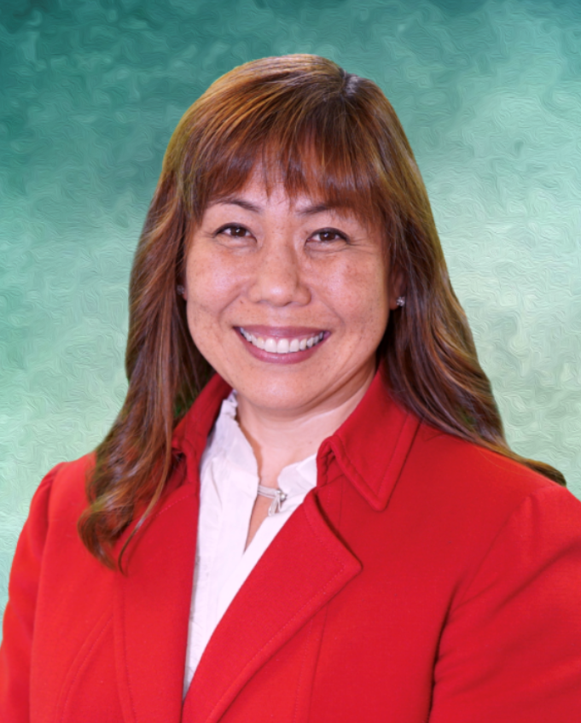
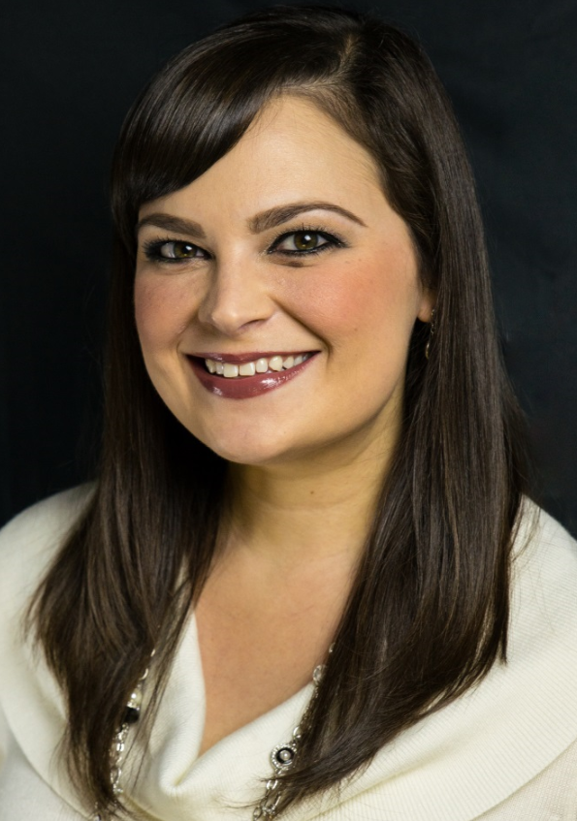

Alison Towery
Chief Academic Officer
Heather Karuza, Ph.D
Middle School Principal

Slide 7
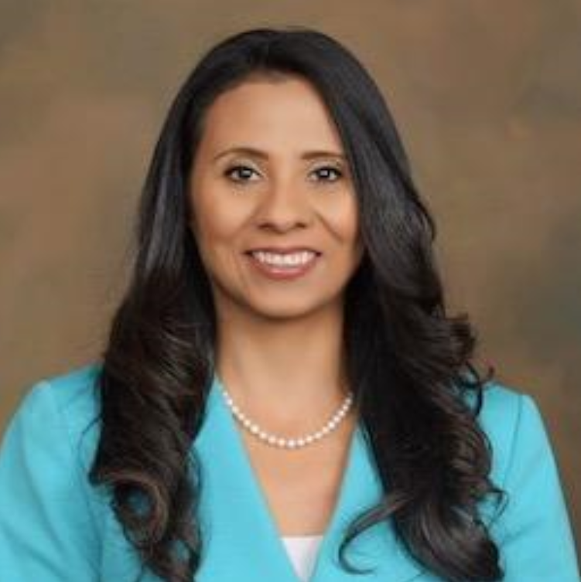
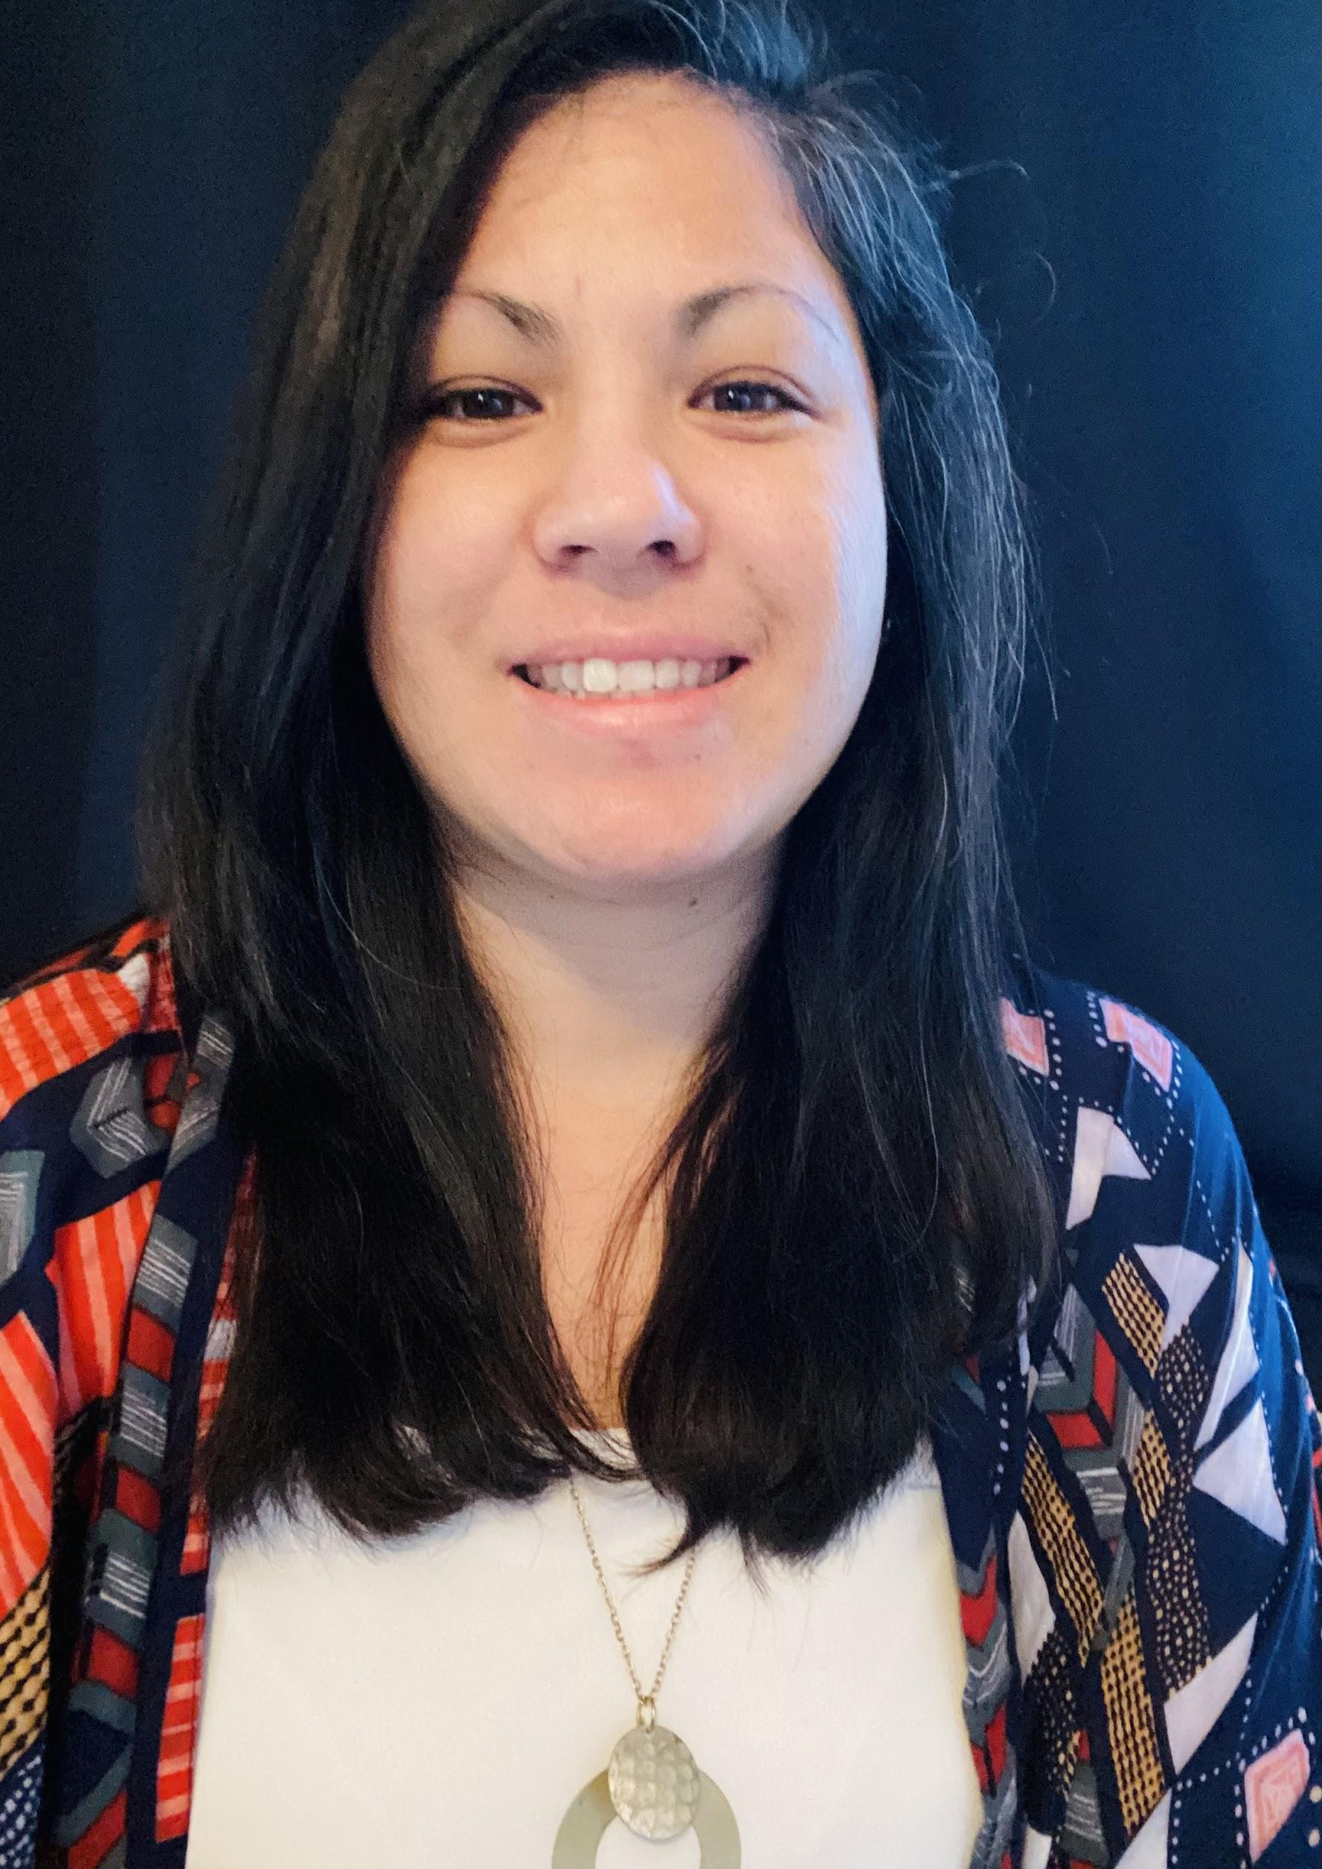
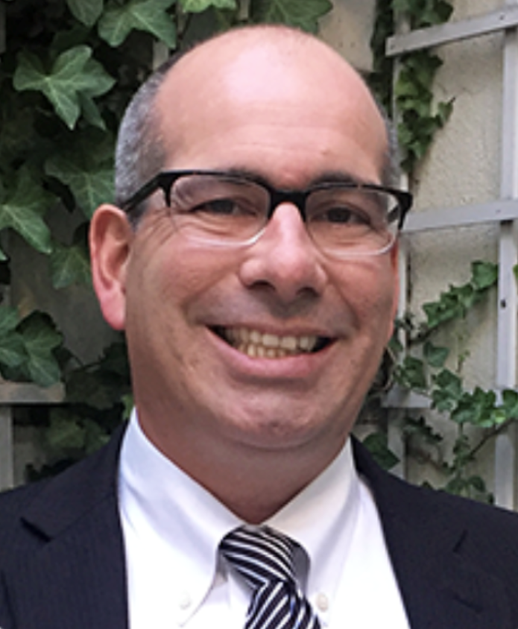

Sofia Roditti
Chief, Leadership and Learning
Alexandra Martinez
Instructional Coordinator TK-12 Mathematics
Patrick Callahan
Consultant

Slide 8
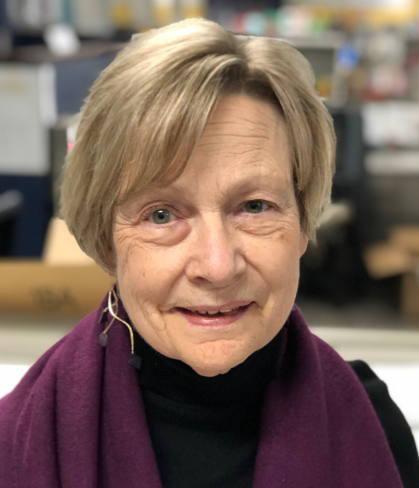
Cathy Martin, Ph.D.
Associate Chief of Academics

Slide 9
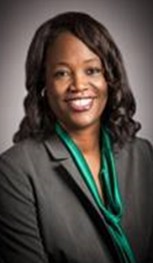

Kathy Shuler, Ed.D.
Chief Academic Officer, Teaching & Learning

Slide 10
Panel Discussion

Slide 11
Alison Towery
Chief Academic Officer
Heather Karuza, Ph.D.
Middle School Principal

Slide 12



STUDENT-DRIVEN ENGAGEMENT
How do we create, support, and monitor online learning environments where students are actively engaged?
Focus Question

Slide 13



Slide 14
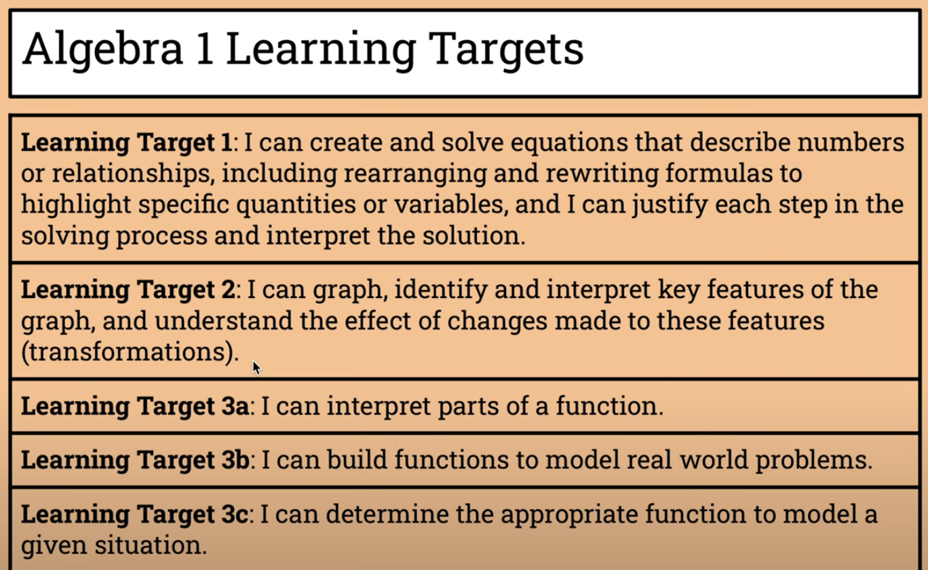

Learning Targets for each course

Slide 15
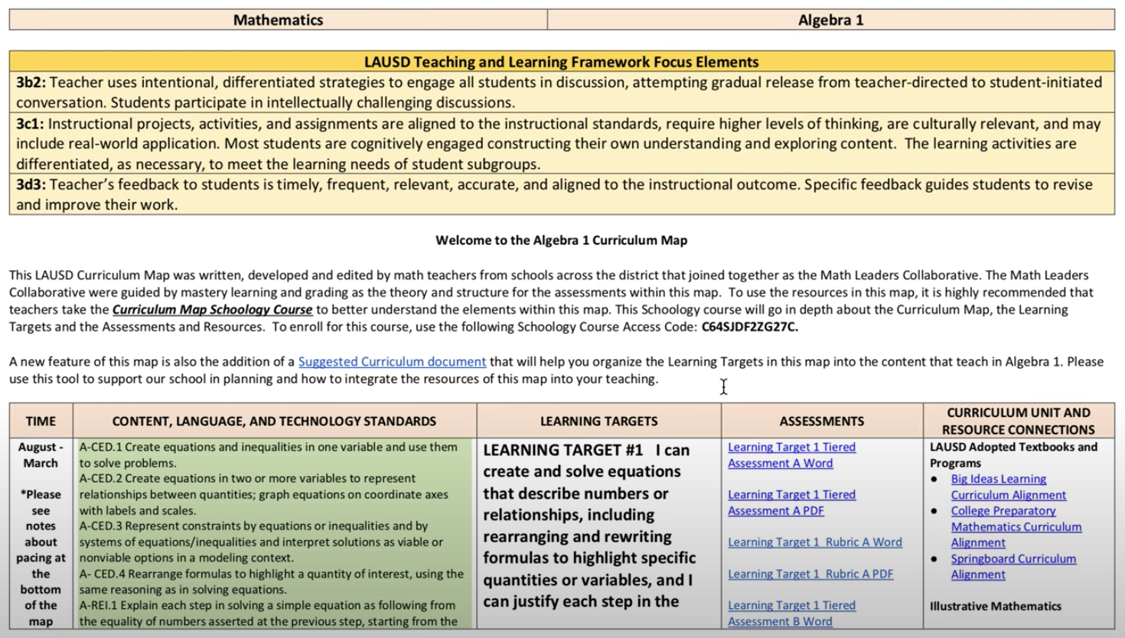

Slide 16
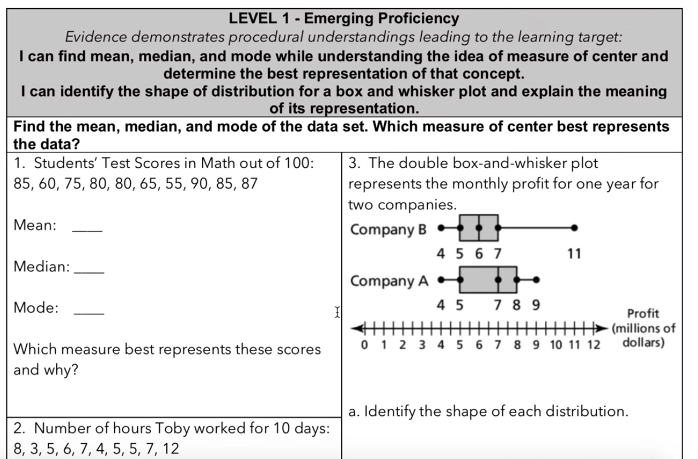
Leveled Assessments

Slide 17
Fleming Middle School (example)
Frequent Formative Assessment
Feedback Loop
Weekly 10-question Diagnostic
  Basic Skills
  Number Sense
  Priority Standards
Grade level assessment given weekly (online)
Data is shared (transparent), disaggregated, & analyzed
Data provides instant feedback for both teachers and students
Students do a Rescue Assignment
  Additional problems based on the questions they missed on the diagnostic
  Allows for a mastery approach
“Now I know what I don’t know and what I need to study.”
Builds metacognition & self-advocacy

Slide 18
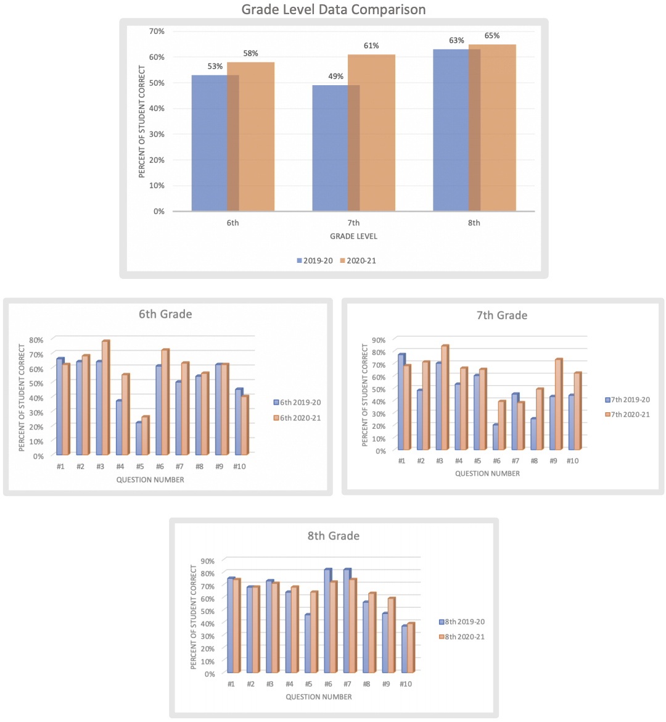
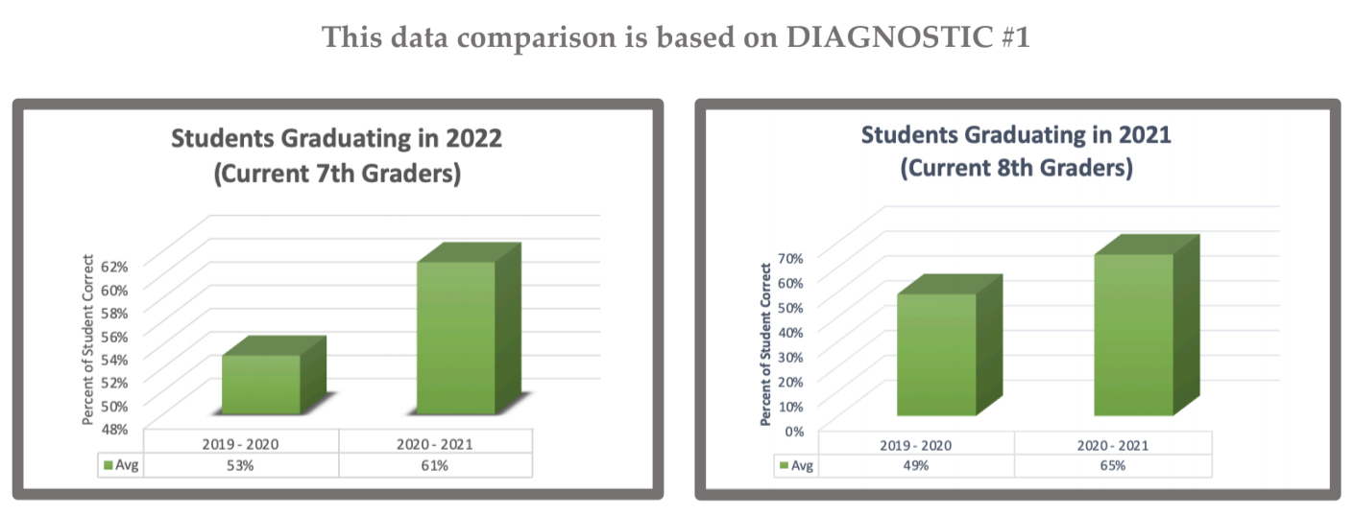
Fleming Middle School (example)

Slide 19
Sofia Roditti
Chief, Leadership and Learning
Alexandra Martinez
Instructional Coordinator TK-12 Mathematics
Patrick Callahan
Consultant

Slide 20


SDUSD Spotlight
Prioritizing learning around essential domains
Implementing a district-wide formative assessment

Slide 21









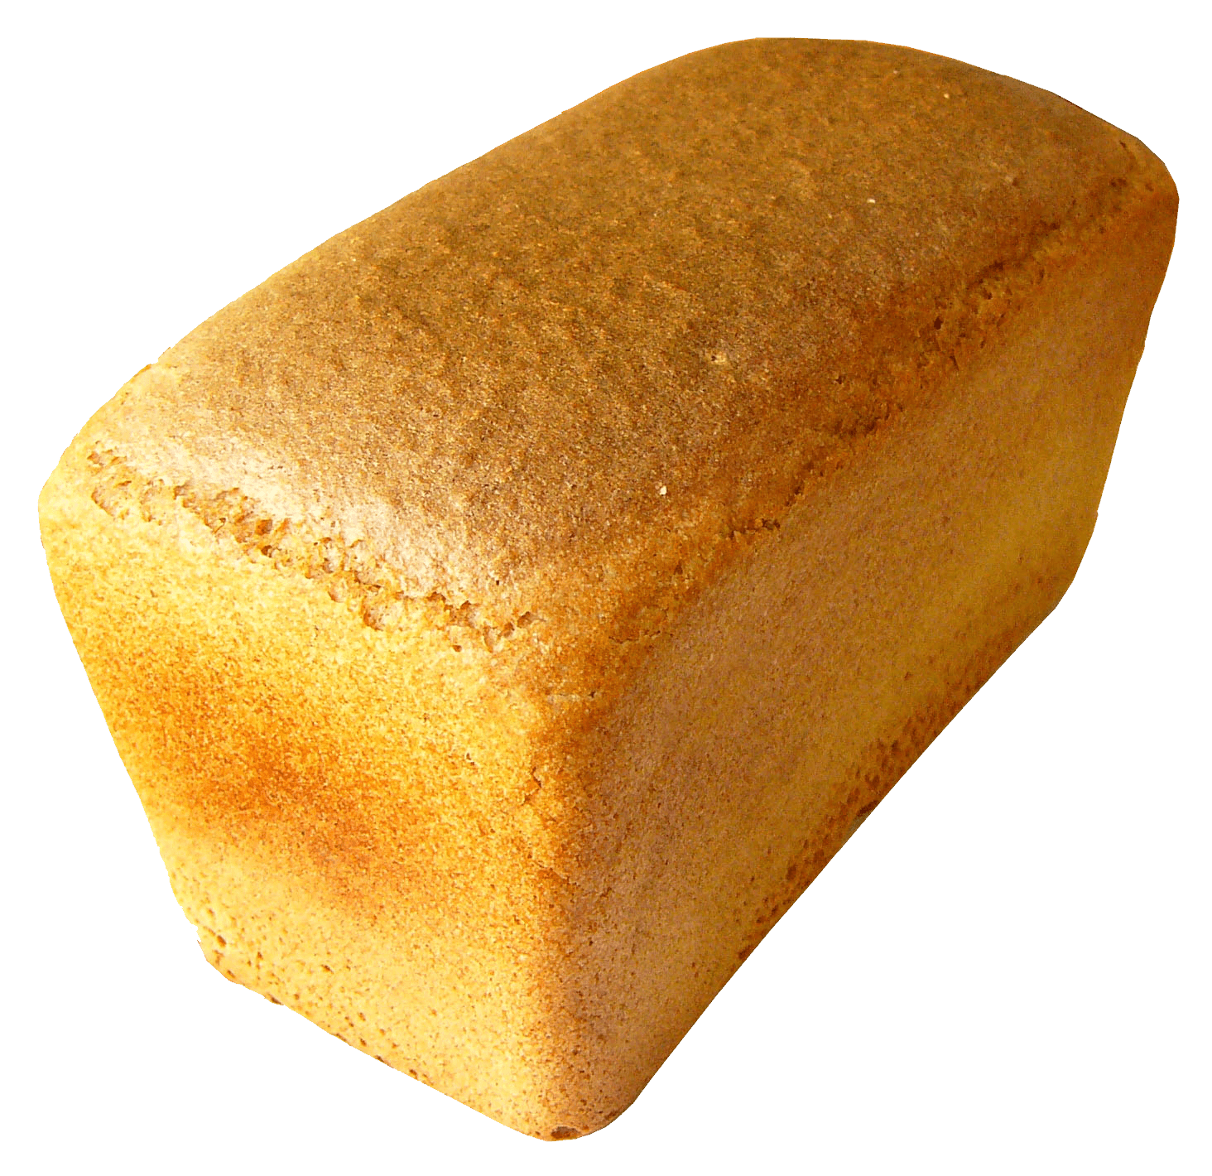



Two major accomplishments this year
Our prioritization of learning around essential domains in all math courses ensured time for building community, communication (writing) and ensuring rigor.
Rigor,
Community,
Reasoning

Slide 22
DISTRICT
ESSENTIAL
MATHEMATICS
INDICATORS
Administered by Grade-Span [2-3, 4-5, MS, and HS]
Design: Asset-based and Formative
Focus on key DOMAINS and PRACTICES, rather than attempt to cover every standard
Data is rich fuel for educator teams
All Students Should
KNOW
APPLY
COMMUNICATE
Essential Mathematics!
District Math Vision Statement: All students engage in rigorous and relevant mathematics to solve problems associated with personal, civic and professional contexts and are able to effectively explain and communicate their reasoning to a variety of audiences.

Slide 23


The DEMI offers a window into student thinking.
DEMI Design
This formative assessment offers actionable data and can track growth fall to spring.
All questions are aligned to one of these competencies:
Knowledge | Application | Communication
What do I know about mathematics? | How do I apply my mathematical understanding? | How do I explain my thinking about mathematics?
Includes an adapted Jo Boaler Mindset survey, providing us insight into how we are developing student identity, mindset, and math classroom culture.

Slide 24
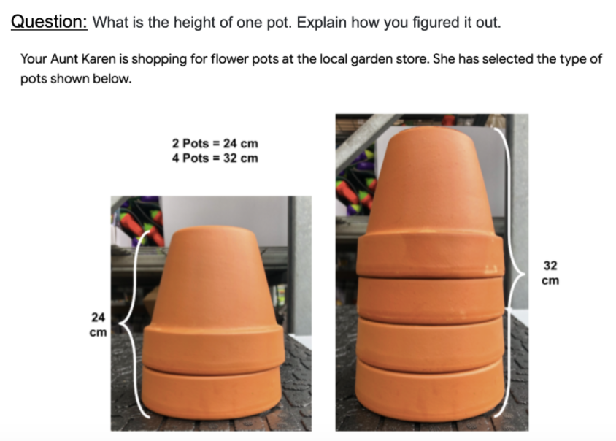
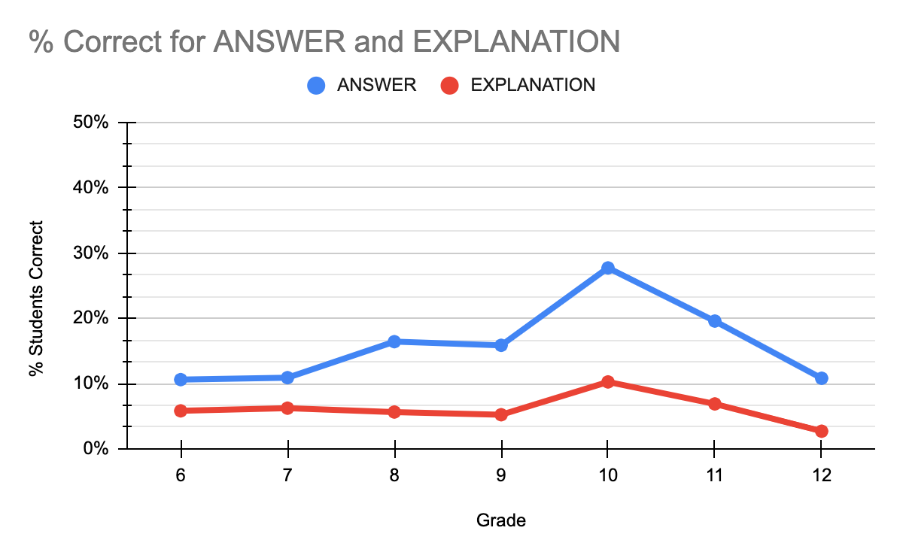
District DEMI data
The exact same item was given to all grades 6 through 12

Slide 25
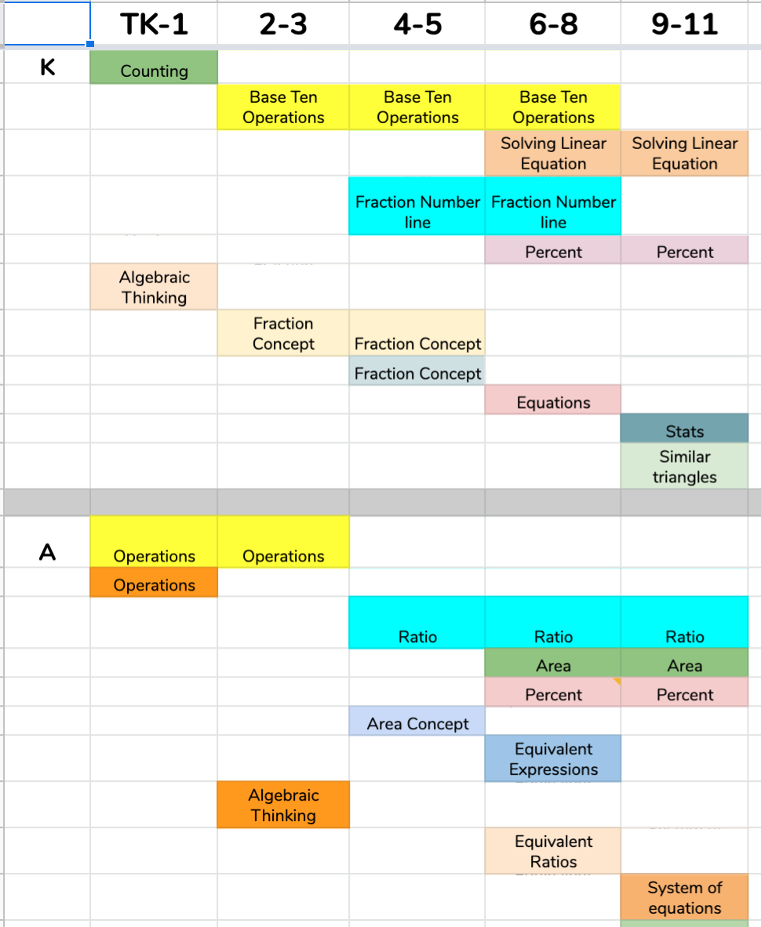
DISTRICT
ESSENTIAL
MATHEMATICS
INDICATORS
Grade bands take identical assessments and certain test items overlap multiple grade bands. This allows a true measure of growth and support site level discussions focused on student learning

Slide 26
Cathy Martin, Ph.D.
Associate Chief of Academics

Slide 27
Formative Assessment Accelerating Unfinished Learning

Slide 28
Unfinished Learning: Definition
the prerequisite skills and concepts that are essential to student engagement in grade-level content that students don’t have yet
not all prerequisite skills and concepts constituting unfinished learning have the same impact on students’ ability to access grade-level content

Slide 29
Diagnosing Unfinished Learning
What It Doesn’t Look Like:
Using a broad diagnostic assessment that assesses all of the previous year content toward the beginning of the school year
What It Does Look Like:
Diagnosing at the unit level
Using data you already have to diagnose student understanding--from classroom discussion, one-on-one conversations, and written work from in-class activities
Diagnosing to support unfinished learning “just in time”

Slide 30
Diagnosing Unfinished Learning: Math Example
Use a task from curriculum materials (example: Bridges in Math, student workbook, p 19)
Solve the problems below. Show all your work using numbers, words, or labeled sketches. Use your math journal if you need extra room.
  a Patrick measured a book that was 27 cm long. Katy measured another book that was 40 cm long. If Patrick and Katy line up the books, how long are the books together?
  b Abby measured 6 markers. They were each 25 cm long. If she lined them up in a row end-to-end, how long would the row be?

Slide 31
Resources for Accelerating Unfinished Learning
●Identification of Essential Understandings
●Units within Scope & Sequence
○Critical prerequisite concepts and skills
○Lesson/task to diagnose unfinished learning
○Lessons to engage with critical prerequisite knowledge
○Opportunities to progress monitor
●Unit Internalization
○Deeply study unit to internalize the big ideas/purposes of lessons
○“Just in time” scaffolds and feedback to accelerate unfinished learning

Slide 32
Kathy Shuler, Ed.D.
Chief Academic Officer, Teaching & Learning

Slide 33
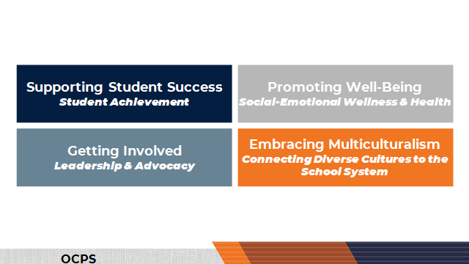
Parent Learning Focus Areas

Slide 34
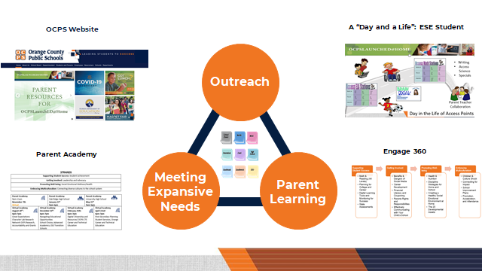
Engagement Strategies
Notes:
Illustrate some of the trainings we offer and or what is illustrated on the web.
https://www.youtube.com/watch?v=_ZCBP9ZLbn0&feature=youtu.be (we provided for parents of our students that have significant cognitive disabilities and learning from home).
https://www.ocps.net/cms/One.aspx?portalId=54703&pageId=816187 (list of some of the offerings on a district-wide web)

Slide 35
Questions for Our Guests?

Slide 36
Audience Question
For San Diego and Denver: You both talked about the importance of professional learning and teacher planning time to support strong instruction. How do we provide teachers the time they need to do this kind of intensive planning?

Slide 37
Thank You!

