Slide 1

Using Assessments to Foster Agency, Identity, and Learning
Core Advocates Monthly Webinar
January 13, 2021
The webinar will begin shortly.
Check your Resource widget to preview the resources for today’s session! Use the Group Chat to introduce yourself!
Notes:
First timer poll
Handouts:
While we’re waiting, we’d like you to participate in a quick poll so we can get an understanding of who’s on the webinar with us tonight.

Slide 2
Introductions
Your hosts from Student Achievement Partners:
Jennie Beltramini Mathematics Specialist
Lisa Goldschmidt
Executive Vice President, Tools and Classroom Resources
This month’s presenters:
Jody Guarino
Mathematics Coordinator
Orange County Department of Education
John Drake
Chief Academic Officer
Newport Mesa Unified School District
Shelly Mymon
Teacher
Newport Mesa Unified S.D.
Christina Selstad
Teacher
Newport Mesa Unified S.D.
Michelle Sperling
Teacher
Newport Mesa Unified S.D.

Slide 3
How many Core Advocate Webinars have you attended?
Please use the Questions tab on your control panel to respond.
If using a poll, please put up to 5 answer choices in the notes section below and indicate if attendees should choose only one response or multiple responses.

Slide 4
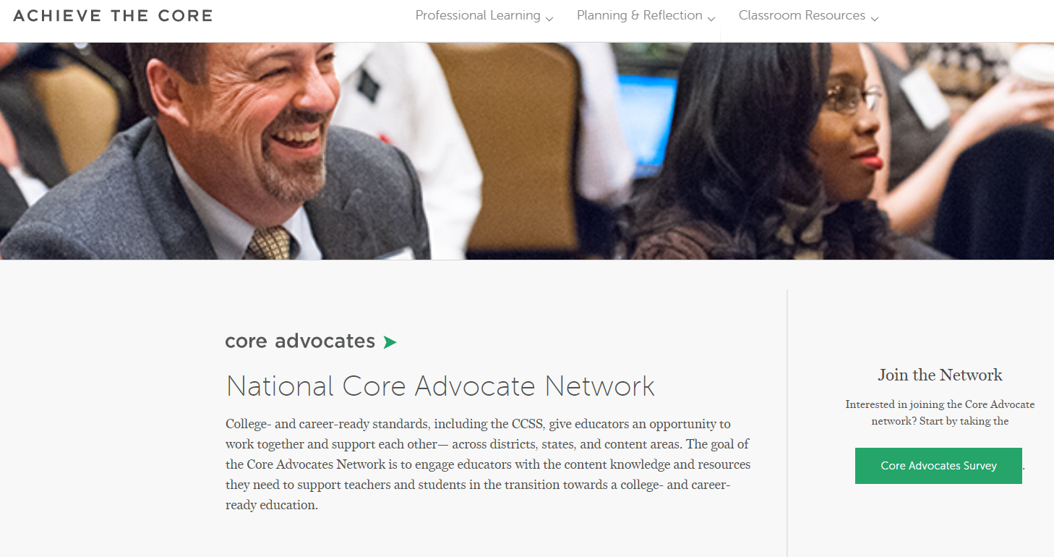
Join Our Network!
www.achievethecore.org/ca-signup
Notes:
If you find tonight’s webinar helpful, we’d like to invite you to join our Core Advocate network! We’re committed to solving real problems that real teachers have and we know the best way to do this is to know more about what folks are experiencing.
We’d love to learn about who you are, where you work, the types of things you’re interested in and the expertise you already have. This way, we will be able to tailor our webinars and other opportunities to your needs and interests (we may even tap you to be our next webinar panelist). So we encourage you to join the network by filling out this survey completely at atc.org/ca-signup

Slide 5


Learn More About Us!
Contact Jennie Beltramini (jbeltramini@studentsachieve.net ) Joy Delizo-Osborne
(jdelizo-osborne@studentsachieve.net)
Complete this survey to join our database (and mailing list): www.achievethecore.org/ca-signup
Visit our website: www.achievethecore.org
Notes:
If you’d like to learn more about the network, contact Jennie (her email is here).
We also want to invite you to join the network by signing up at achievethecore.org/ca-signup and visit our website for more info and opportunities

Slide 6

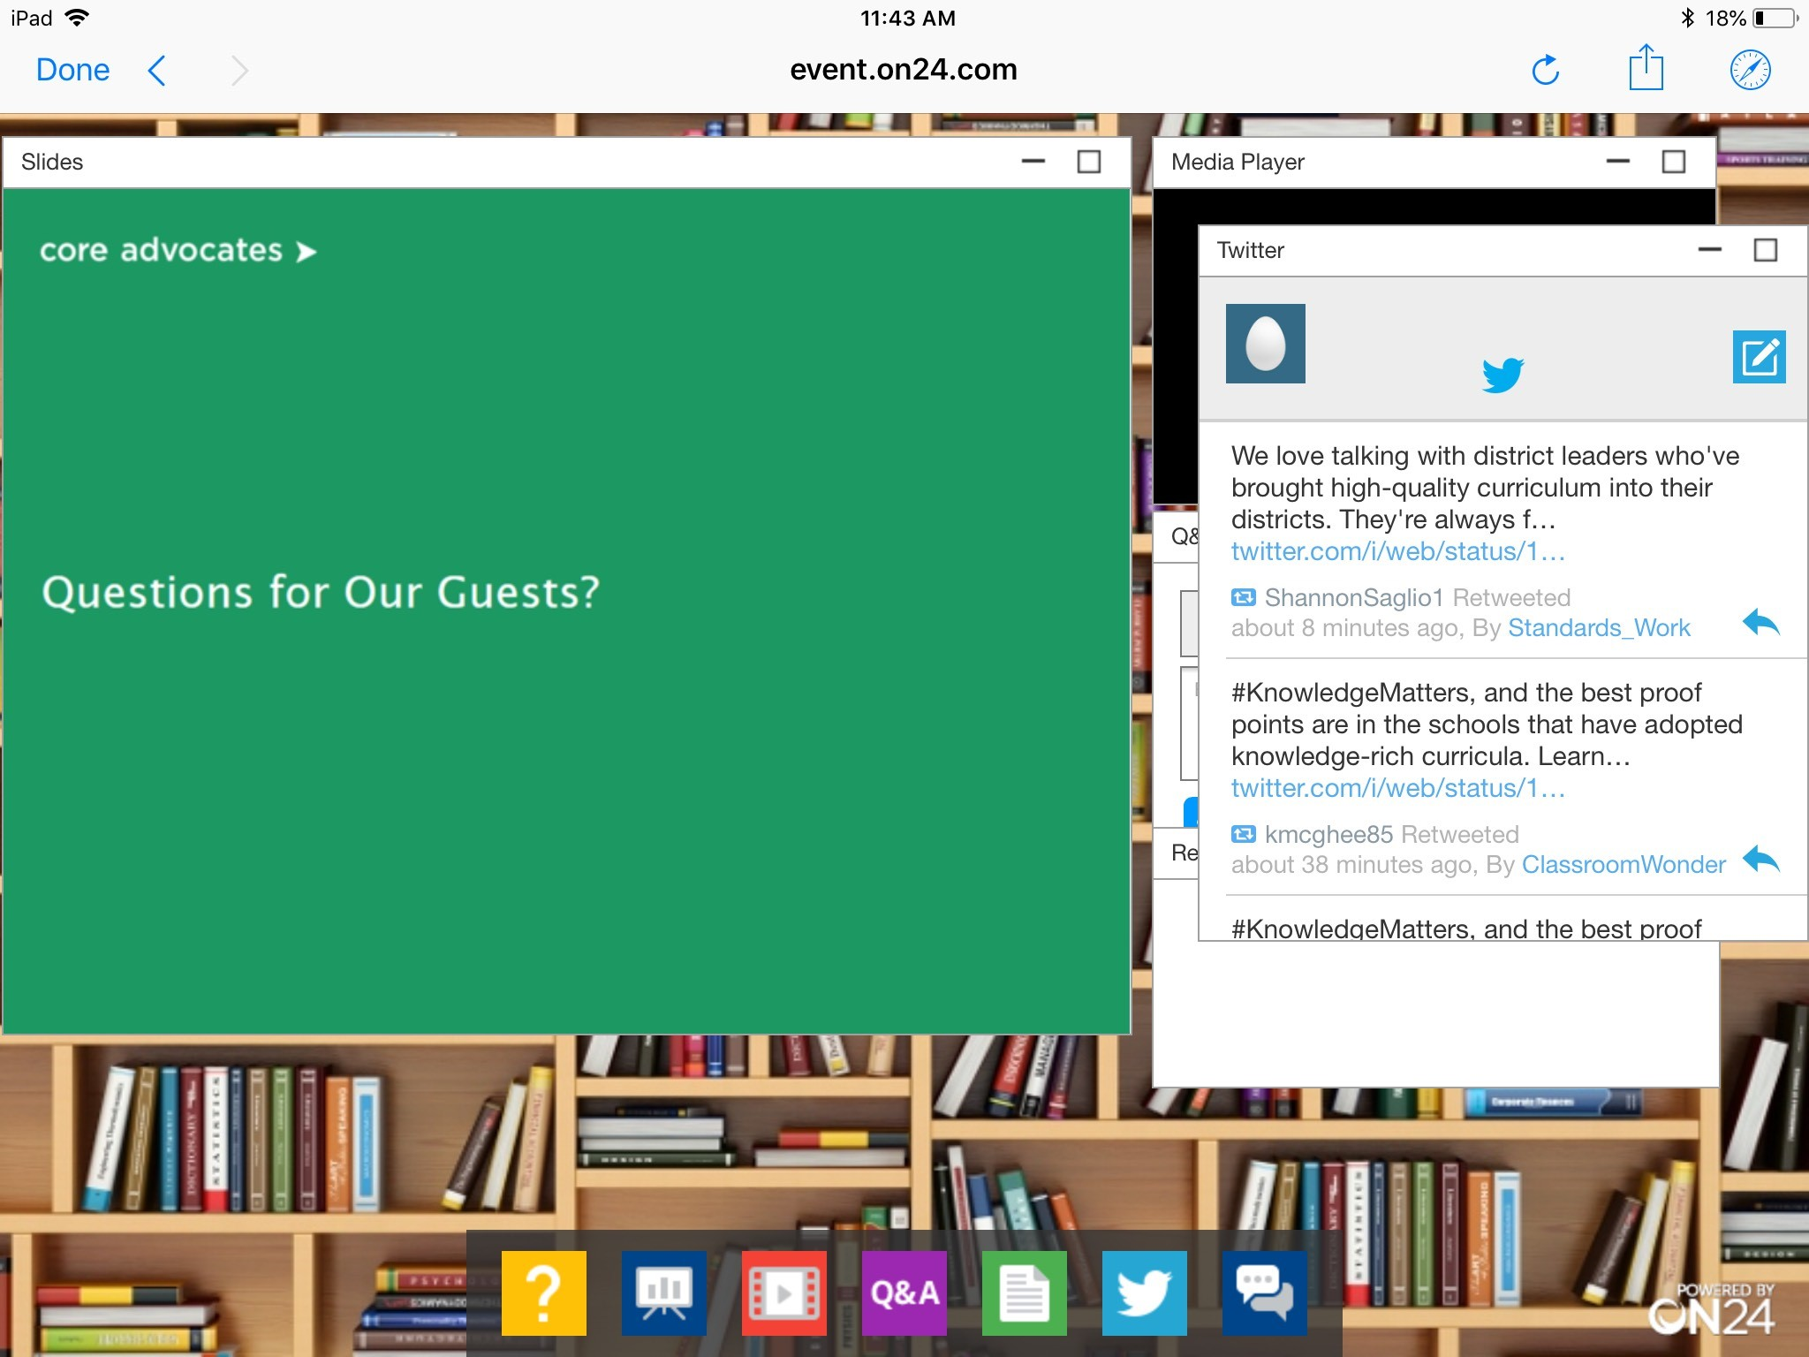
Tweet with Us!
Please feel free to tweet during and after the webinar using #coreadvocates
@achievethecore
@JennieBeltro
@jody_guarino
@msperling777
@DrakeJcdrake1
@christi60530091
@ShellyMymon
Click here!

Slide 7

Engage with Us!
During the webinar:
Question just for the presenters/ tech help
Resources
Group chat
Certificate
After the webinar:
– Access to recording will be emailed to you.

Slide 8
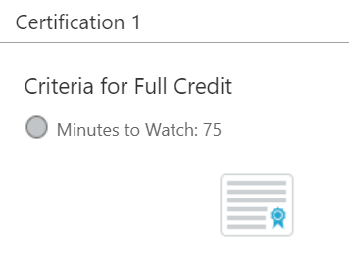
Certification Will Be Provided
A certificate will be available via the Certification box to the right.
Click on the blue-ribbon icon to print or download the certificate at the end of the webinar.

Slide 9
Goals of the Webinar
Understand assessment as part of the daily work of teaching
Explore affordances of an asset lens of assessment
Consider the role of assessment in rehumanizing teaching and learning
Develop lenses to examine your current assessment systems
Notes:
We have four main goals for our webinar tonight. They are to...

Slide 10
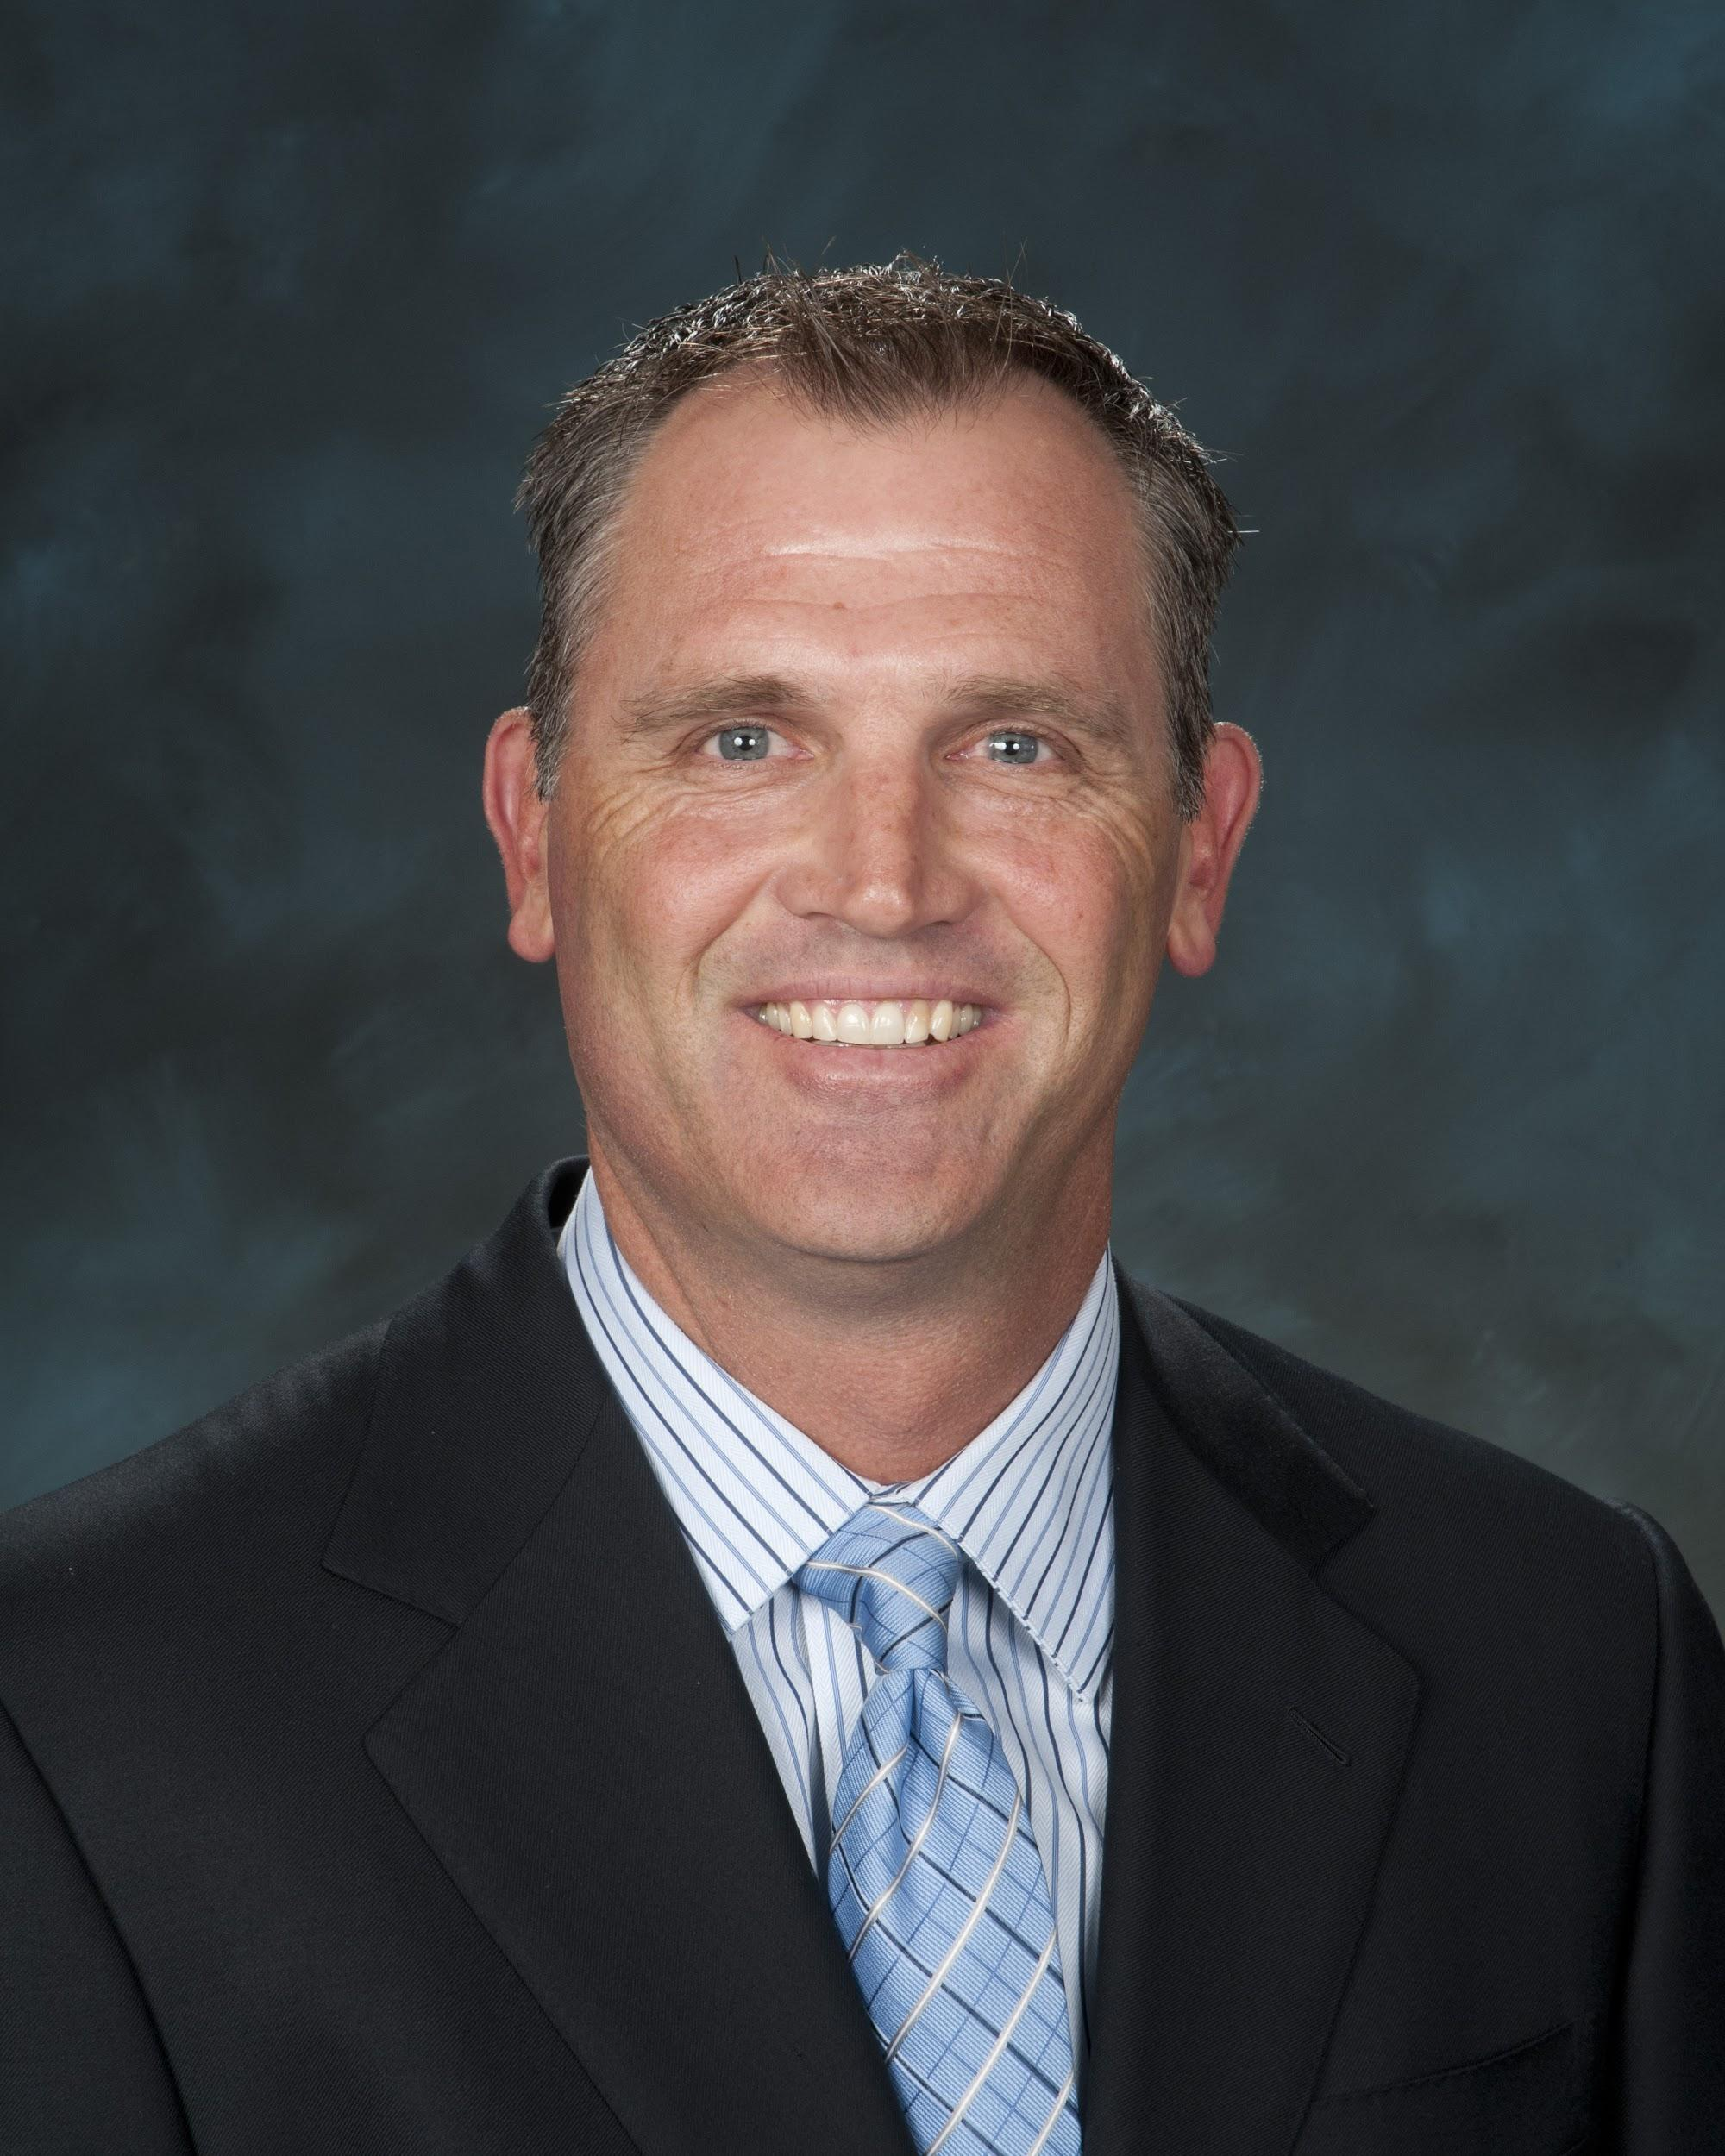
John Drake
Chief Academic Officer
Newport-Mesa Unified School District
please enter a head shot here

Slide 11
Section 1:
How can assessment positively support student agency, identity, and learning and how can it be harmful and dehumanizing?
Are we using it as a tool to identify gaps in student learning or to recognize what students know and understand about critical grade level content?
Notes:
Part of the lens that we are looking through as we focus on improvement and learning is the lens of questioning our current systems, and assessment as you know has a lot of questions that need answering from a systems perspective. These two questions have been driving our work around humanizing assessment. How can assessment positively support student agency, identity, and learning and how can it be harmful and dehumanizing? Are we using it as a tool to identify gaps in student learning or to recognize what students know and understand about critical grade level content?

Slide 12

Newport-Mesa Unified School District
Location: Newport Beach and Costa Mesa, CA
Enrollment: 19,000 TK-12 students
Schools: 22 Elementary
12 Secondary
Teachers: 1,100
(600 elementary)
Notes:
Cover demographics on the slide. While I’ve shared some demographics about NMUSD, I also think its important recognize some other characteristics of our district. We are a district that has amazing teachers in our classrooms, who are committed to kids and families. We are also committed to teaching content often as it’s presented in the instructional materials that we adopt for core instruction throughout the district, and currently our systems are set up to support this. The results we are getting from our systems of compliance are the results we have been getting for years that probably stretch back to when I was in high school at a NMUSD school. SO we have begun examining our systems to see if there is a better way to teach children to love to learn, and learn to learn and for our conversation today I’d like to situate our conversation in K-5 mathematics.
As I’ve shared we rely heavily published instructional materials to provide instructional decisions for us as to what needs to be taught next. We also, have committed for years to an RtI system that assesses to identify and diagnose what gaps students have and filing those gaps with re-teaching or small group targeted instruction. It is about diagnosing what is wrong with our students and fixing them as opposed to identifying and understanding what they do know and building learning on that.

Slide 13
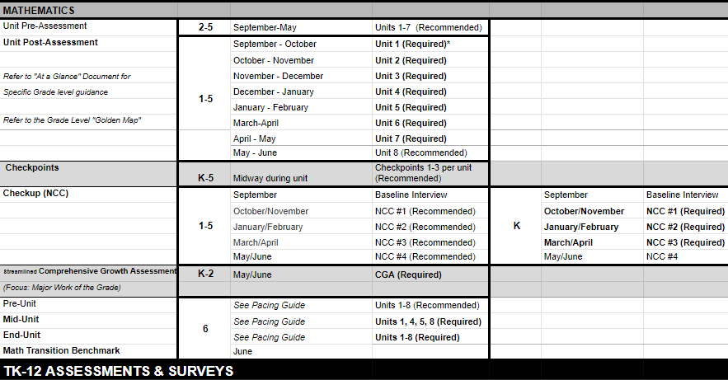
Assessment Calendar
Notes:
About four years ago we adopted new k-5 math materials that provided the promise of being aligned to our common core state standards and supported teachers to teach in ways that would get at the rigor of our standards. After the first year of using these new math materials we were asked to begin to provide data that showed how our kids and teachers were doing with these materials? What indicators do we have that students are meeting grade –level expectations? And our assessment calendar was born and also served as a pacing guide for our teachers and students. Teachers were required to give end of unit assessments within windows in time as a way to monitor student and teacher progress.

Slide 14
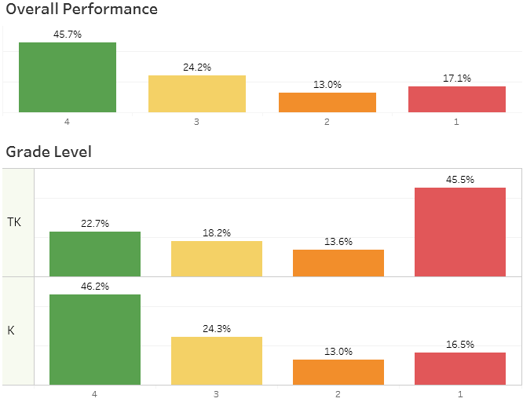
Notes:
From our use of these assessments you can see we are sort of able to identify how kids were doing because we know how many 1s, 2s….we have throughout the district and classrooms
We were able to sort kids to fix the gaps they had, without really understanding what they do know as a foundation to build on. …And we move onto the next unit in our materials and try to fill gaps of for students.
Some big questions began to surface here as we as we looked at our system to support math achievement. We ask..
Why exactly are we looking for gaps?
How are we positioning teachers and students when we focus on gaps?
We began to wonder what message this sends to kids when they are positioned as a 1, 2 , 3 or 4. How is our assessment system contributing to how kids are positioned socially and emotionally in school? Are we positioning all our students as competent mathematicians and sense makers or are only some positioned that way while others are positioned as “needing help”?
What would happen if we focused and identified what they do know about the mathematics?
Are they numbers or human beings?

Slide 15
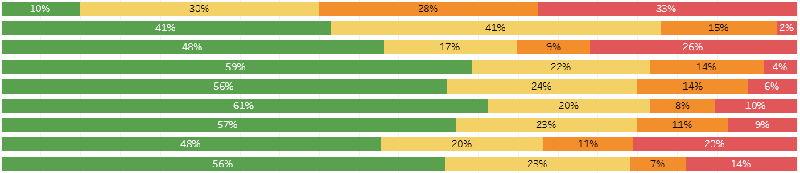
Progress by School
Notes:
We also use results from our publisher assessments to see how our teachers are doing using data like this.
Each bar represents an individual school and how, for this example their kindergartners, performed on a unit test, and again we began to ask questions. What does reducing the hard work of teaching to a percentage do to the identity of a teacher?
Do these graphs represent mathematical knowledge or is this a reflection of the teacher teaching or not teaching the way the content is layed out in the “Book?”
Is this a really a reflection of student learning and teacher effectiveness if no matter what happens we’re moving to the next page in the book?

Slide 16
What we set out to do...
Begin to humanize teaching and learning… move from I teach this book to I teach students math
Build shared understanding of what it means to learn and what it means to teach
Notes:
We continue to grapple with these questions that come from examining our system while at the same time moving in this direction to humanize teaching and learning by understanding what students do know and providing them opportunities to build on their knowledge.
We’re also engaging in common experiences and learning as professionals. We’re moving from sit and get PD, to professional learning that exemplifies the values we hold and the vision we are trying to create. Teachers are seen as capable sense-makers whose knowledge can continually expand when they are positioned as learners. Together we do math, read and discuss research, watch videos of students, look at student work, and learn from students in classrooms.
We’re learning to teach and learn in a ways that recognize and honor the assets and sense making abilities that we all bring.

Slide 17
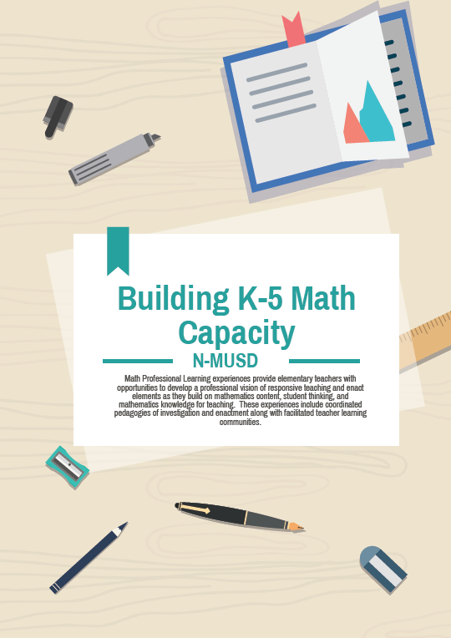
Building a Vision of Learning
130 participating K-5 teachers
Cognitively Guided Instruction
Math Fellows
5526 Hours of professional learning
20 of 22 Schools Represented
Learn by doing
Notes:
Three years ago we started re-invisioning instruction with offering teachers an opportunity to learn together with a focus on building a vision for teaching and learning that is student centered and focused on building identity, agency and belonging. We wanted to move from teachers “teaching a book” to “teaching students math.” We started with offering teachers an opportunity to participate in CGI training and we offered teachers the opportunity to extend their learning through participation in a math fellows program. We had over 130 teachers participate in CGI training 65 of whom also participated in the Fellows extended PD. We have participants form 20 of our 22 schools and what it means to teach and learn began to shift for many of our participants..

Slide 18
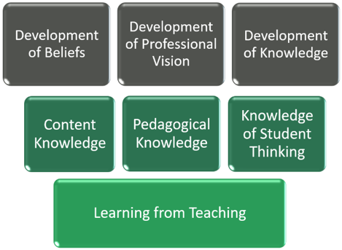
Notes:
As we think about this task of shifting the culture of learning, we knew we needed to create a learning system. A system where teachers would learn in cohorts, over multiple years, and would need the support of learning communities as they would be developing in ways that created tensions with the current district systems. In addition, we knew we’d need to work on all of the elements within this pyramid simultaneously in every professional learning opportunity offered.
We needed to develop shared productive beliefs, beliefs that all students have intuitive knowledge and can do grade level math and that we, as educators, are responsible for creating space and learning experiences for them to actively construct knowledge. We needed to develop a professional vision of high quality mathlearning, where students grapple with and make sense of ideas, where they explain their thinking and listen closely to the thinking of others. And we needed to develop knowledge; content knowledge of the mathematics and the standards. We needed to collaboratively construct our knowledge of pedagogy that supports noticing and responding to what students know and understand about the mathematics in a student centered environment.. We needed build our knowledge about how students think and how their thinking and sense making can be responded to instructionally and leveraged to support the learning for the community of learners in the classroom, including the learning of the teacher.

Slide 19
Principles of Responsive Instruction
Teachers and leaders…
Position students as competent sense-makers
Know students
Engage students in rigorous content
Challenge inequities
Haven’t taught until students have learned
Learn to learn from their teaching
Notes:
We also ground our work in these principles and set up professional learning experiences that help us collectively define and understand what these principles mean and look like in action.
When we think about all the different roles in a district what are the different ways or opportunities that exist to define these principales collectively.
As a result of this work teachers began saying things about their practice that we hadn’t heard before…. like
I’m Redefining what it means to teach… shifting from my thinking about math to their thinking about math, not trying to teach math from a textbook but looking at what students understand and building on that through students sharing and listening.
I can build the knowledge of the entire class by leveraging the thinking that comes from students within the class. Thats learning, I no longer teach particular methods or rules, this now comes from students and their curiosity.

Slide 20
Core Practices of Responsive Teaching
Eliciting and responding to student thinking
Orienting students to each others’ ideas and to the mathematical goal
Setting and maintaining expectations for student participation
Positioning students competently
Teaching towards an instructional goal
Assessing students’ understanding
Using mathematical representations
Adapted from University of Washington Teacher Education By Design
Notes:
To stay true to making sense of our core principles we also focused our efforts in supporting these core practices of teaching that come out of the University of Washington and position kids with agency, identity and belonging. With this in mind, we have begun to look at assessment with a different lens, not to determine what’s right or wrong with a student but instead to determine what each student knows about the mathematics that is put in front of them and then respond instructionally by providing opportunities for students to build on their understanding and move their learning forward.

Slide 21
Instruction should elicit and build on children’s existing understandings, including those developed outside of school. By posing carefully selected problems and allowing children to solve these problems in ways that make sense to them, teachers can learn about children’s existing ideas, consider what those ideas mean in terms of children’s understandings, construct subsequent problems to appropriately challenge and extend those understandings, and then repeat the cycle. Both mathematical goals and children’s thinking guide instructional decision making.
V.R. Jacobs and L.B. Jaslow Helping Kindergartners Make Sense of Numbers to 100-p.196
Notes:
To wrap up this portion of our learning together today, I ask you to read this quote. We focus on being intentional as we build professional experiences with a goal of developing a way of teaching and learning that is considered in this citation. Before I hand it over to Jody Guarino, take a few moments to reflect on what you’ve heard and then use the chat to share with us what this quote leads you to think about.

Slide 22

What does the quote on the previous slide lead you to think about? Please use the Group Chat tab on your control panel to respond.
Notes:
Seeing thoughts about student centered classrooms
Using childrens’ thinking to support others learning
Move children from where they are not fixing them
Positioning students in certain ways impacts their Social Emotional state

Slide 23
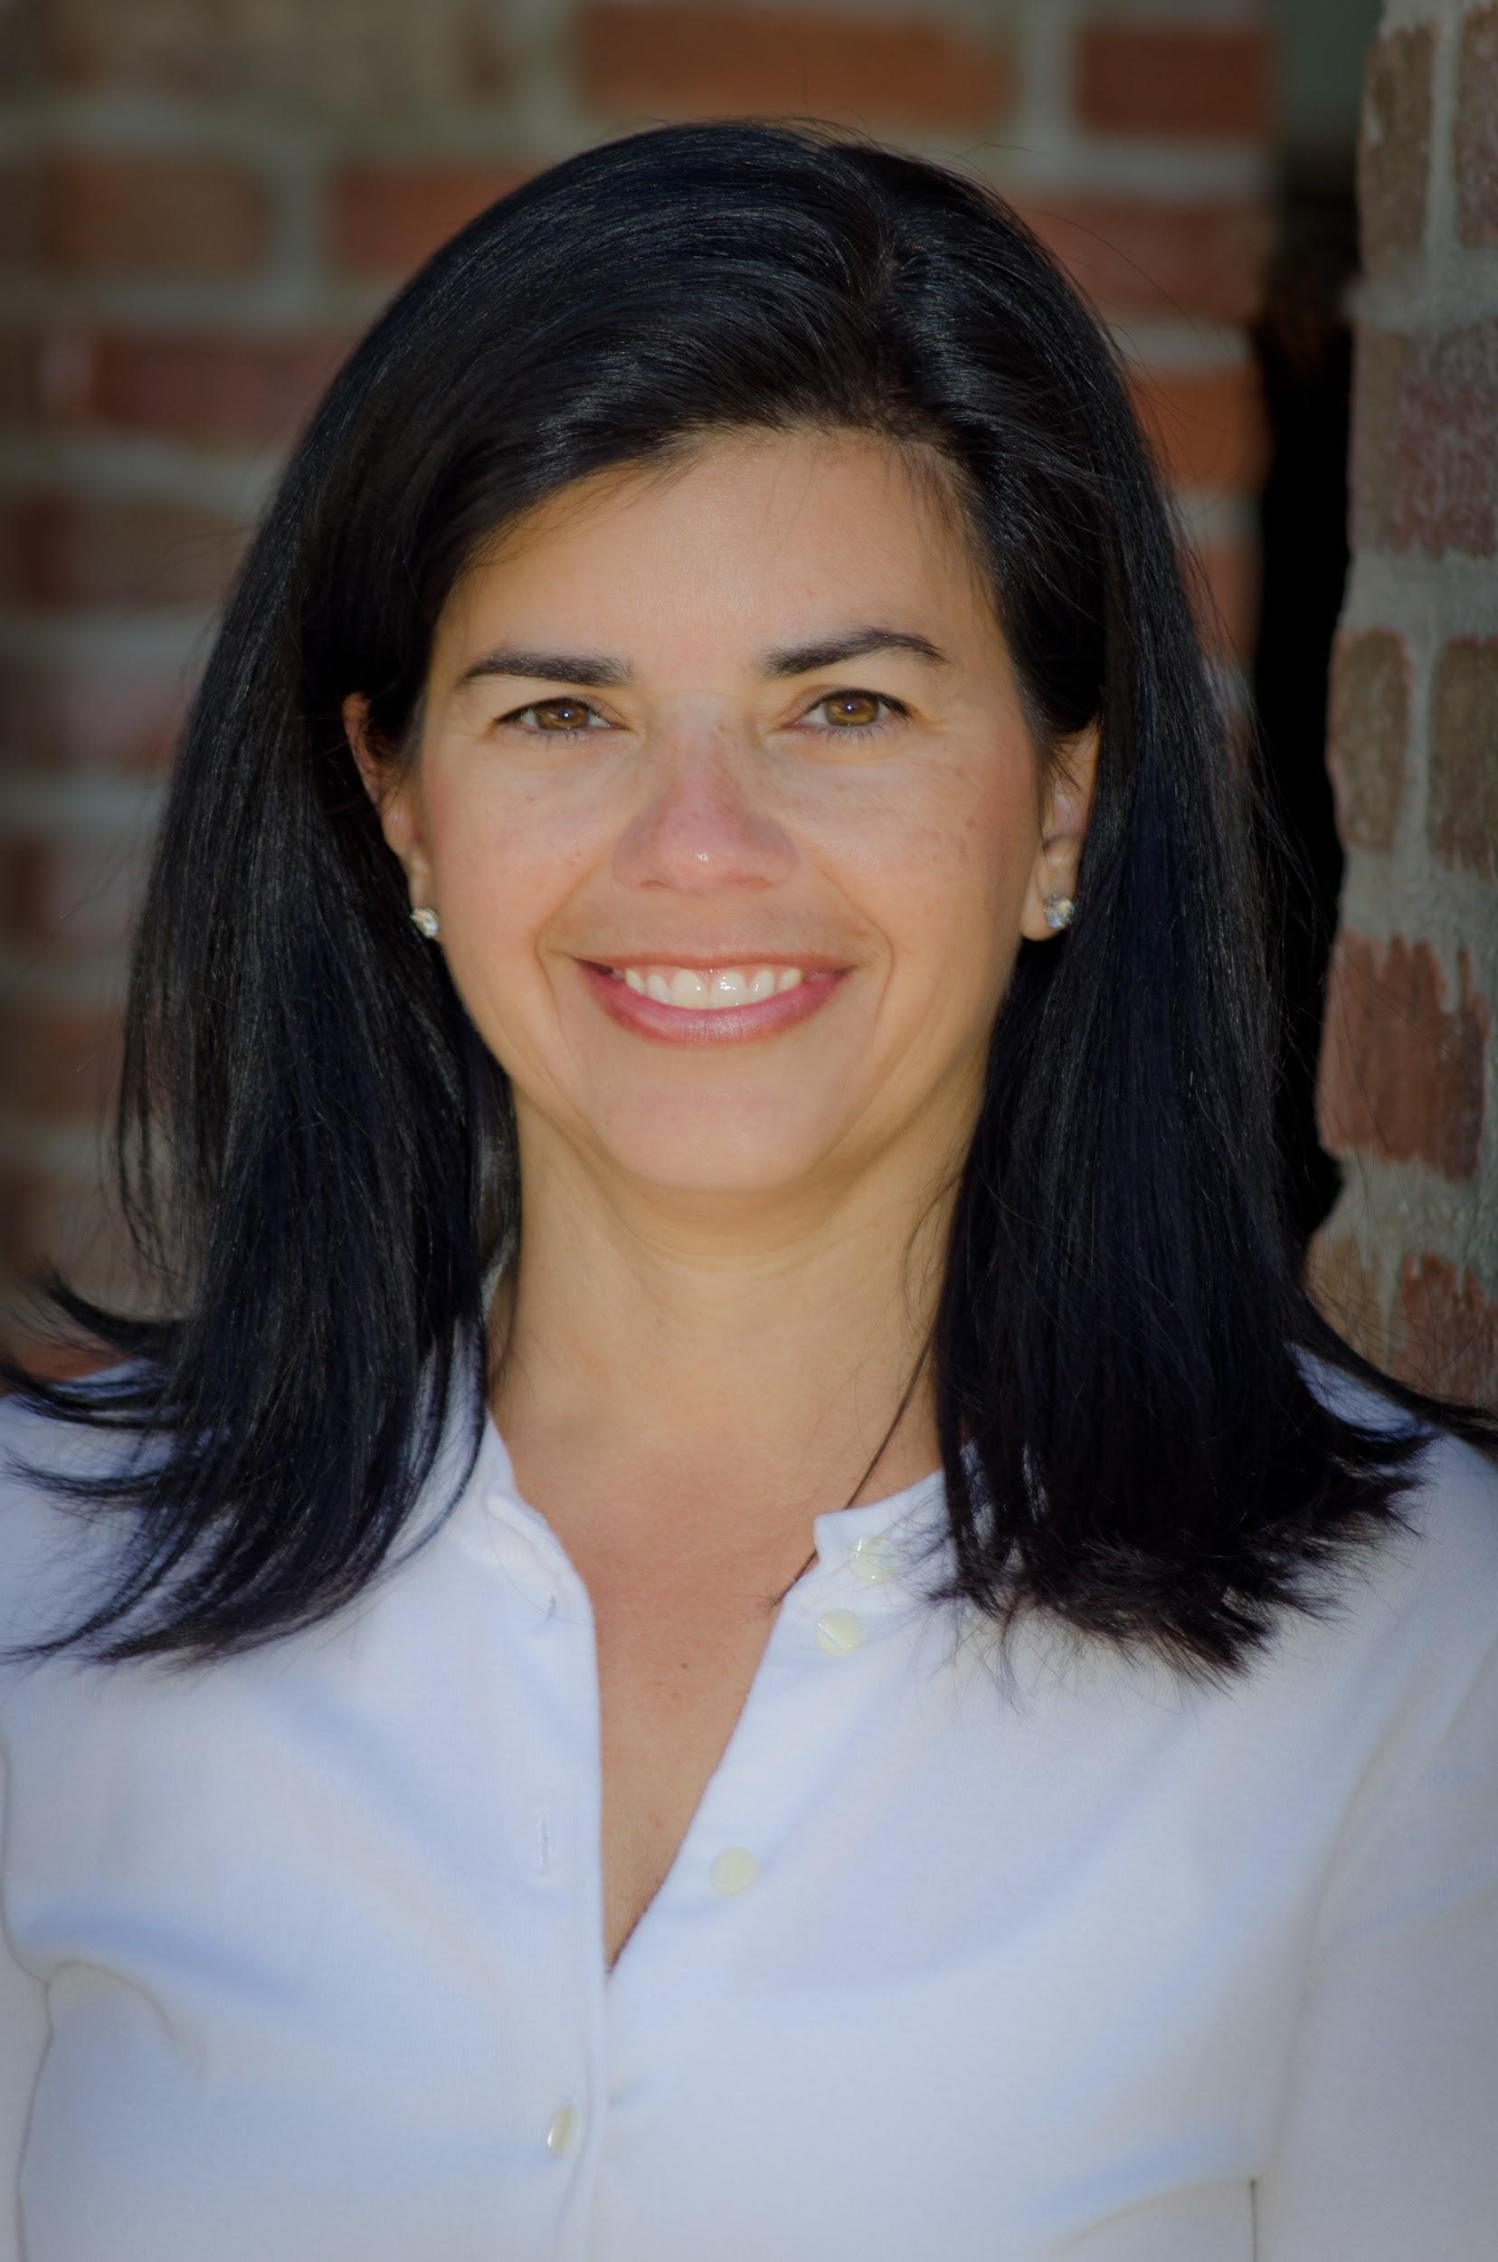
Jody Guarino
Mathematics Coordinator
Orange County Department of Education

Slide 24
Section 2: How is “assessing student understanding” part of the work of teaching?

Slide 25
Assessing Student Understanding
Knowing ALL students
Part of the work of teaching
Knowing what students know and understand everyday in detail
Shapes teaching in real time
Allows for decisions in the moment of teaching, short and long term
Notes:
As we think about the core practice, “assessing student understanding” we wanted to broaden how we think about assessment. Traditionally, assessment has been about giving a test at the end of a period of teaching, perhaps the end of chapter test, and then the results were used to sort kids into groups and re-teach – from a lens of trying to “fix or repair” kids and evaluate student performance and place a grade on a report card.
Within the work John described, one of the things we set out to do was shift the view of assessment to part of the work of teaching. We’re listening to and learning from kids all day, every day. How do we use what we learn to provide intentional learning experiences for students, experiences that are respectful of students, the funds of knowledge they bring, and the assets we can build upon. This is quite a different lens or mindset than “fixing them.”
We also know there’s a progression to this; starting with the work on noticing and interpreting student thinking. How do we learn to notice the details of student work and make sense of and interpret what it is we see kids doing? Then we have to think about how to use that information. Sometimes we plan to use it and don’t end up actually using it, we may plan to use what we learn to inform future lessons, what we’ll do next year differently when we’re teaching fractions as numbers or what we’ll now do tomorrow based on what we learn from students today. And ultimately, we hope to get to a place where we use what we’re noticing in the moment.

Slide 26
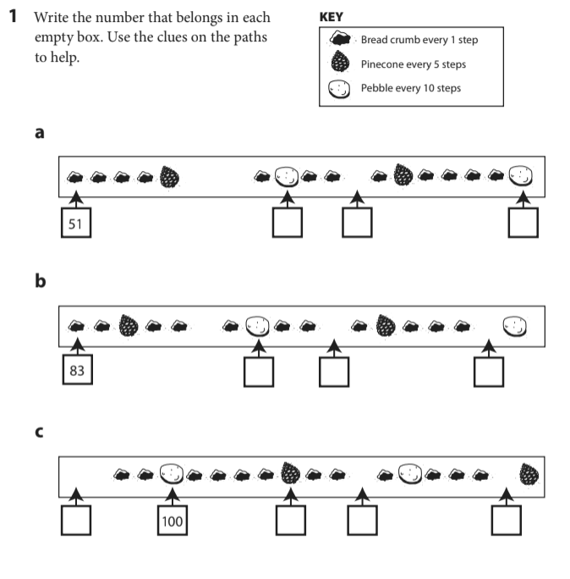
Notes:
Keeping the goal in mind of humanizing math and students, let’s take a look at an assessment task in the newly adopted instructional materials. This item comes from first grade, in a unit that comes near the end of the year.
I’ll pause for a moment, to give you time to determine the numbers that go in the missing boxes. Notice the key in the top right corner.
You might ask yourself, as a teacher, what would I know and understand about my students thinking from this task? How might this shape my teaching?

Slide 27
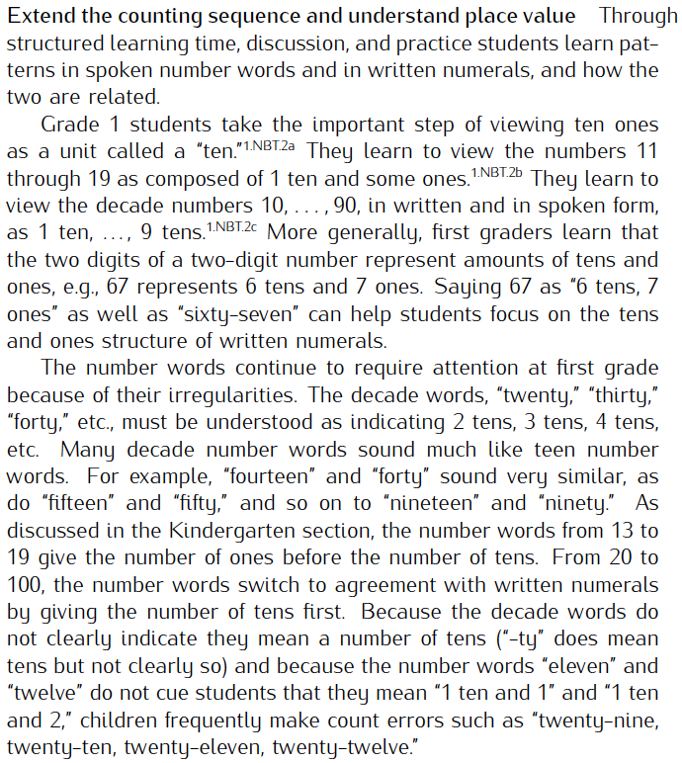
1.NBT.1 Count to 120, starting at any number less than 120. In this range, read and write numerals and represent a number of objects with a written numeral.
CCSS NBT Progression, pg. 6
Notes:
Here’s the standard the instructional materials identify that item to measure.
If students aren’t sure how to make sense of the task, or perhaps have the wrong number in the response squares, does that seem like a reliable indicator that they don’t know how to count to 120 starting from any number?
And what if they filled in the boxes with the correct number, does that give us a false positive?
On the right side of the slide, you’ll see the Number and Base Ten progression document which connects the counting sequence to place value; the shift in language from teen numbers… seventeen where we attend first to the ones (7 ones) and 1 ten to that shift that begins with 20 that now the first part of the language of the numbers is the number of tens or decades to the ones, for example in 37, the thirty refers to 3 tens and the 7 follows. This is an important development for young children, we often hear this cadence as they count and then as they start to get close to the decade, they often slow pause…

Slide 28
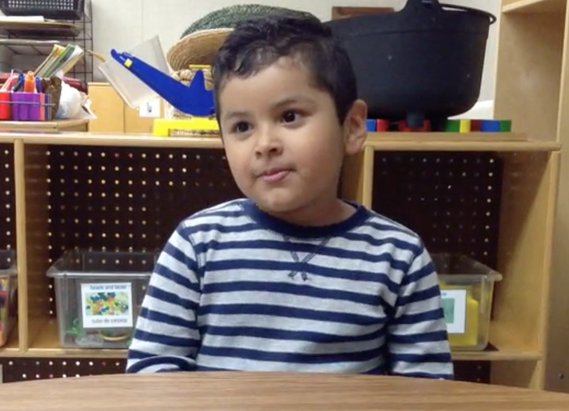
Meet Christopher
Carpenter, Franke, Johnson, Turrou, Wager (2016). Young Children’s Mathematics, Portland, ME: Heinemann.
Notes:
Link to clip: http://hein.pub/YCM9.1​
I’d like to introduce you to Christopher. We’re going to drop in on Christopher counting to 100. What can we learn about Christopher from listening to him count?

Slide 29
Helpful for Christopher? If this is an assessment item, what assumptions might we make about instruction?
Notes:
So now let’s revisit the assessment task… if this is an assessment item, we can make some assumptions that students are doing tasks like this within their everyday instruction. Is spending time on this task teaching the standard or teaching to the test?
Helpful for Christopher or not?
What does this mean for a teacher, do you feel pressured to teach this particular activity? If you don’t, will students have access to the item on the assessment? Or feel defeated and “not good at math.”

Slide 30
Design Principles - Revised Assessments
Valid
Accessible
Critical grade level work
Make student thinking visible
Asset lens
Notes:
Examples like the pinecone and acorn path that you just experienced, led us to the need to revise both the assessment system, and the actual assessments that would be put in front of students.
We started with the assessments from the adopted instructional materials, and developed revised versions using the following design principles:
1-valid – Each item will assess the intent of the standard. We want the assessment information to guide instruction so it’s critical that the assessment tasks are actually aligned with the standards
2-math is accessible to all students (assessment tasks don’t rely on experience with a particular representation or activity, for example with the pinecones and acorns)
3-assesses critical grade level work – we wanted to support instruction and knowing we wanted 65-85% of instruction on major work of the grade, we wanted that present within the assessment too. While this work originated well before covid, it’s especially critical now. Teachers are teaching with less time than ever before, it’s critical that every minute is used intentionally, on the most critical work of the grade level.
4-makes student thinking visible providing teachers with insight into student thinking that could then be leveraged and built upon. We’ll talk about this in more detail later.
5-asset lens – will provide students with opportunities to show their understandings and give teachers insight to leverage the assets and knowledge within their classroom learning community

Slide 31
Section 3: How do you use assessments to guide your instruction?
Notes:
Now Michelle will talk more about these revised items and how this work has shifted her lens of assessment and how she uses assessment to guide instruction.

Slide 32
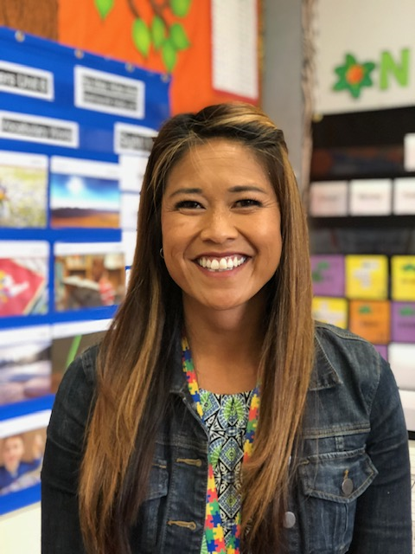
Michelle Sperling
Teacher
Newport Mesa S.D
please enter a head shot here

Slide 33
How might this be different? Where is equity here?
Version 1
Version 2
Start at 87. Write all of the numbers to 113.
Notes:
We are now going to take a look at version 2, which is the revised assessment from version 1 that Jody introduced in the previous slides. The initial feeling a first grader gets when seeing version 1 is fear, intimidation and a lack of confidence. I have seen kids slouch down when given this assessment. On the flip side, when a student sees version 2, they are facing a question with ease and confidence. This simplistic revision allows the teacher to target the most critical understanding in a non intimidating format.
Version 2, the revised assessment, we were intentional about starting at the number 87. When starting at the number 87 students will cross three decades and more importantly they cross 100. Most students in the beginning of 1st grade will write 1001 or 10,010 after the number 100.
As a result the revised assessment allows teachers to gain a greater insight on whether or not students can extend the counting sequence and understand place value.

Slide 34
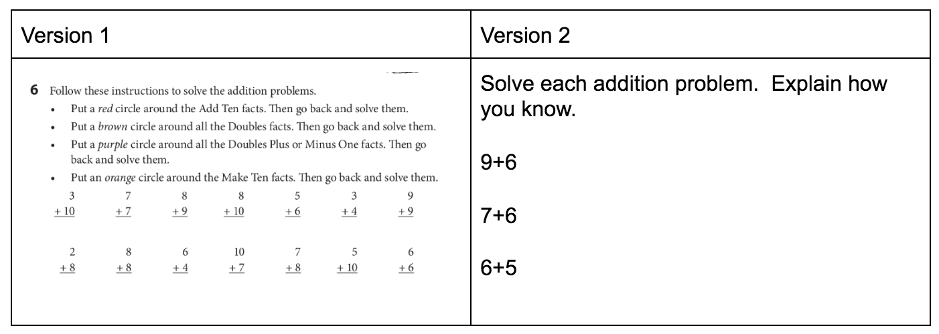
Monitor to Understand Student Thinking
Notes:
(Michelle)
Take a moment to do the first few problems on version 1 (90 seconds), What do you notice?
For example, think about the problem 7+6. This might be considered a doubles plus or minus 1 problem, I’ve seen students add 6+6+1 to solve this, I’ve also seen students add 7+7 and subtract 1. Still others may see 6 as 3+3, adding 3 to the 7 to get 10 and the other 3 to the 10 to get 13. Or perhaps decompose the 7 into 3 and 4, add 4 to the 6 to get 10 and then 3 more to get 13. I’m excited when I see students use flexible strategies that make sense to them. It’s not about labeling a problem as a particular strategy, it’s about solving the problem in a way that makes sense to them. Personally, I’d rather see kids making a ten here, that will help them later think about problems like 37+6 or 37+26. They’re not going to use doubles for those, we’re in a base ten system so building toward 10 is really important.
One of the things that I’ve appreciated about the revised assessments is that the assessments give me insight into actual student thinking. I’m not assessing instructional materials, I’m assessing my students understandings. It’s not just about the right answer or which strategy the instructional materials call out for a particular problem, but understanding what students know.
This is critical especially now with limited time we have with our students during this pandemic. More than ever I am intentional with my teaching and these assessments allow me to build upon their mathematical understandings.
So rather than circling an answer and writing the sum as it call for in version 1 my students now solve these 3 problems. Not only did I see and understand what they did mathematically, I also see how they represented their thinking. These student examples are shared in class after the assessment in order for me to leverage their representation during our mathematical discourse.
Another interesting revelation I discovered with these revised assessment happened when a new student, Daniel, joined my class in the middle of the school year. Daniel came to my class in January and he was not in my class up until that point so I wanted to assess his mathematical knowledge. I was able to pull out the version 2 revised assessment because this version only assesses the math and not the procedural strategies from version 1. If I had given him version 1 instead, Daniel most likely would have done poorly since he was not taught the procedures that the instructional materials addressed in version 1.

Slide 35


Meet Diane, Isabella and Ayden
Diane
Isabella
Ayden
Hazel and her brother frosted all of the cookies that their mom made for the party. Hazel decorated 56 cookies. Her brother decorated 81 cookies. How many cookies will there be?
Notes:
Meet Diane, Isabella, and Ayden, second graders. These colors represent the data system in our district. Green indicates a student solved a problem correctly, red, that an answer is incorrect.
I want you to take a moment and think about these questions: What inferences might you make just based on these colors? How does this color coding system position kids? How does a teacher view these colors? (chat)
Thinking about this color coding system, we would initially think that Isabella needs some help and there are gaps in her learning. Maybe she needs to be pulled out of class for additional intervention. What does Isabella see when she sees this color?
Let me add some context… these three students were given the word problem: Hazel and her brother frosted all of the cookies that their mom made for the party. Hazel decorated 56 cookies. Her brother decorated 81 cookies. How many cookies will there be?
What strategies would you anticipate you might see?

Slide 36
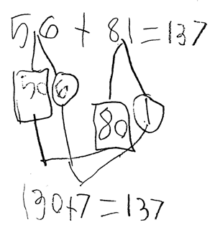
Hazel and her brother frosted all of the cookies that their mom made for the party. Hazel decorated 56 cookies. Her brother decorated 81 cookies. How many cookies will there be?
Diane
Notes:
Here’s Diane’s work…
Diane has used place value. She decomposed 56 into 50 and 6, 81 into 80 and 1. We see evidence of place value understanding here and in the way the units were then combined, 50+80=130 and 6 and 1 into 7. Combining like units, here with place value, will be critical later as she works with fractions and combines like terms in high school math.

Slide 37
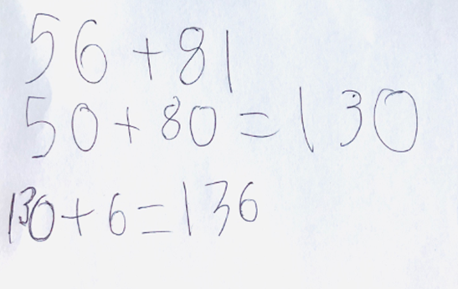

Hazel and her brother frosted all of the cookies that their mom made for the party. Hazel decorated 56 cookies. Her brother decorated 81 cookies. How many cookies will there be?
Isabella
Notes:
Here’s Isabella’s work…
Isabella has used place value like Diane. She started by operating on the tens 50+80=130. Then she adds the 6 ones from 56, perhaps she’s using an incrementing strategy, combining the tens, one of the ones, and forgetting the one from 81. She doesn’t include the 1 from 81, getting to the sum of 136 rather than 137. Her answer is wrong, however we know a lot about her thinking, and she knows a lot!

Slide 38
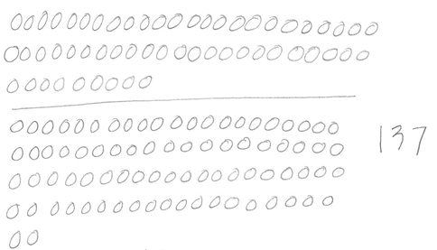
Hazel and her brother frosted all of the cookies that their mom made for the party. Hazel decorated 56 cookies. Her brother decorated 81 cookies. How many cookies will there be?
Ayden
Notes:
Now let’s look at Ayden’s work…
Ayden direct modeled, we see the 56 cookies represented, the 81 cookies represented, the total of 137. He too solved the problem correctly, arrived at the correct answer and made sense of the problem. Focusing on only a “correct answer” might lead a teacher to think, “he’s got it,” when in actuality some important learning still needs to take place.

Slide 39
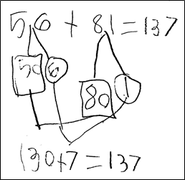
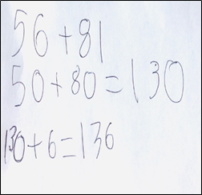
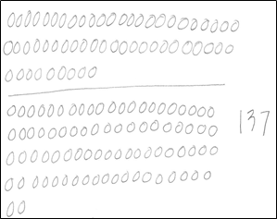
Diane, Isabella and Ayden
Diane Isabella Ayden
Notes:
From looking at the student work, we can see assets in all of the student strategies.
I can use what I learned from their thinking to position them as competent learners. In this example, Isabella has some great thinking which can benefit other students in the class. Isabella relates to Diane’s strategy and as a teacher I would facilitate a conversation around Diane’s work.
For example, in my classroom Isabella can explain to the class how Diane solves the problem and I can anticipate Isabella revising her thinking in the middle of her analysis. As she is explaining Diane’s work she will discover that she didn’t include the 1 from the number 81. She will revise her thinking and as a result feel competent even though her answer was inaccurate. This opportunity for Isabella to discuss a familiar strategy gives her a sense of competence and aides in her social emotional well being. Her strategy and explanation of her strategy provides validation among her peers as well as herself.
After Isabella makes her discovery I shift to Ayden and ask him what he notices about Diane’s notation. He immediately notices that there are numbers inside the square and the circle. I continue to facilitate and ask Isabella what numbers he is referring to. Once she responds 50 and 6 to make 56. I ask Ayden to circle the 56 in his representation. Since Ayden organized his work where he draws 56 circles above the line he can make the connection between the 56 in Diane’s work to his representation of 56. This student discourse has positioned each student as competent sense makers.
It is important to understand that this shift in thinking is part of a much bigger shift as you might infer from John’s opening. Had I been given these new assessments 5 years ago, the assessments would have been viewed as a new tool to be used in ways I formerly used district assessments… to sort kids, reteach, give grades. This work is one part of the much bigger way of thinking about teaching and learning.

Slide 40
Core Practices of Responsive Teaching
Eliciting and responding to student thinking
Orienting students to each others’ ideas and to the mathematical goal
Setting and maintaining expectations for student participation
Positioning students competently
Teaching towards an instructional goal
Assessing students’ understanding
Using mathematical representations
Adapted from University of Washington Teacher Education By Design
Notes:
During this pandemic and thinking about learning loss, as a teacher I am purposeful in my instructional moves with these students and target what they know and build upon their learning versus focusing on what the students do not understand.
This connects to the core practices of responsive teaching that John introduced earlier in this presentation. The student discourse between Isabella and Ayden is an example of orienting students to each other's’ ideas as well as positioning students competently.
Now Shelly will talk about the classroom environment that’s been critical in rehumanizing math along with the opportunities we have to impact the identity of the students we work with.

Slide 41
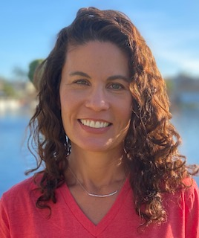
Shelly Mymon
Teacher
Newport-Mesa Unified School District
please enter a head shot here

Slide 42
Classroom Learning Norms
Take responsibility for yourself as a learner.
Make sense of what you are learning.
Keep trying even when learning is challenging.
It’s normal to make mistakes and revise our thinking.
Share your ideas using words, numbers, pictures, gestures, and/or tools. Partial thinking is okay too.
Listen to understand someone else’s idea and give others time to think.
Ask questions to help you understand.
Respectfully agree or disagree with ideas, not each other.
Everyone has good ideas.
Contribute to a learning environment in which it’s safe not to know.
Notes:
These are some classroom learning norms that we have adapted from the work of Elham Kazemi and Allison Hinz in the book Intentional Talk. These norms have been even more crucial during this past year as students have experienced long periods of social isolation and then had to adjust to new protocols such as social distancing and mask wearing at school, which can hinder their interaction. We introduce these norms to our students and refer to them constantly in order to build a classroom culture that supports all students to feel valued and safe to take risks and share ideas. We point out every opportunity to practice these norms throughout all subjects. Our students begin to internalize them, referring to them often with comments like "I'd like to revise my thinking."
As an example of how these norms support student agency, identity and learning, I’ll tell you about a third grader we had named Khloe who particularly embodied all of these ideas as she participated in classroom mathematical discussions. As the class discussed a problem and shared answers and strategies, Khloe would listen carefully to her classmates and consider their thinking and compare their ideas to her own. Sometimes she would respectfully disagree even when she was the only student doing so. Even when Khloe's answer was incorrect, we loved to see how she would take ownership of her own ideas and defend them. She would continue listening to others until she was truly convinced to change her mind. She would not just agree with her classmates until she was truly ready to do so, and she was able to explain why she had revised her thinking.

Slide 43
Let’s Do Some Math!
The teacher has 5 boxes of crayons. Each box has 24 crayons. How many crayons does the teacher have in all?
Notes:
Now let’s look at a math problem from both the teacher and student perspective.. In a moment we will ask you to solve this problem in a way that makes the most sense to you. But first, notice the numbers in the problem, 5 groups of 24. This problem was given to our third graders after they had been working with problems involving ideas like 5 groups of 4, etc. For this problem, the number 24 was intentionally selected to see what we could learn about student thinking. How would they think about 24? Would they notice it was close to 25 and think about 5 groups of 25, or use the distributive property and think about 5x20 and 5x4, or see 20 as two tens, etc.
Go ahead and take a moment to solve the problem yourself.

Slide 44
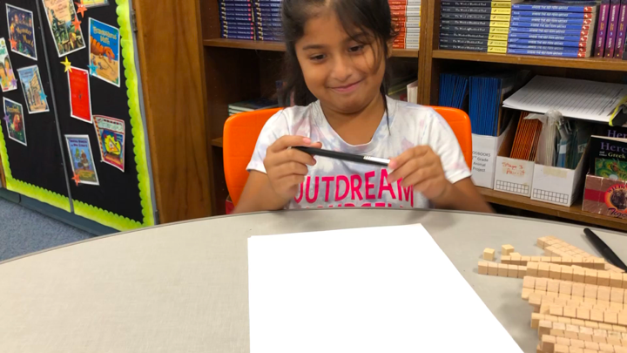
Michelle, 3rd grader
Notes:
Now we’ll watch a 3rd grade student solve the problem. Pay attention to the details of Michelle’s strategy… what does she know and understand?
Link to clip: https://drive.google.com/file/d/1vCONRhZNdLeS3rnAokROuFKmQayFB6UN/view?usp=sharing

Slide 45
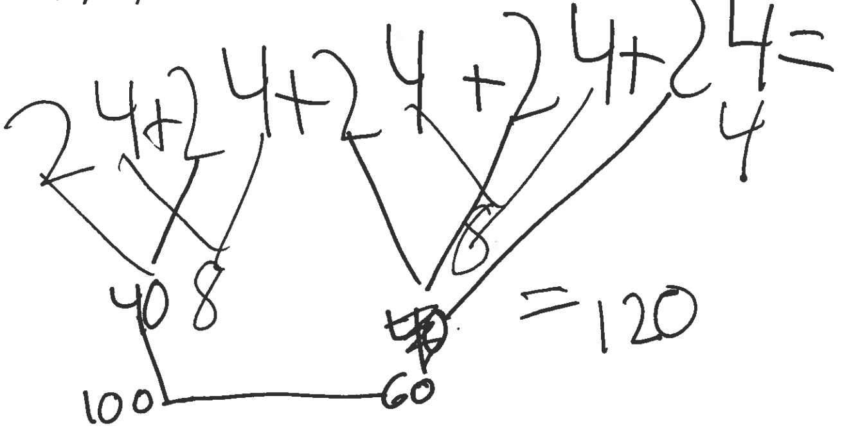
The teacher has 5 boxes of crayons. Each box has 24 crayons. How many crayons does the teacher have in all?
Notes:
Thinking about assessment as part of the work of teaching...
Take a moment to think- What understandings are evident in Michelle's strategy? Send your thoughts in the chat if you'd like.
We noticed that she demonstrates:
-understanding the context of the problem. We see the boxes and the crayons.
-understanding of the relationship of multiplication and addition (5 groups of 24 is the same as 24 + 24 + 24 + 24 + 24)
-flexibility with numbers and understanding of place value as she decomposes 24 into 20 and 4 and then recomposes, combining tens and then ones, 20 + 20 to 40 and 4 + 4 to 8 (her strategy is based on place value and properties of operations- 4.NBT.5)
-ability to communicate her thinking within her representation (we can't sit next to each student and interview them, so we encourage our students to make their thinking evident on paper- she also does this verbally)

Slide 46
5.NBT.5 Fluently multiply multi-digit whole numbers using the standard algorithm.
Excerpts from 3rd and 4th grade standards that built conceptual foundation of 5.NBT.5
●Interpret products of whole numbers
●Use multiplication within 100 to solve word problems … by using drawings and equations
●Determine the unknown whole number in a multiplication or division equation relating three whole numbers
●Apply properties of operations as strategies to multiply and divide
●Multiply whole number of up to four digits by a one-digit whole number, and multiply two two-digit numbers using strategies based on place value and properties of operations. Illustrate and explain the calculation by using equations, rectangular arrays, and/or area models.
Notes:
Michelle's work shows at least partial understanding of these standards that build a conceptual foundation for the standard at the top. These bulleted standards are all 3rd grade except the last which is 4th.
Christina is going to talk about some of the things we do as part of our daily work.

Slide 47
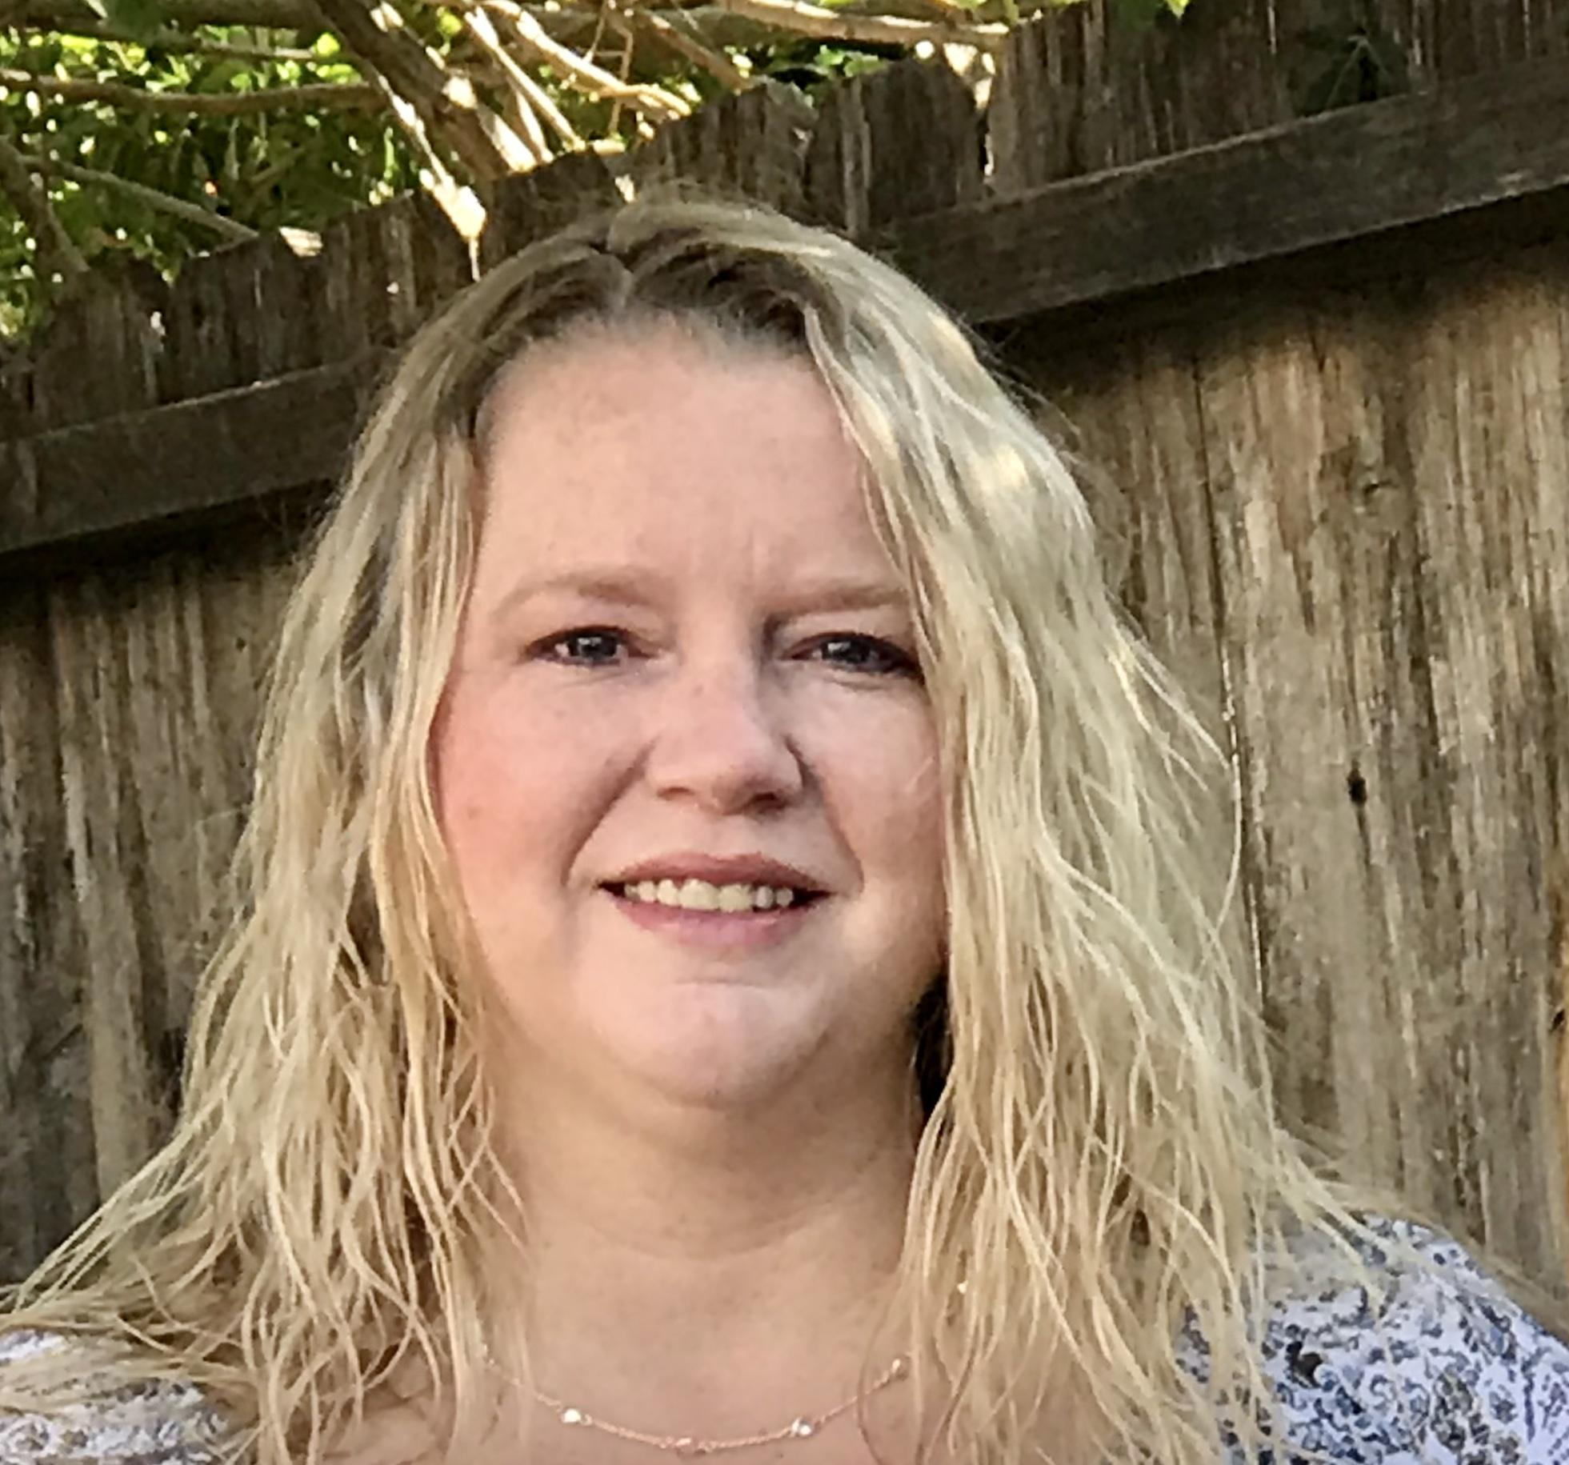
Christina Selstad
Teacher
Newport-Mesa Unified School District
please enter a head shot here

Slide 48
The Daily Work of Teaching
Analyze student work
What problem will we pose next?
Which numbers can we put in the problem to get a specific mathematical idea?
Which strategies will we share with the class and who will share them?
How might we pair students to collaborate and learn from each other?
Notes:
On a daily basis, we look at student work such as Michelle’s. We collaborate and analyze our students’ work to see what they already understand and what might be next steps. We ask ourselves a series of questions:
What do we want students to understand, and consider a learning experience to get them there.
What problem will we pose next?
Which numbers can we put in the problem to get at a specific mathematical idea?
Which strategies will we share with the class and who will share them?
Another question we ask ourselves is
How might we pair students to collaborate around something they’re working on and can learn from each other?
We also think about helping students mold their mathematical identity. We look to bring out the math that a student knows even if it is only a partial understanding. Maybe a student accurately represented a problem but wasn’t sure how to count it. We will have that student share his/her picture, and then we might count it together as a class.

Slide 49
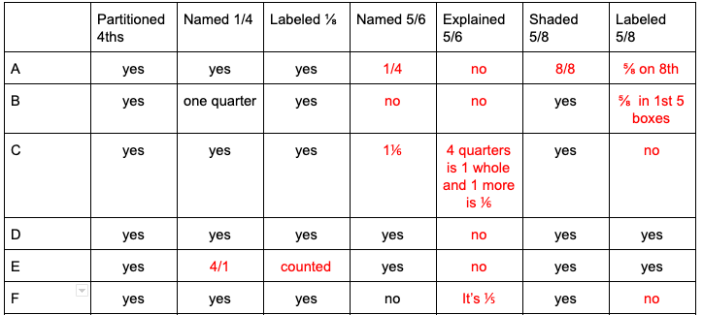
Progress Monitoring Sheet
Notes:
Here is an example of some of the frequent monitoring that we do to keep track of what students are understanding to guide our instruction. In this example, you’ll notice that the students understood fourths, but they struggled more with eighths. We clearly see that this group of students were ready to move on from fourths but needed to continue working on their understanding of eighths. So we can develop some lessons around that.

Slide 50
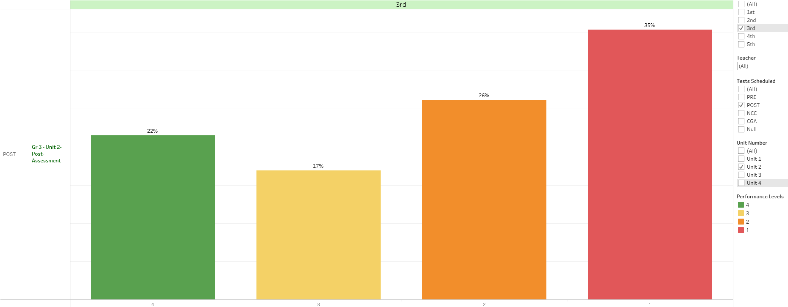
3rd Grade Instructional Materials Unit 2 Post Test
Notes:
Here is what the data from our instructional materials looked like. In the past we got this kind of information at the item level. What were we supposed to do with this?
I can tell you what we did with it. We moved on feeling like we failed. We justified our poor results, saying things like, “Oh, I have the SAI cluster this year,” and we moved on to the next unit. Students were cheated out of the learning opportunities to build upon what they do know and develop critical understandings because the pacing plan told us to move on.
Think back to the previous slides shared of Isabella and Ayden. Isabella would have been in this red group, but she has a more developed understanding. Ayden would appear in the green group, but the green doesn’t show me that Ayden is still direct modeling to solve 56+81.
Now imagine the students receiving a test percentage back at the top of their tests. Isabella would have developed some negative feelings about herself as a mathematician, maybe she would give up on math.
Earlier in the year, as we were still learning on Zoom, my students solved 2 groups of 8 or 2x8, and then they were asked to solve 4x8. I asked them to use 2x8 to help them solve 4x8. Then they were supposed to send me a chat with the answer. Sophia sent me 32 and 40 with a question mark. She knew it was one of the two but wasn’t sure which one was correct. I asked if she would mind talking through her thinking with the rest of the class. As she did, I saw the light bulb click! She confidently told us it was 32 and why. She was beaming! If Sophia had received a score on her problem, she would have missed it. Instead, she walked away from class that day knowing that she can do it.
Would a percentage at the top of a paper or test have helped these students? Do students really need to see a percentage at the top of a test at a young age? At any age?

Slide 51
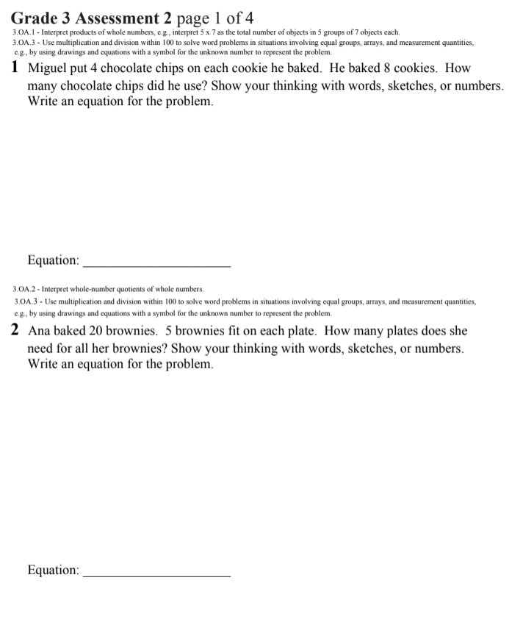
Revised Assessment Example
Notes:
Let’s take a look at one of the revised assessments to then talk about how we’ve changed the data we have and how we look at that data. Take a few minutes to think through some of these problems and the student thinking that could be elicited.
What do you notice?

Slide 52
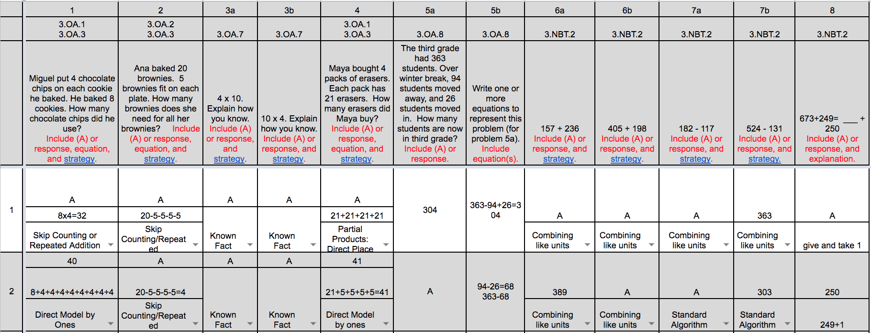
New Assessment Along with Data Sheet
Notes:
So I want to share how we look at data now.
We went from the bar graph to using this new representation of data. We no longer give a percentage on their tests. Instead, we capture student thinking on this data sheet. As you look at the sheet….What do you notice? How could you imagine using this as a teacher? Feel free to put your ideas in the chat.
We use this to plan our next steps. This data sheet doesn’t seem final like a percentage at the top of a test but more like a snapshot of where students are in their learning journey. We no longer move on to the next chapter. It’s like a learning continuum. Within the math fellows learning community we analyze data and plan next instructional steps intentionally, based on the data and our knowledge of our students.
It allows us to see beyond whether a student got the answer right or wrong. We no longer see who is struggling and try to send them off to an intervention group during our math time. Instead, it allows us to ask, how can I support ALL students tomorrow. We now see this as being a tool for us, it’s no longer about being compliant and sending our scores into the district, it’s about how we can use the information to support student learning. The students hear the celebrations of successes rather than feeling like a failure from a percentage.
What do teachers always wish for? More than ever, we wish for more time! Our class times have been cut significantly because of COVID. Every minute counts! We have to be intentional about spending the little time we have on the major work of the grade level. It used to take 4 days to give our formal math assessments. We would spend two days reviewing and two days testing hoping and praying that our bar graph would show mostly green. Now we spend one day assessing each unit. We were previously spending 28 days between reviewing and assessing. Now we spend 7 days a year on formal math assessments. We’ve gained a whole month of instructional time, and we know our kids so much more than a percentage.
The shift in the way we have used assessments has taken the pressure off of getting our students to perform and has given us the freedom to teach in a much more meaningful way. Now, we just teach math! Each day brings new lessons full of intentionality, purpose, and math!

Slide 53
What have we gained?
Students | Teachers
Access to math | Time to actually teach (gained 21 days)
Enthusiasm for math | A deeper knowledge of our students’ mathematical understandings
Mathematical discourse | Agency - Permission to do what’s best for our students
Stronger mathematical identity | Teacher identity
Notes:
So what have we gained from all of this?
The enthusiasm for math is contagious! Last year I had a boy named Danny in my class. Danny came to me with no interest in math. He would stare at the ceiling when it was math time and just seemed to check out. I started noticing that Danny became more interested in math, and one day, Danny’s previous teacher came up to me to share the conversation she had just had with him at recess. He was so excited to tell her about all of the math he was learning. She was so happy to hear that because he had struggled the year before. Danny became more and more involved in all of our mathematical discussions the rest of the year. He raised his hand every time I asked questions. He listened to others to understand their ideas and would say, “I respectfully disagree” when he didn’t agree with them. He brought our Learning Norms to life that Shelly shared with you earlier. How would things have been different for Danny if I had continued just passing back the math test with a failing grade at the top? It might have taken him much longer to find a love for math or he might never have discovered it.
The students blow me away with the conversations they have in our classroom. Even with face masks and social distancing, I am still so impressed with their discussions. Imagine if they continue building the way they have conversations with each other. Think about adults having conversations where it’s okay to respectfully disagree or agree with each other!
We as teachers have gained so much more knowledge about a student’s understanding by analyzing their work. I go to SST meetings for students and truly feel comfortable sharing what a child understands and doesn’t understand instead of telling them his/her test scores.
We feel like we have permission to do what’s best for our students because we don’t have to follow a strict pacing guide. We have the ability to spend more time where it’s needed.
Our teaching has transformed because our leadership (mainly John) has joined us side by side on this journey. He has co-taught lessons with us and spent time in our classrooms listening to students. He’s listened to our thoughts at meetings where he is seeking to make meaningful changes. He sees the benefits of the revised assessments because he has chosen to be fully engaged and involved himself in the process. He’s broken the mold of district leadership by putting himself in our shoes and learning with us. We are grateful for the path he has allowed us to take. The success story of Danny is his story too because he’s allowed the change.
Before I pass it back to John to close us out, take a moment to consider the question on the next slide.

Slide 54
What is something you heard today that you want to think more about? Please use the Group Chat tab on your control panel to respond.
Notes:
Or we can ask…
How does this change your view of analyzing assessment data? Why or why not?
What have you heard today that’s shifted your thinking about assessment?
What is something you heard today that you want to think more about?

Slide 55
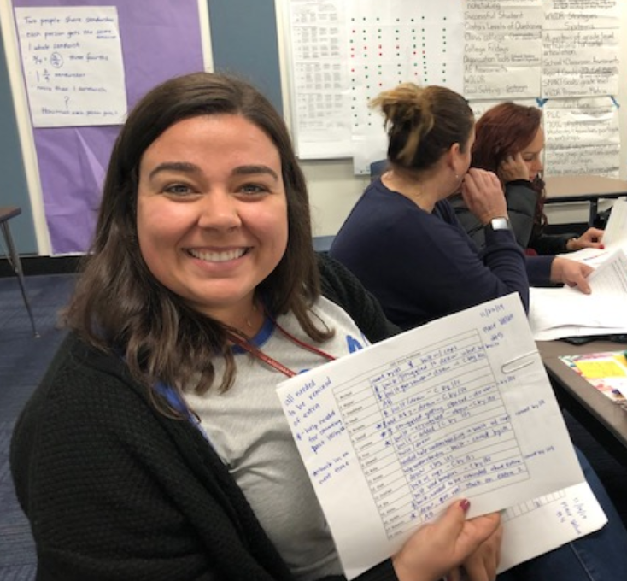
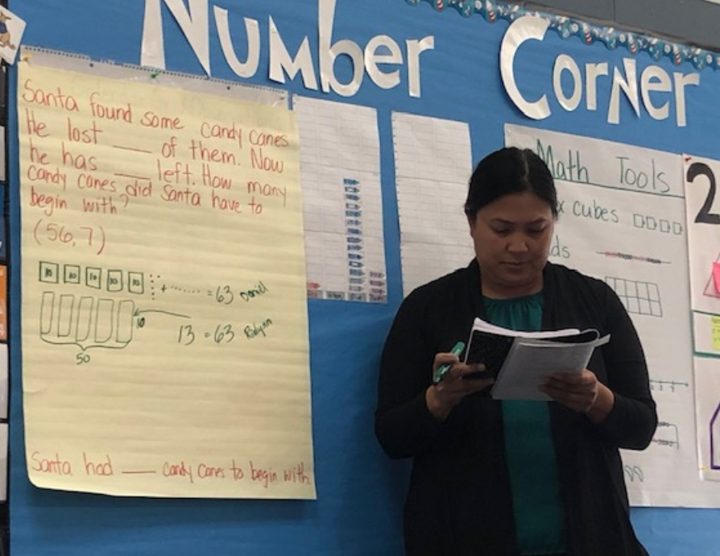
Notes:
JD start here
I can’t tell you how lucky I feel to be able to work with educators like those you just heard from, They are amazing and they are not alone in our District. Here you see images of a few teachers and how they’re humanizing mathematics…. making visible their systems for listening to and keeping track of student thinking and using that to inform their instruction
As you can see this work is happening in classrooms throughout the district but it is not in every classroom yet. Our goal is to have it throughout the entire district in every classroom because if my three children were still in a K-5 classroom,I would want them in a classroom that built their love of learning by positioning them competently in a community of learners, and if I want this for my kids i want it for all kids.

Slide 56
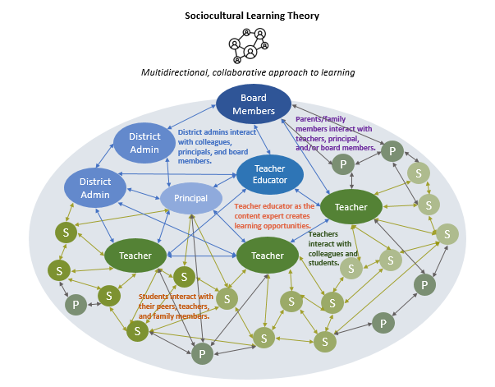
Desired Structure
Notes:
So in our work we’ve learned how critical it is to have a coherent system where District wide professional learning is supported and connected to learning happening regularly at school sites. Adults learn through collaboration; collaboration centered in student thinking and sense making. Learning, collaboration and students are at the center of all our work and as you can see from this graphic our intent is to have everyone involved thinking and learning in connected ways and part of the work. Again when I think of my own three children in a system like this, I realize that they would reap the benefits of every adult and child in the system when all are learning together.

Slide 57
Opportunities through this work
Role of instructional leaders
Site based learning and collaboration
Our perceptions of kids and their perceptions of themselves
Parent engagement
Focus on teaching and learning and shift from sorting and reporting
Continued support of teacher learning
Notes:
This work continues to provide us opportunities to to examine what we are currently doing, learn from it and make adjustments so each student in front of us is positioned as a competent sense maker throughout the entirety of every school day. We can only do this if we are willing to examine our systems some of which you see on this slide.

Slide 58
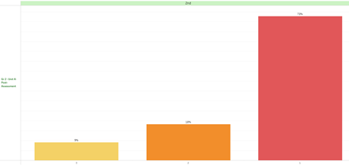
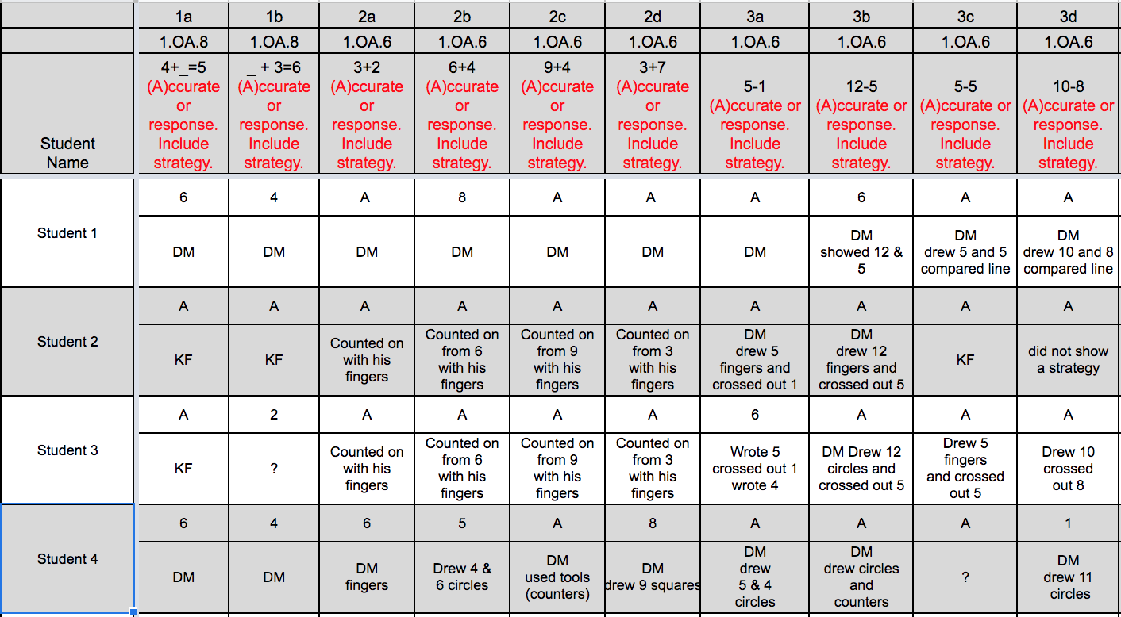
What does it look like to examine the systems we’re part of?
Notes:
What does it look like to examine systems we are part of? It looks like redefining assessment data that supports making instructional decisions based on what students know and understand and positions them as competent sense makers and contributors in a community of learners.

Slide 59
What does it sound like to examine the assessment systems we’re part of?
“Before, honestly, I would have just input the data into illuminate because that’s what I was required to do, but now looking at it from a different lens, and changing the way I see it, I am seeing more of what can I tell, for example this kid understands the math, but the language is definitely impacting him. And so to have the ability to not have to worry about the score so much but to look at, what do I see him getting so I can try to push him a little further along is really powerful for kids, because for him, if I were to just give him a score based on right and wrong answers, it would have been really low, but that’s because of English, because he knows the math.”
-NMUSD Teacher
Notes:
It sounds like a teacher who knows her students beyond a right or wrong answer. It sounds like a teacher who is guided by the thinking of the students in her classroom. It sounds like this teachers who has the freedom to make instructional decisions based on all of her content knowledge, pedagogical knowledge, knowledge of student thinking and most important knowledge of each student as individual learners.

Slide 60
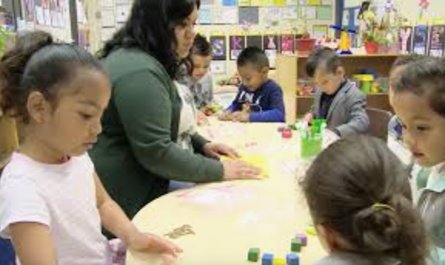
Why must we examine systems we’re part of?
Notes:
We must examine our systems to support the identities of strong, confident, happy, relentless learners who love to learn because they are listened to by a community who seeks to understand what they know in order to learn with and from them. Thank you!

Slide 61
Questions for Our Guests?

Slide 62
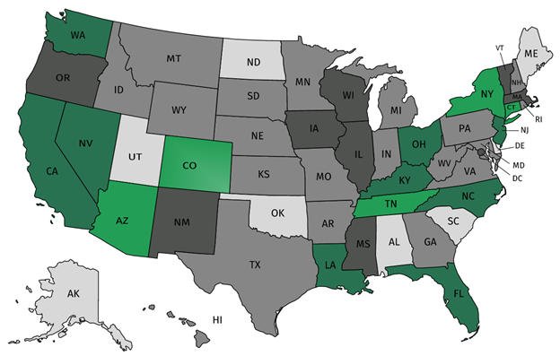
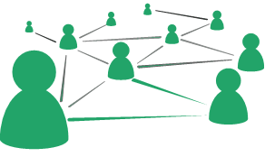
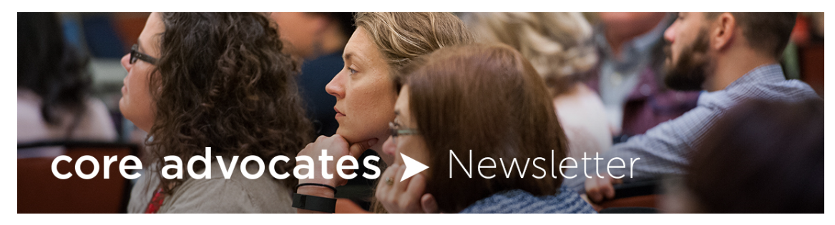


Join our network!
Join a national network of educators
Connect with state networks
Be a part of creating new tools and resources in partnership with SAP
Keep up to date on free resources, upcoming SAP webinars/professional learning opportunities, job postings and more!
Notes:
If you found tonight’s webinar helpful, we’d like to invite you to join our Core Advocate network! We’re committed to solving real problems that real teachers have and we know the best way to do this is to know more about what folks are experiencing.
As part of our national network, you have opportunities to connect with educators across the country, maybe even the network in your state! You can keep up to date on tools and resources available on Achieve the Core, as well as a variety of virtual learning opportunities and other ways to engage with us. We also work with educators in our network to help us build tools and resources.
We’d love to learn about who you are, where you work, the types of things you’re interested in and the expertise you already have. This way, we will be able to tailor our webinars and other opportunities to your needs and interests (we may even tap you to be our next webinar panelist).

Slide 63




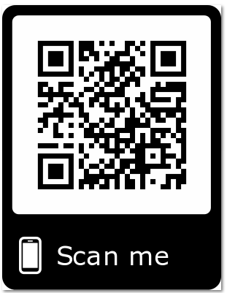
Please Join Us!
https://achievethecore.org/ca-signup
Twitter: twitter.com/achievethecore
Facebook: facebook.com/achievethecore
Pinterest: pinterest.com/achievethecore
Notes:
We encourage you to join the network by filling out this survey completely at atc.org/ca-signup

Slide 64

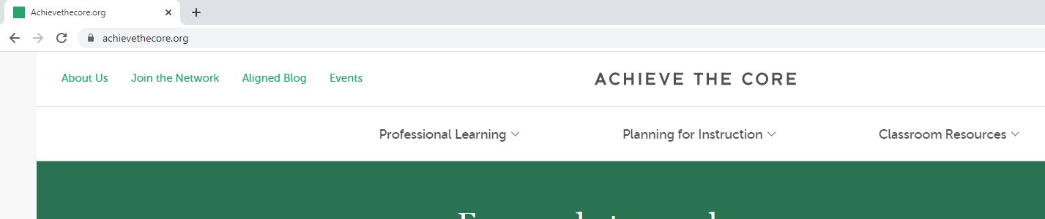
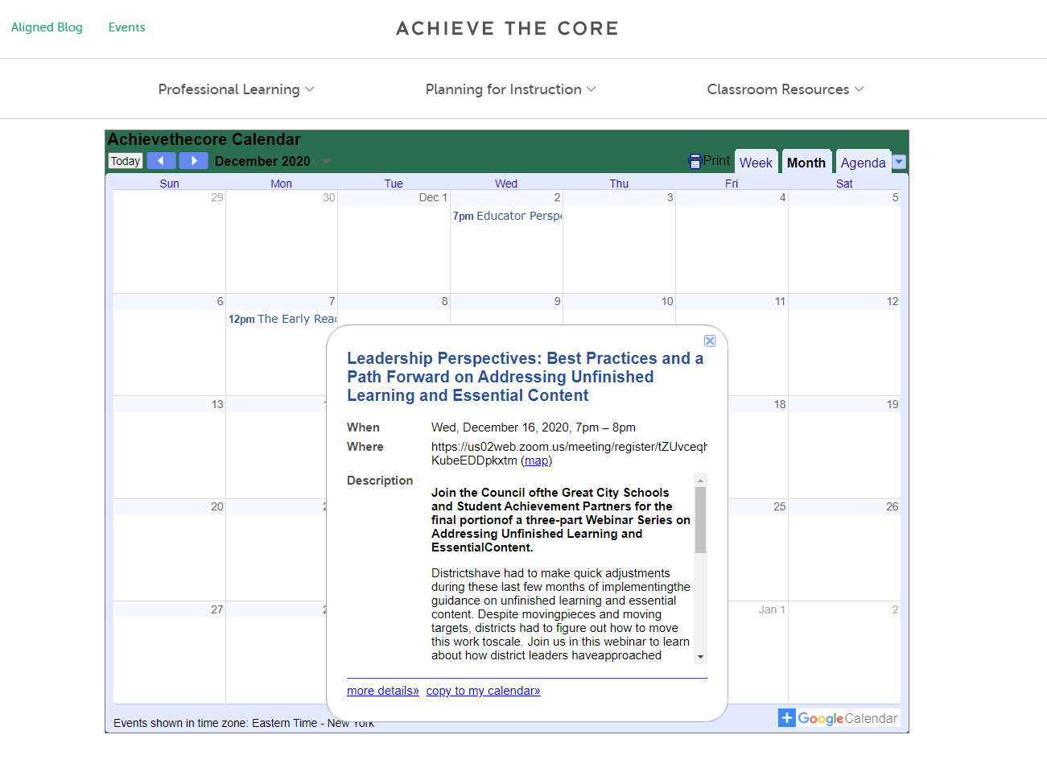
Please Join Us!

Slide 65
Thank You!

Slide 66
Resource Name | Link
SAP Focus Documents | https://achievethecore.org/category/774/mathematics-focus-by-grade-level

