Slide 1

Taking Care of Students and Educators During This School Year: A Conversation with the Core Advocate Advisory Board
Core Advocates Monthly Webinar
February 10, 2021
The webinar will begin shortly.
Check your Resource widget to preview the resources for today’s session! Use the Group Chat to introduce yourself!
Notes:
First timer poll
Handouts:
While we’re waiting, we’d like you to participate in a quick poll so we can get an understanding of who’s on the webinar with us tonight.

Slide 2
Introductions
Your hosts from Student Achievement Partners:
Jennie Beltramini
Mathematics Specialist
Claire Rivero
Digital Strategy Manager
This month’s presenters, Core Advocate Advisory Board:
Melissa Collins
2nd Grade Teacher
Shelby County, Memphis, TN
Glenna Sigmon
9-12 Instructional Coach
St. Lucie County, FL
Tara Warren
Middle School Math Teacher
Santa Monica, CA
Janice Mak
K-12 Teacher on Assignment
Phoenix, AZ
Ashley Cerón
4th Grade Teacher
KIPP DC Schools

Slide 3
How many Core Advocate Webinars have you attended?
Please use the Questions tab on your control panel to respond.
If using a poll, please put up to 5 answer choices in the notes section below and indicate if attendees should choose only one response or multiple responses.

Slide 4
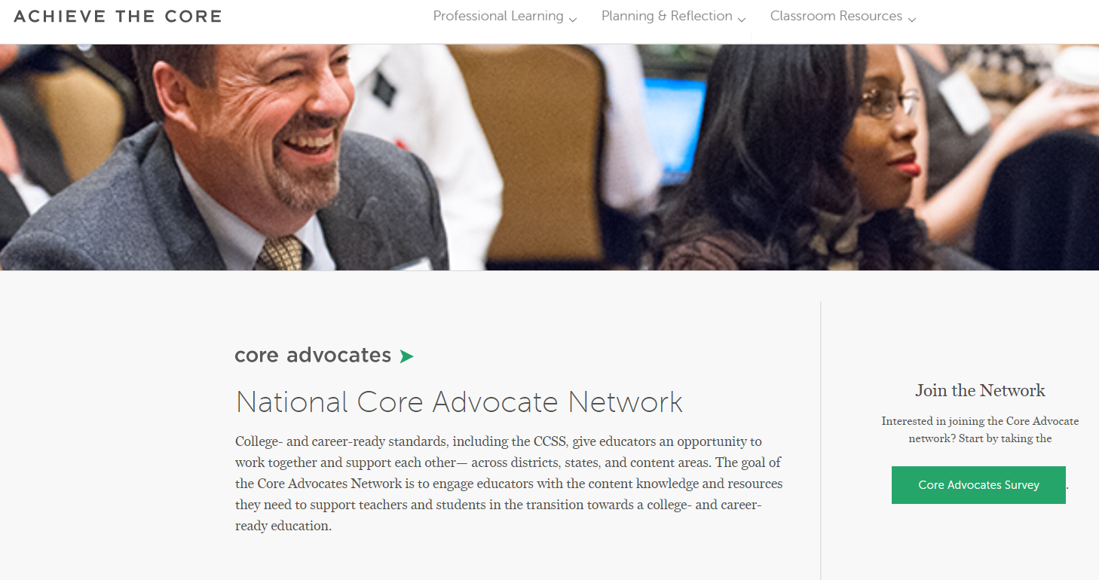
Join Our Network!
www.achievethecore.org/ca-signup
Notes:
If you find tonight’s webinar helpful, we’d like to invite you to join our Core Advocate network! We’re committed to solving real problems that real teachers have and we know the best way to do this is to know more about what folks are experiencing.
We’d love to learn about who you are, where you work, the types of things you’re interested in and the expertise you already have. This way, we will be able to tailor our webinars and other opportunities to your needs and interests (we may even tap you to be our next webinar panelist). So we encourage you to join the network by filling out this survey completely at atc.org/ca-signup

Slide 5
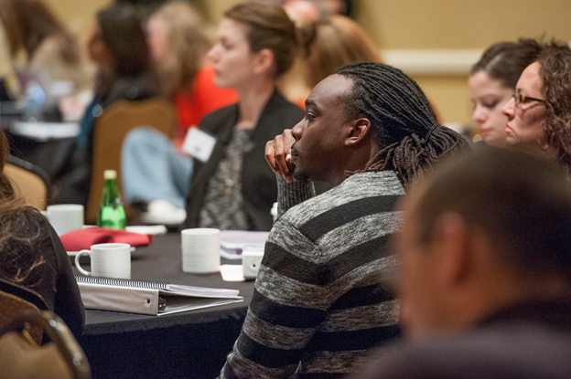
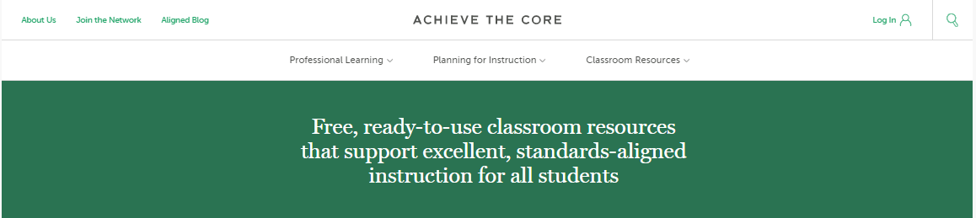
Learn More About Us!
Contact Jennie Beltramini (jbeltramini@studentsachieve.net )
Joy Delizo-Osborne
(jdelizo-osborne@studentsachieve.net)
Complete this survey to join our database (and mailing list): www.achievethecore.org/ca-signup
Visit our website: www.achievethecore.org
Notes:
If you’d like to learn more about the network, contact Jennie (her email is here).
We also want to invite you to join the network by signing up at achievethecore.org/ca-signup and visit our website for more info and opportunities

Slide 6

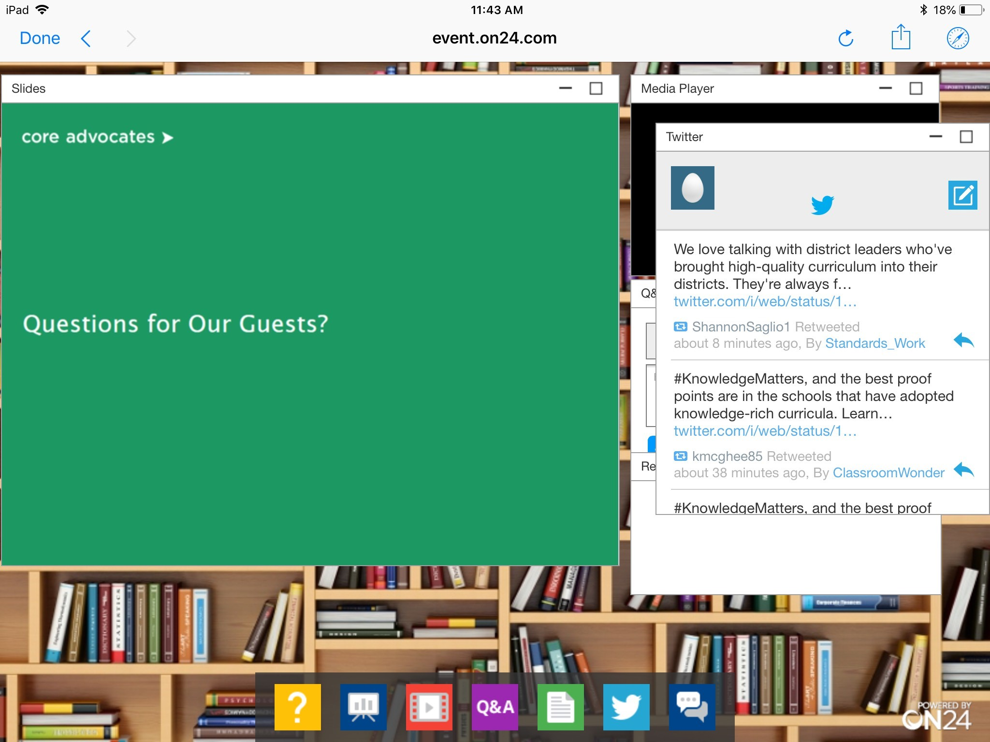
Tweet with Us!
Please feel free to tweet during and after the webinar using #coreadvocates
@achievethecore
@JennieBeltro
@jmakaz
@TeeIDub
@CollinsNBCT
@glennasigmon
Click here!

Slide 7

Engage with Us!
During the webinar:
Question just for the presenters/ tech help
Resources
Group chat
Certificate
After the webinar:
– Access to recording will be emailed to you.

Slide 8
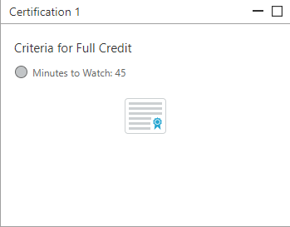
Certification Will Be Provided
A certificate will be available via the Certification box to the right.
Click on the blue-ribbon icon to print or download the certificate at the end of the webinar.

Slide 9
Goals of the Webinar
Meet the educators who serve on the Core Advocate Advisory Board.
Hear what the Advisory Board members have learned this year about taking care of their students and themselves, and how attending to the identities of their students and themselves has been helping to shape their work.
Learn about resources and ideas to consider for your own school, classroom, and community.
Notes:
We have three main goals for our webinar tonight. They are to...

Slide 10

Core Advocate Advisory Board
Daniela
Lisa
Karina
Bernice
Nathan
Melissa
Janice
Glenna
Tara
Jessi
Ashley
Kelly

Slide 11
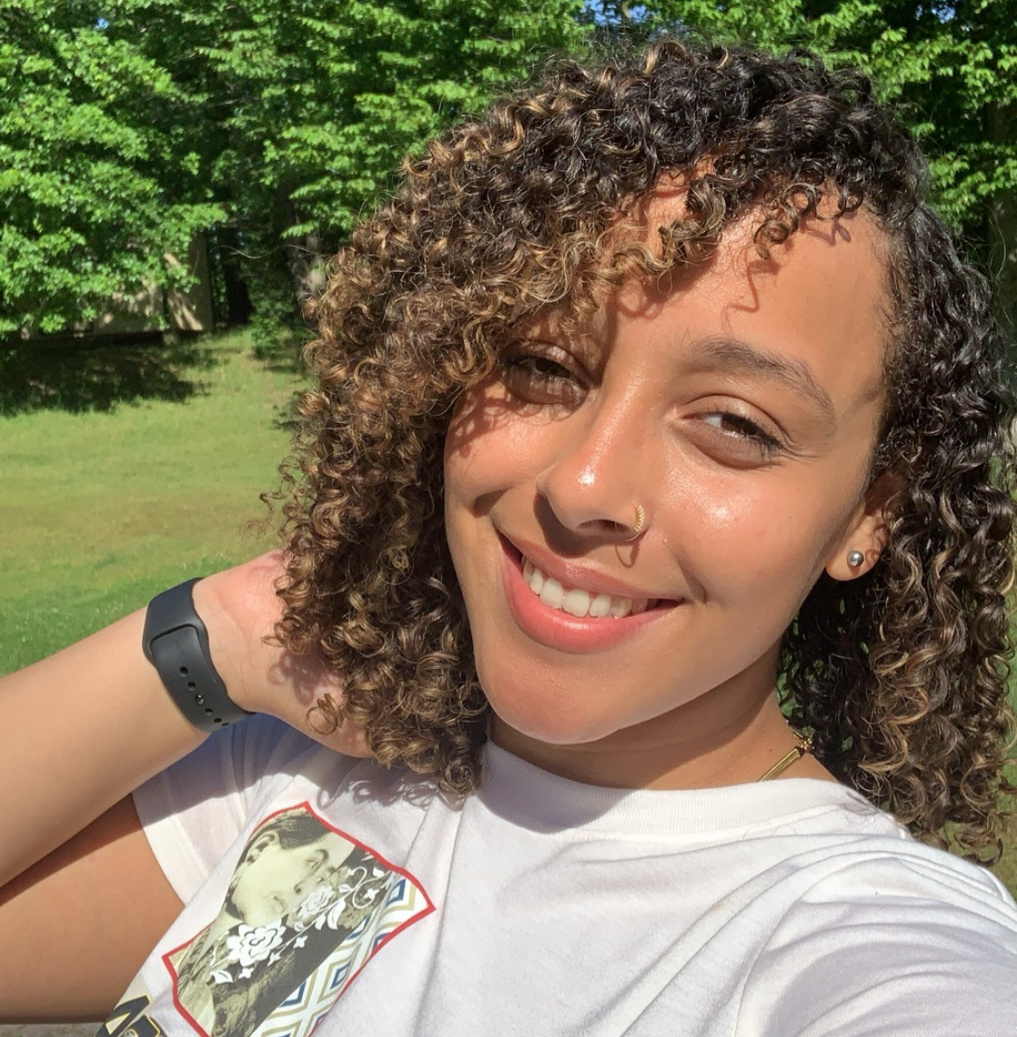

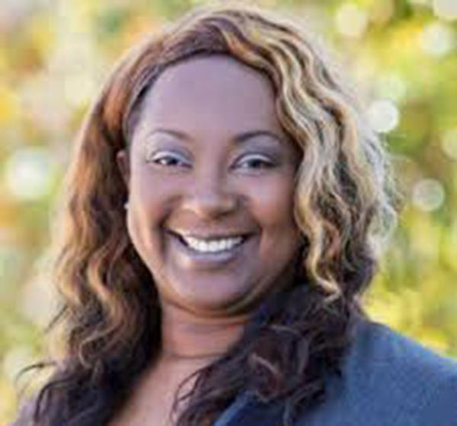
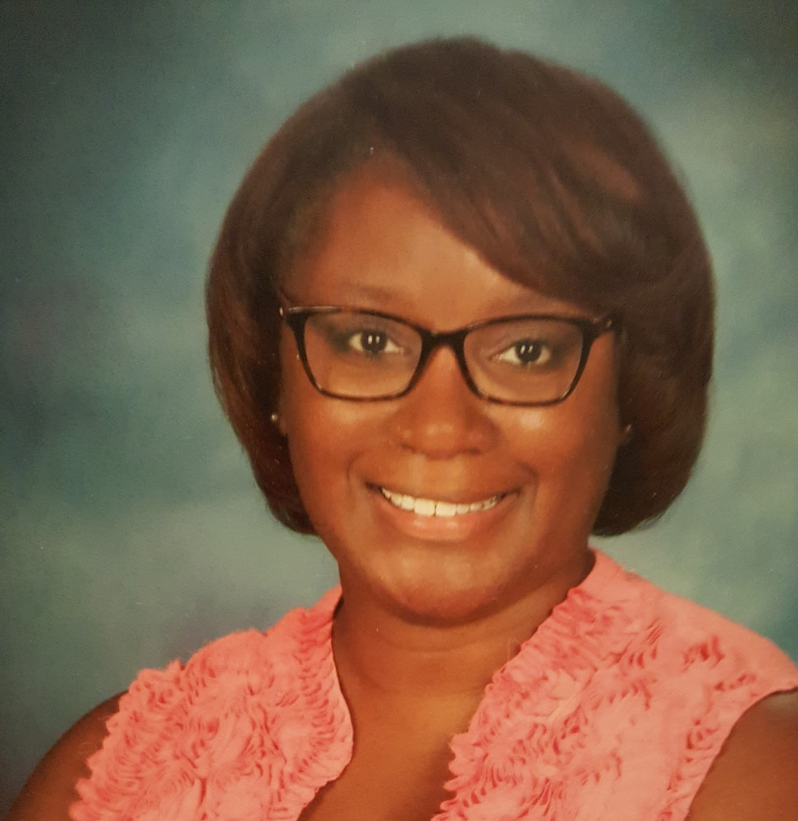
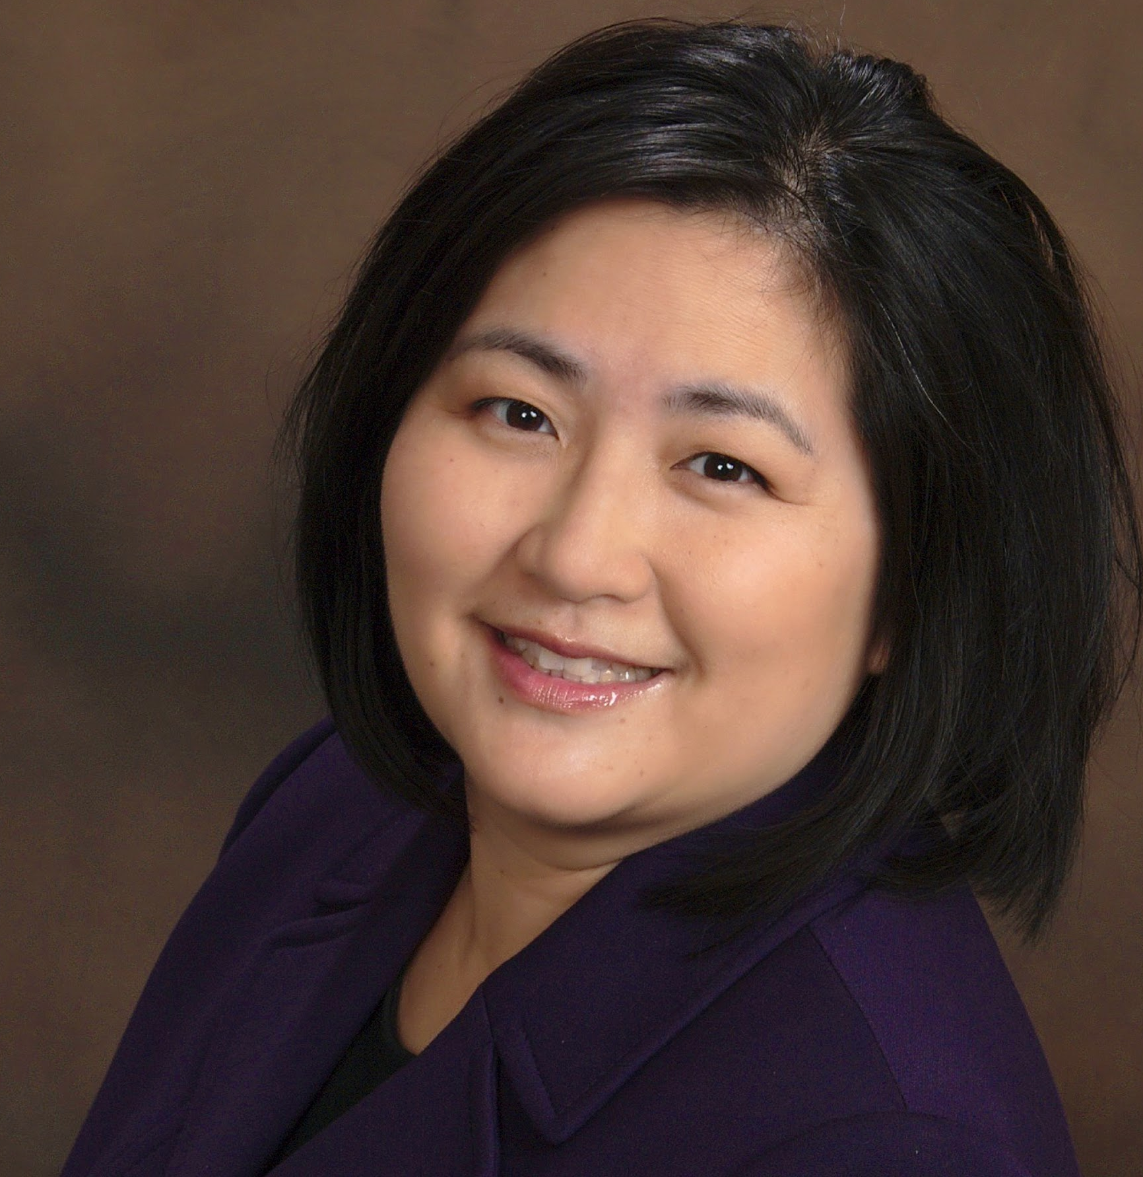
Section 1: Meet the Advisory Board Participants

Slide 12
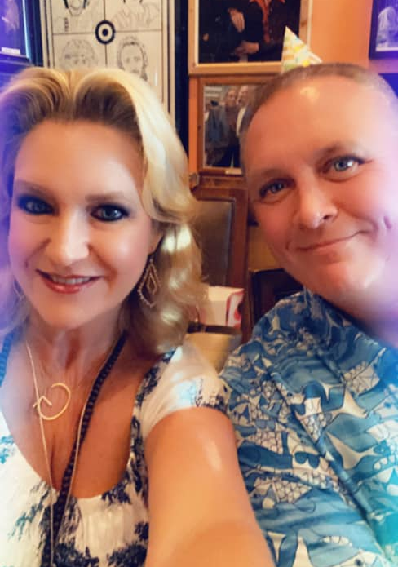
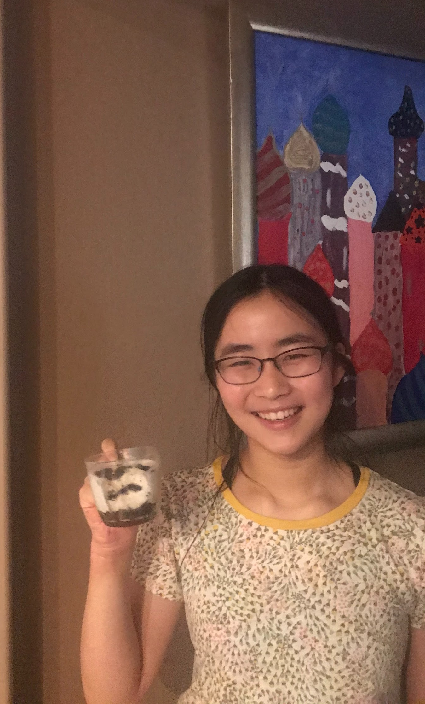
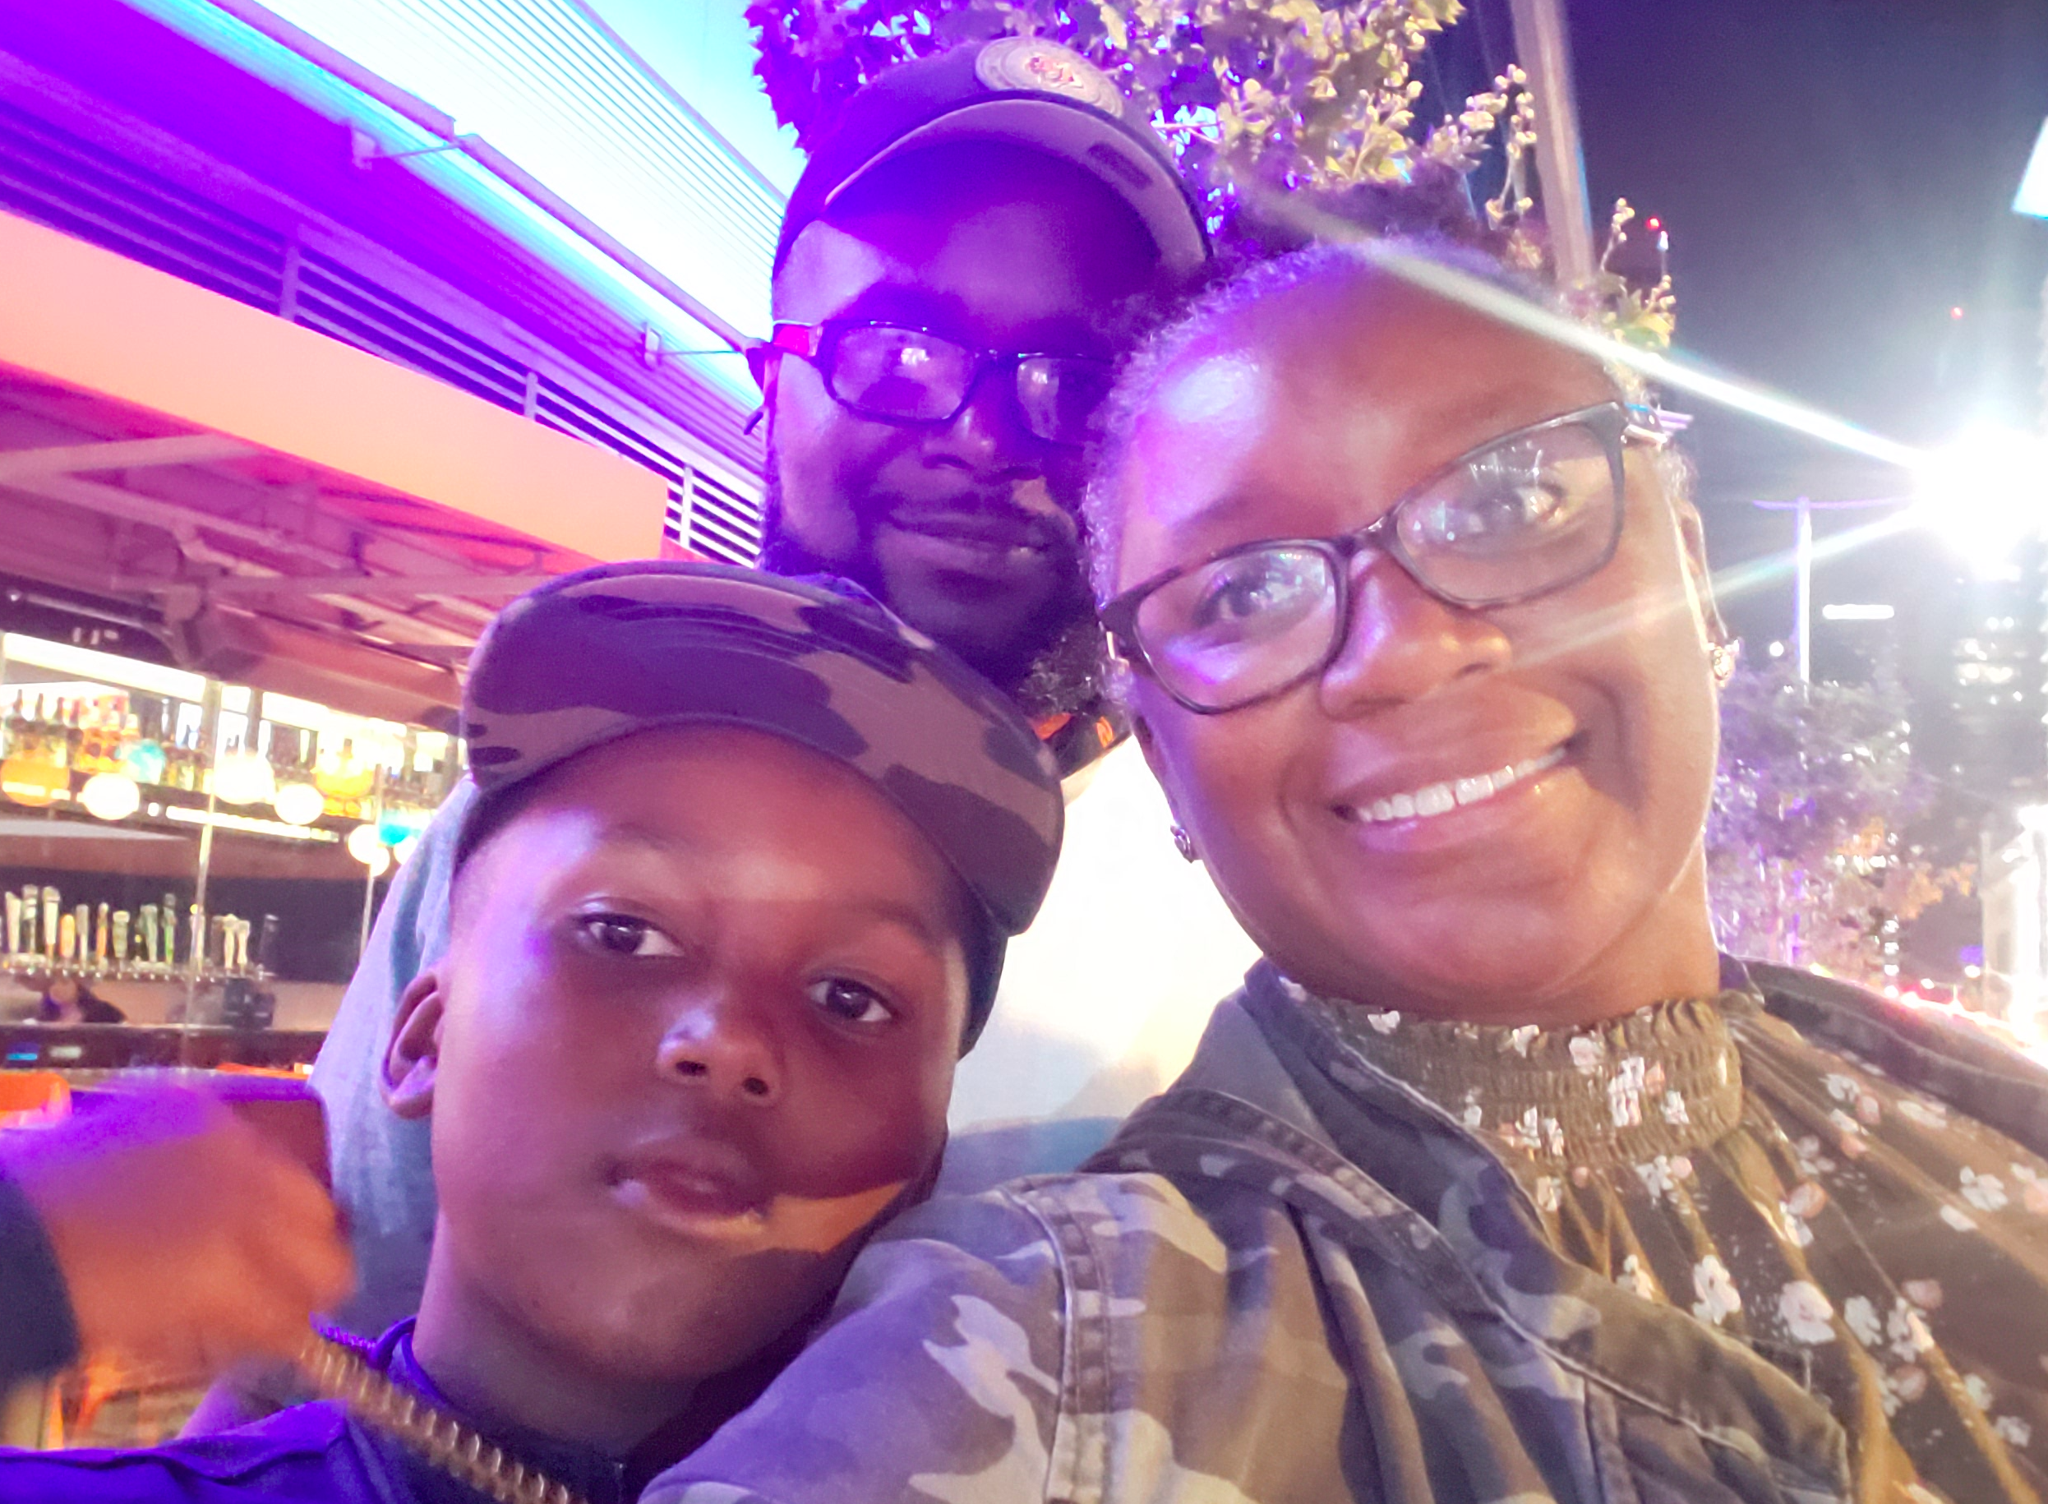

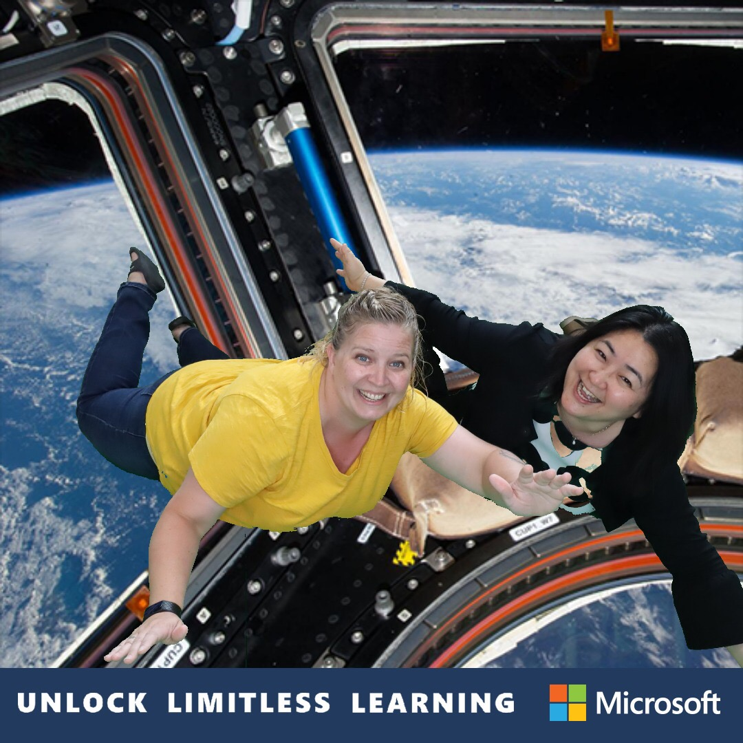





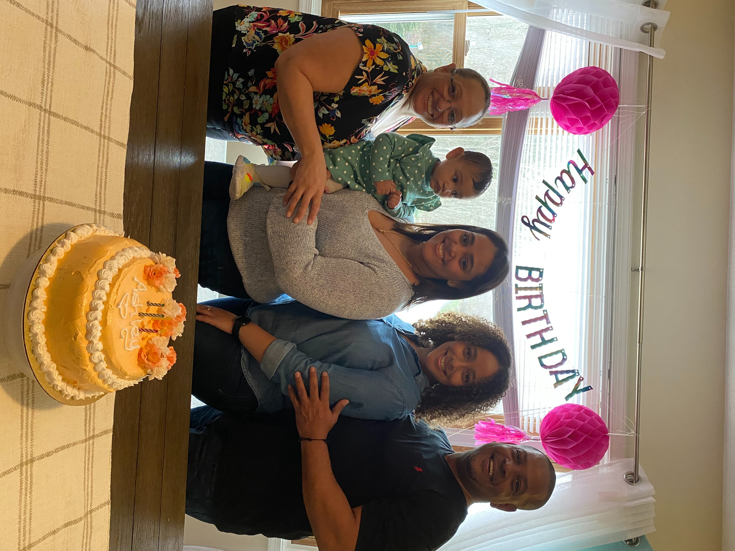
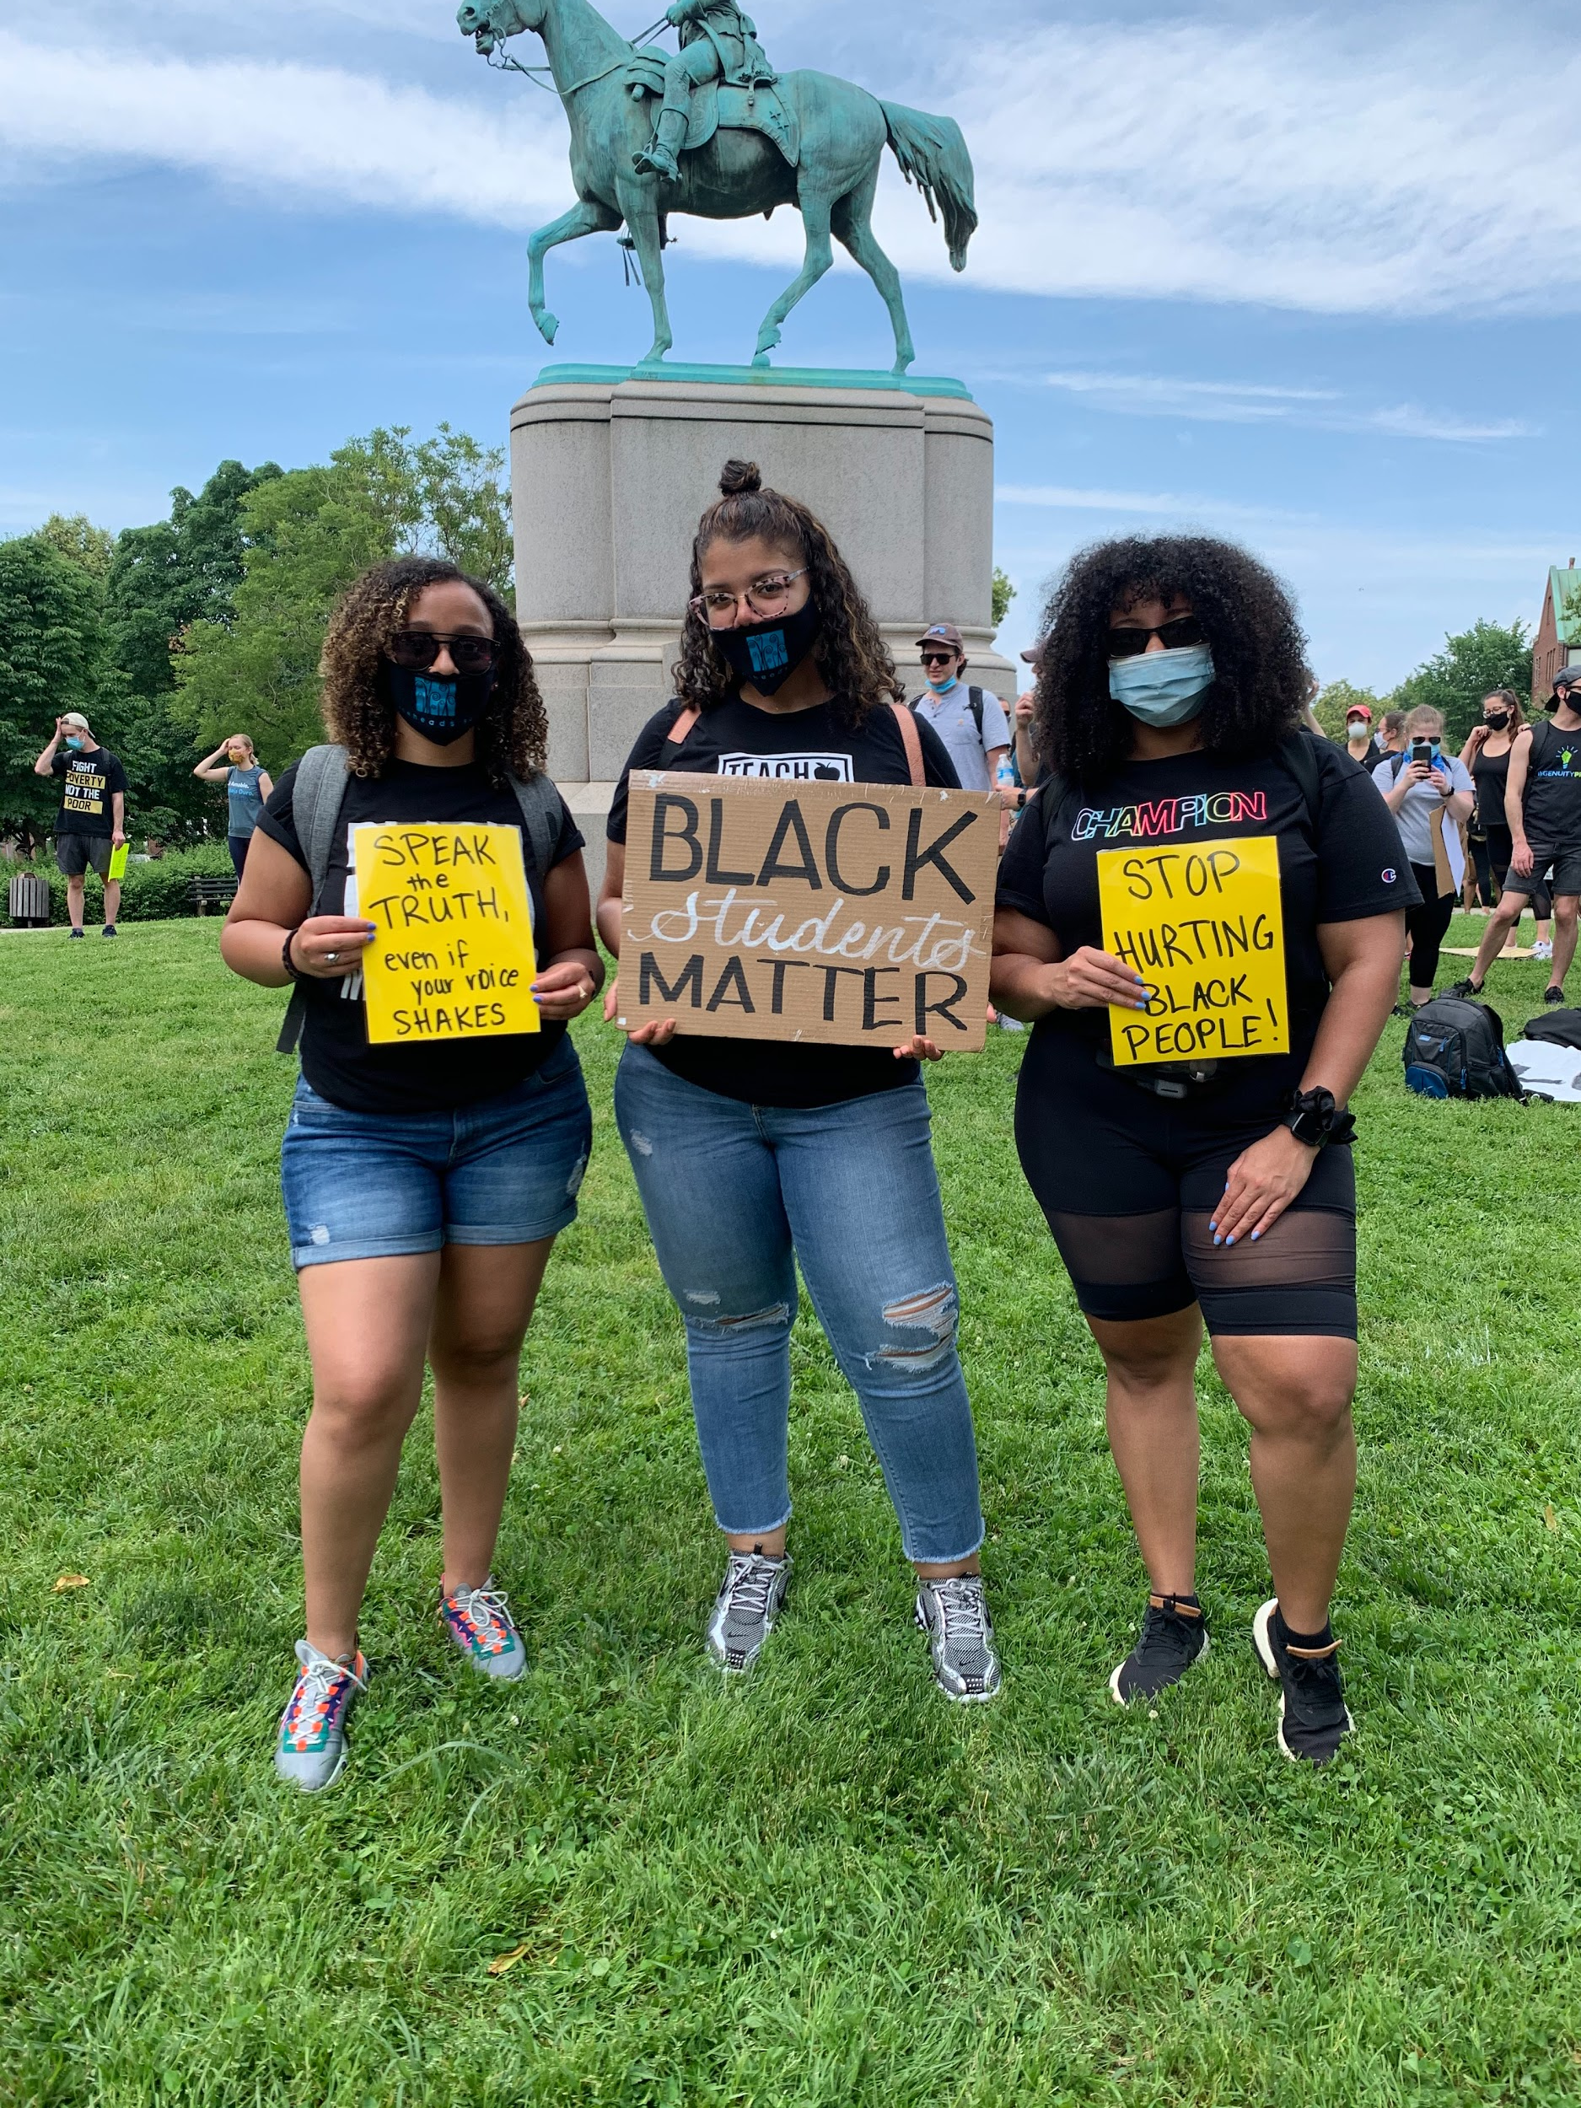
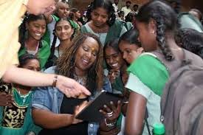



Tara
Glenna
Janice
Melissa
Ashley
Notes:
Ask each, what motivates you, as each person’s photos animate.
Tara-
Glenna- Collaboration and creativity (particularly at school) motivate me. There is no better feeling than working with a team toward a goal, experiencing successes along the way, and knowing that our efforts are positively impacting the lives of kids.
Janice-
Ashley- my family, my students.
Karina-
Melissa-

Slide 13
Panel Question: What is something you’ve done or are doing this year to care for your students?
Notes:
Glenna:
-Social Emotional Learning (SEL) - Welcoming Inclusion Activity, Engaging Strategies (particularly virtual), Optimistic Closure
- Open communication with students and their families - Google Voice (texting)
- Opportunities for students to demonstrate understanding outside of the typical “schoolwork” - videos, polls, pics, voice recordings, etc.
Tara:
-Extended time on assignments
-Targeted office hours to support specific learning
-Posting notes on Google Classroom with additional online support tools
-Open private chat during instruction for in the moment support (students love that they can connect during the lesson in real time)
-Brain breaks and time to refresh
Janice:
-instructional design - teaching with the brain in mind - rethinking time; eduprotocols;
-understanding by design - opportunities to learn - multiple on-ramps; PLT - supporting self-directed learning by providing explicit support around goal setting, planning work time, reflecting on learning with mini-lessons, time to practice,
-Nature principle - get outdoors!
Melissa:

Slide 14

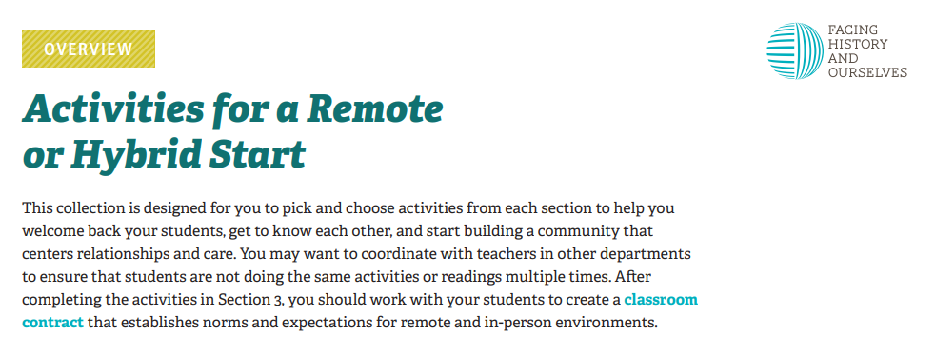

Want more? Resources to check out!
Calm app
Facing History and Ourselves: activities for a remote or hybrid start (Section 3: Fostering a Community of Learners)
Children and Nature Network particularly the Resource Hub
10 Minute Walk
Park Rx Prescription
Science Newest Miracle is Drug-Free, Outdoors
Notes:
Janice: Children and Nature Network particularly the Resource Hub
10 Minute Walk
Park Rx Prescription
Science Newest Miracle is Drug-Free, Outdoors
Casel.org https://www.youtube.com/watch?v=mCwGp-CHg7E&feature=emb_title

Slide 15
Question:
Do you have other ideas to care for students this year that you would like to share with the audience?
Please use the Chat tab to share your ideas.
Notes:
Meissa- When you are teaching remotely, teachers can find ways to see students. I invited my students from the previous school year to my house for a drive through end of school year celebration! During the drive through, students received an on the spot photo where they held their framed future education plans, while I physically distanced myself while a sign that read, "YOU MATTER!”.

Slide 16
Panel Question: How have you attended to identity – yours and/or your students’ – in instruction this year?
Notes:
Ashley
-I value and encourage authenticity from myself and my students. I validate what they experience (relatable books, videos, etc). We speak about the real things that are happening in this world.
Melissa:
-Using texts by black authors or about black people help students see themselves in text. Inviting Black STEM professionals. Had a Virtual White Coat Ceremony led by black doctors

Slide 17



Want more? Resources to check out!
Facing History and Ourselves: activities for a remote or hybrid start (Section 2: Exploring Identity and Getting to Know Each Other)
Revolve Learning is designed to empower educators committed to uplifting underserved communities with relatable professional learning programs and products.
Identity Safe Classrooms and Schools (from Learning for Justice)
NNSTOY 21 day equity challenge

Slide 18
Question:
Do you have other ideas to attended to identity – yours or your students’ – that you would like to share with the audience?
Please use the Chat tab to share your ideas.

Slide 19
Panel Question: How are you caring for yourself – personally and/or professionally this year?
Notes:
Tara:
-Scheduling my time (breaks, log-off, answering emails)
-Leaving work in “the office” once I finish for the day
-Designated work area (bedroom is not for work)
-Make space to learn new things (during specified times)
-Eliminate fluff to maximize learning
Janice:
-Personally - getting out into nature/family time-regional parks
-Professionally - structuring schedule, prioritizing, project management strategies for efficiency - work flow, RACI, constructive and positive self-talk, kind to others and myself, empathy above all!
Glenna
recognize fatigue and take action (Headspace 1-minute meditation, blue light glasses)
connect with professionals outside my school (Core Advocates, Leadership Florida)
Ashley
Personally: Gym, Call Friends and Family, Work on things I enjoy like my business, read/audiobooks
Professionally: Advocate for things I need from Admin, I ask questions, take breaks when necessary and don’t feel guilty

Slide 20
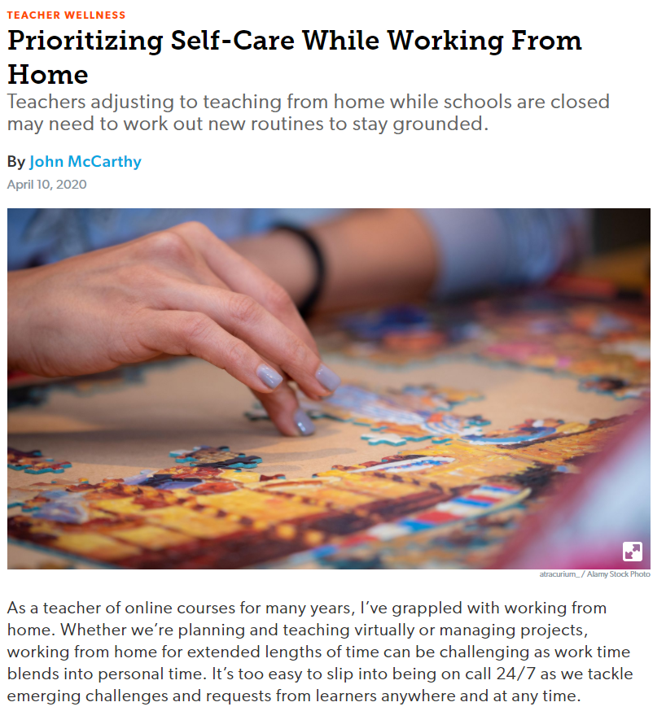




Want more? Resources to check out!
Prioritizing Self-Care While Working From Home (Edutopia)
Scistarter
TED.com
Google Arts and Culture
Mindful Teachers
5 Strategies for Teacher Self Care (ASCD)
Notes:
Janice: Ted, Google arts and culture; https://scistarter.org/;
Glenna: Mindful Moment https://www.youtube.com/watch?list=PLkZ4hcMRUA-KLzZT4DK_8lZ_OVqOerkWm&v=c1Ndym-IsQg&feature=emb_title

Slide 21
Questions for Our Guests?

Slide 22
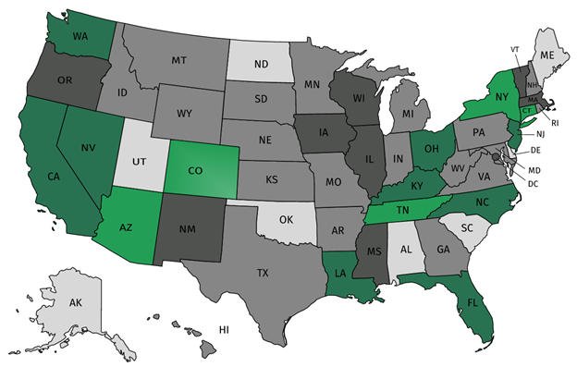
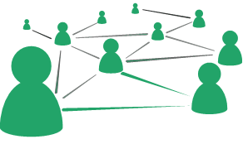



Join our network!
Join a national network of educators
Connect with state networks
Be a part of creating new tools and resources in partnership with SAP
Keep up to date on free resources, upcoming SAP webinars/professional learning opportunities, job postings and more!
Notes:
If you found tonight’s webinar helpful, we’d like to invite you to join our Core Advocate network! We’re committed to solving real problems that real teachers have and we know the best way to do this is to know more about what folks are experiencing.
As part of our national network, you have opportunities to connect with educators across the country, maybe even the network in your state! You can keep up to date on tools and resources available on Achieve the Core, as well as a variety of virtual learning opportunities and other ways to engage with us. We also work with educators in our network to help us build tools and resources.
We’d love to learn about who you are, where you work, the types of things you’re interested in and the expertise you already have. This way, we will be able to tailor our webinars and other opportunities to your needs and interests (we may even tap you to be our next webinar panelist).

Slide 23




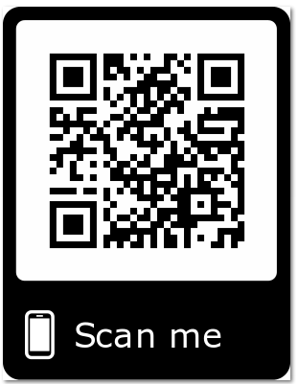
Please Join Us!
https://achievethecore.org/ca-signup
Twitter: twitter.com/achievethecore
Facebook: facebook.com/achievethecore
Pinterest: pinterest.com/achievethecore
Notes:
We encourage you to join the network by filling out this survey completely at atc.org/ca-signup

Slide 24
Please Join Us Again This Month!
Coffee and Conversations: It’s not too early! LGBTQ+ Advocacy in Elementary Schools
How can K-5 educators create inclusive + affirming environments in- and outside of the classroom? Join us in conversation with Bex Mui!
Register Here: https://www.eventbrite.com/e/cc-its-not-too-early-lgbtq-advocacy-in-elementary-schools-registration-139998779117

Slide 25

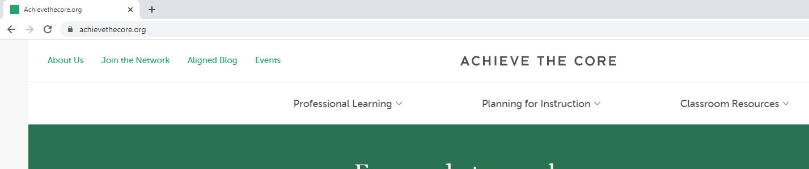
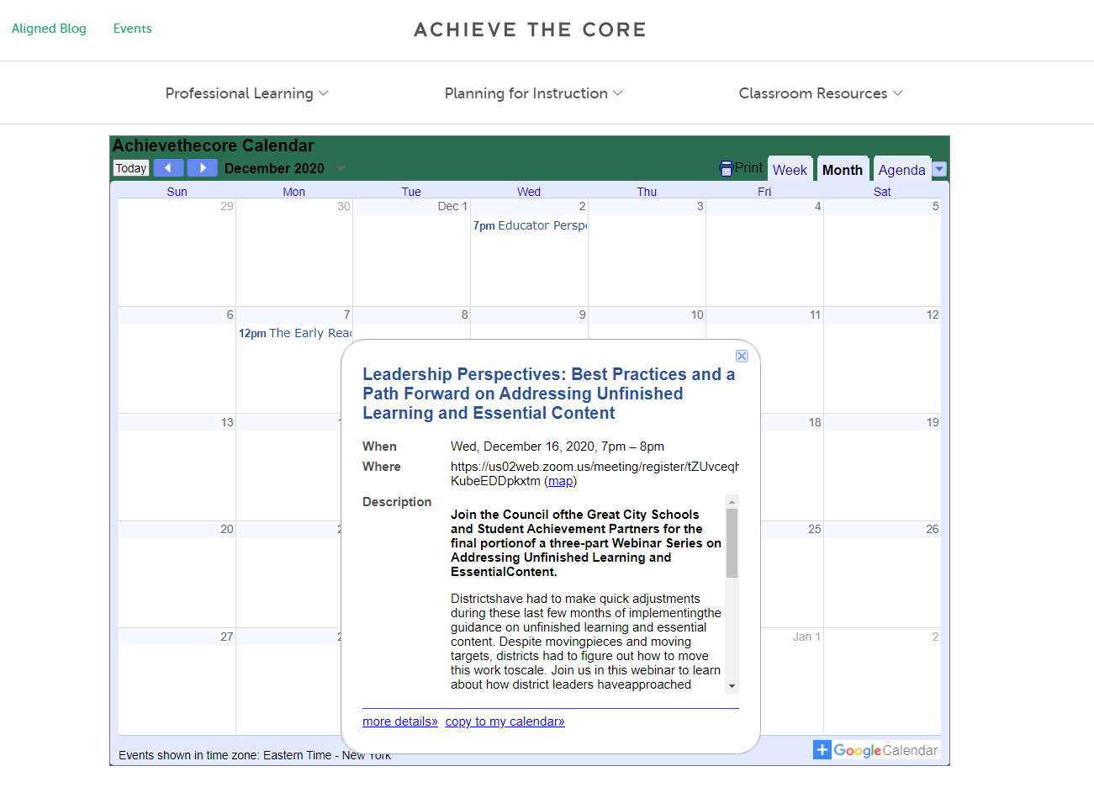
For more professional learning opportunities-

Slide 26
Thank You!

Slide 27
Resource Name | Link
Calm App | https://www.calm.com/
Facing History and Ourselves: activities for a remote or hybrid start (Section 3: Fostering a Community of Learners) | https://www.facinghistory.org/sites/default/files/Overview_Activities_for_Remote_or_Hybrid_Start_0.pdf
Children and Nature | https://www.childrenandnature.org/
Children and Nature Resource Hub | https://www.childrenandnature.org/resource-hub/resources/
10 Minute Walk | https://10minutewalk.org/
Park RX Prescription | https://parkrxamerica.org/about.php
Science Newest Miracle is Drug-Free, Outdoors | https://www.outsideonline.com/2393660/science-newest-miracle-drug-free
Facing History and Ourselves: activities for a remote or hybrid start (Section 2: Exploring Identity and Getting to Know Each Other) | https://www.facinghistory.org/sites/default/files/Overview_Activities_for_Remote_or_Hybrid_Start_0.pdf
Revolve Learning | https://www.revolvelearning.com/
Identity Safe Classroom and Schools | https://www.learningforjustice.org/magazine/identity-safe-classrooms-and-schools
Prioritizing Self-Care While Working From Home | https://www.edutopia.org/article/prioritizing-self-care-while-working-home
Scistarter | https://scistarter.org/
Ted.com | https://www.ted.com/
Google Arts and Culture | https://artsandculture.google.com/
NNSTOY 21 day equity challenge | https://www.nnstoy.org/wp-content/uploads/2021/02/21-Day-Equity-Challenge-Full-Month-1.pdf
Mindful Teachers | http://mindfulteachers.org/
5 Strategies for Teacher Self Care | http://www.ascd.org/ascd-express/vol15/num13/5-strategies-for-teacher-self-care.aspx

