Slide 1
Comparing Traditional Mathematics Assessment to CCSS Mathematics Assessment
Notes:
This module was last updated on January 2017.
This presentation is intended for self-learning. As you move through the slides, the notes section provides important information and explanation about the topics addressed on each slide. Please study the slide and then read through the notes. The notes and the slides work together, so please read both!
Throughout this PowerPoint, when we refer to assessments, we generally mean course-level or grade-level summative assessments and formative assessment systems that cover an entire year’s worth of material. Assessment systems will apply to focus and rigor, while individual assessment items could be written to exemplify coherence in ways such as tying supporting cluster standards to the major work of the grade.
On the next slide, you’ll find the outline for this presentation.

Slide 2
Outline of the Presentation
Topic | Slides
The Shifts: An Overview | 3–8
Making the Shifts in Assessment
Focus | 9–19
Coherence | 20–28
Rigor | 29–38
Summary and Resources | 39–44
Notes:
This slide outlines the order that this presentation will follow. Please note that the amount of time spent on the presentation should be about 1 hour. Of course feel free to take more time on topics that are new for you or require it!

Slide 3
The Shifts: An Overview
Notes:
In the next few slides, you will review the Shifts in mathematics and see an overview of how each Shift applies to assessment.

Slide 4



How Are The Standards Different?
An Overview of the Shifts
The CCSS bring three key shifts to mathematics instruction and assessment.
Focus strongly where the standards focus*
Coherence: think across grades, and link to major topics within grades
Rigor: in major topics* pursue:
• conceptual understanding,
• procedural skill and fluency, and
• application with equal intensity.
*For a list of major, supporting, and additional clusters by grade, please refer to ‘Where to focus by grade level” at http://achievethecore.org/shifts-mathematics
Notes:
You’ll notice that these are the same Shifts that the Standards are asking for in classroom instruction; that’s a good thing. Assessments and instruction should work together.
For more information on the Shifts for Mathematics, please follow this link: http://achievethecore.org/shifts-mathematics

Slide 5
How Are CCSS Assessments Different?
An Overview
Shift 1: Focus strongly where the Standards focus
From | To
Cover content that is a “mile-wide and an inch-deep” | Assess fewer topics at each grade (as required by the Standards)
Give equal importance to all content | Dedicate large majority of score points to the major work* of the grade
Notes:
The first Shift calls for a greater focus in mathematics. Traditionally, U.S. standards were arranged in a way that gave equal importance to four areas (Number and Operations, Measurement and Geometry, Algebra and Functions, and Statistics and Probability) like “shopping aisles.” Each grade would go up and down the aisles, tossing topics into the cart, losing focus.
Rather than racing to cover topics in a mile-wide, inch-deep curriculum, the Standards require us to significantly narrow and deepen the way time and energy is spent in the math classroom. Additionally, many elementary students were dipping into advanced topics at the expense of mastering fundamentals. In this narrowing process, some topics that were covered previously in the grade will continue to be emphasized in that grade. It’s not new mathematics; it’s a new way of emphasizing the most important content for the grade.
We focus deeply on the major work* of each grade so that students can gain strong foundations: solid conceptual understanding, a high degree of procedural skill and fluency, and the ability to apply the math they know to solve problems inside and outside the math classroom.
*For a list of major, supporting, and additional clusters by grade, please refer to ‘Where to focus by grade level” at http://achievethecore.org/shifts-mathematics.

Slide 6
How Are CCSS Assessments Different?
An Overview
Shift 2: Coherence: think across grades, and link to major topics within grades
From | To
Assessment as a checklist of individual standards | Items that connect standards, clusters, and domains (as is natural in mathematics) as well as items that assess individual standards
Each topic in each year is treated as an independent event | Consistent representations are used for mathematics across the grades, and Content connects to and builds on previous knowledge
Notes:
The second Shift, coherence, requires:
Thinking across grades: The Standards are designed around coherent progressions from grade to grade. Learning is carefully connected across grades so that students can build new understanding onto foundations built in previous years. Each standard is not a new event, but an extension of previous learning.
In seeing math as a set of isolated topics, certain topics were taught year after year. Typically, recent math curricula would spend as much as 25% of the instructional school year on reviewing and re-teaching previous grade level expectations – not as an extension – but rather as a re-teaching because many students have very little command of critical concepts. If there's re-teaching, there's re-assessing and, as a result, the same topics were being assessed in every grade. Instead, the Standards require us to use the grade-level content and build on previous knowledge.
Linking to major topics within a grade: Instead of allowing additional or supporting topics to detract from the focus of the grade, these concepts serve the grade level focus. For example, instead of data displays being an end in themselves, they are an opportunity to do grade-level word problems focused on operations.

Slide 7
How Are CCSS Assessments Different?
An Overview
Shift 3: Rigor: in major topics pursue conceptual understanding, procedural skill and fluency, and
application with equal intensity
From | To
Unbalanced emphasis on procedure or application | Assessment of all three aspects of rigor in balance
A lack of items that require conceptual understanding | Items that require students to demonstrate conceptual understanding of the mathematics, not just the procedures
Fluency items that are only routine and ordinary | Fluency items that are presented in new ways, as well as some that are routine and ordinary
Application of mathematics to routine and contrived word problems | Application of mathematics to authentic non-routine problems and real-world situations
Notes:
The third Shift, rigor, requires:
Equal Intensity: Balancing the three elements of rigor includes many things that assessments have done well for years, but adds the additional element of balancing these three types of questions. We have all seen questions require students to demonstrate procedural skills and fluencies. Those items are still critical, and still exist in CCSS-aligned assessments. As we will see there are even some improved item formats that help ensure that students can demonstrate this knowledge quickly and accurately. In addition, real-world application questions that require students to use mathematics to solve problems are still critical. The CCSS does emphasize the growing importance of these types of questions.
Many educators appreciate the visual of the three legged stool. All three aspects of rigor (conceptual understanding, procedural skill and fluency and application) need to be addressed for students to be able to reach the depth of learning that is expected by the CCSS.
The three aspects of rigor are not always separate. Conceptual understanding needs to underpin fluency work; fluency can be practiced in the context of applications; and applications can build conceptual understanding.
Nor are the three aspects of rigor always together. Fluency requires dedicated practice to that end. Rich applications cannot always be shoehorned into the mathematical topic of the day. And conceptual understanding will not come along for free unless explicitly taught.
Conceptual understanding: The Standards call for conceptual understanding of key concepts, such as place value and ratios. Rather than relying on mnemonic devices and tricks like “Please Excuse My Dear Aunt Sally” (for the order of operations) or “Ours is not to reason why, just invert and multiply,” students must show that they understand the meaning of the mathematics. There are many ways for students to show that they have conceptual understanding. In addition to explaining why a procedure works, students can demonstrate conceptual understanding by showing their work well or representing the work pictorially. Students must be able to access concepts from a number of perspectives so that they are able to see math as more than a set of mnemonics or discrete procedures.
Procedural skill and fluency: The Standards call for speed and accuracy in calculation. Students are given opportunities to practice core functions such as single-digit multiplication so that they have access to more complex concepts and procedures. New ways of presenting fluency items include placing unknowns in all positions of an equation and showing linear quadratic equations in a variety of ways.
Application: The Standards call for students to use math flexibly and authentically for applications in problem-solving contexts. The Standards also call for a variety in what students produce, leading to assessment items that ask for the answer, an explanation, or a different representation. Prior to the CCSS, most word problems were not on grade level, using numbers that fit easily into the problem. These “cooked” problems typically prompted students on which operations to use to get the answer and were often routine, following a similar format. In content areas outside of math, particularly science, students are given the opportunity to use math to make meaning of and access content.

Slide 8
For More Information on the Shifts
For more information on the Shifts, please see the newly updated Introduction to the Math Shifts Professional Development Module on achievethecore.org.
Notes:
Alternatively, you may choose to engage with the key Shifts required by the CCSSM through the iTunes U Courses, created by teachers for teachers.
Available at: achievethecore.org/itunes-u.

Slide 9
Making the Shifts in Assessment:
Assessments focus where the standards focus
Notes:
In the next few slides, you will learn more about how the focus of assessments aligned to the Common Core State Standards differs from past assessments.
In CCSSM-aligned assessments, major content represents the majority of points and problems on assessments.

Slide 10
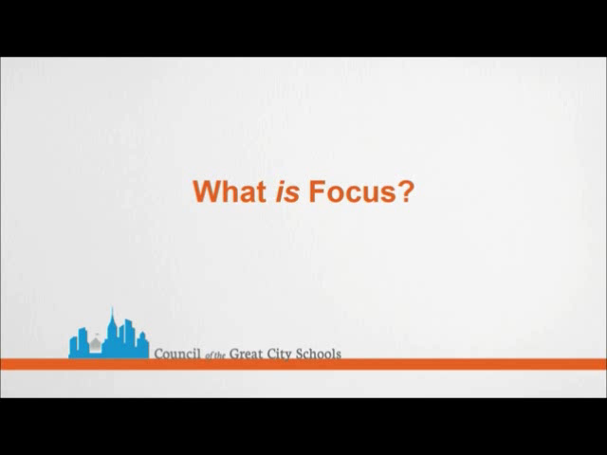
Focus in K–8
Notes:
The video above clearly and succinctly details the idea of focus. Please note that focus in K–8 and in HS are addressed separately in this presentation.

Slide 11
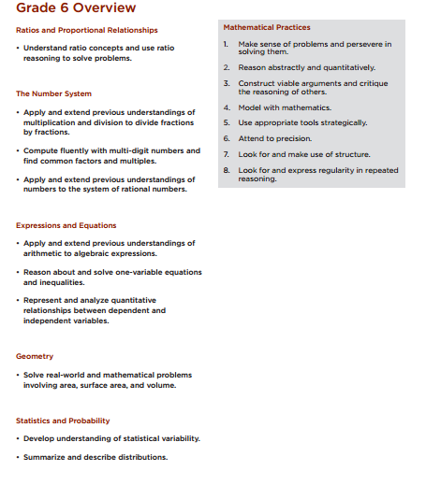
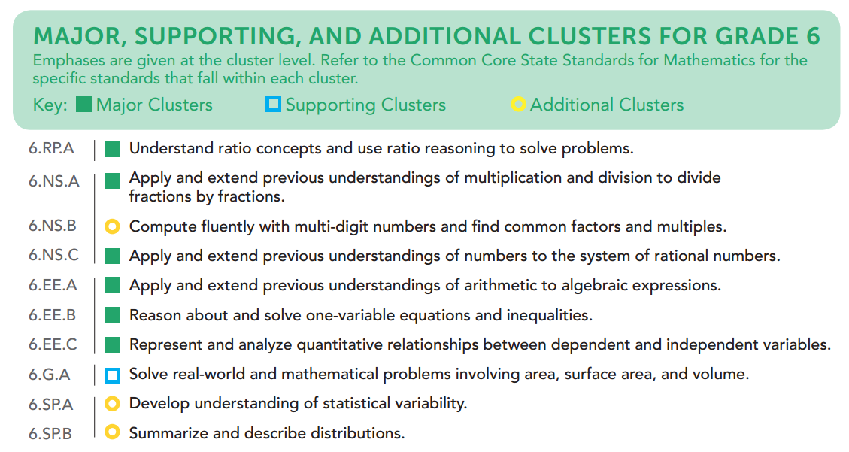
Focus in K–8
Major Work of the Grade
The large majority of score points on any grade-level assessment system should be devoted to the major work of the grade.
See achievethecore.org/focus for major work at other grade levels.
Notes:
In the CCSSM, the clusters of standards for K–8 are broken up into major, supporting, and additional clusters.
On the left is the Grade 6 Overview chart that is found in the Standards document. It is important to note that these are NOT the standards, but simply an overview of the domains and cluster headings for each grade. The pages that follow this overview will have the actual standards and will tell us what really is going on in each of these areas, but it can be useful to look at a grade level from the overview, where we only see the domain and cluster headings. We can see that there are 5 domains in grade 6. They are not the same 5 domains in all other grades. In grade 6, the domains are ratios and proportional relationships, the number system, expressions and equations, geometry, and statistics and probability. The clusters give us a general idea of what is happening within each domain.
On the right is the list of clusters with the emphasis of each cluster for grade 6. Looking at this, you can see the main emphases for the grade. The items marked with green squares are the major clusters. These are the things that are the clear focus of the grade. The other content listed here, the supporting clusters (blue squares), and the additional clusters (yellow circles), are also things that are important for grade 6.
The large majority of points in each grade K–8 should be devoted to the major work of the grade (the green clusters and standards within those clusters).

Slide 12
Focus in K–8
Distribution of Score Points
Traditional Summative Assessment (Grade 6) | CCSS-Aligned Summative Assessment (Grade 6)
Source: Student Achievement Partners. For illustrative purposes only.
Domain (with Clusters) | % of Pts
Ratios and Proportional Relationships (6.RP.A: 18 pts) | 18
The Number System (6.NS.A: 12 pts, 6.NS.B: 7 pts, 6.NS.C: 10 pts) | 27
Expressions and Equations (6.EE.A: 13 pts, 6.EE.B: 15 pts, 6.EE.C: 10 pts) | 38
Geometry (6.G.A: 7 pts) | 7
Statistics and Probability (6.SP.A: 4 pts, 6.SP.B: 4 pts) | 8
Total *Green denotes Major Clusters | 100
% on Major Work | 78
Domain | % of Points
Ratios and Proportional Relationships | 20
The Number System | 20
Expressions and Equations | 20
Geometry | 20
Statistics and Probability | 20
Total | 100
% on Major Work | 53
Notes:
The CCSS-aligned example of score point distribution shows 78% of the test points (or the large majority) assessing major work of the grade. For assessments to be aligned to the Shifts and major features of the CCSS , 65% or more of the total score points in the assessment(s) for each grade 6, 7, and 8 align exclusively to the Major Work of the grade.
The traditional summative assessment only has 53% of points on the Major Work (20% from RP, ~13% from NS, and 20% from EE).
Notice that the CCSS-aligned version focuses on major and supporting/additional clusters within the domains, not the domains themselves. Prior to CCSS, score points were distributed by topic making it difficult to know if the most important content within each topic was being assessed. It’s important to note that within each topic listed on the left, there might be content that falls within the major work of the grade (as seen in the CCSS-aligned example on the right). The score point distribution with CCSS is simply a different way to categorize content and ensure that the most important content is being assessed.
Ensuring that assessments are focused requires a finer analysis of blueprints and specifications to ensure the vast majority of score points focus on the most important content. For example, most college- and career-ready (CCR) standards introduce multiplication and area in the same grade because area models and applications help build understanding of multiplication. Many CCR standards also introduce perimeter with area. Perimeter would support building skills in addition and would be considered important content in early grades. However, when multiplication is the focus of the grade, area is most important and items assessing perimeter would not contribute to the vast majority of score points focusing on the content that is most important. So it is best to look at the mathematical topics, rather than the domains, when determining if assessments are focused.

Slide 13
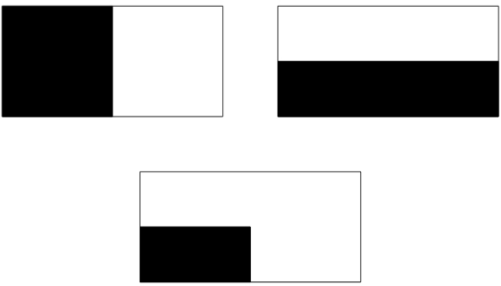
Focus in K–8
Grade 2 Geometry Example
Traditional Approach (Grade 2 Geometry) | CCSS-Aligned Approach (2.G.A.3)
Shawn cut a rectangle along two lines of symmetry. How many equal shares will he have? | Ms. Nim gave her students a picture of a rectangle. Then she asked them to shade in one half of the rectangle. Here are three pictures: Which ones show one half? Explain. Source: Illustrative Mathematics. https://www.illustrativemathematics.org/illustrations/827
Notes:
The item on the left is a topic that has long been covered in early grades; however, symmetry does not appear in the Standards until grade 4. As a result, it cannot be assessed before grade 4.
The item on the right assesses standard 2.G.A.3 appropriately (Partition circles and rectangles into two, three, or four equal shares, describe the shares using the words halves, thirds, half of, a third of, etc., and describe the whole as two halves, three thirds, four fourths. Recognize that equal shares of identical wholes need not have the same shape.). Notice that partitioning is the key component of the item, not symmetry.

Slide 14
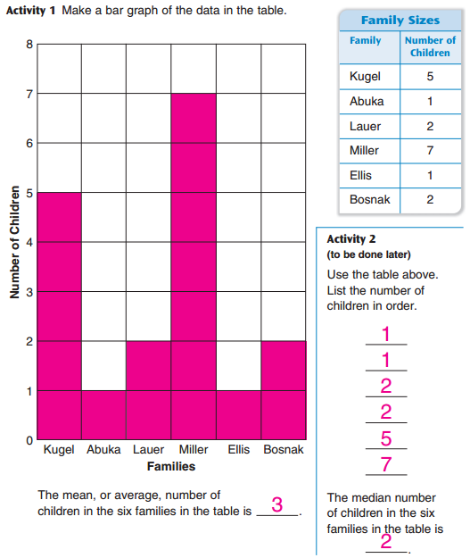
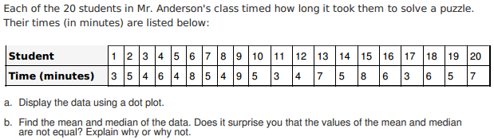
Focus in K–8
Measures of Center Example
Traditional Approach (Grade 3 Mean and Median) | CCSS-Aligned Approach (6.SP.B.4, 5c))
 | Source: Illustrative Mathematics. https://www.illustrativemathematics.org/illustrations/877
Notes:
Before, measures of center would have been assessed as early as grade 2 or 3 with an item like the one on the left. Now, measures of center is assessed starting in grade 6, with an item like the one on the right. The item on the left is a low-level "fake data" item and the item on the right is a richer more authentic item with full use of rational numbers (the mean is 5.35). The CCSS-aligned item shows the richness of the item when we wait for the appropriate grade for the content.

Slide 15
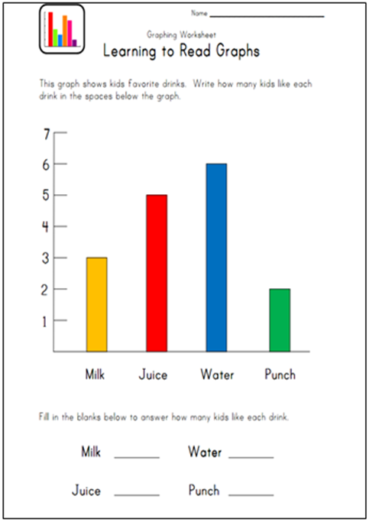
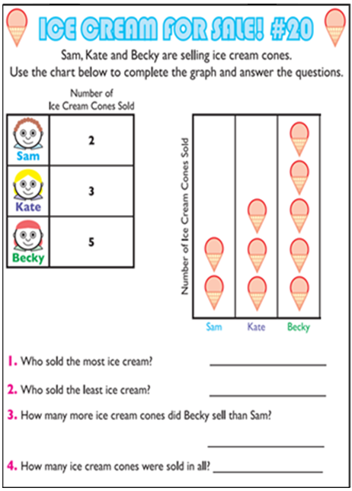
Focus in K–8
Supporting Work Reinforcing Major Work
Traditional Approach (Grade 1) | CCSS-Aligned Approach (1.MD.C.4)
Notes:
The CCSS-aligned item on the right shows how supporting content enhances focus by engaging students in the major work of the grade. In grade 1, 1.MD.C.4 is a supporting cluster standard. That means it should support and reinforce the major work of the grade. In grade 1, focus areas are around addition and subtraction.
Prior to CCSS, items like the one of the left just asked kids to read the information from the data display. As you can see, the questions on the left merely ask students to count. The item on the left does not require students to complete grade-level work and uses data displays as an end in themselves.
Now with CCSS, students are not only asked to read data displays, but also to answer “how many more” and “how many less” questions, solving using addition and subtraction, part of the major work for grade 1. As you can see, the questions on the right have students interpret the data given and perform operations on the data.
Note that the connections among content are explicitly written into the standards.

Slide 16
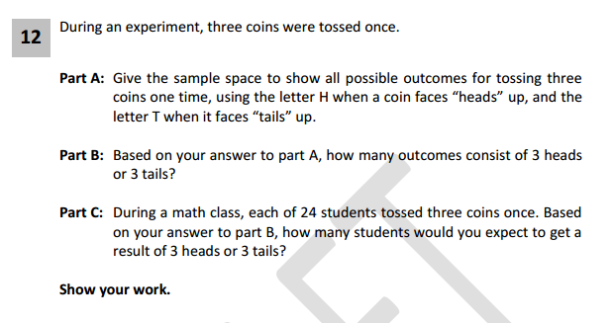
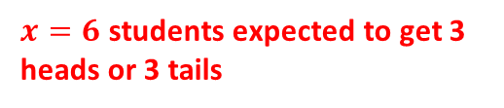

Focus in K–8
Supporting Work Reinforcing Major Work
Traditional Approach (Grade 7) | CCSS-Aligned Approach (7.SP.C.8)
A coin is flipped three times. Part A: Draw a tree diagram that shows all possible outcomes. Part B: Create an organized list that shows all possible outcomes. | Source: EngageNY. http://www.engageny.org/sites/default/files/resource/attachments/math-grade-7.pdf
HHH
HHT
HTH
HTT
THH
THT
TTH
TTT
2
$$\frac{2}{8}=\frac{x}{24}$$
$x=6$ students expected to get 3 heads or 3 tails
Notes:
Prior to CCSS, items like the one of the left just asked kids to calculate simple and compound probabilities. As is, this item does align to 7.SP.C.8; however, it misses a prime opportunity to connect this learning back to major work of the grade (proportional relationships).
Now with CCSS, work with probability links to major work of the grade (7.RP.A, Analyze proportional relationships and use them to solve real-world and mathematical problems). To answer part C, the student may do the following:
$\frac{2}{8}$ outcomes are either 3 heads or 3 tails, so for 24 students, $\frac{2}{8}=\frac{x}{24}$
x = 6 students.

Slide 17
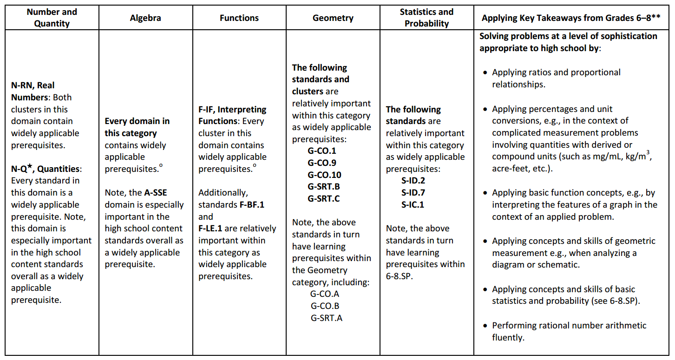
Focus in High School
Widely Applicable Prerequisites
Widely Applicable Prerequisites for College and Careers
www.achievethecore.org/prerequisites
Notes:
You learned in the previous slides that the large majority of points in K–8 should be devoted to the major work of the grade. Similarly, the majority of points in each high school course should be devoted to widely applicable prerequisites (shown in the table on the slide).
The widely applicable prerequisites are the clusters and standards with relatively wide applicability across a range of postsecondary work. It is a subset of the material students must study to be college and career ready (CCSSM, pp. 57, 84). Assessments must give especially careful treatment to the domains, clusters, and standards in this table, including their interconnections and their applications—amounting to a majority of score points on assessments. The right-most column represents key takeaways from grades 6–8: “…some of the highest priority content for college and career readiness comes from Grades 6–8. This body of material includes powerfully useful proficiencies such as applying ratio reasoning in real-world and mathematical problems, computing fluently with positive and negative fractions and decimals, and solving real-world and mathematical problems involving angle measure, area, surface area, and volume.” (CCSSM, p. 84)

Slide 18
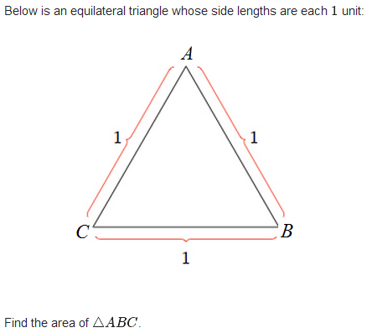
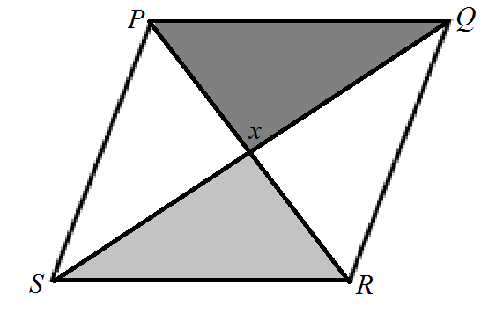
Focus in High School
Widely Applicable Prerequisites
Traditional Approach (Geometry) | CCSS-Aligned Approach (G-CO.C.10, G-SRT.C)
In the diagram below of rhombus PQRS, decide whether there is enough information to prove that the two triangles are congruent. | Source: Illustrative Mathematics. https://www.illustrativemathematics.org/illustrations/1322
Notes:
One key change with the CCSSM is that geometry is always an opportunity to reinforce algebra concepts and skills.
In the traditional item on the left, the student is investigating congruence through rigid motions. However, there is no connection back to algebra.
In the CCSS-aligned item on the right, the student may choose to interact with the area of a triangle formula (1/2 x base x height). However, to do so, she must either:
Use triangle congruence by finding the midpoint of one side and creating two, congruent right triangles. Then, the student can use the Pythagorean Theorem to find the height of the triangle, and ultimately find the area using the formula for the area of a triangle.
Use trigonometry and angle relationships.

Slide 19
Focus in High School
The mile-wide inch-deep problem looks different in high school. In earlier grades it’s a matter of having too many topics. In high school it’s a matter of having too many separately memorized techniques, with no overall understanding of the structure to tie them altogether. So narrowing and deepening the curriculum is not so much a matter of eliminating topics, as seeing the structure that ties them together.
–Prof. William McCallum
http://commoncoretools.me/2012/02/16/the-structure-is-the-standards/#comments
Notes:
In the quote on the slide, Prof. McCallum begins to explain the connection between focus and coherence (the next topic!). For example, if students see that the distance formula and the trig identity sin^2(t) +cos^2(t) = 1 are both manifestations of the Pythagorean theorem, they have an understanding that helps them reconstruct these formulas rather than memorize them. The CCSS high school standards in the Algebra and Function categories are arranged under headings like “Seeing Structure in Expressions” and “Building Functions” in order to help teachers and curriculum developers see this coherence.
In high school, the shifts of focus and coherence are very closely related. In the next section, you will dive deeper into the ways coherence shapes assessments.

Slide 20
Making the Shifts in Assessment:
Assessments honor the coherence of the standards
Notes:
In the next few slides, you will learn more about how the coherence of assessments aligned to the Common Core State Standards differs from past assessments.
In CCSS-aligned assessments, there is a balance of tasks assessing individual standards and related standards within the context of the grade and, as relevant, the progressions.

Slide 21
Coherence Across Grades
Seeing the Structure
“The Standards were not so much assembled out of topics as woven out of progressions.”
What It Means
Aligning items to grade-level expectations requires understanding of all the standards at that grade (e.g., NBT standards often give bounds for OA items) and understanding how the standard fits into a progression with previous and future grades
Why It Matters for Assessment
The Standards were woven out of connected topics (the progressions) and so assessments should also rely on the connections between topics (coherence across grades).
Notes:
The progressions are narratives of how the standards play out over grades. The initial conception of these progression documents was to render the standards in narrative form so that you can readily see what is going on across the grades. The documents sometimes have useful sample questions in the margins as well. The progressions provide helpful information about alignment that can be used to ensure items are aligned to the expectations articulated in the Standards.
It’s important to note that the distinction between “means” and “equals” is part of learning progressions. Do not think of the standards as assembled out of topics, but think of them as woven out of progressions, at least in the early grades.

Slide 22
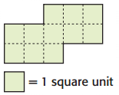
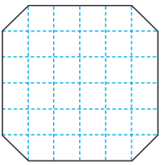

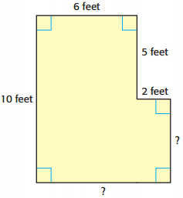


Coherence Across Grades
Consistent Progressions
Traditional Progressions (Perimeter and Area)
Grade 3:
Grade 4:
Grade 5:
Grade 6:
Write the area of the shape.
Determine the area of the shape in square units.
Find the perimeter of the figure.
Select the rectangle with an area of 24 square units and a perimeter of 20 units.
Notes:
For the traditional progression illustrated by these items, notice how there is an infinitesimal advancement from year to year. However, there is no increase in the magnitude or type of numbers used: each example uses relatively small whole numbers. Even the grade 4 example, which shows halves via the corner sections, can be counted in pairs to represent a whole. There is also no progression in the type of questions asked.

Slide 23
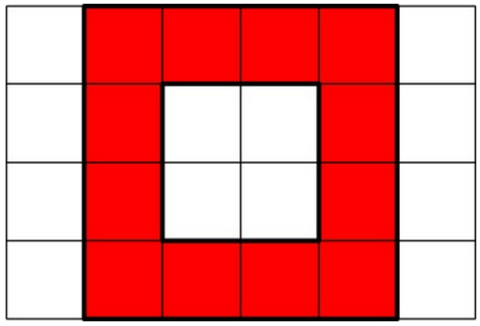
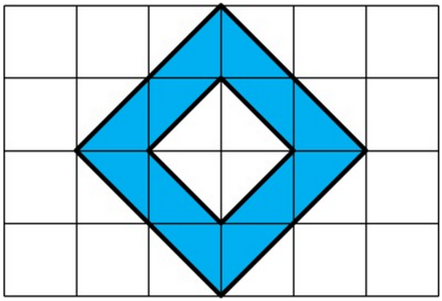
Coherence Across Grades
Consistent Progressions
CCSS-Aligned Progressions (Area and Surface Area)
3.MD.C.6:
4.MD.A.3:
5.NF.B.4b:
6.G.A, 6.RP.A.3:
Find the area of each colored figure.
Karl’s rectangular vegetable garden is 20 feet by 45 feet, and Makenna’s is 25 feet by 40 feet. Whose garden is larger in area? How much larger is that garden?
An aerial photo of farmland shows the dimensions of a field in fractions of a mile. Create a model to show the area, in square miles, of a field that is 3/4 mile by 1/3 mile.
Alexis needs to paint the four exterior walls of a large rectangular barn. The length of the barn is 80 feet, the width is 50 feet, and the height is 30 feet. The paint costs $28 per gallon, and each gallon covers 420 square feet. How much will it cost Alexis to paint the barn? Explain your work.
Notes:
In contrast to the traditional approach on the previous slide, the CCSS-aligned approach displays the following features as the items progress through the grades:
The numbers increase in magnitude to reflect the grade-level expectations (from within 20, to within 1000, to fractions, to within 10,000)
The types of numbers used changes to reflect the grade-level expectations (from whole numbers, to fractions, to general rational numbers)
There is an increasing complexity in types of questions used to assess similar topics (e.g., the grade 4 item is a word problem that requires comparison AND broaches the commutative and associative properties).
For reference:
3.MD.C.6: Measure areas by counting unit squares (square cm, square m, square in, square ft, and improvised units).
4.MD.A.3: Apply the area and perimeter formulas for rectangles in real-world and mathematical problems. For example, find the width of a rectangular room given the area of the flooring and the length, by viewing the area formula as a multiplication equation with an unknown factor.
5.NF.B.4b: Find the area of a rectangle with fractional side lengths by tiling it with unit squares of the appropriate unit fraction side lengths, and show that the area is the same as would be found by multiplying the side lengths. Multiply fractional side lengths to find areas of rectangles, and represent fraction products as rectangular areas.
6.G.A: Solve real-world and mathematical problems involving area, surface area, and volume.
6.RP.A.3: Use ratio and rate reasoning to solve real-world and mathematical problems, e.g., by reasoning about tables of equivalent ratios, tape diagrams, double number line diagrams, or equations.
(Source for 5.NF.B.4b: adapted from http://www.learner.org/courses/learningmath/number/session9/part_a/try.html)
(Source for other CCSS-aligned examples – http://www.illustrativemathematics.org)

Slide 24
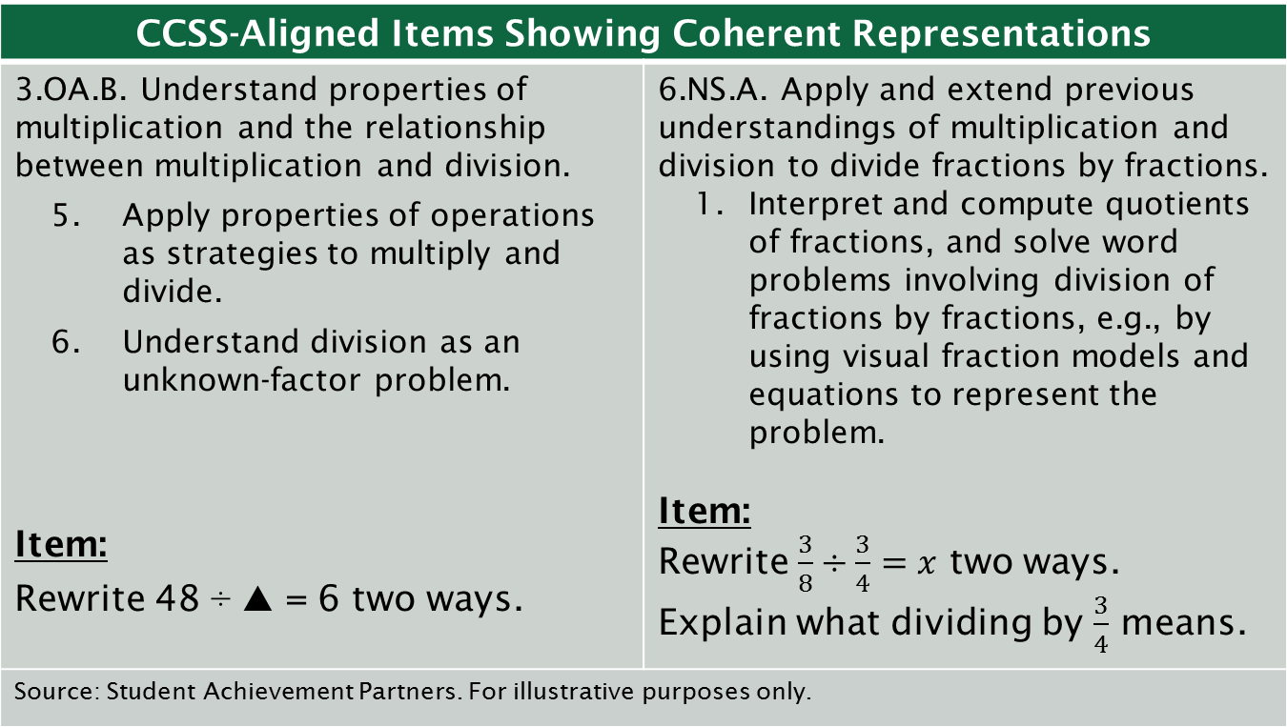
Coherence Across Grades
Consistent Representations
CCSS-Aligned Items Showing Coherent Representations
3.OA.B. Understand properties of multiplication and the relationship between multiplication and division. Apply properties of operations as strategies to multiply and divide. Understand division as an unknown-factor problem. Item: Rewrite 48 ÷ 🔺 = 6 two ways. | 6.NS.A. Apply and extend previous understandings of multiplication and division to divide fractions by fractions. Interpret and compute quotients of fractions, and solve word problems involving division of fractions by fractions, e.g., by using visual fraction models and equations to represent the problem. Item: Rewrite $\frac{3}{8}÷\frac{3}{4}=x$ two ways. Explain what dividing by $\frac{3}{4}$ means.
Source: Student Achievement Partners. For illustrative purposes only.
Notes:
Before the CCSSM, assessments were often written without attention to how models, visuals, and other representations were treated from year to year. So, a grade 4 assessment likely looked wildly different than a grade 3 assessment. Now, assessments need to reflect the coherence in the Standards – and this includes consistent representations (e.g., symbols, number lines).
These two items reflect a similar structure although they are both well-aligned to different standards. These two items assess the CCSS. The first measures the grade 3 expectations about understanding of multiplication and division of whole numbers. By grade 6, students are working with the same concepts, but are using fractions (and variables).
NOTE: You may notice that there is an additional part of the prompt in the grade 6 item asking for an explanation; this reflects the growing influence of the practices in later grades.

Slide 25
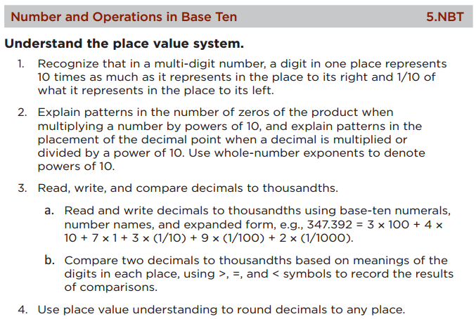
Coherence Within a Single Grade
Assessing all levels of the content hierarchy
Where appropriate, CCSSM items will assess content at all levels of the
content hierarchy:
Part(s) of standards
Individual standards
Multiple standards
Clusters
Domains
Grade
This means that rather than an assessment being only a checklist of items for each individual standard, they address content in ways that connect ideas together meaningfully.
Domain
Cluster (5.NBT.A)
Standards
Notes:
Standards and tests have long been designed as a checklist of topics to address individually. Now, as you can see in the slide, assessments are written to recognize and emphasize the connections between content within a grade. Rather than only assessing at the standard-level, assessments also assess multiple standards and at the cluster-, domain-, and grade-levels to highlight the deep connections and assess broad understanding of concepts. Taking 5.NBT.A as an example, where appropriate, you can aim some of the problem development at the cluster level. So, good problems may address: “Understand the place value system.”
With this freedom, there should be more creative problems and tasks assessing these connections between content.
For background information, reference #6b from the Publishers’ Criteria:
Including problems and activities that serve to connect two or more clusters in a domain, or two or more domains in a grade, in cases where these connections are natural and important. If instruction only operates at the individual standard level, or even at the individual cluster level, then some important connections will be missed. For example, robust work in 4.NBT should sometimes or often synthesize across the clusters listed in that domain; robust work in grade 4 should sometimes or often involve students applying their developing computation NBT skills in the context of solving word problems detailed in OA. Materials do not invent connections not explicit in the standards without first attending thoroughly to the connections that are required explicitly in the Standards (e.g., 3.MD.C.7 connects area to multiplication, to addition, and to properties of operations; A-REI.D.11 connects functions to equations in a graphical context.) Not everything in the standards is naturally well connected or needs to be connected (e.g., Order of Operations has essentially nothing to do with the properties of operations, and connecting these two things in a lesson or unit title is actively misleading). Instead, connections in materials are mathematically natural and important (e.g., base-ten computation in the context of word problems with the four operations), reflecting plausible direct implications of what is written in the Standards without creating additional requirements.

Slide 26
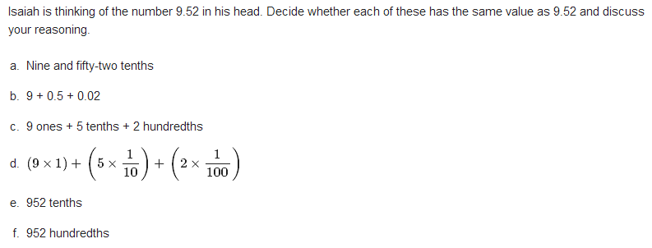
Coherence Within a Single Grade
Assessing at the Cluster Level
CCSS-Aligned Item at the Cluster Level (5.NBT.A: Understand the place value system)
Are these equivalent to 9.52? Source: Illustrative Mathematics. https://www.illustrativemathematics.org/illustrations/1813
Notes:
Prior to CCSS, most assessment items assessed at the standard level. Now with CCSS, we’re assessing, where appropriate, at the cluster level. Instead of pinpointing items at the standard level, we’re now weaving the standards together to assess broader concepts and understanding.
This slide shows an illustrative cluster-level item assessing 5.NBT.A, “Understand the place value system.” It's a cluster-level item because it's a single item that addresses the actual cluster statement itself, or multiple standards within a cluster. The purpose of this task is to help students develop the understanding that a single base-ten number can be represented in many different ways.
Parts of this task are straightforward; parts are not. Many students may be able to directly connect the numeric representation (9.52) with its word form ("nine and fifty two hundredths") as well as its expanded form (9 + 0.5 + 0.02). The more challenging part of the task will likely be questioning whether 9.52 has the same value as 952 tenths or 952 hundredths. Though these parts of the task do not directly address 5.NBT.A.3, they encompass the cluster-level understandings that embody deep understanding of our place value system.

Slide 27
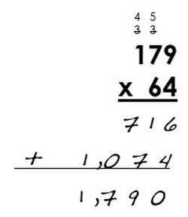
Coherence Within a Single Grade
Assessing at the Domain Level
CCSS-Aligned Item at the Domain Level (5.NBT)
Elmer’s Multiplication Error This is Elmer’s work on a multiplication problem: Use estimation to explain why Elmer’s answer is not reasonable. What error do you think Elmer made? Find 179 × 64 using a correct version of Elmer’s method. Then show another way of doing it to help Elmer see why your answer is correct. Source: Adapted from Illustrative Mathematics. https://www.illustrativemathematics.org/illustrations/1812
Notes:
Throughout the grades, the NBT domain’s first cluster is often about understanding place value and the second cluster is often about place value computation. In this example, the first two clusters are blended.
Part a of this task requires students to use place value understanding (5.NBT.A) to pinpoint a common multiplication error that occurs when using the standard algorithm. The student can use her understanding of estimation to quickly recognize that the product of 179 and 64 should be considerably larger than the product of 100 and 60, which is 6,000.
Part c of this task directly asks students to multiply multi-digit whole numbers using the standard algorithm (5.NBT.B.5).

Slide 28
Coherence Within a Single Grade
Assessing at the Grade Level
CCSS-Aligned Item at the Grade Level (Grade 5)
Minutes and Days What time was it 2011 minutes after the beginning of January 1, 2011? Source: Illustrative Mathematics. https://www.illustrativemathematics.org/illustrations/878
Notes:
Here’s an illustrative grade-level item assessing grade 5 content, specifically 5.MD.A.1 and 5.NBT.B.6. This grade-level item shows how a supporting cluster, 5.MD.A, reinforces the major work of dividing multi-digit numbers in the context of changing units.
Prior to CCSS, items didn’t assess multiple standards. Most were pinpointed to one standard instead of using multiple standards to coherently assess broader understanding of content. Without CCSS, an item assessing geometry standards would assess them in isolation, rather than connecting to more important grade-level content like ratios and proportions. Now with CCSS, items are written to assesses standards across the domains with the grade to ensure a broad understanding and command of all grade-level content.

Slide 29
Making the Shifts in Assessment:
Assessments reflect the rigor of the standards
Notes:
In the next few slides, you will learn more about how the rigor of assessments aligned to the Common Core State Standards differs from past assessments.
In CCSS-aligned assessments, there is a balance of tasks assessing conceptual understanding, procedural skill and fluency, and application of mathematics to solve problems.

Slide 30
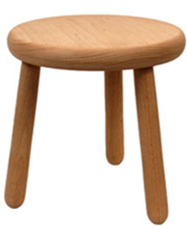
Rigor
Balanced Assessments
CCSSM-aligned assessments and sets of assessments will be balanced by distributing score points across the three aspects of rigor:
Procedural skill and fluency
Conceptual understanding
Application
Notes:
With the third Shift, rigor, many educators appreciate the visual of the three legged stool. All three aspects of rigor (conceptual understanding, procedural skill and fluency and application) need to be addressed for students to be able to reach the depth of learning that is expected by the CCSS.
That said, it is also noted in the Publishers’ Criteria that:
1. The three aspects of rigor are not always separate in assessment questions. Conceptual understanding and fluency go hand in hand; fluency can indirectly be assessed through applications; and applications can elicit information about students’ conceptual understanding
2. Nor are the three aspects of rigor always together in assessment questions. Fluency requires dedicated assessment questions. Rich applications cannot always be forced into any assessment question. And conceptual understanding cannot be assumed, but must be explicitly assessed.
It is important to note that many educators have been attending to the various aspects of rigor for years. The difference that exists for all educators is the explicit attention to the balance of these three aspects of rigor to ensure the students have a firm grasp on the mathematics of their grade. The “Math Wars” of previous decades are over. We do not need understanding OR fluency for students to be college and career ready. College and career readiness requires flexible understanding as well as fast and efficient procedural skills. And, students must apply these mathematical skills in grade-appropriate applications.

Slide 31
Rigor
Balanced Assessments
The language of the Standards indicates which aspect(s) of rigor is targeted. For example,
Conceptual understanding
  8.F.A.1: Understand that a function is a rule that assigns to each input exactly one output. The graph of a function is the set of ordered pairs consisting of an input and the corresponding output.
Procedural skill and fluency
  5.NBT.B.5: Fluently multiply multi-digit whole numbers using the standard algorithm.
Application
  2.MD.B.5: Use addition and subtraction within 100 to solve word problems involving lengths that are given in the same units, e.g., by using drawings (such as drawings of rulers) and equations with a symbol for the unknown number to represent the problem.
Notes:
As you can see in the slide, the standards use certain key words (bolded in green text) to signal which aspect of rigor is targeted in that standard.
The examples in the slide show one standard targeting one aspect of rigor. However, sometimes a single standard might call for all three aspects of rigor. For example, 8.EE.C.8 reads:
Analyze and solve pairs of simultaneous linear equations.
a. Understand that solutions to a system of two linear equations in two variables correspond to points of intersection of their graphs, because points of intersection satisfy both equations simultaneously.
b. Solve systems of two linear equations in two variables algebraically, and estimate solutions by graphing the equations. Solve simple cases by inspection. For example, 3x + 2y = 5 and 3x + 2y = 6 have no solution because 3x + 2y cannot simultaneously be 5 and 6.
c. Solve real-world and mathematical problems leading to two linear equations in two variables. For example, given coordinates for two pairs of points, determine whether the line through the first pair of points intersects the line through the second pair.

Slide 32
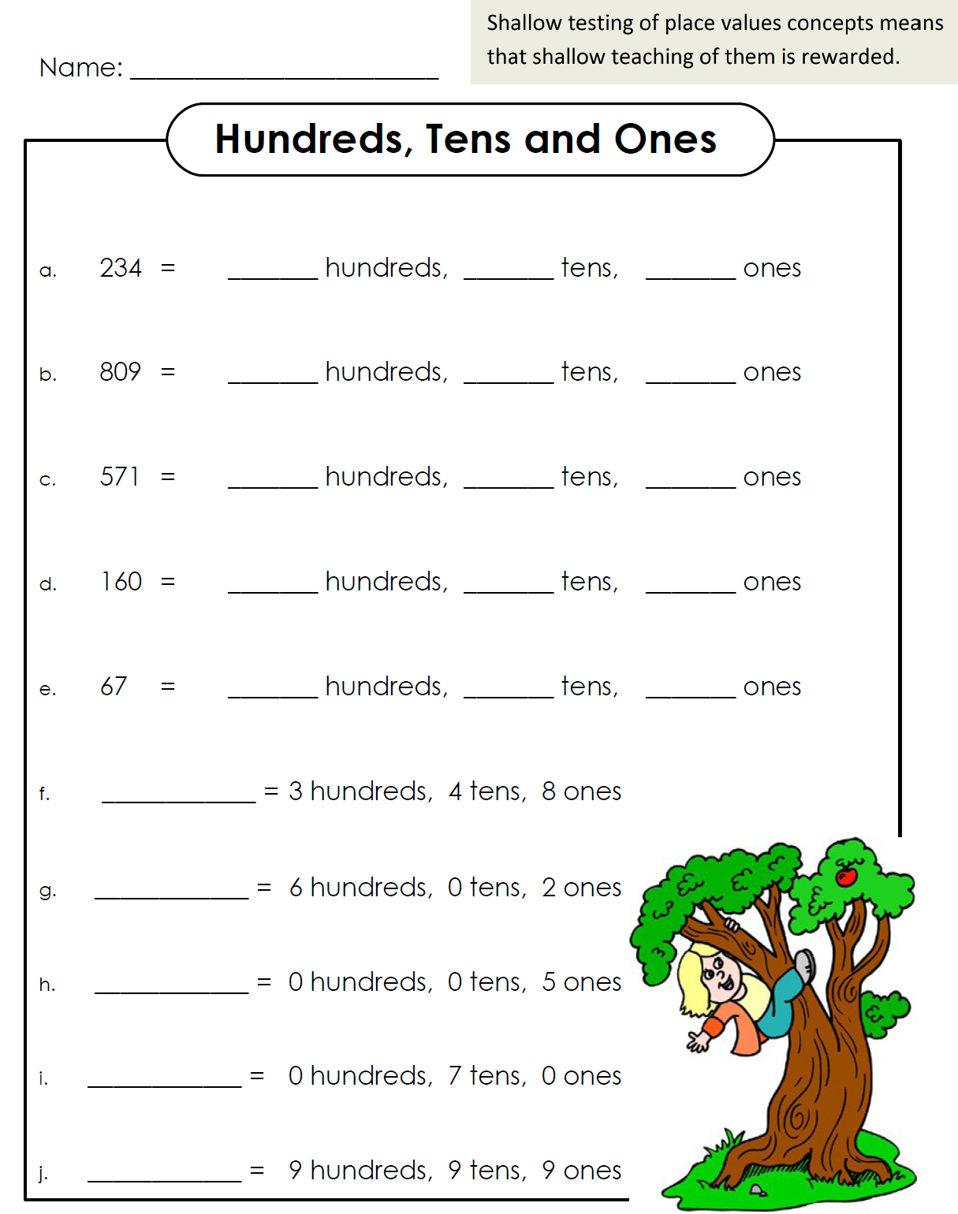
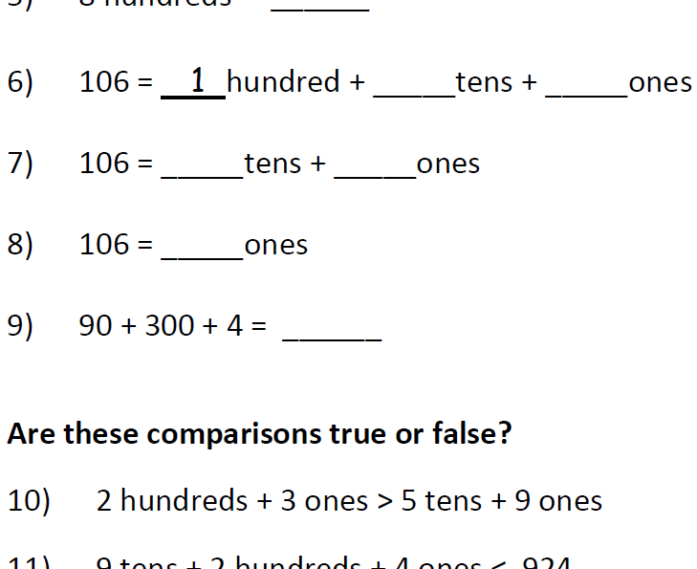
Rigor
Assessing Conceptual Understanding
Traditional Approach to Conceptual Understanding (Grade 2) | CCSS-Aligned Approach to Conceptual Understanding (2.NBT.A)
Source: Achieve the Core. http://achievethecore.org/page/253/thinking-about-place-value-in-grade-2
Notes:
The traditional grade 2 example on the left shows how conceptual understanding can be undermined by weak item construction. As you can see, it would not be possible to assess whether students have a conceptual understanding of place value by taking this assessment. It would be fairly obvious to a student who does not understand place value that the first number goes with “hundreds,” the second number with “tens,” and the third number with the “ones.” Essentially, traditionally we assessed procedural skills at the expense of conceptual understanding, but now we are aiming to assess conceptual understanding directly.
The CCSS-aligned example on the right shows a grade 2 assessment checking for place value understanding. Note that a teacher would be able to assess a student’s conceptual understanding of place value more clearly with the results of this worksheet. In problems 6–8, the base ten units in 106 are bundled in different ways. This is helpful when learning how to subtract in a problem like 106-37. In problem 9, you can see that if the order is always given “correctly,” then all we do is teach students rote strategies without thinking about the size of the units or how to encode them in positional notation. A student with strong conceptual understanding of place value would not be thrown off by problem 9. A good conceptual problem is often really easy if you understand the concept, but really hard if you don’t.

Slide 33
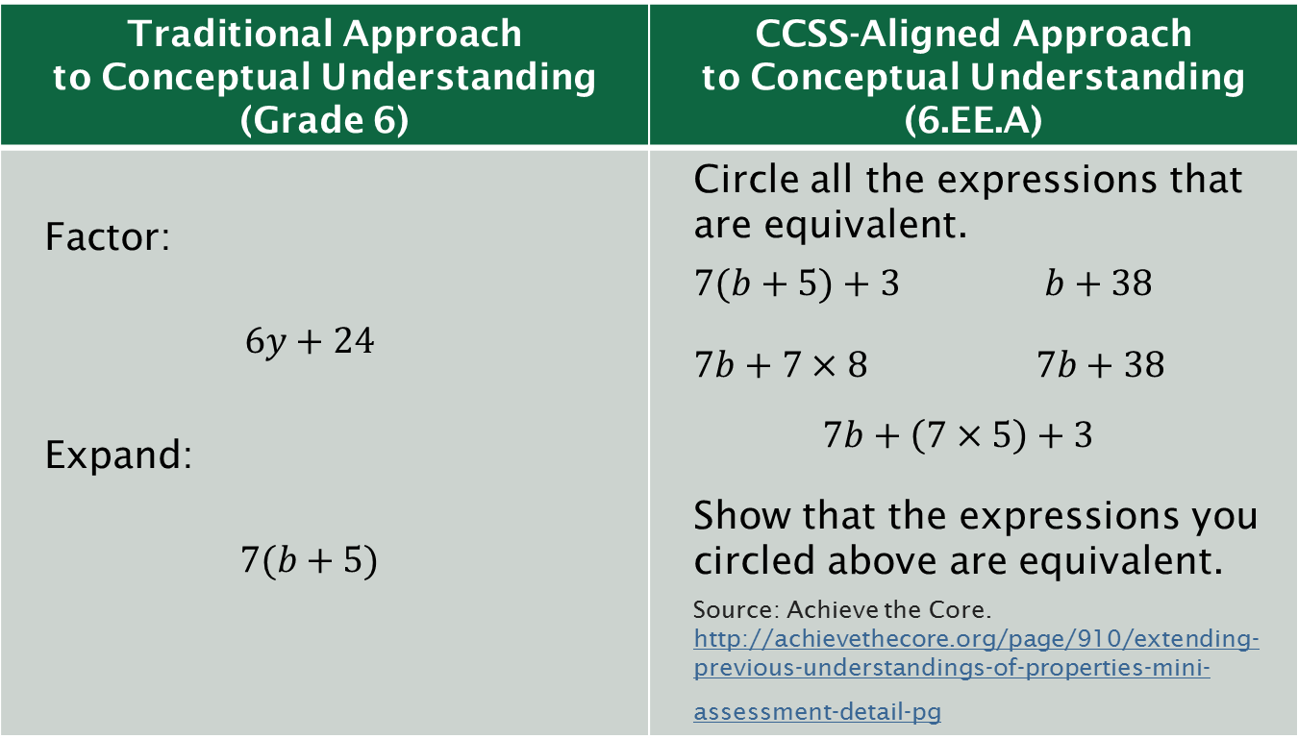
Rigor
Assessing Conceptual Understanding
Traditional Approach to Conceptual Understanding (Grade 6) | CCSS-Aligned Approach to Conceptual Understanding (6.EE.A)
Factor: $$6y+24$$ Expand: $$7(b+5)$$ | Circle all the expressions that are equivalent. $7(b+5)+3$ $b+38$ $7b+7×8$ $7b+38$ $$7b+\left(7×5\right)+3$$ Show that the expressions you circled above are equivalent. Source: Achieve the Core. http://achievethecore.org/page/910/extending-previous-understandings-of-properties-mini-assessment-detail-pg
Notes:
The examples on the slide show the traditional approach to finding equivalent expressions compared to the CCSS-aligned approach requiring the students to demonstrate conceptual understanding. The cluster targeted on the right is 6.EE.A, “Apply and extend previous understandings of arithmetic to algebraic expressions.”
Traditionally, this concept has been assessed as procedural skill, but the CCSS calls for students to show understanding of the math behind the procedures. It is not sufficient to simply know the procedure for finding equivalent expressions as shown on the left (expanding and factoring); students also need to know what it means for expressions to be written in equivalent forms as shown on the right.

Slide 34
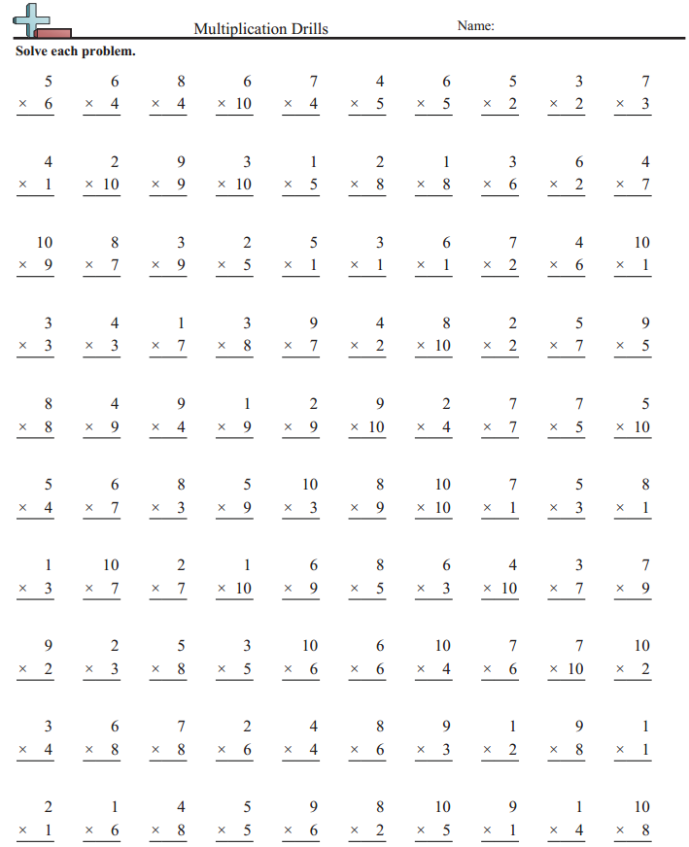
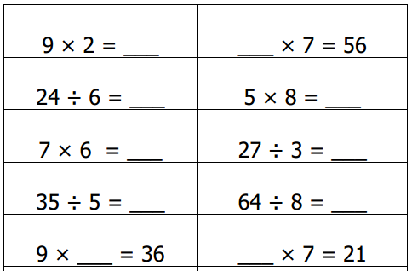
Rigor
Assessing Procedural Skill and Fluency
Traditional Approach to Procedural Skill and Fluency (Grade 3) | CCSS-Aligned Approach to Procedural Skill and Fluency (3.OA.C.7)
 | Source Achieve the Core: http://achievethecore.org/page/861/multiplication-and-division-within-100
Notes:
Notice that the before and after are very similar! That’s because a lot of work around procedural skill and fluency is the same. However, there are differences if you look closely.
One key difference is that the structure of the CCSS-aligned items are more intentional: unknowns are in all positions, and multiplication and division problems are mixed together.
Another key difference is that the problems are given horizontally. Vertical orientation often implies that there is paper-and-pencil calculation to be done. Practicing to become fluent with standard 3.OA.C.7 requires students to “know from memory all products of two one-digit numbers.” The horizontal orientation is meant to encourage students to use their memory and resist the urge to write calculations.
Note that fluency doesn’t mean timed questions; however, these problems would be daunting to a student relying on pictures and repeated addition to solve them. Developing fluency will help students access more complex mathematics so they’re not stuck on basic mathematics.

Slide 35
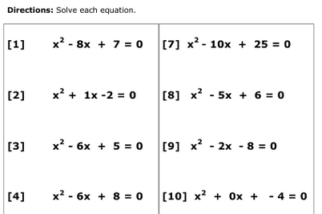
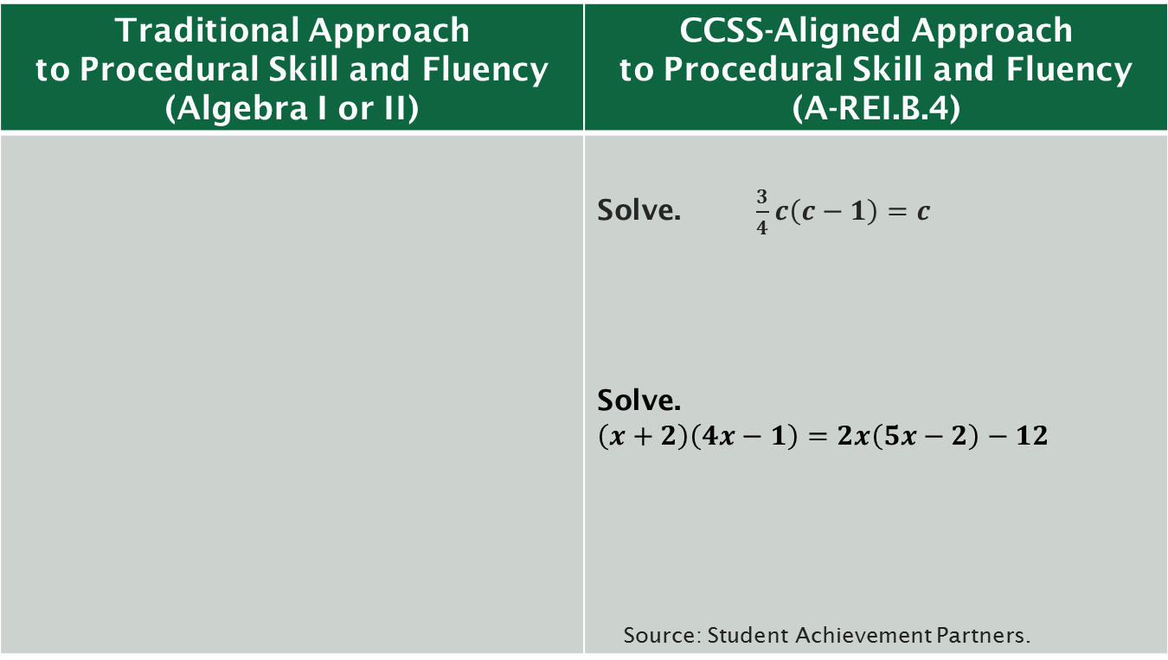
Rigor
Assessing Procedural Skill and Fluency
Traditional Approach to Procedural Skill and Fluency (Algebra I or II) | CCSS-Aligned Approach to Procedural Skill and Fluency (A-REI.B.4)
 | Solve. $\frac{3}{4}c\left(c−1\right)=c$ Solve. $\left(x+2\right)\left(4x−1\right)=2x\left(5x−2\right)−12$ Source: Student Achievement Partners.
Notes:
The traditional problems illustrate how traditional procedural skill problems can be solved without conceptual understanding. The student factors in a similar fashion for all problems. The equations are all given in the same format, and the coefficient a is always 1.

Slide 36



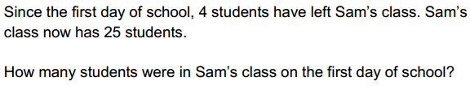

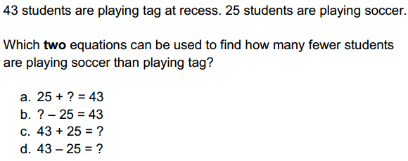
Rigor
Assessing Application
Traditional Approach to Application (Grade 2) | CCSS-Aligned Approach to Application (2.OA.A.1)
 | Source: Achieve the Core. http://achievethecore.org/page/258/representing-and-solving-addition-and-subtraction-problems-mini-assessment-detail-pg
Notes:
The traditional approach to assessing multiplication on the left uses word problems that are all similar in structure (they are all “add to, result unknown”), ignoring the fourteen other situation types for addition and subtraction. Further, these sample items only address addition, and do not mix the two operations of addition and subtraction together.
Notice in the CCSS-aligned examples on the right, the situations and placement of the unknown vary. The first example is a “put together, total unknown.” The second is a “take from, start unknown,” and the third is a “compare, difference unknown.” Further, in the first two examples, the student will need to answer a number, while–in the third–she will need to identify the correct equations that represent the situation. This shows a more complete alignment to the depth of standard 2.OA.A.1, which calls for “using drawings and equations with a symbol for the unknown number to represent the problem.”
Note that this item also aligns to MP.4, Model with mathematics. In early grades, modeling can be “as simple as writing an addition equation to describe a situation.” (CCSS, p.7)

Slide 37
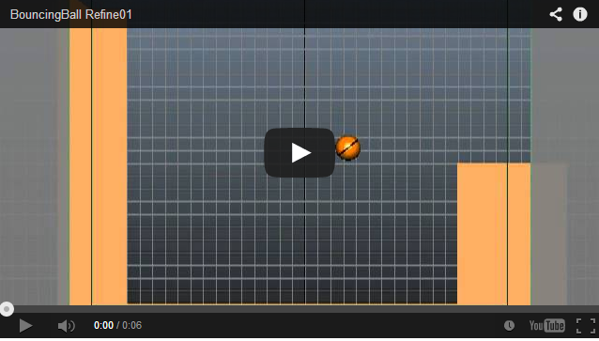
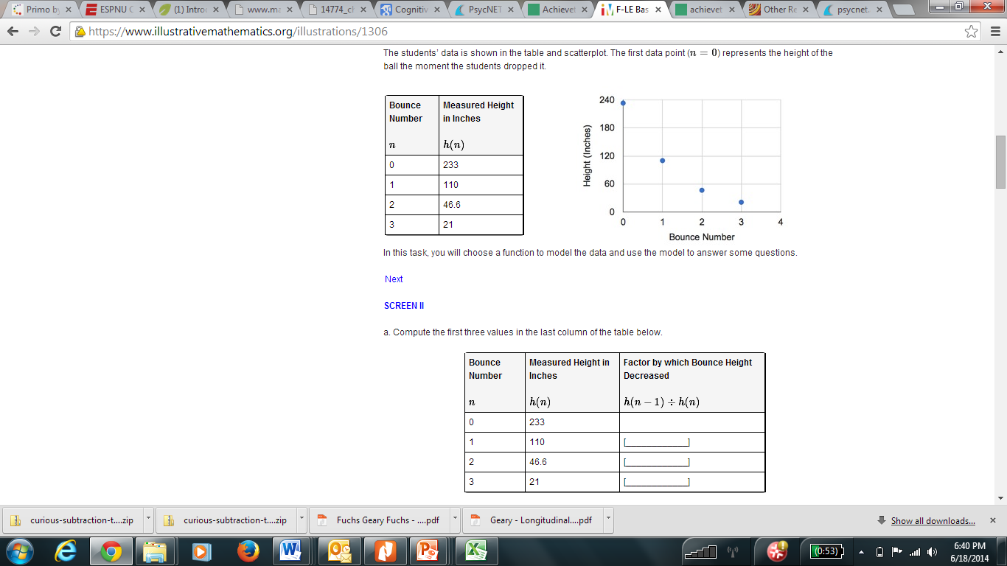
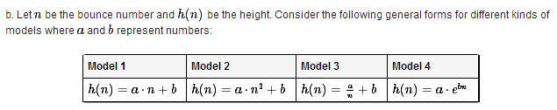
Rigor
Assessing Application
Traditional Approach to Application (Algebra I or II) | CCSS-Aligned Approach to Application (F-LE.A.1, 2)
Use the general exponential decay formula: A(t)=A₀(1–r)^{t} to find the value of $50 after 5 years with a 25% rate of decrease per year. | Source: Illustrative Mathematics. https://www.illustrativemathematics.org/illustrations/1306
Notes:
The traditional exponential growth item on the left is an application with a very thin context. The item really boils down to procedural skill, where the student would plug the values into the exponential growth formula. This could essentially be done void of understanding or having read the context.
Like most good high school modeling tasks, the CCSS-aligned item on the right does not fit well on the screen. But the video shows a basketball bouncing, and some data is given in a table and graph. One of the follow-up questions is shown here where the student chooses what function models this situation. Then, students give values for a and b to find the height of the basketball after n bounces.

Slide 38
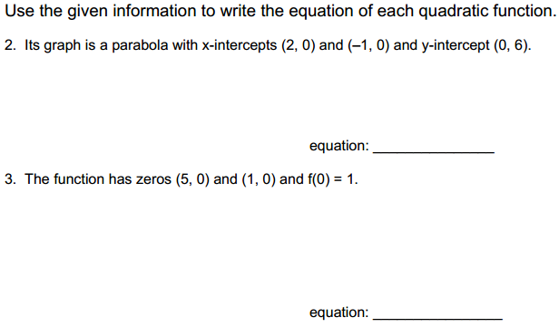
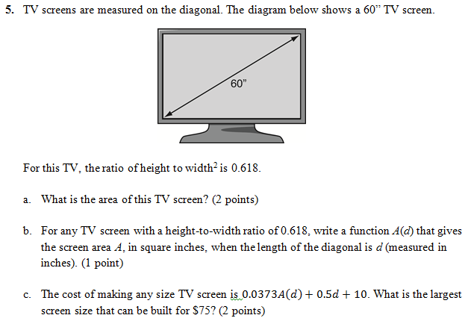
Rigor
Not Always Together, Not Always Separate
Traditional Approach Ignoring Combined Rigor (Algebra I) | CCSS-Aligned Approach to Combining Aspects of Rigor (A-REI.B.4, A.CED.A.1)
 | Source: Achievethecore.org. http://achievethecore.org/page/976/quadratic-equations-mini-assessment
Notes:
The traditional approach on the left has two items that assess writing quadratic functions from a purely procedural standpoint.
The CCSS-aligned approach on the right has a rich context application problem that also addresses conceptual understanding.

Slide 39
Summary and Resources
Notes:
The next three slides review the major changes to assessment for each Shift as shown through the examples we've just explored.

Slide 40
How Are CCSS Assessments Different?
An Overview
Shift 1: Focus strongly where the Standards focus
From | To
Cover content that is a “mile-wide and an inch-deep” | Assess fewer topics at each grade (as required by the Standards)
Give equal importance to all content | Dedicate large majority of score points to the major work of the grade

Slide 41
How Are CCSS Assessments Different?
An Overview
Shift 2: Coherence: think across grades, and link to major topics within grades
From | To
Assessment as a checklist of individual standards | Items that connect standards, clusters, and domains (as is natural in mathematics) as well as items that assess individual standards
Each topic in each year is treated as an independent event | Consistent representations are used for mathematics across the grades, and Content connects to and builds on previous knowledge

Slide 42
How Are CCSS Assessments Different?
An Overview
Shift 3: Rigor: in major topics pursue conceptual understanding, procedural skill and fluency, and
application with equal intensity
From | To
Unbalanced emphasis on procedure or application | Assessment of all three aspects of rigor in balance
A lack of items that require conceptual understanding | Items that require students to demonstrate conceptual understanding of the mathematics, not just the procedures
Fluency items that are only routine and ordinary | Fluency items that are presented in new ways, as well as some that are routine and ordinary
Application of mathematics to routine and contrived word problems | Application of mathematics to authentic non-routine problems and real-world situations

Slide 43
Additional Resources:
For a growing bank of mini-assessments that can be used in the classroom, go to www.achievethecore.org/math/mini-assessments.
For a growing bank of tasks that can be used for instructional or assessment purposes, go to www.achievethecore.org/math/tasks.
For more information about the Shifts, go to http://achievethecore.org/shifts-mathematics
For Illustrative Math tasks, go to www.illustrativemath.org.
For PARCC sample items and practice tests, grades 3–11, go to www.parcconline.org.
For SBAC practice tests, grades 3–high school, go to www.smarterbalanced.org.
For more about the progressions documents, go to http://math.arizona.edu/~ime/progressions/#products

Slide 44
Thank you for taking the time to learn more about CCSS-aligned assessments!

