Slide 1
Selecting and Sequencing: Coherence and Complexity
Creating an Expert Pack
Notes:
This module was last updated on February 2016.

Slide 2
Selecting and Sequencing Text: Coherence
Each resource contributes to the whole set.
Resources are sequenced to create a coherent and gradual learning process.
The set develops knowledge of words and the world, and a love of learning.
Notes:
There are many ways to organize resources in the Expert Pack, as long as it makes sense to the specific topic.
Cause and Effect, Problem/Solution, Chronologically, etc. can all work.
Building knowledge is the goal

Slide 3
Coherence Guide:
Tips for Organizing Expert Packs
Read the Coherence Guide.
2. Discuss with your table:
  Based on your particular set of resources, which tips or information resonate the most in your thoughts about organizing your resources at this point?
  What challenges or questions do you have about organizing your resources at this point?
3. Select a member of your team to share with the larger group.
Notes:
There are many option for facilitation. Participant should read and share their insight about the information in the Coherence Guide:
Ideas for facilitation:
Jigsaw:
Divide the room, making certain tables responsible for summarizing big ideas from the various sections of the Coherence Guide
The document is divided into:
The Beginning
The Middle
The End
Some Tips

Slide 4
Selecting and Sequencing Text: Complexity
Graduated approach will also support:
  students’ ability to read the next selection
  students gradually becoming ‘experts’ on the topic they are reading about
Generally begin with less-complex resources (quantitative and qualitative measures).
Move to more complex in the latter resources.
Notes:
Must also consider complexity at the same time.
Learning from on resource should provide support for the next.
The most complex of readings/resources should come later in the sequence.

Slide 5
The work is grounded in:
CCSS Anchor 10: Read and comprehend complex literary and informational texts independently and proficiently.
The standards have raised the bar for what students should read and understand at each level.
Passages should be of high quality so that they are worthy of reading.
With text sets, considerations of ‘high quality’ take in the learning available from each text.
Notes:
Big Idea:
The standards call for the ability to read and comprehend text independently and proficiently, so instruction has to change.
Details:
The same factors of text complexity (think of the triangle!) are at play here: quantitative measures, qualitative features and reader and task consideration)
But they play out differently with text sets. The quality of the whole text set is what you need to think about. The texts are the parts of the whole, and need to be considered in relationship to each other.
.

Slide 6
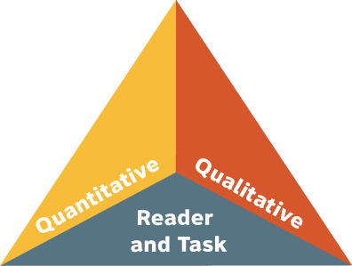
Notes:
Rachel
Big Idea:
Three factors determine the complexity of a text.
Details:
Before the standards, text complexity was usually determined by quantitative value, like its Lexile, alone.
This is the CCSS text complexity triangle (ask how many participants have seen it).
Point out this is an equilateral triangle, so each side of it has equal weight.

Slide 7
Three Factors of Text Complexity
Quantitative Scale: What a computer can “see” and measure
Qualitative Measures: Text features best judged by human evaluation (structure, language and knowledge demands, and purpose)
Professional Judgment: What the instructor does with this text to help students read and understand it
Notes:
Rachel
Big Idea:
Three factors determine the complexity of a text.
Details:
These explanations are clear
Read them through with participants.
Remind them that QUALITATIVE features are the 10 features we just discussed
Address any questions and confusions.
NOTE: More detail is coming on the next slides.

Slide 8
Quality and Complexity:
A Powerful Connection
  By reading series of high-quality, complex texts as independently as possible*, students increase reading proficiency that carries over to the next reading experience.
  * Many students will need support for reading some of the texts in each text set. This must be anticipated and designed into the text set.
Notes:
Glossary is an example of a resource built into the design of the set to help support readers with more complex resources.

Slide 9
What Is Complex Text, Exactly?
Dense information
Lack of words, sentences or paragraphs that review or pull things together for the student
Lengthy paragraphs
Complex sentences
Text structure that is less narrative and/or mixes structures
Notes:
Big Idea:
There are 10 features that can make a text complex; a text with more of these features will be more complex. Stop and consider for a minute which of these are likely to be important in the informational text that makes up the bulk of a text set.
(Optional) Details:
Go through each of the definitions.
These qualities, or features of text can be present in text in any number of ways. Ten factorial ways, actually (factorial =10 x 9 x 8 x 7 … which equals 3,628,800).
Complex sentences: sentences with lots of parts to them, or lots of variation in sentence length and styles
Uncommon vocabulary: not likely to be familiar to many students at this level.
Lack of….: the author does not repeat ideas or summarize much. Also may not offer clues to the reader through words like: “next”, “as we just saw”, “in conclusion”, “because”
Lengthy paragraphs: long, dense paragraphs
Text structures: narrative structure is story-like. It is easier to follow than problem – solution, or cause and effect. When an author mixes up structures (which textbooks and articles often do) that gets even trickier to follow.
Subtle and/or frequent transitions: the author does not give you clues (next, thus, consequently) before moving to a new idea
Multiple and/or subtle themes and purposes: the author does not directly state or clearly offer, what his purpose for writing is, or the big ideas are hard to figure out.
Dense information: informational text tends to pack ideas in very tightly and authors may assume that readers know more about the topic than students might actually know.
Unfamiliar settings, topics or events: it is harder to visualize and imagine what you have never experienced. This is why contemporary fiction can be read so fast and is considered so enjoyable. Almost everything is familiar.
Lack of repetition, overlap, or similarity in words and sentences: the author keeps moving to new ideas or settings and does not stop to summarize or support what he has just discussed. Or he finds new ways to express the same idea. If the reader didn’t understand right away, or doesn’t realize the new phrasing is a restating of the original idea, it is easy in both cases to get lost.

Slide 10
What Is Complex Text, Exactly?
6. Subtle and/or frequent transitions
7. Multiple and/or subtle themes and purposes
8. Uncommon vocabulary
9. Unfamiliar settings, topics or events
10. Lack of repetition, overlap, or similarity in words and sentences

Slide 11
Complex Vs. Difficult
Dense information
Lack of words, sentences, or paragraphs that review or pull things together for the student
Lengthy paragraphs
Complex sentences
Text structure that is less narrative and/or mixes structures
Notes:
Big Idea:
Two features of a complex text make a text not just more complicated, but difficult.
Details:
Ask participants which f the two are not just complex, but difficult?
Difficulty is in the READER. Complexity is in the TEXT.
The difference is that 8 of them can make a text more complicated, but two of them also contribute most to make a text more difficult.
Let participants discuss which two for a minute and then ask. The two are uncommon vocabulary (#1 by a landslide) and complex sentences (#2 and far ahead of the others).
After lots of research, it has been found that words have a lot to do with reading. ☺

Slide 12
Complex Vs. Difficult
6. Subtle and/or frequent transitions
7. Multiple and/or subtle themes and purposes
8. Uncommon vocabulary
9. Unfamiliar settings, topics or events
10. Lack of repetition, overlap, or similarity in words and sentences

Slide 13
1. Quantitative Scale
CCSS GRADE BANDS | ATOS | Degrees of Reading Power | Flesch-Kincaid | The Lexile Framework | Reading Maturity
(2nd – 3rd) | 2.75 – 5.14 | 42 – 54 | 1.98 – 5.34 | 420 – 820 | 3.53 – 6.13
(4th – 5th) | 4.97 – 7.03 | 52 – 60 | 4.51 – 7.73 | 740 – 1010 | 5.42 – 7.92
(6th – 8th) | 7.00 – 9.98 | 57 – 67 | 6.51 – 10.34 | 925 – 1185 | 7.04 – 9.57
(9th – 10th) | 9.67 – 12.01 | 62 – 72 | 8.32 – 12.12 | 1050 – 1335 | 8.41 – 10.81
(11th – CCSS) | 11.20 – 14.10 | 67 – 74 | 10.34 – 14.2 | 1185 – 1385 | 9.57 – 12.00
Notes:
Big Idea:
Several tools exist to measure the quantitative value of a text.
Details:
Of the three factors involved in measuring text complexity, this is the one most familiar to educators.
Each one develops a “staircase” of complexity through the grade levels.
Each one will achieve the requirements of the CCSS band level text complexity, and align to college and career readiness
Each of them have been validated in themselves and against each other in a strenuous research study (Nelson et al, 2012). In other words, any of them work.
There is a lot of overlap between the top of one band and the beginning of the next. This is for a couple of reasons:
Readers progress and backslide in surges and hard to predict ways. The overlap acknowledges that.
That backsliding often happens when students move from grade to grade.
Putting a numerical value on words is still a new and inexact science. So we should allow for overlap within the scale so we don’t misstate the precision of the scale.
No need to always choose Lexile but whatever you choose must be consistently used in the entire set.

Slide 14
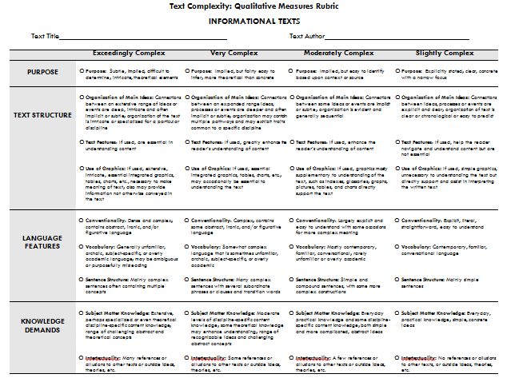
2. Qualitative Measures
Notes:
Big Idea:
Qualitative measures are best measured through human evaluation of a text’s structure, language
Details:
This is the chart we will be working with during the activity.
The features (or qualities) of text that go down the left column are the cluster of features we will be evaluating in the text excerpt
The definitions for structure, language and knowledge demands, and purpose come from the CCSSO rubric
Quantitative measure lets them know in what level the text belongs, but the qualitative analysis they are going to do will give them information about how hard the text will be for their students and where they will need to pay attention when they are teaching the text.

Slide 15
3. Professional Judgment
“Students who struggle greatly to read texts within (or even below) their text complexity [level] must be given the support needed to enable them to read at an appropriate level of complexity. Even many students on course for college and career readiness are likely to need scaffolding as they master higher levels of text complexity.”
(From Appendix A, p.9, CCSS – ELA)
Notes:
Big Idea:
Students who struggle with reading complex texts must be provided with the proper support so they can access texts in a meaningful way.
Details:
This quote comes directly from the standards.
Just because a student READS at a lower level doesn’t mean s/he THINKS at a lower level.
Access to appropriate text for everyone is paramount.
We will look more at this third side of the triangle in the next activity.
It is very important to keep instruction in mind and always consider how we might approach teaching students how to comprehend text as we evaluate it for its appropriateness for the classroom.

Slide 16
Sequencing Resources: Complexity
For All Texts and Resources
For Some Texts and Resources
Quantitative
Your own sense of the qualitative features
Always consider reader and task – students working independently
For the most complex also provide:
Detailed qualitative information
Specific reader and tasks considerations
Notes:
Not all texts will need this detail analysis of the text complexity, but some will.

Slide 17
Sequencing Texts: Earth’s Precious Resource
760L “For the World’s Poor, Drinking Water Can Kill”
  Genre: Informational; narrative introduction and conclusion, includes clear section headings
  Length: 573 words
N/A “Millions Lack Safe Water”
  Genre: Informational (infographic); heavy use of statistics and images
  Length: N/A
Notes:
These provide an example of less complex resources at the beginning of the set.
The first articles provides a narrative account of the effects of water shortage across the world.
The infographic is simple to use and provides a lot of basic facts and figures about water around the world.

Slide 18
Sequencing Texts: Earth’s Precious Resource
N/A “The Water Cycle”
  Genre: Informational video; includes graphics, animation, narrative setting, and focus on vocabulary
  Length: 3:27 minutes
1010L “Water, Water, Everywhere!”
  Genre: Informational; contains clear section heading and questions to check for understanding
  Length: 583 words

Slide 19
Sequencing Texts: Earth’s Precious Resource
790L Hydrology: The Study of Water
  Genre: Informational; text characteristics similar to a simple textbook
  Length: 48 pages
820L A Drop Around the World
  Genre: Literary Nonfiction; narrative poem with rhyming couplets
  Length: 32 pages

Slide 20
Sequencing Texts: Earth’s Precious Resource
1070L “Researchers Discover Huge Underground Water Reserve in Africa”
  Genre: Informational; includes maps
  Length: 404 words
N/A “What is Your Water Footprint?
  Genre: Website (interactive calculator); web-based survey format
  Length: N/A
Notes:
Most complex article is last in the set. Analysis of text complexity will be provide for this resource.
Set ends with an interactive website.
Both resources provide information about working towards a solution to the water shortage crisis.

Slide 21
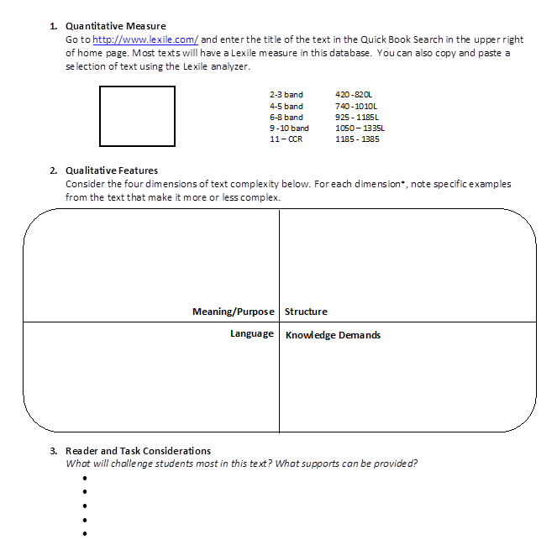
Text Complexity Guide
Notes:
Template for complexity analysis

Slide 22
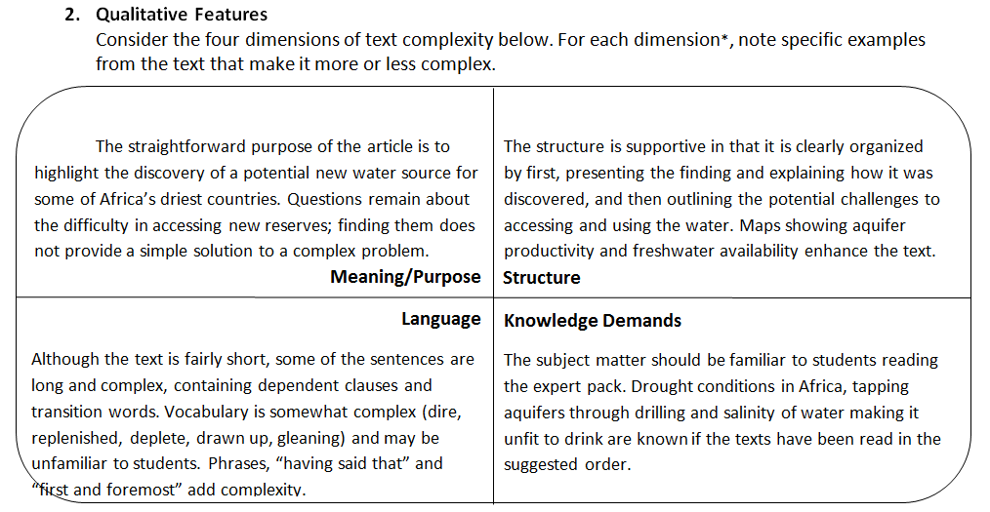
“Researchers Discover Huge Underground Water Reserve in Africa”
Notes:
Detailed analysis of what make this article complex
Read one or two examples from the slide
If participant need practice with analyzing text complexity and if time allows. Read the article and discuss the complexity demand using the rubric for Qualitative Features of Text complexity

Slide 23
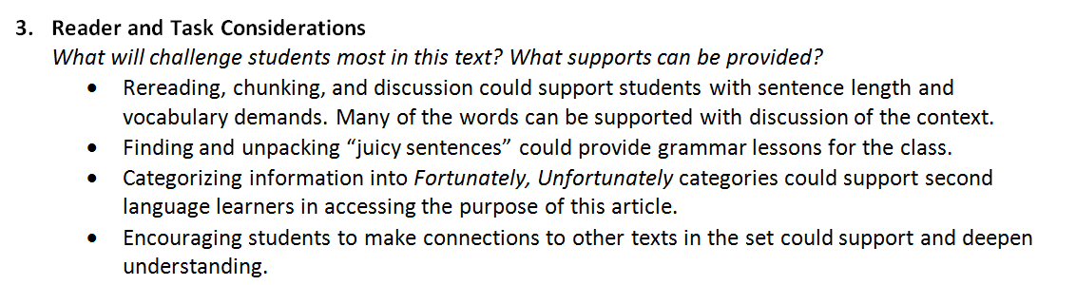
“Researchers Discover Huge Underground Water Reserve in Africa”
Notes:
Specific guidance provided for the teacher, when thinking about supporting students with the reading of this article

Slide 24
Learning Worth Remembering
Step 5 on the Checklist for Creating an Expert Pack

Slide 25
Learning Worth Remembering
Capturing students’ new vocabulary, connections, and knowledge as they read through the Expert Pack.

Slide 26
Close Reading | Volume of Reading
Less pages | More pages
Grade-level complex text | Text at different levels of complexity
All students same text | Student or teacher choice of text
Teaches students to attend to text and to words | Expands knowledge, vocabulary, and schema
Notes:
Review some key ideas about Expert Pack that were shared earlier in the training.
The bolded ideas are the foundation for how LWR activities are designed.

Slide 27
Close Reading | Volume of Reading
Heavy support | Light support
Solely teacher-facilitated | Mostly student-facilitated
Exposes students to higher-level content | Builds knowledge of words, and the world
Gives all students access | Builds love of reading

Slide 28
Learning Worth Remembering
Cumulative Activities
Capture knowledge building from one resource to the next
Provide a holistic snapshot of central ideas and learnings of the content covered in the expert pack
Required
Notes:
Two types of LWR activities. The first type are Cumulative.
Read and discuss.

Slide 29
Learning Worth Remembering
Singular Activities
Check for understanding
Capture knowledge gained
Provide variety of ways for students to interact with individual resources
Recommended based on the demands of each resource

Slide 30
Cumulative Activities | Singular Activities
Rolling Knowledge Journal | A Picture of Knowledge
Rolling Vocabulary | Quiz Maker
 | Wonderings
 | Pop Quiz
 | If available, questions included within a resource

Slide 31
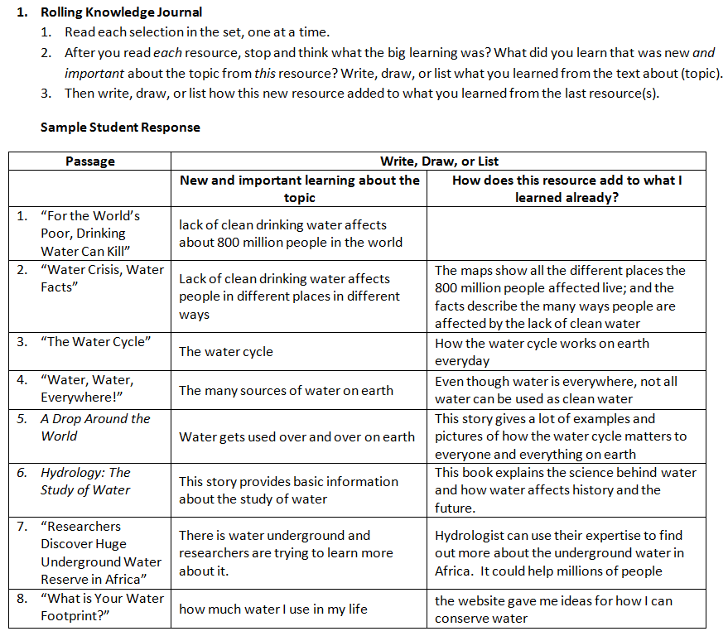
Rolling Knowledge Journal
Sample student response:
provides support for teachers
checks the cohesiveness of the set
Notes:
Read instructions from slide and discuss information in the text box.

Slide 32
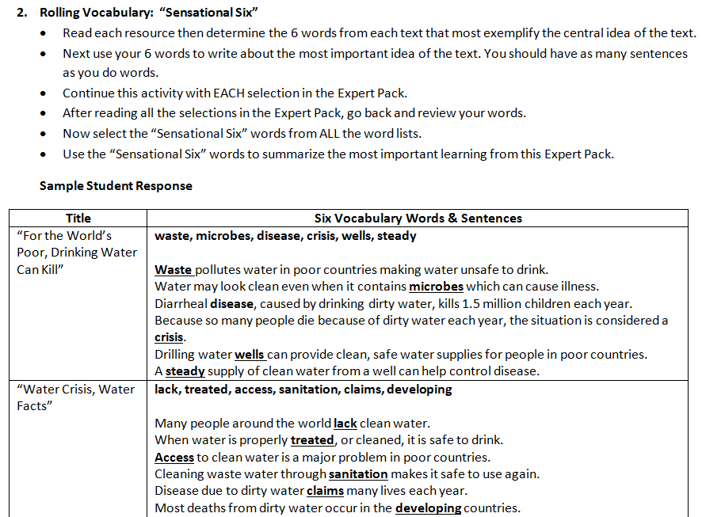
Rolling Vocabulary
Notes:
Read instructions from slide

Slide 33
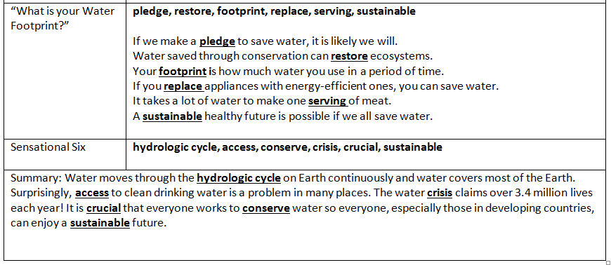
Rolling Vocabulary
Provide sample student response
Complete the Expert Pack Glossary at the same time
Notes:
Discuss information in the text box.

Slide 34
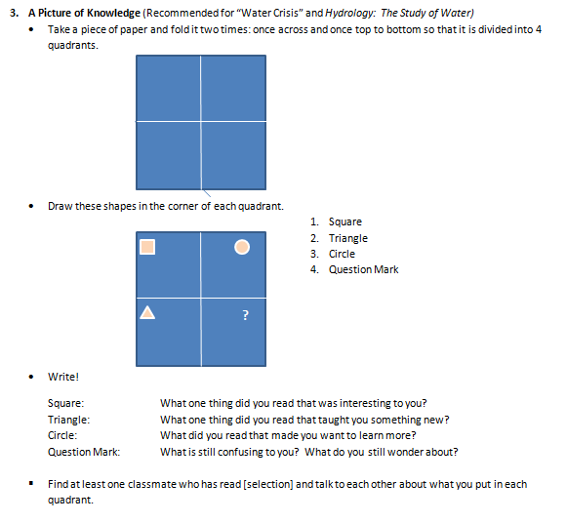
A Picture of Knowledge
Works well with resources that provide a lot of varied information
Resources that provide an overview of a topic
Resources that contain many facts and basic information
Notes:
Read instructions from slide and discuss information in the text box.

Slide 35
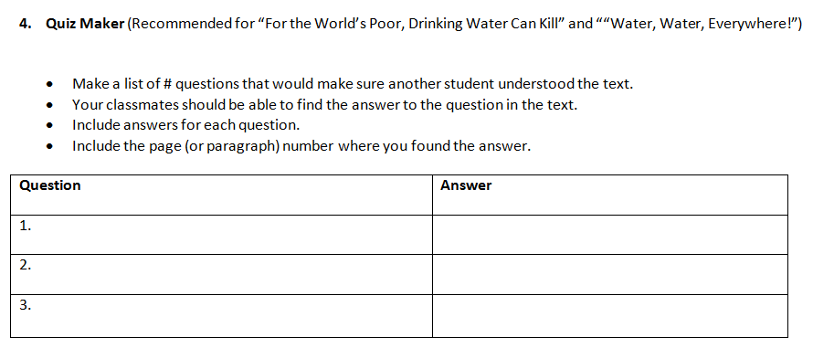
Quiz Maker
Recommended for “Millions Lack Safe Water”, “The Water Cycle”, “Water, Water, Everywhere!”
Good for checking for understanding
Versatile – can be used with all types resources (video, infographics, etc.)
All students have access
Notes:
Read instructions from slide and discuss information in the text box.

Slide 36
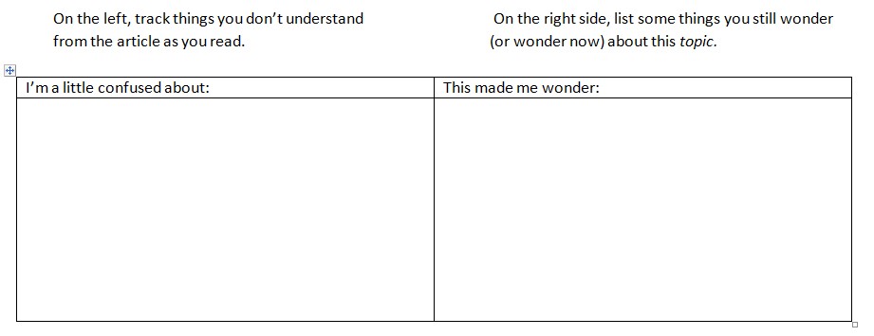
Wonderings
Recommended for “For the World’s Poor, Drinking Water Can Kill”, “Researchers Discover Huge Underground Water Reserve in Africa”
Great for first and last resources in set, but can be used any time
Also good for resources that ask questions or explore ideas and solutions
Notes:
Read instructions from slide and discuss information in the text box.

Slide 37
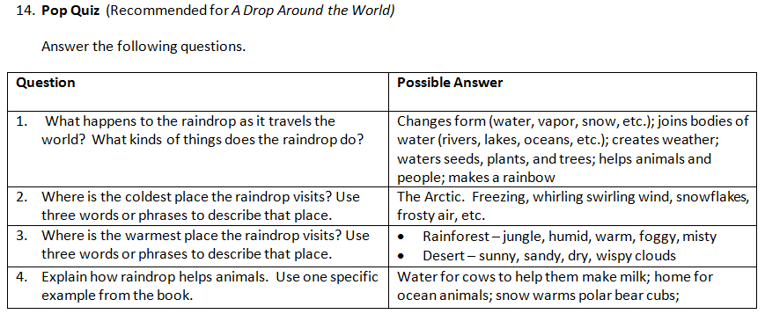
Pop Quiz
3 – 5 questions
Great for literary texts; help connect literature to the content
Provide suggested student responses
Notes:
Read instructions from slide and discuss information in the text box.

Slide 38
Work in Progress
Attempting to strike balance between:
Student accountability – Is this work worth doing? Is this knowledge worth remembering?
Effective teacher support – Do teachers have what they need to support students?
“Light-touch approach” for teachers and students. Can this be done with ease?

Slide 39
“The intuitive mind is a sacred gift and the rational mind is a faithful servant. We have created a society that honors the servant and has forgotten the gift.”
- Albert Einstein
Notes:
Activities should support and excite students while learning; they shouldn’t be a burden or distraction.

Slide 40
Creating an Expert Pack
A Step-by-Step Guide

Slide 41
It takes a village.
Librarians and media specialist searching for the right resources
Teachers creating the right experiences

Slide 42
The Process
Collaborative
Iterative
Methodical
Purposeful

Slide 43
Checklist for Creating an Expert Pack
Refer to Participants Handout
pg. 27

Slide 44
Step 1: Choose a topic
Topics K-2 Science and Social Studies
Topics 3-5 Science and Social Studies
Refer to Participants Handout
pg. 28 – 32

Slide 45
Step 2: Gather texts and resources
Text-based Resources Along A Range of Difficulty
Finding Resources
to Build Texts
Refer to Participants Handout pg. 33 – 37

Slide 46
Step 3: Narrow the list to 5-7 resources at most! Purposefully sequence the resources
Coherence Guide
Text Complexity Guide
Refer to Participants Handout
pg. 38 – 42

Slide 47
Step 3: Narrow the list to 5-7 resources at most! Purposefully sequence the resources
Refer to Participants Handout pg. 38 – 42

Slide 48
Step 4: Complete Annotated Bibliography
Annotated Bibliography
APA Citation Guide
Refer to Participants Handout
pg. 43 – 48

Slide 49
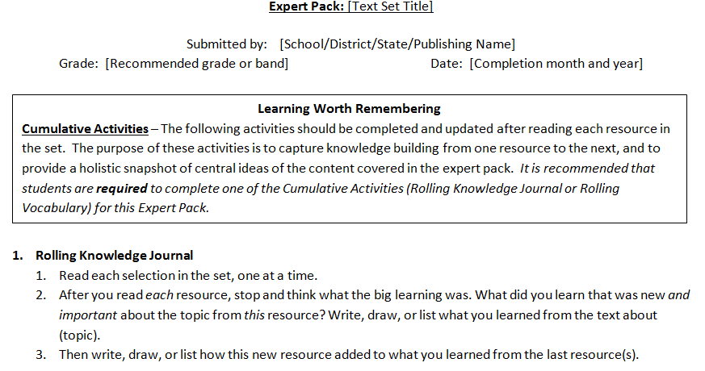
Step 5: Create Learning Worth Remembering Activities
Refer to Participants Handout pg. 49 – 53

Slide 50
Step 6: Create Expert Pack Glossary
Expert Pack Glossary
Creating and Using EPG
Refer to Participants Handout pg. 54 – 57

Slide 51
Step 7: Save files with proper naming conventions

Slide 52
Step 8 and Beyond
Point person sends AB v1 to Farren (fliben@studentsachieve.net)
Farren sends AB v1 to reviewer for feedback
Farren returns “AB v1 – with comments” to point person, and the team creates an AB v2 (version 2), LWR v1, EPG v1, CG v1.
Point person sends all four documents to Farren.
Revision loop continues until reviewer deems the Expert Pack to be final

Slide 53
Text Set Project on Edmodo
Make a teacher account at www.edmodo.com
On the left side of home screen, it will say “Groups” under your name and picture. Click on the + next to “Groups” and choose “Join”.
Type in the group code: sma265
From your home screen, you should now see “Text Set Project” listed under “Groups”. Click on this tab.
Choose “Folders” from the left side of your screen.

