Slide 1
Introduction to the Instructional Materials Evaluation Tool (IMET): Mathematics
www.achievethecore.org
Notes:
This module was last updated on September 2016.

Slide 2
“In general, teachers are much more likely to cover topics presented in the materials selected by their school or district than to cover topics not included; they are likely to follow the sequence of topics in the selected materials; and their pedagogical approach is influenced by the instructional design of the materials. The evidence is clear that instructional interactions between students and teachers are framed by the instructional materials that are provided by their schools and districts.”
Chingos & Whitehurst,
Choosing Blindly: Instructional Materials, Teacher Effectiveness, and the Common Core
Notes:
Big Idea: Why is this work important?
Talking Points:
<Ask participants to reflect on how this quote resonates with what they are seeing in their school or district.>
Instructional materials may be one of the most important factors in student learning.
There is a lot of research and time invested in teacher effectiveness and the importance of a high-quality teacher in classrooms. Aligned instructional materials are a factor in that effectiveness.
In moving to CCSS, the textbook is an important guide for teaching the standards, especially for new teachers, but also for more experienced teachers who are learning what the new standards mean. That’s why it’s so important that instructional materials get it right!
Quote is from a Brookings Institution report from 2012, available here: http://www.brookings.edu/~/media/research/files/reports/2012/4/10%20curriculum%20chingos%20whitehurst/0410_curriculum_chingos_whitehurst.pdf

Slide 3
Essential Questions
What is the Instructional Materials Evaluation Tool (IMET)? How is it structured?
How does the IMET enable reviewers to evaluate whether instructional materials are aligned to the major features of the Standards and fulfill the Shifts they require?
How could the IMET be useful in a variety of settings to bring the CCSS and Shifts to life for students?
Notes:
Big Idea: Share essential questions and frame the session
Talking Points:
This module is intended to be an introduction and orientation to the Math IMET. Participants will gain an understanding of the tool and how it relates to the Common Core State Standards and the instructional shifts they require.
There are more PD modules available on achievethecore.org to use to go more in-depth with how to use the IMET.

Slide 4
Goals
Understand that the IMET is a powerful tool that enables reviewers to evaluate whether instructional materials are aligned to the Common Core State Standards
Understand how the structure and levels of alignment within the IMET illuminate the major features of the standards
Consider pertinent uses for the IMET including evaluating new or current curricular materials, developing materials, and professional learning
Notes:
Big Idea: Share goals of the session
Talking Points:
The goals outline what participants will know and be able to do at the end of this module.
As the goals imply, understanding the IMET and what is required in aligned instructional materials is part of a constant cycle of learning that is required in the transition to Common Core. What we know about the CCSS informs how we look at the IMET; what we learn about the IMET deepens our understanding of CCSS.
The last goal refers to the fact that there are many use cases for IMET training beyond choosing materials to adopt.

Slide 5
Agenda
Introduction to the IMET
Find the Shifts
Focus in the IMET
Coherence in the IMET
Rigor in the IMET
Major Features of the Standards in the IMET
Summarizing
Notes:
Big Idea: Preview the agenda for the session
Talking Points:
We will be taking a walk through the IMET and seeing how the instructional Shifts required by the CCSS inform the design and specific metrics of the tool.

Slide 6
What Is the IMET?
The IMET is a tool designed to help educators determine whether instructional materials are aligned to the Shifts and major features of the Common Core State Standards.
Designed to be used to evaluate full-year curricula
2 versions: K-8 and High School
Available at: achievethecore.org/imet
Notes:
Big Idea: Define the IMET
Details:
Available for Math in K-8 and HS. We will just be focusing on K-8 in these modules.
Also available for Literacy in K-2 and 3-12.
All versions available here (http://achievethecore.org/imet)

Slide 7
How Do the Publishers’ Criteria Support Use of the IMET?
Developed by the CCSSM writing team, to support faithful implementation by providing criteria for alignment to the Standards
Provide detail and further guidance on criteria and metrics of the IMET
Notes:
Big Idea: Define the Publishers’ Criteria and explain how they can support users of the IMET
Talking Points:
The Publishers’ Criteria (K-8 and High School), created in 2012 by the Standards’ authors, were written to capture the overarching instructional practice goals which should be present in Common Core-aligned materials.
They are publisher-facing documents that offer guidance on how to embed the Standards and Shifts into instructional materials.
It is helpful for reviewers to be familiar with the Publishers’ Criteria and the documents can be a helpful reference during the training and review processes.
K-8 Publishers’ Criteria can be found here: http://www.corestandards.org/assets/Math_Publishers_Criteria_K-8_Summer%202012_FINAL.pdf
HS Publishers’ Criteria can be found here: http://www.corestandards.org/assets/Math_Publishers_Criteria_HS_Spring%202013_FINAL.pdf

Slide 8

“These standards are not intended to be new names for old ways of doing business. They are a call to take the next step.”
−CCSSM, page 5
Notes:
Big Idea: The Standards require change in the way we do business, especially in instructional materials
Talking Points:
This quote comes from the introduction in Common Core State Standards document.
This is the message for everyone involved. In the past, state standards might have been revised and it didn’t necessarily have an impact on instructional materials, which means that what happened in the classroom was business as usual.
That can’t happen here—there are some real shifts represented with these standards. There is no room for old ways of doing business in instructional materials.
This means that materials need to do more than just swapping topics from one grade to another.
<The facilitator may choose to share a personal story of changes in district and/or state to help in framing the need for change.>

Slide 9
How Is Reviewing Using the IMET Different?
Traditionally, judging alignment has been approached as a crosswalking exercise. But crosswalking can result in large percentages of “aligned content” while obscuring the fact that the materials in question align not at all to the letter or the spirit of the standards being implemented.
- K-8 Publishers’ Criteria, Spring 2013, p. 1
Notes:
Big Idea: This review process may be very different from how we’ve looked at materials in the past
Talking Points:
<Have participants read the slide>
Although it’s important to make sure that all required content is included, cross-walking often leads to a bureaucratic checklist about what content is covered in books.
<Ask: How many people have been a part of a review process that required cross-walking?>
The IMET requires a process that looks for materials that truly embody the Shifts required by the Standards.
This will allow us to avoid books which may have a Table of Contents that reads like the Standards but doesn’t take into account that some clusters of standards require more time or attention, or misses the Standards’ emphasis on a balance of rigor.

Slide 10
What’s in the IMET?
Non-Negotiable Alignment Criteria
Freedom from Obstacles to Focus
Focus and Coherence
Alignment Criteria
Rigor and Balance
Standards for Mathematical Practice
Access for All Students
Notes:
Big Idea: Give a high-level overview of the tool
Talking Points:
There are two types of criteria in the IMET: Non-Negotiable and Alignment. Each criterion has metrics that are rated individually to determine whether the criterion is met.
The Non-Negotiables evaluate the way instructional materials treat the most important shifts required by the CCSS: focus and coherence.
The Alignment criteria evaluate other important aspects of the Shifts and Standards.

Slide 11



The CCSS Requires Three Shifts in Mathematics
Focus: Focus strongly where the Standards focus.
Coherence: Think across grades, and link to major topics within grades.
Rigor: In major topics, pursue conceptual understanding, procedural skill and fluency, and application.
Notes:
Big Idea: Name the three shifts prior to going into detail about each.
Talking Points:
The Common Core State Standards for Mathematics were designed to address the need for change in mathematics instruction. To learn more about instructional materials that are aligned to the Standards, we are going to talk about the three shifts which represent the overarching messages.
These Shifts are meant to be succinct, and easy to remember; we’ll discuss them each in turn.

Slide 12
Shift 1: Focus
Narrow the scope of content
Focus deeply on what is emphasized in the Standards
Move away from "mile wide, inch deep"
Less topic coverage can be associated with higher scores on those topics covered
Focus strongly where the Standards focus
Notes:
Big Idea: Review of the shift of Focus.
Talking Points: (corresponds to each bullet on the slide)
Significantly narrow the scope of content and deepen how time and energy is spent in the math classroom. This is that notion of “the power of the eraser.” We don’t focus and do less just to do less; we focus to allow the time to go more deeply into content.
Focus deeply on what is emphasized in the Standards, so that students gain strong foundations. Rather than skating through a lot of topics (covering the curriculum), there are fewer topics on the list– but the expectations in those topics are much deeper. Without focus, deep understanding of core math concepts for all students cannot be realized. Relate to Algebra and HS graduation.
Move away from "mile wide, inch deep" curricula. Many math teachers in the U.S. can relate to a “mile wide, inch deep” curriculum where instruction feels rushed. Prior to CCSSM, teachers might even realize that students don’t have a solid understanding and move on anyway, due to the pressure to cover everything.
“Less topic coverage can be associated with higher scores on those topics covered because students have more time to master the content that is taught.” -Ginsburg, et al., 2005
(Summary information for the slide.) The Trends in International Math and Science Study (TIMSS) not only ranks assessment performance of many industrialized nations, but also analyzes the education systems of those countries. It showed that curriculum in the U.S. “covers” far more topics than those countries that significantly outperform us. In fact, the TIMSS study revealed that in grade 4, high scoring Hong Kong covered only 52% of the topics assessed in TIMSS. However, the U.S., on average, covered 83%. In the U.S. we have been covering more topics with the net result of learning less about them. In essence, we need to “go slow to go fast”- when students have a deep understanding of major topics, they are able to make connections and figure out problems, even those they haven’t been explicitly taught.

Slide 13
Shift 2: Coherence
Connect learning within and across grades
Each standard is not a new event, but an extension of previous learning
Mathematics makes sense.
Think across grades and link to major topics within grades
Notes:
Big Idea: Review of the shift of Coherence
Talking Points: (corresponds to each bullet on the slide)
There are two types of coherence required by the Standards: connecting topics within a given grade and connecting learning across grades. Both of these enhance students’ understanding of mathematical concepts. The organization of the Standards themselves build on previous learning, sometimes explicitly in the language of the cluster headings.
Teachers should be able to count on conceptual understanding of core content and build on it. Sometimes cluster headings specifically state that students are building on previous learning, but even when it’s not explicitly named in a standard or cluster, connecting to previous learning is part of the design of the Standards. Typically, current math instructional materials spend as much as 25% of the instructional school year on reviewing and re-teaching previous grade level expectations, not as an extension but rather as a re-teaching which doesn’t leverage the coherence of mathematical ideas to focus on the important content. This eliminates the idea for teachers that “it doesn’t really matter whether my students learned this topic, they will see it again next year.”
Mathematics makes sense – this is what high-performing mathematics get. It speaks to the idea that math does not consist of a list of isolated topics, but the connectedness is what helps us make sense of math.

Slide 14
Shift 3: Rigor
The CCSSM require a balance of:
-Conceptual understanding
-Procedural skill and fluency
-Application in problem- solving situations
Equal intensity in time, activities, and resources
In major topics, pursue conceptual understanding, procedural skill and fluency, and application
Notes:
Big Idea: Review of the shift of Rigor
Talking Points:
Although rigor has a lot of uses in education, there is a very precise definition in the CCSS and what they require.
In the context of the Common Core State Standards, rigor means pursuing conceptual understanding, procedural skill and fluency, and application as they are called for in the Standards.
It is about the depth of what is expected in the Standards, and also about what one should expect to see in instructional materials.
Rigor in the CCSS speaks to the balance of three components and the fact that each requires specific attention in instructional materials. This doesn’t mean that it’s an equal amount of time in each lesson (20 min/20 min/20 min) but equal over the course of the year, as required by the Standards.
Often, bias comes into play when we think about rigor and whether a specific aspect is more important. However, the Standards require a balance of all 3 aspects.

Slide 15
How Is the IMET Organized?
Review the cards – each represents a metric from the IMET.
As a group, sort the metrics based on which category they fall under:
Freedom from Obstacles to Focus
Focus and Coherence
Rigor and Balance
Standards for Mathematical Practice
Access to Standards for All Students
Notes:
Big Idea: This activity provides an opportunity for participants to see all the metrics at once as well as to see how the metrics are organized into criteria.
Talking Points:<15-20 minutes>
There are 14 metrics in the IMET.
These aren’t just random things that a few people got together and named to be what a book should have to be CCSS aligned.
These metrics relate directly to the structure of the Standards- the call for focus and coherence, the balance of rigor in the Standards, as well as other features around the Standards for Mathematical Practice and accessibility.
Here are the metrics- sort them into the categories on the slide. The goal of the activity is to read through all the metrics and get a sense of what is in the IMET and how the metrics are organized to reflect the shifts and major features of the standards.
Remind participants:
Don’t use the IMET.
There is no prize; it’s not a competition. The point is to discuss the metrics and learn together.

Slide 16
Activity Discussion Questions
Which metrics are you still not sure about?
Which metrics were hardest to classify? Did any correspond to more than one category?
Notes:
Big Idea: Conduct a quick debrief the activity to inform how the facilitator approaches the rest of the presentation
Talking Points:
This debrief is meant to be quick, as participants will have an opportunity to look at the specific metrics in each criterion throughout the rest of the presentation. Use these questions to see whether there are specific criteria or metrics that will need more time in the following slides.

Slide 17
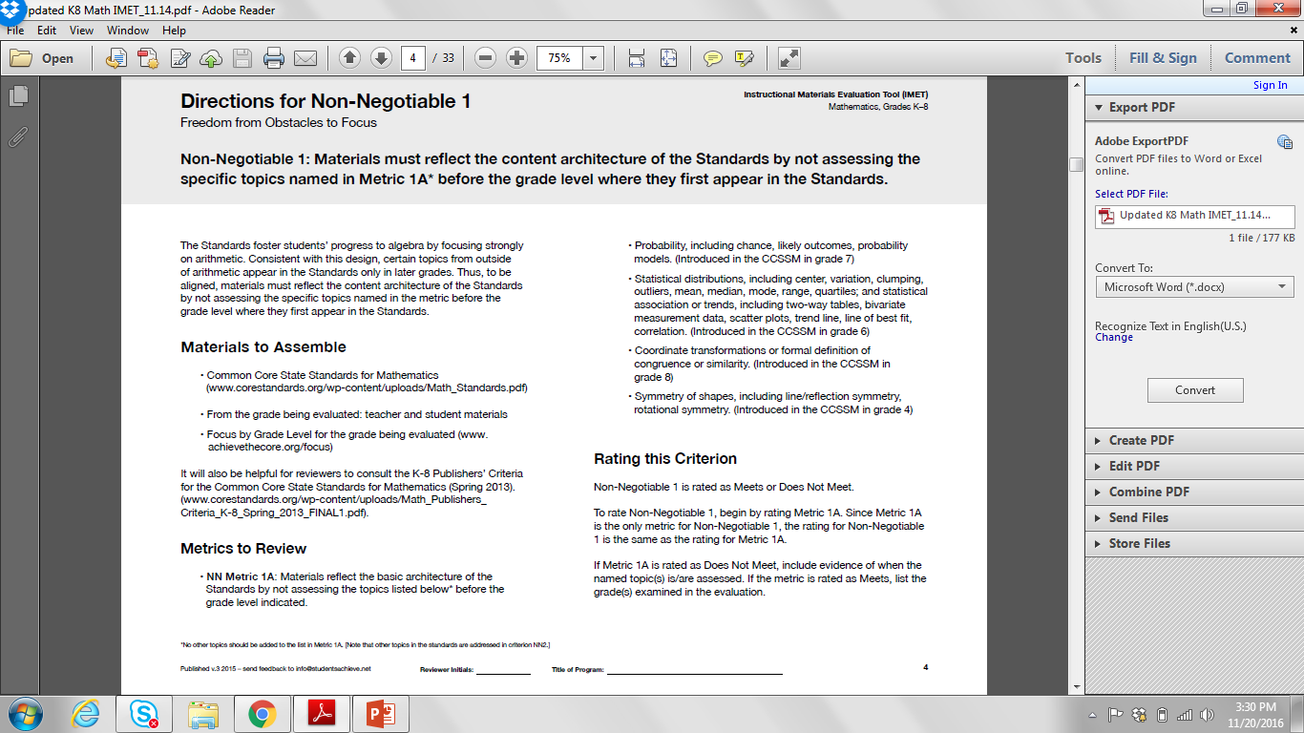
Focus
Non-Negotiable 1: Materials must reflect the content architecture of the Standards by not assessing the
specific topics named in Metric 1A* before the grade level where they first appear in the Standards.
IMET p. 4
Notes:
Big Idea: Quickly show the non-negotiables that relate to the first instructional shift: Focus
Talking Points:
Slides 21 and 22 should be shown very briefly to situate the conversation about focus in the context of the IMET.

Slide 18
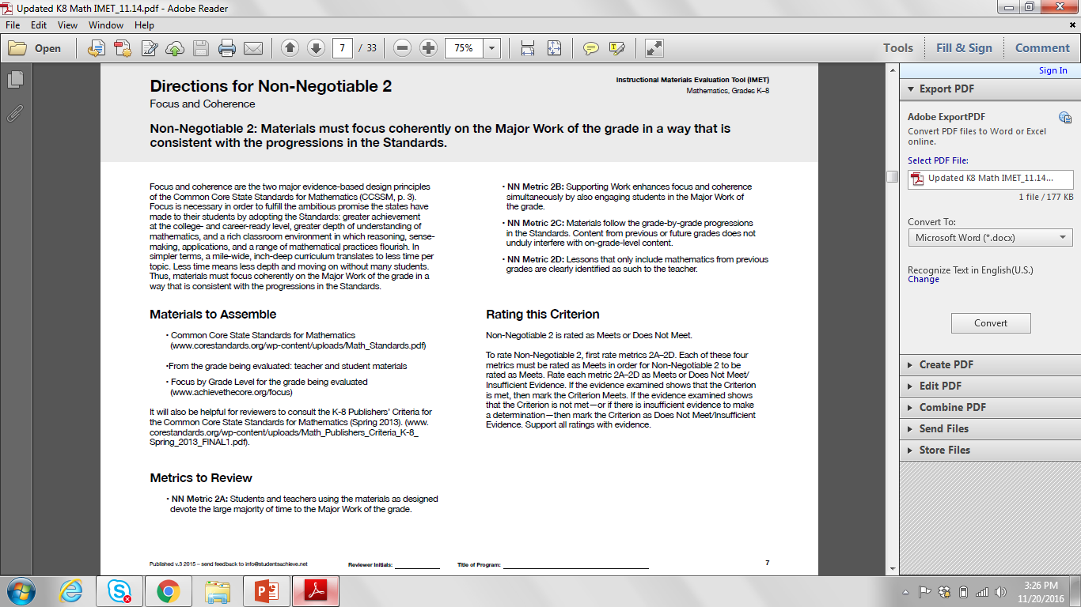
Focus
Non-Negotiable 2: Materials must focus coherently on the Major Work of the grade in a way that is
consistent with the progressions in the Standards.
IMET p. 7
Notes:
Big Idea: Quickly show the non-negotiables that relate to the first instructional shift: Focus
Talking Points:
Slides 21 and 22 should be shown very briefly to situate the conversation about focus in the context of the IMET.

Slide 19
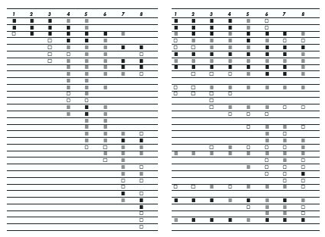
The Shape of Math in A+ Countries
Mathematics topics intended at each grade by at least two-thirds of A+ countries
Mathematics topics intended at each grade by at least two-thirds of 21 U.S. states
¹ Schmidt, Houang, & Cogan, “A Coherent Curriculum: The Case of Mathematics.” (2002).
Notes:
Big Idea: Use a visual to highlight the difference between how math is taught in high-performing countries and how math is taught in
the US
Talking Points:
You can visually see that the overall shape of math topics in A+ countries and those typical in the US (pre-Common Core) is different.
There are no detailed labels here as to not detract from the goal. That being said, each row is a math topic, like fractions, or congruence.
In 2/3rds of the high-performing countries, the foundations are laid and then further knowledge is built on them. The design principle is focus and coherent progressions. On the contrary, in the U.S., the design principle is to teach everything every year that can possibly be taught, as well as, many things that cannot.
In 2/3rds of the high-performing countries, note the amount of time that is spent in grades 1-3 on so few topics and the return on that investment of instructional minutes in middle school. It is easy to see the uniqueness of each grade level as opposed to the nearly identical grade levels in the U.S.
This graph makes clear that to have focused materials we have to get rid of some topics.
Background information: The A+ countries were identified as Singapore, Korea, Japan, Hong Kong, Belgium (Flemish-speaking), and the Czech Republic based on grade 8 math scores. For more information, see https://www.aft.org/sites/default/files/periodicals/curriculum.pdf

Slide 20
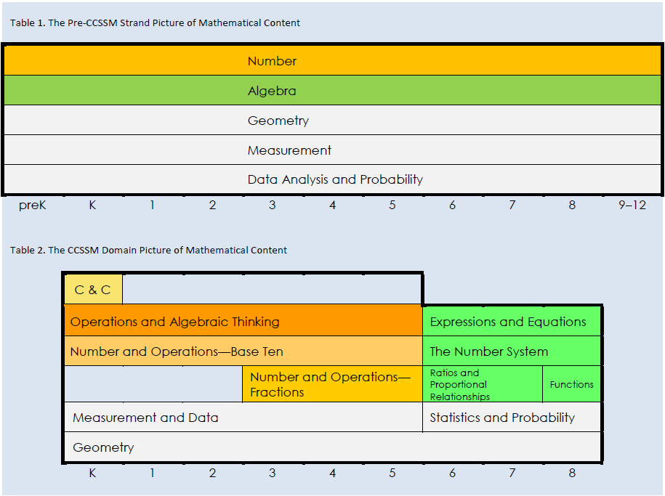
Focus Through Domains
Notes:
Big Idea: The domain-level organization of the Standards is a helpful way to see the focus required.
Talking Points:
The two tables give the big picture of the way that content is organized in the CCSS, and how it shifted from past versions.
The top table shows the traditional domain organization of mathematical standards. All 5 domains were equally important in all grades K-8.
The bottom table shows the reorganization under CCSS.
The color-coding shows how the domain of Number has been split up into multiple domains within K-5 in order to emphasize the importance of this work in the elementary grades. The green shading shows that Algebra has been turned into the major focus of the middle school grades. Everything is no longer created equal.
Background information: This graphic comes from Jason Zimba’s article <http://achievethecore.org/content/upload/What%20Content%20is%20Visibly%20Emphasized%20in%20the%20CCSSM.pdf>

Slide 21
Key Areas of Focus in Mathematics
Grade(s) | Focus Areas
K–2 | Addition and subtraction - concepts, skills, and problem solving and place value
3–5 | Multiplication and division of whole numbers and fractions – concepts, skills, and problem solving
6 | Ratios and proportional relationships; early expressions and equations
7 | Ratios and proportional relationships; arithmetic of rational numbers
8 | Linear algebra and linear functions
Notes:
Big Idea: Highlight the areas for focus which are the Major Work for K-8
Talking Points:
Each grade level has specific clusters designated as Major Work. This table gives a simplified list of the Major Work of each grade band.
Most teachers you talk to would name these as the most important topics for their grade. Emphasize this point. These are the things kids need most time and energy on in order to be successful in mathematics.
This focus is built into the structure of the Standards.

Slide 22
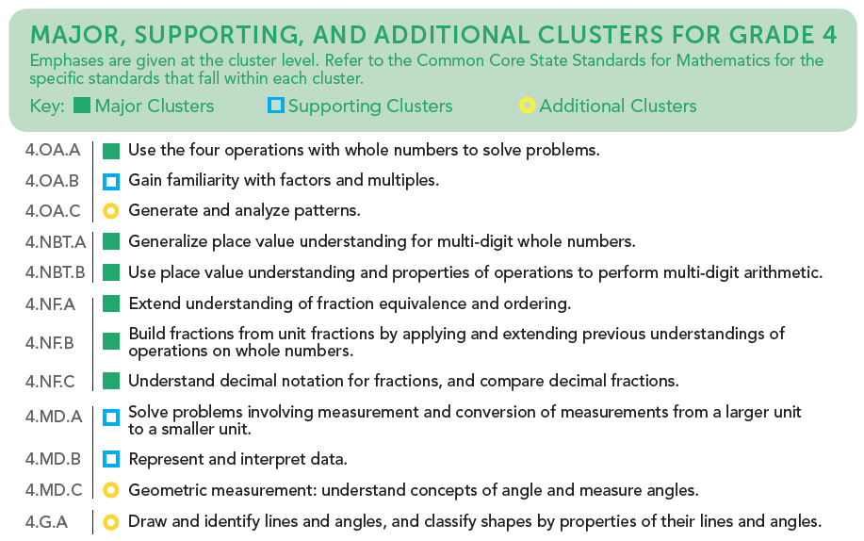
Cluster Emphases
Notes:
Big Idea: The “Focus by Grade Level” document names the Major/Supporting/Additional work for each grade.
Talking Points:
These documents are available in K-8 to outline Major, Supporting, and Additional clusters for each grade.
This shows the cluster-level alignment for grade 4 and should be used in conjunction with the full Standards to understand how individual standards are classified.
Note that “Supporting” and “Additional” clusters are not “Nice to Know” concepts. ALL of the standards are important, but these emphasis labels help a teacher know what is most important, which ideas support a deep conceptual understanding of the most important ideas, and which are setting the groundwork for future math concepts.
Note: Note that these documents can be downloaded (a single grade, or the whole group, K-8) at www.achievethecore.org

Slide 23
Focus
Non-Negotiable 1: Materials must reflect the content architecture of the Standards by not assessing the specific topics named in Metric 1A* before the grade level where they first appear in the Standards.
Metric 1A: Materials reflect the basic architecture of the Standards by not assessing the topics listed below* before the grade level indicated.
*No other topics should be added to the list in Metric 1A. [Note that other topics in the standards are addressed in criterion NN2.]
Notes:
Big Idea: NN Metric 1A lays out obstacles to Focus that should not be in instructional materials.
Talking Points:
The first Criterion asks reviewers to look at topics that are traditionally obstacles to Focus in K-8 materials.
Designed to be a very straightforward criterion with only one metric. It can serve as a screening device to identify materials that may have major issues of alignment.
The asterisk in both the criterion and the metric is meant to emphasize that this metric should not be expanded to look for more topics that are assessed early. In Non-Negotiable 2, reviewers will get more into other topics that may appear early. Due to the nature of this metric as a gatekeeper, reviews should be limited to the named topics (which we’ll take a look at in a couple of slides.)

Slide 24
NN Metric 1A: Topics That Crowd Out Focus in Elementary Grades
Probability, including chance, likely outcomes, probability models (introduced in grade 7)
Statistical distributions, including center, variation, clumping, outliers, mean, median, mode, range, quartiles; and statistical association or trends, including two-way tables, bivariate measurement data, scatter plots, trend line, line of best fit, correlation (introduced in grade 6)
Coordinate transformations or formal definition of congruence or similarity (introduced in grade 8)
Symmetry of shapes, including line/reflection symmetry, rotational symmetry (introduced in grade 4)
Notes:
Big Idea: NN Metric 1A requires reviewers to look for specific topics to make sure they are not assessed before the grade-level they are introduced in the Standards.
Talking Points:
These are the specific topics from NN Metric 1A that reviewers will be looking to see if there are assessment questions on these topics before the grade listed.
<Ask participants to discuss what they see as common attributes of these topics.>
These topics are common offenders that turn up in materials that don’t respect the “power of the eraser” to make sure that students have time to go in-depth in the Major Work of the grade. (They are often the topics that get repeated in each grade in the visual on slide 23.)
There will be opportunities to look to see if there are other topics that take away focus from the Major Work of the grade in later metrics (NN Metric 2A and 2C).

Slide 25
Focus
Non-Negotiable 2: Materials must focus coherently on the Major Work of the grade in a way that is
consistent with the progressions in the Standards.
Metric 2A: Students and teachers using the materials as designed devote the large majority of time to the Major Work of the grade.
Notes:
Big Idea: The first metric for Non Negotiable 2 looks for Focus based on how time is spent over the course of the year.
Talking Points:
The second Non-Negotiable Criterion has 4 metrics, but we will just look at the first one which relates specifically to Focus.
In evaluating NN Metric 2A, we look at how time is spent and whether a large majority of time is spent on the Major Work for the grade under review.

Slide 26
Discussion - Focus in Instructional Materials
What does Focus look like in instructional materials?
What are the implications of having materials that are not focused?
How might this information regarding NN1 and NN 2A be useful to your current situation?
IMET pp. 4,7
Notes:
Big Idea: Give participants an opportunity to reflect on the metrics that relate to Focus
Talking Points:
Refer participants back to the sorting activity they did, which will allow them to see all the metrics related to Focus.
Give participants time to discuss the questions and then share out with the whole group.

Slide 27
Coherence
Non-Negotiable 2: Materials must focus coherently on the Major Work of the grade in a way that is
consistent with the progressions in the Standards.
IMET p. 7
Notes:
Big Idea: Quickly show the Non-Negotiable that relates to the second instructional shift: Coherence
Talking Points:
Non-Negotiable 2 is about both Focus and Coherence

Slide 28
Coherence
Non-Negotiable 2: Materials must focus coherently on the Major Work of the grade in a way that is
consistent with the progressions in the Standards.
Metric 2B: Supporting Work, where present, enhances focus and coherence simultaneously by also engaging students in the Major Work of the grade.
Metric 2C: Materials follow the grade-by-grade progressions in the Standards. Content from previous or future grades does not unduly interfere with on-grade-level content.
Metric 2D: Lessons that only include mathematics from previous grades are clearly identified as such to the teacher.
IMET p. 7
Notes:
Big Idea: Introduce metrics related to Coherence in Non-Negotiable 2
Talking Points:
Three of the four metrics in Non-Negotiable 2 are specifically related to the mathematical coherence of the materials.
<Have participants reach each metric in turn.>

Slide 29
Coherence: Think Across Grades
Example: Fractions
“The coherence and sequential nature of mathematics dictate the foundational skills that are necessary for the learning of algebra. The most important foundational skill not presently developed appears to be proficiency with fractions (including decimals, percents, and negative fractions). The teaching of fractions must be acknowledged as critically important and improved before an increase in student achievement in algebra can be expected.”
Final Report of the National Mathematics Advisory Panel (2008, p. 18)
Notes:
Big Idea: It is important to build Coherence across grades.
Talking Points:
As an example of Coherence, the Common Core State Standards take a different approach to preparing students for success in algebra. Previous approaches moved topics of pre-algebra and algebra earlier and earlier in the grade sequence rather than attend to careful progressions of conceptual development that in fact prepare students for algebra.
For more background information, see: https://www2.ed.gov/about/bdscomm/list/mathpanel/report/final-report.pdf

Slide 30
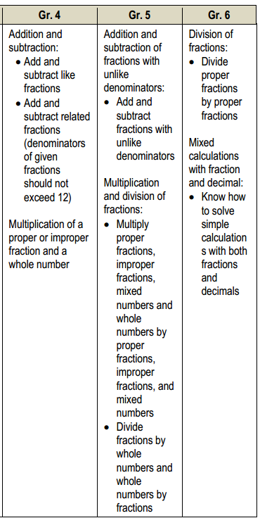
CCSS
4.NF.4. Apply and extend previous understandings of multiplication to multiply a fraction by a whole number.
Grade 4
5.NF.4. Apply and extend previous understandings of multiplication to multiply a fraction or whole number by a fraction.
5.NF.7. Apply and extend previous understandings of division to divide unit fractions by whole numbers and whole numbers by unit fractions.
Grade 5
6.NS. Apply and extend previous understandings of multiplication and division to divide fractions by fractions. 6.NS.1. Interpret and compute quotients of fractions, and solve word problems involving division of fractions by fractions, e.g., by using visual fraction models and equations to represent the problem.
Grade 6
Informing Grades 1-6 Mathematics Standards Development: What Can Be Learned from High-Performing Hong Kong, Singapore, and Korea? American Institutes for Research (2009, p. 13)
Notes:
Big Idea: The progression of concept development for multiplication is illustrated over three grades, based on evidence from high-performing countries
Talking Points:
Here you see some of the international data that informed the development of the CCSSM. On the left you see a coherent progression of multiplication and division of fractions over three grade levels.
On the right you see excerpts from the Common Core that address fractions with purpose and direction. The term “apply and extend previous understandings…” is a sure sign of the expectation within a progression of concept development.
Looking at the progression of multiplying and dividing fractions, you will see that, over these 3 years, the students are building on previous knowledge and not just repeating the same thing each year. You’ll see that, in grade 4, students apply and extend previous understandings of multiplication to multiply a fraction by a whole number. In grade 5, that knowledge and skill is extended to multiply a fraction or whole number by a fraction. Also in grade 5, students extend previous understandings of division to divide unit fractions by whole numbers and the reverse. In grade 6, students will continue to build on the foundations laid and will divide fractions by fractions. These are clear and carefully laid progressions.
Background Information available at http://www.air.org/sites/default/files/downloads/report/MathStandards_0.pdf

Slide 31
Coherence: Link to Major Topics Within Grades
Example: Data Representation
3.MD.B.3 Draw a scaled picture graph and a scaled bar graph to represent a data set with several categories. Solve one- and two-step “how many more” and “how many less” problems using information presented in scaled bar graphs. For example, draw a bar graph in which each square in the bar graph might represent 5 pets.
Notes:
Big Idea: Many Supporting Work standards specifically call out connections to Major Work topics.
Talking Points:
This grade 3 standard comes from the Measurement and Data domain and is part of a cluster that is Supporting Work, while solving word problems is Major Work as part of the Operations and Algebraic Thinking domain.
This is Coherence within the grade level.
Instead of bar charts being “yet another thing to cover,” detracting from focus, the standard is telling you how to “aim” bar charts back around to the Major Work of the grade. These connections are explicit in the Standards. While in the past, picture or bar graphs might have been distinct things to be assessed, now they need to be connected to the Major Work of the grade.

Slide 32
Coherence: Link to Major Topics Within Grades
Example: Statistics
8.SP.A.3 Use the equation of a linear model to solve problems in the context of bivariate measurement data, interpreting the slope and intercept. For example, in a linear model for a biology experiment, interpret a slope of 1.5cm/hr as meaning that an additional hour of sunlight each day is associated with an additional 1.5 cm in mature plant height.
Notes:
Big Idea: Provide another example of a Supporting Work standard that specifically calls out connections to Major Work topics
Talking Points:
This grade 8 standard comes from the Statistics and Probability domain and is part of a cluster that is Supporting Work, while working with equations and understanding slope is Major Work as part of the Expressions and Equations and Functions domains.
Instead of statistics being “yet another thing to cover,” detracting from focus, this grade 8 standard tells you how to link working with bivariate data to the Major Work of the grade, linear algebra and functions.

Slide 33
Discussion - Coherence in Instructional Materials
What does Coherence look like in instructional materials?
What are the implications of having materials that are not coherent?
How might this information regarding NN2 be useful to your current situation?
IMET pp. 7-12
Notes:
Big Idea: Give participants an opportunity to talk about how the shift of Coherence should be present in instructional materials
Talking Points:
Refer participants back to the sorting activity they did, which will allow them to see all the metrics related to Coherence.
Give participants time to discuss the questions and then share out with the whole group.

Slide 34

Non Negotiable vs. Alignment Criteria
Non- Negotiable Criteria | Alignment Criteria
Each metric rated Meets/Does Not Meet | Each metric rated Meets/Partially Meets/Does Not Meet
Every metric must be met to rate the criterion as Meets | Must receive 5 out of 6 points to rate the criterion as Meets
Notes:
Big Idea: Differentiate between Non-Negotiable and Alignment Criteria
Talking Points:
We have looked at the two Non-Negotiable criteria that relate to Focus and Coherence. For these criteria, each metric was rated as “meets” or “does not meet” and materials needed to meet every metric in order to be considered aligned. Focus and Coherence are considered to be non-negotiable. The reason for this is right in the introduction to the Standards themselves. The introduction starts with a sub-head that outlines the most important shifts required by the Standards. <Click to reveal.>
As we move to look at the Alignment Criteria, we are looking at metrics that may be a little more subjective. Because of that, they are scored out of 2 points and each metric can be rated as “meets” (2), “partially meets” (1) or “does not meet” (0). For materials to meet any single criterion, they need to receive 5 out of 6 points on the metrics associated with that criterion.

Slide 35
Rigor
Alignment Criterion1: Materials must reflect the balances in the Standards and help students meet the Standards’ rigorous expectations.
Metric 1A: The materials support the development of students’ conceptual understanding of key mathematical concepts, especially where called for in specific content Standards or cluster headings.
Metric 1B: The materials are designed so that students attain the fluencies and procedural skills required by the Standards.
Metric 1C: The materials are designed so that teachers and students spend sufficient time working with applications, without losing focus on the Major Work of each grade.
IMET p. 13
Notes:
Big Idea: Introduce Alignment Criterion 1 and the associated metrics
Talking Points:
The first Alignment Criterion, AC 1, attends to the shift of Rigor.
<Have participants read each of the metrics.>
We will look specifically at what each metric requires of instructional materials.

Slide 36
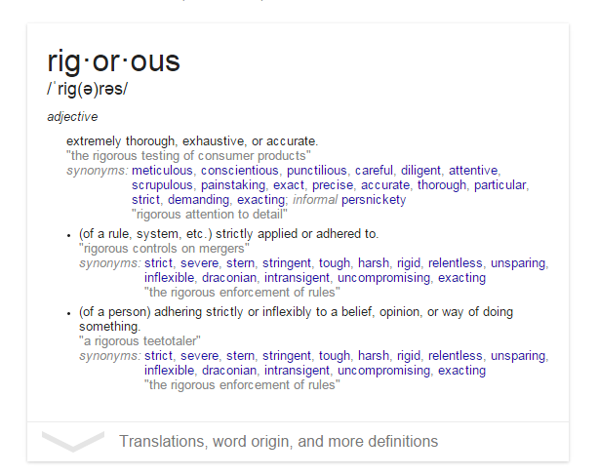
What Is Rigor?
Notes:
Big Idea: Define Rigor as it relates to the Shift required by the Standards.
Talking Points:
How do people in education use the word “rigorous?” What do you mean?
What does it mean → “the company has a rigorous hiring process?”
This word “rigor” is one that gets thrown around a lot, particularly in the education world.
<Ask participants to write down two sentences that use the word “rigorous”:
One that uses it in a sentence in the context of education
One that uses it in a sentence outside the context of education.> <2 minutes>
As participants share, highlight the connections between the context in education and the context outside of education. Point out that it usually refers to some vague ideas about the difficulty of problems in the education world.
Although this idea of difficulty comes into play with this shift, there is a more precise definition we are going for.
To put a point on this, take a look at the definition of rigor provided by Google. <Click PPT to reveal the definition.>
This idea of being extremely thorough and exhaustive characterizes what is so important in instructional materials. That’s a pretty good definition of how we want our students to understand and be able to do mathematics.

Slide 37
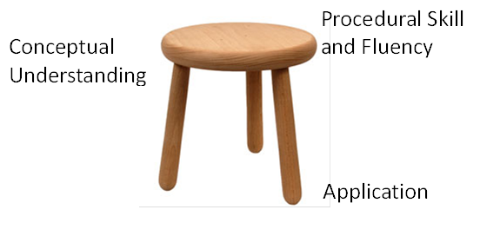
The Three-Legged Stool
Notes:
Big Idea: Emphasize importance of each component with the visual of the three-legged stool that is representative of the balance needed for the three parts of rigor.
Talking Points:
In considering this idea of thorough and exhaustive instruction, we can consider that each of the three aspects of rigor plays an important role in ensuring students are powerful mathematicians.
For a long time in math, there were very strong and opposing opinions about what was most important in instruction.
The math wars are over.
This visual gets to the balance of each aspect of rigor that is necessary. These three components can be thought of as three legs of a stool; each is equally critical to establishing stability.
The three aspects of rigor are not always separate. Conceptual understanding needs to underpin fluency work; fluency can be practiced in the context of applications, and applications can build conceptual understanding.
Nor are the three aspects of rigor always together. Fluency requires dedicated practice to that end. Rich applications cannot always be shoehorned into the mathematical topic of the day. And conceptual understanding will not come along for free unless explicitly taught.
We are now going to discuss each of the 3 aspects of rigor which has a metric associated with it.

Slide 38
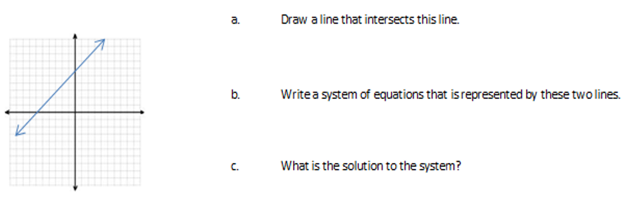
Conceptual Understanding
8.EE.C.8.a Understand that solutions to a system of two linear equations in two variables correspond to points of intersection of their graphs, because points of intersection satisfy both equations simultaneously
Notes:
Big Idea: Show an example of a standard and problem that targets Conceptual Understanding
Talking Points:
The metrics in Alignment Criterion 1 require that materials address each aspect of rigor as they are called for in the Standards.
This grade 8 standard calls for students to develop understanding about what the solution to a systems of equation means in terms of both the graph and the equations.
The problem that follows is an example of an opportunity for students to demonstrate conceptual understanding through answering a series of brief questions.
Lots of times, we think of problems that ask students to explain their thinking as examples of targeting conceptual understanding. This is a nice example of targeting conceptual understanding because it shows that there are other types of work students can do that targets conceptual understanding.

Slide 39
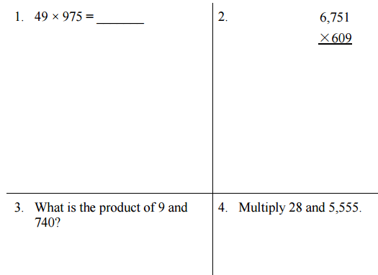
Procedural Skill and Fluency
5.NBT.B.5 Fluently multiply multi-digit whole numbers using the standard algorithm
Notes:
Big Idea: Show an example of a standard and exercises that target Procedural Skill and Fluency
Talking Points:
This grade 5 standard calls for students to demonstrate fluency with multi-digit multiplication. This is the end of a progression that began in grade 3 when students developed a conceptual understanding of the meaning of multiplication and developed fluency with single-digit facts. In grade 4, the standards require students to apply their understanding to multiply larger numbers. This progression to fluency culminates in grade 5 with 5.NBT.B.5.
The exercises that follow show how a student would demonstrate the fluency required by the standard.
The Standards require that instructional materials include repeated practice to ensure students develop procedural skill and fluency.

Slide 40
Application
2.OA.A Represent and solve problems involving addition and subtraction
A pencil costs 59 cents, and a sticker costs 20 cents less. How much do a pencil and a sticker cost together?
Notes:
Big Idea: Show an example of a standard and problem that targets Application
Talking Points:
This grade 2 cluster calls for students to solve application problems with addition and subtraction. Application problems allow students to use both conceptual understanding and procedural skill in real-world situations.
The problem that follows shows a multi-step problem that aligns to standard 2.OA.A.1 Use addition and subtraction within 100 to solve one- and two-step word problems involving situations of adding to, taking from, putting together, taking apart, and comparing, with unknowns in all positions, e.g., by using drawings and equations with a symbol for the unknown number to represent the problem.

Slide 41
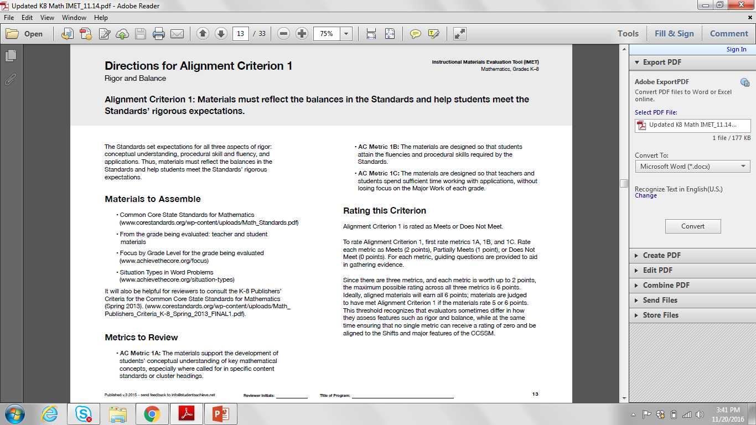
Discussion - Rigor in Instructional Materials
What does Rigor look like in instructional materials?
What are the implications of having materials that overly focus on one aspect of rigor?
How might this information regarding AC1 be useful to your current situation?
IMET pp. 13-20
Notes:
Big Idea: Give participants an opportunity to talk about how the shift of Rigor should be present in instructional materials
Talking Points:
Refer participants back to the sorting activity they did, which will allow them to see all the metrics related to Rigor.
Give participants time to discuss the questions and then share out with the whole group.

Slide 42
Standards for Mathematical Practice
Alignment Criterion 2: Materials must authentically connect content standards and practice standards.
Metric 2A: Materials address the practice standards in such a way as to enrich the Major Work of the grade; practices strengthen the focus on Major Work instead of detracting from it, in both teacher and student materials.
Metric 2B: Tasks and assessments of student learning are designed to provide evidence of students’ proficiency in the Standards for Mathematical Practice.
Metric 2C: Materials support the Standards’ emphasis on mathematical reasoning.
IMET p. 21
Notes:
Big Idea: Introduce Alignment Criterion 2 and the associated metrics
Talking Points:
Alignment Criterion 2 attends to the Standards for Mathematical Practice, a major feature of the Standards.
<Have participants read each of the metrics.>
Have participants look back to the sorting activity to see whether they identified all the metrics related to Standards for Mathematical Practice.
Within these metrics, reviewers are looking to see not just whether materials note that the Standards for Mathematical Practice are identified within the books but also whether teachers are supported in developing their students’ abilities to engage in the practices in order to enhance their understanding of the content standards. Reviewers are also noting whether the program provides opportunities for students to show how they are engaging with the Practices.
Reviewers look to see whether each practice is fully developed over the course of the year, as well as whether there is time and attention spent to develop students’ mathematical reasoning in a grade-appropriate way.

Slide 43
Access for All Students
Alignment Criterion 3: Materials must provide supports for English Language Learners and other special populations.
Metric 3A: Support for English Language Learners and other special populations is thoughtful and helps those students meet the same Standards as all other students. The language in which problems are posed is carefully considered.
Metric 3B: Materials provide appropriate level and type of scaffolding, differentiation, intervention, and support for a broad range of learners with gradual removal of supports, when needed, to allow students to demonstrate their mathematical understanding independently.
Metric 3C: Design of lessons attends to the needs of a variety of learners (e.g., using multiple representations, deconstructing/reconstructing the language of problems, suggestions for addressing common student difficulties).
IMET p. 27
Notes:
Big Idea: Introduce Alignment Criterion 3 and the associated metrics
Talking Points:
Alignment Criterion 3 attends to the need for access to the standards for all students.
Because the Standards are for all students, evaluation requires that careful attention be paid to ensure that all students, including English Language Learners and those with different learning needs, have access to high-quality, aligned materials.
<Have participants read each of the metrics.>
Have participants look back to the sorting activity to see whether they identified all the metrics related to Access for All Students.
Reviewers will look for the supports that are provided for all learners and make sure they are adequate to ensure that all students are accessing grade-level mathematics.
Required supports may look different depending on the context – districts will need to consider their teachers and students to make decisions about exactly what these supports should look like.

Slide 44
Essential Questions
What is the Instructional Materials Evaluation Tool (IMET)? How is it structured?
How does the IMET enable reviewers to evaluate whether instructional materials are aligned to the major features of the Standards and fulfill the Shifts they require?
How could the IMET be useful in a variety of settings to bring the CCSS and Shifts to life for students?
Notes:
Big Idea: Remind participants of the essential questions of the module
Talking Points:
- Facilitators may choose to use this slide to have participants reflect on the learning of the module. There will also be an opportunity to do that on the next slide.

Slide 45
Use Cases for the IMET
Evaluating current materials
Purchasing decisions
Creation of materials
Professional learning
Discussion question:
How will the IMET be useful to you in your context?
Notes:
Big Idea: There are many ways to use the IMET and the related training materials.
Talking Points:
The IMET was developed with the purpose to help educators determine whether instructional materials are aligned to the Shifts and major features of the Common Core State Standards.
Originally, this meant that its primary use case was by districts who were reviewing materials to be considered for adoption. However, as we’ve talked to people who used the tool, we’ve heard that the learning about the IMET is a very powerful professional development opportunity. Learning about the IMET gives participants a better understand of the CCSS in general, as well as implications for the classroom.
The IMET review can be helpful for districts or schools to identify gaps in their current materials in order to plan how to adapt them. It can also help for teachers or leaders who are developing instructional materials.
<Click to advance the slide.>
Have participants discuss how they might use the IMET in their current context.

Slide 46
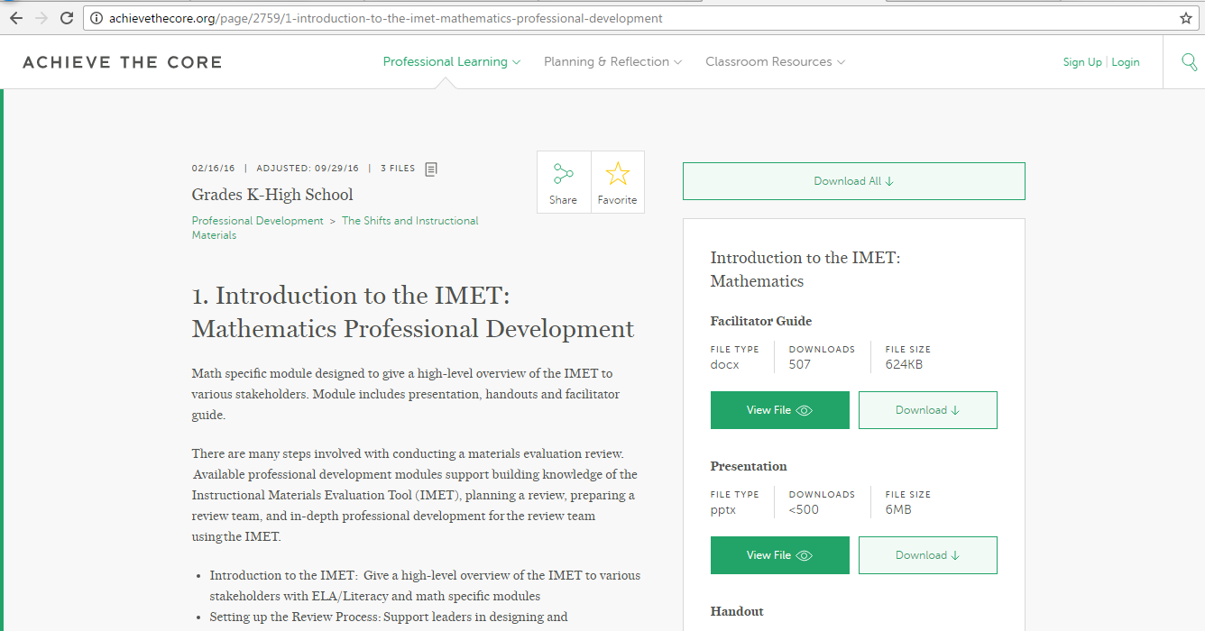
Want to Learn More?
Additional Professional Development modules for the IMET are available on achievethecore.org
Notes:
Big Idea: Share other available resources
Talking Points:
This presentation is an introduction to the content and structure of the IMET.
If you are interested in using the IMET to review instructional materials, or conducting professional development that will help participants better understand what is required in aligned materials, check out the other resources available.

Slide 47
Thank you!

